Slide 1
T0 and Beam Spot Calibration
Mathieu Ouillon (Mississippi State University)
07/13/26

Slide 2
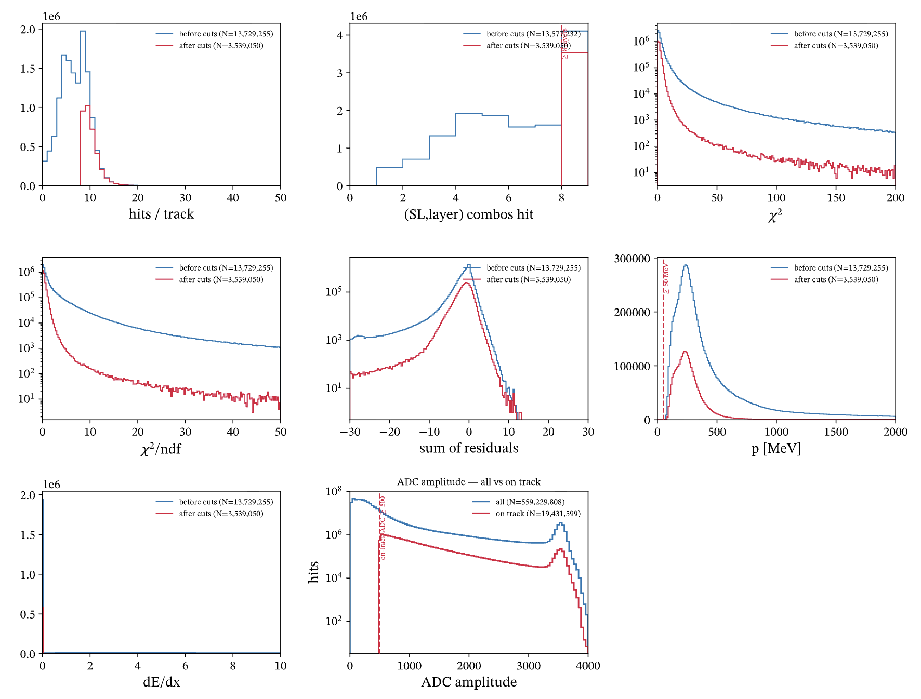
T0 Calibration
Extraction of T0 for the AHDC
First on elastic D2 run: 22990
Need to select hits on track:
At least one hits per layer/superlayer
p > 50MeV
ADC > 500

Slide 3
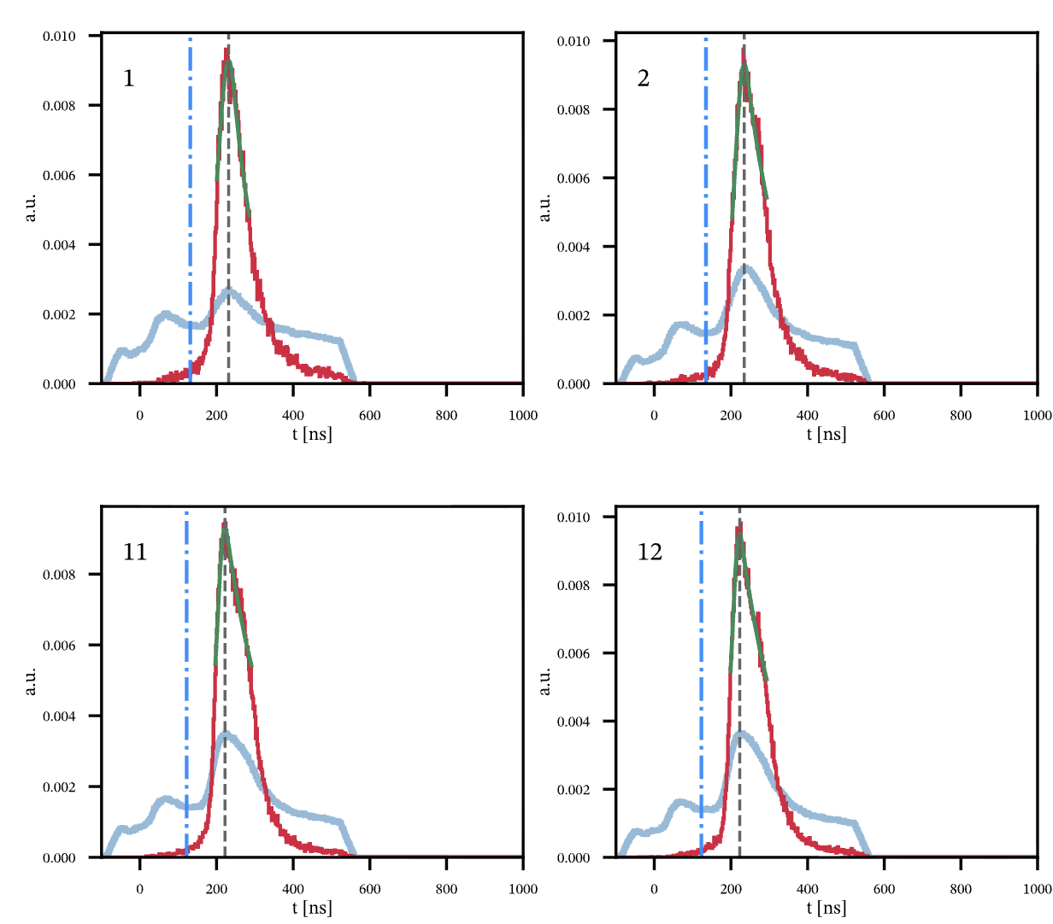
T0 Calibration
Extraction of T0 for the AHDC
First on elastic D2 run: 22990
Need to select hits on track:
At least one hits per layer/superlayer
p > 50MeV
ADC > 500

Slide 4
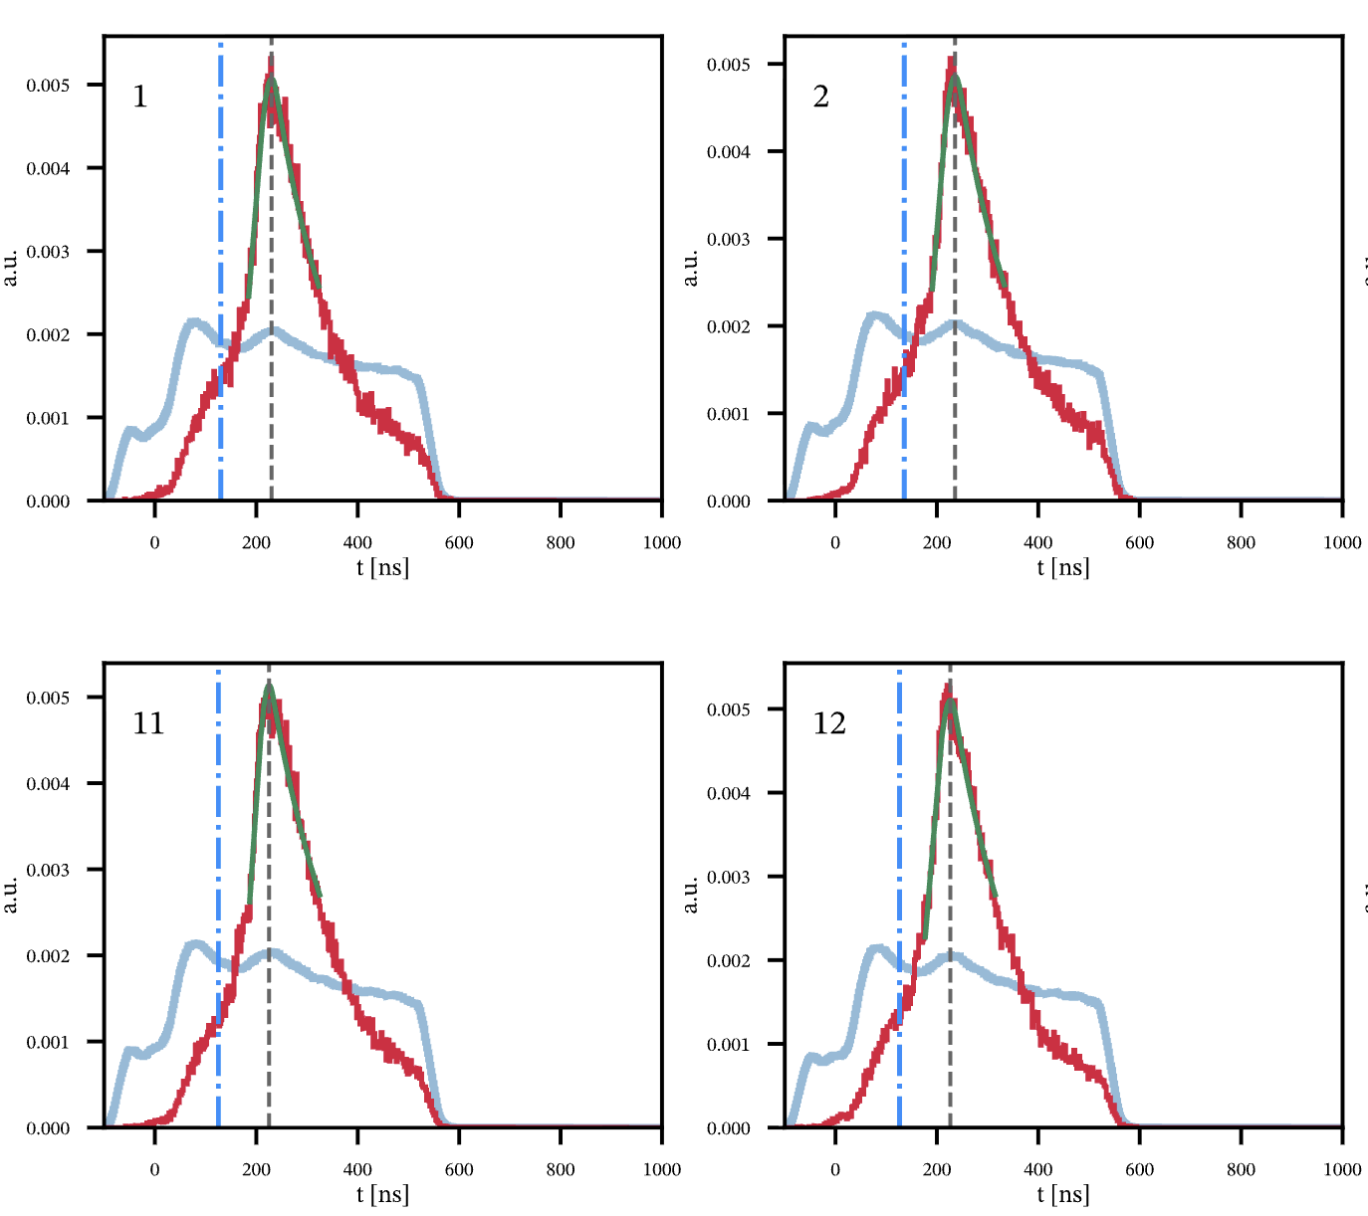
T0 Calibration
Extraction of T0 for the AHDC
Then on ⁴He 10.6 GeV run (22083)
Need to select hits on track:
At least one hits per layer/superlayer
p > 50MeV
ADC > 500

Slide 5
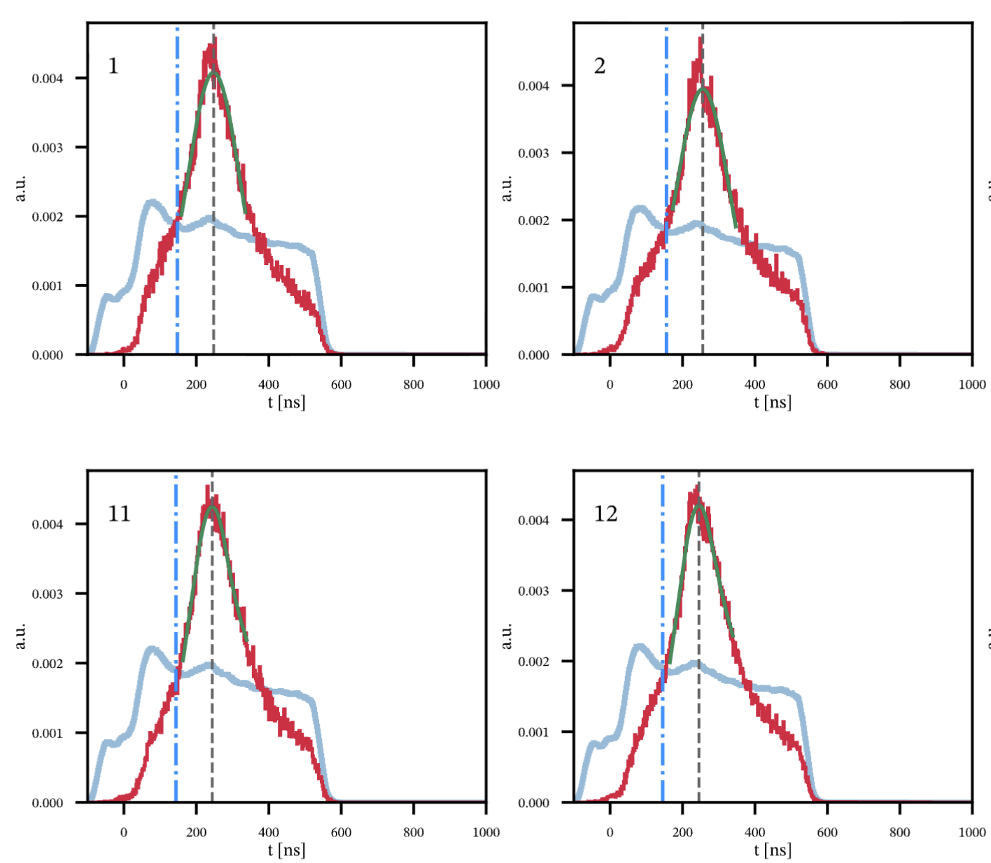
T0 Calibration
Extraction of T0 for the AHDC
Then on D2 10.6 GeV run (22598)
Need to select hits on track:
At least one hits per layer/superlayer
p > 50MeV
ADC > 500

Slide 6
T0 Calibration
To find T0:
Find the peak (5-bin method):
Smooth the spectrum with a 5-bin moving sum (each bin replaced by the sum of itself ±2 neighbours) to suppress bin-to-bin noise.
Take the max bin of the smoothed spectrum as the coarse peak.
Define t0: t0 = peak − 100 ns.
Fill every wire (all 576 from geometry):
a wire with a good peak → its measured peak − 100.
a wire with too few counts / no usable peak → the per-(SL,layer) median t0 as a fallback (no wire left blank).

Slide 7
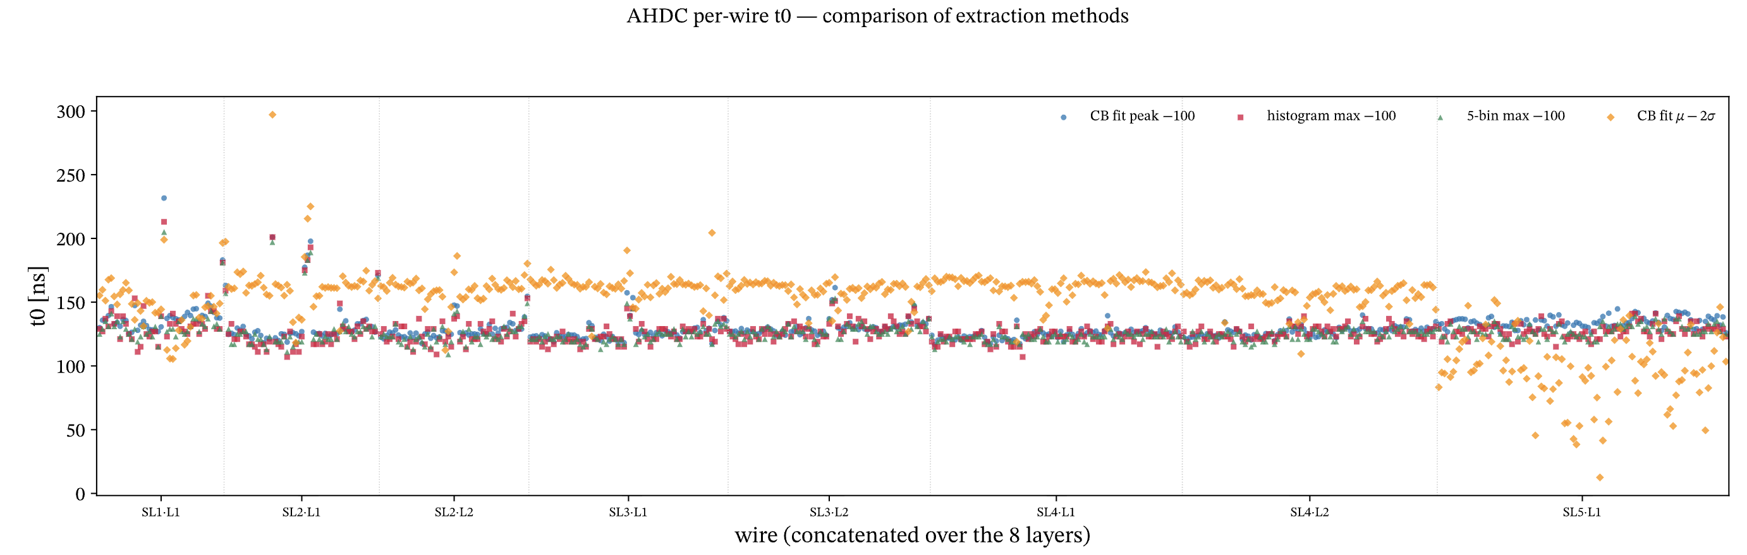
T0 Calibration
All T0s for 1 run (22083):

Slide 8
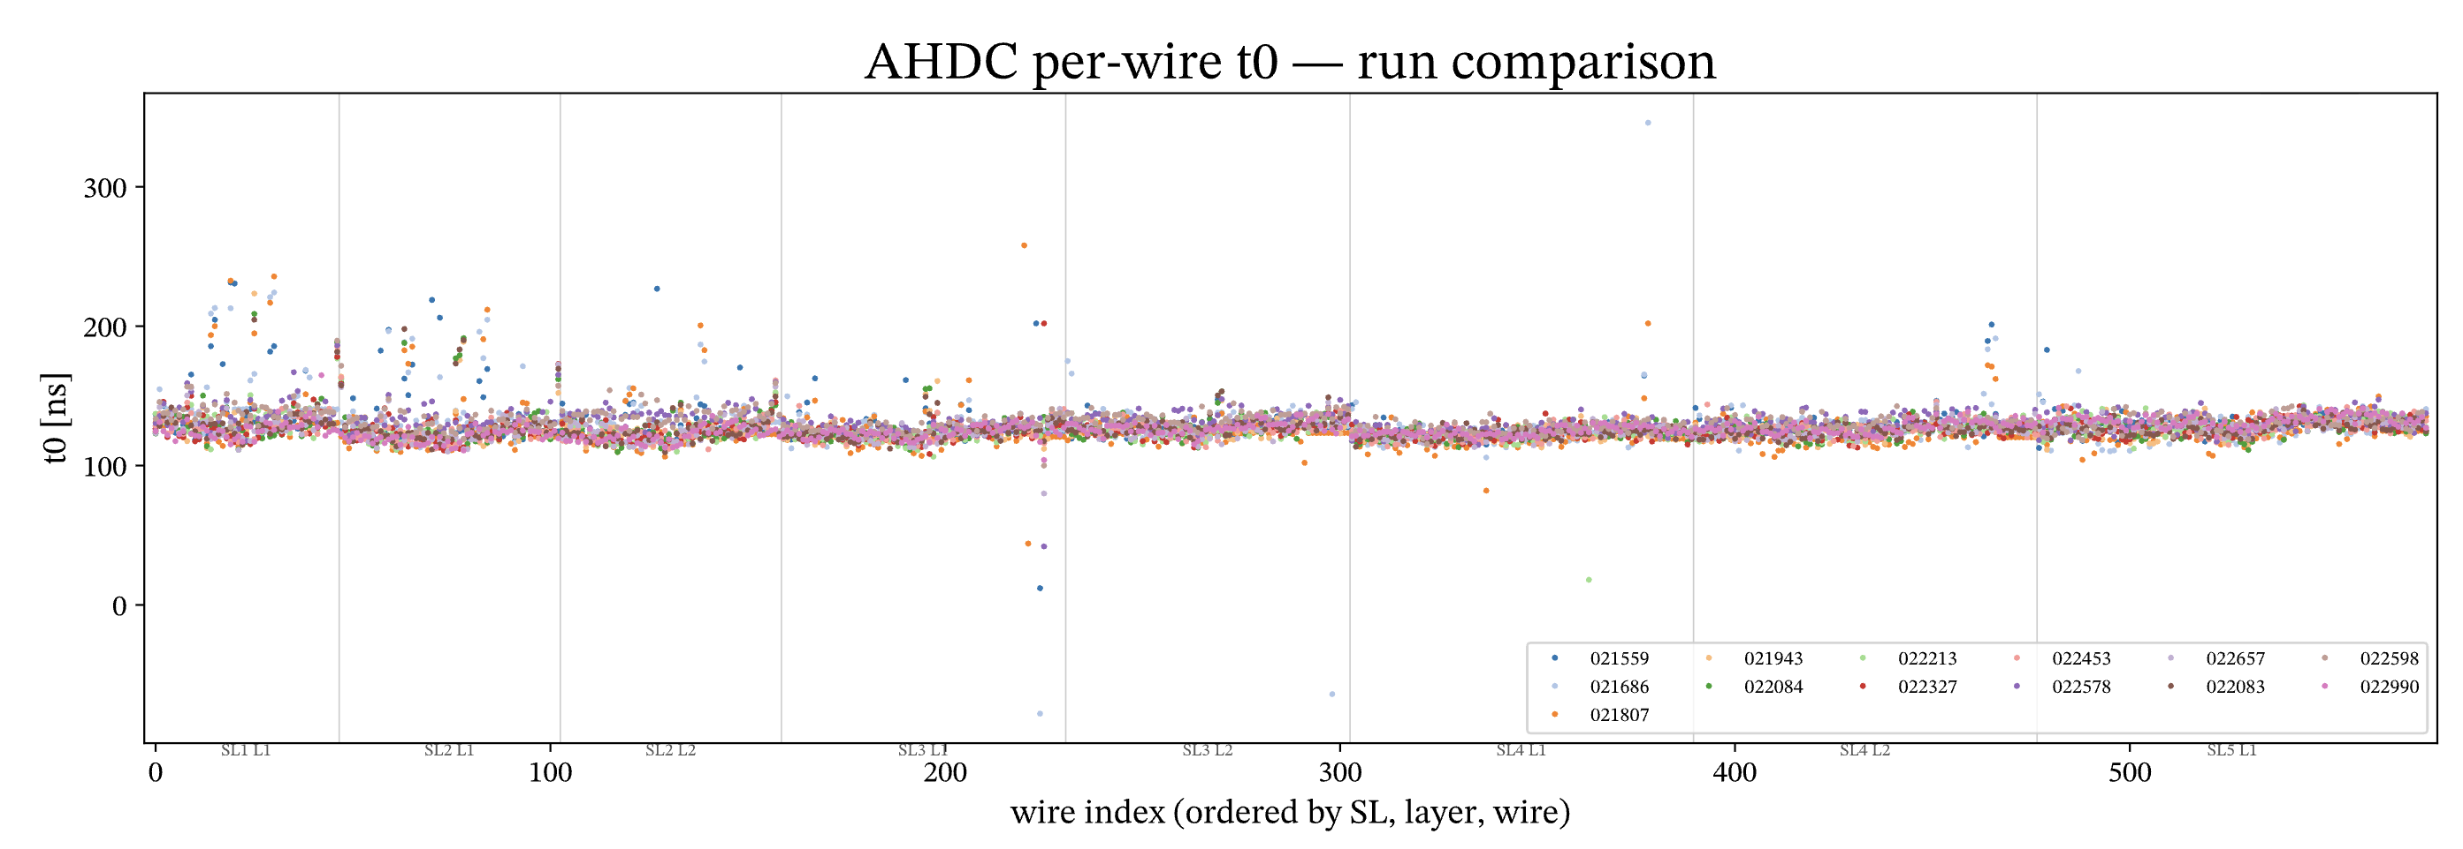
T0 Calibration
Compare T0s for different runs:

Slide 9
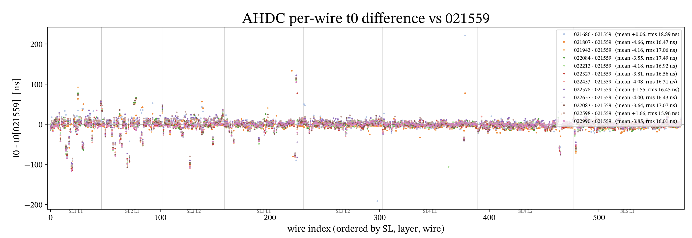
T0 Calibration
Compare T0s for different runs:

Slide 10
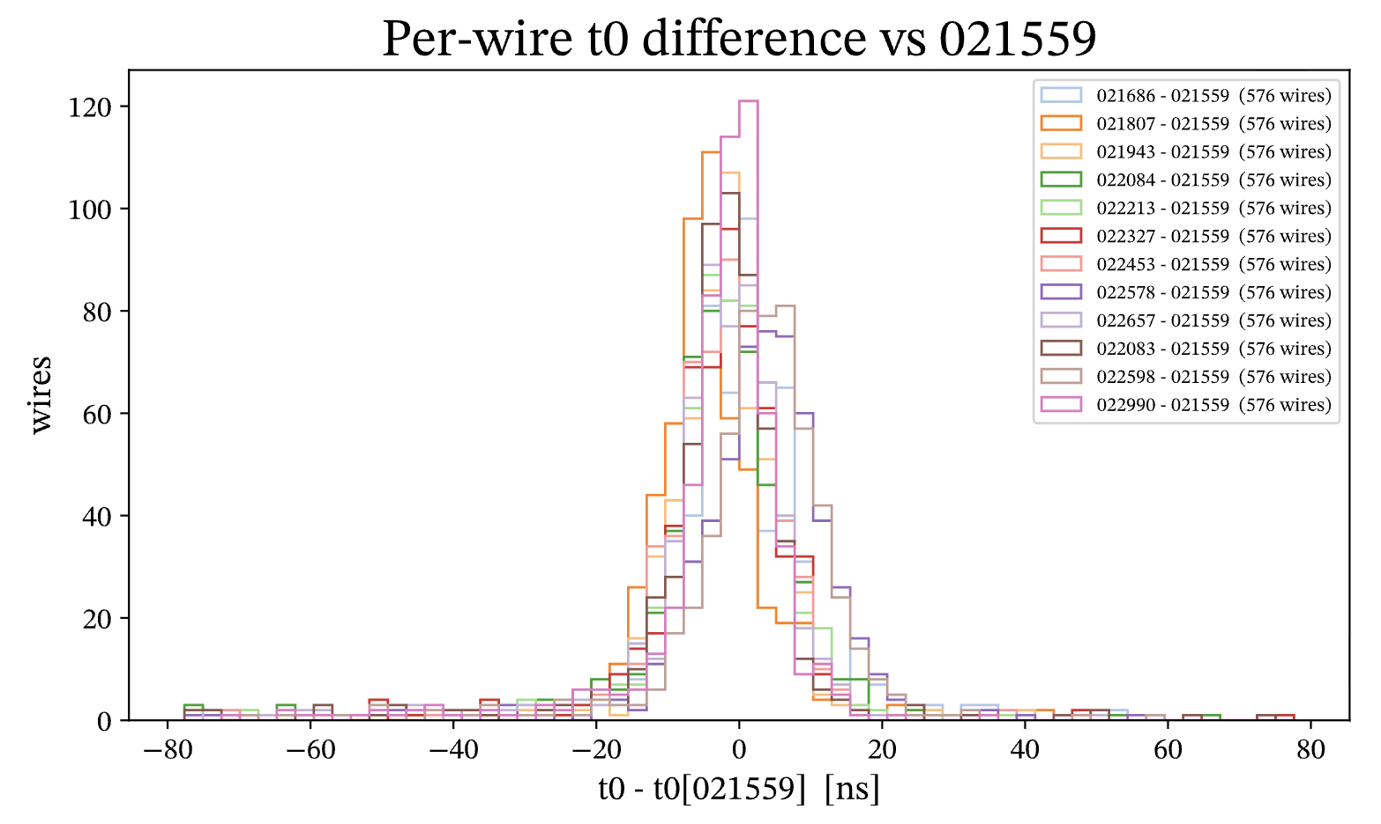
T0 Calibration
Compare T0s for different runs:

Slide 11
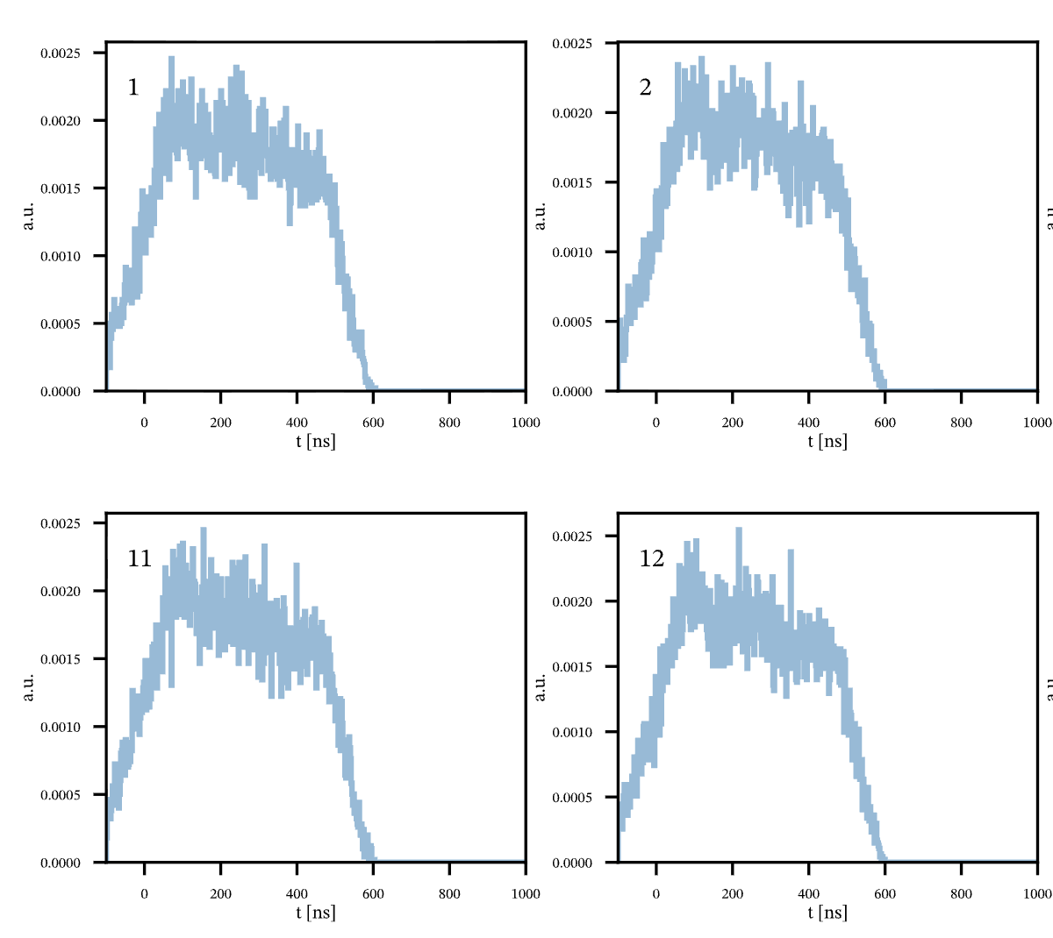
T0 Calibration
Extraction of T0 for the AHDC
On 4He 10.6 GeV run (22083)
For all hits coming from random trigger

Slide 12

ALERT Beamspot position
Measure the transverse (𝑥, 𝑦) offset between the ALERT recoil detector and the forward- CLAS / beamline frame using coherent elastic 𝑒 + 𝑑 → 𝑒′ + 𝑑′ events.
The electron is reconstructed in forward CLAS (defining the CLAS frame); the recoil deuteron is seen in ALERT/AHDC.
For elastic kinematics the two are coplanar, so a transverse misalignment appears as a sinusoidal modulation of the azimuthal coplanarity Δ𝜑 versus the electron azimuth 𝜑𝑒.
First test it on simulation:

Slide 13
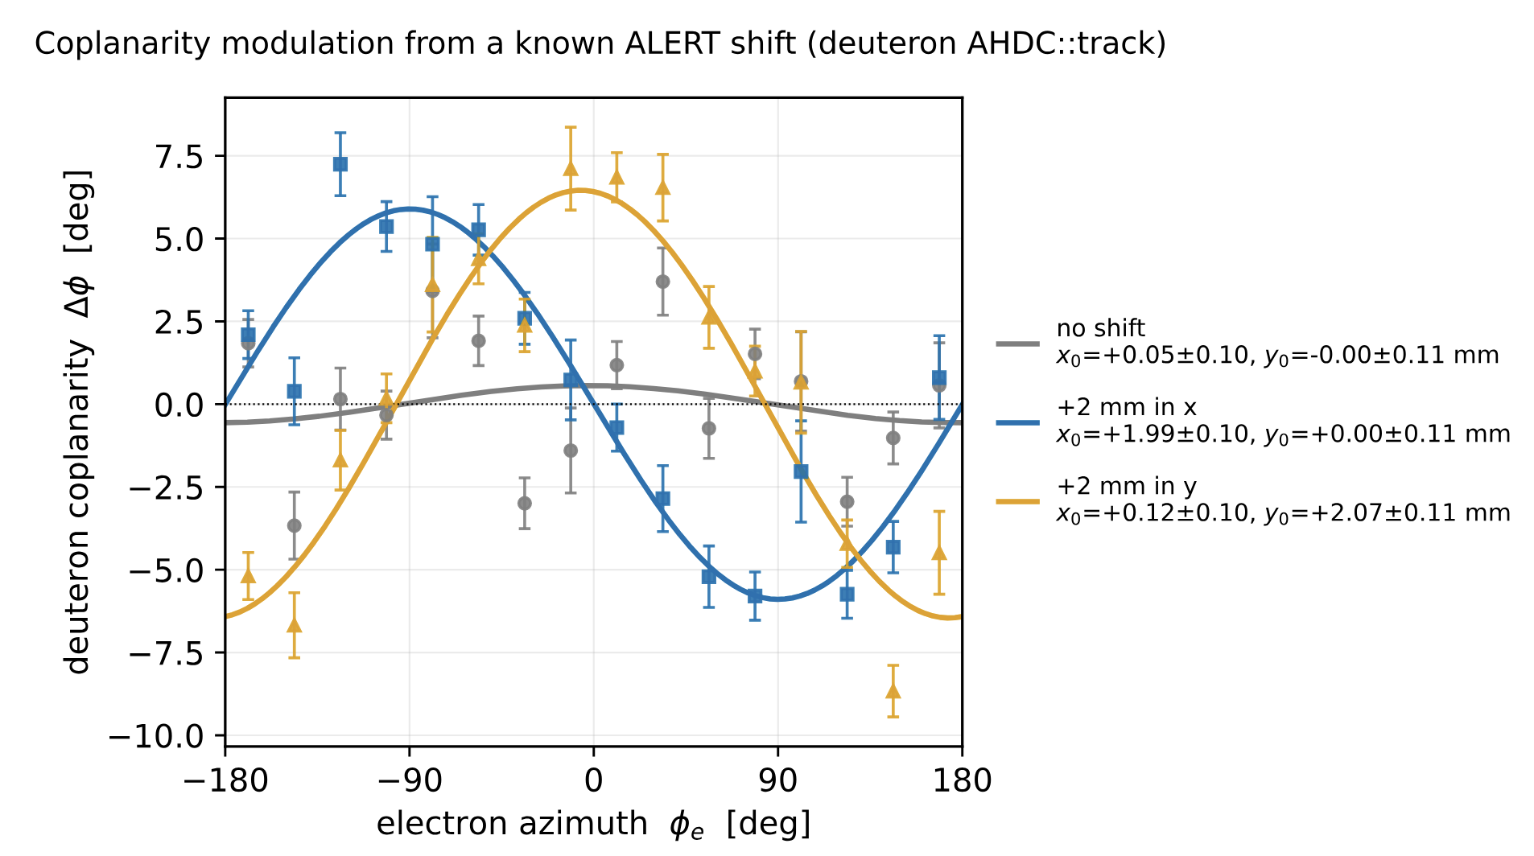
ALERT Beamspot position
First test it on simulation:

Slide 14
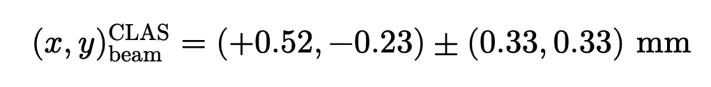
ALERT Beamspot position
And on data found (−0.75, +0.26). It is the difference between CLAS and ALERT beamspot NOT the absolute beamspot position of ALERT
For the run 22990, CLAS absolute position is
So the absolute ALERT beamspot position is

