Slide 1
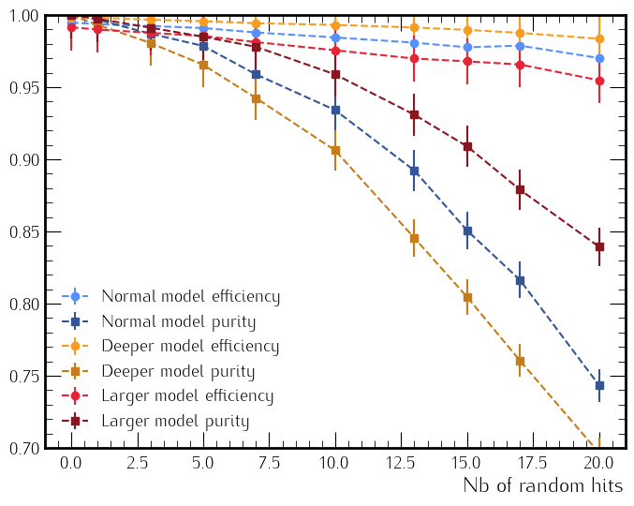
AI for ALERT: Model
Develop a AI using MLP with 10 inputs, 3 hidden layer with 20 and 1 output for track finding.
Tracks are generated by GEMC:
Good tracks : proton with p ∈ [60, 250] MeV/c, φ ∈ [0, 360]°, θ ∈ [60, 120]° and vz ∈ [-15, 15] cm.
False tracks: interchanging randomly up to two super-precluster, with a adjacent event.
To validate the model we use:
Efficiency: Number of good tracks classified as good / number of event.
Purity: Number of good tracks classified as good / number of tracks (good or bad) classified as good.

Slide 2
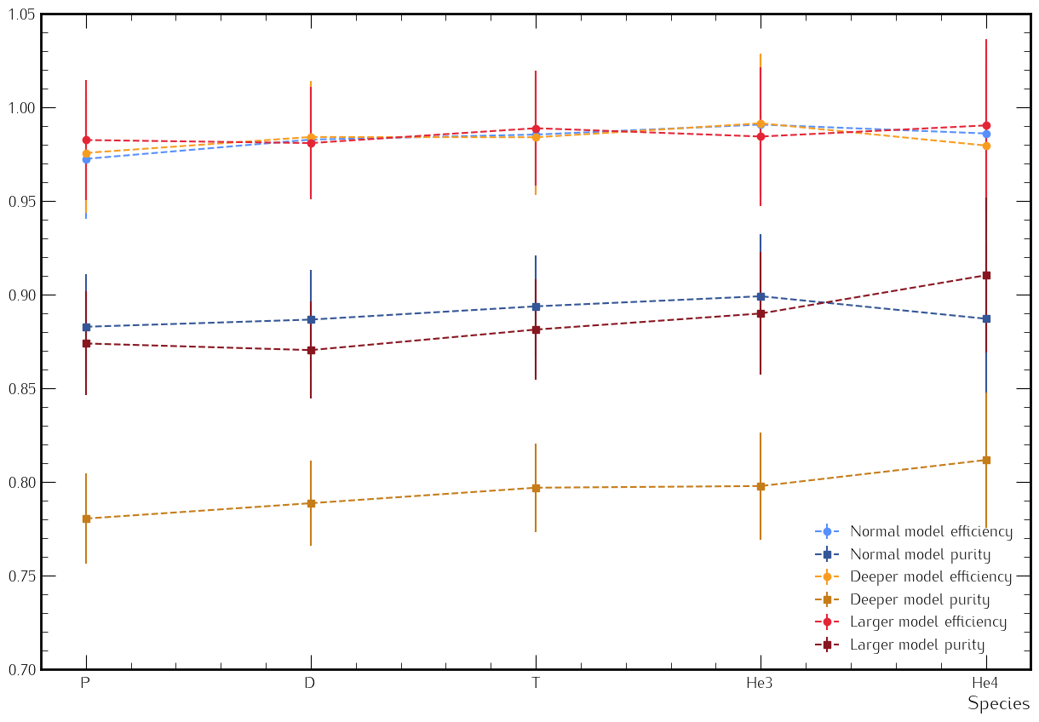
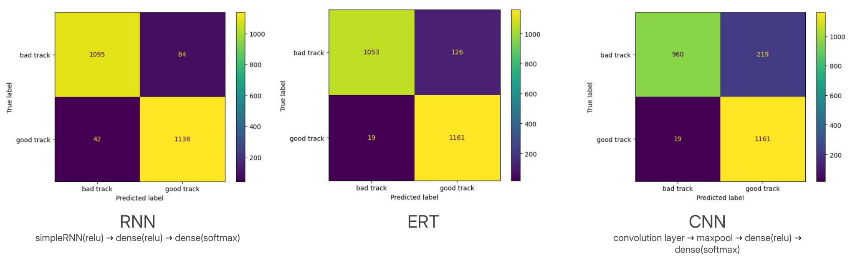
Efficiency and purity as function of species
Have also check the efficiency as function of the threshold.
Have also check the efficiency as function of the particle.
Test differents AI algorithms : CNN, RNN and ERT.
Train the model with tracks from proton, deuterium, tritium, helium 3 and helium 4.
Constant for all species.

Slide 3
Implementation in COATJAVA
Implementation of the clustering in COATJAVA:
Same implementation as in python
Implementation of the AI model with the library Deep Java Library
Allow us to load the PyTorch model in Java
Implementation is done on local github, will be push to the main ALERT repo
The output of the model in Python and COATJAVA is the same.
Will reproduce efficiency plot as function of number of random hits to validate the implementation.

