Slide 1

ALERT software group meeting
Mathieu Ouillon (Mississippi State University)
December 02th, 2024

Slide 2
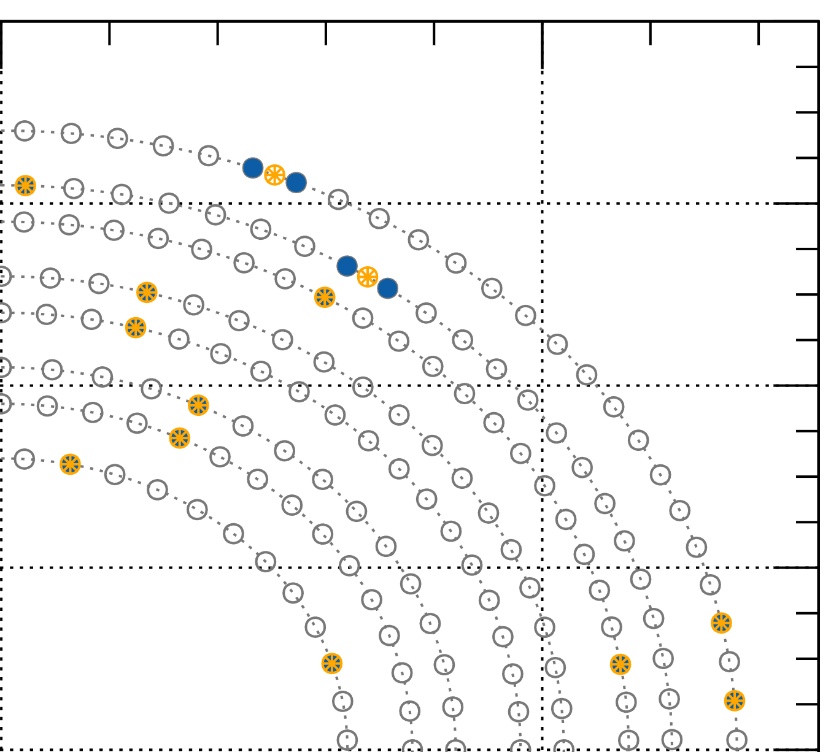
AI for ALERT
Implementation of the clustering in COATJAVA:
Raw hits in blue.
Merge hits that on the same layer and 1 wire away together into precluster (orange circle).​
Merge precluster that are on the same superlayer and 8mm away into super-precluster (green circle)​.
x (mm)
y (mm)

Slide 3
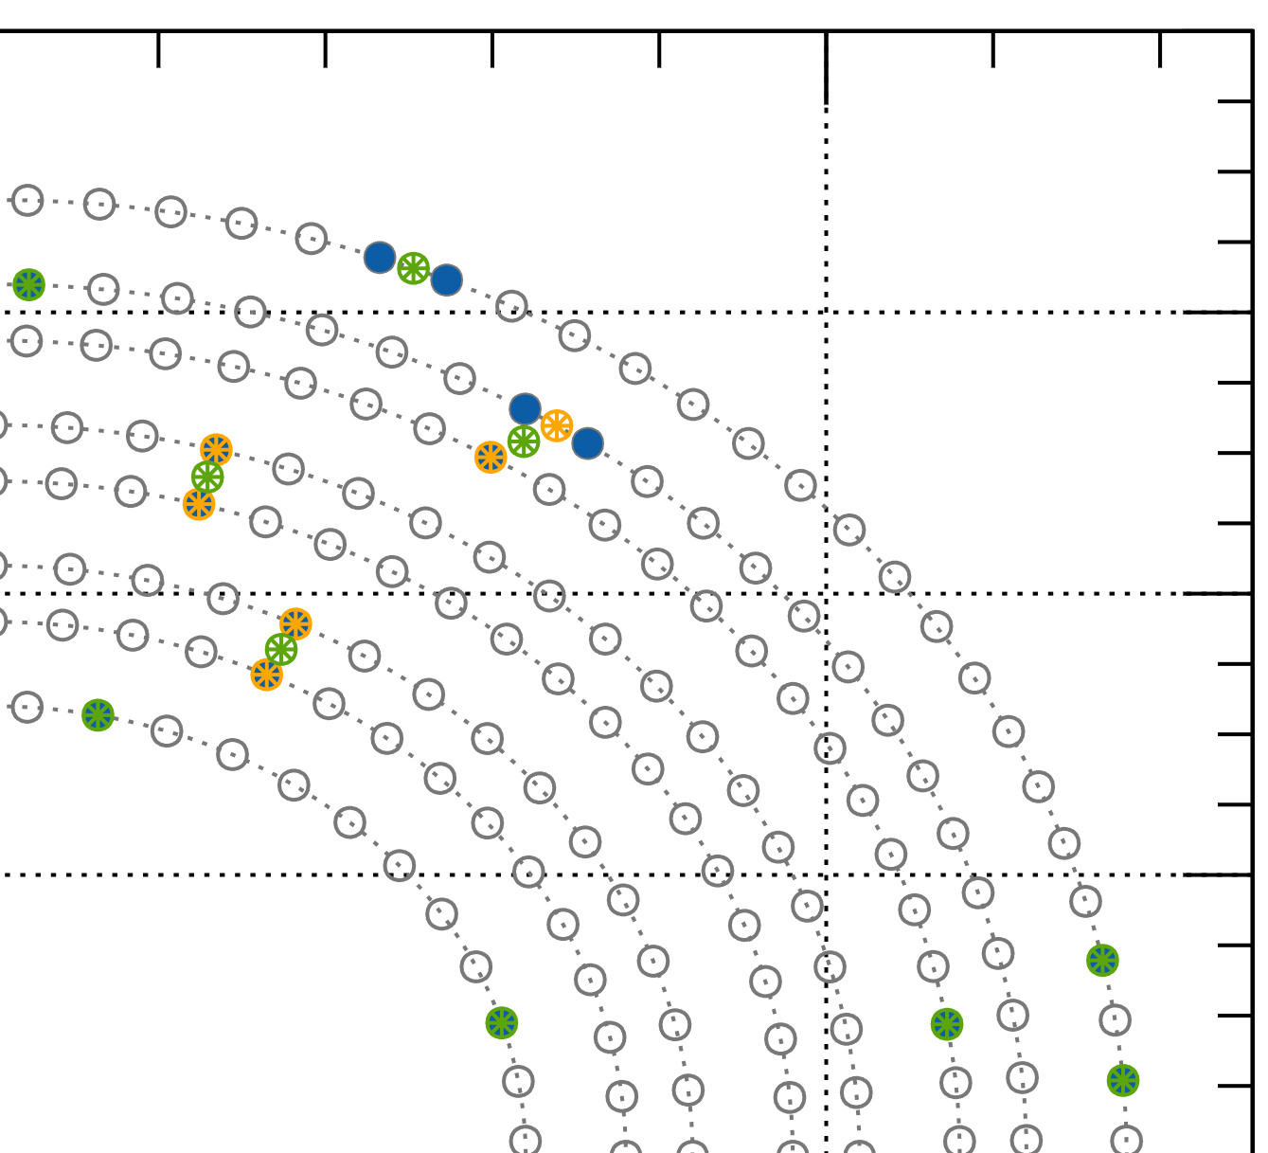
AI for ALERT
Implementation of the clustering in COATJAVA:
Raw hits in blue.
Merge hits that on the same layer and 1 wire away together into precluster (orange circle).​
Merge precluster that are on the same superlayer and 8mm away into super-precluster (green circle)​.
x (mm)
y (mm)

Slide 4
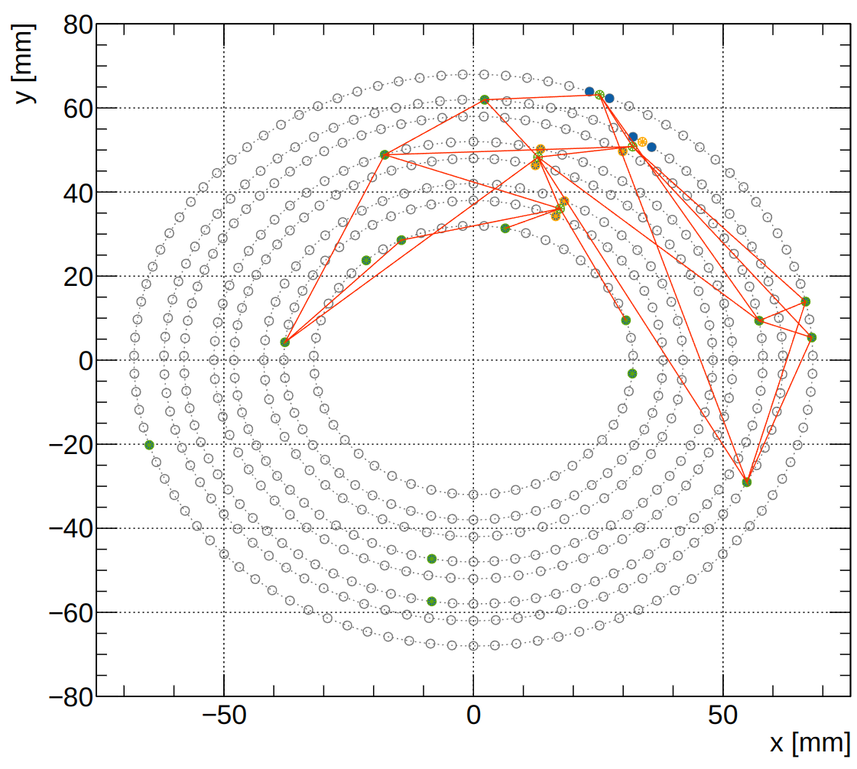
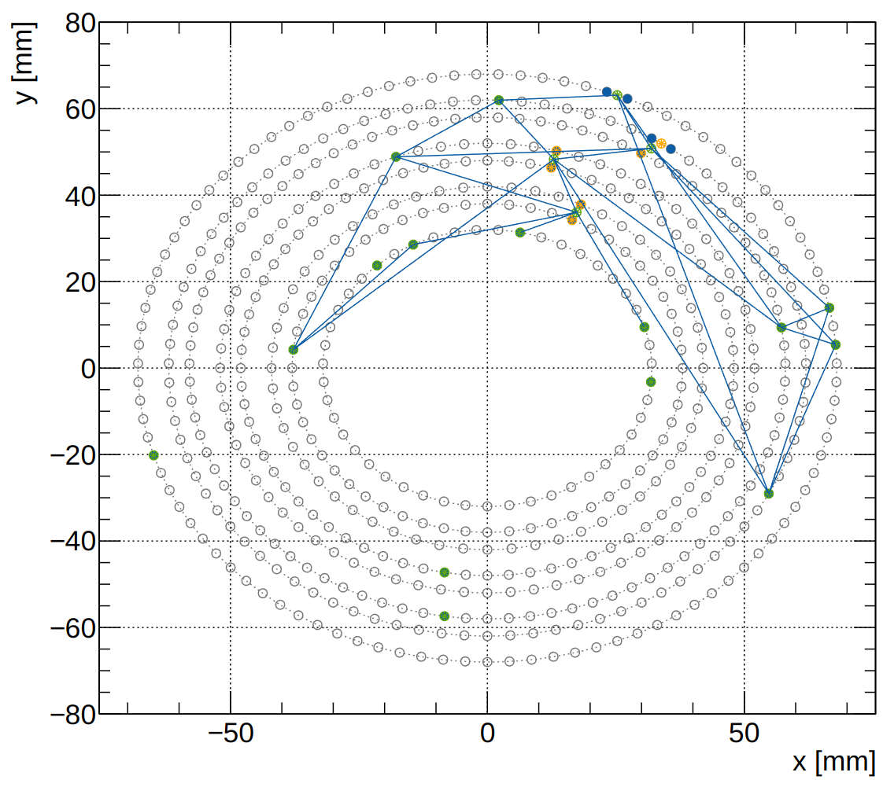
AI for ALERT
Find all possible tracks: implementation in COATJAVA
Python
Java

Slide 5
AI for ALERT
Implementation of the AI in COATJAVA, use Deep Java Library
Prediction of python AI:
4.1537e-06, 1.7346e-06, 4.2557e-07,2.9792e-08,
1.8523e-10,9.8938e-01, …
Prediction of AI in COATJAVA:
4.153695E-6, 1.7346407E-6, 4.255732E-7, 2.9791678E-8, 1.8522876E-10, 0.9893768, …
Working on multithreading with CLARA.
Will make a pull request soon

