Slide 1

ALERT software group meeting
Mathieu Ouillon (Mississippi State University)
6 January 2025

Slide 2
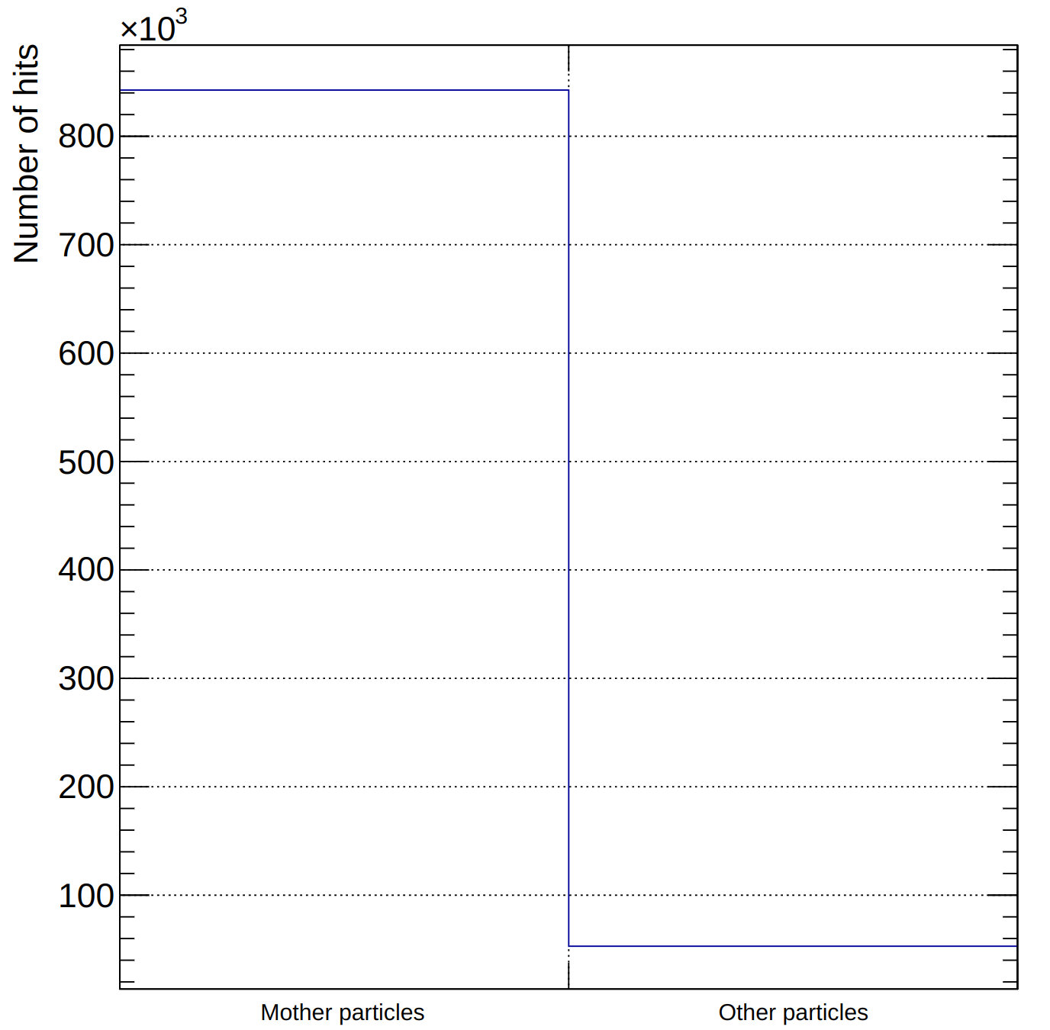
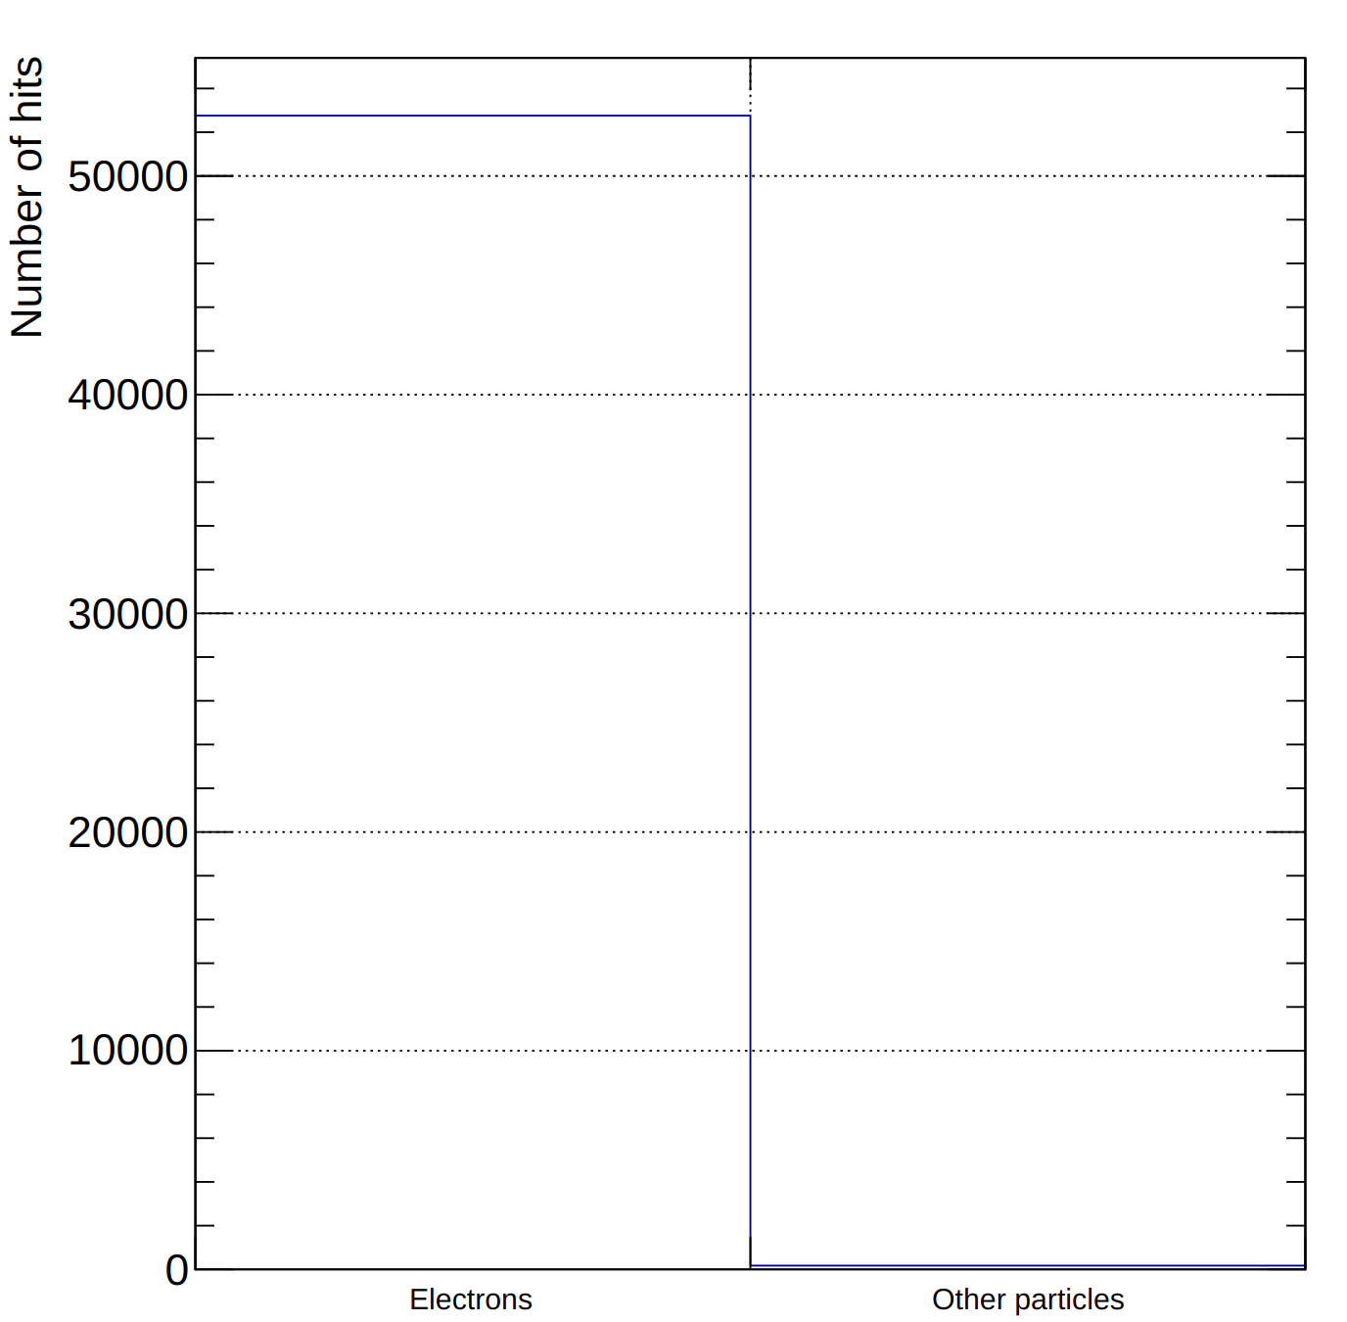
Study secondary particles
Determine the frequency of secondary particle production and its ability to cause hits in the AHDC.
Data use: 1 proton p∈ [60, 250] MeV/c, φ ∈ [0, 360]°, θ ∈ [60, 120]° and vz ∈ [-15, 15] cm.

Slide 3
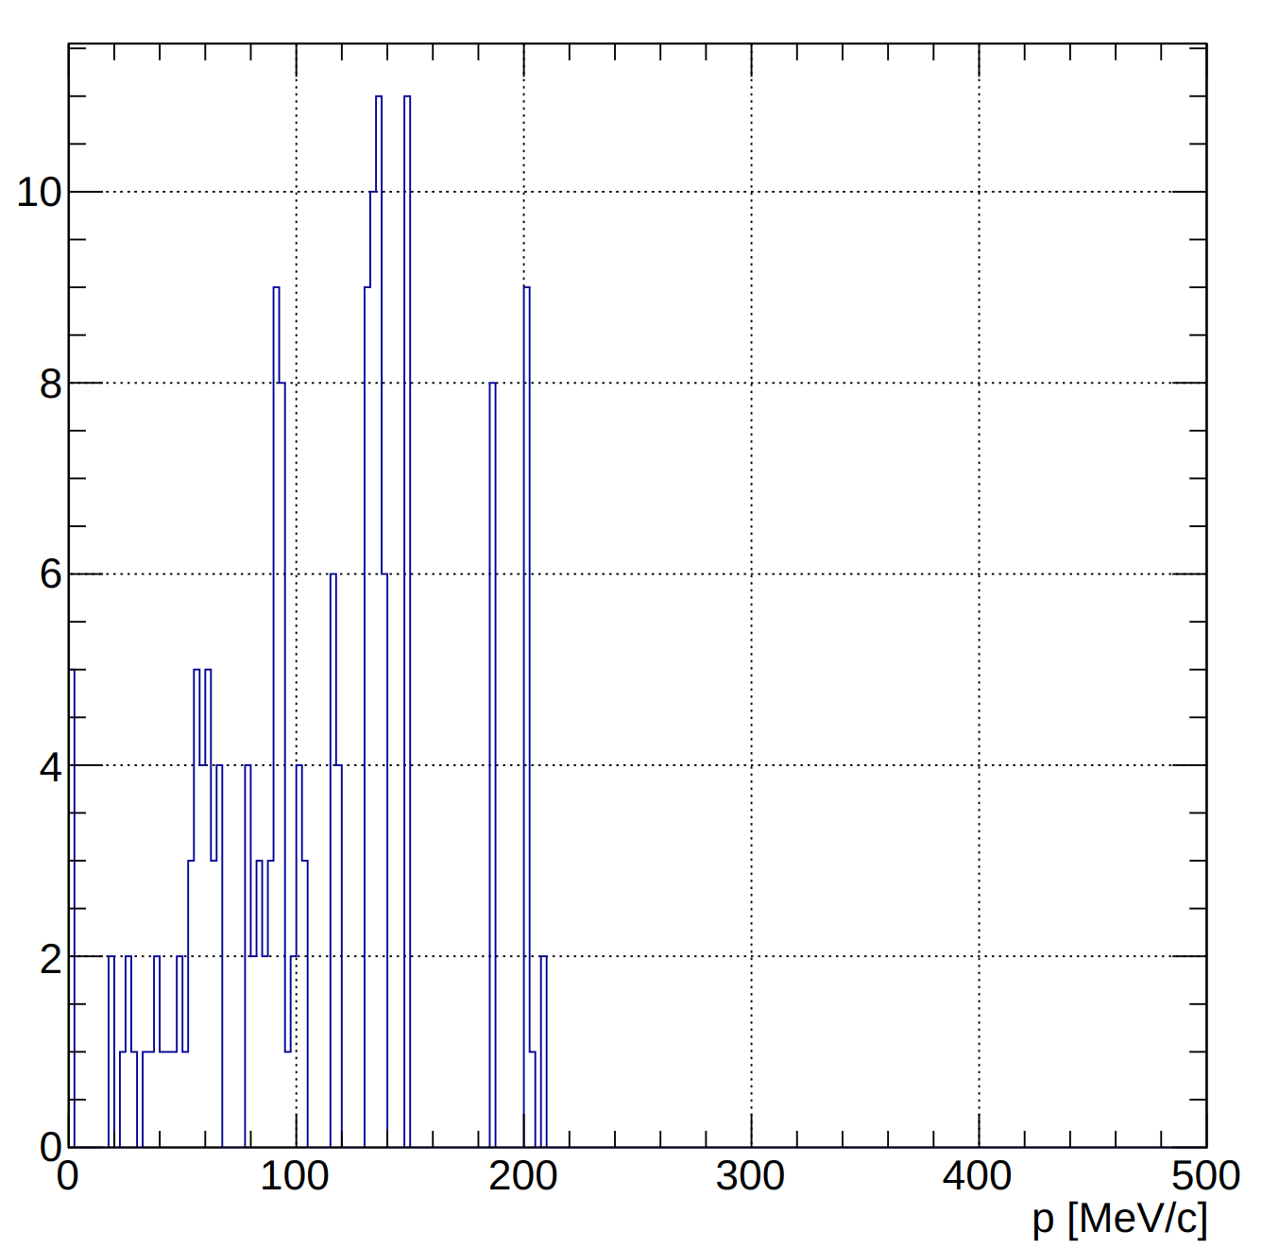
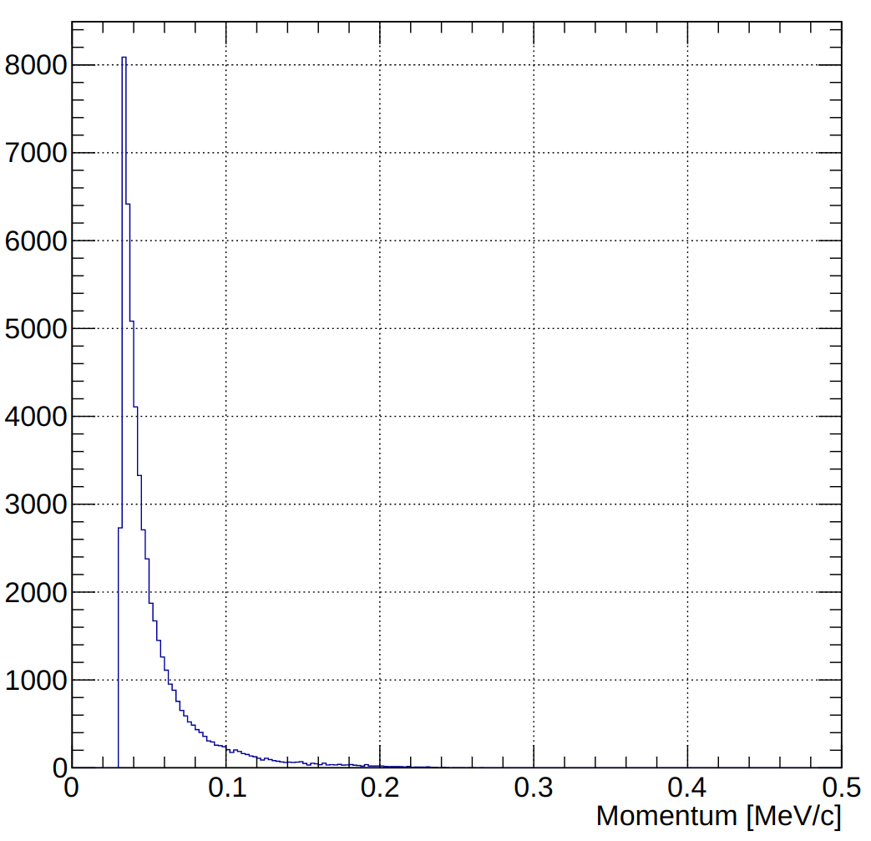
Study secondary particles
Electron
Other

Slide 4
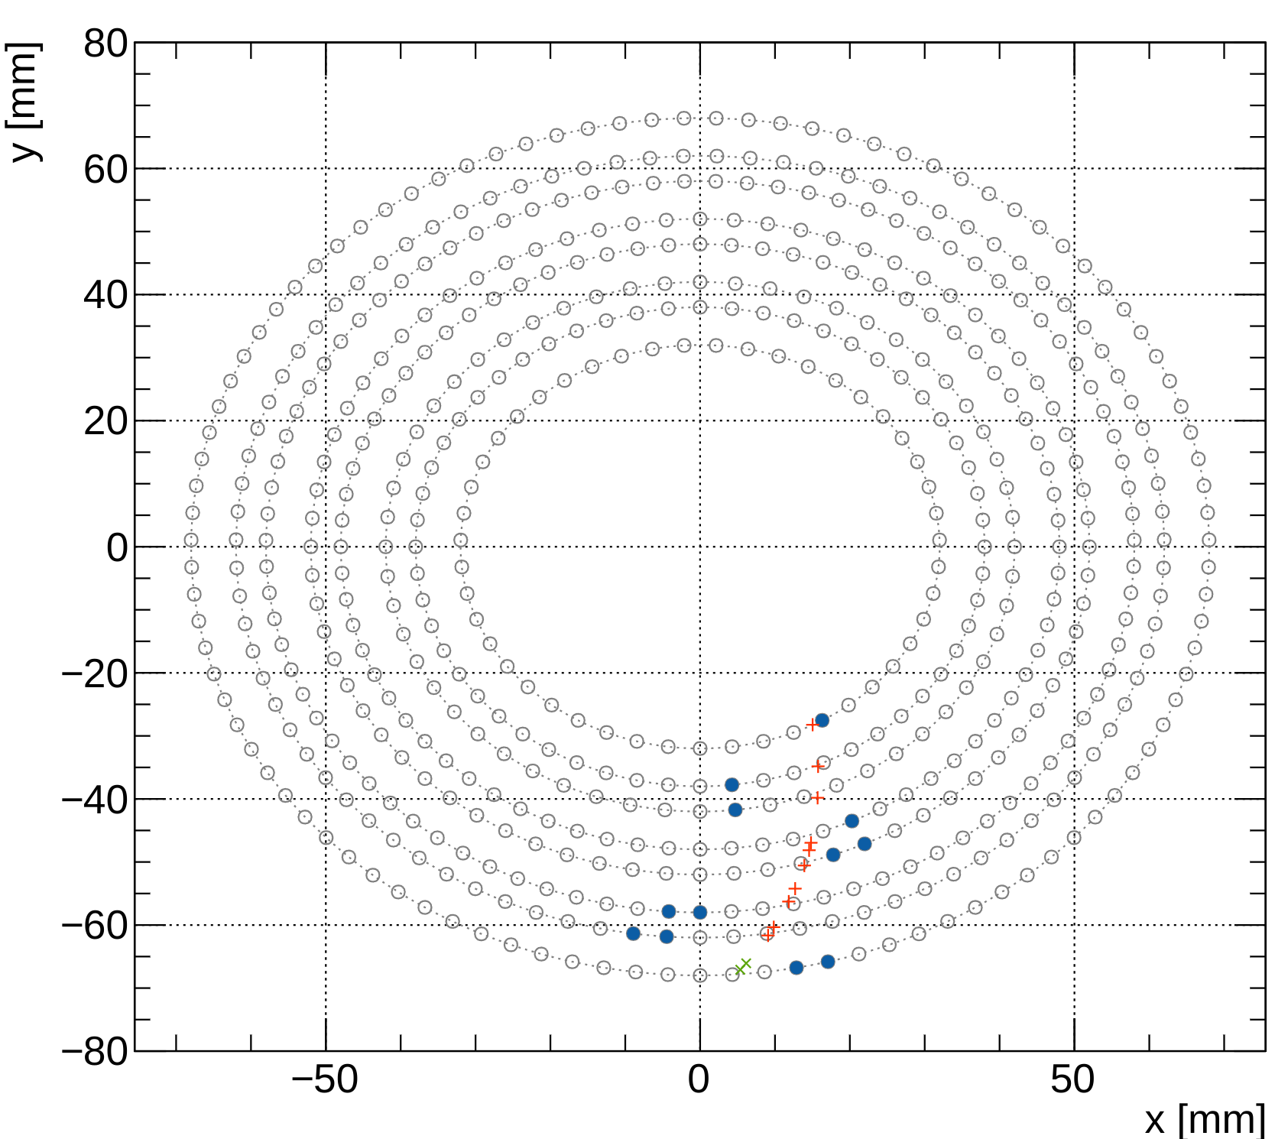
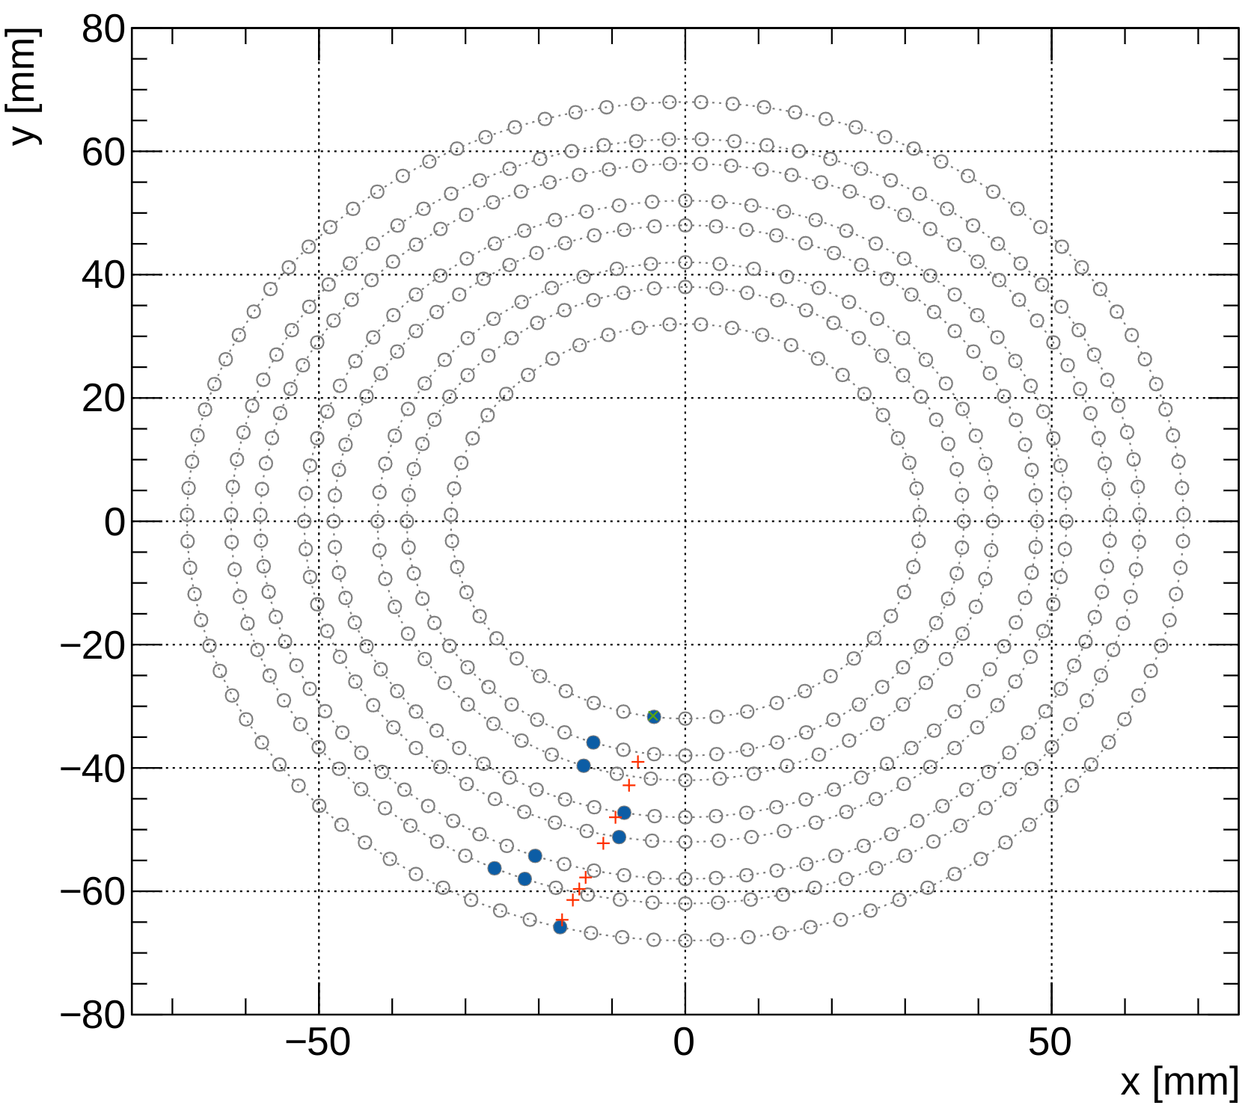
Study secondary particles

Slide 5
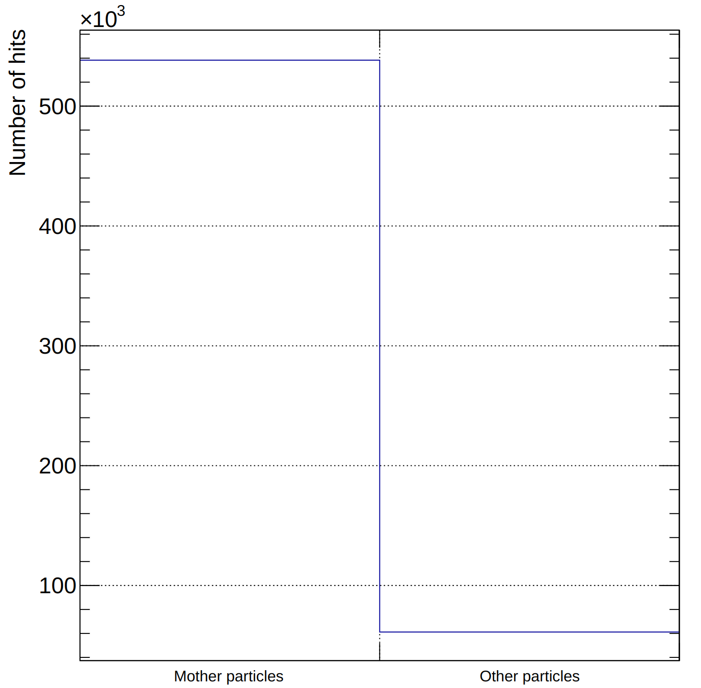
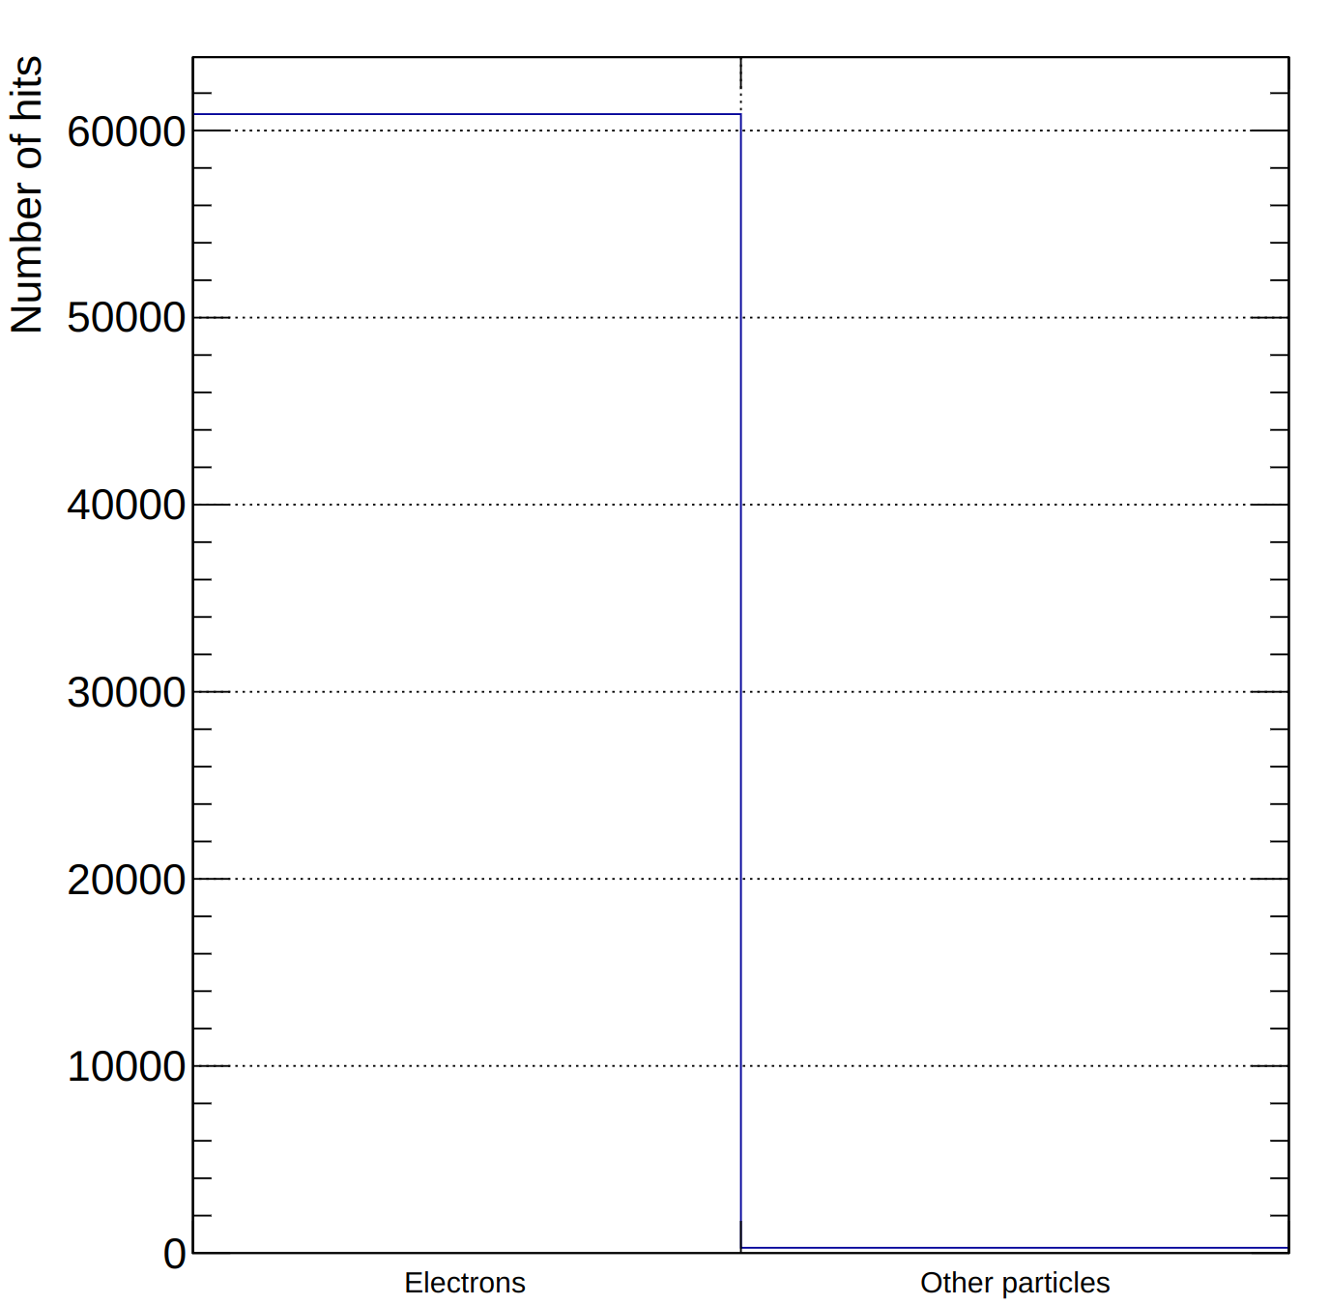
Study secondary particles
Determine the frequency of secondary particle production and its ability to cause hits in the AHDC.
Data use: p,²H,³H,³He,⁴He ∈ [60, 450] MeV/c, φ ∈ [0, 360]°, θ ∈ [60, 120]° and vz ∈ [-15, 15] cm.

