Slide 1

RG-D Background Merging and Efficiency Studies
Mathieu Ouillon (Mississippi State University)
CalColm Meeting
4 April, 2025

Slide 2
Background Merging
Goal: Study DC efficiency vs. current for simulation and data using AI-assisted and conventional tracking (CV)
RG-D have three target configurations: LD2, CxC and CuSn -> Focus on LD2 first
First step: extract background events
Two current settings: 50 and 60 nA
Use trigger-filter to extract background events based on the trigger
-> trigger bit mask: 0x0000008000000000
Take 20 random files for each current, get 5k background events per file ⇒ end with 100k background events per current

Slide 3
Simulation vs. Data
Simulate SIDIS events with this event generator
GEMC 5.11: inbending configuration
COATJAVA: 11.1.0
AI-assisted reconstruction using the trained network by the end of data taking back in December 2023
Merge background and simulation events with bg-merger
Use Luminosity scan runs with current: 5, 20, 35, 50, 75 & 100 nA
Cooked data with COATJAVA 11.1.0

Slide 4
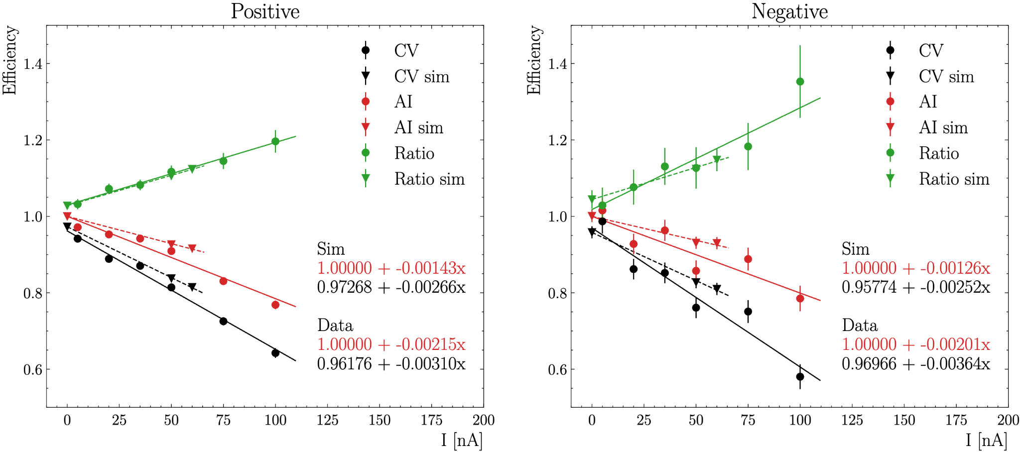
Efficiency Results for Simulation and Data

Slide 5
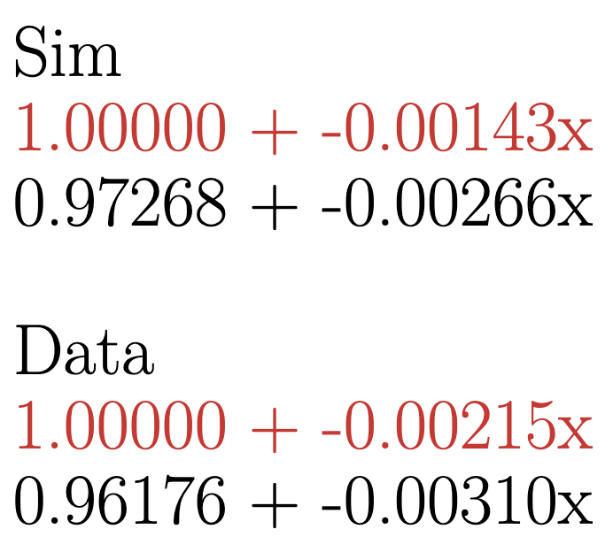
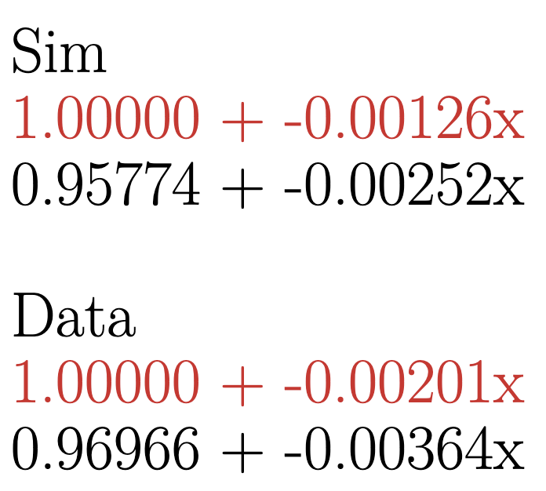
Efficiency Results for Simulation and Data
Positive
Negative
Difference between simulation and data: ~30%
Slope of the simulation is lower than the data, as expected!
Difference could be due to the old trained network online before the offline alignment and calibrations!?
Next step: redo it with the new AI network & try other nuclear target, carbon

Slide 6
Backup

Slide 7
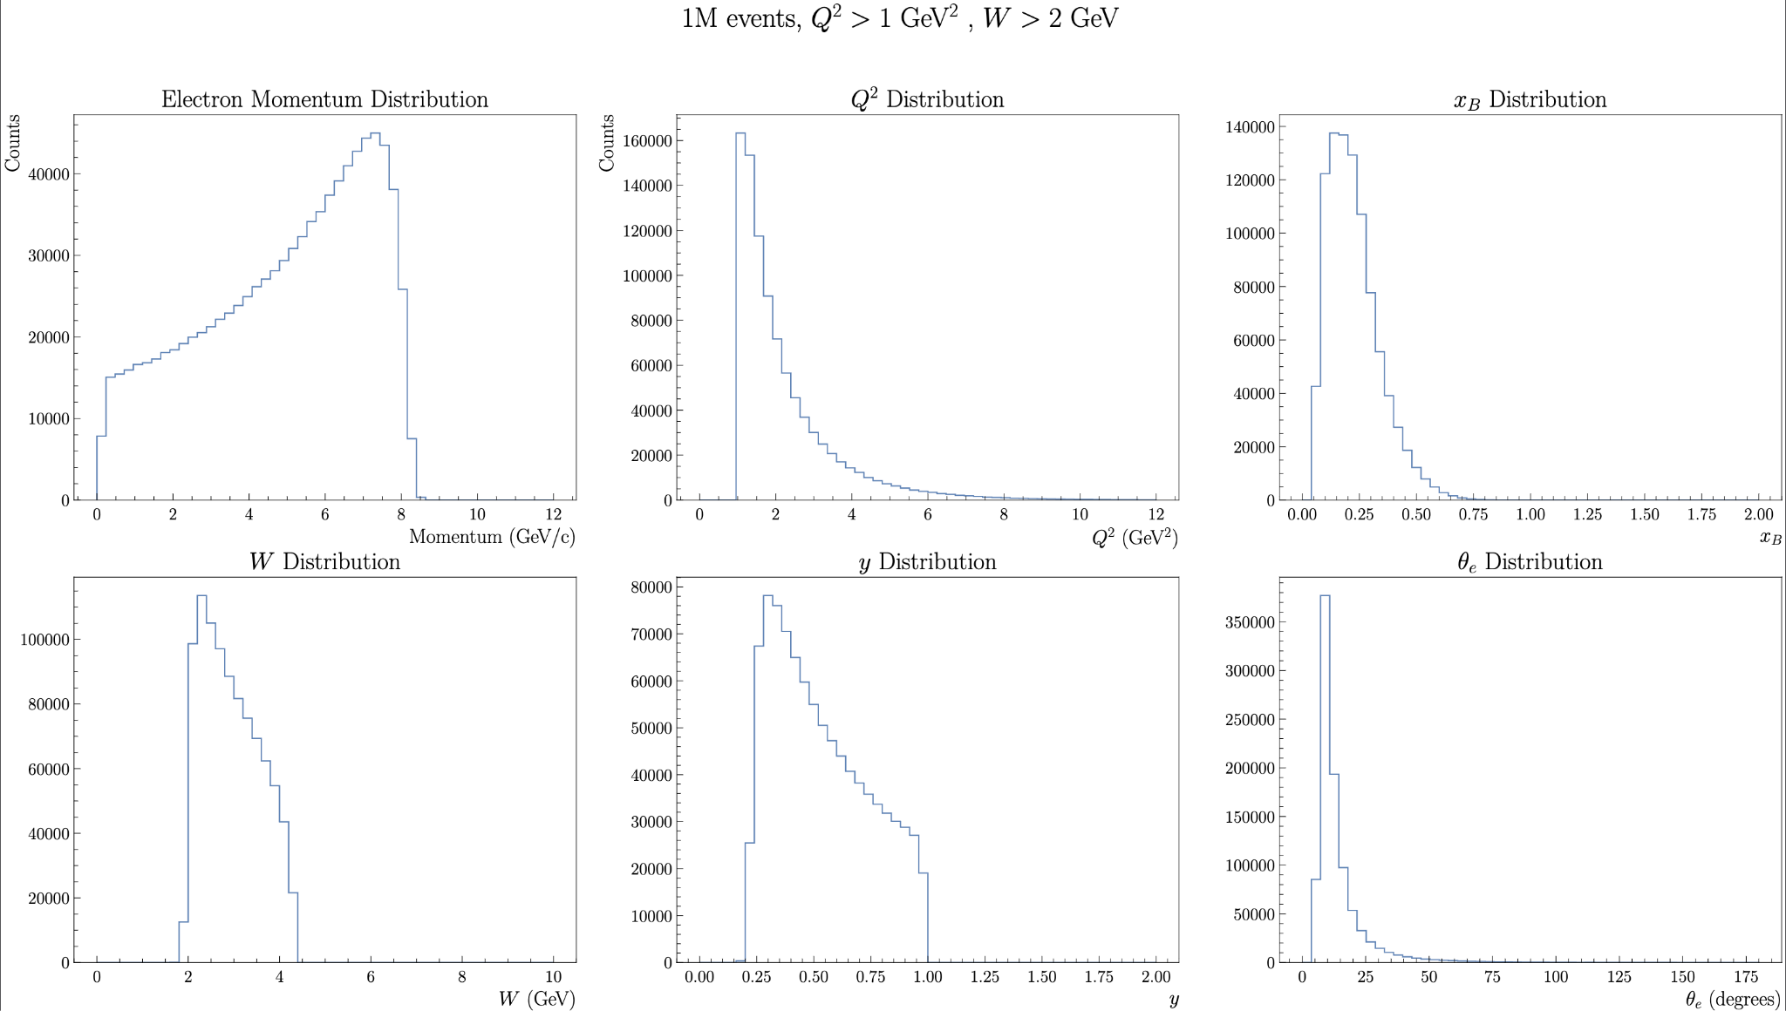
Kinematics of Generated Events

