Slide 1

RG-D Background Merging and Efficiency Studies
Mathieu Ouillon (Mississippi State University)
CalColm Meeting
May 2nd, 2025

Slide 2
Background Merging
Goal: Study DC efficiency vs. current for simulation and data using AI-assisted and conventional tracking (CV)
Focus on CuSn this time
Currents:
Simulation: 90, 95, 100, 110, 130, 150, and 175 nA
Data: 100, 110, 130, 150, 175 nA
Generate background events for all of them
Generated SIDIS events with a modified Phythia-based event generator
Used
GEMC 5.11 with inbending configuration
COATJAVA: 12.0.4t for real data and simulation
AI-assisted reconstruction with the newly trained network of one LD2 outbending run

Slide 3
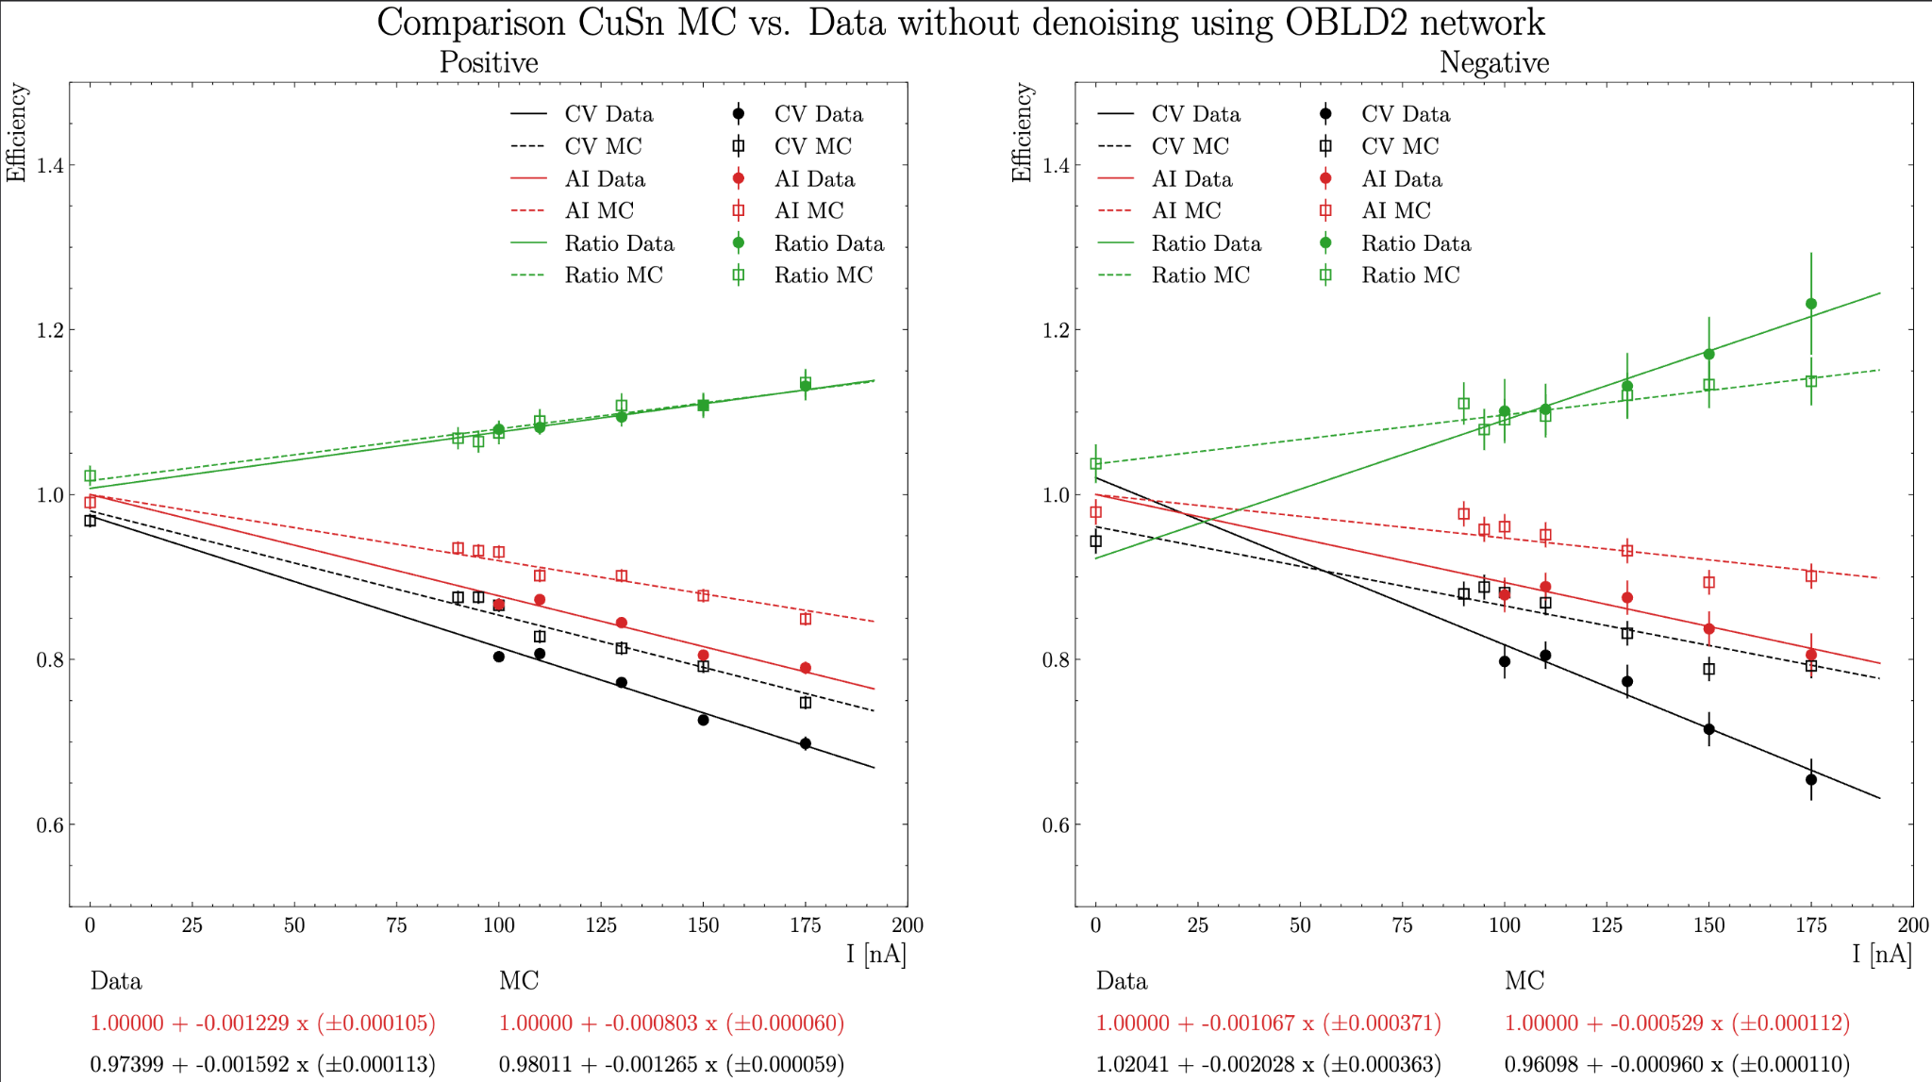
Efficiency Results for Simulation and Data

Slide 4
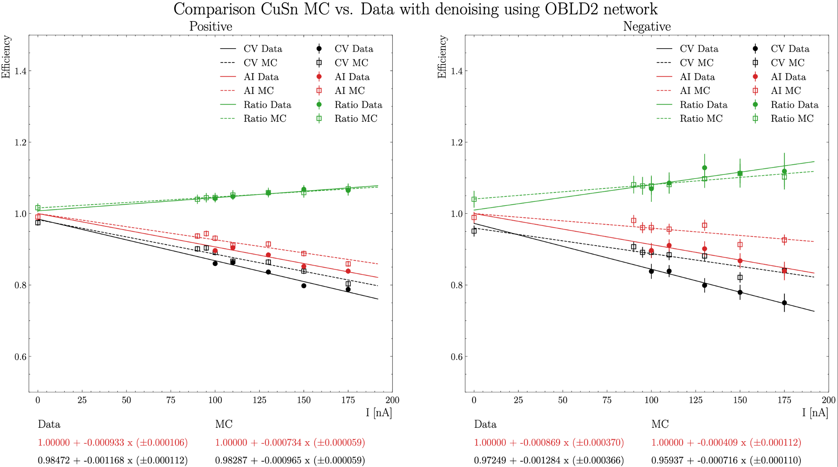
Efficiency Results for Simulation and Data

Slide 5
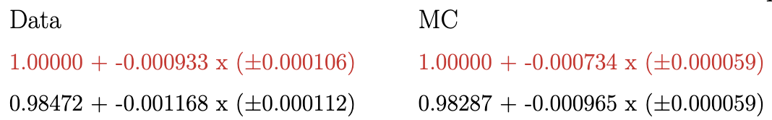
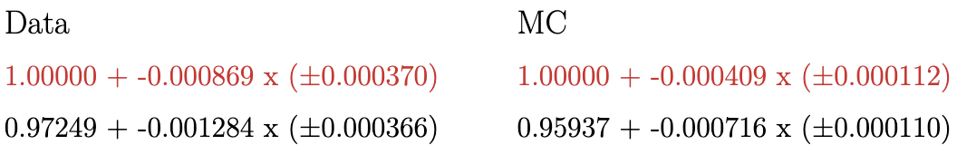
Efficiency Results for Simulation and Data
OB LD2 AI-network with denoising:
Positive:
Negative:
Slope of the simulation is lower than the data, as expected!
Bigger difference between MC and Data (approx. 20/52% for positive/negative) compared to LD2 case.

Slide 6
Background

Slide 7
Background Merging
Goal: Study DC efficiency vs. current for simulation and data using AI-assisted and conventional tracking (CV)
RG-D has three target configurations: LD2, CxC and CuSn ⇒ Focus on LD2 first then CuSn
First step: extract background events using
two current settings: 50 and 60 nA
trigger-filter to extract background events based on the trigger bitmask: 0x0000008000000000
20 random files for each current, which yields 5k background events per file and thus 100k background events per current

Slide 8
Simulation vs. Data
Generated SIDIS events with a modified Phythia-based event generator
Used
GEMC 5.11 with inbending configuration
COATJAVA: 12.0.4t for real data and simulation
AI-assisted reconstruction with the newly trained network of one LD2 outbending run
Merged background and simulation events with bg-merger
Reconstruction done with and without denoising
Comparison performed for LD2 luminosity scan runs taken with beam currents of 5, 20, 35, 50, 75 & 100 nA

Slide 9
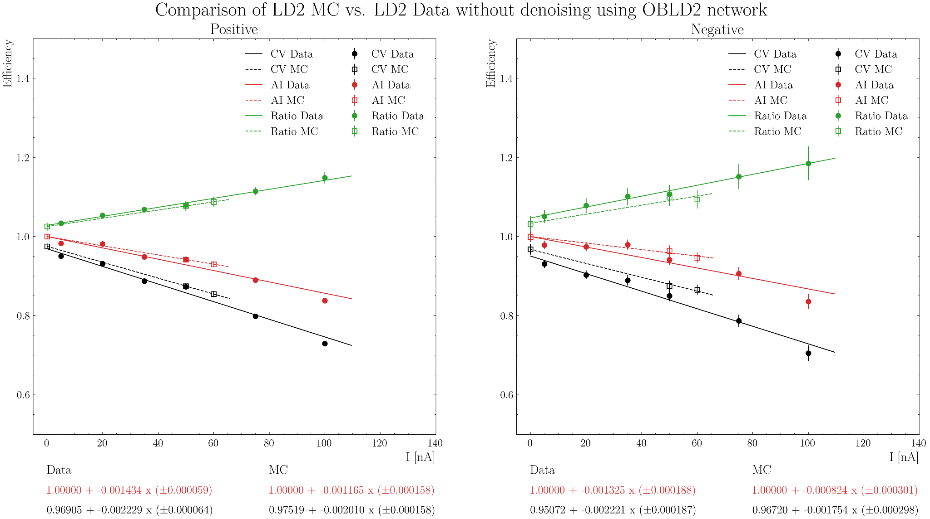
Efficiency Results for Simulation and Data

Slide 10
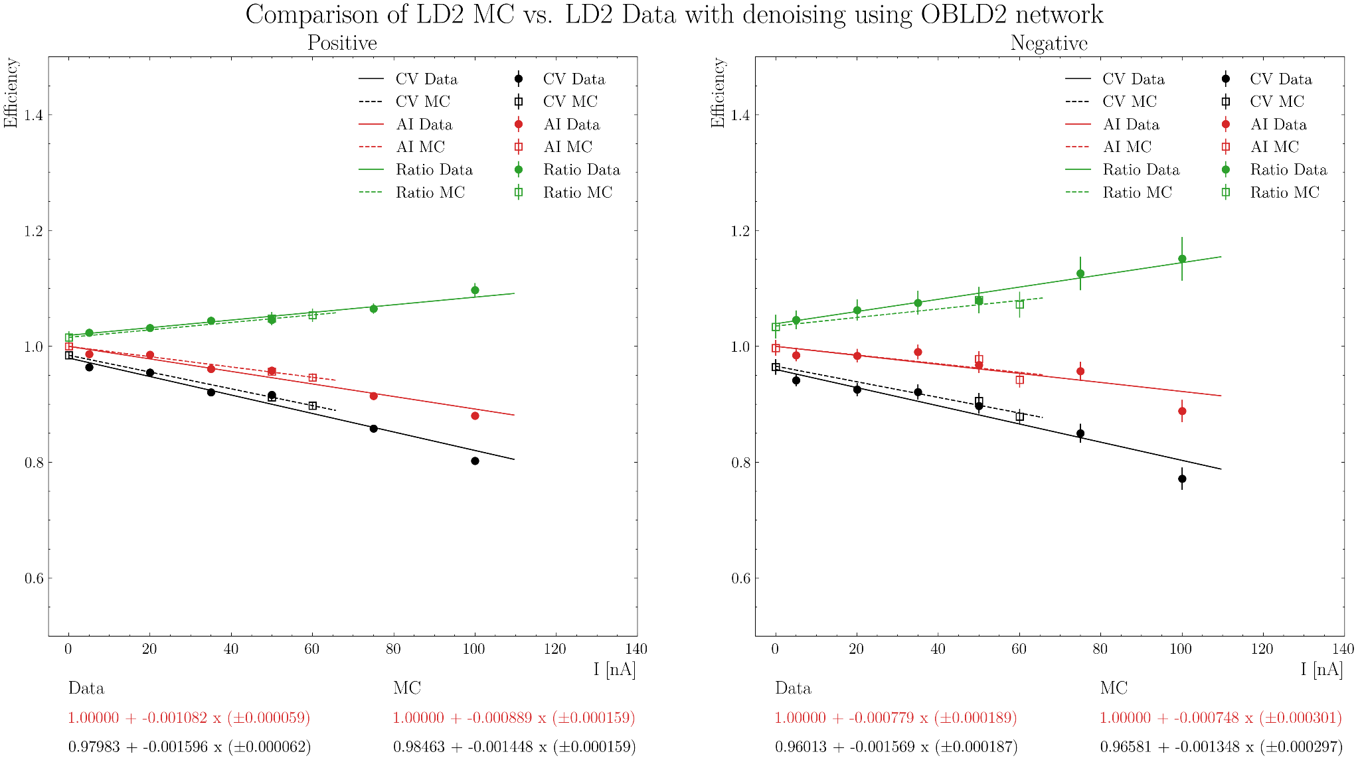
Efficiency Results for Simulation and Data

Slide 11
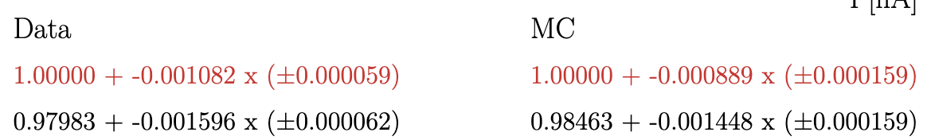
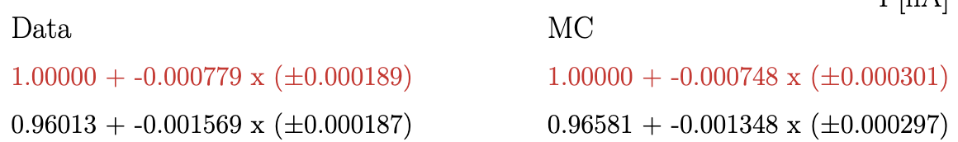
Efficiency Results for Simulation and Data
OB LD2 AI-network with denoising:
Positive:
Negative:
Slope of the simulation is lower than the data, as expected!
Smaller difference between MC and Data (approx. 18/4% for positive/ negative) compared to the former study with fall 2023 AI-network
Next step: repeat the same study for solid-foil configuration, CuSn

Slide 12
Simulation vs. Data: Study done April 4th
Simulate SIDIS events with this Pythia-based event generator
GEMC 5.11: Inbending configuration
COATJAVA: 11.1.0
AI-assisted reconstruction using the trained network by the end of data taking back in December 2023
Merge background and simulation events with bg-merger
Use Luminosity scan runs with current: 5, 20, 35, 50, 75 & 100 nA
Cooked data with COATJAVA 11.1.0

Slide 13
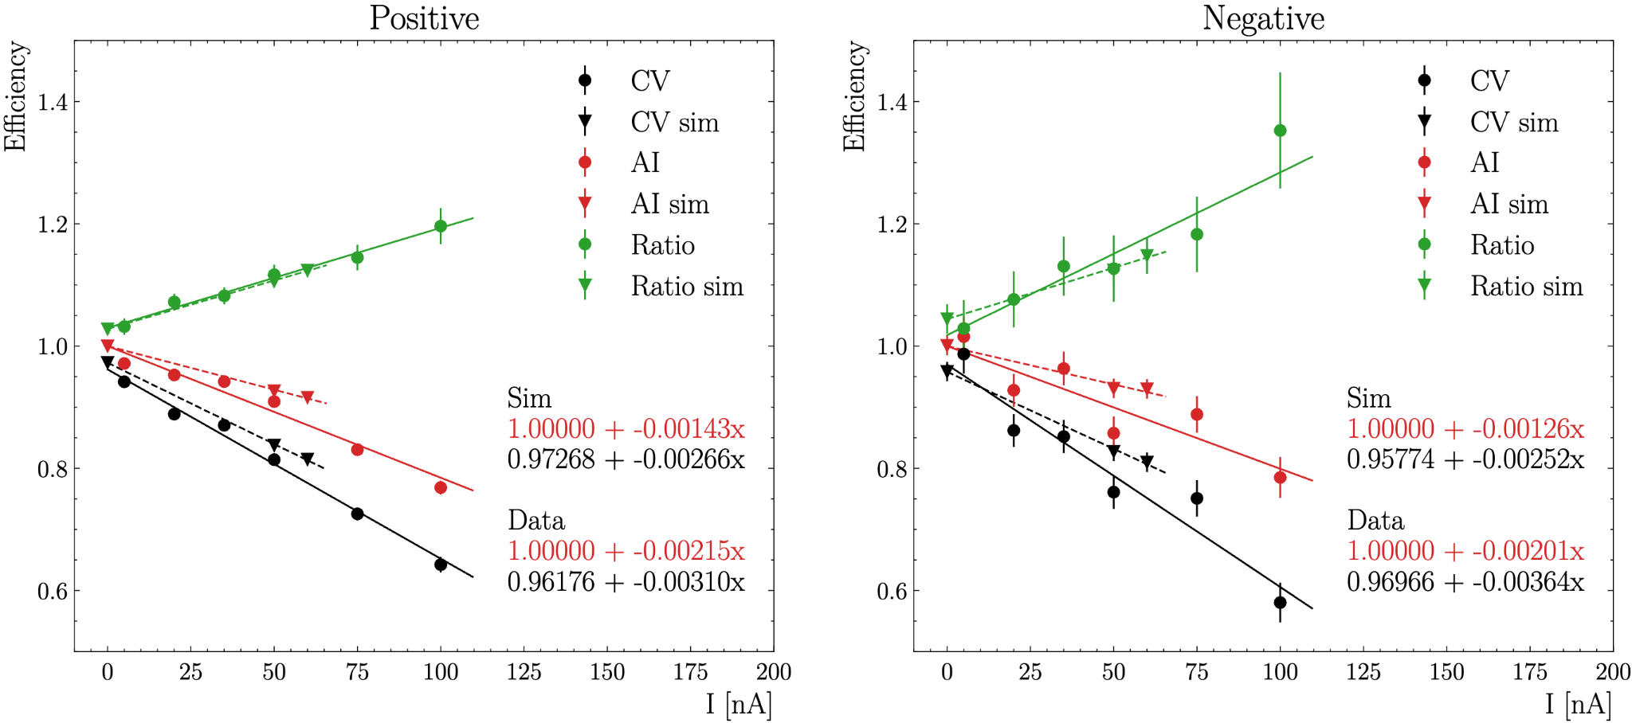
Efficiency Results for Simulation and Data: Study done on April 4th

Slide 14
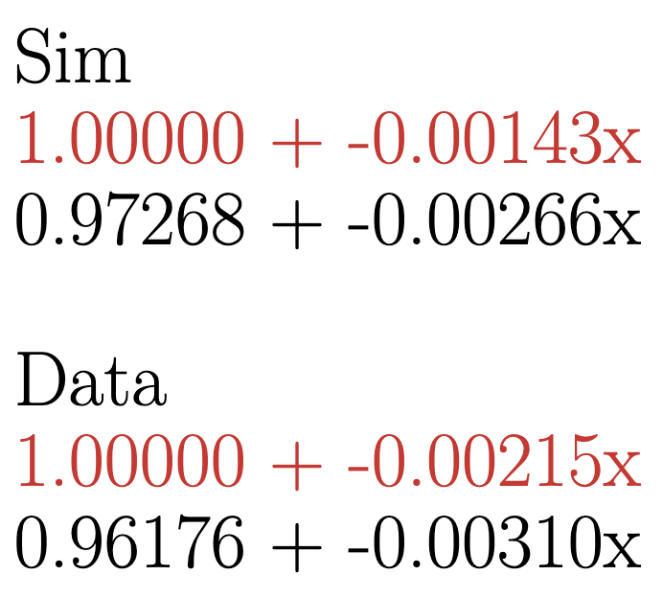
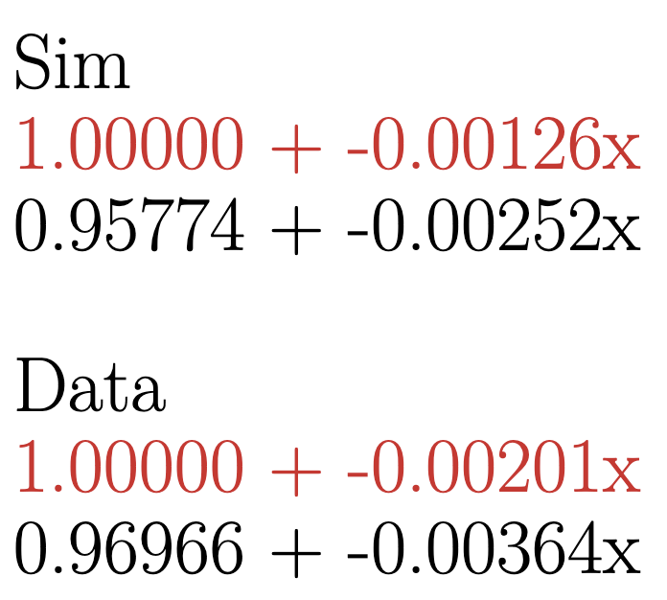
Efficiency Results for Simulation and Data: Study done on April 4th
Positive
Negative
Difference between simulation and data: ~30%
Slope of the simulation is lower than the data, as expected!
Difference could be due to the old trained network online before the offline alignment and calibrations!?
Next step: redo it with the new AI network & try other nuclear target, carbon

