Slide 1

Stuffs for Pass1 review
Mathieu Ouillon (Mississippi State University)

Slide 2
MC vs Data efficiency: LD2

Slide 3
Background merging
Goal: Study DC efficiency vs. current for simulation and data using AI-assisted and conventional tracking (CV)
RG-D has three target configurations: LD2, CxC and CuSn ⇒ Focus on LD2 first then CuSn
First step: extract background events using
two current settings: 50 and 60 nA, torus field: 1
trigger-filter to extract background events based on the trigger bitmask: 0x0000008000000000
Extract background events for 25 and 62 runs for 50 nA and 60 nA respectively.
This gitlab repository contains the code to generate the background files and to merge it with the simulation:

Slide 4
Simulation vs. Data
Generated SIDIS events with a modified Pythia-based event generator
Used
GEMC 5.11 with inbending configuration
COATJAVA: 12.0.4t for real data and simulation
AI-assisted reconstruction with the newly trained network of one LD2 outbending run
Merged background and simulation events with bg-merger
Reconstruction done with and without denoising
Comparison performed for LD2 luminosity scan runs taken with beam currents of 5, 20, 35, 50, 75 & 100 nA

Slide 5
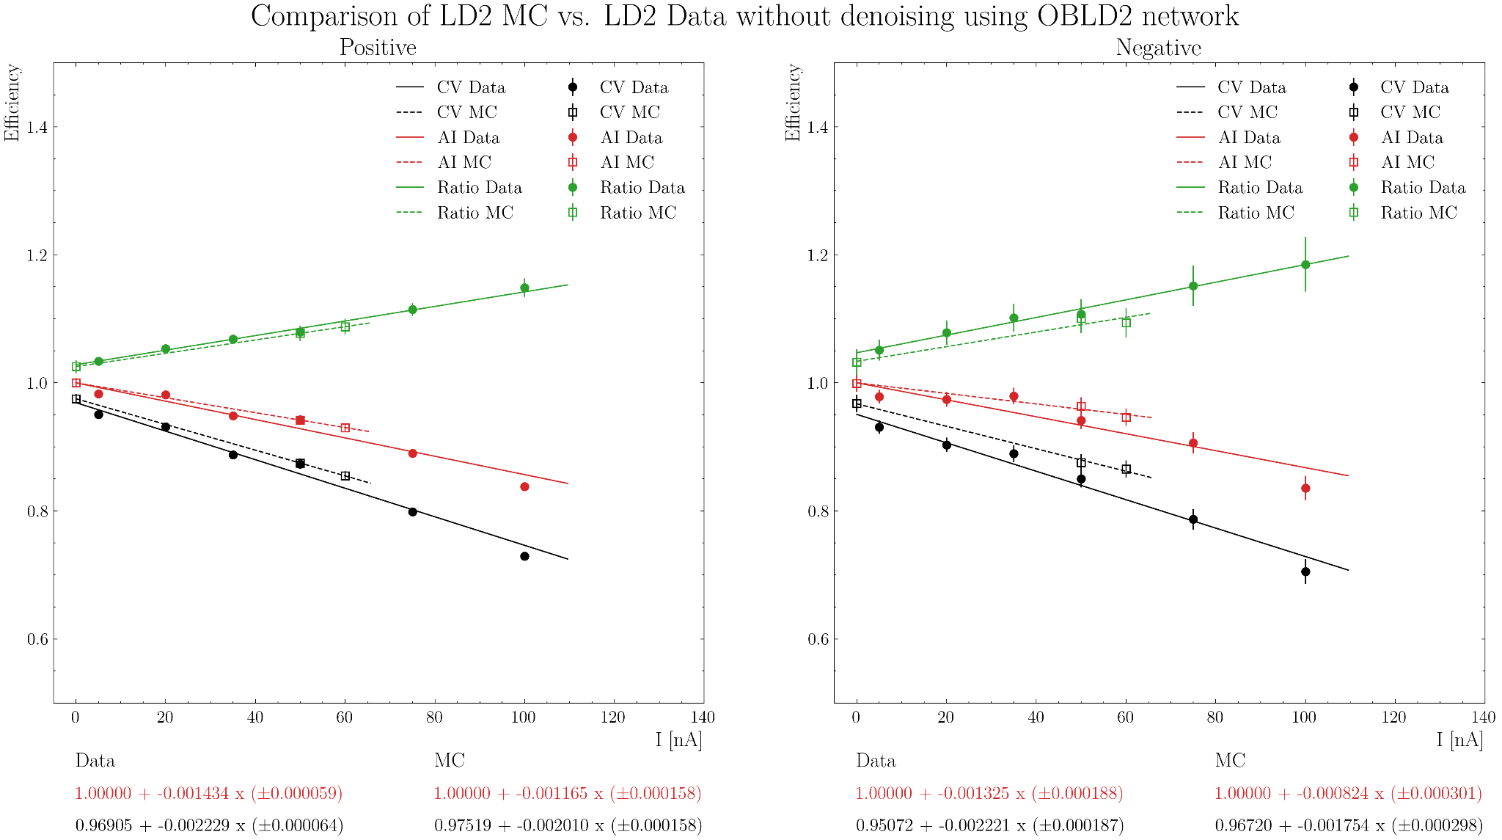
Efficiency Results for Simulation and Data

Slide 6
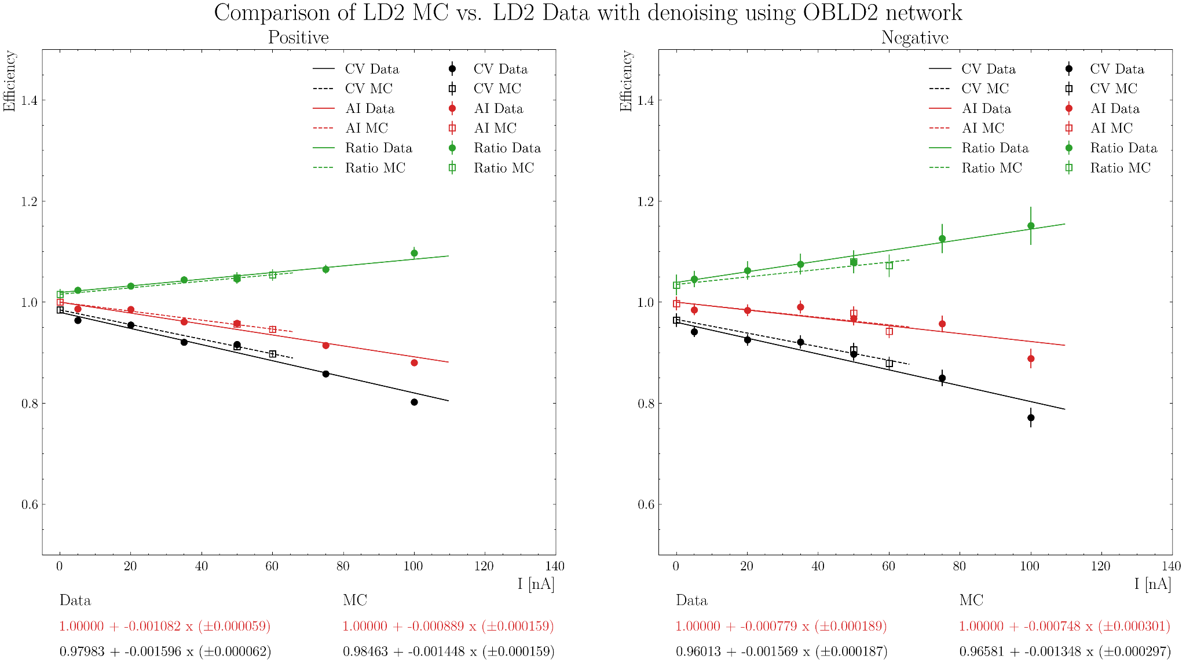
Efficiency Results for Simulation and Data

Slide 7
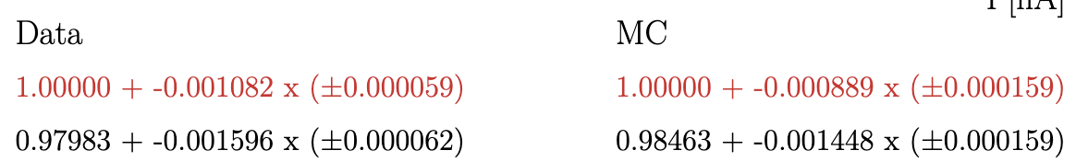
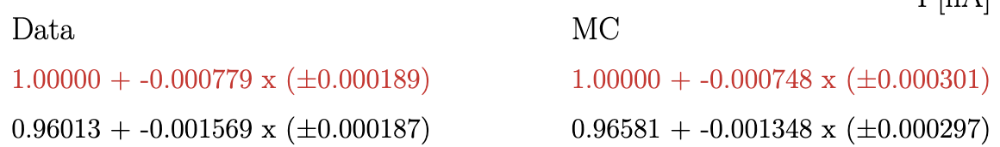
Efficiency Results for Simulation and Data: 25 April
OB LD2 AI-network with denoising:
Positive:
Negative:
Slope of the simulation is lower than the data, as expected!
Smaller difference between MC and Data (approx. 18/4% for positive/ negative) compared to the former study with fall 2023 AI-network

Slide 8
MC vs Data efficiency: CuSn

Slide 9
Background Merging
Goal: Study DC efficiency vs. current for simulation and data using AI-assisted and conventional tracking (CV)
Focus on CuSn this time
Currents:
Simulation: 90, 95, 100, 110, 130, 150, and 175 nA
Data: 100, 110, 130, 150, 175 nA
Generate background events for all of them
Generated SIDIS events with a modified Pythia-based event generator
Used
GEMC 5.11 with inbending configuration
COATJAVA: 12.0.4t for real data and simulation
AI-assisted reconstruction with the newly trained network of one LD2 outbending run

Slide 10
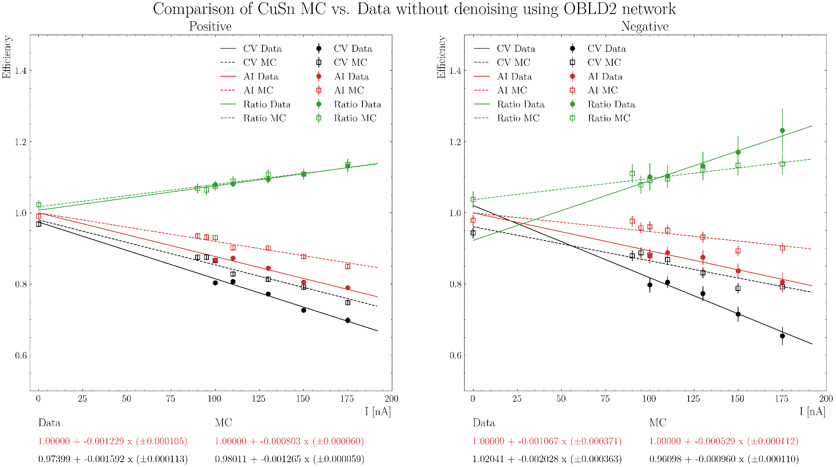
Efficiency Results for Simulation and Data

Slide 11
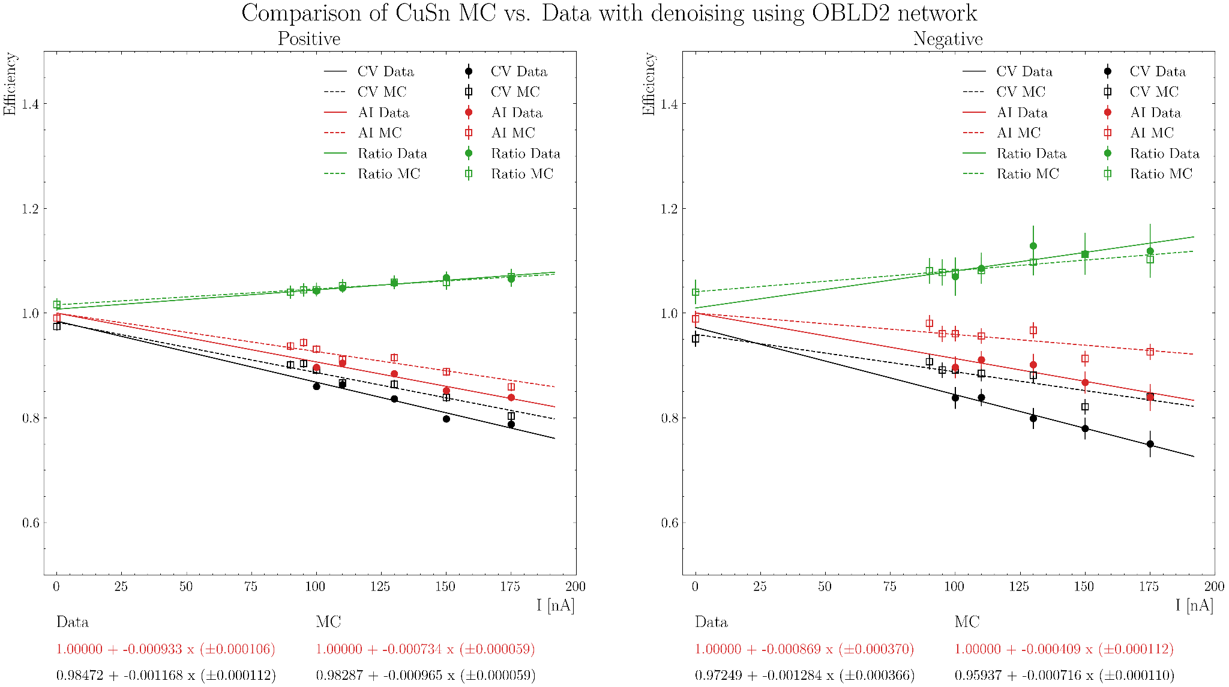
Efficiency Results for Simulation and Data

Slide 12
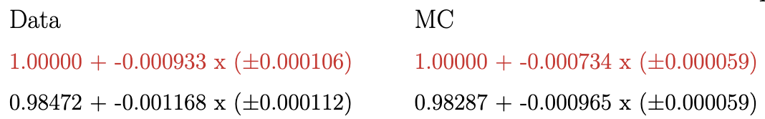
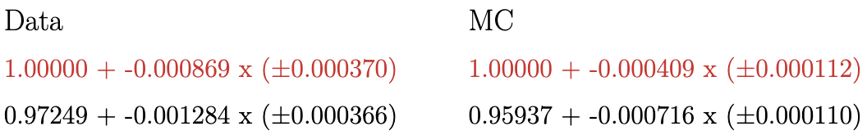
Efficiency Results for Simulation and Data
OB LD2 AI-network with denoising:
Positive:
Negative:
Slope of the simulation is lower than the data, as expected!
Bigger difference between MC and Data (approx. 20/52% for positive/negative) compared to LD2 case.

Slide 13
Data efficiency vs occupancy: LD2 vs CuSn

Slide 14
Efficiency Results for Data LD2 vs Cusn using DC occupancy
Using the decoded files of Pass0v8, extract the DC occupancy for a run (20 files):
Select the random events with the trigger (if RUN::config:trigger & 0x0000008000000000 = true)
DC occupancy per event = (number of hits in the DC::tdc bank) / (6 x 6 x 6 x 112)
6 sectors, 6 superlayers, 6 layers, 112 wires
Take the average of the 20 files
Compute the DC occupancy for the runs 18318, 18319, 18321, 18324, 18325:
Run: 018318 | 5 nA → Average occupancy: 0.37%
Run: 018319 | 20 nA → Average occupancy: 1.28%
Run: 018321 | 35 nA → Average occupancy: 2.06%
Run: 018324 | 50 nA → Average occupancy: 2.73%
Run: 018325 | 75 nA → Average occupancy: 4.17%
Run: 018326 | 100 nA → Average occupancy: 5.67%
Compute the DC occupancy for the runs 18348, 18394, 18354, 18372, 18373:
Run: 018348 | 100nA -> Average occupancy: 3.35%
Run: 018394 | 110nA -> Average occupancy: 2.68%
Run: 018354 | 130nA -> Average occupancy: 4.01%
Run: 018372 | 150nA -> Average occupancy: 4.95%
Run: 018373 | 175nA -> Average occupancy: 5.67%

Slide 15
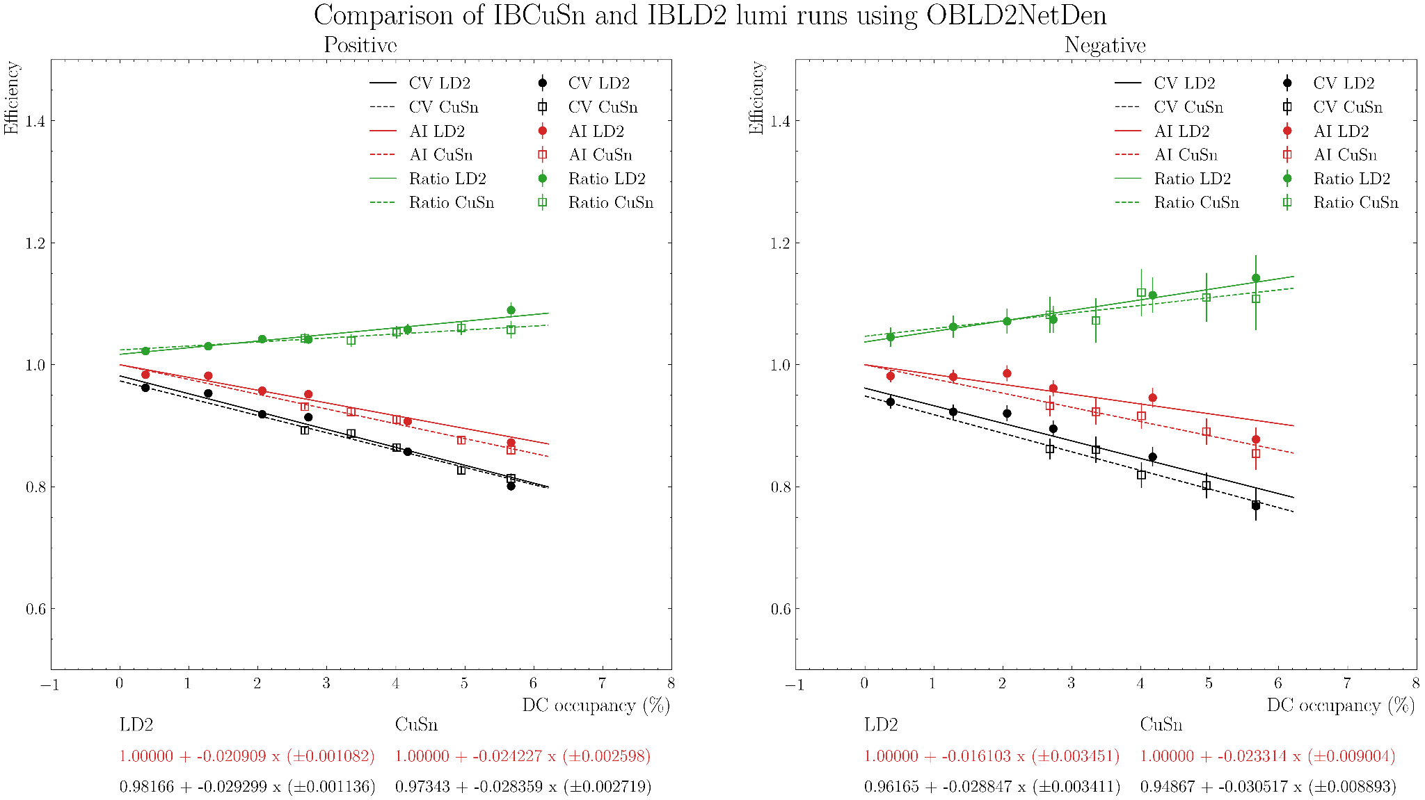
Efficiency Results for Data LD2 vs Cusn using DC occupancy

Slide 16
MC vs Data efficiency vs occupancy: LD2

Slide 17
Efficiency Results for MC vs Data LD2 using DC occupancy
We already have the occupancy for the data and we can get the occupancy for the simulation in a similar way:
Extract the occupancy for a run at 50 nA and another one at 60 nA (18548 and 18653)
Run: 018548 | 50 nA → Average occupancy: 2.77%
Run: 018653 | 60 nA → Average occupancy: 3.02%
The occupancy at 0 nA is 0
Then use the command:
./bin/aiTracking -histo 1 -lumi "0:data,50:data,60:data" SimLD2Den4_occupancy/0nA_SimLD2Den_histo.hipo SimLD2Den4_occupancy/50nA_SimLD2Den_histo.hipo SimLD2Den4_occupancy/60nA_SimLD2Den_histo.hipo
./bin/aiTracking -histo 1 -lumi "0:data,2.77:data,3.02:data" SimLD2Den4_occupancy/0nA_SimLD2Den_histo.hipo SimLD2Den4_occupancy/50nA_SimLD2Den_histo.hipo SimLD2Den4_occupancy/60nA_SimLD2Den_histo.hipo

Slide 18
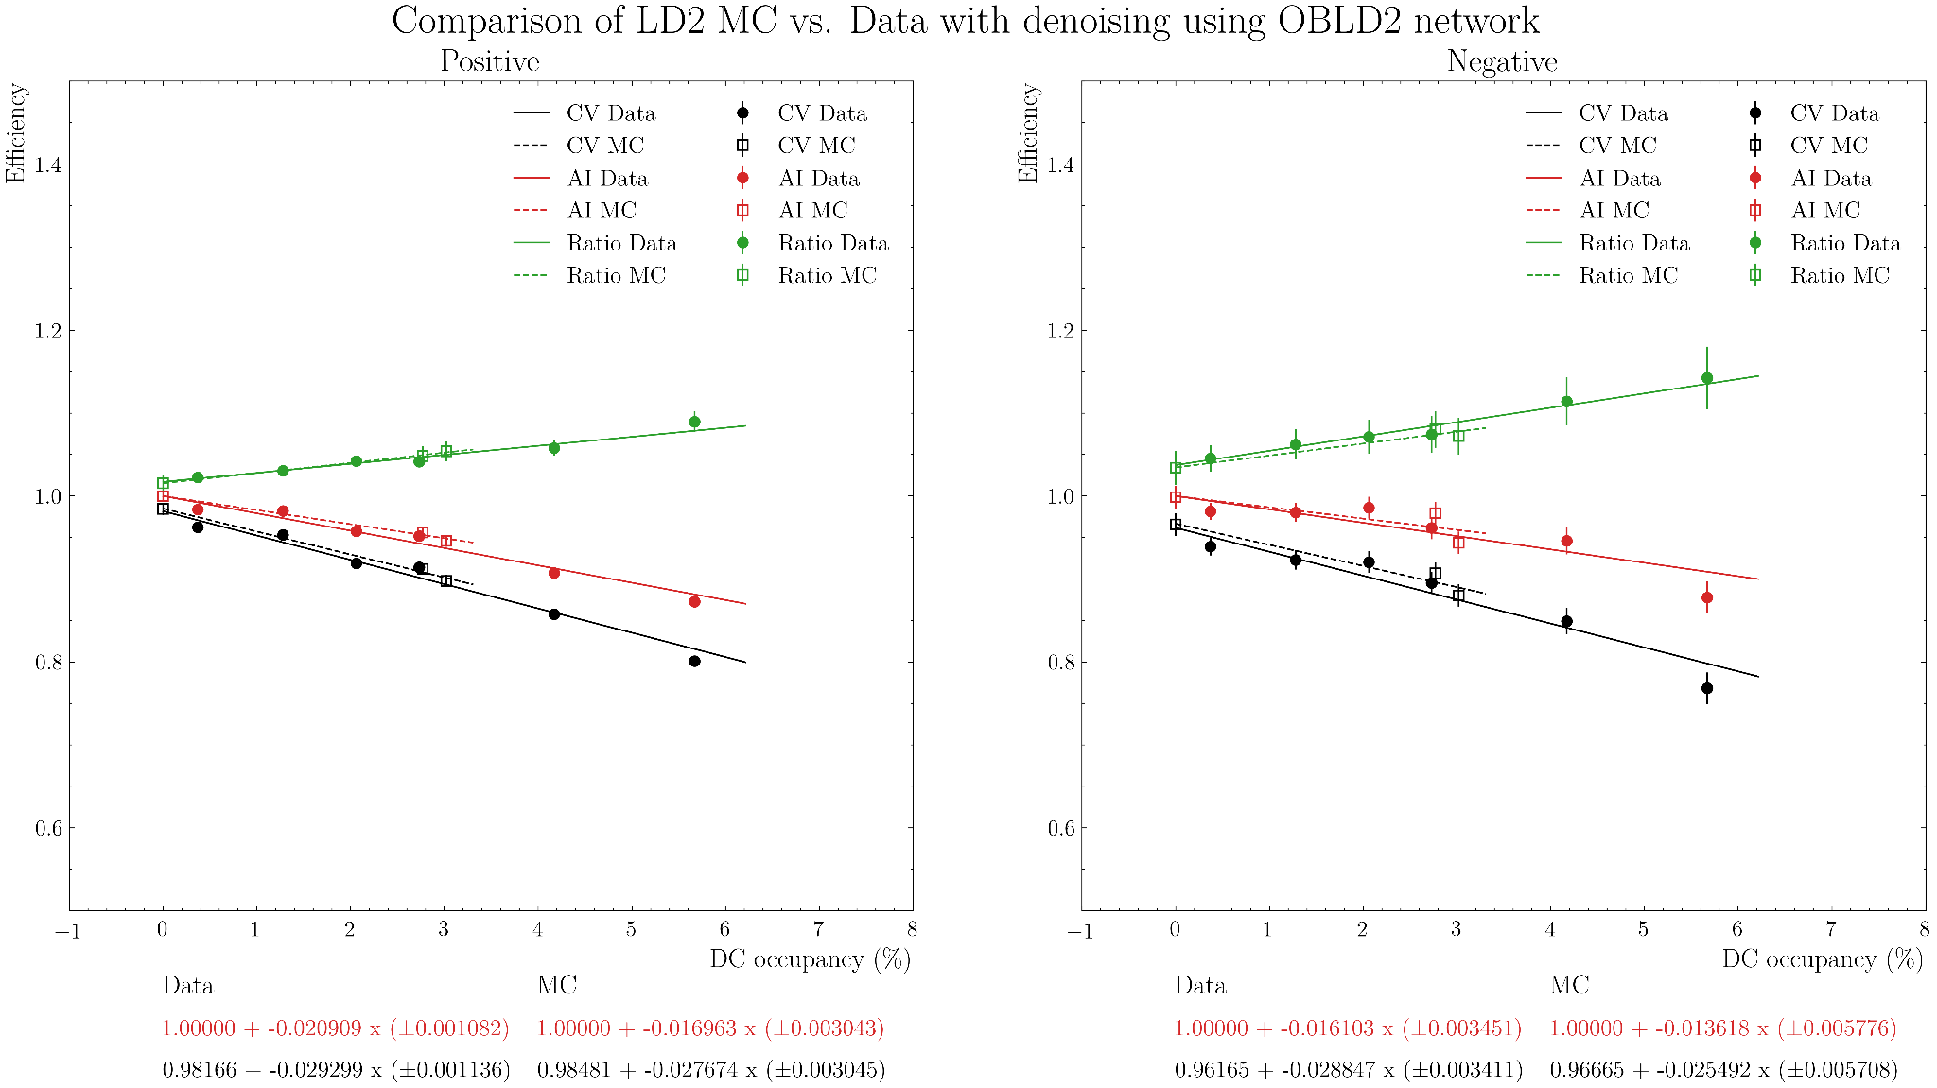
Efficiency Results for MC vs Data LD2 using DC occupancy

Slide 19
MC vs Data efficiency vs occupancy: CuSn

Slide 20
Efficiency Results for MC vs Data CuSn using DC occupancy
We already have the occupancy for the data and we can get the occupancy for the simulation in a similar way:
Extract the occupancy for a run at 90 nA and another one at 95 nA and 100 nA (18628, 18669 and 19065)
CuSn Run: 018628 | 90nA → Average occupancy: 2.21%
CuSn Run: 018669 | 95nA → Average occupancy: 2.42%
CuSn Run: 019065 | 100nA → Average occupancy: 2.51%
The occupancy at 0 nA is 0
Then use the command:
./bin/aiTracking -histo 1 -lumi "0:data,2.21:data,2.42:data,2.51:data,2.68:data,4.01:data,4.95:data,5.67:data" SimCuSnDen_occupancy/0nA_SimCuSnDen_histo.hipo SimCuSnDen_occupancy/90nA_SimCuSnDen_histo.hipo SimCuSnDen_occupancy/95nA_SimCuSnDen_histo.hipo SimCuSnDen_occupancy/100nA_SimCuSnDen_histo.hipo SimCuSnDen_occupancy/110nA_DataCuSnDen_histo.hipo SimCuSnDen_occupancy/130nA_SimCuSnDen_histo.hipo SimCuSnDen_occupancy/150nA_SimCuSnDen_histo.hipo SimCuSnDen_occupancy/175nA_DataCuSnDen_histo.hipo

Slide 21
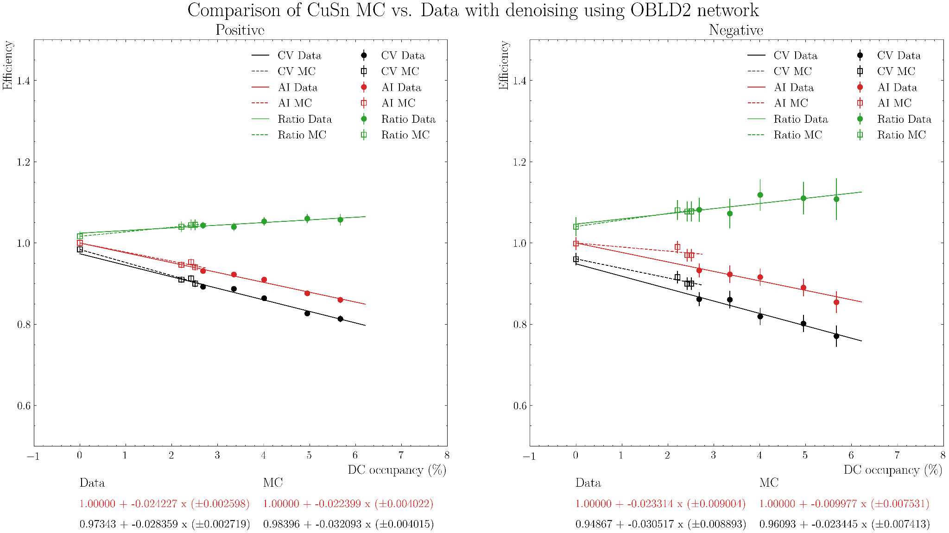
Efficiency Results for MC vs Data CuSn using DC occupancy

Slide 22
Timelines cross check

Slide 23
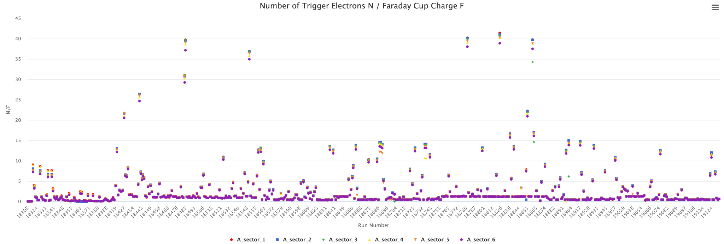
Electron FD normalized yield
Issue: Spikes observed in the electron FD normalized yield timelines in clas12mon
Limited data for pass0 (max 40 files cooked for pass0v11)
Charge is given for an entire run
Mismatch between number of processed files and charge creates artificial spikes

Slide 24
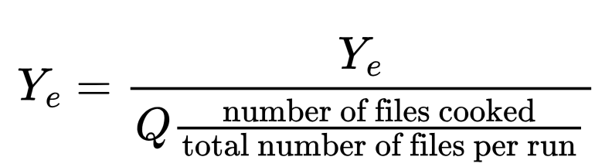
Electron FD normalized yield
Try to fix the electron FD normalized yield timeline:
Instead of dividing by the total charged for the run, divide by the charge normalized by the number of files cooked:
Cuts used:
pid = 11 status < 0 and 2000 < |status| < 4000
REC::Calorimeter::sector variable need to be between 1 and 6 for the precalo or inner or outer.
Vz cut depend of the target and the magnetic field
-5 < chi2pid < 5

Slide 25
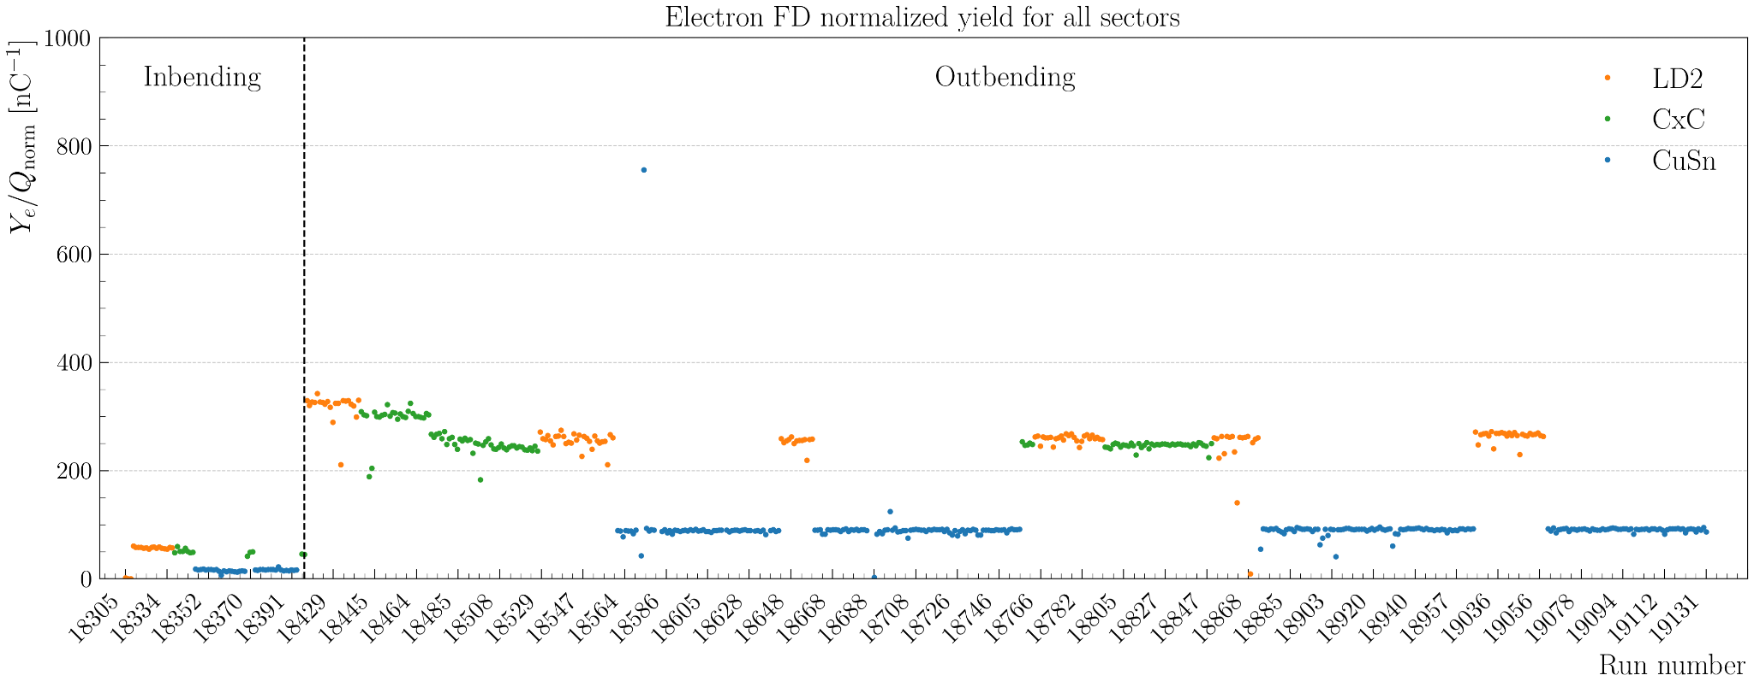
Electron FD normalized yield
Try to fix the electron FD normalized yield timeline:
Instead of dividing by the total charged for the run, divide by the charge normalized by the number of files cooked:

Slide 26
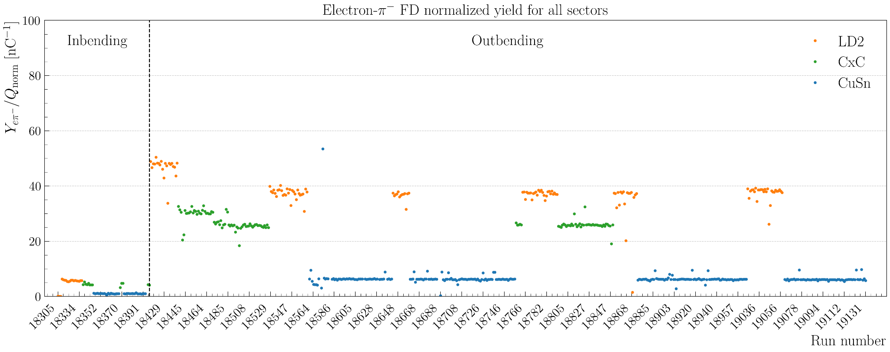
Electron-π⁻ FD normalized yield
Produce the same timelines for electron and π⁻: Cuts:
Same as before for the electron + pid = 211, 2000 < |status| < 4000, and -10 < chi2pid < 10
REC::Calorimeter::sector variable need to be between 1 and 6 for the precalo or inner or outer.

Slide 27
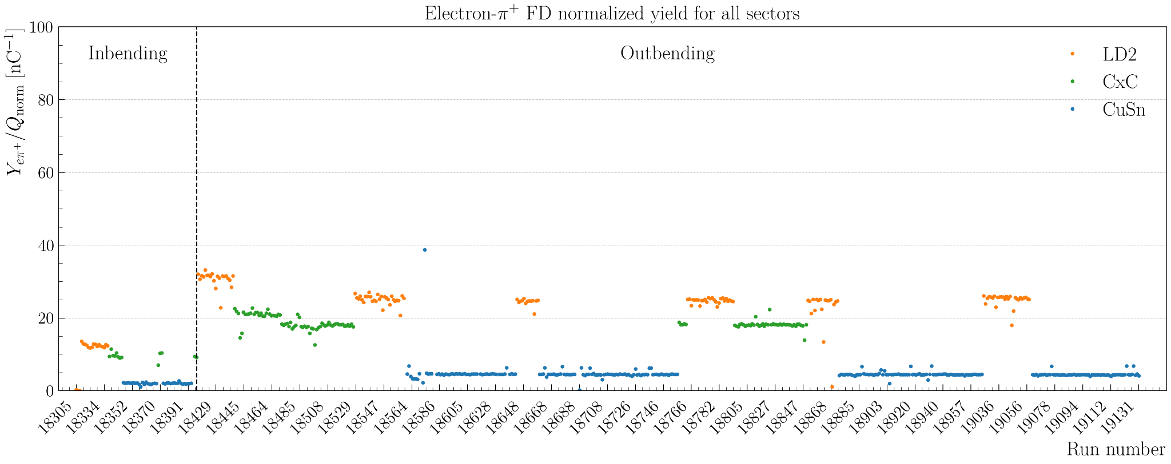
Electron-π⁺ FD normalized yield
Produce the same timelines for electron and π⁺: Cuts:
Same as before for the electron + pid = -211, 2000 < |status| < 4000, and -10 < chi2pid < 10
REC::Calorimeter::sector variable need to be between 1 and 6 for the precalo or inner or outer.

Slide 28
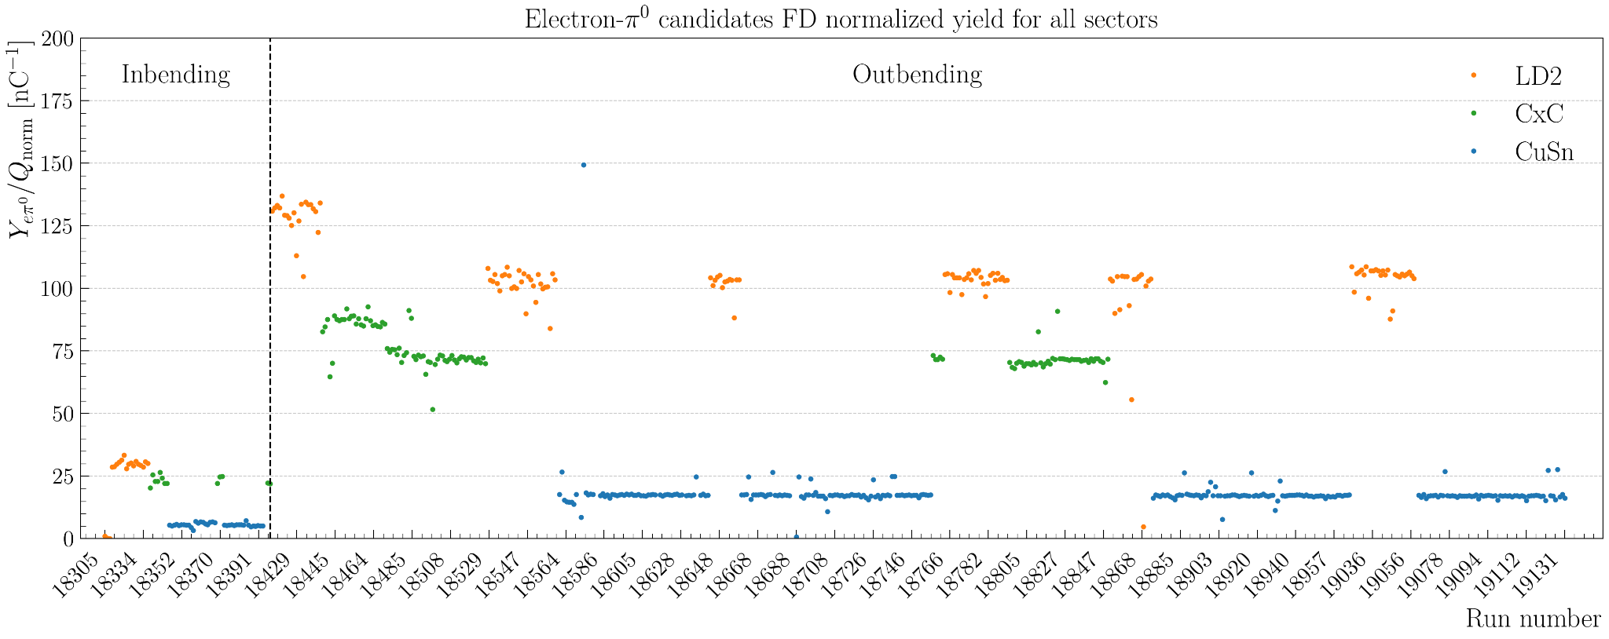
Electron-π⁰ FD normalized yield
Produce the same timelines for electron and π⁰: Cuts:
Same as before for the electron
For the photon: pid = 22 and 2000 < |status| < 4000
For π⁰ candidates: 0.07 < Mᵧᵧ < 0.2 GeV

Slide 29
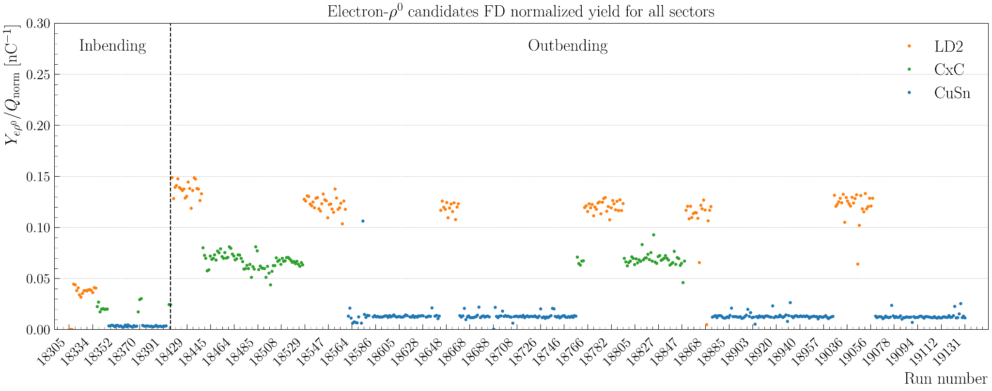
Electron-ρ⁰ FD normalized yield
Produce the same timelines for electron and ρ⁰:
Same as before for the electron
For the π⁻: pid = 211, 2000 < |status| < 4000, |chi2pid|<10, and Vz depend on the target. Same cuts for π⁺: pid = 211
For ρ⁰ candidates: Q² > 1 GeV², W > 2 GeV, 0.1 < -t < 0.5 GeV² and z > 0.8

Slide 30
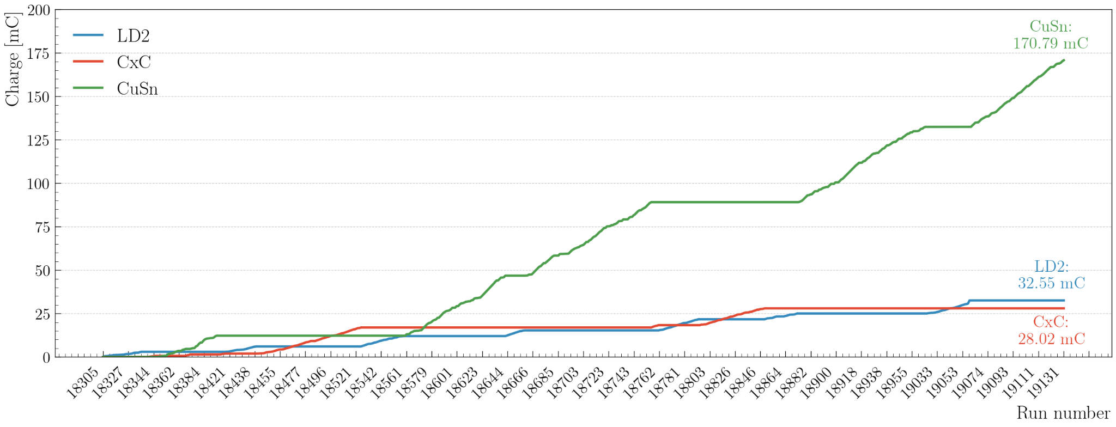
Timeline: accumulated charge per target

Slide 31
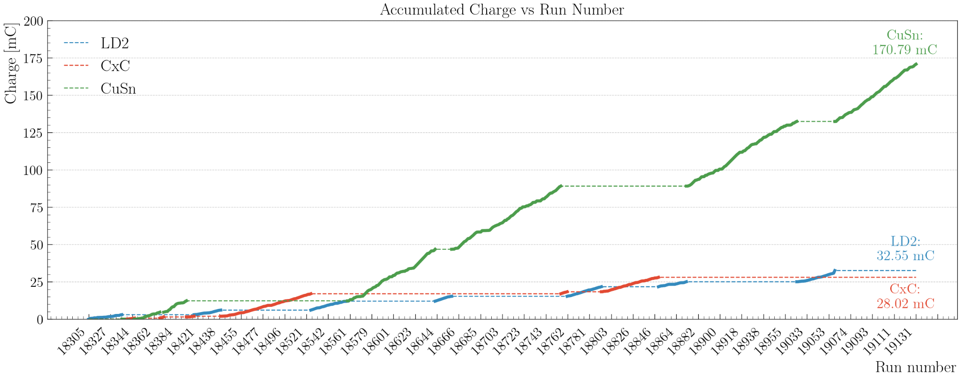
Timeline: accumulated charge per target v2

Slide 32
SIDIS π⁰ analysis

Slide 33
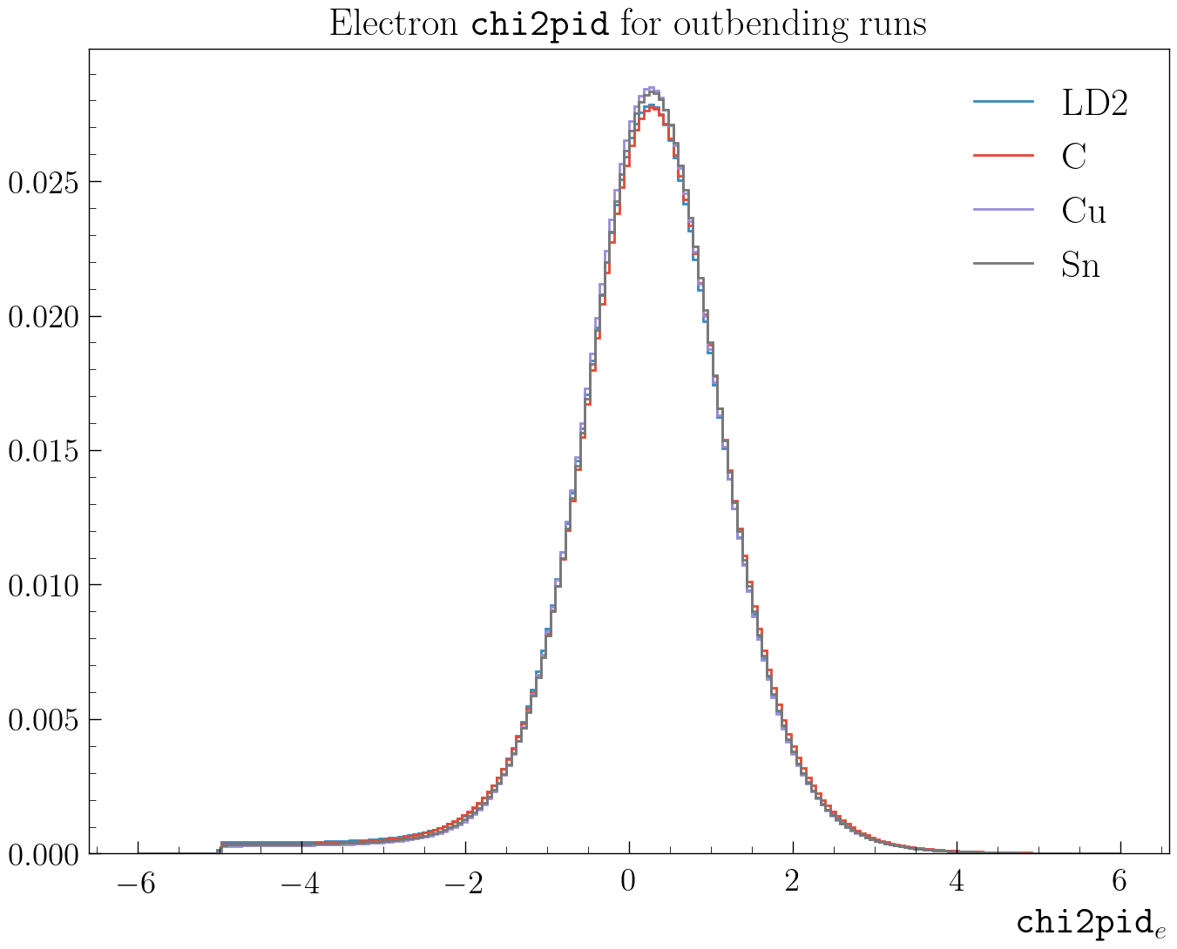
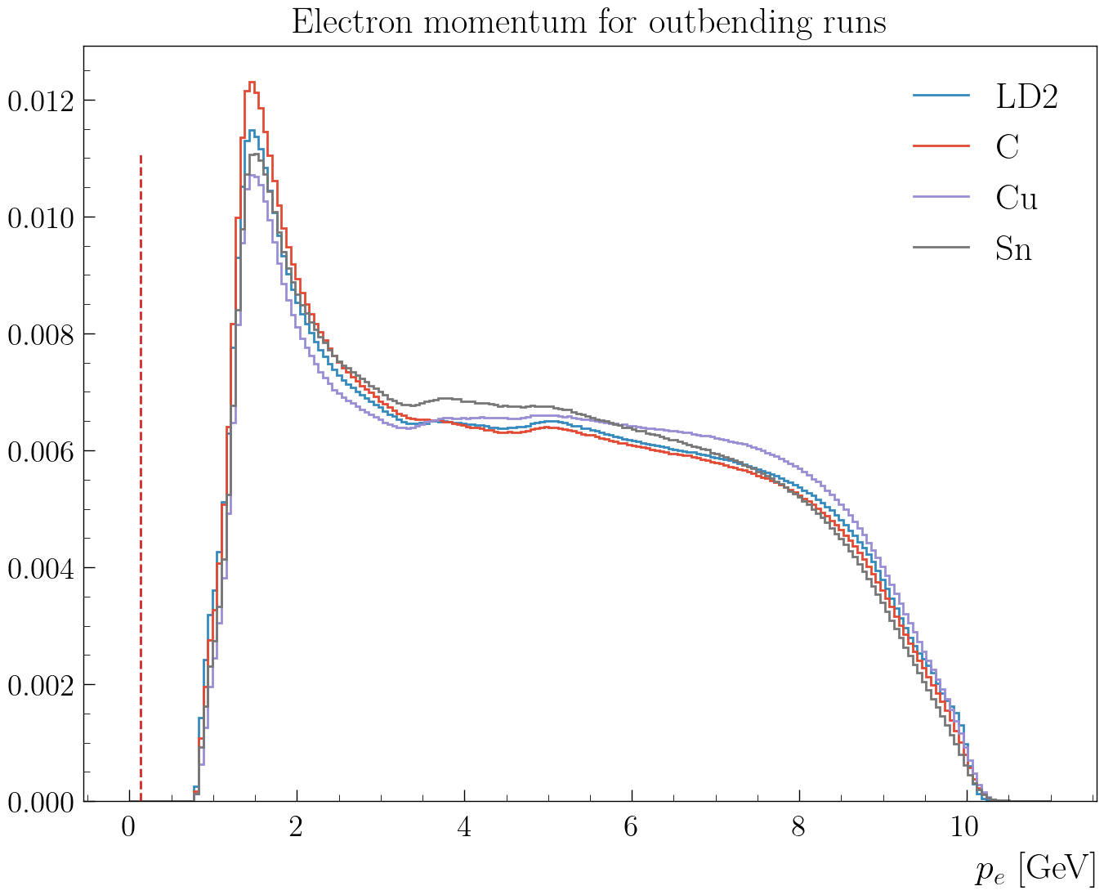
SIDIS π⁰ analysis
Event selection: trigger electron + photons
Cuts for the electron:
pid = 11 status < 0 and 2000 < |status| < 4000
Vz cut depend of the target and the magnetic field
-5 < chi2pid < 5

Slide 34
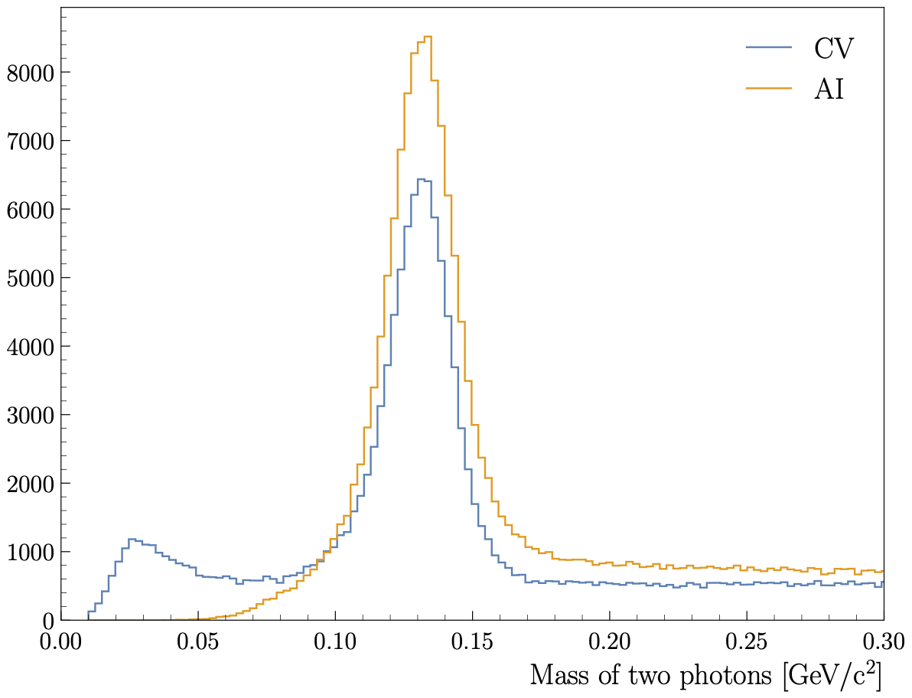
SIDIS π⁰ analysis
Photon cuts: E > 0.2 GeV, EPCal > 0 GeV and 5<𝜃_{e}<35 deg and AI response > 0.78.
Use the AI develop by Gregory Matousek: Photon Classification with AI at CLAS12 for the photon identification
Photon cuts CV:
pid = 22
E > 0.6 GeV
1.57077 < Δt < 1.68663 ns
θ_{eγ} > 8 deg
Photon cuts AI:
pid = 22
E > 0.2 GeV
E_{PCAL} > 0 GeV
AI response > 0.78
Kinematical cuts:
Q² > 1 GeV²
W > 2 GeV
0.3 < z_{h} < 0.7
y < 0.9

Slide 35
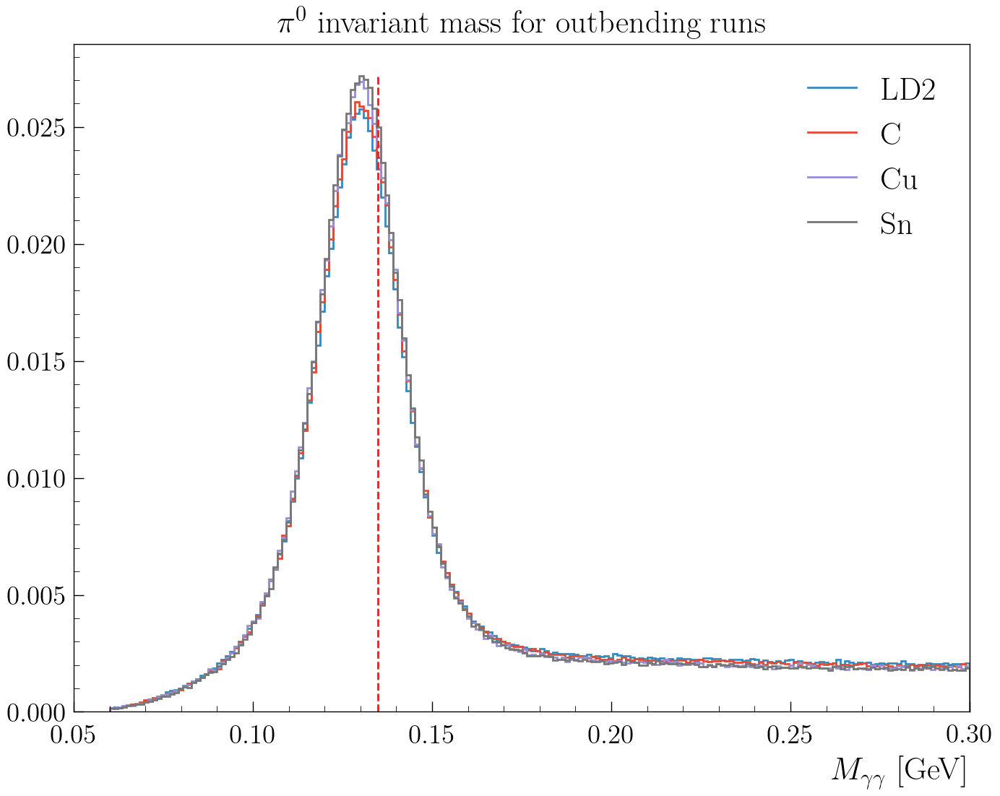
SIDIS π⁰ analysis
Comparison of the invariant mass of the two photons for all the targets for outbending runs
Photon cuts AI:
pid = 22
E > 0.2 GeV
E_{PCAL} > 0 GeV
AI response > 0.78
Kinematical cuts:
Q² > 1 GeV²
W > 2 GeV
0.3 < z_{h} < 0.7
y < 0.9

Slide 36
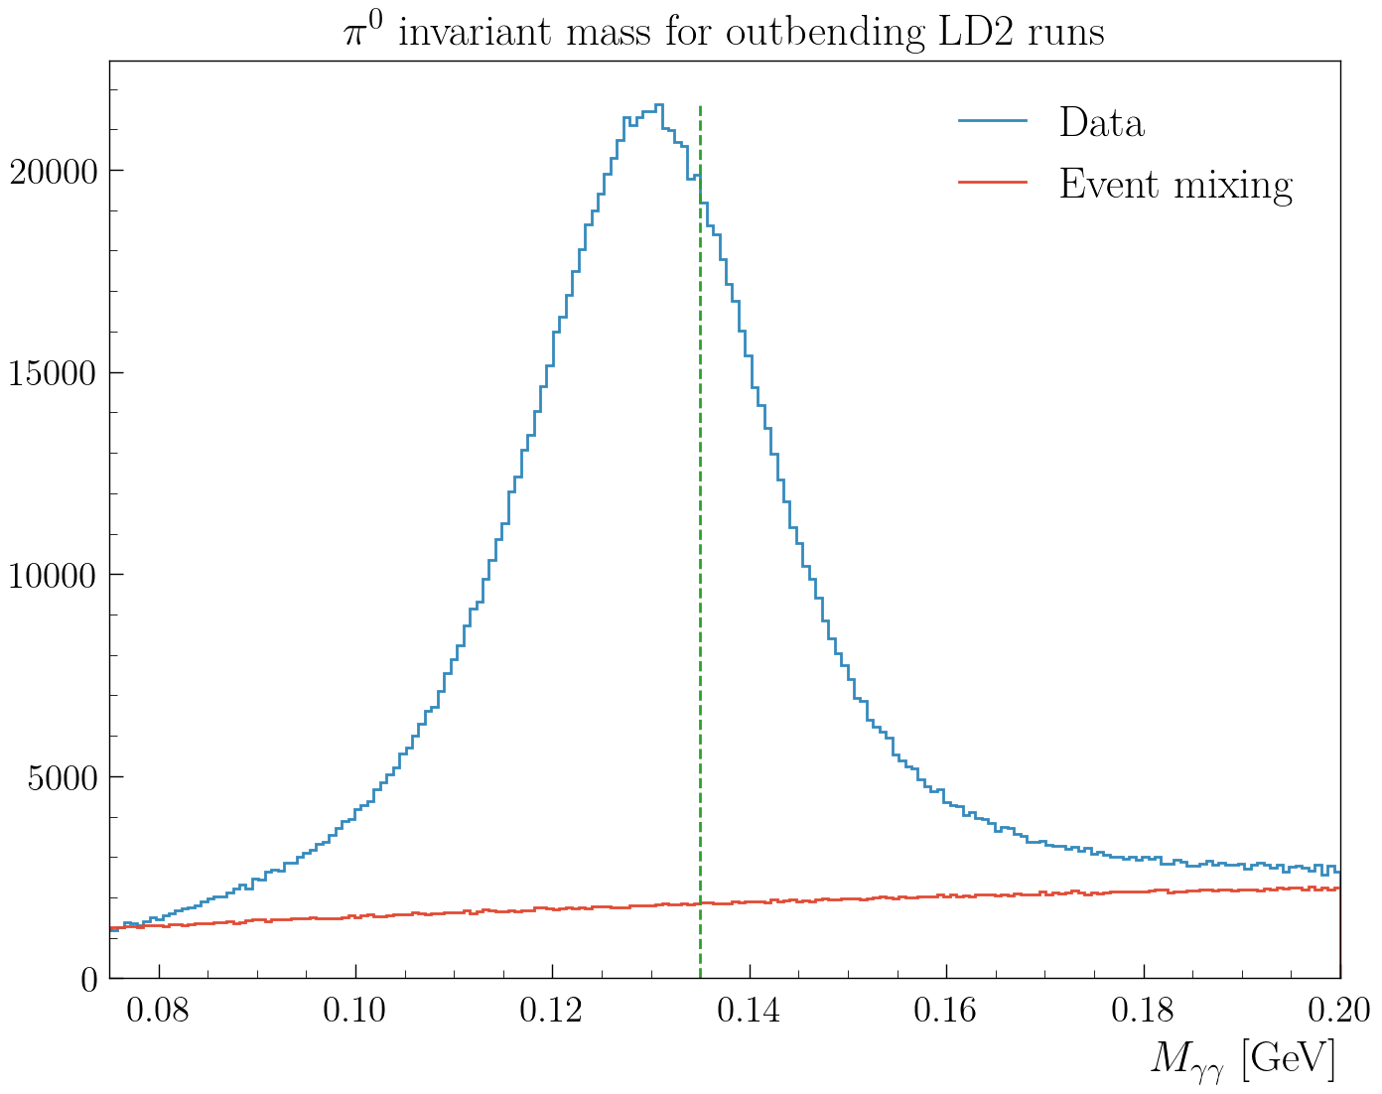
SIDIS π⁰ analysis
To subtract the background bellow the pick, we use the event mixing method
Mixing all the photons for a event A with all the photons in the next 20 events.
Same cuts as before

Slide 37
color transparency analysis

Slide 38
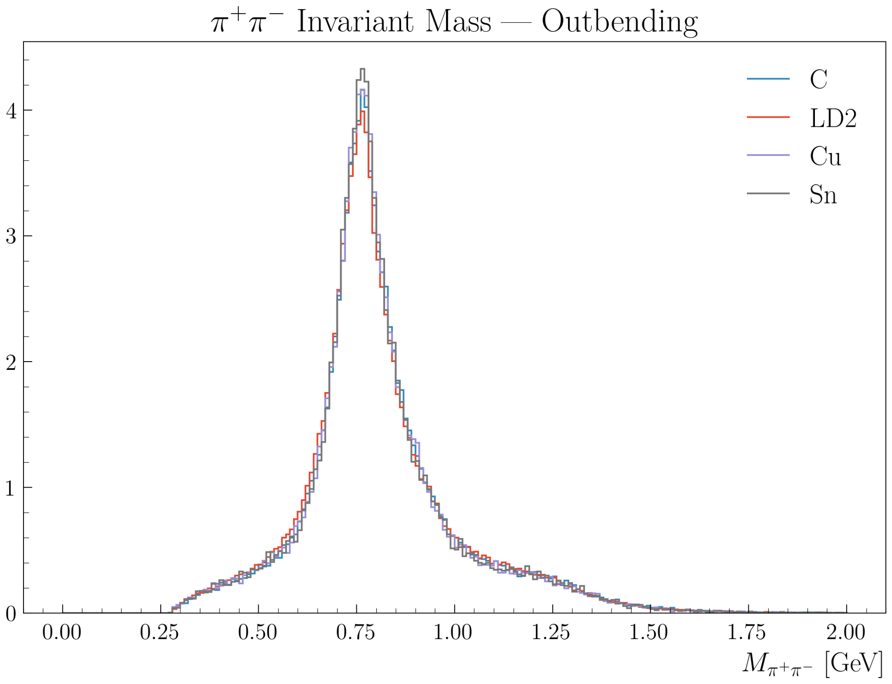
Color transparency
Cuts:
Electron: pid = 11, status < 0 and 2000 <= |status| < 4000
|chi2pid|<5 and Vz cuts
Pions: pid=+/-211 |chi2pid| < 10 and Vz cuts (pions can be in the central, is it ok?)
Kinematical cuts:
W>2 GeV, 0.9<zh<1, 0.1<-t<0.5 GeV2 and lc < 1 fm

Slide 39
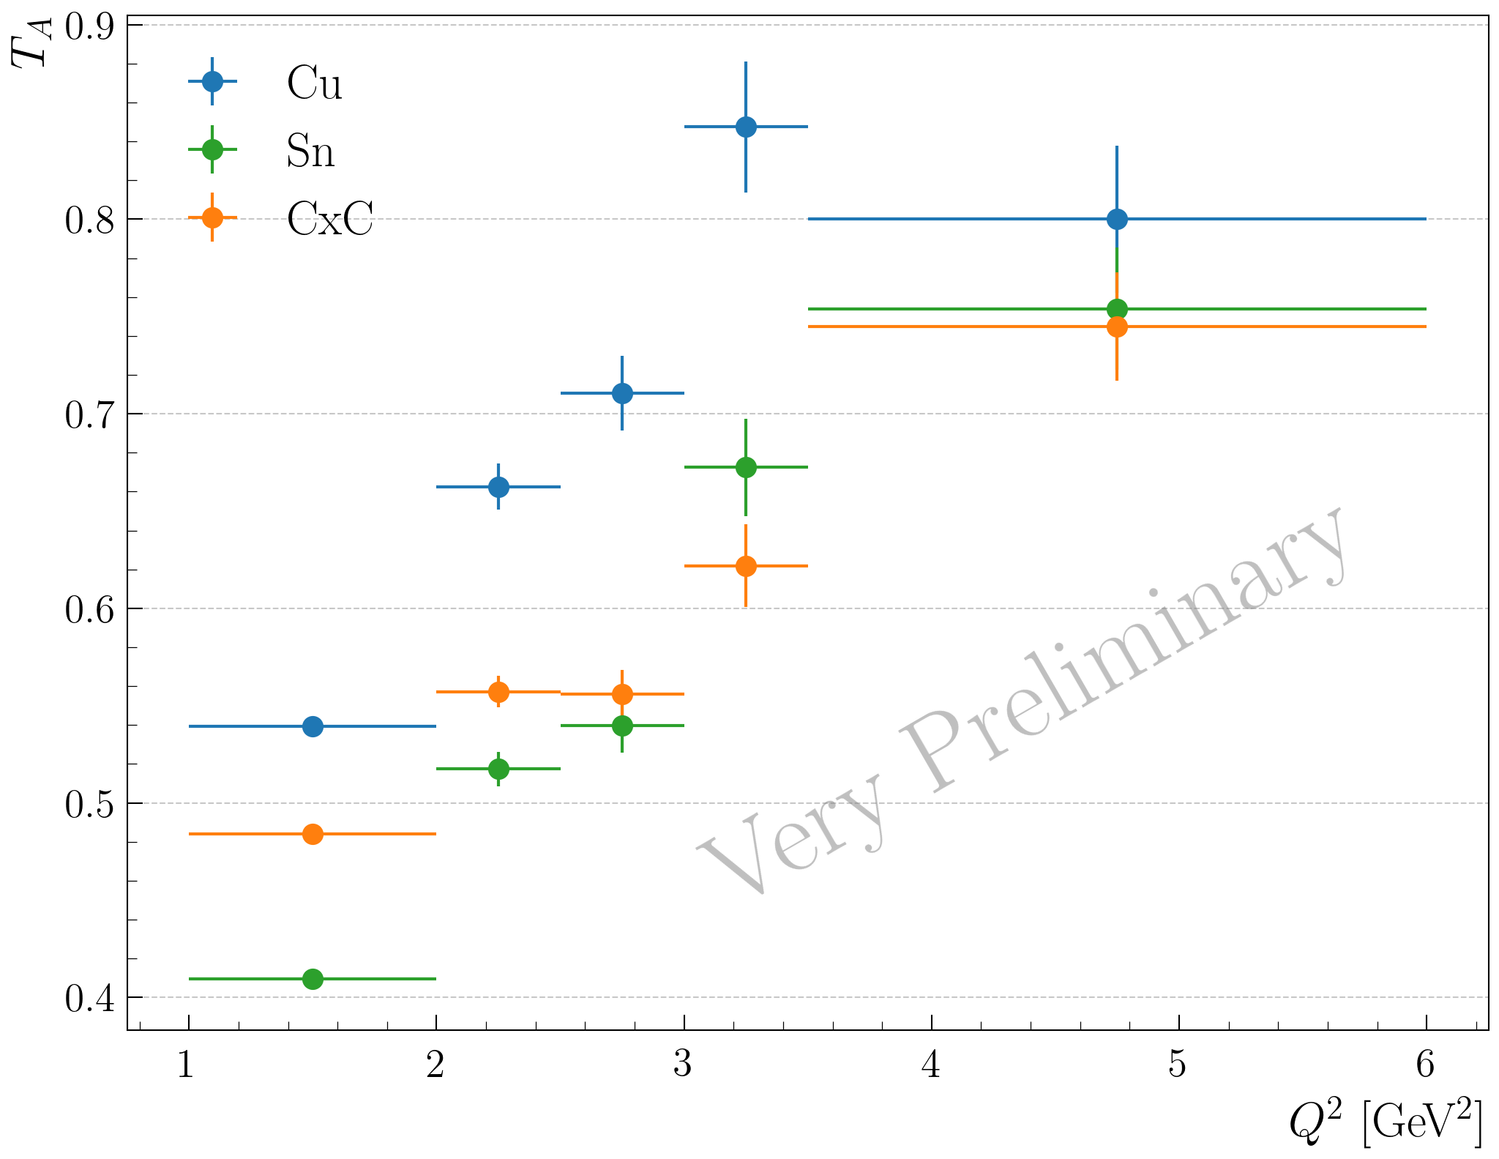
Color transparency
Cuts:
Electron: pid = 11, status < 0 and 2000 <= |status| < 4000
|chi2pid|<5 and Vz cuts
Pions: pid=+/-211 |chi2pid| < 10 and Vz cuts (pions can be in the central, is it ok?)
Kinematical cuts:
W>2 GeV, 0.9<zh<1, 0.1<-t<0.5 GeV2 and lc < 1 fm

Slide 40
Vz analysis

Slide 41
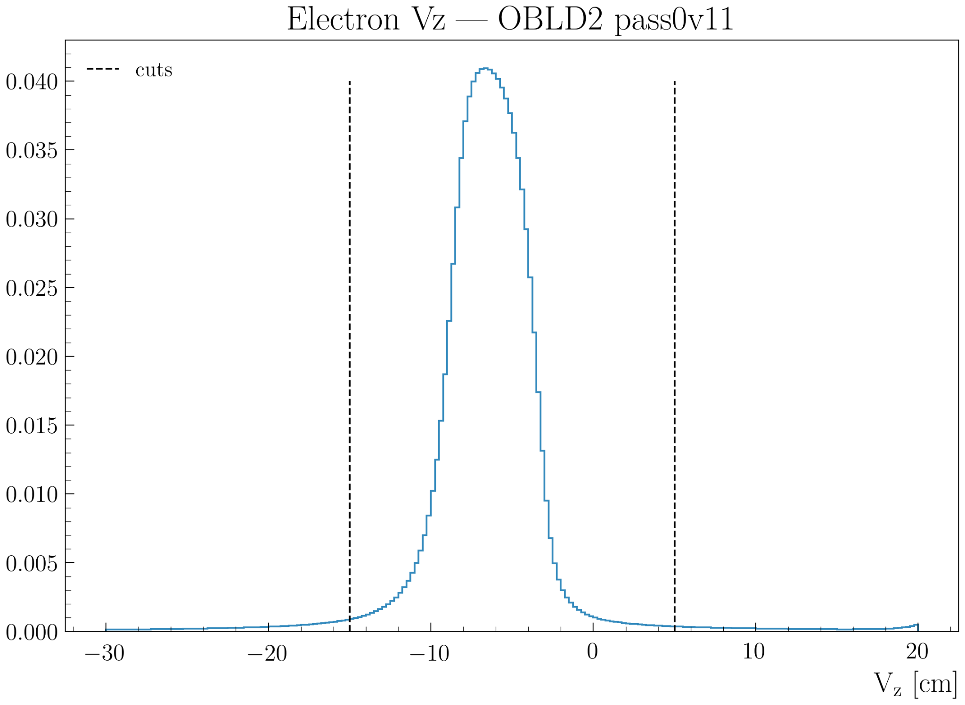
Outbending LD2: Electron
cuts at -15cm and 5 cm for both inbending and outbending

Slide 42
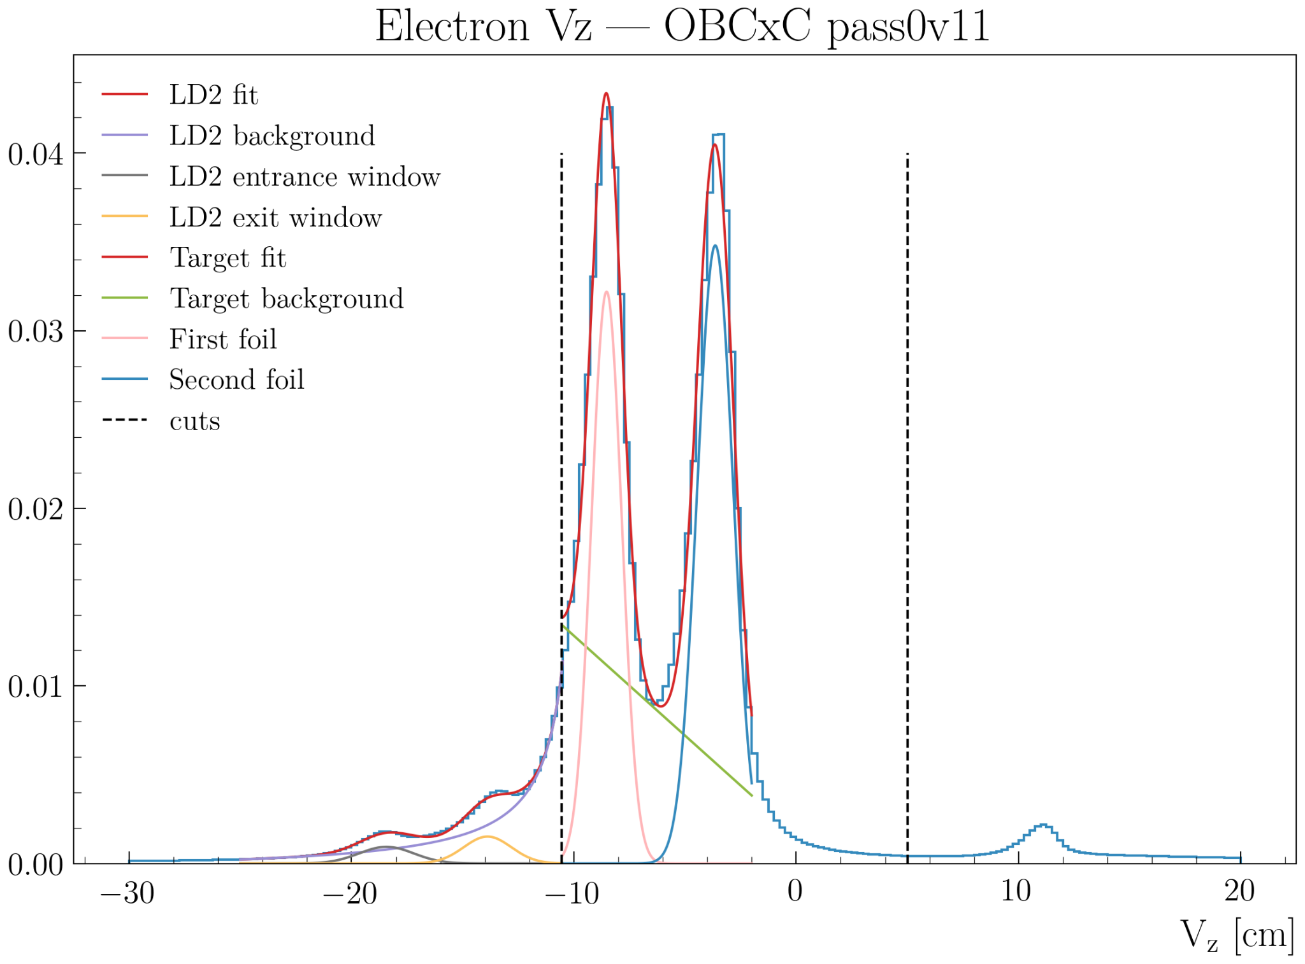
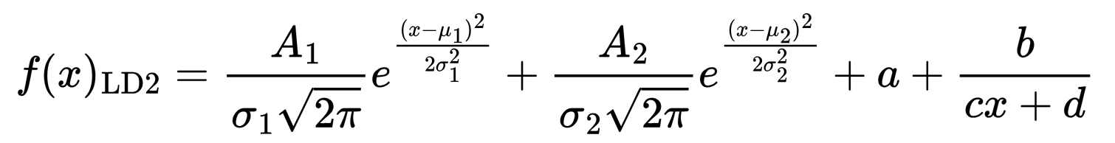
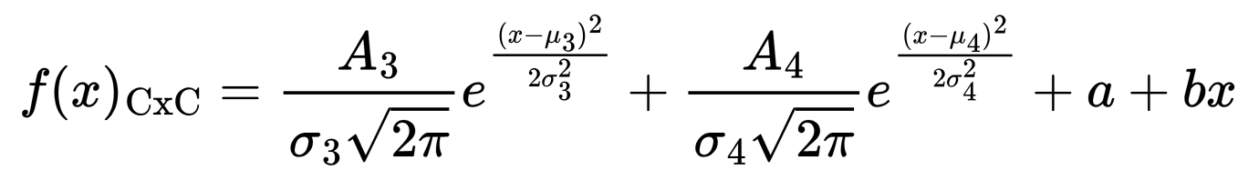
Outbending CxC: Electron
Fit the empty LD2 cell with:
And fit the carbon foils with a double gaussian and first-order polynomial:
To separate the LD2 exit window from the first target, cut at 3σ_{LD2 exit}: -10.56 cm
To separate the second foil from the window of the scattering chamber, cut: 5 cm

Slide 43
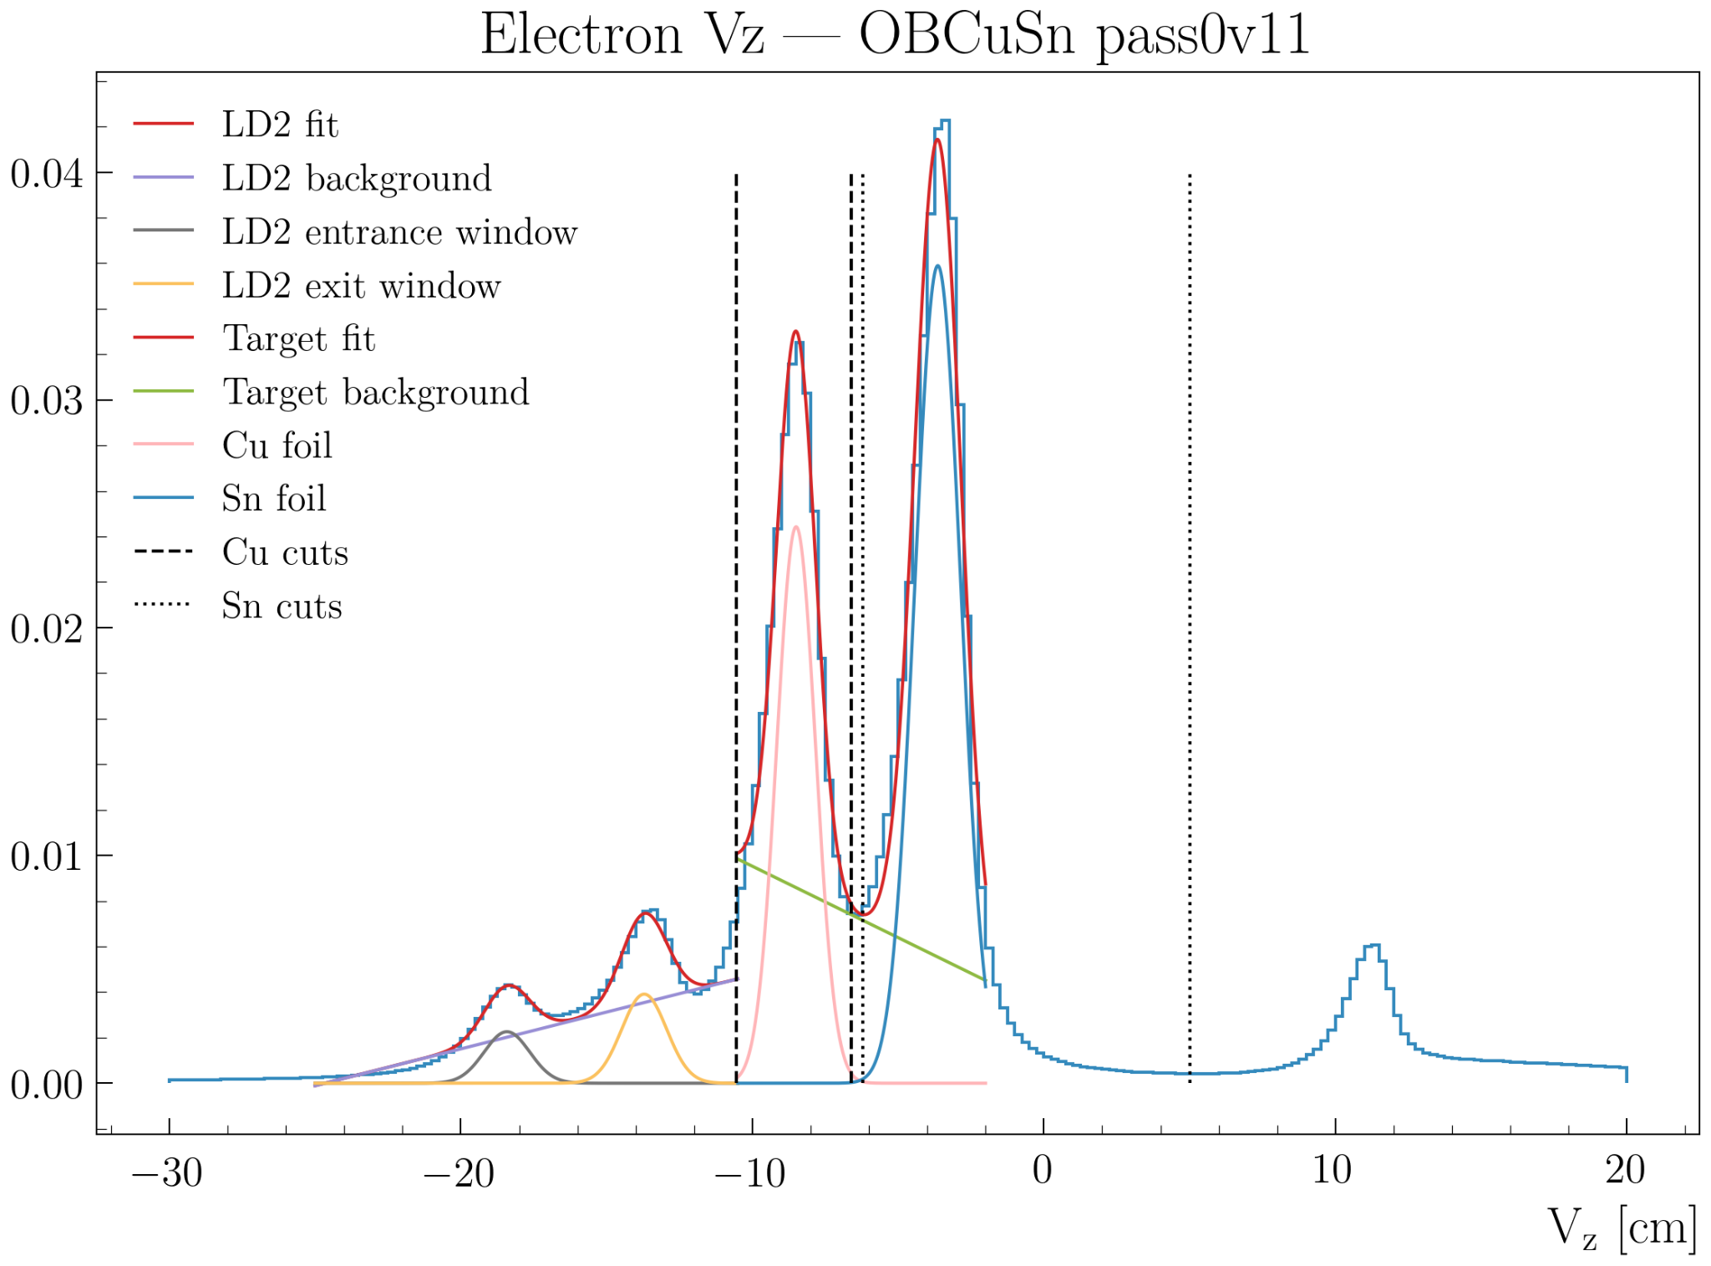
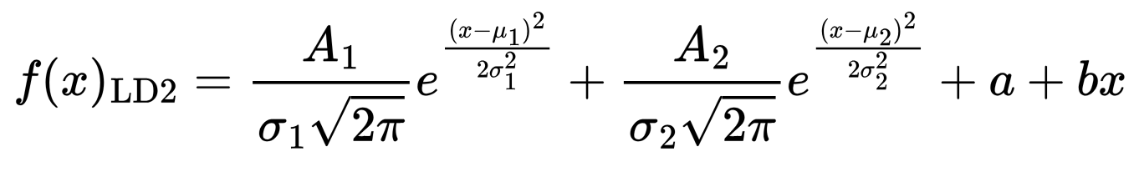
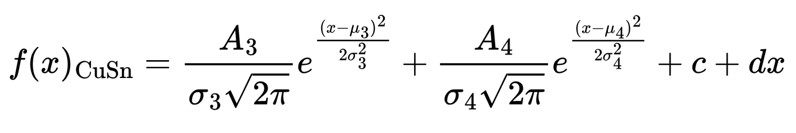
Outbending CuSn: Electron
Fit the empty LD2 cell and nuclear-foil regions with double gaussians and first-order polynomial:
To separate the LD2 exit window from the Cu foil, cut at 3σ_{LD2 exit}: -10.55 cm
To separate the Cu foil from the Sn, cut at 3σ_{Cu}: -6.62 cm
To separate the Sn foil from the Cu, cut at 3σ_{Sn}: -6.21 cm
To separate the Sn foil from the window of the scattering chamber, cut: 5 cm

Slide 44
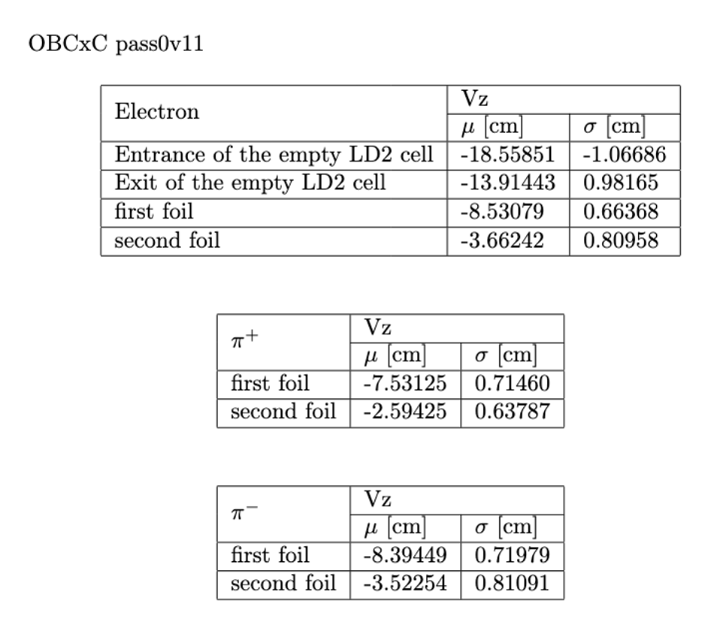
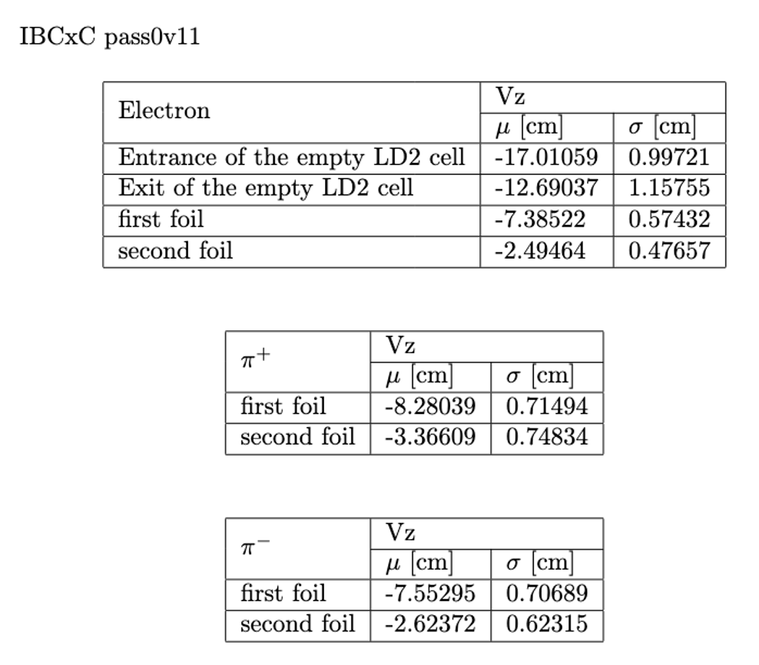
Vz fit: CxC

Slide 45
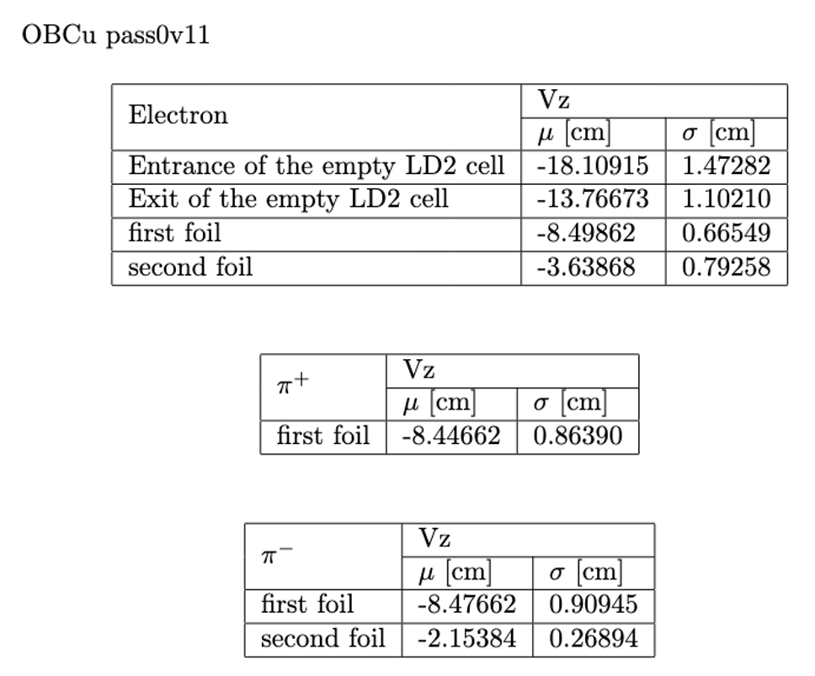
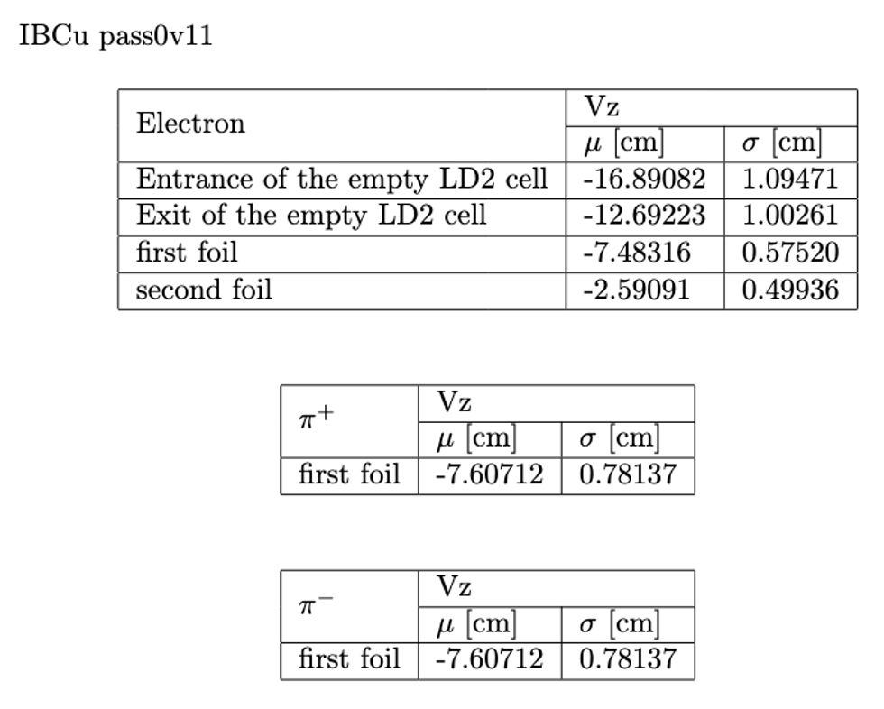
Vz fit: Cu

Slide 46
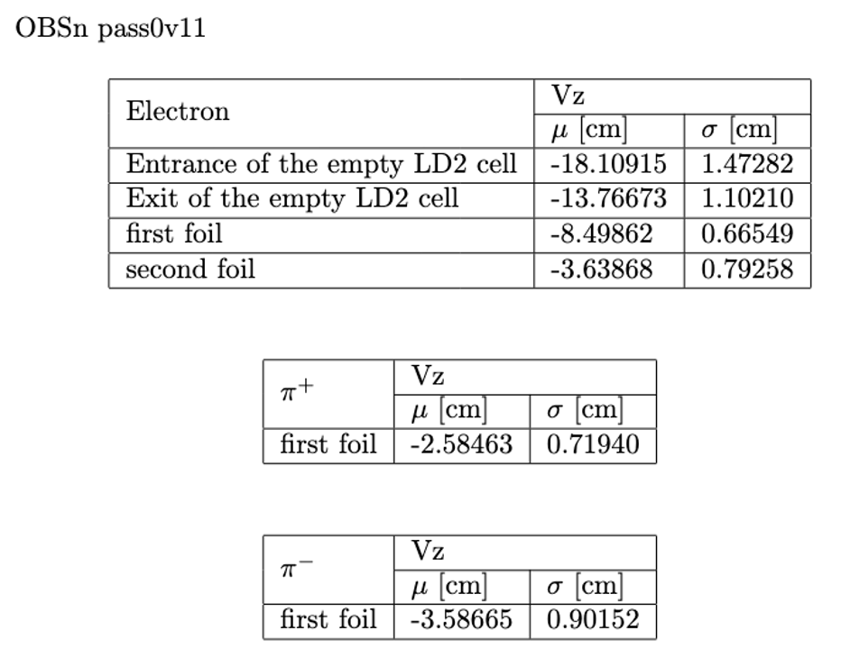
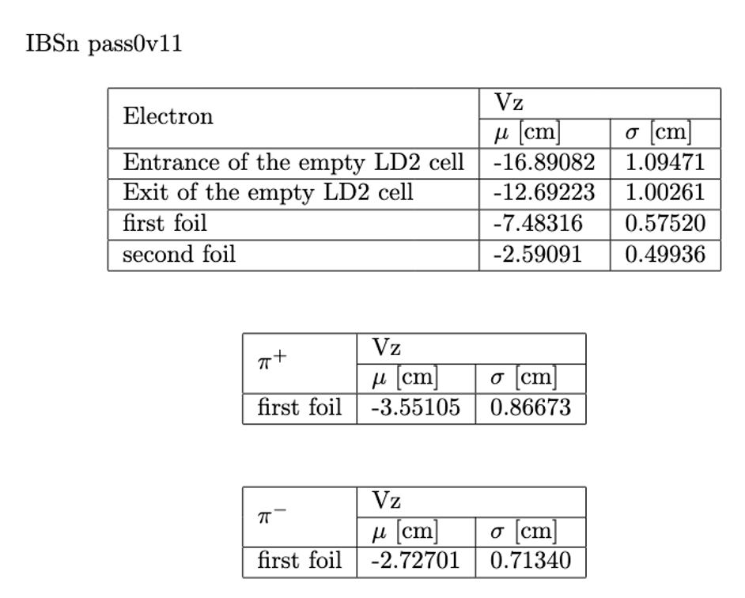
Vz fit: Sn

Slide 47
DC problematic runs analysis

Slide 48
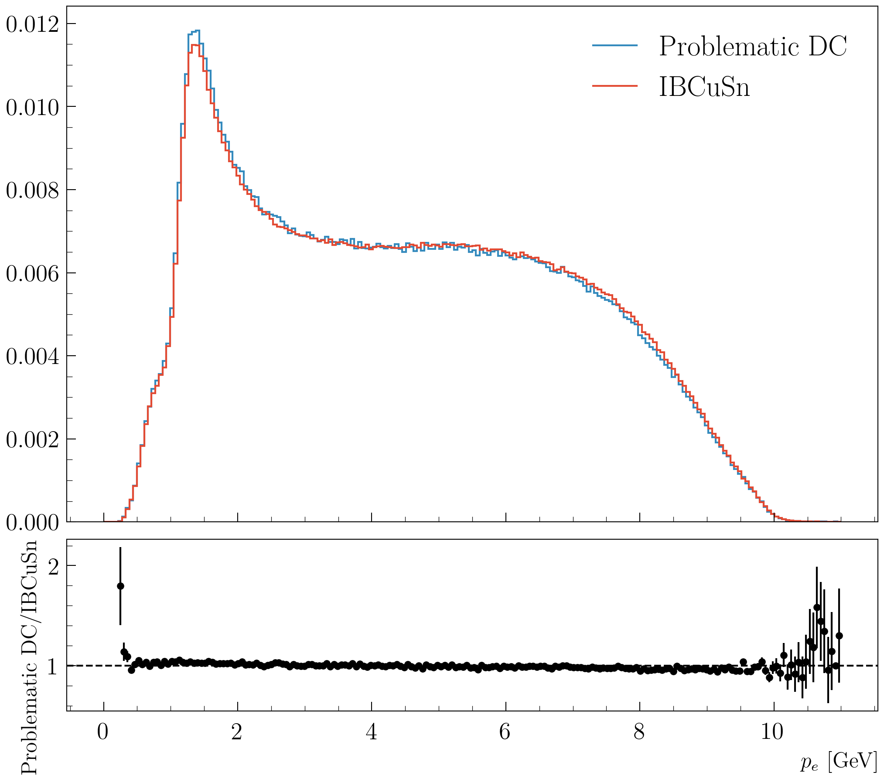
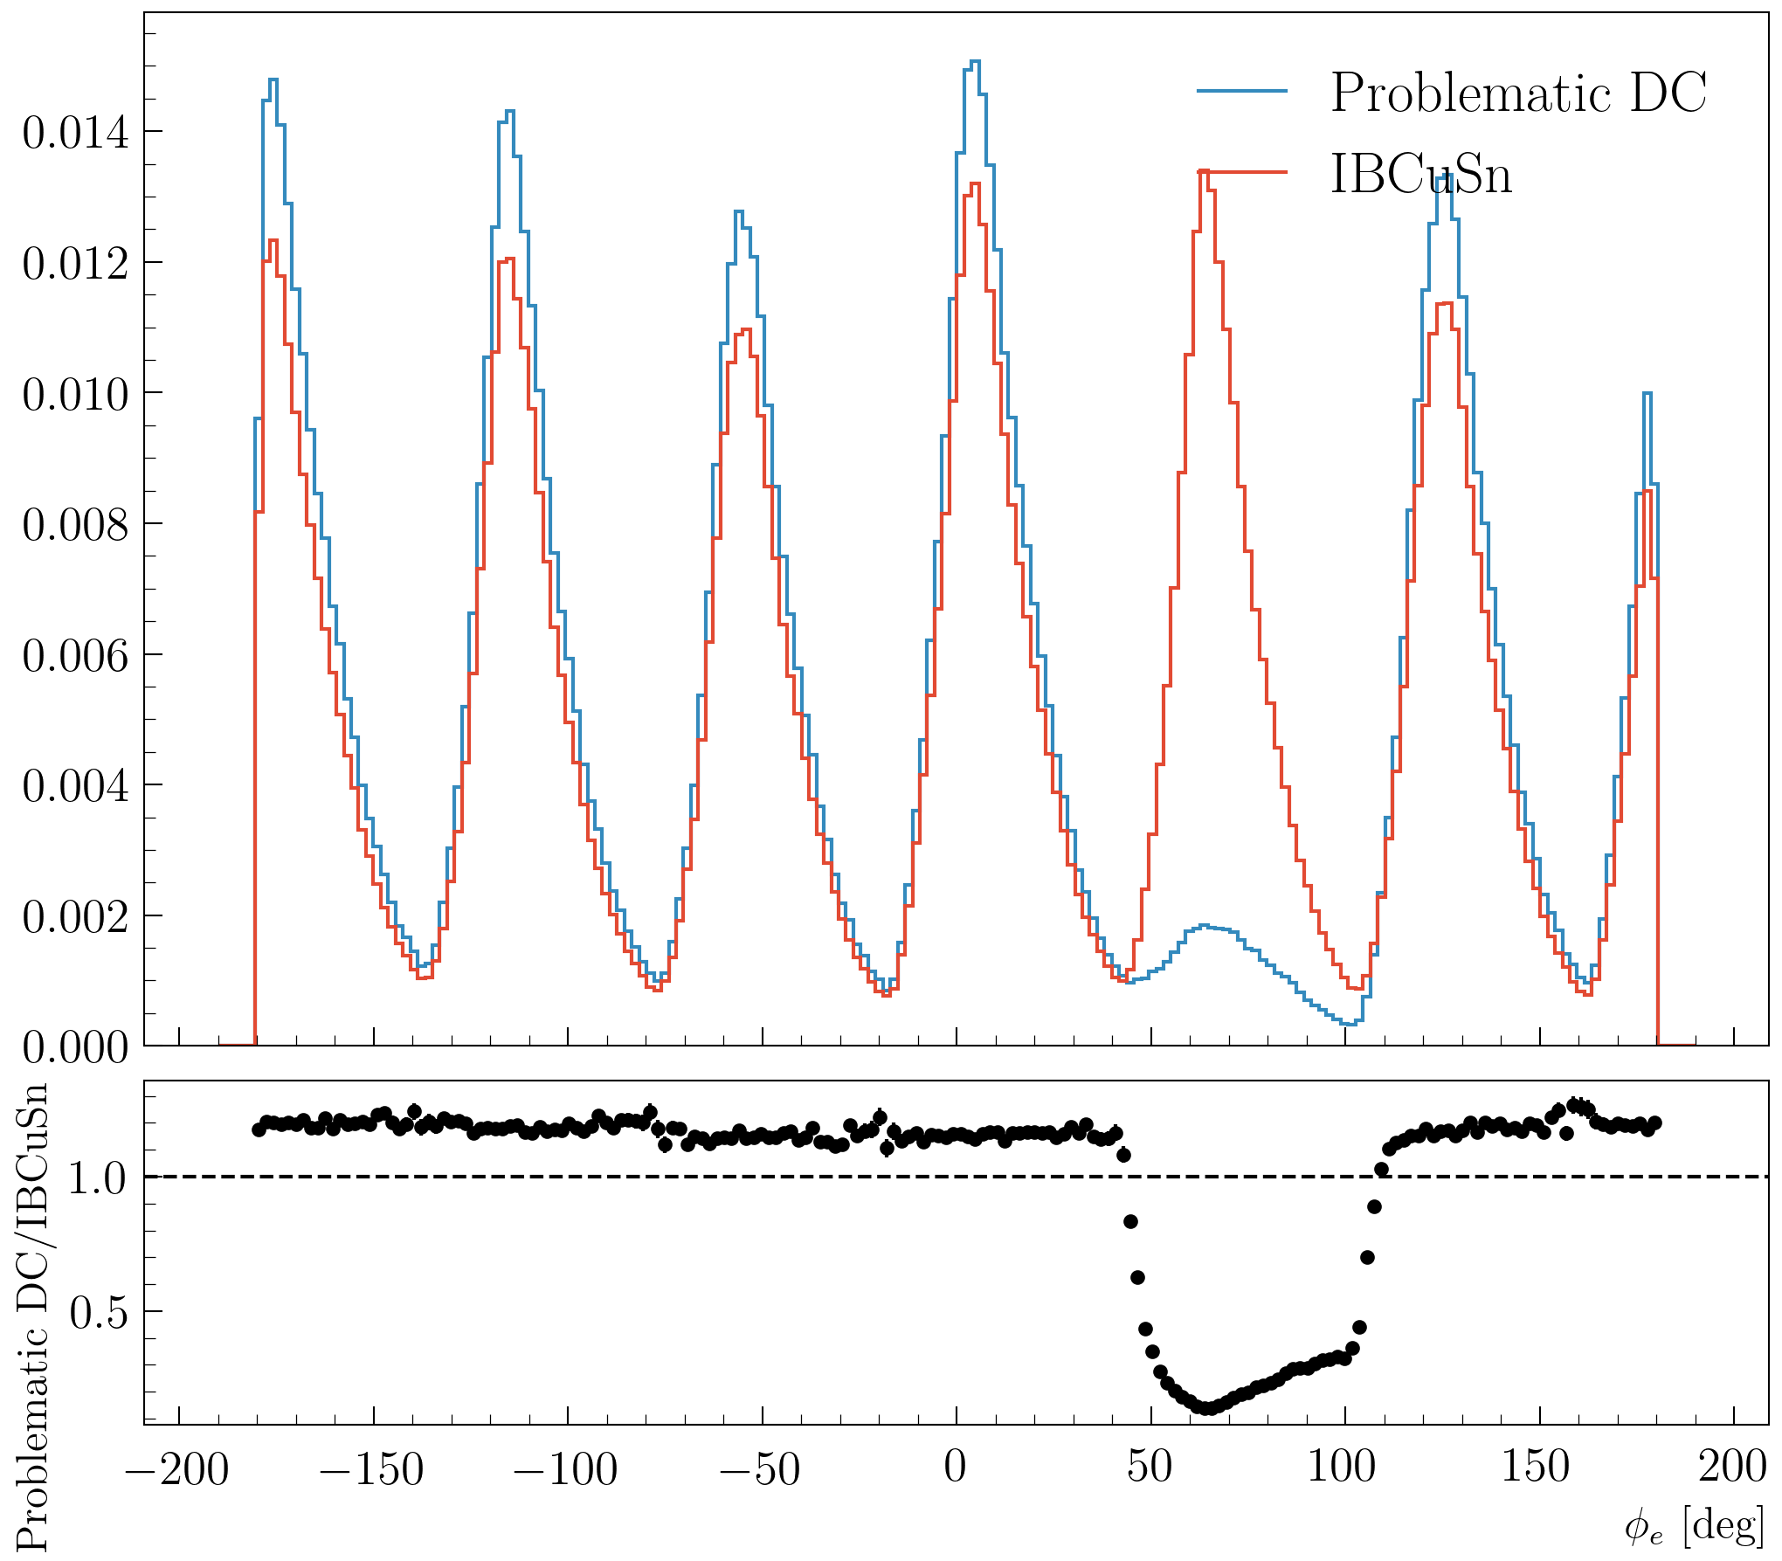
DC problematic runs
Runs: 18358, 18359, 18360, 18361, 18362, 18363, 18364, 18365, 18366, 18368
Electron: pid = 11, status < 0 and -9.22 < Vz < 5 cm

Slide 49
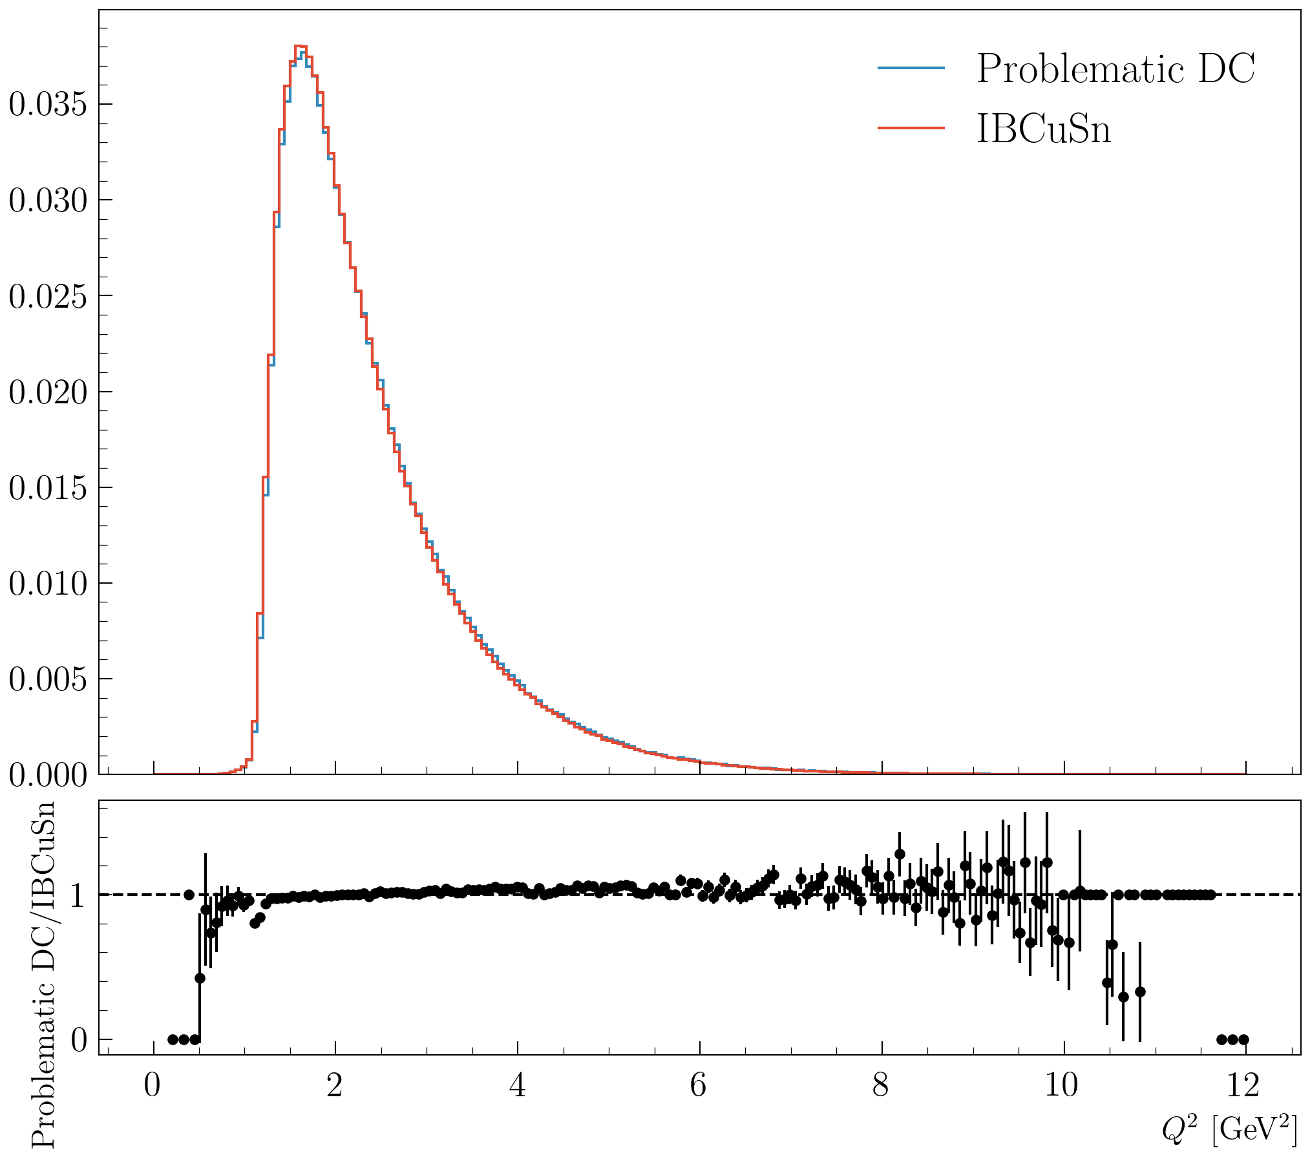
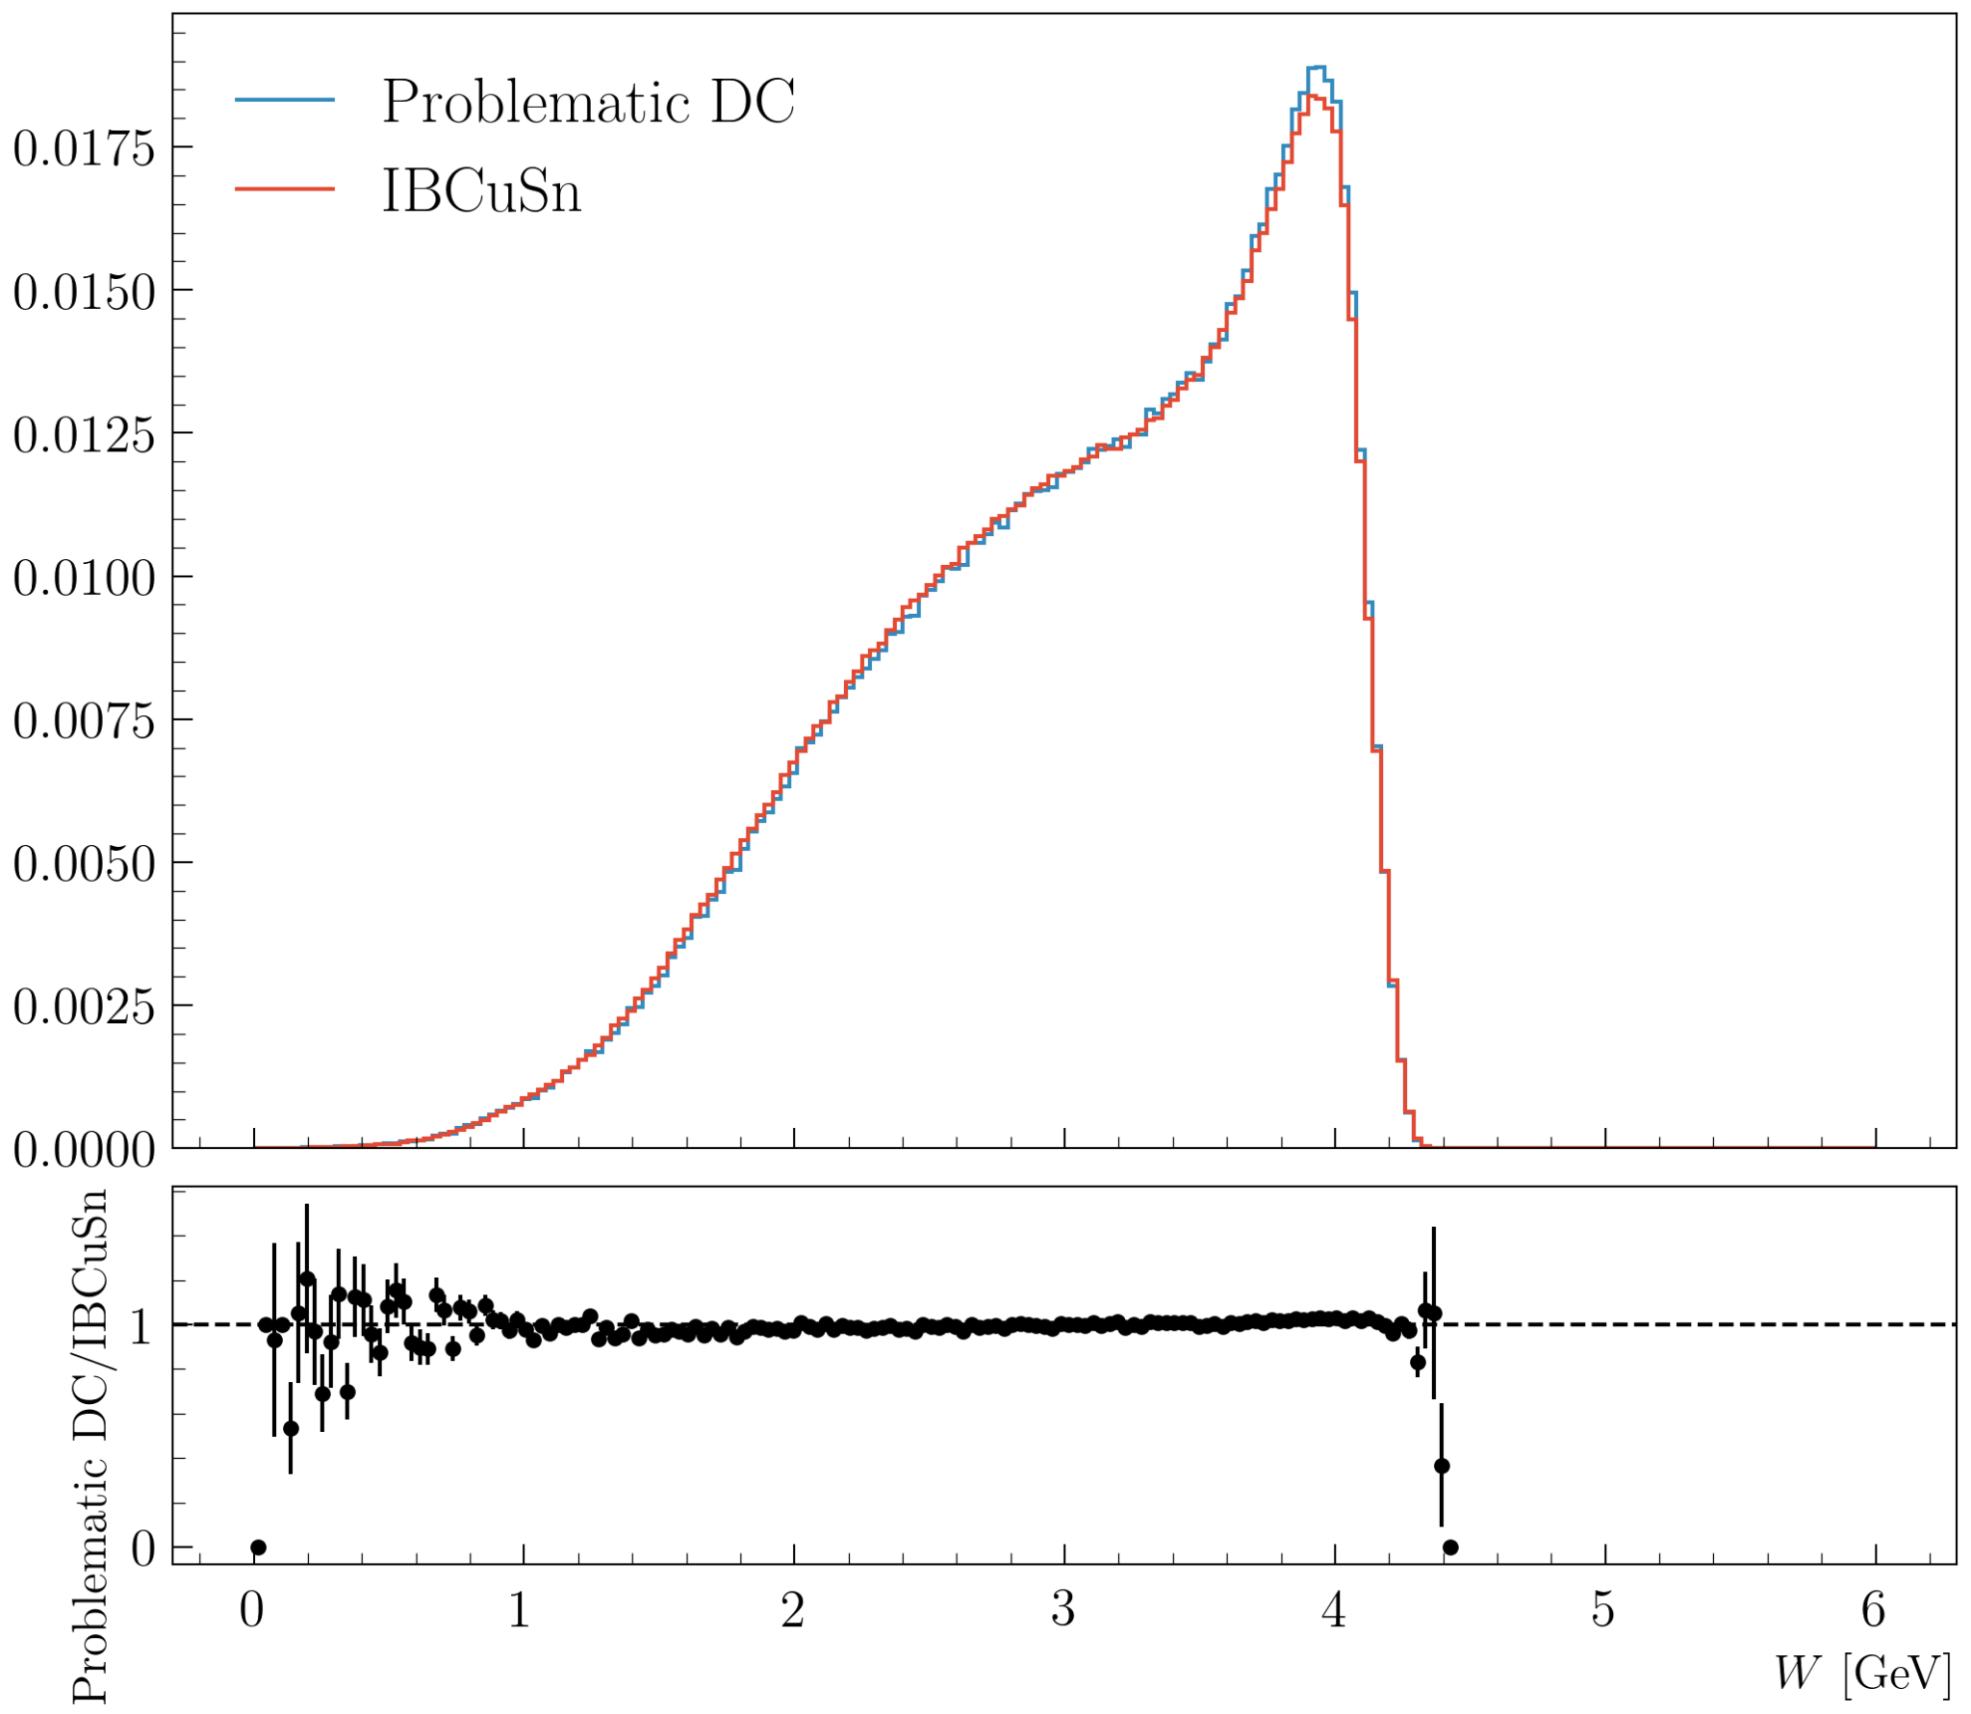
DC problematic runs
Runs: 18358, 18359, 18360, 18361, 18362, 18363, 18364, 18365, 18366, 18368
Electron: pid = 11, status < 0 and -9.22 < Vz < 5 cm

Slide 50
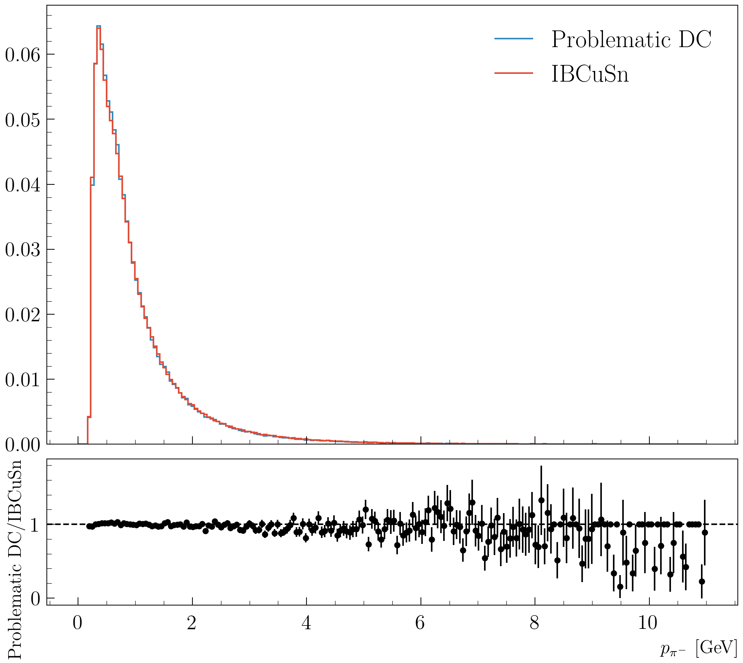
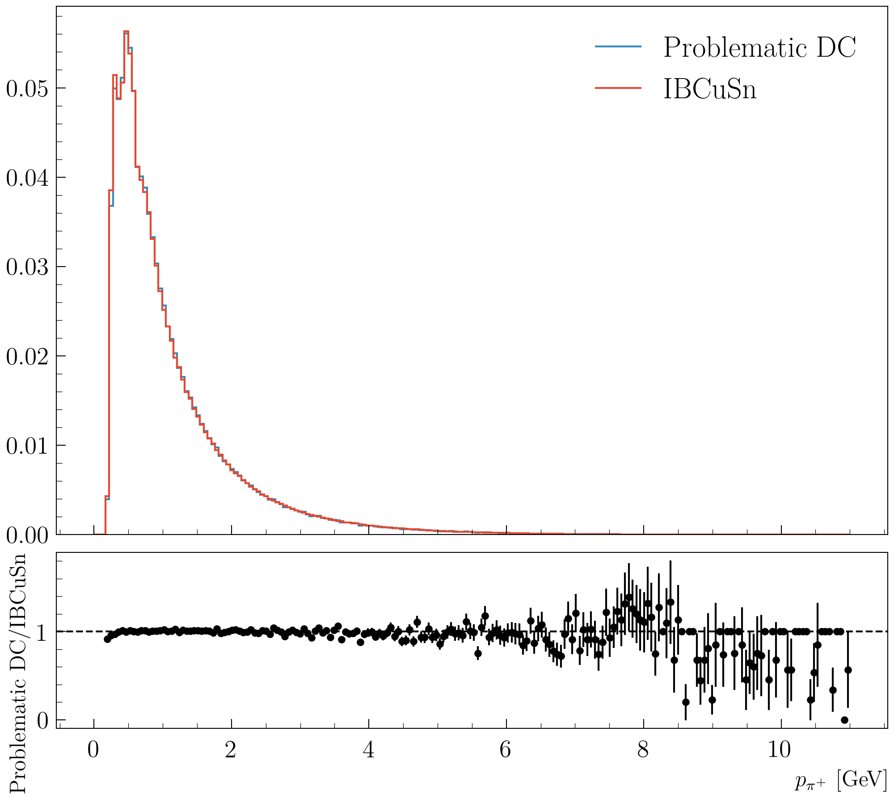
DC problematic runs
Runs: 18358, 18359, 18360, 18361, 18362, 18363, 18364, 18365, 18366, 18368
Electron: pid = 11, status < 0 and -9.22 < Vz < 5 cm

Slide 51
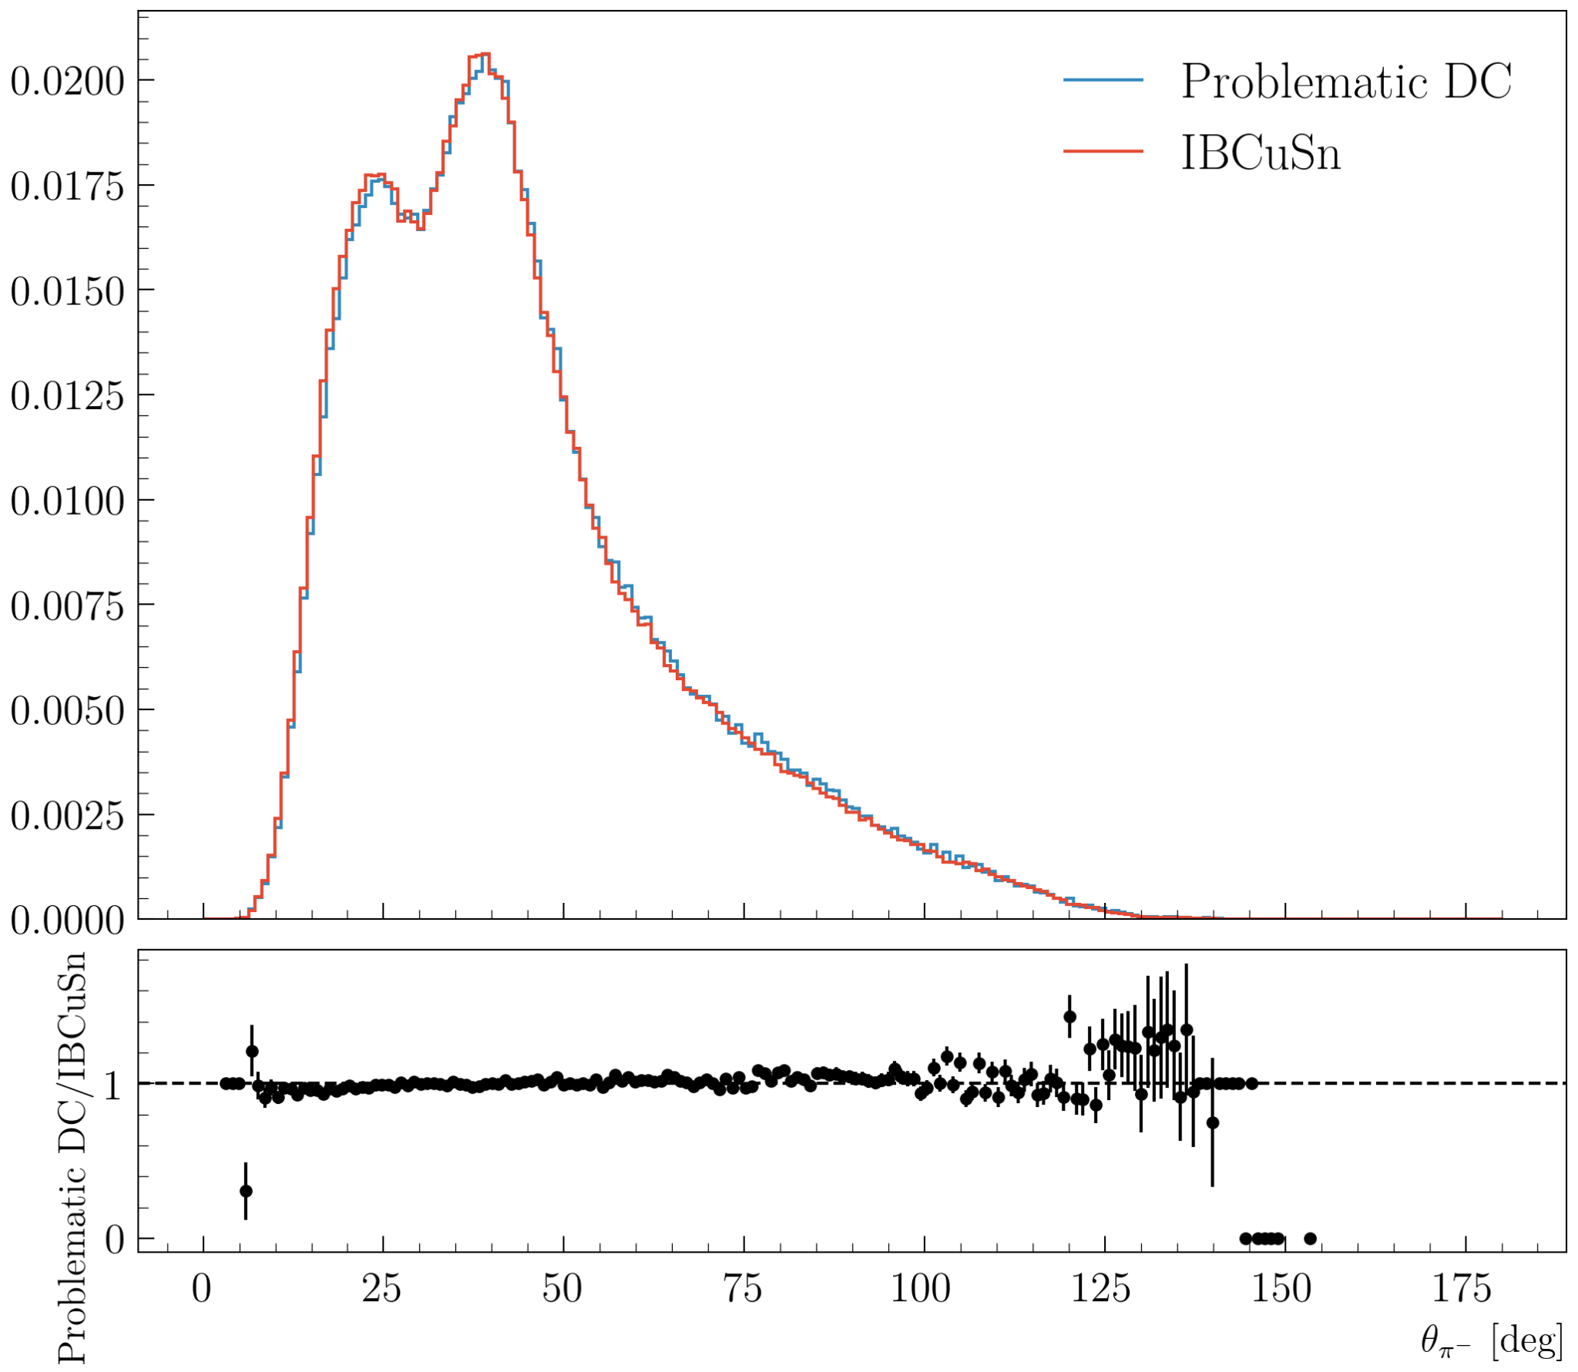
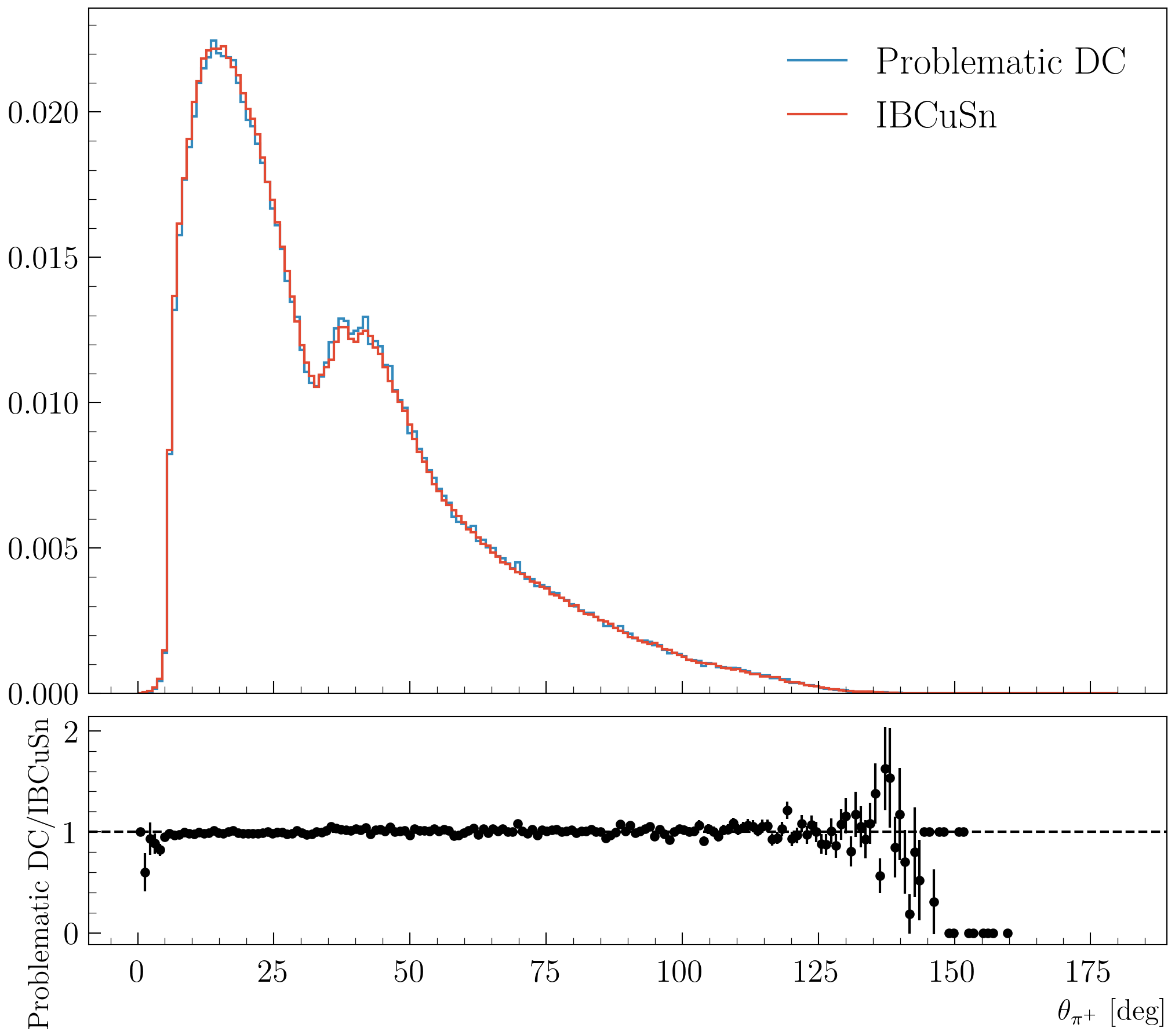
DC problematic runs
Runs: 18358, 18359, 18360, 18361, 18362, 18363, 18364, 18365, 18366, 18368
Electron: pid = 11, status < 0 and -9.22 < Vz < 5 cm

Slide 52
Triggers analysis

Slide 53
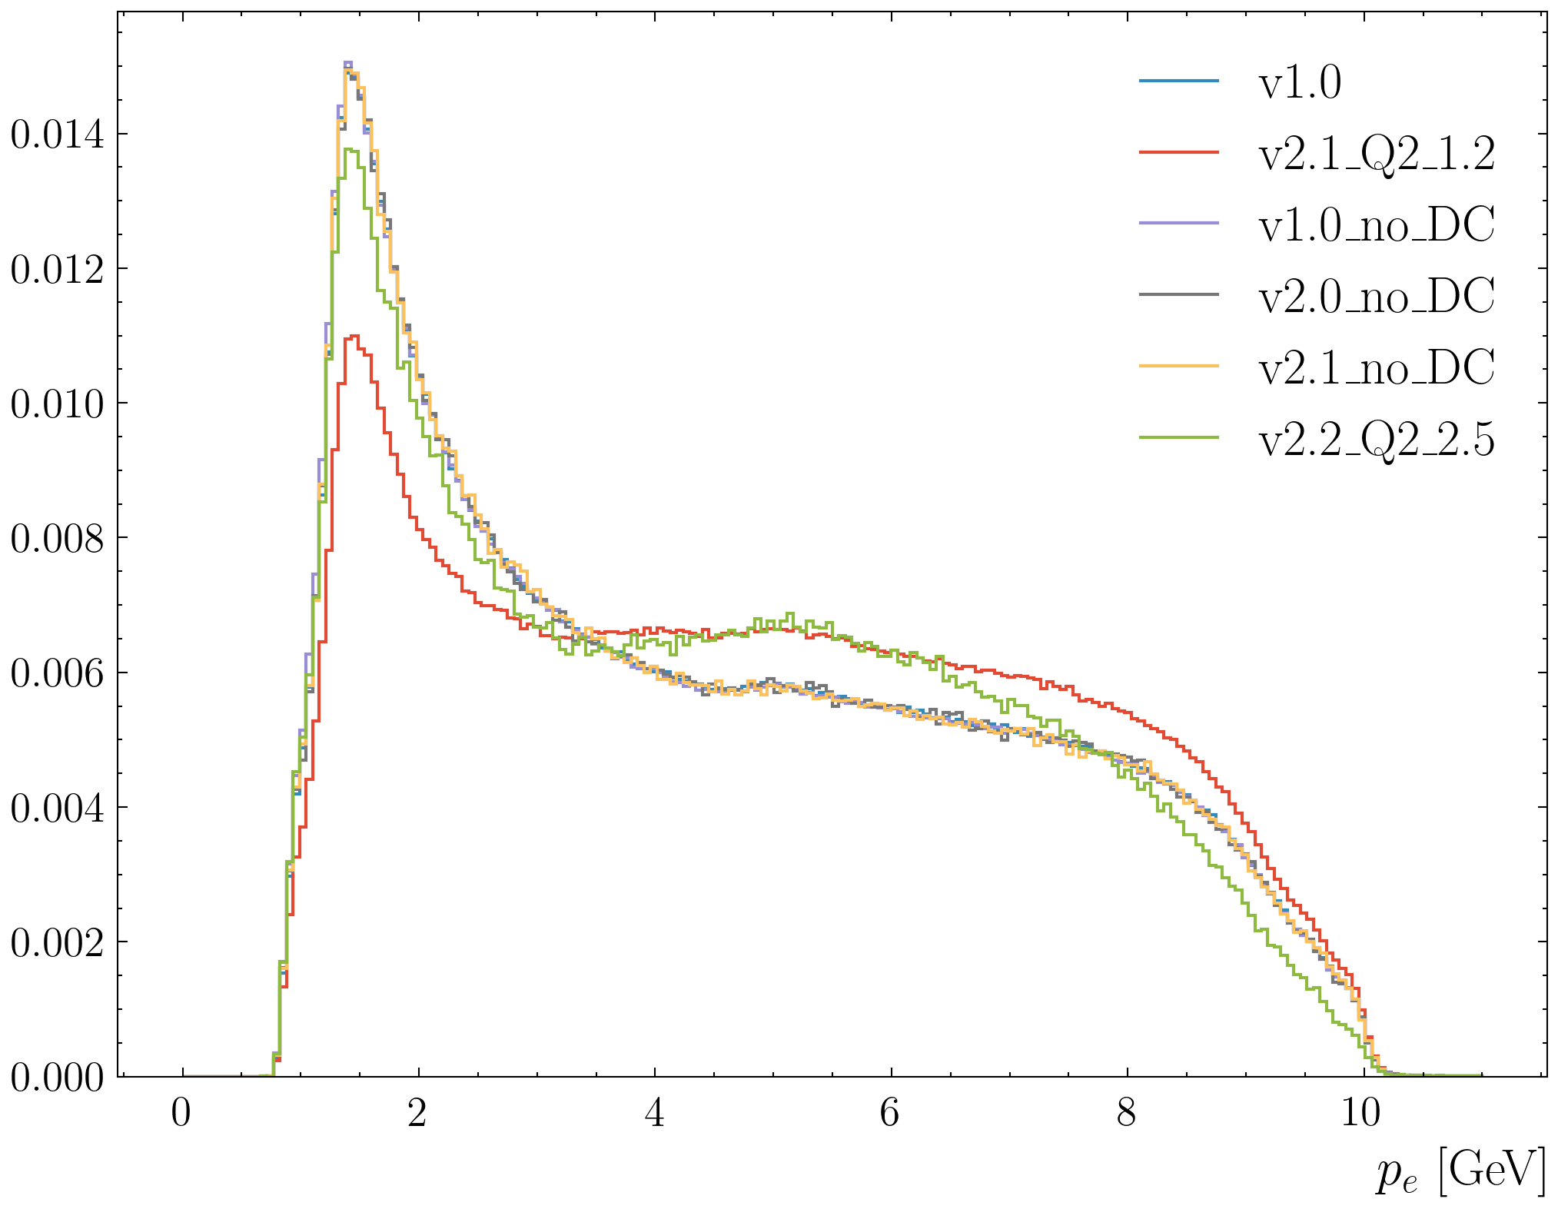
Trigger analysis
Look at the effect of the trigger in LD2 outbending.
runs | triggers
18432 | rgd_v2.2_Q2_2.5
18431,18423,22,21,20,19 | rgd_v1.0_no_DC
18430 | rgd_v2.1_no_DC
18429 | rgd_v2.0_no_DC
18433,34,35,36,37,38,39 | rgd_out_v1.0
18528,29,30,32,33,35 | rgd_out_v2.1_Q2_1.2

Slide 54
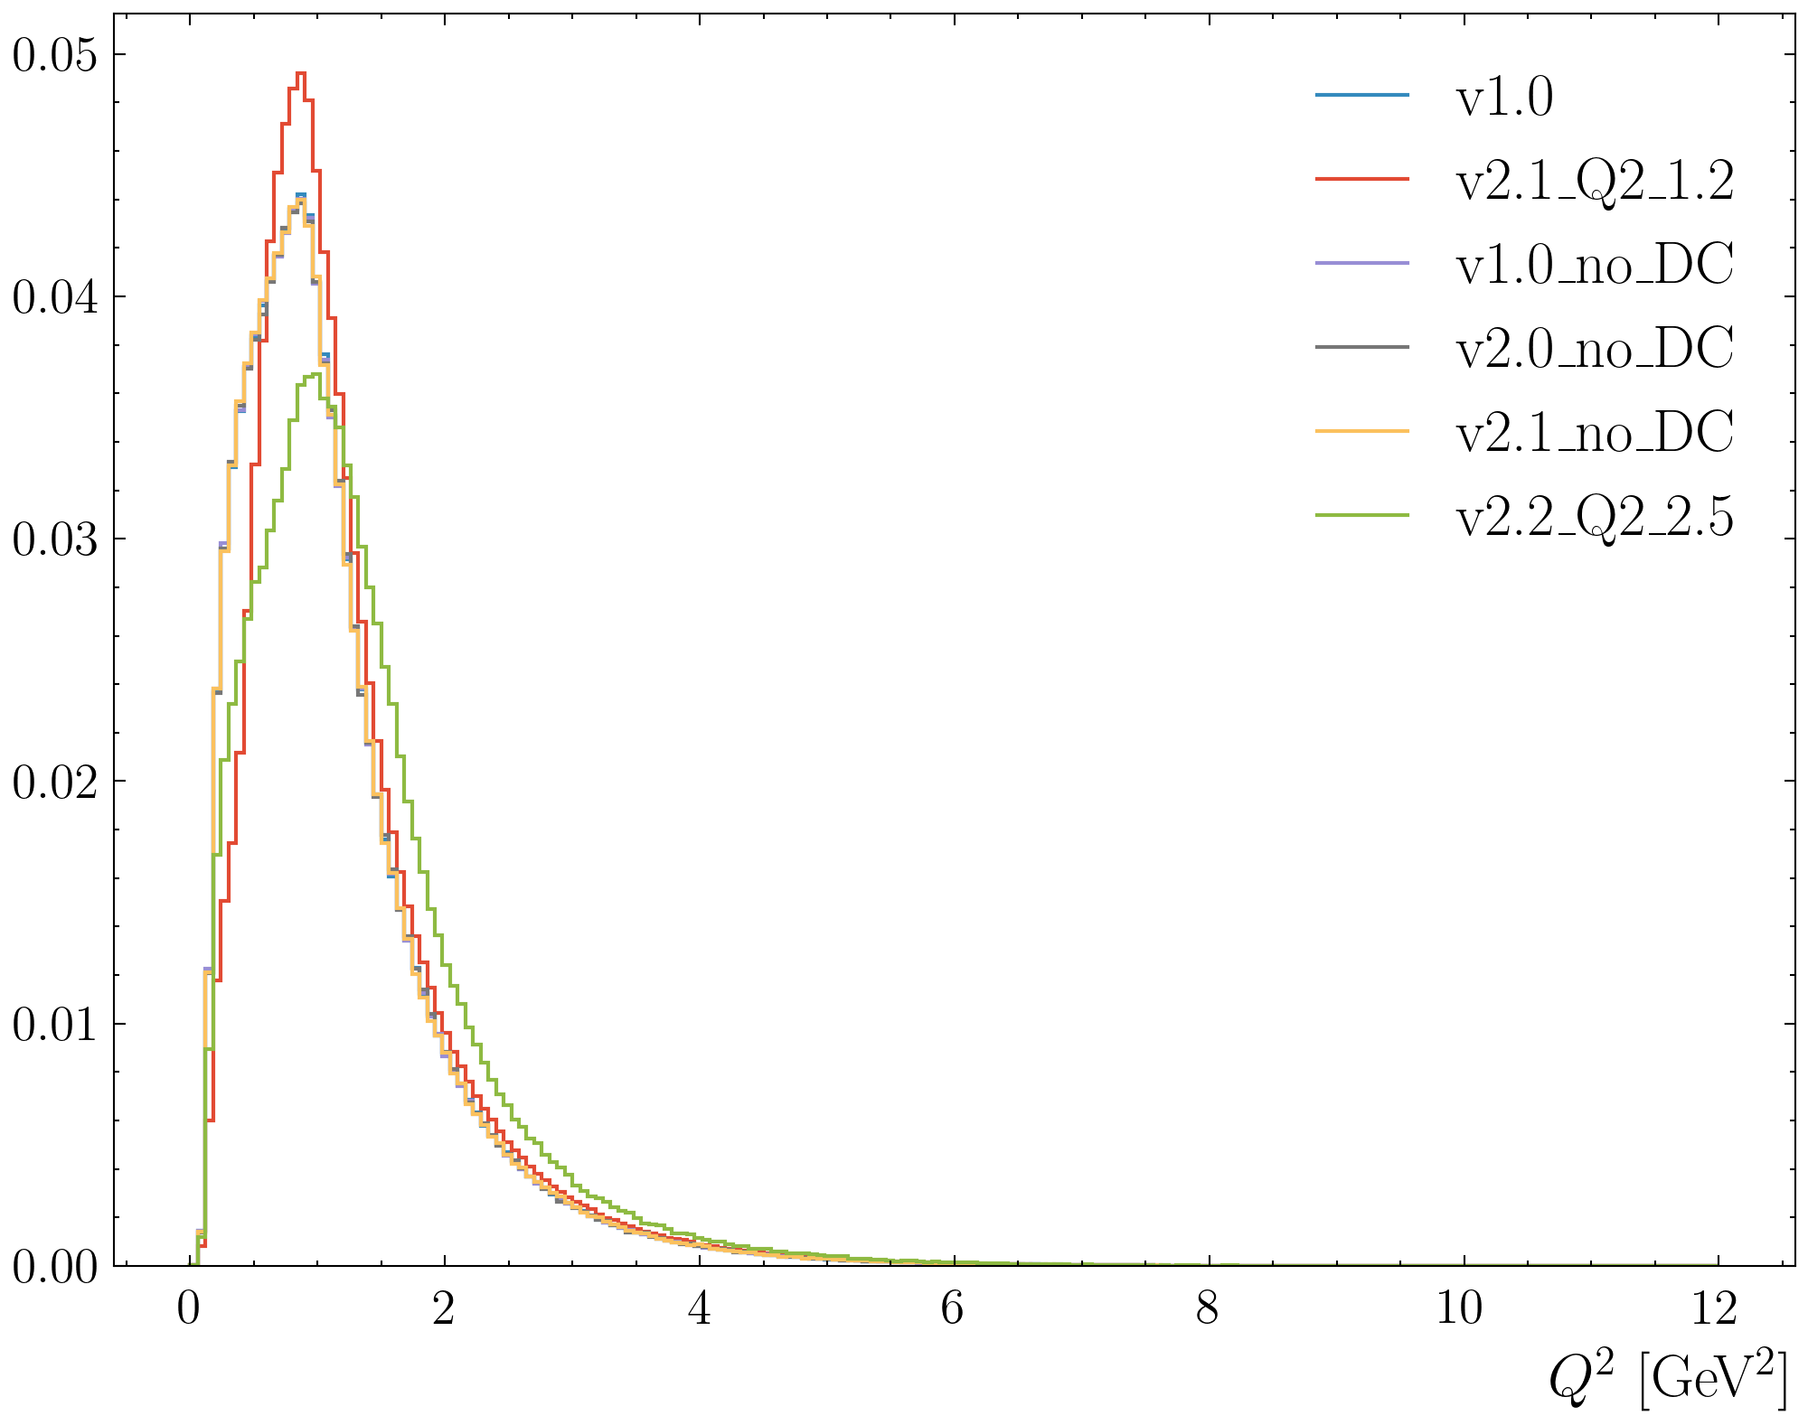

Trigger analysis

Slide 55


Trigger analysis pi minus

Slide 56


Trigger analysis pi plus

Slide 57
Data/Time estimate

Slide 58

clara-ana-log output
Pass0v11:
Flavor Fail: farm23 0.09% (8/8429) (8421) farm19 0.02% (3/13537) (13534) farm18 0.04% (1/2229) (2228) farm16 N/A farm14 N/A
Time for each engine: BAND: 0.06 ms 0.01% | BAND: 0.06 ms 0.01% CND: 0.84 ms 0.11% | CND: 0.84 ms 0.11% CTOF: 4.42 ms 0.58% | CTOF: 4.42 ms 0.58% CVTFP: 356.01 ms 46.83% | CVTFP: 356.01 ms 46.83% CVTSP: 90.39 ms 11.89% | CVTSP: 90.39 ms 11.89% DCCR: 14.87 ms 1.96% | DCCR: 14.87 ms 1.96% DCHAI: 62.62 ms 8.24% | DCHAI: 62.62 ms 8.24% DCHB: 0.11 ms 0.01% | DCHB: 0.11 ms 0.01% DCTB: 168.01 ms 22.10% | DCTB: 168.01 ms 22.10% EBHB: 1.17 ms 0.15% | EBHB: 1.17 ms 0.15% EBTB: 1.72 ms 0.23% | EBTB: 1.72 ms 0.23% EC: 2.07 ms 0.27% | EC: 2.07 ms 0.27% FMT: 4.70 ms 0.62% | FMT: 4.70 ms 0.62% FTCAL: 0.04 ms 0.01% | FTCAL: 0.04 ms 0.01% FTEB: 0.03 ms 0.00% | FTEB: 0.03 ms 0.00% FTHODO: 0.03 ms 0.00% | FTHODO: 0.03 ms 0.00% FTOFHB: 2.75 ms 0.36% | FTOFHB: 2.75 ms 0.36% FTOFTB: 2.82 ms 0.37% | FTOFTB: 2.82 ms 0.37% FTTRK: 0.20 ms 0.03% | FTTRK: 0.20 ms 0.03% HTCC: 0.10 ms 0.01% | HTCC: 0.10 ms 0.01% LTCC: 0.08 ms 0.01% | LTCC: 0.08 ms 0.01% MAGFIELDS: 0.04 ms 0.00% | MAGFIELDS: 0.04 ms 0.00% MLTD: 35.35 ms 4.65% | MLTD: 35.35 ms 4.65% RASTER: 0.03 ms 0.00% | RASTER: 0.03 ms 0.00% READER: 0.13 ms 0.02% | READER: 0.13 ms 0.02% RICH: 7.03 ms 0.92% | RICH: 7.03 ms 0.92% RTPC: 0.05 ms 0.01% | RTPC: 0.05 ms 0.01% WRITER: 4.61 ms 0.61% | WRITER: 4.61 ms 0.61%

Slide 59
Data size
Total events: 40,164,051,428
Total number of EVIO files: 573,493
Number of runs: 619
Number of events per EVIO file: approx. 74,000
Size of raw file (2GB) 1146 TB on mss (2GB x 573,493)
Size of decoded files: 442TB decoded pass0v11: 19.1TB for 619*40 files, for 573,493 → 573,493*19.1/(619*40)
Size of DST files: 172TB based on run 18542 → 12GB → 573,493*12/40 = 172000GB
Size skim forward: 11:X+:X-:Xn 143TB
Total: Size skim forward: 11:X+:X-:Xn && Q2 > 0.7 GeV² && W > 1.8 GeV 98.9TB
Total: Size skim forward: 11:X+:X-:Xn && Q2 > 0.7 GeV² && W > 1.7 GeV 100.3TB
Total: Size JPSITCS: 2.7TB
Removing the RICH bank (RICH::Particle, RICH::Ring, RICH::tdc) and REC::Caloextra and REC::ScintaExtra lead to a 29% reduction
11:X+:X-:Xn 102TB
11:X+:X-:Xn && Q2 > 0.7 GeV² && W > 1.8 GeV 70.2TB
11:X+:X-:Xn && Q2 > 0.7 GeV² && W > 1.7 GeV 71.2TB

