Slide 1

Analysis and cooking status
Mathieu Ouillon (Mississippi State University)
November 06, 2024

Slide 2
RG-D: Cooking chef​
Skim for Pass0v6: /cache/hallb/scratch/rg-d/production/skim_pass0v6/
I will skim the calib_v9 (same state of calibration as Pass0v6) dataset today.
Will be in /cache/hallb/scratch/rg-d/production/skim_calib_v9/

Slide 3
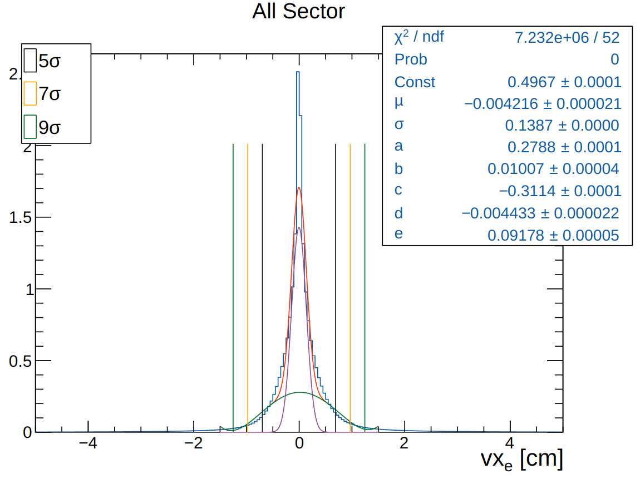
RG-D: Vertex study​
data: all pass0v6
target: CuSn
Fit with a gaussian + 4 order polynomial.

Slide 4
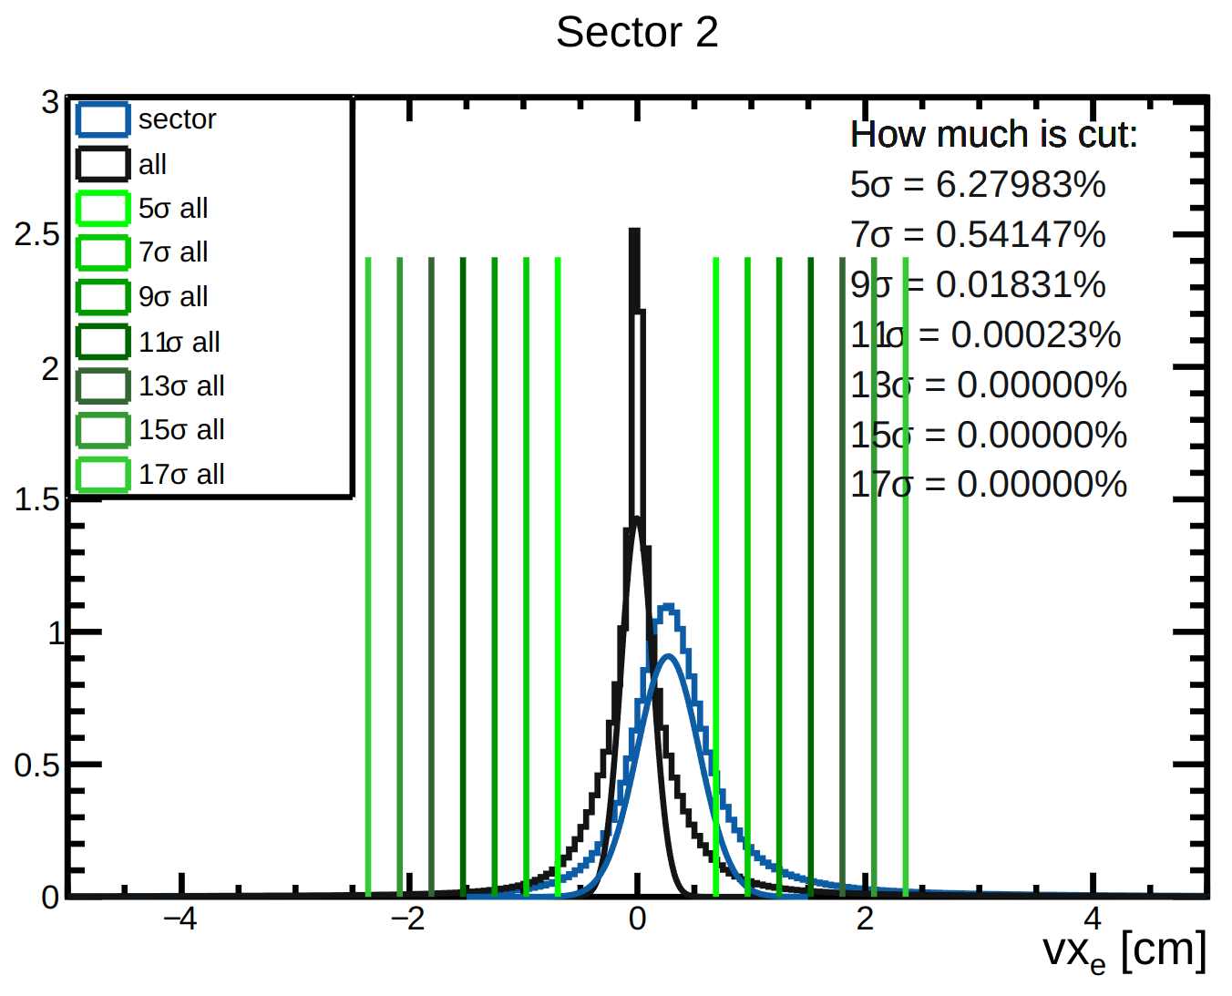
RG-D: Vertex study​
Fit sector 2 with a gaussian + 4 order polynomial.
We look at how much of the sector's gaussian is cut by applying the cuts at 5, 7,... σ of the gaussian obtained with all sectors.
Sector 2 is the worse one. And a cut at 11σ keep most of the stats
cuts at : -1.529 cm and 1.521 cm

Slide 5
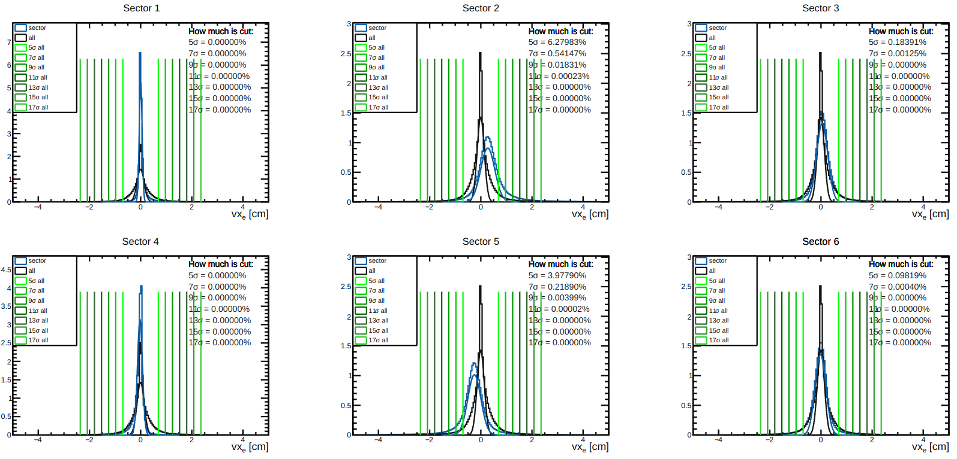
RG-D: Vertex study​

Slide 6
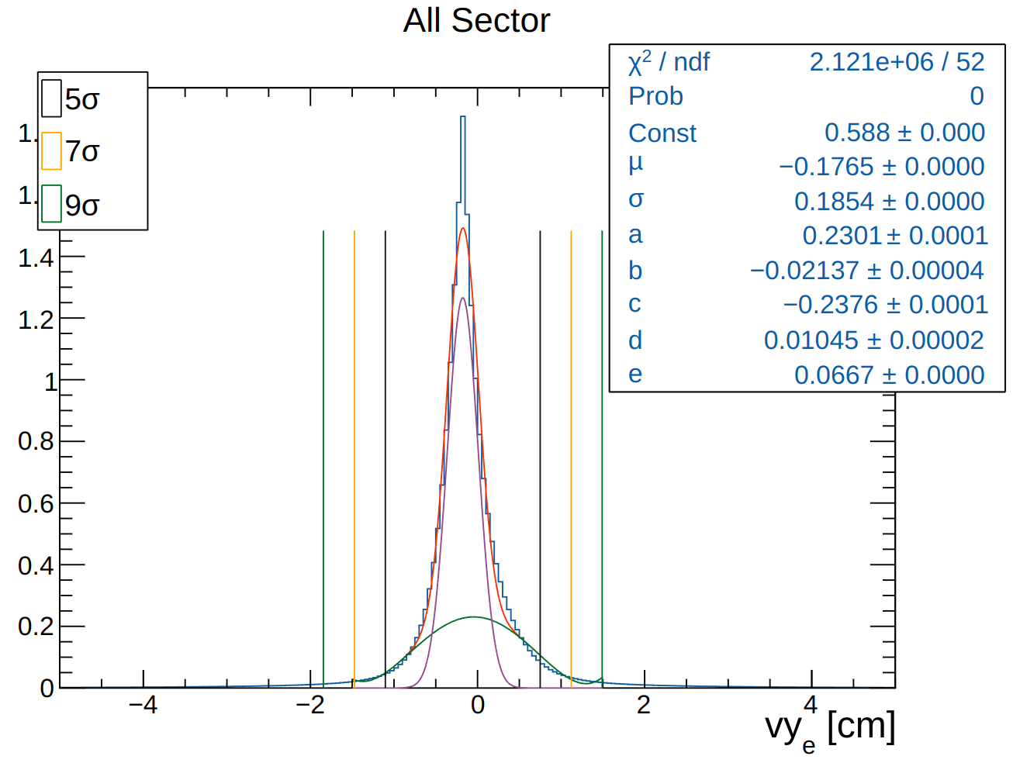
RG-D: Vertex study​
data: all pass0v6
target: CuSn
Vy is fit with a gaussian + 4 order polynomial.

Slide 7
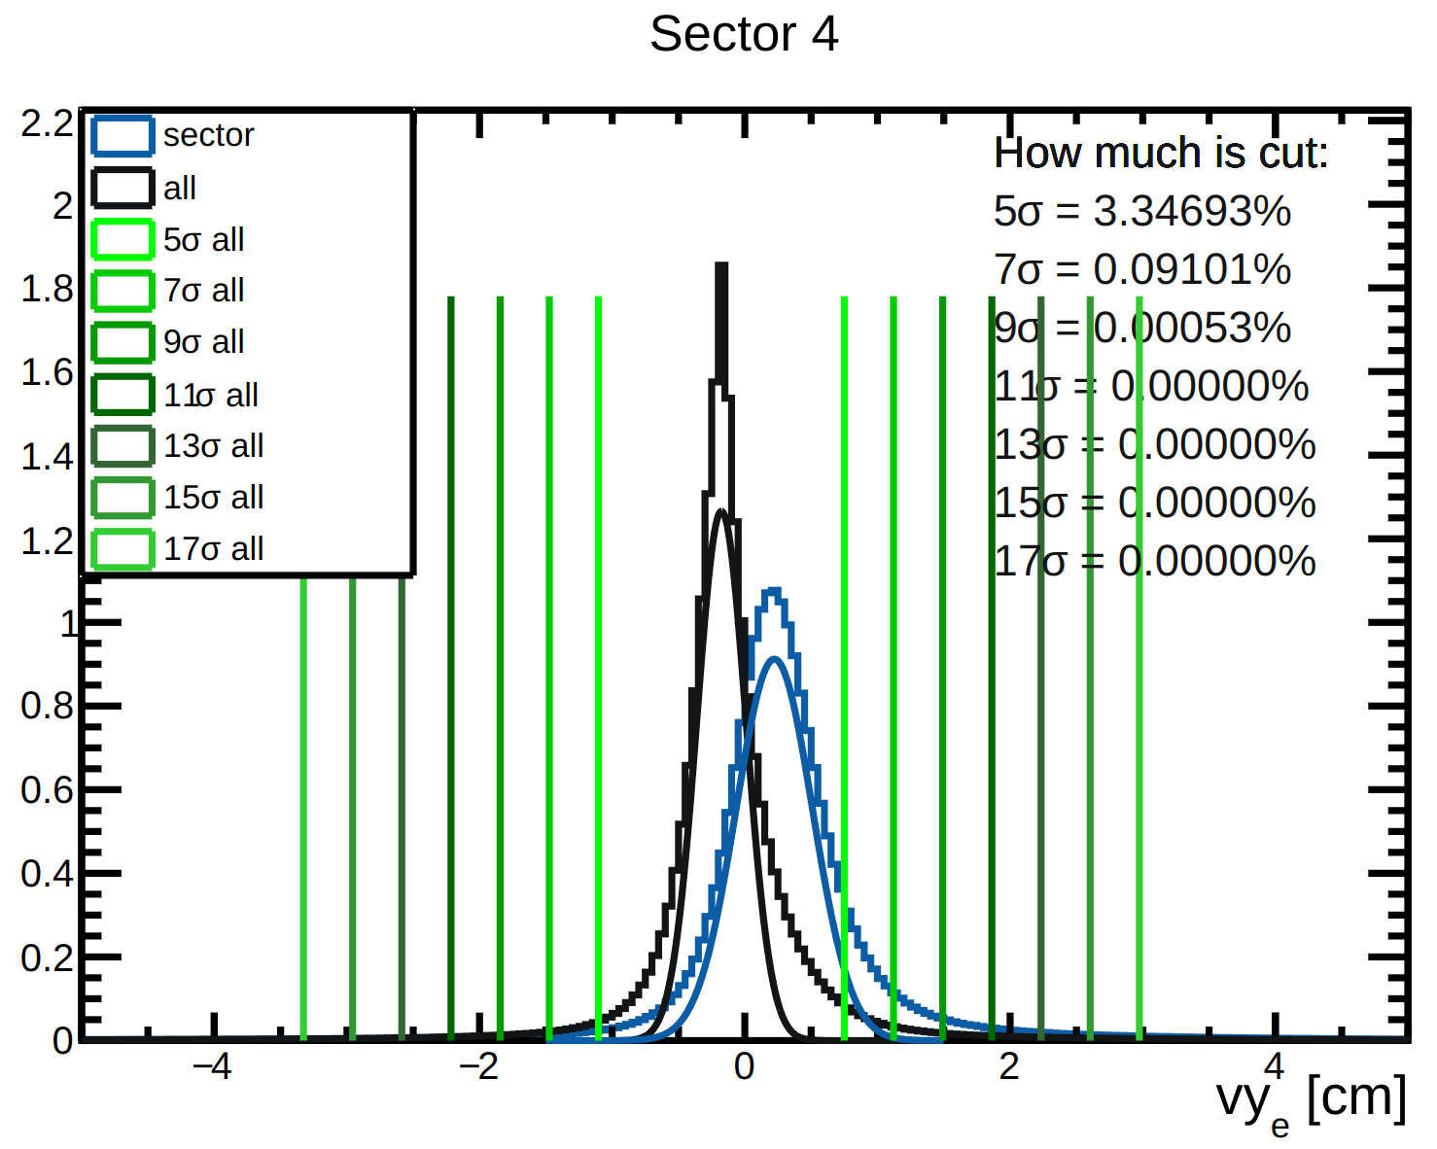
RG-D: Vertex study​
Fit sector 4 with a gaussian + 4 order polynomial.
We look at how much of the sector's gaussian is cut by applying the cuts at 5, 7,... σ of the gaussian obtained with all sectors.
Sector 4 is the worse one. And a cut at 11σ keep most of the stats
cuts at: -2.216 cm and 1.862 cm

Slide 8
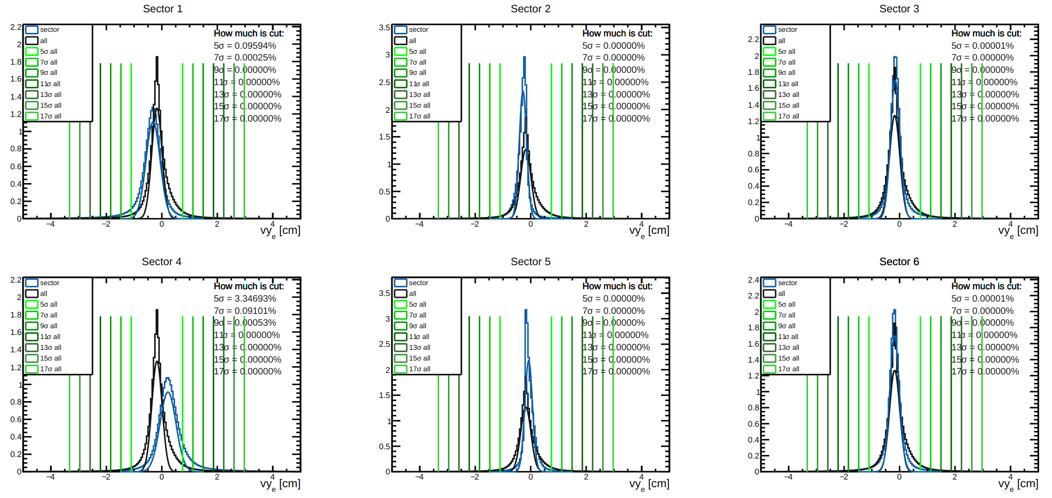
RG-D: Vertex study​

Slide 9
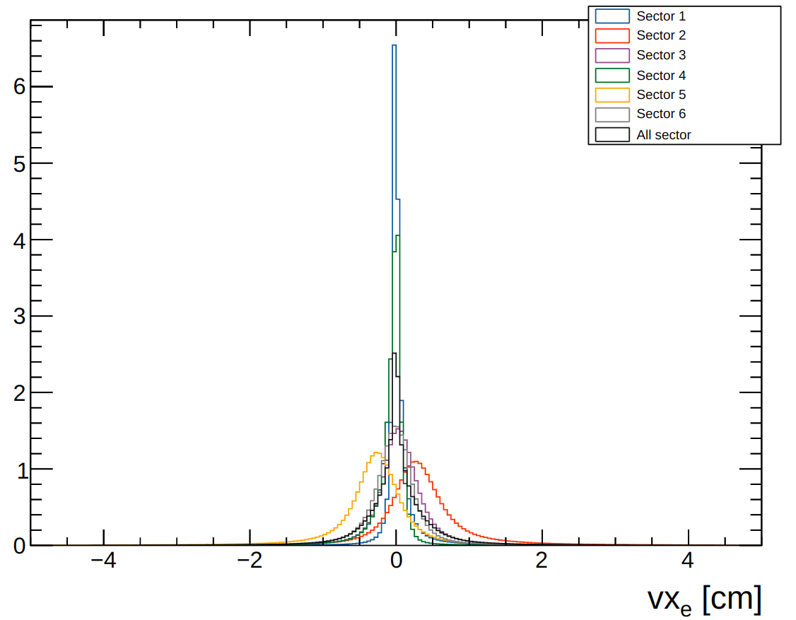
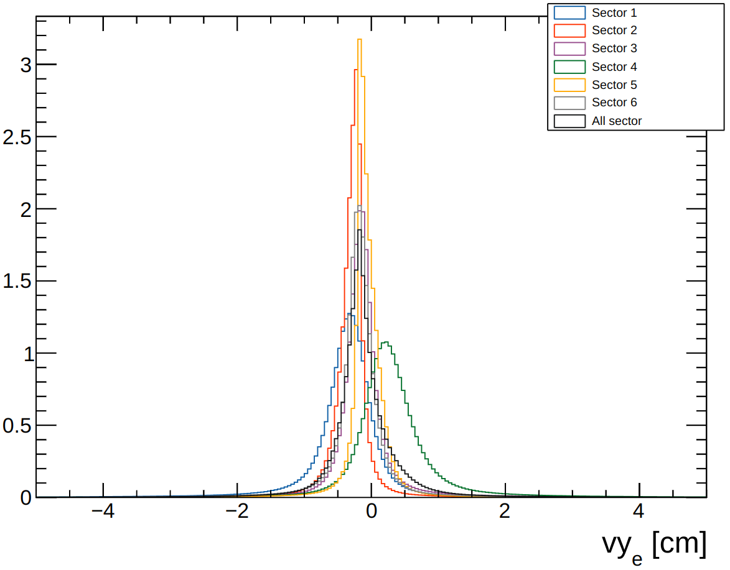
RG-D: Vertex study​

Slide 10
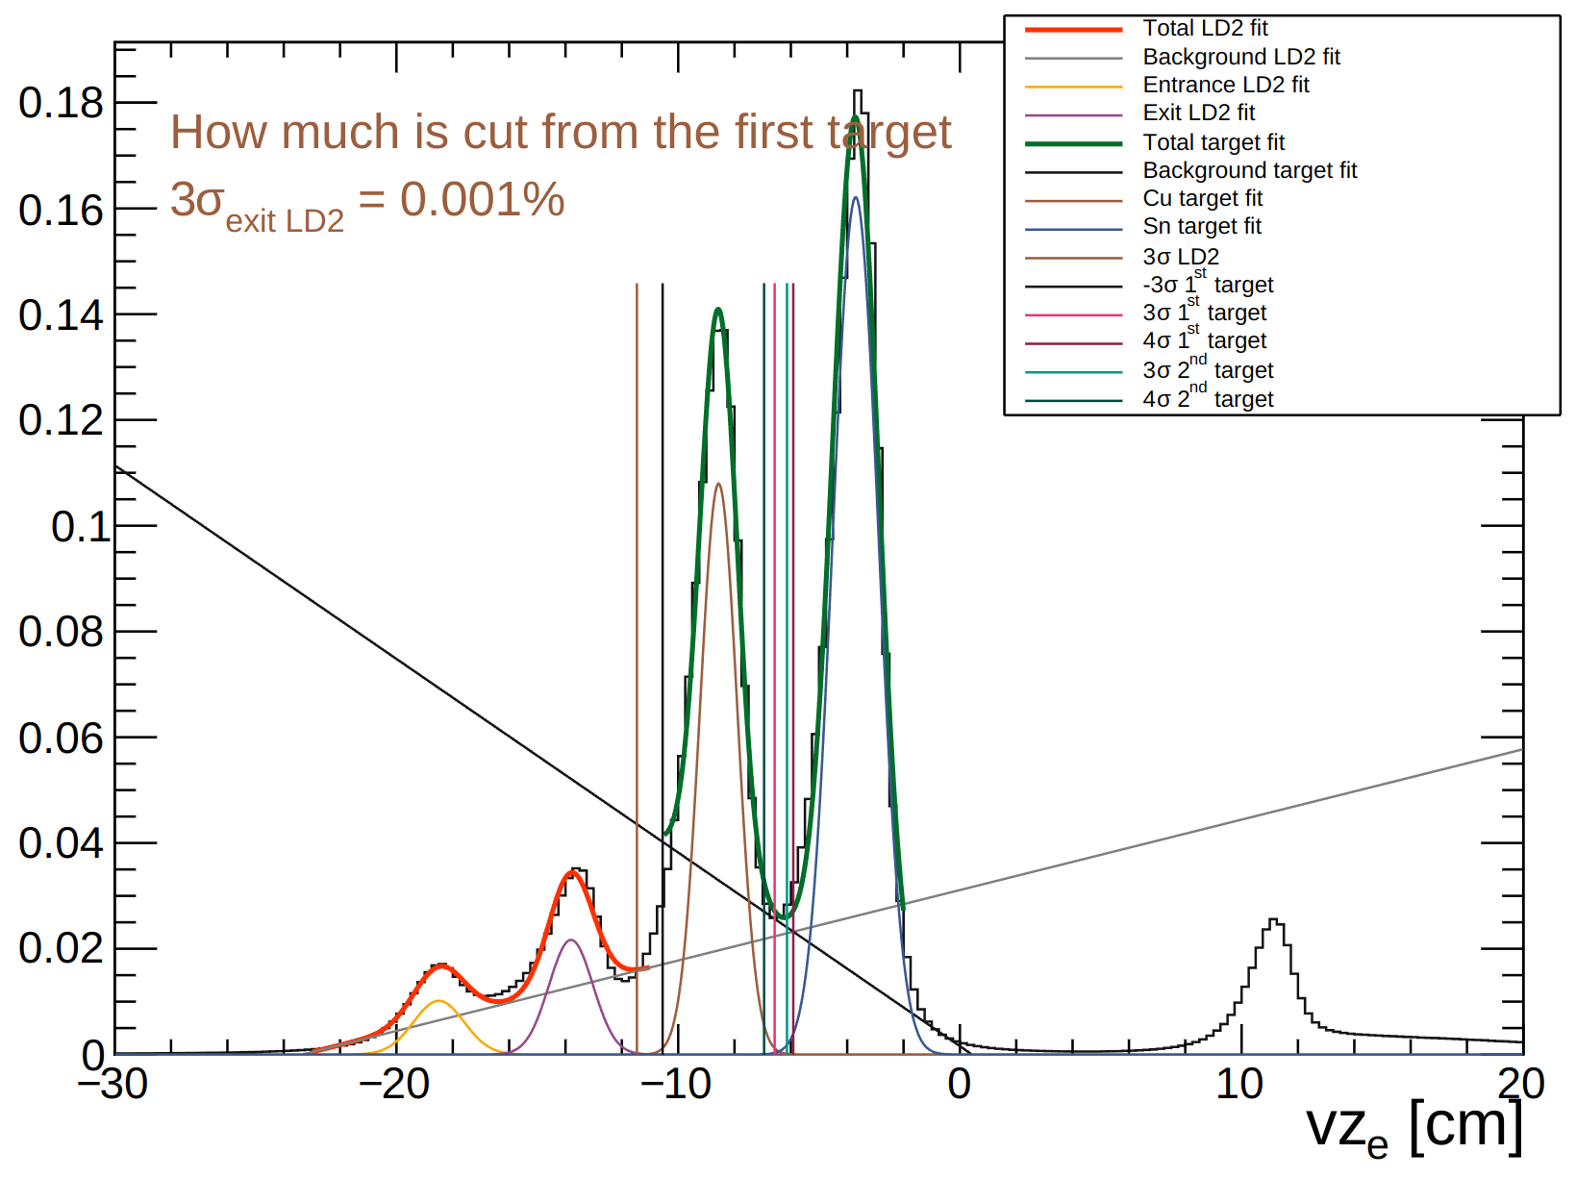
RG-D: Vertex study​
Vz distribution after a cut at 11σ on vx and 11σ on vy.
Two separate fits:
The LD2 region: 2 gaussians + pol1
The CuSn region: 2 gaussins + pol1
To separate the LD2 exit window from the first target, cut at 3σ: -11.463 cm
To separate the two target, cut at 3σ for the first target: -6.576 cm and at 3σ for the second: -6.137 cm.
And to separate the second target from the scattering window, we can cut at 5cm.

Slide 11
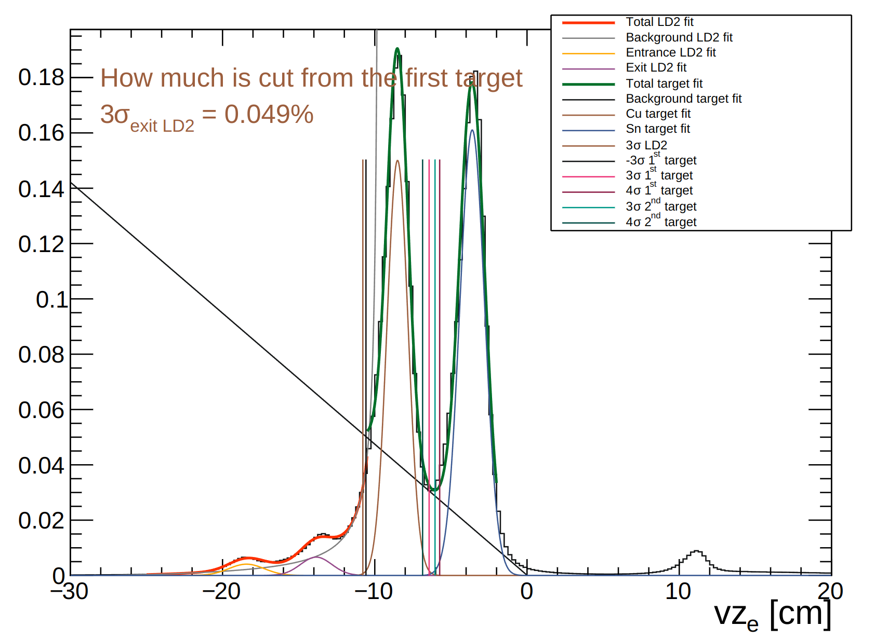
RG-D: Vertex study​
Data: Pass0v6
Target: carbon
Vz distribution after a cut at 11σ on vx and 11σ on vy.
Two separate fits:
The LD2 region: 2 gaussians + 1/x
The CuSn region: 2 gaussins + pol1
To separate the LD2 exit window from the first target, cut at 3σ: -10.784 cm

Slide 12
RG-D: Vertex study​
Be aware: I need to cross check all of that with Matt.

