Slide 1

Analysis and cooking status
Mathieu Ouillon (Mississippi State University)
November 20th, 2024

Slide 2
Cooking status
Cooking for Pass0v7 and DC calibration is done.
Took ~5 days (Pass0v7 use 20 files per runs, dc use decoded files from calib_v9)
Launch new workflow Calib_v10 for CTOF calibration and Calib_v11 for CND.
Skimed Pass0v7, same location: /cache/hallb/scratch/rg-d/production/skim_pass0v7/
I have deleted the decoded files for Pass0v7.
Same for recon files.

Slide 3
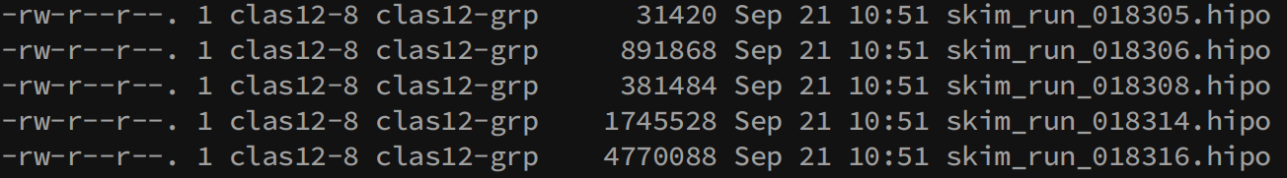
Try to delete previous Pass0 from /cache/hallb/scratch/
But /cache became read-only yesterday during the maintenance.

Slide 4
Collaboration Meeting
I give a talk to the collaboration meeting about the RG-D update and the current analysis.
Here is the slides.

Slide 5
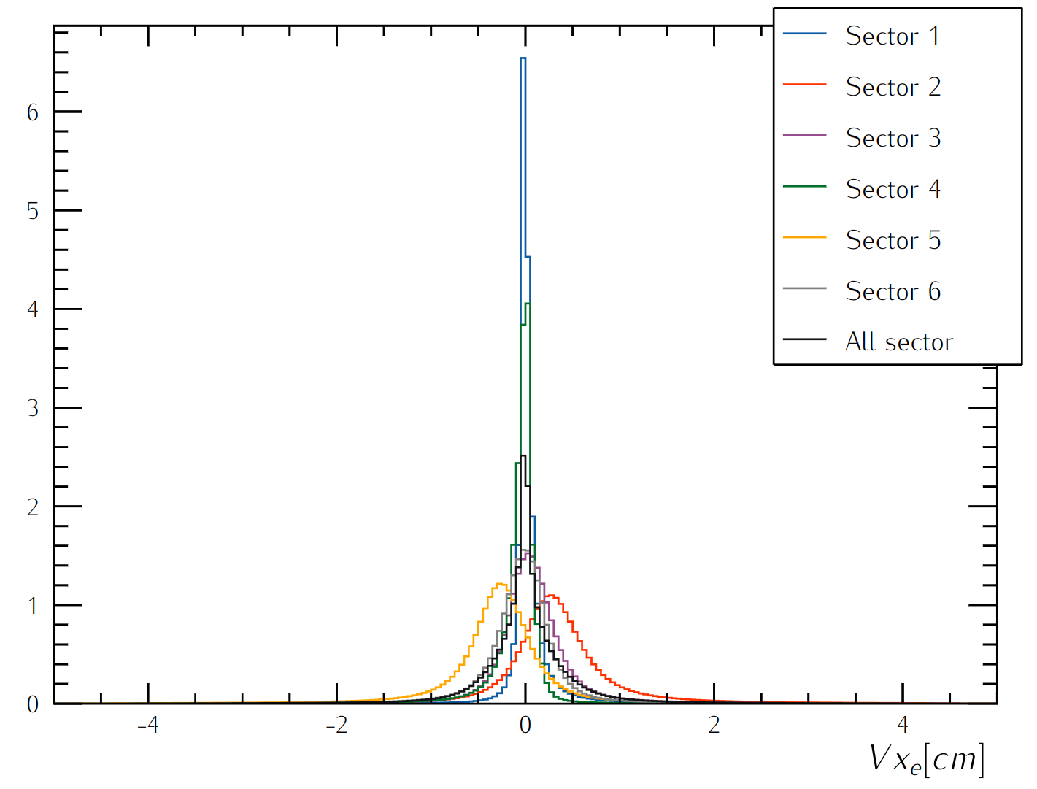
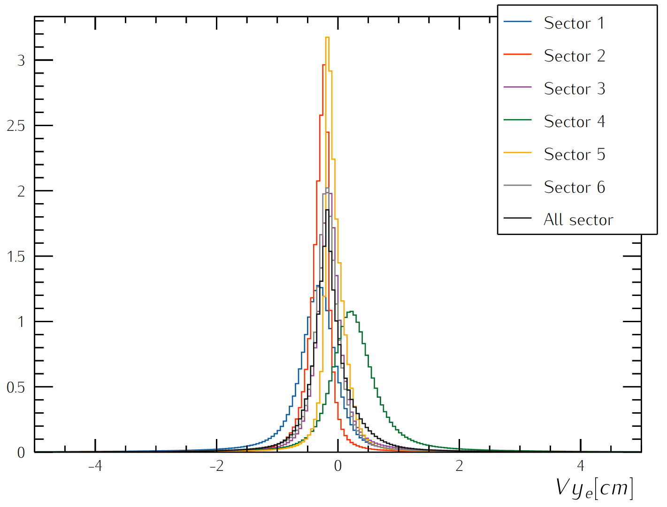
RG-D Vertex Studies
Goal:
Check whether all sectors are well aligned in Vx, Vy and Vz distributions
Could sector-independent cuts on Vx, Vy and Vz be applied?
Reduce the contamination for the target configuration with two different foils, Cu and Sn

Slide 6
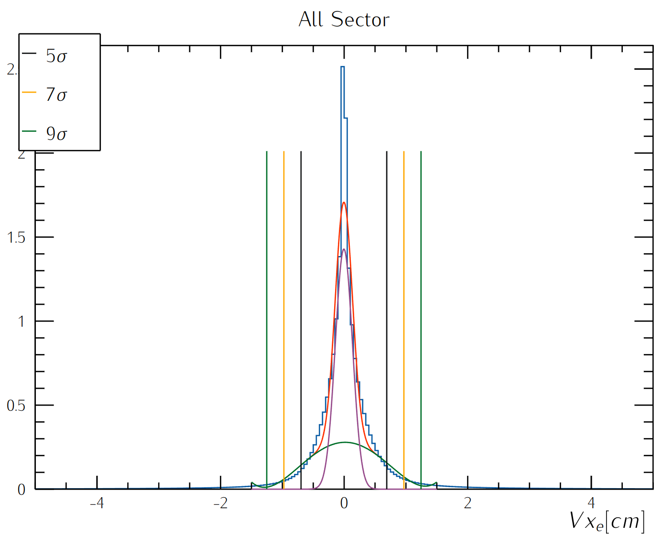
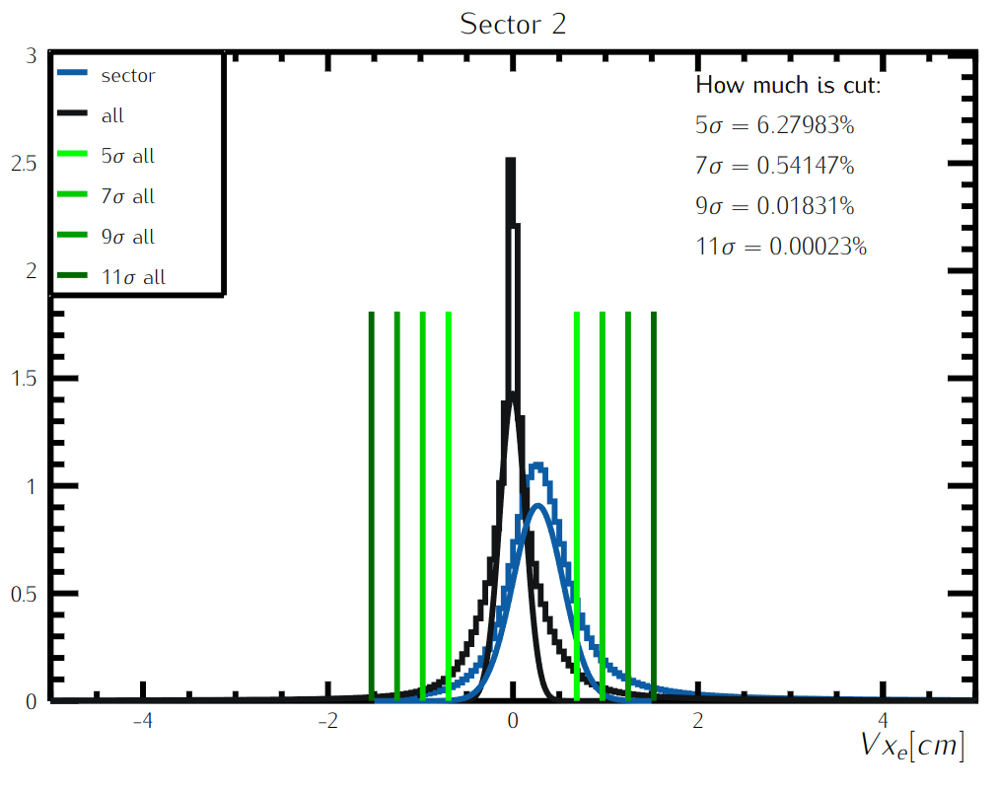
RG-D Vertex Studies: Transverse Components
Get rid of sector-dependent cuts for Vx

Slide 7
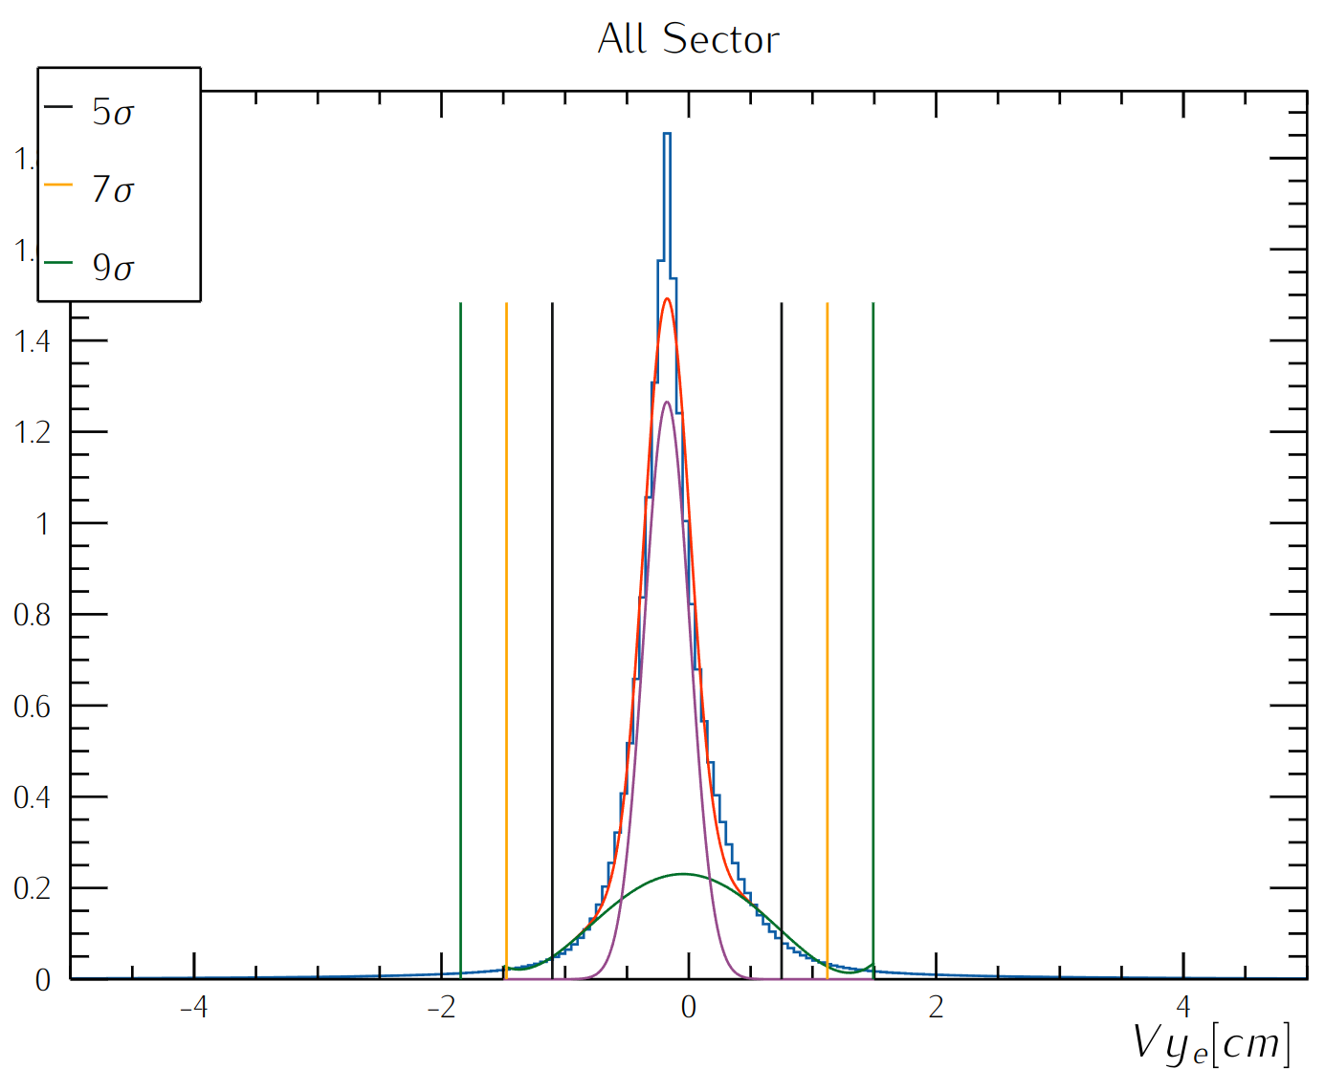
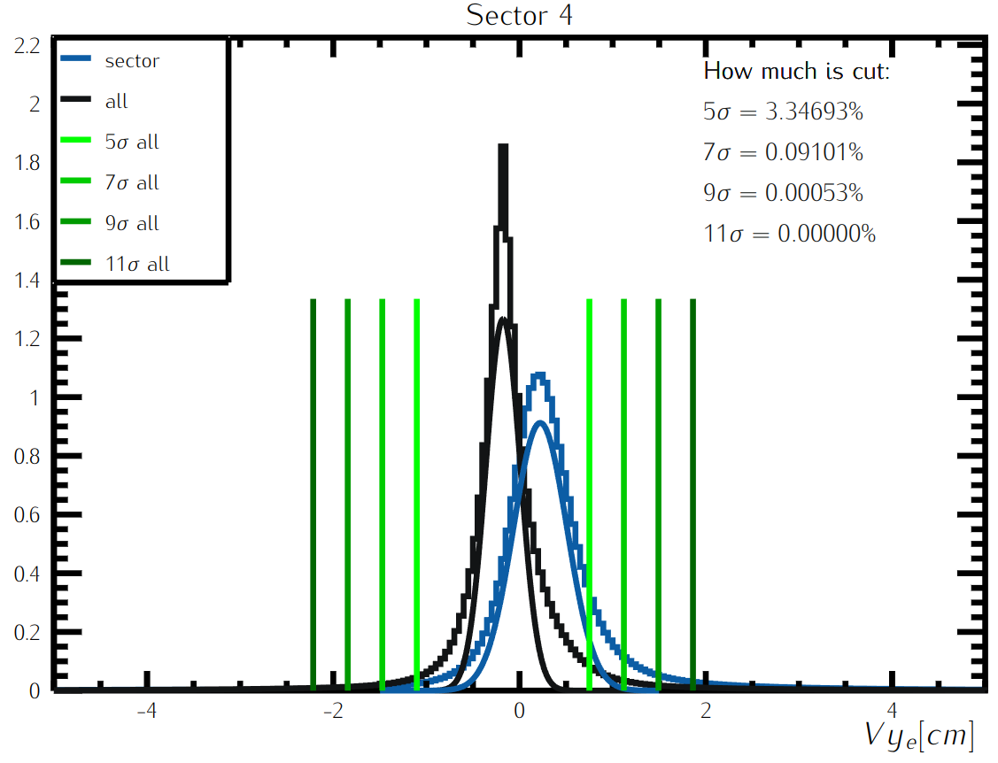
RG-D Vertex Studies: Transverse Components
Get rid of sector-dependent cuts for Vy

Slide 8
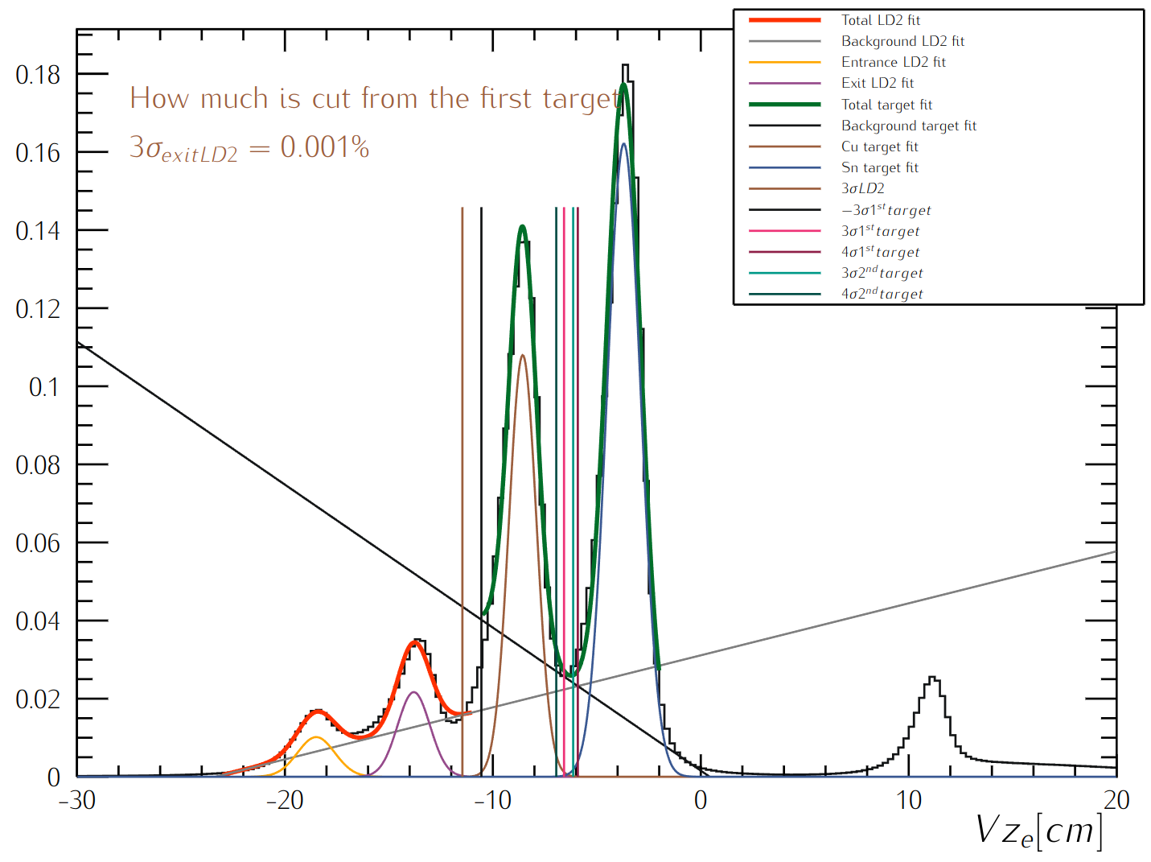
RG-D Vertex Studies: z-Vertex
Fits:
Fit the empty LD2 cell and nuclear-foil regions with double gaussians and first-order polynomial
Separate the two different foils, Cu and Sn from each other
Same study is performed for carbon
Similar study is underway for hadrons
Target | z-Vertex (cm)
LD2 | [-20, 5]
C | [-10.784, 5]
Cu | [-11.463, -6.576]
Sn | [-6.137, 5]
Empty LD2 cell
Nuclear-foil

Slide 9
RG-D Vertex Studies Carbon: μ and σ values
 | Vx |  | Vy
 | Mean [cm] | Sigma [cm] | Mean [cm] | Sigma [cm]
Sector independant | -0.00431889 | 0.138538 | -0.175104 | 0.184344
Sector 1 | 0.00207391 | 0.0568253 | -0.320168 | 0.249121
Sector 2 | 0.273244 | 0.270524 | -0.27552 | 0.133421
Sector 3 | 0.0489401 | 0.213238 | -0.154027 | 0.168174
Sector 4 | -0.0290649 | 0.0975361 | 0.214474 | 0.283372
Sector 5 | -0.250731 | 0.252091 | -0.0754824 | 0.135787
Sector 6 | -0.0224166 | 0.207086 | -0.182258 | 0.17224
 |  | Mean [cm] | Sigma [cm]
Vz | Entrance of the empty LD2 cell | -18.4237 | 1.16015
 | Exit of the empty LD2 cell | -13.8489 | 1.02154
 | first foil | -8.50419 | 0.691596
 | second foil | -3.59758 | 0.815107

Slide 10
RG-D Vertex Studies CuSn: μ and σ values
 | Vx |  | Vy
 | Mean [cm] | Sigma [cm] | Mean [cm] | Sigma [cm]
Sector independant | -0.00421593 | 0.138723 | -0.176477 | 0.185352
Sector 1 | 0.00104791 | 0.0560966 | -0.316161 | 0.253364
Sector 2 | 0.270278 | 0.273344 | -0.279131 | 0.133888
Sector 3 | 0.0482362 | 0.21678 | -0.156601 | 0.170709
Sector 4 | -0.0279068 | 0.0987972 | 0.22215 | 0.288263
Sector 5 | -0.253408 | 0.253318 | -0.0739325 | 0.137628
Sector 6 | -0.0178941 | 0.210021 | -0.180336 | 0.17197
 |  | Mean [cm] | Sigma [cm]
Vz | Entrance of the empty LD2 cell | -18.4969 | 0.896509
 | Exit of the empty LD2 cell | -13.803 | 0.779741
 | Cu foil | -8.56379 | 0.662424
 | Sn foil | -3.70048 | 0.812302

Slide 11
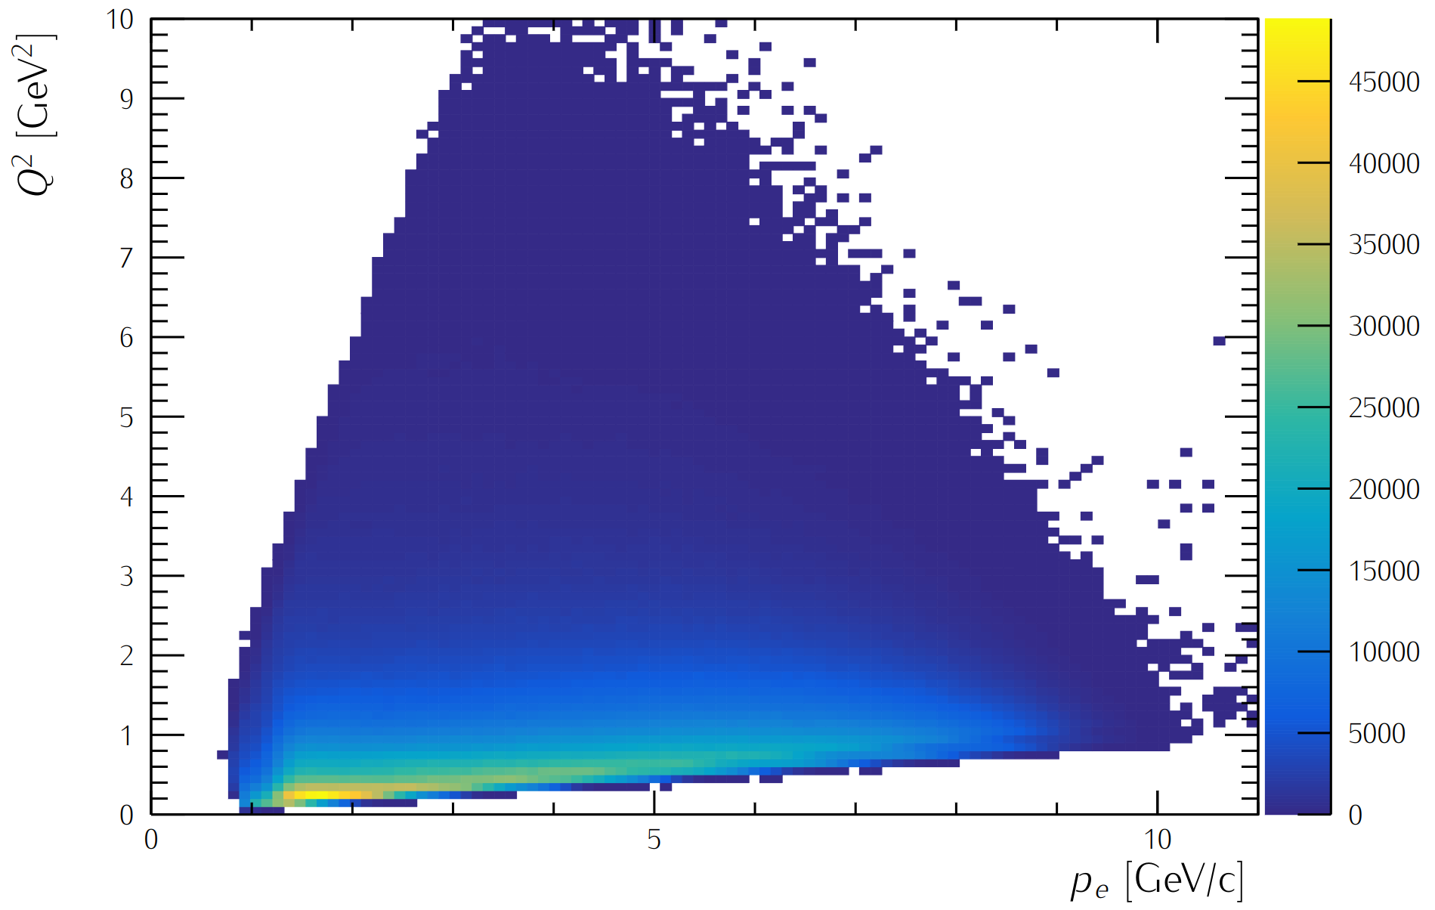
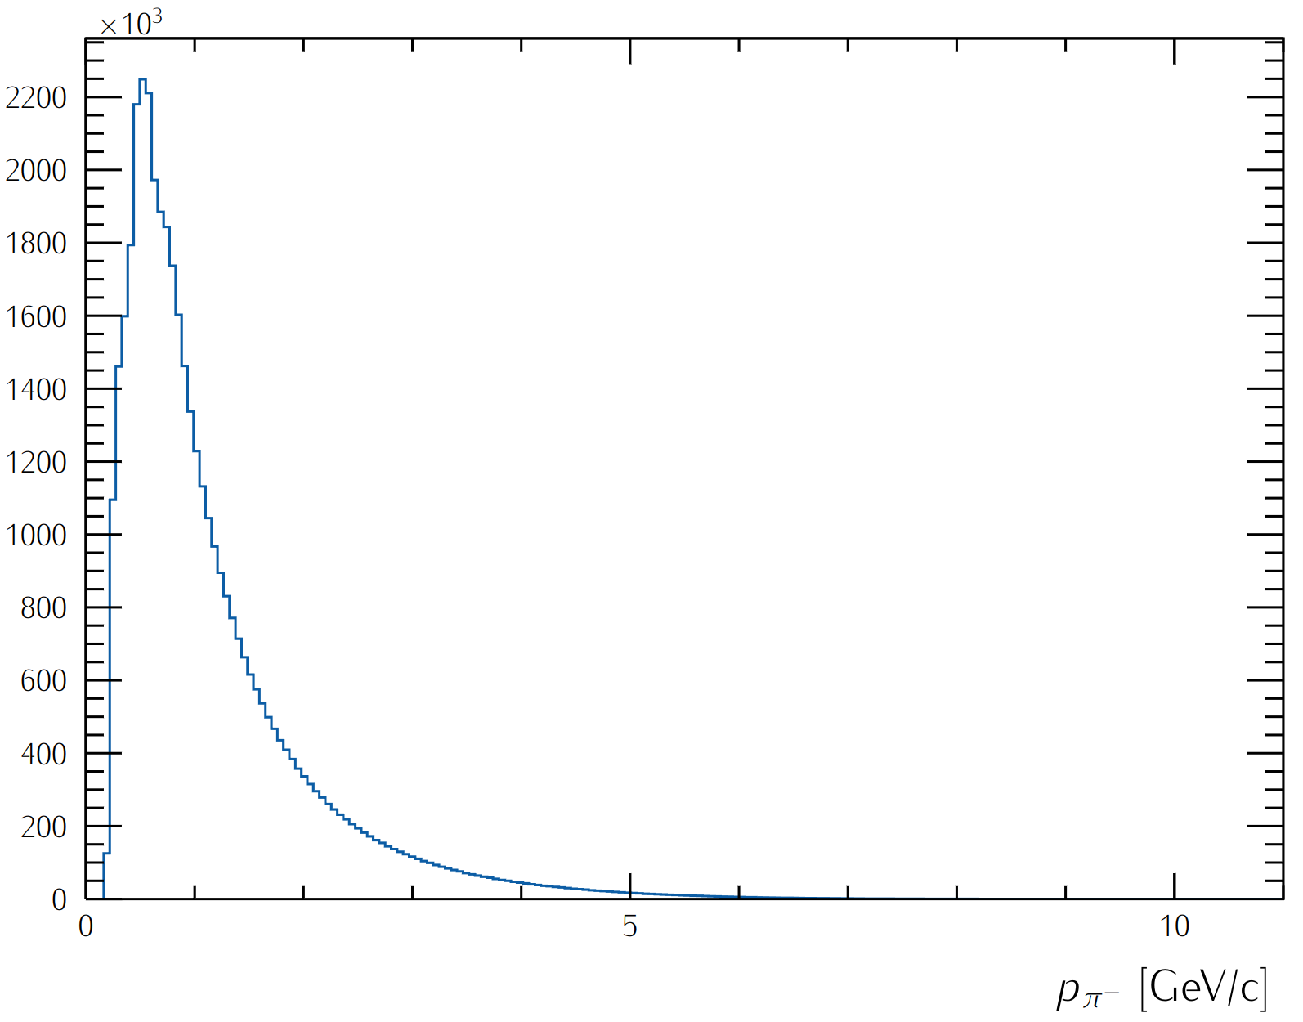
RG-D Analysis Study: Particle IDentification
Electron:
PID= 11
Status< 0
-5 < chi2pid < 5
Charged pions, π±:
PID (+/-) = (+/-) 211
-10 < chi2pid < 10

Slide 12
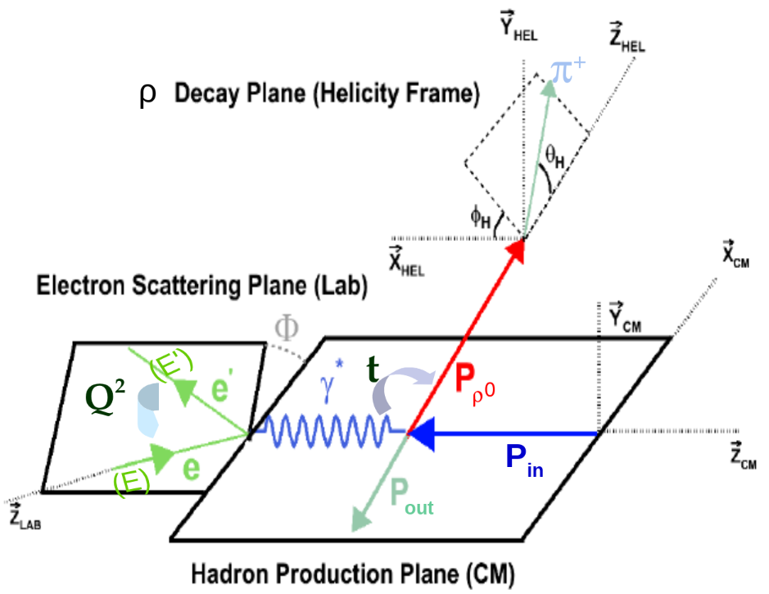
RG-D CT Study: Kinematical Cuts
ν= E - E’: virtual photon(γ*) energy in the Lab frame,
Q²= -(P_{e}- P_{e’})²= 4EE’sin²(θ/2): photon virtuality,
t= (P_{γ*} - P_{γ})²: momentum transfer square,
W²= (P_{in} + P_{γ*})²= -Q² + M_{p}² + 2M_{p}ν: invariant mass squared in (γ*, p) center of mass (CM).
Kinematical cuts:
W> 2 GeV ↦ avoid resonance region
z_{h}= E_{h}/ν > 0.9 ↦ select elastic channel
-t > 0.1 GeV² ↦ exclude coherent production
-t < 0.5 GeV² ↦ select diffractive process

Slide 13
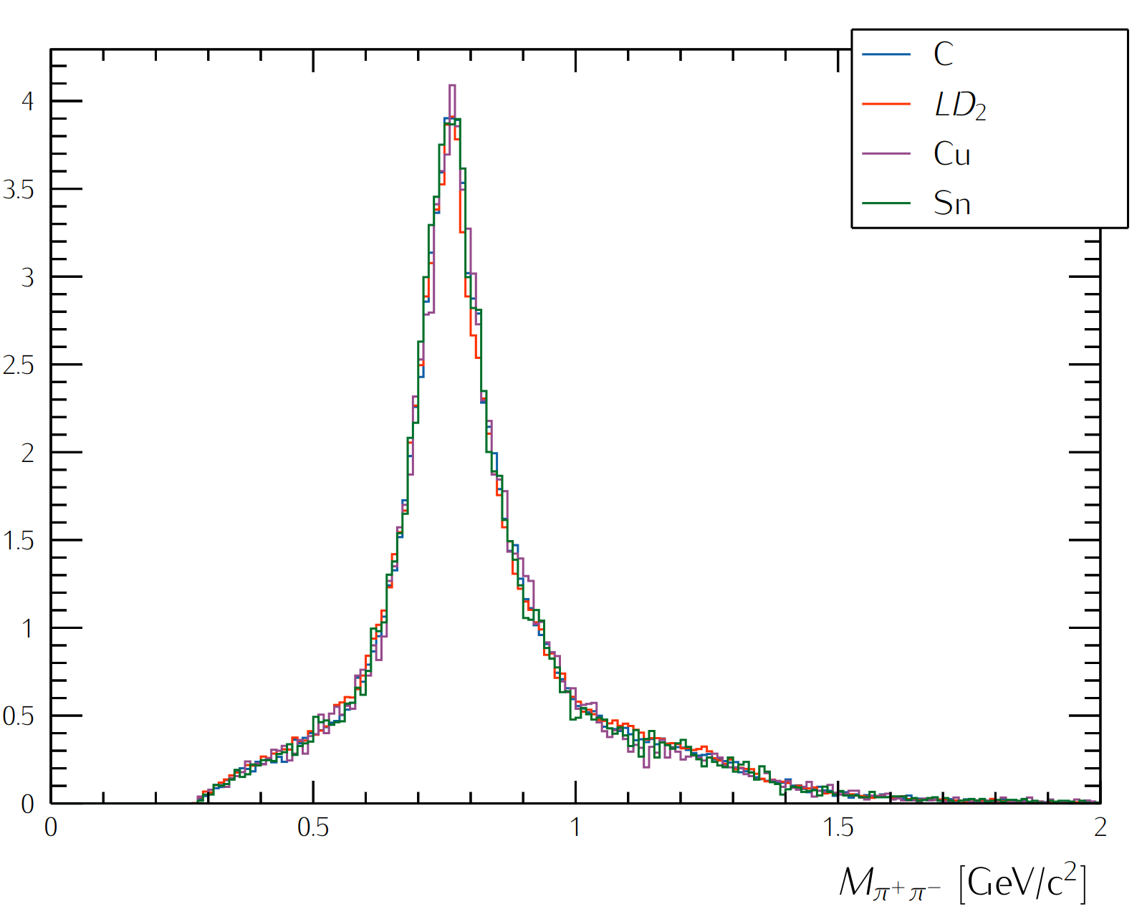
CT Study: Two-pion Invariant Mass

Slide 14
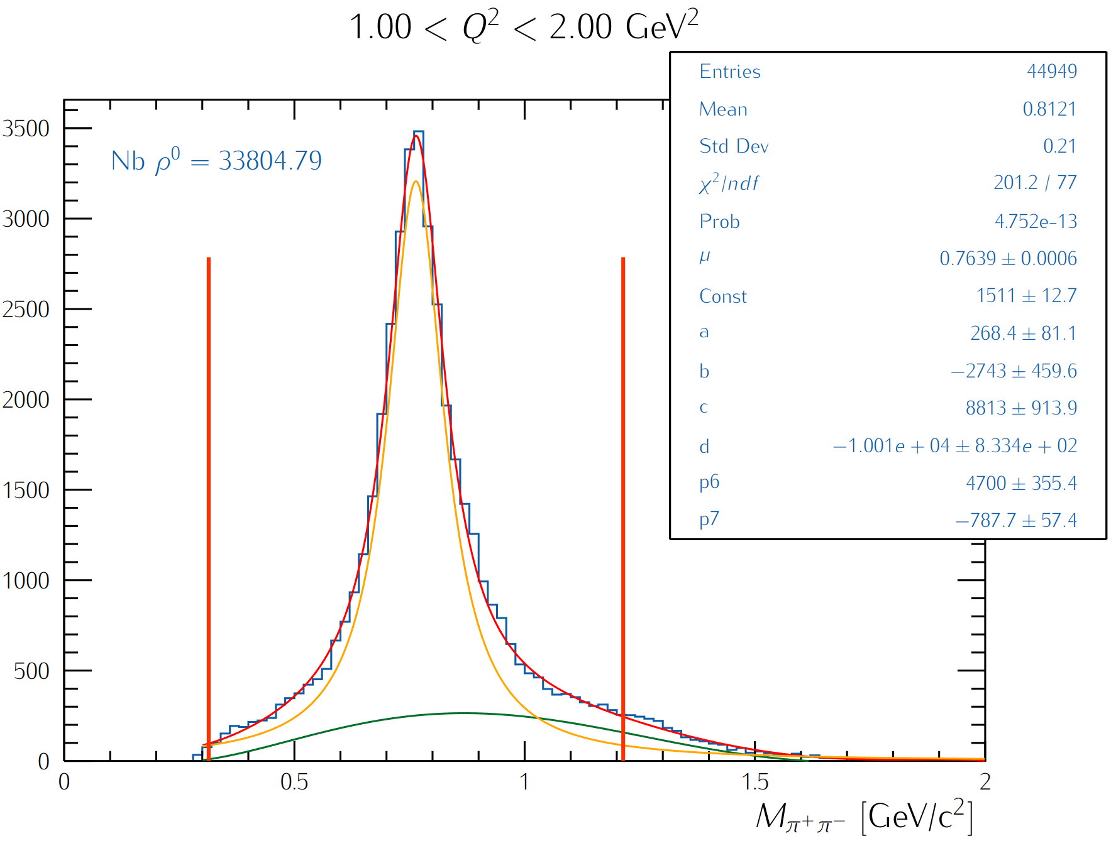
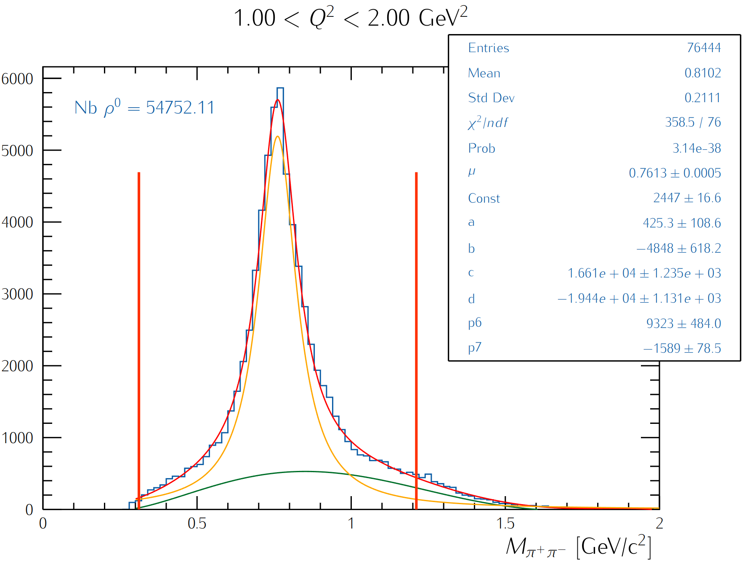
CT Study: Two-pion Invariant Mass
Fit the invariant mass shapes for the two-oppositely charged pions with a Breit-Wigner and five-order polynomial function (the latter will be replaced with the simulated background shape)
Extract ρ⁰ yield by integrating the background-subtracted BW within a 3σ range
Carbon data
LD2 data

Slide 15
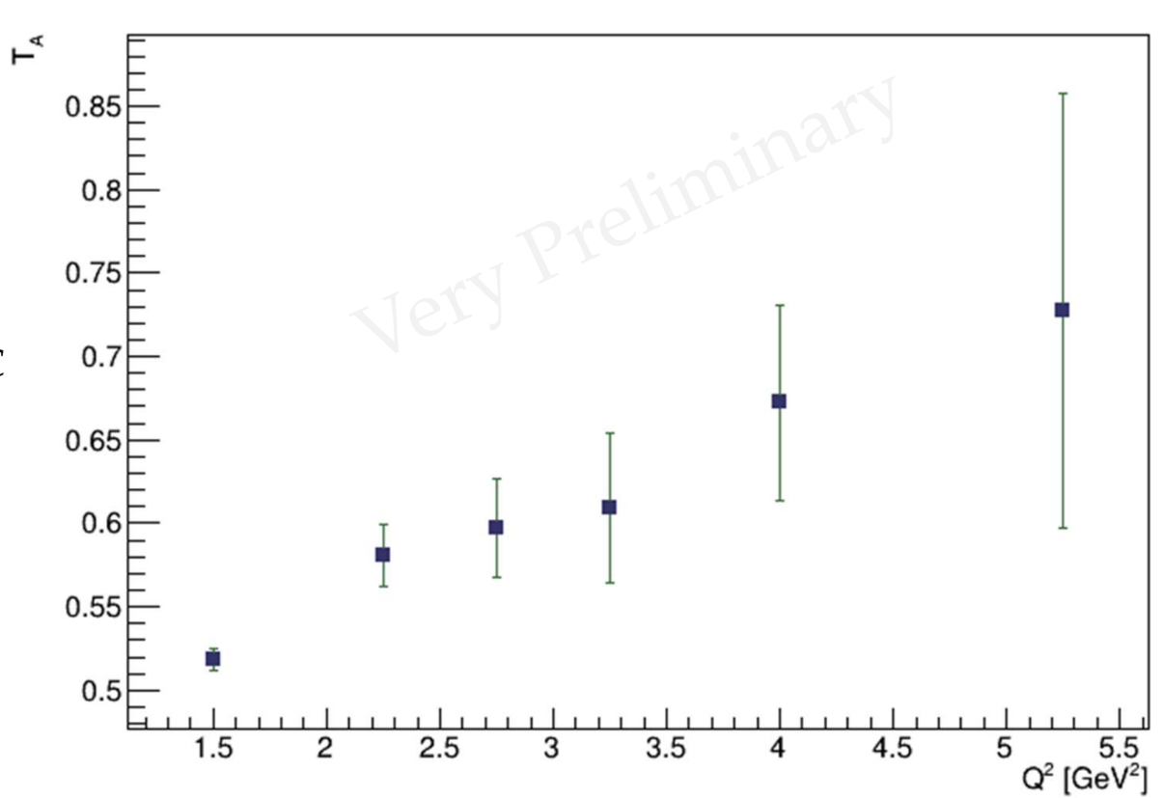
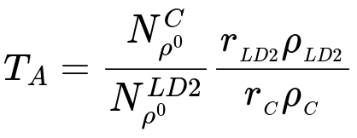
RG-D Color Transparency Study
Extract the nuclear transparency:
r_{LD2}= 5 cm: LD2 thickness
r_{CxC} = 0.4 cm: is CxC thickness
ρ_{LD2}= 0.164 g/cm³: LD2 density
ρ_{C}= 2.2g/cm³ : carbon density
Ongoing analysis by M. Maynes

Slide 16
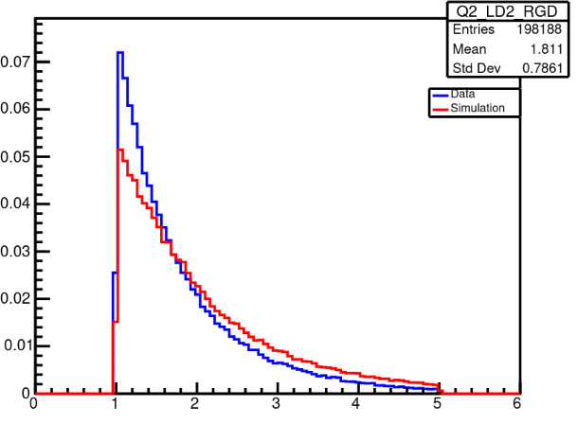
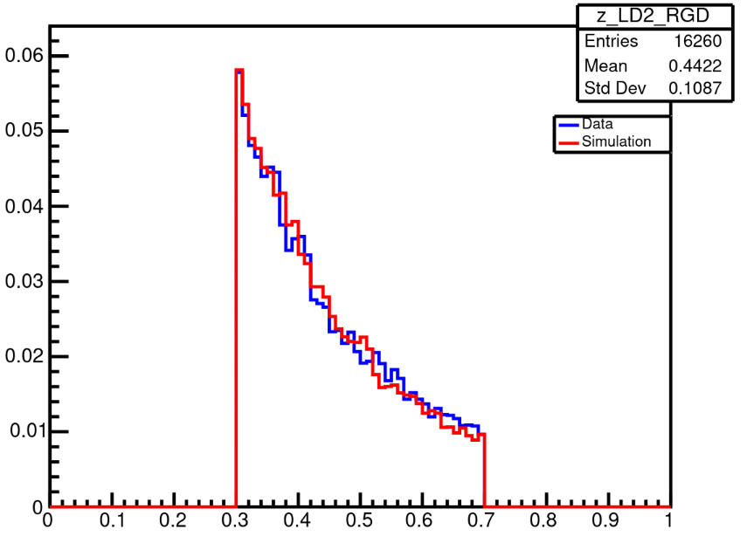
RG-D nTMDs Studies: Positively-charged Pion
Ongoing simulation efforts: preliminary results
Simulations are produced using modified version of Pythia
Comparing experimental data to simulation
Analysis by D. Matamoros
LD2
LD2
Q² [GeV²]
z_{h}
Parallel nTMDs analysis for charged pions by S. Shrestha

Slide 17
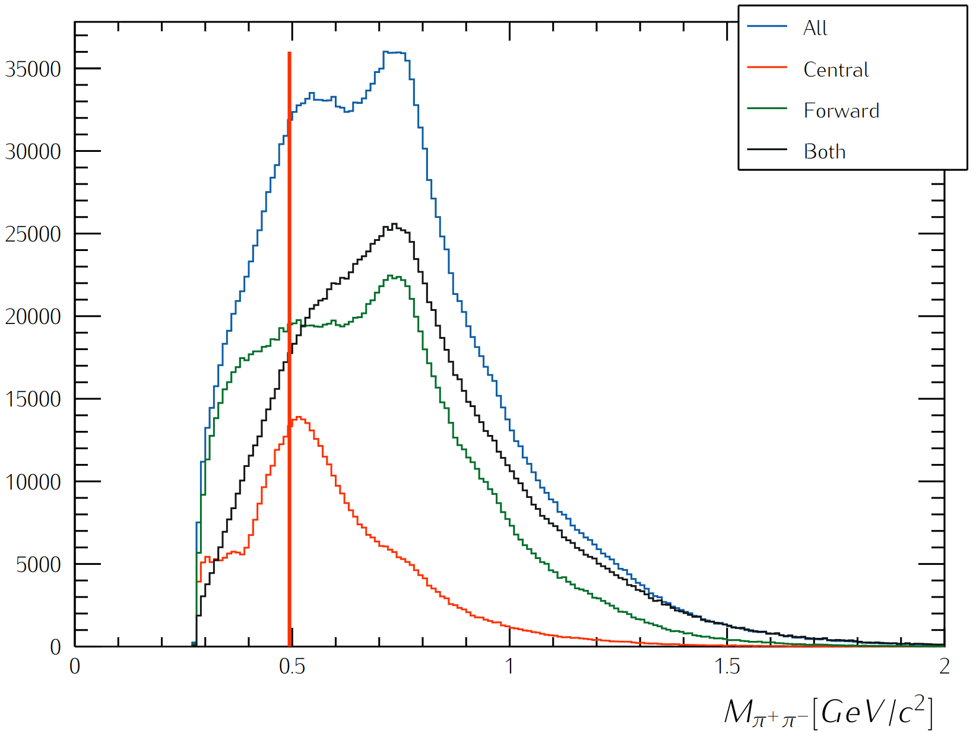
RG-D nTMDs Studies: K-short Channel
First look at the K⁰ channel to extract multiplicity ratios and azimuthal asymmetries:
In-progress studies to improve the two-pion invariant mass reconstruction in the mass region of interest
Kinematical cuts:
W> 2 GeV
Q²>1 GeV²
z_{h}< 0.7
|ΔVz| < 3 cm
by M. Ouillon

