Slide 1

Analysis and cooking status
Mathieu Ouillon (Mississippi State University)
18 December, 2024

Slide 2
Cooking status
Florian asked to cook:
The runs for T2D are (need at least 4M):
-inbending: 18321 (25M events), 18348 (10M events), 18369 (101M), 18388 (13M), 18331 (100M) (LD2)
-outbending: 19125, 18670, 18588 , 18846, 18937 , 19090 , 18522
Special DC runs 18309, 18310, 18311, 18312 with 1-2M events for individual T00 calibration.
It is hard to know in advance the number of events per file. Should I cook all the runs or 100 files, maybe?

Slide 3
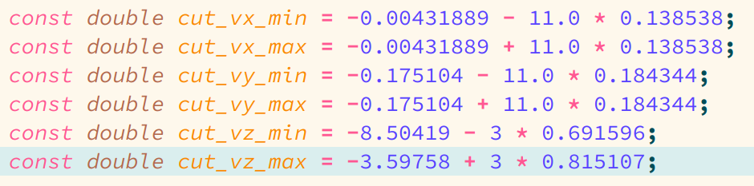
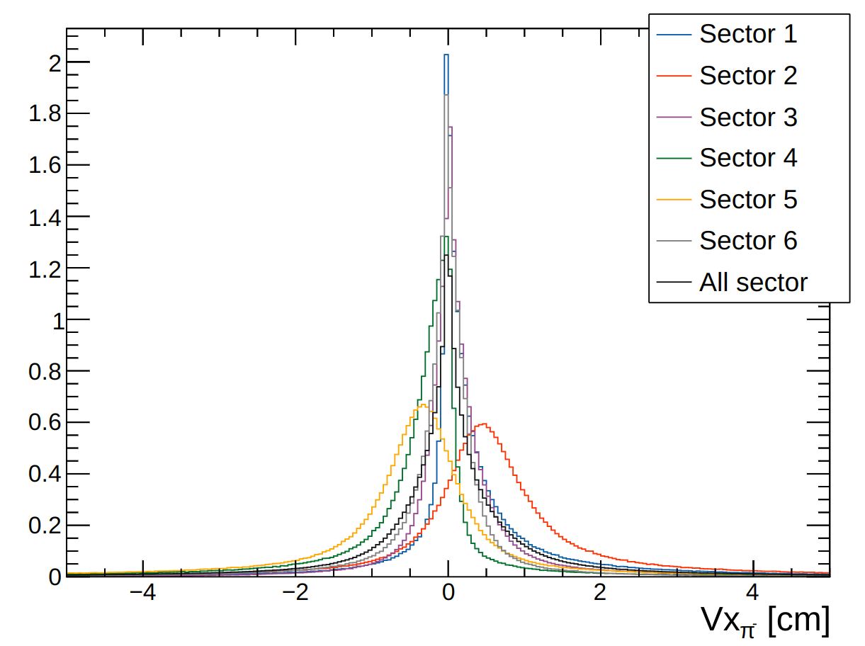
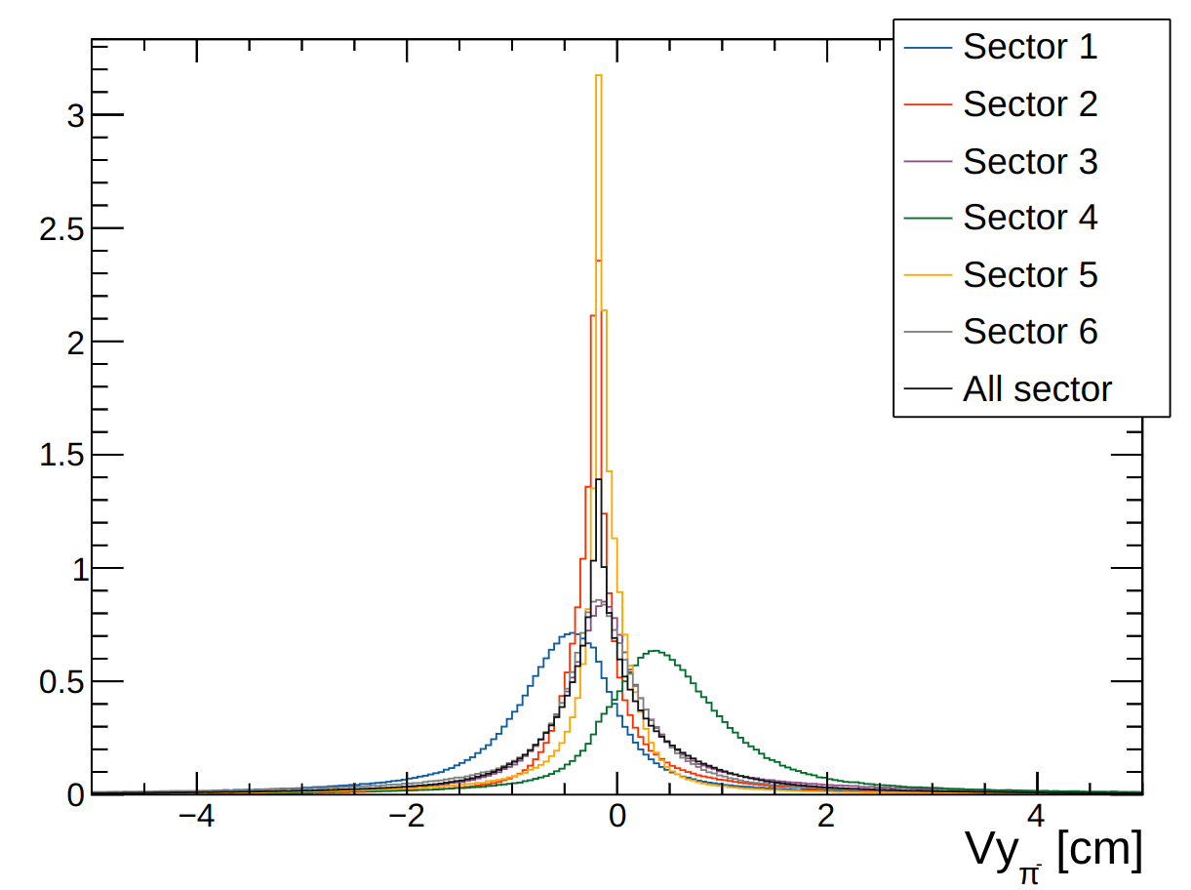
RG-D Vertex study: π⁻ in CxC
π⁻ after Vx, Vy and Vz cuts on the electron

Slide 4
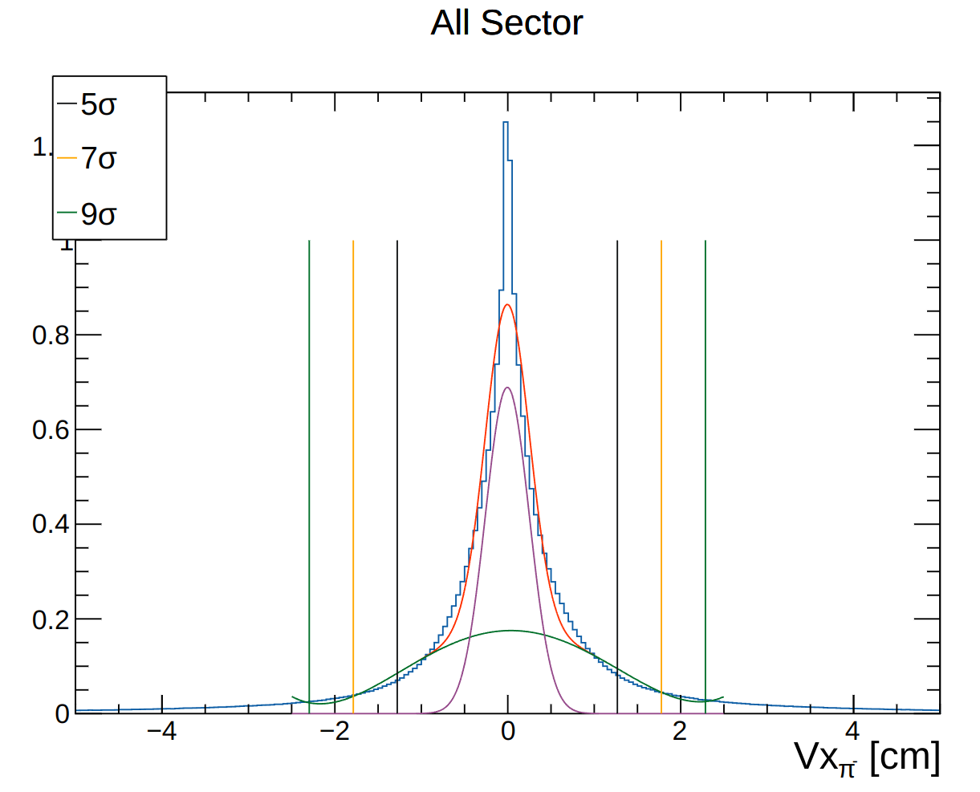
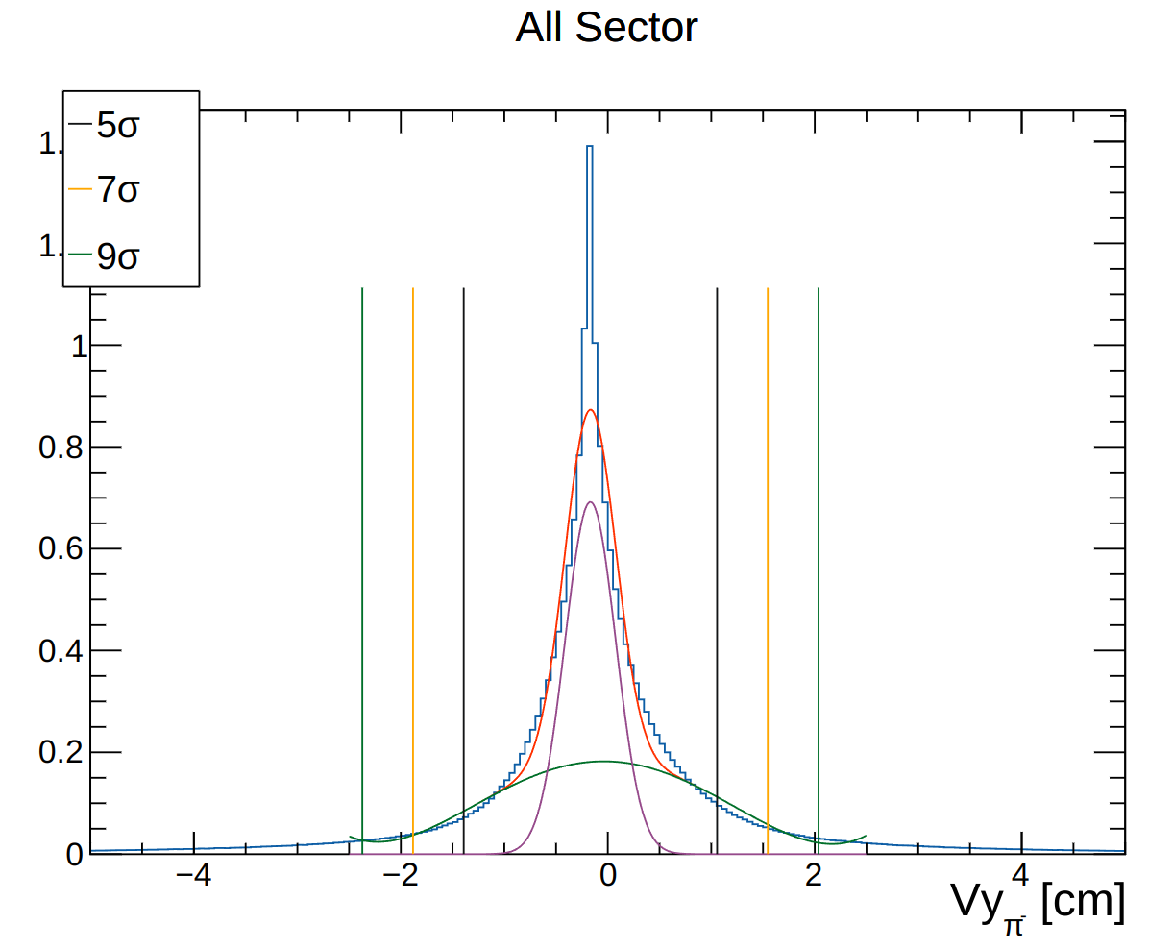
RG-D Vertex study: π⁻ in CxC

Slide 5
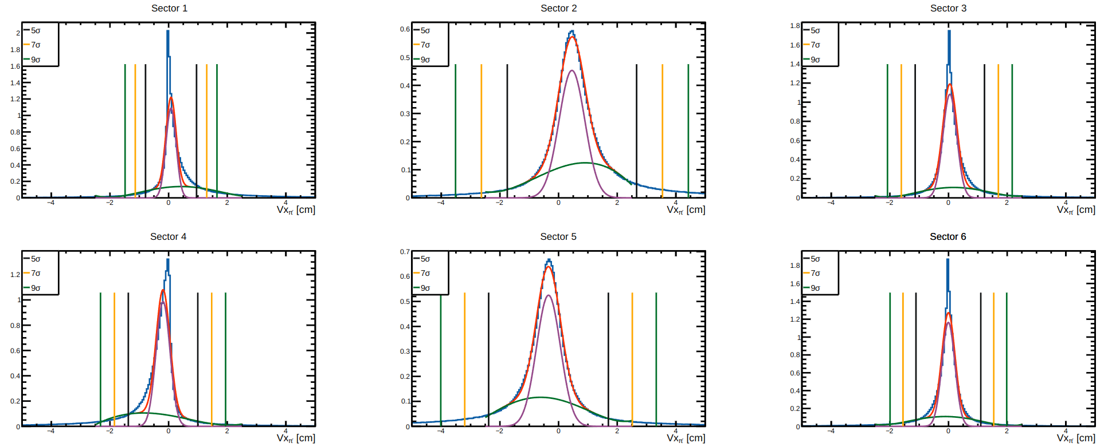
RG-D Vertex study: π⁻ in CxC

Slide 6
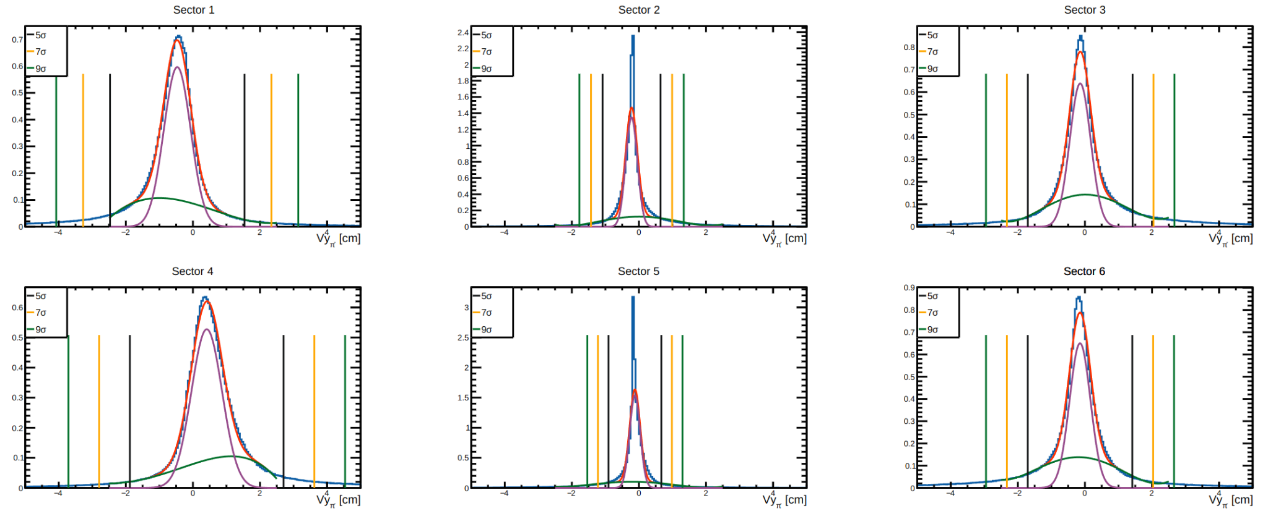
RG-D Vertex study: π⁻ in CxC

Slide 7
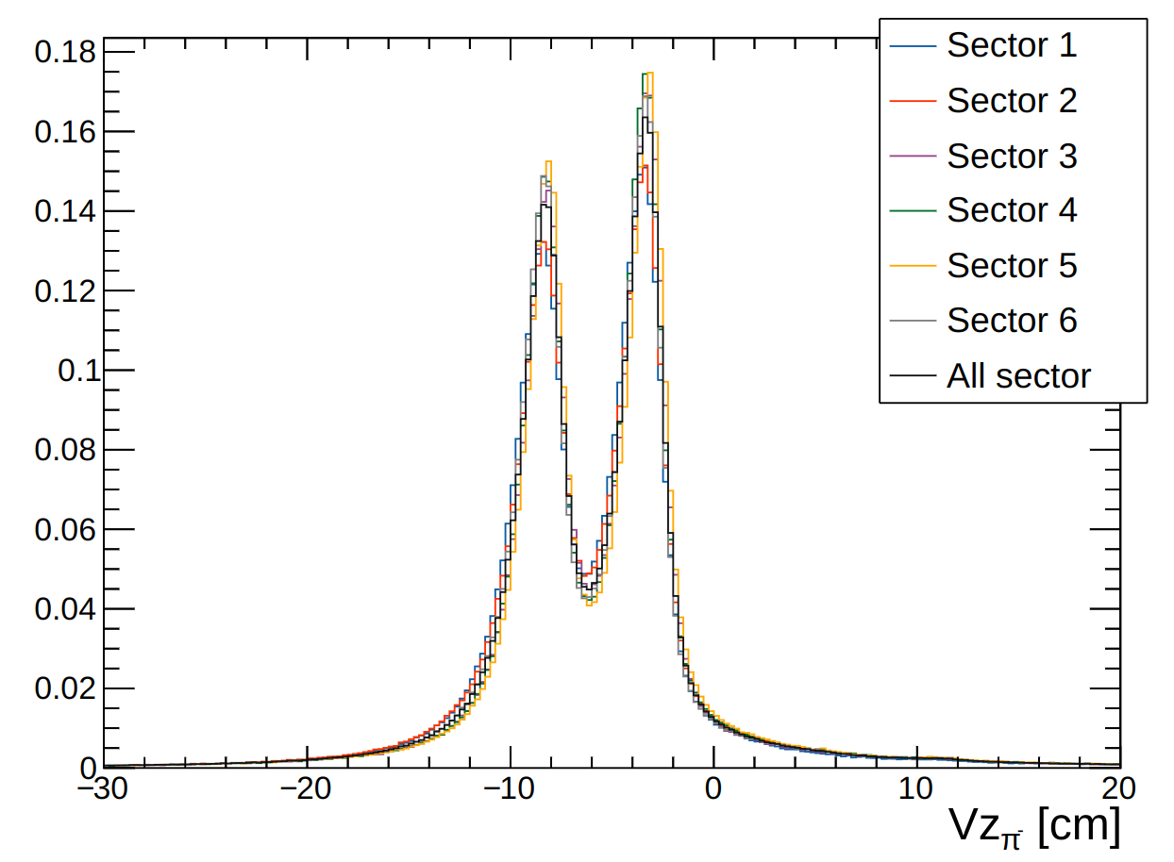
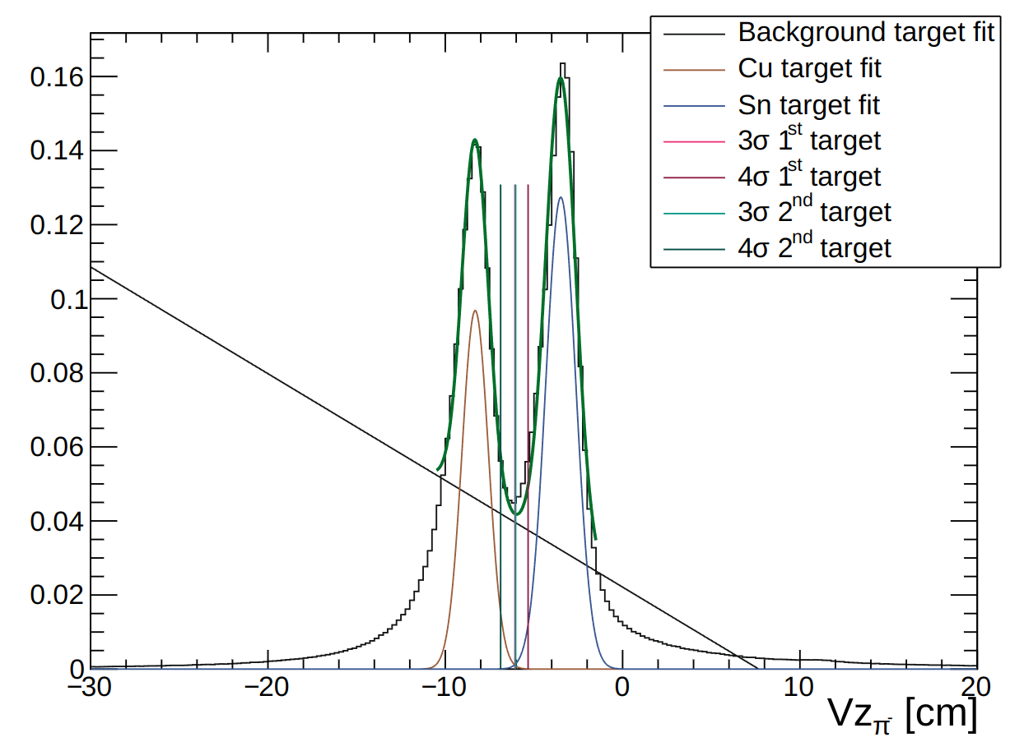
RG-D Vertex study: π⁻ in CxC

Slide 8
RG-D Vertex study: π⁻ in CxC
 | Vx |  | Vy
 | Mean [cm] | Sigma [cm] | Mean [cm] | Sigma [cm]
Sector independant | -0.00514765 | 0.254569 | -0.167978 | 0.244907
Sector 1 | 0.0823251 | 0.174071 | -0.466764 | 0.401006
Sector 2 | 0.456328 | 0.441058 | -0.219773 | 0.172871
Sector 3 | 0.0449543 | 0.236303 | -0.14104 | 0.312123
Sector 4 | -0.189492 | 0.236972 | 0.412643 | 0.458341
Sector 5 | -0.343068 | 0.408256 | -0.119481 | 0.157631
Sector 6 | -0.00472142 | 0.220994 | -0.146407 | 0.311463
 |  | Mean [cm] | Sigma [cm]
Vz | first foil | -8.31203 | 0.745773
 | second foil | -3.48624 | 0.848342

Slide 9
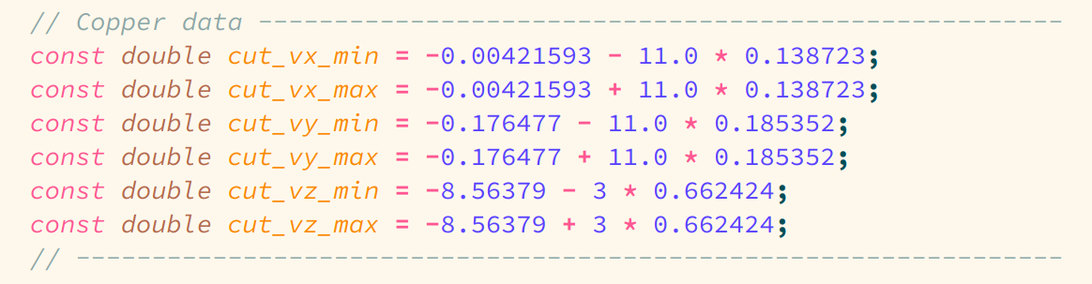
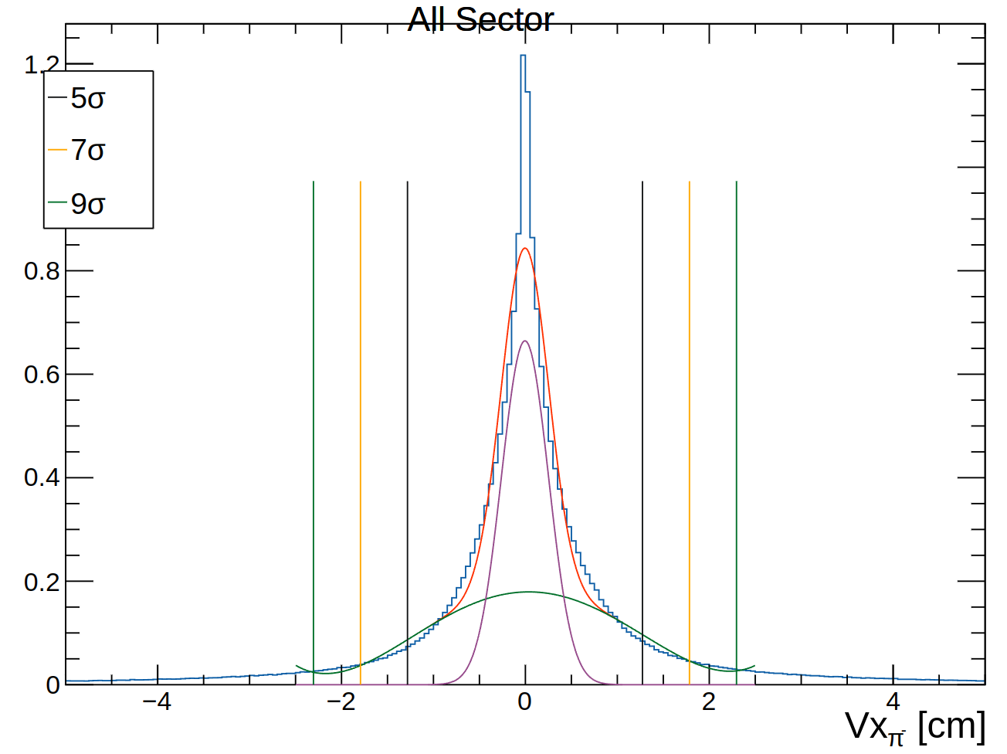
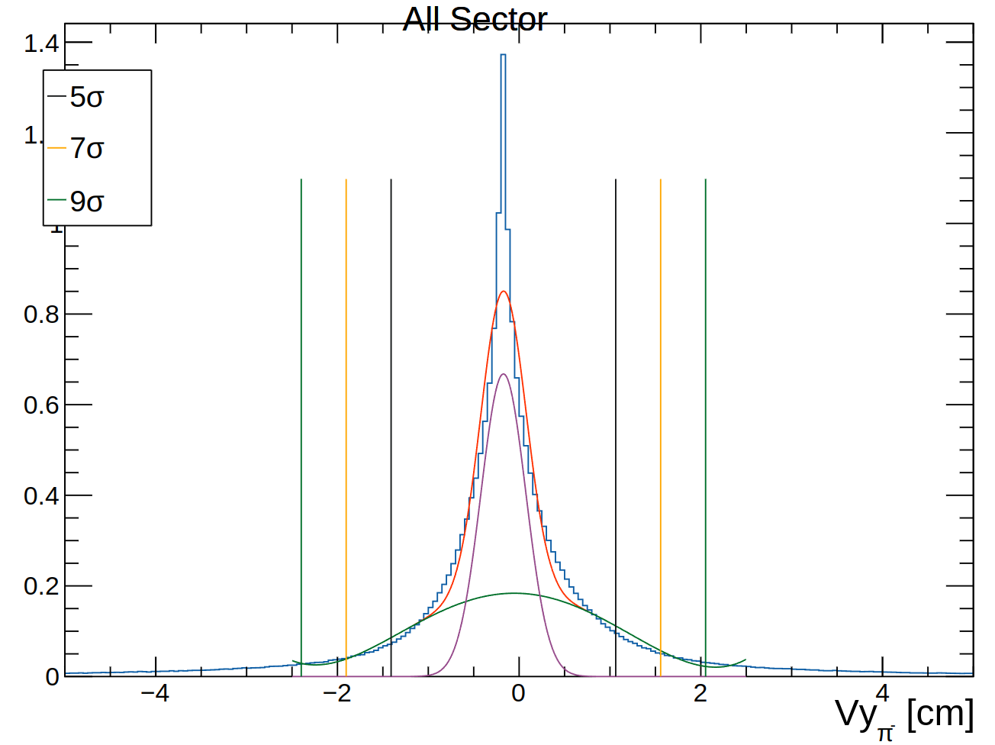
RG-D Vertex study: π⁻ in Cu
π⁻ after Vx, Vy and Vz cuts on the electron

Slide 10
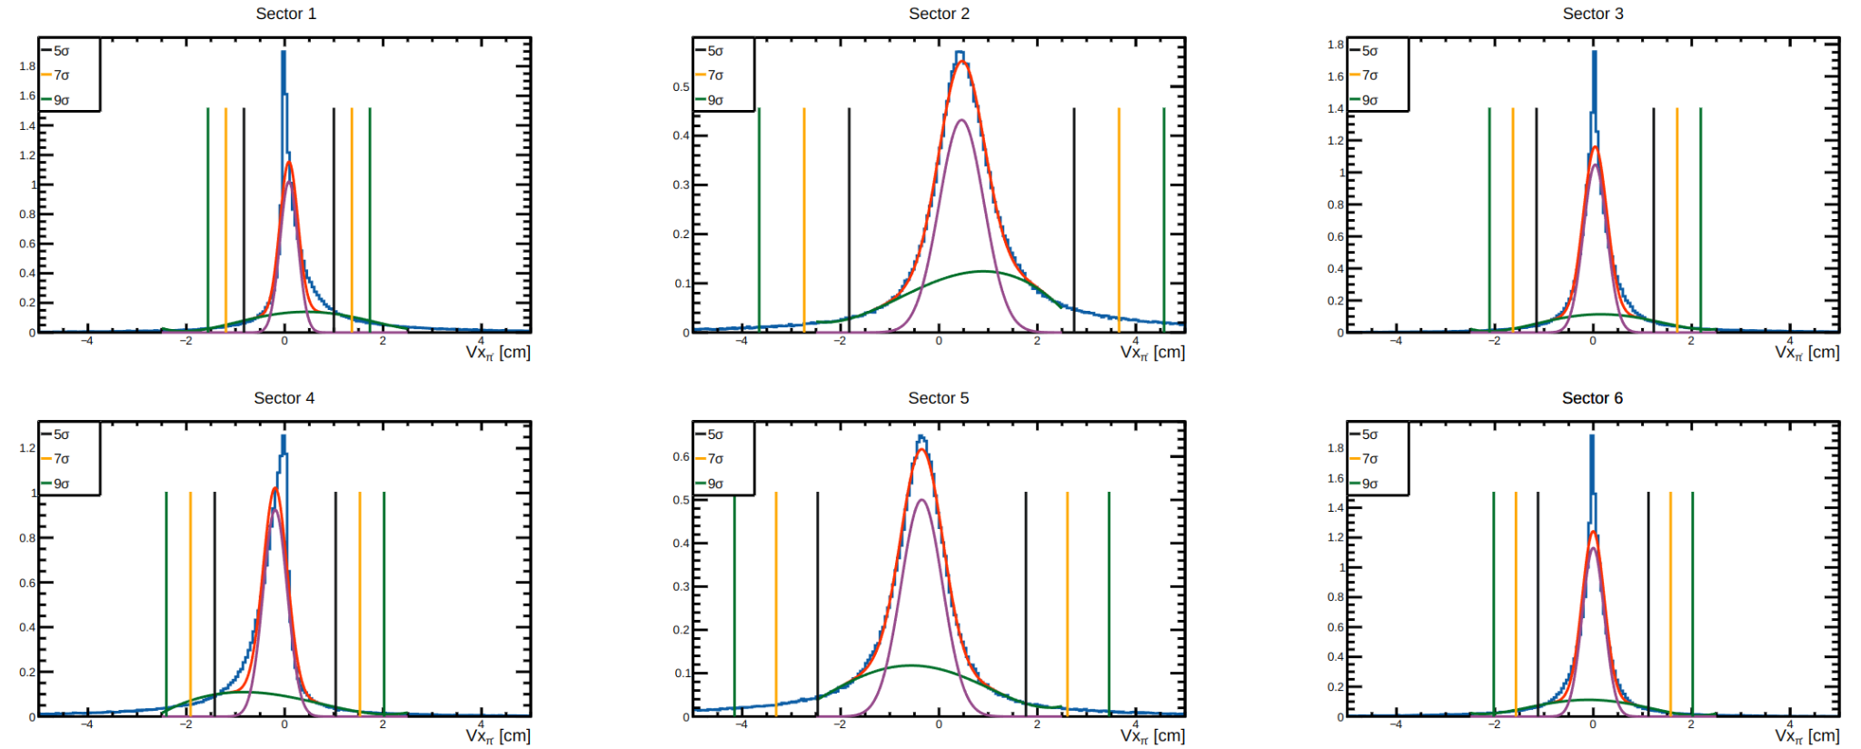
RG-D Vertex study: π⁻ in Cu

Slide 11
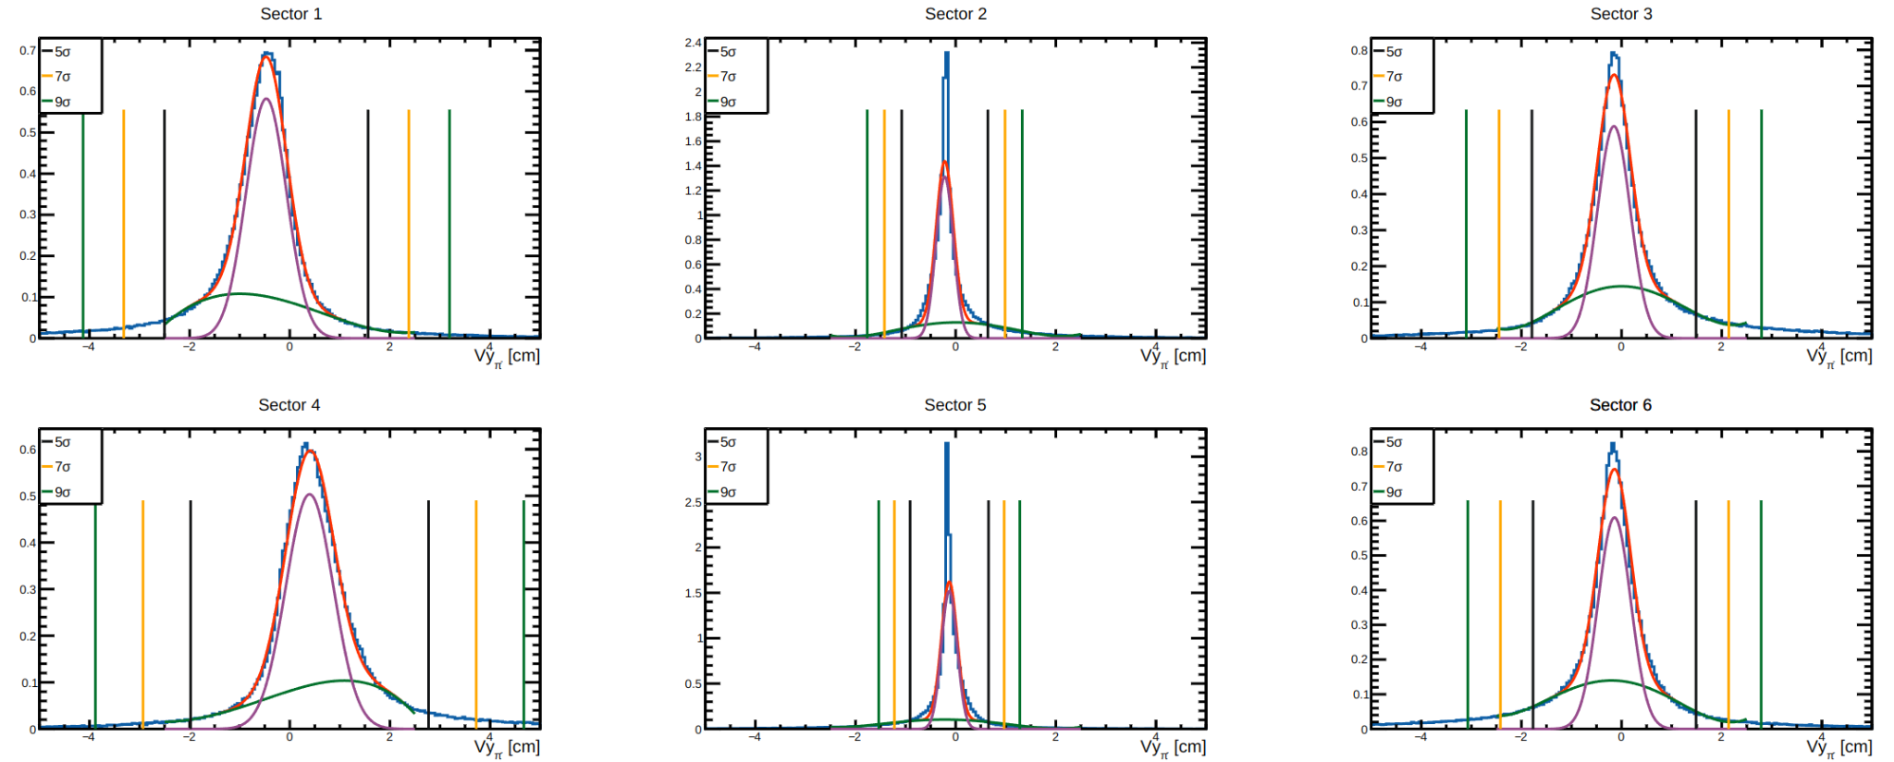
RG-D Vertex study: π⁻ in Cu

Slide 12
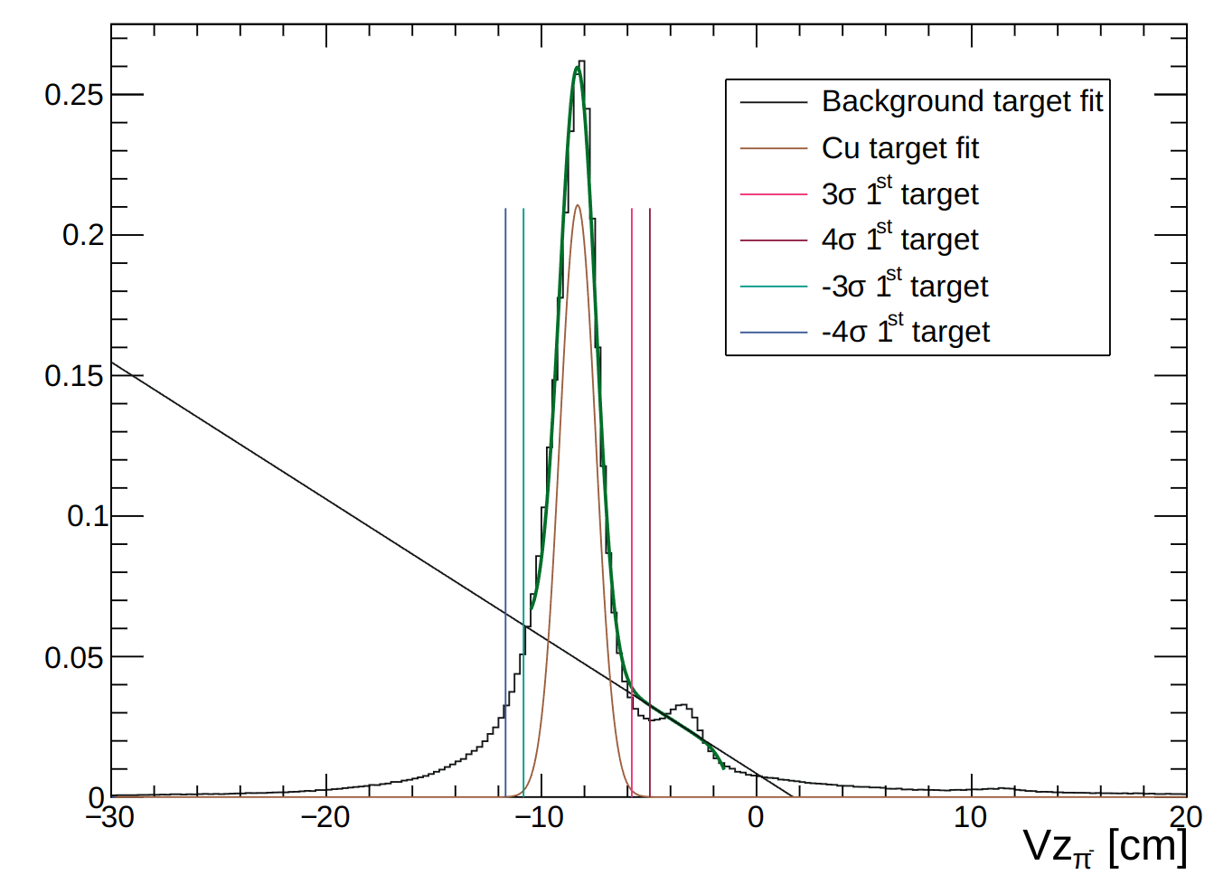
RG-D Vertex study: π⁻ in Cu
I have code for Sn target also and also π⁺

Slide 13
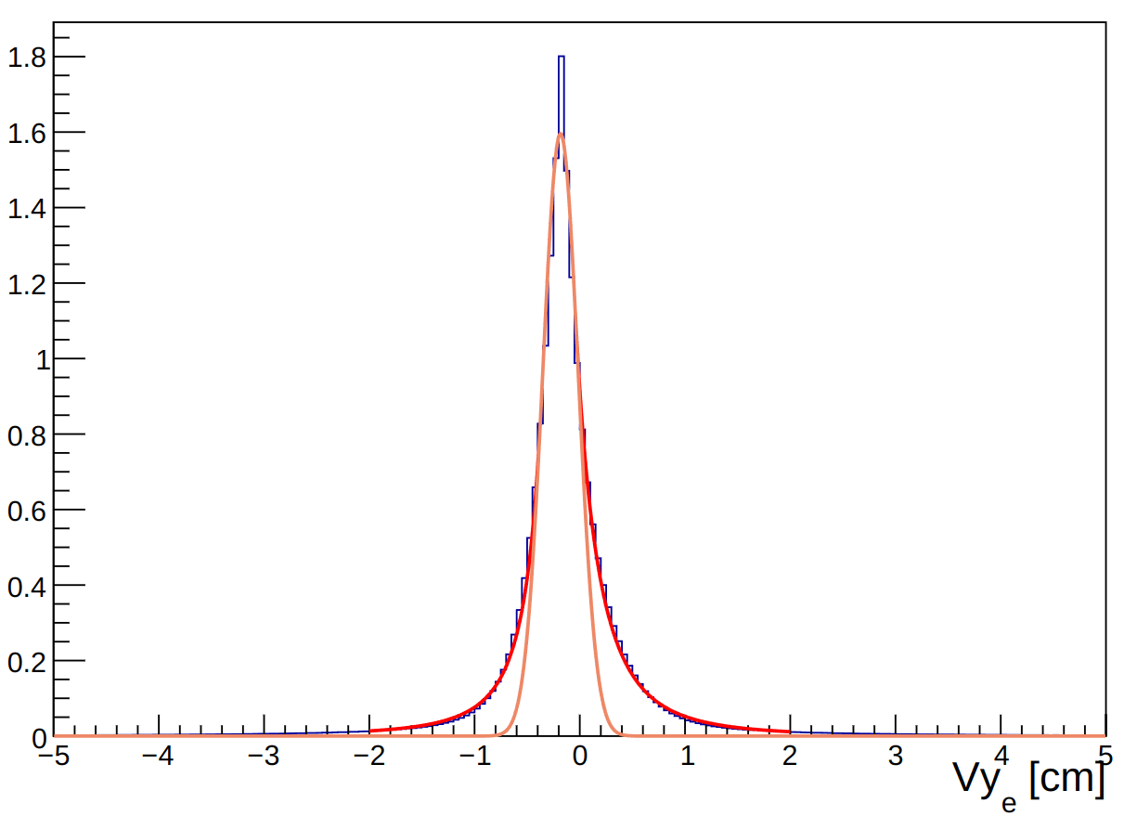
RG-D Vertex study: electron
Fit with double-sided Crystal Ball function.
Function from here
Draw the gaussian

