Slide 1

Analysis and cooking status
Mathieu Ouillon (Mississippi State University)
08 January, 2025

Slide 2
RG-D: Vertex study
Use Pass0v7 data, select an event with a trigger electron with pid=11 and status<0
Charged pions identified with pid=211 and pid=-211.
Strategy:
Plot Vx and Vy distribution for the electron, fit to get mean and sigma, cut at 11 sigma.
Plot Vz distribution for the electron, fit to get mean and sigma for the entrance/exit of the LD2 target and the mean and sigma for the CxC or CuSn targets, cut a 3 sigma to remove contamination for the LD2 target, and separate Cu and Sn target + cut at 5 cm to remove scattering chamber.
Plot Vx and Vy distribution for the charged pion, fit to get mean and sigma, cut at 11 sigma.
Plot Vz distribution for the charged pion, fit to get 2 mean and sigma for the CxC target or 1 mean and sigma for the Cu and Sn target.

Slide 3
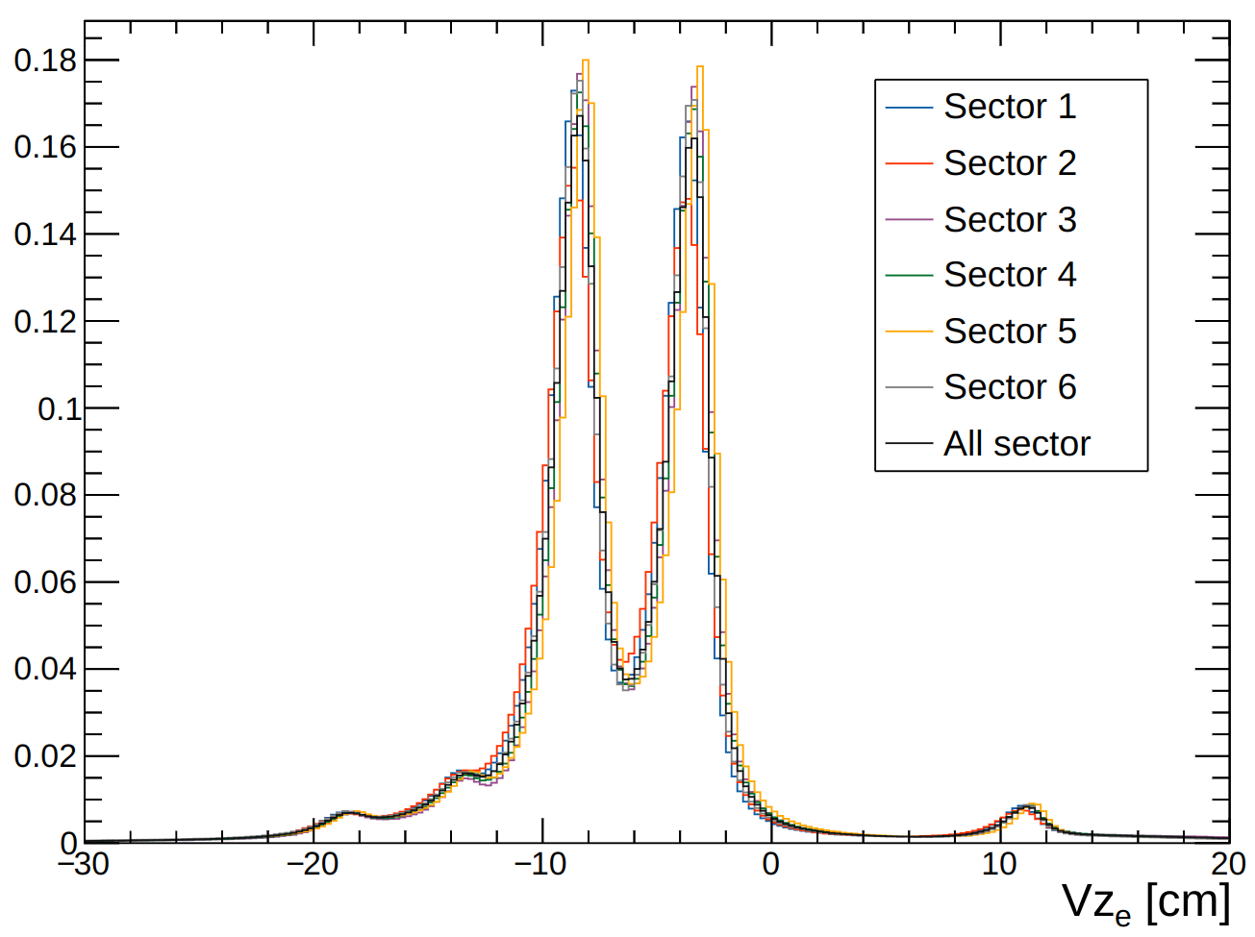
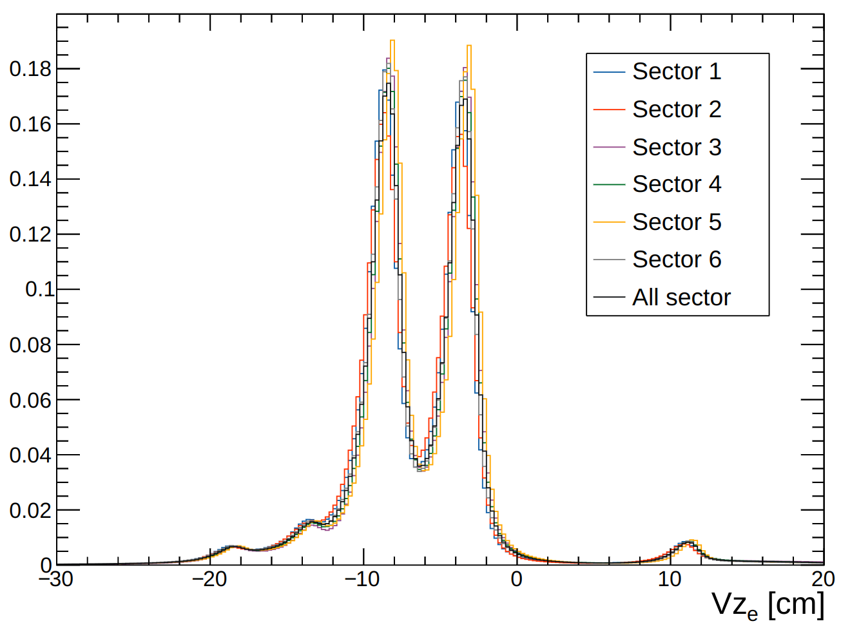
RG-D: Vertex study: Carbon
Electron before Vx and Vy cuts
Electron after Vx and Vy cuts
Normalizations for the two plots are differents

Slide 4
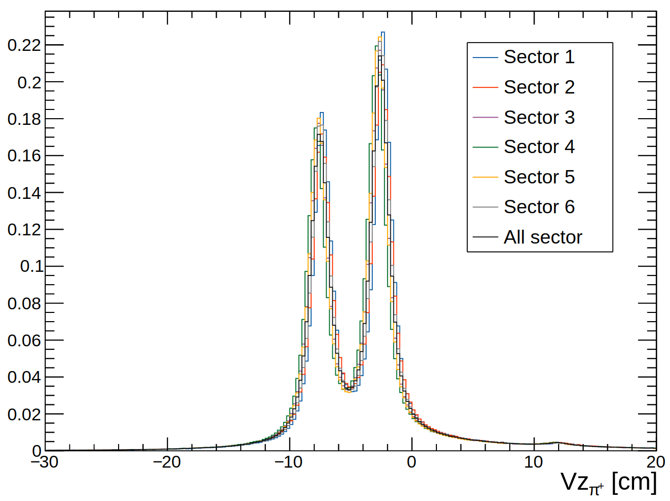
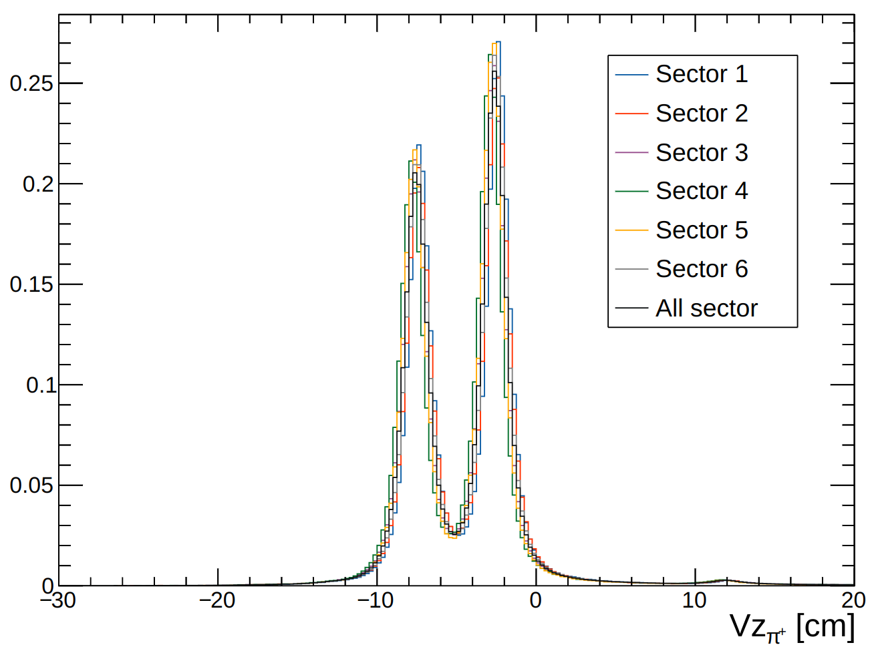
RG-D: Vertex study: Carbon
𝛑⁺ before Vx and Vy cuts but after e⁻ cuts
𝛑⁺ after Vx and Vy cuts and after e⁻ cuts
Normalizations for the two plots are differents

Slide 5
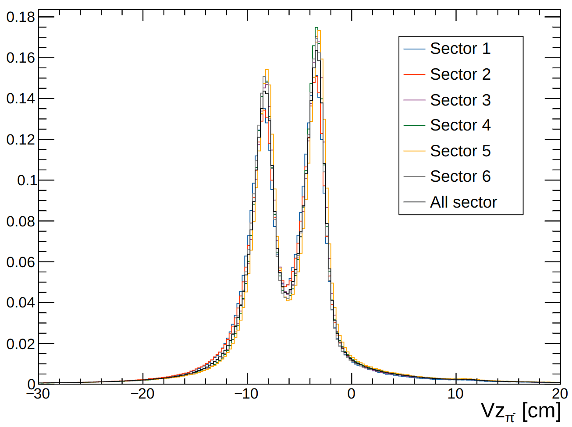
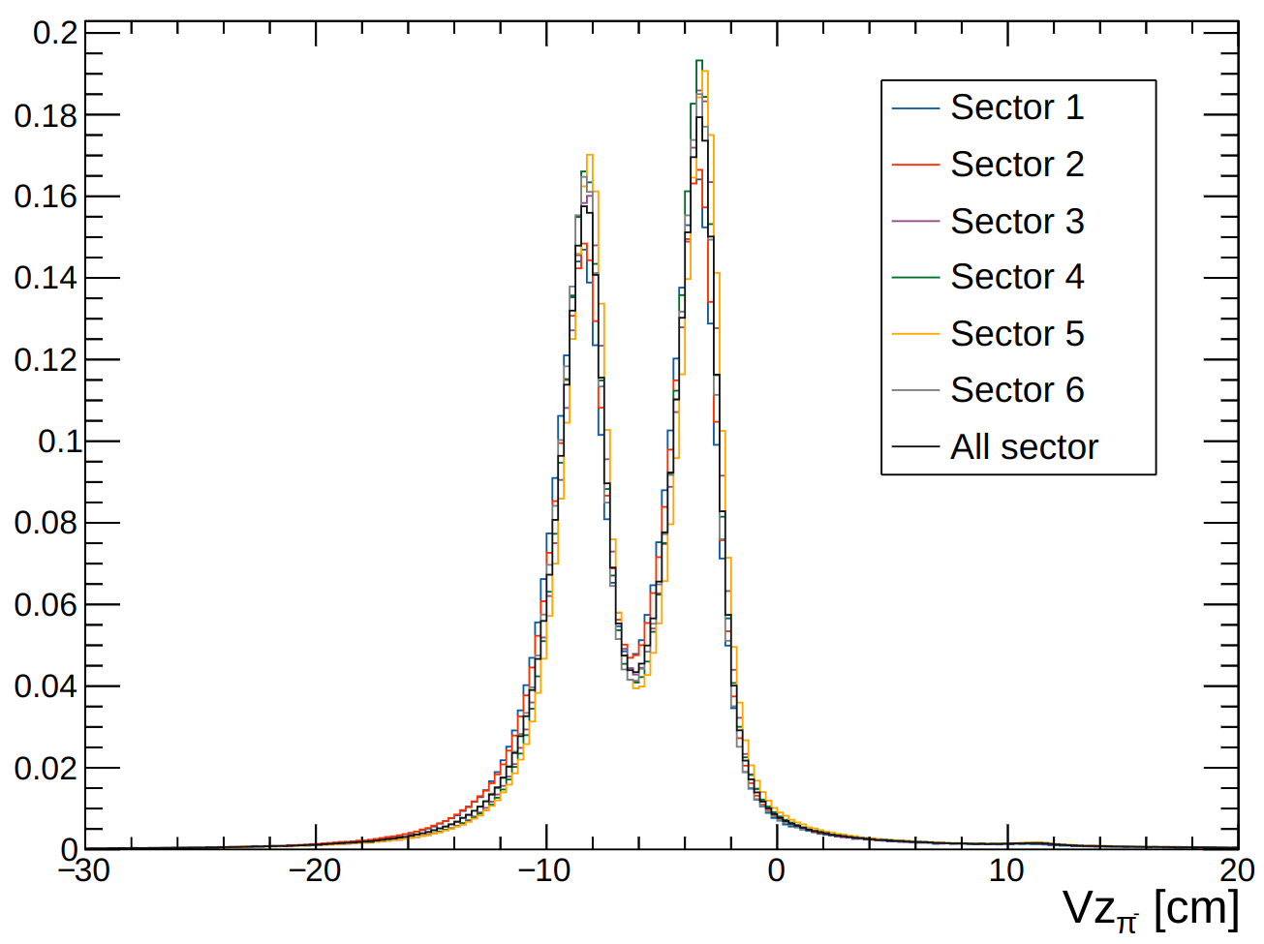
RG-D: Vertex study: Carbon
𝛑⁻ before Vx and Vy cuts but after e⁻ cuts
𝛑⁻ after Vx and Vy cuts and after e⁻ cuts
Normalizations for the two plots are differents

Slide 6
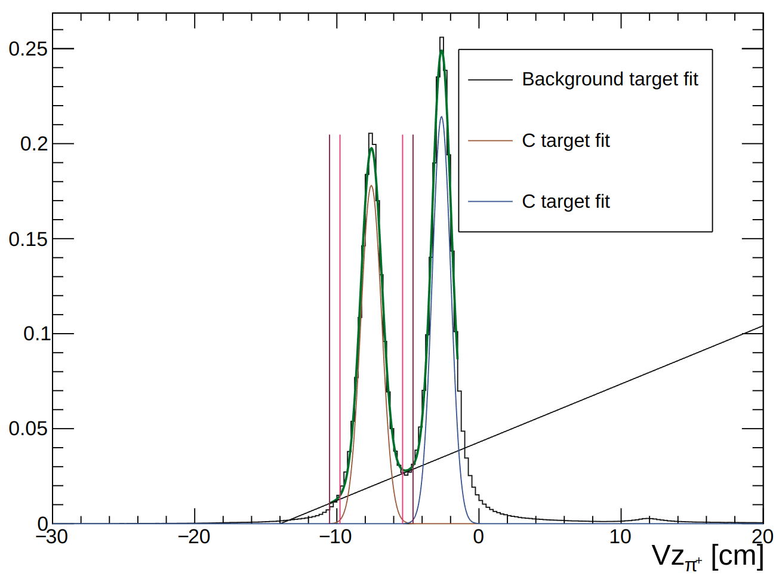
RG-D: Vertex study: Carbon
For the Carbon target only, we don’t need to cut on Vz for the charged pions. We can take all the distributions.

