Slide 1

Analysis and cooking status
Mathieu Ouillon (Mississippi State University)
22 January, 2025

Slide 2
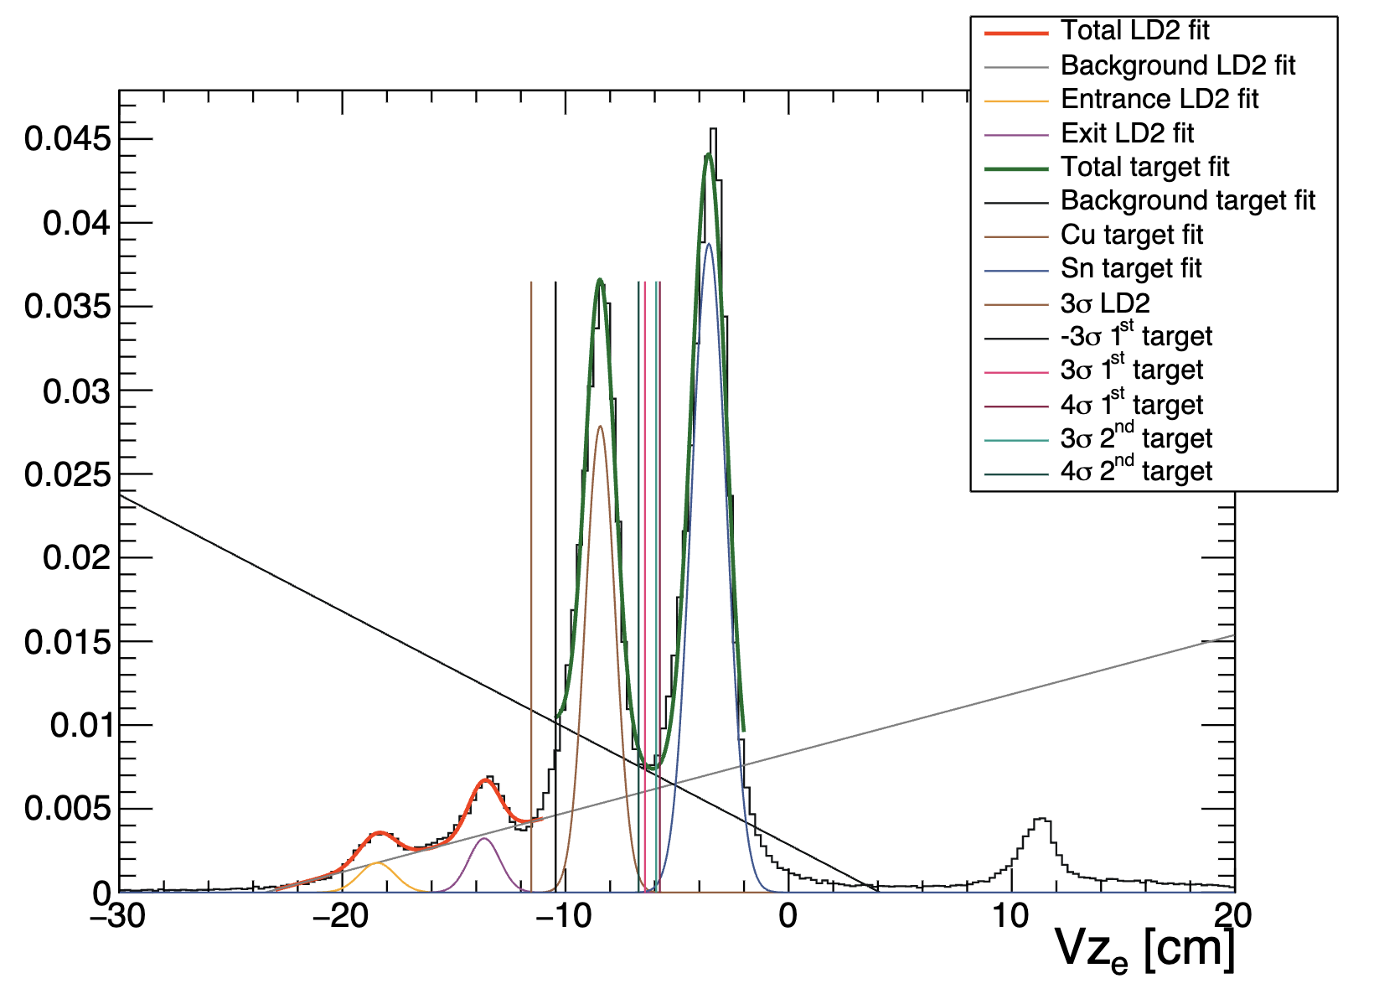
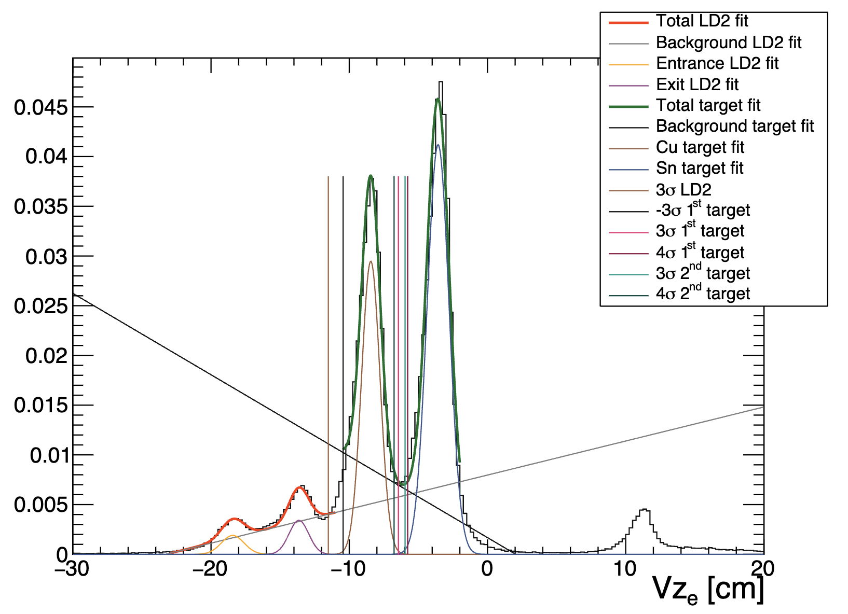
Vertex study: Vz with and without Vx and Vy cuts
Use Pass0v7 data, run 018563, 018564, and 018565, CuSn target
Check the effect of Vx and Vy cuts on Vz for the electron:
without Vx and Vy cuts
with Vx and Vy cuts

Slide 3
Vertex study: vz with and without Vx and Vy cuts
without Vx and Vy cuts:
μ₁:-8.44092 cm, μ₂:-3.57345 cm
𝜎₁:0.666788 cm, 𝜎₂:0.787793 cm
with Vx and Vy cuts:
μ₁:-8.4429 cm, μ₂:-3.5734 cm
𝜎₁:0.666602 cm, 𝜎₂:0.796239 cm
Small difference between, can remove at least for the electron, the Vx and Vy cuts.
Check on the charged pions.

Slide 4
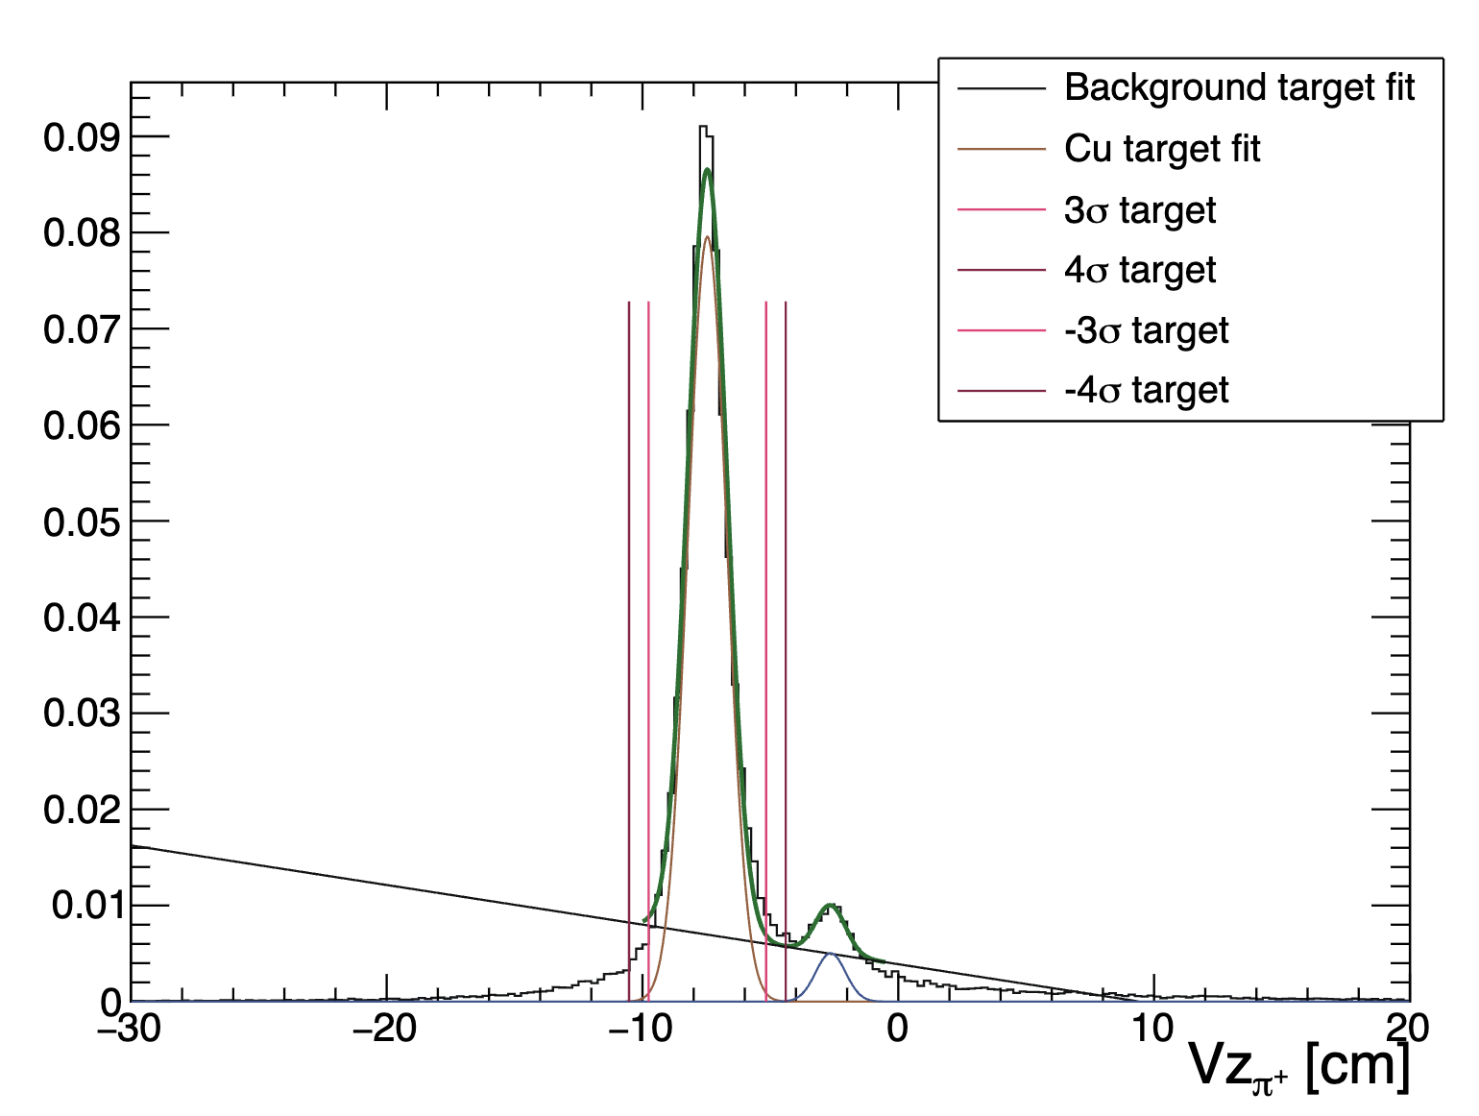
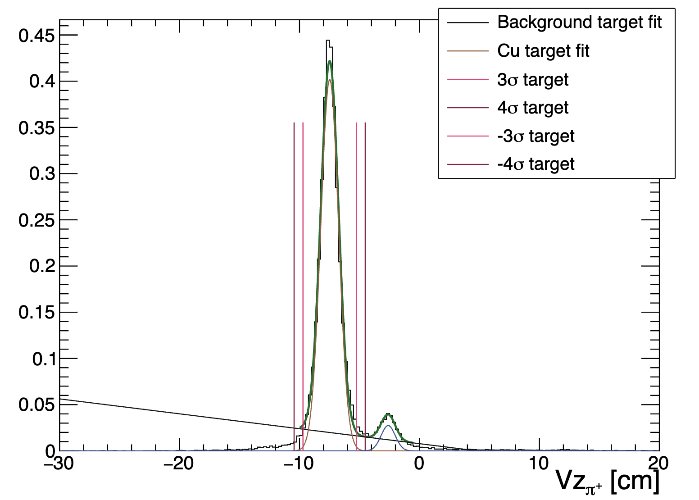
Vertex study: Vz with and without Vx and Vy cuts, π⁺
Use Pass0v7 data, run 018563, 018564, and 018565, Cu target
Check the effect of Vx and Vy cuts on Vz for the π⁺:
without Vx and Vy cuts
with Vx and Vy cuts

Slide 5
Vertex study: Vz with and without Vx and Vy cuts, π⁺
without Vx and Vy cuts:
μ₁:-7.46329 cm, μ₂:-2.64484 cm
𝜎₁:0.765496 cm, 𝜎₂:0.582904 cm
with Vx and Vy cuts:
μ₁:-7.48404 cm, μ₂:-2.60837 cm
𝜎₁:0.741636 cm, 𝜎₂:0.588712 cm
Small difference between, can remove at least for the electron, the Vx and Vy cuts.
However, there was a reduction in the number of events from 10 to 15%.

Slide 6
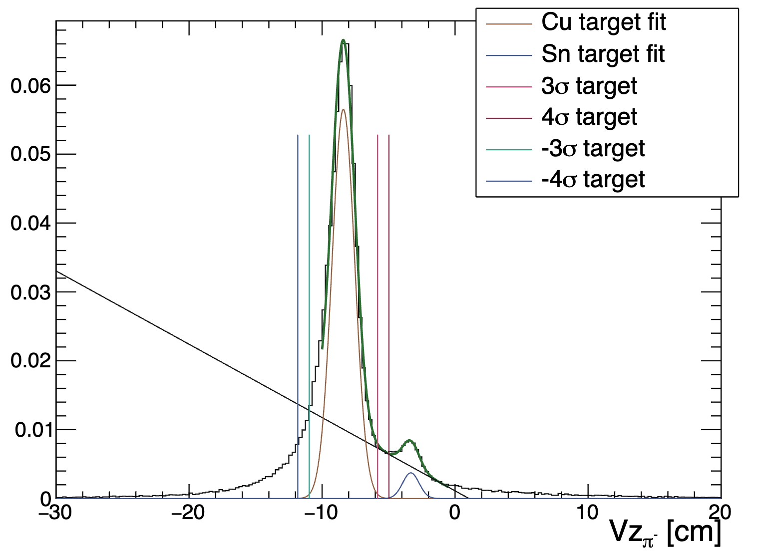
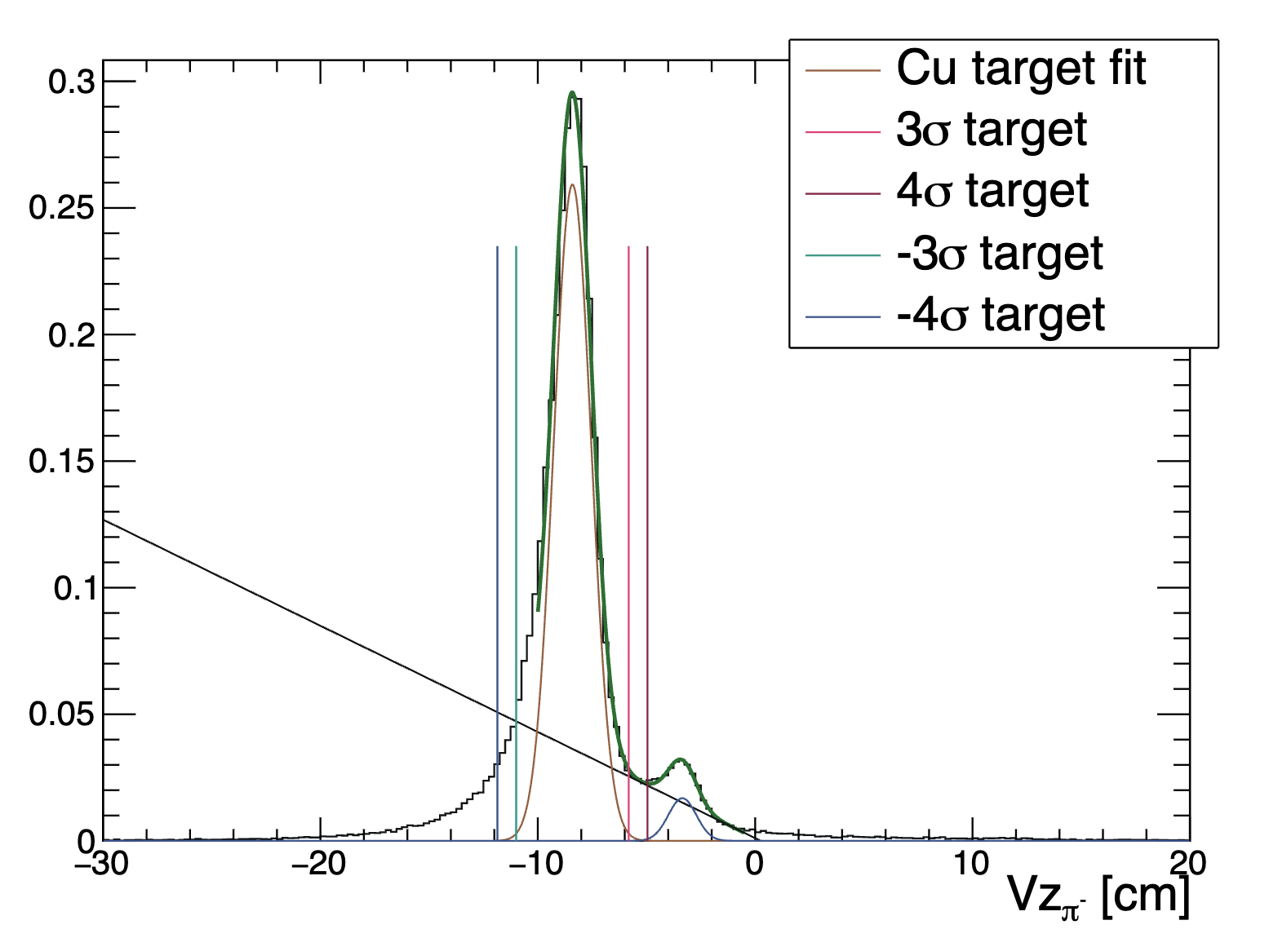
Vertex study: Vz with and without Vx and Vy cuts, π⁻
Use Pass0v7 data, run 018563, 018564, and 018565, Cu target
Check the effect of Vx and Vy cuts on Vz for the π⁻:
without Vx and Vy cuts
with Vx and Vy cuts

Slide 7
Vertex study: Vz with and without Vx and Vy cuts, π⁻
without Vx and Vy cuts:
μ₁:-8.40478 cm, μ₂:-3.34964 cm
𝜎₁:0.863088 cm, 𝜎₂:0.642865 cm
with Vx and Vy cuts:
μ₁:-8.39617 cm, μ₂:-3.32516 cm
𝜎₁:0.85648 cm, 𝜎₂:0.615739 cm
Small difference between, can remove at least for the electron, the Vx and Vy cuts.
However, there was a reduction in the number of events from 10 to 15%.

Slide 8
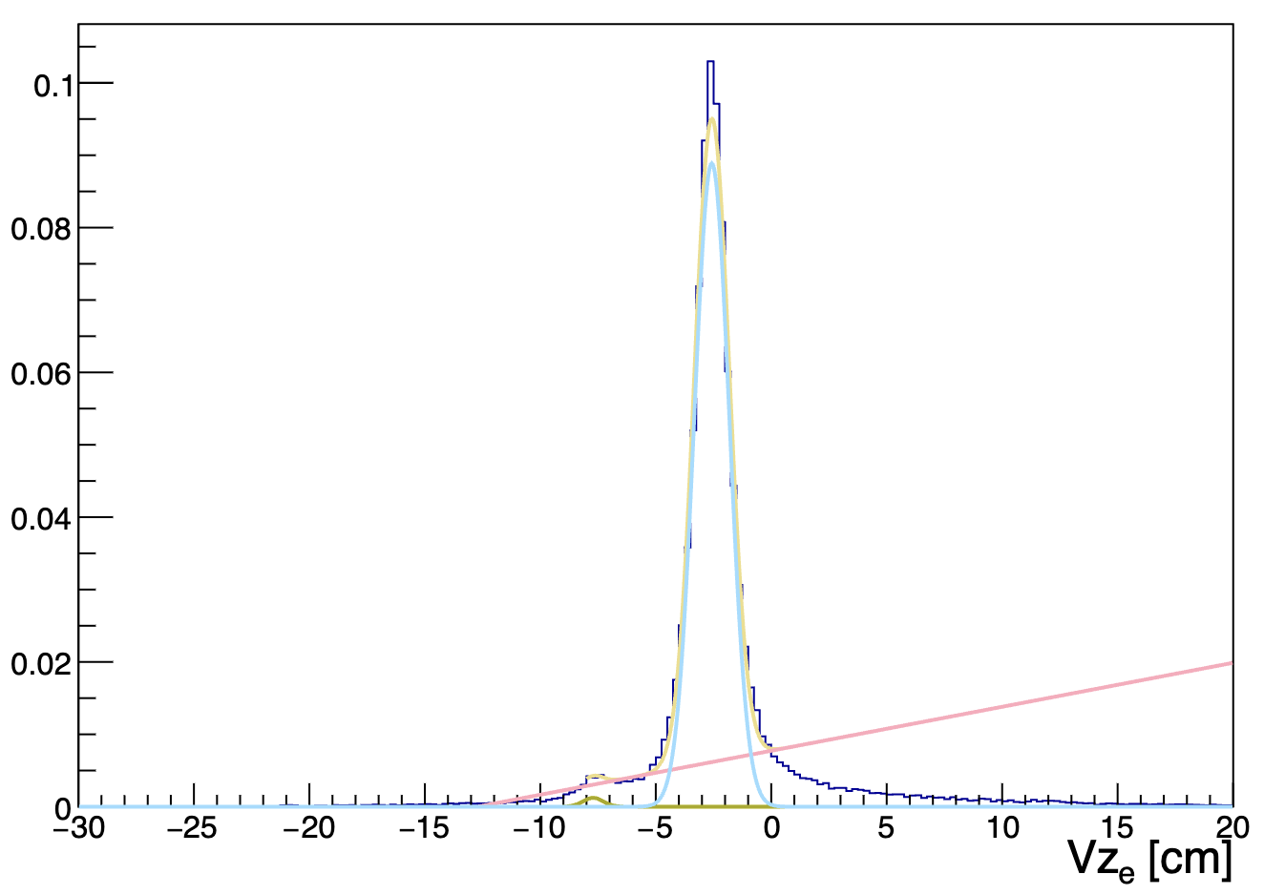
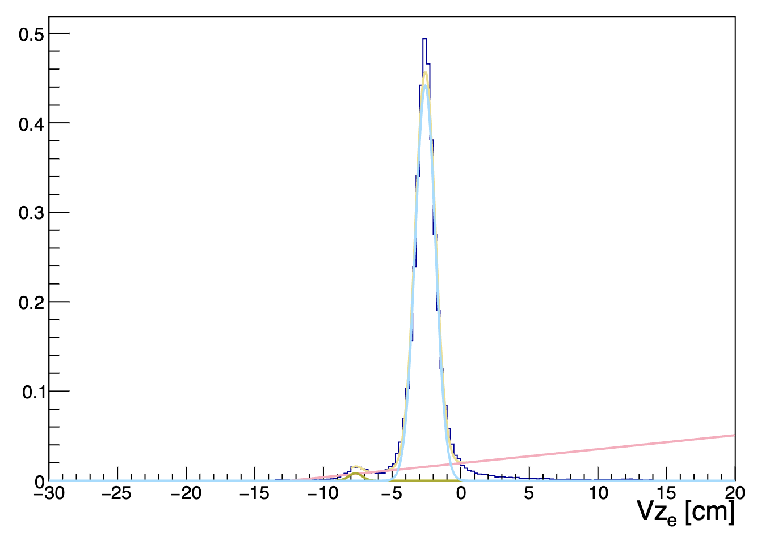
Vertex study: Vz with and without Vx and Vy cuts, π⁺
Use Pass0v7 data, run 018563, 018564, and 018565, Sn target
Check the effect of Vx and Vy cuts on Vz for the π⁺:
without Vx and Vy cuts
with Vx and Vy cuts

Slide 9
Vertex study: Vz with and without Vx and Vy cuts, π⁺
without Vx and Vy cuts:
μ₁:-7.71096 cm, μ₂:-2.57297 cm
𝜎₁:0.437021 cm, 𝜎₂:0.758201 cm
with Vx and Vy cuts:
μ₁:-7.66705 cm, μ₂:-2.57891 cm
𝜎₁:0.435134 cm, 𝜎₂:0.736229 cm
Small difference between, can remove at least for the electron, the Vx and Vy cuts.
However, there was a reduction in the number of events from 10 to 15%.

Slide 10
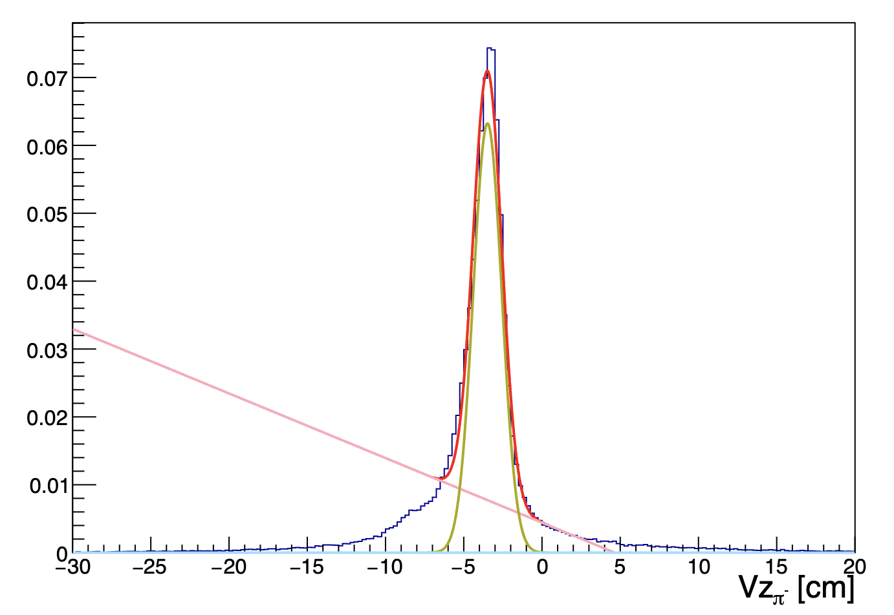
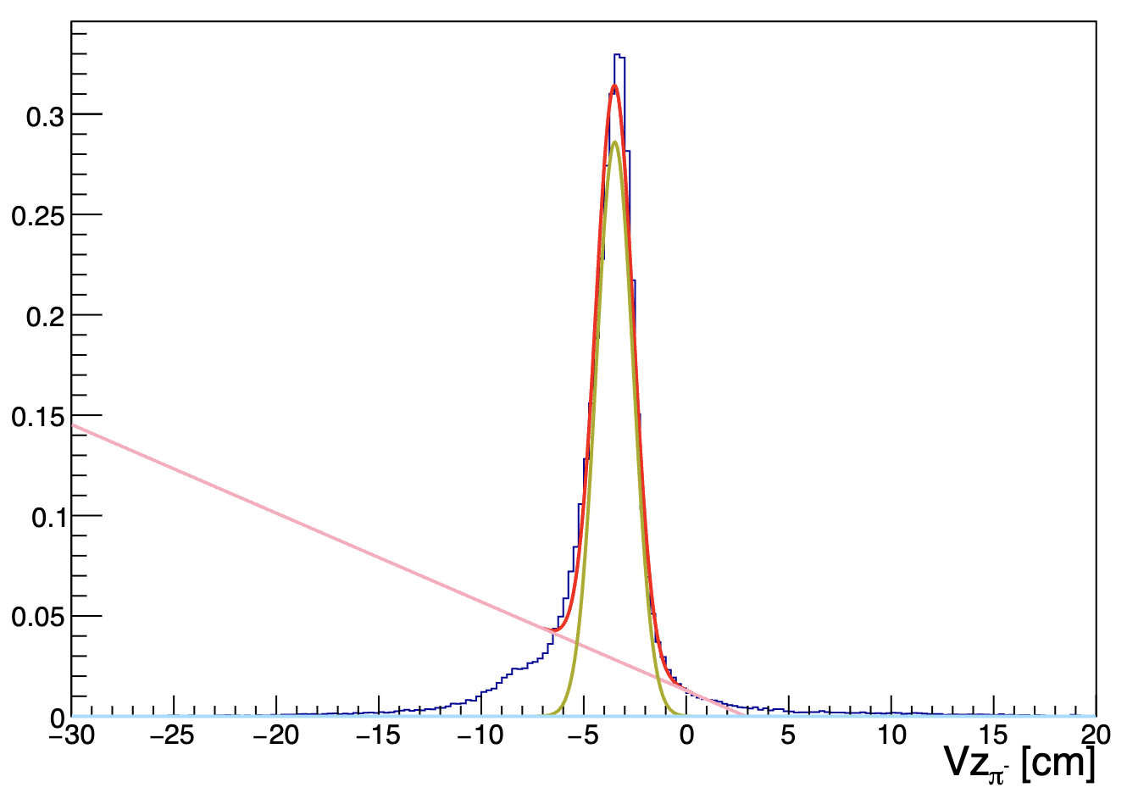
Vertex study: Vz with and without Vx and Vy cuts, π⁻
Use Pass0v7 data, run 018563, 018564, and 018565, Sn target
Check the effect of Vx and Vy cuts on Vz for the π⁻:
without Vx and Vy cuts
with Vx and Vy cuts

Slide 11
Vertex study: Vz with and without Vx and Vy cuts, π⁺
without Vx and Vy cuts:
μ₁:-3.48275 cm
𝜎₁:0.912229 cm
with Vx and Vy cuts:
μ₁:-3.48701 cm
𝜎₁:0.908826 cm
Small difference between, can remove at least for the electron, the Vx and Vy cuts.
However, there was a reduction in the number of events from 10 to 15%.

Slide 12
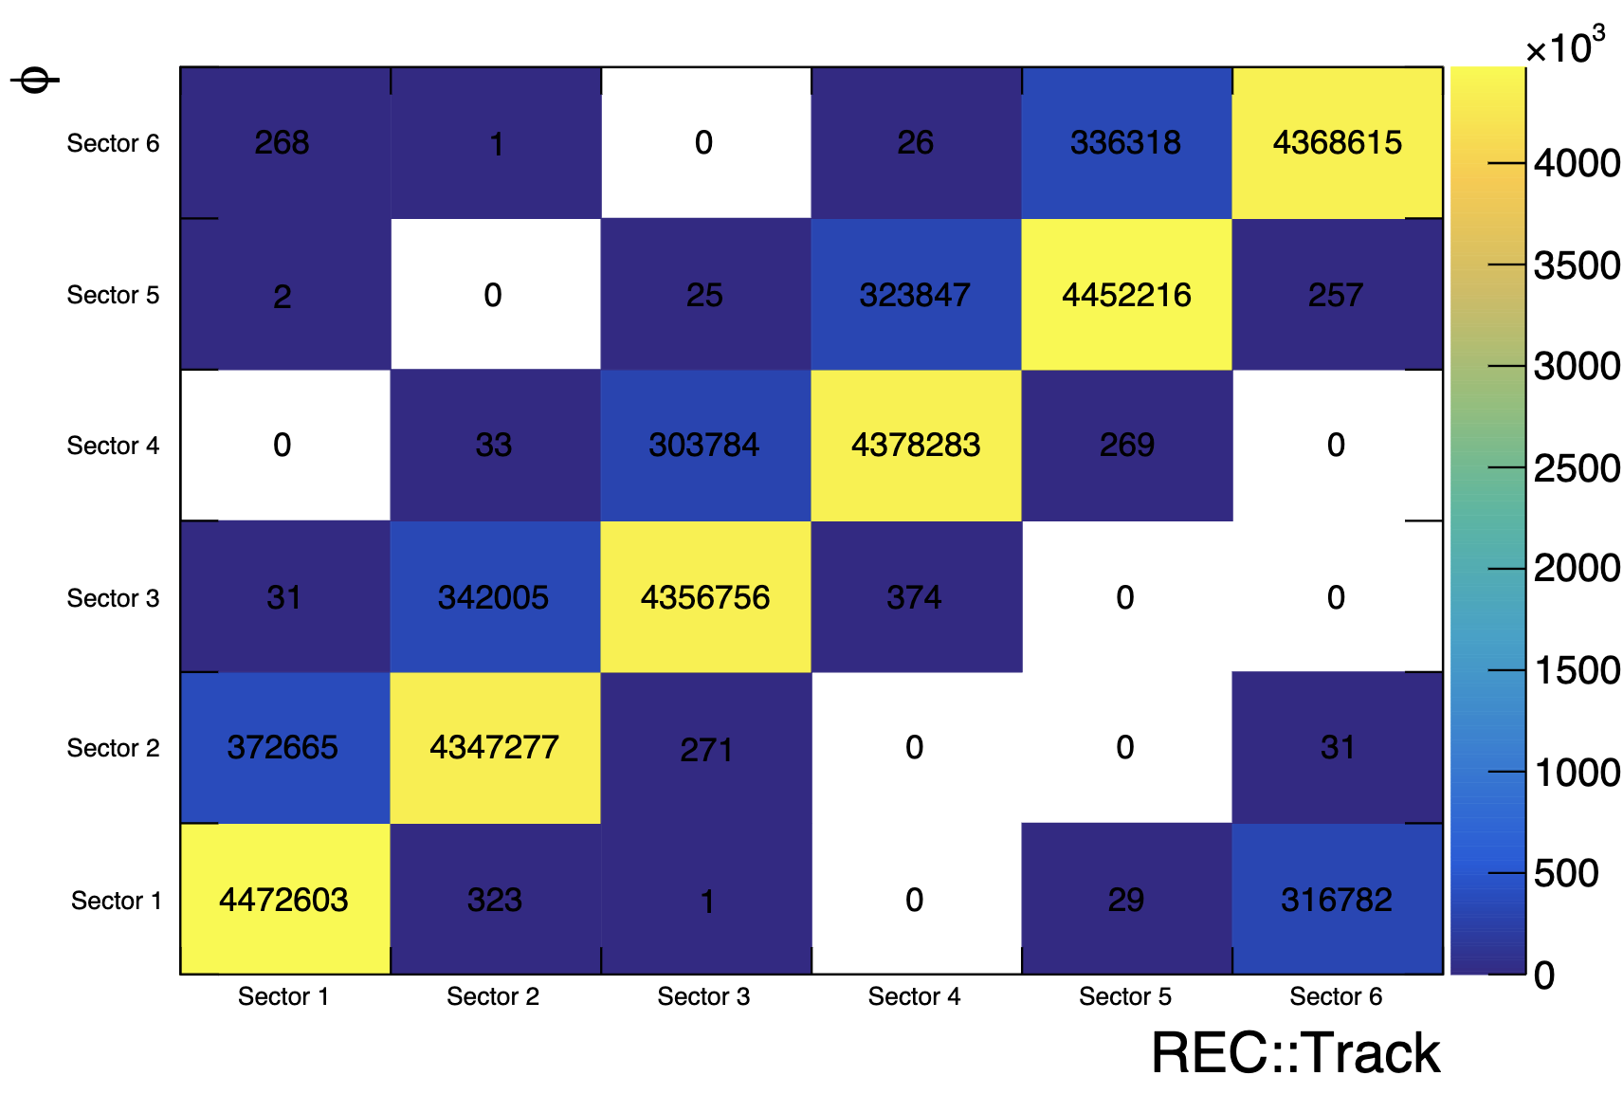
Vertex study: φ vs REC::Track
Sector information can come from the REC::Track bank or the φ information for the electron. Use Pass0v7 data, CuSn target.
Some mistake made last time:
sector information is from REC::Track bank
In the fiducial cuts of RG-A, they use the x and y positions in the DC.
I haven’t found how they get the sector information in some analysis 1,2,3.
I have discussed this with Raffaella, and she recommends using the information in the REC::Track, REC::Calorimeter, or REC::Scintillator.

Slide 13
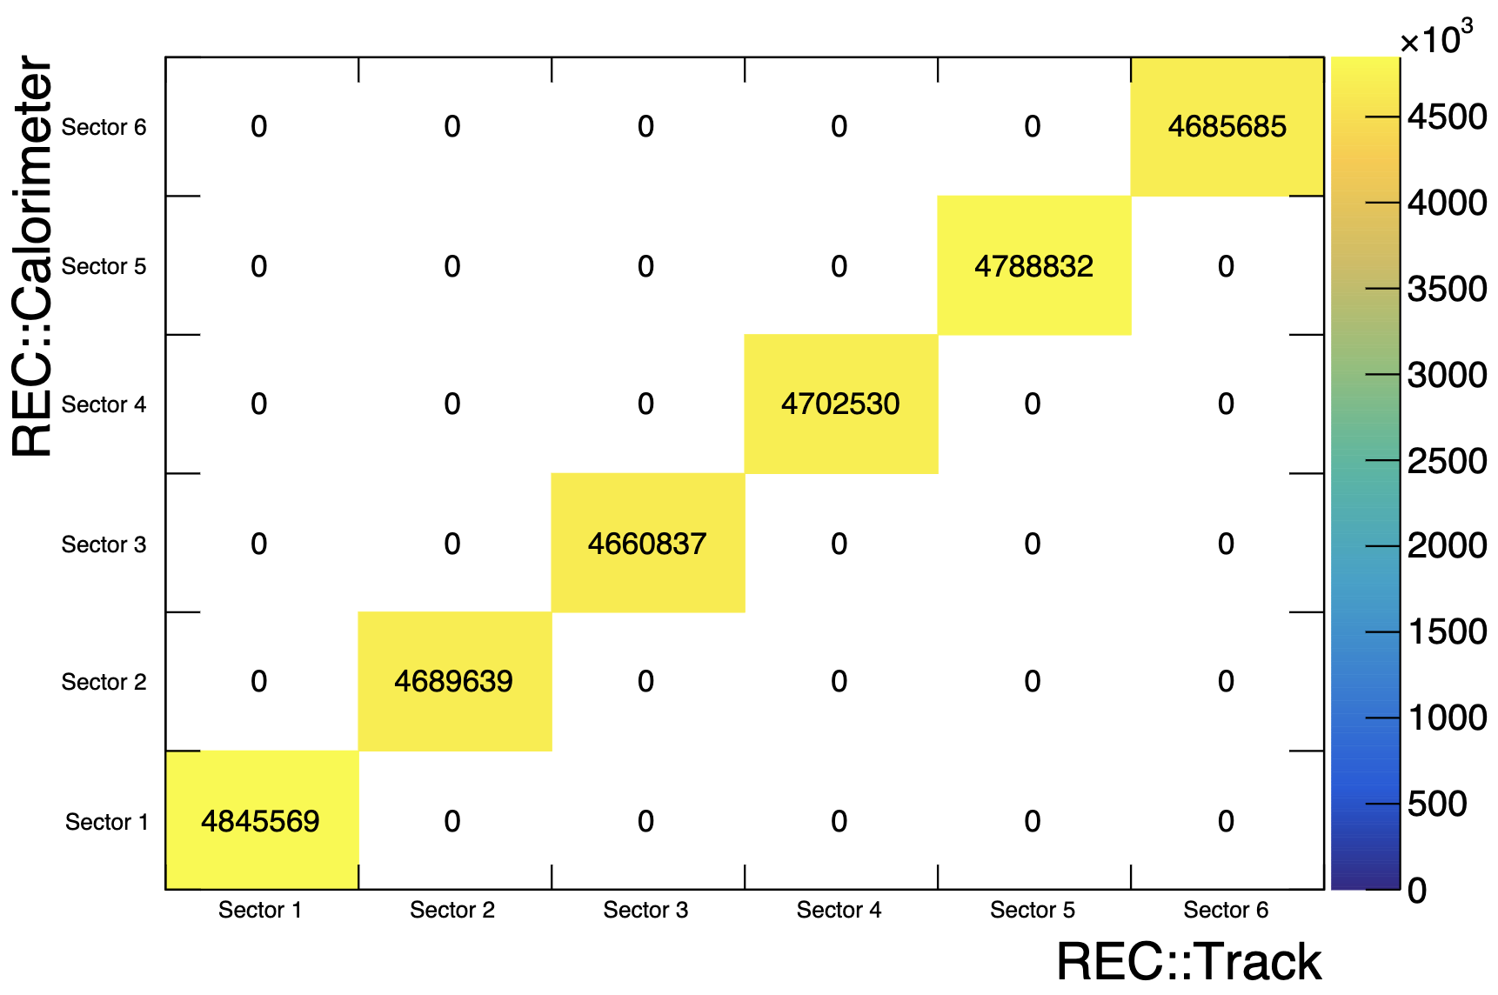
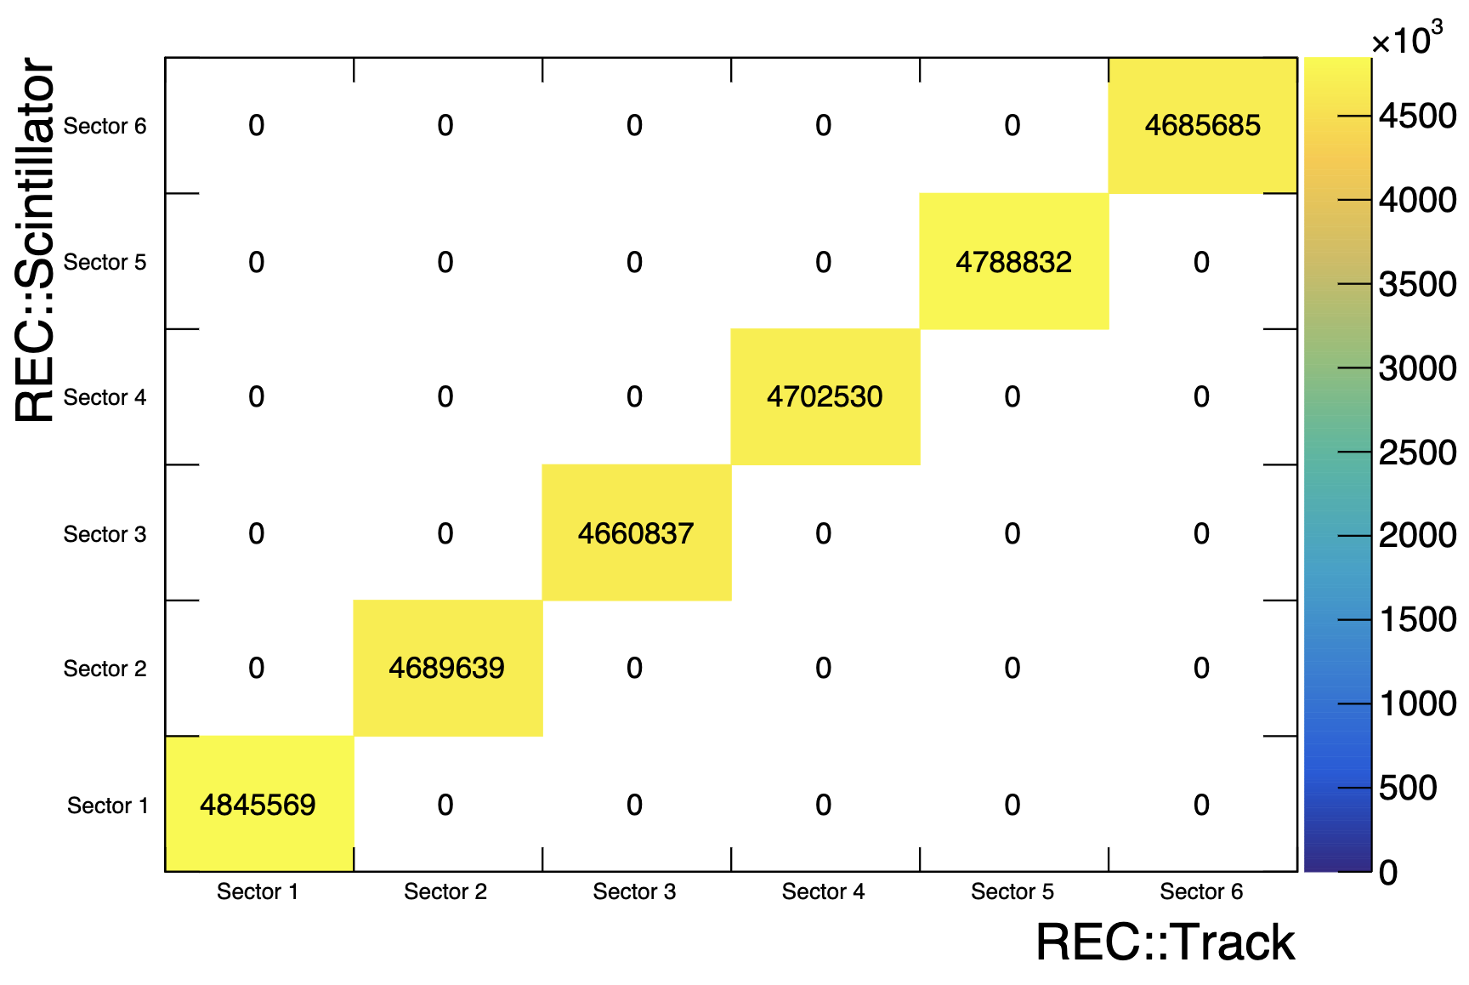
Vertex study: REC::Scintillator and REC::Calorimeter

