Slide 1

Analysis and cooking status
Mathieu Ouillon (Mississippi State University)
12 February, 2025

Slide 2
Cooking status
Pass0v8 has been cooked. (problems with the trains, but it is not a issue for us).
You can find the files here: /volatile/clas12/ouillon/skim_pass0v8_RGD
I will not copy them into /cache/hallb/scratch directory, since we have already processed the Pass0v9.
But you can have a look at them.
Pass0v9 has been produced. (problems with the timelines for the CND, RICH and helicity, Chris has been able to produce the timelines locally. He still doesn’t understand the issues I faced. He still works on that.)
I have started to skimed them, and I will copy them into the /cache/hallb/scratch directory

Slide 3
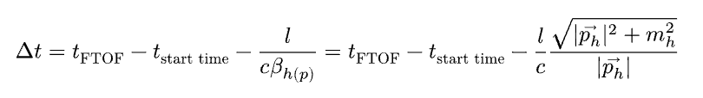
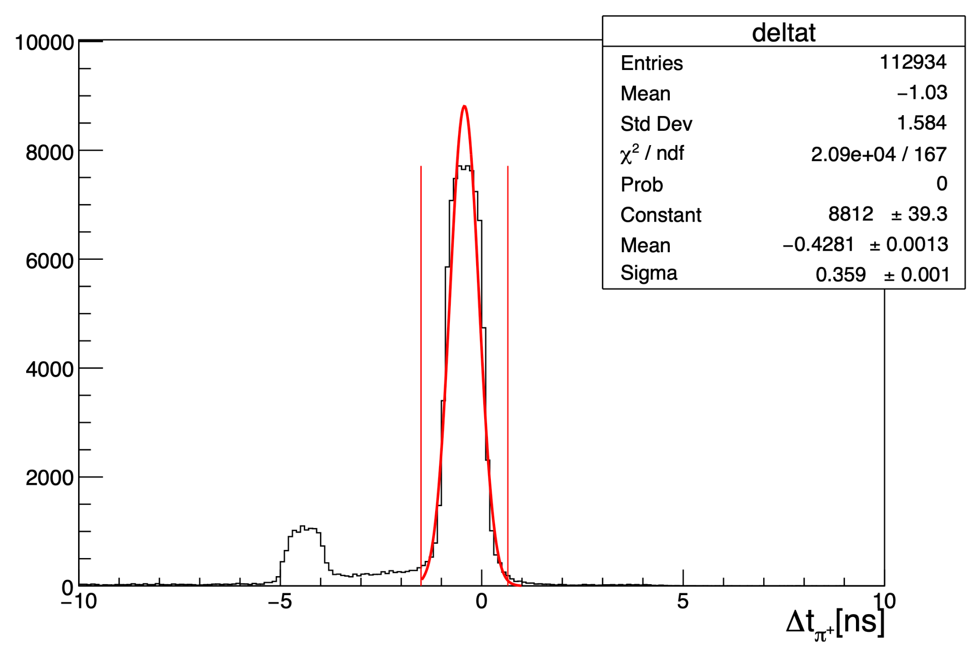
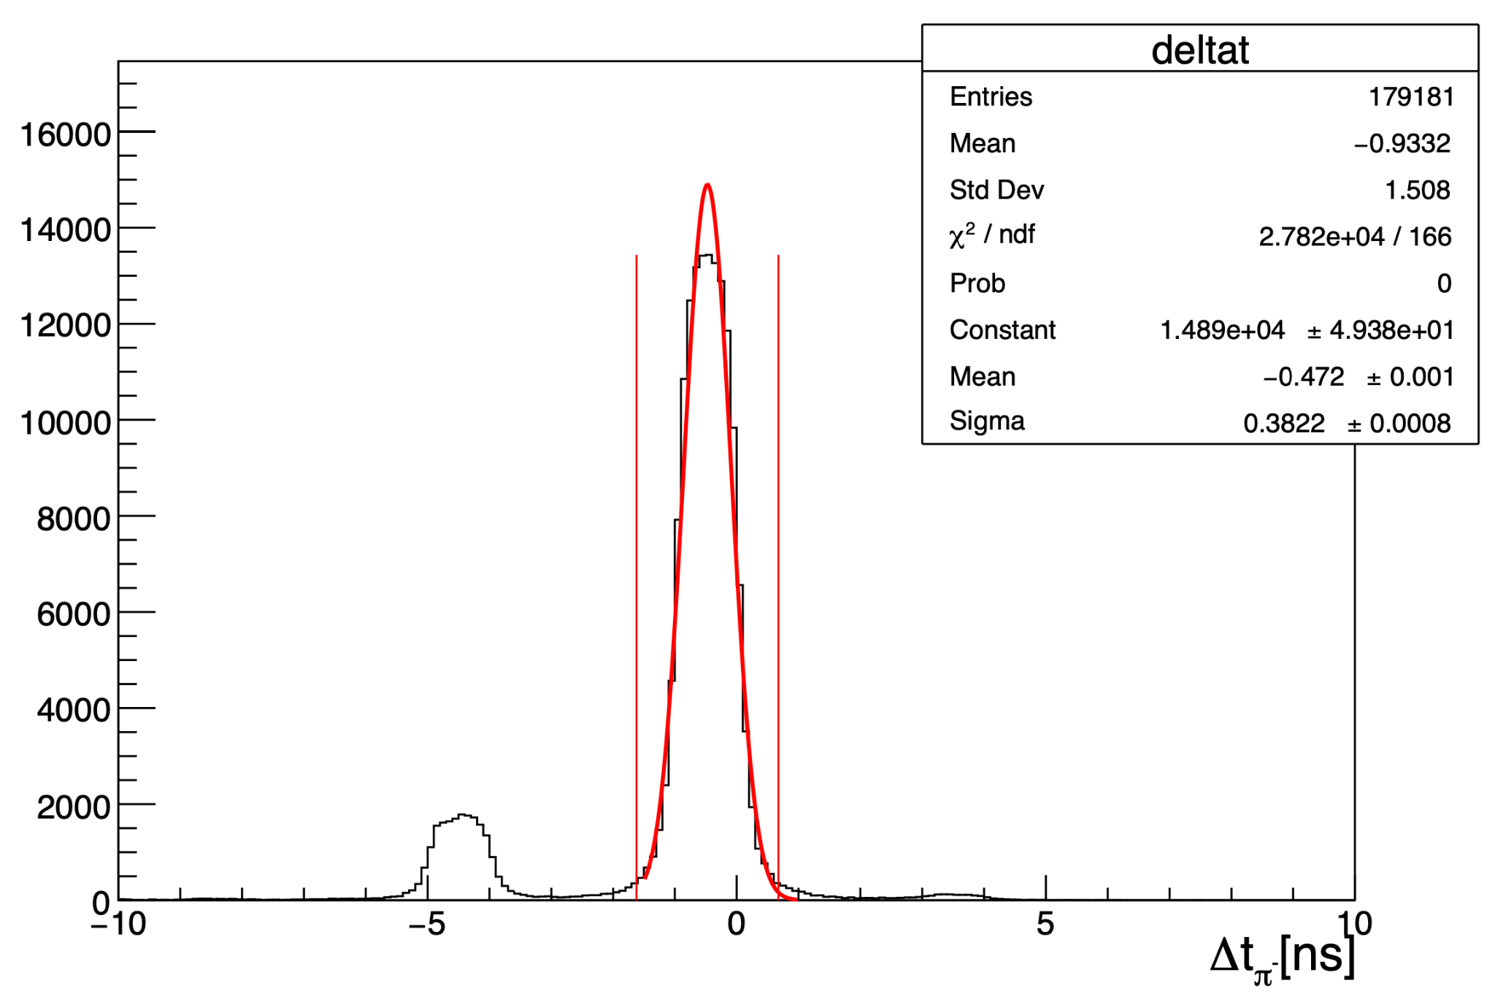
Vertex study: effect of a cut on Δt on Vz
Goal: see if a cut on Δt for the charged pions is able to reduce the second peak in Vz
Use Pass0v7 data, run 018563, 018564, and 018565, Cu target
Cut electron: pid=11, status < 0, -5 < chi2pid < 5 and -10.502 < Vz < -6.452 cm

Slide 4
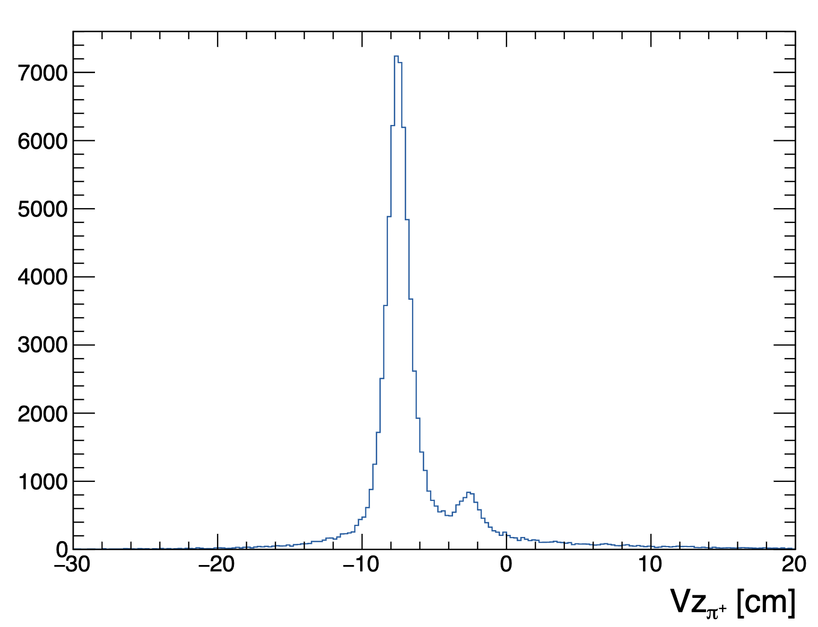
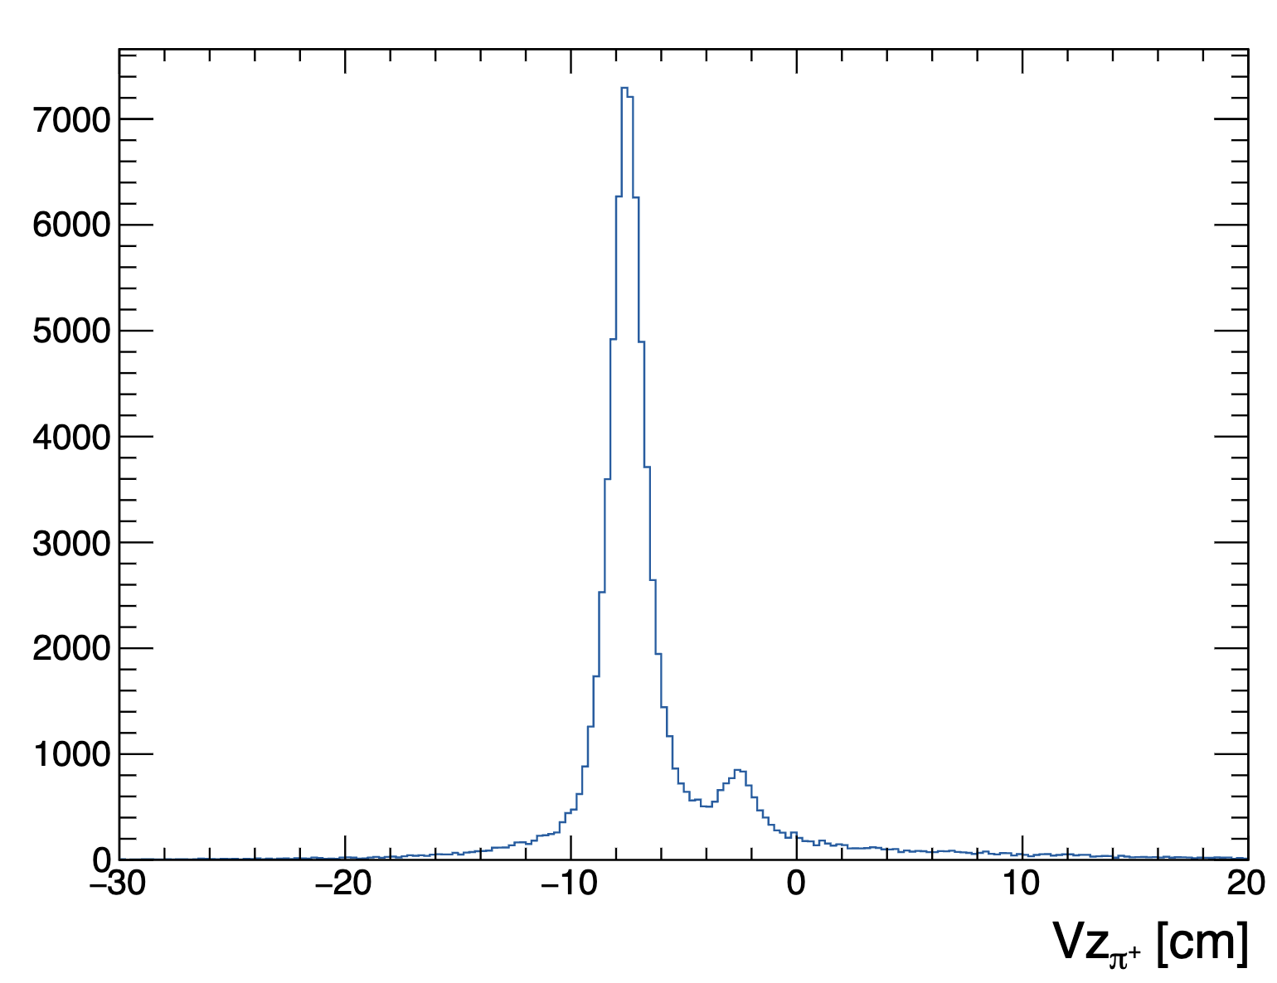
Vertex study: effect of a cut on Δt on Vz
pid= 211
-10 < chi2pid < 10
pid = 211
-10 < chi2pid < 10
-1.5 < Δt < 0.65 ns
A cut on Δt doesn’t reduce the secondary peak in Vz.

Slide 5
RG-D study: π⁰ analysis
Due to the difficulty and the small amount of K⁰ found in the data, I have switch to π⁰.
Data: pass0v7 LD2 data
Select trigger electron: pid=11, status<0, -5 < chi2pid < 5 and -15 < Vz < 5 cm
Select photon:
pid=22 (EB use a cut on ꞵ>0.9 to assign the pid + E>0.0001GeV)
E > 0.2 GeV
-15 < Vz < 5 cm
Opening angle between electron and photon, θ_{eɣ} > 8 deg
−1.68 < Δt < 1.55 ns
DIS cuts: Q²>1 GeV², W > 2 GeV, 0.3 < z_{h} < 0.7
I am working on an event mixing method to reproduce the background below the peak in the two photons' mass distribution.
1: (Analysis note by Stefan Diehl, Andrey Kim, Kyungseon Joo)

Slide 6
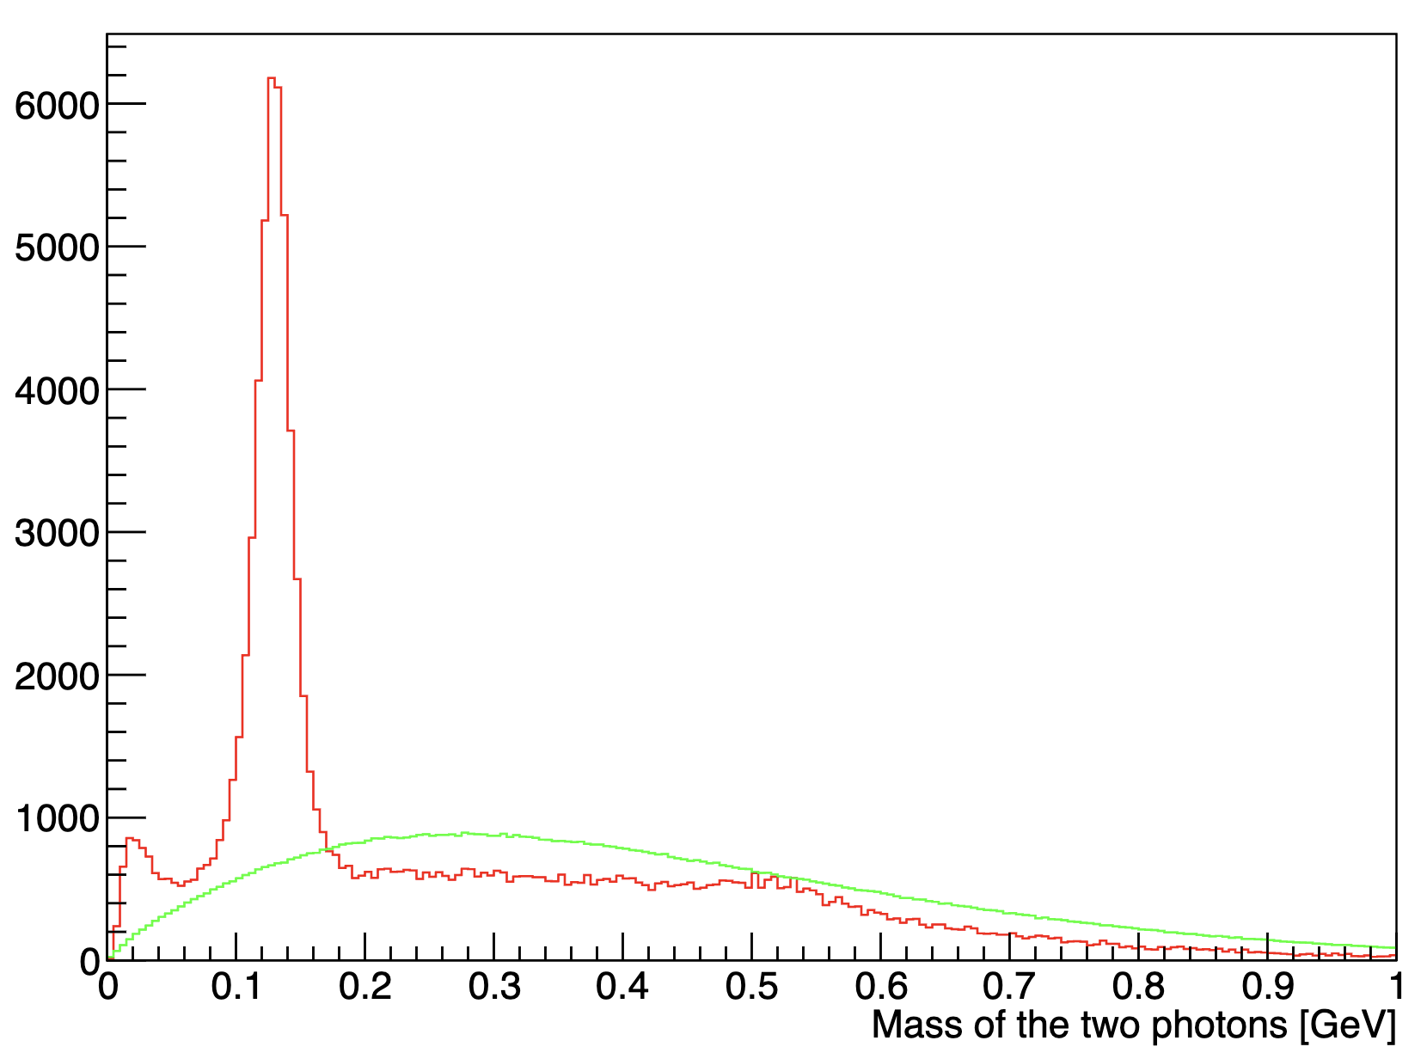
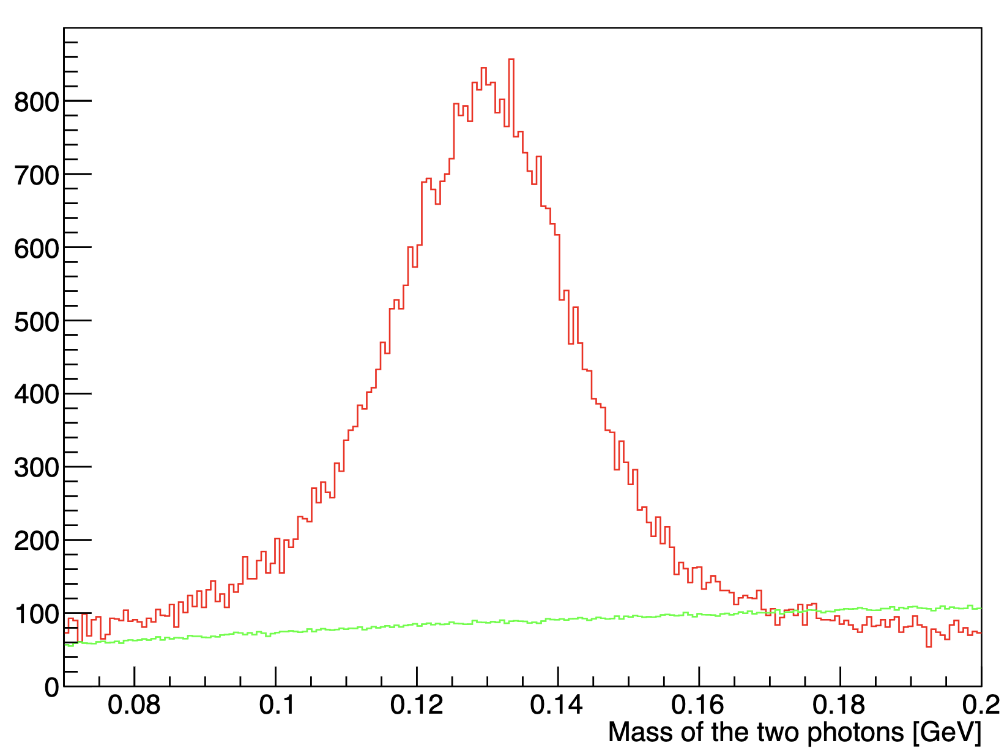
RG-D study: π⁰ analysis
Red - main event Green - event mixing

