Slide 1

Analysis and cooking status
Mathieu Ouillon (Mississippi State University)
12 February, 2025

Slide 2
Cooking status
Mini-timeline Pass0v9_dc have been cooked.
Mini-timeline Pass0v9_dcv2 have been cooked.
These timelines have been made to check the DC Calibration: T0 and T2D.
calib_dcv4 have been cooked (DC Calibration for special HV settings runs)
The Pass0v9 have been skimmed.
You can find the files here: /cache/hallb/scratch/rg-d/production/skim_pass0v9/
I have copy the high-QA timelines into the rg-d directory, they should appear on the clas12mon website.

Slide 3
Cross-check high-QA timeline
Goal: Understand the high-QA timelines for RG-D and cross-check the results.
Beam charge asymmetry
Beam spin asymmetry
Define helicity fraction
Electron FD normalize yield
Electron FT normalize yield : No FT in RG-D, set to 0
Faraday cup charge gated
Faraday cup charge gated accumulated
Faraday cup gated non-monotonic : Set to 1
Faraday cup charge ungated : Same as gated version
Live time from fc charge totals : Set to 1
piMinus/piPlus kinematics means/stddevs
Q² W x y means/stddevs

Slide 4
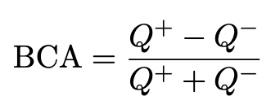
Cross-check high-QA timeline: Beam charge asymmetry
Beam charge asymmetry based on the total accumulated charge with positive and negative helicities:
The charge is read from the HEL::scalers bank.
Q⁺ is the total accumulated charge per run when the helicity is positive.
Q⁻ is the total accumulated charge per run when the helicity is negative.
For RG-D the charge in the HEL::scalers bank is corrupted by the FC vacuum issue.

Slide 5
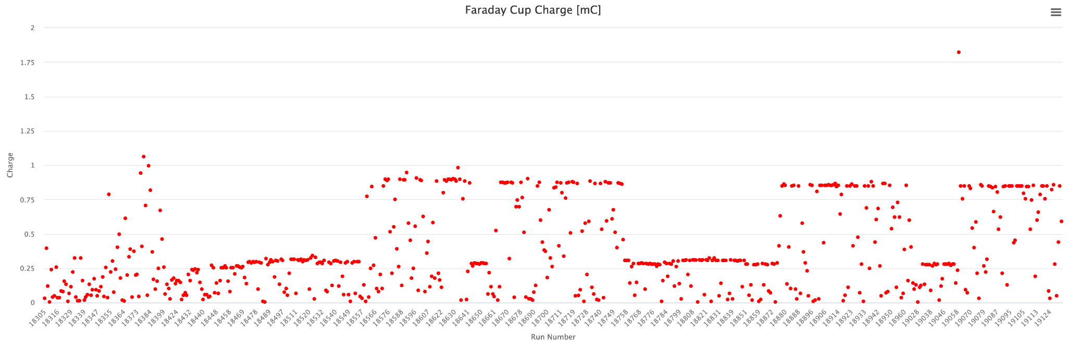
Cross-check high-QA timeline: Faraday cup charge gated
Charge information from Maurik work.
Timeline

Slide 6
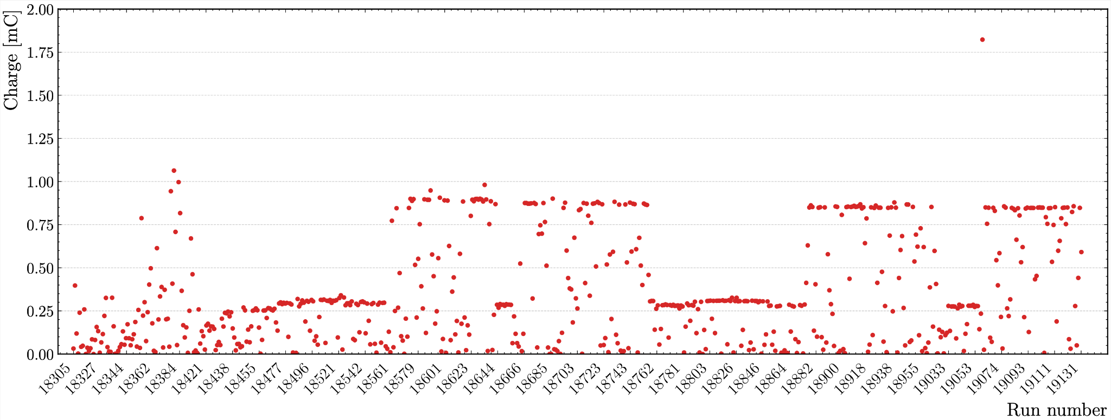
Cross-check high-QA timeline: Faraday cup charge gated
My cross-check

Slide 7
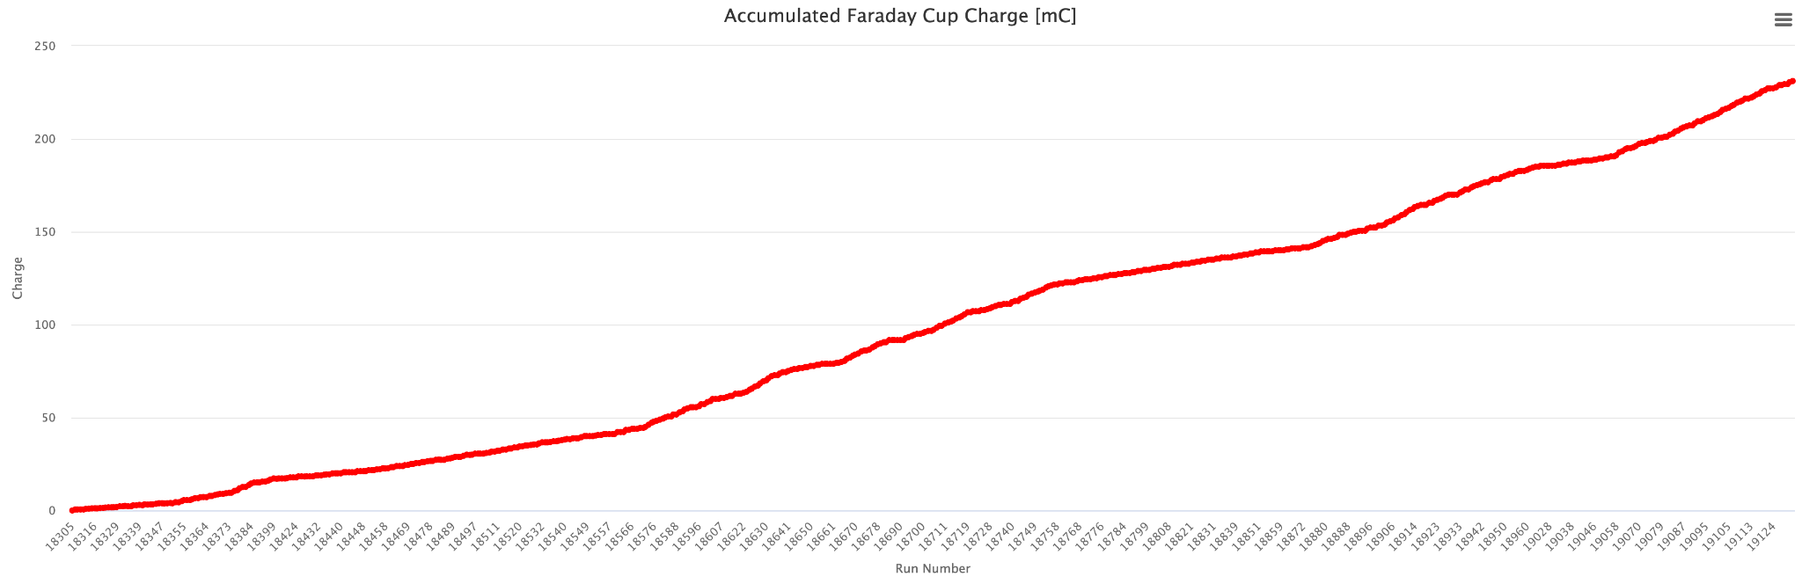
Cross-check high-QA timeline: Faraday cup charge accumulated
Charge information from Maurik work.
Timeline

Slide 8
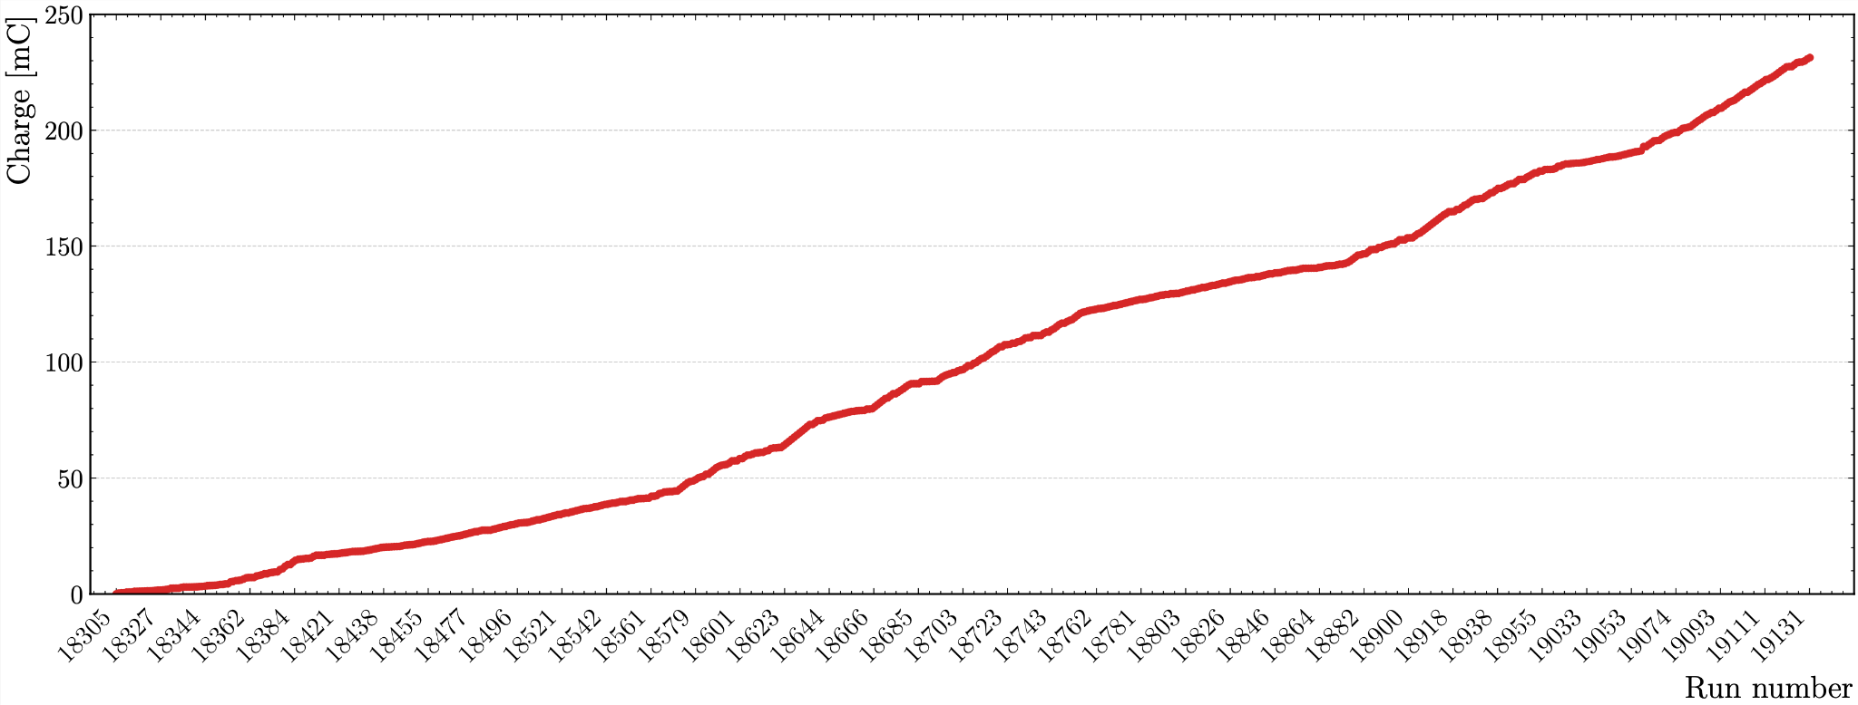
Cross-check high-QA timeline: Faraday cup charge accumulated
My cross-check

Slide 9
Cross-check high-QA timeline: piMinus/piPlus kinematics means/stddevs
To compute the values these timelines:
Each run is divided into three bins:
Bin 1: Contains only the first event
Bin 2: Spans from the first event to the last event with the RUN::scaler bank.
Bin 3: Extends from the end of Bin 2 to the run's ending.
For each of theses 3 bins, we fill histograms for the following kinematic variables: p, p_{T}, phiH, θ, and z.
We calculate the weighted mean for each histograms.
We create 5 new histograms filled with the previously extracted weighted means for each kinematic variable.
We compute the weighted mean for these secondary histograms. This final value is what plot in the timelines.

Slide 10
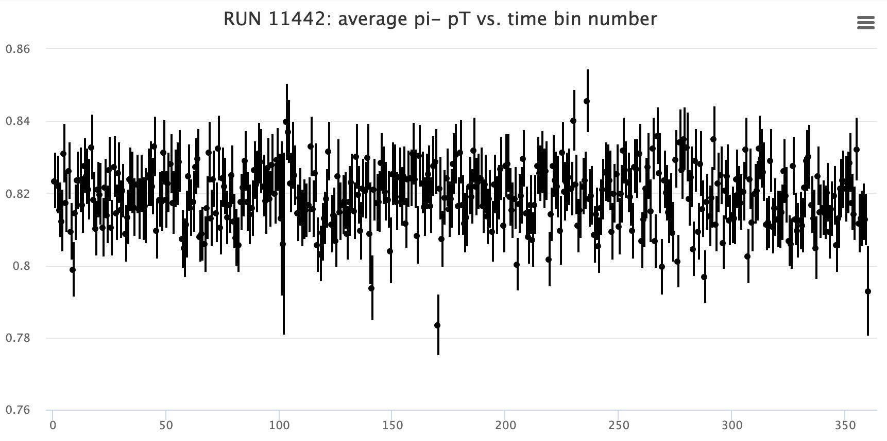
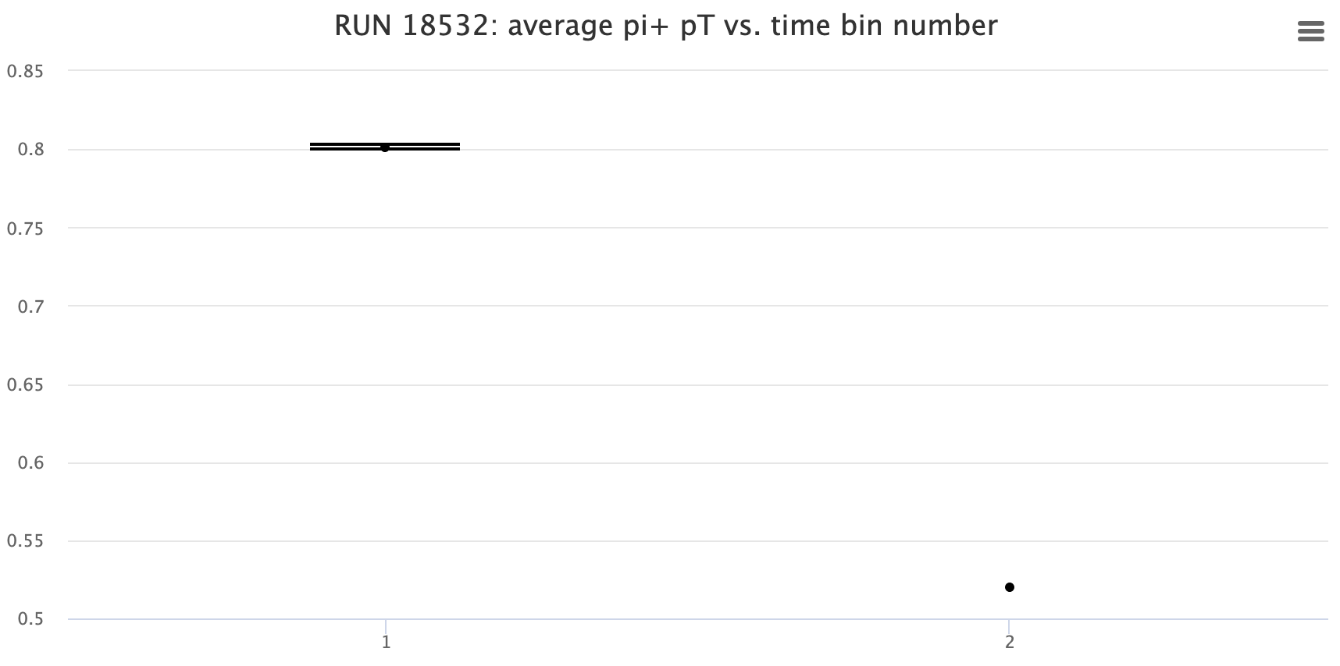
Cross-check high-QA timeline: piMinus/piPlus kinematics means/stddevs
Compare to other run group, RG-D have only 3 bins. The first is always empty.
RG-B pass2 qa
RG-D pass0v9 qa
Step 3.
They use this binning for the kinematics to reject part of the run if they see some issue in the timelines. For example a bin if a value very different than the other.

Slide 11
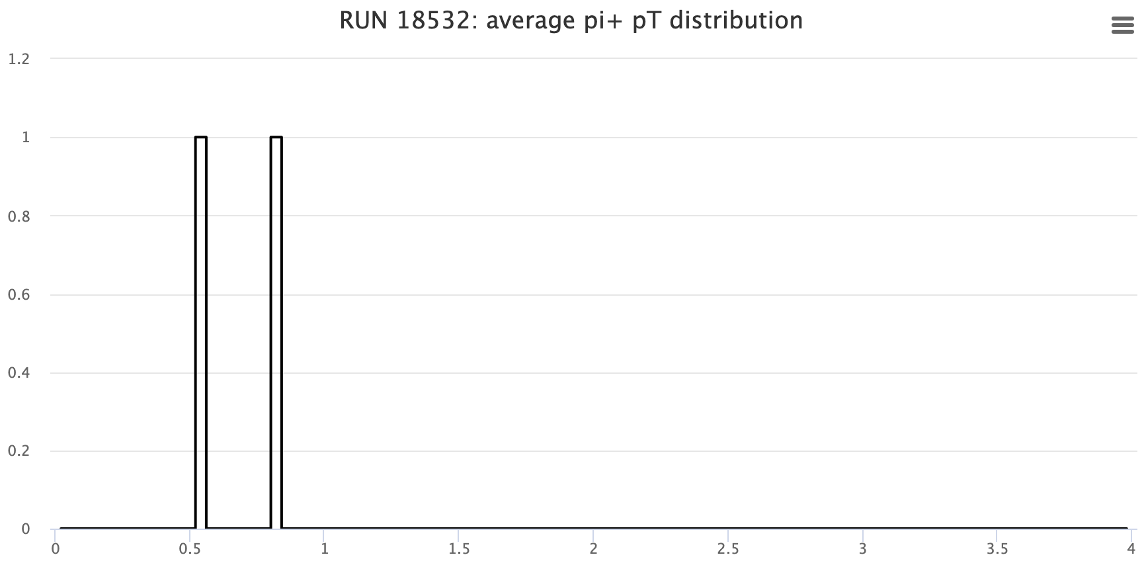
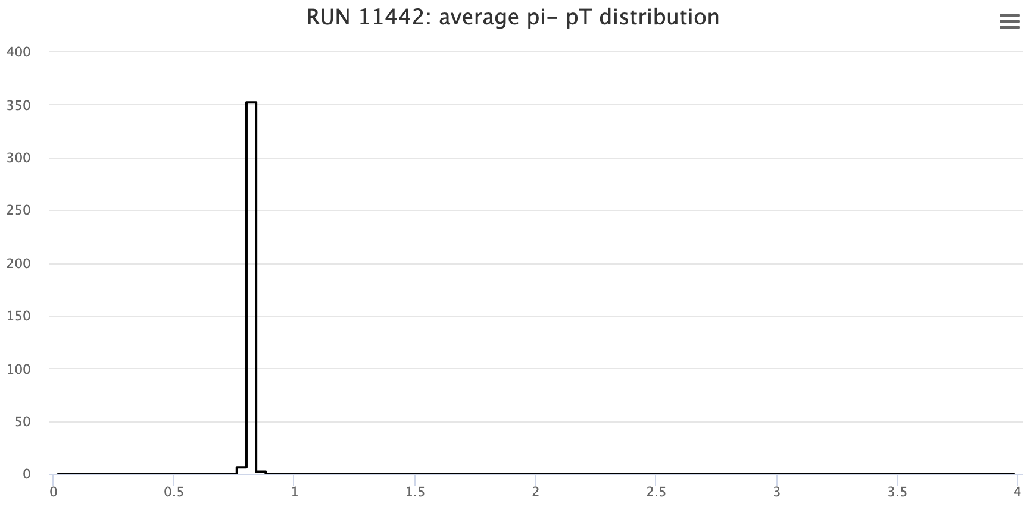
Cross-check high-QA timeline: piMinus/piPlus kinematics means/stddevs
RG-B pass2 qa
RG-D pass0v9 qa
Step 4.

Slide 12
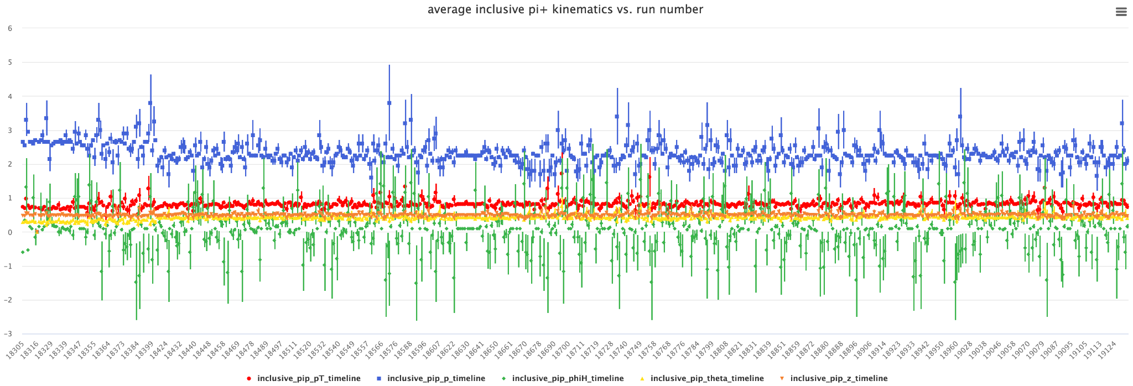
Cross-check high-QA timeline: piMinus/piPlus kinematics means/stddevs

Slide 13
Cross-check high-QA timeline: piMinus/piPlus kinematics means/stddevs
There are some issue with this for RG-D:
We compute a weighted mean of two values instead of 3XX.
So we give the same weight for the second bin which have almost all the event and the third bin which have 1,2 or 3 events. So it biased the mean a lot.
To fix this, Chris agreed to change steps 3,4,5:
Fill a single histogram for each kinematic variables for the entire run.
Take the weighted mean of these histograms.
Plot these values in the main timelines.

