Slide 1

Analysis and cooking status
Mathieu Ouillon (Mississippi State University)
19 March, 2025

Slide 2
Cross-check High-level Physics QA Timeline
Goal: Understand the high-level QA timelines, its relevance for RG-D, and cross-check its results
Beam charge asymmetry (should be removed; see next slide)
Beam spin asymmetry
Define helicity fraction
Electron FD normalized yield
Electron FT normalized yield: No FT in RG-D, set to 0 (could be removed as FT was OFF )
Faraday cup charge gated
Faraday cup charge gated accumulated (not significant for RG-D with various target configurations as it can’t be compared with the live accumulated charge plot)
Faraday cup gated non-monotonicity: Set to 1 (could be removed)
Faraday cup charge ungated: Same as gated for RG-D (could be removed)
Livetime from fc charge totals: Set to 1 (could be removed)
π⁺/π⁻ Kinematics means/stddevs (require further tweaks; more later)
Q², W, x, y means/stddevs (require further tweaks; more later)

Slide 3
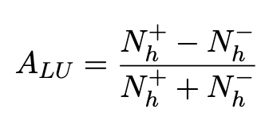
Beam Spin Asymmetry
The BSA extraction is done by performing a SIDIS-type analysis for π⁺ and π⁻ with the following criteria:
trigger electron selected with pid= 11, status< 0, 2000≤ |status|< 8000, & -3< chi2pid < 3
DIS cuts: Q² > 1 GeV², W > 2 GeV, and y < 0.8
charged pions (π⁺/π⁻) selected with pid = 211/-211
Then, BSA is computed as
What is monitored in the timelines is
Amplitude: the slope of the asymmetry (fitted with a first-order polynomial function)
Offset: intercept of the first-order polynomial function

Slide 4
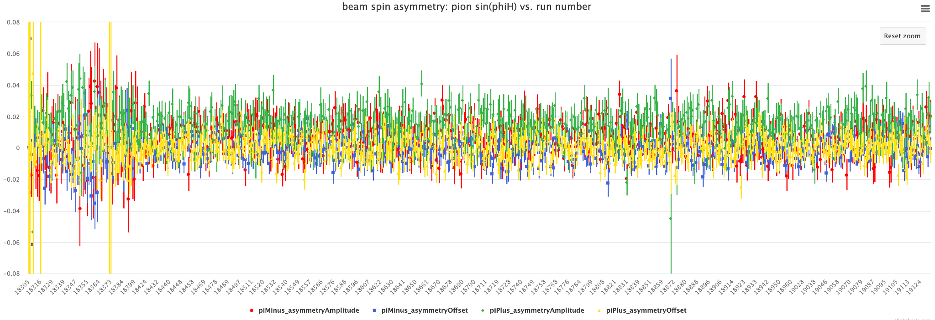
Beam Spin Asymmetry
From the timeline

Slide 5
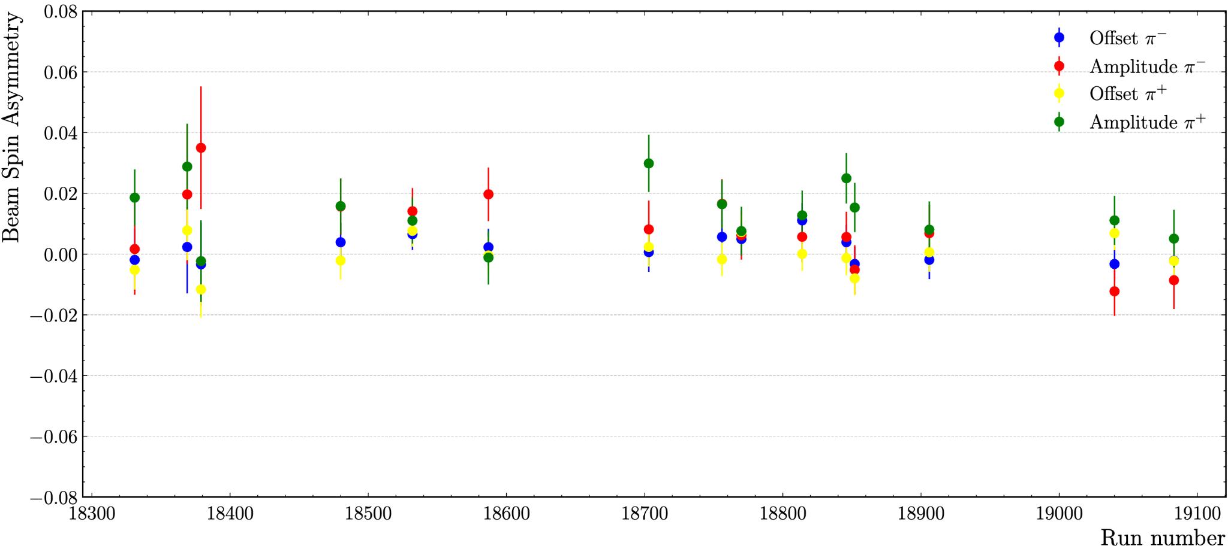
Beam Spin Asymmetry
Run 18532:
My values: π⁻ amplitude: 0.0141, offset: 0.00656
Timeline: π⁻ amplitude: 0.0142, offset: 0.00653
My values: π⁺ amplitude: 0.0110, offset: 0.00766
Timeline: π⁺ amplitude: 0.01087, offset: 0.00765
Run 18331:
My values: π⁻ amplitude: 0.00166, offset: -0.00190
Timeline: π⁻ amplitude: 0.00164, offset: -0.00192
My values: π⁺ amplitude: 0.01861, offset: 0.00518
Timeline: π⁺ amplitude: 0.001866, offset: -0.00517
Run 18852:
My values: π⁻ amplitude: -0.0052, offset: -0.00322
Timeline: π⁻ amplitude: -0.0054, offset: -0.00320
My values: π⁺ amplitude: -0.0149, offset: 0.00798
Timeline: π⁺ amplitude: -0.00143, offset: 0.00804

Slide 6
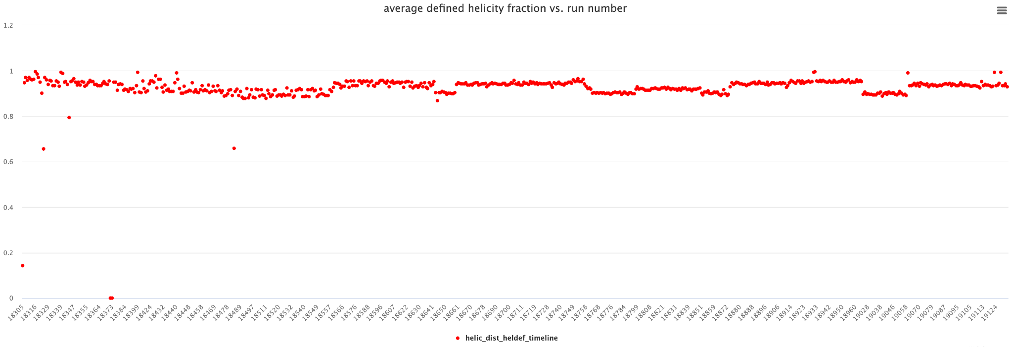
Defined Helicity Fraction
Computed as a ratio of the number of events with defined helicity (1 or -1) and the total number of events

Slide 7
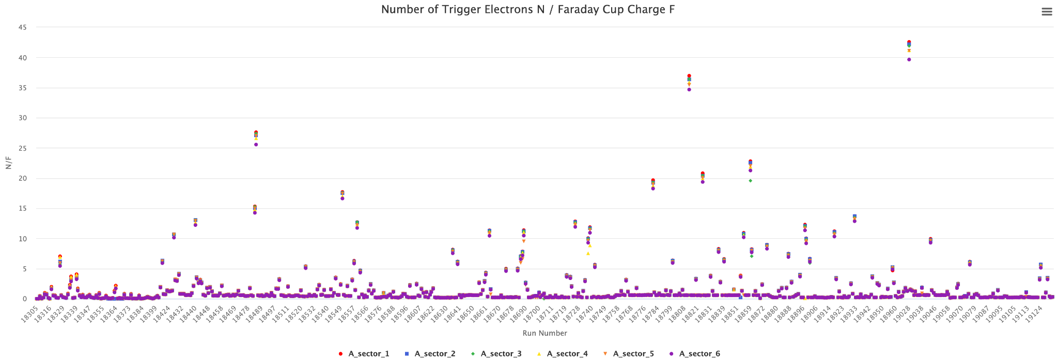
Electron FD Normalized Yield
Represents the number of identified trigger electrons normalized by the accumulated gated beam-charge
Outliers are expected to diminish once full runs are processed since the normalization is done with the accumulated gated per-run beam-charge (current timelines has only 20 files per run)

Slide 8
Electron FD Normalized Yield
run 18532 my value | timelines
nTrigger sector1: 188953: 0.6664335074 | 0.66643
nTrigger sector2: 186635: 0.6582579671 | 0.65826
nTrigger sector3: 188220: 0.6638482308 | 0.66385
nTrigger sector4: 180457: 0.6364682828 | 0.063647
nTrigger sector5: 184638: 0.6512145874 | 0.65121
nTrigger sector6: 177411: 0.6257251009 | 0.62573
run 18331: my value | timelines
nTrigger sector1: 48458: 0.1488494736 | 0.14885
nTrigger sector2: 42969: 0.131988795 | 0.13199
nTrigger sector3: 39778: 0.1221869322 | 0.12219
nTrigger sector4: 47976: 0.1473689039 | 0.14737
nTrigger sector5: 41075: 0.1261709548 | 0.12737
nTrigger sector6: 37752: 0.1159636247 | 0.11596

Slide 9
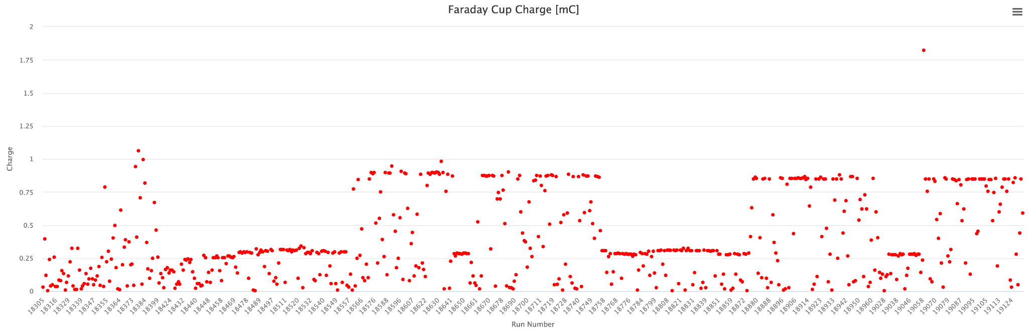
Faraday Cup Charge Gated
Represents BPM/BCM accumulated livetime-corrected charge extracted by Maurik H. by reading BCM currents and livetime information stored in the MYA database
From the timeline

Slide 10
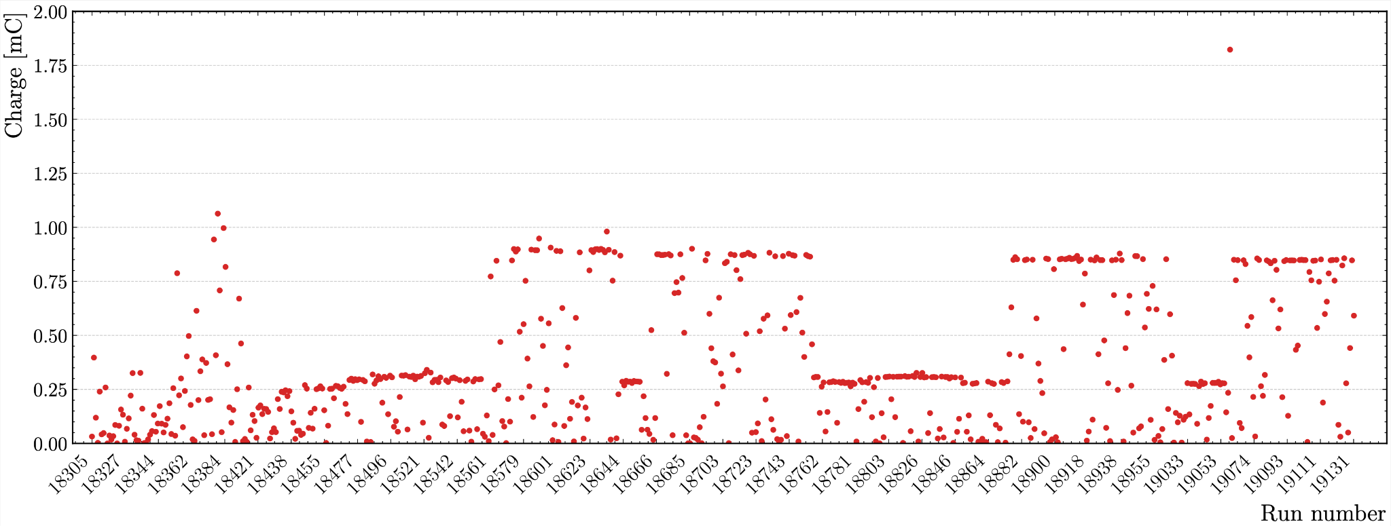
Faraday Cup Charge Gated
My cross-check

Slide 11
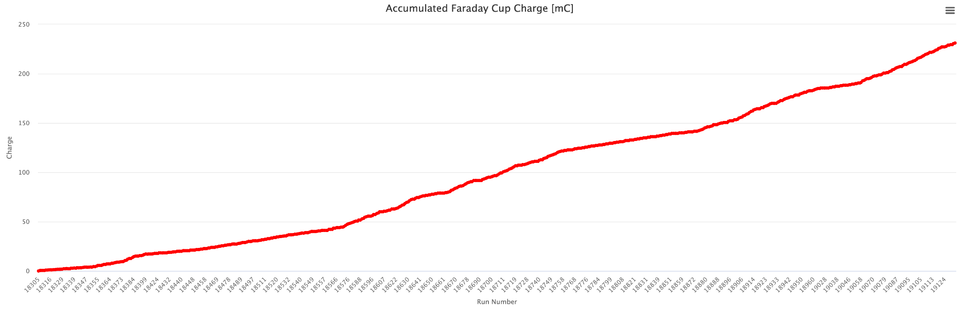
Faraday Cup Charge Accumulated
Extracted by performing a per-run charge accumulation throughout the whole run-period
From the timeline

Slide 12
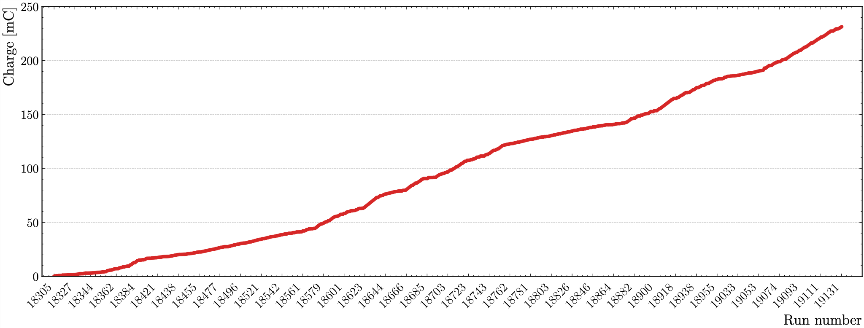
Faraday Cup Charge Accumulated
My cross-check

Slide 13
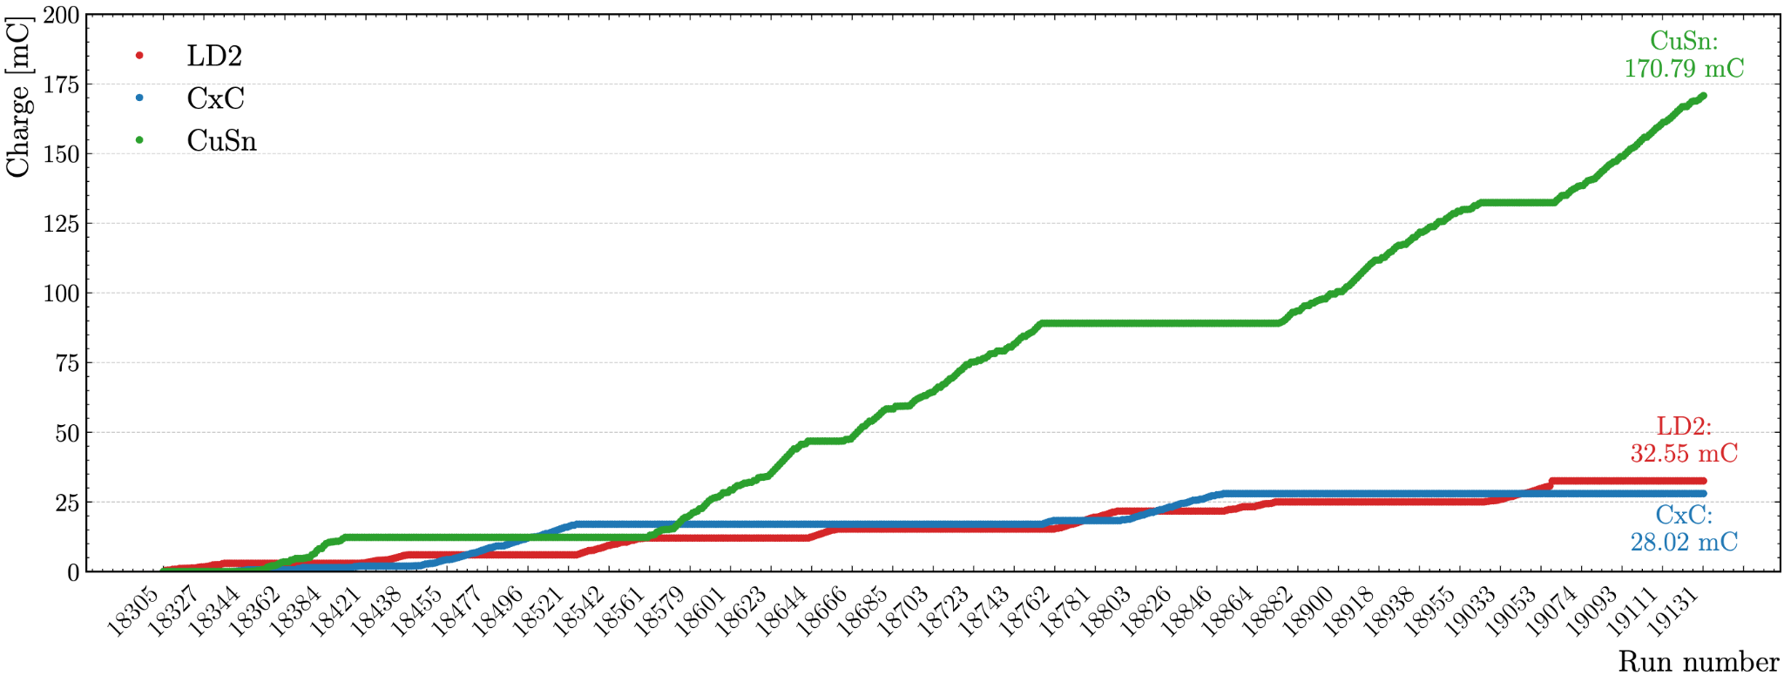
Faraday Cup Charge Accumulated
The same accumulated per-run charge throughout the whole run period but separated by target configurations

Slide 14
π⁺/π⁻ Kinematics means/stddevs
To compute the values for these timelines:
Each run is divided into three bins:
Bin 1: Contains only the first event
Bin 2: Spans from the first event to the last event within the RUN::scaler bank
Bin 3: Extends from the end of Bin 2 until the end of the run
For each of these three bins, histograms are filled for the following kinematical variables: p, p_{T}, phiH, θ, and z.
The weighted mean is then calculated for each histogram
Next, five new histograms get created and filled with the previously extracted weighted means for each kinematical variable
Then, the weighted mean for these five histograms is computed and displayed in the corresponding timeline for each kinematical variable

Slide 15
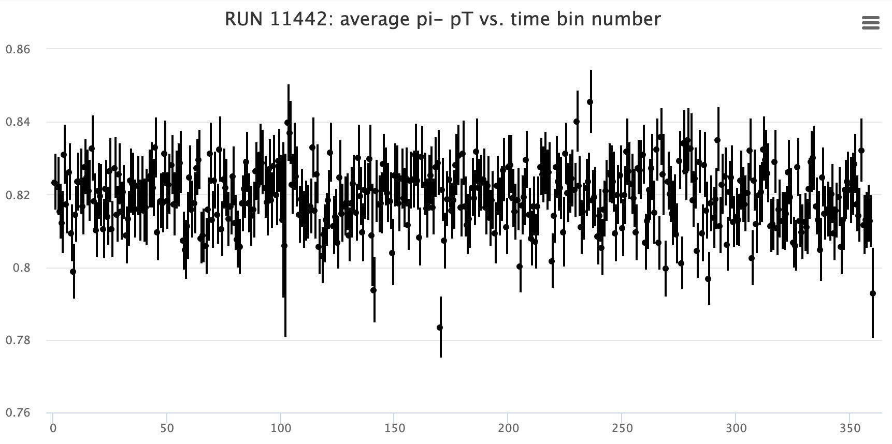
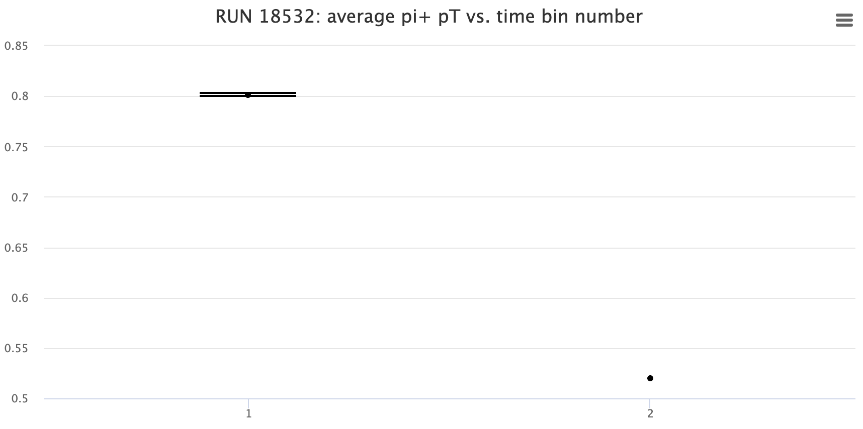
π⁺/π⁻ Kinematics means/stddevs
Compared to other run group, RG-D has only 3 bins. The first is always empty.
RG-B Pass2 QA
RG-D Pass0v9 QA
Step 3
This kinematical binning is used to reject part of the run if some issues are observed in the timelines

Slide 16
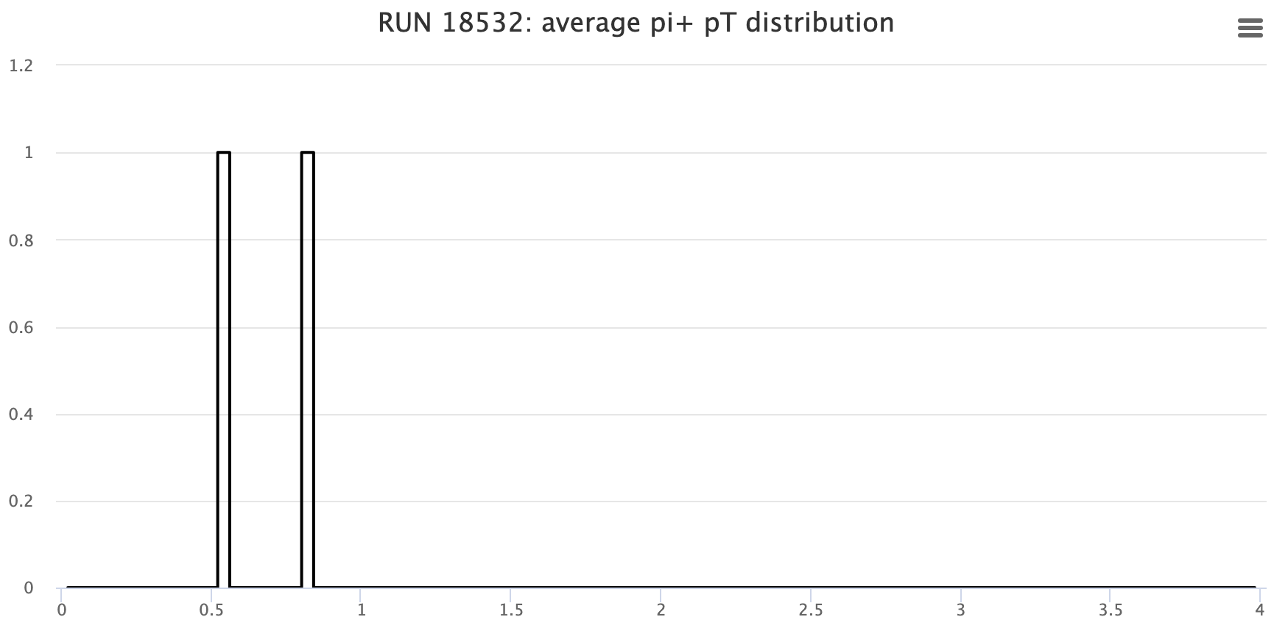
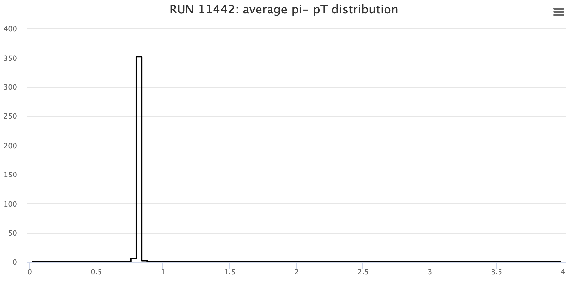
π⁺/π⁻ Kinematics means/stddevs
RG-B Pass2 QA
RG-D Pass0v9 QA
Step 4

Slide 17
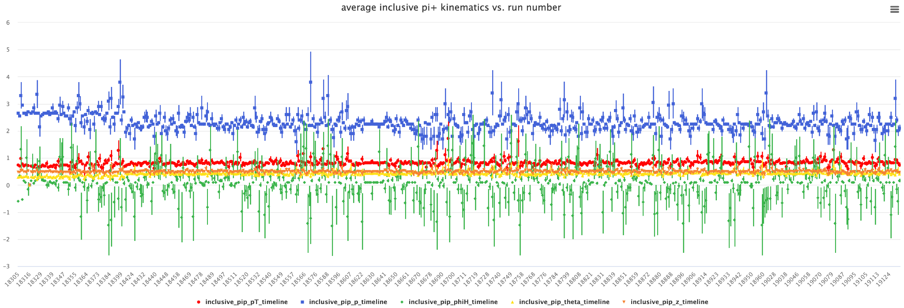
π⁺/π⁻ Kinematics means/stddevs

Slide 18
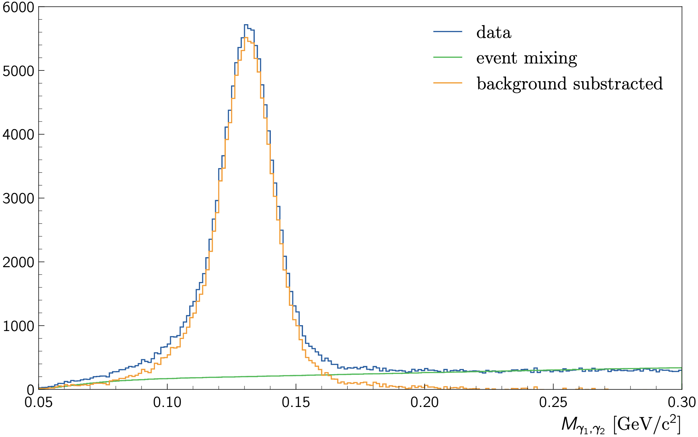
π⁰ analysis: Event mixing
Photon cuts:
E > 1 GeV
-1.67 < Δt < 1.55 ns
θ_{eɣ}> 8 deg
W > 2 GeV
Q² > 1 GeV²
0.3 < z_{h}< 0.7
θ_{ɣ1ɣ2} > 2.5 deg

Slide 19
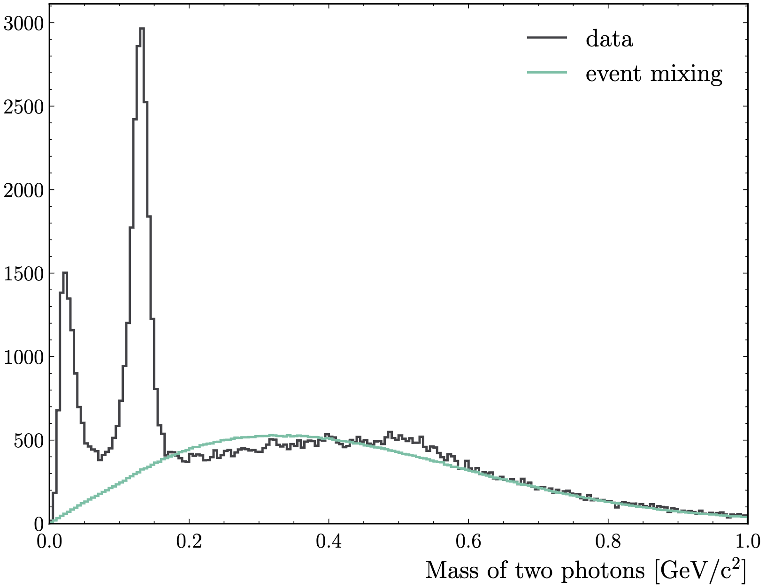
π⁰ analysis: Event mixing

Slide 20
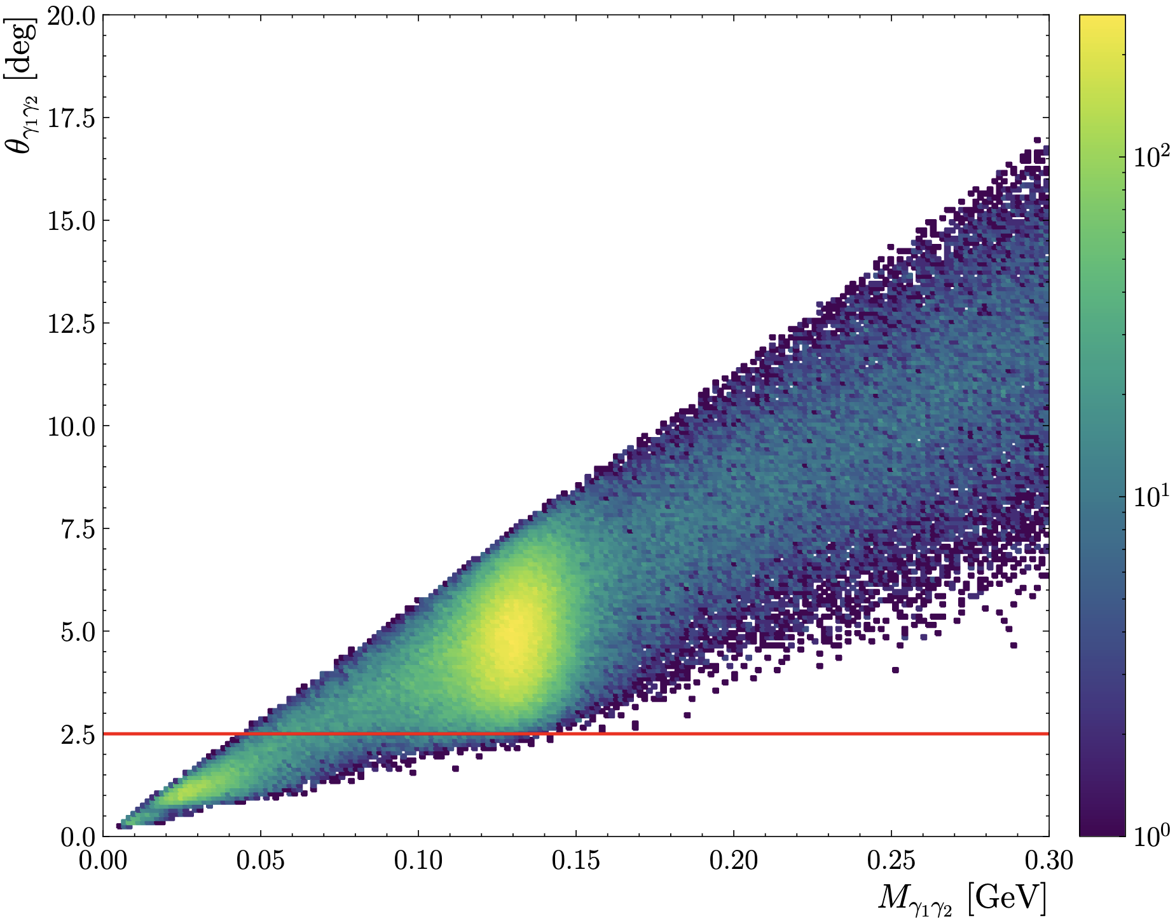
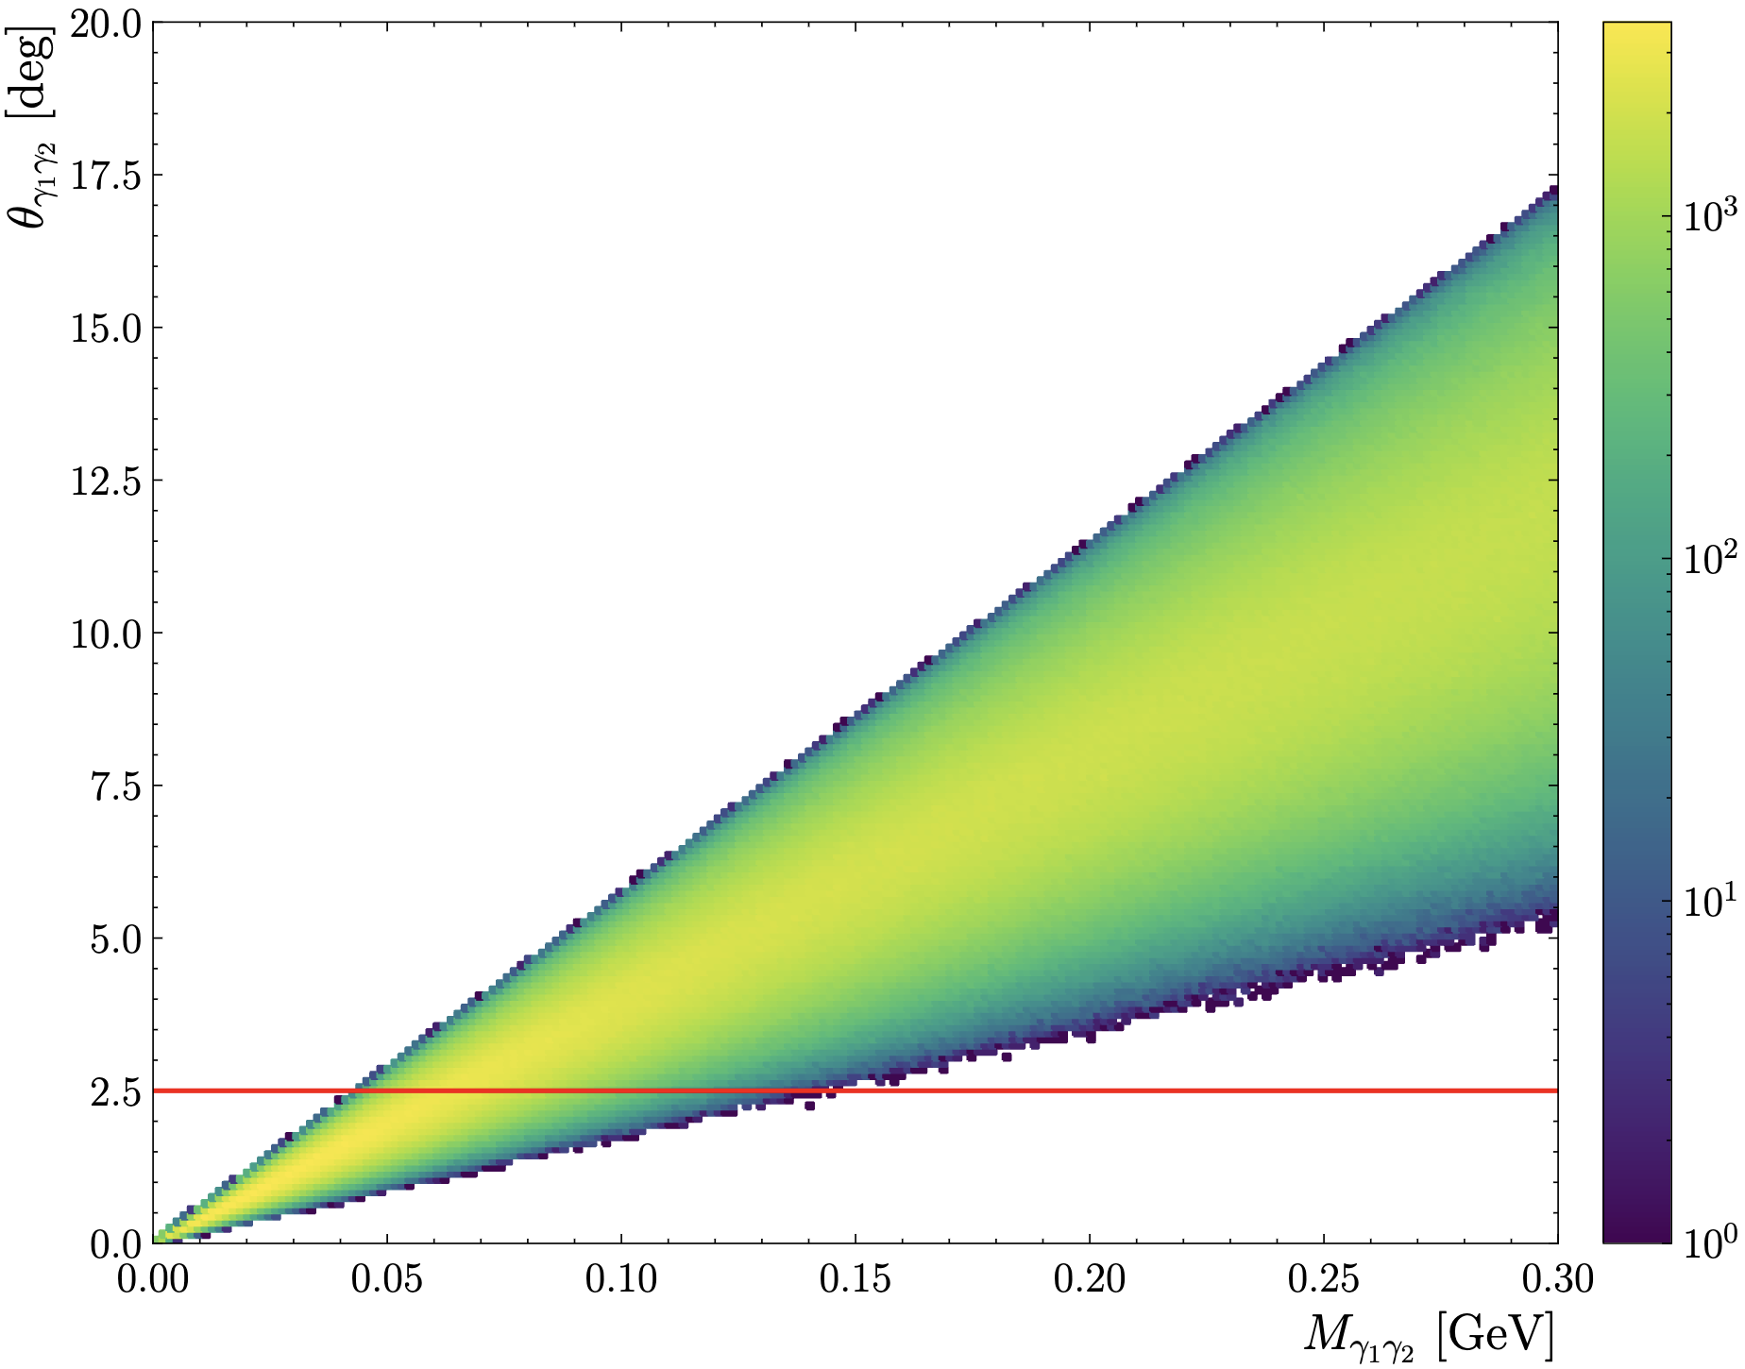
π⁰ analysis: Event mixing
Data
Event mixing

Slide 21
Background merging
For pass1 review, perform this only LD2
First step ⇒ Get 100k background events from 50nA and 60nA runs (trigger-spliter, trigger-filter and hipo-utils -merge)
The strategy here is to take 20 random runs at 50nA and take 5k background events per run and merge them. (same for 60nA)
Second step ⇒ Generate 100k SIDIS events with sidis_mc.
Third step ⇒ merge background and simulation (bg-merger)
Finally ⇒ use aiTracking to reproduce the results obtained with the lumi scan
gcard: /work/clas12/ouillon/background_merging/clas12_lD2-RGD.gcard
yaml: /work/clas12/ouillon/background_merging/data-aicv.yaml

Slide 22
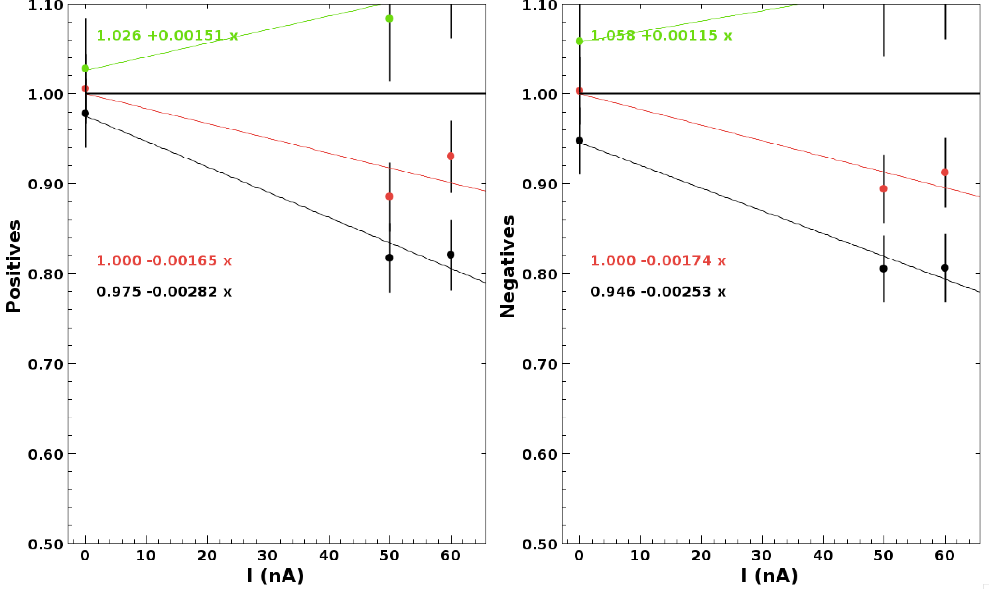

Slide 23
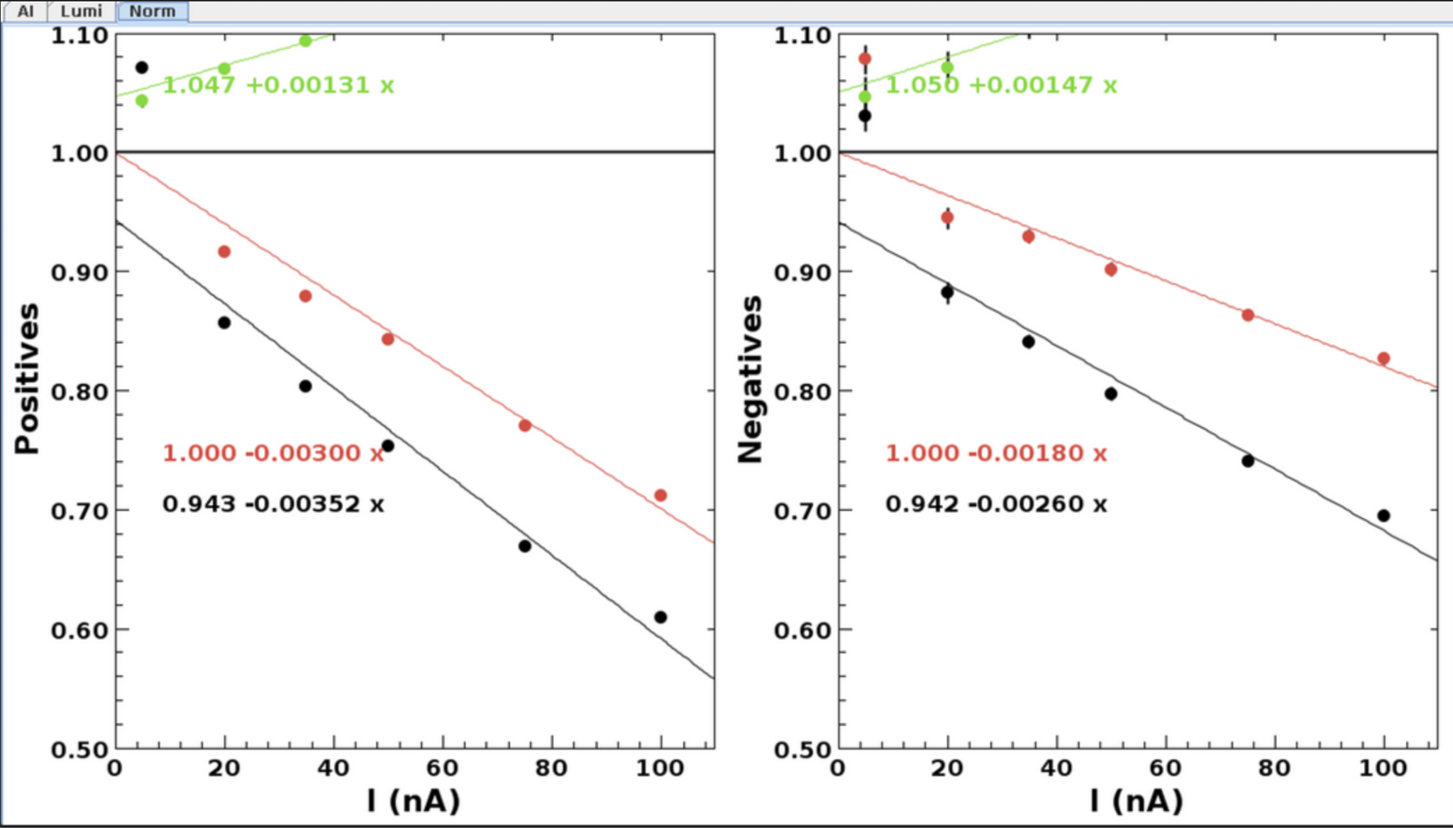
MC + background
Luminosity scan (done by Daniel)

