Slide 1

TMD group meeting
Mathieu Ouillon (Mississippi State University)
7 January 2025

Slide 2
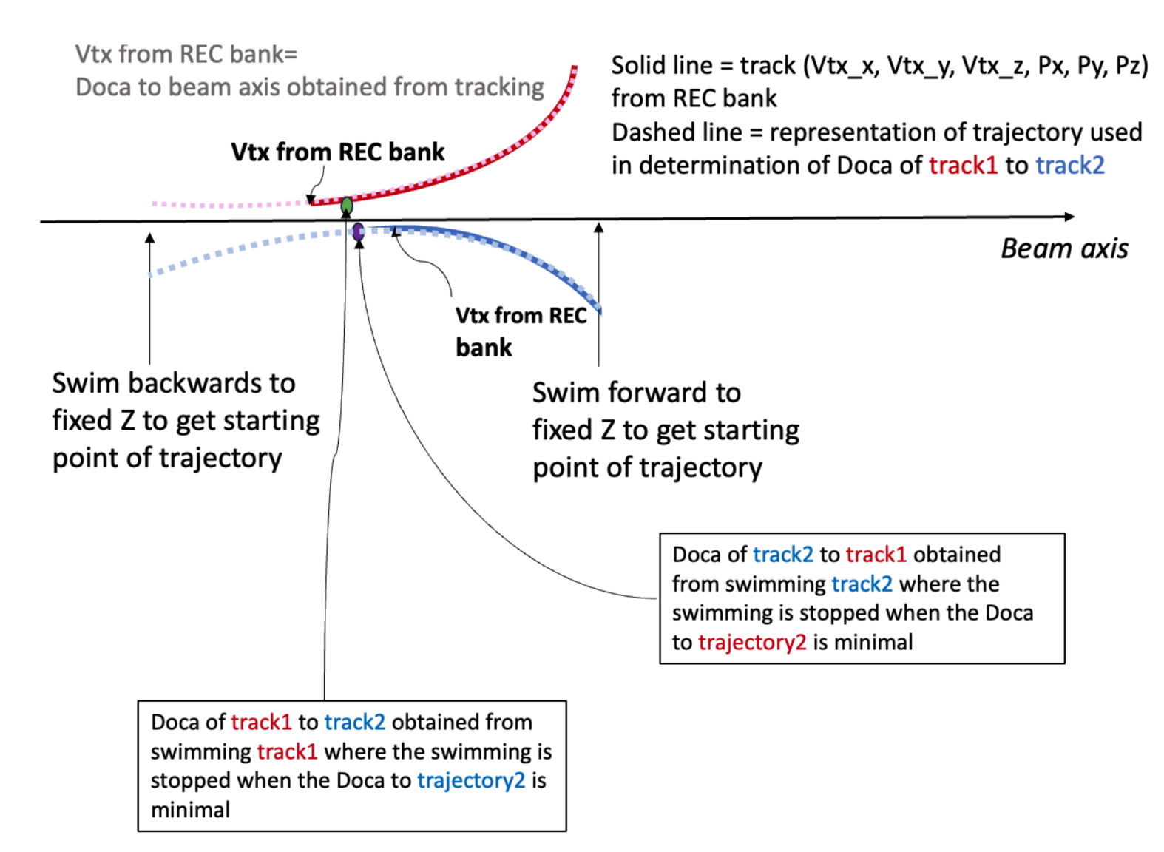
Detached vertex
Cuts electron:
-10 < Vz < 0 cm
-3 < chi2pid < 3
Pions:
-10 < Vz < 0 cm
-10 < chi2pid < 10
Kinematical cuts:
Q² > 1 GeV²
W > 2 GeV
0 < zh < 1
Detached vertex cuts:
r < 5 mm
pions vertex to be downstream of the e- vertex

Slide 3
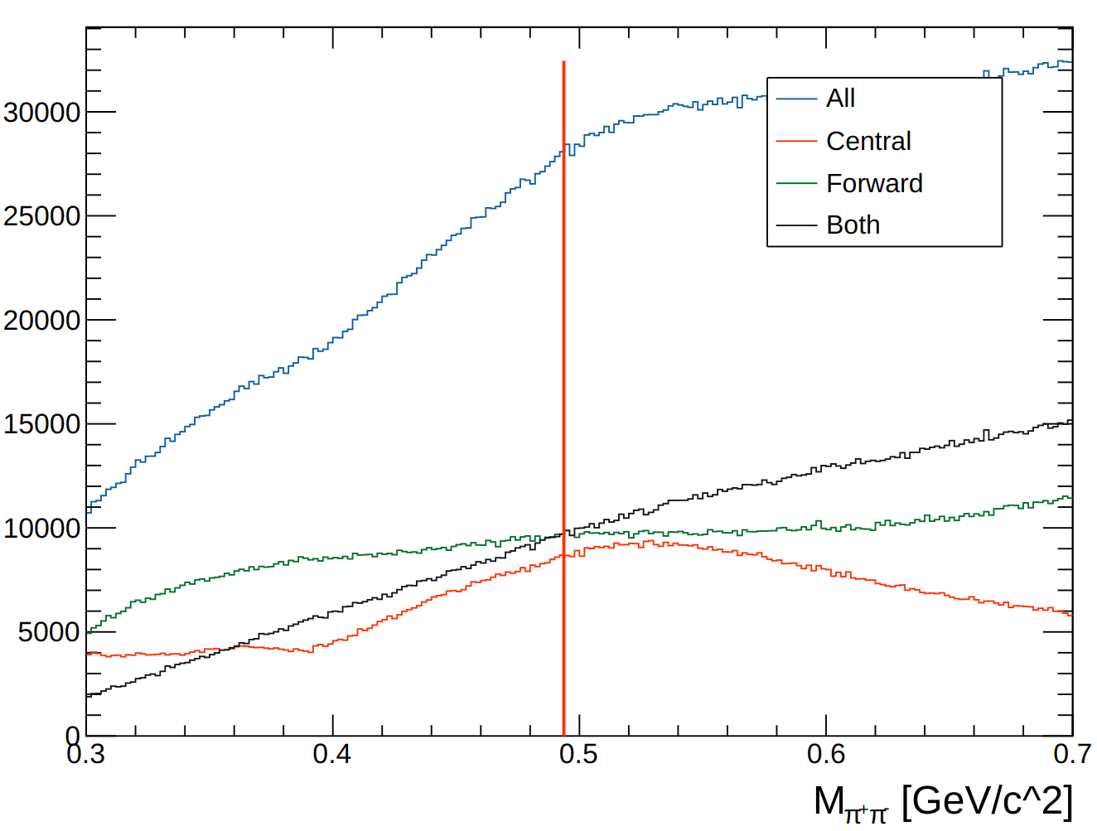
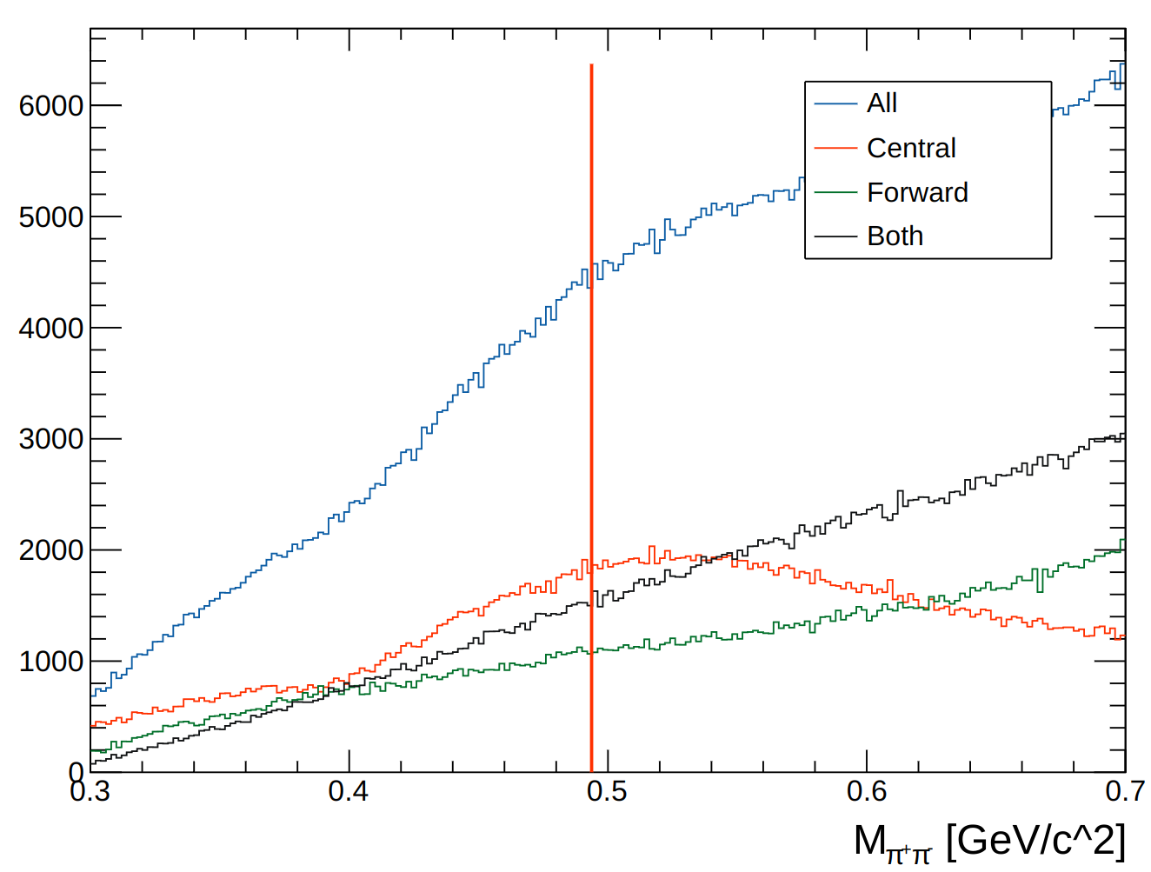
Detached vertex
Use LD2 data from Pass0v7
Before
After

Slide 4
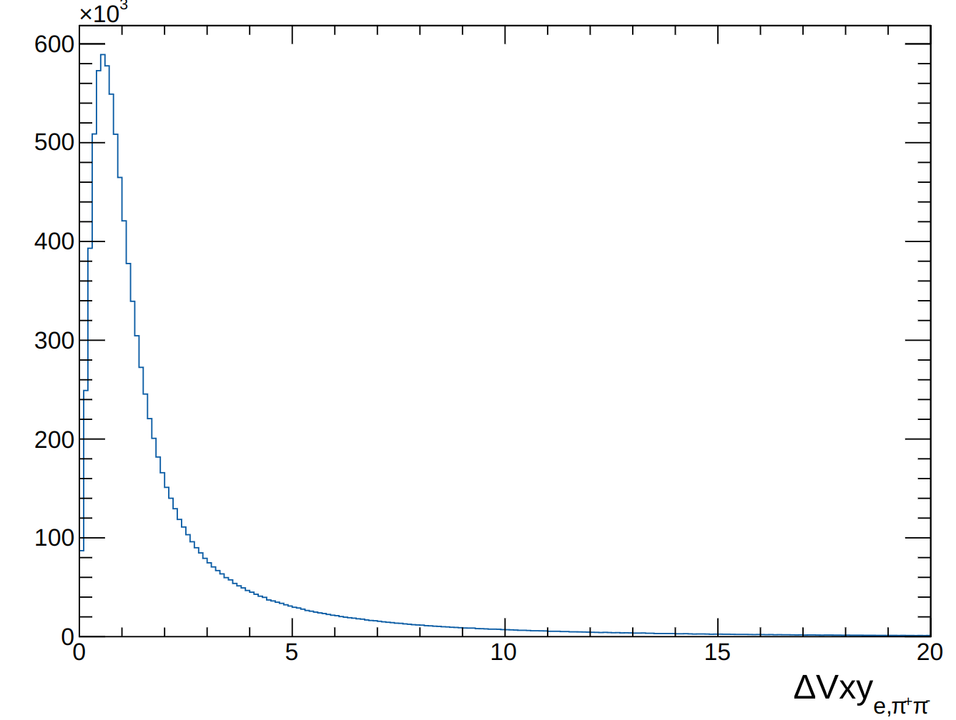
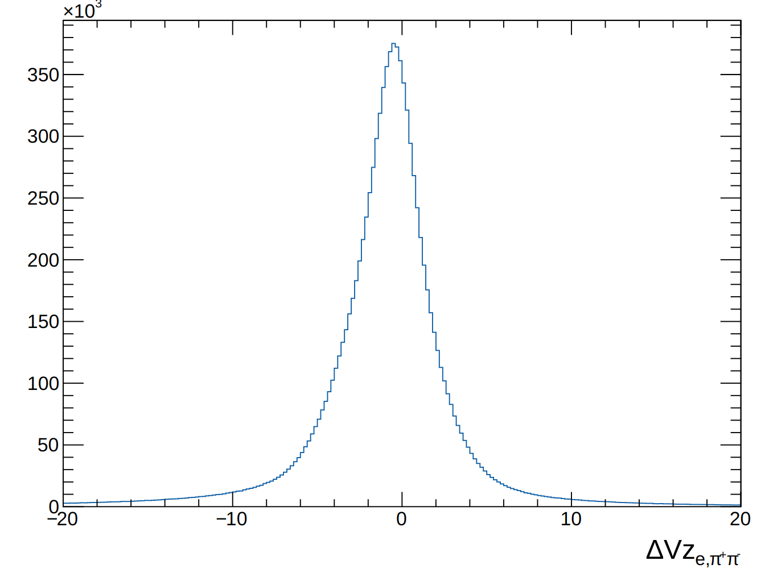
Detached vertex

