Slide 1

TMD group meeting
Mathieu Ouillon (Mississippi State University)
28 January, 2025

Slide 2
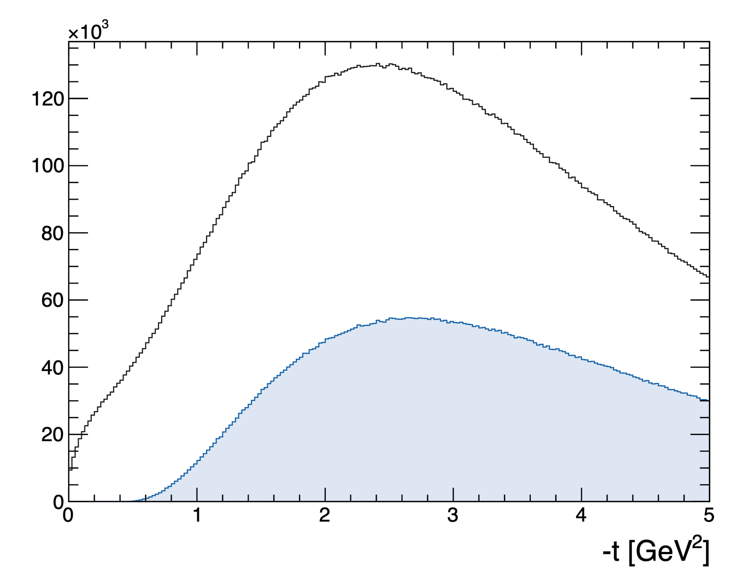
RG-D study: K⁰ analysis
Data: Pass0v7, LD2 target
Electron cuts:
pid = 11 and status < 0
-5 < chi2pid < 5
-10 < vz < 0 cm
Pions cuts:
pid = 211, -211
-10 < chi2pid < 10
-10 < vz < 0 cm
Kinematical cuts:
Q² > 1 GeV² to select the DIS regime
W > 2 GeV to avoid the resonance region
y < 0.85 to avoid large contribution from radiative processes
z_{h}<0.9 to reduce diffractive ρ⁰
-t > 0.4 GeV² to reduce diffractive ρ⁰
With z_{h} cut

Slide 3
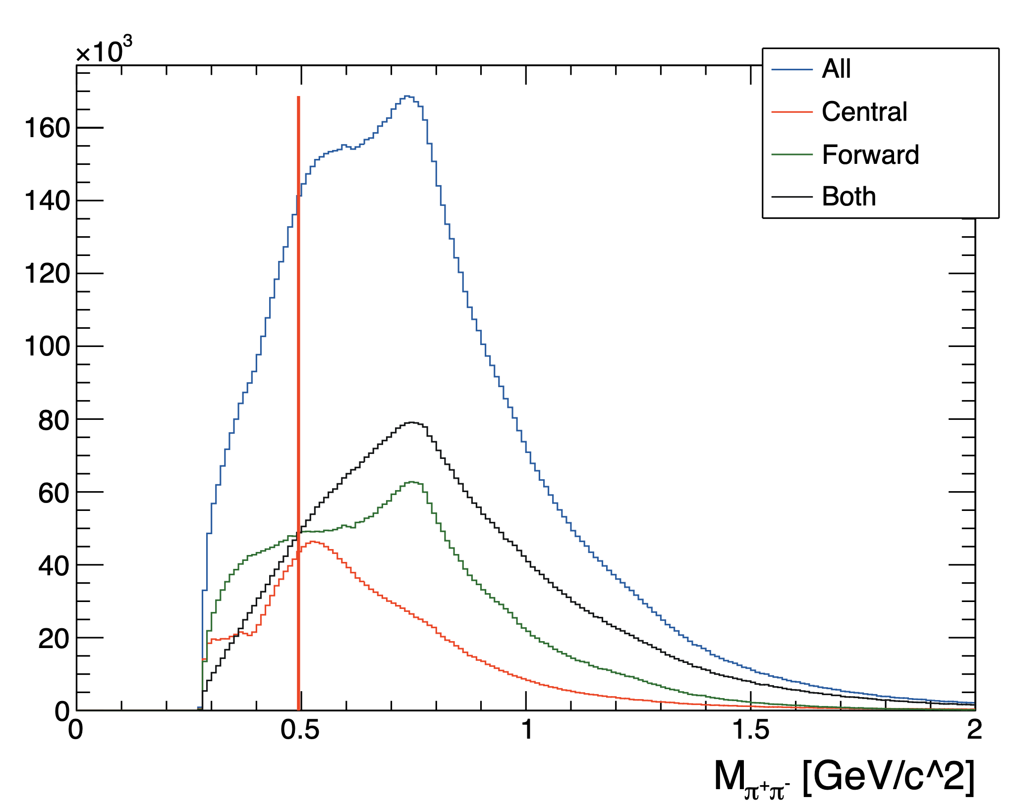
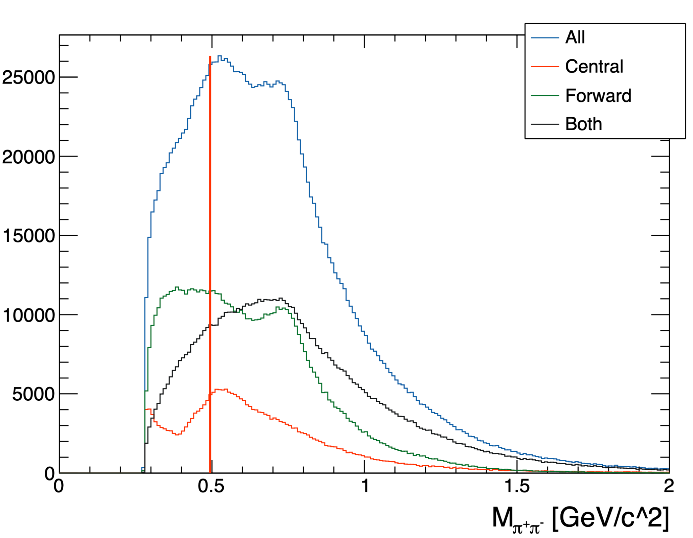
RG-D study: K⁰ analysis, without cuts on z_{h} and -t
No cut on r and ΔVz
r < 5mm and ΔVz > 0 cm

Slide 4
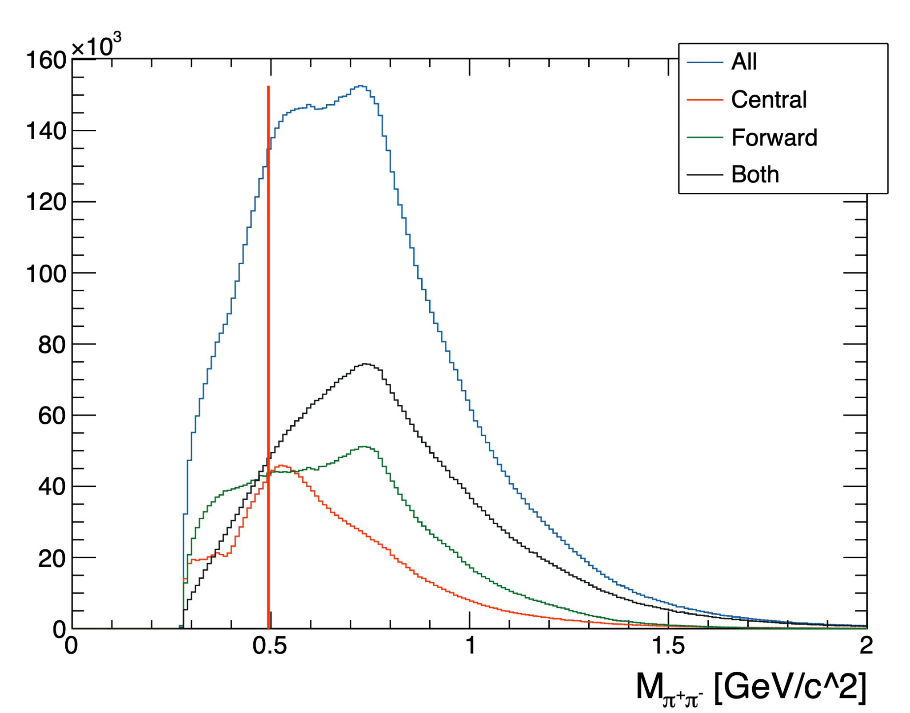
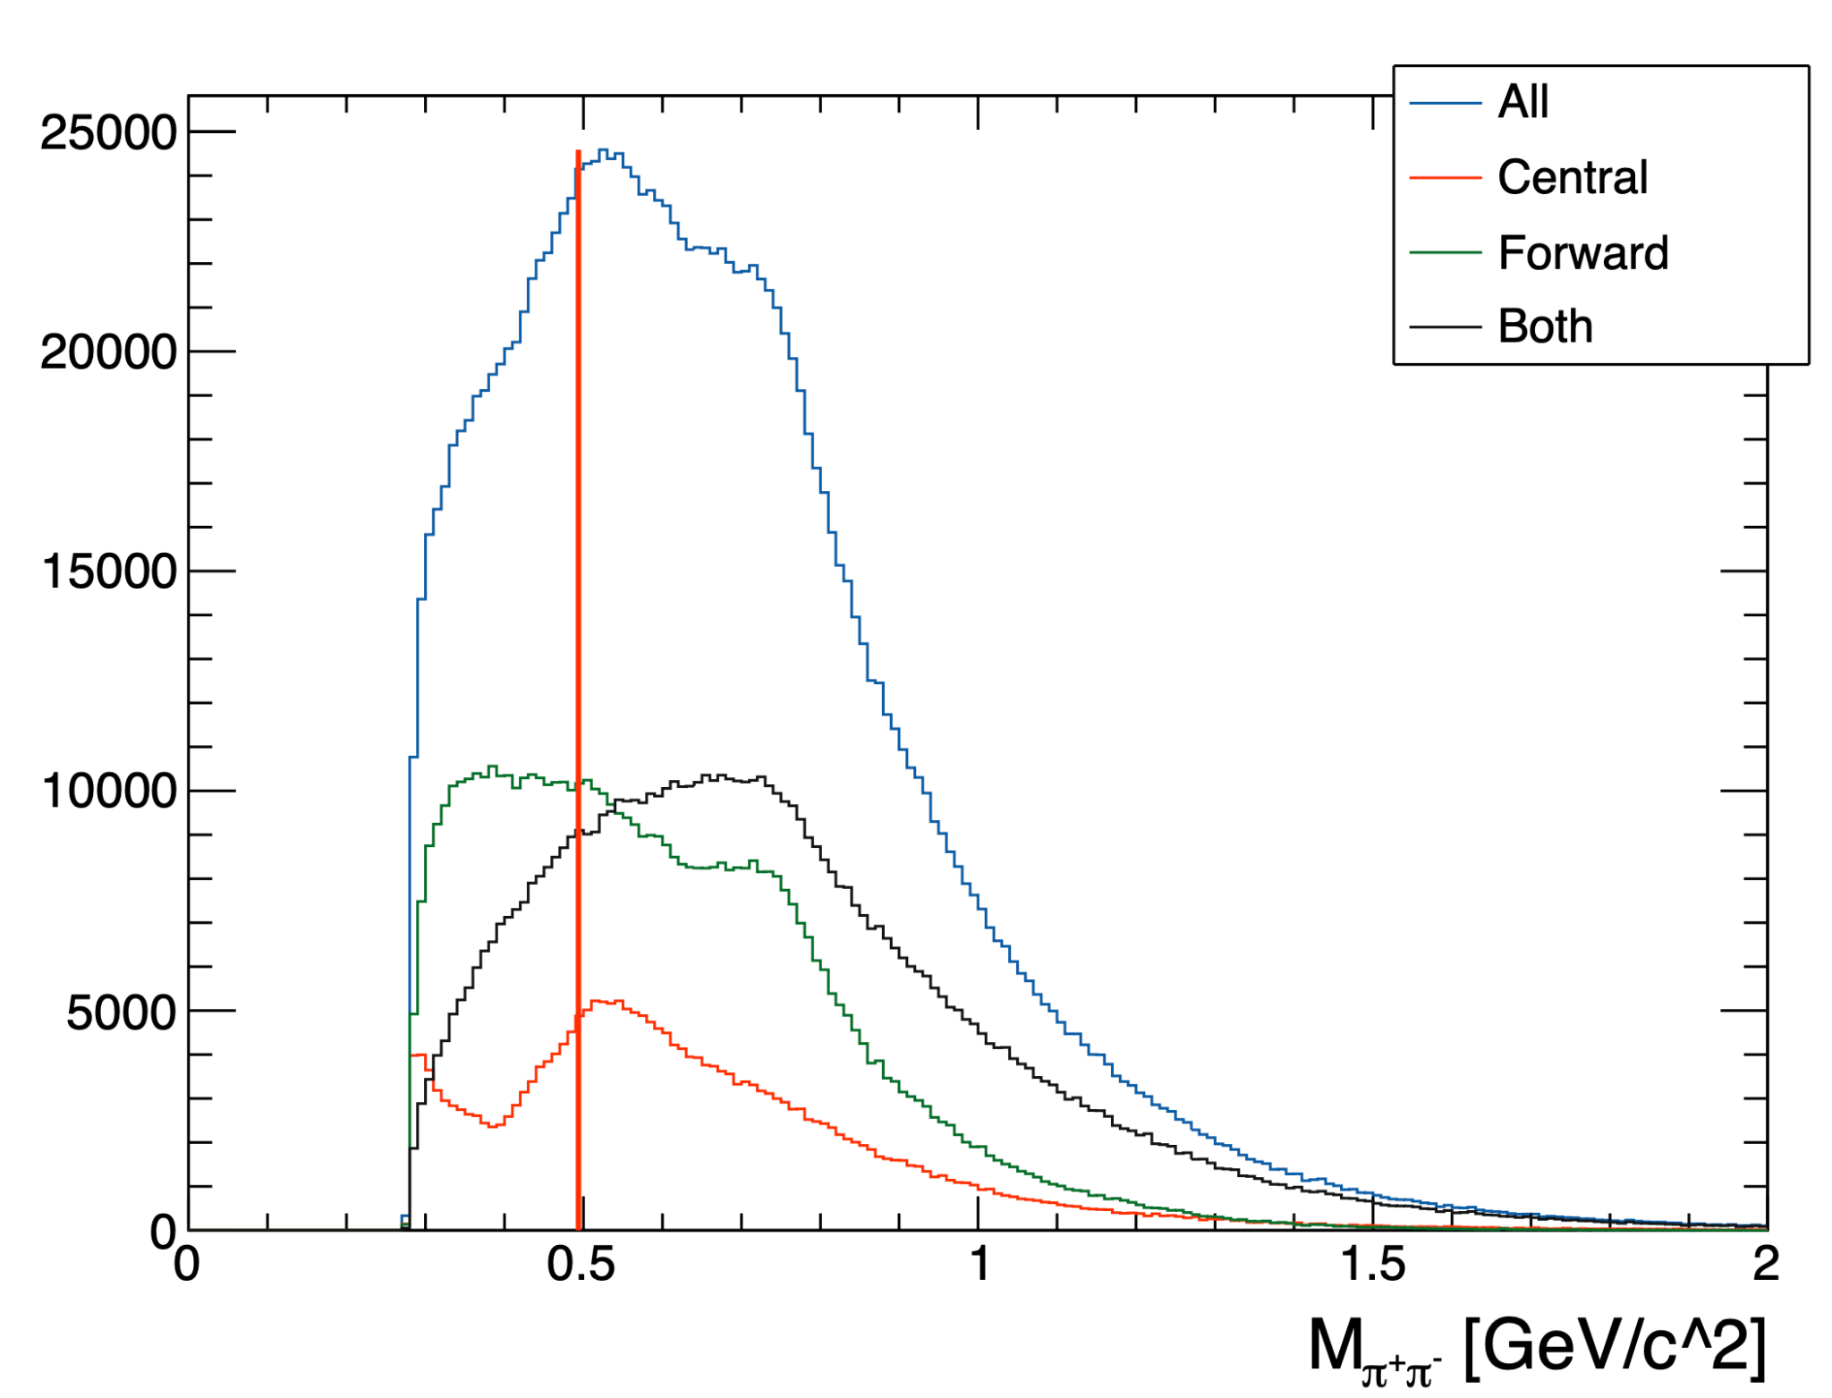
RG-D study: K⁰ analysis, with cuts on z_{h} and -t
No cut on r and ΔVz
Small reduction of the ρ⁰ peak
r < 5mm and ΔVz > 0 cm

Slide 5
RG-D study: π⁰ analysis
Use all Pass0v7 data, LD2 target.
Goal: find the π⁰ and estimate the amount.
Select trigger electron: pid=11, status<0, -5 < chi2pid < 5 and -11 < Vz < 0 cm
Select photon:
pid=22 (EB use a cut on ꞵ>0.9 to assign the pid + E>0.0001GeV)
E > 0.6 GeV → reduce radiative photon ¹
-11 < Vz < 0 cm
sector_{e} != sector_{γ} → reduce radiative photon ¹
cut based on the matching of the photon flight time with the path which photon traveled from target to the EC: −1.68 < t_{EC} − t_{start} − l_{EC} /30 < 1.55 ns (Analysis note by T.Mineeva, W.Brooks, K.Joo)
Radiative photons are dominant at small energies and show a small opening angle in relation to the emitting scattered electron
1: (Analysis note by Stefan Diehl, Andrey Kim, Kyungseon Joo)

Slide 6
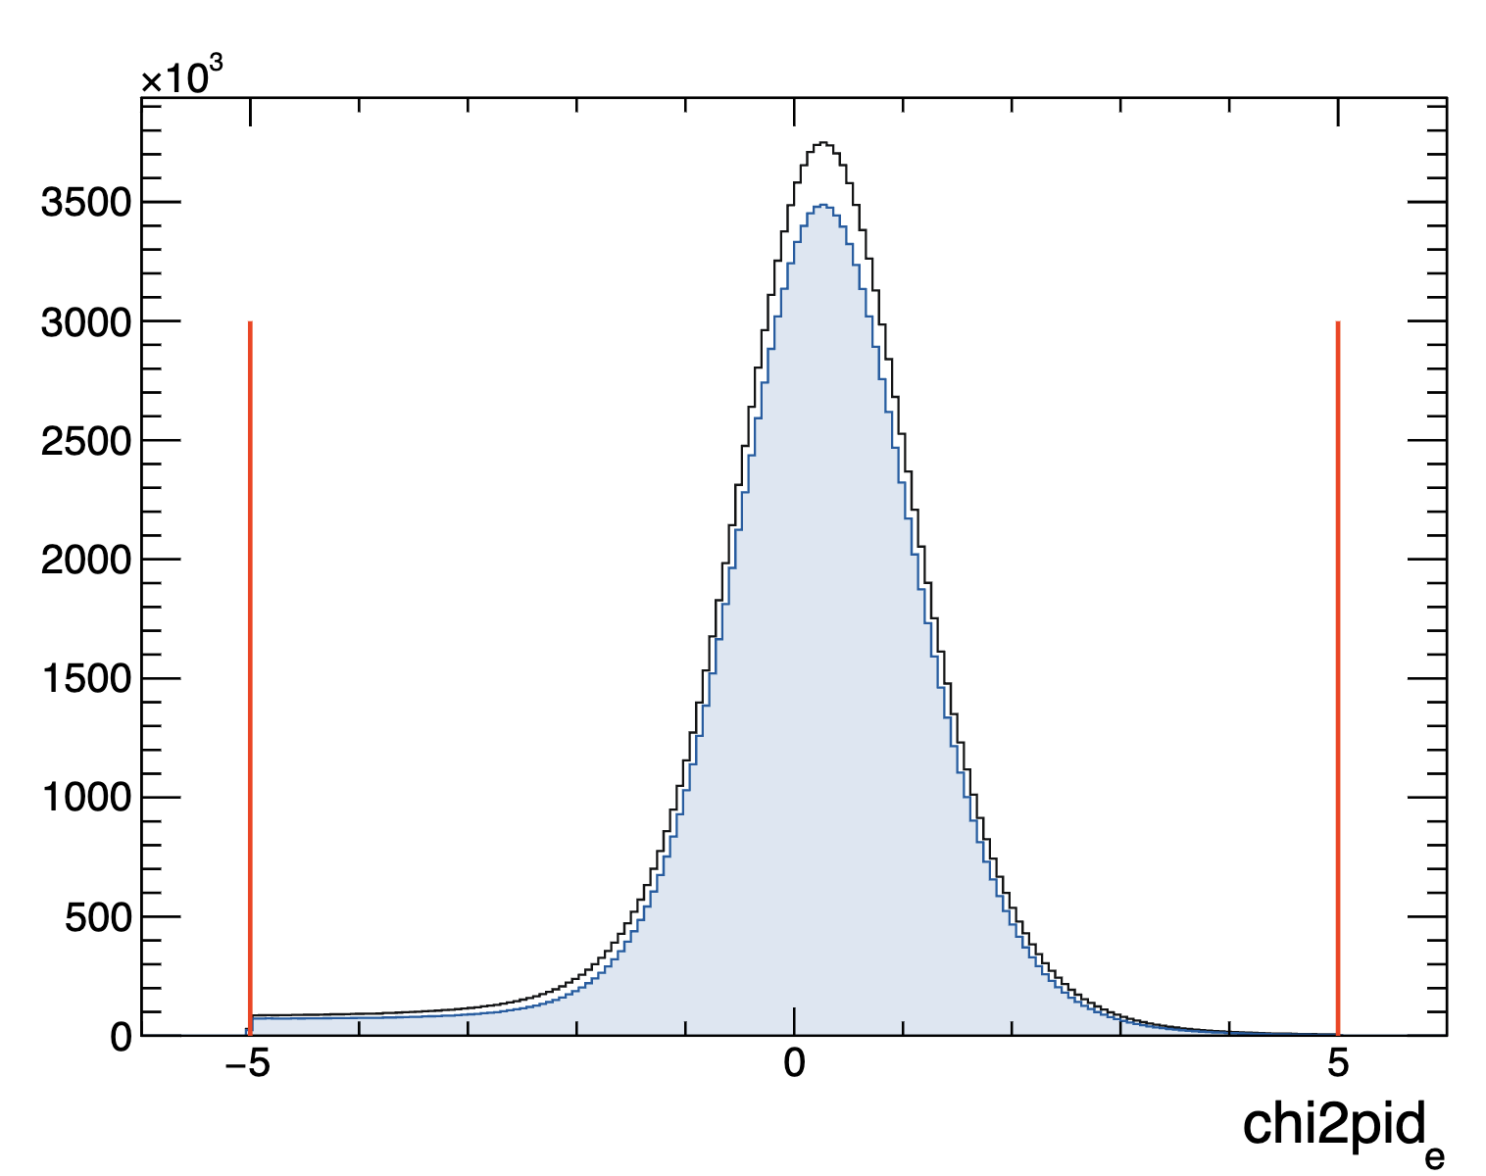
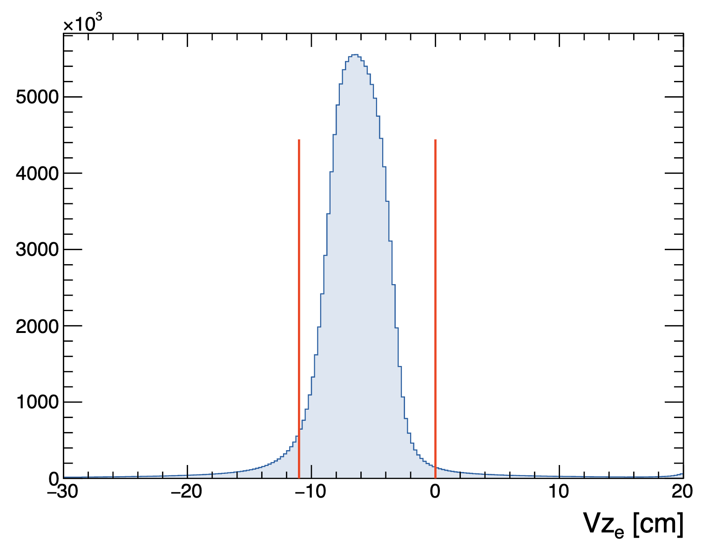
RG-D study: π⁰ analysis

Slide 7
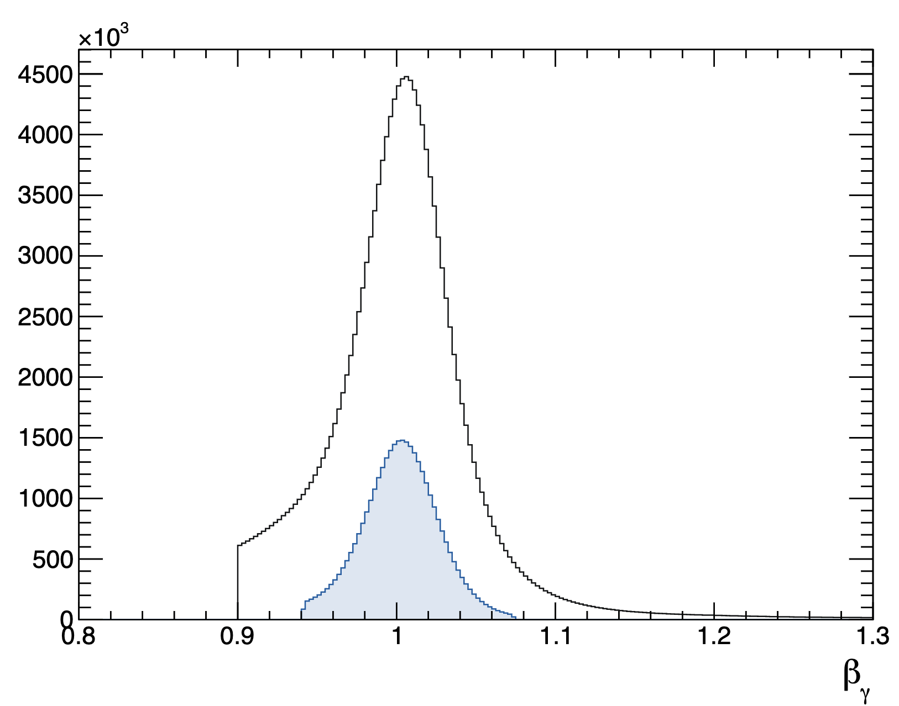
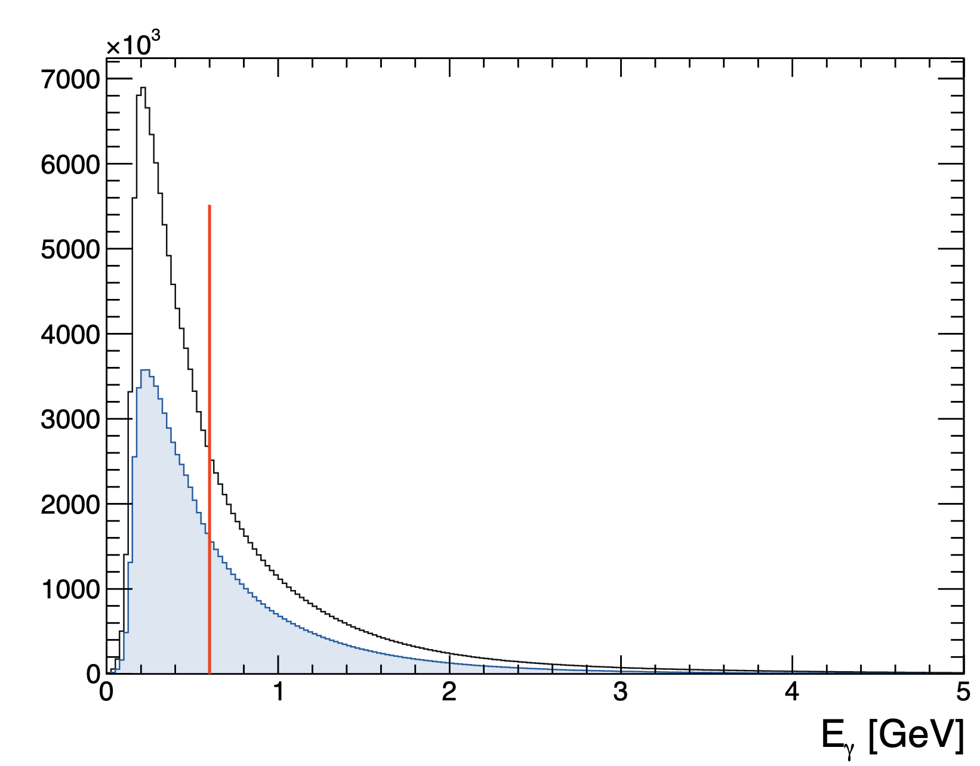
RG-D study: π⁰ analysis

Slide 8
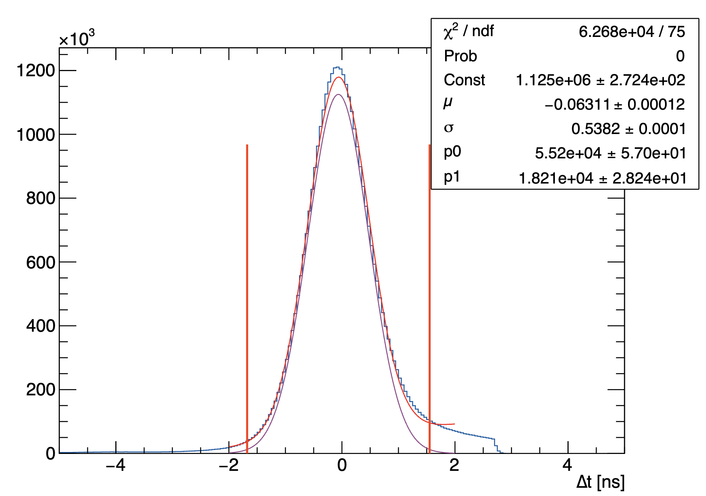
RG-D study: π⁰ analysis

Slide 9
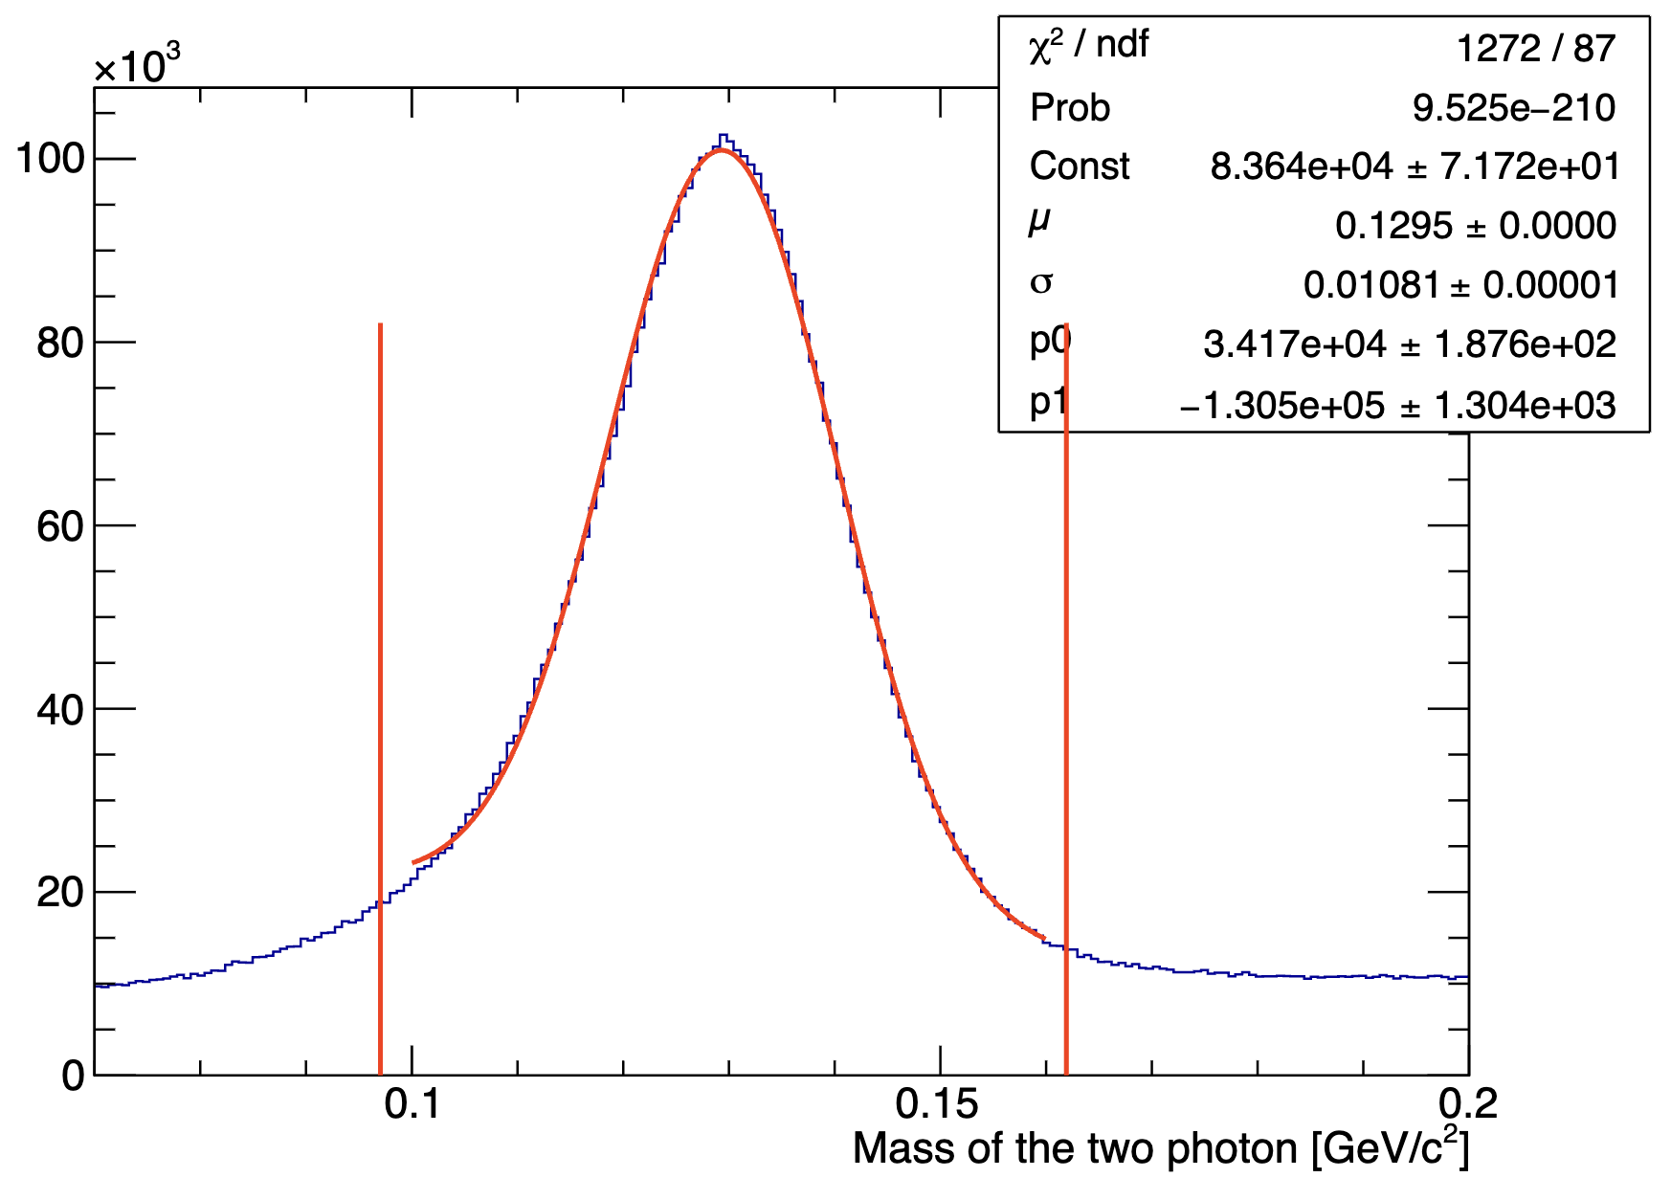
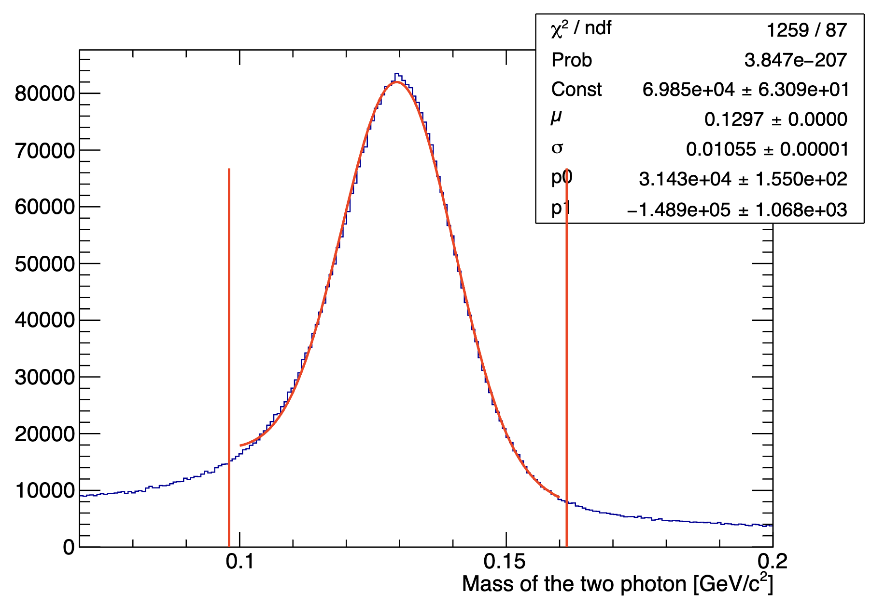
RG-D study: π⁰ analysis
Try a cut on the photon sector: sector_{γ1} = sector_{γ2} kinematically both photons from neutral pion decay are more likely to end up in the same sector (Analysis note by Stefan Diehl, Andrey Kim, Kyungseon Joo)
Number of π⁰: 3477790
Number of π⁰: 2835602
Without sector cut
With sector cut

Slide 10
RG-D study: π⁰ analysis
Try a cut on the photon sector: sector_{γ1} = sector_{γ2} : kinematically both photons from neutral pion decay are more likely to end up in the same sector (Analysis note by Stefan Diehl, Andrey Kim, Kyungseon Joo)
Fit the two photons mass distribution with a gaussian and a 1st order polynomial function.
Small improvement with the sector cuts but reduction of the number of π⁰ by 20%
Without sector cut
Number of π⁰: 3477790
μ: 0.1295 GeV/c²
𝜎: 0.01081 GeV/c²
With sector cut
Number of π⁰: 2835602
μ: 0.1297 GeV/c²
𝜎: 0.01055 GeV/c²

Slide 11
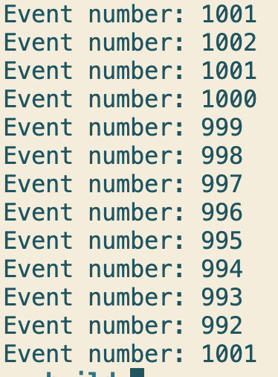
RG-D study: π⁰ analysis
Nothings to show.
I started working on the event mixing method, based on Neutral Pion Multiplicity Ratios from SIDIS Lepton-nuclear Scattering T.Mineeva, W.Brooks, K.Joo
Need to be able to process next and previous event with the HIPO C++ library, I had to develop code to do that. And also be able to come back to a specific event.

