Slide 1

TMD meeting
Mathieu Ouillon (Mississippi State University)
04 February, 2025

Slide 2
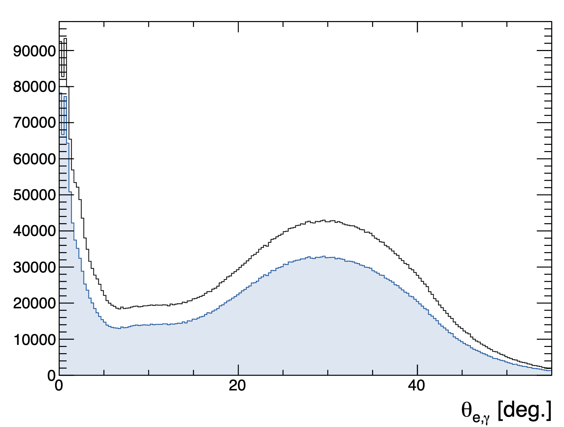
RG-D study: π⁰ analysis
I have applied a cut on the photon to have a different sector than the electron; this cut aims to reduce the radiative photon.
A better way to reduce this is to cut on the opening angle between the electron and photon.
Data: pass0v7 LD2 data
Cuts: Electron pid=11, status<0 and -11<vz<0 cm
Photons: pid =22, E>0.2 GeV and -1.67 < Δt < 1.55 ns
Black just with pid=22
Blue with E>0.2GeV,Δt

Slide 3
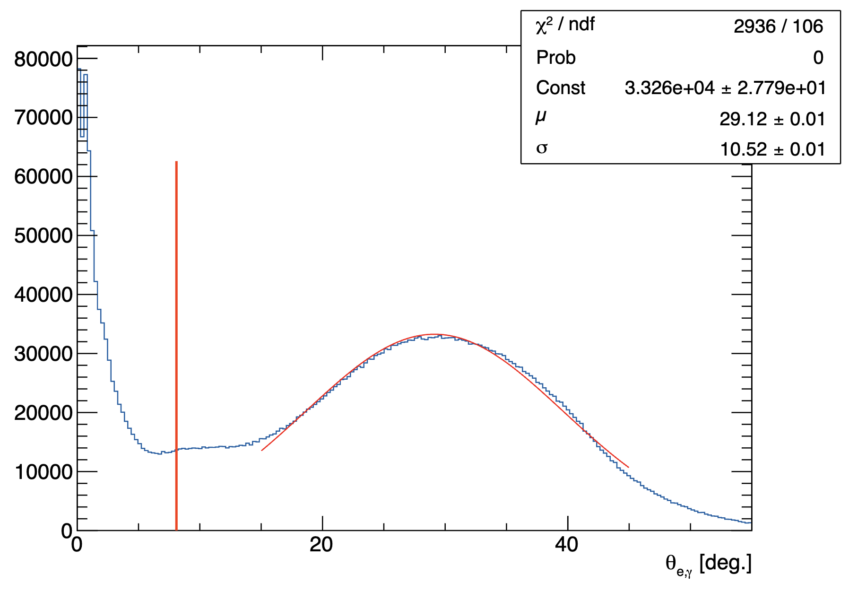
RG-D study: π⁰ analysis
Data: pass0v7 LD2 data
Cuts: Electron pid=11, status<0 and -11<vz<0 cm
Photons: pid =22, E>0.2 GeV and -1.67 < Δt < 1.55 ns
Use a 2σ cut: 29.12 - 2 * 10.52 deg

Slide 4
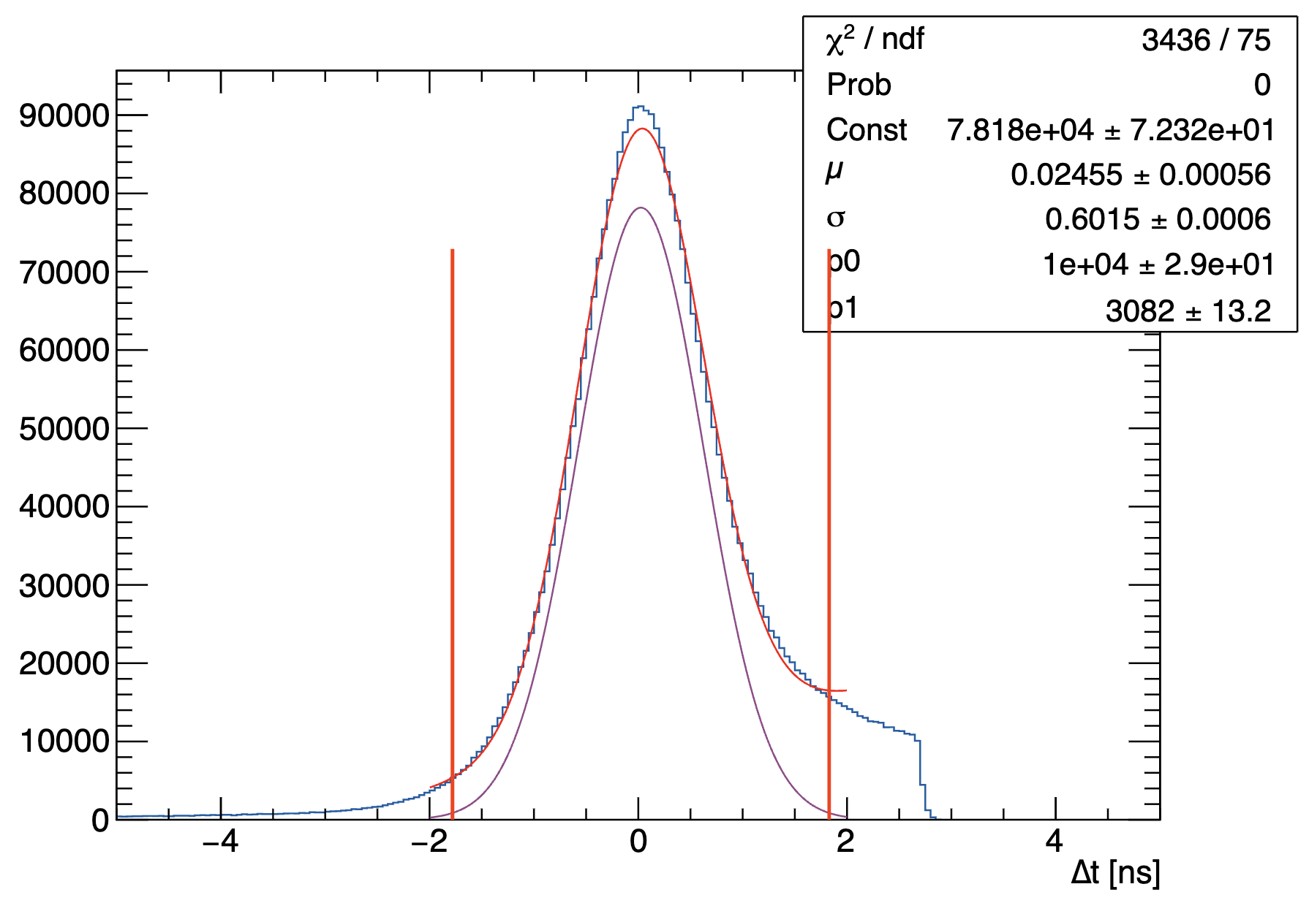
RG-D study: π⁰ analysis
Data: pass0v7 LD2 data
Cuts: Electron pid=11, status<0 and -11<vz<0 cm
Photons: pid =22, E>0.2 GeV,
Use a 2σ cut: 29.12 - 2 * 10.52 deg

Slide 5
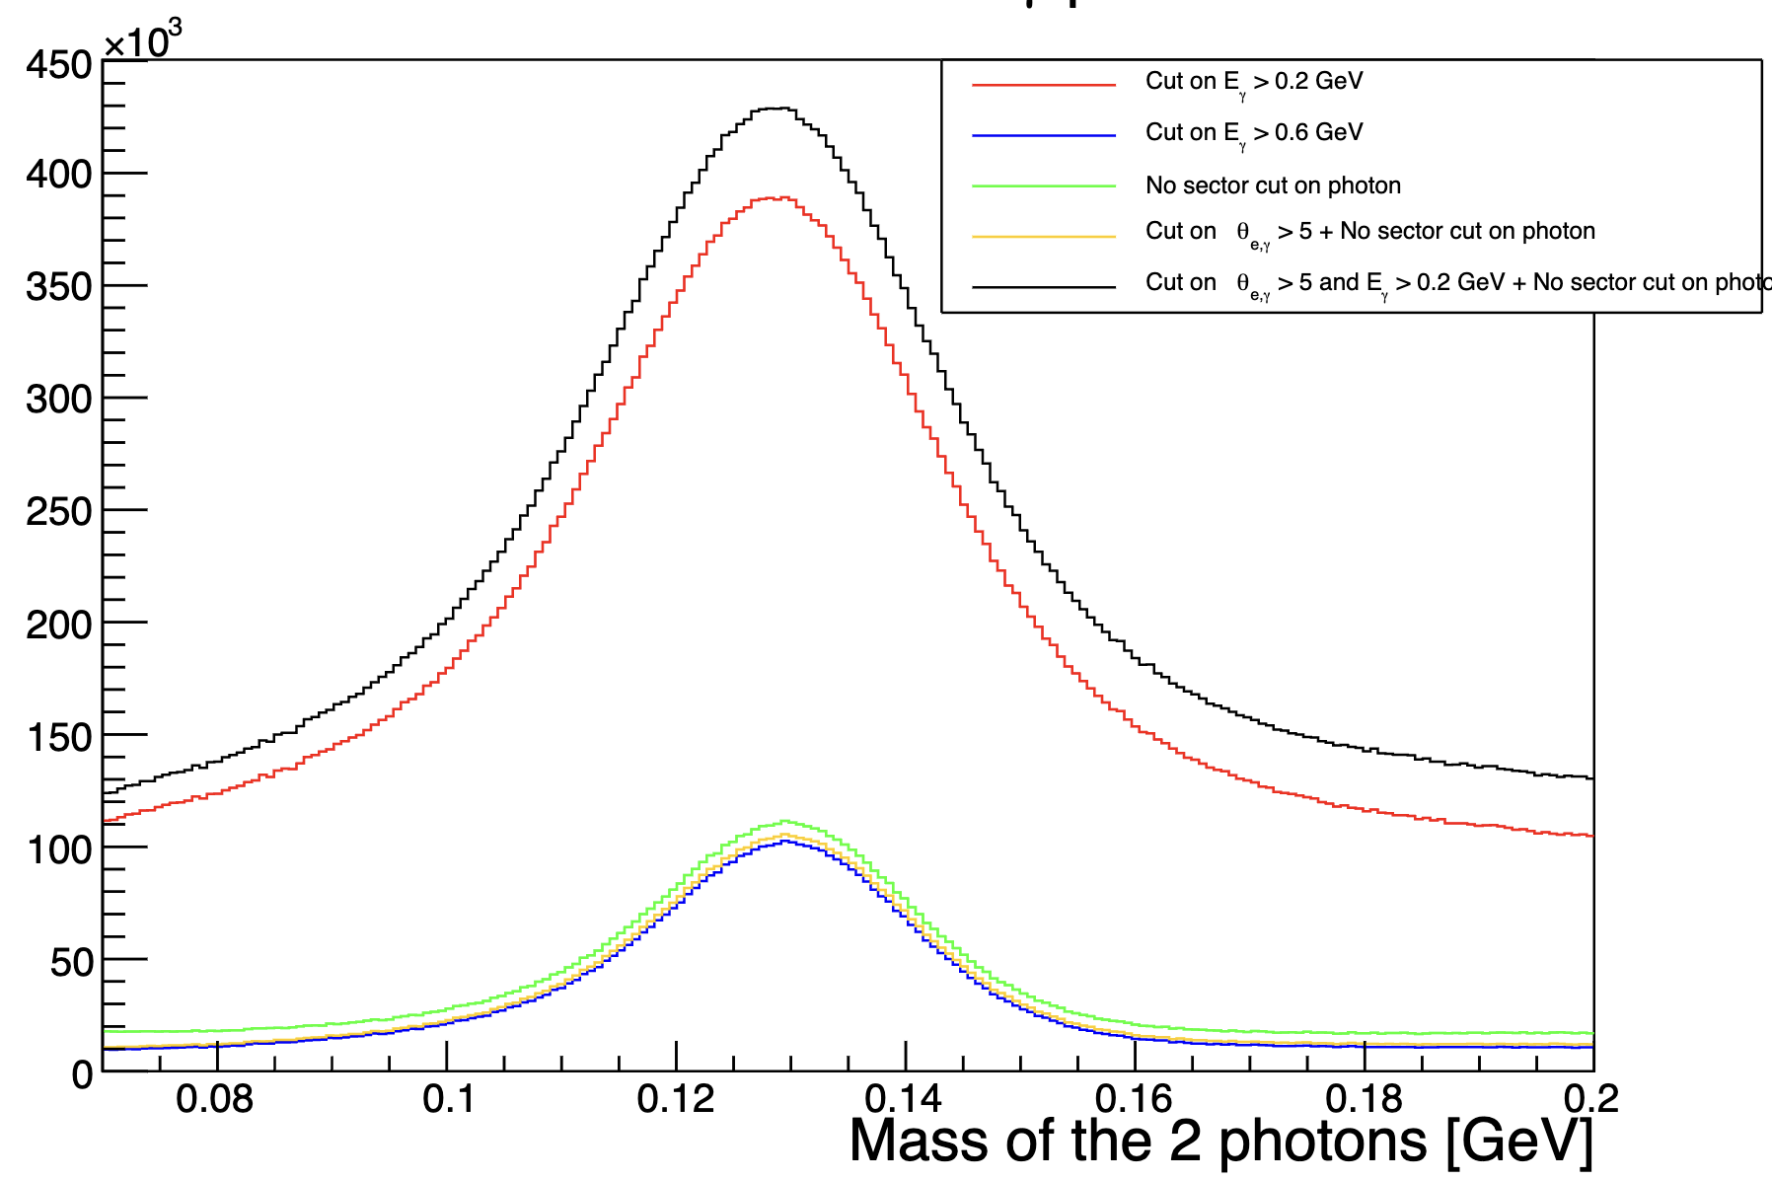
RG-D study: π⁰ analysis
I aimed to investigate the influence of the photon energy cut and the sector cut—where both photons must reside within the same sector—on the invariant mass.
Notably, the photon energy cut eliminates many photons.
Blue, (E>0.6 GeV,sector cut, no cut on opening angle)
Red, (E>0.2 GeV,sector cut, no cut on opening angle)
Black, (E>0.2 GeV, no sector cut, cut on opening angle)
Green, (E>0.6 GeV,no sector cut, no cut on opening angle)
Orange, (E>0.6 GeV,no sector cut, cut on opening angle)

Slide 6
RG-D study: π⁰ analysis
Red -> Background: 123580, Signal: 387946, S/B: 3.13923 diff: 264366
Blue -> Background: 10882, Signal: 101918, S/B: 9.36574 diff: 91036
Green -> Background: 17936, Signal: 110780, S/B: 6.1764 diff: 92844
Orange -> Background: 11962, Signal: 104764, S/B: 8.75807 diff: 92802
Black -> Background: 137886, Signal: 427952, S/B: 3.10367 diff: 290066

Slide 7
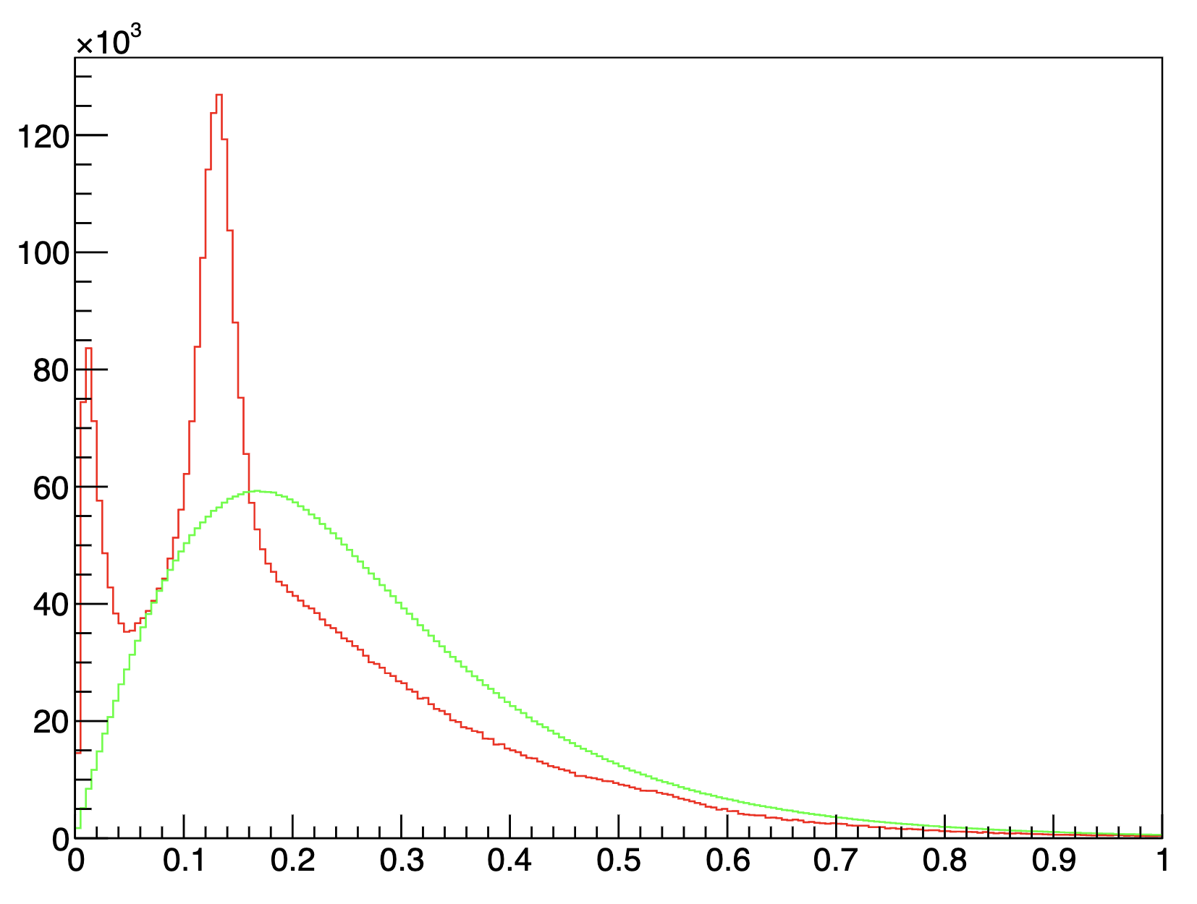
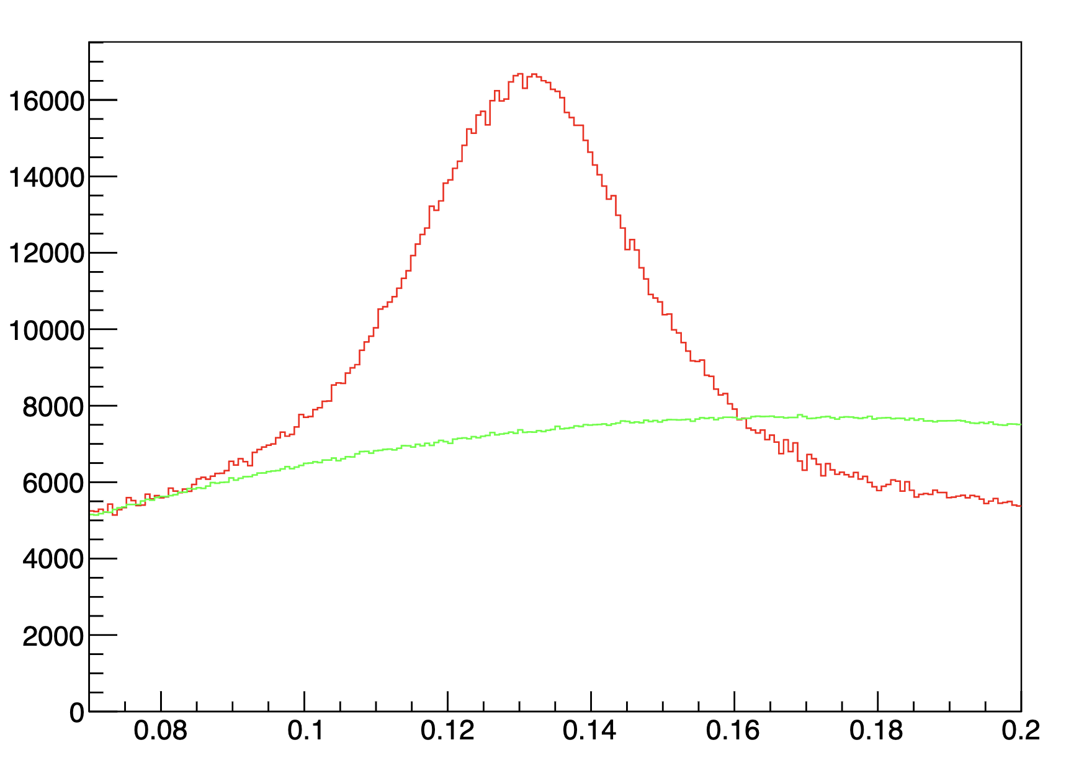
RG-D study: π⁰ analysis
I iterate over the next 10 events; however, if fewer than ten events are available, I iterate over the previous 10 events instead.

