Slide 2
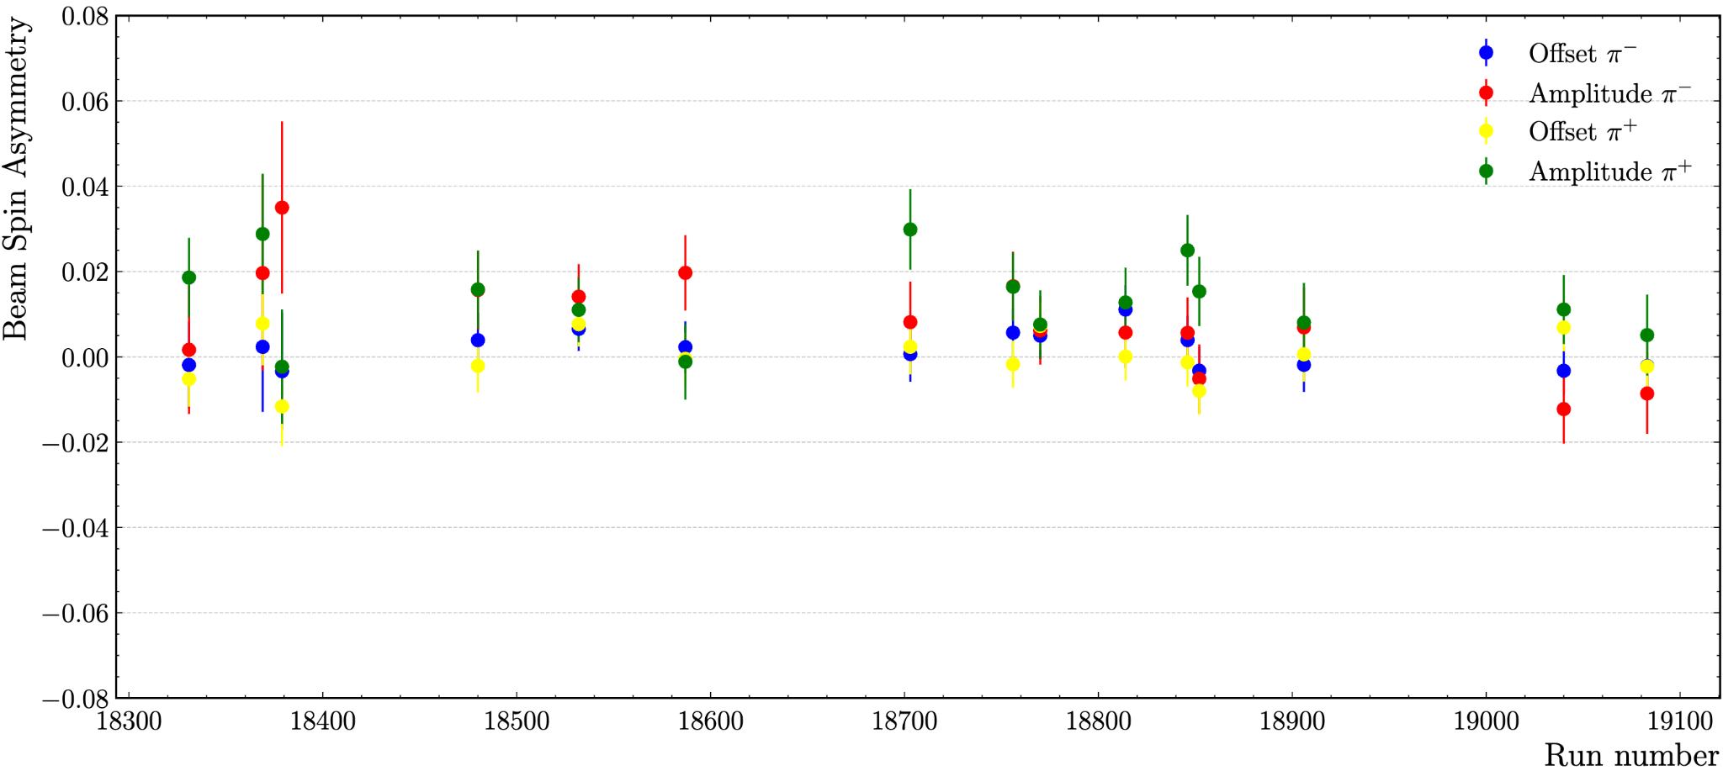
Run 18532:
My values: π⁻ amplitude: 0.0141, offset: 0.00656
Timeline: π⁻ amplitude: 0.0142, offset: 0.00653
My values: π⁺ amplitude: 0.0110, offset: 0.00766
Timeline: π⁺ amplitude: 0.01087, offset: 0.00765
Run 18331:
My values: π⁻ amplitude: 0.00166, offset: -0.00190
Timeline: π⁻ amplitude: 0.00164, offset: -0.00192
My values: π⁺ amplitude: 0.01861, offset: 0.00518
Timeline: π⁺ amplitude: 0.001866, offset: -0.00192
Run 18852:
My values: π⁻ amplitude: -0.0052, offset: -0.00322
Timeline: π⁻ amplitude: -0.0054, offset: -0.00320
My values: π⁺ amplitude: -0.0149, offset: 0.00798
Timeline: π⁺ amplitude: -0.00143, offset: 0.00804

