Slide 1
Clas Collaboration meeting
ɸ electroproduction on the neutron with RGB: K⁺ K⁻ channel
13 Feb 2026
M. Ronayette, P. Chatagnon
Mathieu Ronayette
rgB - meeting
1/18
Mathieu Ronayette
13 Feb 2026

Slide 2
Summary
Motivations
Events selection
Generator for MC simulation
Effect of differents cuts
Extraction of the yield
Neutron Efficiency correction
Acceptance correction
Binning correction
Preliminary plot of differential cross section
Mathieu Ronayette
rgB - meeting
2/18
Mathieu Ronayette
13 Feb 2026

Slide 3
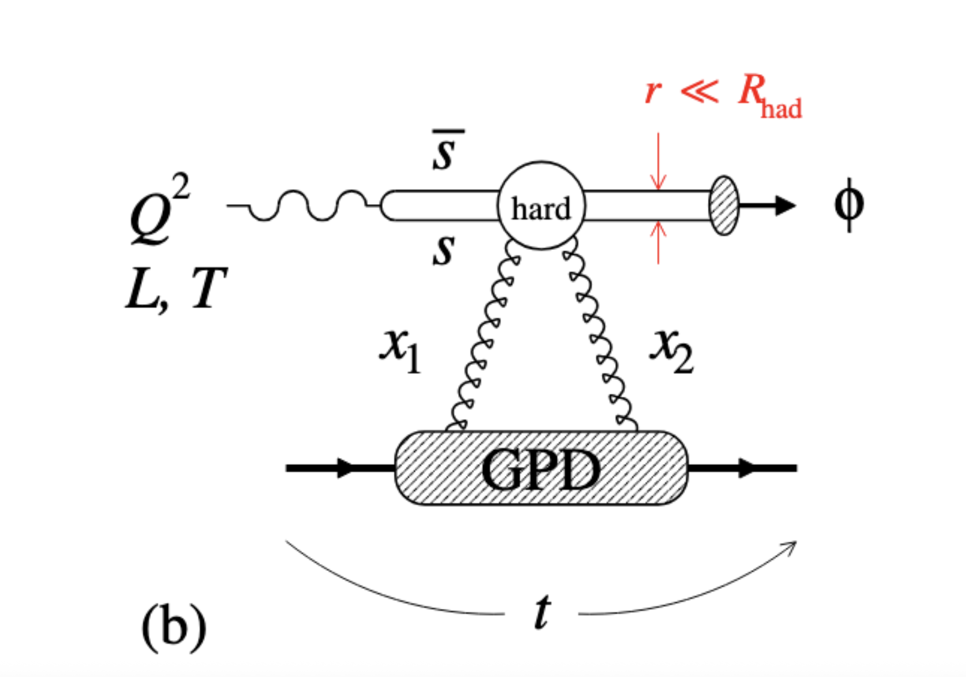
Introduction
Analysis objective :
- Measurement of the cross section and differential cross section of the electroproduction of ɸ in the K⁺ K⁻ channel with RGB data (deuterium target).
e n → e n’ K⁺ K⁻
→
Acess to the gluon GPD of the neutron
- We expect that cross section measurement to be similar to that of proton. We will compare with proton bound target (RGB) and with the work on free proton target (Bhawani’s work on RGA).
Change of t–dependence with Q2 →
gluonic radius of the neutron
Mathieu Ronayette
rgB - meeting
3/18
Mathieu Ronayette
13 Feb 2026

Slide 4
Introduction
Analysis :
Datas :
sidisdvcs RG-B outbending fall 2019
e n → e n’ K⁺ K⁻
Events selection :
→
→
Cuts :
→ Cut on the angle between the missing nucleon and the neutron
→ Cut on –0.5 < MissingMass_{tot} ² < 0.5 GeV ²
→ Cut on status of K⁺ and K⁻ (keep event with both kaons in FD)
e⁻ | K⁺ | K ⁻ | neutron | proton
1 | 1 | 1 | >= 1 | 0
(select the best neutron wich minimize the angle
between the missing nucleon and the neutron)
Q² > 1.0 GeV | P_{electron} > 2 GeV | θ_{neutron} > 4 ° | P_{neutron} > 0.25 GeV
Mathieu Ronayette
4/18
Mathieu Ronayette
rgB - meeting
13 Feb 2026

Slide 5
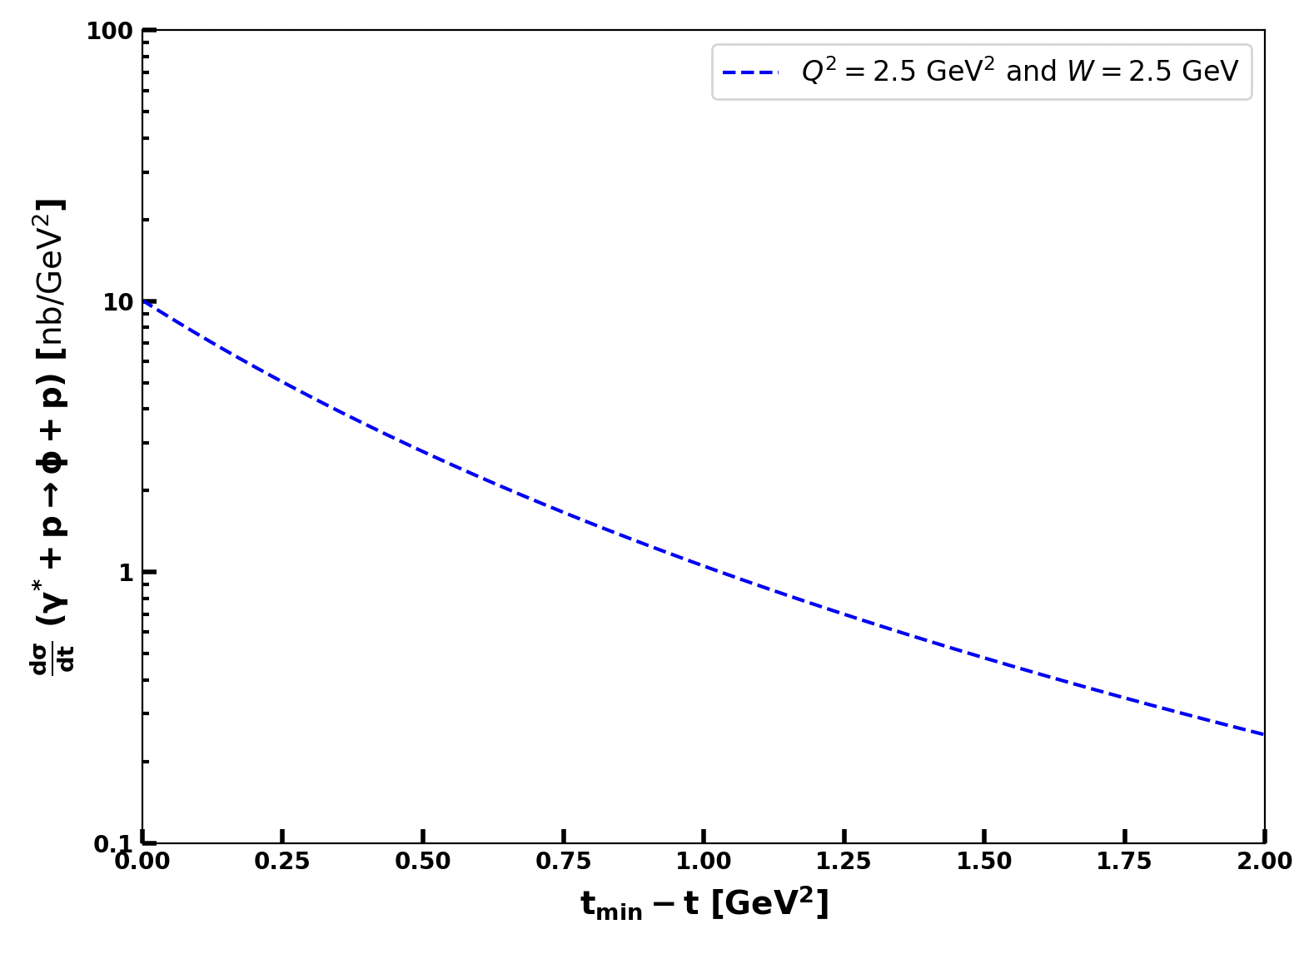
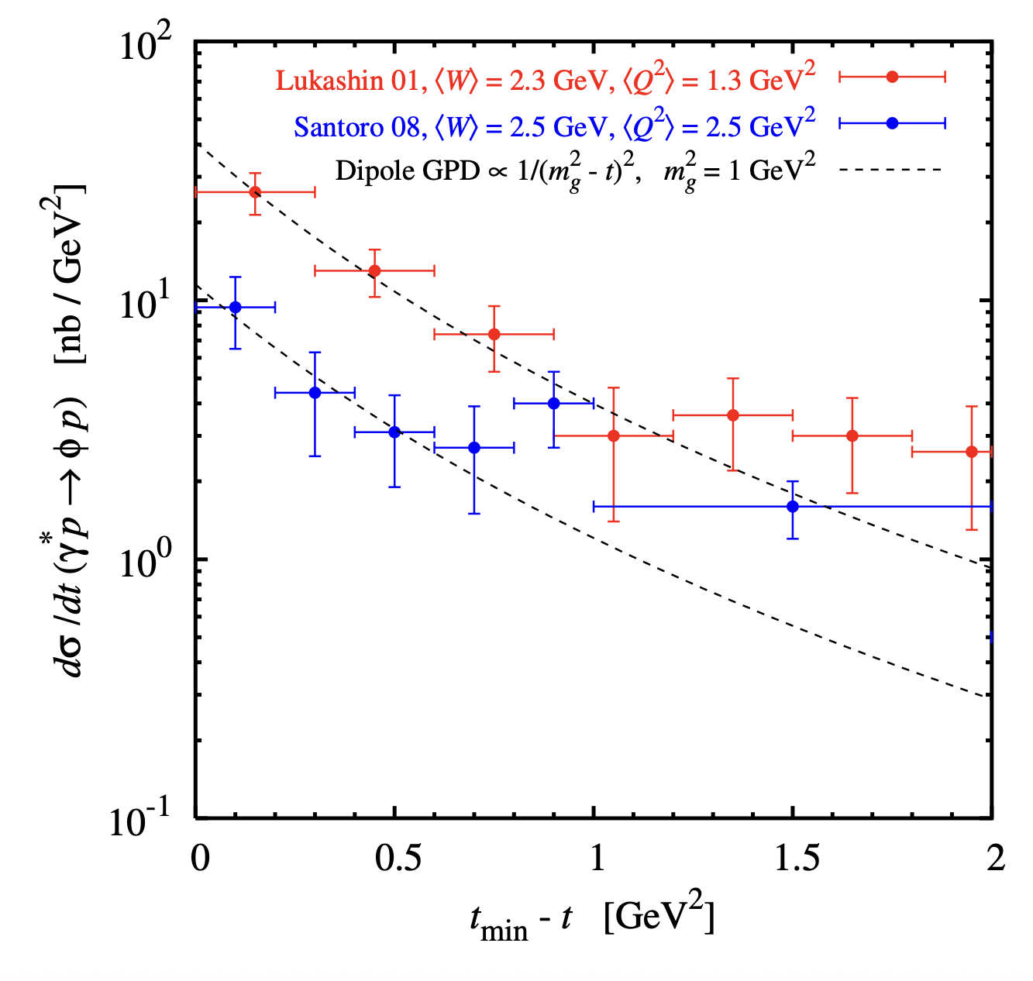
ɸ generator
Implemented in the generator
From Proposal to Jeﬀerson Lab PAC39
Mathieu Ronayette
5/18
Mathieu Ronayette
rgB - meeting
13 Feb 2026

Slide 6
Details on cuts : angle between miss nucleon and detected neutron
Missing_nucleon = the missing particle of this reaction : e n → e’ K⁺ K⁻ X
K⁺
K⁺
K⁻
K⁻
e⁻
e⁻
neutron
neutron
missing_nucleon
missing_nucleon
Not a good event
Good event
→ Cut on the angle between the missing nucleon and the neutron < 5 °
Mathieu Ronayette
6/18
Mathieu Ronayette
rgB - meeting
13 Feb 2026

Slide 7
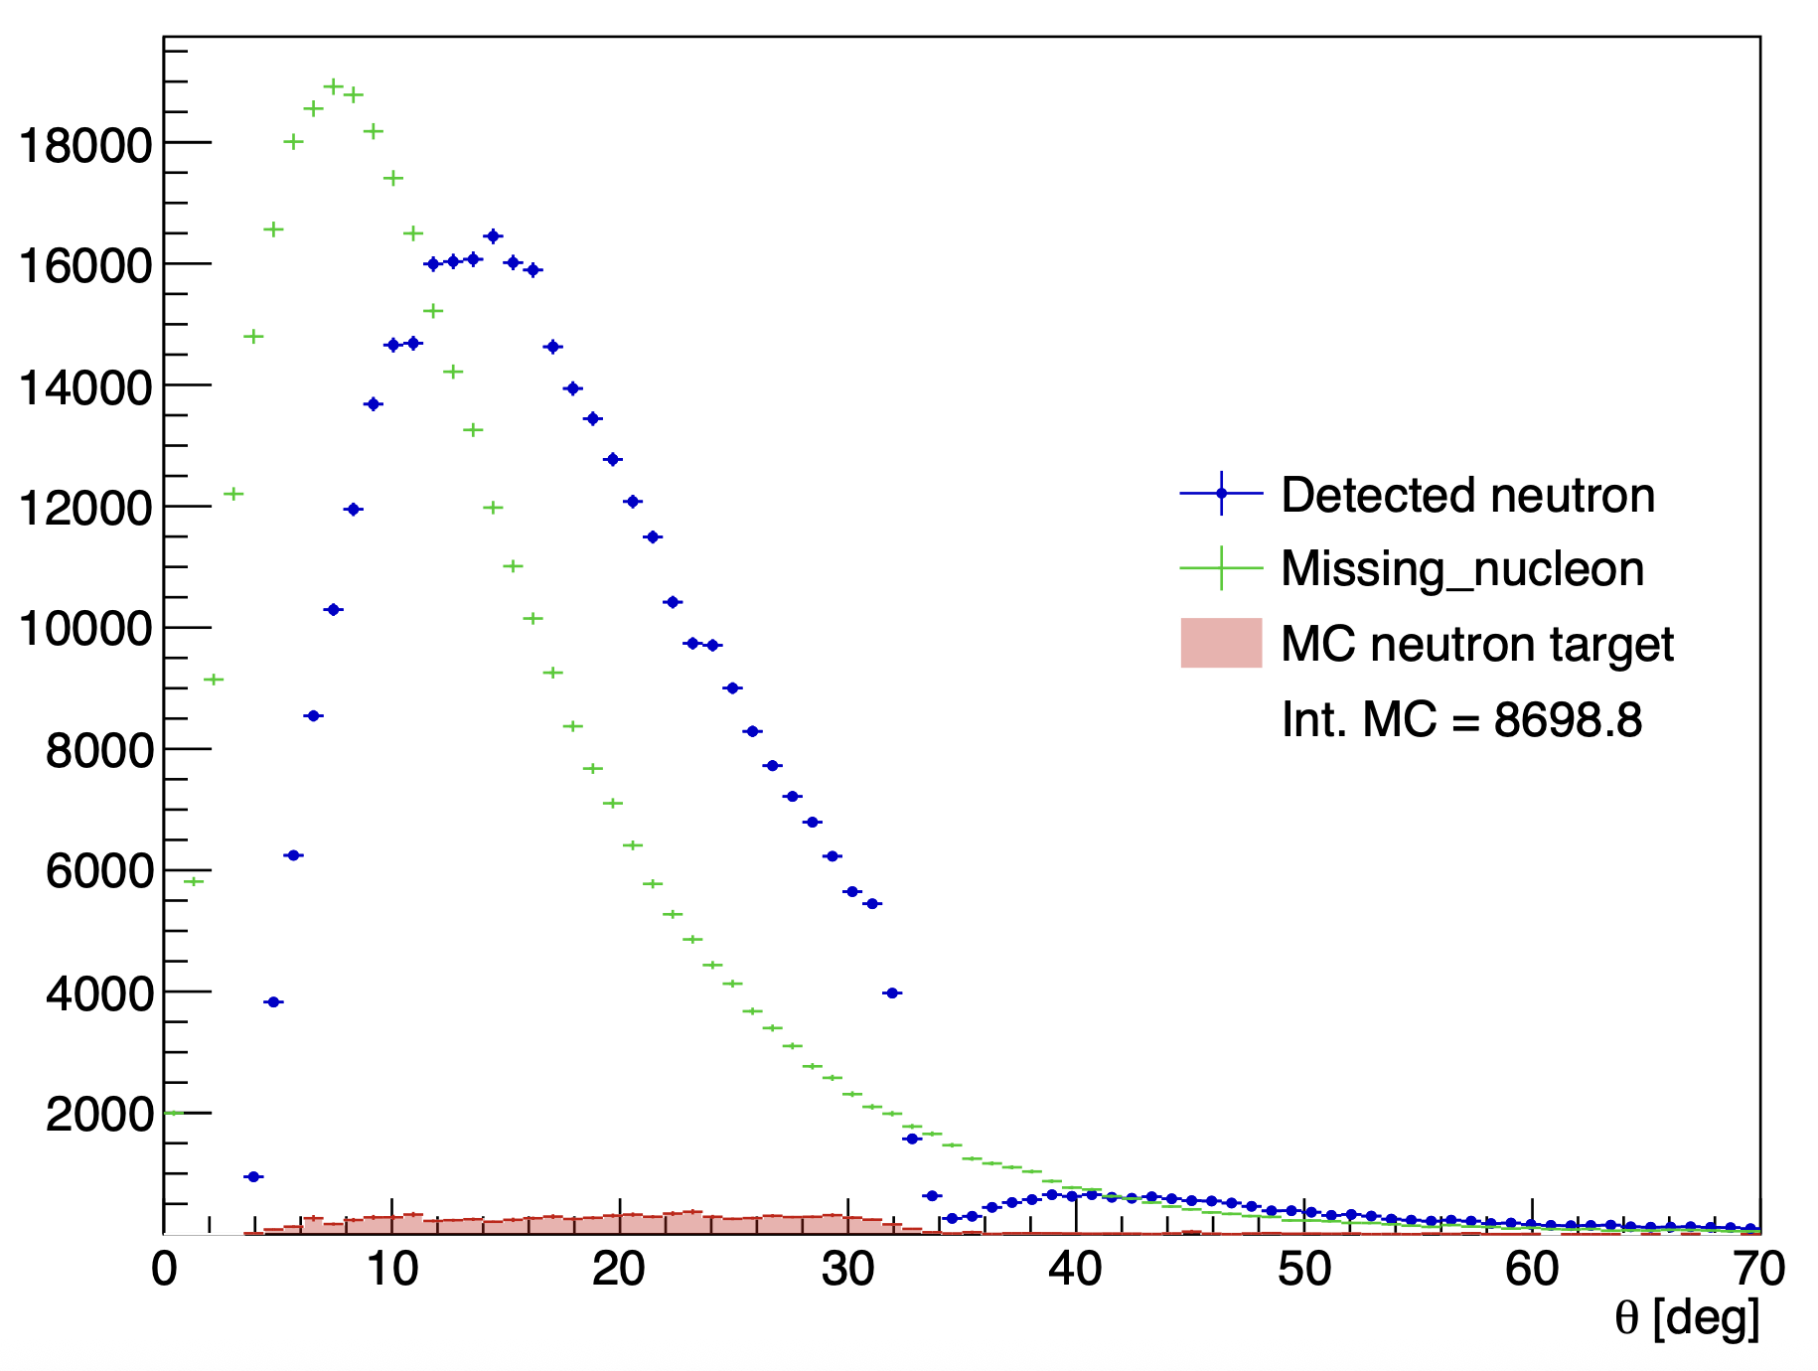
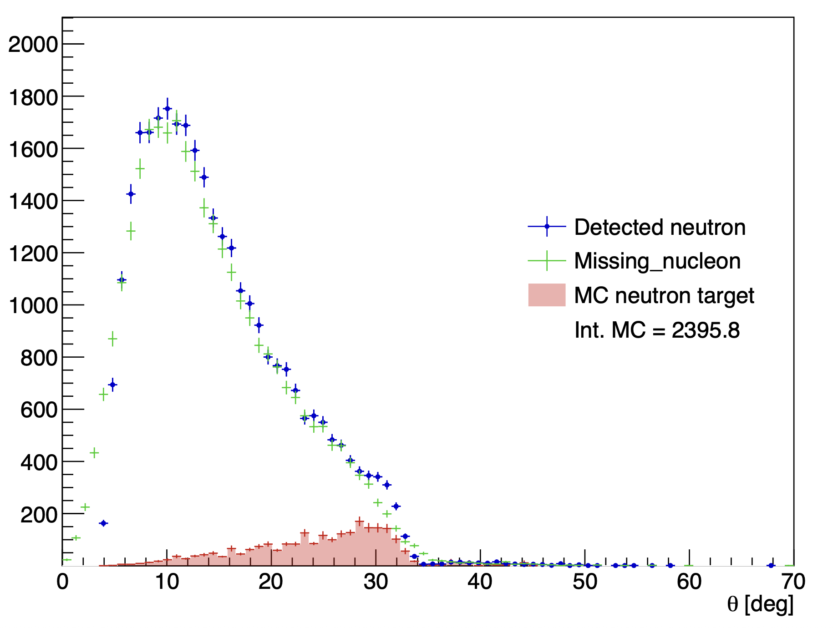
Details on cuts : angle between missing nucleon and detected neutron
Without the angle cut
With the angle cut
Mathieu Ronayette
7/18
Mathieu Ronayette
rgB - meeting
13 Feb 2026

Slide 8
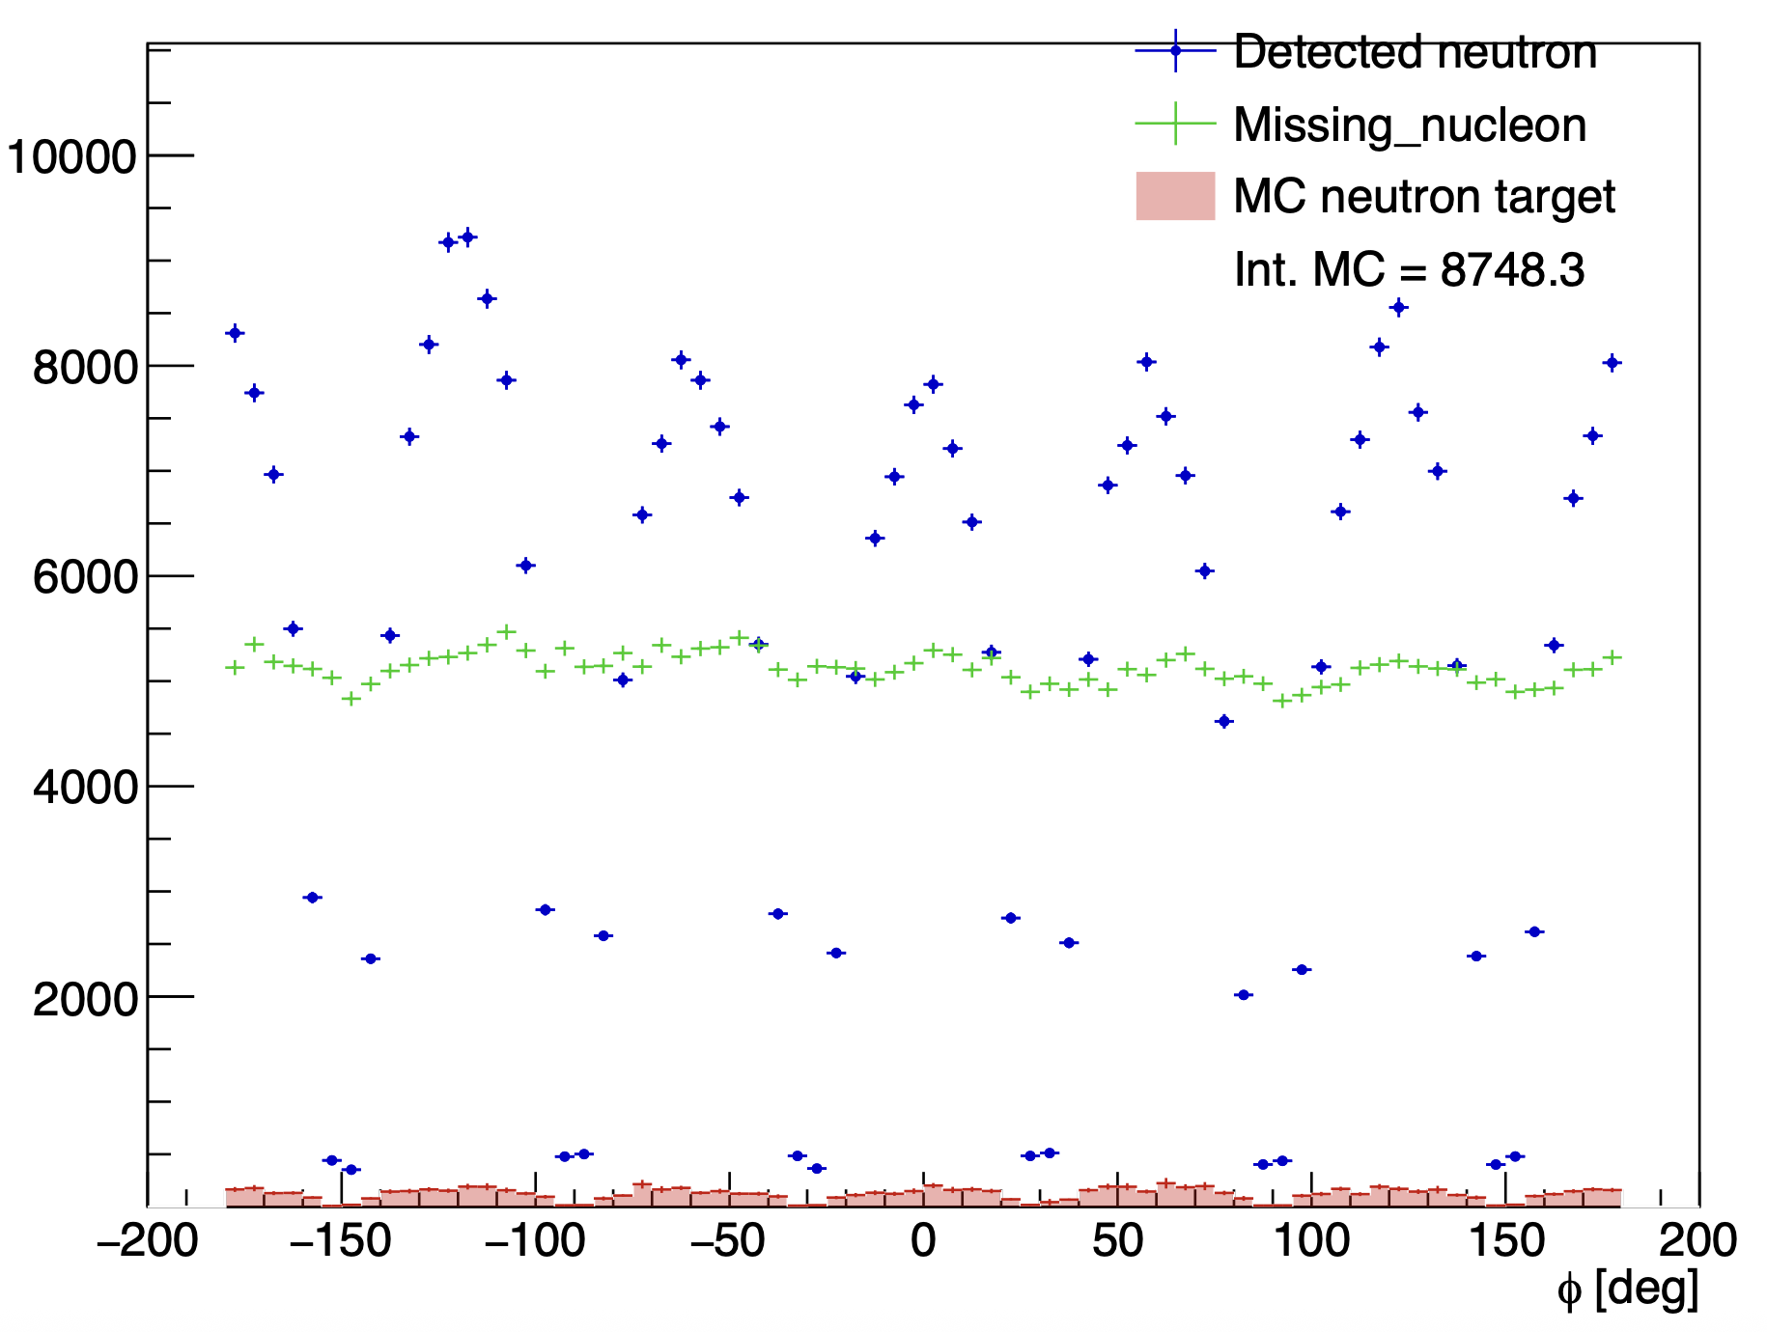
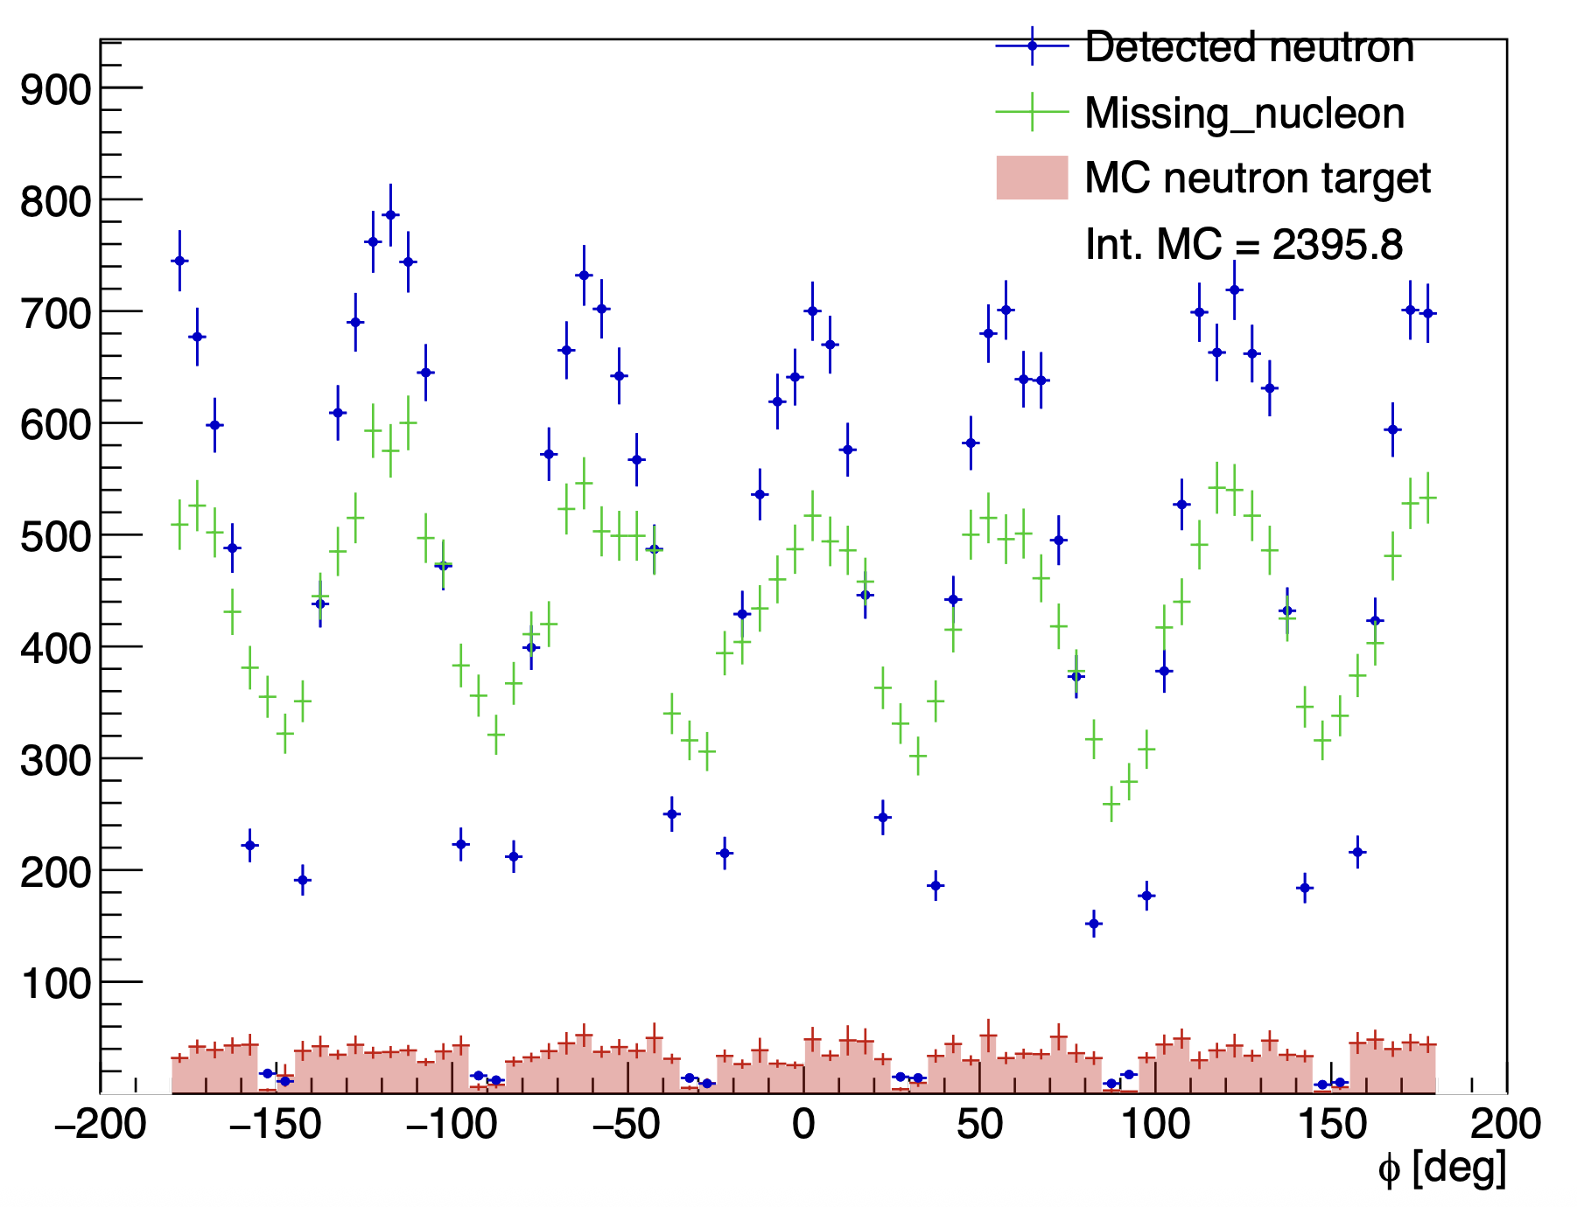
Details on cuts : angle between missing nucleon and detected neutron
Without the angle cut
With the angle cut
Mathieu Ronayette
8/18
Mathieu Ronayette
rgB - meeting
13 Feb 2026

Slide 9
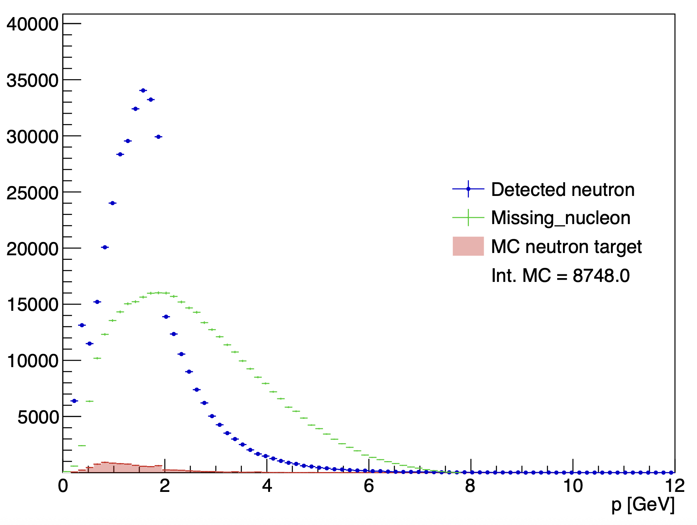
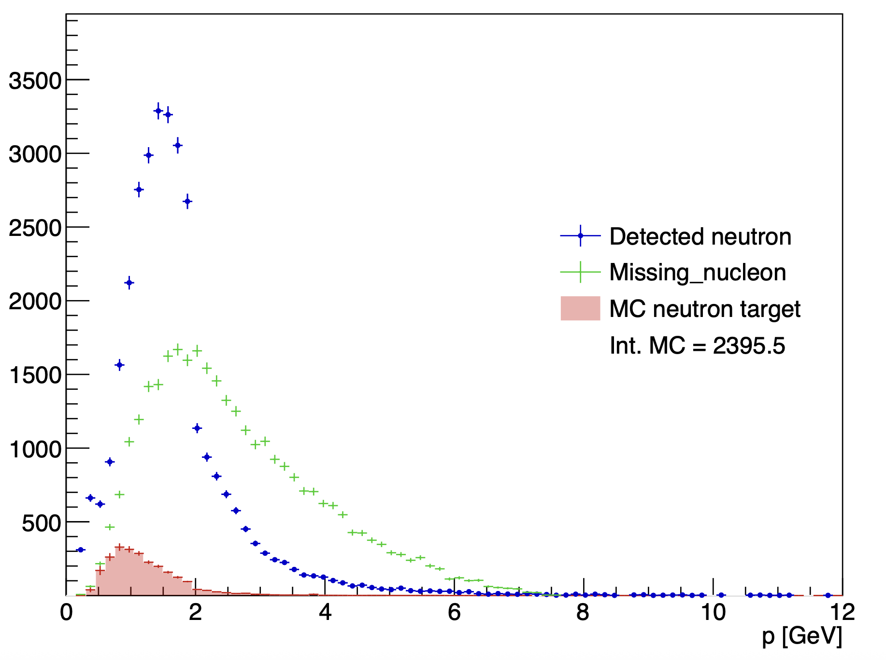
Details on cuts : angle between missing nucleon and detected neutron
Without the angle cut
With the angle cut
Mathieu Ronayette
9/18
Mathieu Ronayette
rgB - meeting
13 Feb 2026

Slide 10
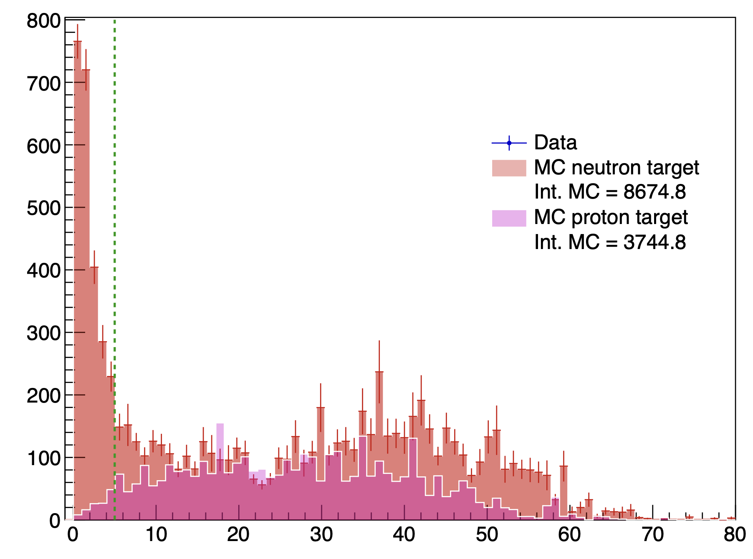
Proton contamination : prediction of MC
<-- Cut at 5 °
K⁺
K⁻
e⁻
fake neutron
non detected proton
Contamination when the missing_nucleon is a
non detected proton there is a fake neutron signal who pass the cut on the angle
angle between the missing_nucleon and the neutron detected
Mathieu Ronayette
10/18
Mathieu Ronayette
rgB - meeting
13 Feb 2026

Slide 11
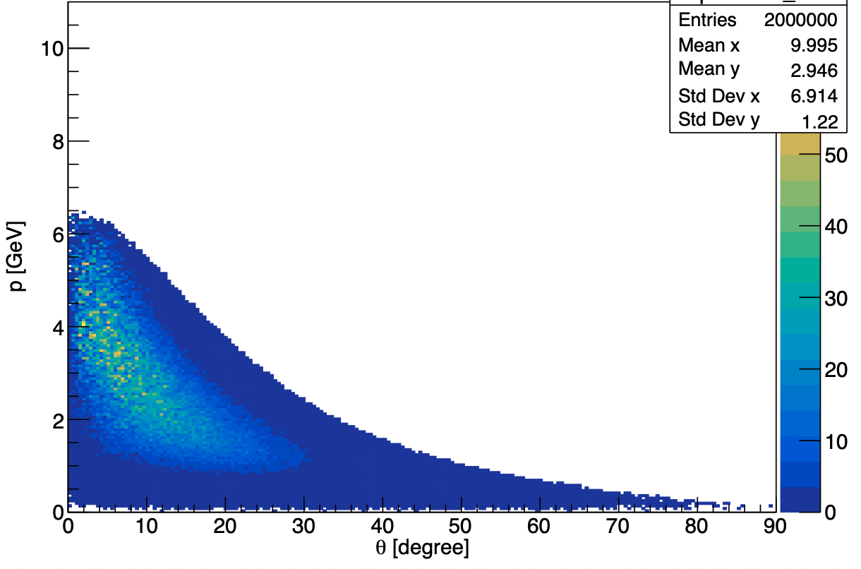
Details on cuts : keep K+ K- in FD
Generated event : p vs theta for K⁺⁻
Two argument to cut K+ K- in CD :
Reconstruction of kaons in the CD is less good than in the FD
The generator predict few events in the CD
Mathieu Ronayette
11/18
Mathieu Ronayette
rgB - meeting
13 Feb 2026

Slide 12
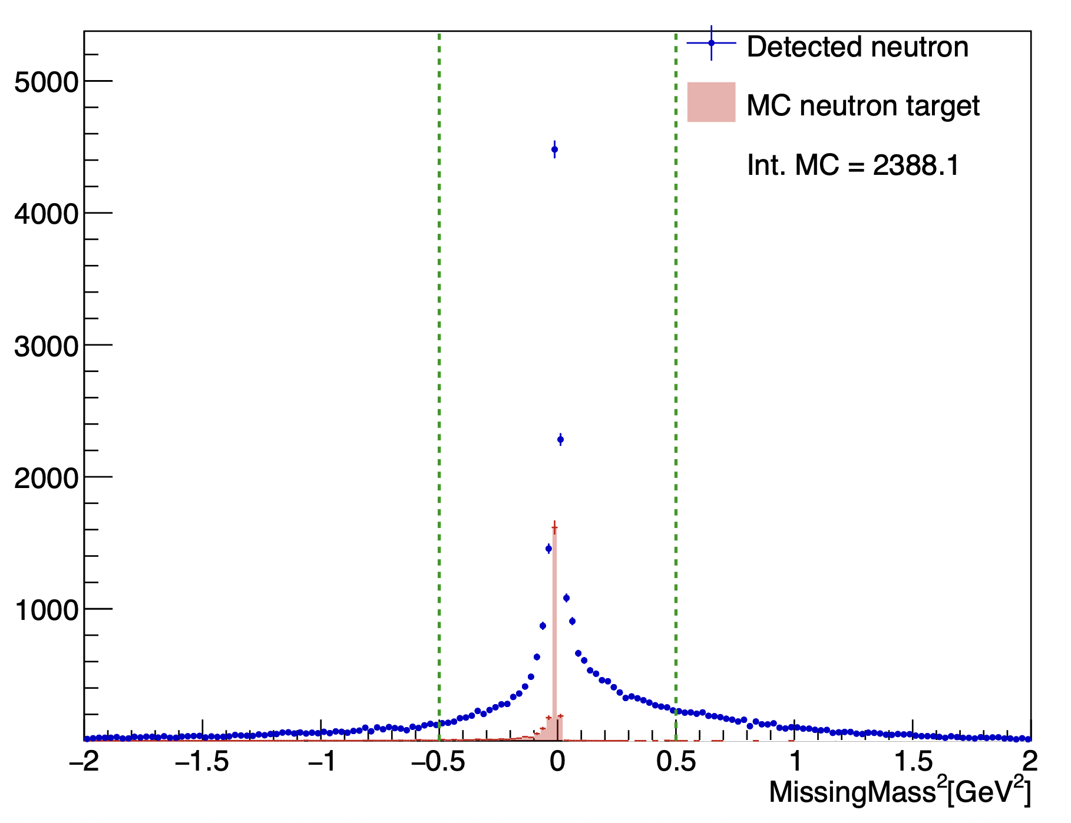
Details on cuts : Total missing mass
Total missing mass e n → e’ n’ K⁺ K⁻ X
(after all the previous cut)
–0.5 < MissingMass_{tot} ² < 0.5 GeV ²
Mathieu Ronayette
12/18
Mathieu Ronayette
rgB - meeting
13 Feb 2026

Slide 13
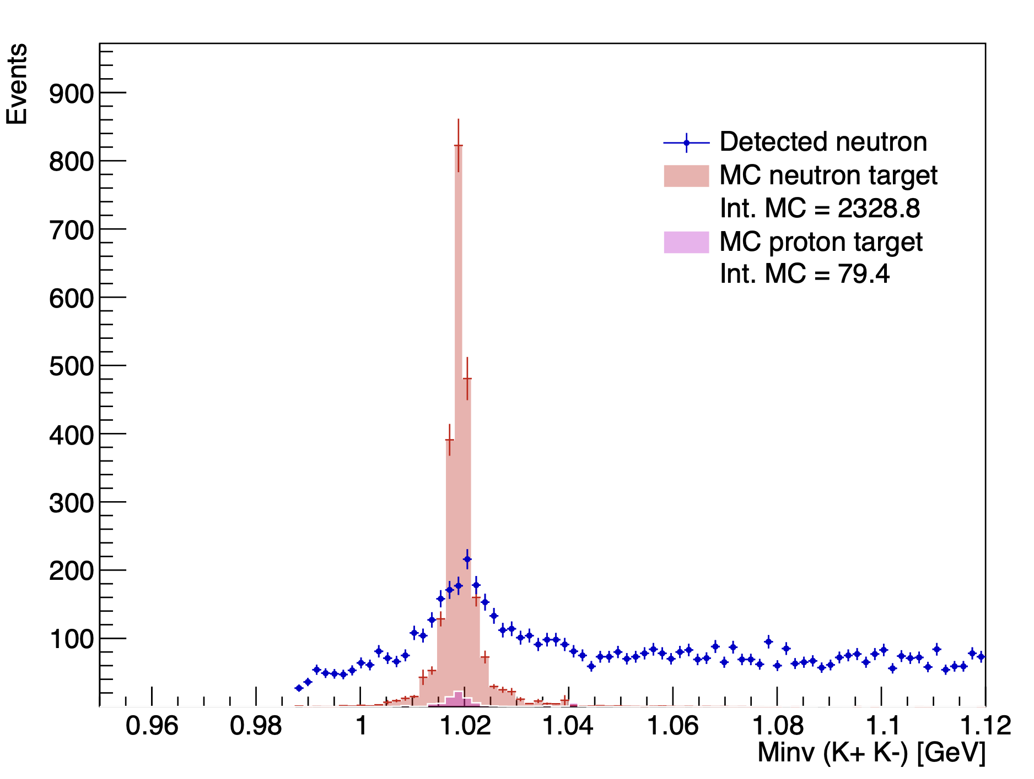
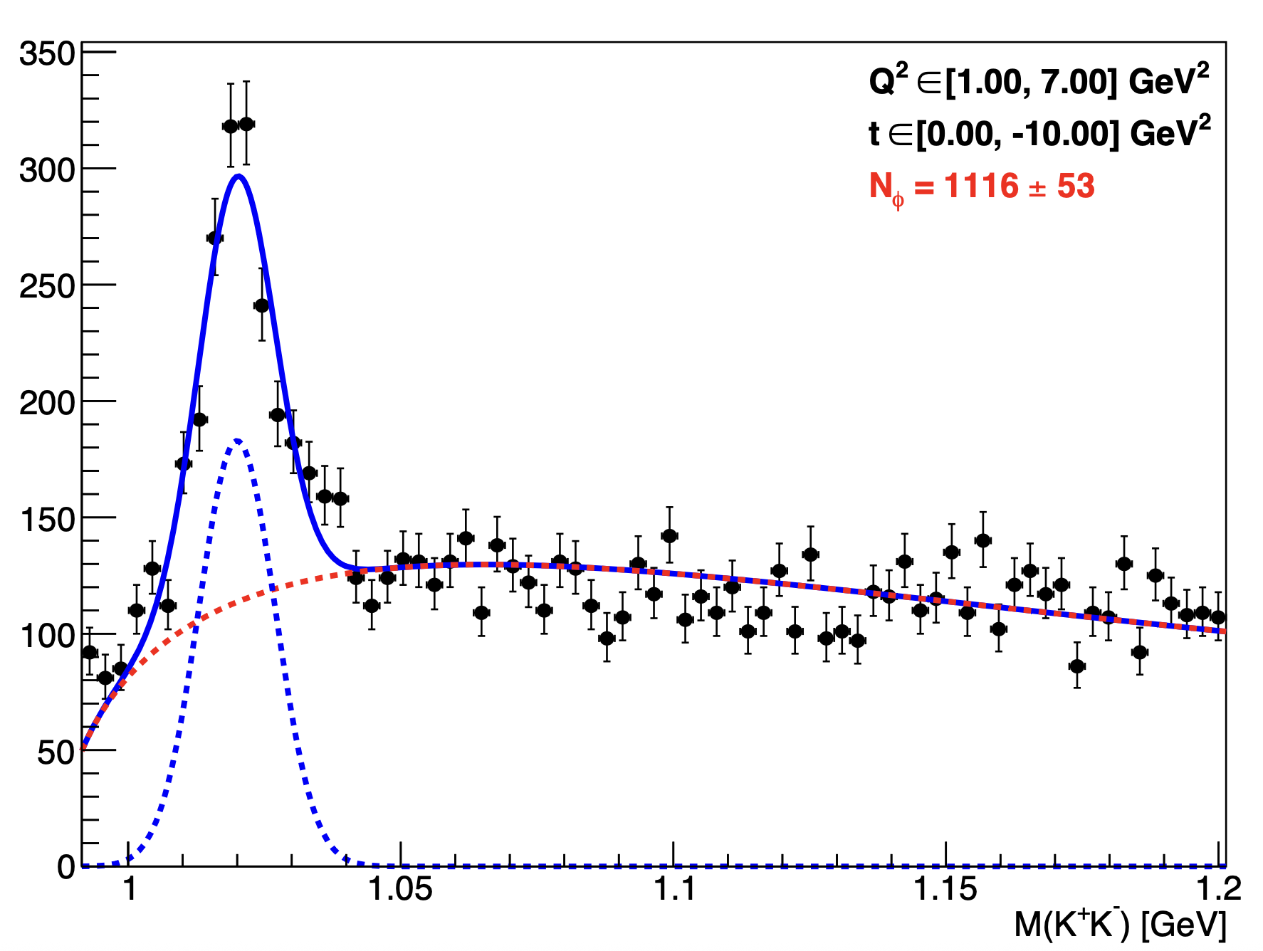
Invariant mass K⁺ K⁻ :
With angle cut, K+ K- in FD, and cut on MissingMass
Fit all fall2019 outbending data
Mathieu Ronayette
13/18
Mathieu Ronayette
rgB - meeting
13 Feb 2026

Slide 14
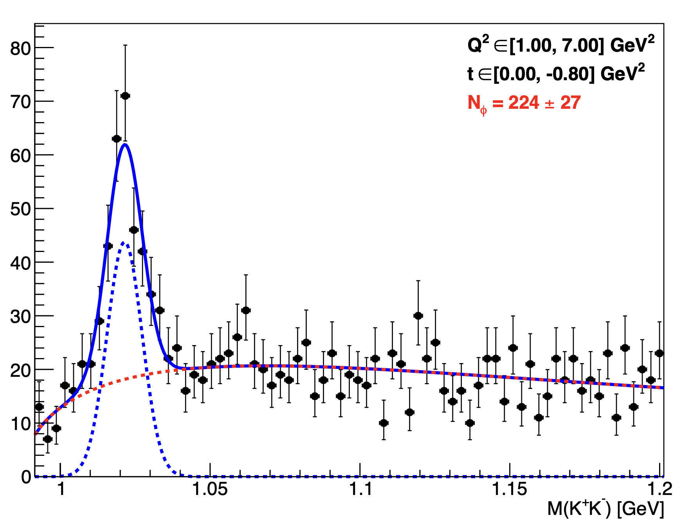
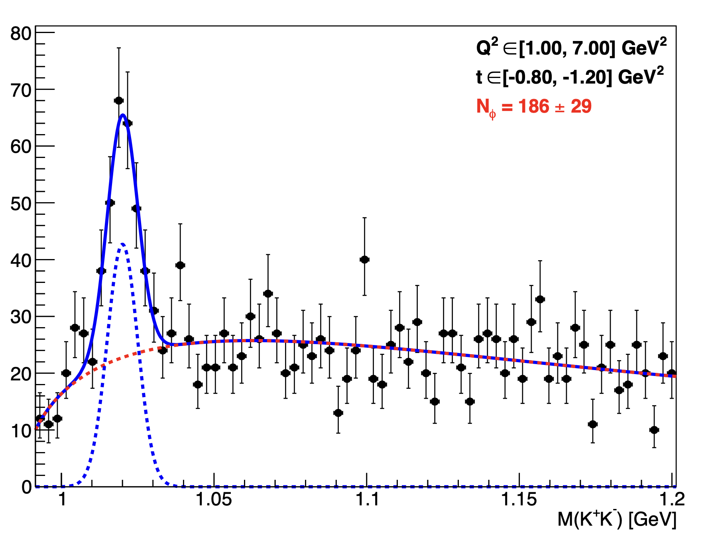
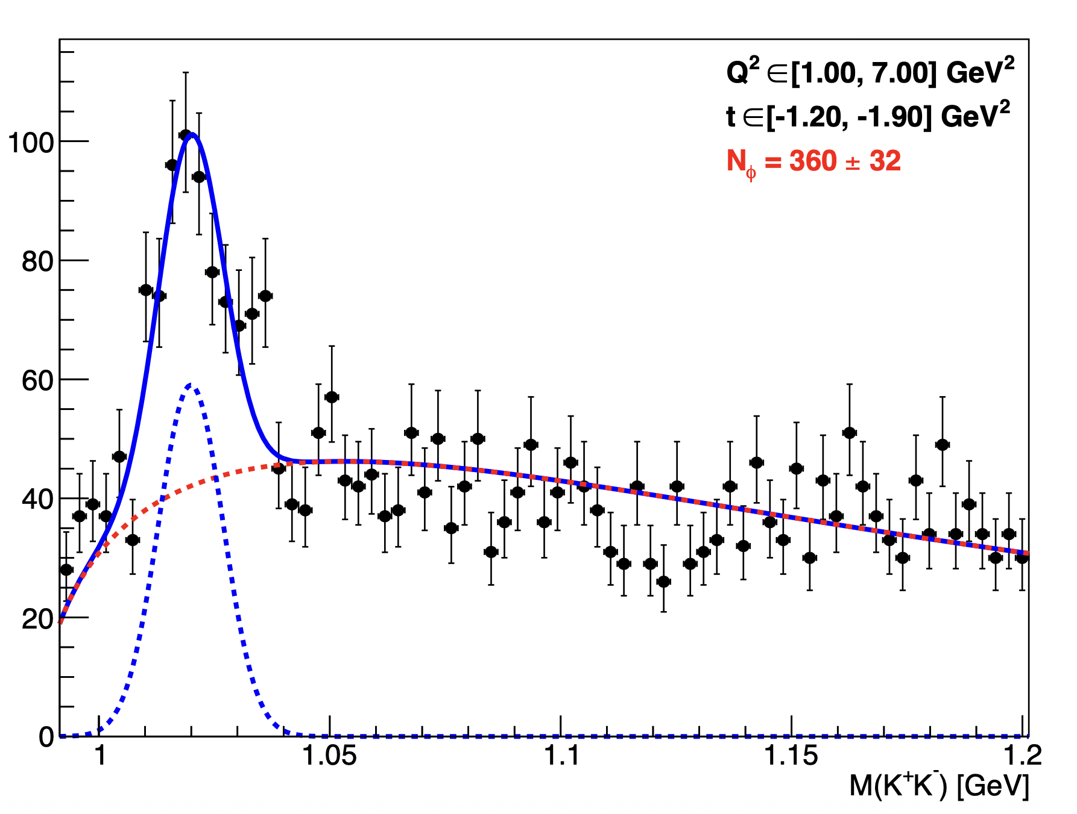
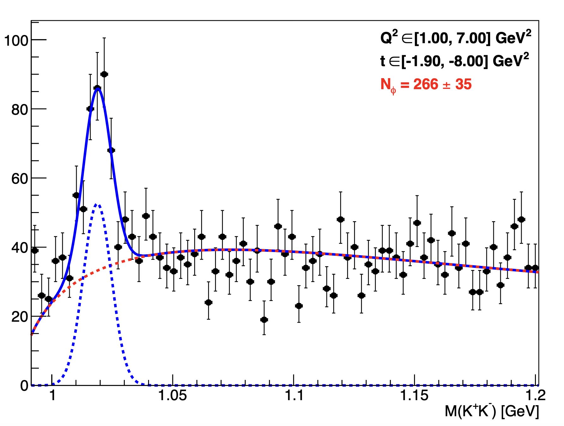
Invariant mass K⁺ K⁻ : Fit per bins
Mathieu Ronayette
14/18
Mathieu Ronayette
rgB - meeting
13 Feb 2026

Slide 15
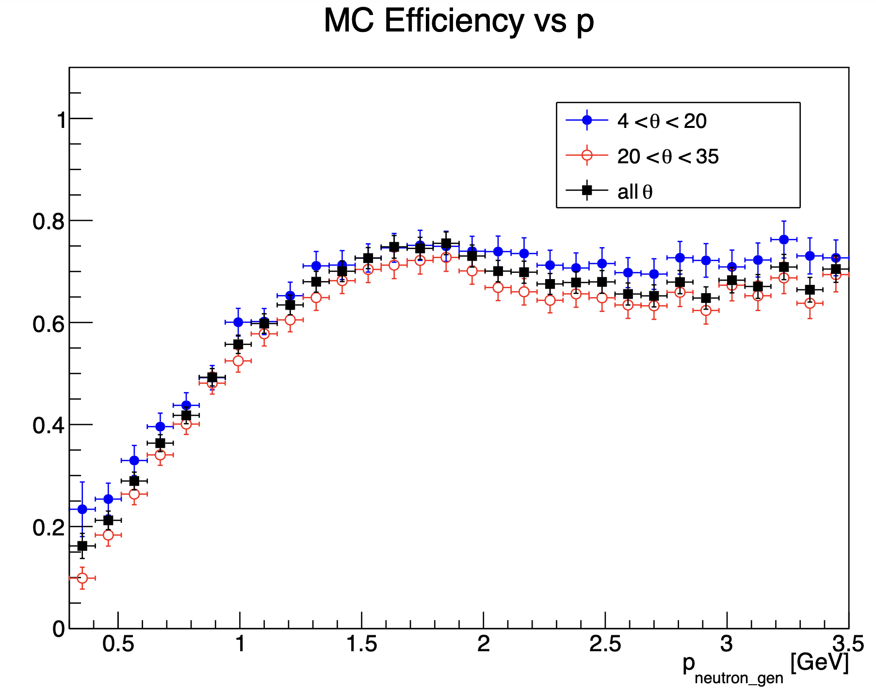
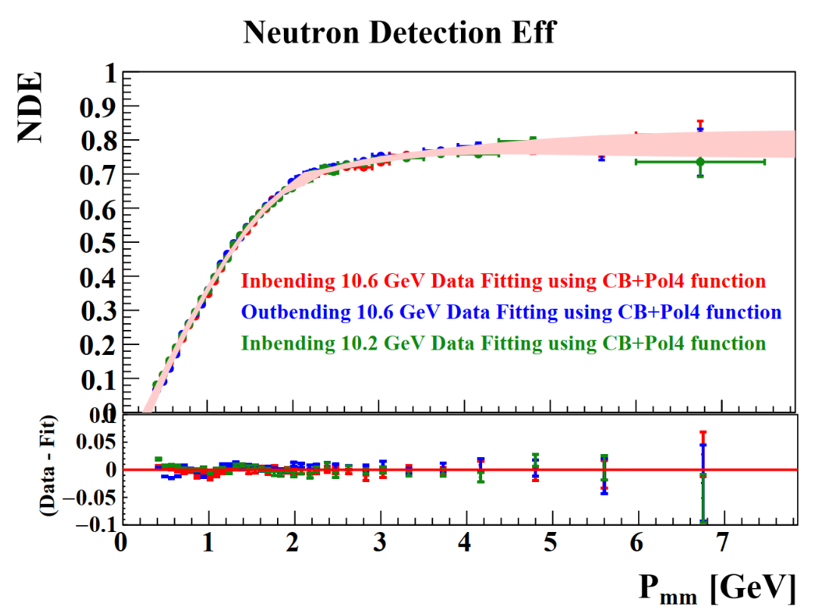
Efficiency correction
Neutron efficiency in MC :
Neutron efficiency (FD) in data from Lamya Baashen thesis
(with P_{mm} the missing momentum)
(Fiducial cut for Nrec and accpetance cut for Ngen)
Mathieu Ronayette
15/18
Mathieu Ronayette
rgB - meeting
13 Feb 2026

Slide 16
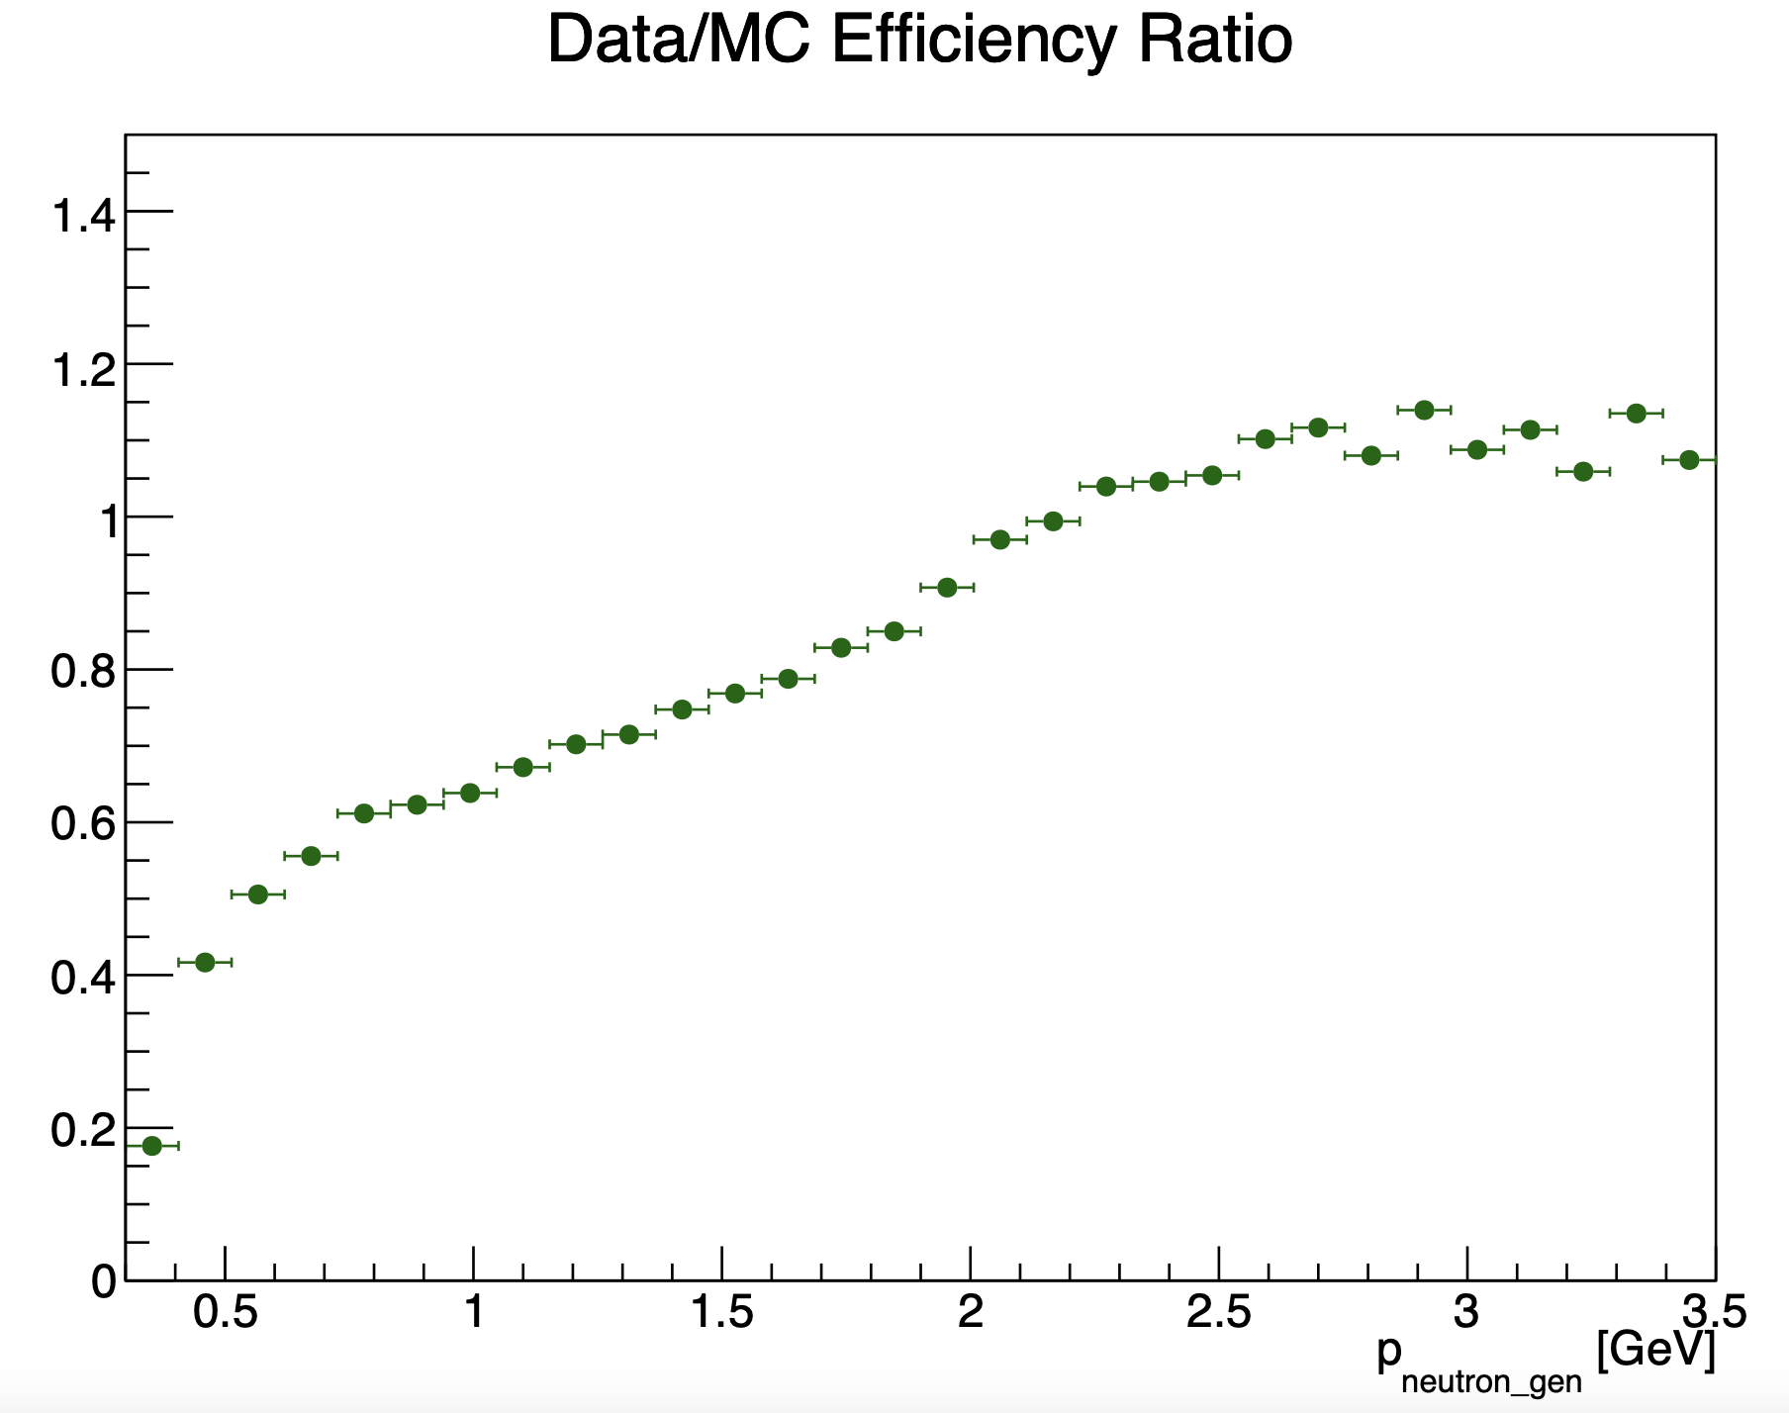
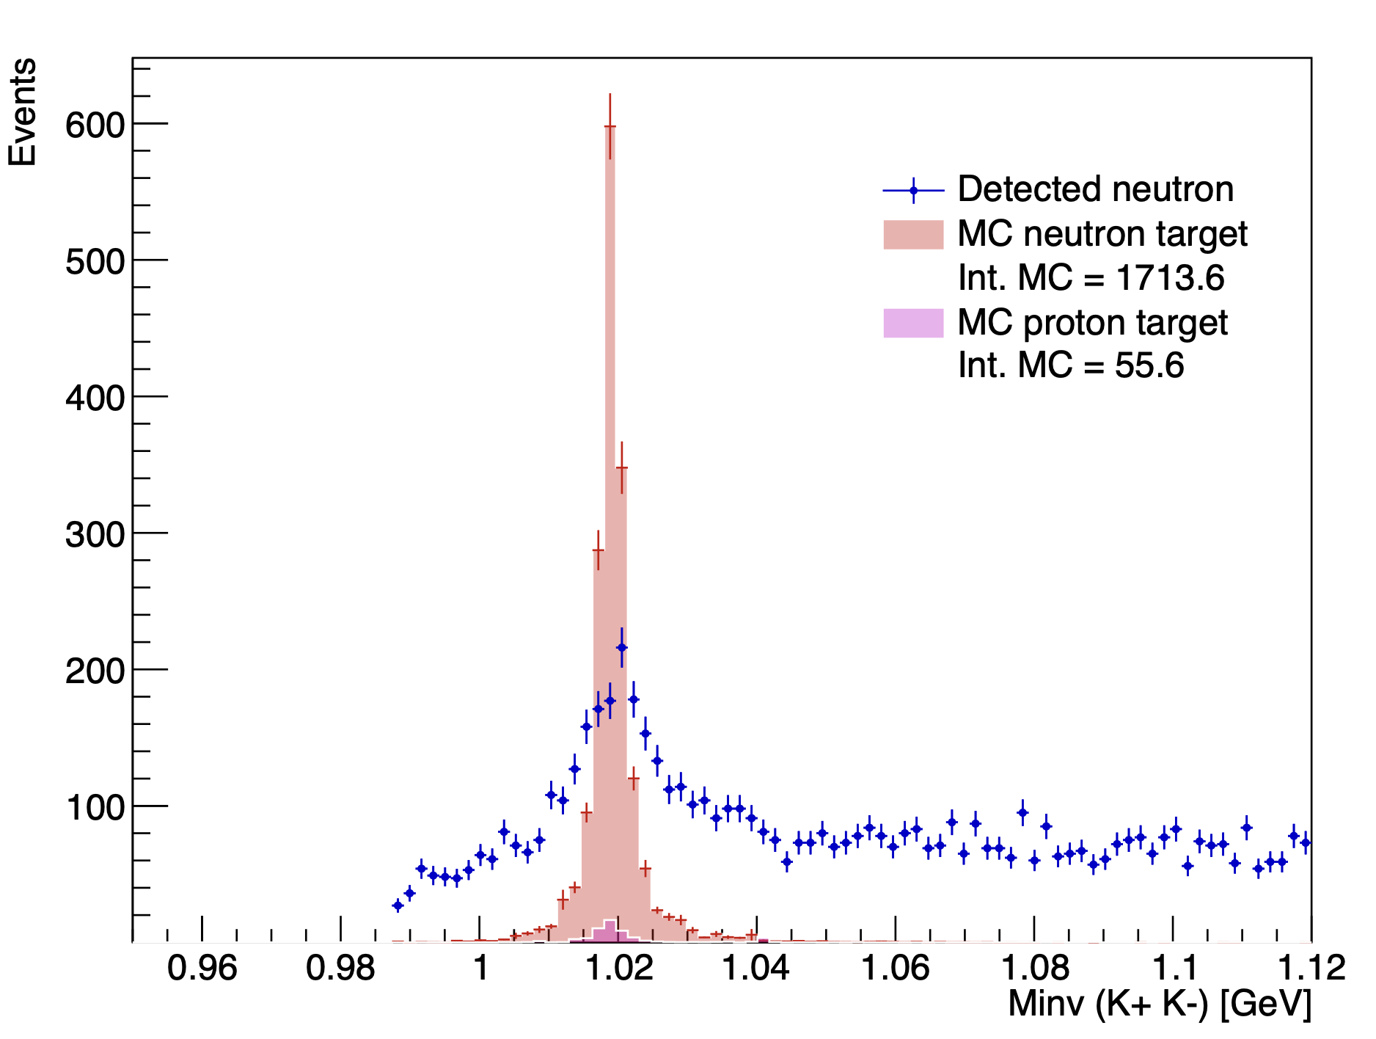
Efficiency correction
MC with neutron efficiency correction
Mathieu Ronayette
16/18
Mathieu Ronayette
rgB - meeting
13 Feb 2026

Slide 17
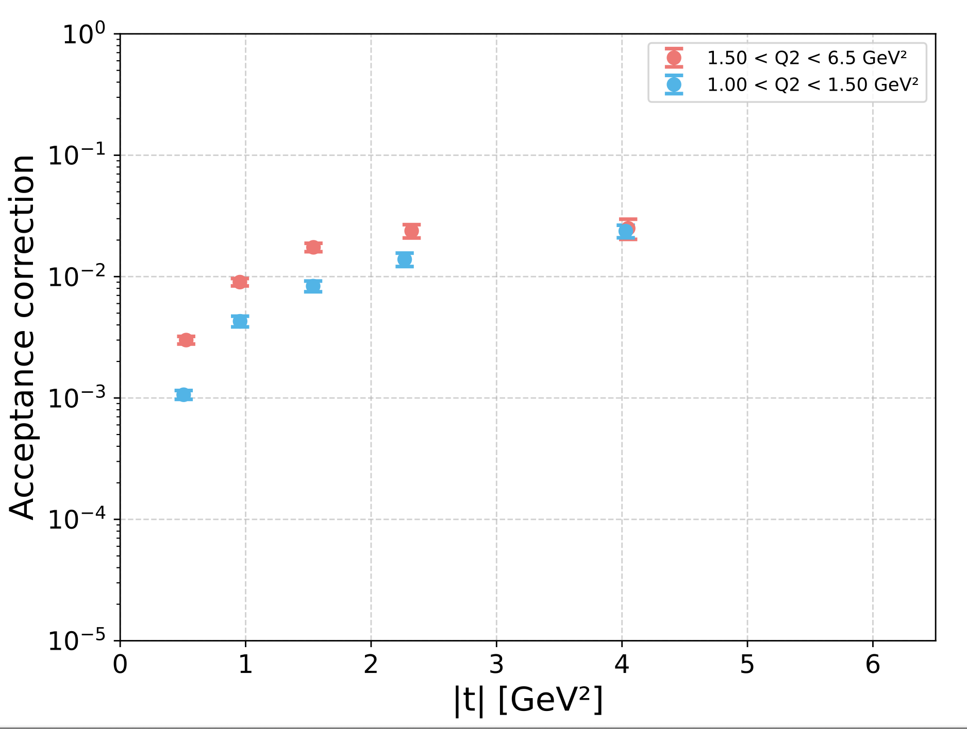
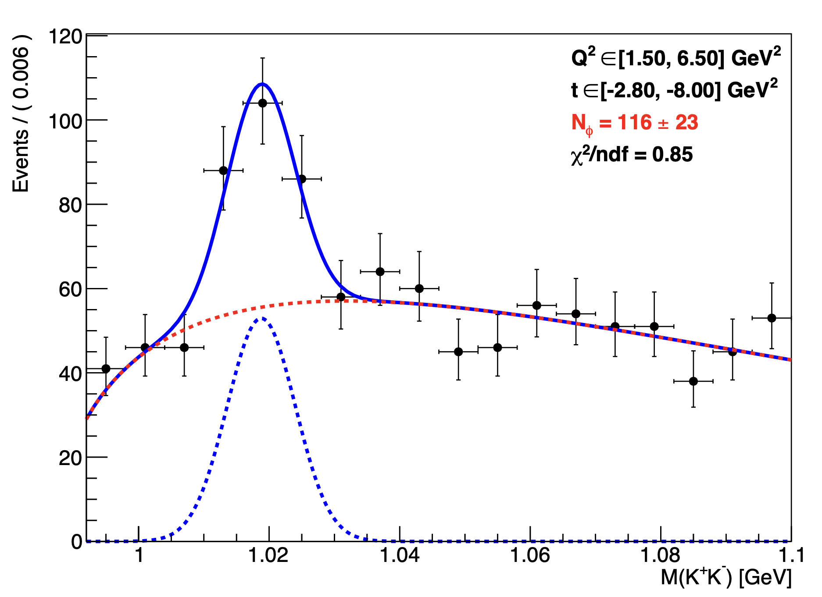
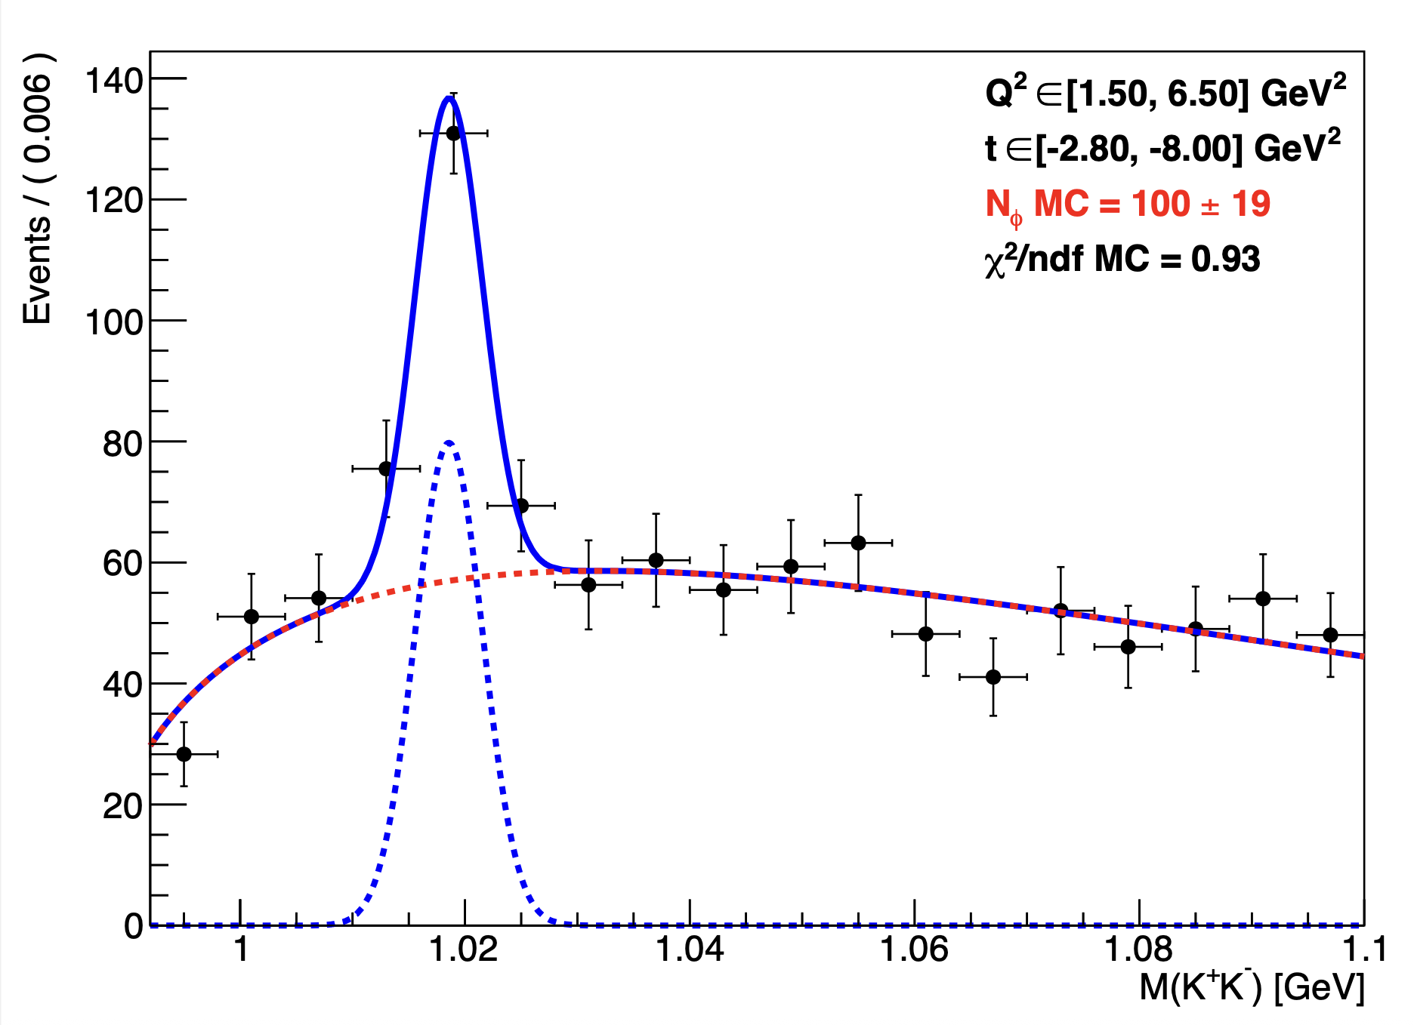
Acceptance correction
A =
Mathieu Ronayette
17/18
Mathieu Ronayette
rgB - meeting
13 Feb 2026

Slide 18
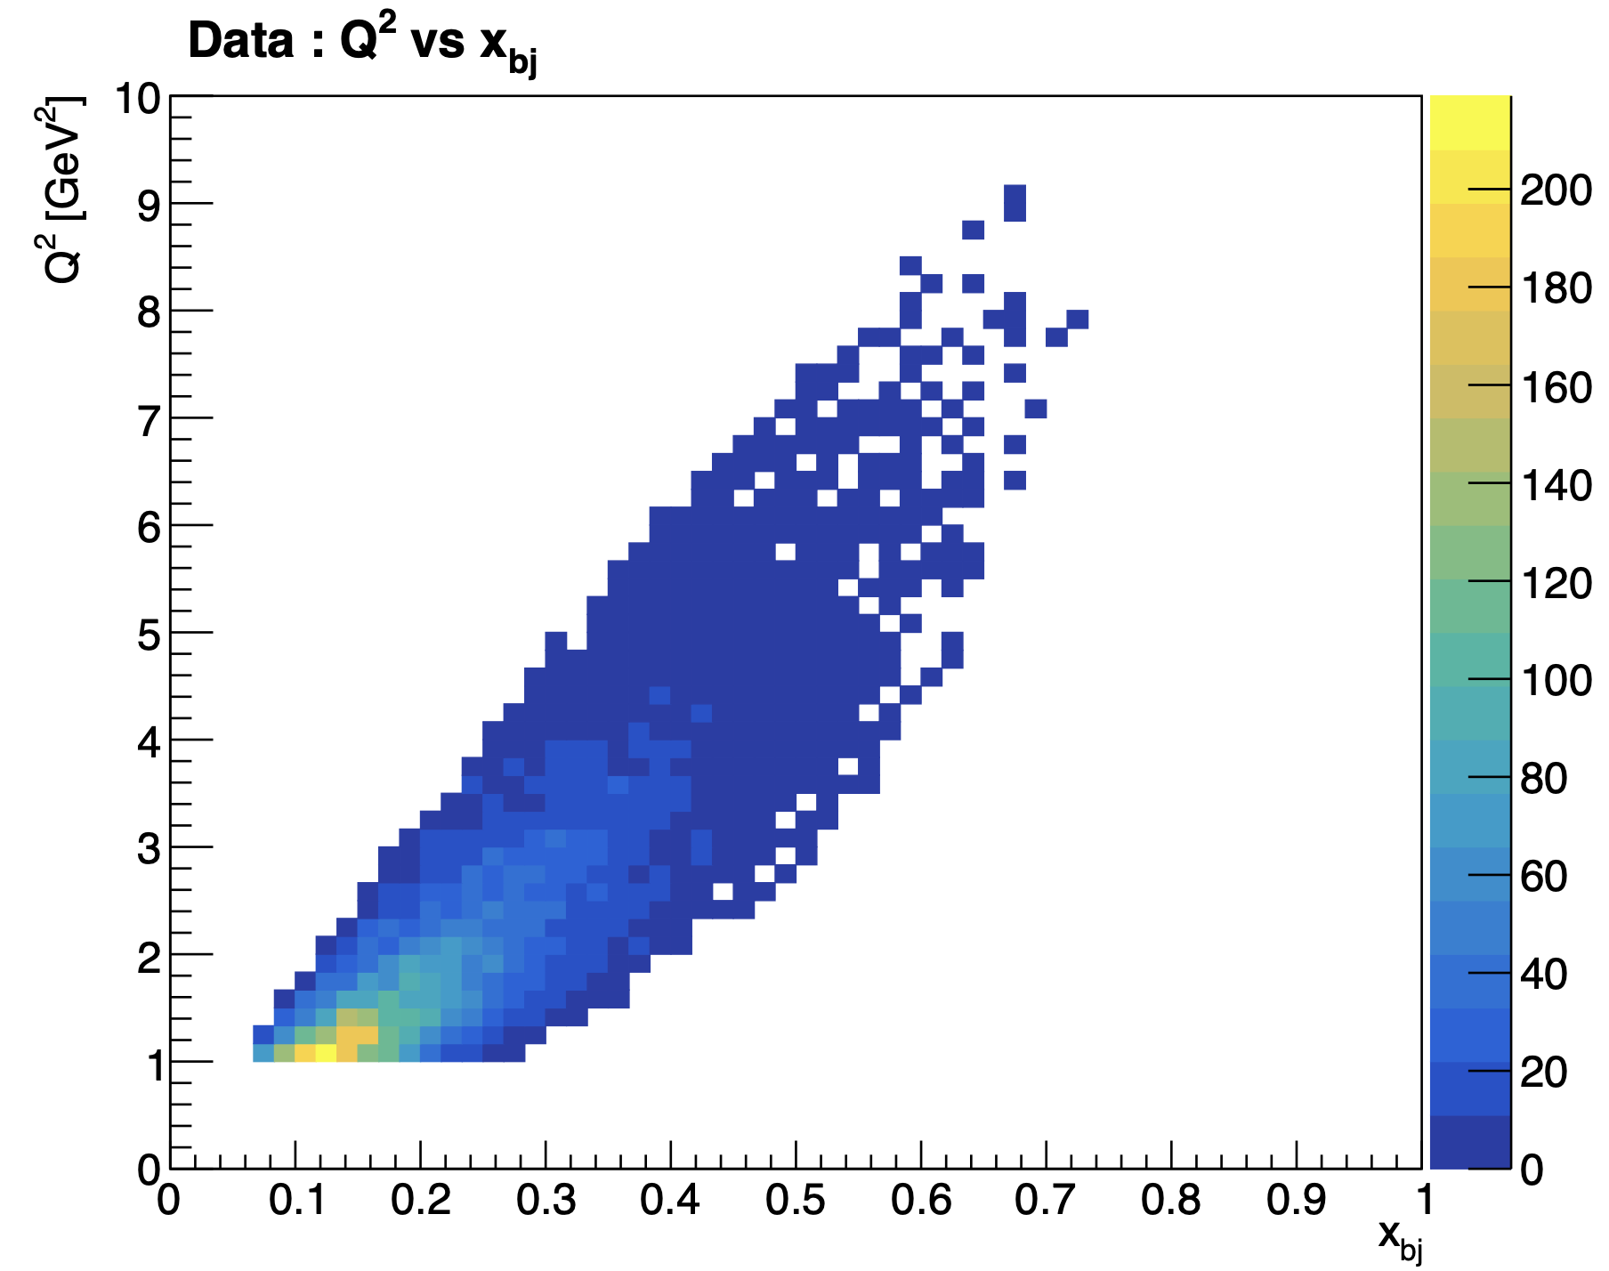
Binning correction
f =
Mathieu Ronayette
18/18
Mathieu Ronayette
rgB - meeting
13 Feb 2026

Slide 19
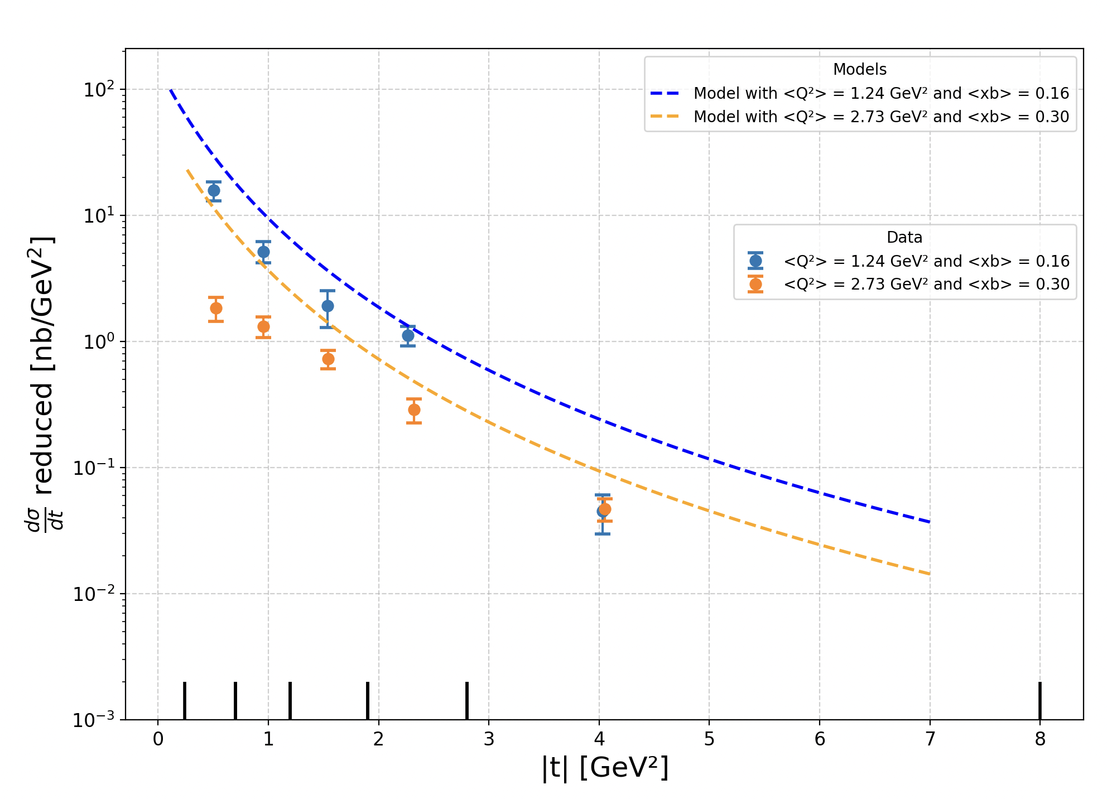
Preliminary plot of the differential reduced cross section
Mathieu Ronayette
19/18
Mathieu Ronayette
rgB - meeting
13 Feb 2026

Slide 20
Conclusion
Next steps :
- Improve fits for signal and background
Run the code with the other data set
More MC simulations
Events in CD
Momentum corrections
Thanks!
Mathieu Ronayette
20/18
Mathieu Ronayette
rgB - meeting
13 Feb 2026

Slide 21
Proton contamination
Missing_nucleon = the missing particle of this reaction : e n → e’ K⁺ K⁻ X
K⁺
K⁺
K⁻
K⁻
e⁻
e⁻
fake neutron
neutron
non detected proton
missing_nucleon
There is still a contamination when the missing_nucleon is a non detected proton and there is a fake signal neutron who pass the cut on the angle
Good event with the angle between the missing nucleon and the neutron < 5 °
→ Evaluate the contamination with simulation on proton target and apply the cuts of neutron analysis and see how many
events pass the cuts
Mathieu Ronayette
9/18
Mathieu Ronayette
rgB - meeting
13 Feb 2026

Slide 22
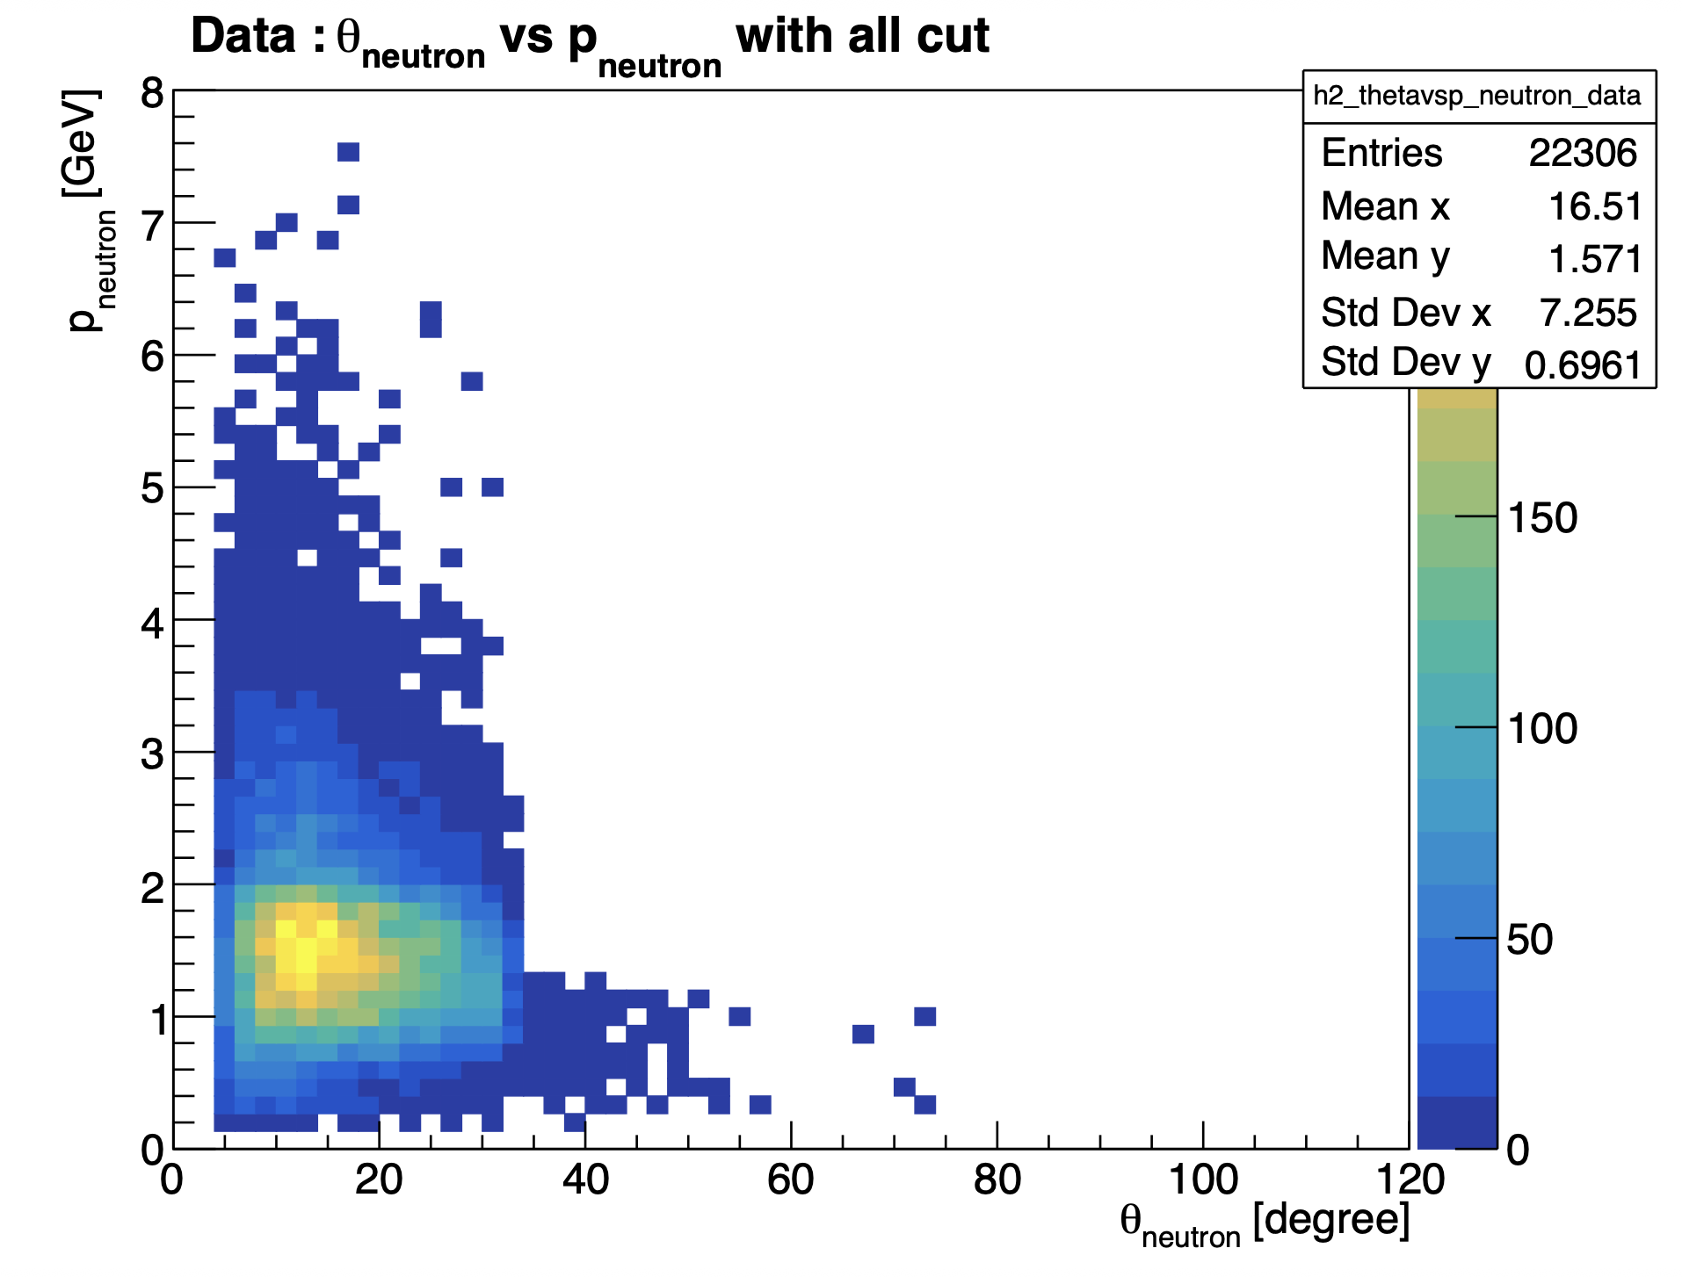
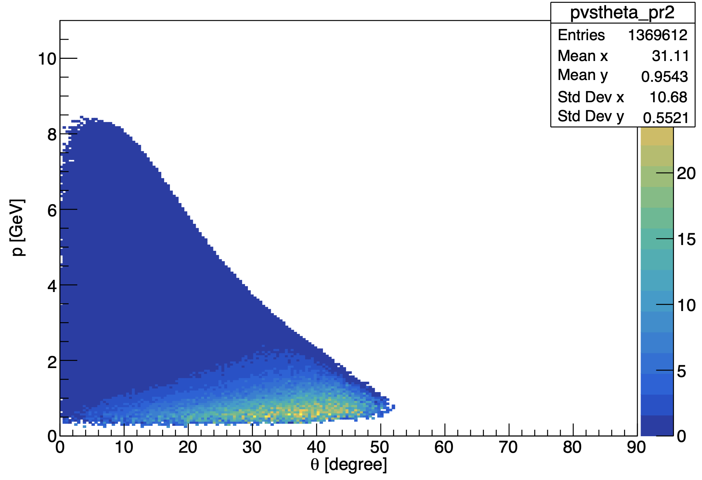
Neutron phasespace :
MC : θ_{neutron} vs P_{neutron} generated
(with acceptante cuts)
Mathieu Ronayette
12/18
Mathieu Ronayette
rgB - meeting
13 Feb 2026

Slide 23
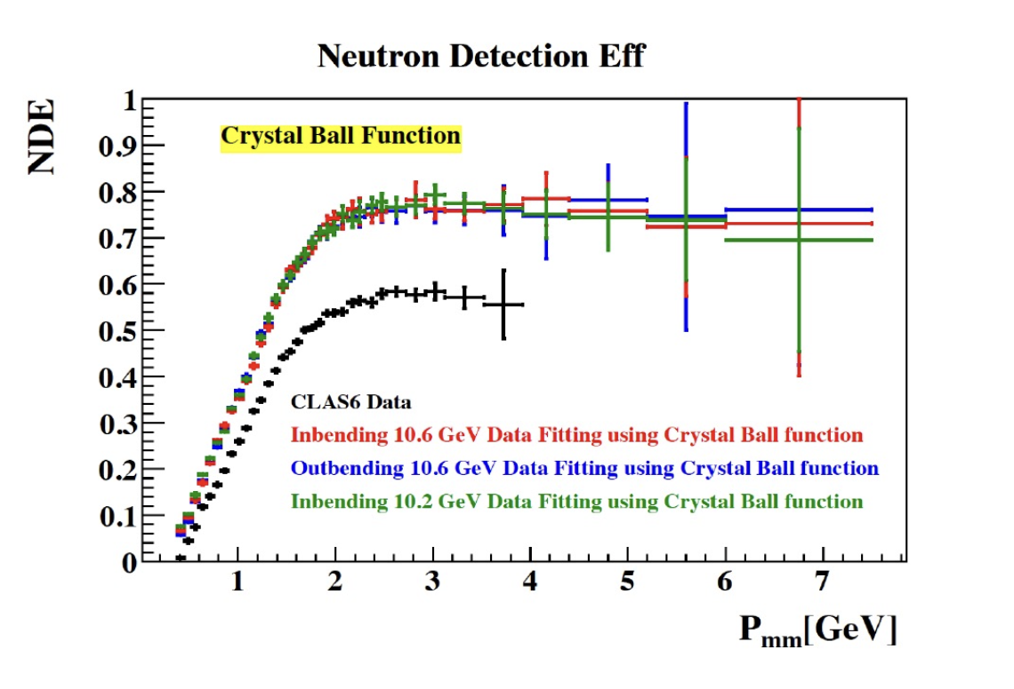
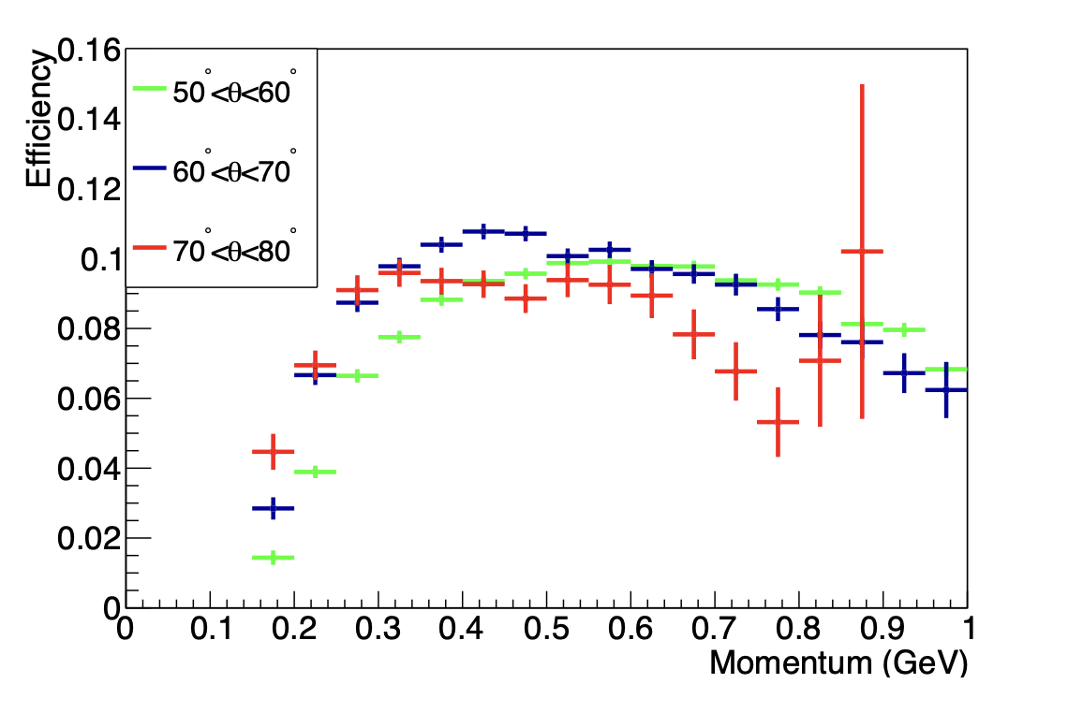
Neutron phasespace :
P. Chatagnon’s plot
Neutron detection efficiency in the FD
Neutron detection efficiency in the CND
Mathieu Ronayette
13/18
Mathieu Ronayette
rgB - meeting
13 Feb 2026

Slide 24
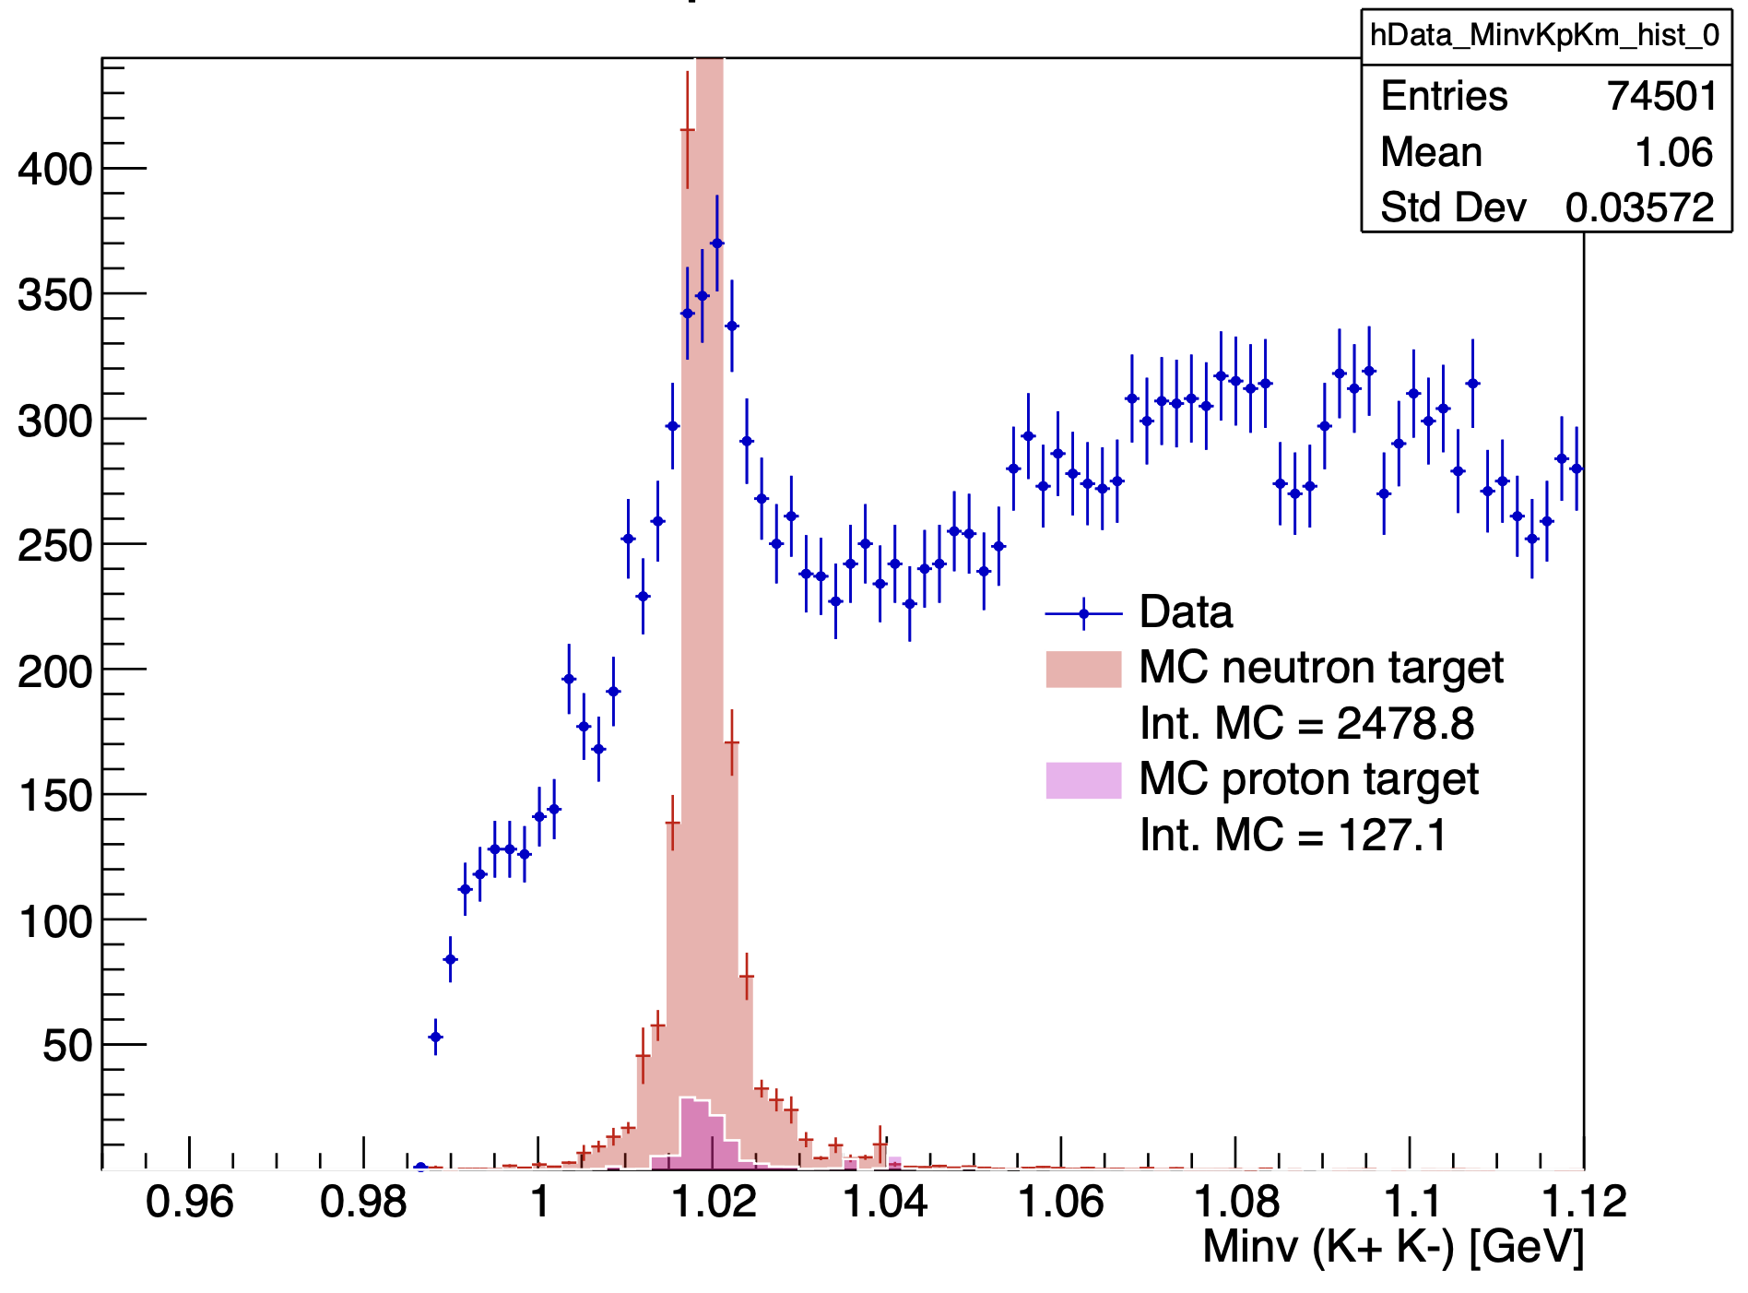
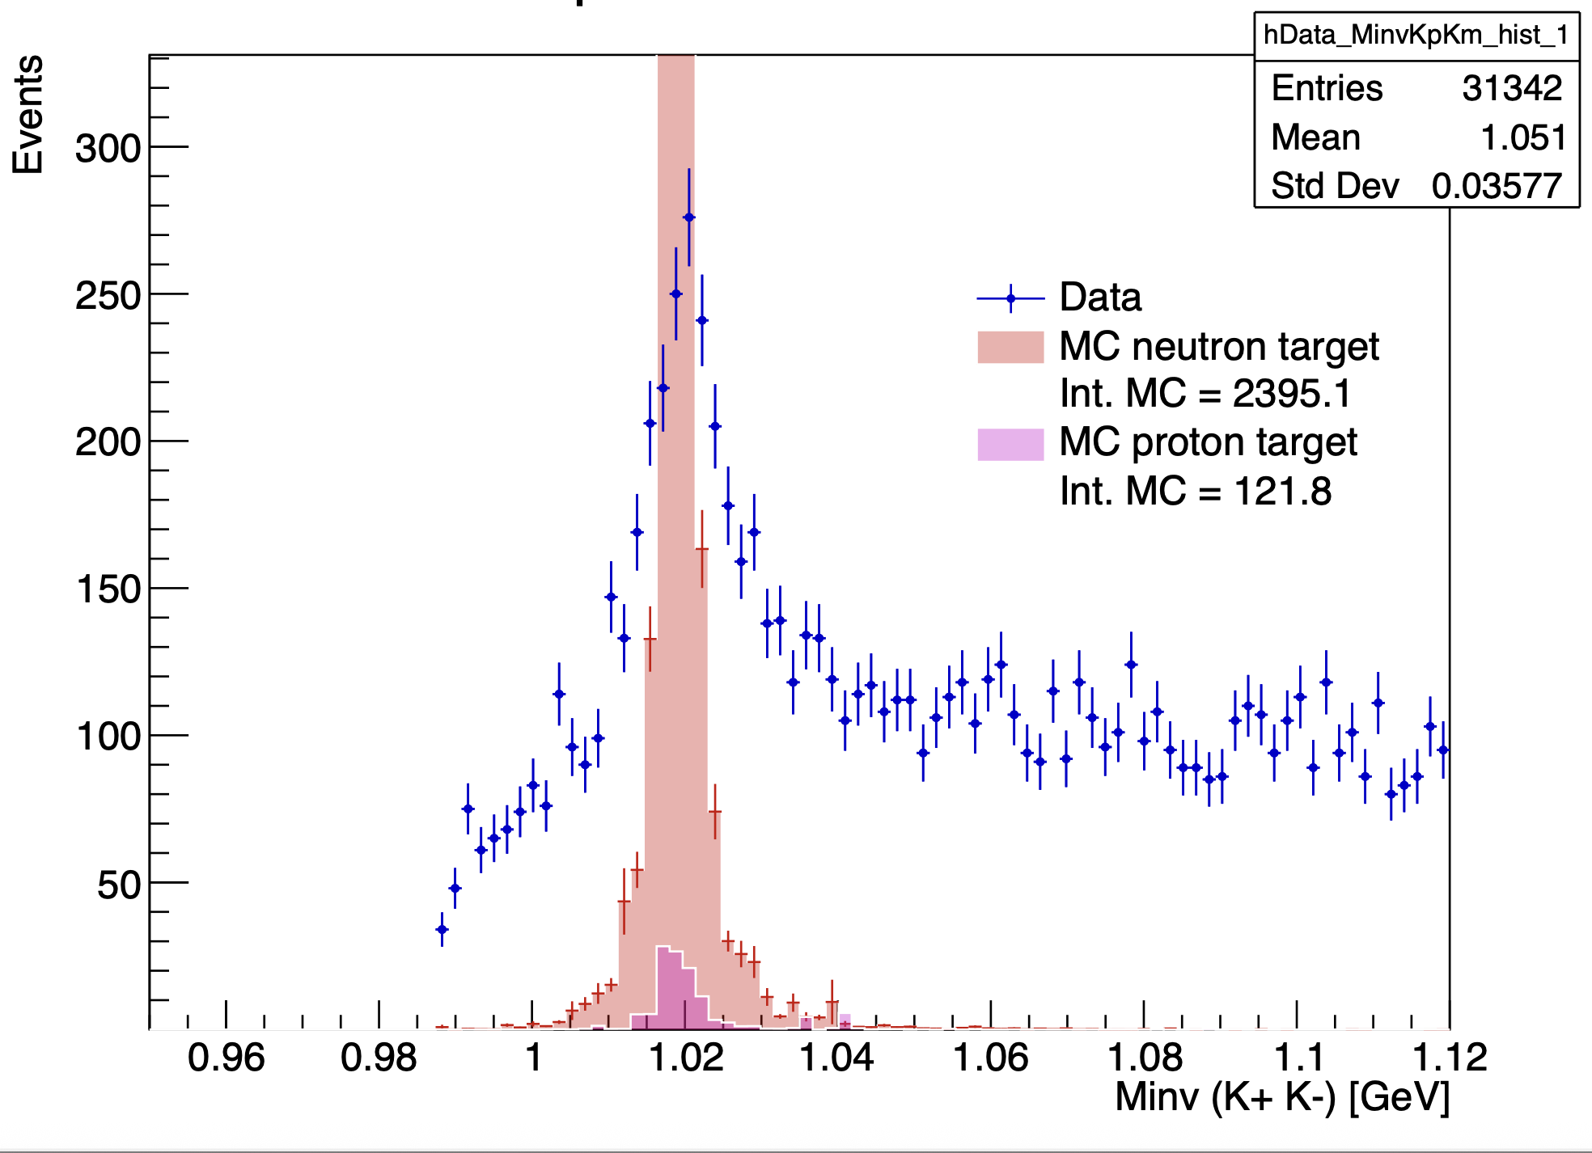
Influence of cuts on the invariant mass K⁺ K⁻ :
With angle cut
With angle cut and K+ K- in FD
Mathieu Ronayette
15/18
Mathieu Ronayette
rgB - meeting
13 Feb 2026

