Slide 1
Electroproduction of phi meson with CLAS12
Mathieu Ronayette
Thesis at CEA Saclay with Pierre Chatagnon
17 October 2025
Mathieu Ronayette
1/12
Mathieu Ronayette
meeting
17 October 2025

Slide 2
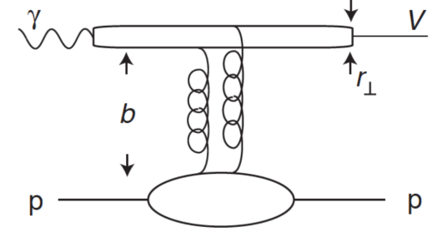
Introduction and objectives
Analysis objective :
- Measurement of the cross section and diferential cross section of the electroproduction of ɸ in the Ks KL channel
ϕ
- Interpretation with gluon Generalised Parton Distribution (GPDs) and gravitational form factors (GFFs)
GFFs
Mathieu Ronayette
2/12
Mathieu Ronayette
meeting
17 October 2025

Slide 3
Introduction and objectives
Reaction :
e p →ɸ e’ p’
Decay Channel :
ɸ → K⁰s K⁰L (Br = 34.2 %)
cτKs = 2.68 cm and cτKL = 15.34 cm
Detection :
K⁰s →π⁺ π⁻ (Br = 69.20 %)
K⁰L→ cut on missing mass
ϕ
GFFs
Mathieu Ronayette
3/12
Mathieu Ronayette
meeting
17 October 2025

Slide 4
Introduction and objectives
Reaction :
e p →ɸ e’ p’
Exclusivity Cuts :
- Selection of events with one e⁻ , p , π⁺ and π⁻ in the final state.
- Cut on invariant mass of π⁺ π⁻ with
0.4 < Minv(π⁺ π⁻) < 0.6 GeV.
- Cut on Missing Mass in the reaction e p → e’ p’ Ks X
with 0.4 < MissMass < 0.6 GeV.
- Cut on Vze- - Vzπ- < 0 && -5 < Vzπ+ - Vzπ- < 5 cm
Datas :
Rg-A datas : fall2018 inbending
Mathieu Ronayette
4/12
Mathieu Ronayette
meeting
17 October 2025

Slide 5
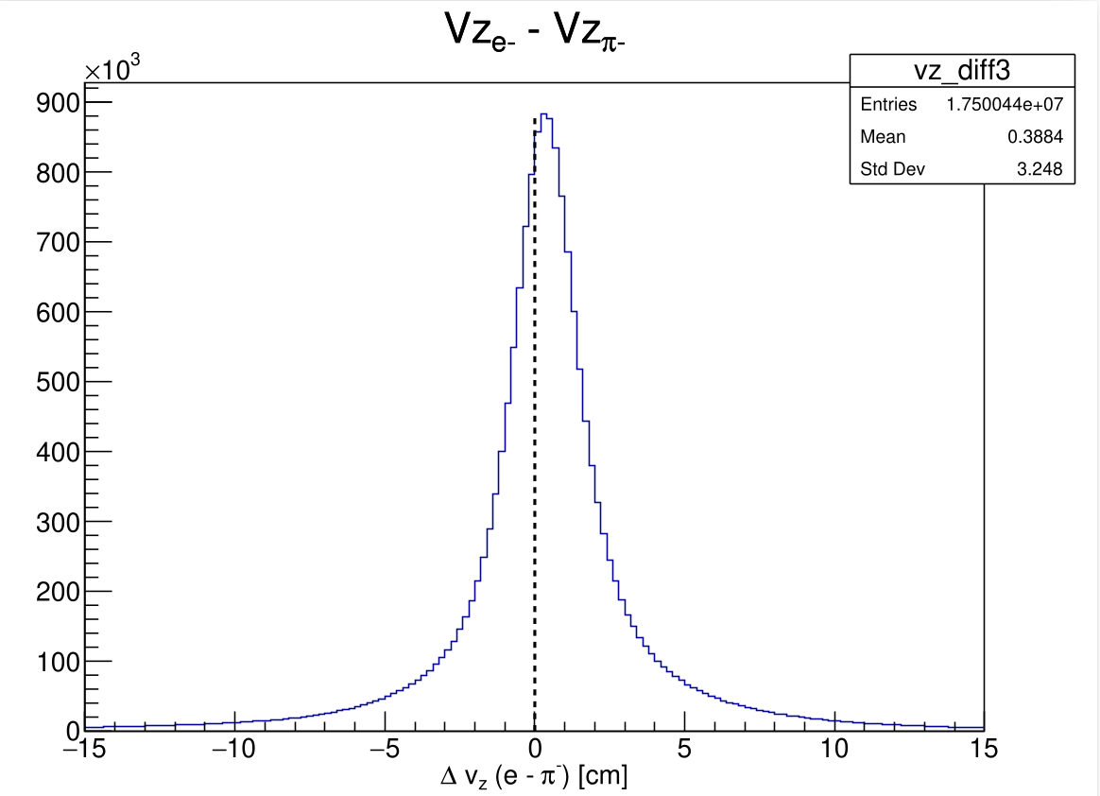
Introduction and objectives
Cut on Vze- - Vzπ- < 0 to ensure that the vertex of Ks→π+ π- is located further than the vertex of ɸ→ KsKL
Mathieu Ronayette
5/12
Mathieu Ronayette
meeting
17 October 2025

Slide 6
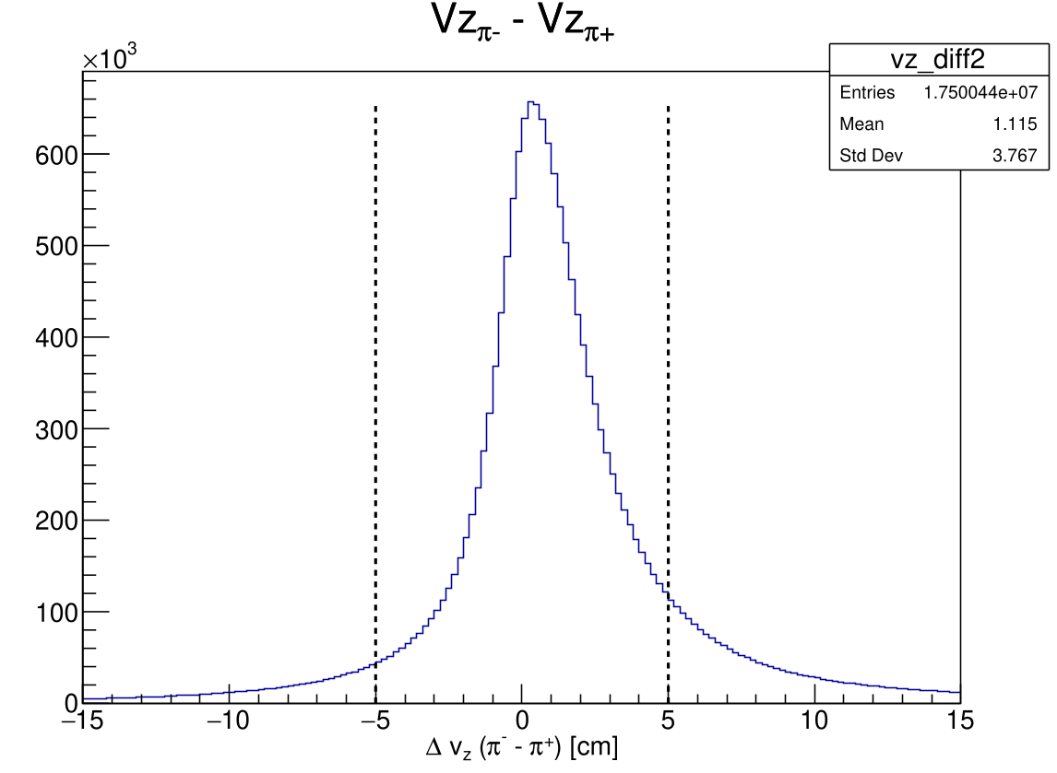
Introduction and objectives
Large cut on -5 < Vzπ- - Vzπ+ < 5 cm to ensure that π+ and π- have the same vertex
Mathieu Ronayette
6/12
Mathieu Ronayette
meeting
17 October 2025

Slide 7
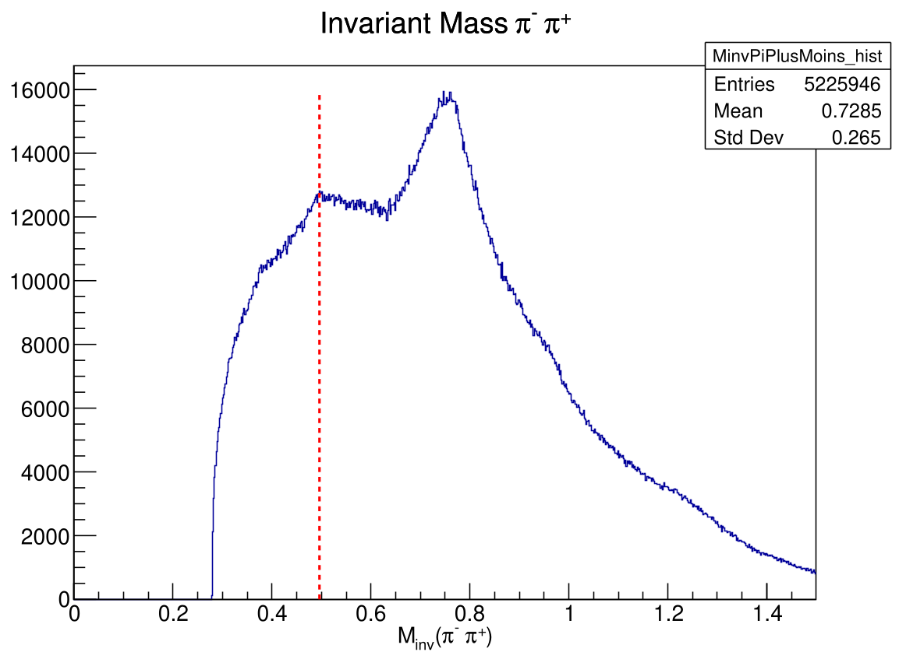
First Plots
Cuts :
* Particle final state
* Vze- - Vzπ- < 0
* -5 < Vzπ+ - Vzπ- < 5 cm
Ks (0.496 GeV)
Mathieu Ronayette
7/12
Mathieu Ronayette
meeting
17 October 2025

Slide 8
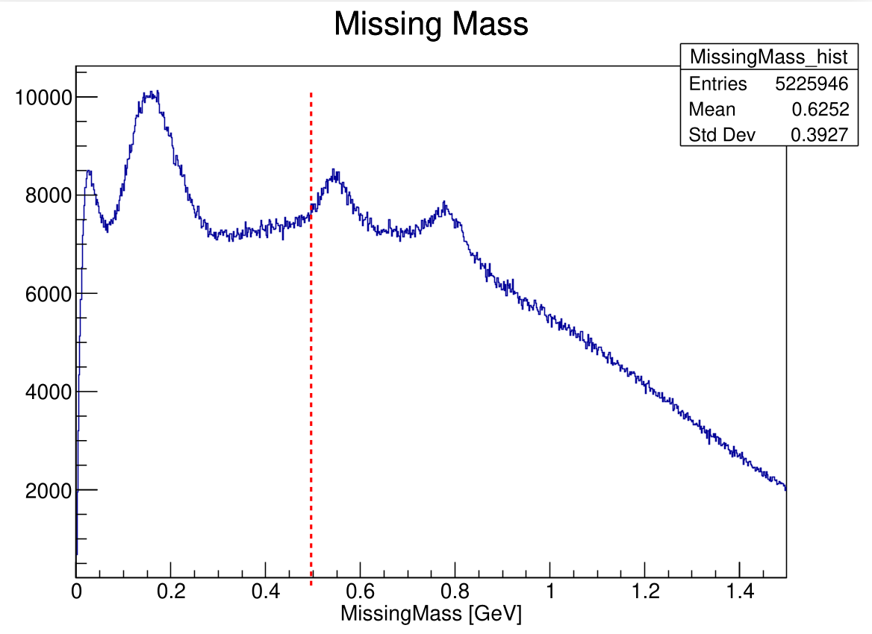
First Plots
Cuts :
* Particle final state
* Vze- - Vzπ- < 0
* -5 < Vzπ+ - Vzπ- < 5 cm
KL (0.496 GeV)
Mathieu Ronayette
8/12
Mathieu Ronayette
meeting
17 October 2025

Slide 9
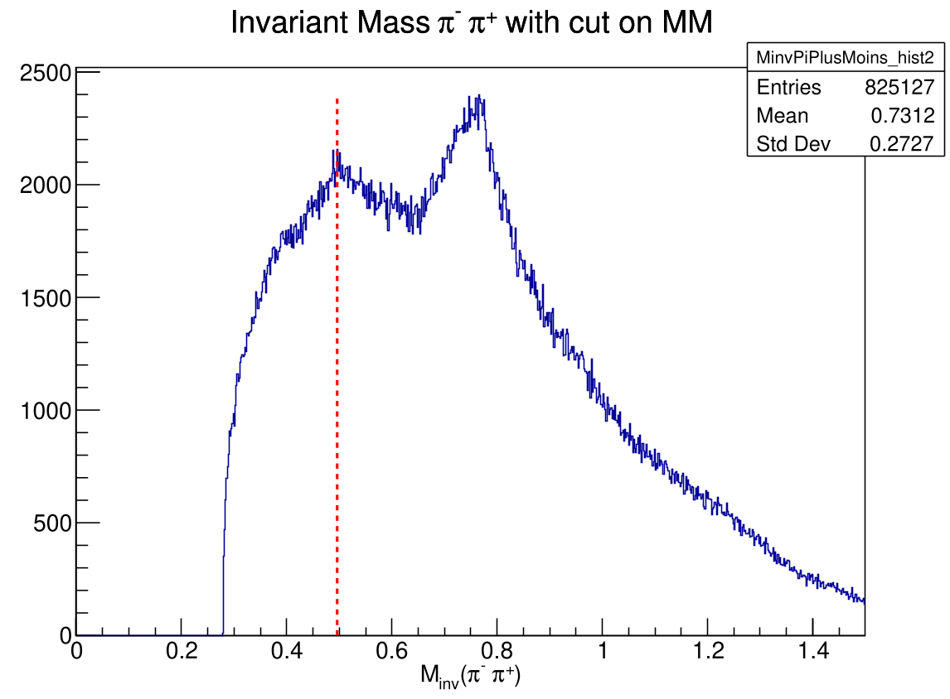
First Plots
Cuts :
* Particle final state
* Vze- - Vzπ- < 0
* -5 < Vzπ+ - Vzπ- < 5 cm
* 0.4 < MissingMass < 0.6 Gev
Ks (0.496 GeV)
Mathieu Ronayette
9/12
Mathieu Ronayette
meeting
17 October 2025

Slide 10
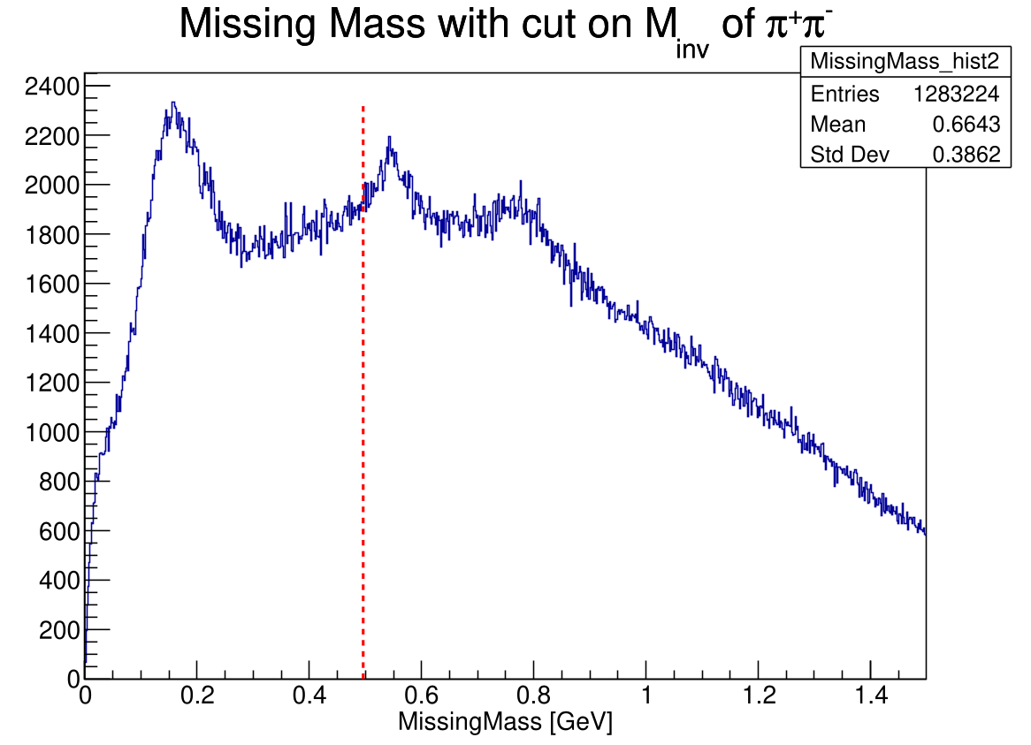
First Plots
Cuts :
* Particle final state
* Vze- - Vzπ- < 0
* -5 < Vzπ+ - Vzπ- < 5 cm
* 0.4 < Minv (π⁺ π⁻ ) < 0.6 GeV
KL (0.496 GeV)
Mathieu Ronayette
10/12
Mathieu Ronayette
meeting
17 October 2025

Slide 11
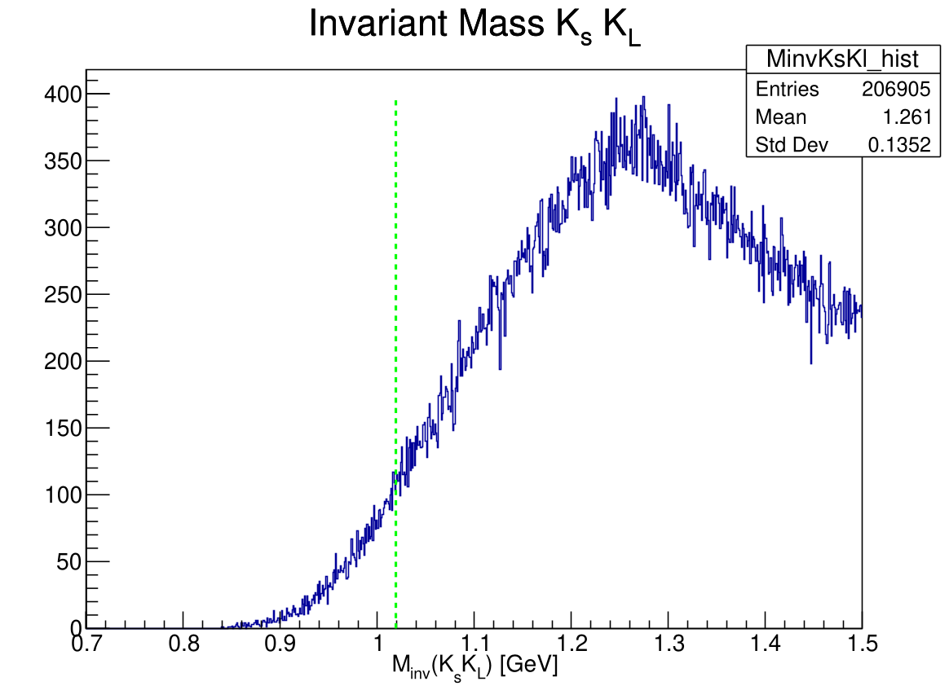
First Plots
ɸ (1.019 GeV)
Cuts :
* Particle final state
* Vze- - Vzπ- < 0
* -5 < Vzπ+ - Vzπ- < 5 cm
* 0.4 < Minv (π⁺ π⁻ ) < 0.6 GeV
* 0.4 < MissingMass < 0.6 GeV
Mathieu Ronayette
11/12
Mathieu Ronayette
meeting
17 October 2025

Slide 12
Outlook
Test already done :
* Move the missing mass cut between 0.5 – 0.7 GeV if the peack of KL is shifted
* Same cut with rg-K datas
Further cuts :
* Improve the cut on ΔVz with
the code of Veronique Ziegler
* Cut on Vt
Thanks !
Mathieu Ronayette
12/12
Mathieu Ronayette
meeting
1 April 2025

