Slide 1
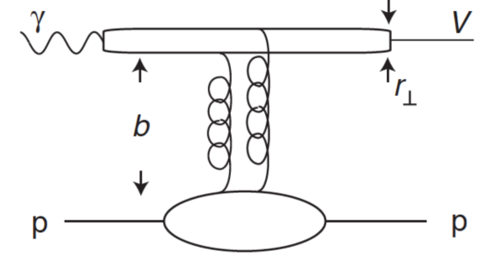
Introduction and objectives
Analysis objective :
- Measurement of the cross section and diferential cross section of the electroproduction of ɸ in the K_{s} K_{L} channel
ϕ
- Datas : nSidis RG-A inbending and
outbending fall 2018
GFFs
Mathieu Ronayette
1/15
Mathieu Ronayette
meeting
7 Nov 2025

Slide 2
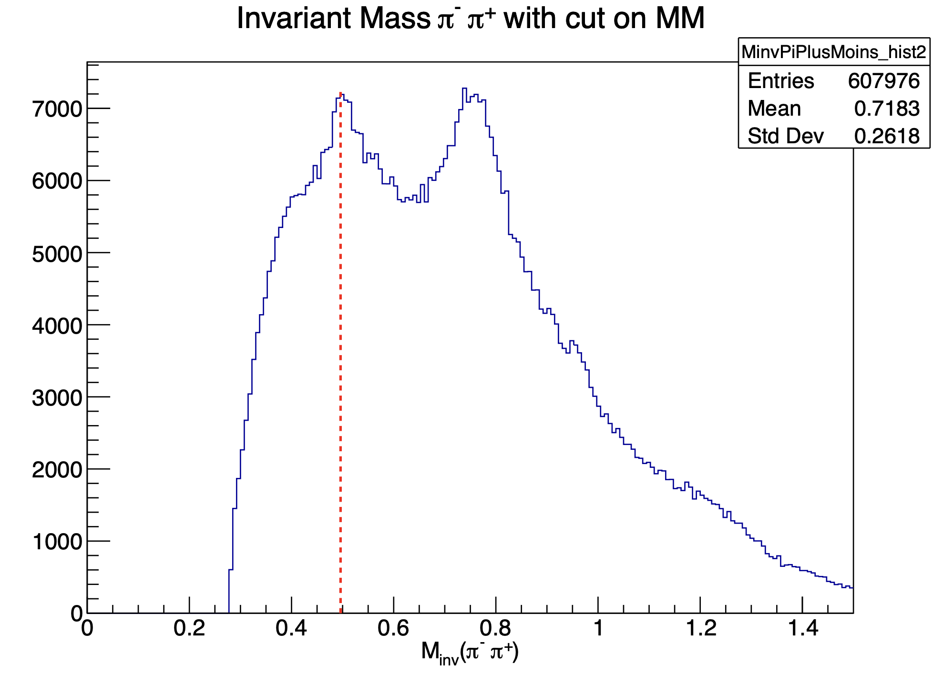
Update on Ks Kl analysis
ɸ → Ks Kl and Ks → π⁺ π⁻
Vertex of π⁺ π⁻ are recalculated with the code of Veronique Ziegler
→ Add some cut on :
Distance between vertex of π⁺ π⁻ < 2 cm
Distance between vertex Ks and e⁻ (1.5 < Dist < 5.0 cm)
Mathieu Ronayette
2/15
Mathieu Ronayette
meeting
7 Nov 2025

Slide 3
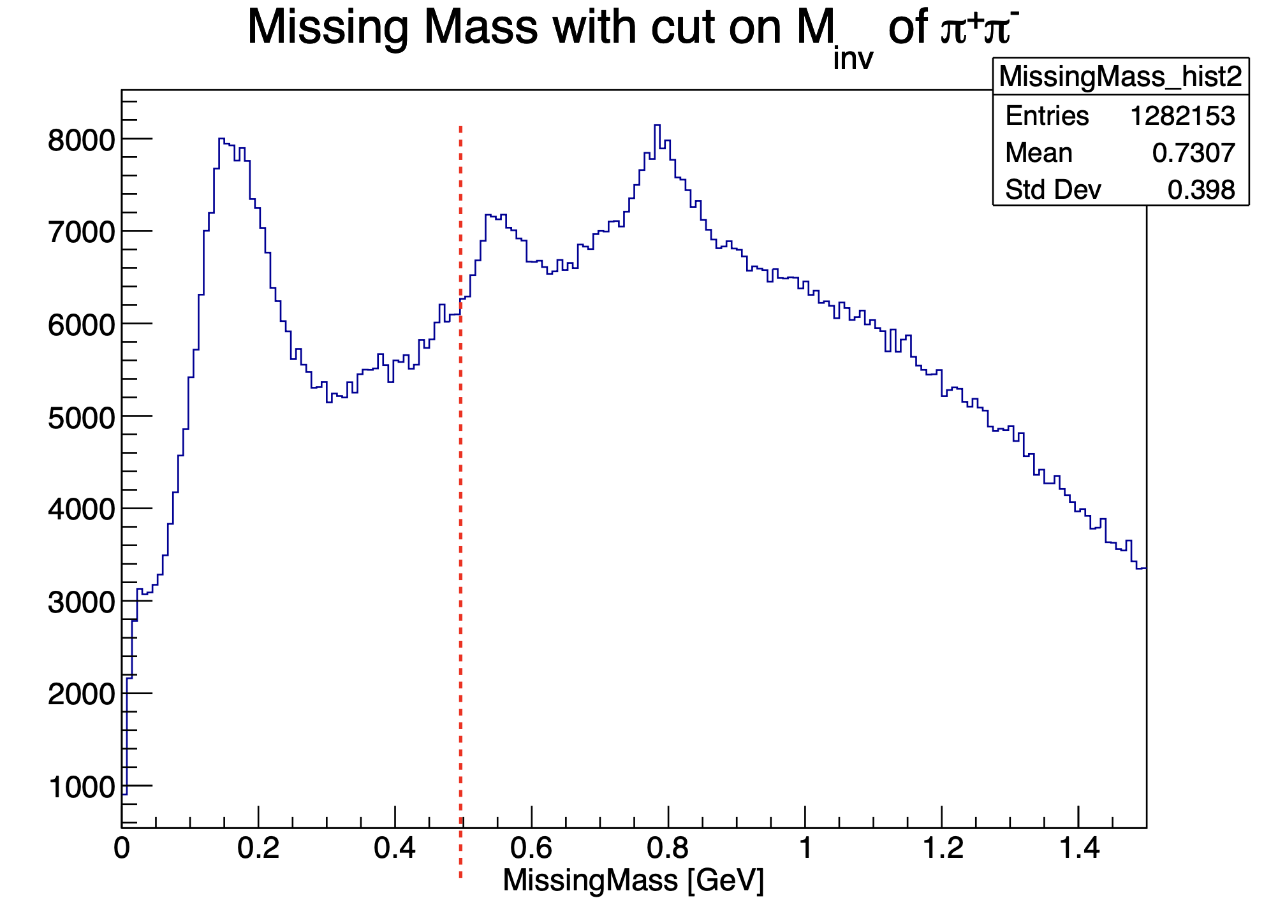
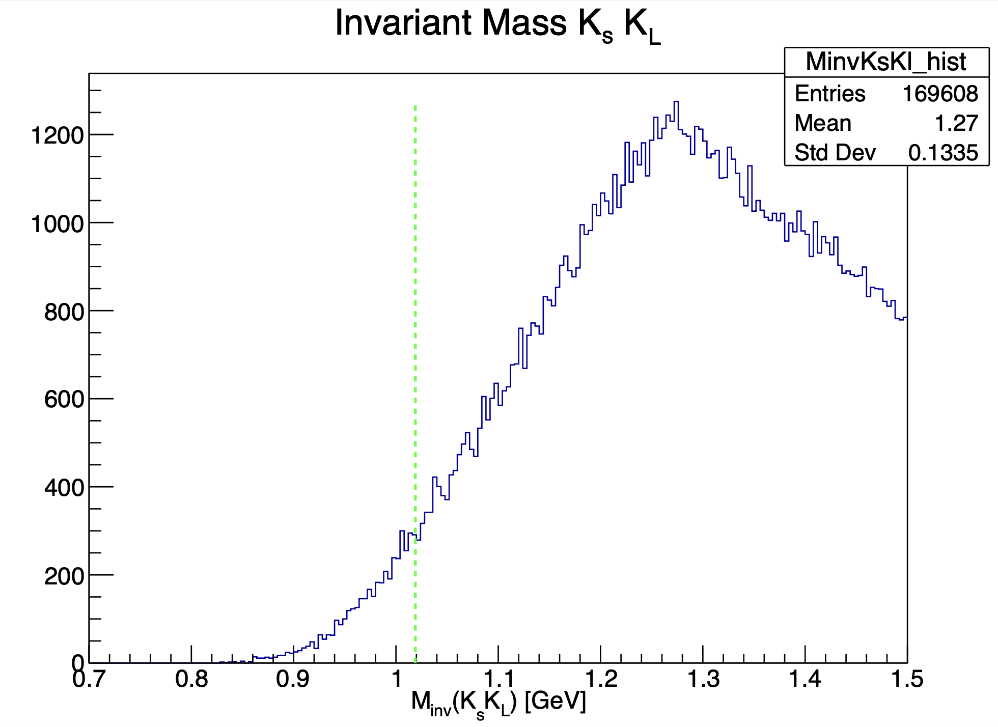
Update on Ks Kl analysis
Mathieu Ronayette
3/15
Mathieu Ronayette
meeting
7 Nov 2025

Slide 4
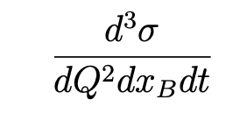
Generator with TGenPhaseSpace
Step 1 : e p → ɸ e’ p’
Vertex :
V_{x} = 0
V_{y} = 0
V_{z} = random(-5.5, -0,5)
Cross section :
Target :
p = ( 0, 0, 0, m_{p})
Beam :
e = (0, 0, E_{b}, E_{b})
Decay of p + e → ɸ e’ p’
with TGenPhaseSpace
Implemented from
Proposal to Jeﬀerson Lab PAC39 Exclusive Phi Meson Electroproduction with CLAS12
Mathieu Ronayette
4/15
Mathieu Ronayette
meeting
7 Nov 2025

Slide 5
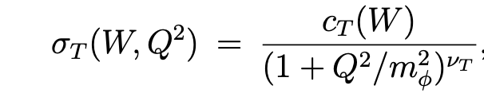
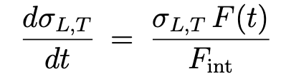

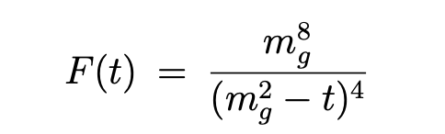
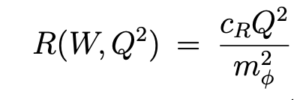
Generator with TGenPhaseSpace
Details on cross section :
σ_{T} and σ_{L} (γ*p → ɸ p) :
t-dependence (dipole) :
Mathieu Ronayette
5/15
Mathieu Ronayette
meeting
7 Nov 2025

Slide 6
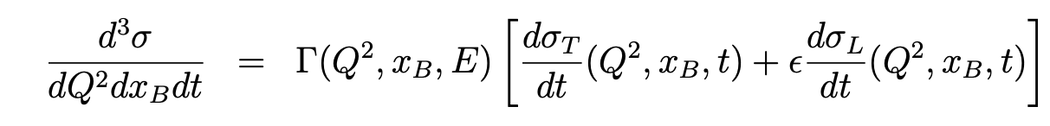
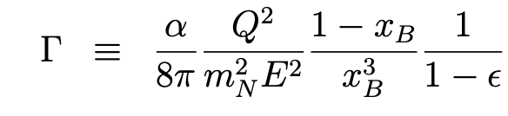
Generator with TGenPhaseSpace
Cross section (ep → ɸ p) :
The virtual photon flux :
Mathieu Ronayette
6/15
Mathieu Ronayette
meeting
7 Nov 2025

Slide 7
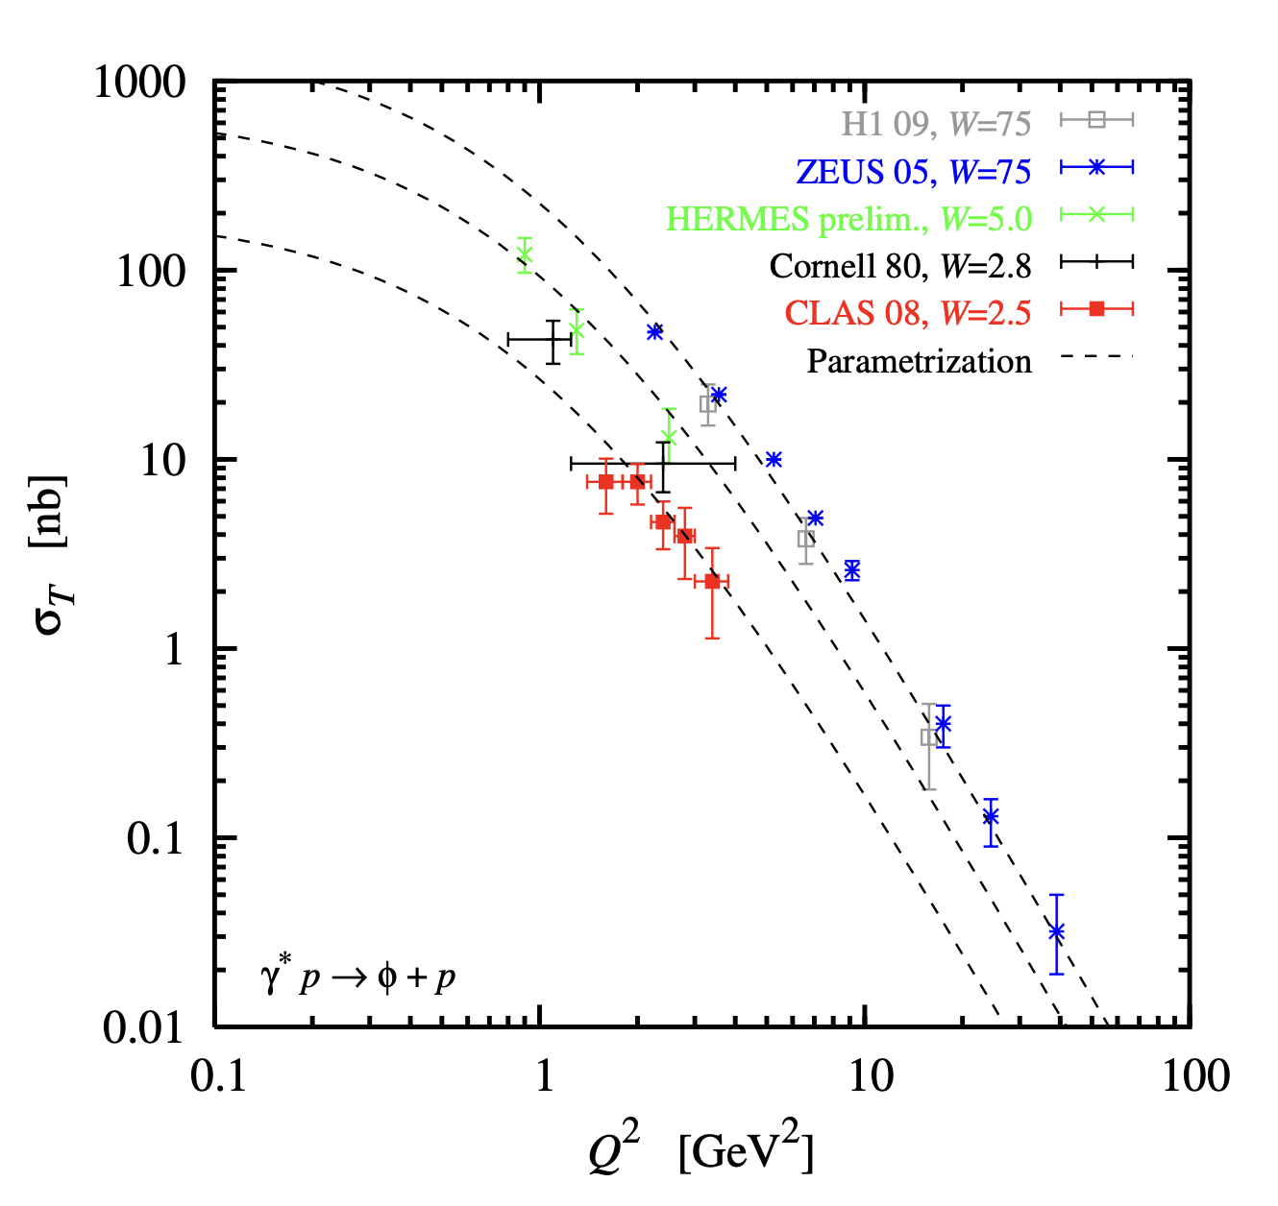
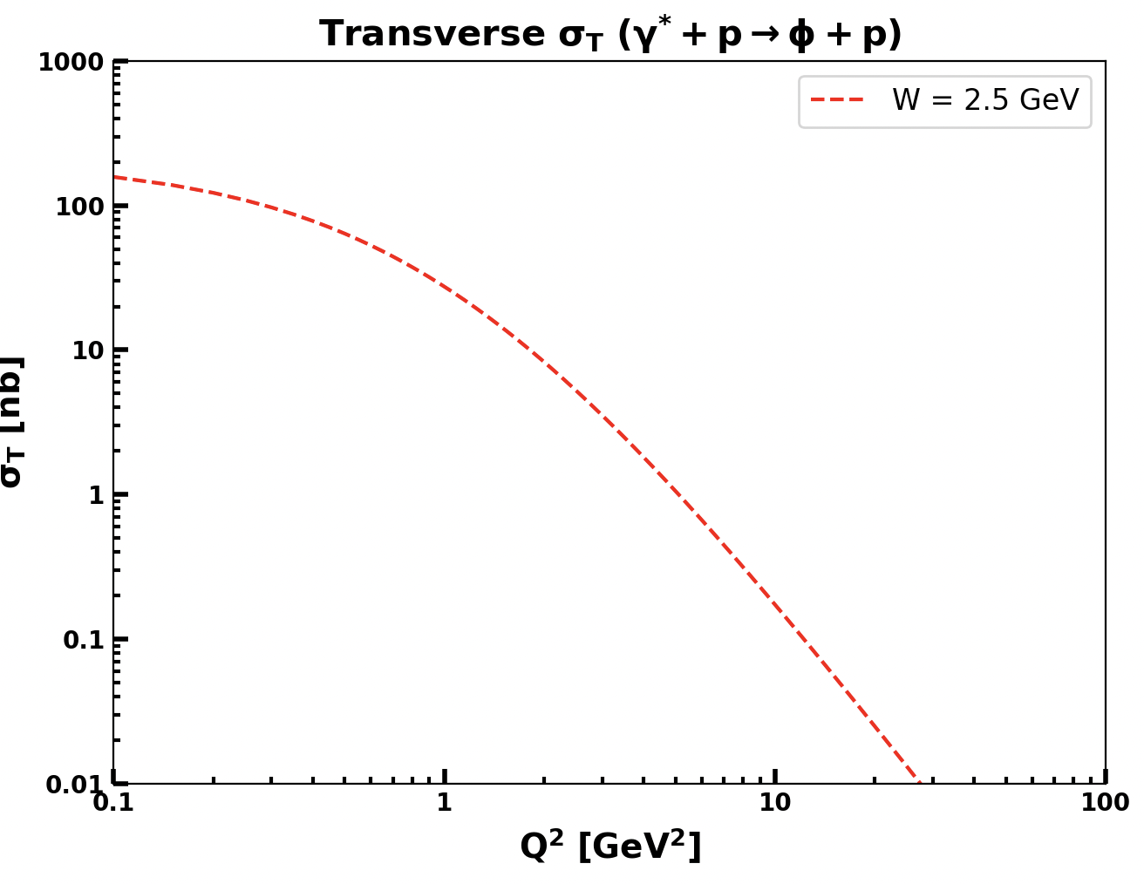
Generator with TGenPhaseSpace
Implemented in the generator
From Proposal to Jeﬀerson Lab PAC39
Mathieu Ronayette
7/15
Mathieu Ronayette
meeting
7 Nov 2025

Slide 8
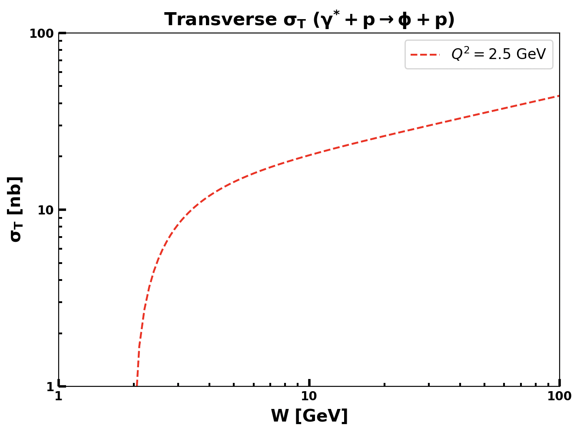
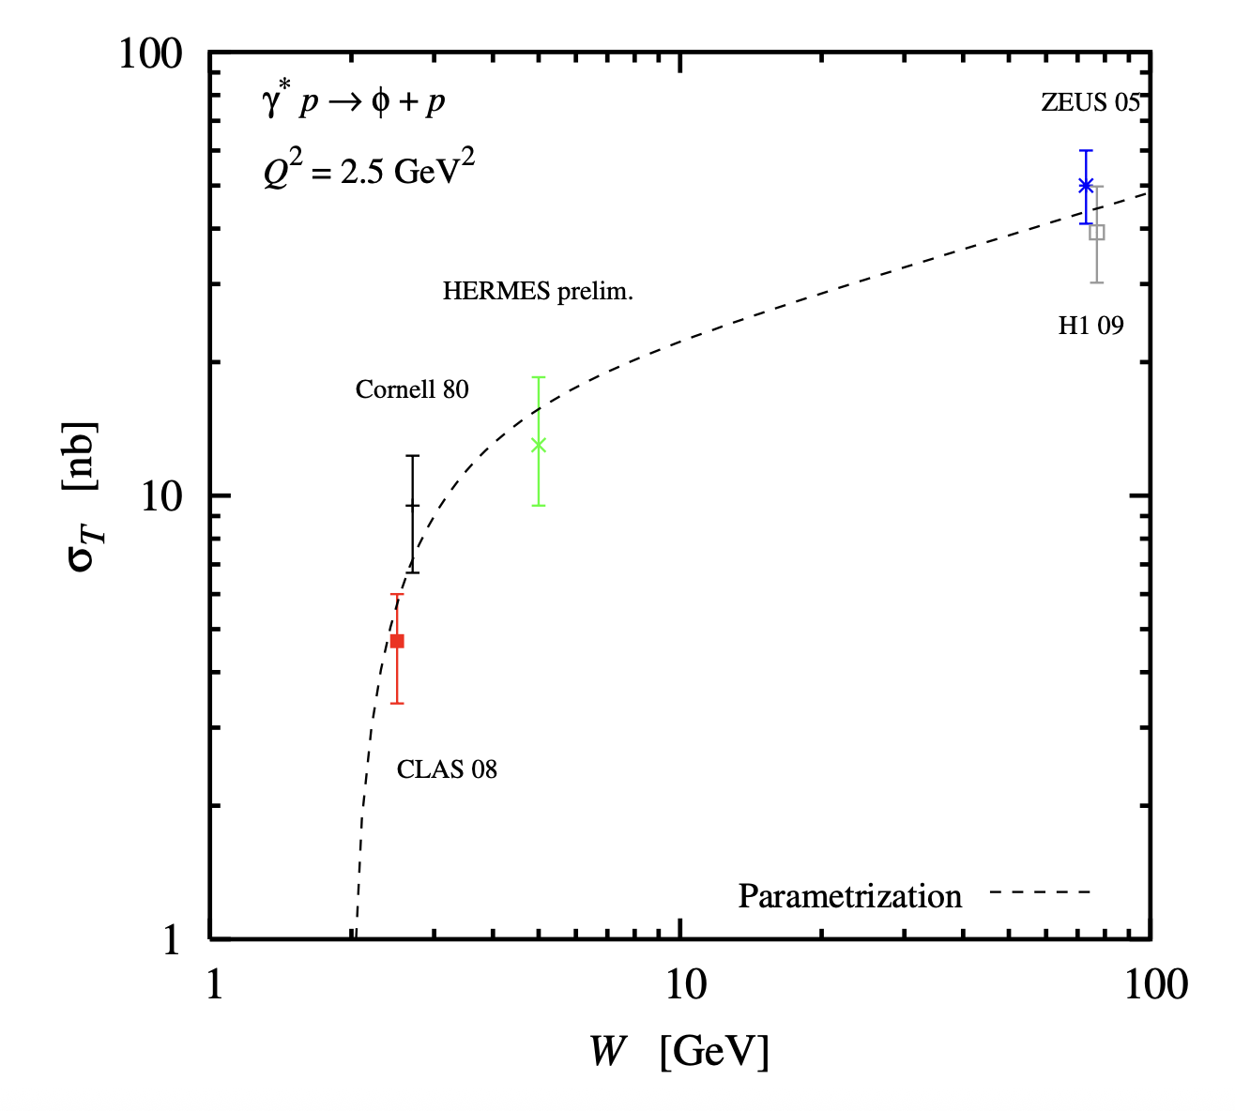
Generator with TGenPhaseSpace
Implemented in the generator
From Proposal to Jeﬀerson Lab PAC39
Mathieu Ronayette
8/15
Mathieu Ronayette
meeting
7 Nov 2025

Slide 9
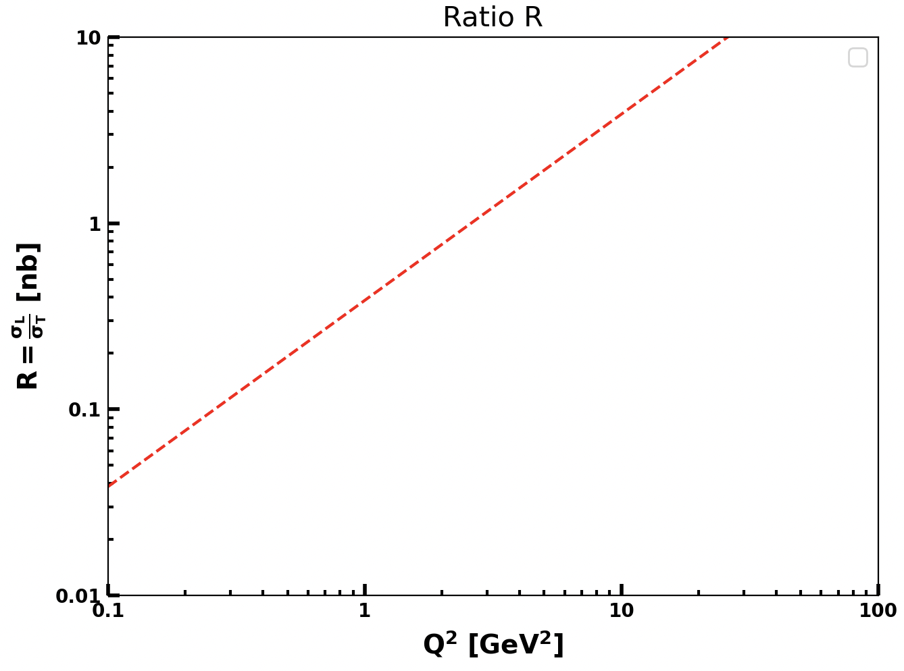
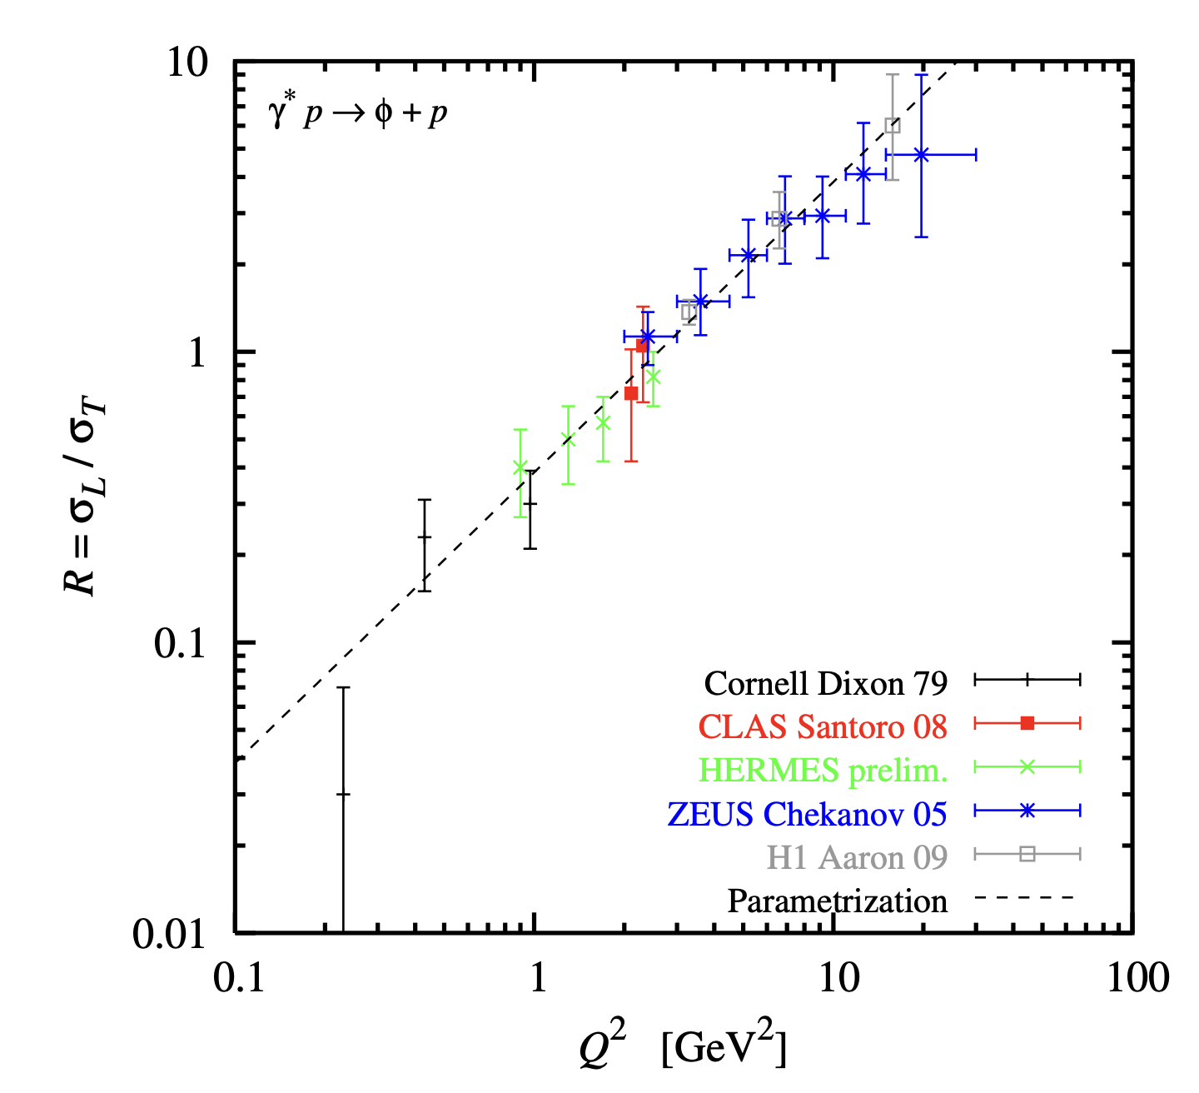
Generator with TGenPhaseSpace
Implemented in the generator
From Proposal to Jeﬀerson Lab PAC39
Mathieu Ronayette
9/15
Mathieu Ronayette
meeting
7 Nov 2025

Slide 10
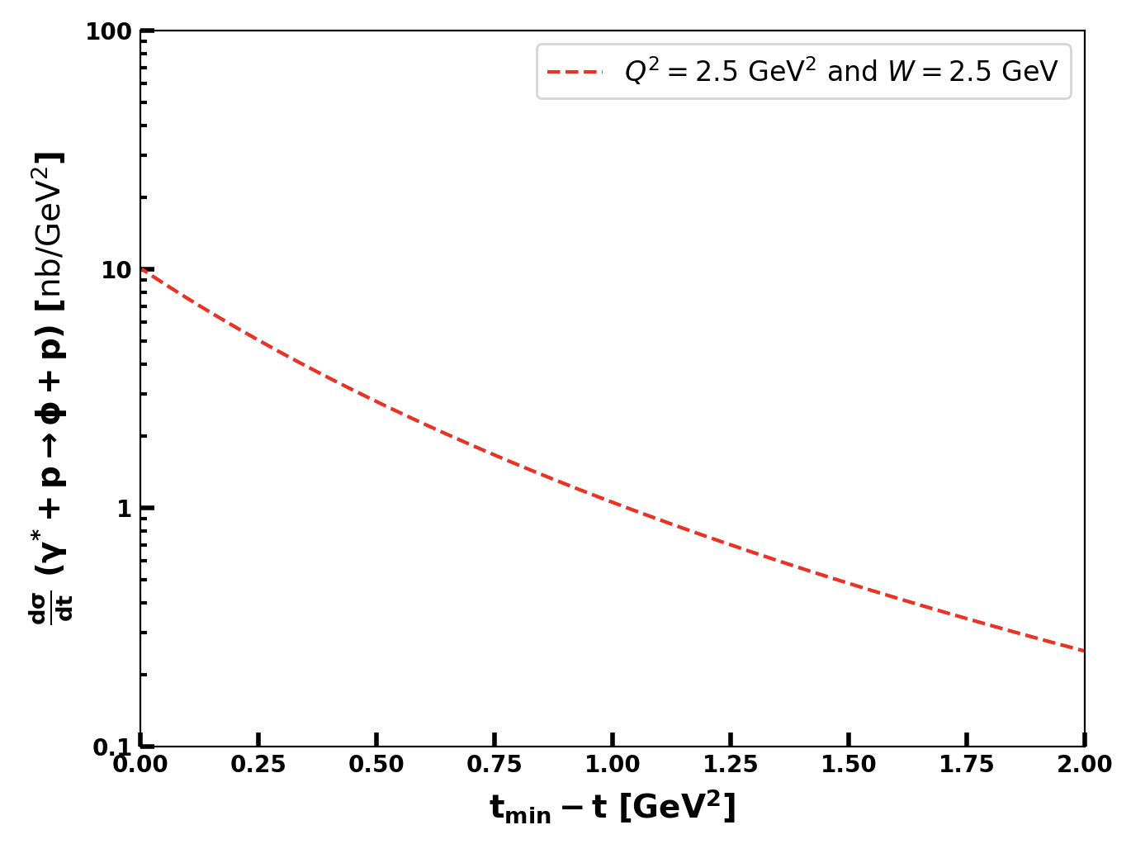

Generator with TGenPhaseSpace
Implemented in the generator
From Proposal to Jeﬀerson Lab PAC39
Mathieu Ronayette
10/15
Mathieu Ronayette
meeting
7 Nov 2025

Slide 11
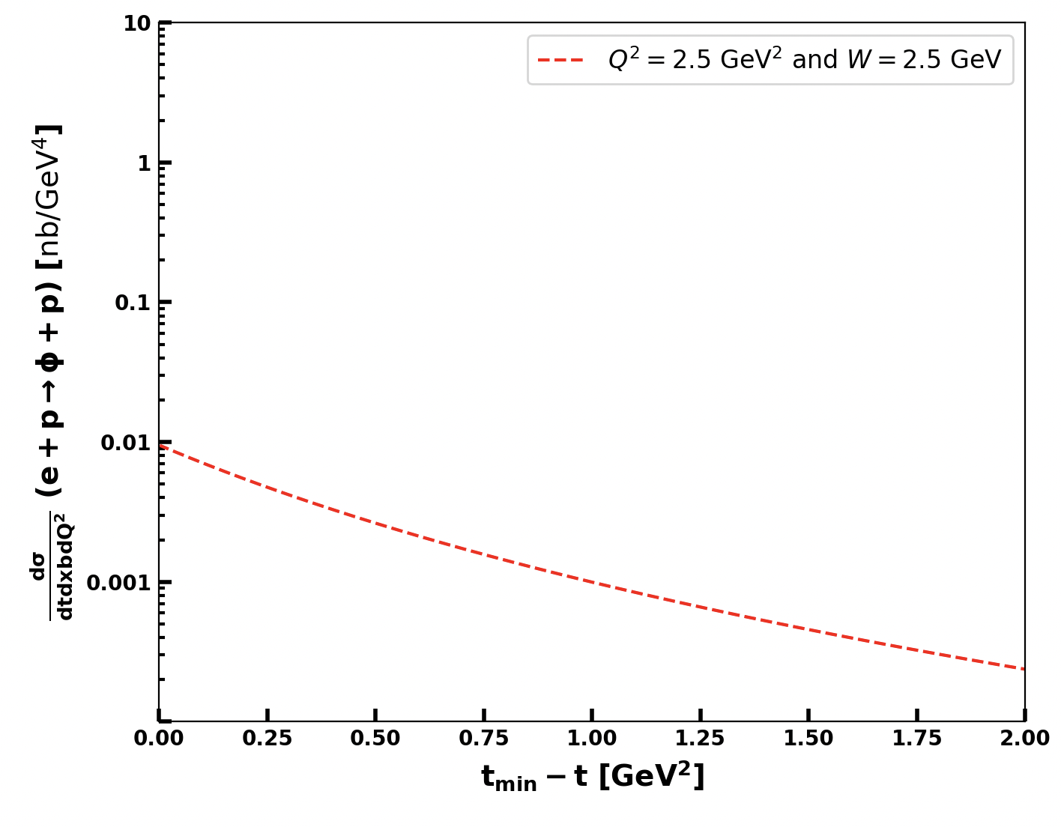
Generator with TGenPhaseSpace
Cross section (ep → ɸ p) (with the virtual photon flux) :
Implemented in the generator
Mathieu Ronayette
11/15
Mathieu Ronayette
meeting
7 Nov 2025

Slide 12
Generator with TGenPhaseSpace
Step 2 : ɸ → KsKl
Step 3 : Ks → π⁺ π⁻
Branching ratio = 34%
Uniform decay in θ in first approximation
Same V_{x} V_{y} V_{z} as in the previous decay
Branching ratio = 69%
Uniform decay in θ in first approximation
V_{x} V_{y} V_{z} shifted by 2.8 cm in the direction of Ks emmision to simulate the flight of Ks
Total weight = weight_{SpacePhase}* σ * BR_{KsKl}*BR π+ π-
Mathieu Ronayette
12/15
Mathieu Ronayette
meeting
7 Nov 2025

Slide 13
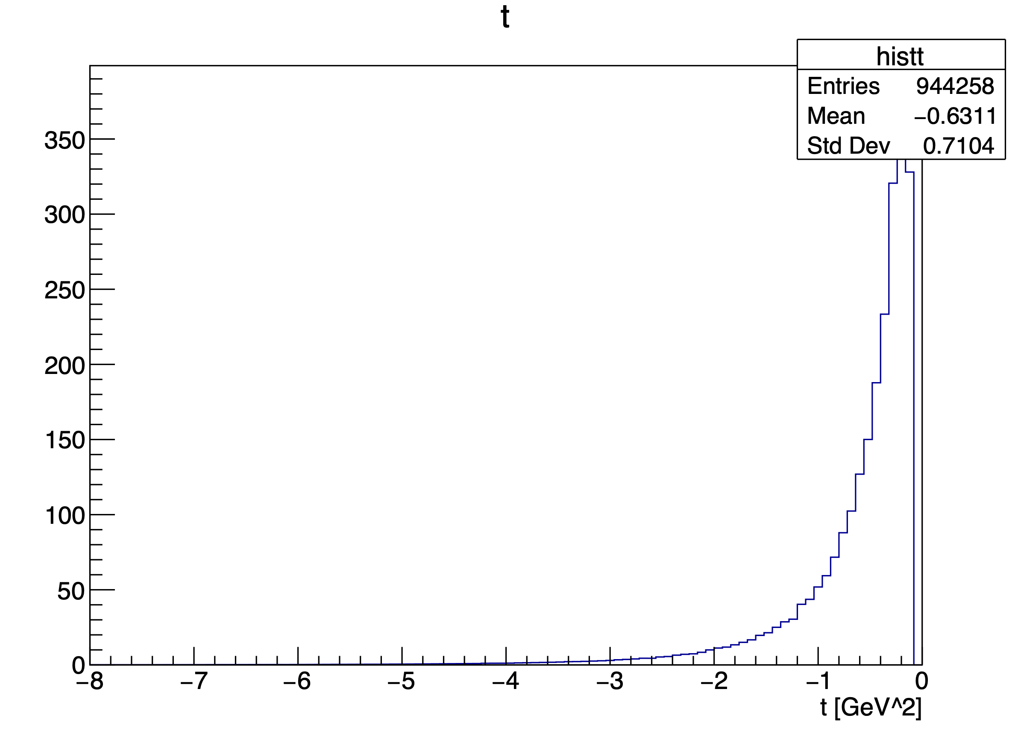
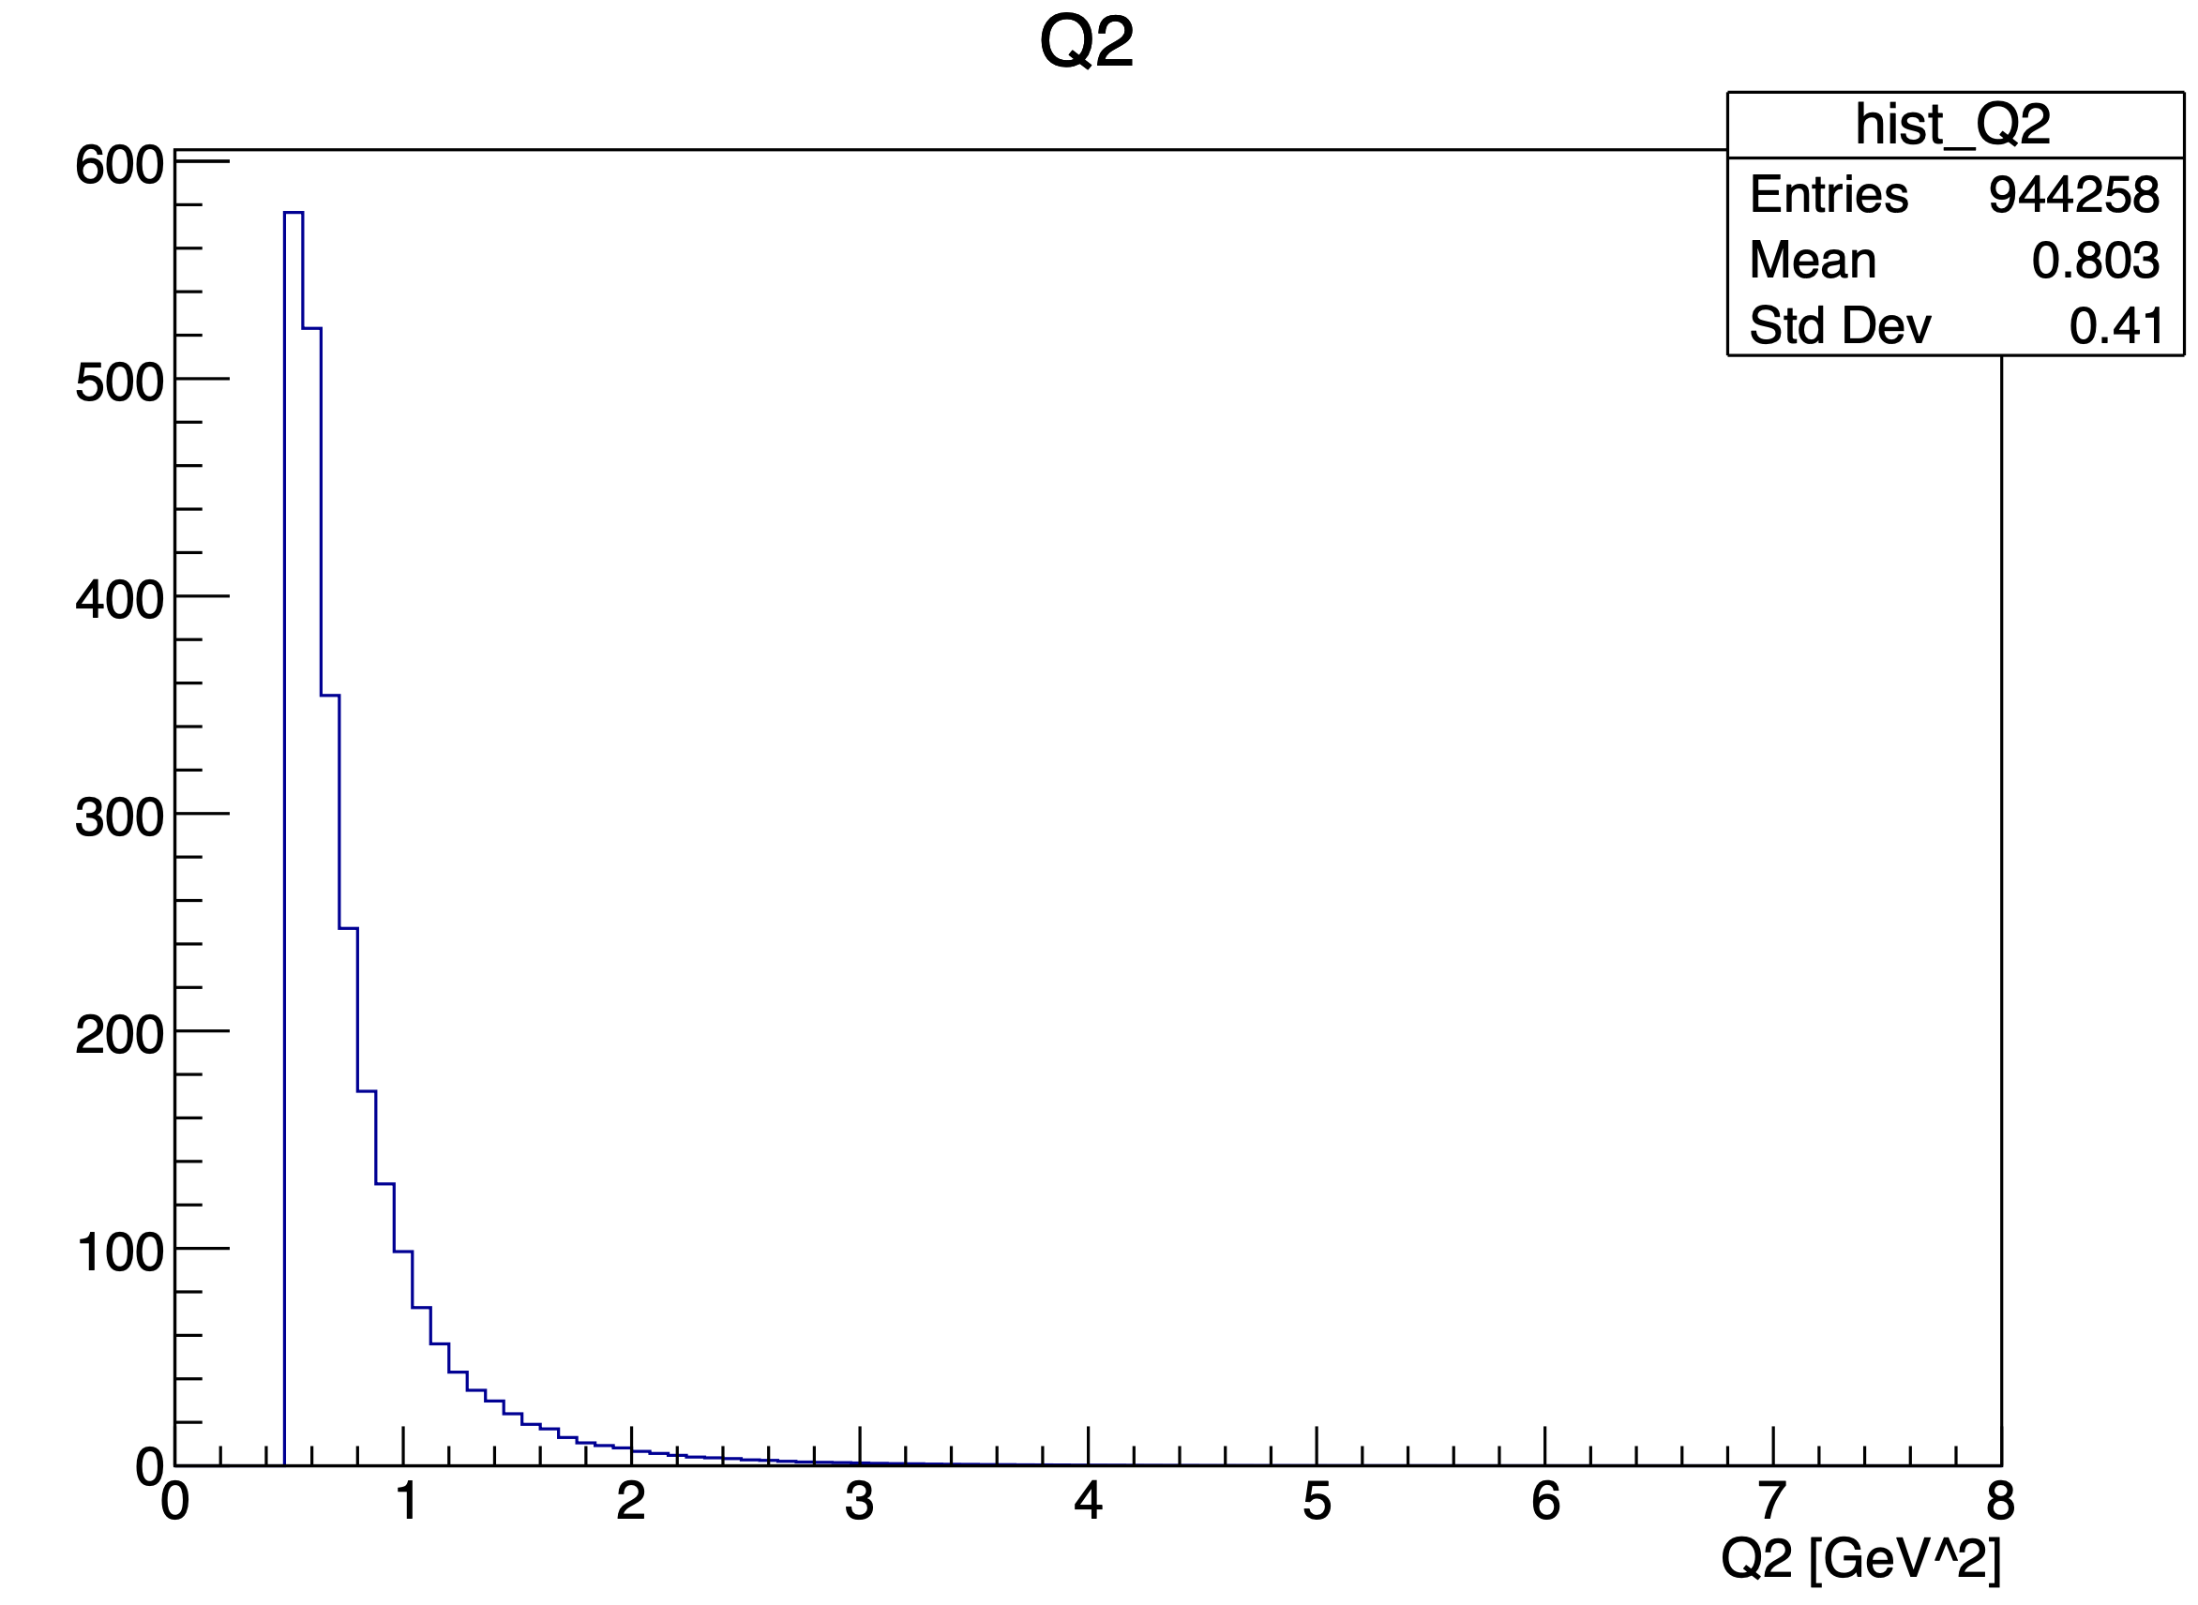
Generator with TGenPhaseSpace
Mathieu Ronayette
13/15
Mathieu Ronayette
meeting
7 Nov 2025

Slide 14
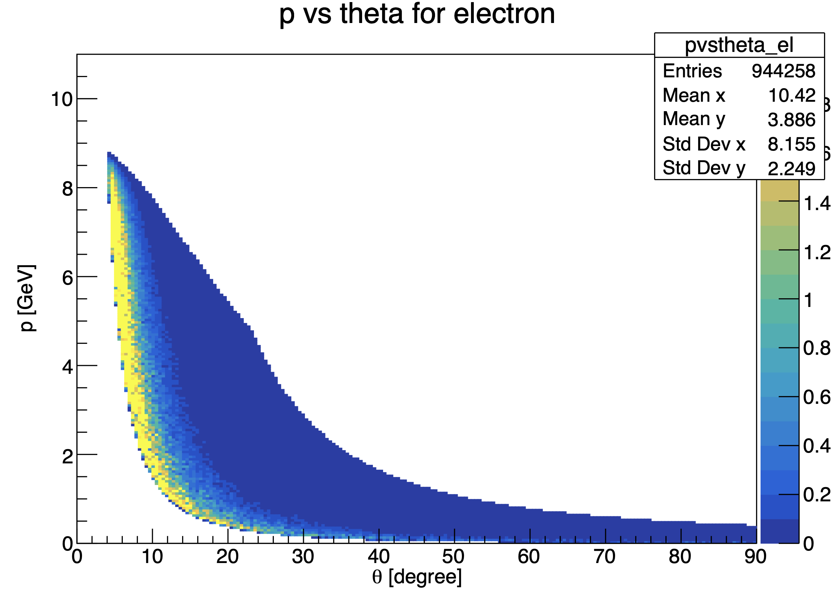
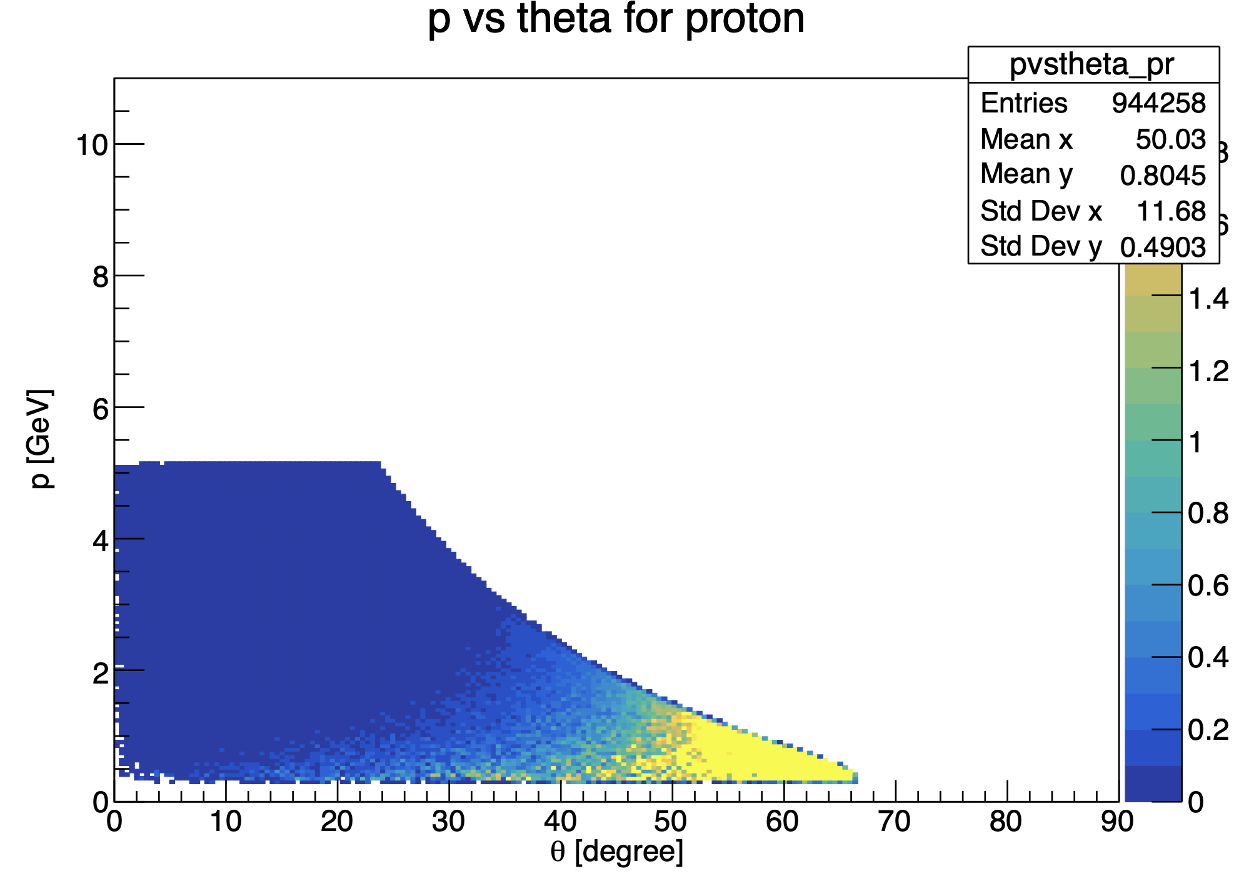
Generator with TGenPhaseSpace
Cuts : -8 < t < -0.1 GeV² and 0.5 < Q² < 8 GeV
Mathieu Ronayette
14/15
Mathieu Ronayette
meeting
7 Nov 2025

Slide 15
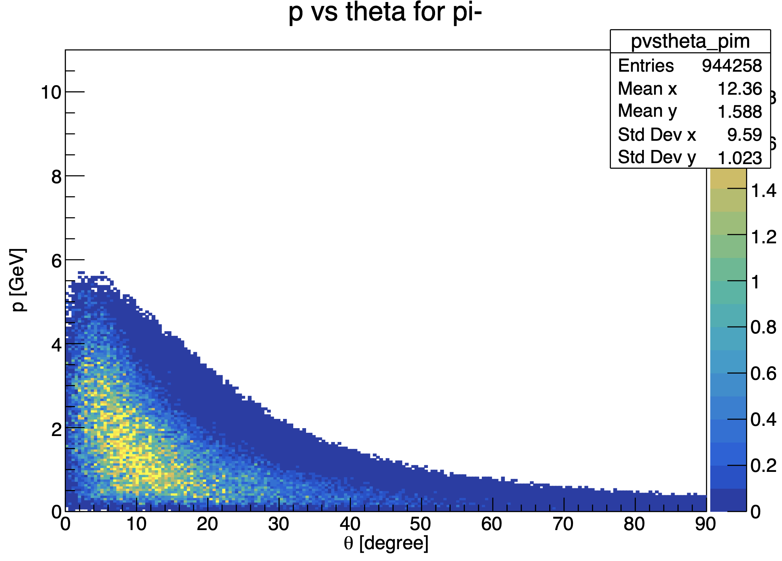
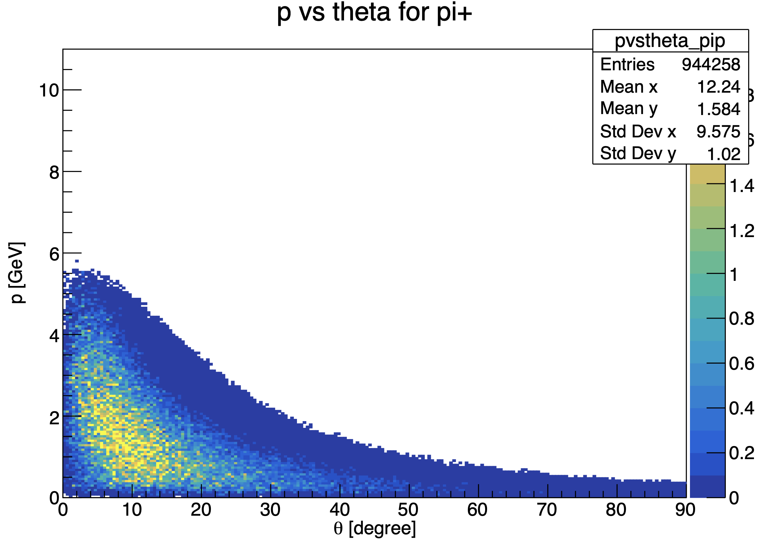
Generator with TGenPhaseSpace
Mathieu Ronayette
15/15
Mathieu Ronayette
meeting
7 Nov 2025

