Slide 1
CLAS12 Collaboration Meeting
ɸ electroproduction on the neutron with RGB
11 March 2026
M. Ronayette, P. Chatagnon
Mathieu Ronayette
1/20
Mathieu Ronayette
Clas12 Collaboration Meeting
11 March 2026
Notes:
1

Slide 2
Summary
Motivations
Events selection
Generator for MC simulation
Effect of differents cuts
Yield extraction
Neutron Efficiency correction
Acceptance correction
Binning correction
Preliminary plot of differential cross section
Mathieu Ronayette
2/20
Mathieu Ronayette
Clas12 Collaboration Meeting
11 March 2026
Notes:
2

Slide 3
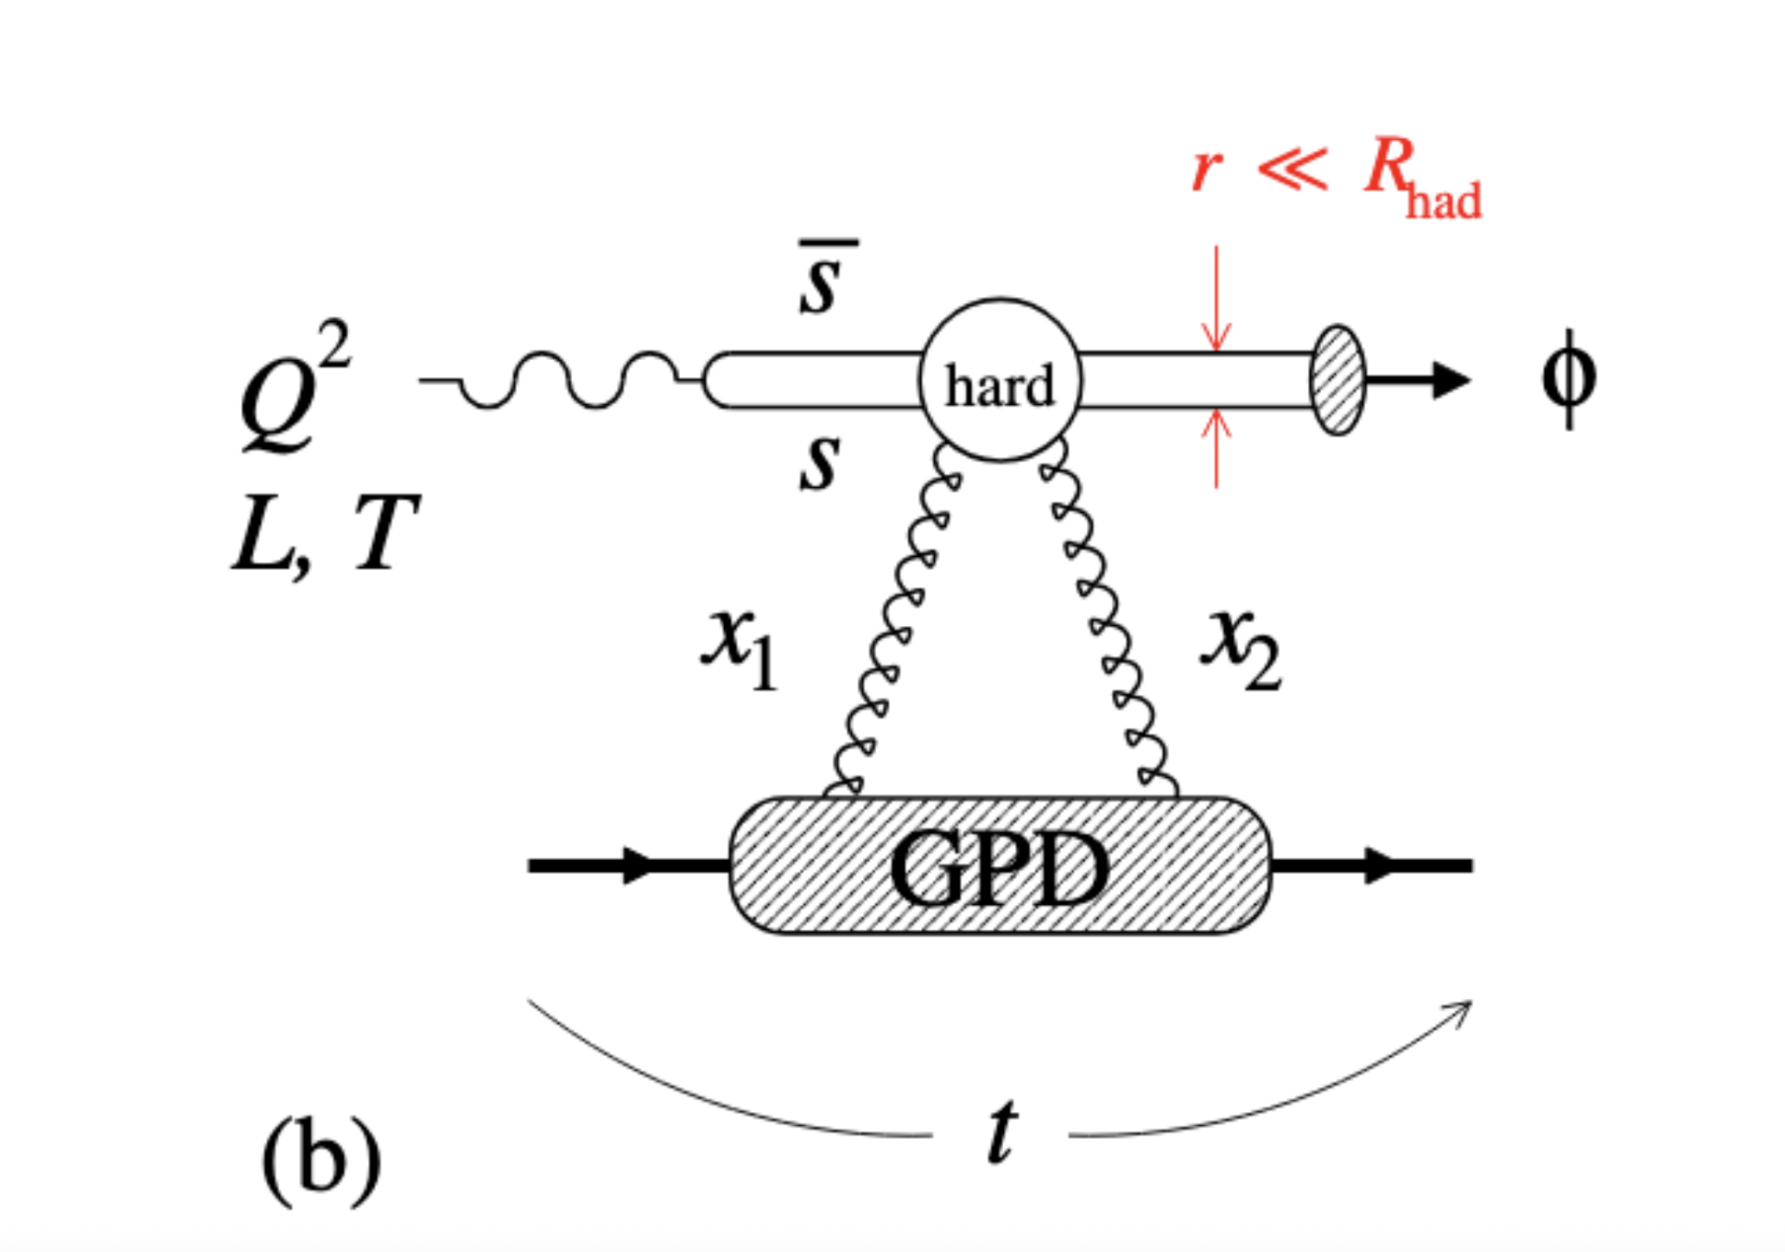
Introduction
Analysis objective :
- Measurement of the cross section and differential cross section of the electroproduction of ɸ in the K⁺ K⁻ channel with RGB data (deuterium target).
e n → e n’ K⁺ K⁻
→
Acess to the gluon GPD of the neutron
- We expect that cross section measurement to be similar to that of proton. We will compare with proton bound target (RGB) and with the work on free proton target (Bhawani’s work on RGA).
Change of t–dependence with Q2 →
gluonic radius of the neutron
Mathieu Ronayette
3/20
Mathieu Ronayette
Clas12 Collaboration Meeting
11 March 2026
Notes:
3

Slide 4
Events selection
Analysis :
Datas :
sidisdvcs RG-B outbending fall 2019
e n → e n’ K⁺ K⁻
Events selection :
Cuts :
→ Cut on the angle between the missing nucleon and the neutron
→ Cut on –0.5 < MissingMass_{tot} ² < 0.5 GeV ²
→ Cut on status of K⁺ and K⁻ (keep event with both kaons in FD)
e⁻ | K⁺ | K ⁻ | neutron | proton
1 | 1 | 1 | >= 1 | 0
(select the best neutron wich minimize the angle
between the missing nucleon and the neutron)
Q² > 1.0 GeV | P_{electron} > 2 GeV | θ_{neutron} > 4 ° | P_{neutron} > 0.25 GeV
Mathieu Ronayette
4/20
Mathieu Ronayette
Clas12 Collaboration Meeting
11 March 2026
Notes:
4

Slide 5
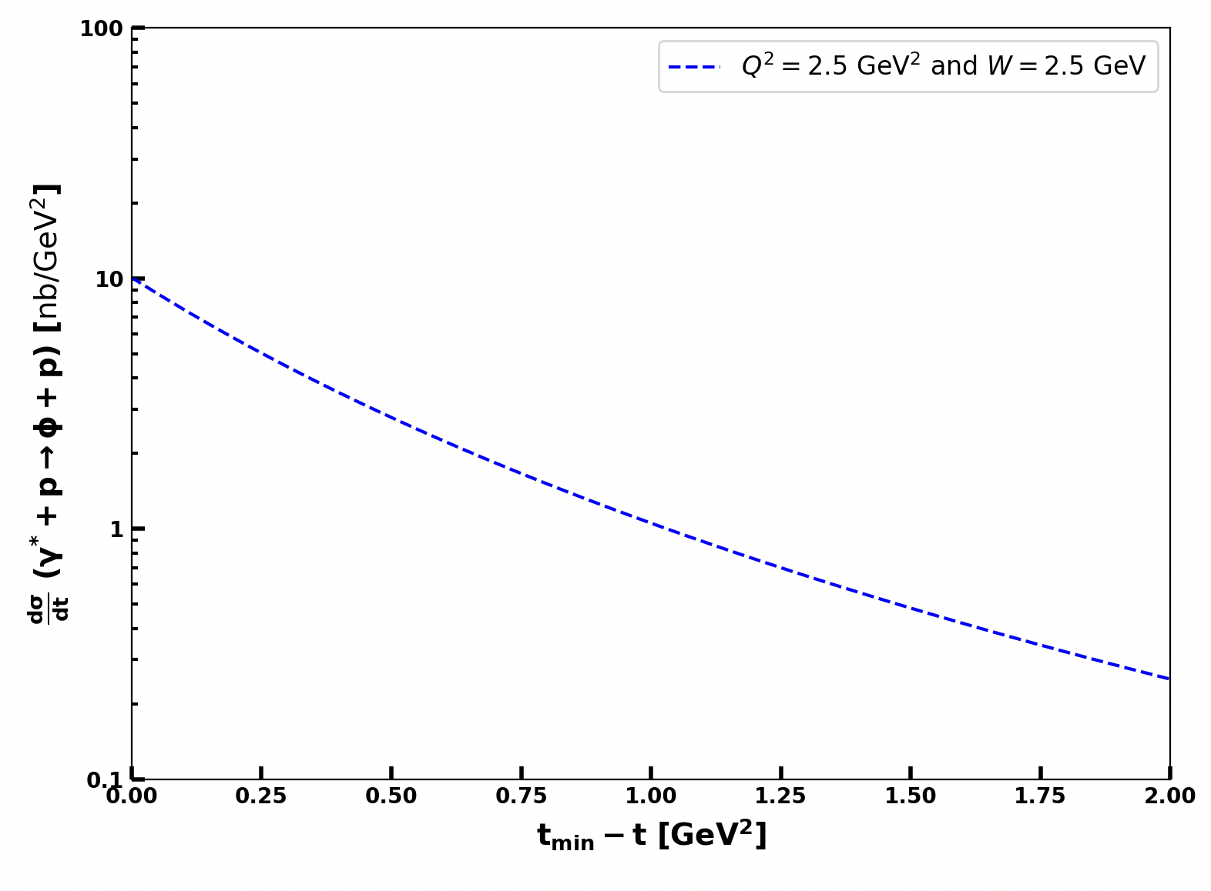
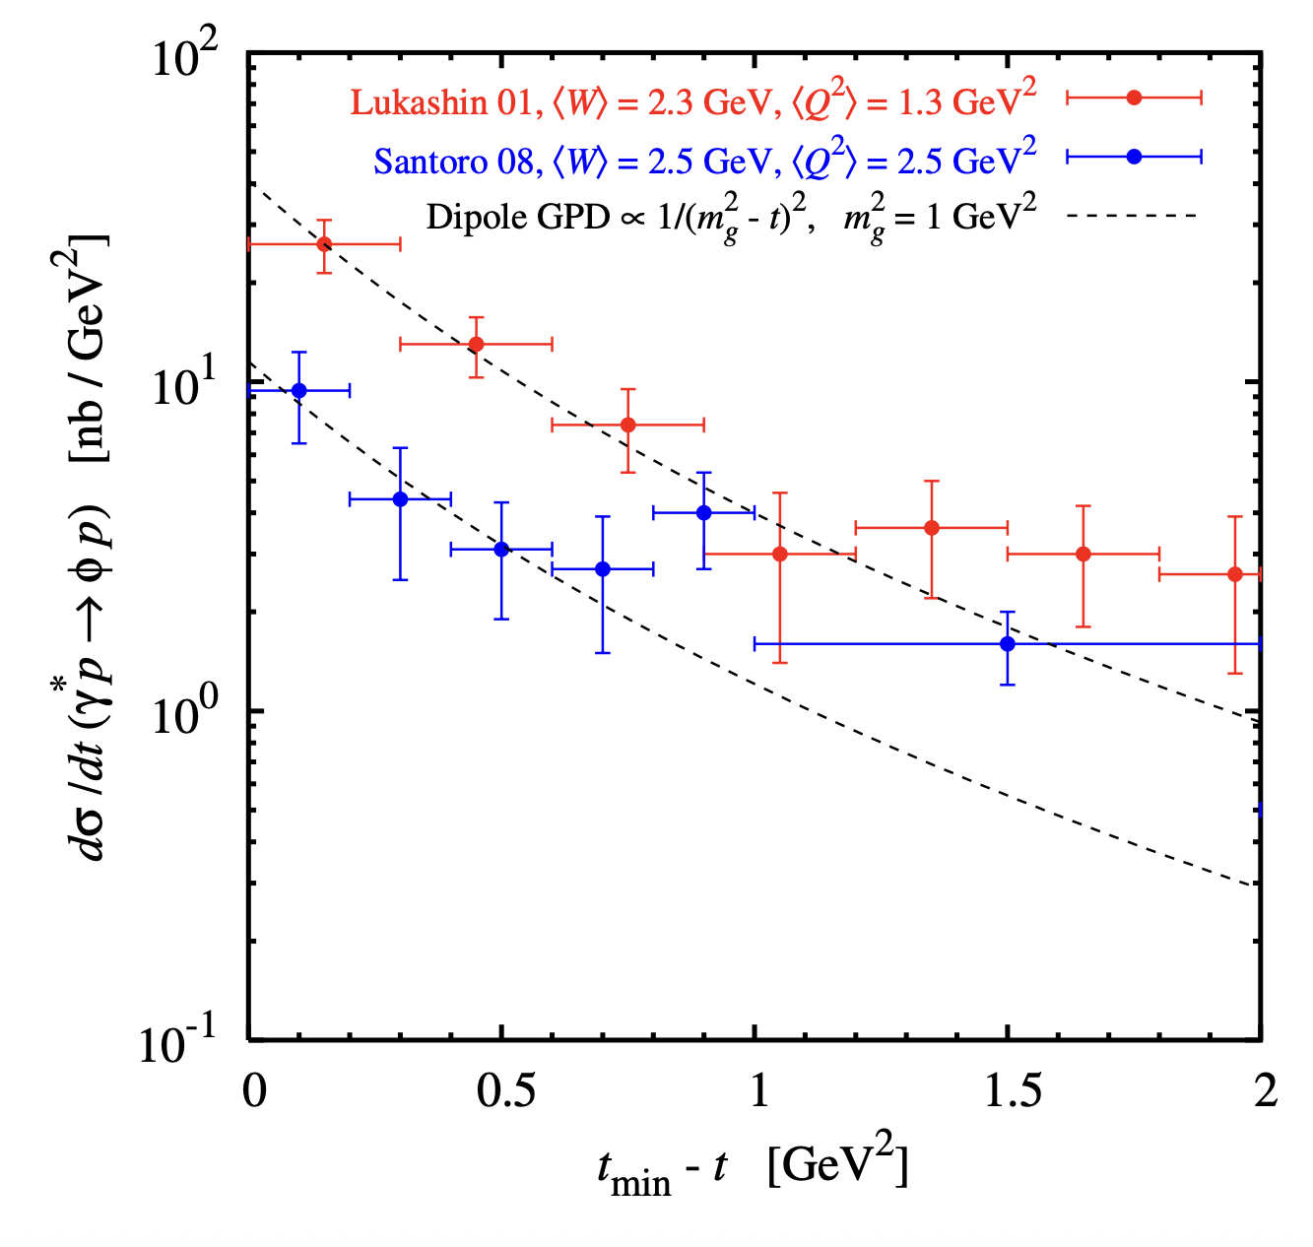
ɸ generator for MC simulation
Implemented in the generator
From Proposal to Jeﬀerson Lab PAC39
Mathieu Ronayette
5/20
Mathieu Ronayette
Clas12 Collaboration Meeting
11 March 2026
Notes:
5

Slide 6
Cut on the angle between missing nucleon and detected neutron
Missing nucleon = the missing particle of : e n → e’ K⁺ K⁻ X
K⁺
K⁺
K⁻
K⁻
e⁻
e⁻
neutron
neutron
missing nucleon
missing nucleon
Not a good event
Good event
→ Cut on the angle between the missing nucleon and the neutron < 5 °
Mathieu Ronayette
6/20
Mathieu Ronayette
Clas12 Collaboration Meeting
11 March 2026
Notes:
6

Slide 7
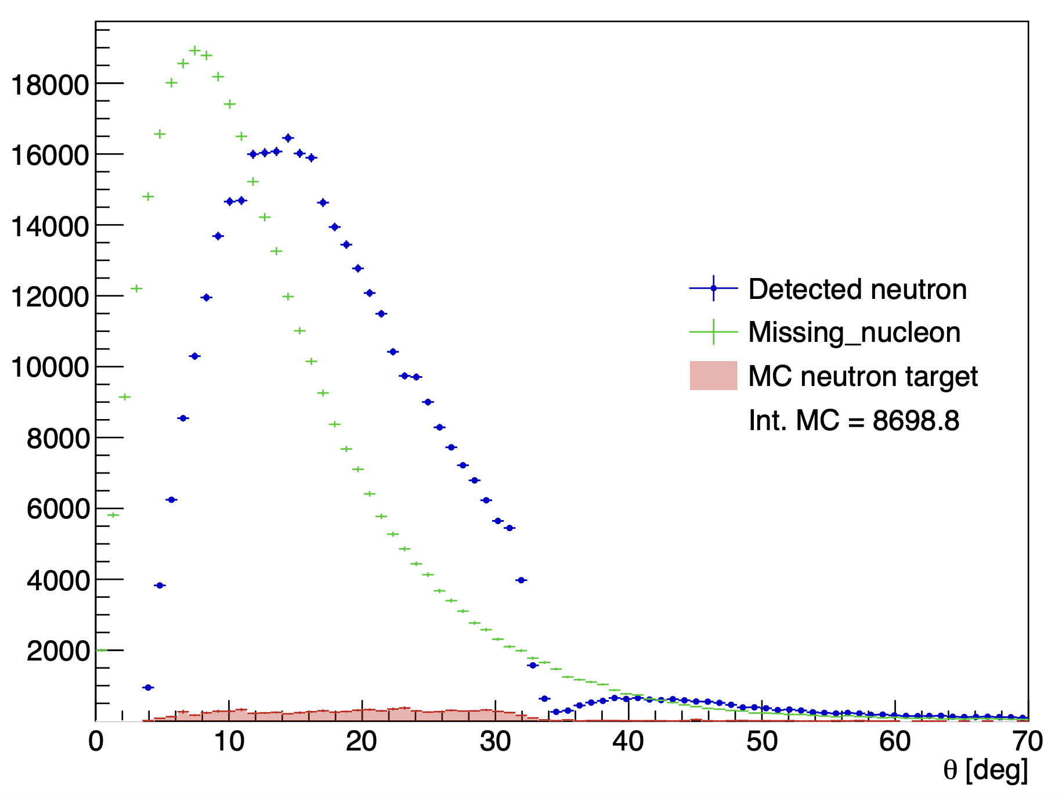
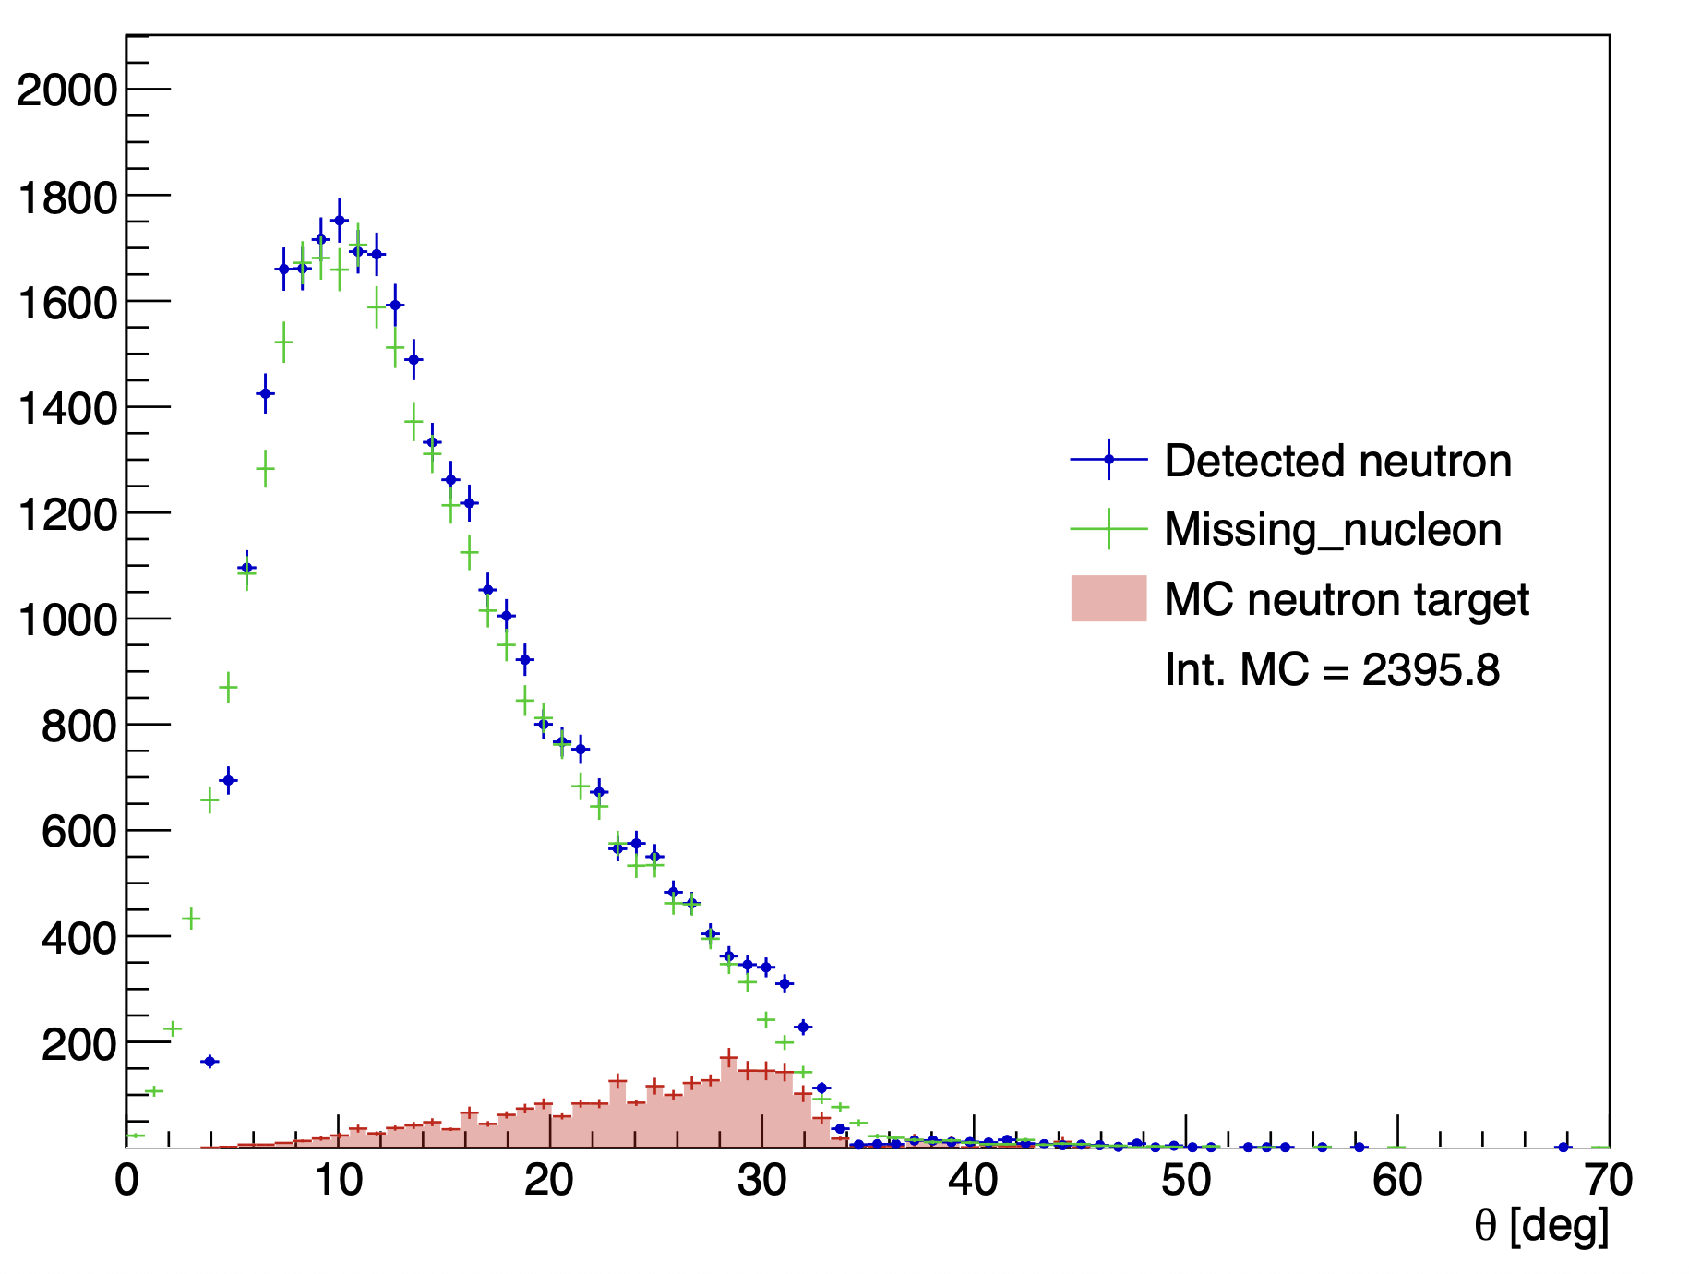
Cut on the angle between missing nucleon and detected neutron
Without the angle cut
With the angle cut
Mathieu Ronayette
7/20
Mathieu Ronayette
Clas12 Collaboration Meeting
11 March 2026
Notes:
7

Slide 8
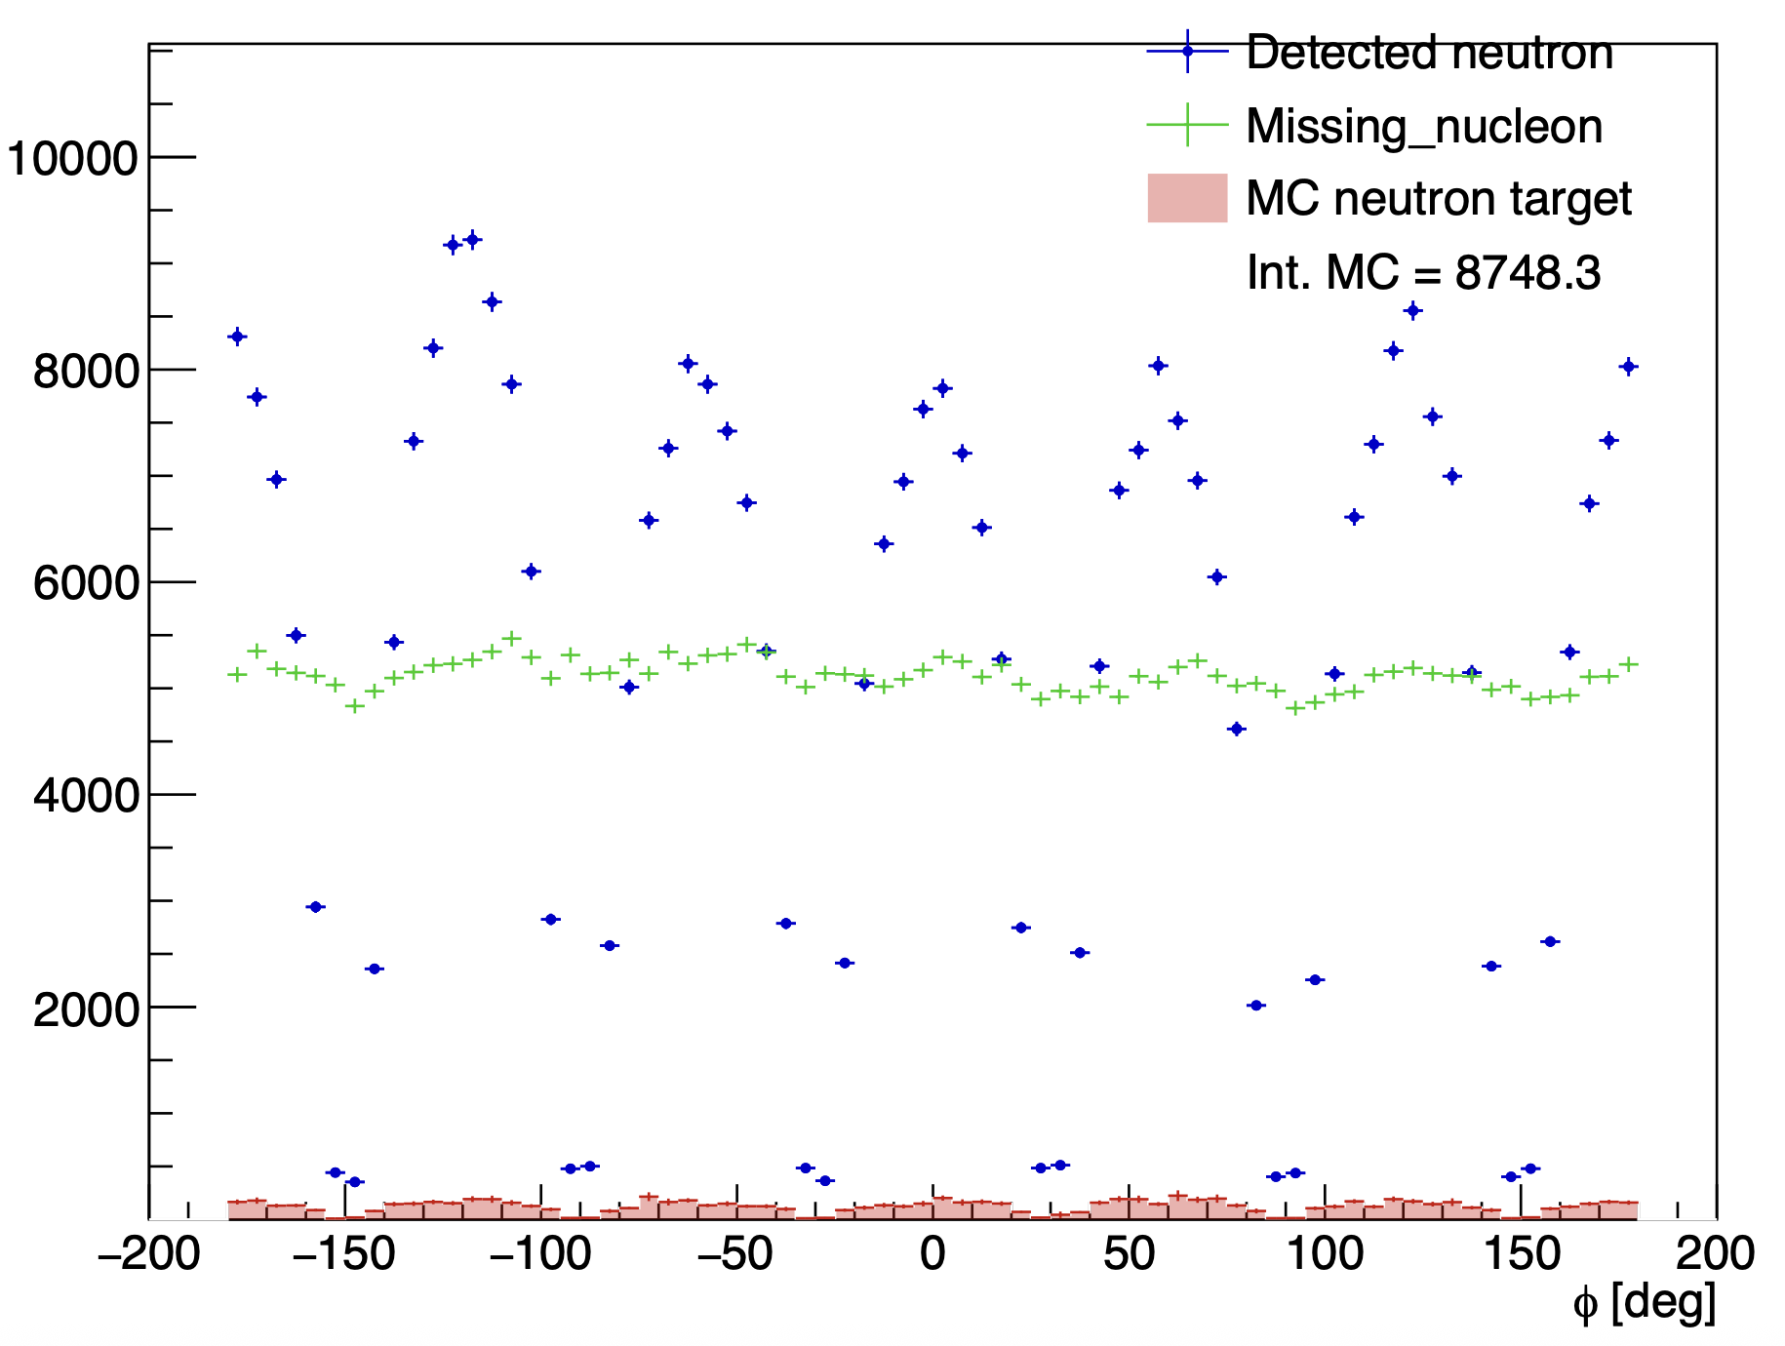
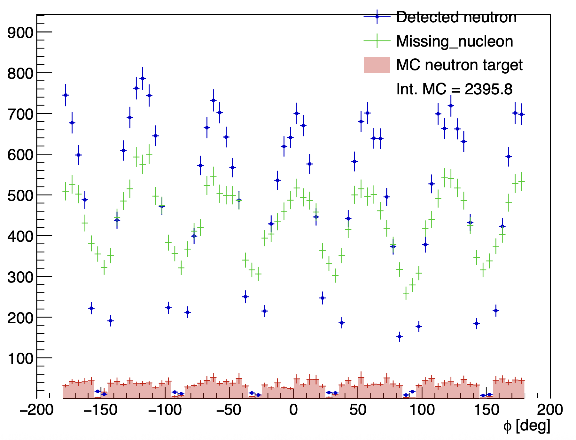
Cut on the angle between missing nucleon and detected neutron
Without the angle cut
With the angle cut
Mathieu Ronayette
8/20
Mathieu Ronayette
Clas12 Collaboration Meeting
11 March 2026
Notes:
8

Slide 9
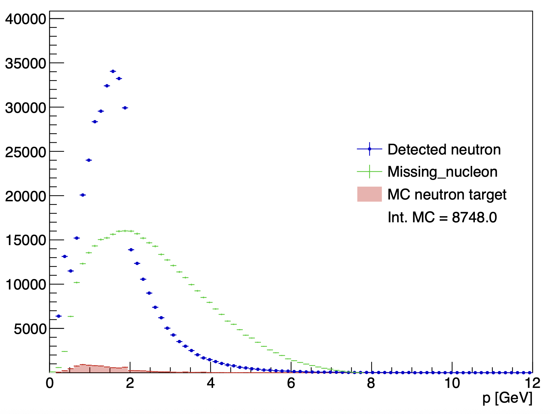
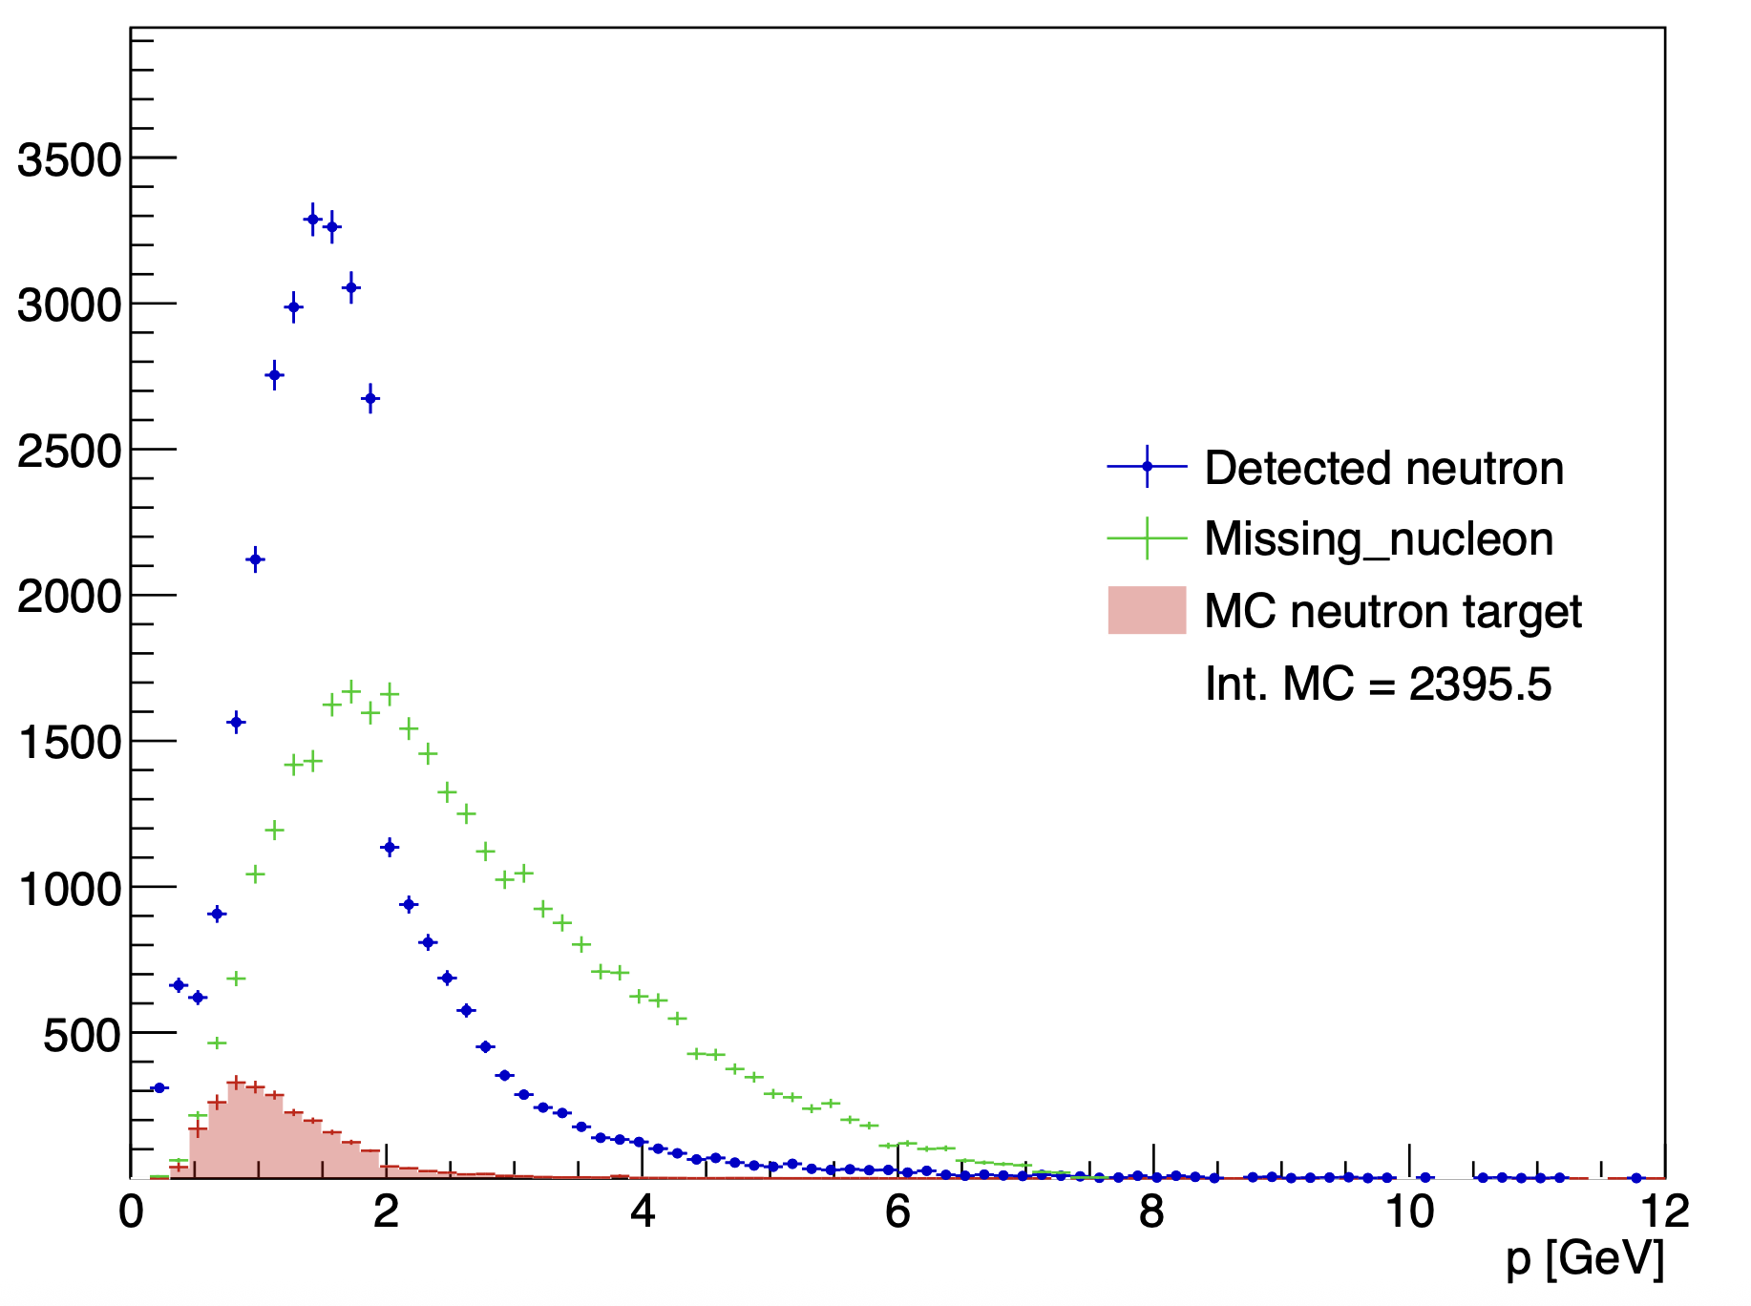
Cut on the angle between missing nucleon and detected neutron
Without the angle cut
With the angle cut
Mathieu Ronayette
9/20
Mathieu Ronayette
Clas12 Collaboration Meeting
11 March 2026
Notes:
9

Slide 10
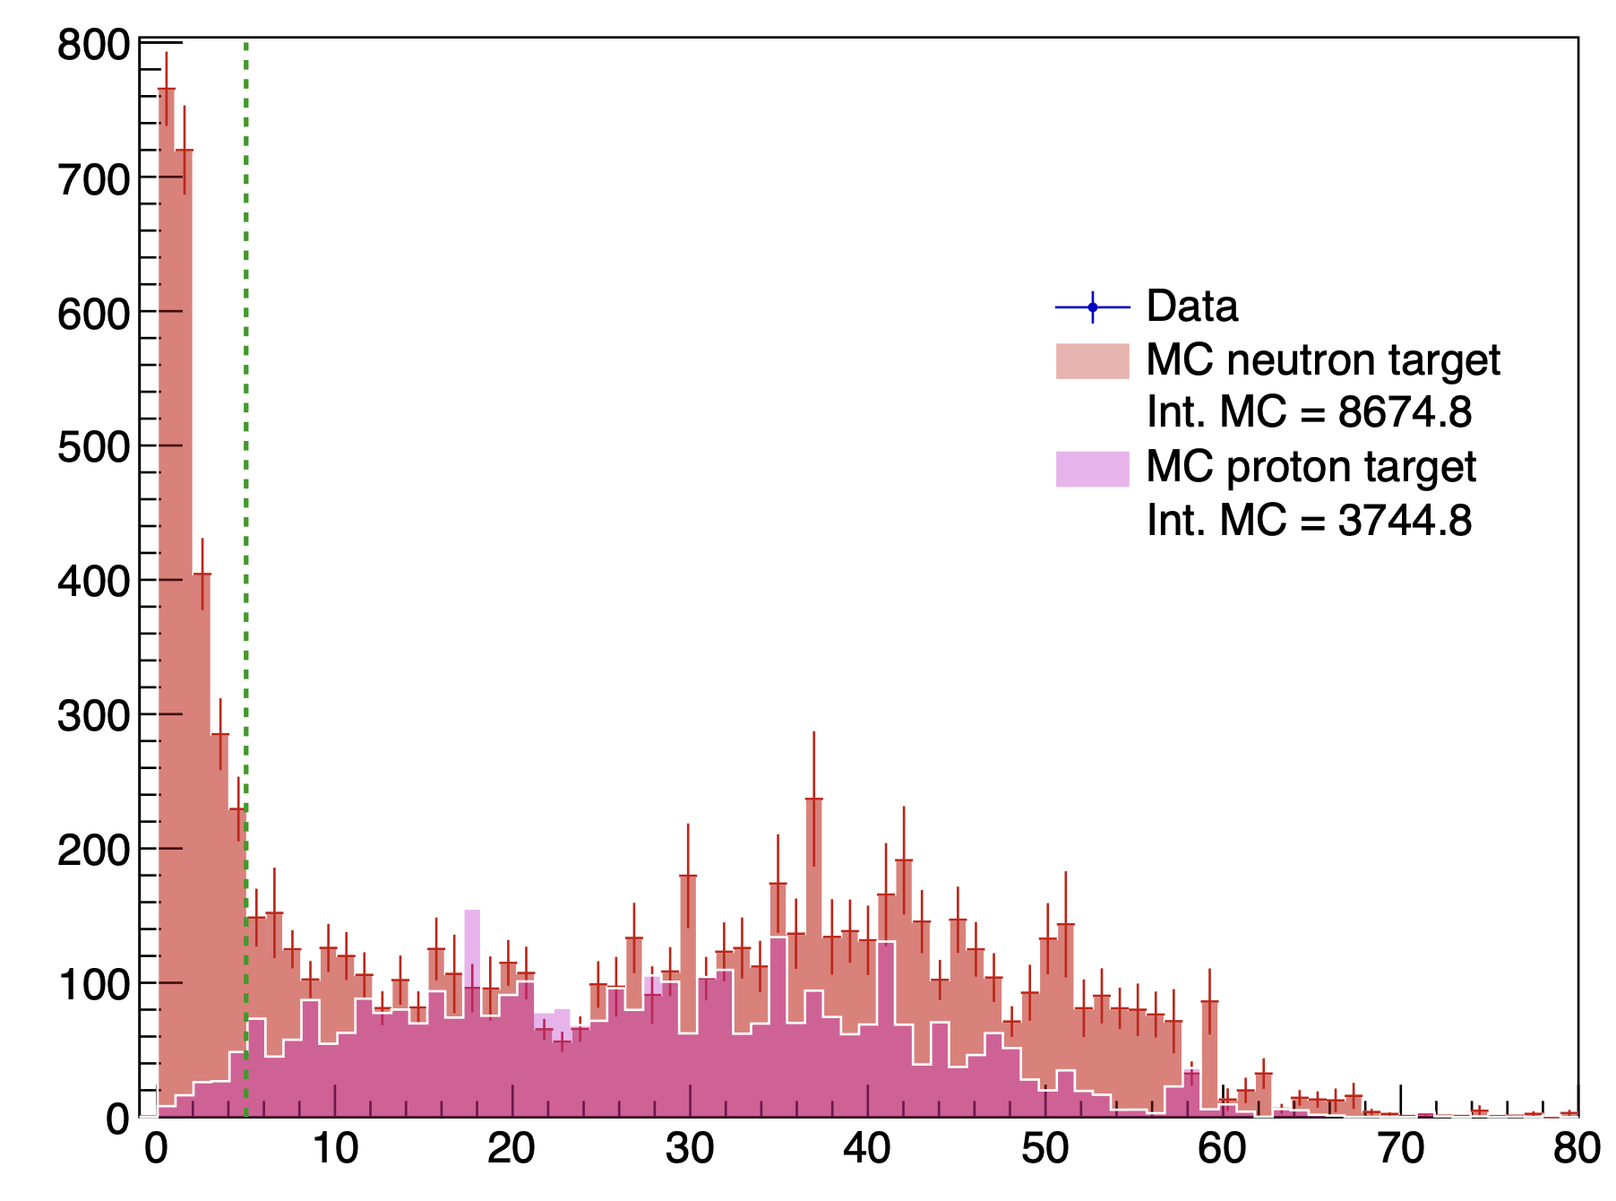
Cut on the angle between missing nucleon and detected neutron
<-- Cut at 5 °
K⁺
K⁻
e⁻
fake neutron
non detected proton
Contamination when the missing_nucleon is a
non detected proton there is a fake neutron signal who pass the cut on the angle
angle between the missing_nucleon and the neutron detected
Mathieu Ronayette
10/20
Mathieu Ronayette
Clas12 Collaboration Meeting
11 March 2026
Notes:
10

Slide 11
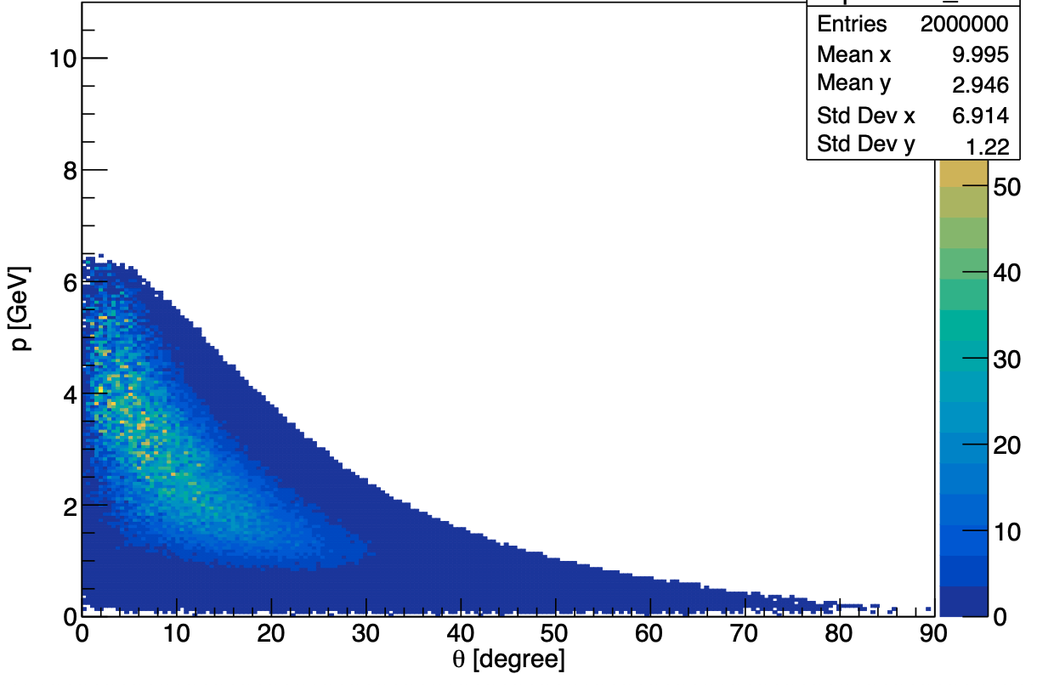
Cut on the status of K⁺K⁻
Generated event : p vs theta for K⁺⁻
Two argument to cut K+ K- in CD :
Reconstruction of kaons in the CD is less good than in the FD
The generator predict few events in the CD
Mathieu Ronayette
11/20
Mathieu Ronayette
Clas12 Collaboration Meeting
11 March 2026
Notes:
11

Slide 12
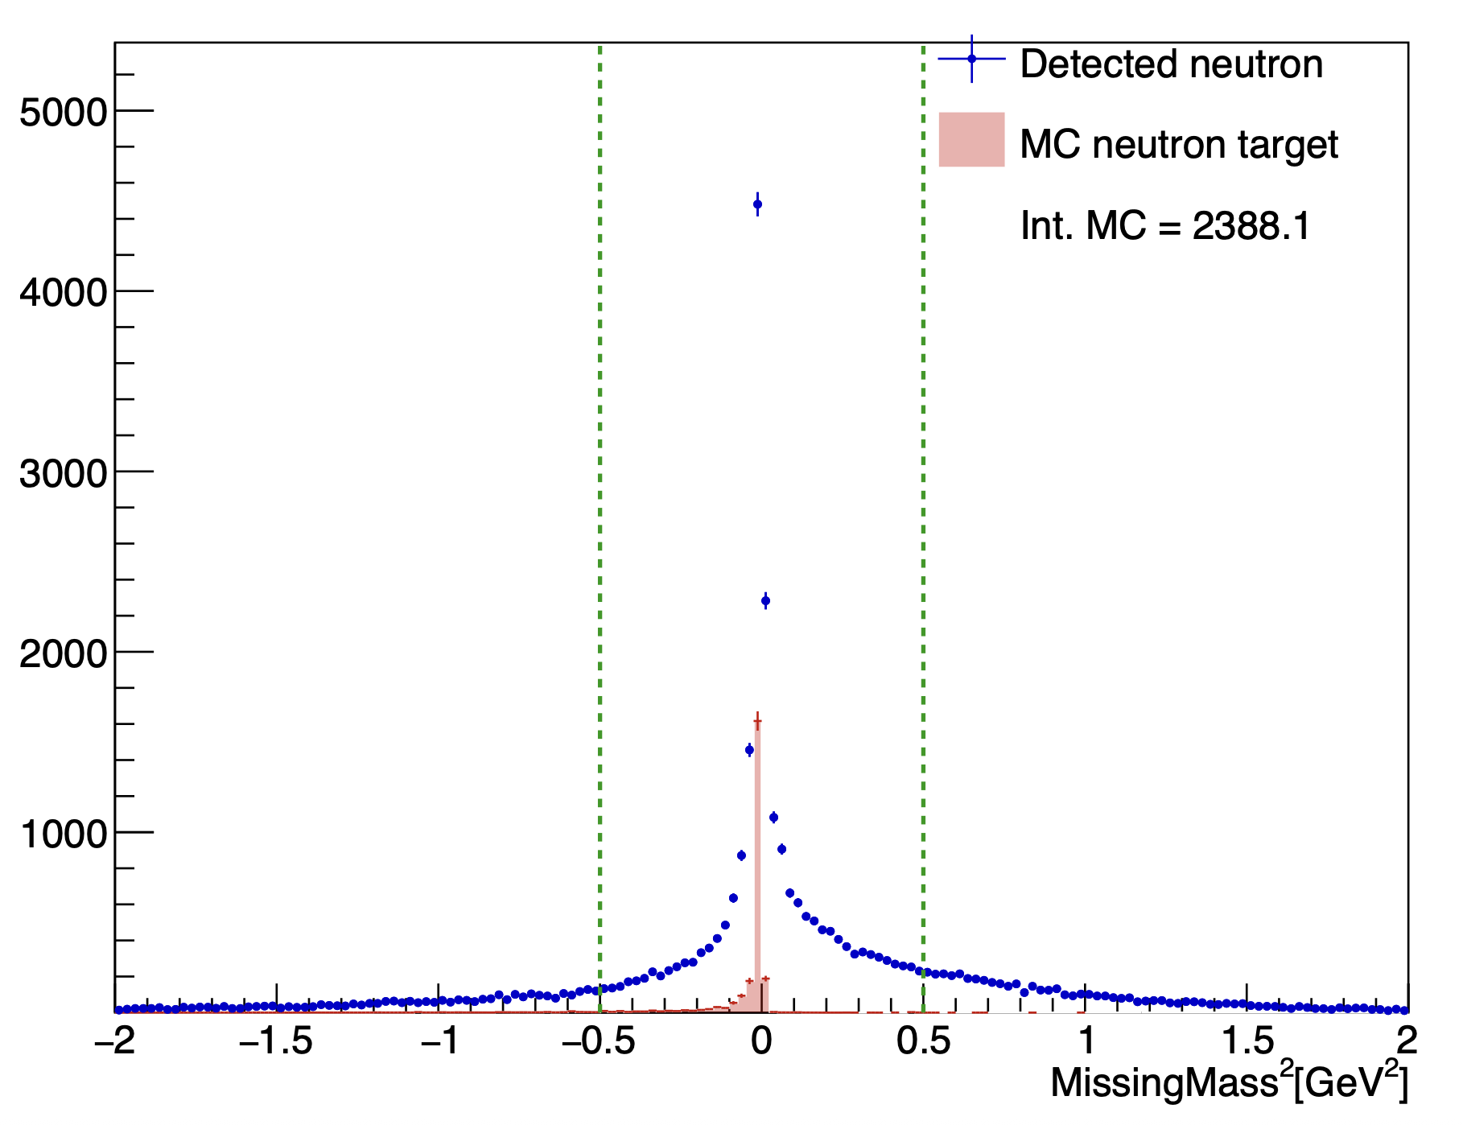
Cut on total missing mass
Total missing mass e n → e’ n’ K⁺ K⁻ X
(after all the previous cut)
–0.5 < MissingMass_{tot} ² < 0.5 GeV ²
Mathieu Ronayette
12/20
Mathieu Ronayette
Clas12 Collaboration Meeting
11 March 2026
Notes:
12

Slide 13
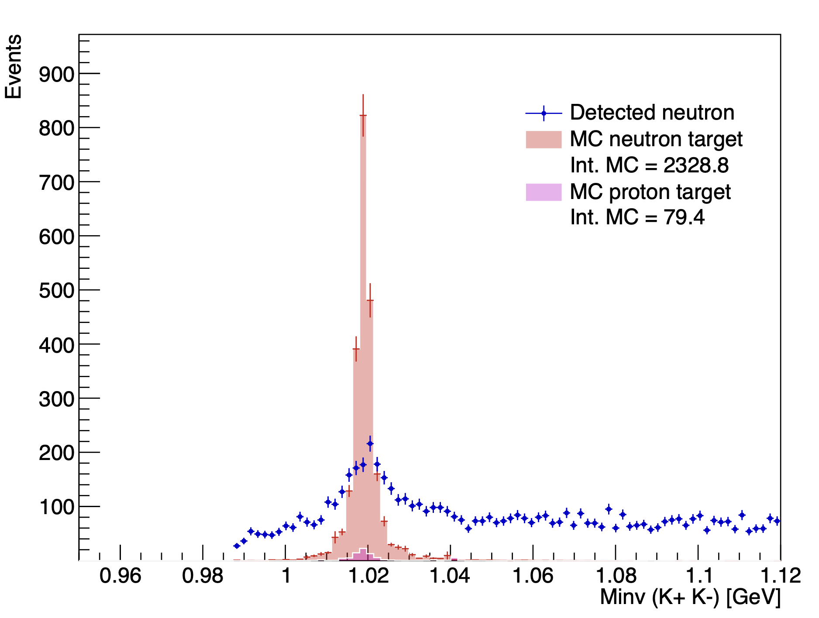
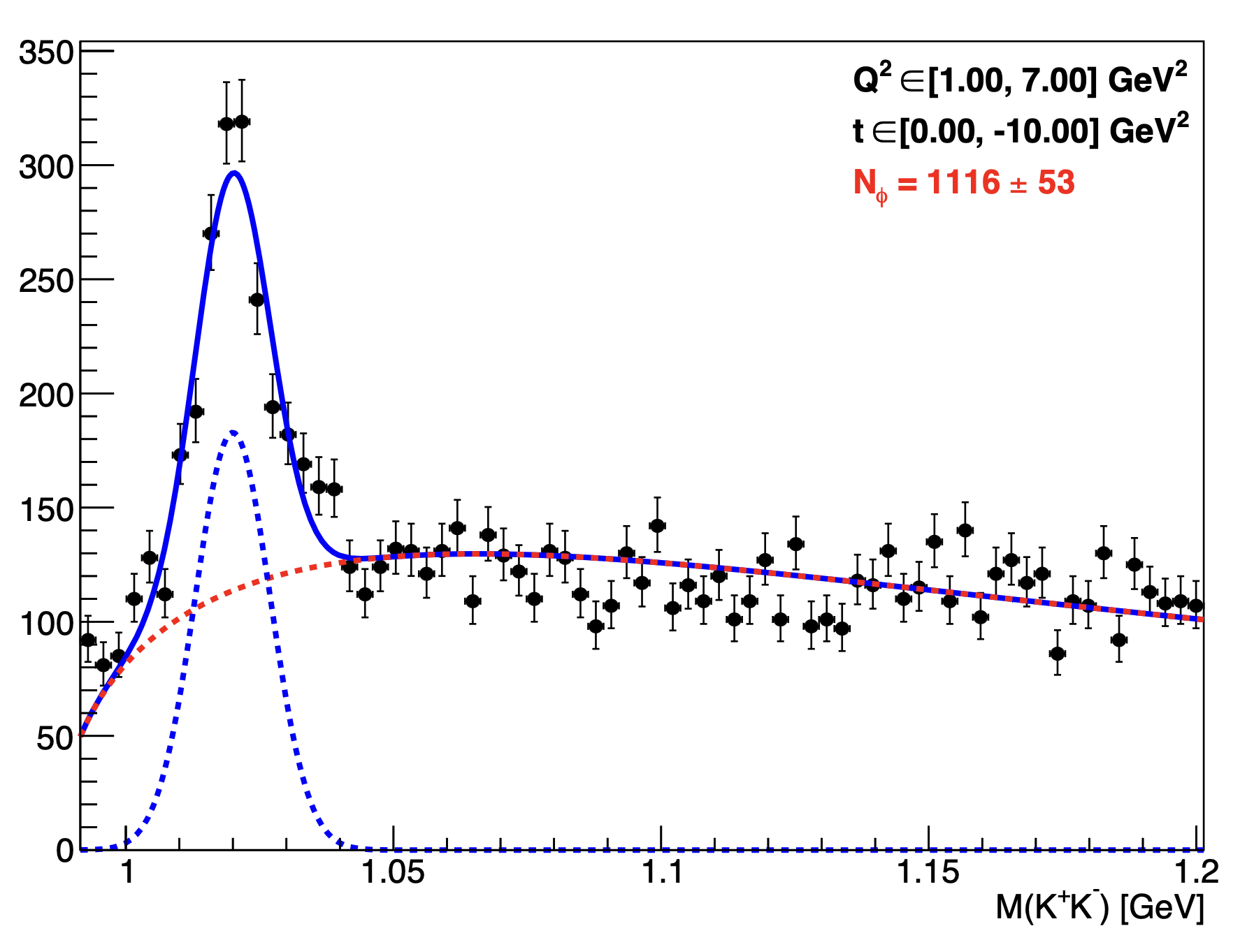
Yield extraction
With angle cut, K+ K- in FD, and cut on MissingMass
Fit all fall2019 outbending data
Mathieu Ronayette
13/20
Mathieu Ronayette
Clas12 Collaboration Meeting
11 March 2026
Notes:
13

Slide 14
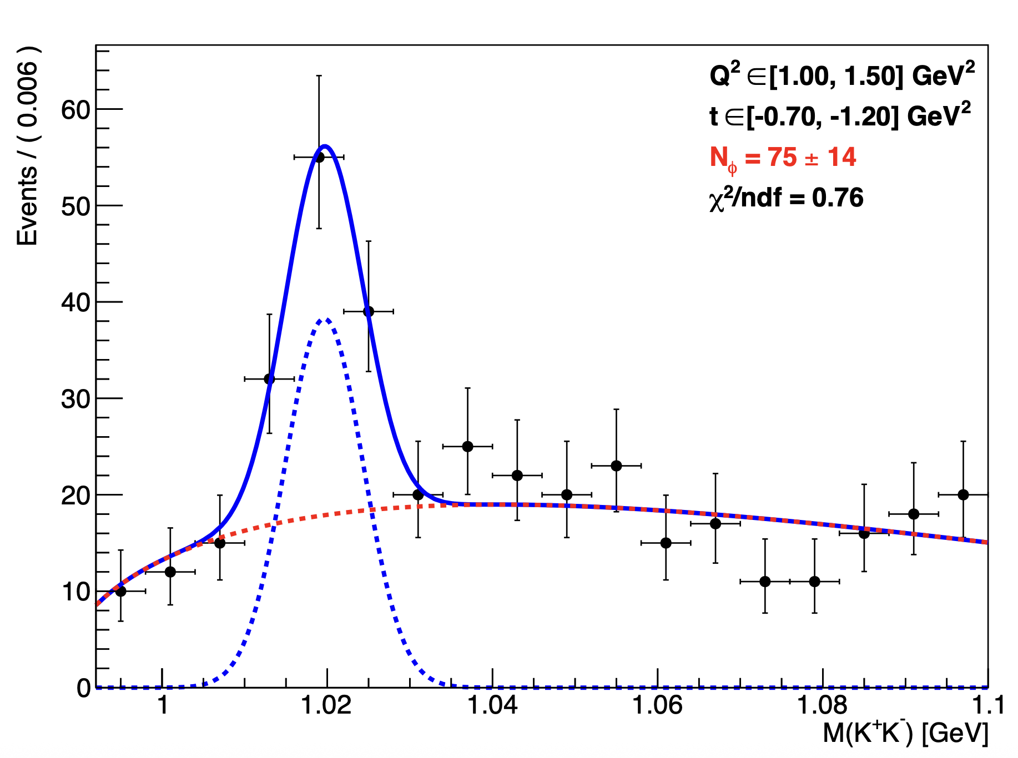
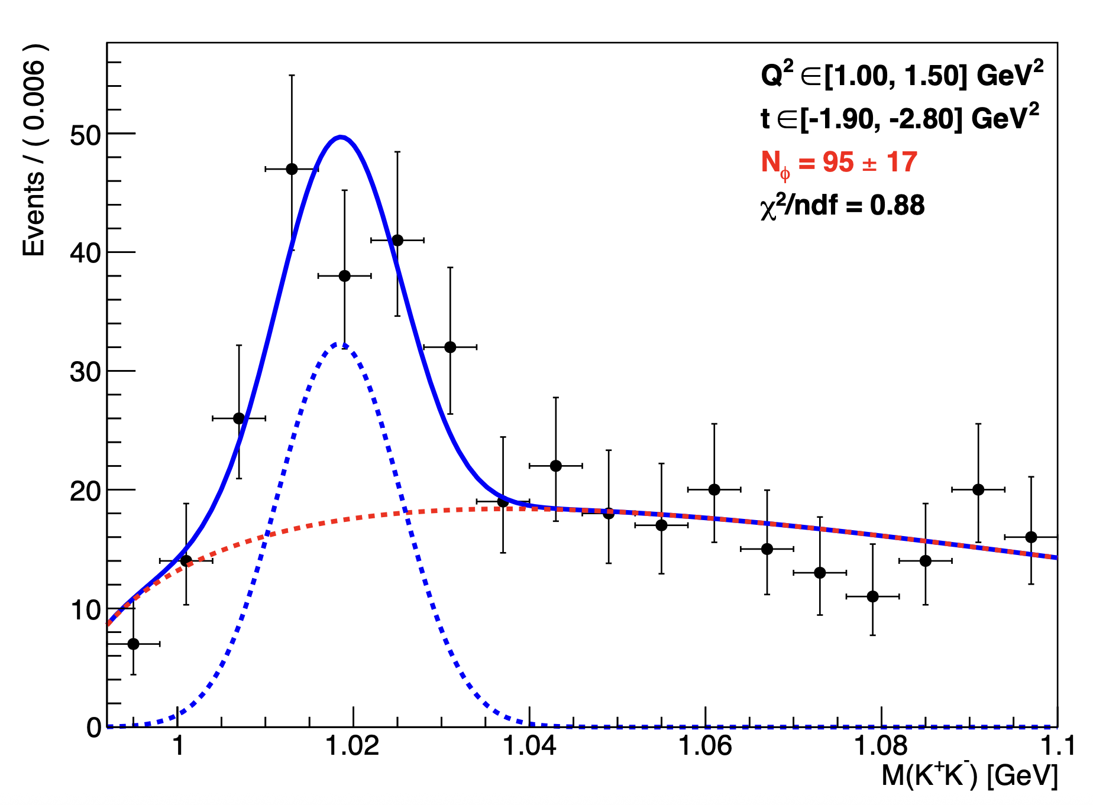
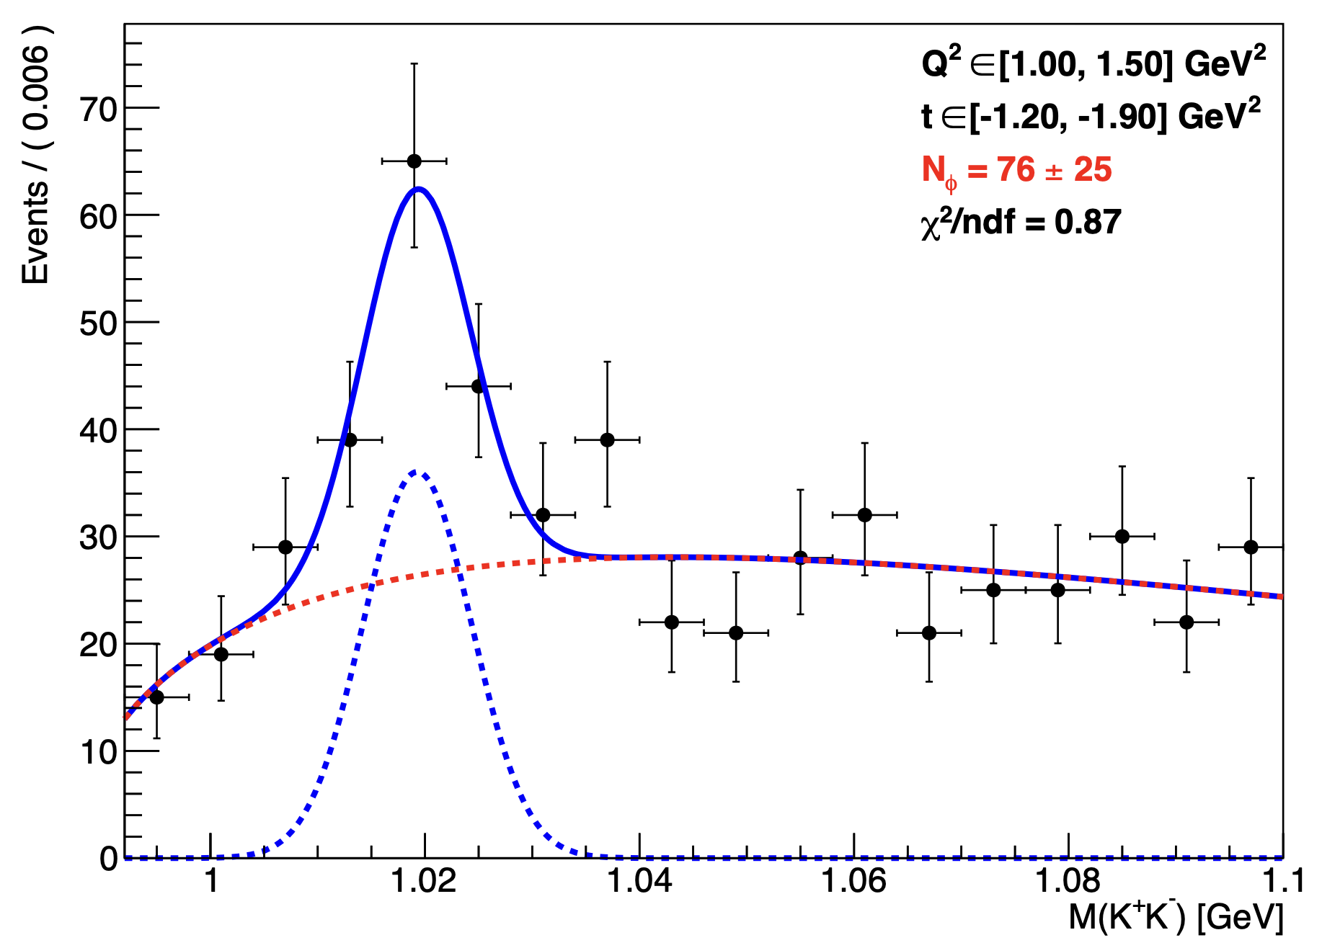
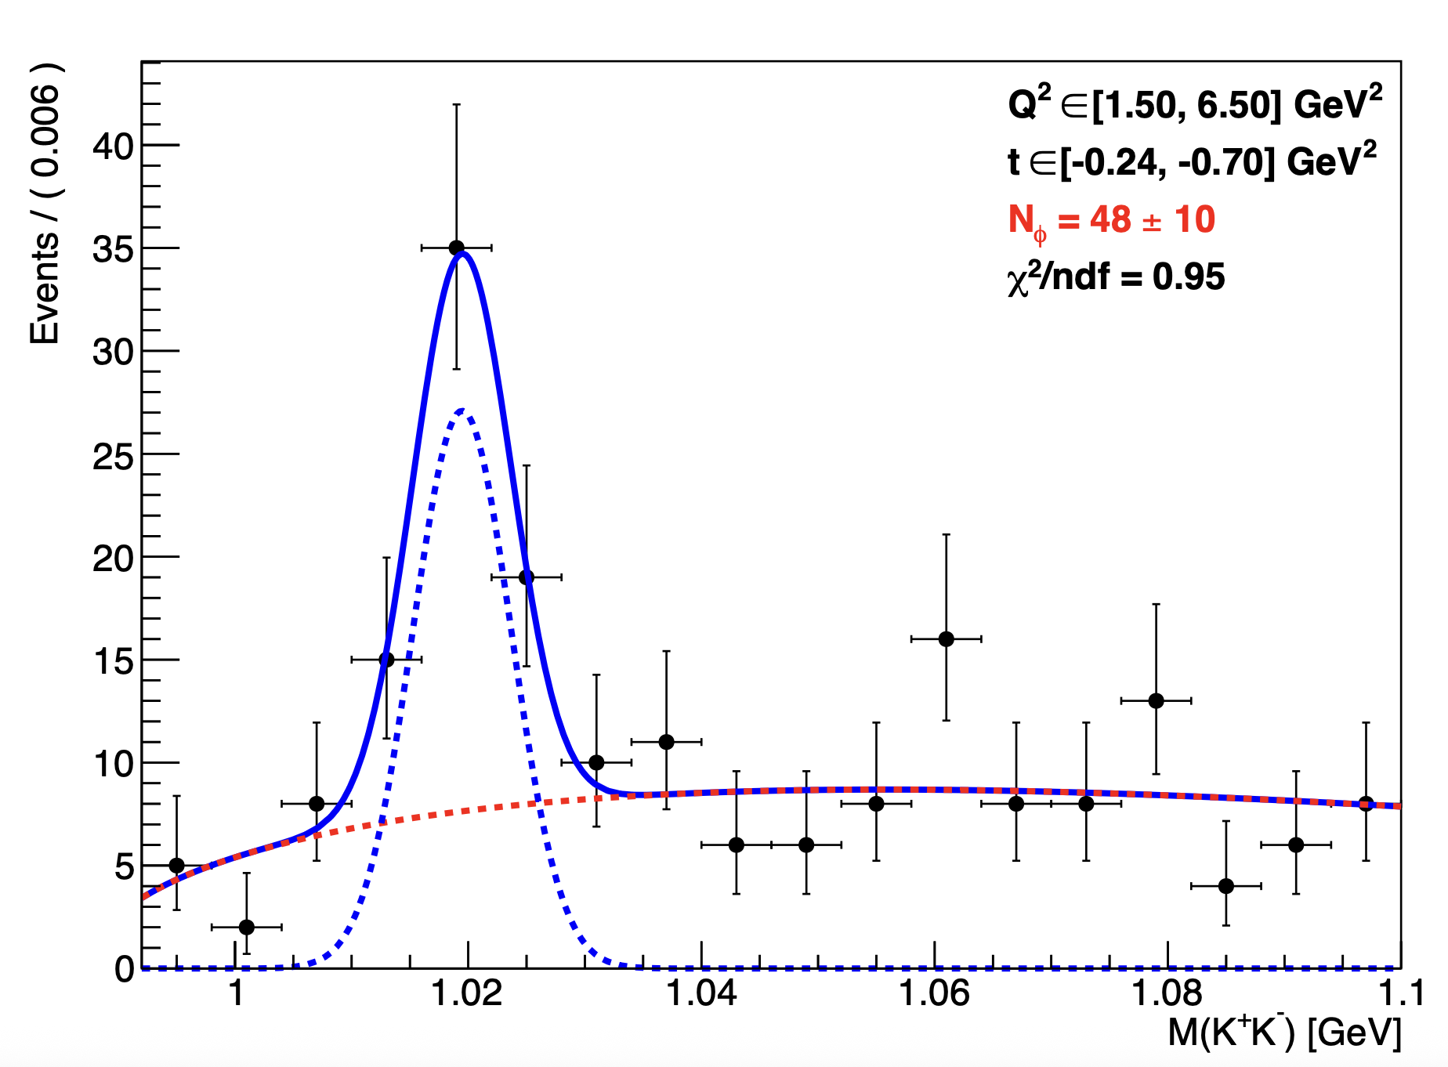
Yield extraction
Mathieu Ronayette
14/20
Mathieu Ronayette
Clas12 Collaboration Meeting
11 March 2026
Notes:
14

Slide 15
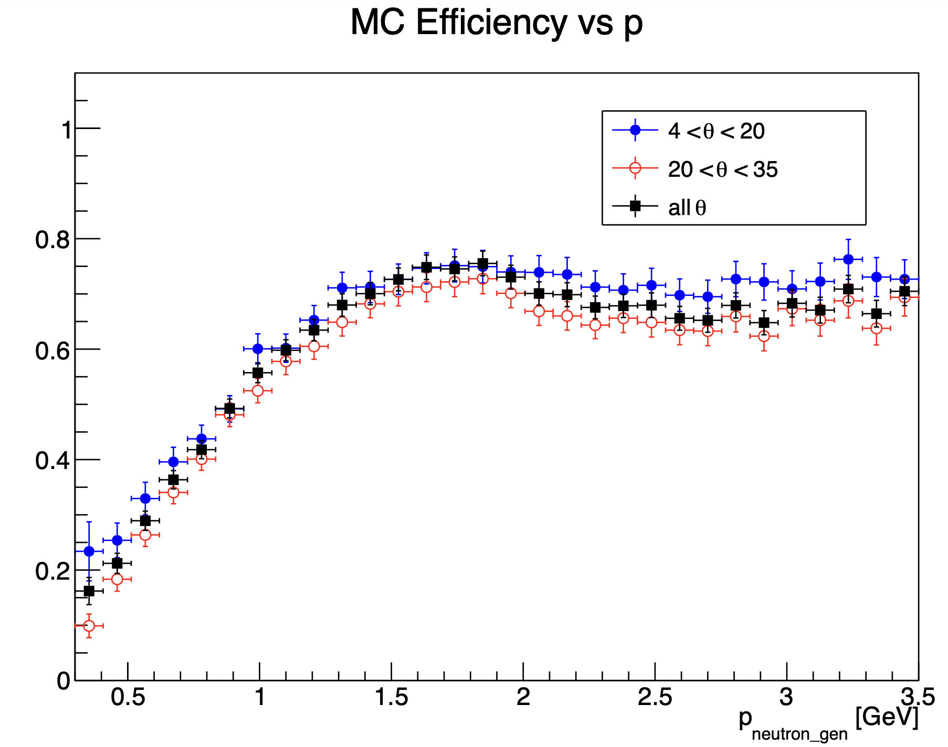
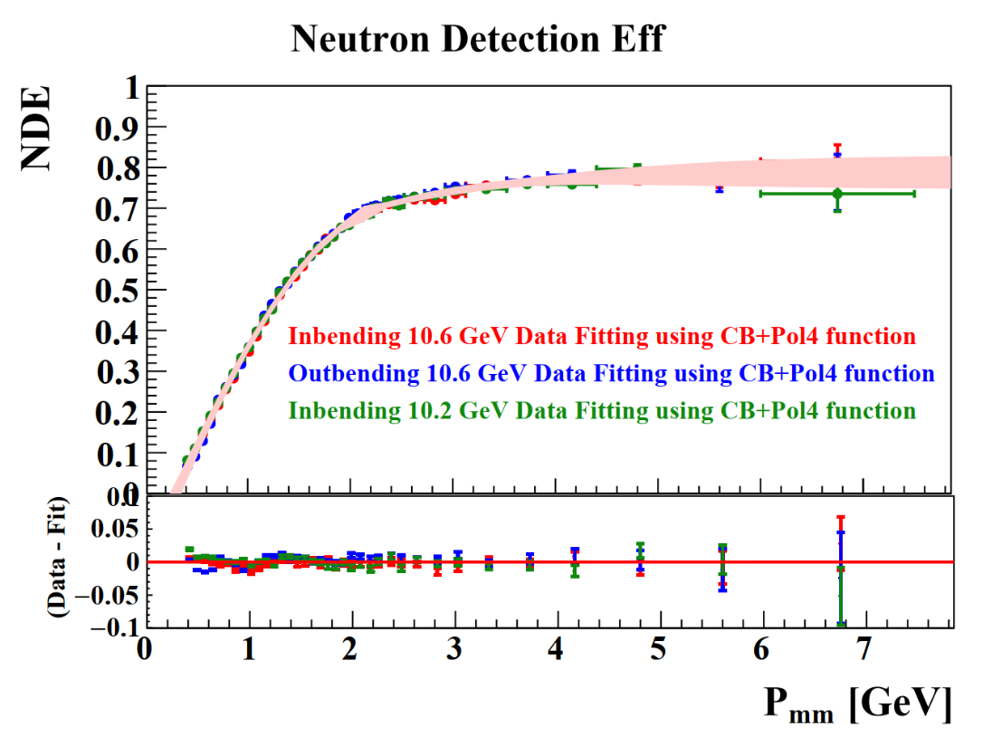
Efficiency correction
Neutron efficiency in MC :
Neutron efficiency (FD) in data from Lamya Baashen thesis
(with P_{mm} the missing momentum)
(Fiducial cut for Nrec and accpetance cut for Ngen)
Mathieu Ronayette
15/20
Mathieu Ronayette
Clas12 Collaboration Meeting
11 March 2026
Notes:
15

Slide 16
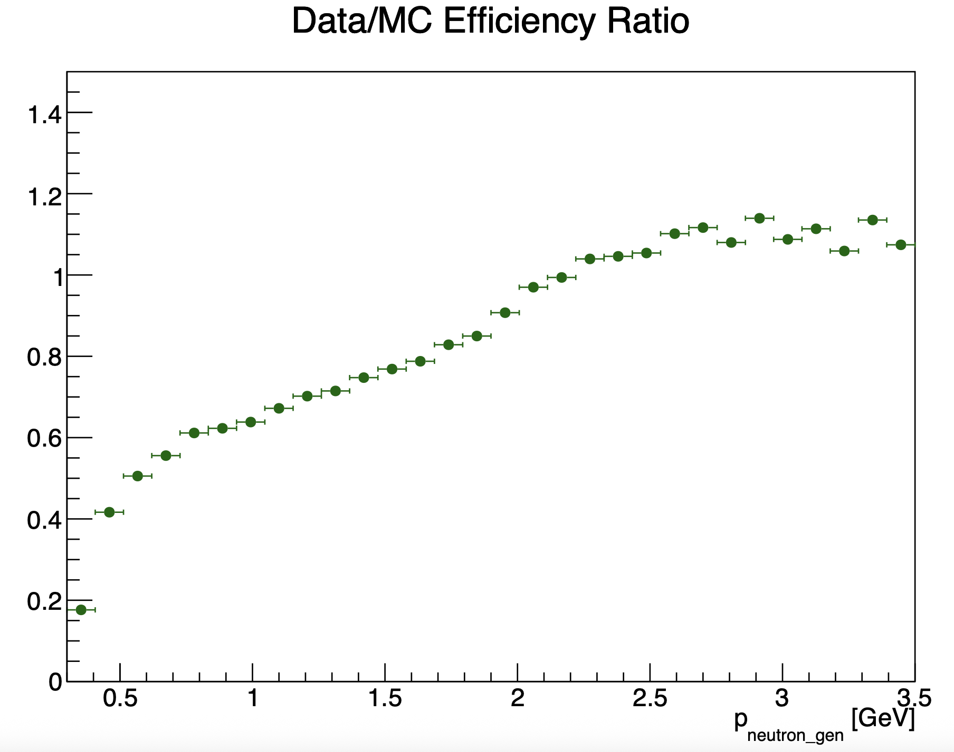
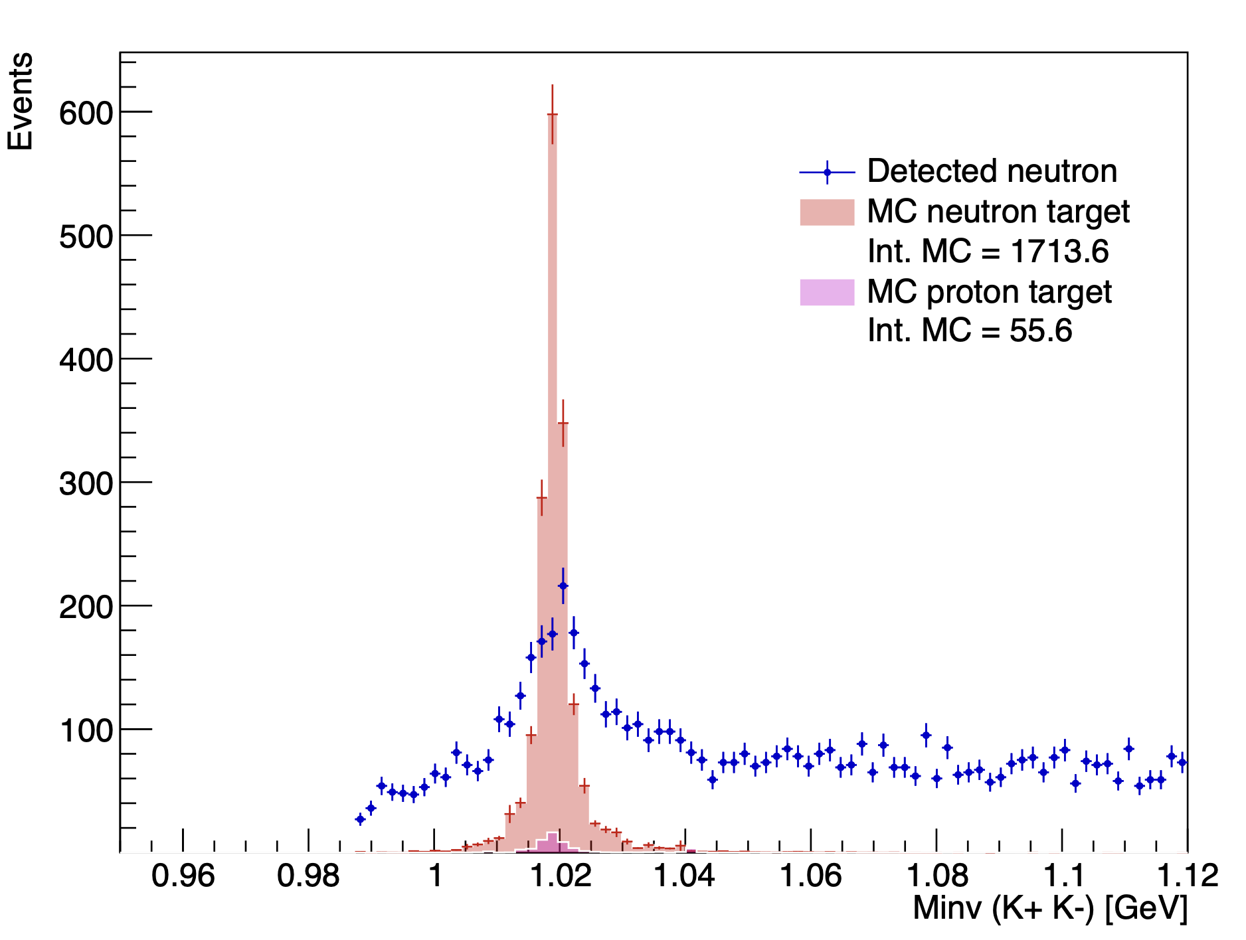
Efficiency correction
MC with neutron efficiency correction
Mathieu Ronayette
16/20
Mathieu Ronayette
Clas12 Collaboration Meeting
11 March 2026
Notes:
16

Slide 17
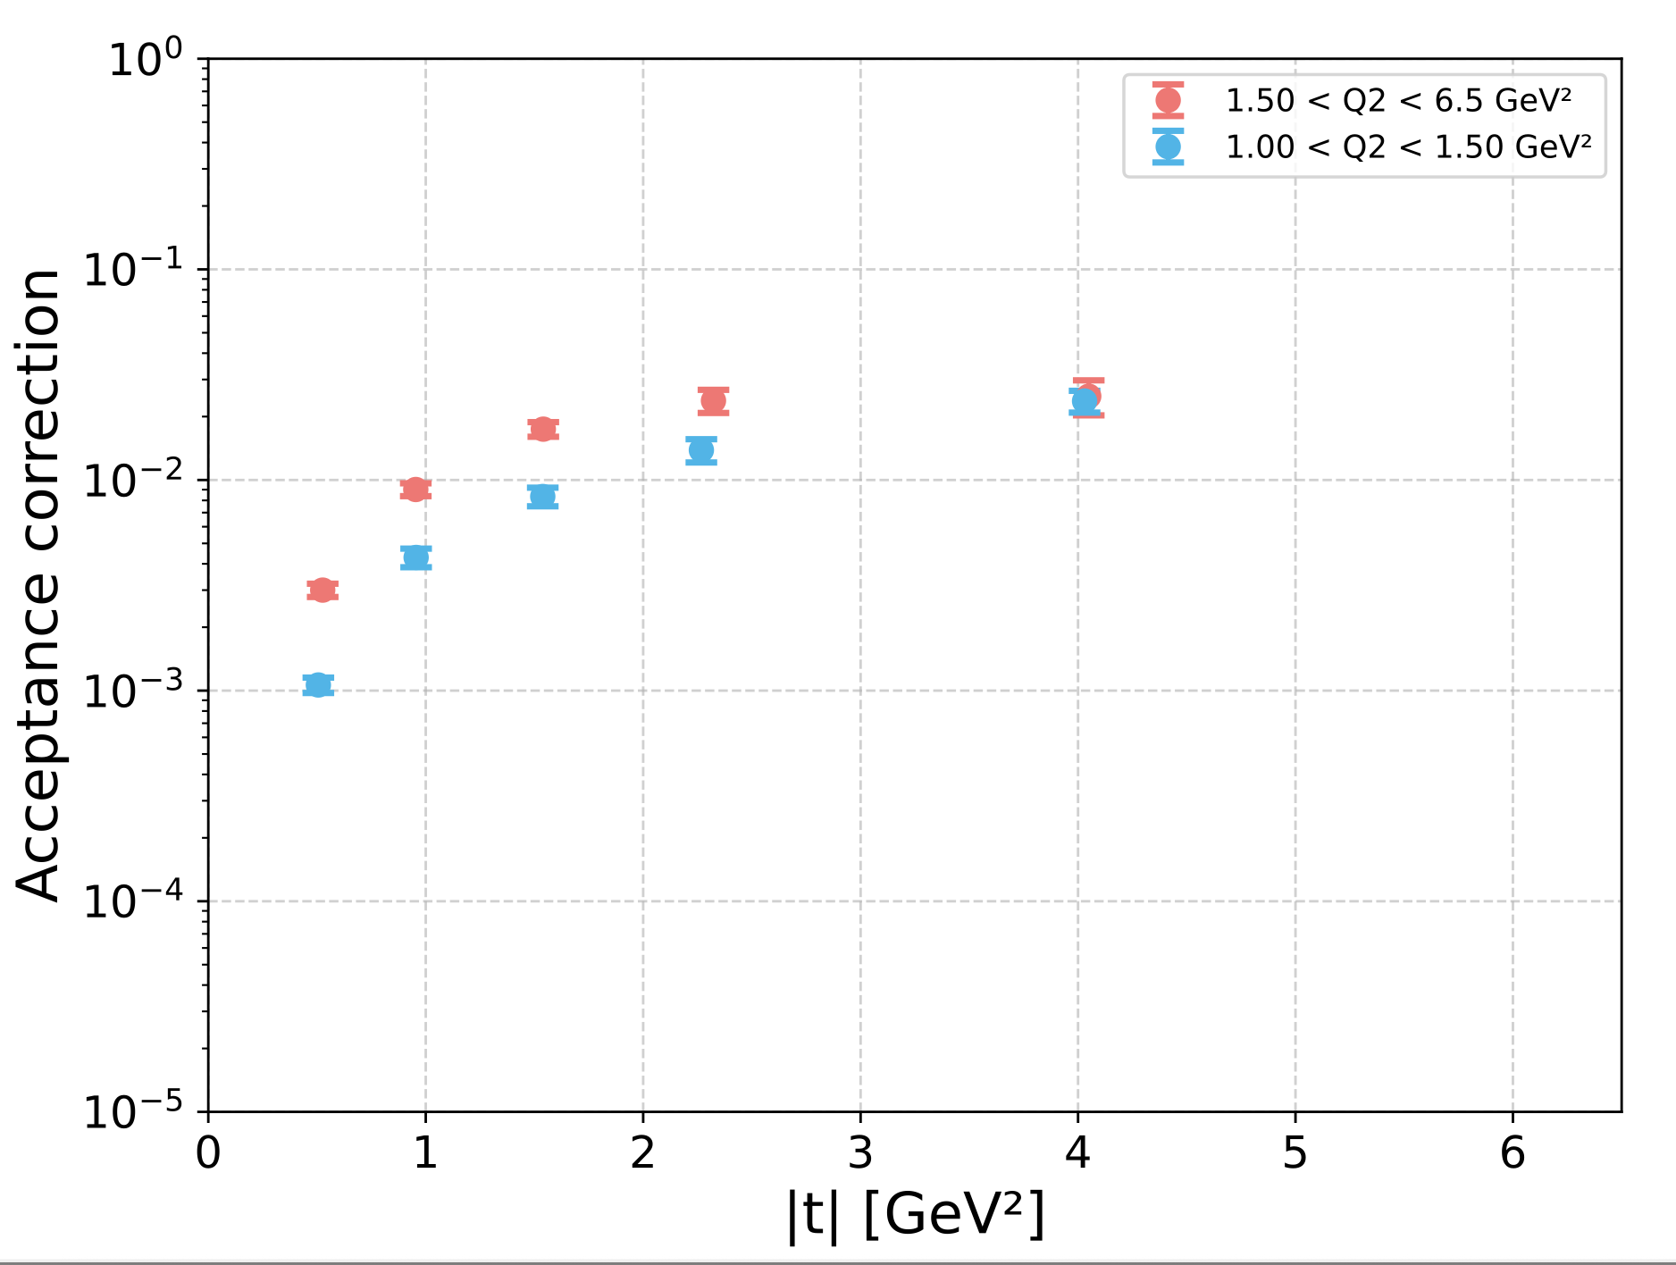
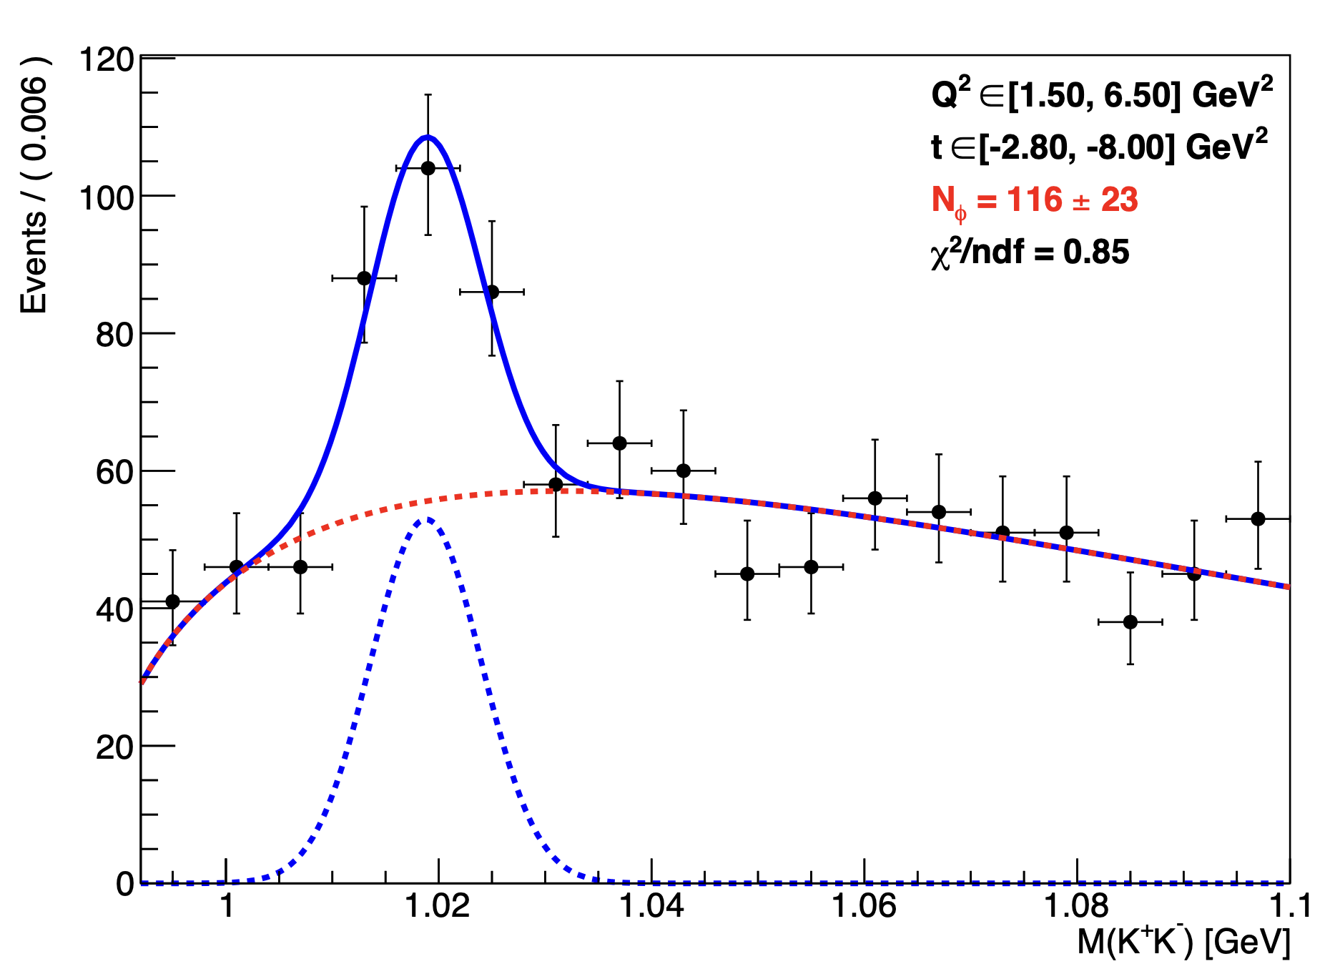
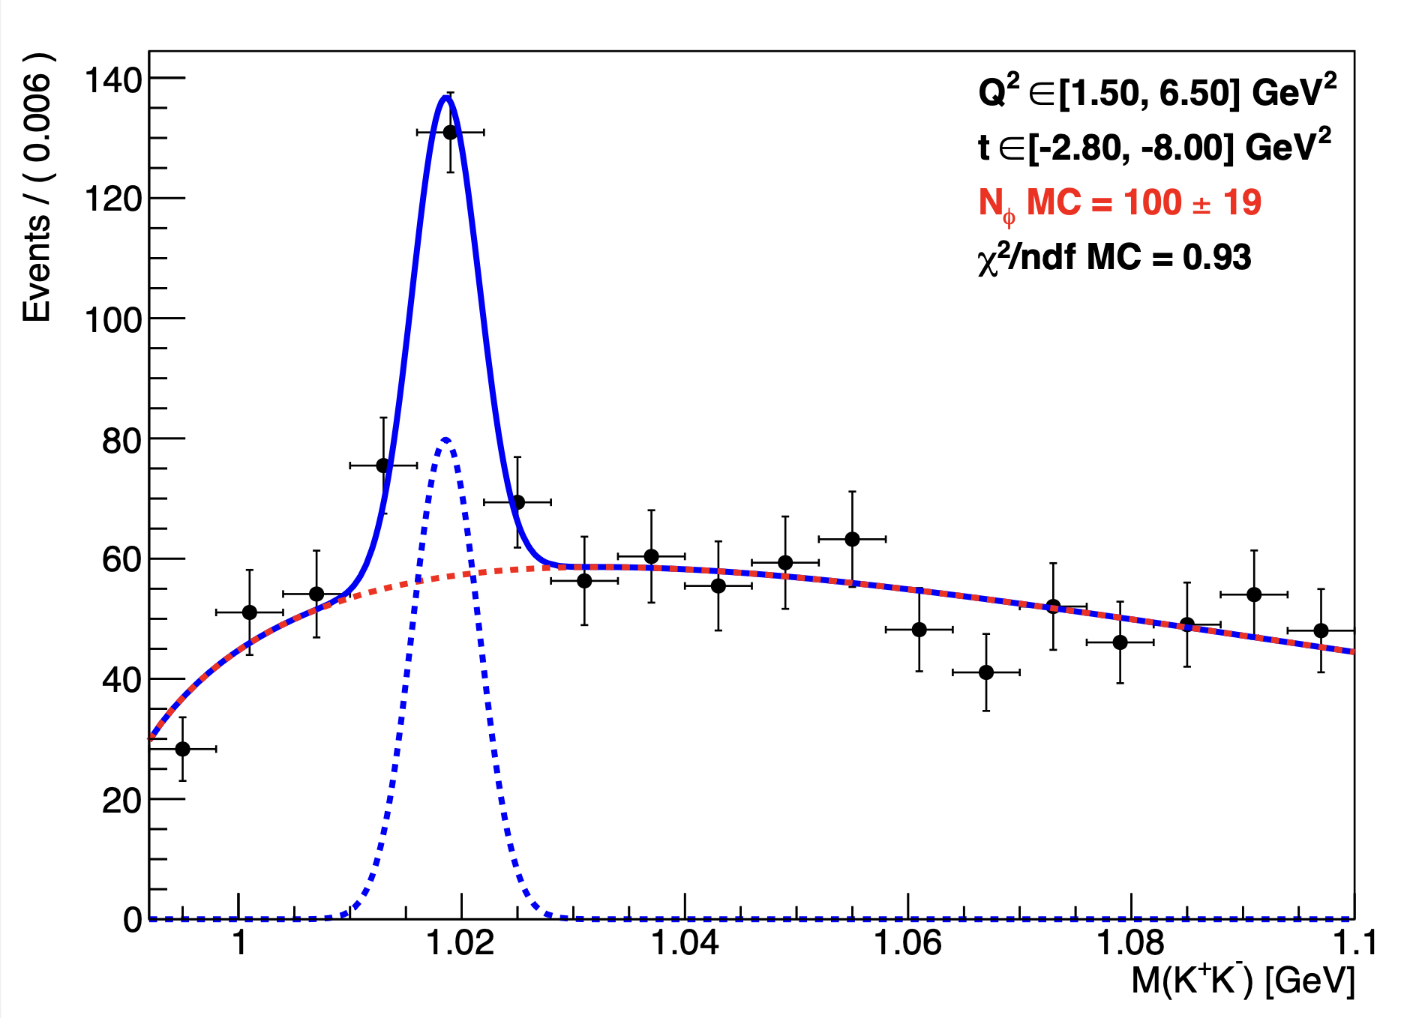
Acceptance correction
A =
Mathieu Ronayette
17/20
Mathieu Ronayette
Clas12 Collaboration Meeting
11 March 2026
Notes:
17

Slide 18
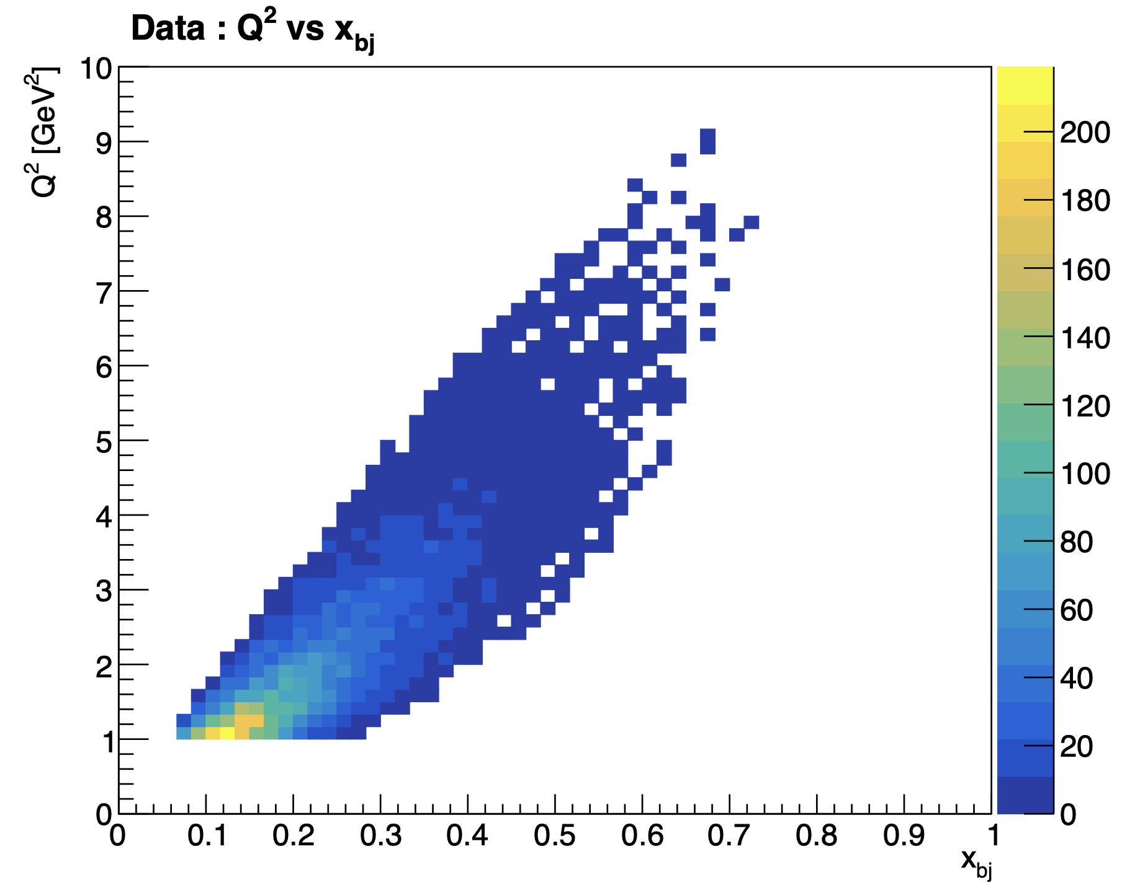
Binning correction
f =
bin | 1.0 < Q² < 1.5 GeV² 0.05 < xb < 1.34 | 1.5 < Q² < 6.5 GeV² 0.08 < xb < 0.7
f | 0.81 | 0.49
Mathieu Ronayette
18/20
Mathieu Ronayette
Clas12 Collaboration Meeting
11 March 2026
Notes:
18

Slide 19
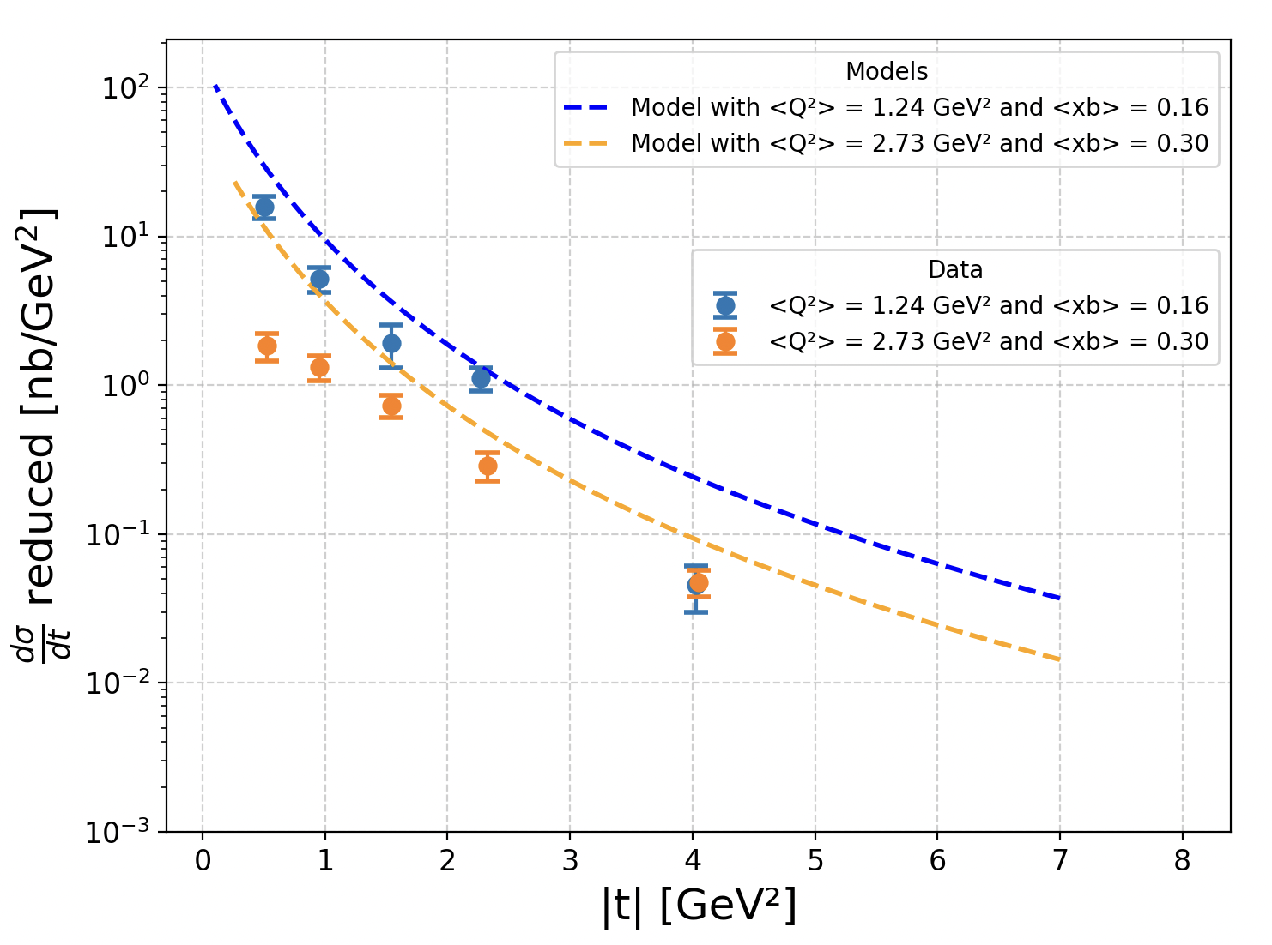
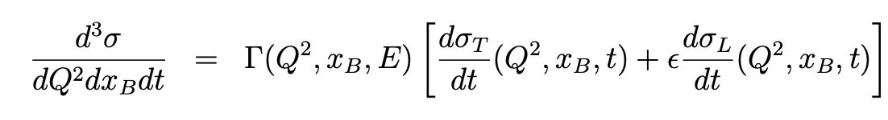
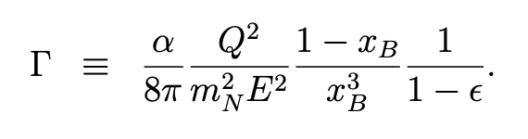
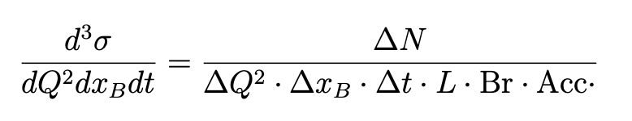
Preliminary plot of the differential reduced cross section
Mathieu Ronayette
19/20
Mathieu Ronayette
Clas12 Collaboration Meeting
11 March 2026
Notes:
19

Slide 20
Conclusion
Next steps :
- Improve fits for signal and background
Run the code with the other data set
More MC simulations
Events in CD
Momentum corrections
Thanks!
Mathieu Ronayette
20/20
Mathieu Ronayette
Clas12 Collaboration Meeting
11 March 2026
Notes:
20

Slide 21
Backup
Backup slides
Mathieu Ronayette
20/20
Mathieu Ronayette
Clas12 Collaboration Meeting
11 March 2026
Notes:
21

Slide 22
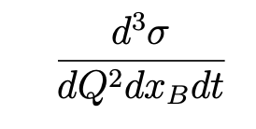

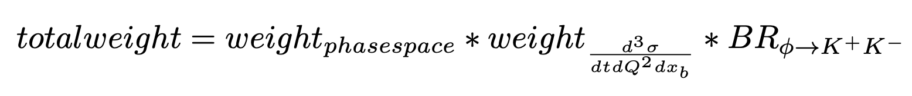
ɸ generator for MC simulation
From Proposal to Jeﬀerson Lab PAC39 Exclusive Phi Meson Electroproduction with CLAS12
Mathieu Ronayette
20/20
Mathieu Ronayette
rgB - meeting
13 Feb 2026
Notes:
22

Slide 23
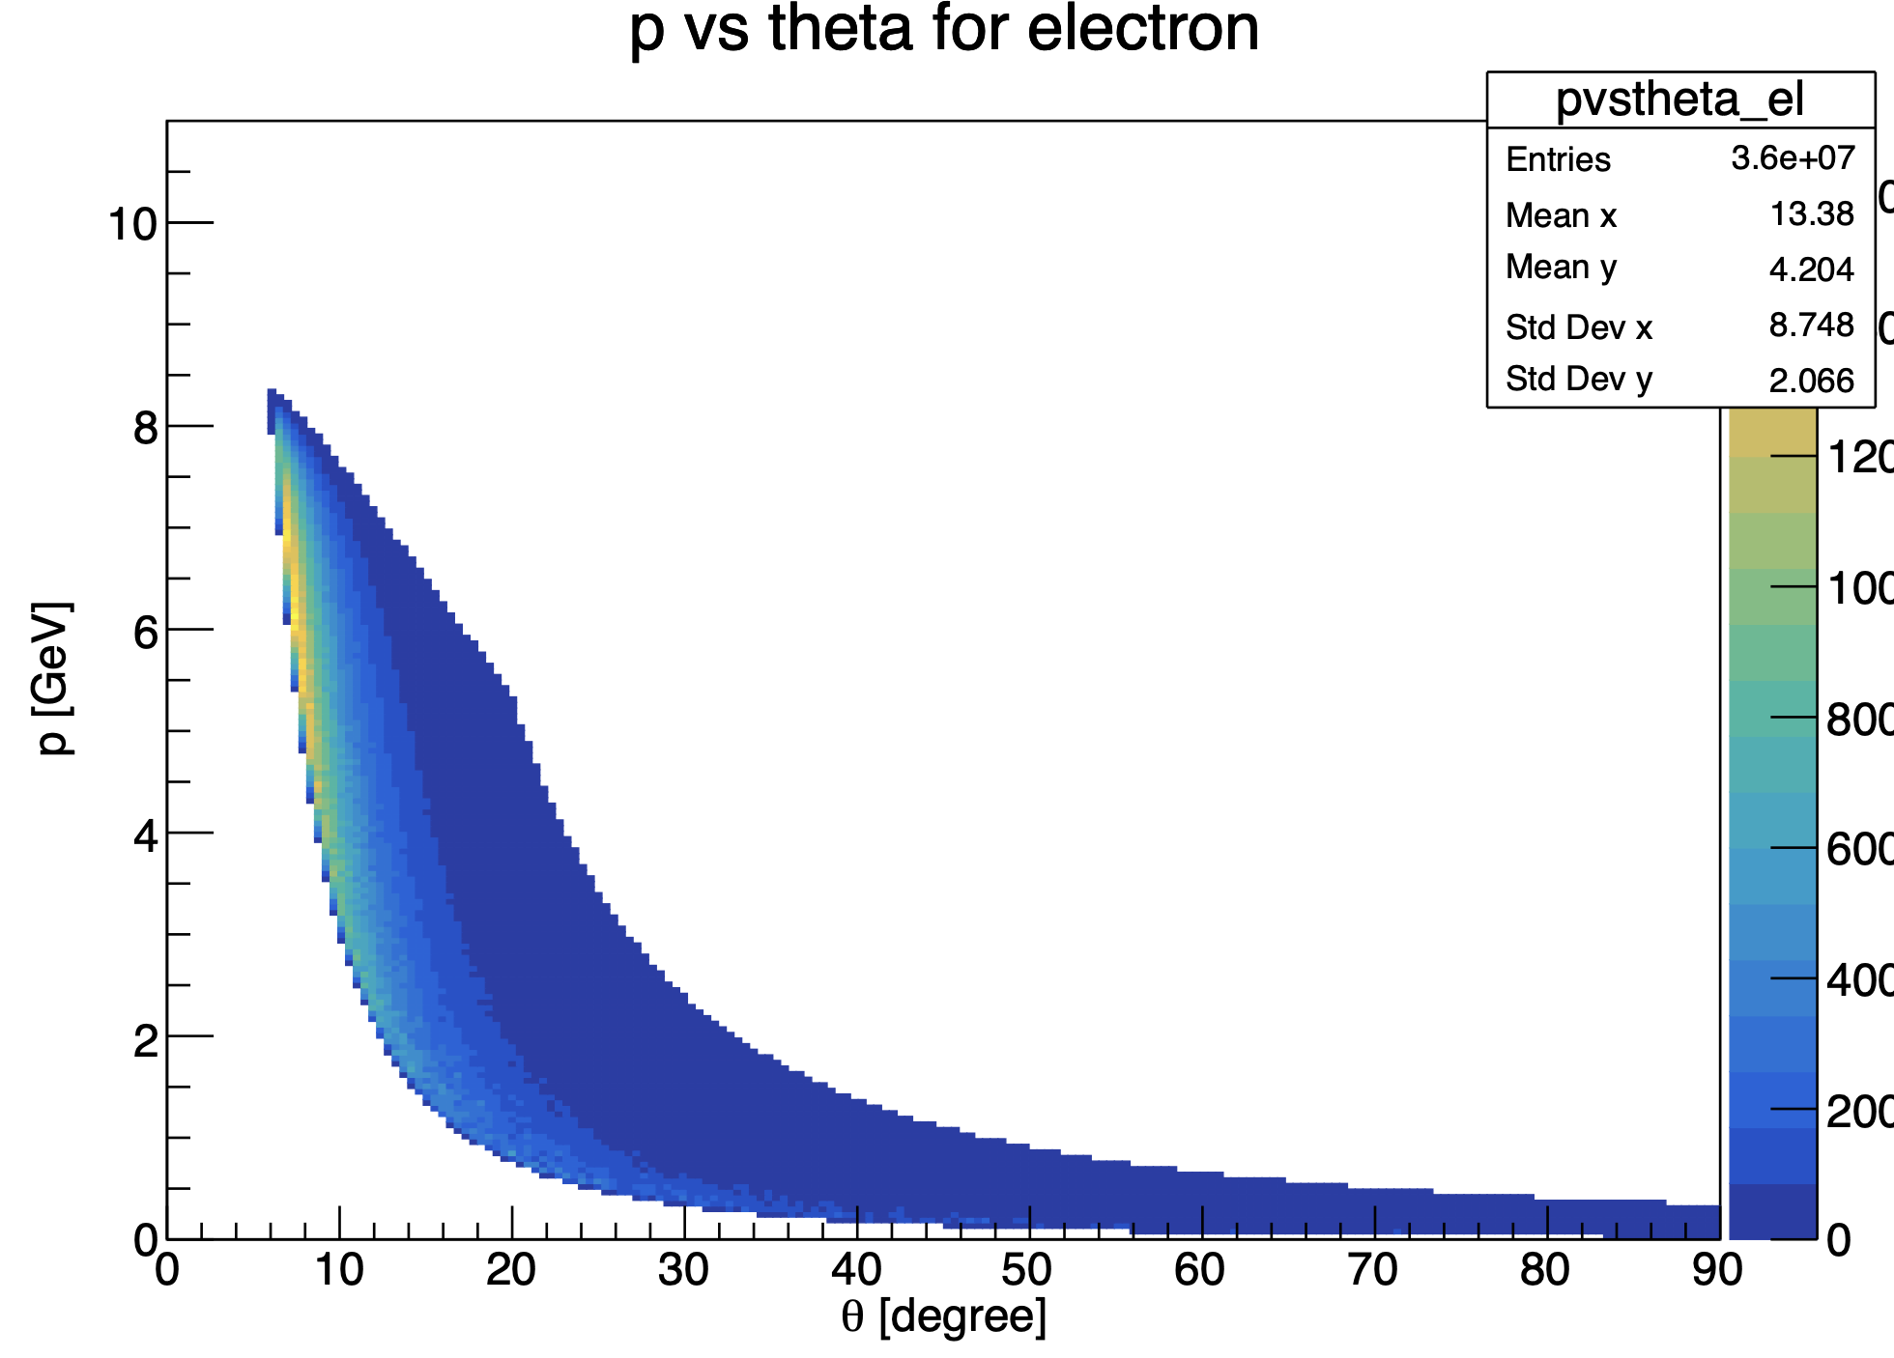
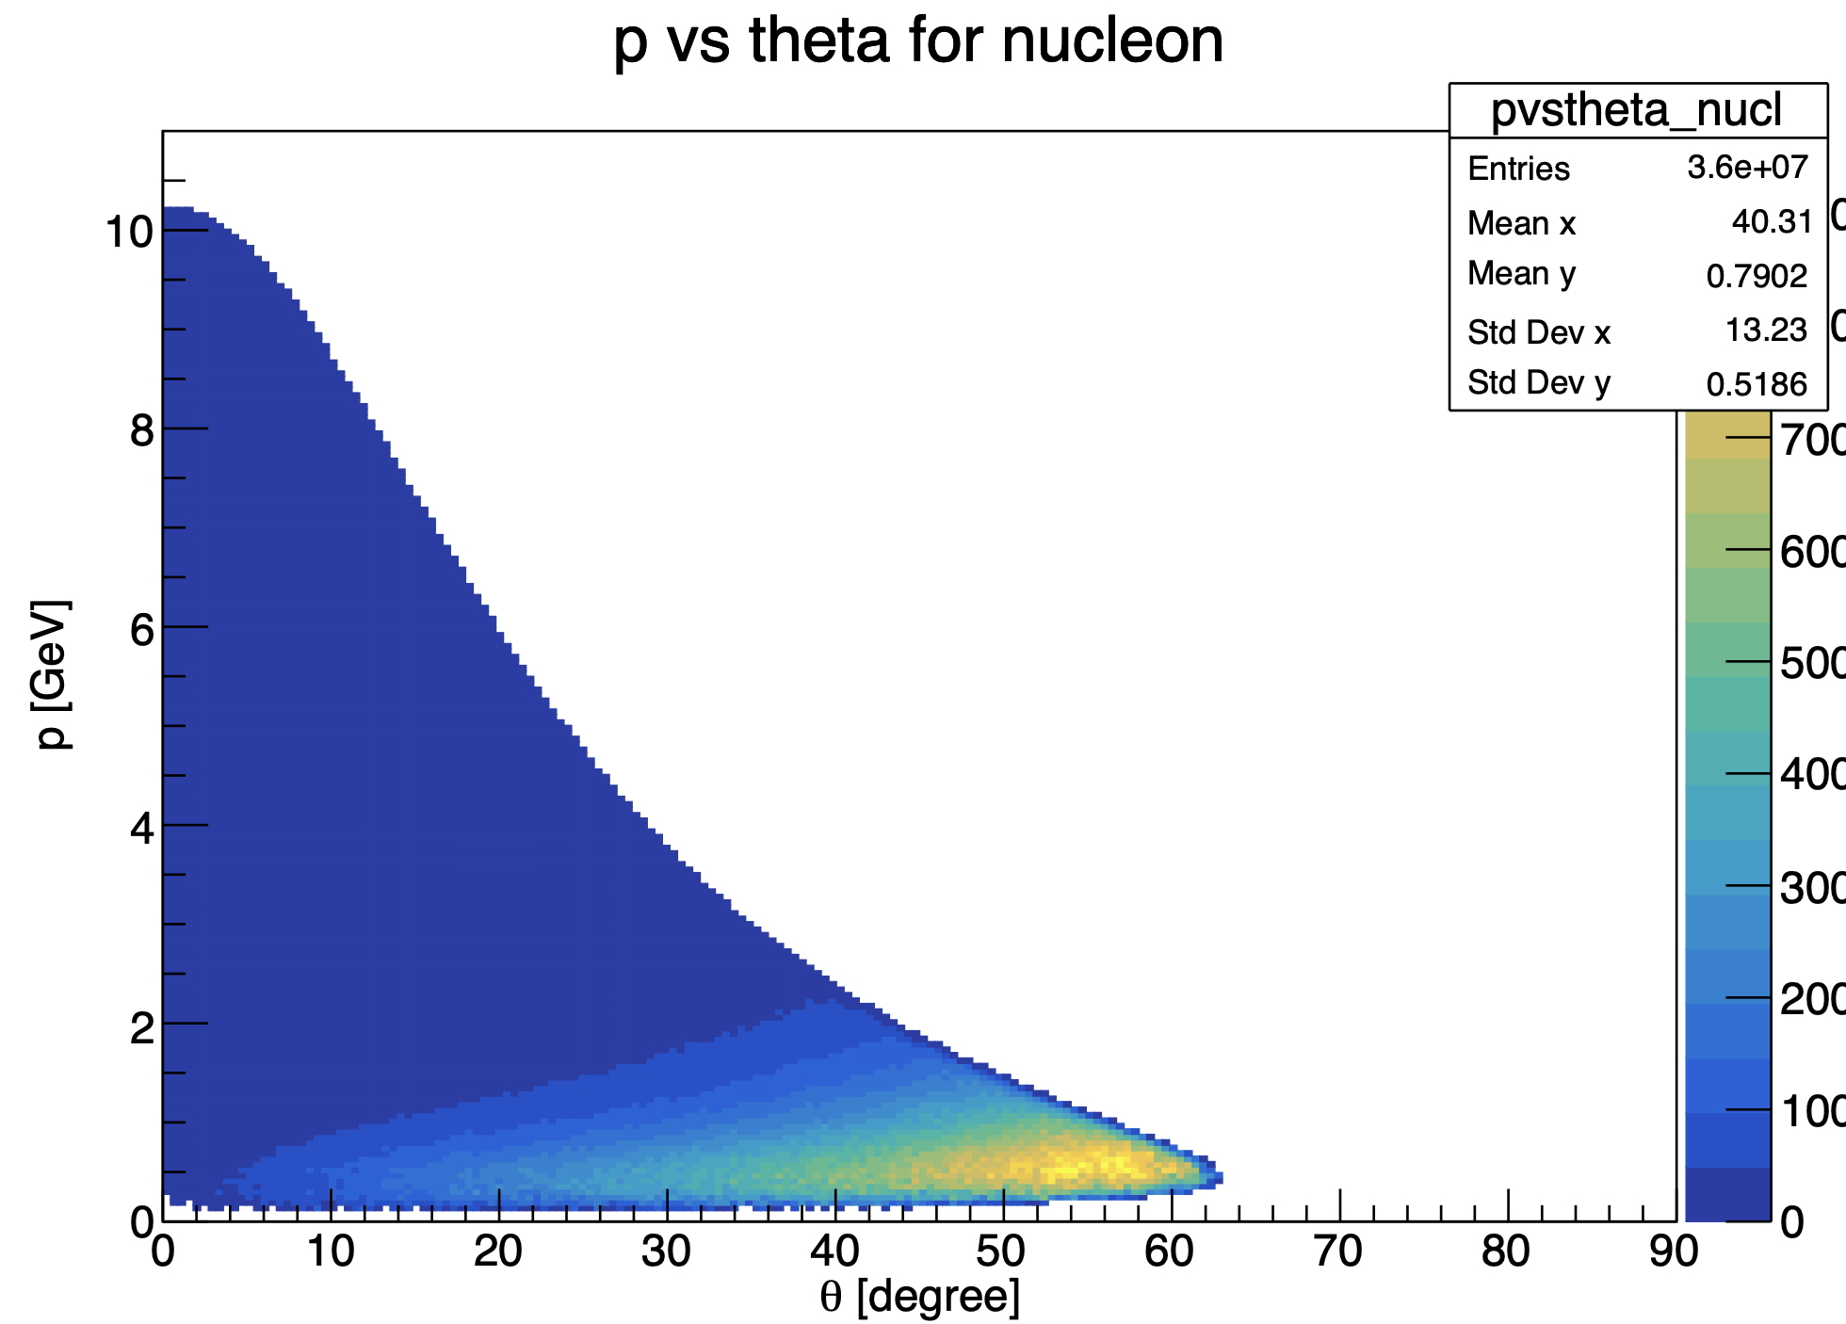
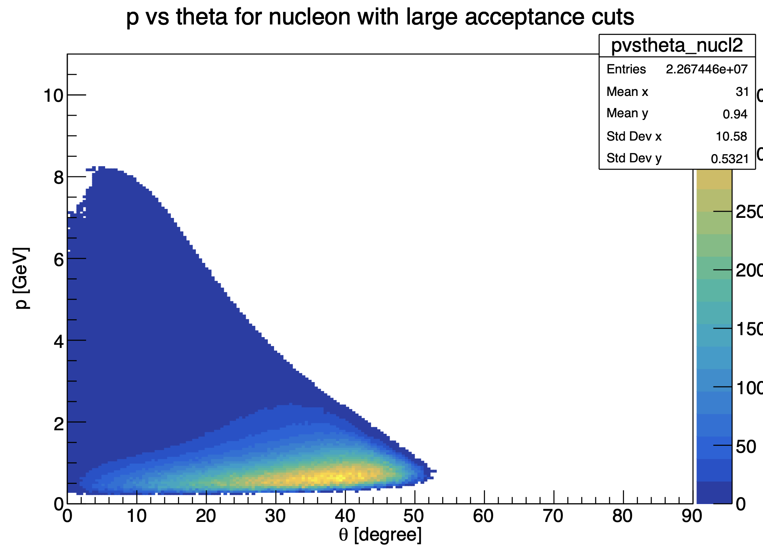
Generator plots
Mathieu Ronayette
20/20
Mathieu Ronayette
Clas12 Collaboration Meeting
11 March 2026
Notes:
23

Slide 24
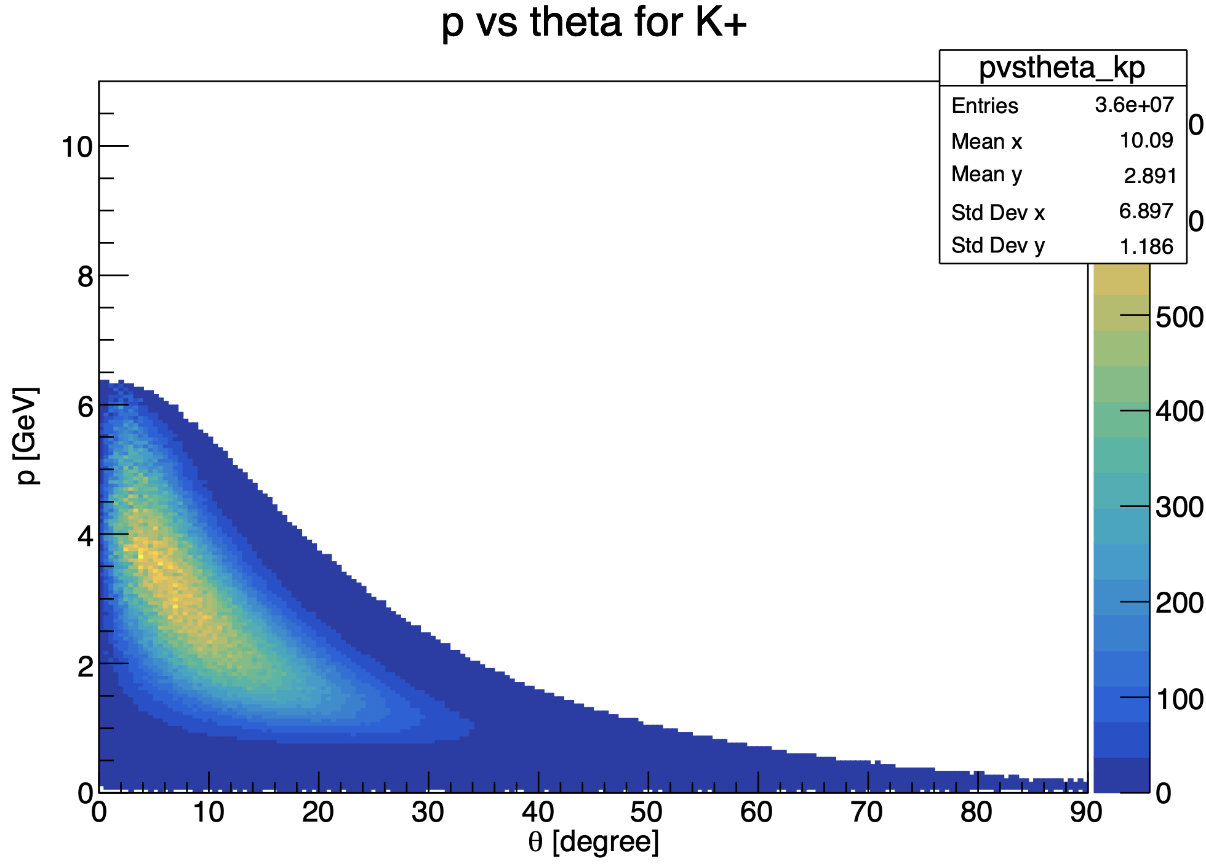
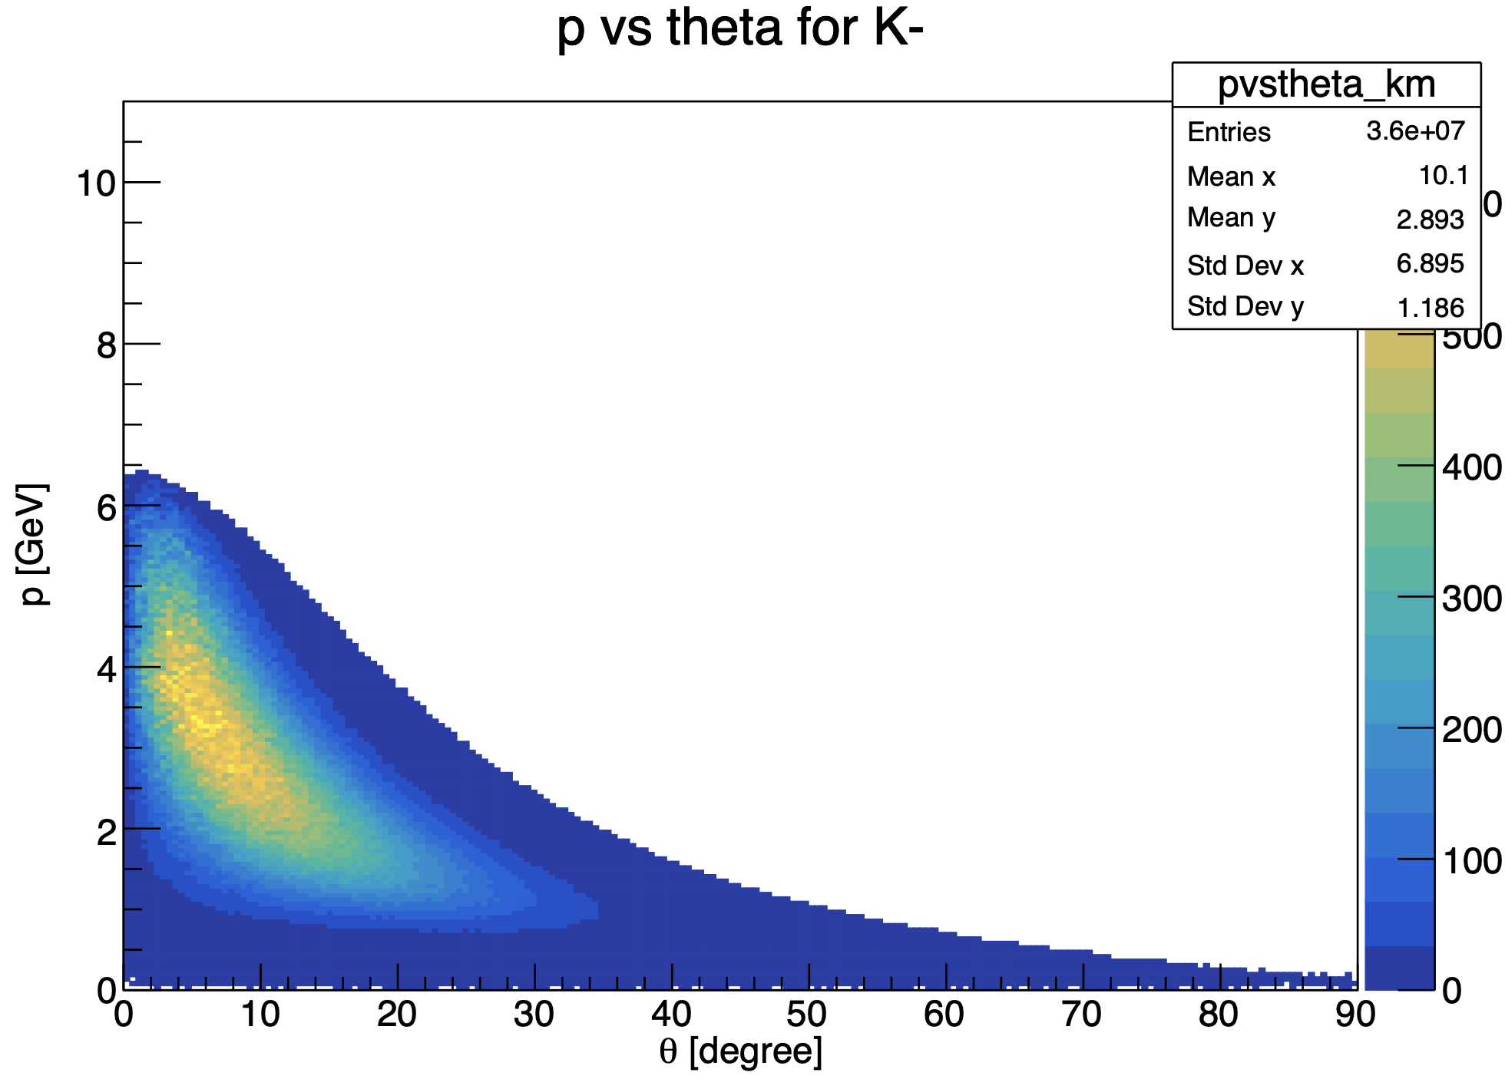
Generator plots
Mathieu Ronayette
20/20
Mathieu Ronayette
Clas12 Collaboration Meeting
11 March 2026
Notes:
24

Slide 25
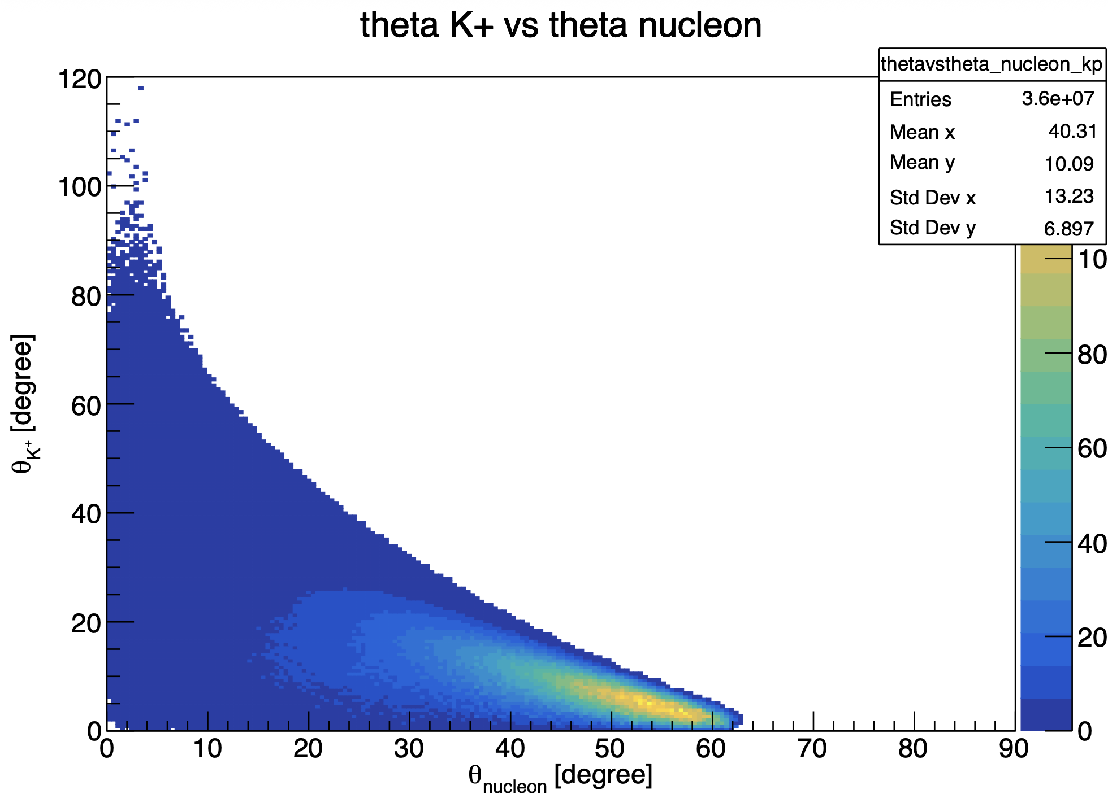
Generator plots
Mathieu Ronayette
20/20
Mathieu Ronayette
Clas12 Collaboration Meeting
11 March 2026
Notes:
25

Slide 26
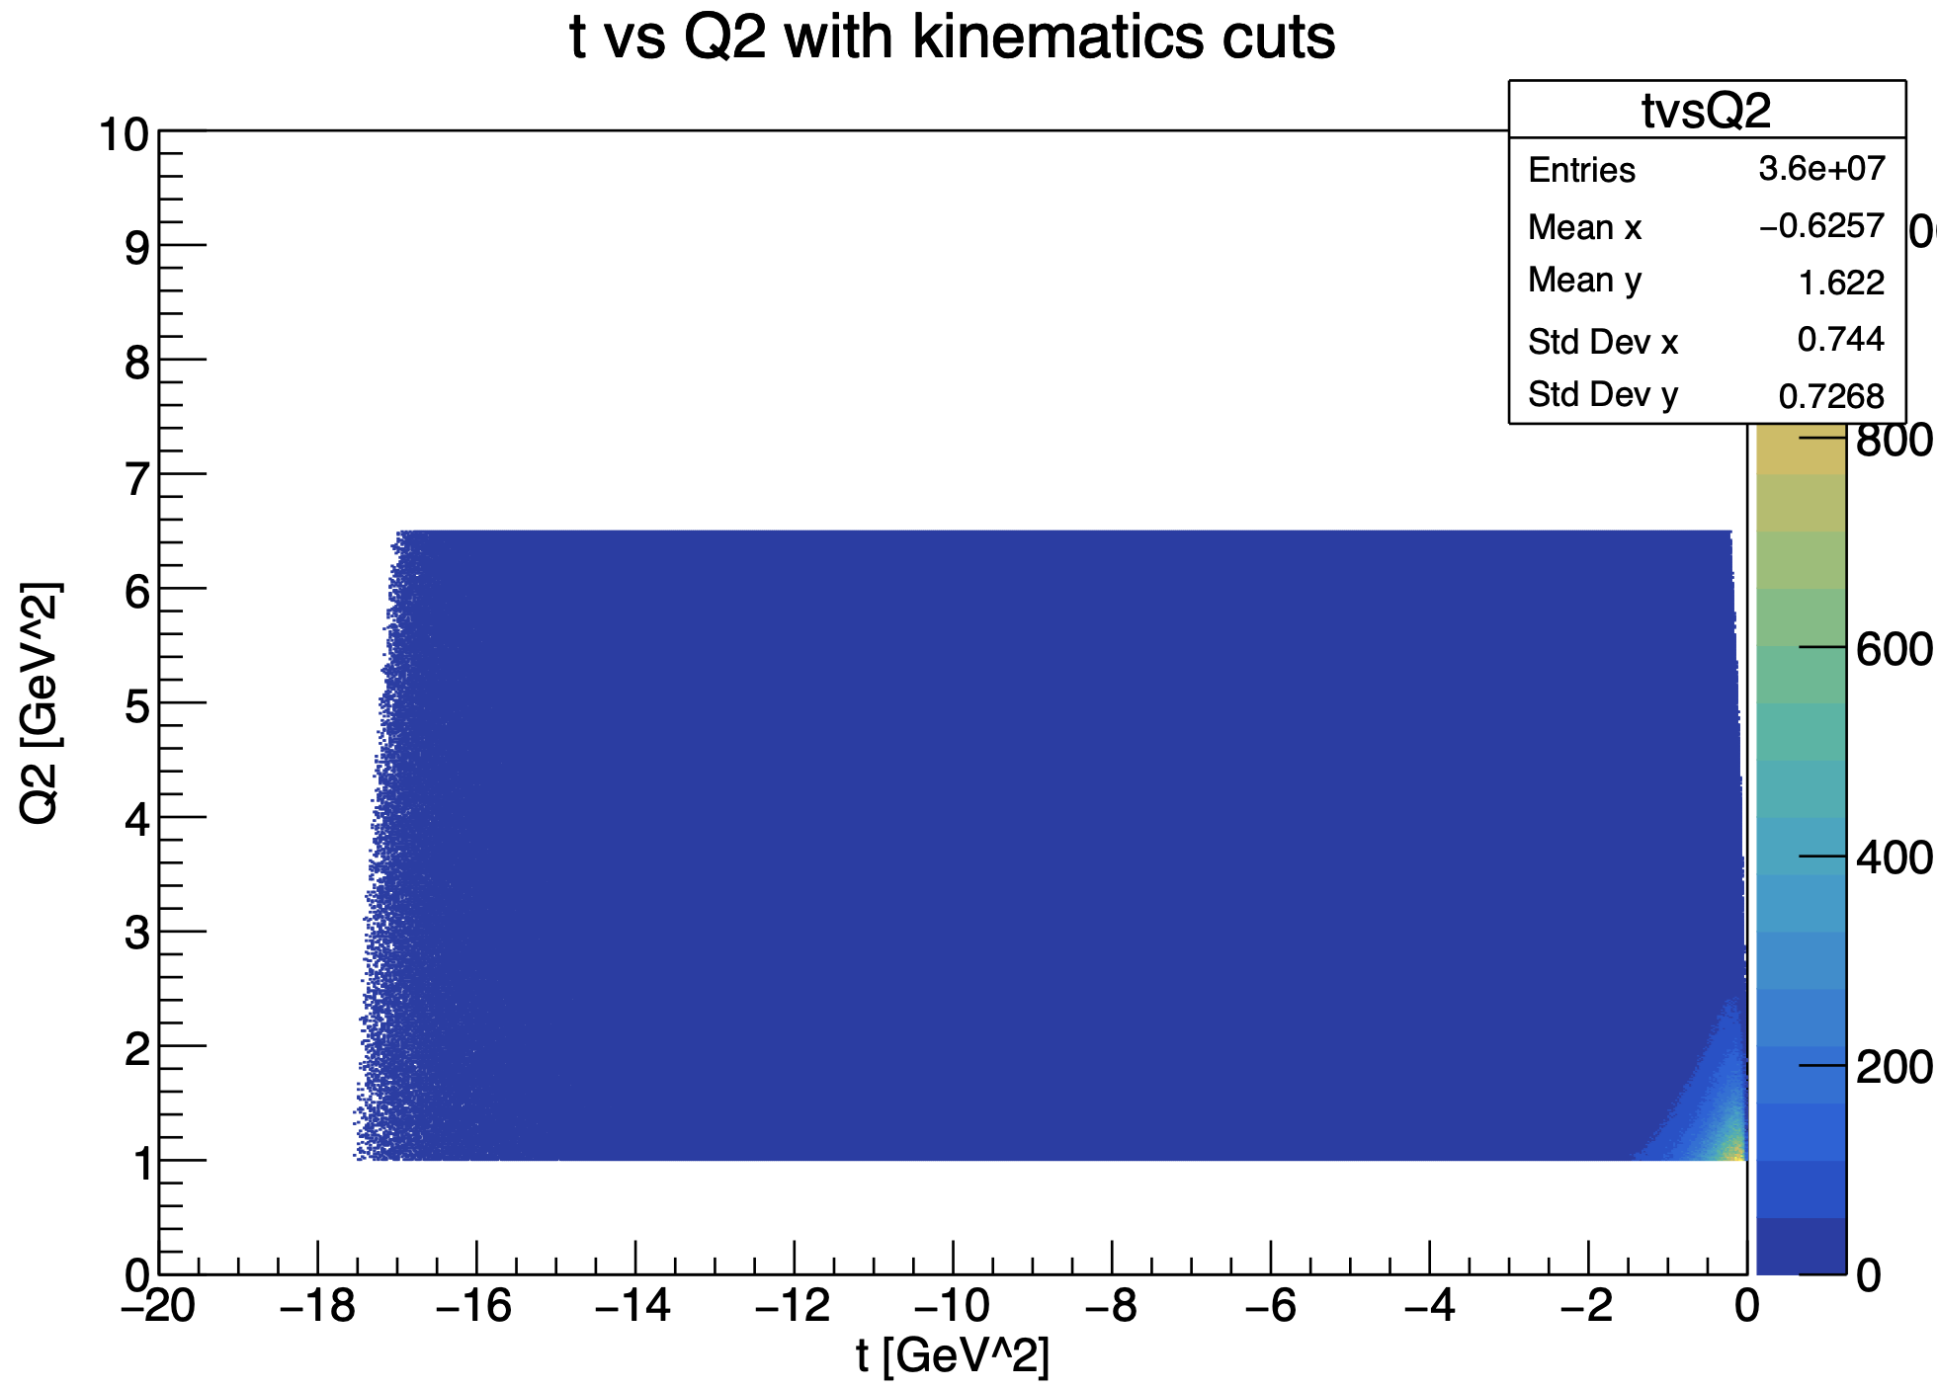
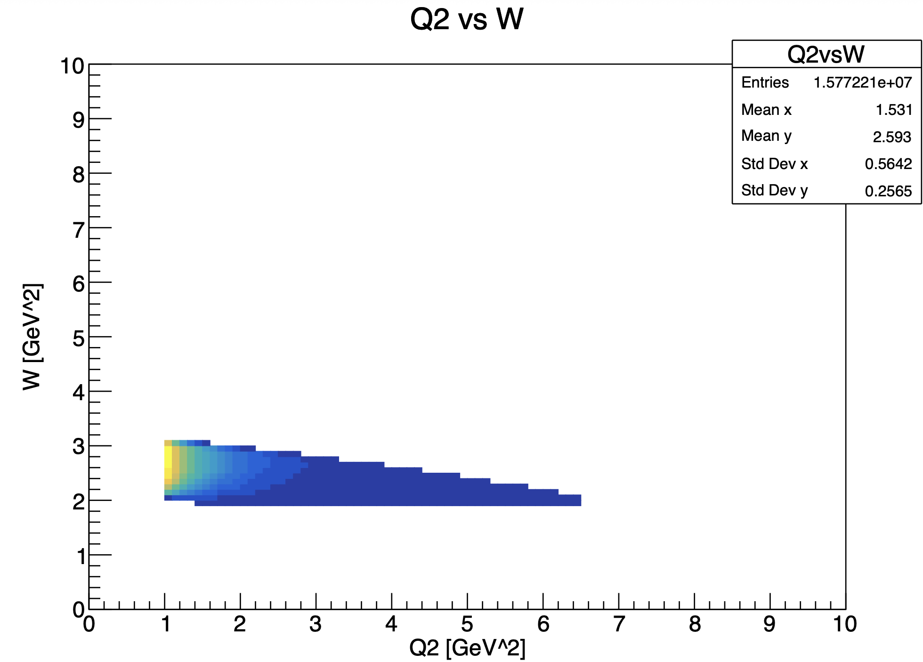
Generator plots
Mathieu Ronayette
20/20
Mathieu Ronayette
Clas12 Collaboration Meeting
11 March 2026
Notes:
26

Slide 27
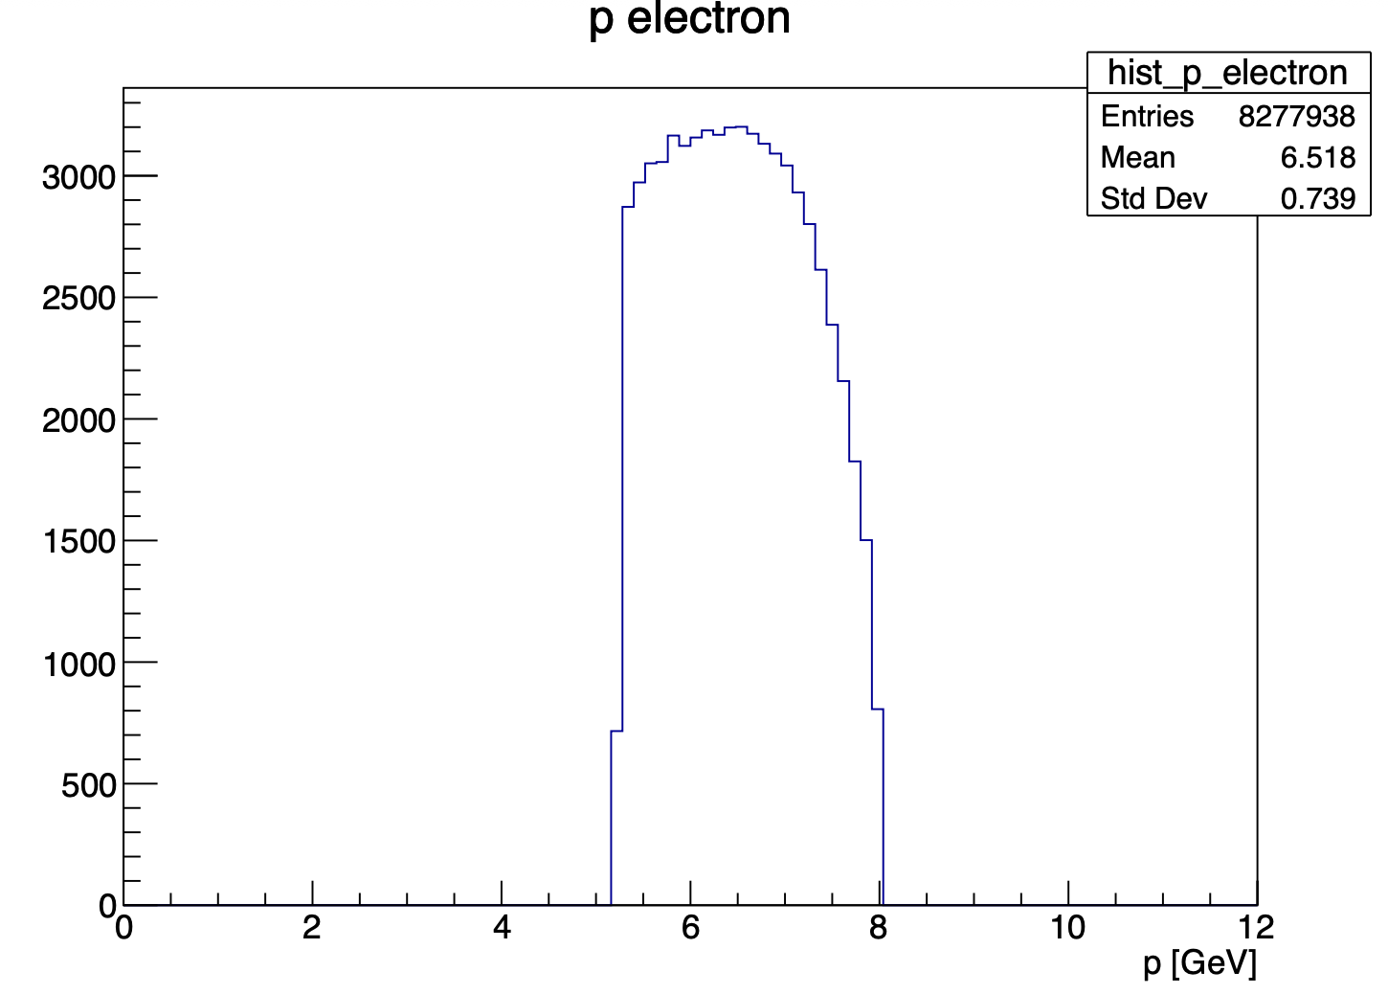
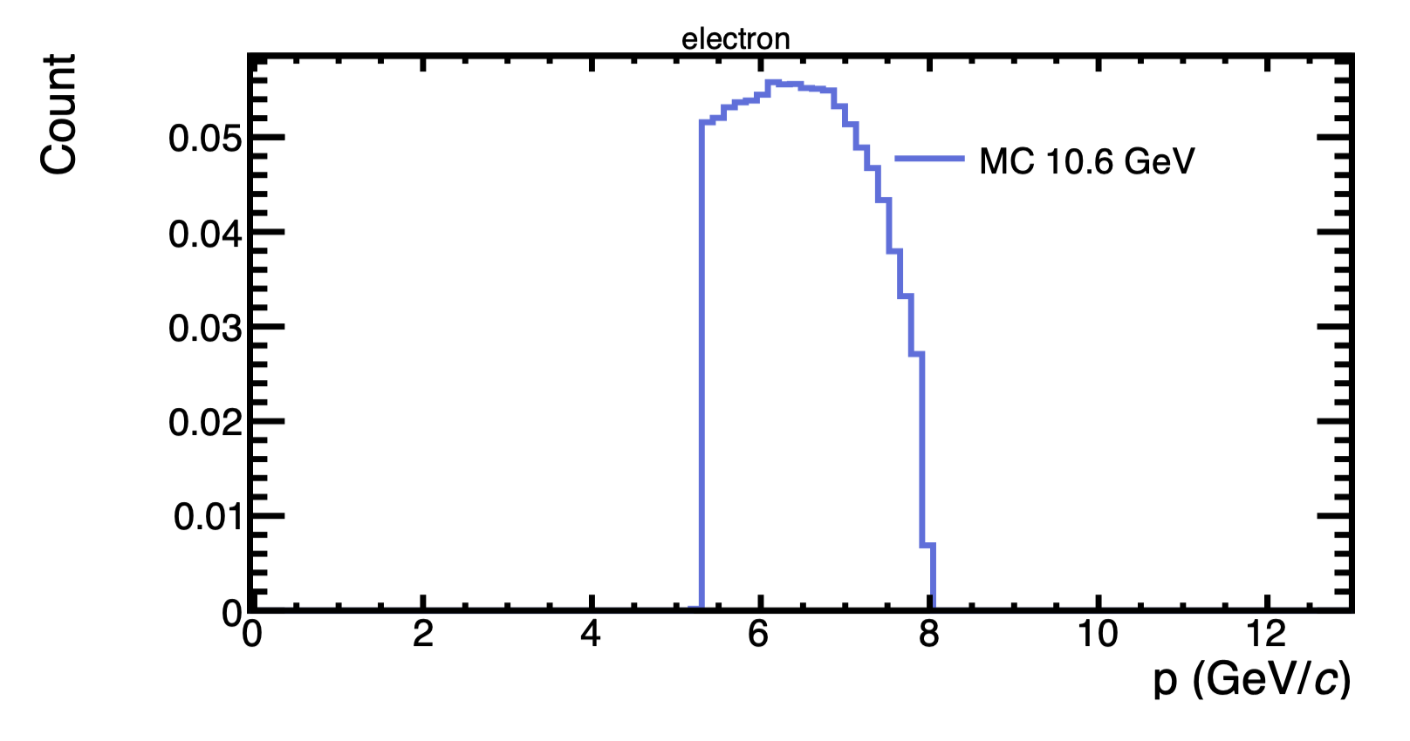
Generator plots
With this cuts : 5.25 < P_{electron} < 8 GeV and P_{proton} > 0.45 GeV
my generator
Bhawani plot
Mathieu Ronayette
20/20
Mathieu Ronayette
Clas12 Collaboration Meeting
11 March 2026
Notes:
27

Slide 28
Generator plots
With this cuts : 5.25 < P_{electron} < 8 GeV and P_{proton} > 0.45 GeV
my generator
Bhawani plot
Mathieu Ronayette
20/20
Mathieu Ronayette
Clas12 Collaboration Meeting
11 March 2026
Notes:
28

Slide 29
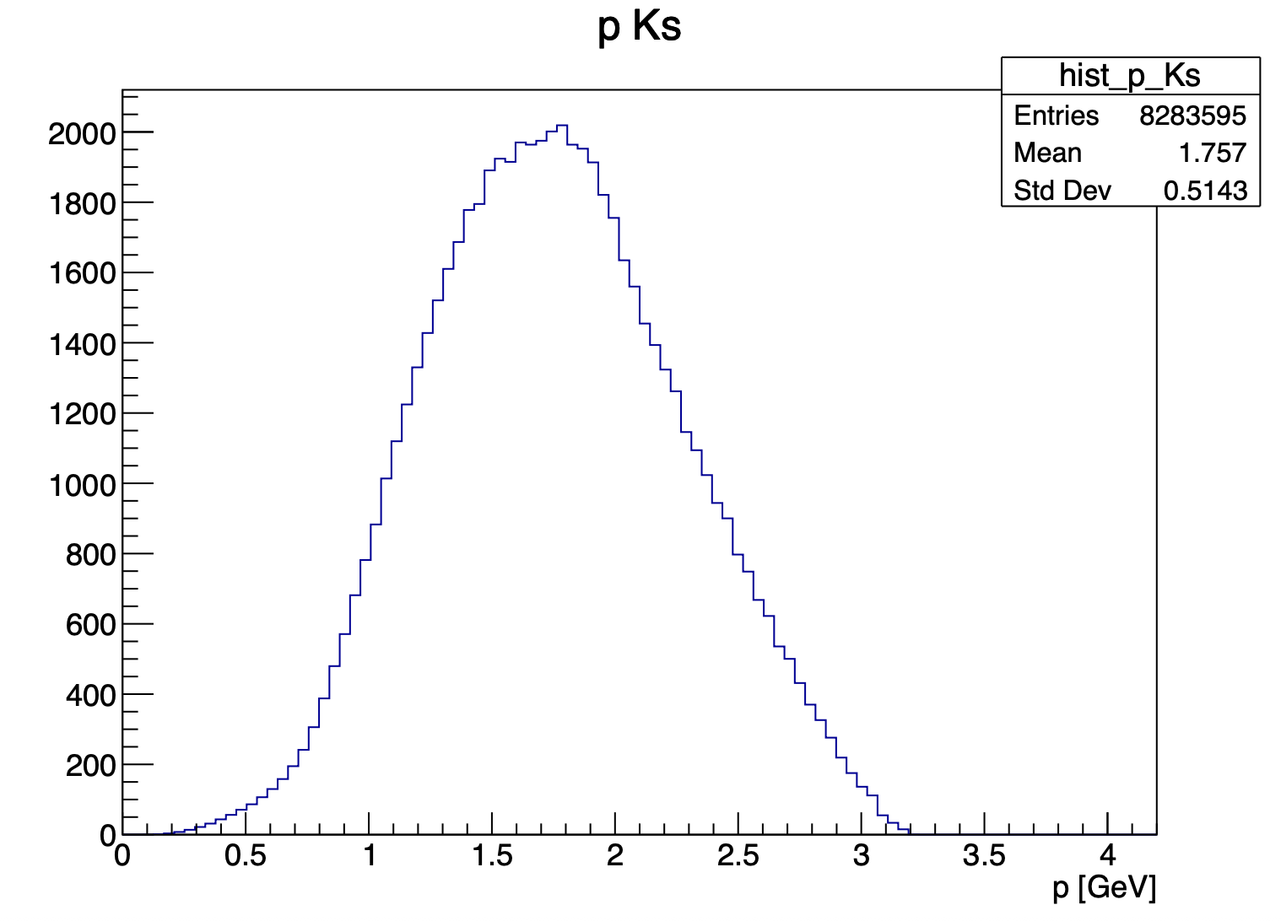
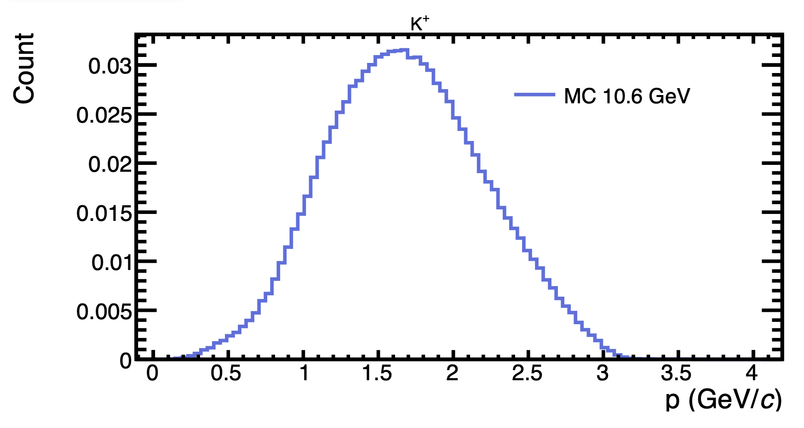
Generator plots
With this cuts : 5.25 < P_{electron} < 8 GeV and P_{proton} > 0.45 GeV
K⁺
my generator
Bhawani plot
Mathieu Ronayette
20/20
Mathieu Ronayette
Clas12 Collaboration Meeting
11 March 2026
Notes:
29

Slide 30
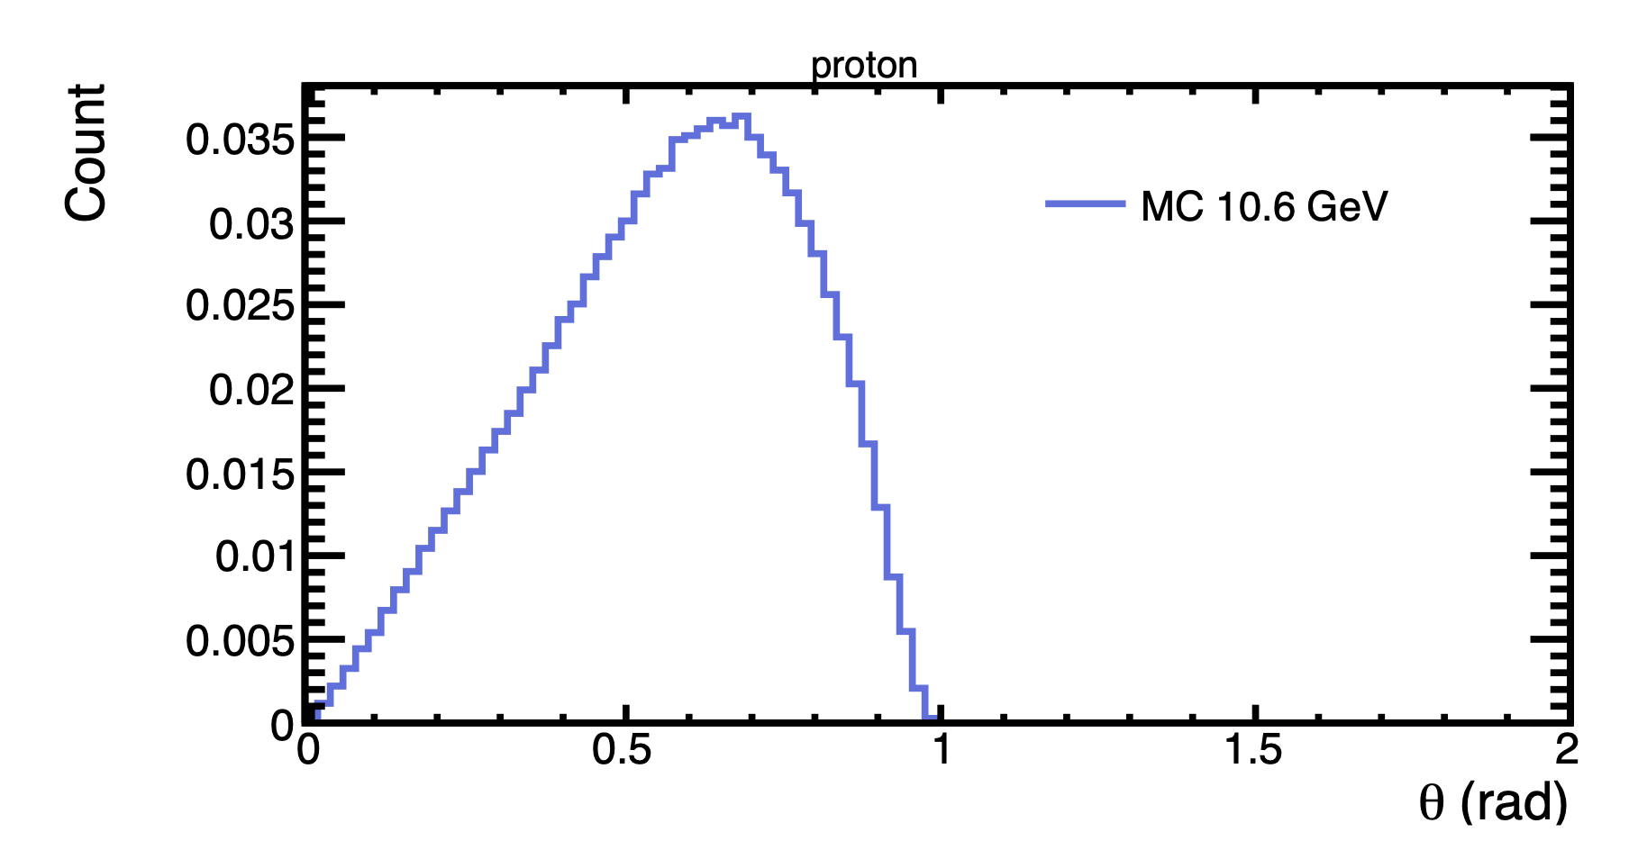
Generator plots
With this cuts : 5.25 < P_{electron} < 8 GeV and P_{proton} > 0.45 GeV
my generator
Bhawani plot
Mathieu Ronayette
20/20
Mathieu Ronayette
Clas12 Collaboration Meeting
11 March 2026
Notes:
30

Slide 31
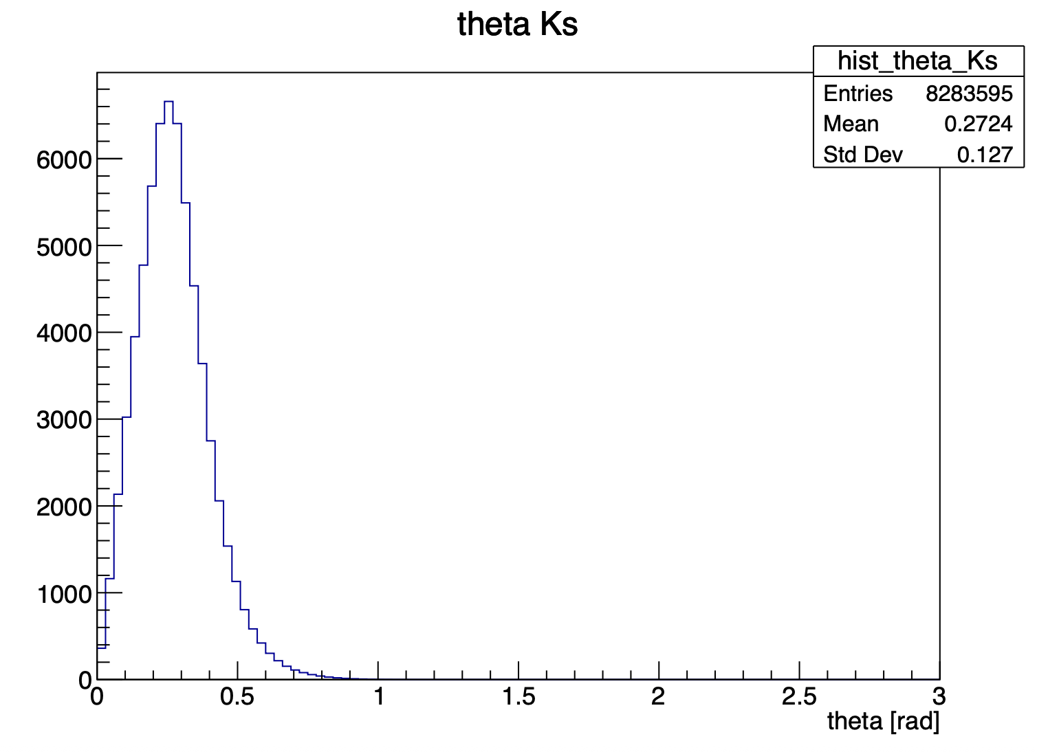
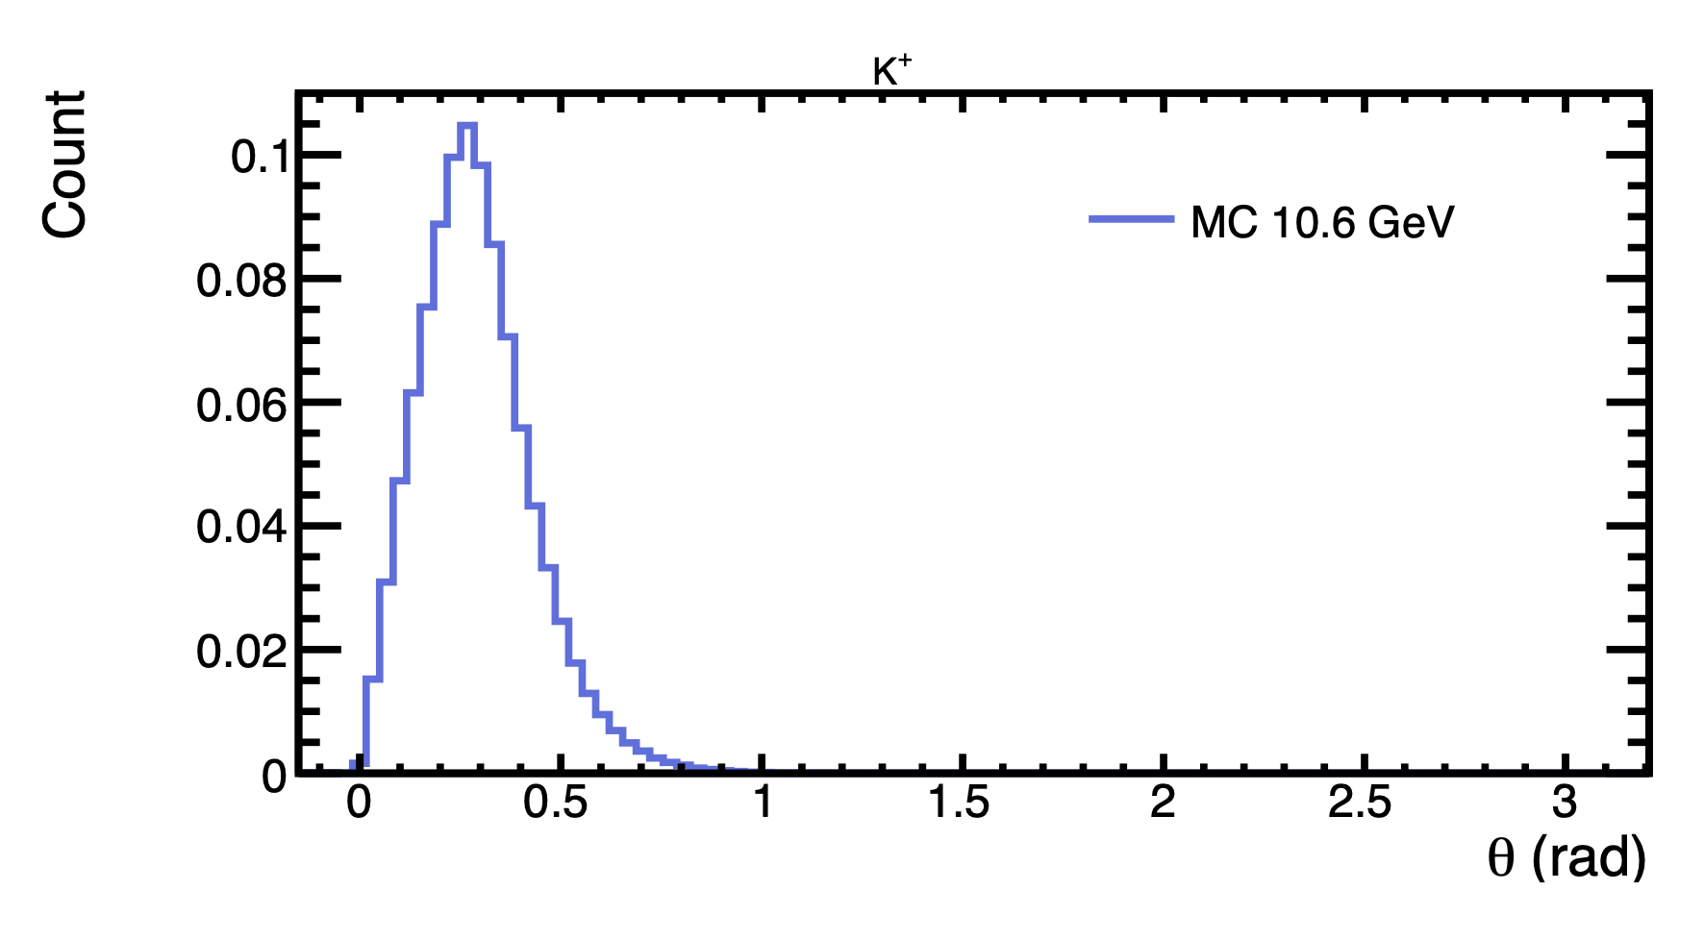
Generator plots
With this cuts : 5.25 < P_{electron} < 8 GeV and P_{proton} > 0.45 GeV
my generator
Bhawani plot
Mathieu Ronayette
20/20
Mathieu Ronayette
Clas12 Collaboration Meeting
11 March 2026
Notes:
31

Slide 32
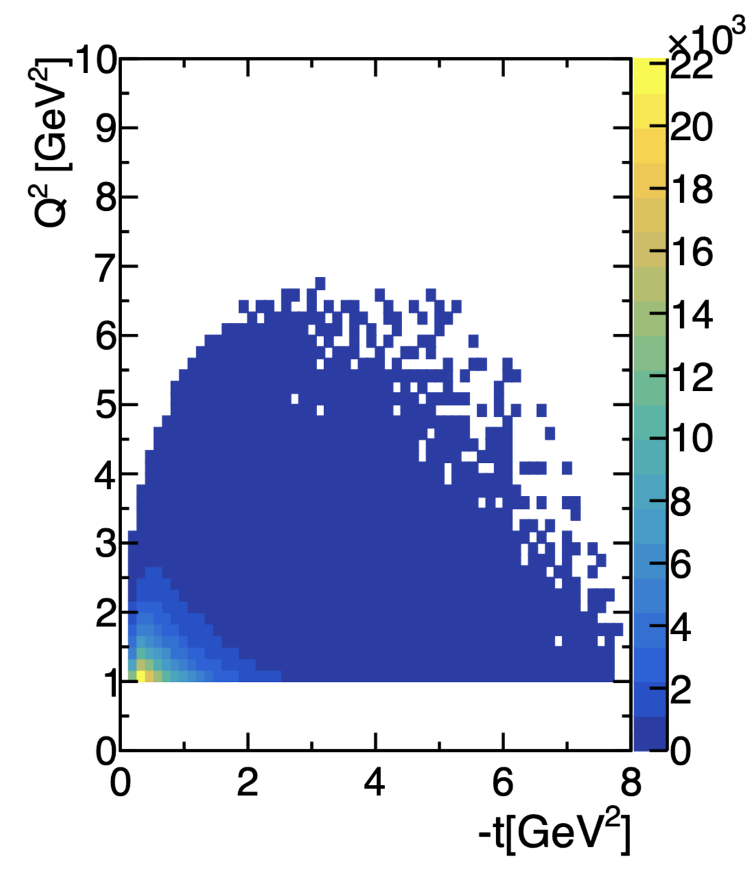
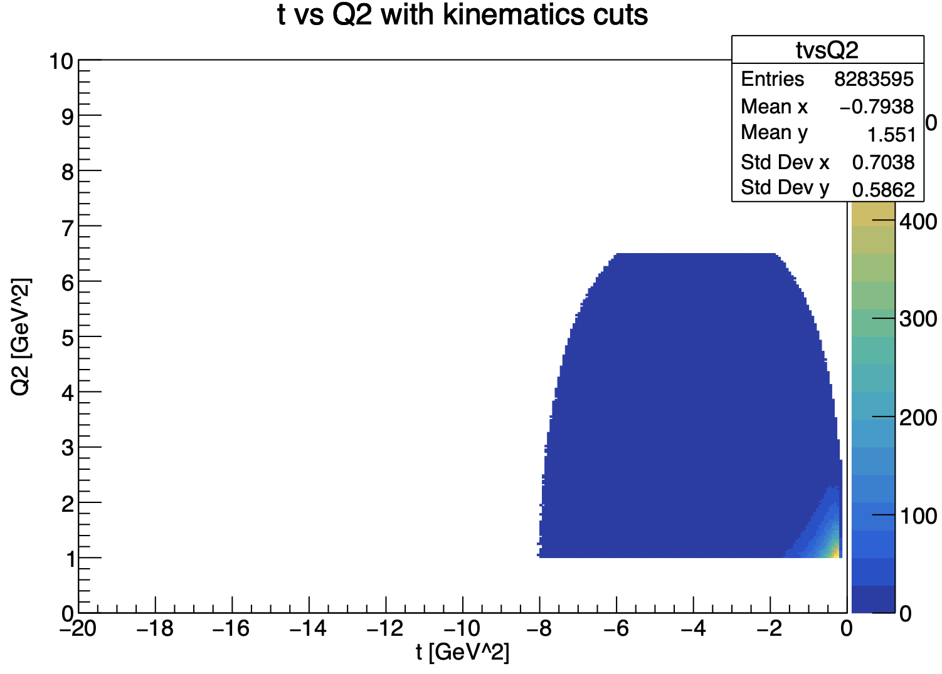
Generator plots
With this cuts : 5.25 < P_{electron} < 8 GeV and P_{proton} > 0.45 GeV
my generator
Bhawani plot
Mathieu Ronayette
20/20
Mathieu Ronayette
Clas12 Collaboration Meeting
11 March 2026
Notes:
32

Slide 33
Proton contamination
Missing_nucleon = the missing particle of this reaction : e n → e’ K⁺ K⁻ X
K⁺
K⁺
K⁻
K⁻
e⁻
e⁻
fake neutron
neutron
non detected proton
missing_nucleon
There is still a contamination when the missing_nucleon is a non detected proton and there is a fake signal neutron who pass the cut on the angle
Good event with the angle between the missing nucleon and the neutron < 5 °
→ Evaluate the contamination with simulation on proton target and apply the cuts of neutron analysis and see how many
events pass the cuts
Mathieu Ronayette
20/20
Mathieu Ronayette
Clas12 Collaboration Meeting
11 March 2026
Notes:
33

Slide 34
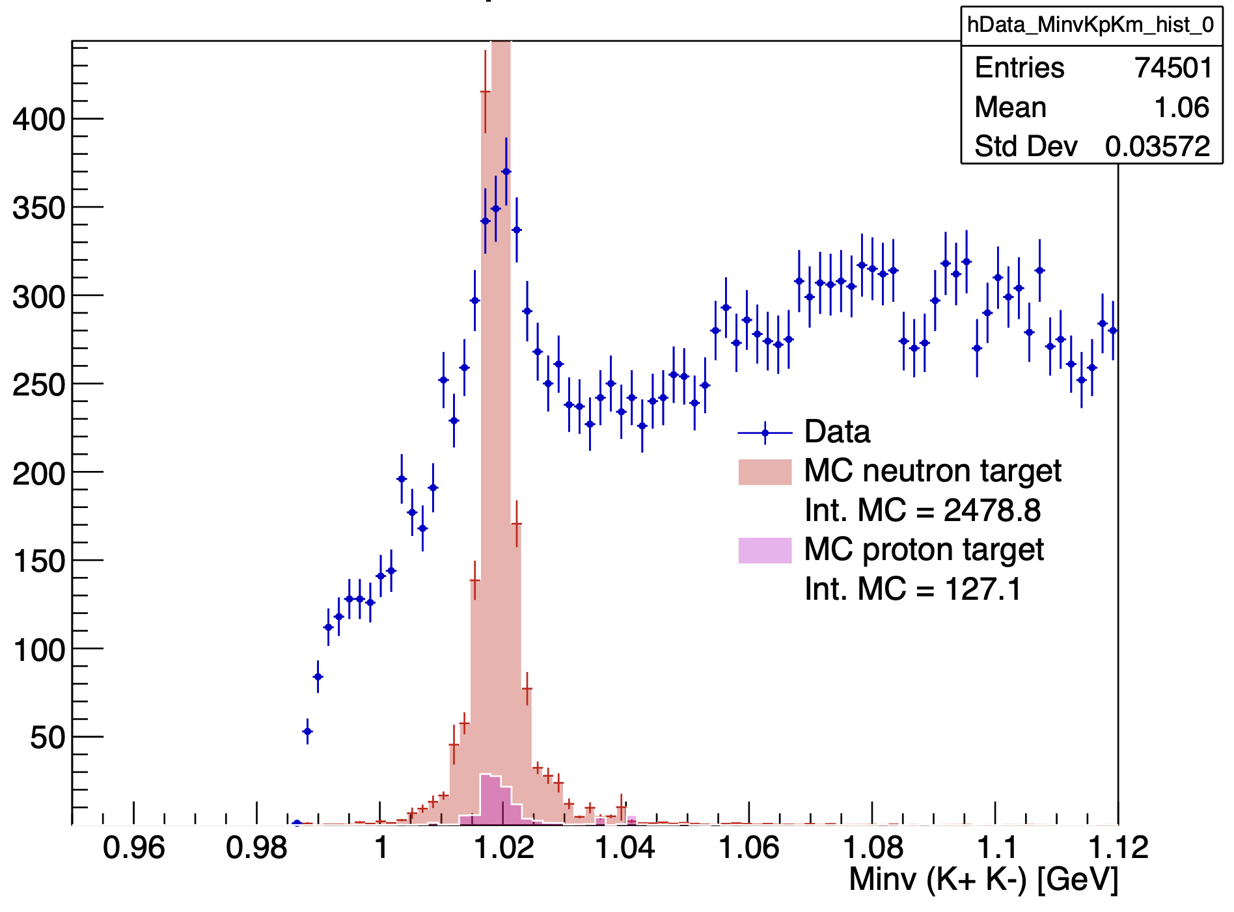

Influence of cuts on the invariant mass K⁺ K⁻ :
With angle cut
With angle cut and K+ K- in FD
Mathieu Ronayette
20/20
Mathieu Ronayette
Clas12 Collaboration Meeting
11 March 2026
Notes:
34

Slide 35





All fit data bin1 Q²
Mathieu Ronayette
20/20
Mathieu Ronayette
Clas12 Collaboration Meeting
11 March 2026
Notes:
35

Slide 36





All fit data bin2 Q²
Mathieu Ronayette
20/20
Mathieu Ronayette
Clas12 Collaboration Meeting
11 March 2026
Notes:
36

Slide 37





All fit mc bin1 Q²
Mathieu Ronayette
20/20
Mathieu Ronayette
Clas12 Collaboration Meeting
11 March 2026
Notes:
37

Slide 38





All fit mc bin2 Q²
Mathieu Ronayette
20/20
Mathieu Ronayette
Clas12 Collaboration Meeting
11 March 2026
Notes:
38

Slide 39


Neutron efficiency correction additional plots
Mathieu Ronayette
20/20
Mathieu Ronayette
Clas12 Collaboration Meeting
11 March 2026
Notes:
39

Slide 40


Neutron efficiency correction additional plots
Mathieu Ronayette
20/20
Mathieu Ronayette
Clas12 Collaboration Meeting
11 March 2026
Notes:
40

Slide 41


Neutron phasespace :
MC : θ_{neutron} vs P_{neutron} generated
(with acceptante cuts)
Mathieu Ronayette
20/20
Mathieu Ronayette
Clas12 Collaboration Meeting
11 March 2026
Notes:
41

Slide 42


Neutron phasespace :
P. Chatagnon’s plot
Neutron detection efficiency in the FD
Neutron detection efficiency in the CND
Mathieu Ronayette
20/20
Mathieu Ronayette
Clas12 Collaboration Meeting
11 March 2026
Notes:
42

