Slide 1
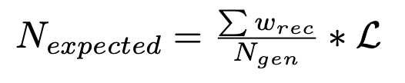
Update on ɸ generator
Simulation objectives :
- Estimate the expected number of ɸ with
- Find interresting cuts
π⁺
e
e’
Ks
π⁻
Previously with TGenPhasespace (root module) :
- Generate automatically quadri-impulsion in the phasespace
- But problems with the weight associated with the phasespace
q
ɸ
Kl
p
p’
→ In the next slides the generator that we implemented without TGenPhaseSpace
Mathieu Ronayette
1/18
Mathieu Ronayette
meeting
27 Nov 2025

Slide 2
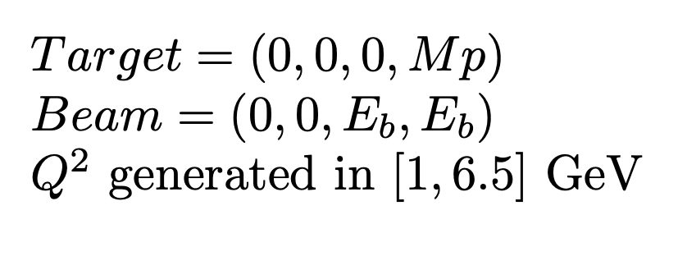
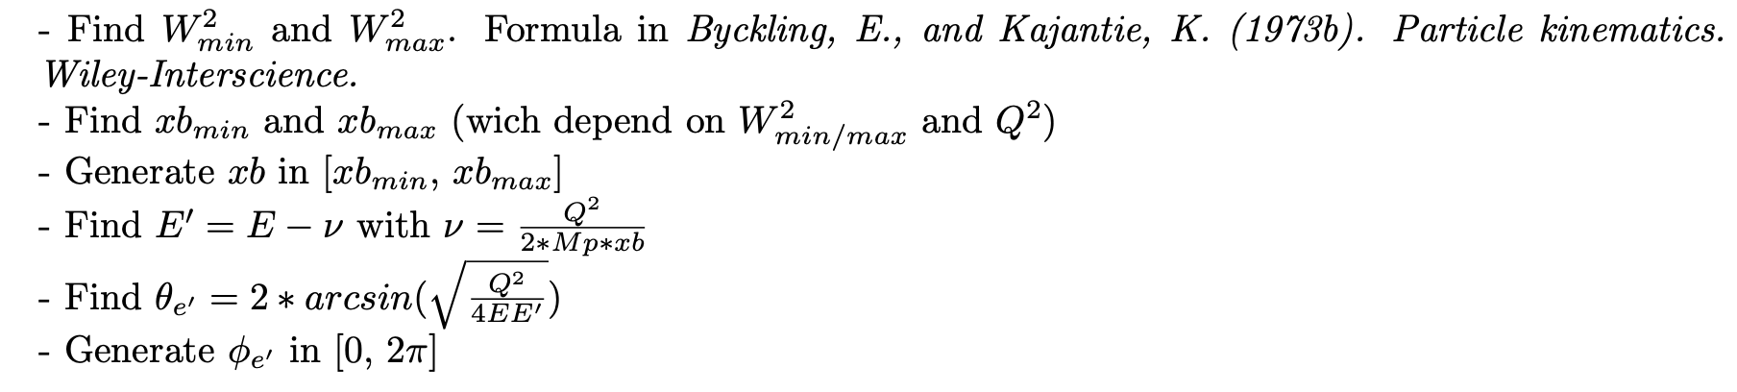
Update on ɸ generator
Initially :
e
e’
q
2. Scattering electron kinematics :
Mathieu Ronayette
2/18
Mathieu Ronayette
meeting
27 Nov 2025

Slide 3

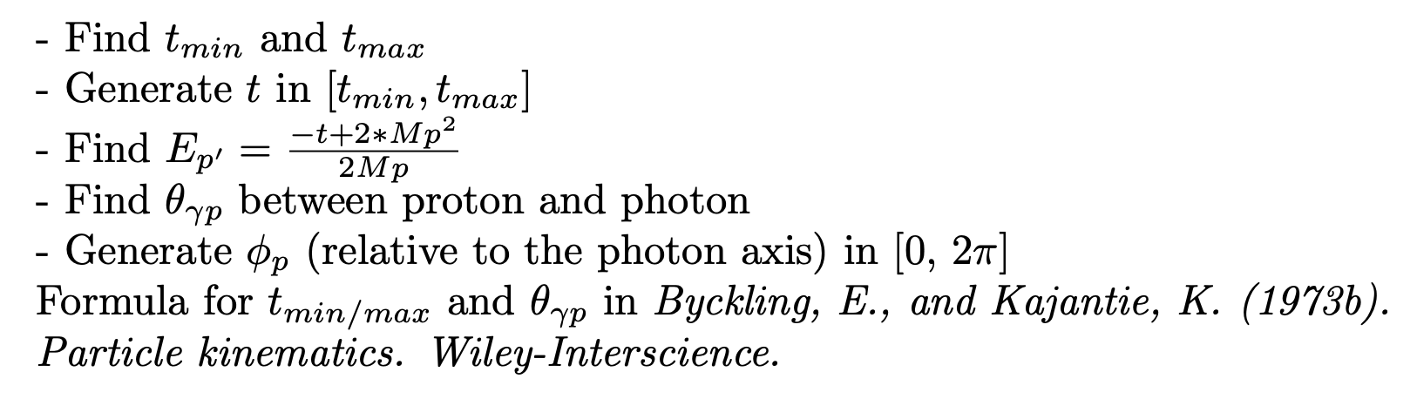

Update on ɸ generator
3. Virtual photon kinematics :
q
ɸ
4. Scattering proton kinematics :
p
p’
5. Meson ɸ kinematics :
Mathieu Ronayette
3/18
Mathieu Ronayette
meeting
27 Nov 2025

Slide 4
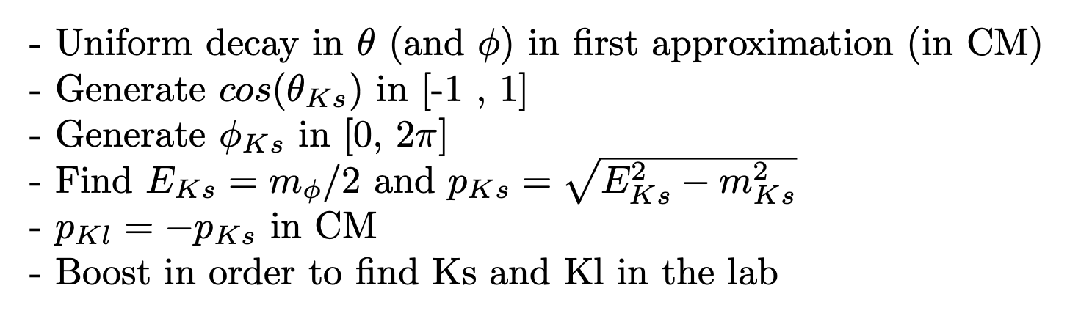
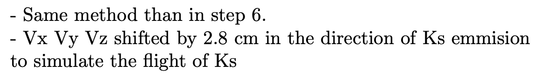
Update on ɸ generator
Ks
6. Kinematics of second decay ɸ → Ks Kl :
_{Ks}
ɸ
Kl
π⁺
7. Kinematics of thrid decay Ks → π⁺ π⁻ :
π⁺
Ks
π⁻
Mathieu Ronayette
4/18
Mathieu Ronayette
meeting
27 Nov 2025

Slide 5
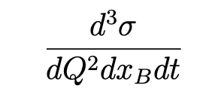
Update on ɸ generator
From Proposal to Jeﬀerson Lab PAC39 Exclusive Phi Meson Electroproduction with CLAS12
Branching ratio Ks → π⁺ π⁻ = 69%
Branching ratio ɸ → Ks Kl = 34%
Mathieu Ronayette
5/18
Mathieu Ronayette
meeting
27 Nov 2025

Slide 6
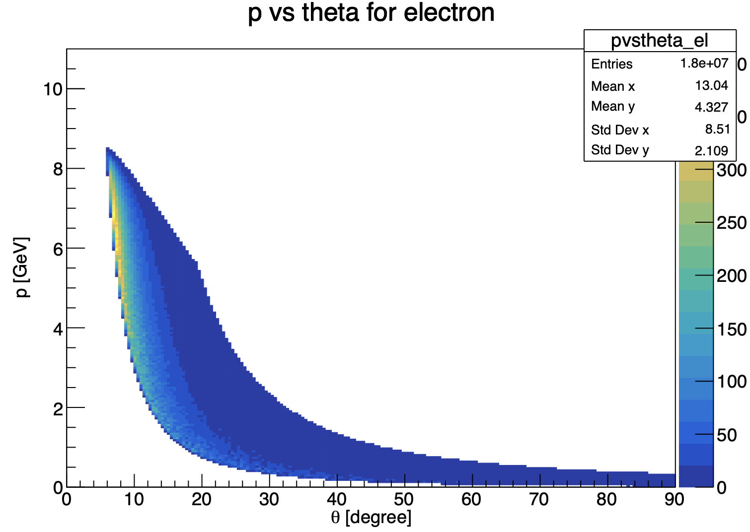
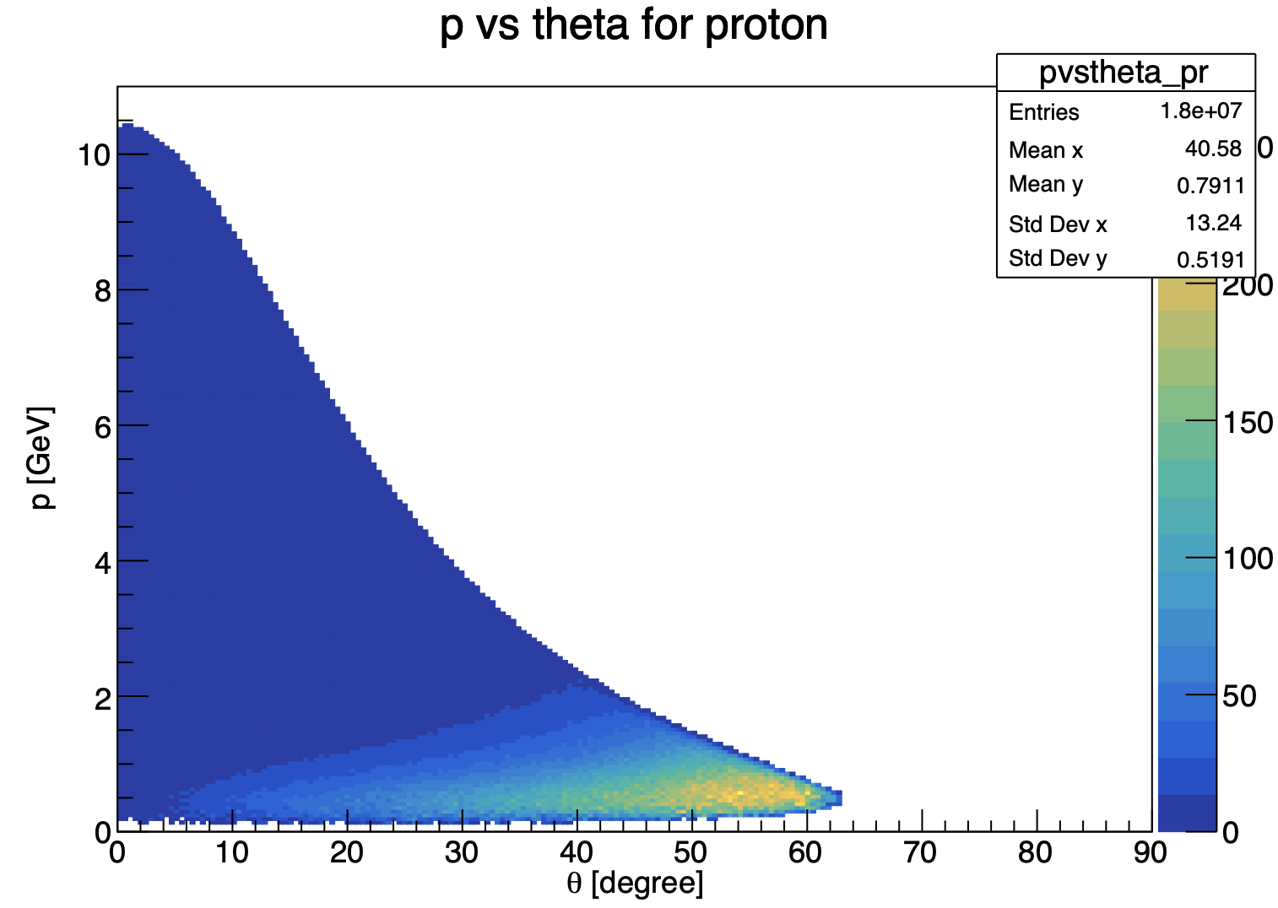
Update on ɸ generator
Mathieu Ronayette
6/18
Mathieu Ronayette
meeting
27 Nov 2025

Slide 7
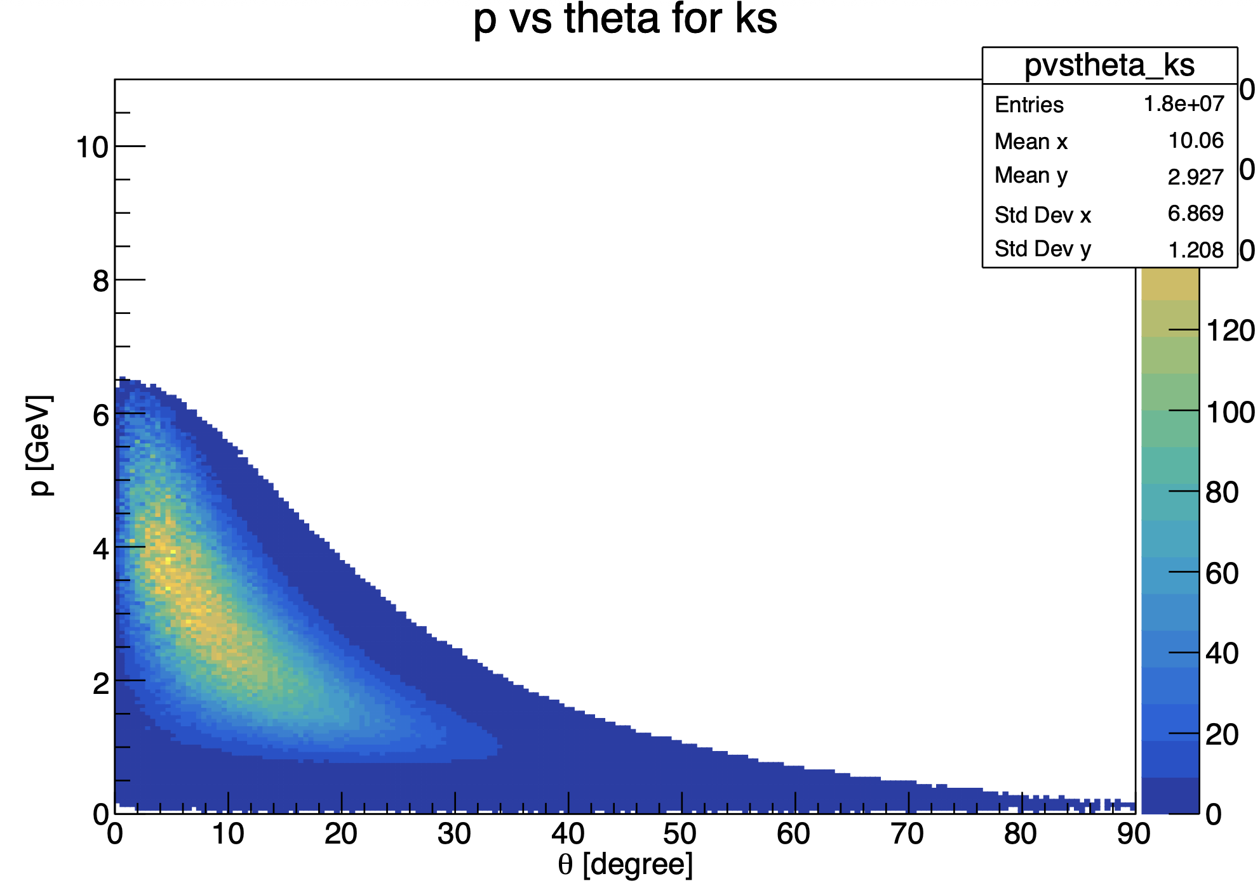
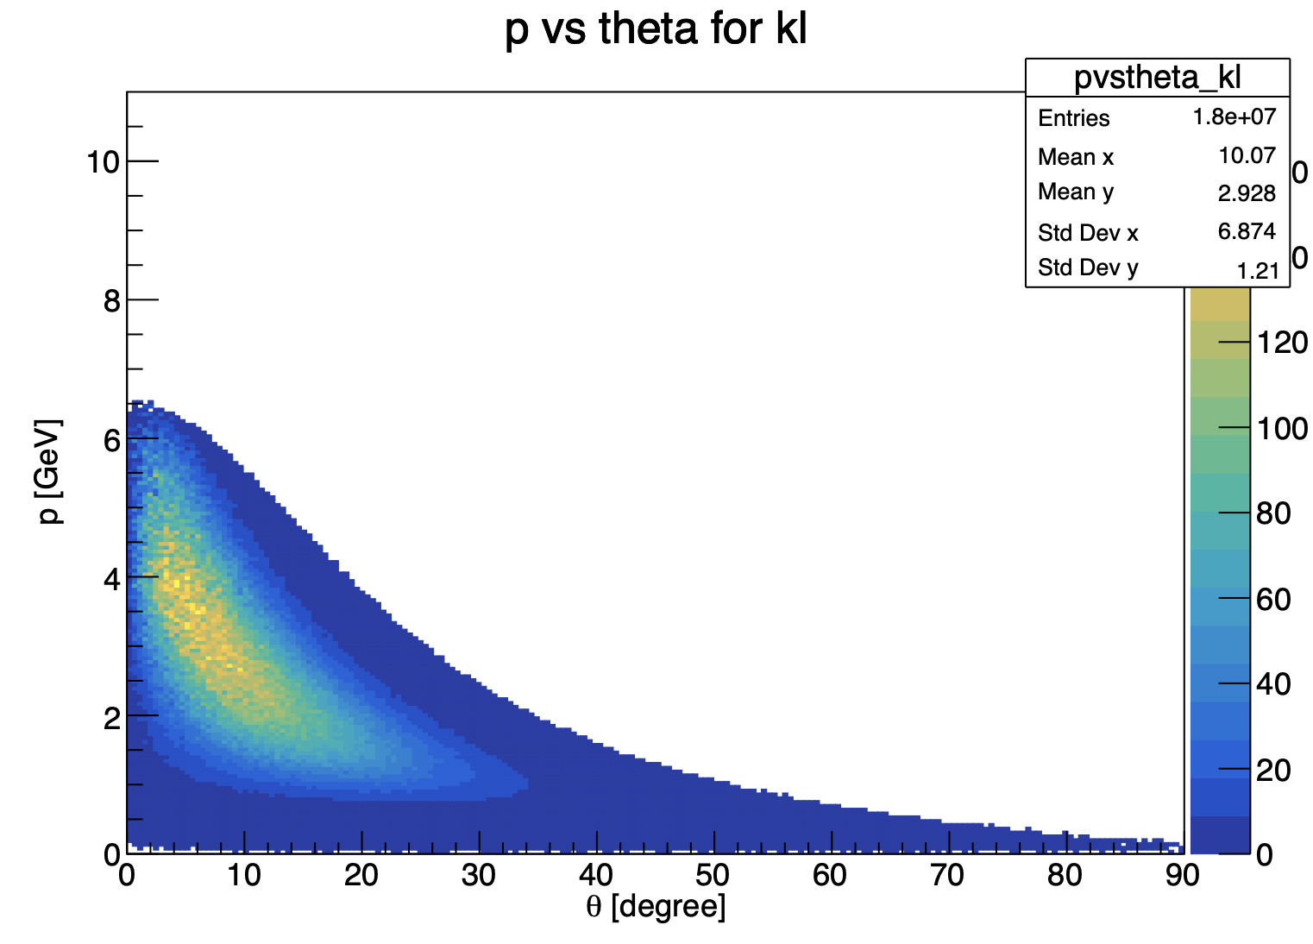
Update on ɸ generator
Mathieu Ronayette
7/18
Mathieu Ronayette
meeting
27 Nov 2025

Slide 8
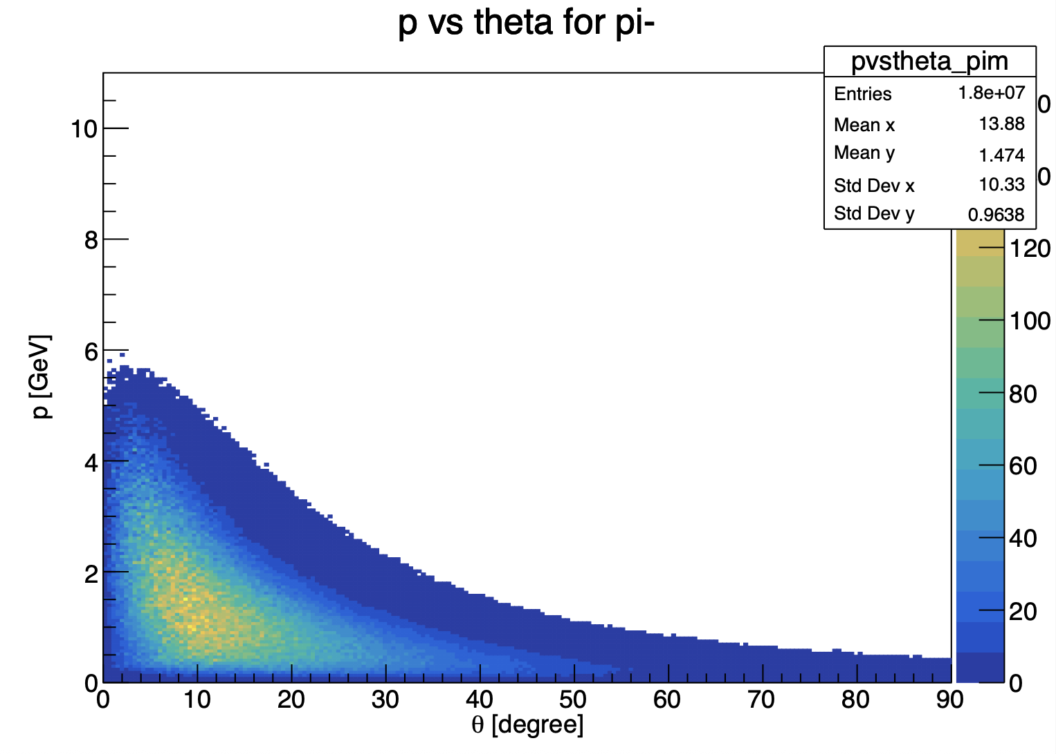

Update on ɸ generator
Mathieu Ronayette
8/18
Mathieu Ronayette
meeting
27 Nov 2025

Slide 9
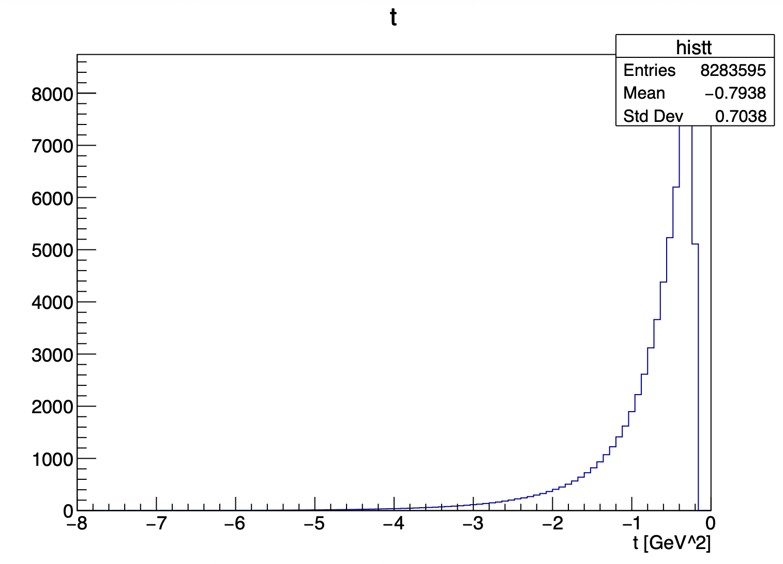
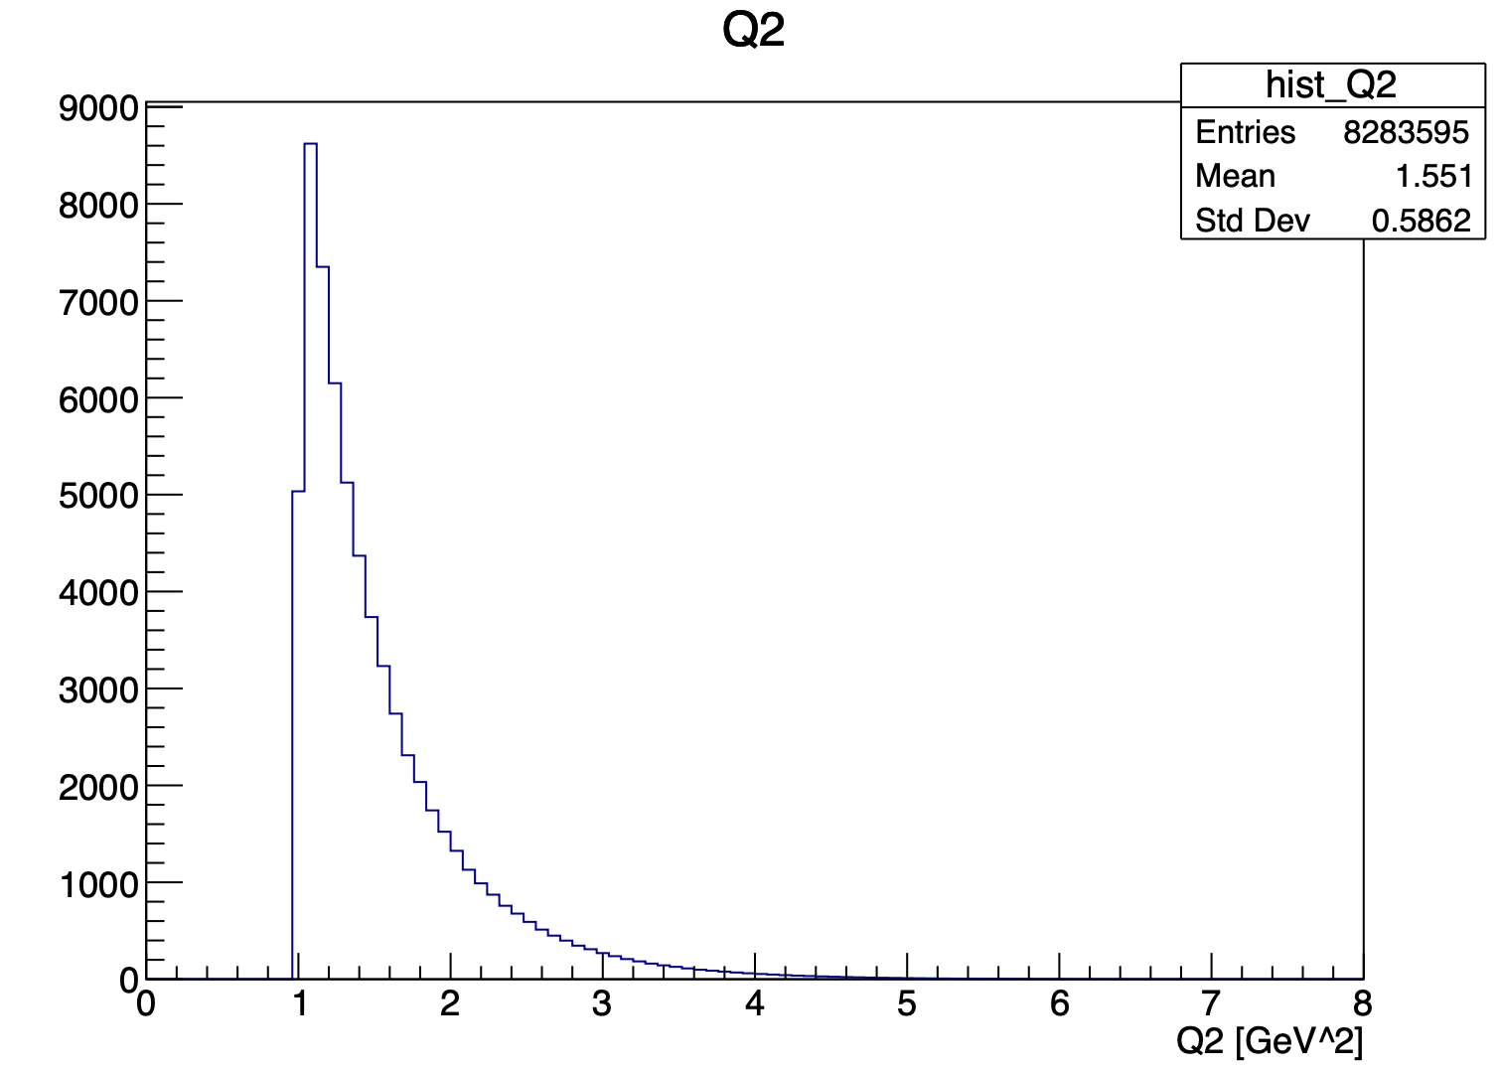
Update on ɸ generator
Mathieu Ronayette
9/18
Mathieu Ronayette
meeting
27 Nov 2025

Slide 10
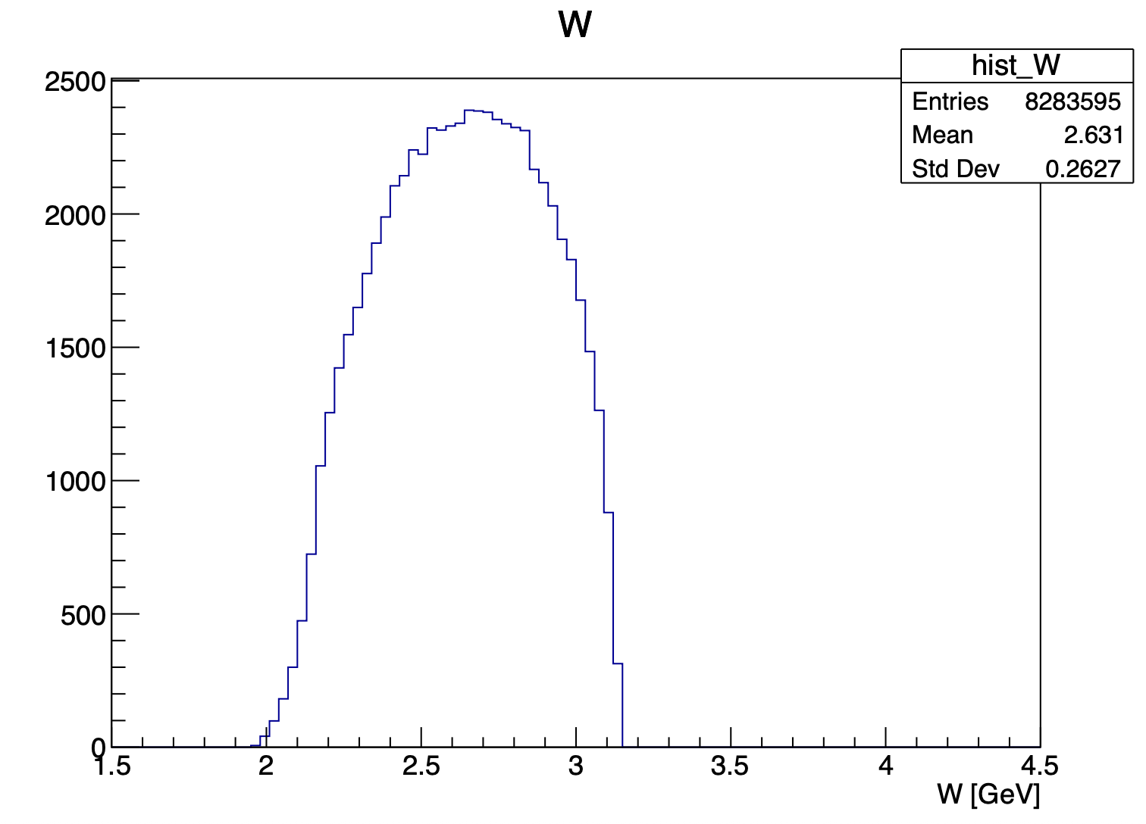
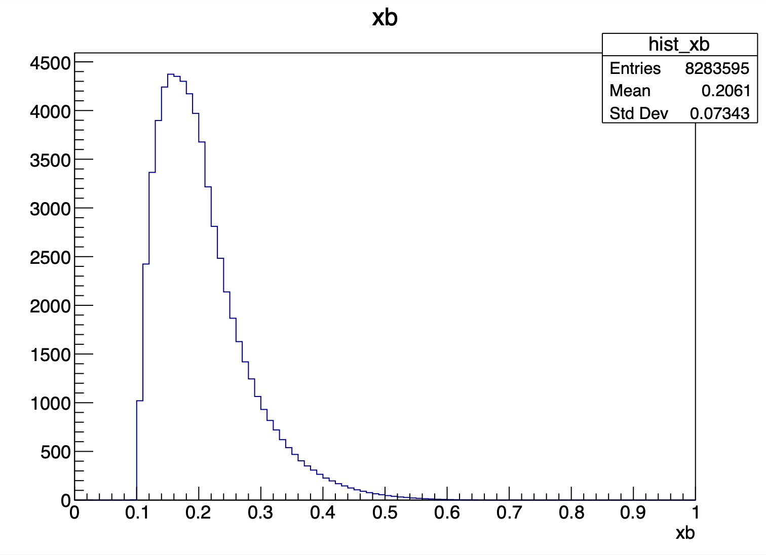
Update on ɸ generator
Mathieu Ronayette
10/18
Mathieu Ronayette
meeting
27 Nov 2025

Slide 11
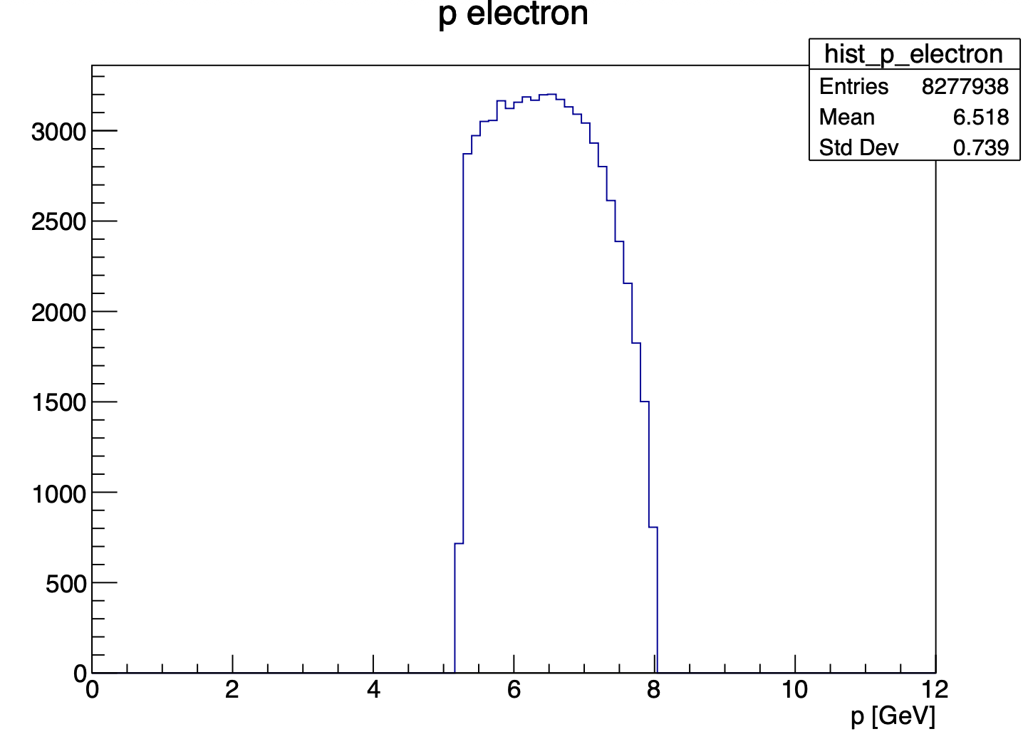
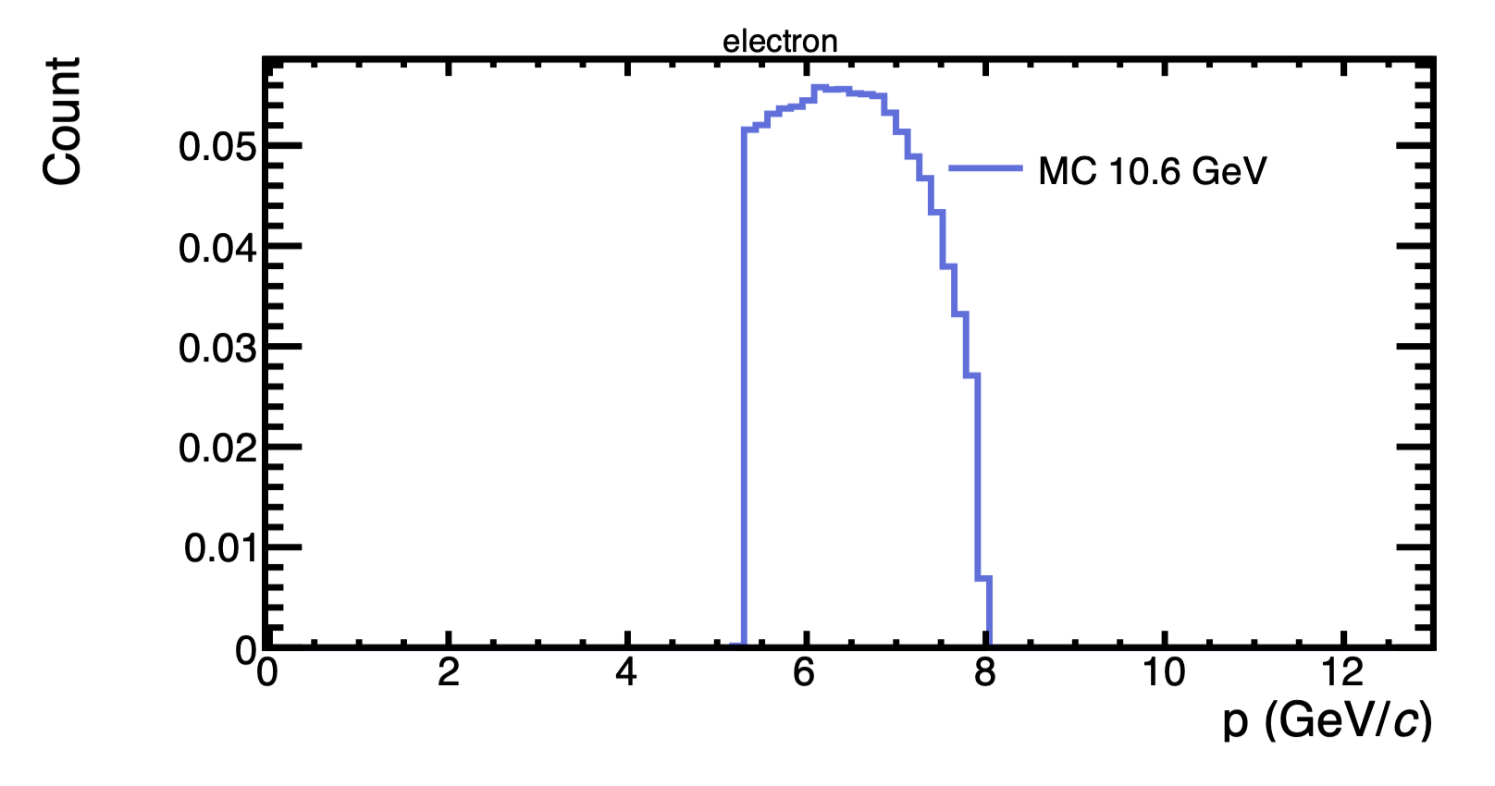
Update on ɸ generator
With this cuts : 5.25 < P_{electron} < 8 GeV and P_{proton} > 0.45 GeV
my generator
Bhawani plot
Mathieu Ronayette
11/18
Mathieu Ronayette
meeting
27 Nov 2025

Slide 12
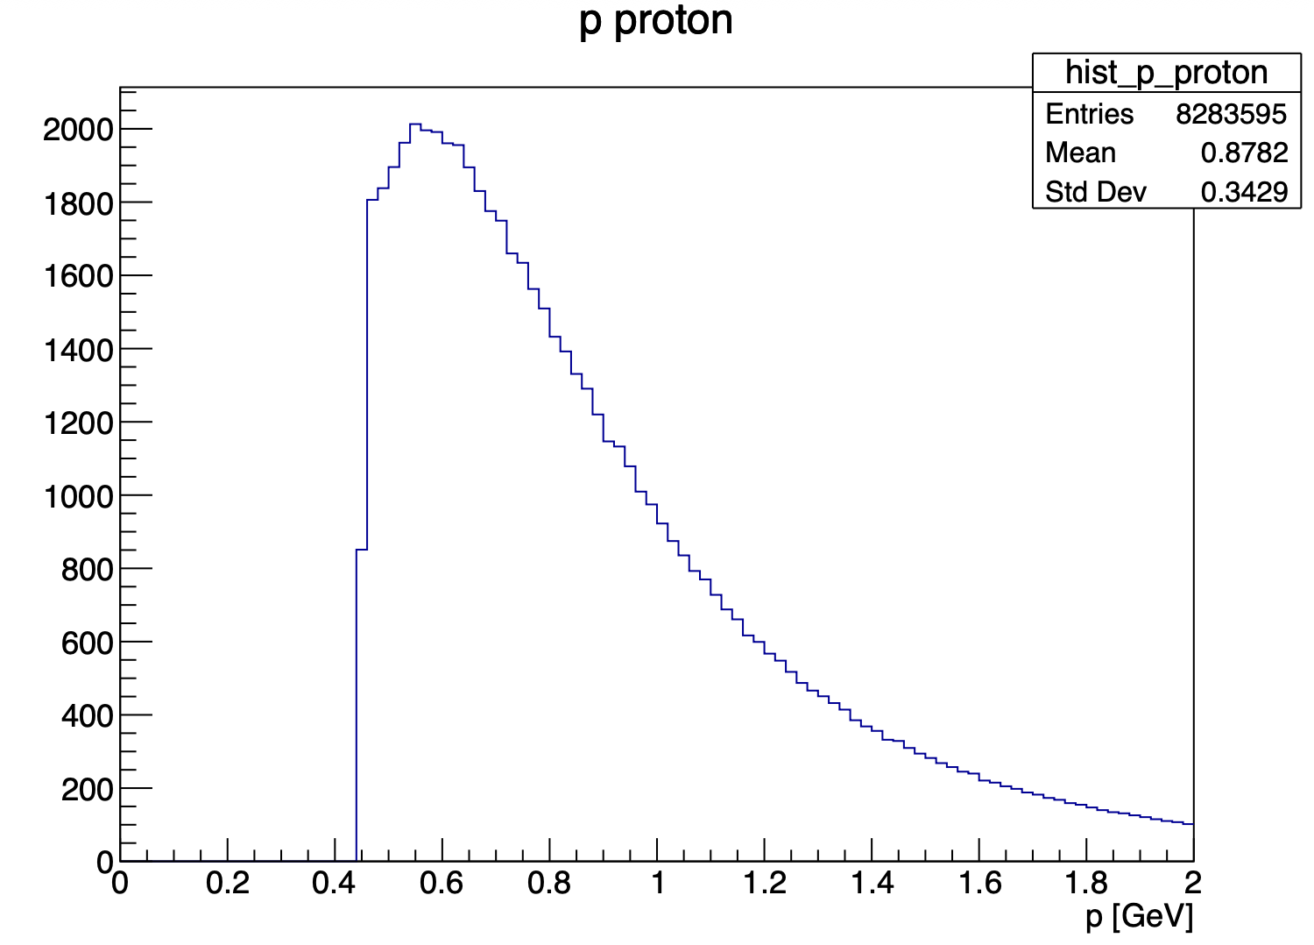
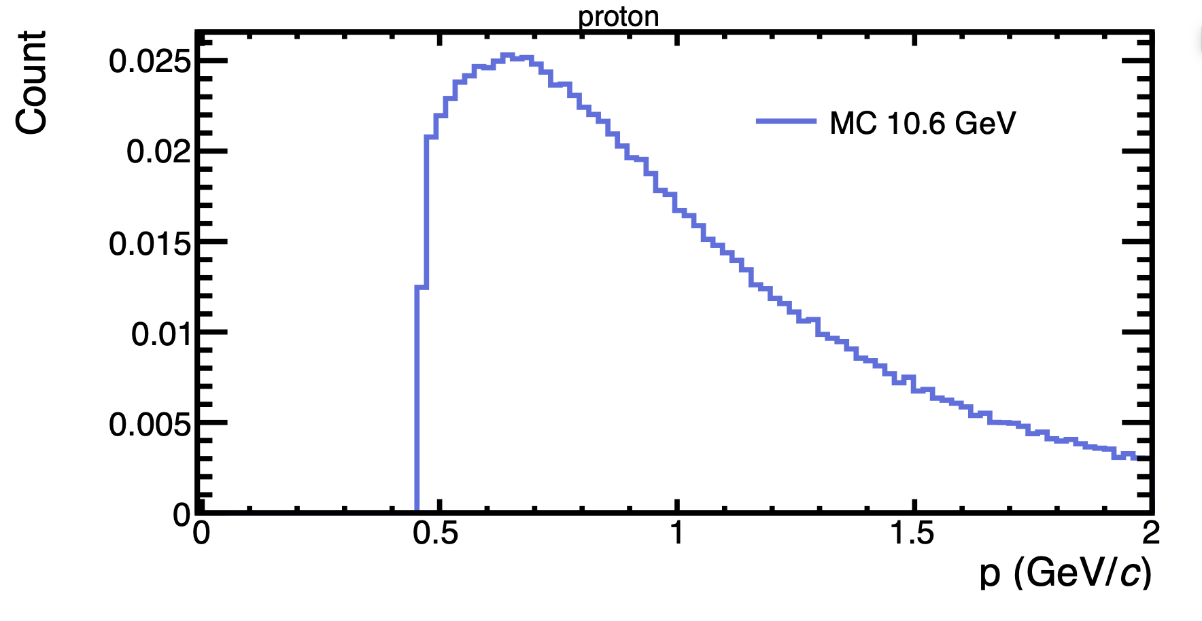
Update on ɸ generator
With this cuts : 5.25 < P_{electron} < 8 GeV and P_{proton} > 0.45 GeV
my generator
Bhawani plot
Mathieu Ronayette
12/18
Mathieu Ronayette
meeting
27 Nov 2025

Slide 13
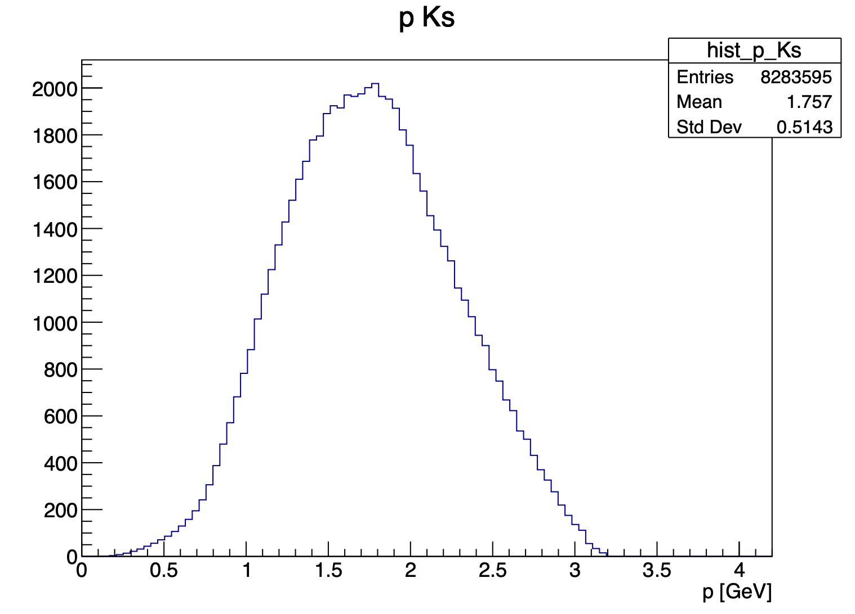
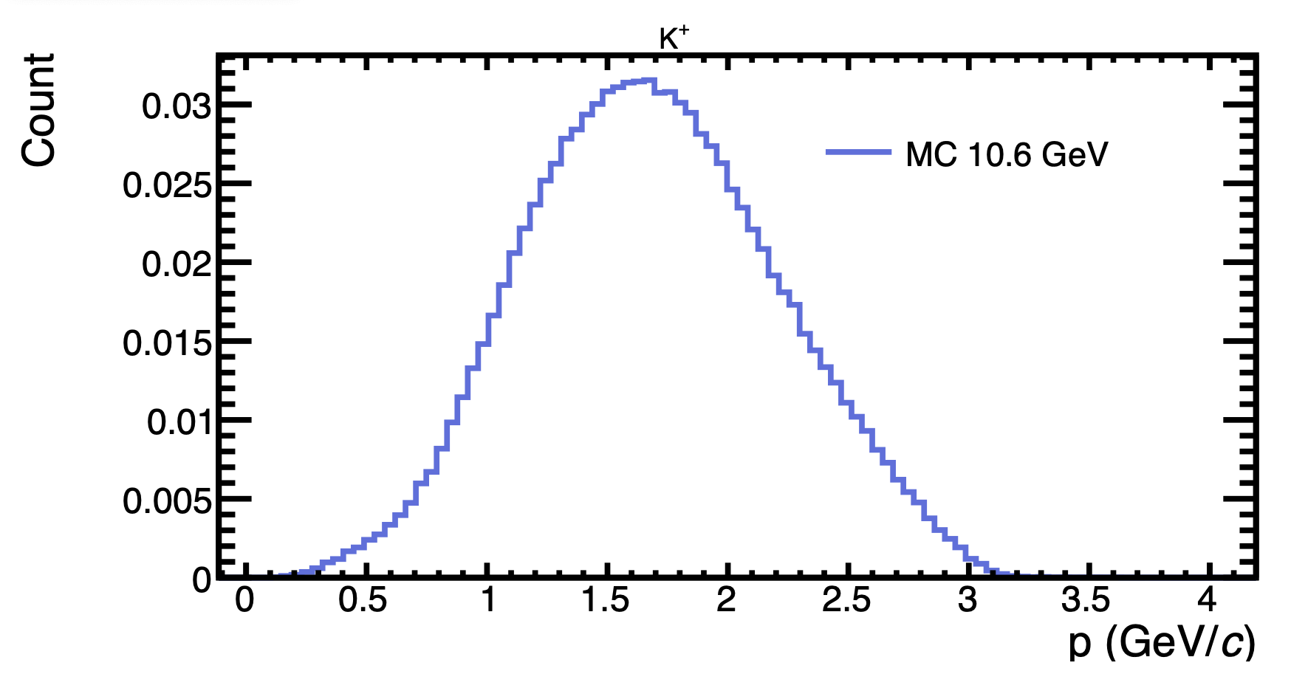
Update on ɸ generator
With this cuts : 5.25 < P_{electron} < 8 GeV and P_{proton} > 0.45 GeV
my generator
Bhawani plot
Mathieu Ronayette
13/18
Mathieu Ronayette
meeting
27 Nov 2025

Slide 14
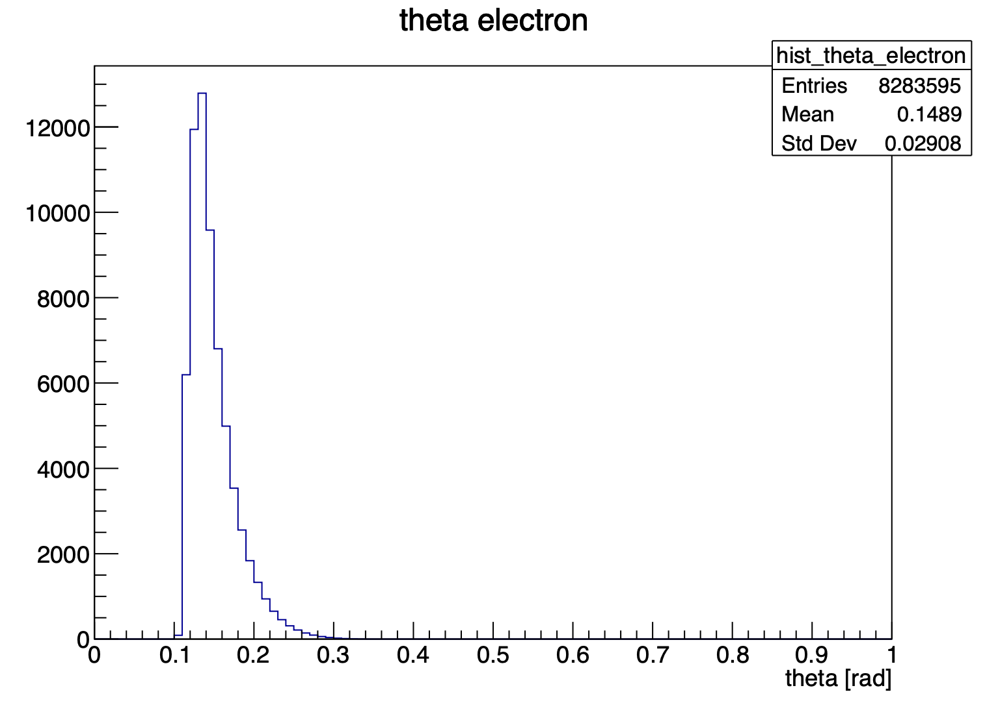
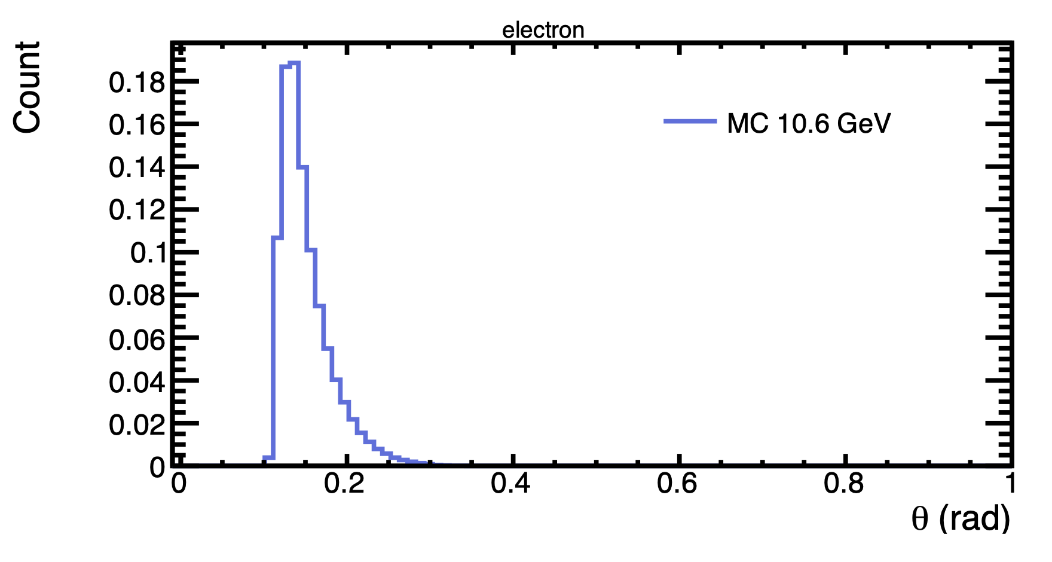
Update on ɸ generator
With this cuts : 5.25 < P_{electron} < 8 GeV and P_{proton} > 0.45 GeV
my generator
Bhawani plot
Mathieu Ronayette
14/18
Mathieu Ronayette
meeting
27 Nov 2025

Slide 15
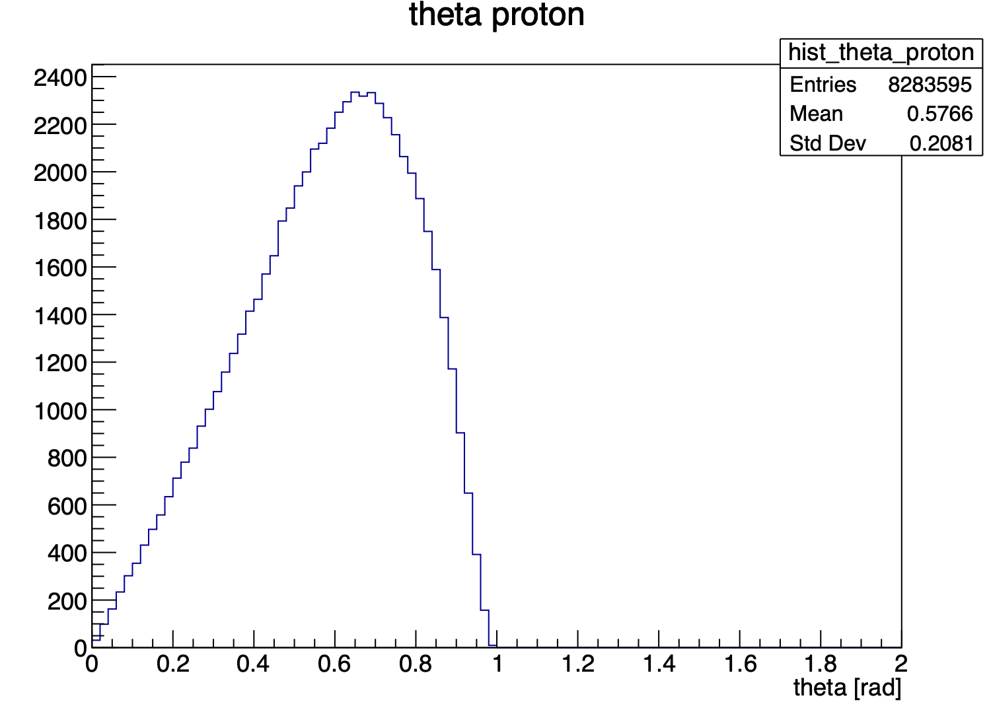
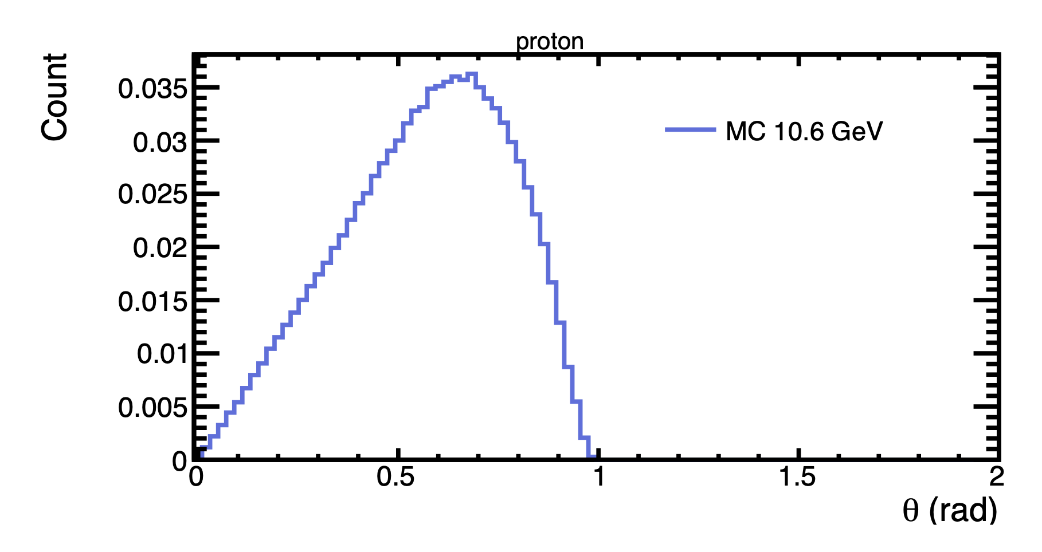
Update on ɸ generator
With this cuts : 5.25 < P_{electron} < 8 GeV and P_{proton} > 0.45 GeV
my generator
Bhawani plot
Mathieu Ronayette
15/18
Mathieu Ronayette
meeting
27 Nov 2025

Slide 16
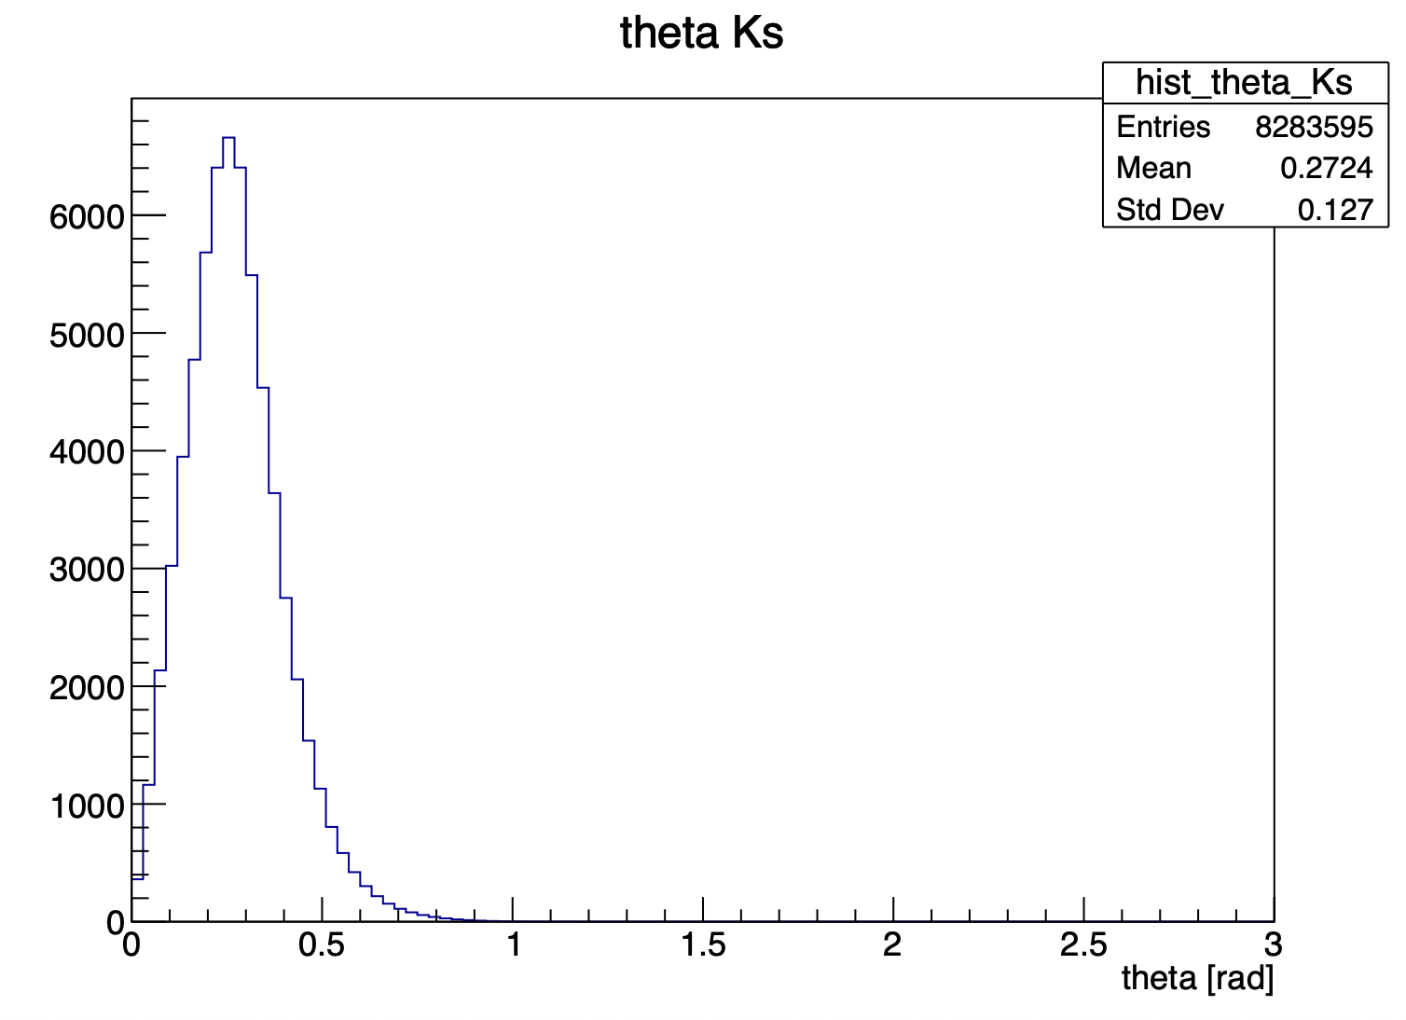
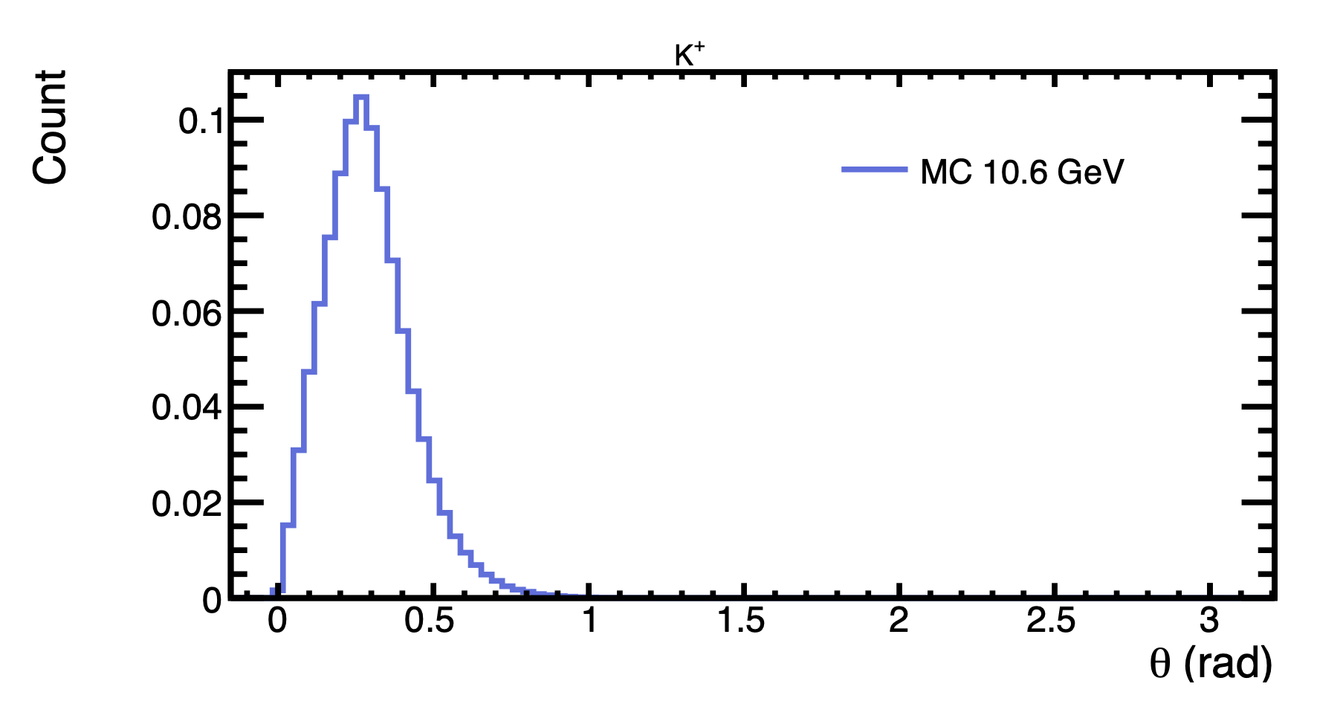
Update on ɸ generator
With this cuts : 5.25 < P_{electron} < 8 GeV and P_{proton} > 0.45 GeV
my generator
Bhawani plot
Mathieu Ronayette
16/18
Mathieu Ronayette
meeting
27 Nov 2025

Slide 17
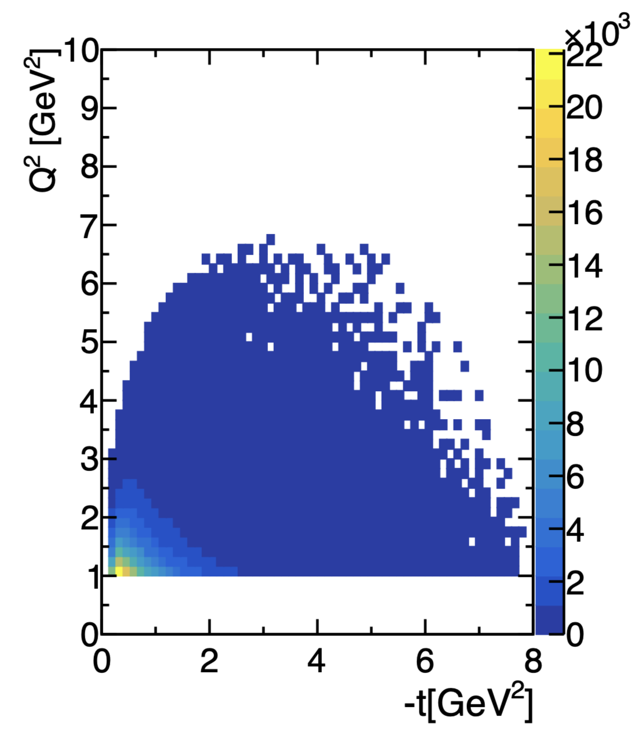
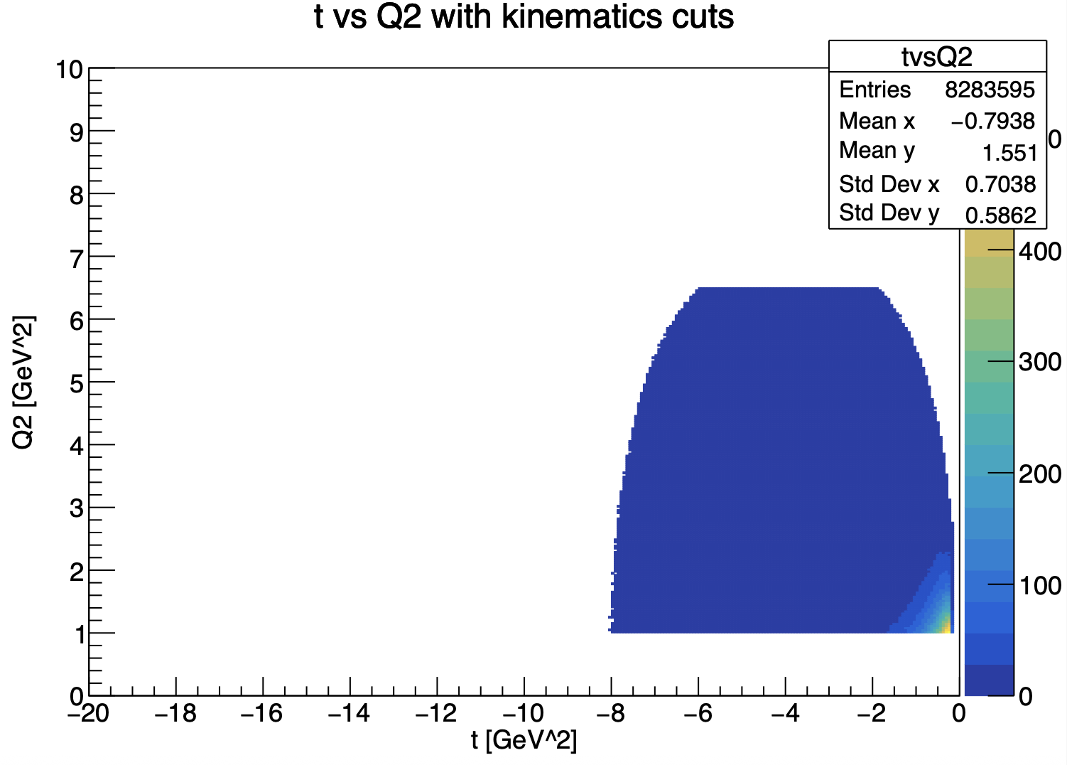
Update on ɸ generator
With this cuts : 5.25 < P_{electron} < 8 GeV and P_{proton} > 0.45 GeV
my generator
Bhawani plot
Mathieu Ronayette
17/18
Mathieu Ronayette
meeting
27 Nov 2025

Slide 18
Update on ɸ generator
Next steps :
Analysis of REC data with GEMC (find interresting cuts and the number of ɸ expected)
Improve the generator with radiatives corrections
Improve the generator with θ dependance in ɸ → Ks Kl and Ks → π⁺ π⁻
Thanks!
Mathieu Ronayette
18/18
Mathieu Ronayette
meeting
27 Nov 2025

Slide 19
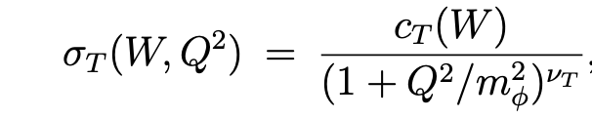
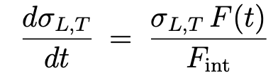

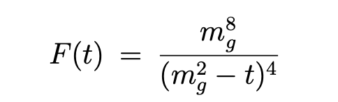
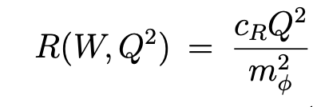
Update on ɸ generator
Details on cross section :
σ_{T} and σ_{L} (γ*p → ɸ p) :
t-dependence (dipole) :
Mathieu Ronayette
5/15
Mathieu Ronayette
meeting
7 Nov 2025

Slide 20
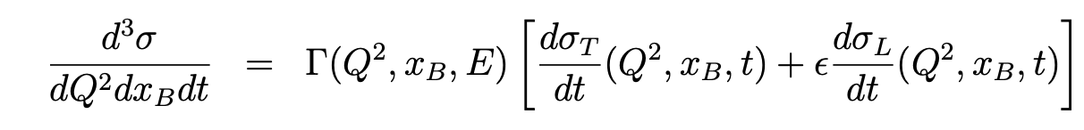
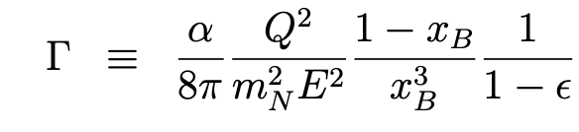
Update on ɸ generator
Cross section (ep → ɸ p) :
The virtual photon flux :
Mathieu Ronayette
6/15
Mathieu Ronayette
meeting
7 Nov 2025

Slide 21
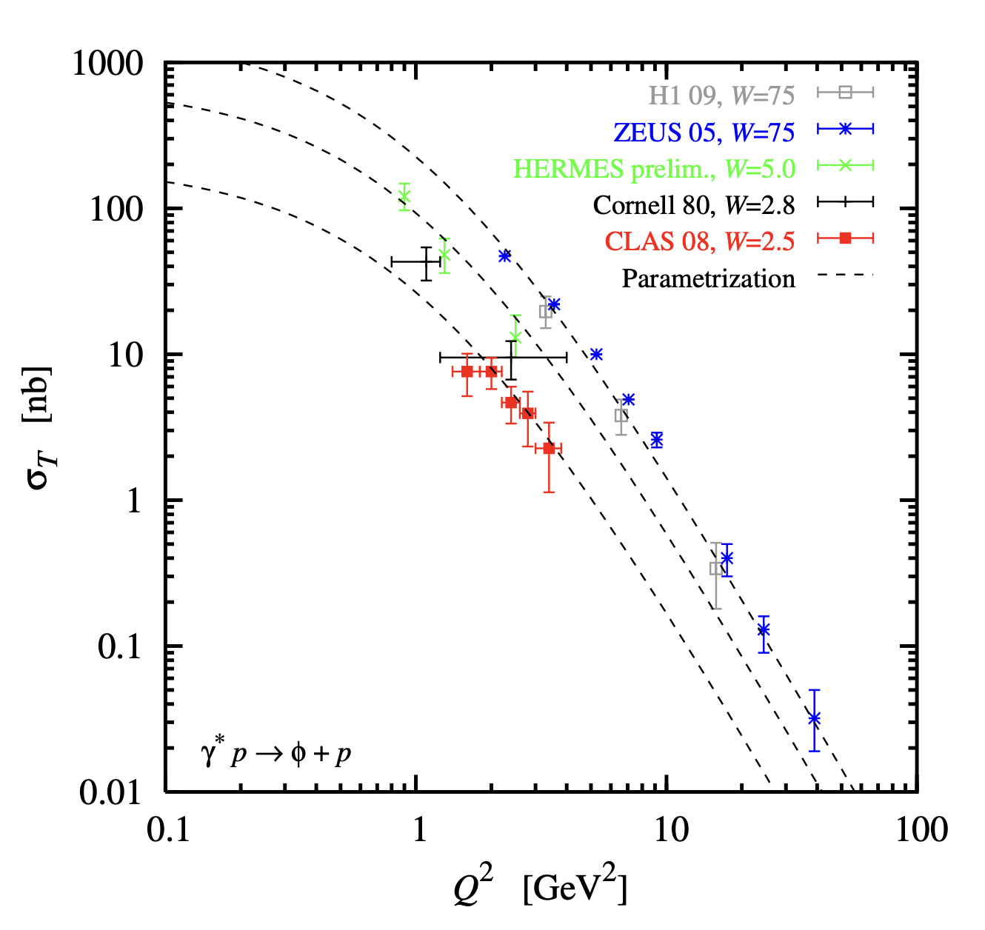
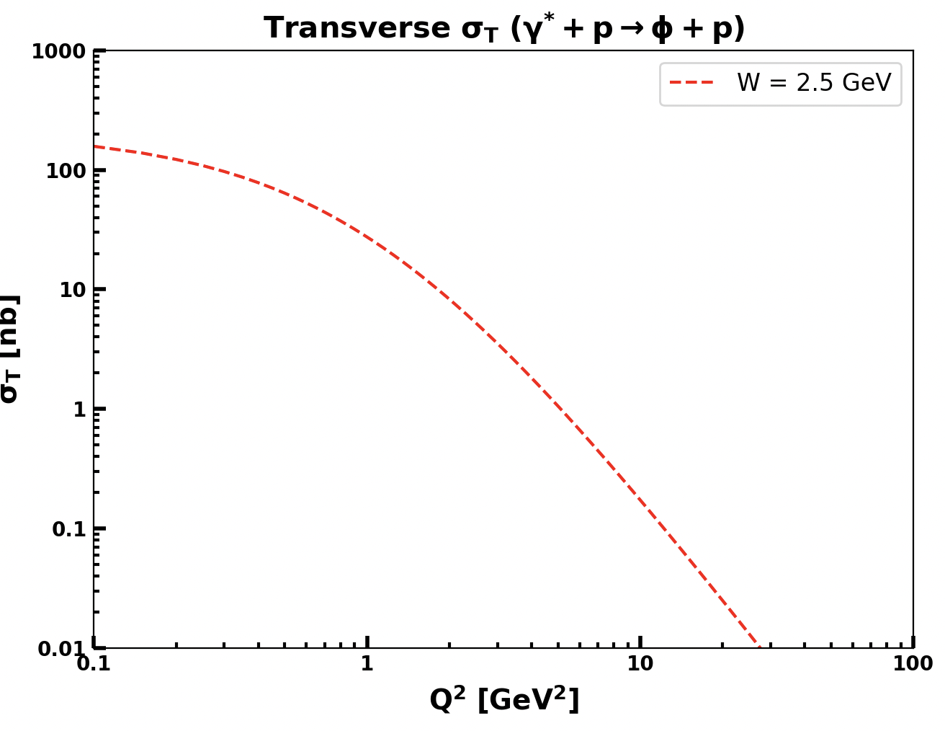
Update on ɸ generator
Implemented in the generator
From Proposal to Jeﬀerson Lab PAC39
Mathieu Ronayette
7/15
Mathieu Ronayette
meeting
7 Nov 2025

Slide 22
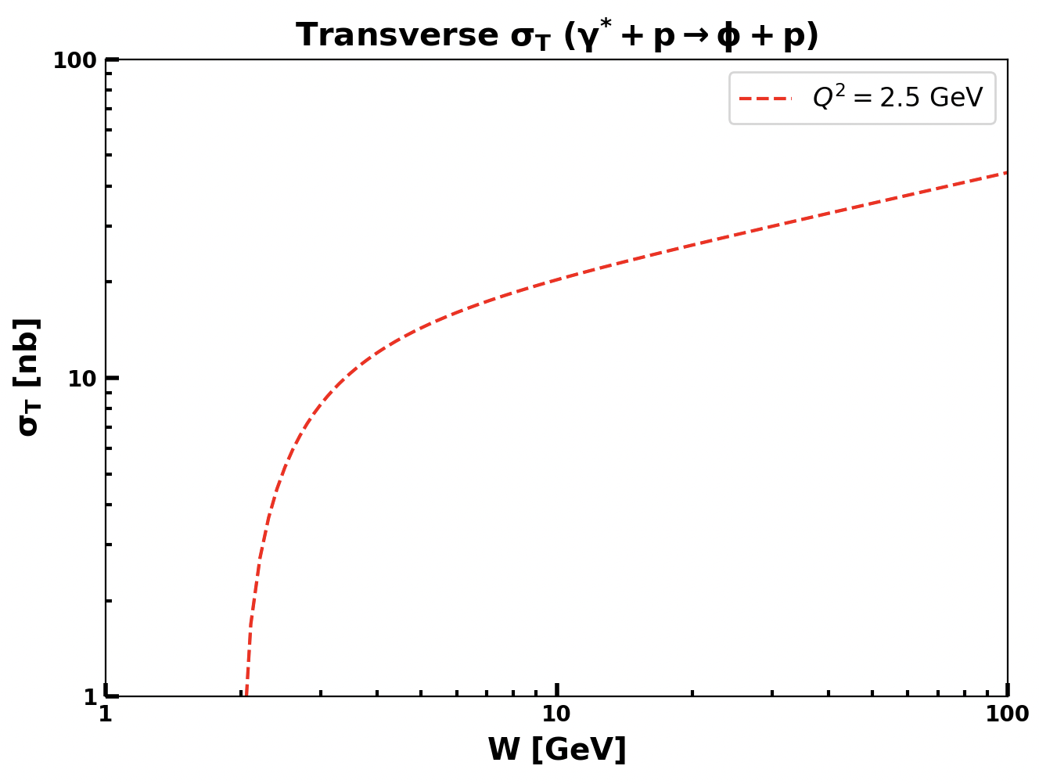
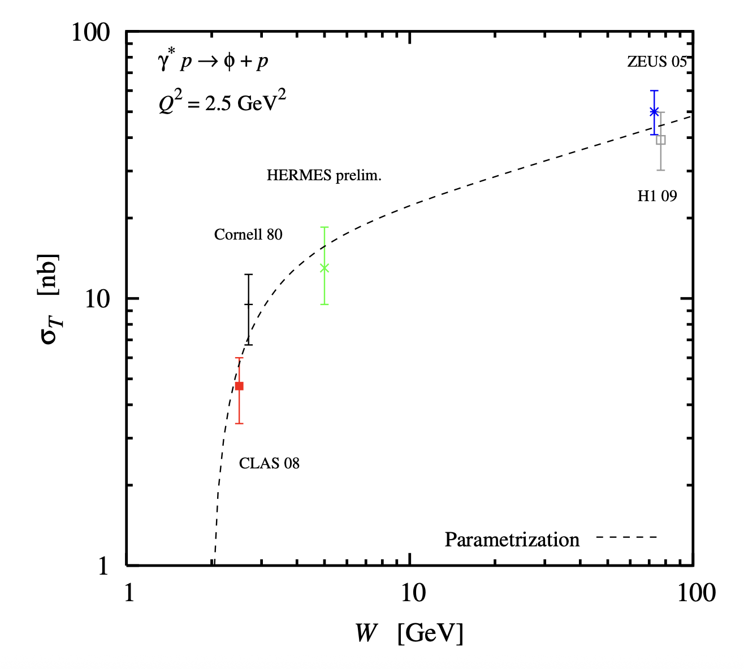
Update on ɸ generator
Implemented in the generator
From Proposal to Jeﬀerson Lab PAC39
Mathieu Ronayette
8/15
Mathieu Ronayette
meeting
7 Nov 2025

Slide 23
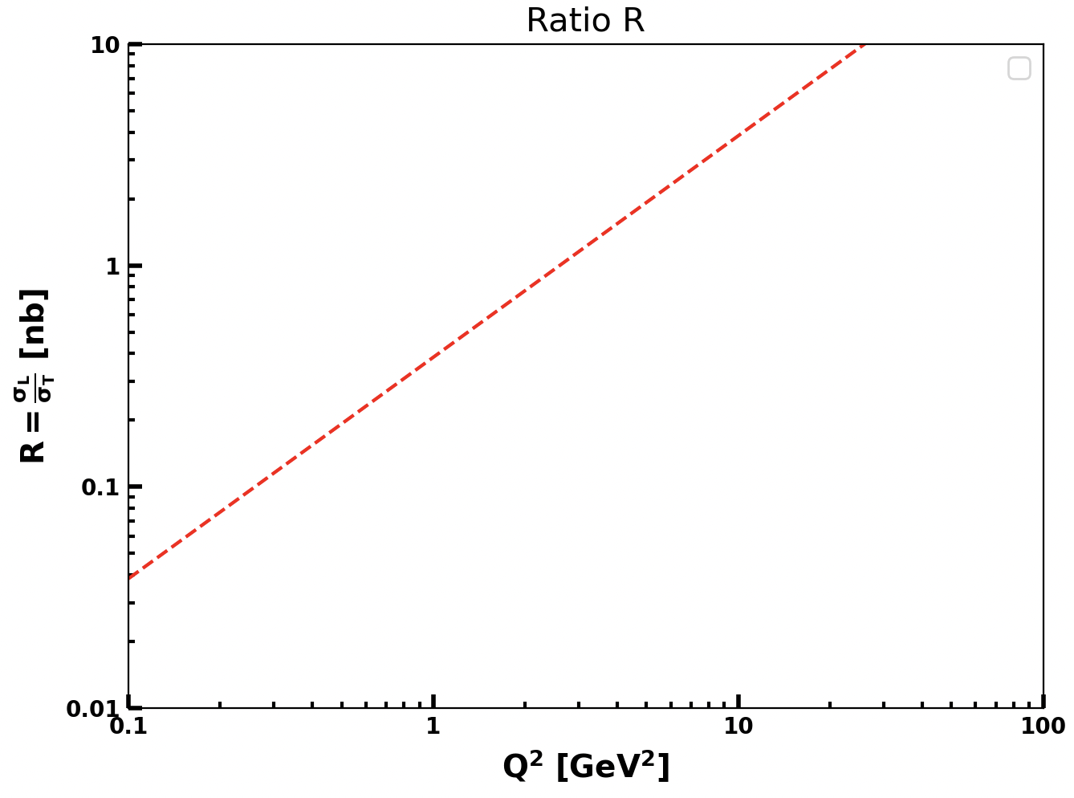
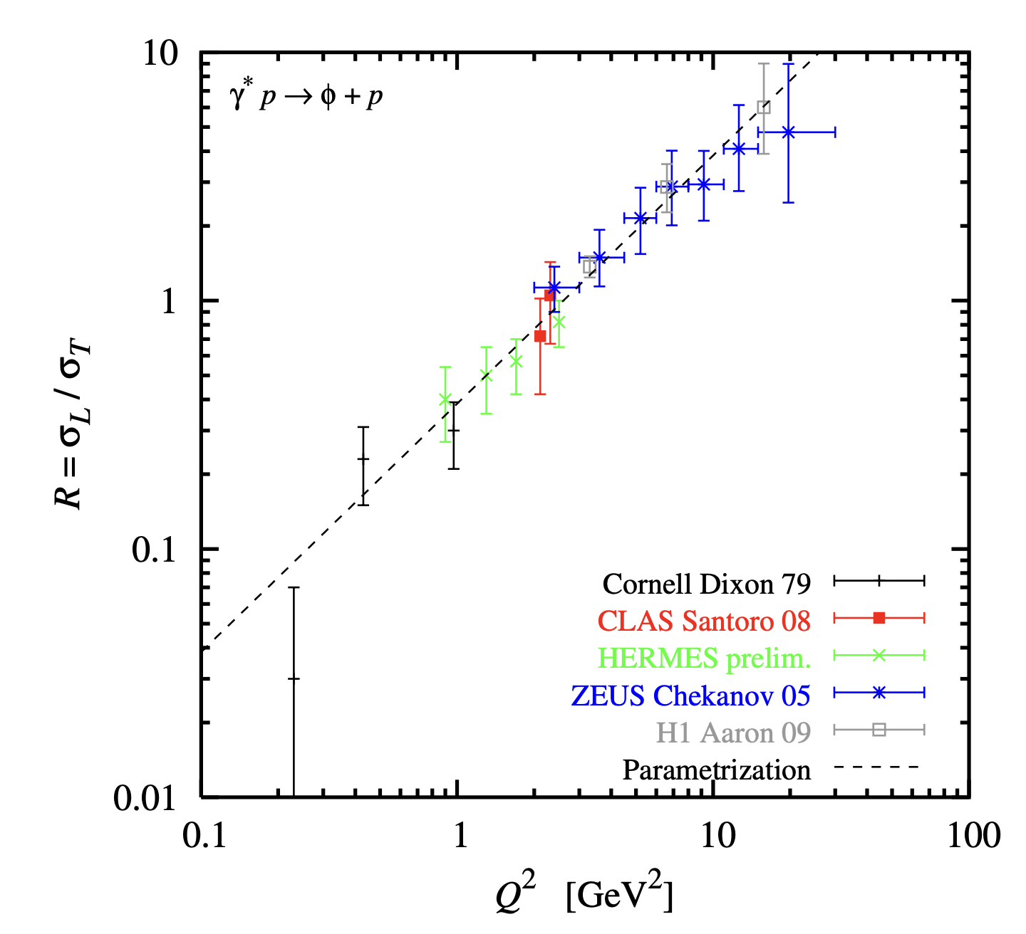
Update on ɸ generator
Implemented in the generator
From Proposal to Jeﬀerson Lab PAC39
Mathieu Ronayette
9/15
Mathieu Ronayette
meeting
7 Nov 2025

Slide 24
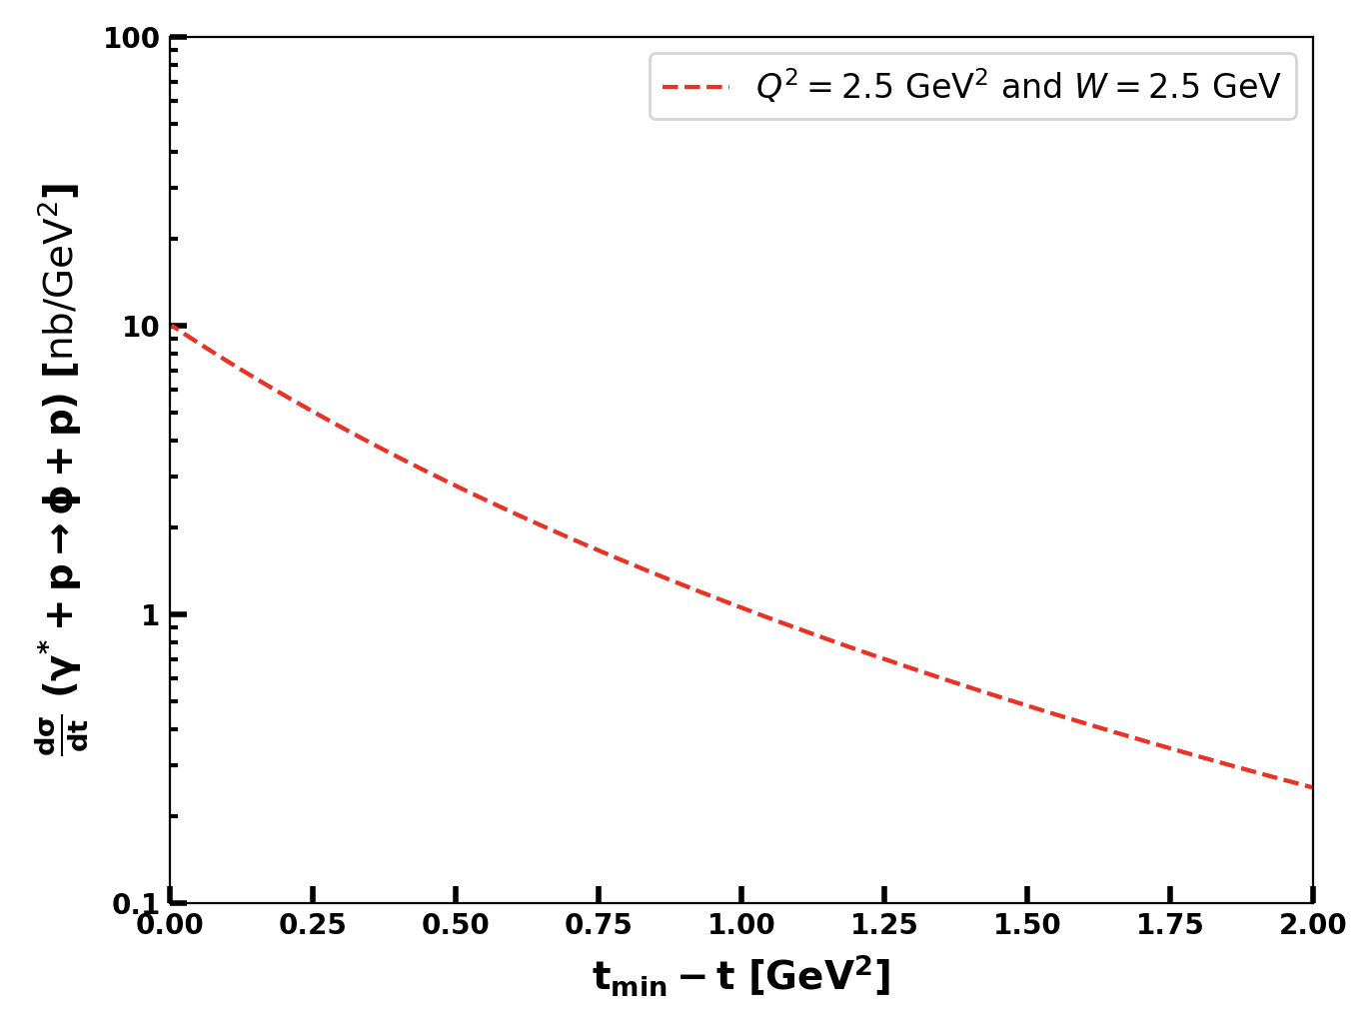

Update on ɸ generator
Implemented in the generator
From Proposal to Jeﬀerson Lab PAC39
Mathieu Ronayette
10/15
Mathieu Ronayette
meeting
7 Nov 2025

Slide 25
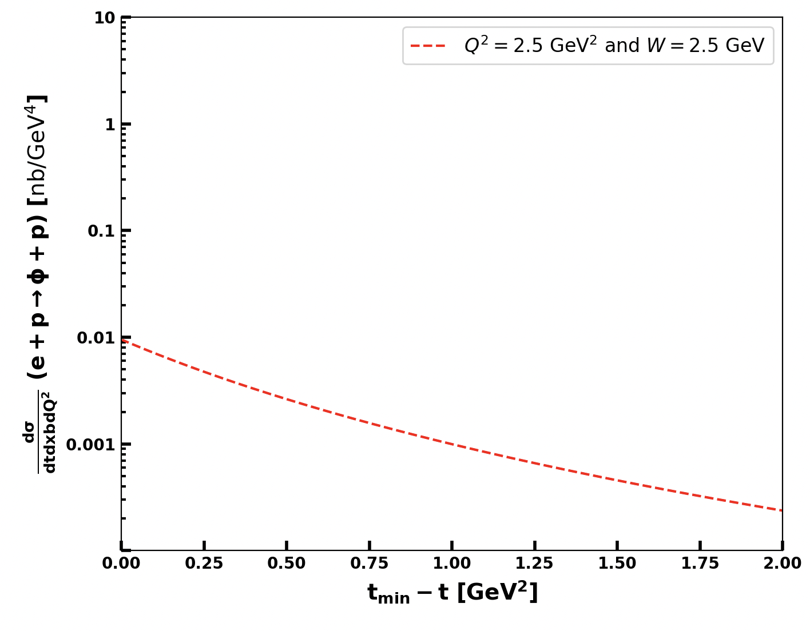
Update on ɸ generator
Cross section (ep → ɸ p) (with the virtual photon flux) :
Implemented in the generator
Mathieu Ronayette
11/15
Mathieu Ronayette
meeting
7 Nov 2025

