Slide 1
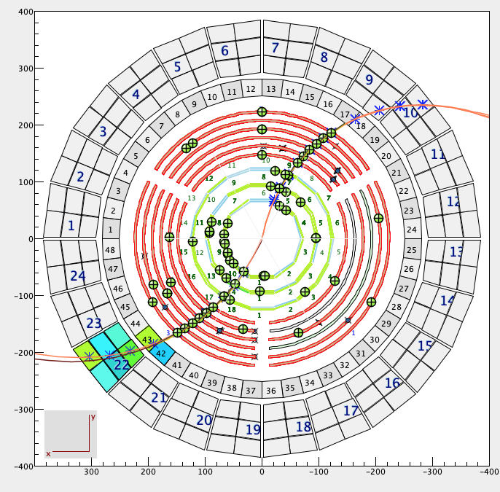
Update on CVT ML
CVT denoising :
Input variables already implemeted in the model :
Layer, strip, sector, order, x1, y1, z1, x2, y2, z2,
cweight, sweight
Tests without cweight and sweight
Tests with energy deposited per hits in BST and BMT
Tests with the time of hits in BST and BMT
Mathieu Ronayette
1/9
Mathieu Ronayette
ML tracking meeting
15 dec 2025

Slide 2
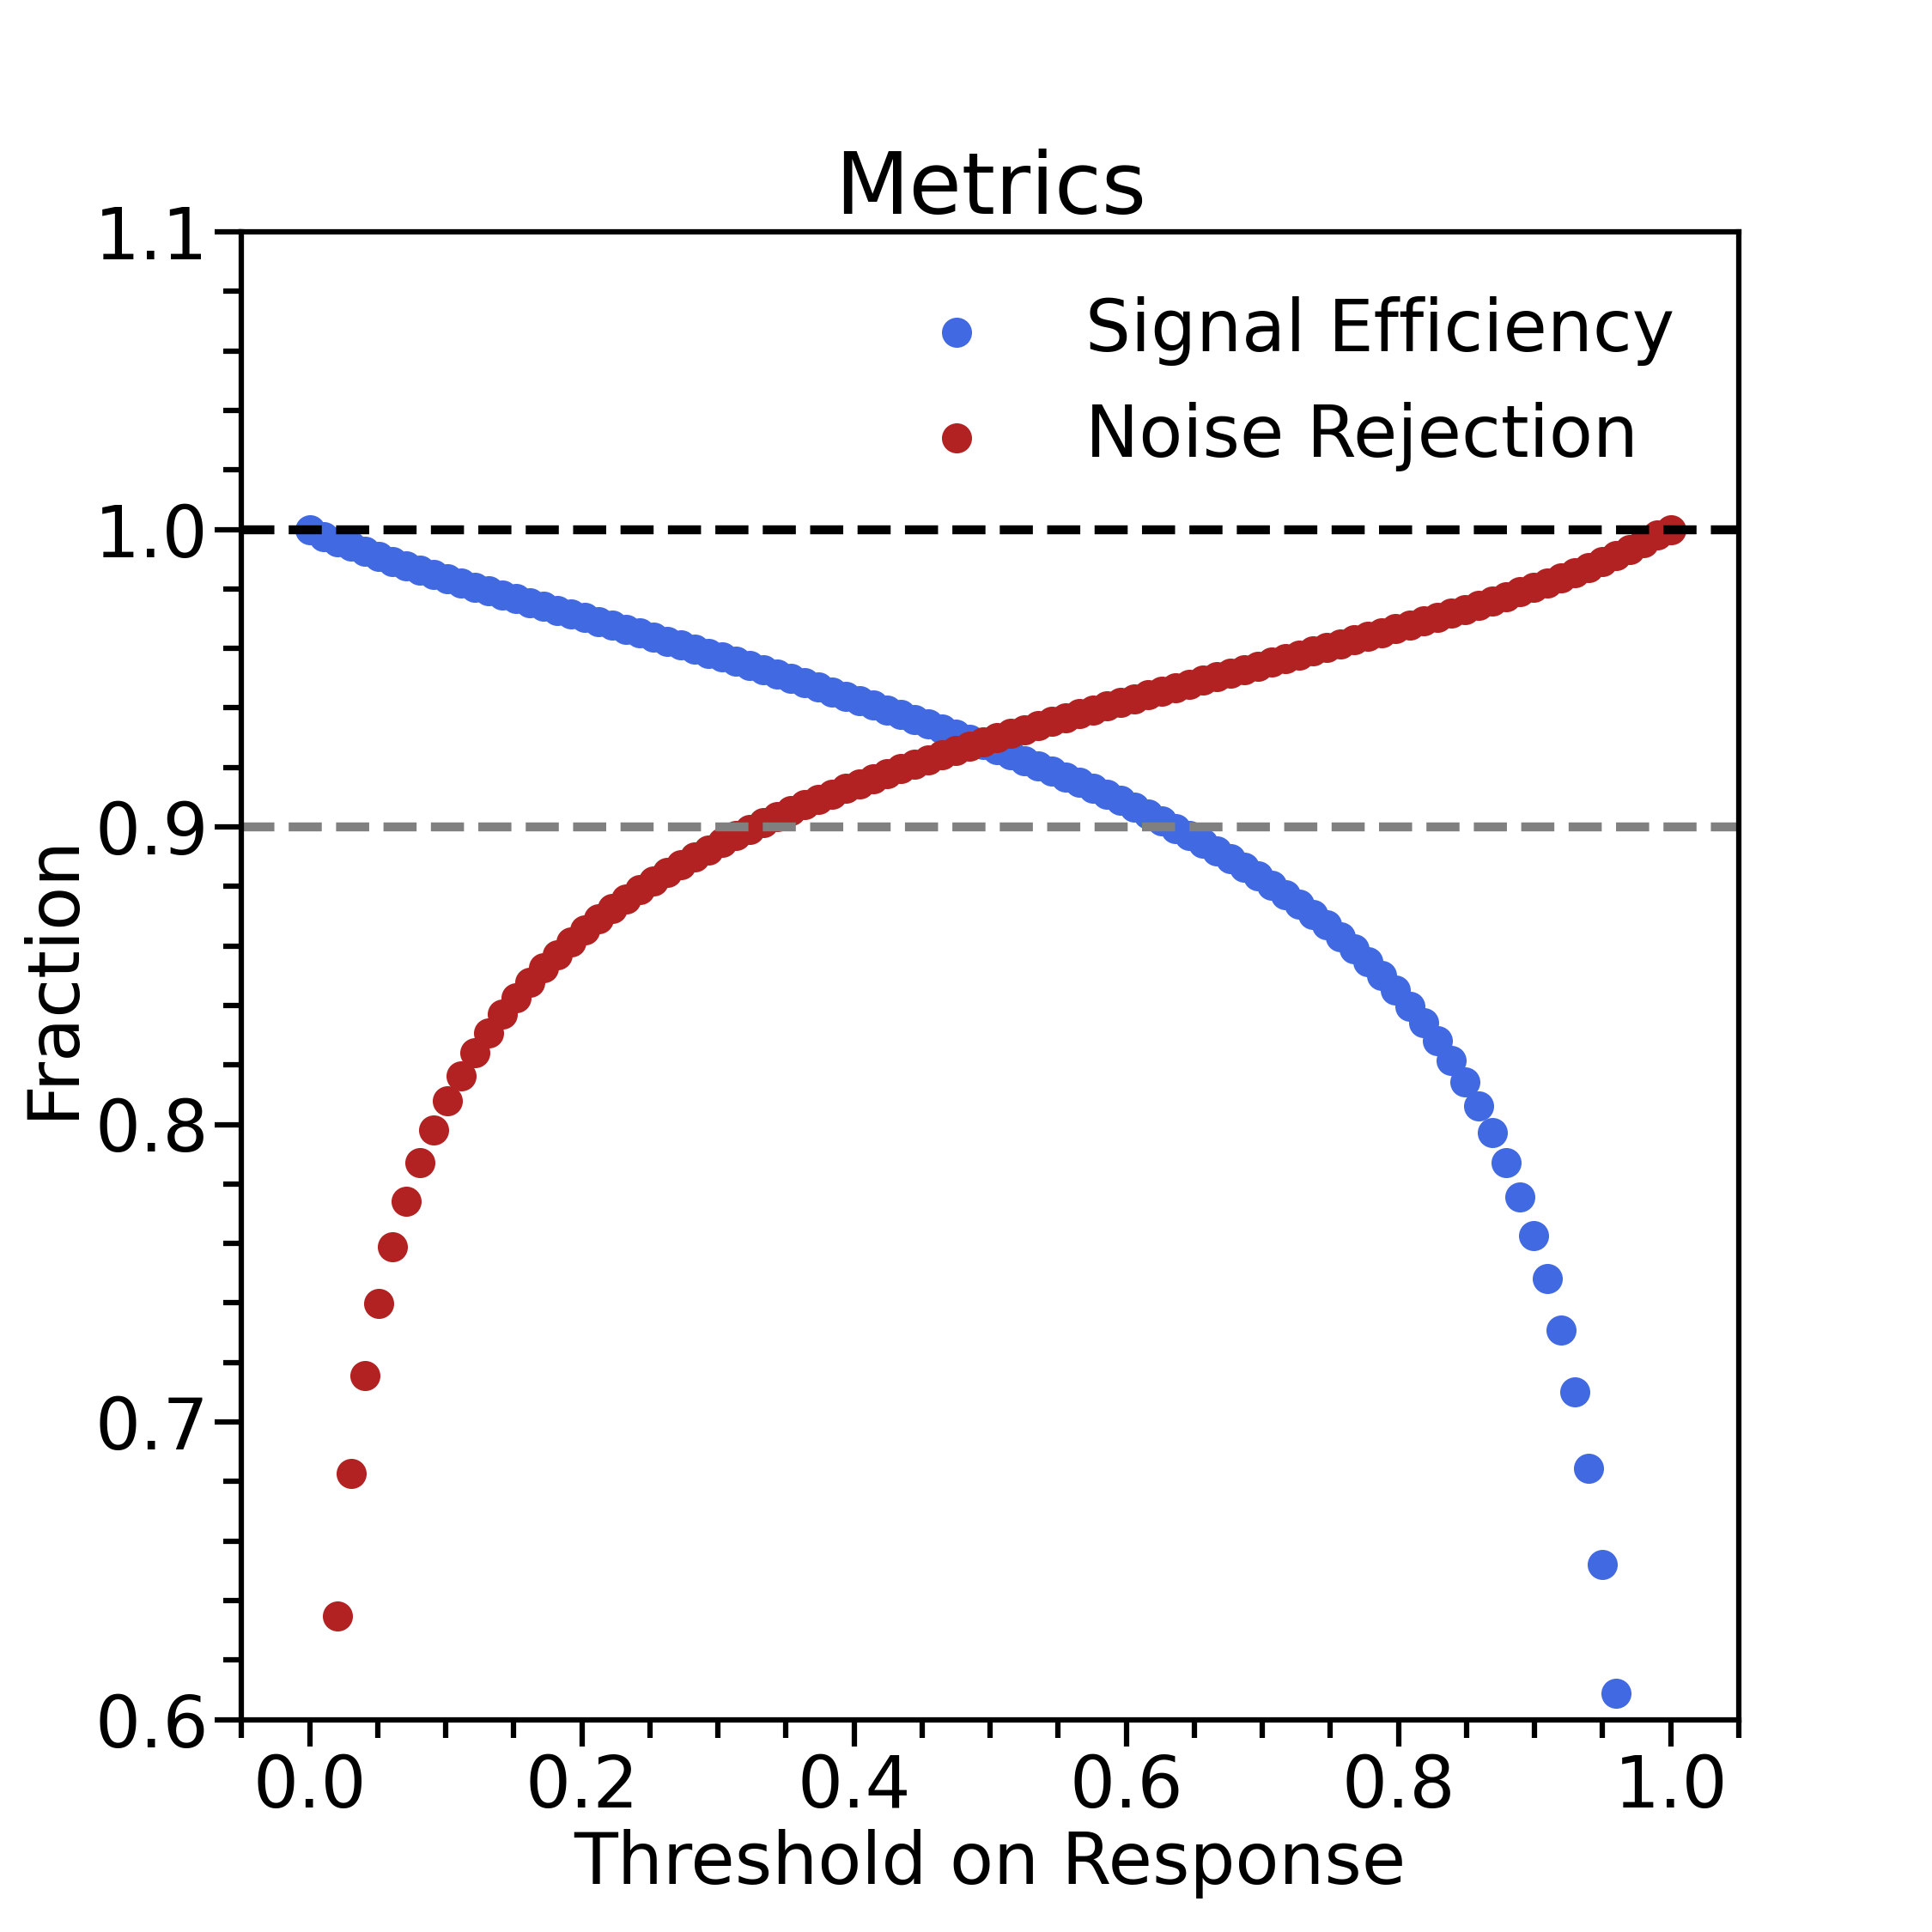
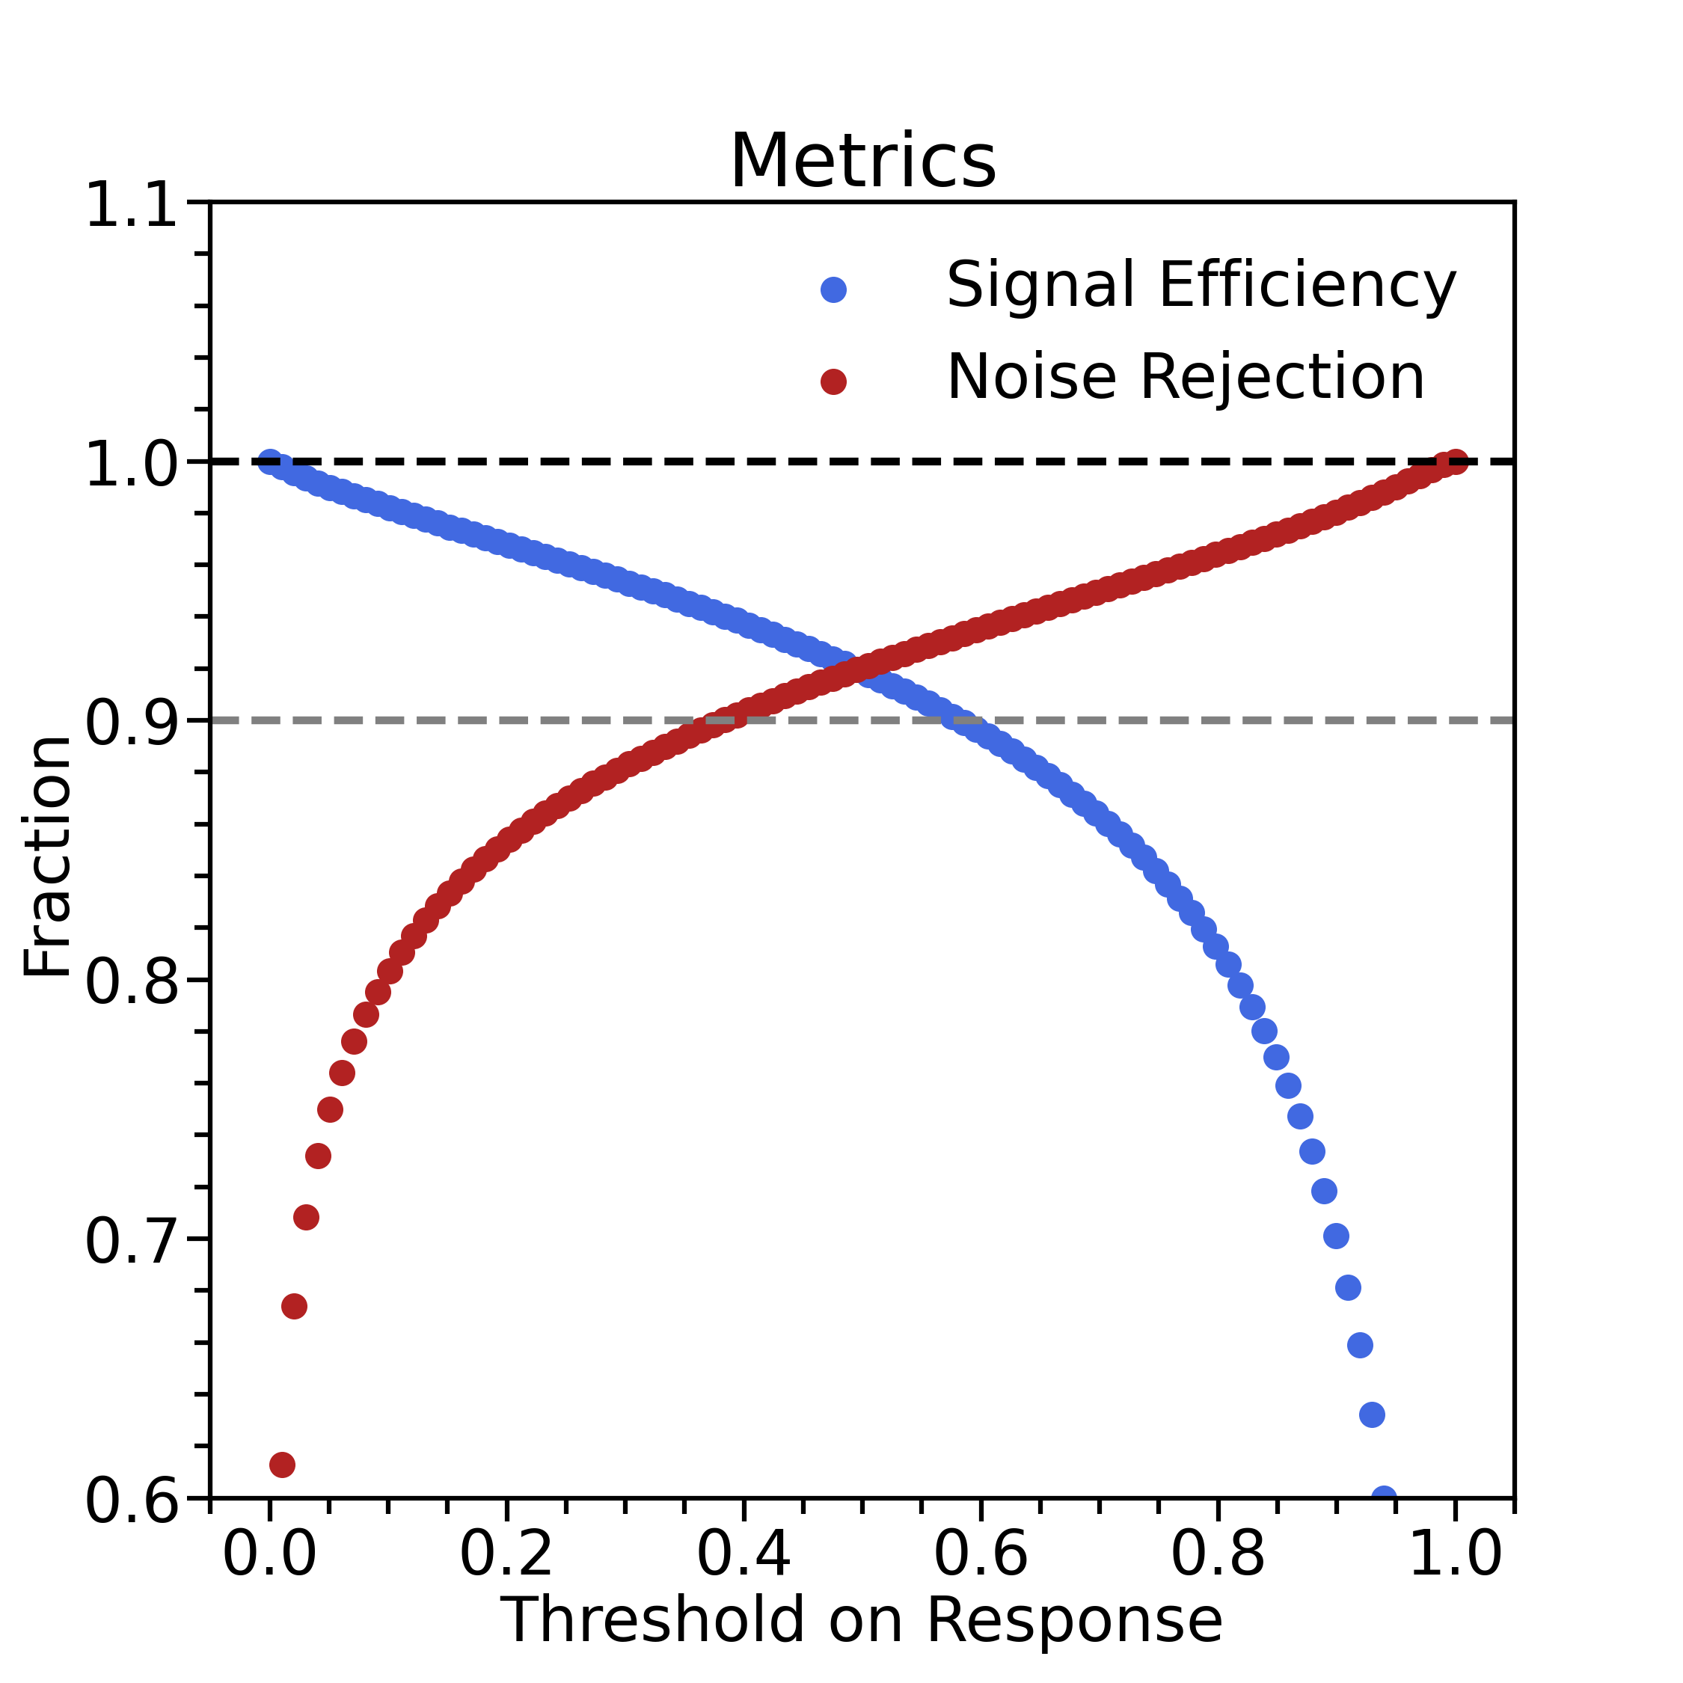
Tests without cweight and sweight
Without cweight and sweight (sector 1)
With cweight and sweight (sector 1)
Mathieu Ronayette
2/9
Mathieu Ronayette
ML tracking meeting
15 dec 2025

Slide 3
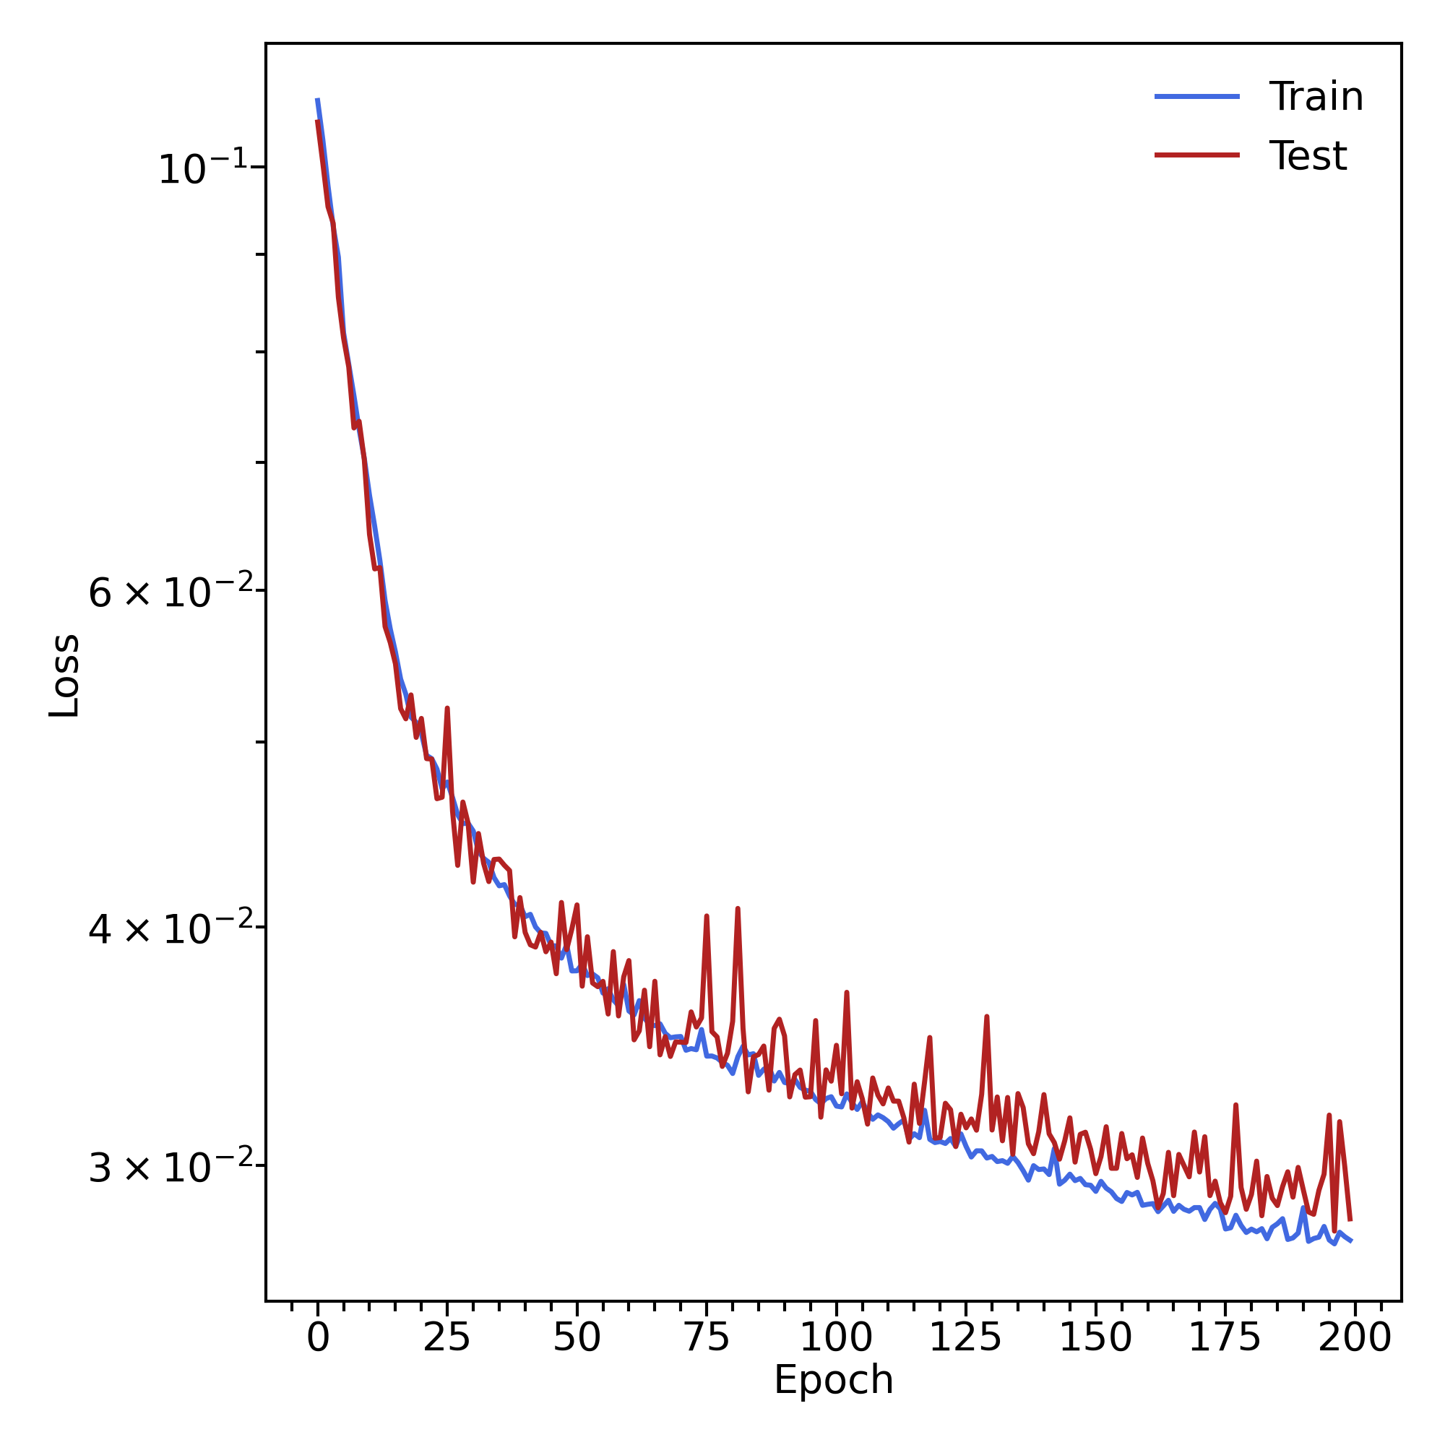
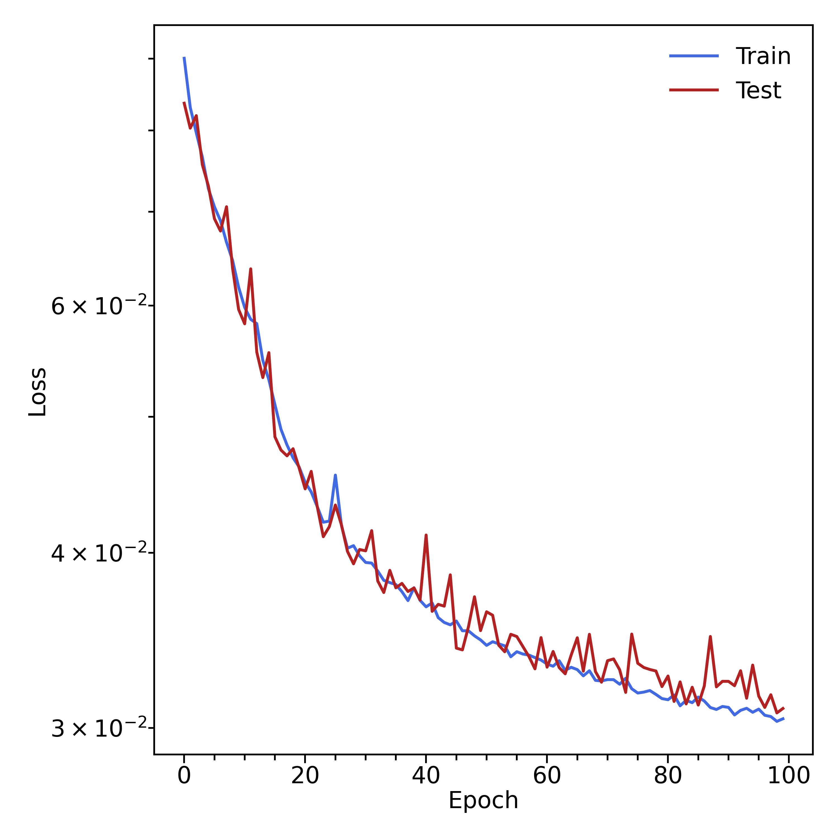
Tests without cweight and sweight
Without cweight and sweight (sector 1)
With cweight and sweight (sector 1)
Mathieu Ronayette
3/9
Mathieu Ronayette
ML tracking meeting
15 dec 2025

Slide 4
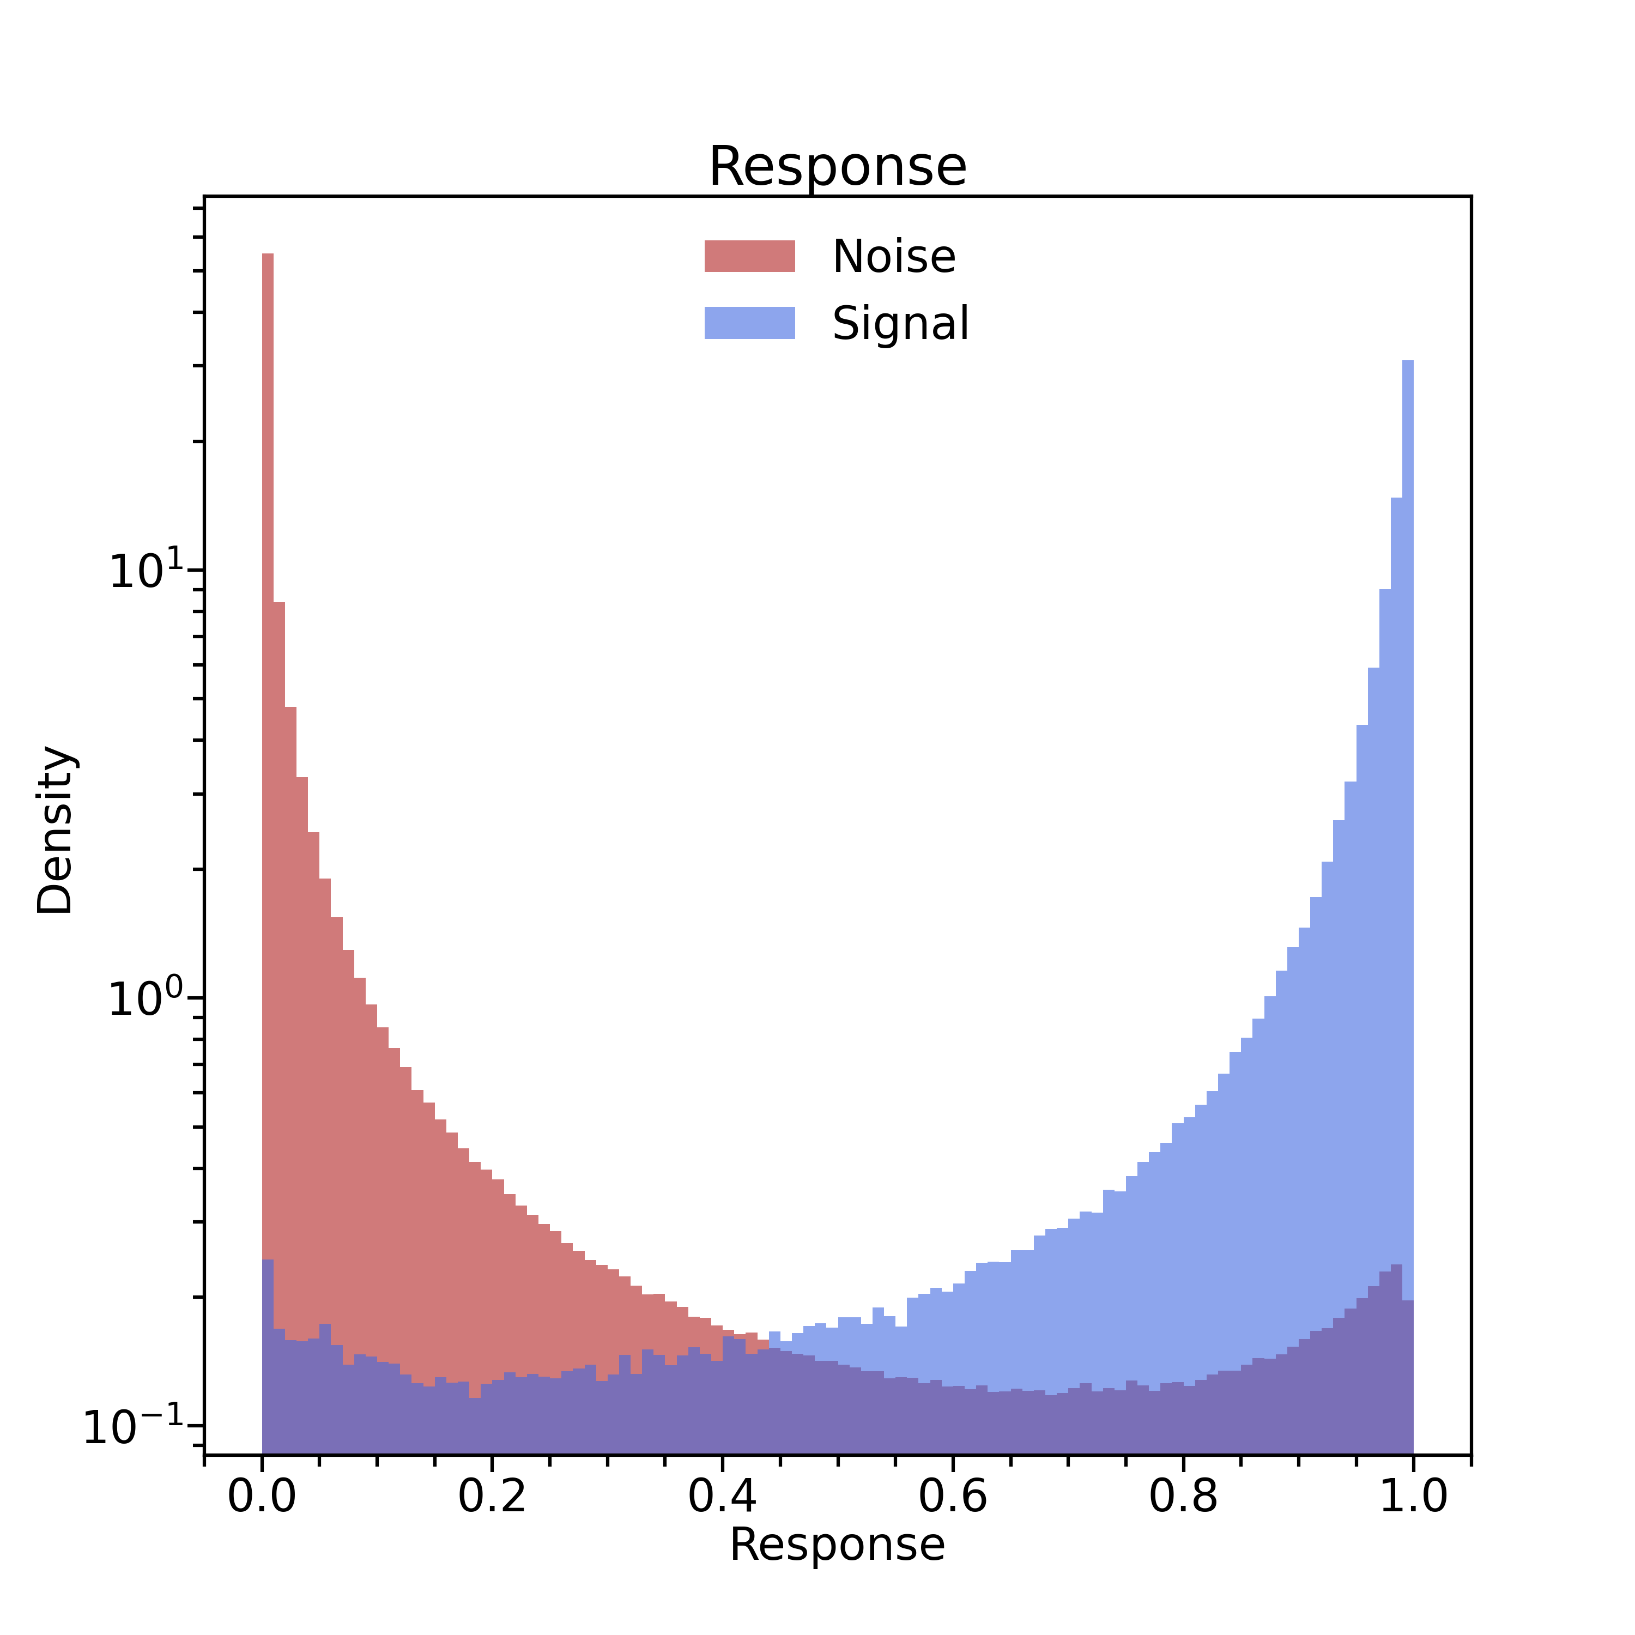
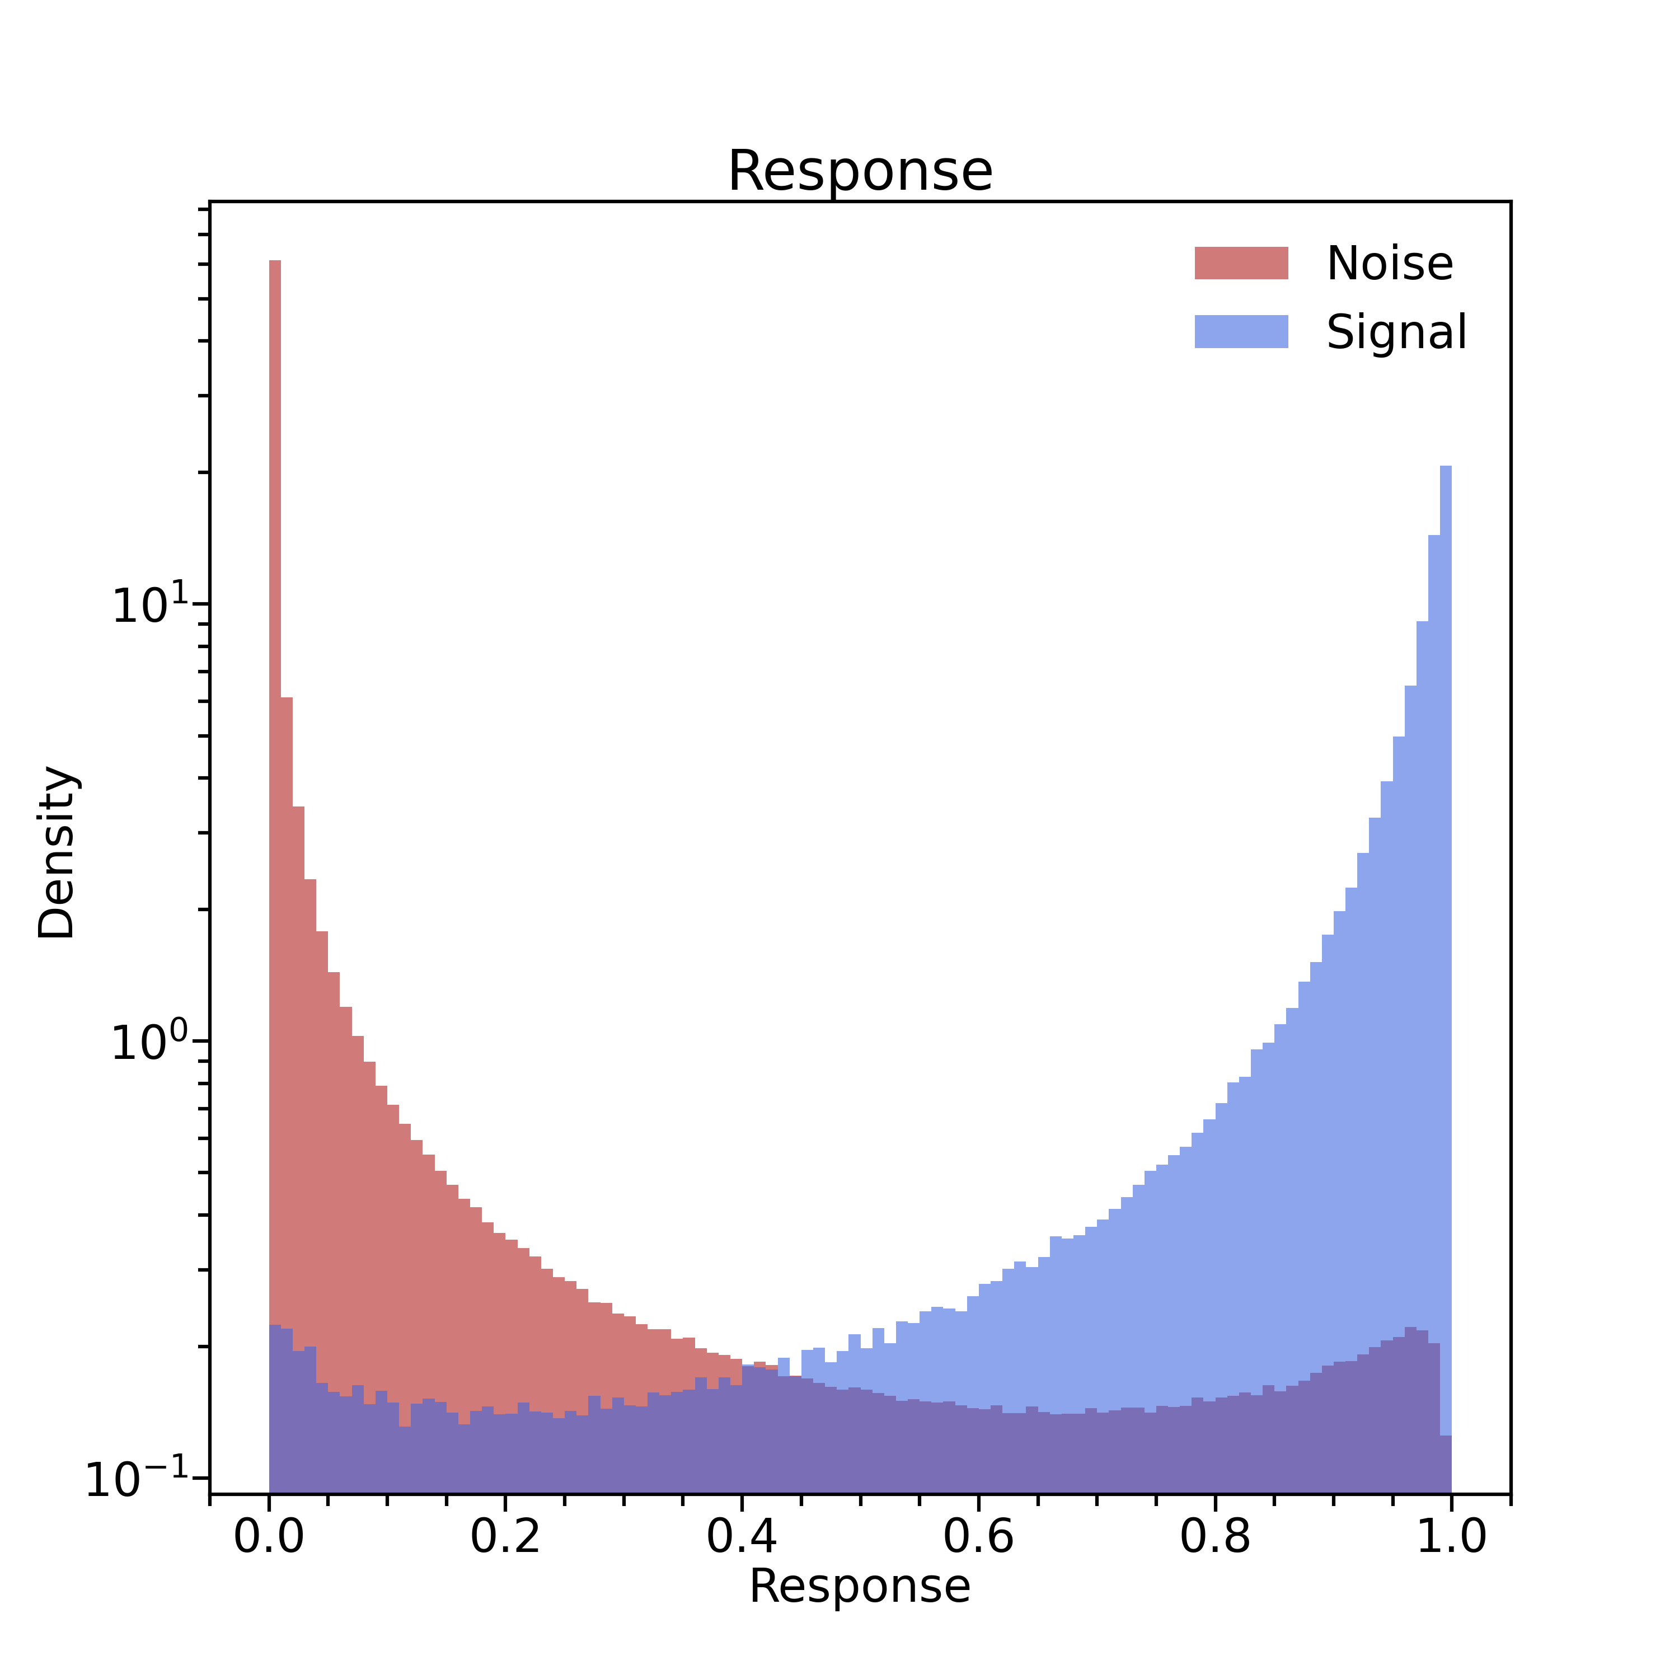
Tests without cweight and sweight
Without cweight and sweight (sector 1)
With cweight and sweight (sector 1)
Mathieu Ronayette
4/9
Mathieu Ronayette
ML tracking meeting
15 dec 2025

Slide 5
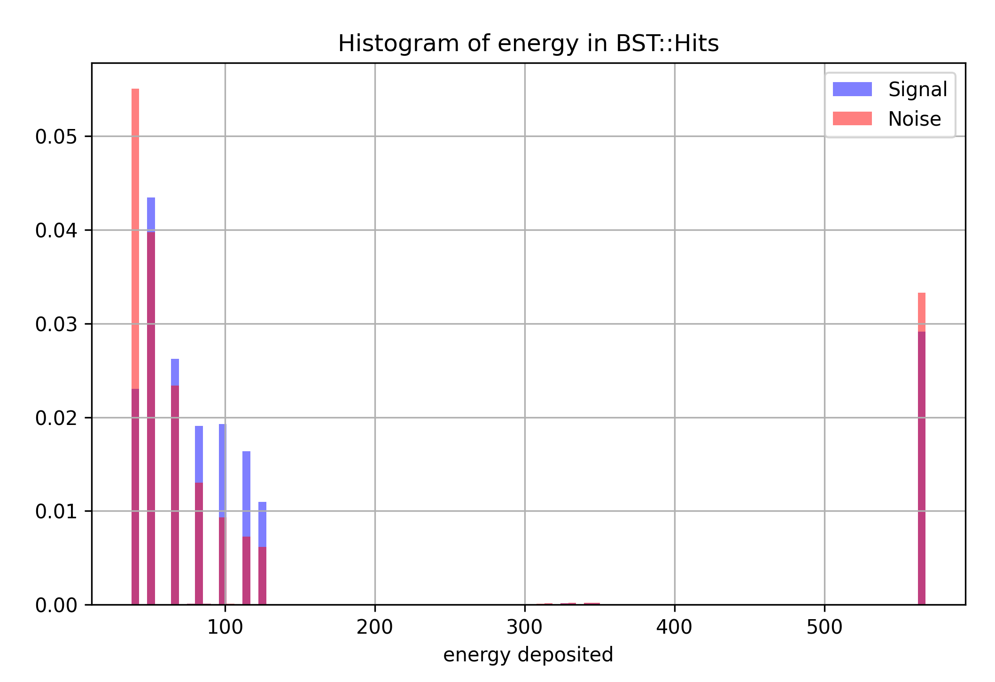
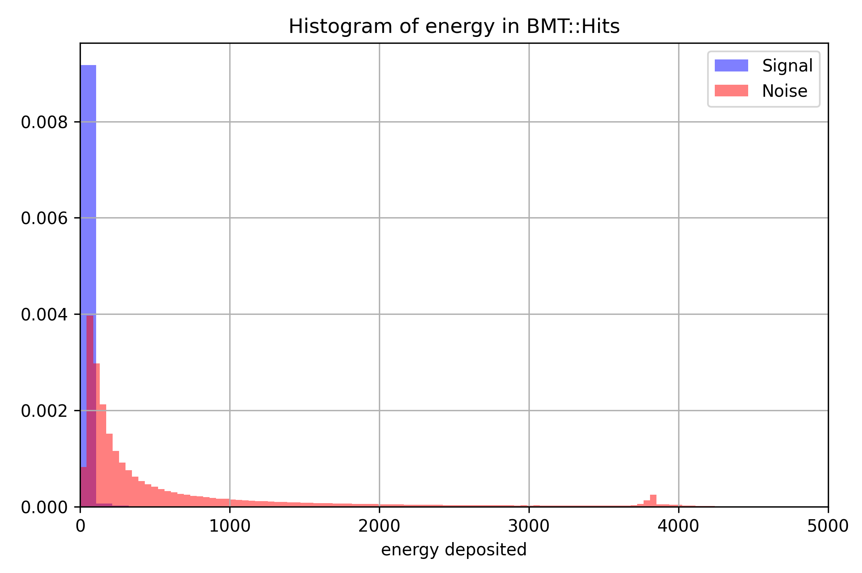
Tests with energy depostited in BST and BMT
Low energy deposition in BMT for the signal :
Is this characteristic of muons, or is it due to an
unrealistic simulation?
Mathieu Ronayette
5/9
Mathieu Ronayette
ML tracking meeting
15 dec 2025

Slide 6
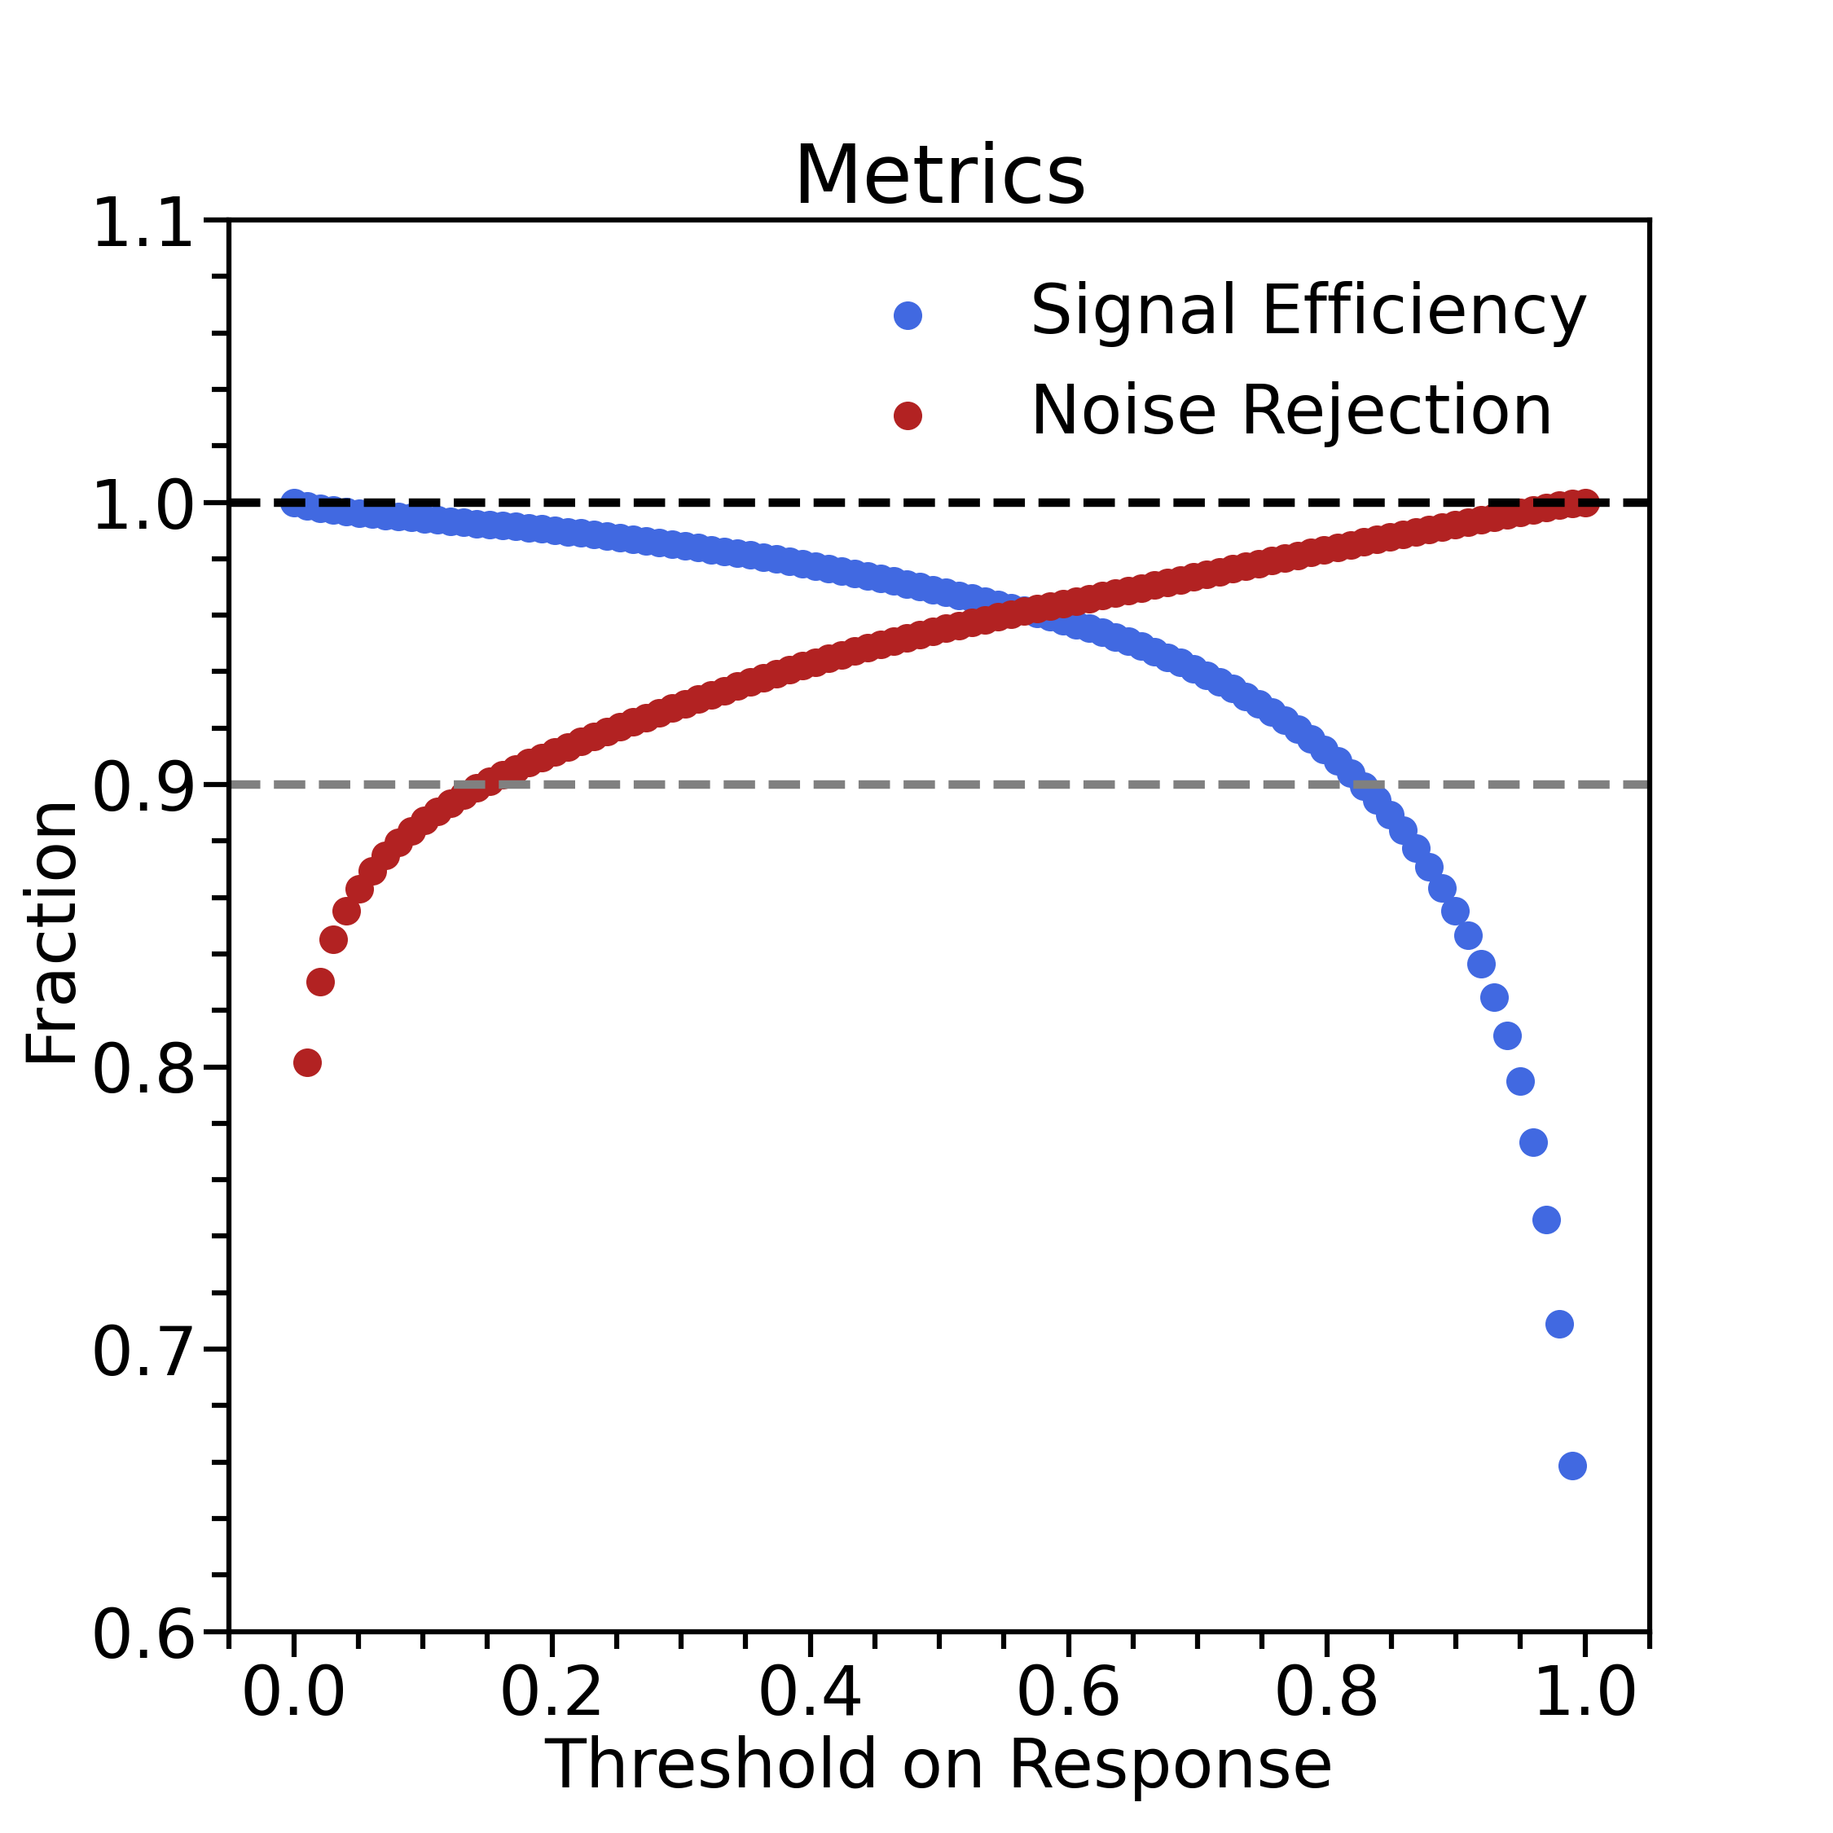
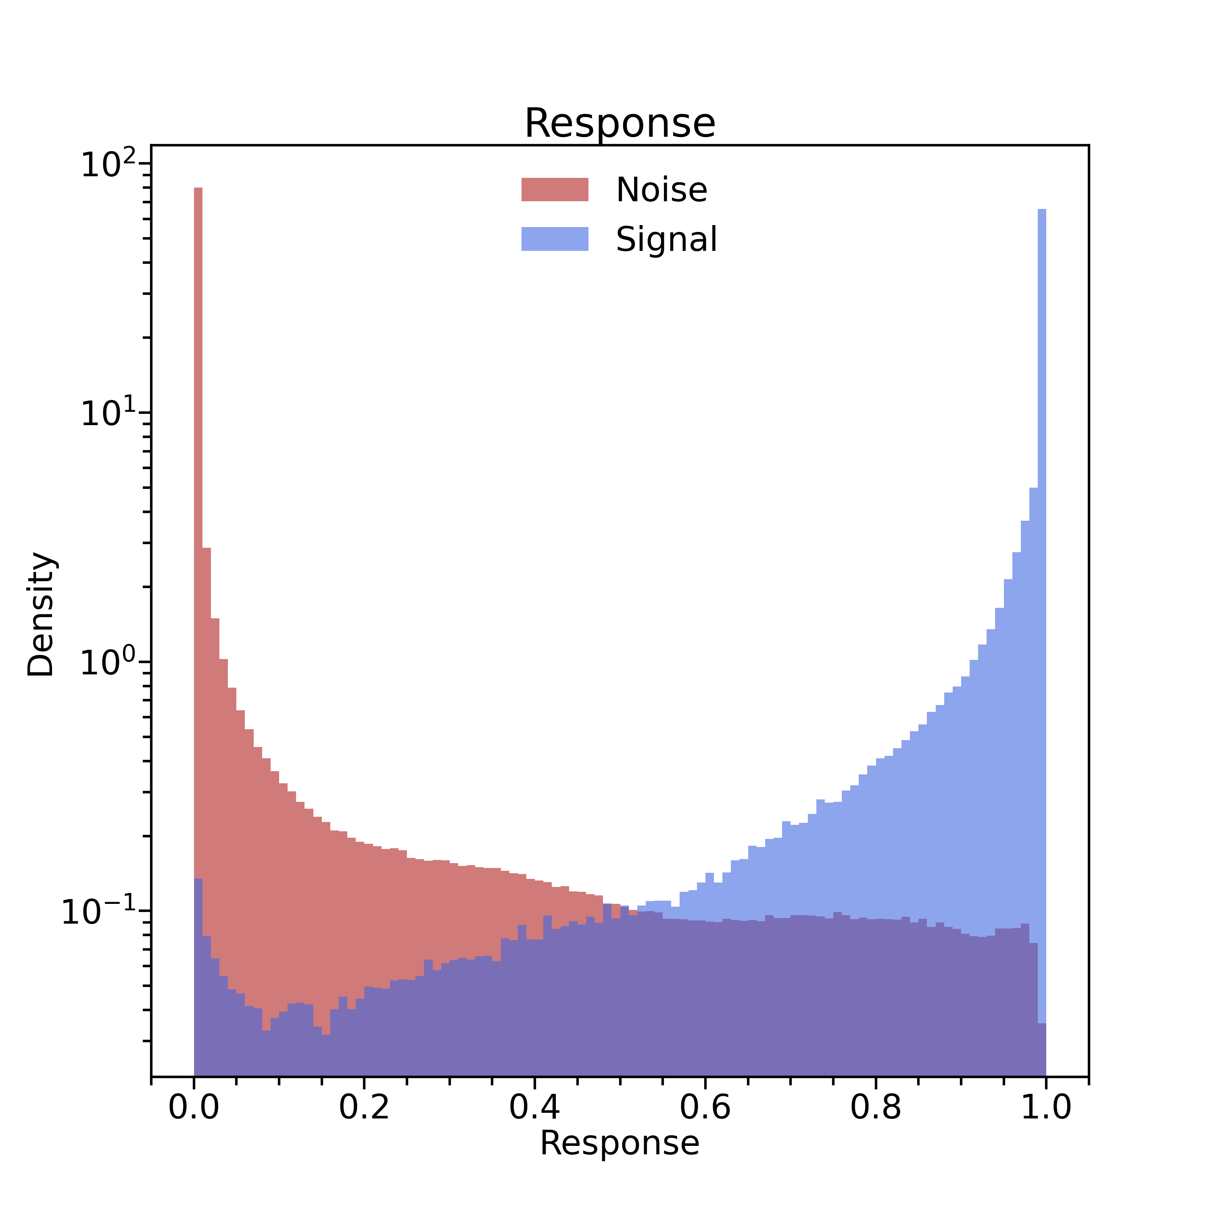
Tests with energy depostited in BST and BMT
Mathieu Ronayette
6/9
Mathieu Ronayette
ML tracking meeting
15 dec 2025

Slide 7
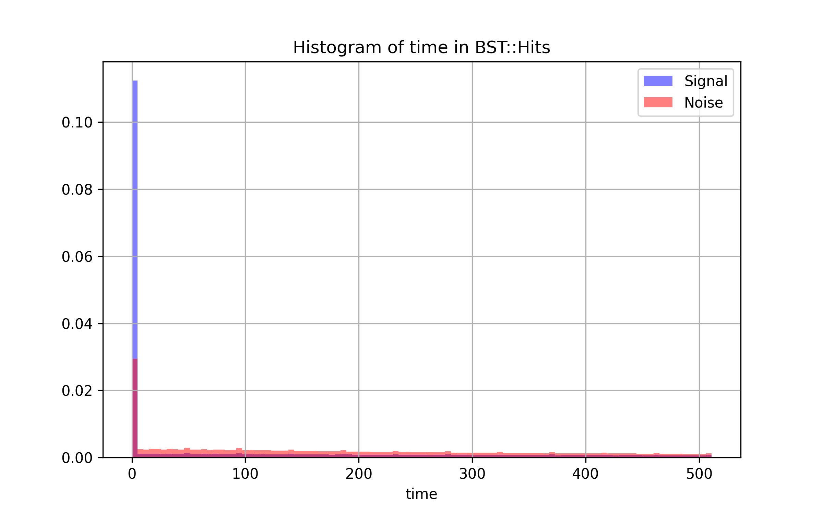
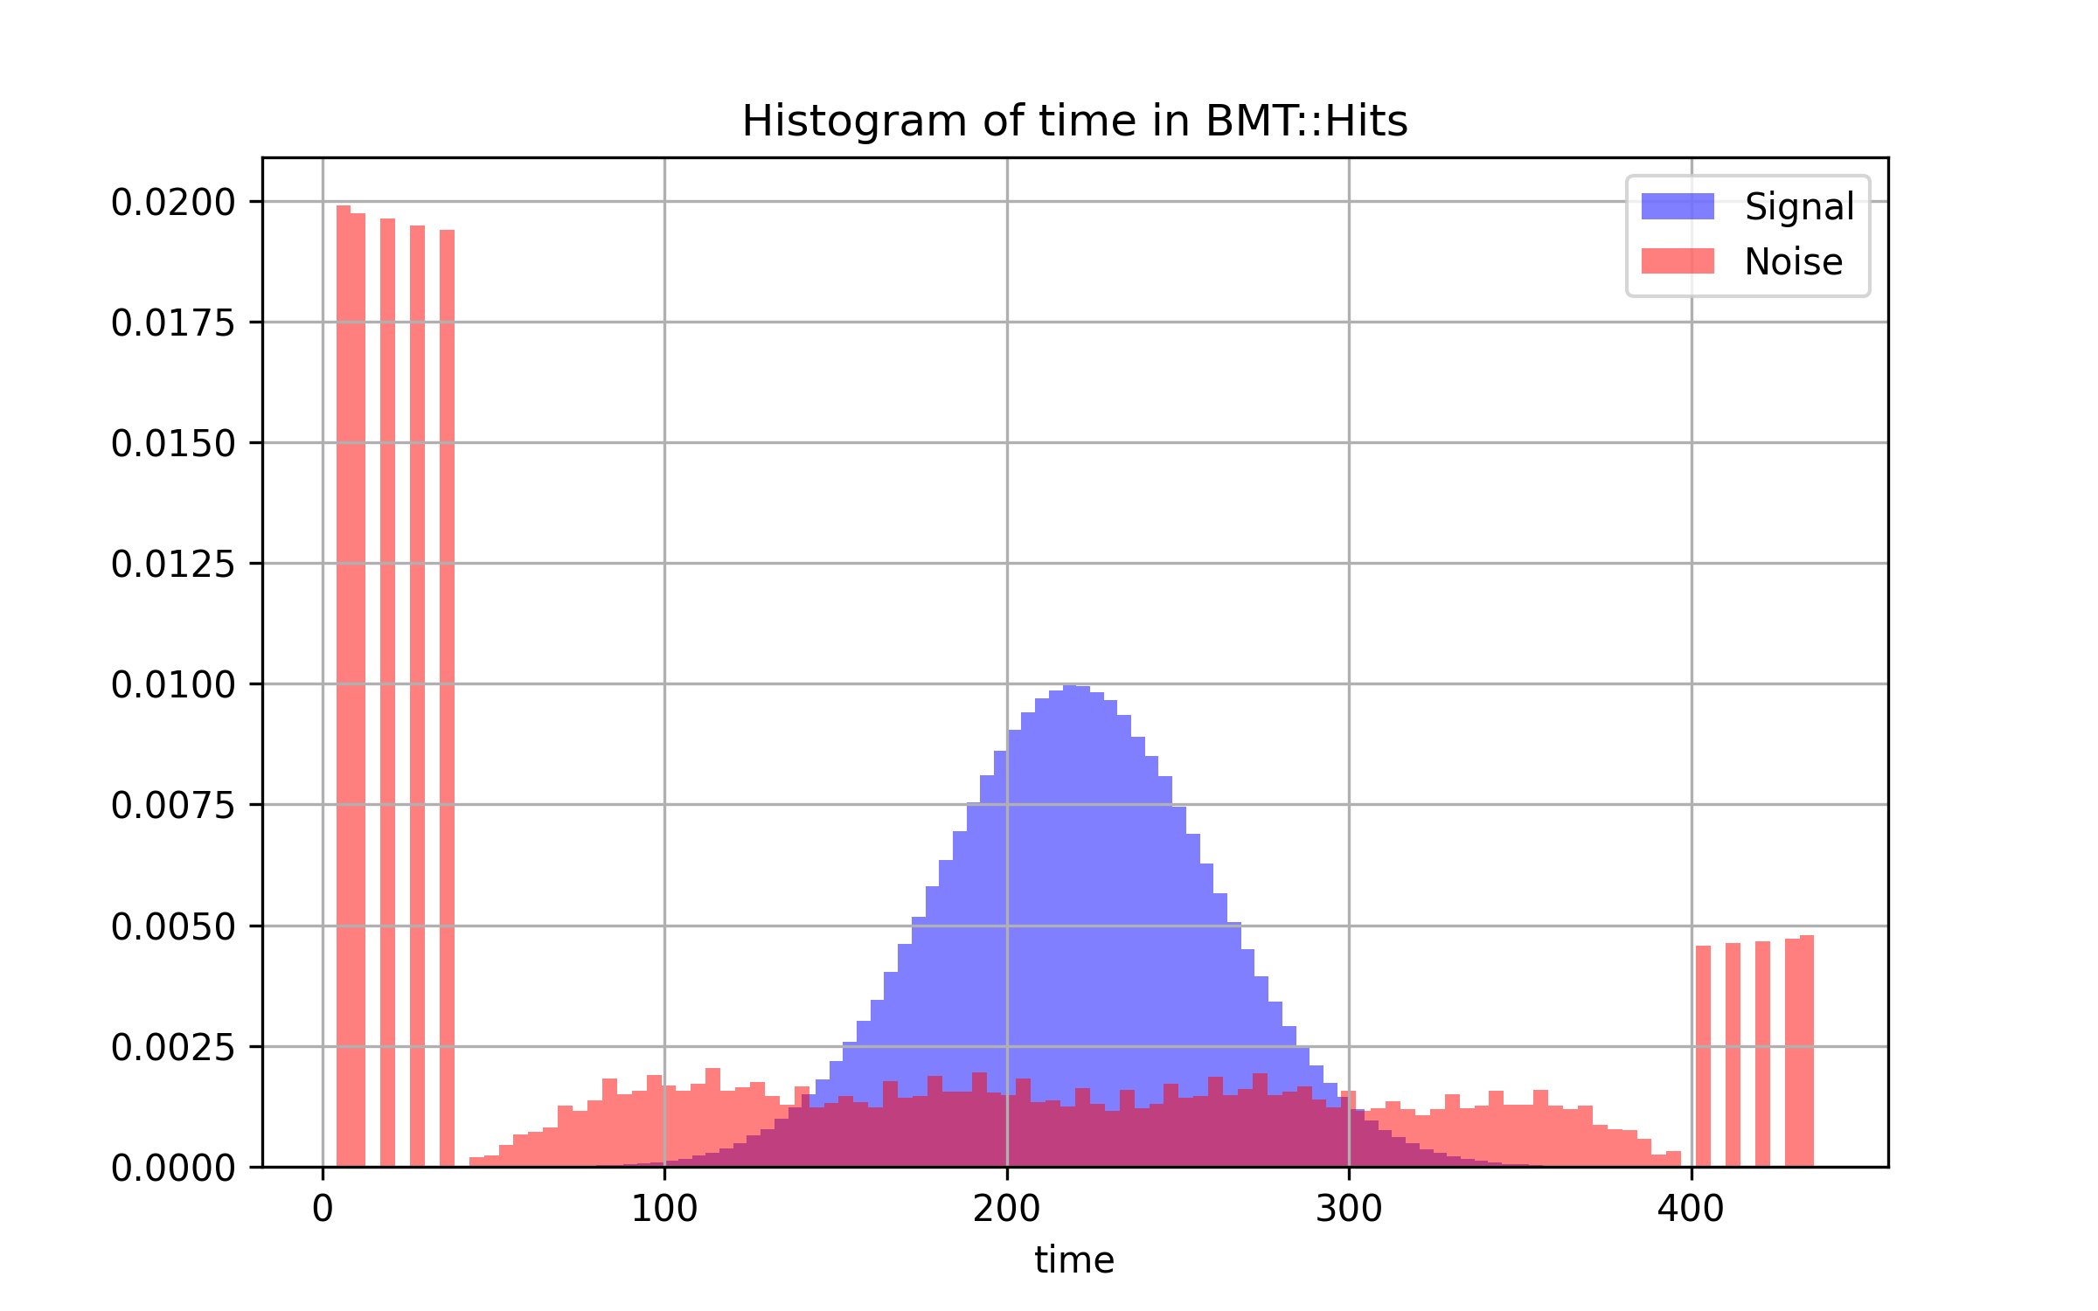
Tests with time of hits in BST and BMT
BST : seems unrealistic time for signal
BMT : The time for signal could be correctly simulated
Mathieu Ronayette
7/9
Mathieu Ronayette
ML tracking meeting
15 dec 2025

Slide 8
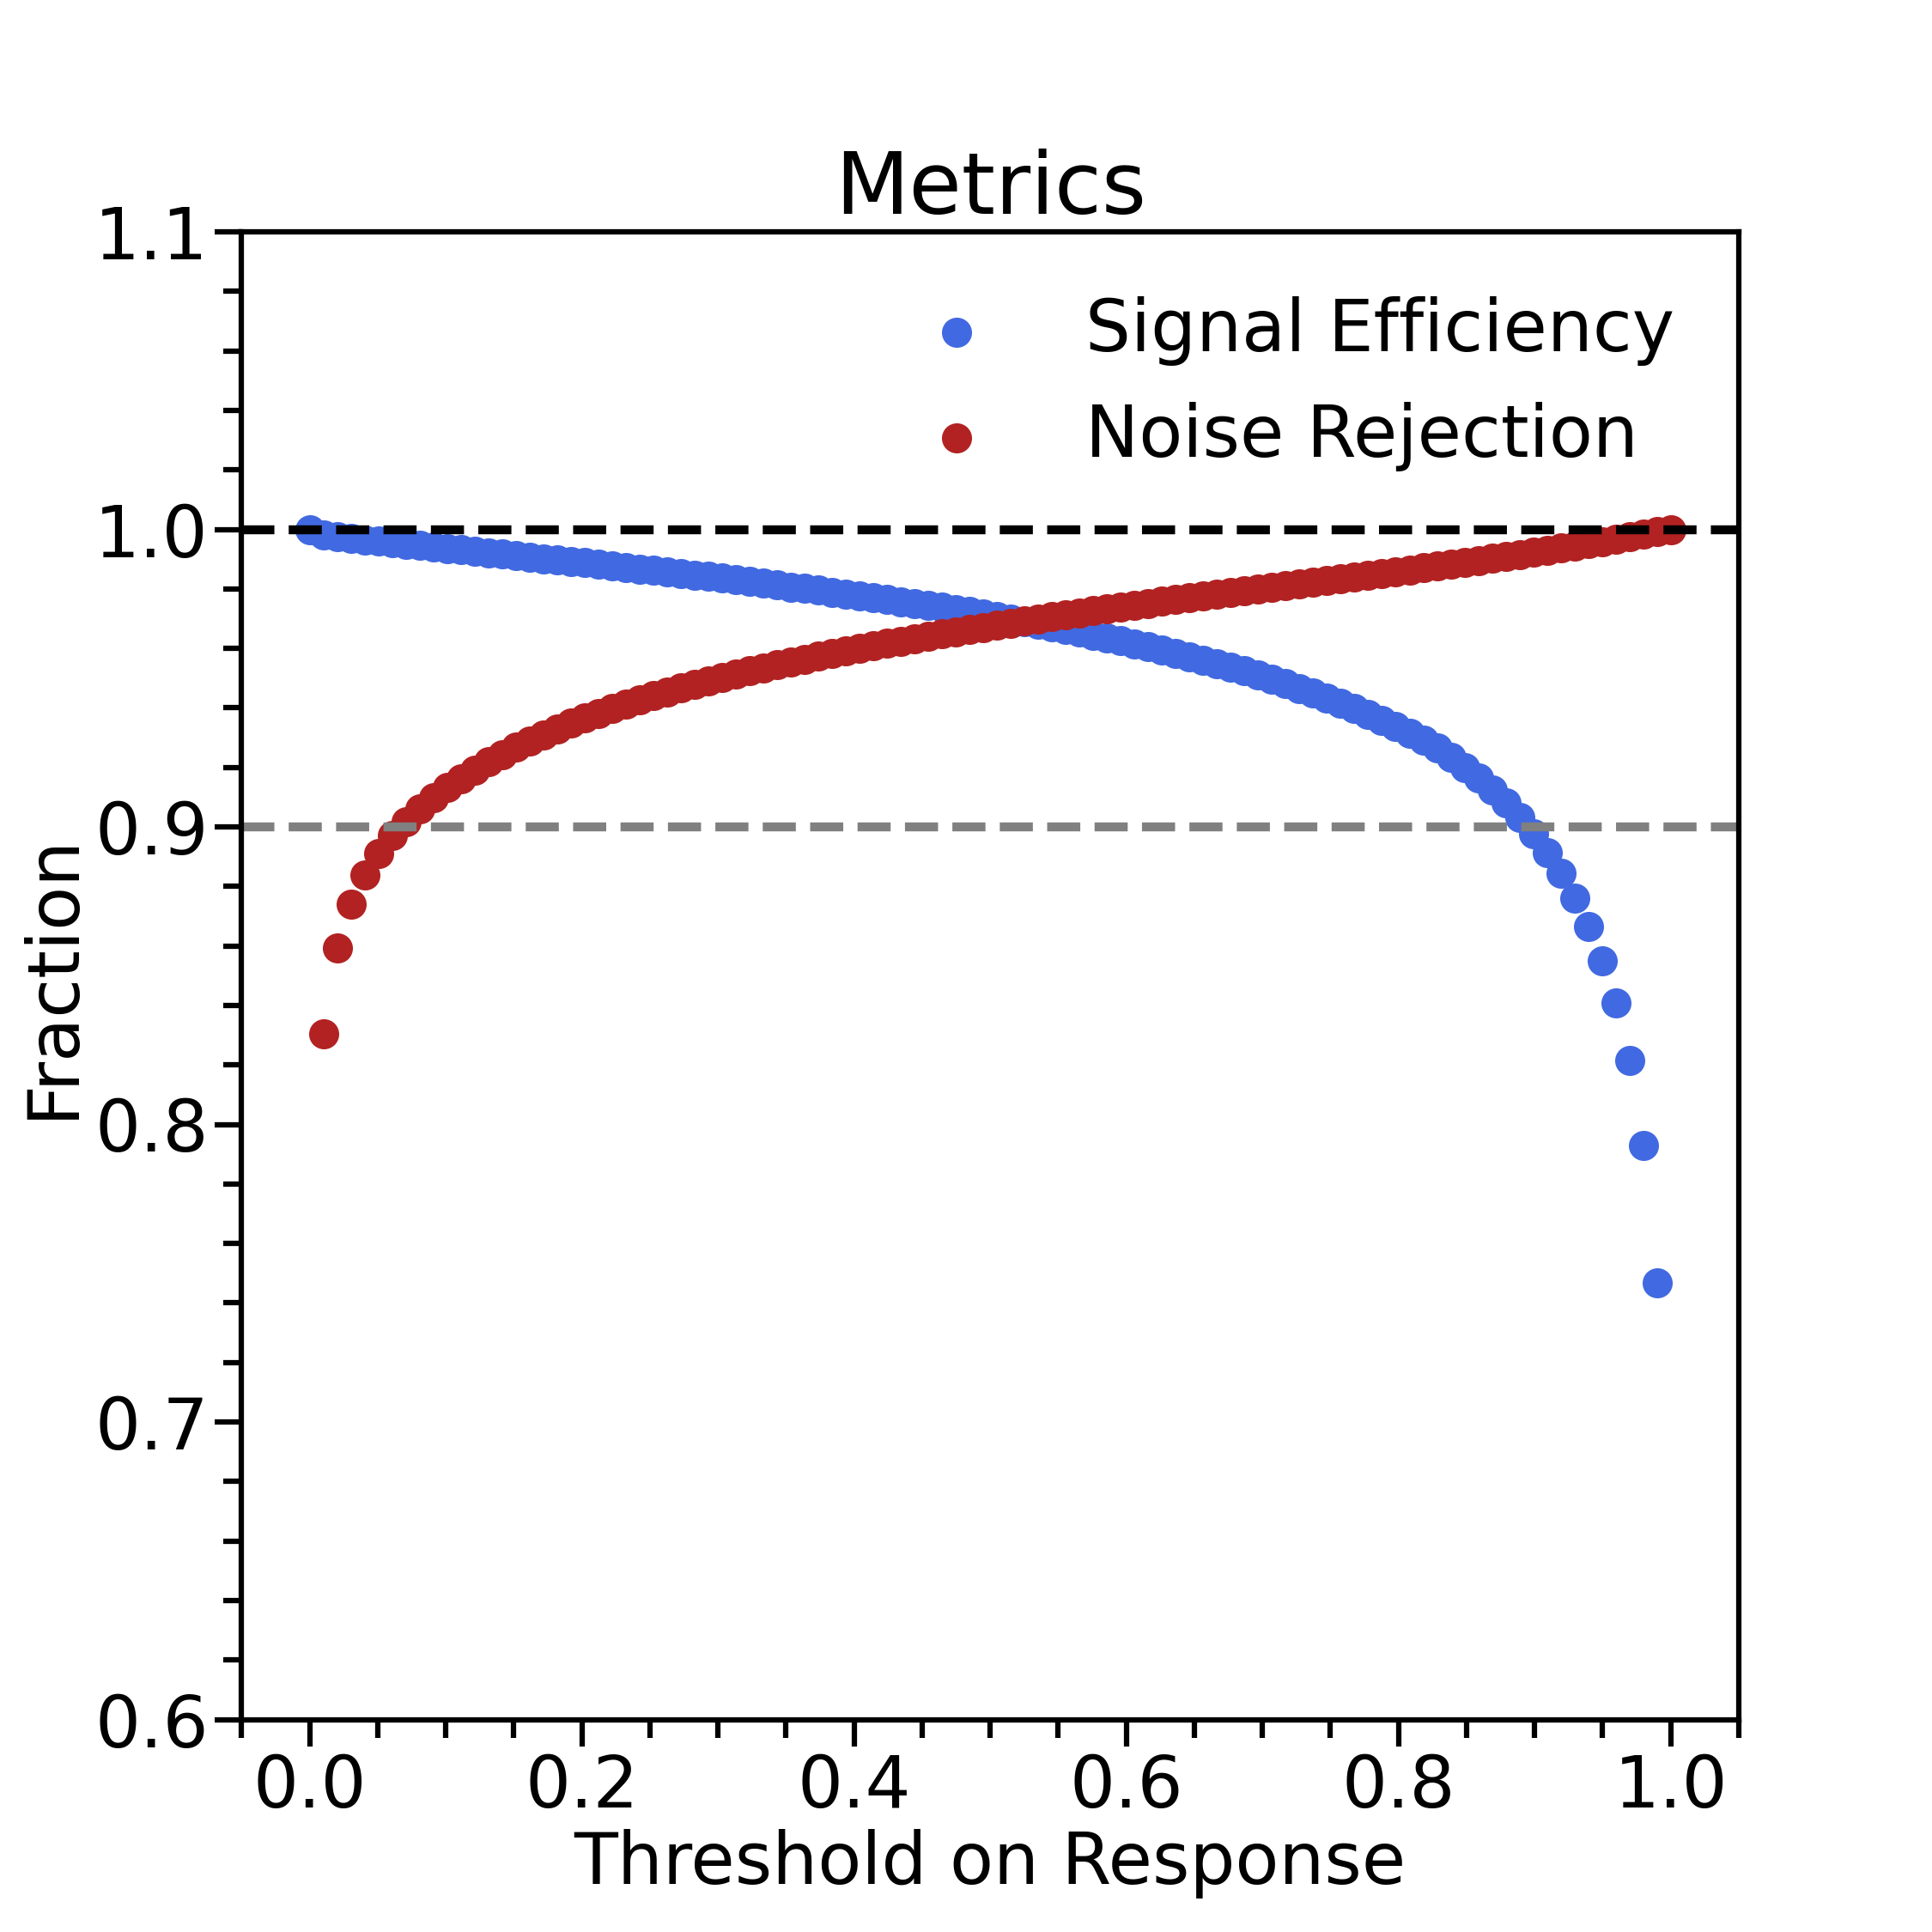
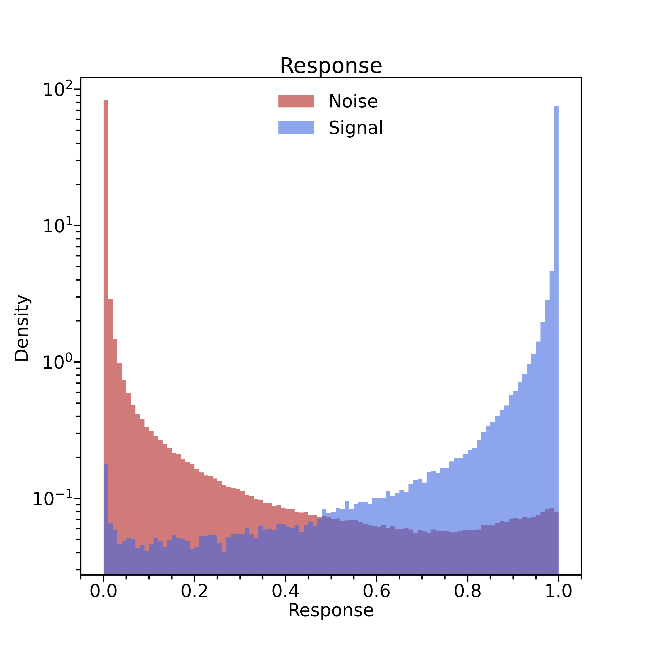
Tests with time of hits in BST and BMT
Mathieu Ronayette
8/9
Mathieu Ronayette
ML tracking meeting
15 dec 2025

Slide 9
Outlook
For now :
Understand whether the BMT and BST banks for energy and time are realistic or not
If not, is it possible to improve the signal simulation for the deposited energy and time in BST and BMT?
Outlook :
Do more realistic training of ML model with these inputs and try to do validation with real data set
Mathieu Ronayette
9/9
Mathieu Ronayette
ML tracking meeting
15 dec 2025

