Slide 1
Clas12 meeting
Analysis objective :
- Measurement of the cross section and diferential cross section of the electroproduction of ɸ in the K_{s} K_{L} channel
π⁺
e
e’
Ks
π⁻
q
ɸ
Kl
- Datas : nSidis RG-A inbending and
outbending fall 2018 + spring 2019
p
p’
Mathieu Ronayette
1/20
Mathieu Ronayette
meeting
15 Jan 2025

Slide 2
General informations
Datas :
nSidis Rg-A datas : fall2018 inbending
Correction on π⁺ π⁻ vertex :
Vertex of π⁺ π⁻ are recalculated with the code
of Veronique Ziegler
Add some cut on :
→ Distance between vertex of π⁺ π⁻ < 2.5 cm
→ Distance between vertex Ks and e⁻
(1.5 < Dist < 5.0 cm) because cτ_{Ks} = 2.68 cm
Cuts :
→ Selection of events with one
e⁻ , p , π⁺ and π⁻ in the final state.
→ Cut on invariant mass of π⁺ π⁻ with
0.4 < M_{inv}(π⁺ π⁻) < 0.6 GeV.
→ Cut on Missing Mass in the reaction
e p → e’ p’ K_{s} X with 0.4 < M_{issMass} < 0.6 GeV.
Mathieu Ronayette
2/20
Mathieu Ronayette
meeting
15 Jan 2025

Slide 3
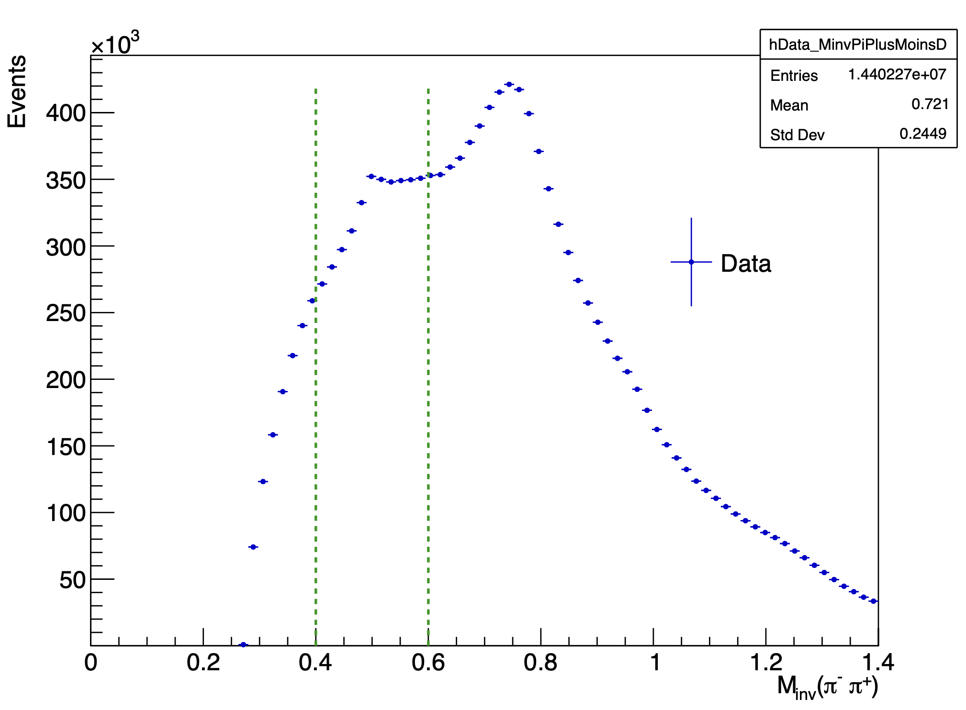
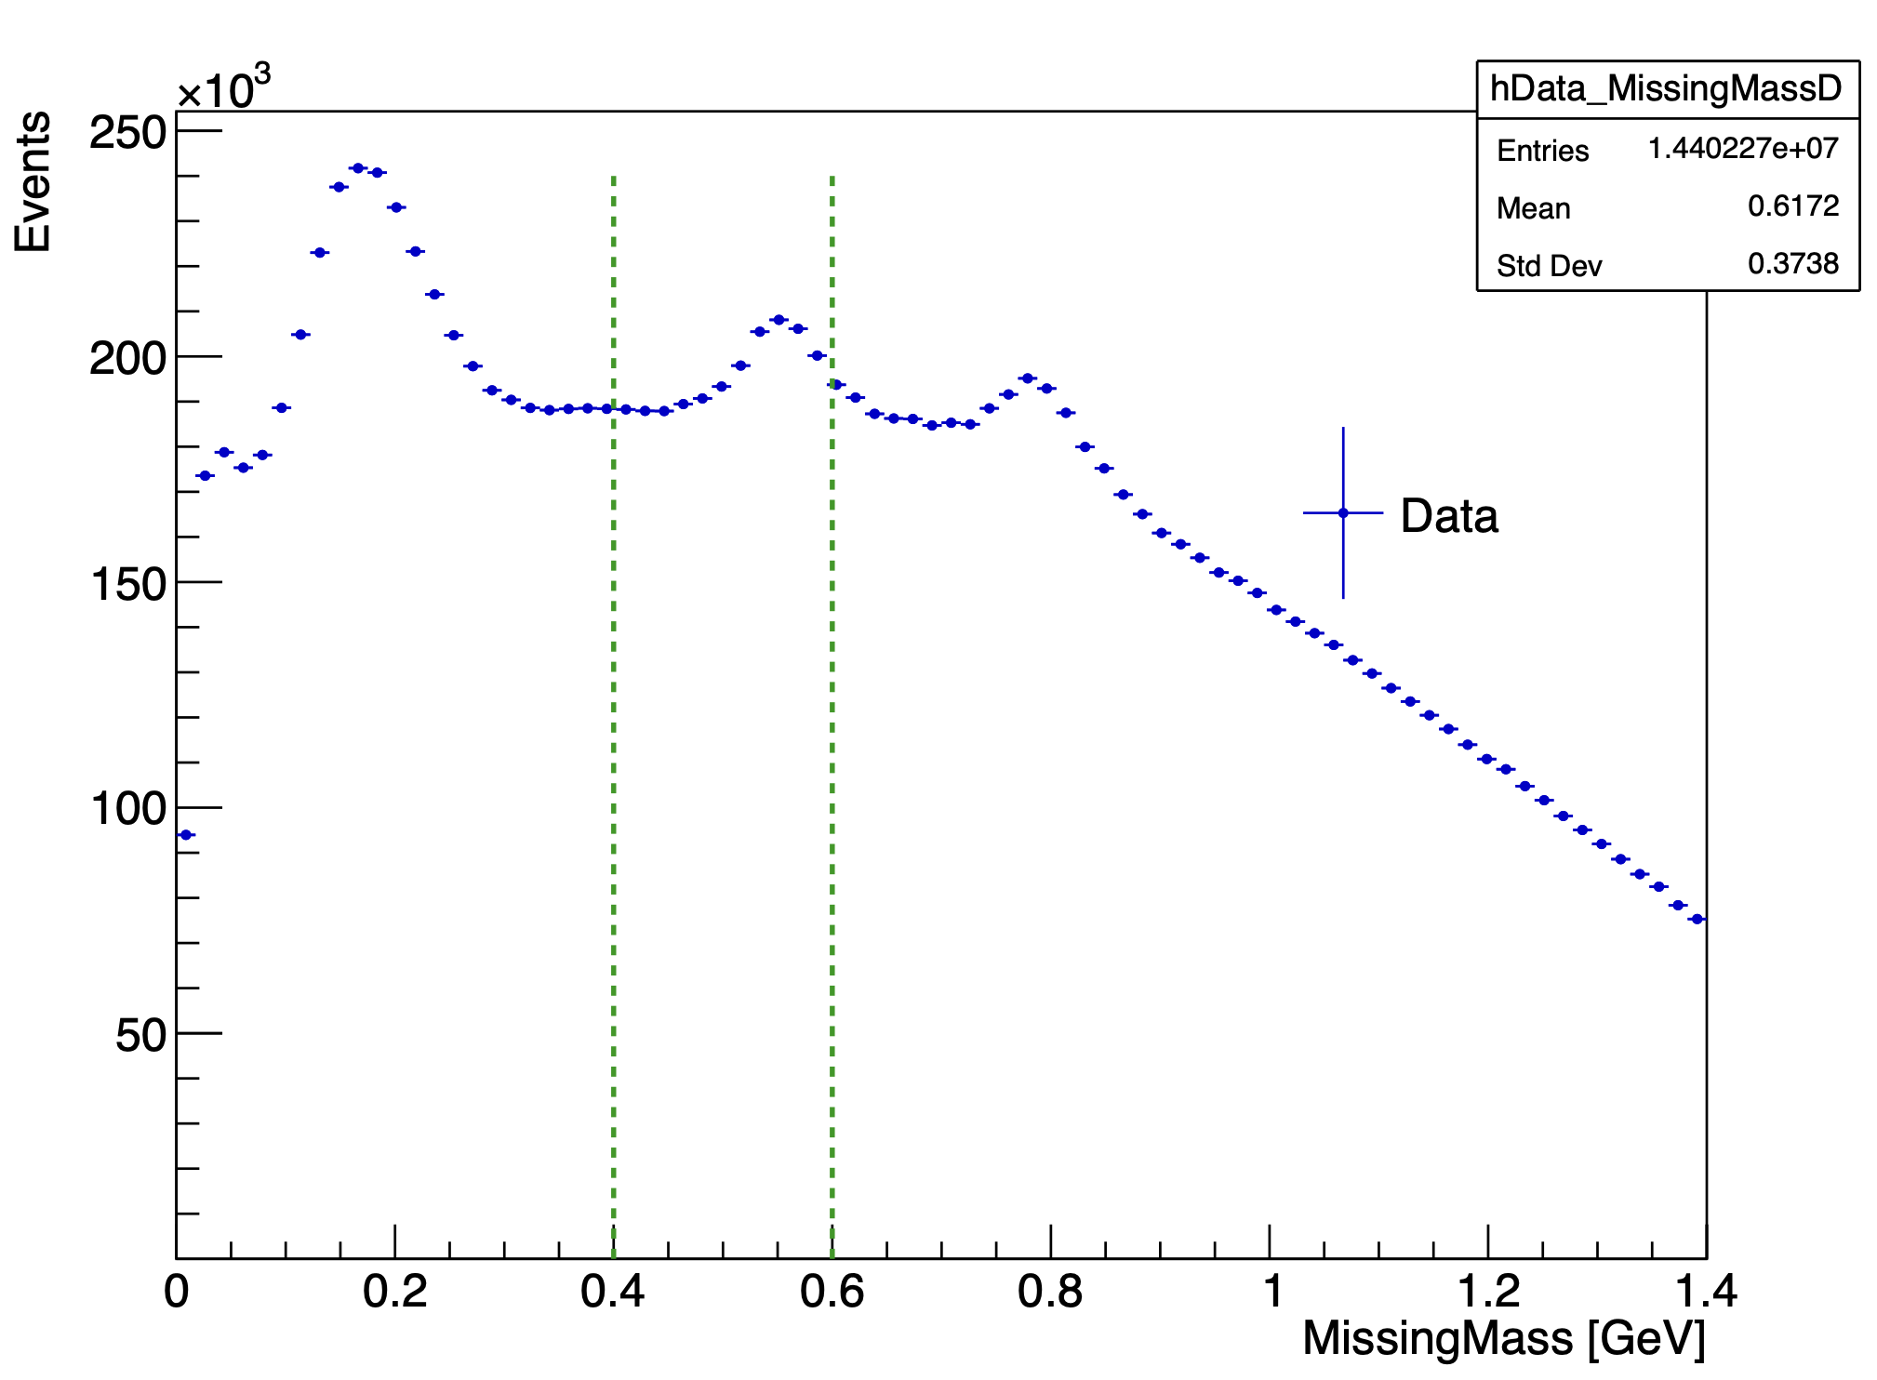
Details of cuts on datas
Invariant Mass π⁺ π⁻
Missing Mass
Mathieu Ronayette
3/20
Mathieu Ronayette
meeting
15 Jan 2025

Slide 4
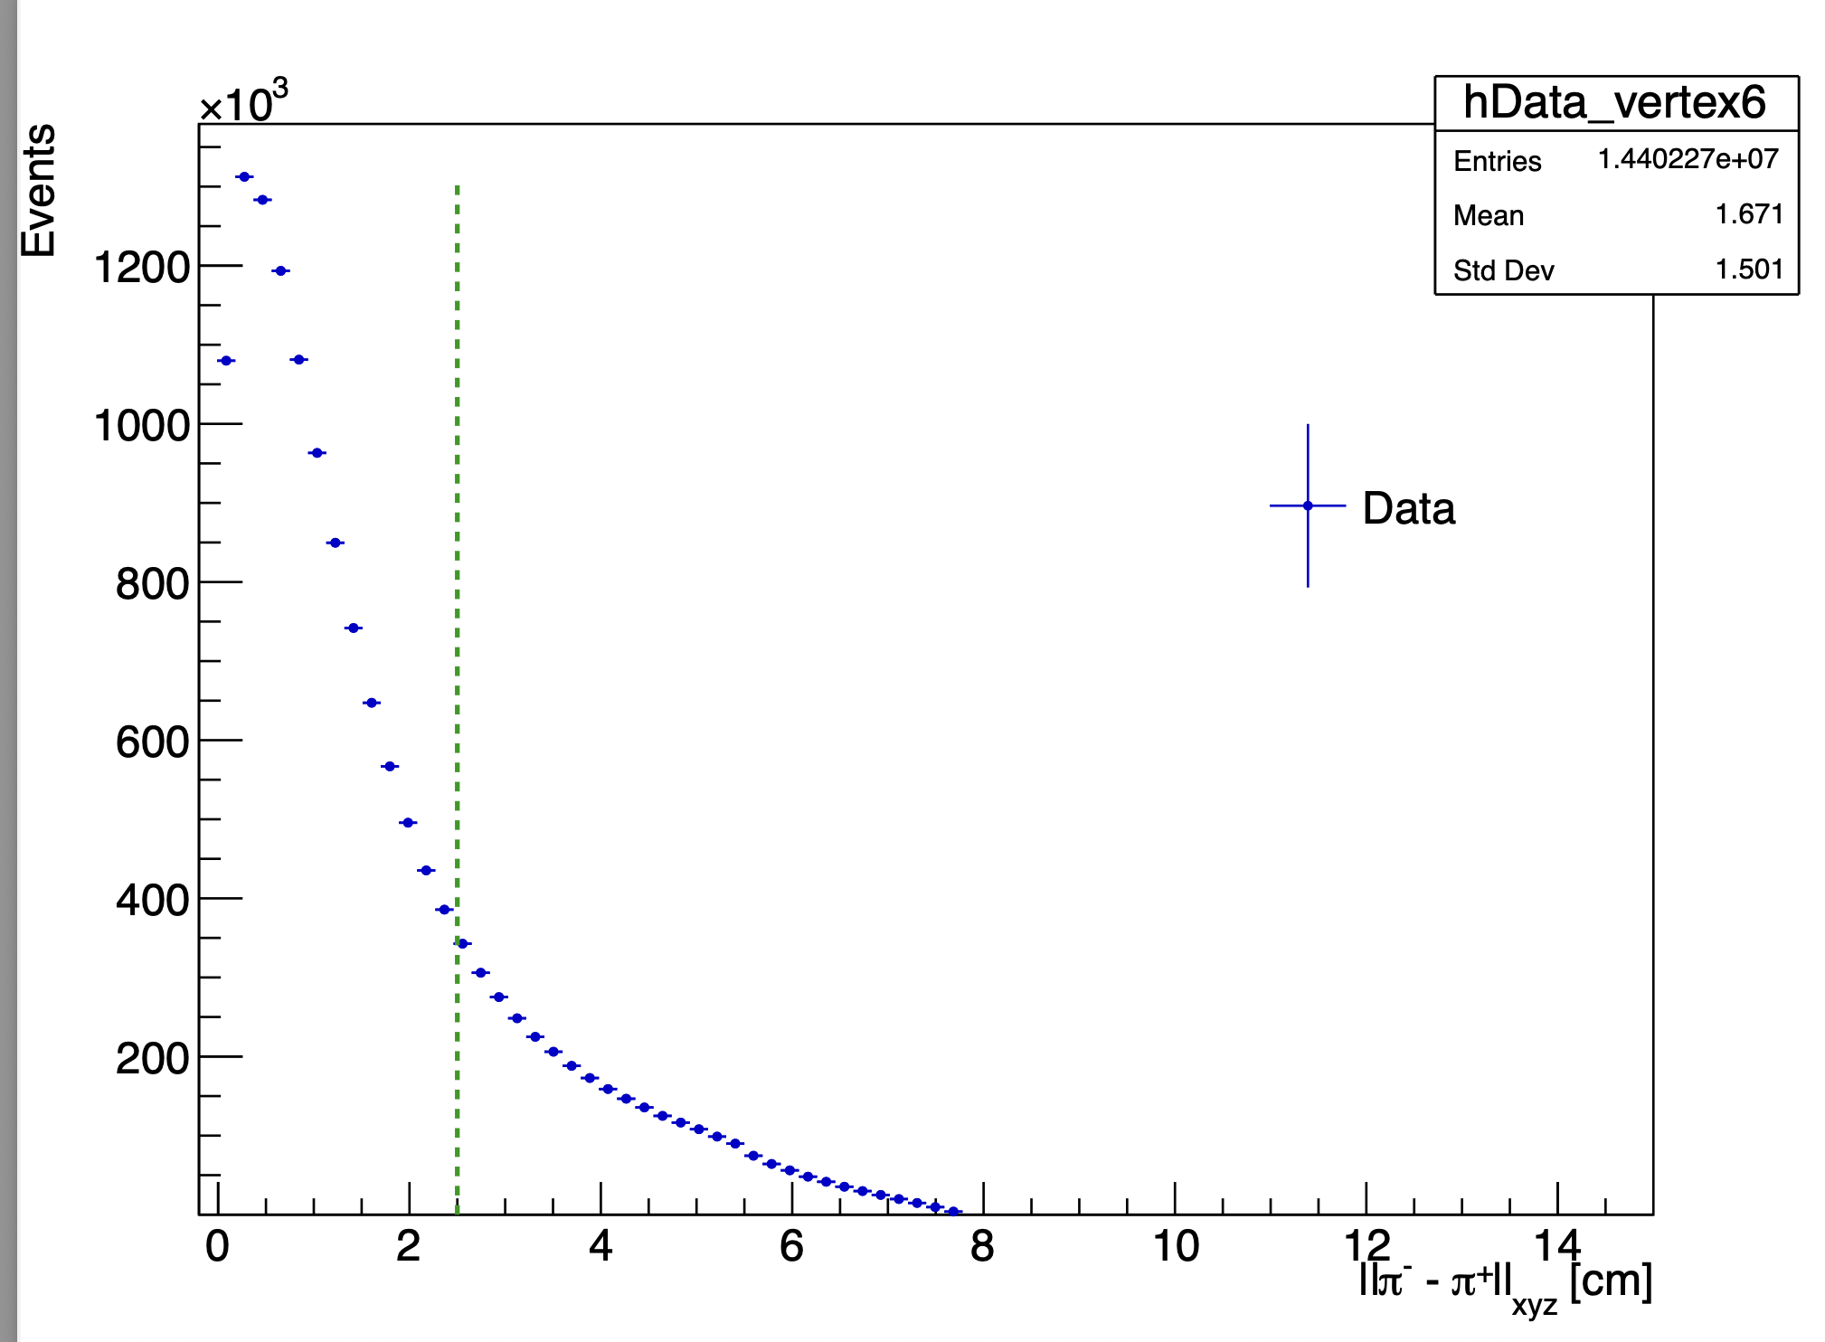
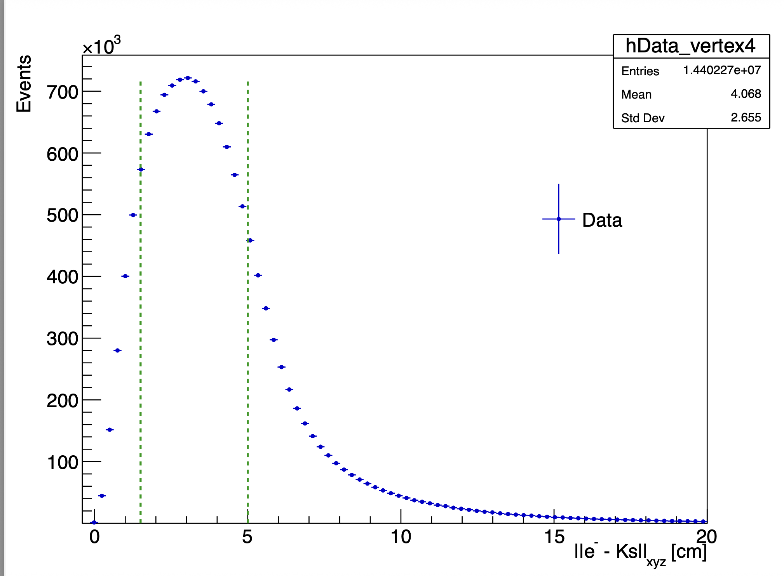
Details of cuts on datas
Distance vertex π ⁺ and π ⁻
Distance vertex e⁻ and Ks
Mathieu Ronayette
4/20
Mathieu Ronayette
meeting
15 Jan 2025

Slide 5
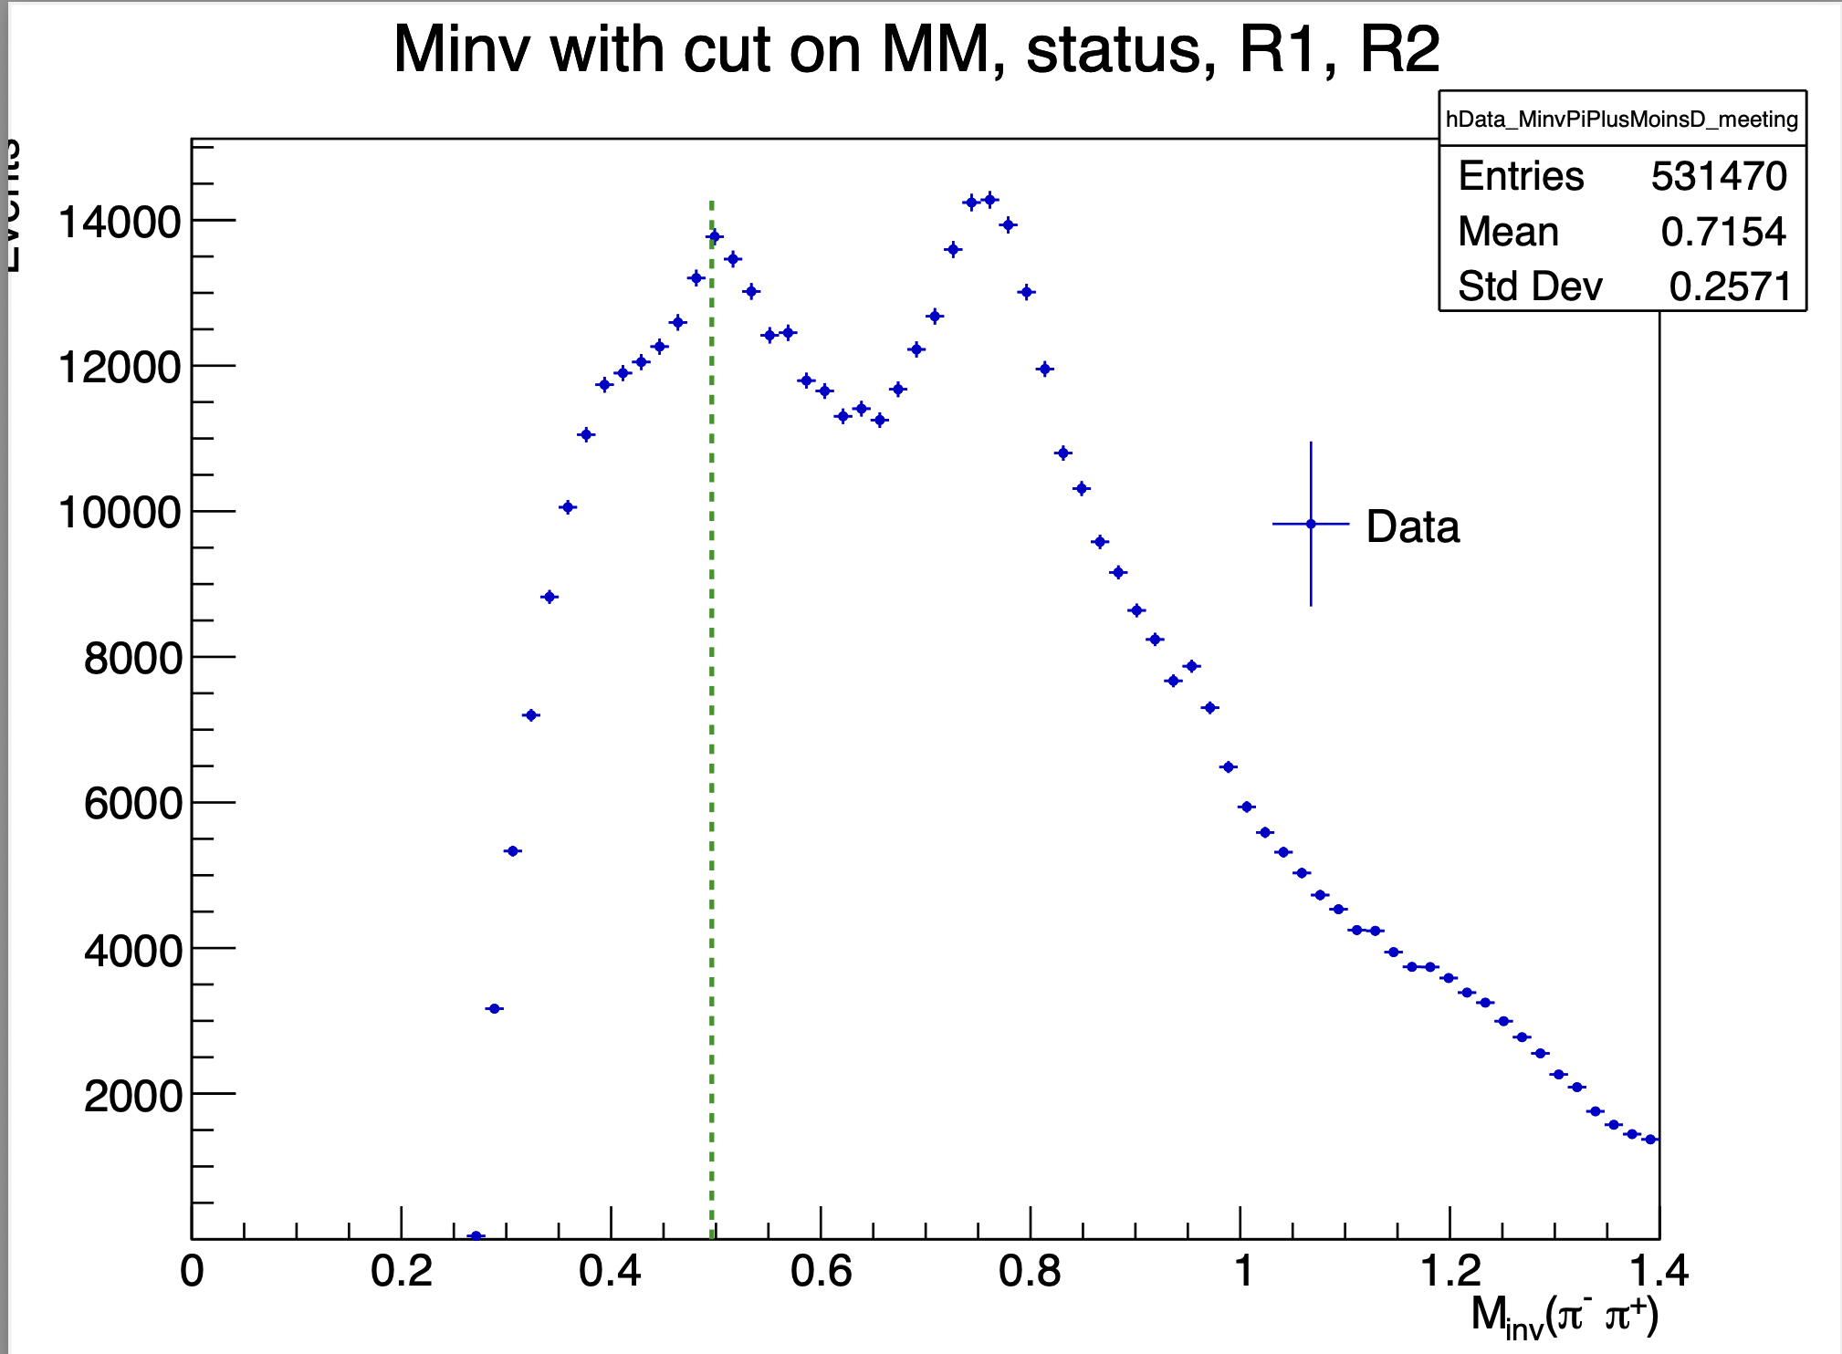
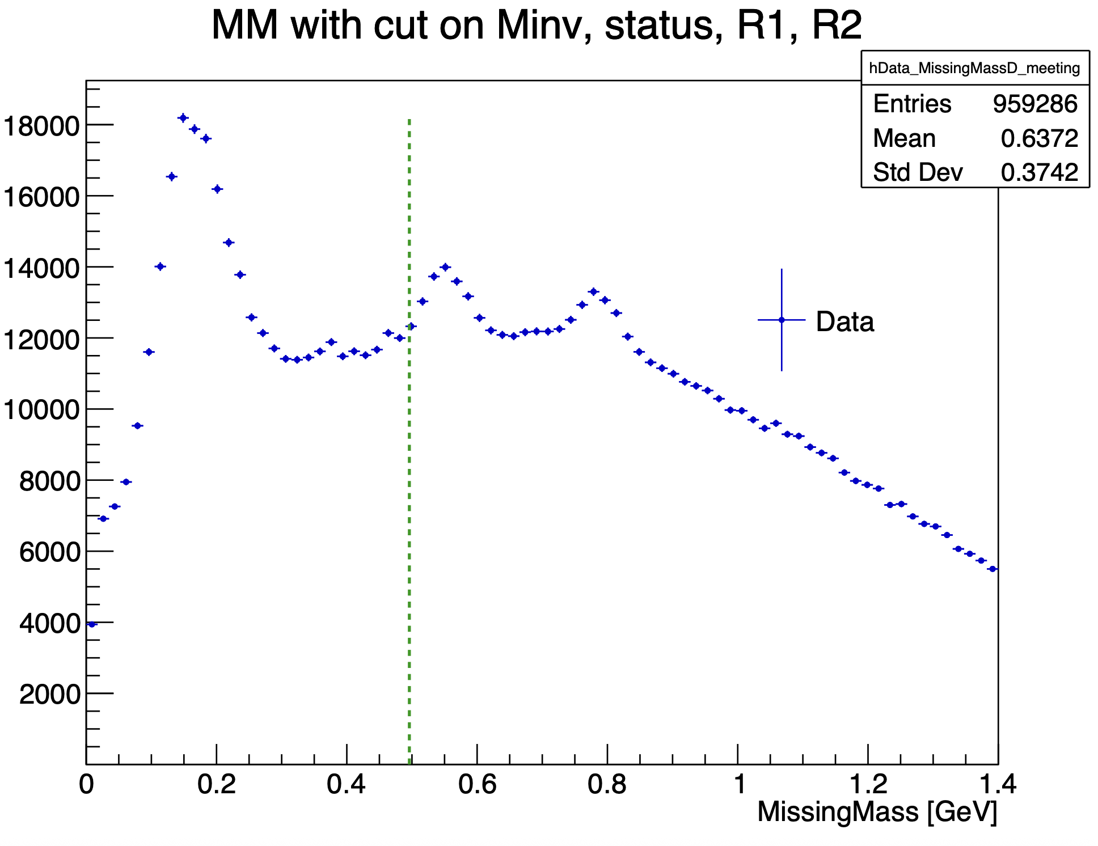
Influence of cuts on datas
Mathieu Ronayette
5/20
Mathieu Ronayette
meeting
15 Jan 2025

Slide 6
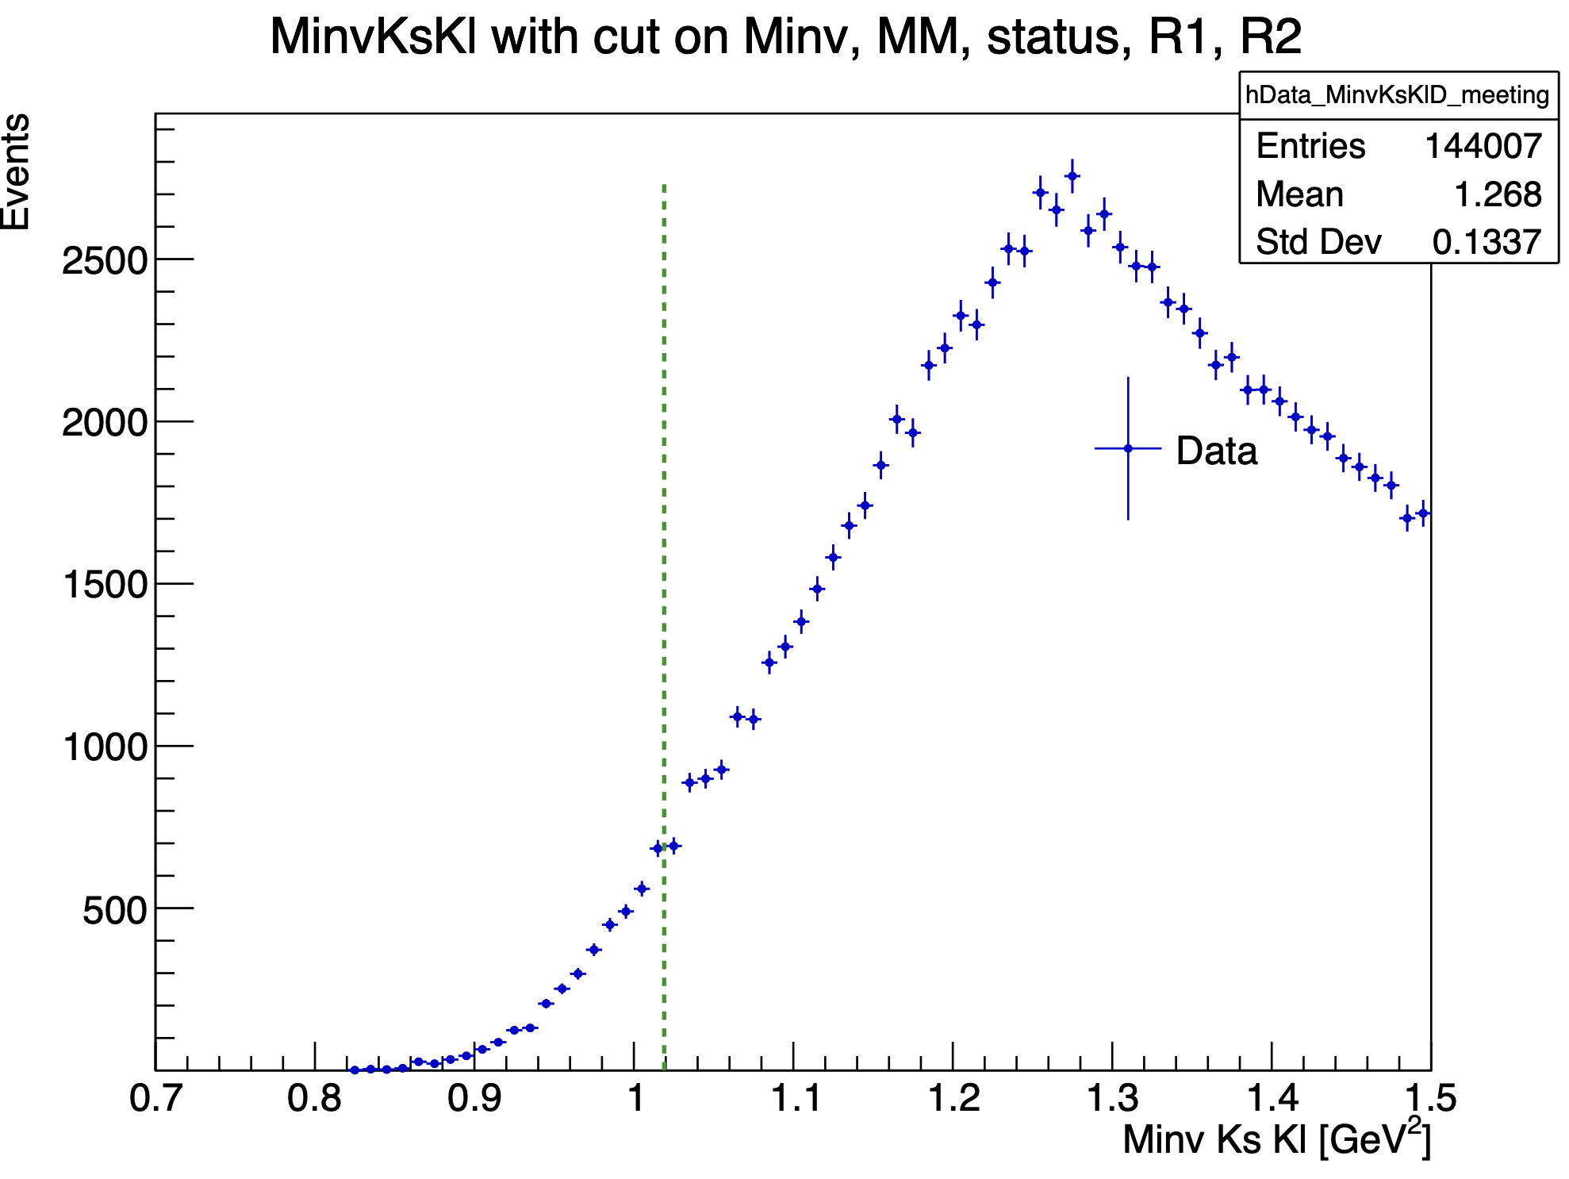
Influence of cuts on datas
Mathieu Ronayette
6/20
Mathieu Ronayette
meeting
15 Jan 2025

Slide 7
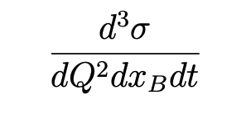
Simulation Monte Carlo : ɸ generator
From Proposal to Jeﬀerson Lab PAC39 Exclusive Phi Meson Electroproduction with CLAS12
Branching ratio Ks → π⁺ π⁻ = 69%
Branching ratio ɸ → Ks Kl = 34%
Mathieu Ronayette
7/20
Mathieu Ronayette
meeting
15 Jan 2025

Slide 8
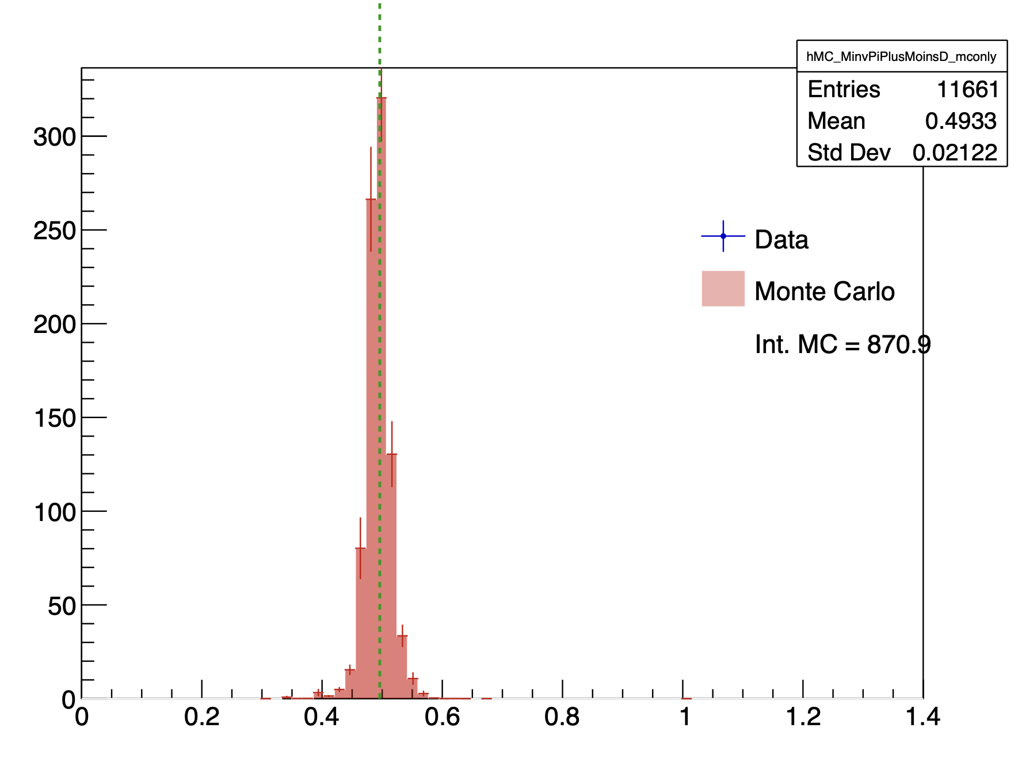
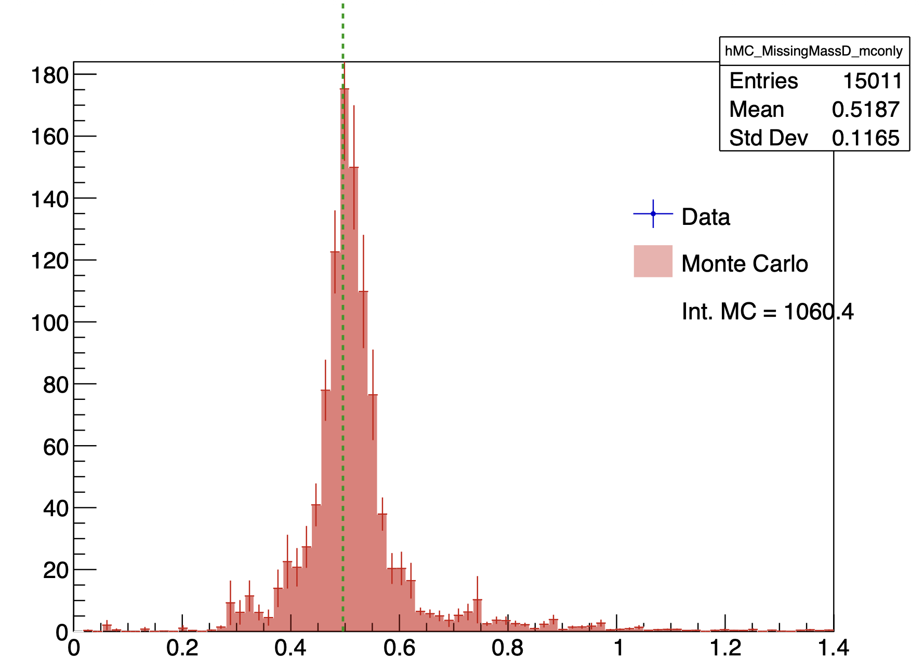
Pions in the FT ?
Minv pi+pi-
Missing Mass
Mathieu Ronayette
17/20
Mathieu Ronayette
meeting
15 Jan 2025

Slide 9
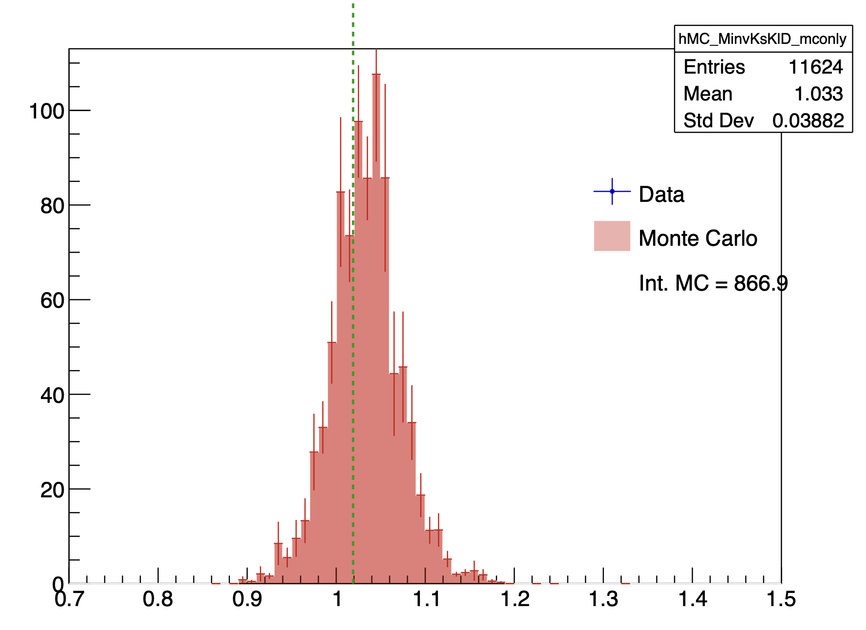
Pions in the FT ?
Minv Kskl
Mathieu Ronayette
17/20
Mathieu Ronayette
meeting
15 Jan 2025

Slide 10
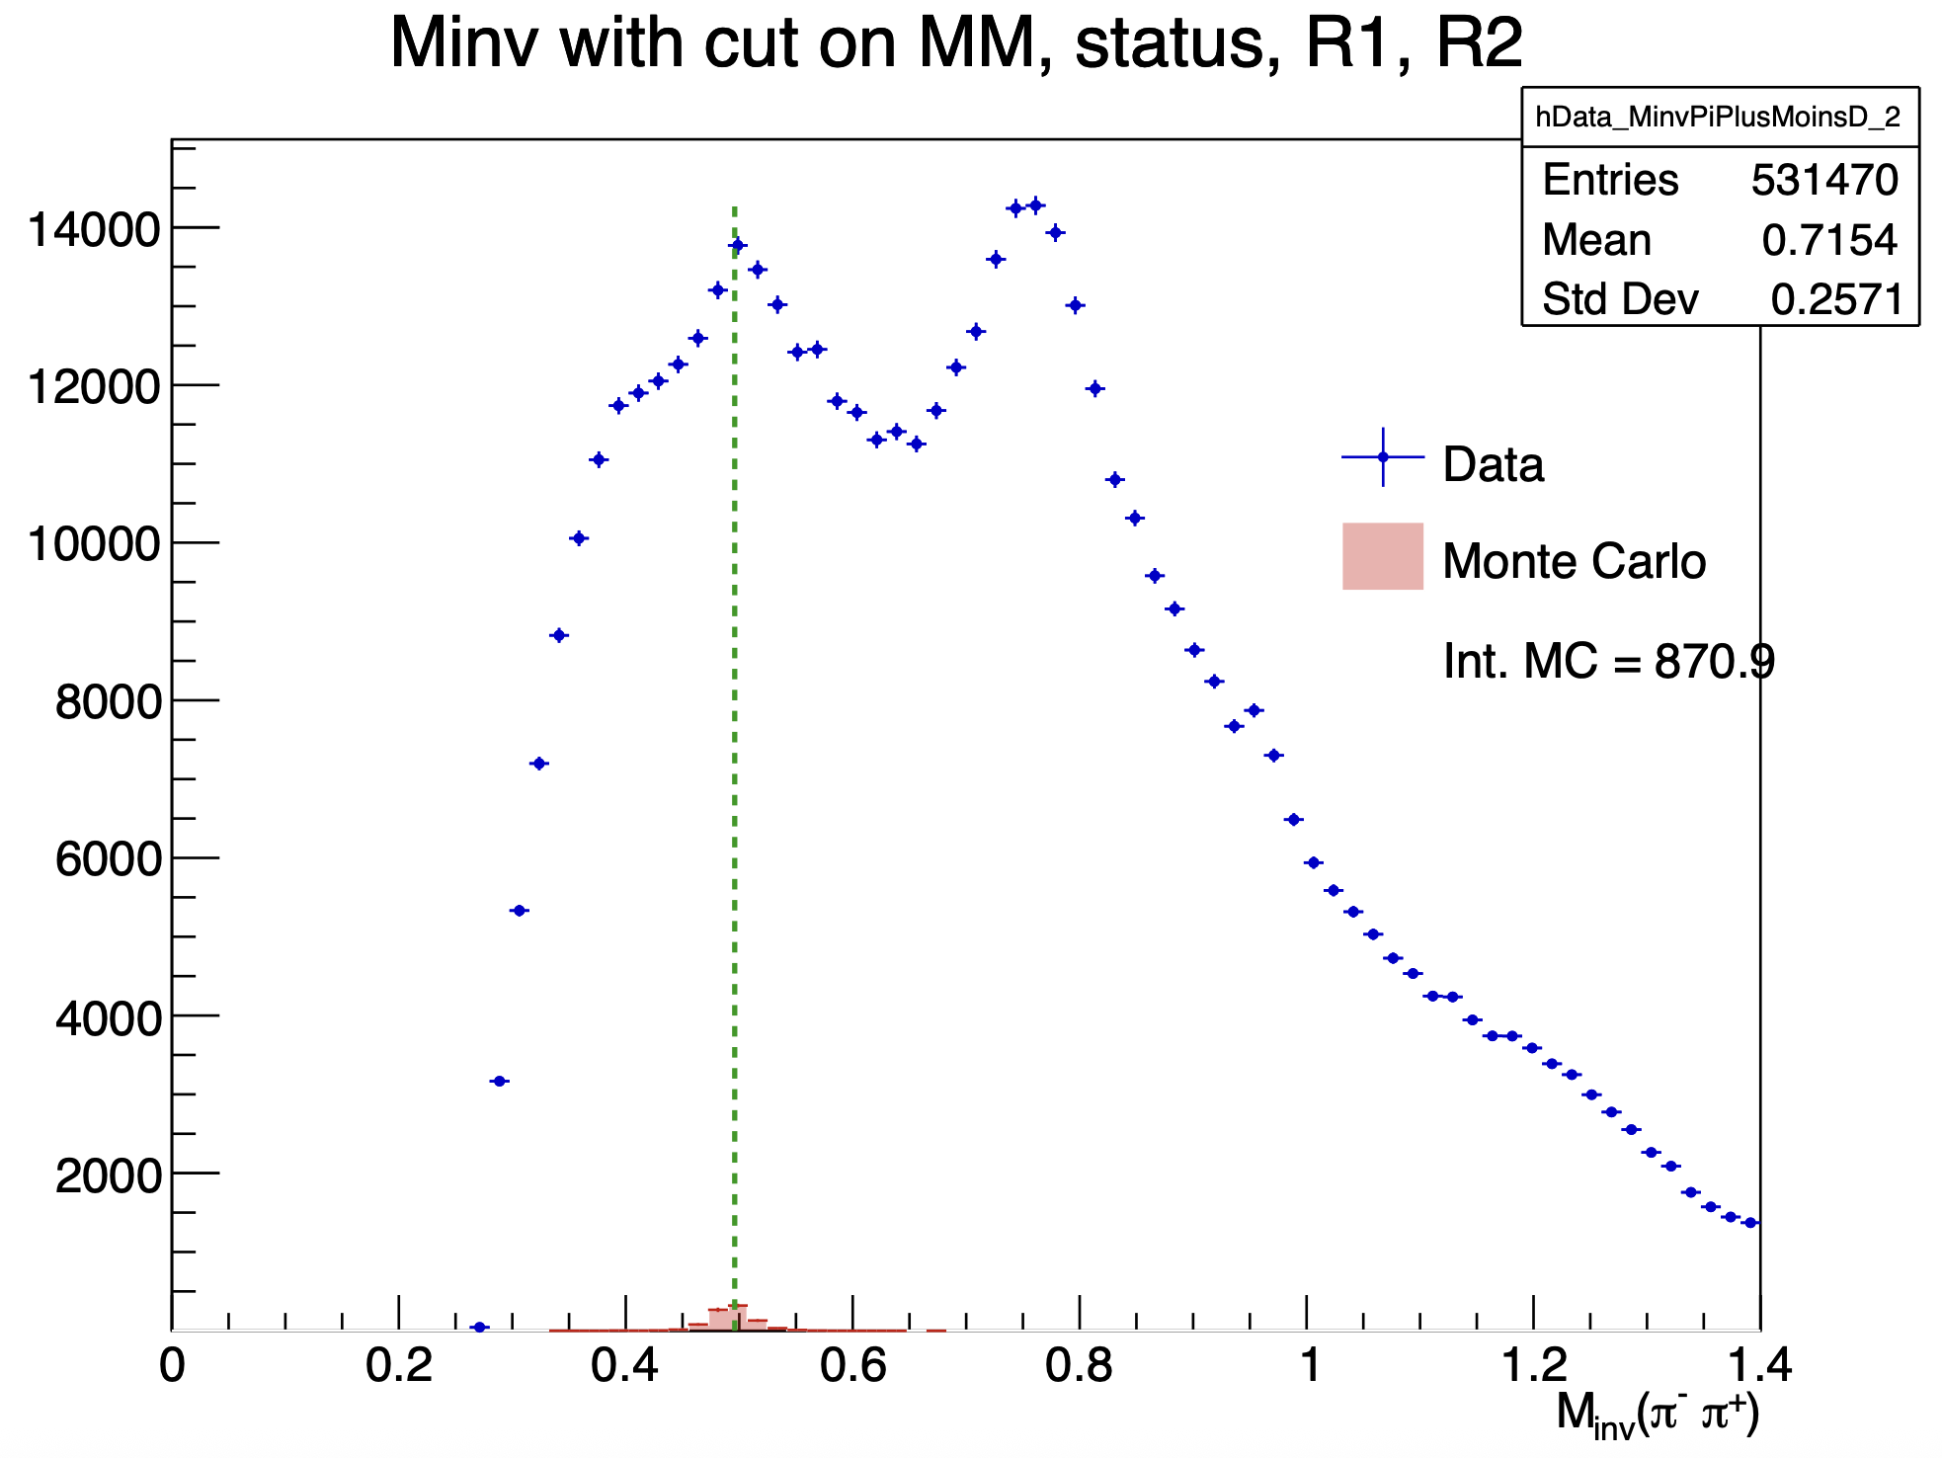
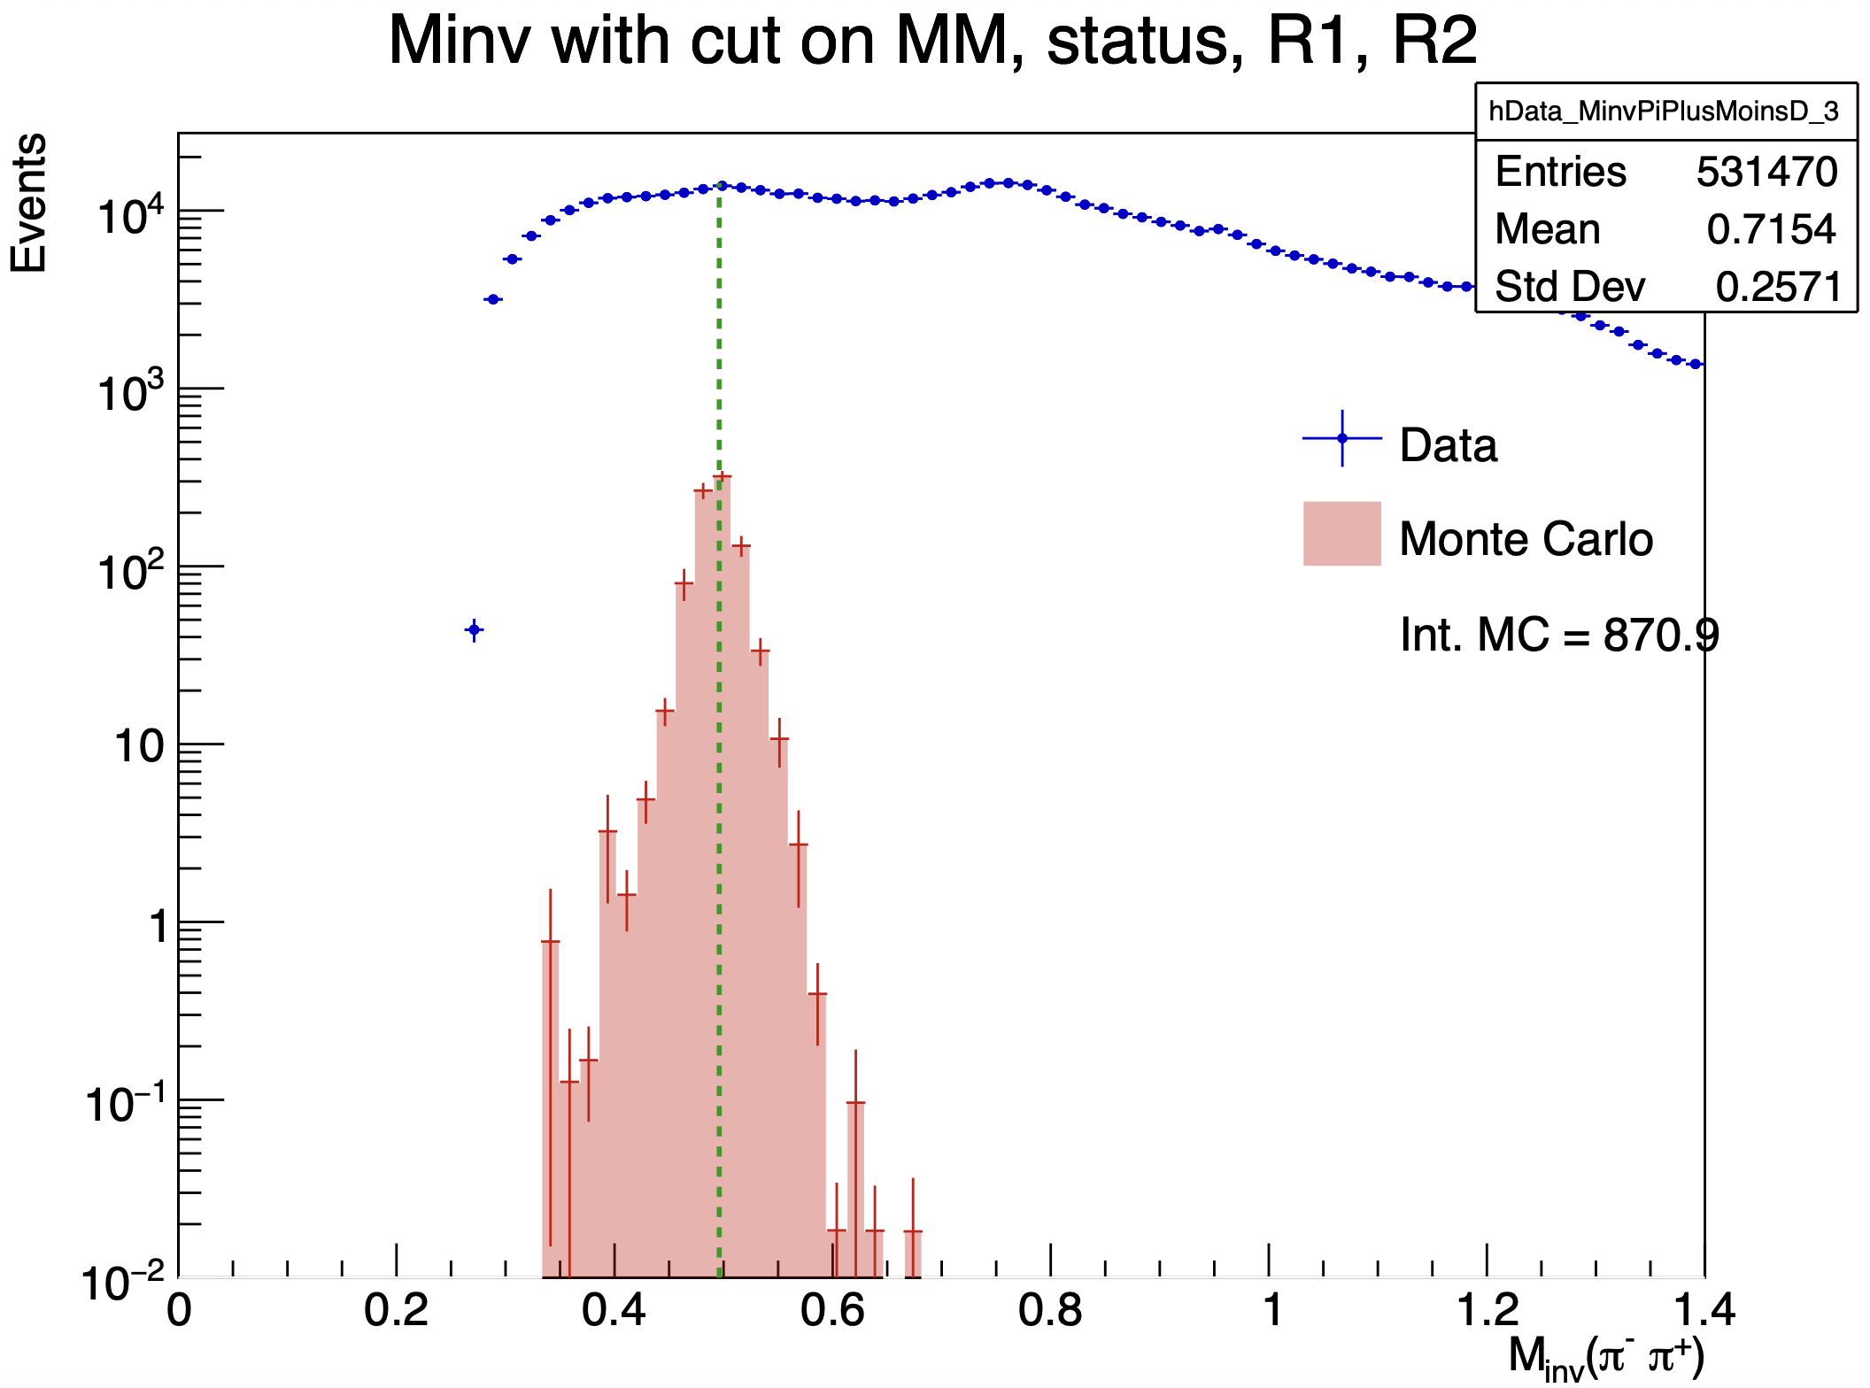
Simulation Monte Carlo with datas
Mathieu Ronayette
8/20
Mathieu Ronayette
meeting
15 Jan 2025

Slide 11
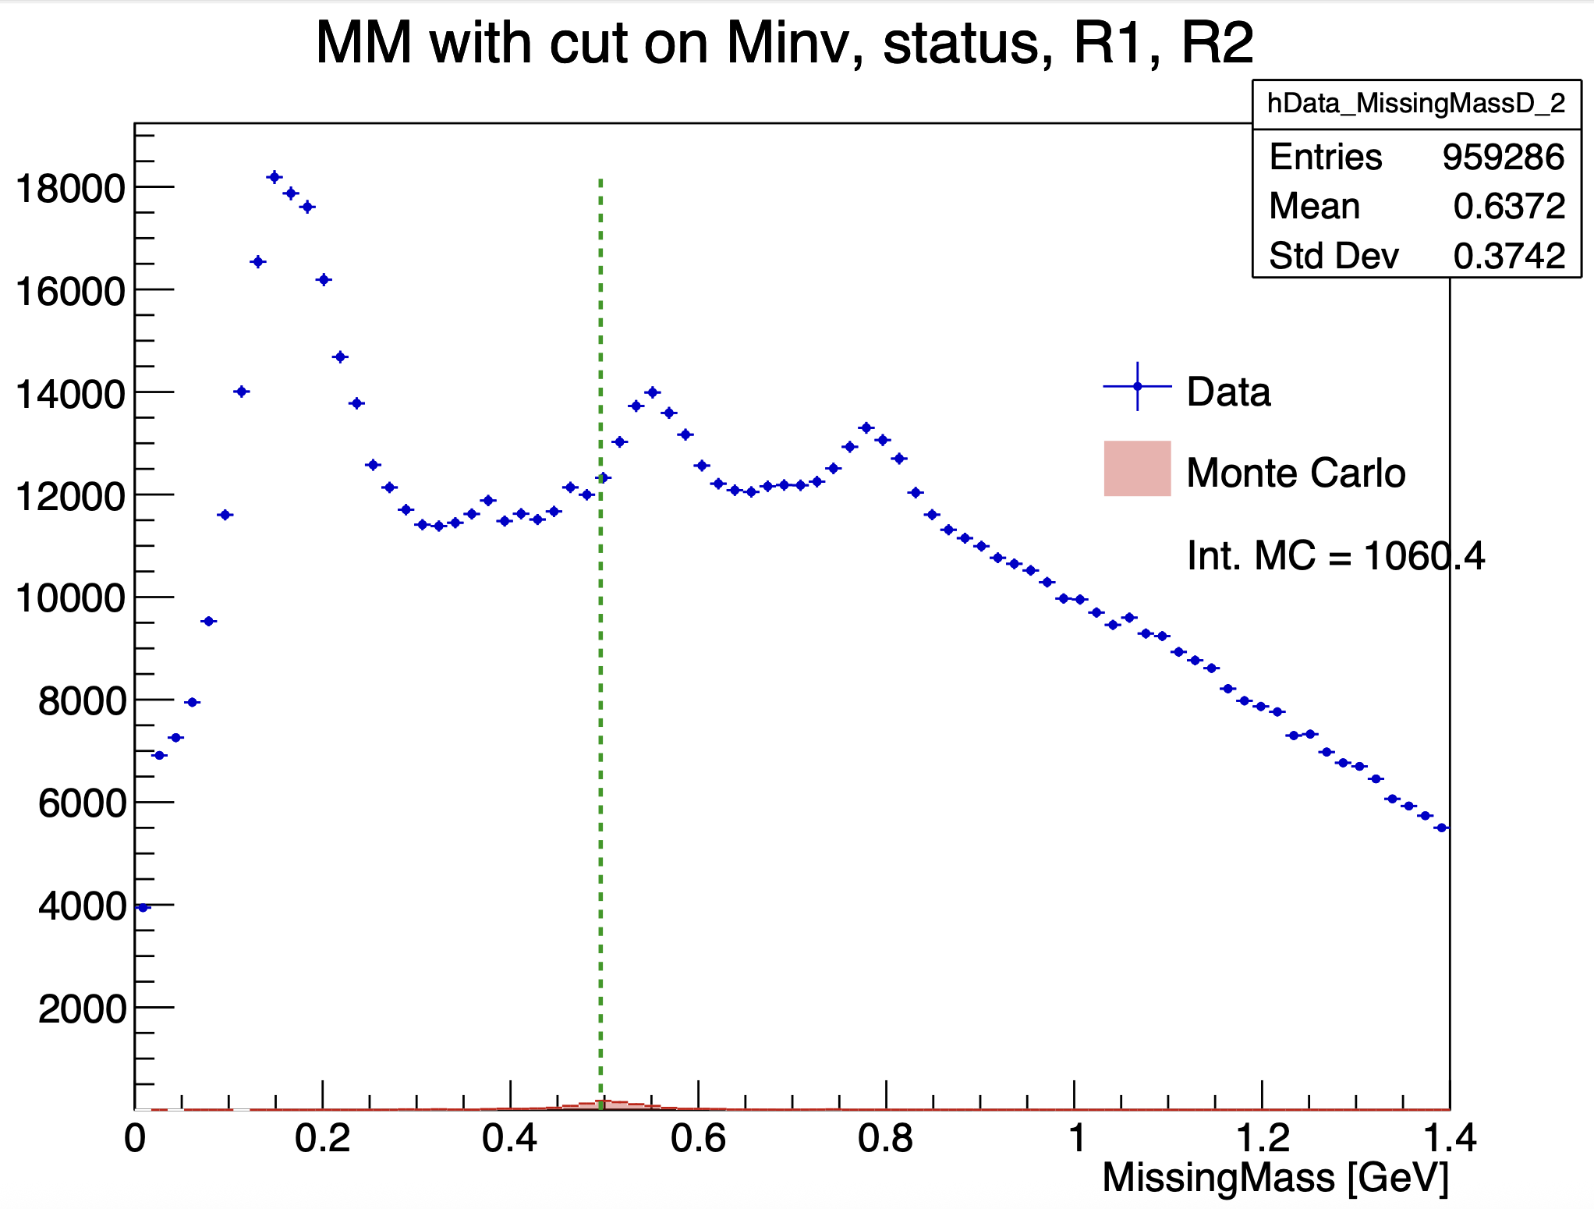
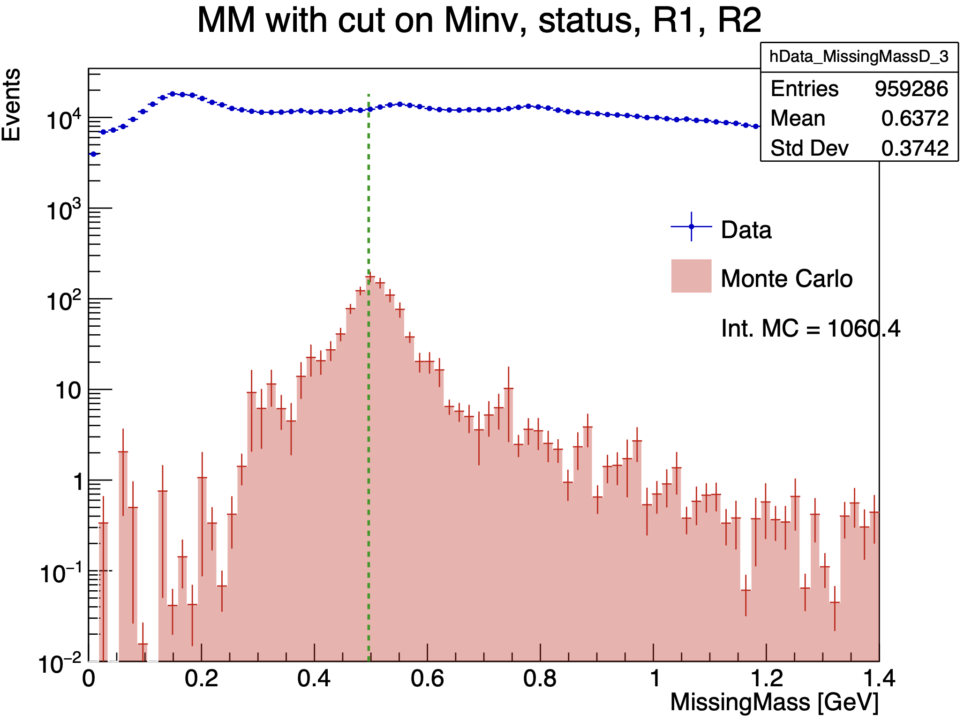
Simulation Monte Carlo with datas
Mathieu Ronayette
9/20
Mathieu Ronayette
meeting
15 Jan 2025

Slide 12
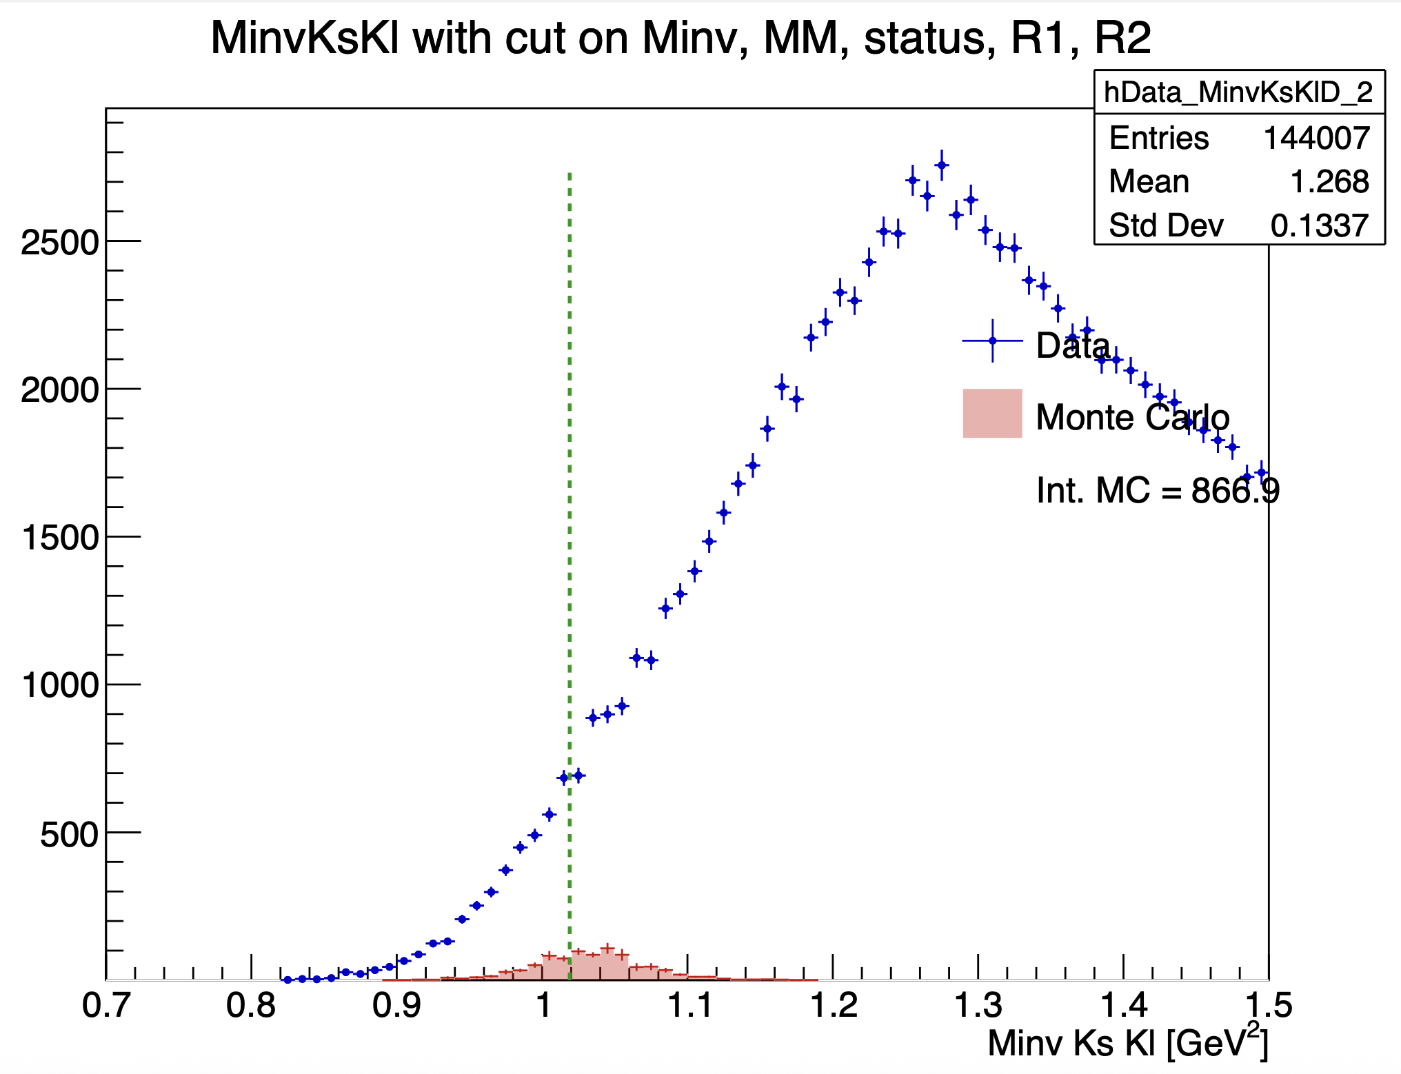
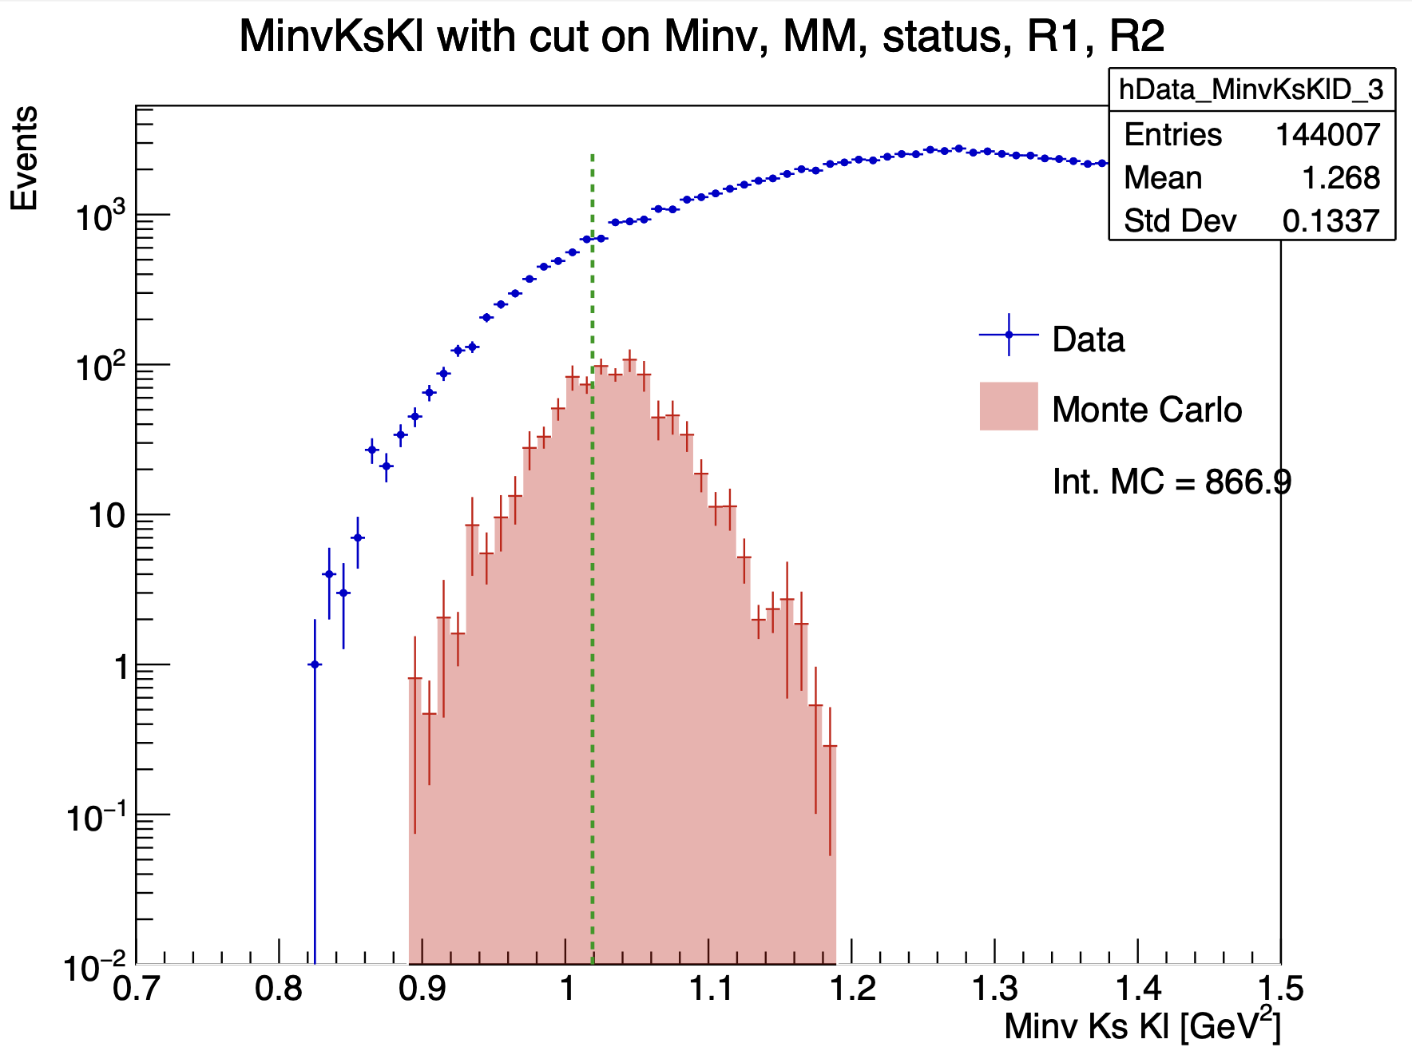
Simulation Monte Carlo with datas
Mathieu Ronayette
10/20
Mathieu Ronayette
meeting
15 Jan 2025

Slide 13
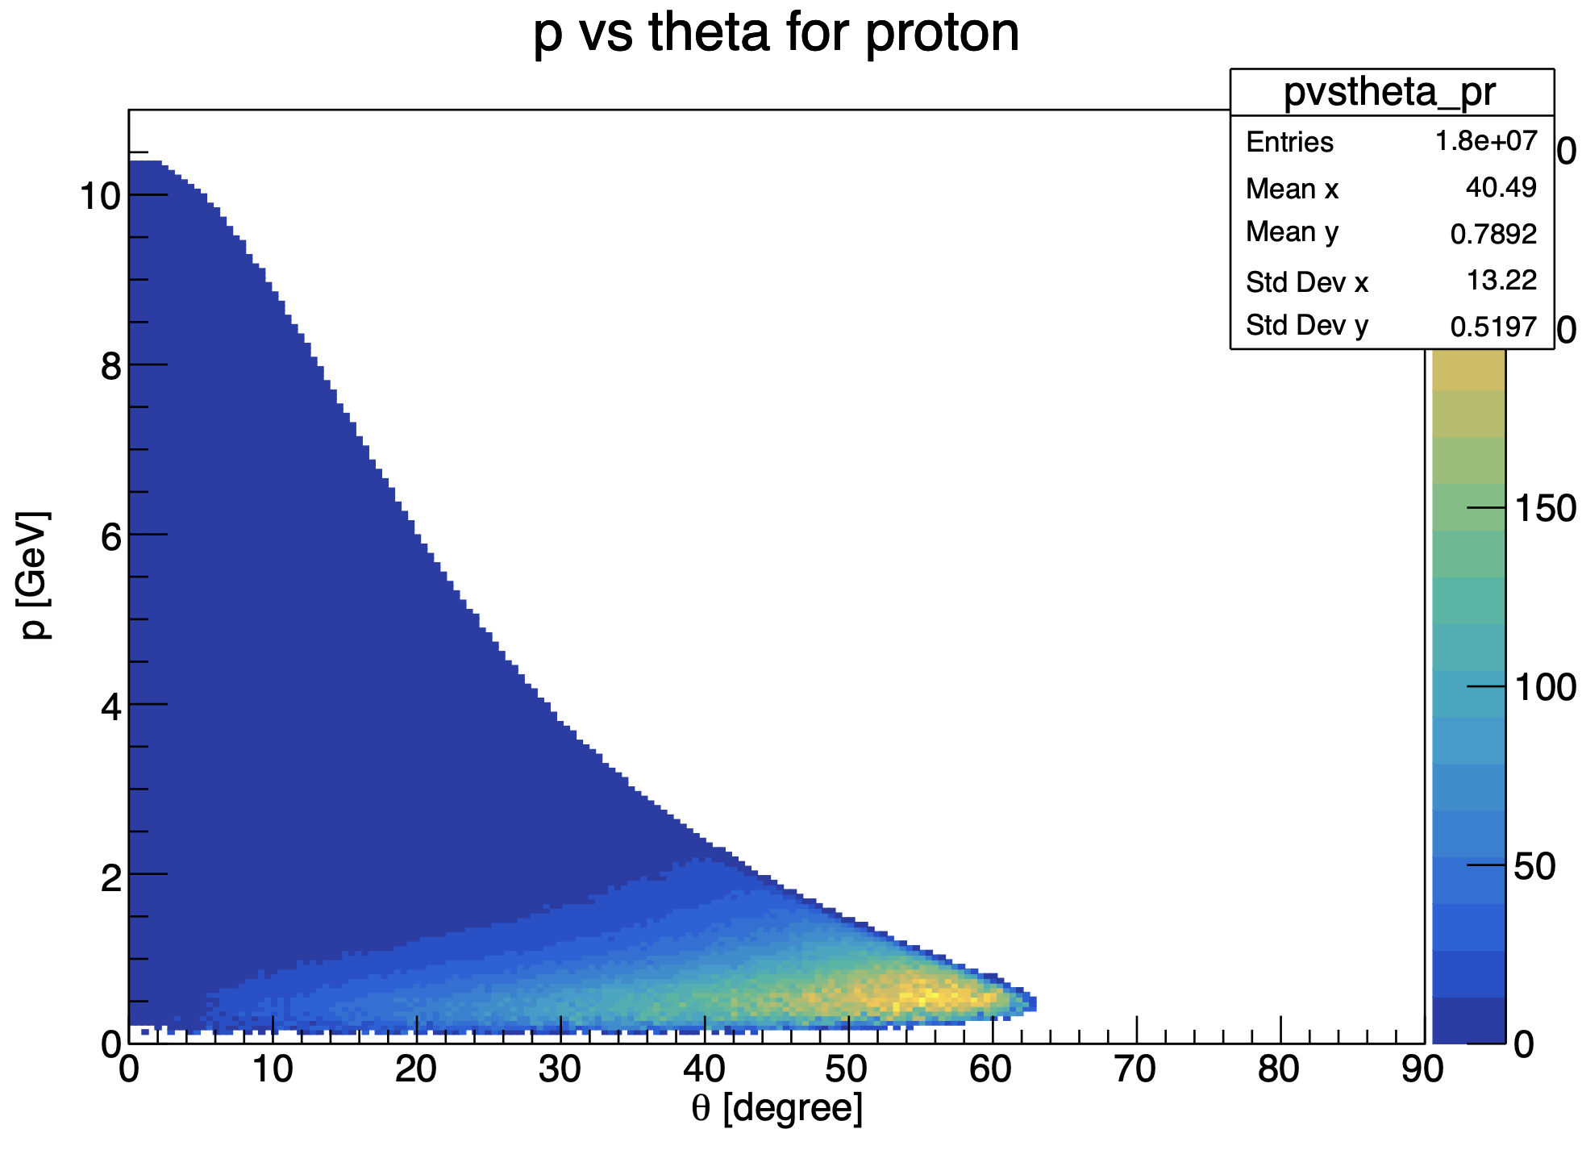
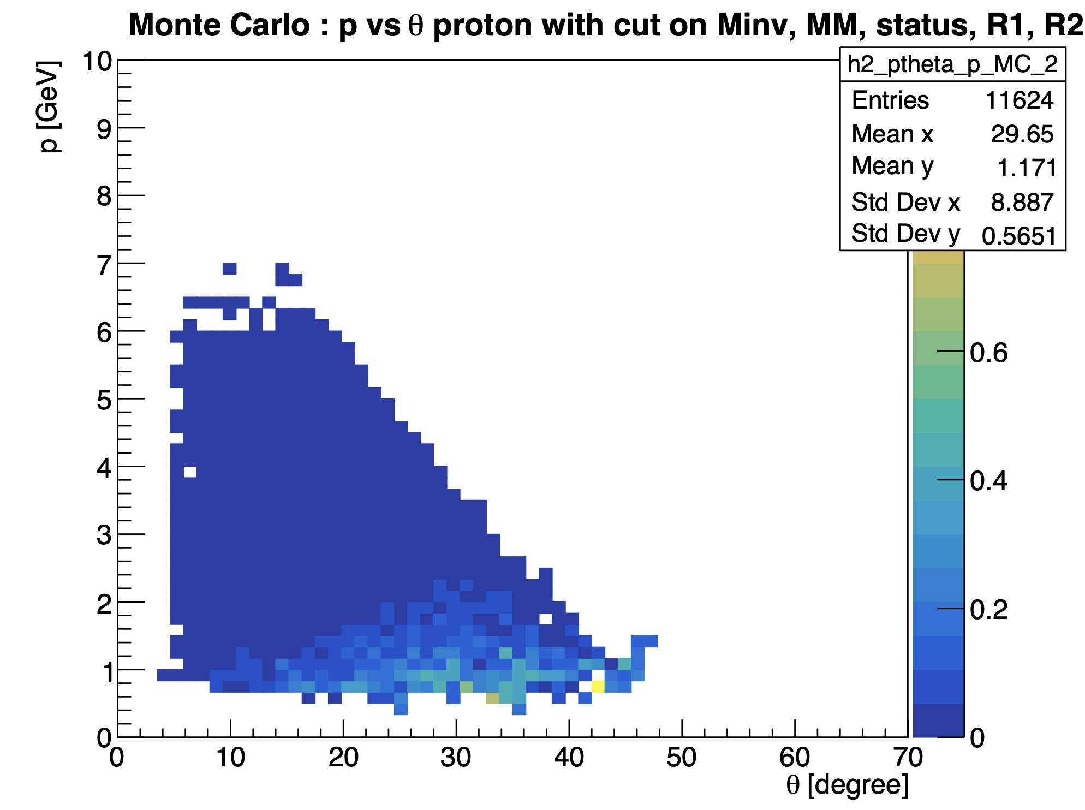
Simulation Monte Carlo with datas
Events generated
Events reconstructed (after cuts)
Mathieu Ronayette
11/20
Mathieu Ronayette
meeting
15 Jan 2025

Slide 14
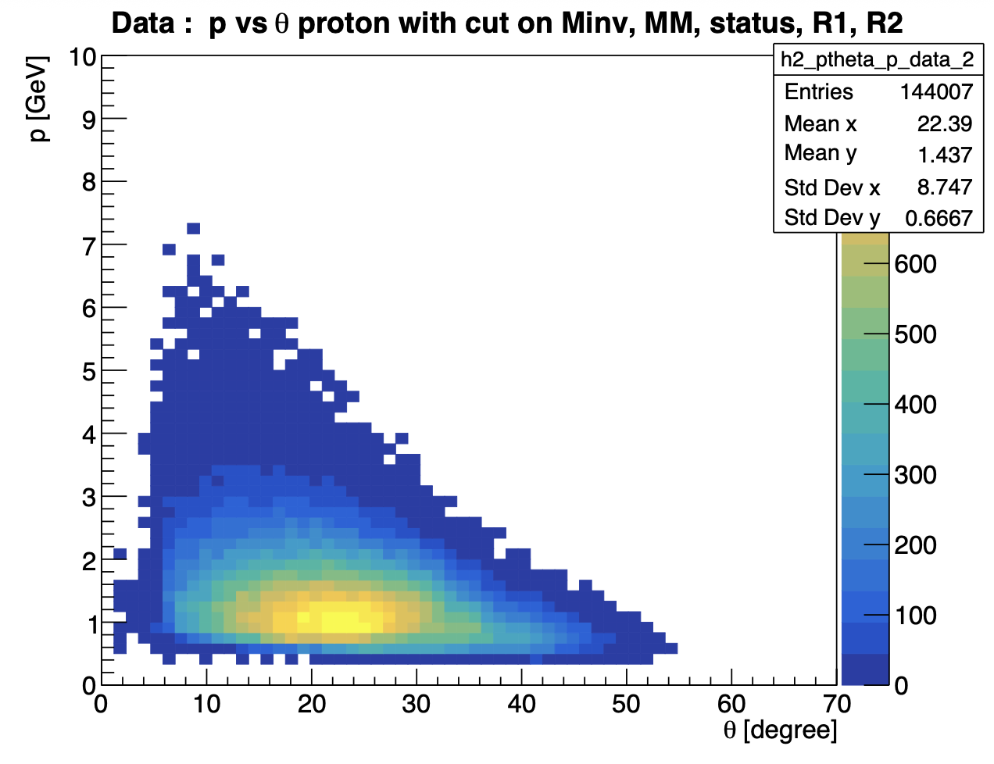
Simulation Monte Carlo with datas
Events generated
Events from data (after cuts)
Mathieu Ronayette
12/20
Mathieu Ronayette
meeting
15 Jan 2025

Slide 15
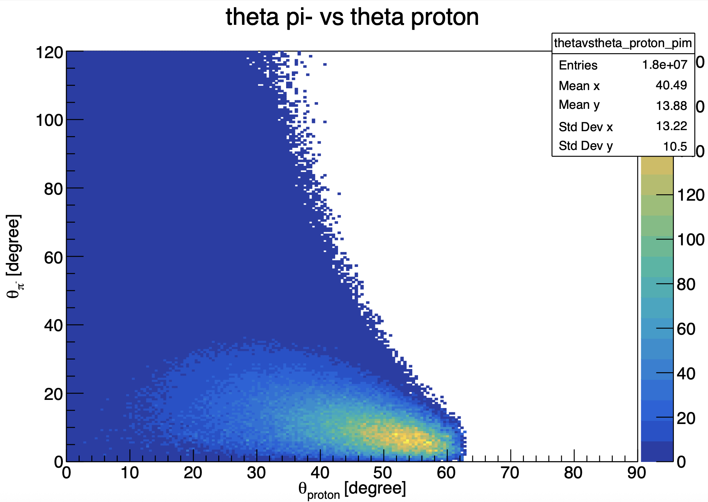
Simulation Monte Carlo with datas
Events generated
(same figure with pi+)
Mathieu Ronayette
13/20
Mathieu Ronayette
meeting
15 Jan 2025

Slide 16
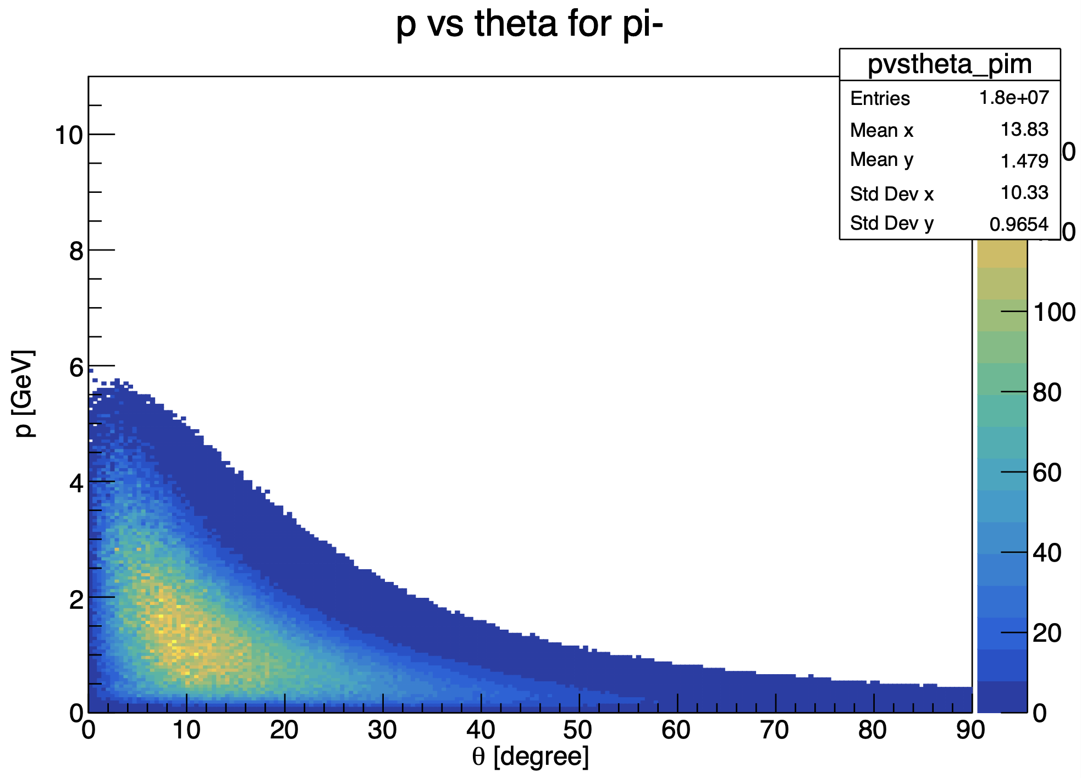

Simulation Monte Carlo with datas
Mathieu Ronayette
14/20
Mathieu Ronayette
meeting
15 Jan 2025

Slide 17
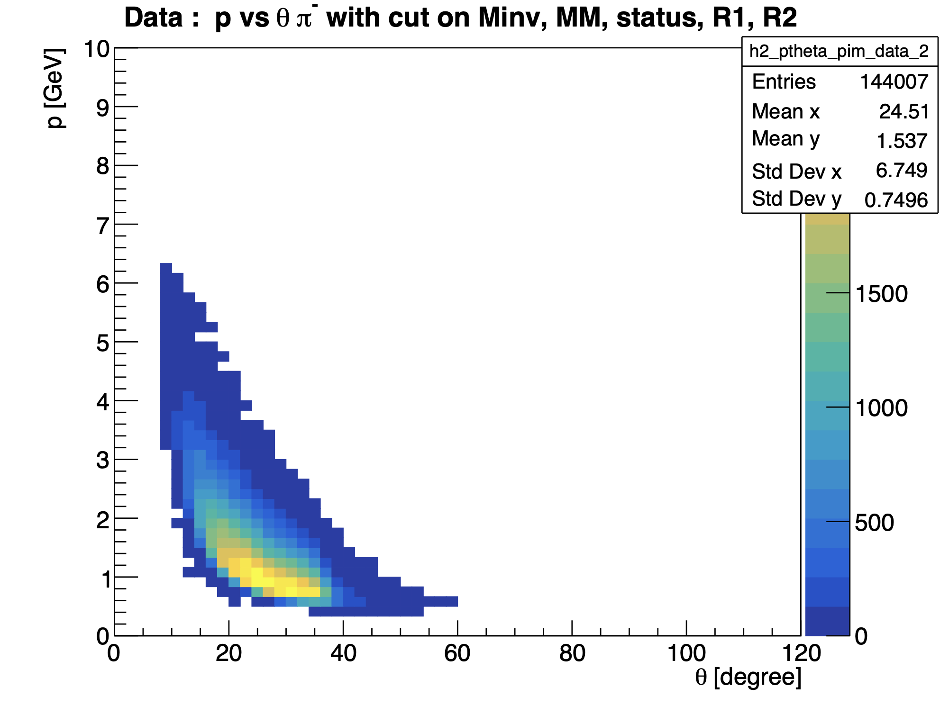
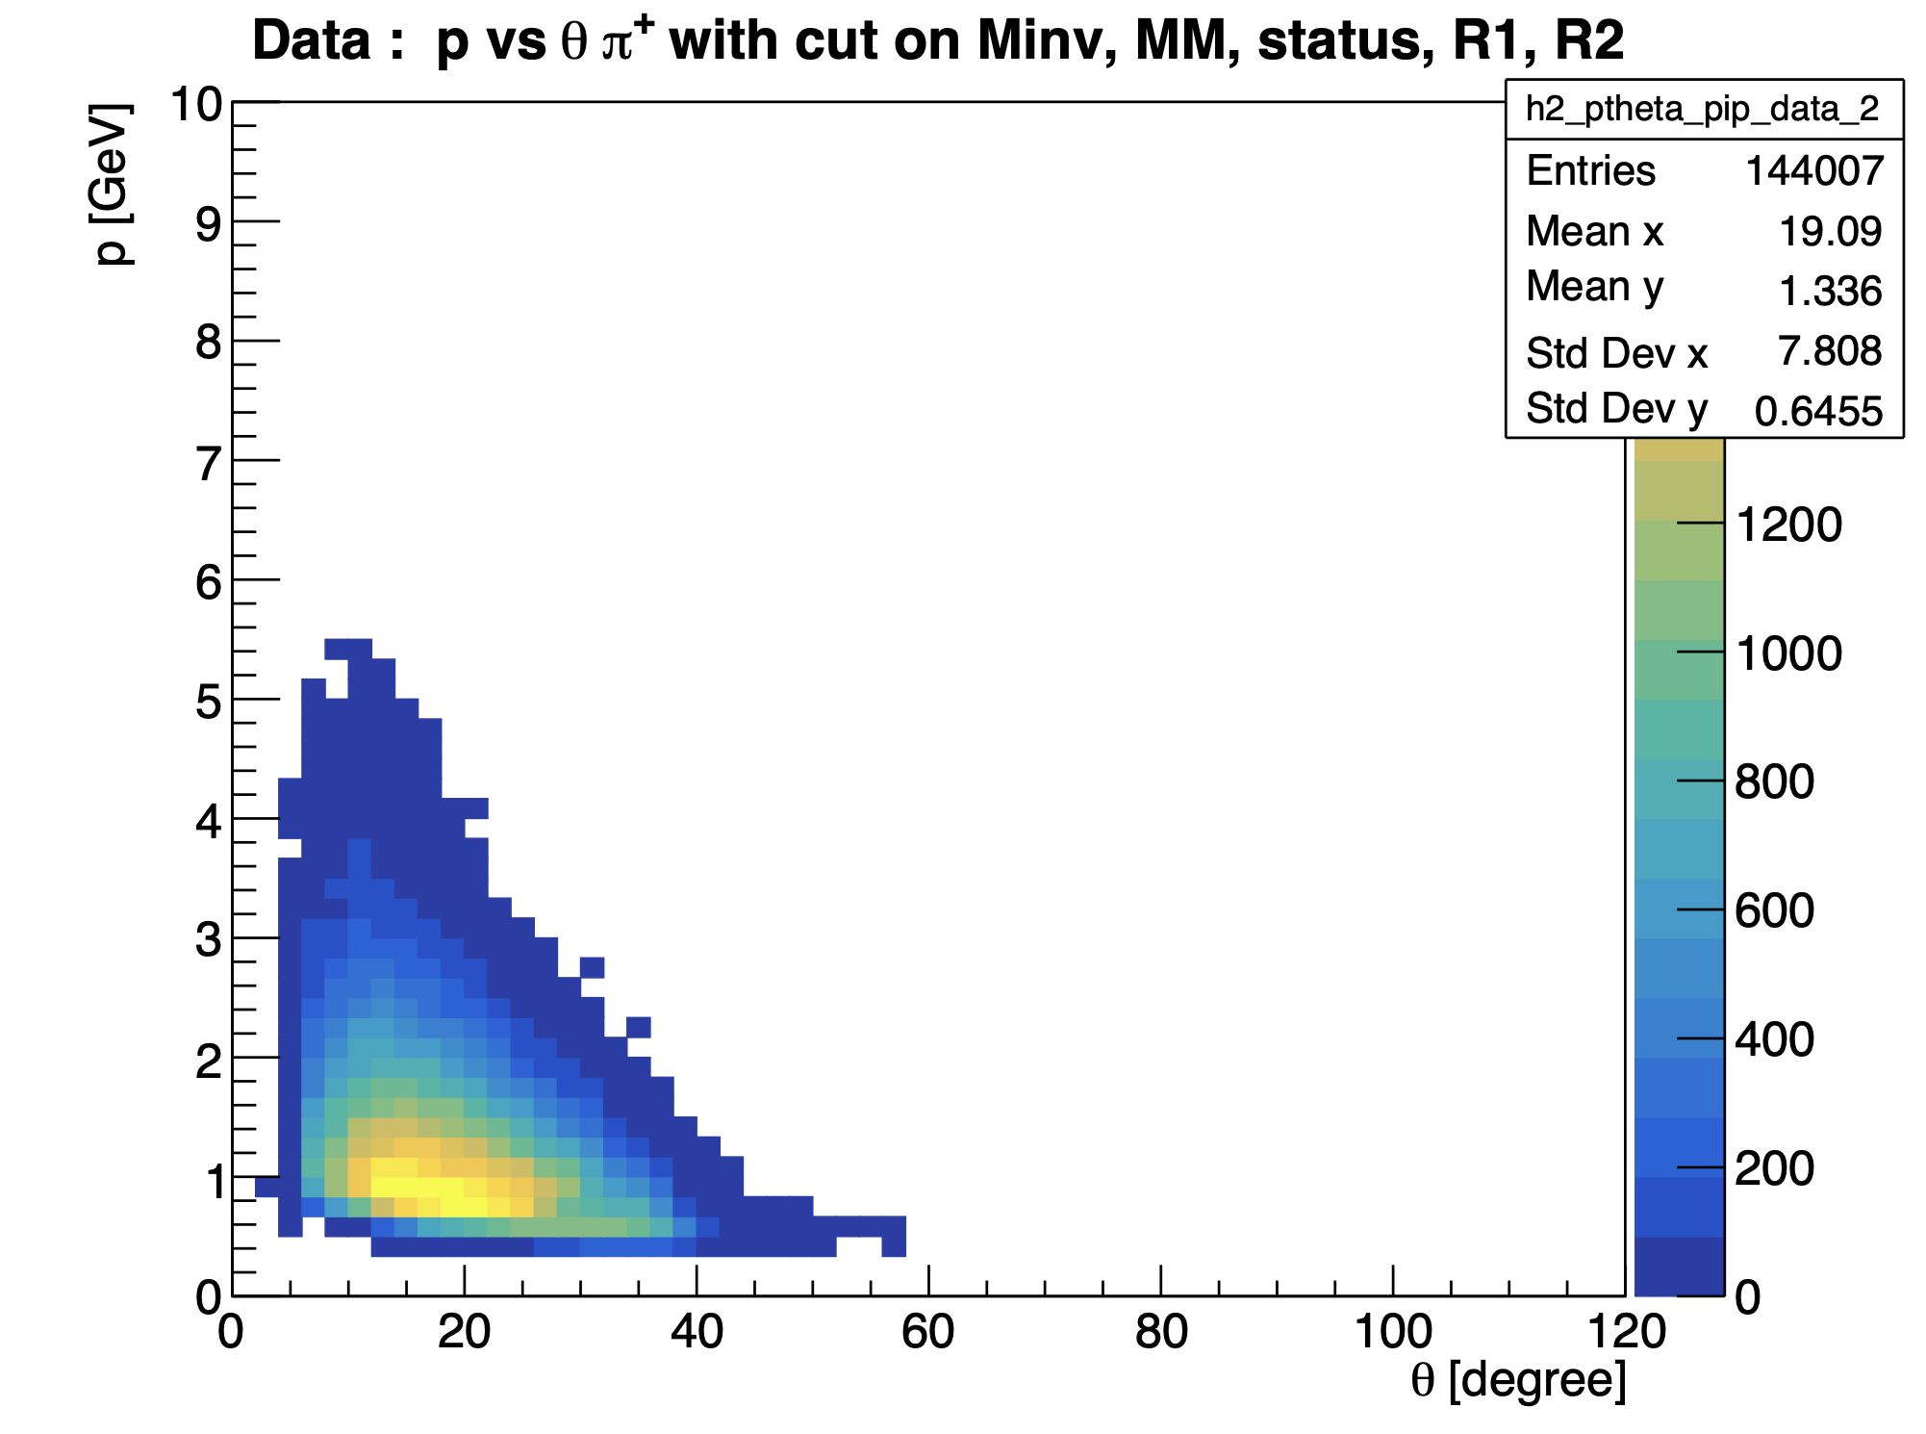
Simulation Monte Carlo with datas
DATA Inbending
Mathieu Ronayette
15/20
Mathieu Ronayette
meeting
15 Jan 2025

Slide 18
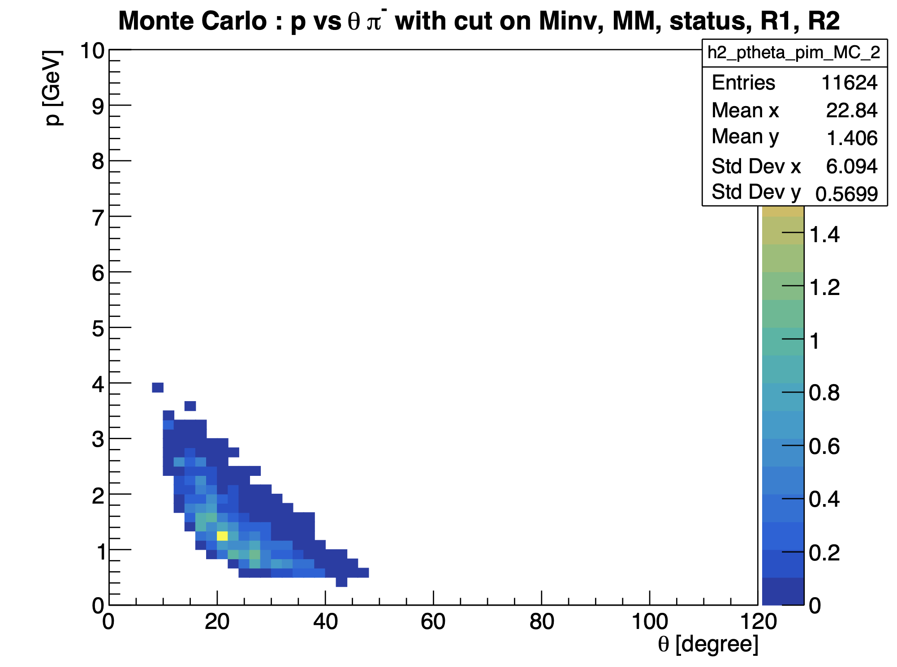
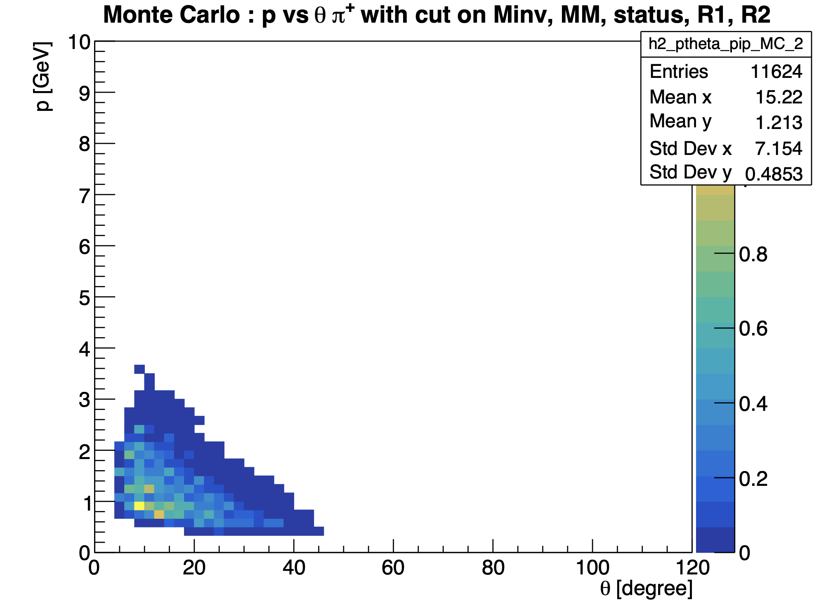
Simulation Monte Carlo with datas
MC Inbending
Mathieu Ronayette
16/20
Mathieu Ronayette
meeting
15 Jan 2025

Slide 19
Pions in the FT ?
For inbending : events with 1 proton 1 π ⁺ and 2 e⁻
→ one e⁻ in the FD (real e⁻)
→ one e⁻ in the FT (π – identified like an e⁻)
For outbending: events with 1 proton 1 π ⁻ and 2 e⁻
→ one e⁻ in the FD (real e⁻)
→ one e⁻ in the FT (π ⁺ identified like an e⁻)
No correction with veronique zigler code
→ no cuts on vertex
Mathieu Ronayette
17/20
Mathieu Ronayette
meeting
15 Jan 2025

Slide 20
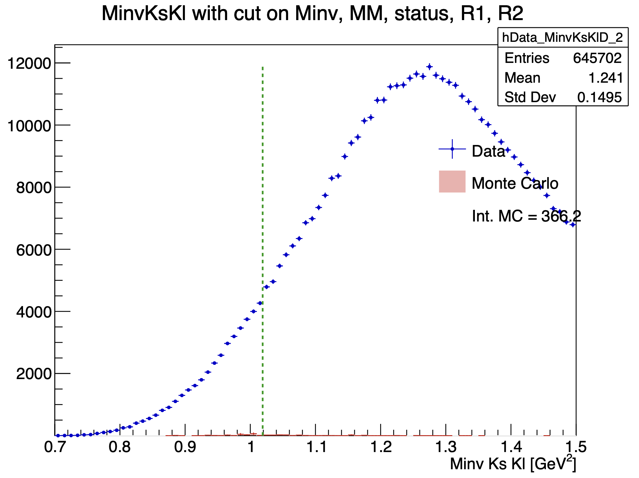
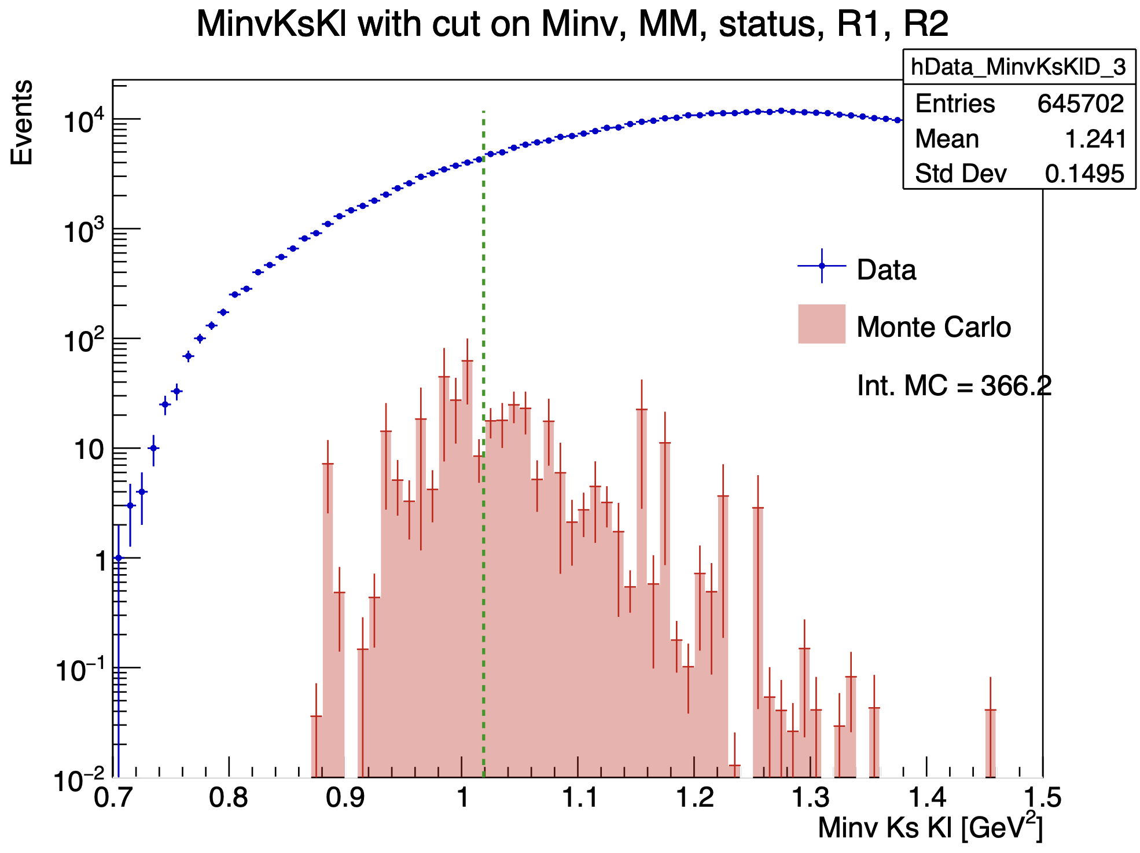
Pions in the FT ?
inbending
Mathieu Ronayette
18/20
Mathieu Ronayette
meeting
15 Jan 2025

Slide 21
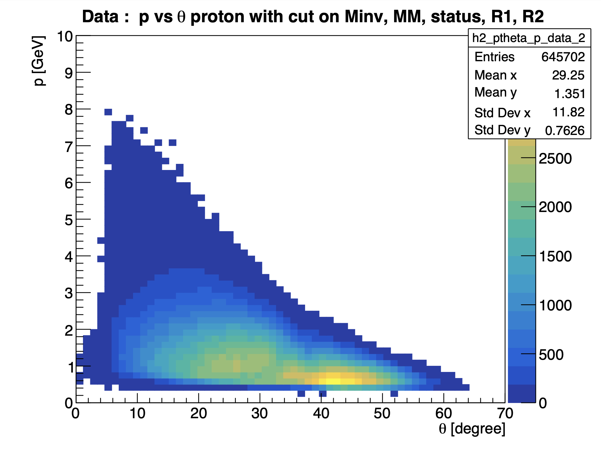
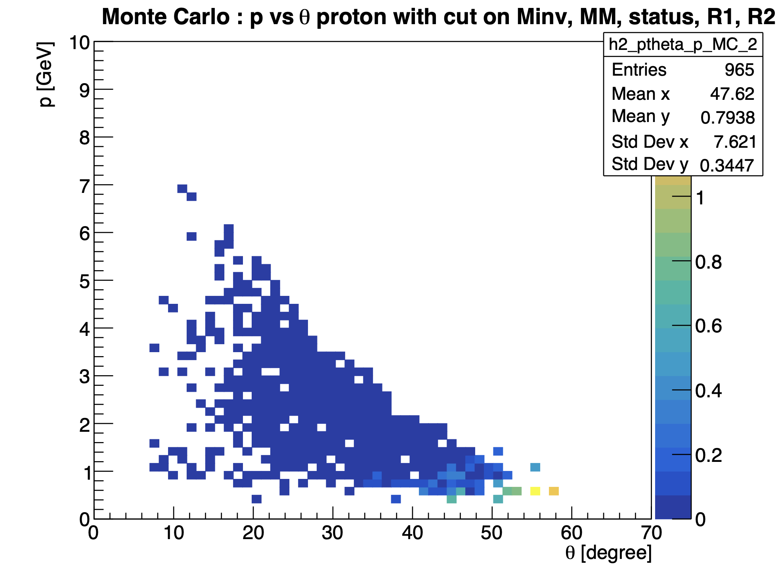
Pions in the FT ?
inbending
Mathieu Ronayette
19/20
Mathieu Ronayette
meeting
15 Jan 2025

Slide 22
Pions in the FT ?
Hypothesis :
This method make it possible to recover some events in the region where the π⁻ (in inbending) is at a small angle, but with very poor efficiency.
There may be no energy deposited in the FT calorimeter → no detection ?
Mathieu Ronayette
20/20
Mathieu Ronayette
meeting
15 Jan 2025

Slide 23
Update on ɸ generator
Backup ɸ generator
Mathieu Ronayette
18/18
Mathieu Ronayette
meeting
27 Nov 2025

Slide 24
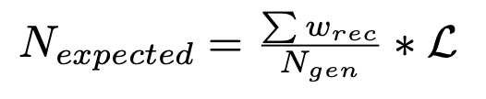
Update on ɸ generator
Simulation objectives :
- Estimate the expected number of ɸ with
- Find interresting cuts
π⁺
e
e’
Ks
π⁻
Previously with TGenPhasespace (root module) :
- Generate automatically quadri-impulsion in the phasespace
- But problems with the weight associated with the phasespace
q
ɸ
Kl
p
p’
→ In the next slides the generator that we implemented without TGenPhaseSpace
Mathieu Ronayette
1/18
Mathieu Ronayette
meeting
27 Nov 2025

Slide 25
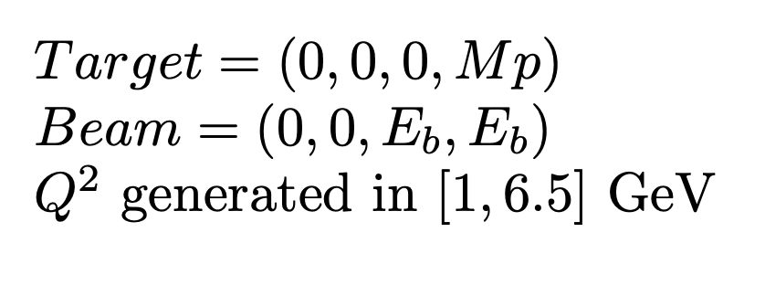
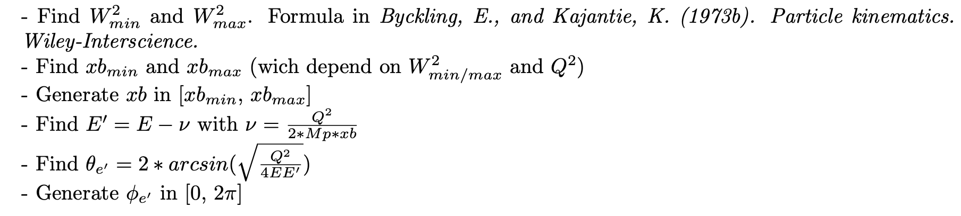
Update on ɸ generator
Initially :
e
e’
q
2. Scattering electron kinematics :
Mathieu Ronayette
2/18
Mathieu Ronayette
meeting
27 Nov 2025

Slide 26

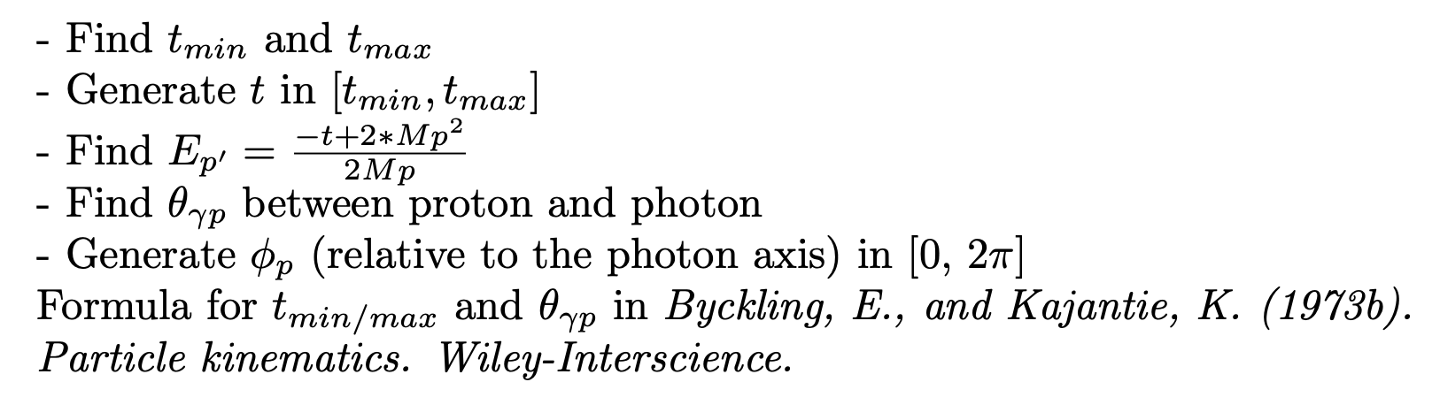

Update on ɸ generator
3. Virtual photon kinematics :
q
ɸ
4. Scattering proton kinematics :
p
p’
5. Meson ɸ kinematics :
Mathieu Ronayette
3/18
Mathieu Ronayette
meeting
27 Nov 2025

Slide 27
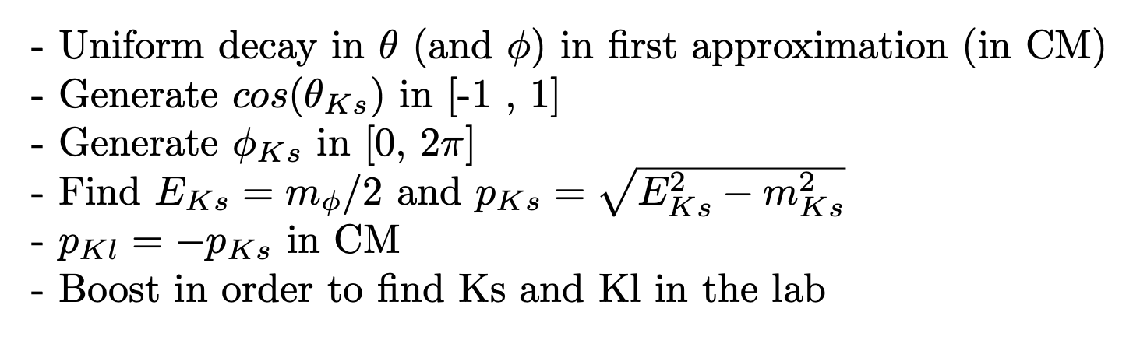
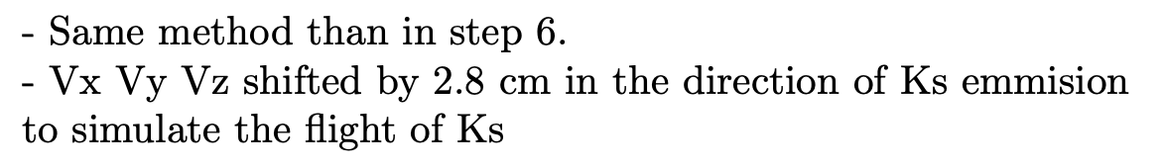
Update on ɸ generator
Ks
6. Kinematics of second decay ɸ → Ks Kl :
_{Ks}
ɸ
Kl
π⁺
7. Kinematics of thrid decay Ks → π⁺ π⁻ :
π⁺
Ks
π⁻
Mathieu Ronayette
4/18
Mathieu Ronayette
meeting
27 Nov 2025

Slide 28
Update on ɸ generator
From Proposal to Jeﬀerson Lab PAC39 Exclusive Phi Meson Electroproduction with CLAS12
Branching ratio Ks → π⁺ π⁻ = 69%
Branching ratio ɸ → Ks Kl = 34%
Mathieu Ronayette
5/18
Mathieu Ronayette
meeting
27 Nov 2025

Slide 29
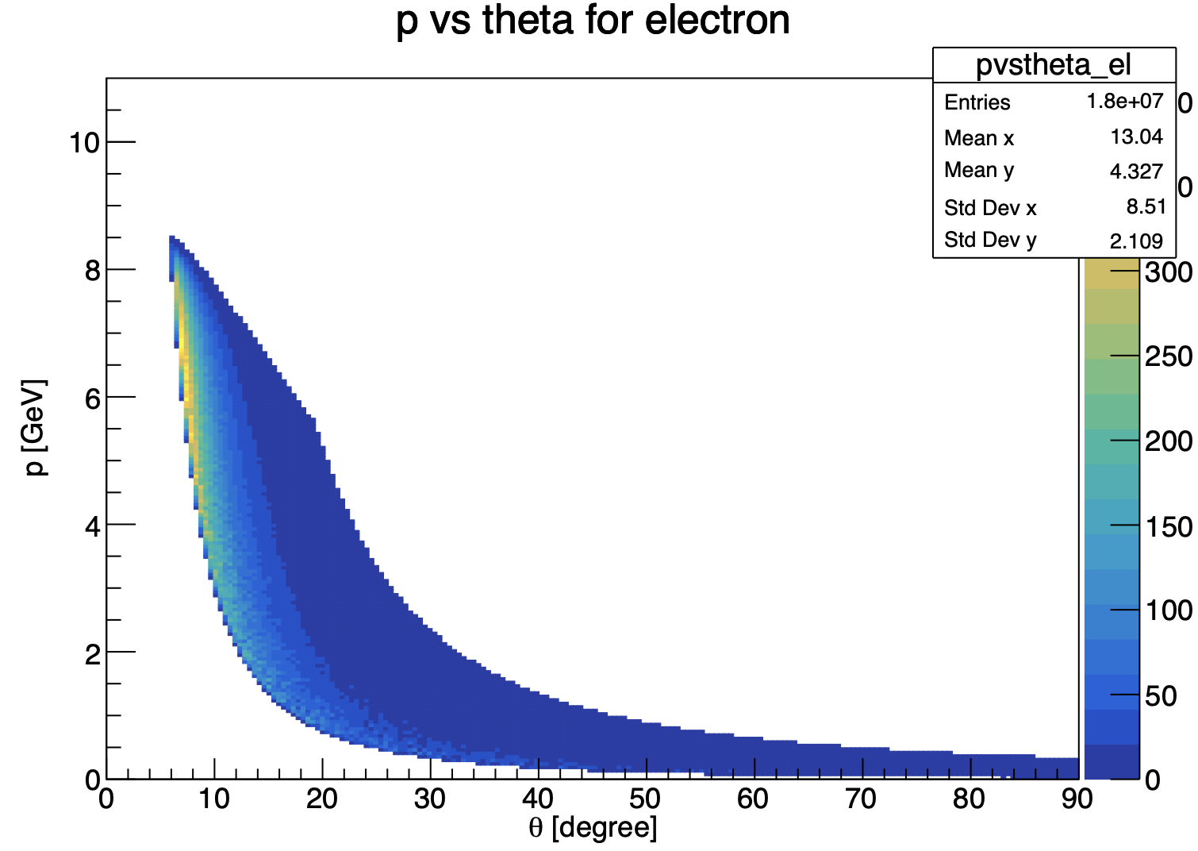
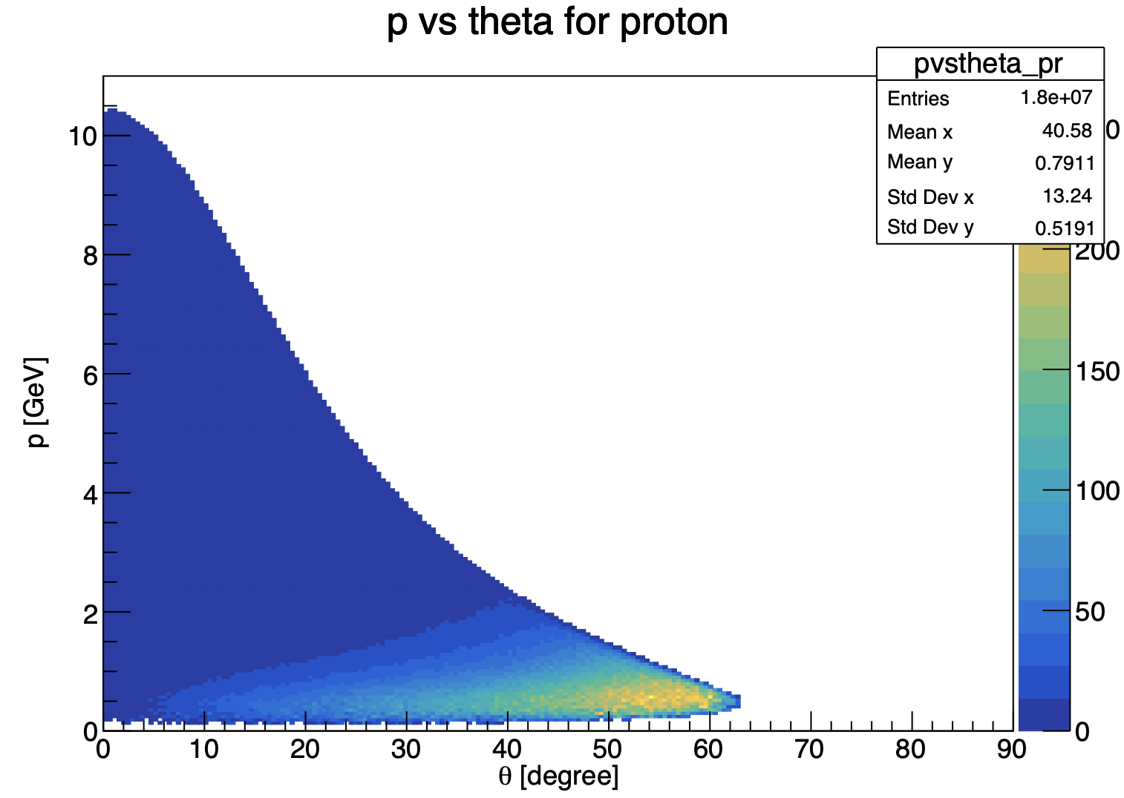
Update on ɸ generator
Mathieu Ronayette
6/18
Mathieu Ronayette
meeting
27 Nov 2025

Slide 30
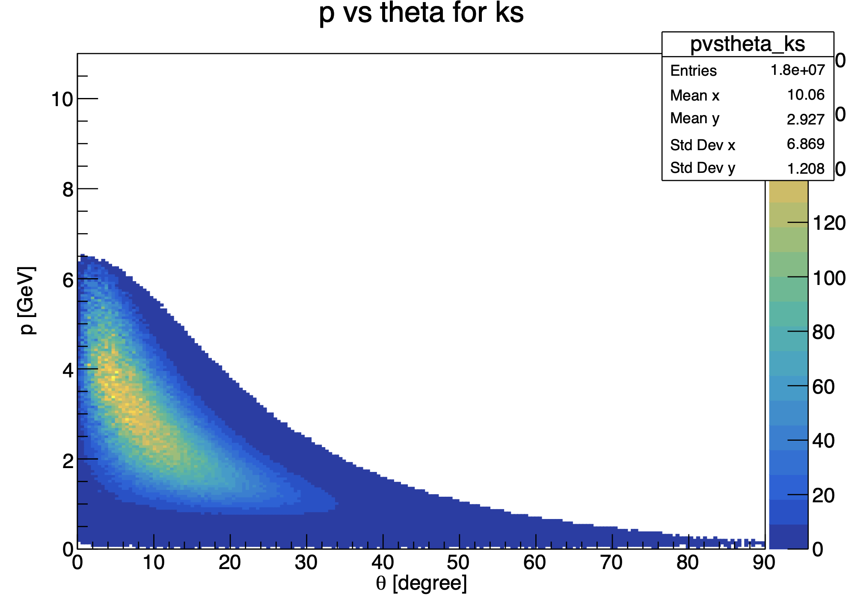
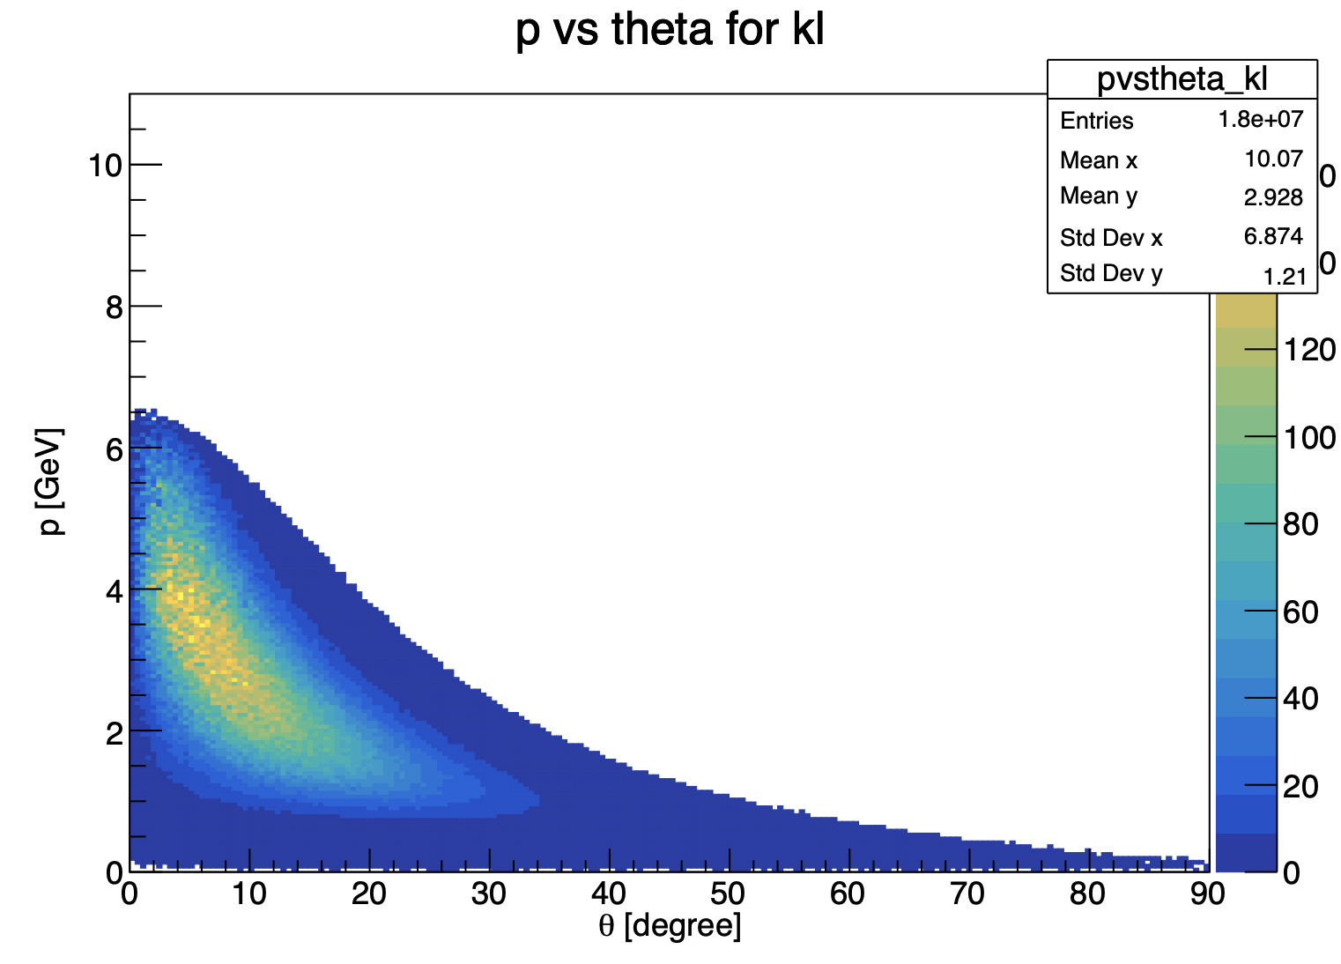
Update on ɸ generator
Mathieu Ronayette
7/18
Mathieu Ronayette
meeting
27 Nov 2025

Slide 31
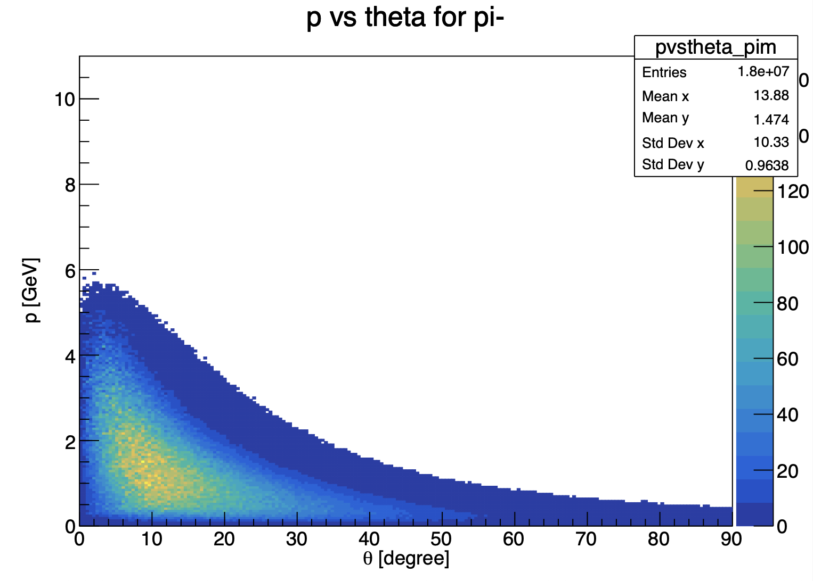

Update on ɸ generator
Mathieu Ronayette
8/18
Mathieu Ronayette
meeting
27 Nov 2025

Slide 32
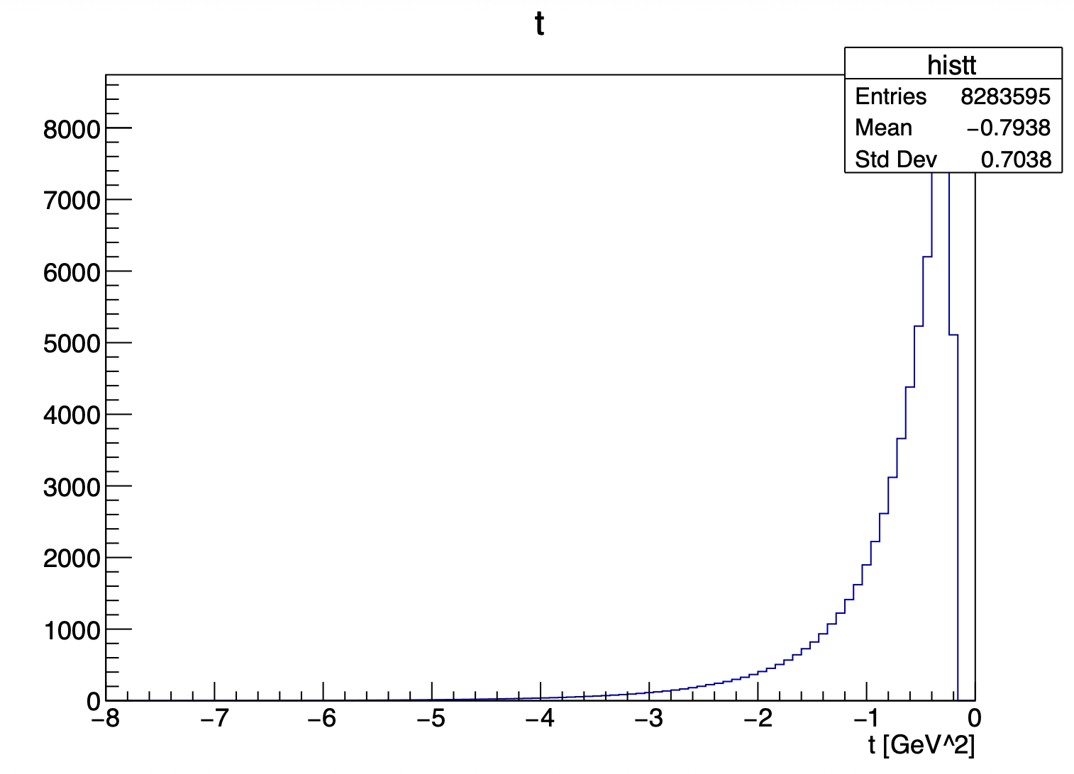
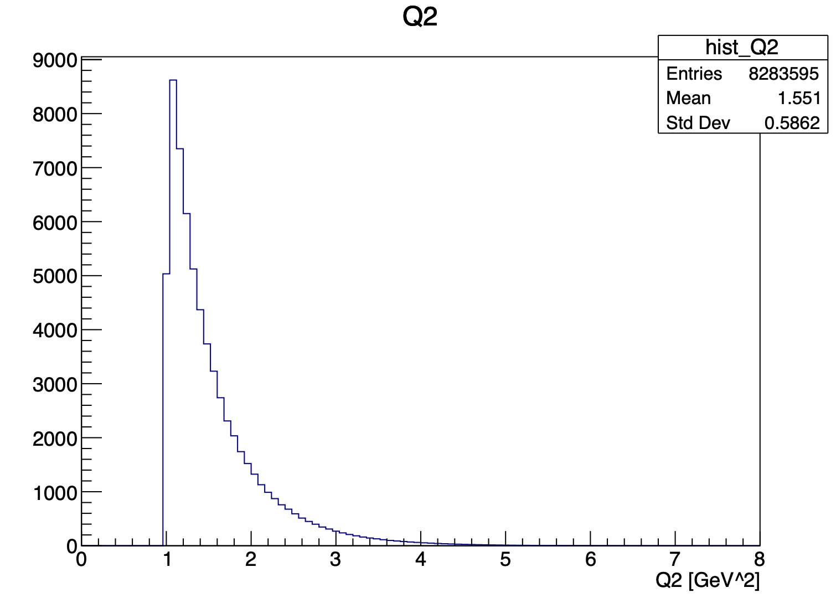
Update on ɸ generator
Mathieu Ronayette
9/18
Mathieu Ronayette
meeting
27 Nov 2025

Slide 33
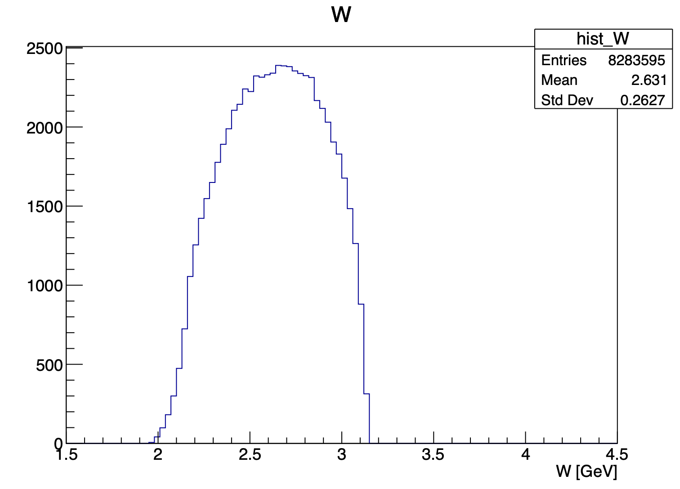
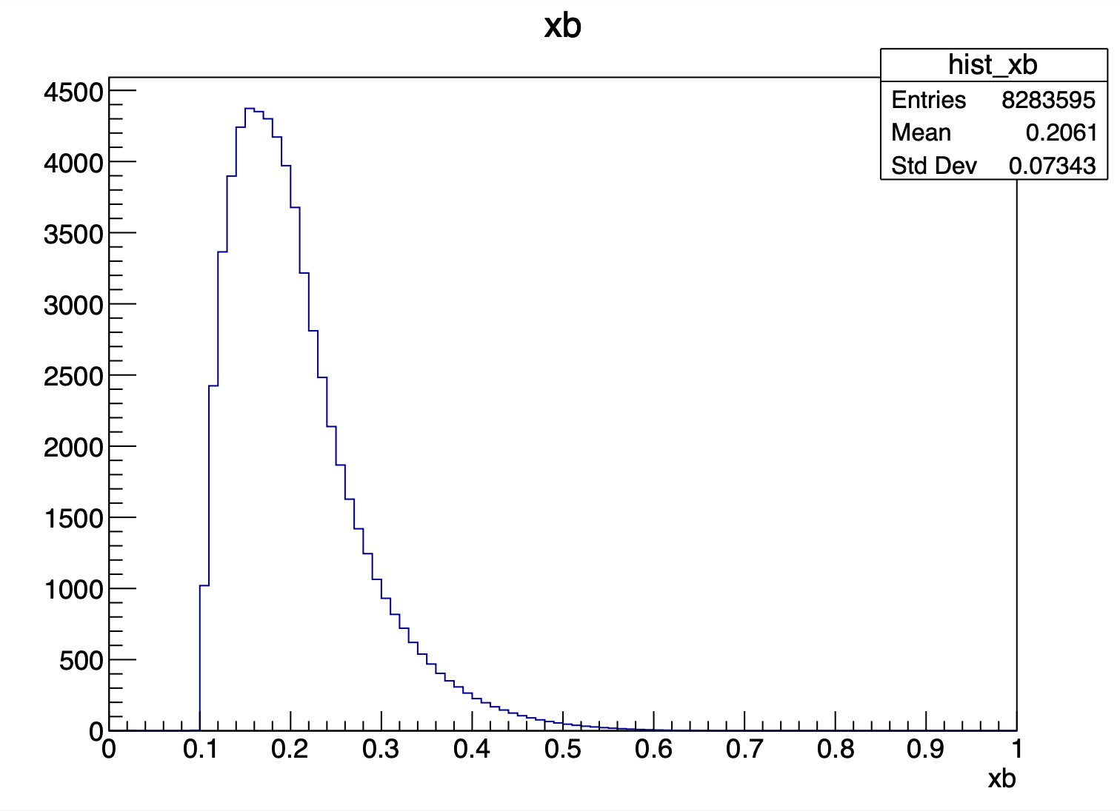
Update on ɸ generator
Mathieu Ronayette
10/18
Mathieu Ronayette
meeting
27 Nov 2025

Slide 34
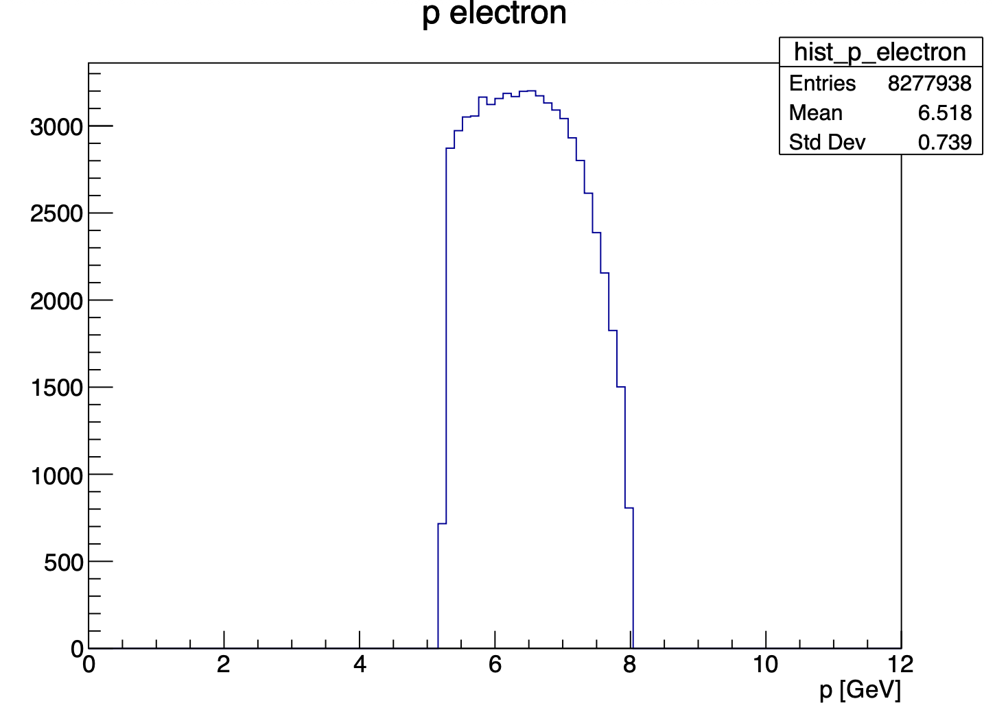
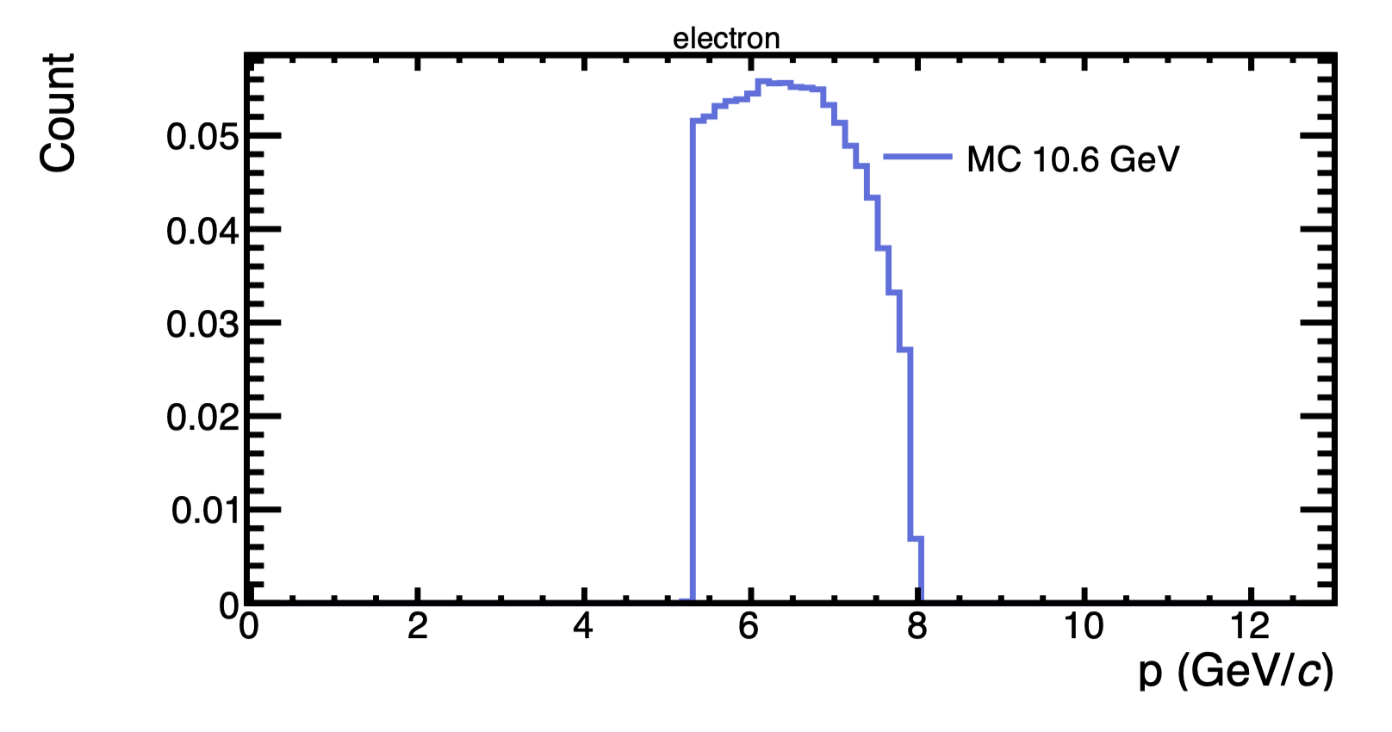
Update on ɸ generator
With this cuts : 5.25 < P_{electron} < 8 GeV and P_{proton} > 0.45 GeV
my generator
Bhawani plot
Mathieu Ronayette
11/18
Mathieu Ronayette
meeting
27 Nov 2025

Slide 35
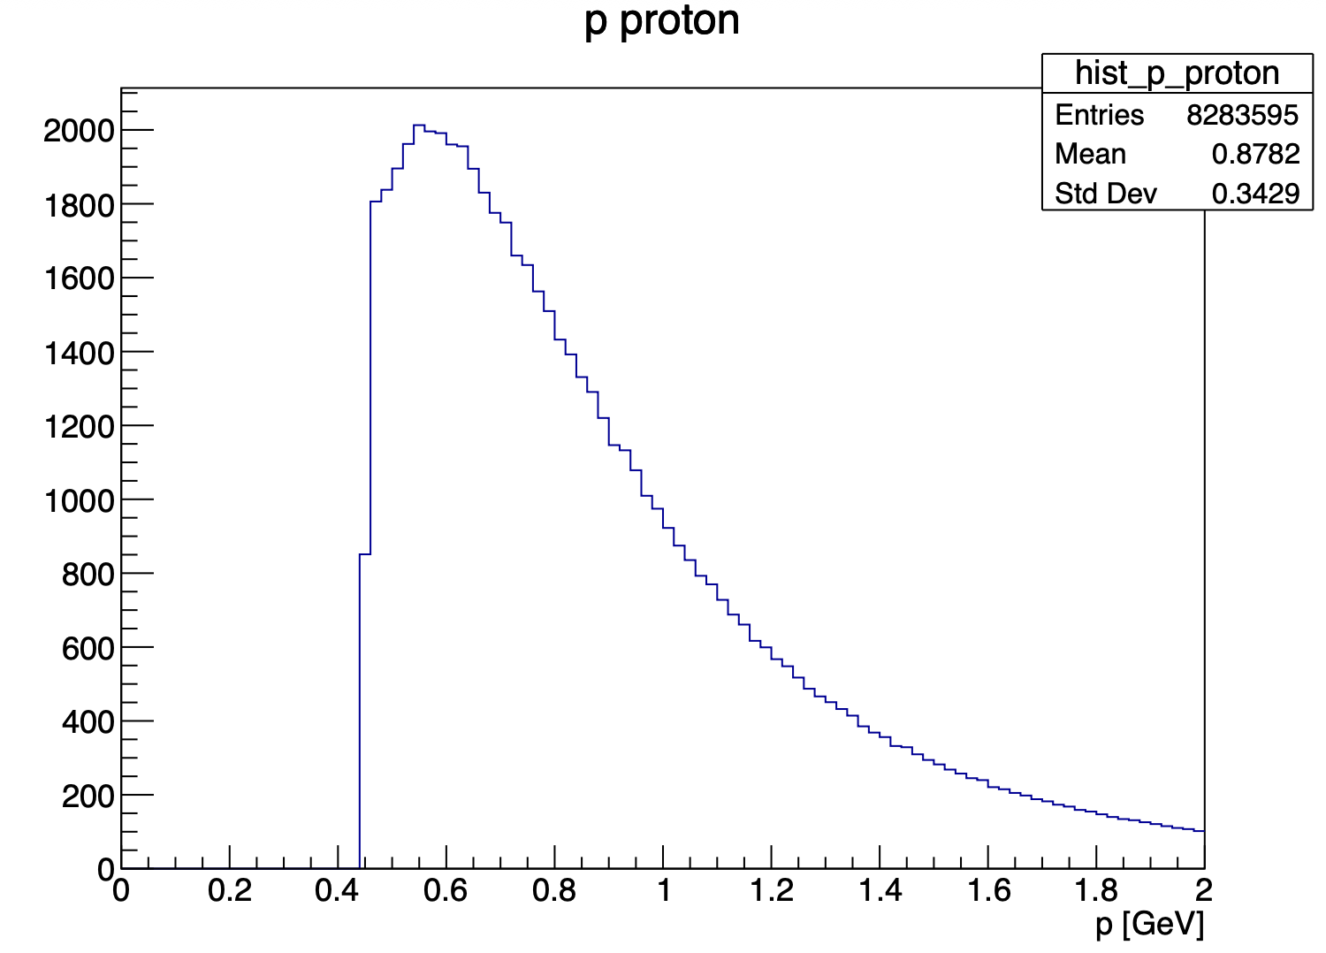
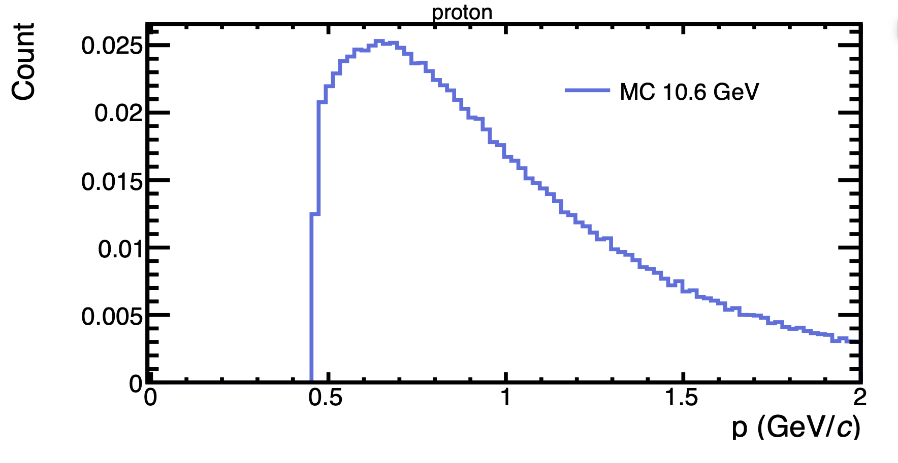
Update on ɸ generator
With this cuts : 5.25 < P_{electron} < 8 GeV and P_{proton} > 0.45 GeV
my generator
Bhawani plot
Mathieu Ronayette
12/18
Mathieu Ronayette
meeting
27 Nov 2025

Slide 36
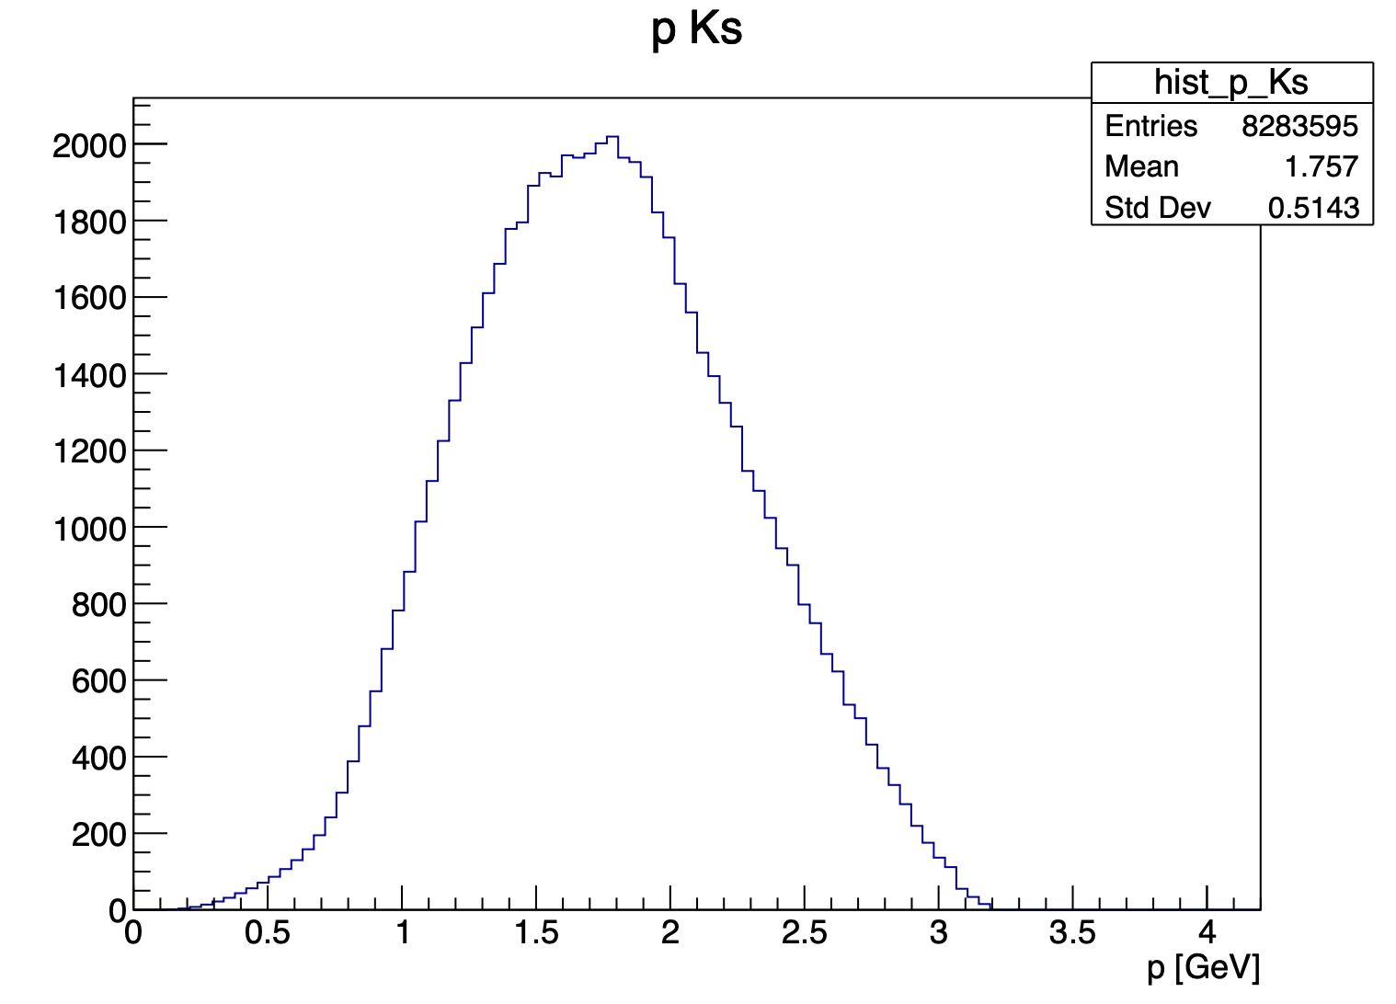

Update on ɸ generator
With this cuts : 5.25 < P_{electron} < 8 GeV and P_{proton} > 0.45 GeV
my generator
Bhawani plot
Mathieu Ronayette
13/18
Mathieu Ronayette
meeting
27 Nov 2025

Slide 37


Update on ɸ generator
With this cuts : 5.25 < P_{electron} < 8 GeV and P_{proton} > 0.45 GeV
my generator
Bhawani plot
Mathieu Ronayette
14/18
Mathieu Ronayette
meeting
27 Nov 2025

Slide 38


Update on ɸ generator
With this cuts : 5.25 < P_{electron} < 8 GeV and P_{proton} > 0.45 GeV
my generator
Bhawani plot
Mathieu Ronayette
15/18
Mathieu Ronayette
meeting
27 Nov 2025

Slide 39


Update on ɸ generator
With this cuts : 5.25 < P_{electron} < 8 GeV and P_{proton} > 0.45 GeV
my generator
Bhawani plot
Mathieu Ronayette
16/18
Mathieu Ronayette
meeting
27 Nov 2025

Slide 40


Update on ɸ generator
With this cuts : 5.25 < P_{electron} < 8 GeV and P_{proton} > 0.45 GeV
my generator
Bhawani plot
Mathieu Ronayette
17/18
Mathieu Ronayette
meeting
27 Nov 2025

Slide 41
Update on ɸ generator
Backup cross section
Mathieu Ronayette
18/18
Mathieu Ronayette
meeting
27 Nov 2025

Slide 42





Update on ɸ generator
Details on cross section :
σ_{T} and σ_{L} (γ*p → ɸ p) :
t-dependence (dipole) :
Mathieu Ronayette
5/15
Mathieu Ronayette
meeting
7 Nov 2025

Slide 43


Update on ɸ generator
Cross section (ep → ɸ p) :
The virtual photon flux :
Mathieu Ronayette
6/15
Mathieu Ronayette
meeting
7 Nov 2025

Slide 44


Update on ɸ generator
Implemented in the generator
From Proposal to Jeﬀerson Lab PAC39
Mathieu Ronayette
7/15
Mathieu Ronayette
meeting
7 Nov 2025

Slide 45


Update on ɸ generator
Implemented in the generator
From Proposal to Jeﬀerson Lab PAC39
Mathieu Ronayette
8/15
Mathieu Ronayette
meeting
7 Nov 2025

Slide 46


Update on ɸ generator
Implemented in the generator
From Proposal to Jeﬀerson Lab PAC39
Mathieu Ronayette
9/15
Mathieu Ronayette
meeting
7 Nov 2025

Slide 47


Update on ɸ generator
Implemented in the generator
From Proposal to Jeﬀerson Lab PAC39
Mathieu Ronayette
10/15
Mathieu Ronayette
meeting
7 Nov 2025

Slide 48

Update on ɸ generator
Cross section (ep → ɸ p) (with the virtual photon flux) :
Implemented in the generator
Mathieu Ronayette
11/15
Mathieu Ronayette
meeting
7 Nov 2025

