Slide 1
rgB - meeting
ɸ electroproduction analysis : K⁺ K⁻ channel
13 Feb 2026
M. Ronayette, P. Chatagnon
Mathieu Ronayette
rgB - meeting
1/18
Mathieu Ronayette
13 Feb 2026

Slide 2
Introduction
Analysis objective :
- Measurement of the cross section and differential cross section of the electroproduction of ɸ in the K⁺ K⁻ channel with rgB data (deuterium target). 3 analysis are possible :
e’
e
K+
q
ɸ
K-
e n → e n’ K⁺ K⁻
→
Acces of gluons GPDs of the neutron
n
n’
e p → e p’ K⁺ K⁻
→
Acces of gluons GPDs of the proton and
compare with results on rgA
(e d → e d’ K⁺ K⁻)
→
Maybe possible : acces on gluons GPDs of the deuterium
Mathieu Ronayette
rgB - meeting
2/18
Mathieu Ronayette
13 Feb 2026

Slide 3
Introduction
Analysis :
Datas :
sidisdvcs RG-B outbending fall 2019
+ spring 2019 and spring 2020 inbending
e n → e n’ K⁺ K⁻
Cuts :
→ Selection of events with one e⁻ , K⁺ , K ⁻ , more than 1 neutron and 0 proton (select the best neutron wich minimize the angle between the missing nucleon and the neutron)
→ Q² > 1.0 GeV , P_{electron} > 2 GeV , θ_{neutron} > 4 ° and P_{neutron} > 0.25 GeV
→ Cut on the angle between the missing nucleon and the neutron
→ Cut on –0.5 < MissingMass_{tot} ² < 0.5 GeV ²
→ Cut on status of K⁺ and K⁻ (keep event with both kaons in FD)
Mathieu Ronayette
3/18
Mathieu Ronayette
rgB - meeting
13 Feb 2026

Slide 4
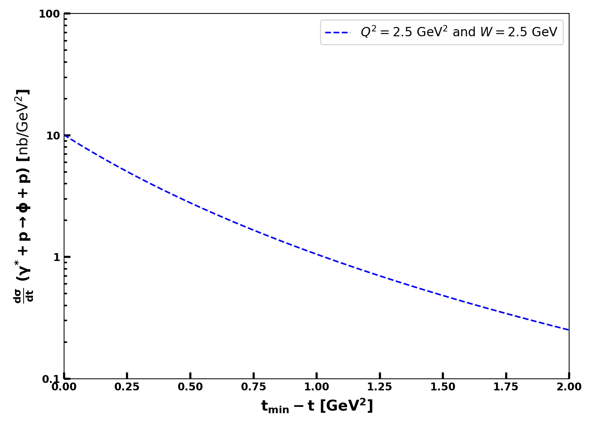

ɸ generator
Implemented in the generator
From Proposal to Jeﬀerson Lab PAC39
Mathieu Ronayette
4/18
Mathieu Ronayette
rgB - meeting
13 Feb 2026

Slide 5
Details on cuts : angle between miss nucleon and detected neutron
Missing_nucleon = beam + target - e’ - K⁺ - K⁻ (the missing particle of this reaction : e n → e’ K⁺ K⁻ X)
K⁺
K⁺
K⁻
K⁻
e⁻
e⁻
neutron
neutron
missing_nucleon
missing_nucleon
Not a good event
Good event
→ Cut on the angle between the missing nucleon and the neutron < 5 °
Mathieu Ronayette
5/18
Mathieu Ronayette
rgB - meeting
13 Feb 2026

Slide 6
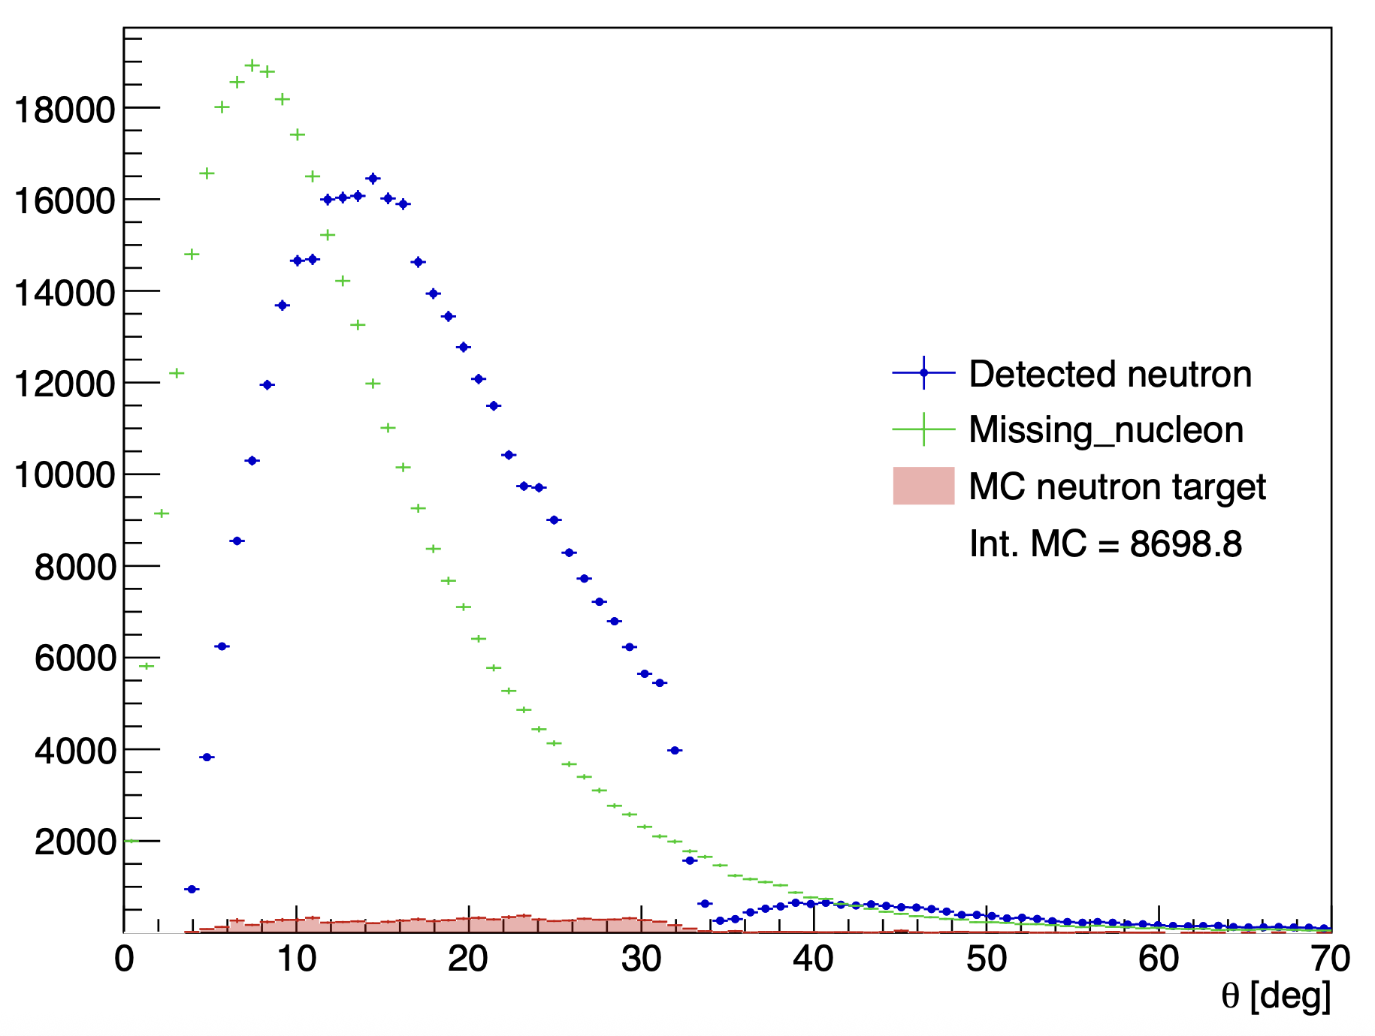
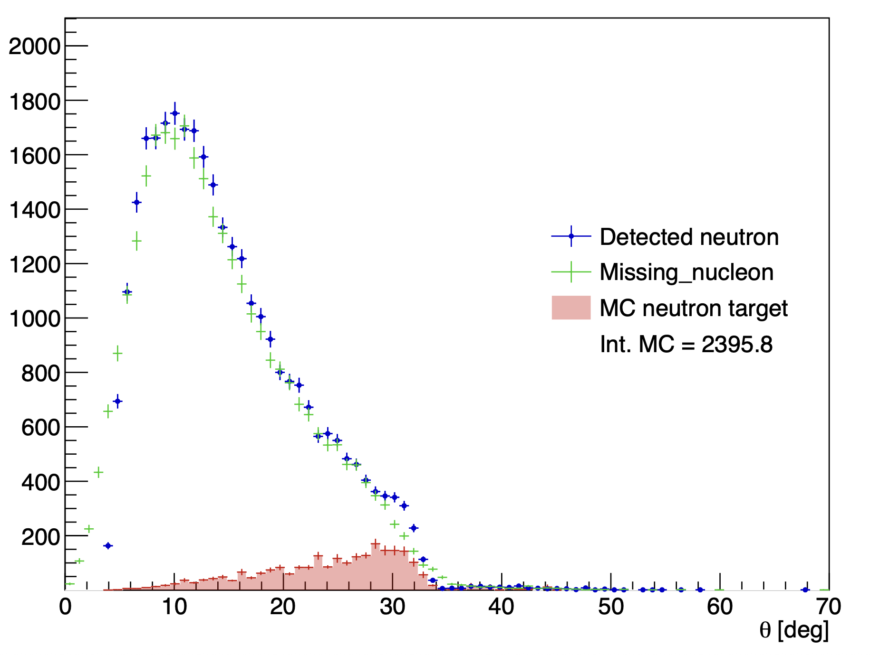
Details on cuts : angle between missing nucleon and detected neutron
Without the angle cut
With the angle cut
Mathieu Ronayette
6/18
Mathieu Ronayette
rgB - meeting
13 Feb 2026

Slide 7
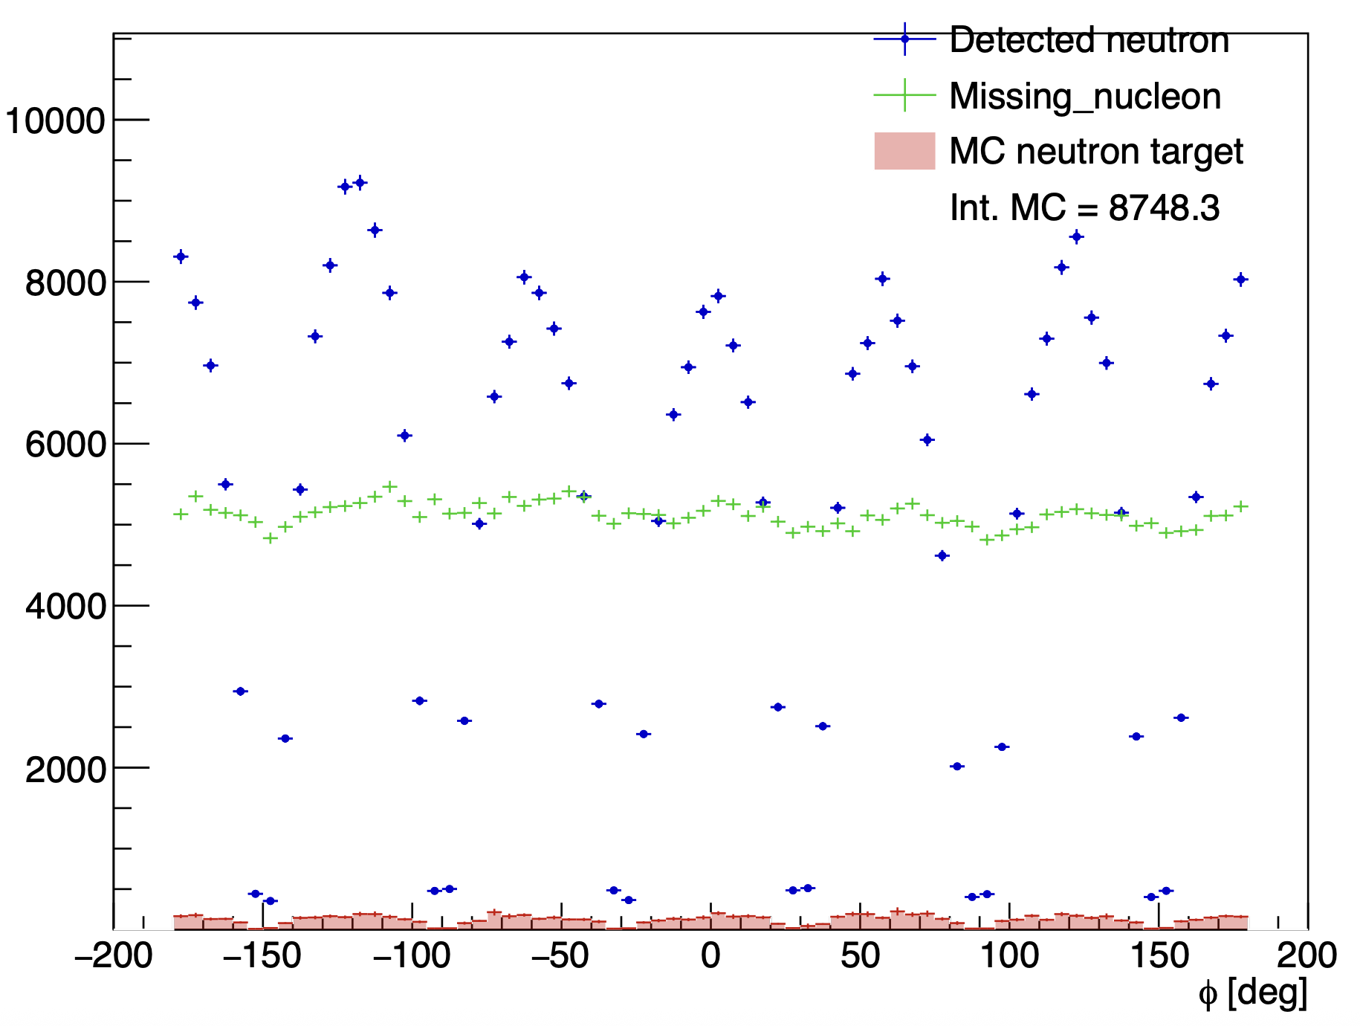
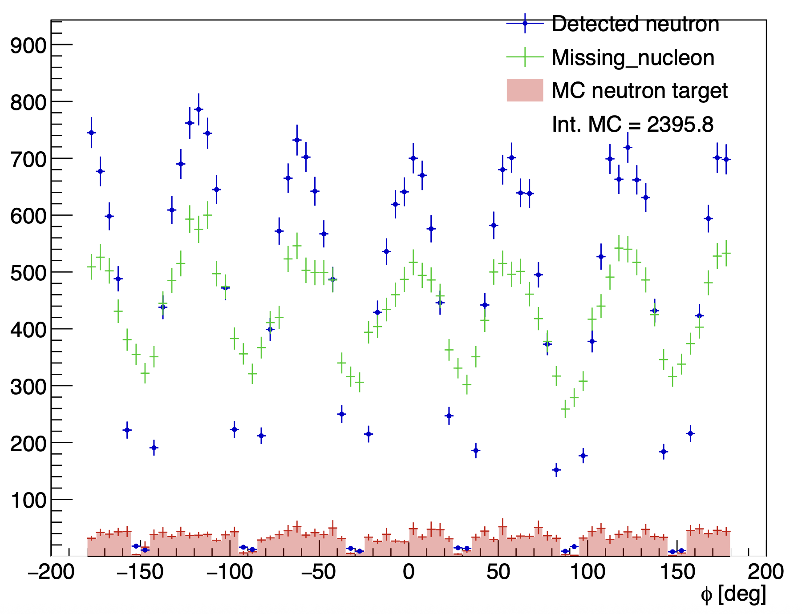
Details on cuts : angle between missing nucleon and detected neutron
Without the angle cut
With the angle cut
Mathieu Ronayette
7/18
Mathieu Ronayette
rgB - meeting
13 Feb 2026

Slide 8
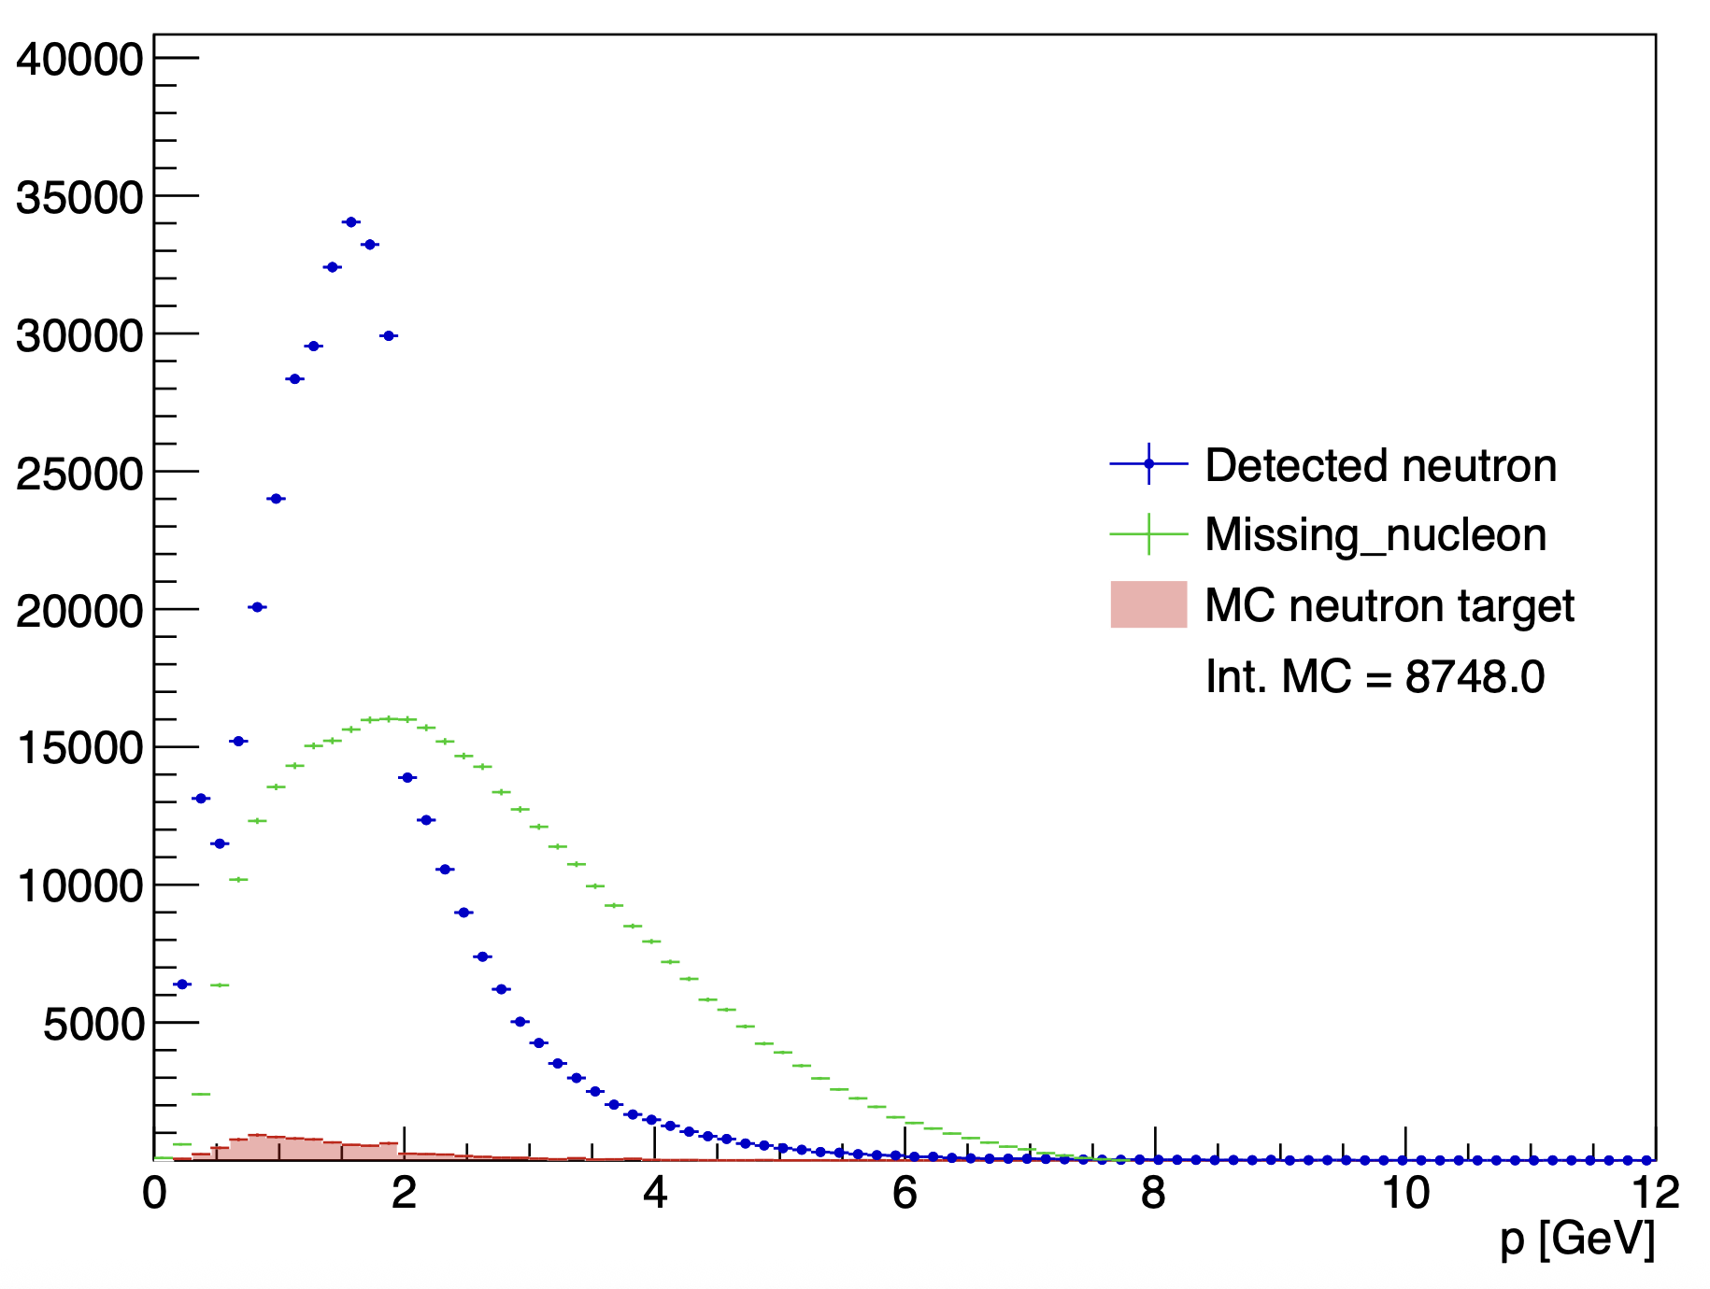
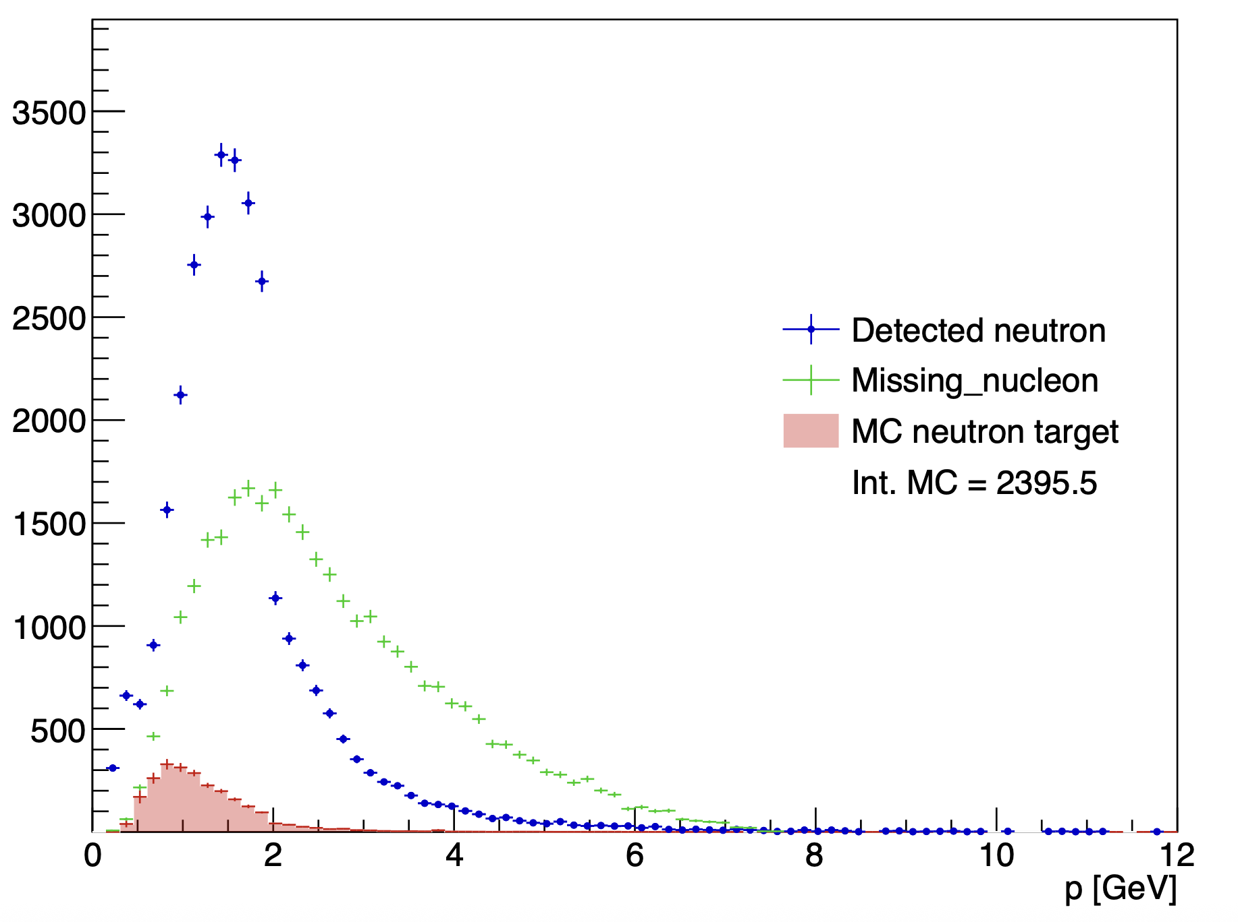
Details on cuts : angle between missing nucleon and detected neutron
Without the angle cut
With the angle cut
Mathieu Ronayette
8/18
Mathieu Ronayette
rgB - meeting
13 Feb 2026

Slide 9
Proton contamination
Missing_nucleon = beam + target - e’ - K⁺ - K⁻ (the missing particle of this reaction : e n → e’ K⁺ K⁻ X)
K⁺
K⁻
There is always a contamination when the missing_nucleon is a non detected proton and there is a fake signal neutron who pass the cut on the angle
e⁻
neutron
missing_nucleon
→ Evaluate the contamination with simulation on proton target and apply the cuts of neutron analysis and see how many
events pass the cuts
Keep event with the angle between the missing nucleon and the neutron < 5 °
Mathieu Ronayette
9/18
Mathieu Ronayette
rgB - meeting
13 Feb 2026

Slide 10
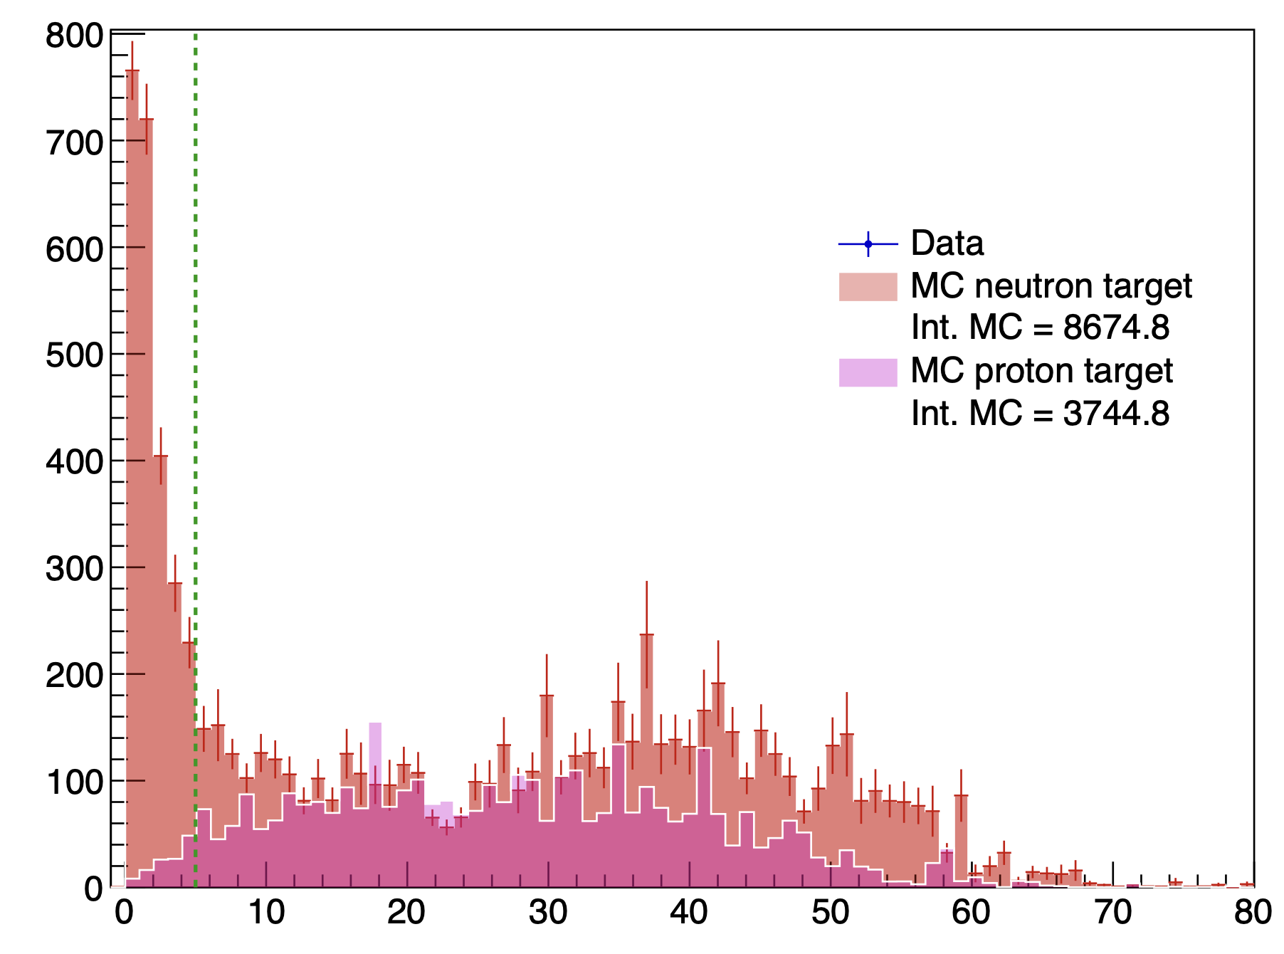
Proton contamination : prediction of MC
<-- Cut at 5 °
angle between the missing_nucleon and the neutron detected
Mathieu Ronayette
10/18
Mathieu Ronayette
rgB - meeting
13 Feb 2026

Slide 11
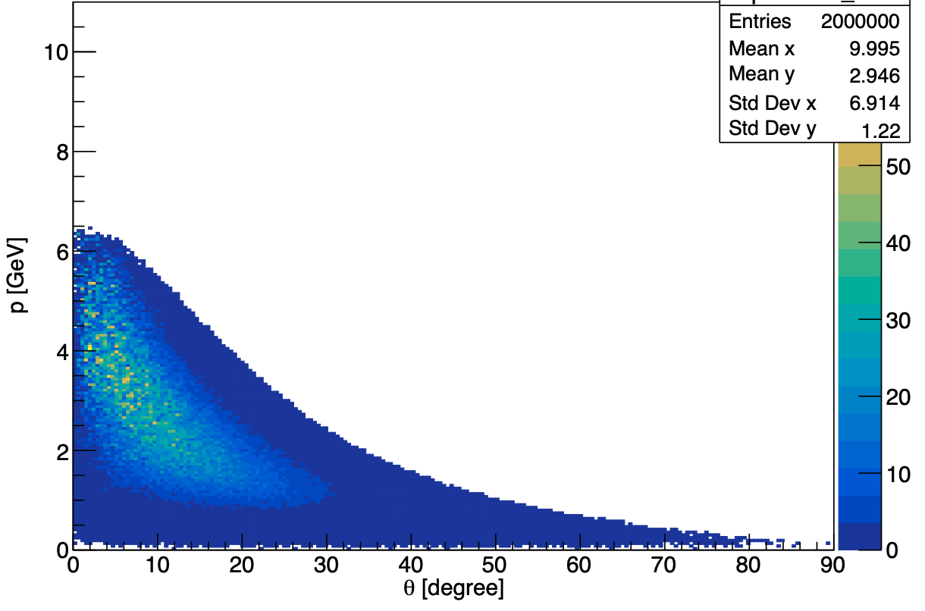
Details on cuts : keep K+ K- in FD
Generated event : p vs theta for K⁺⁻
Two argument to cut K+ K- in CD :
Reconstruction of kaons in the CD is less good than in the FD
The generator predict few events in the CD
Mathieu Ronayette
11/18
Mathieu Ronayette
rgB - meeting
13 Feb 2026

Slide 12
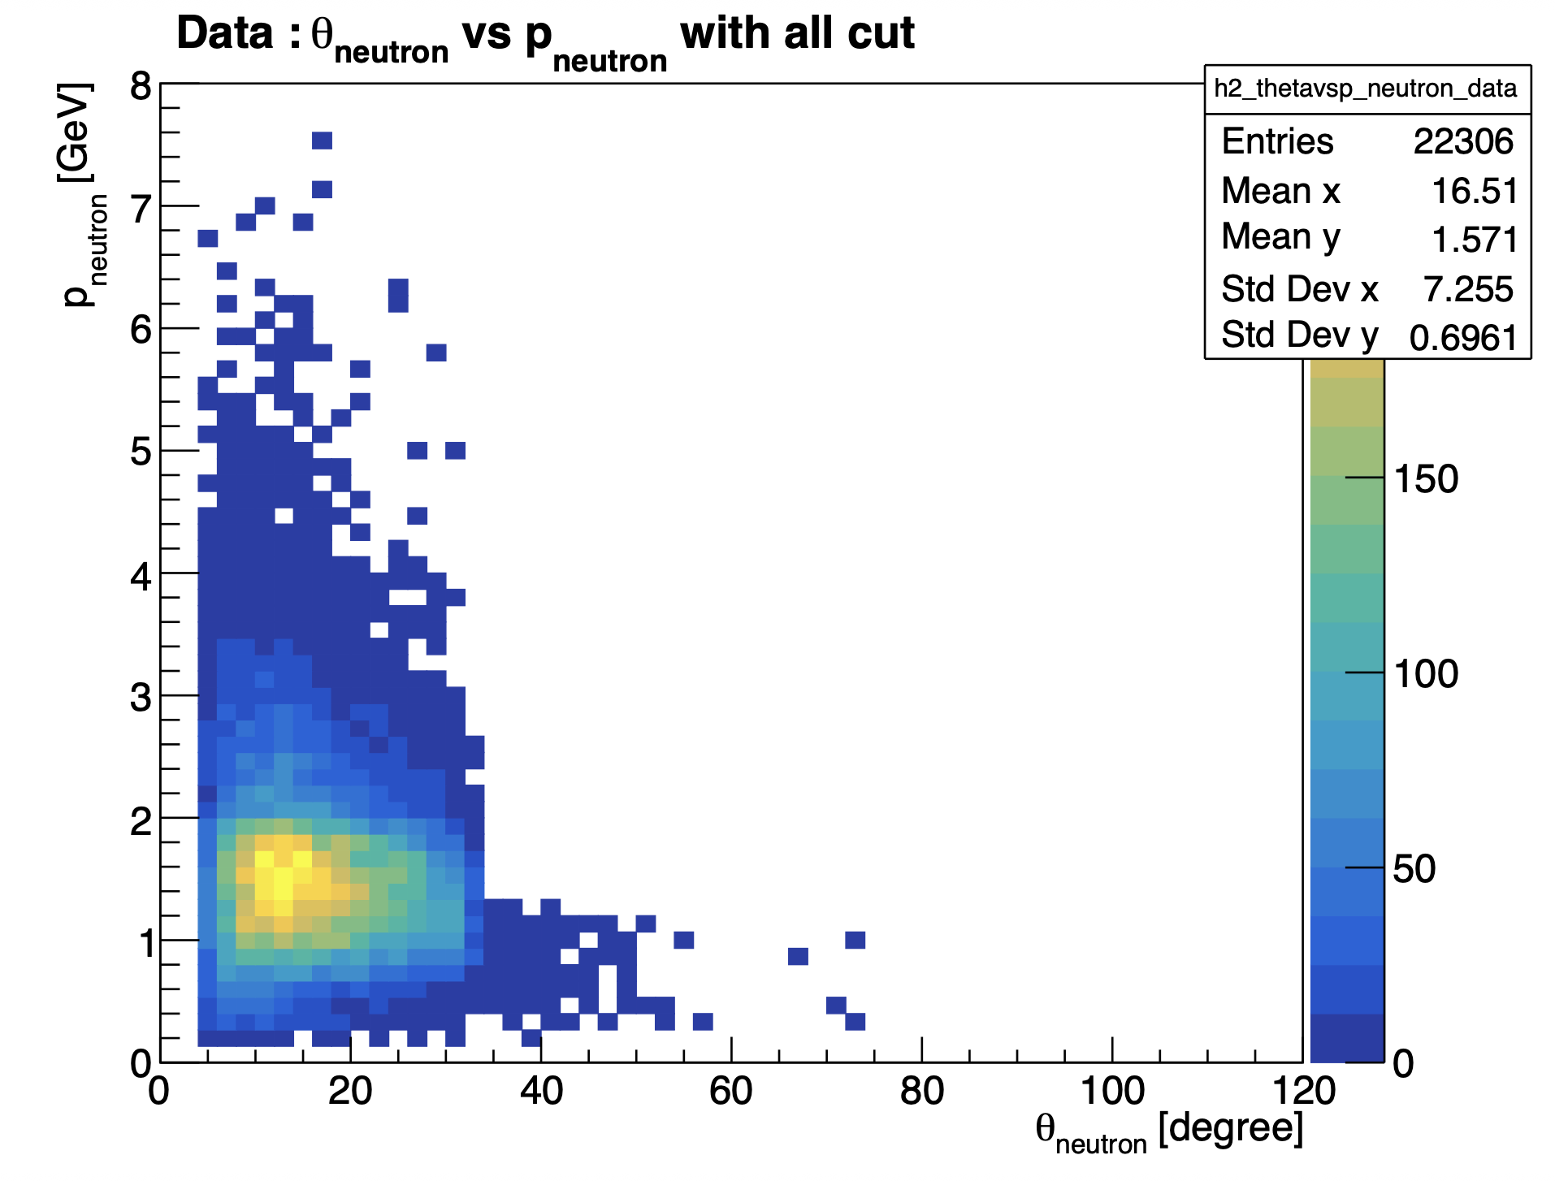
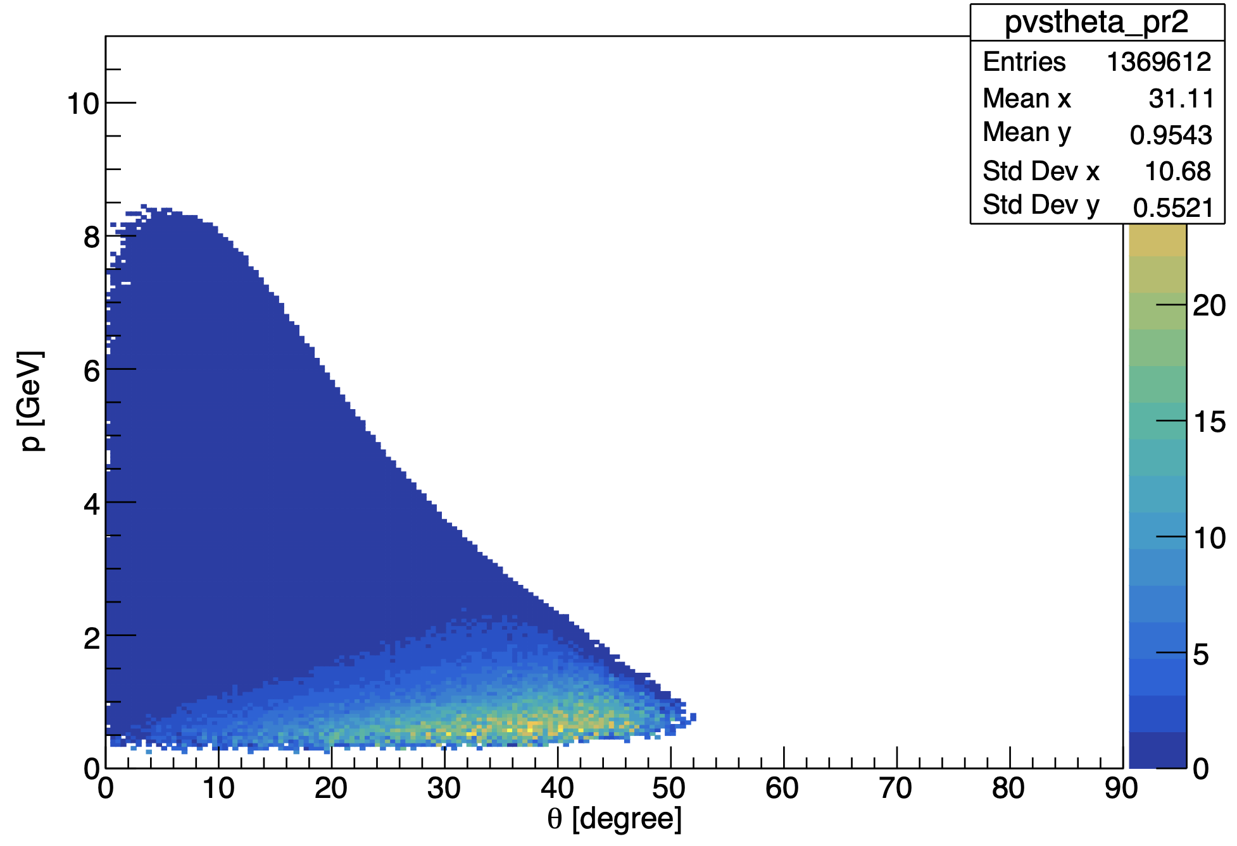
Neutron phasespace :
MC : θ_{neutron} vs P_{neutron} generated
(with acceptante cuts)
Mathieu Ronayette
12/18
Mathieu Ronayette
rgB - meeting
13 Feb 2026

Slide 13
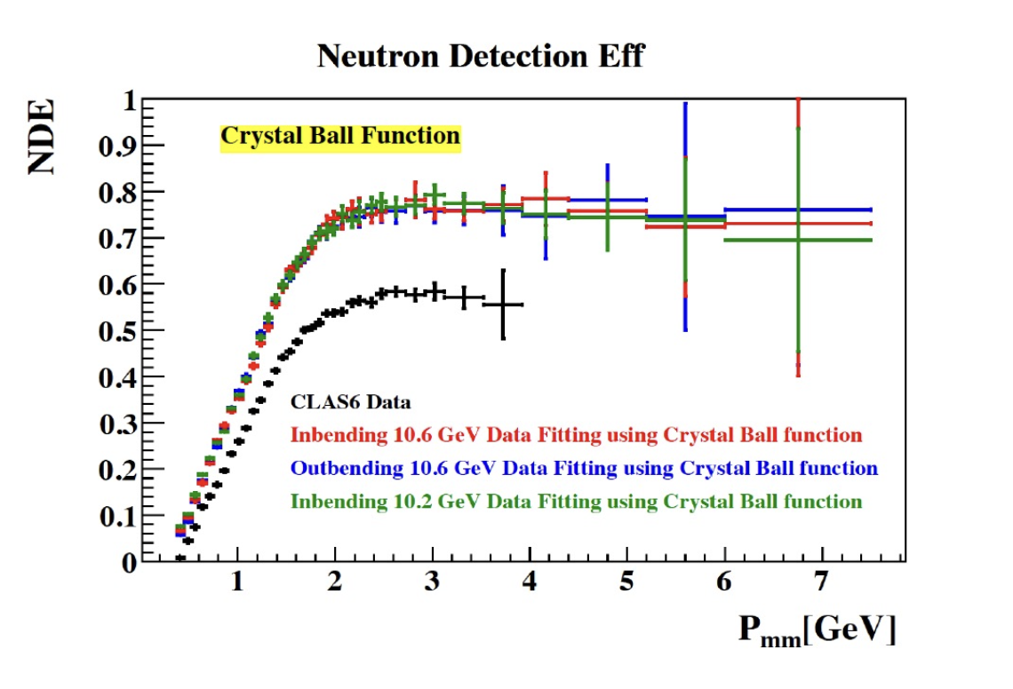
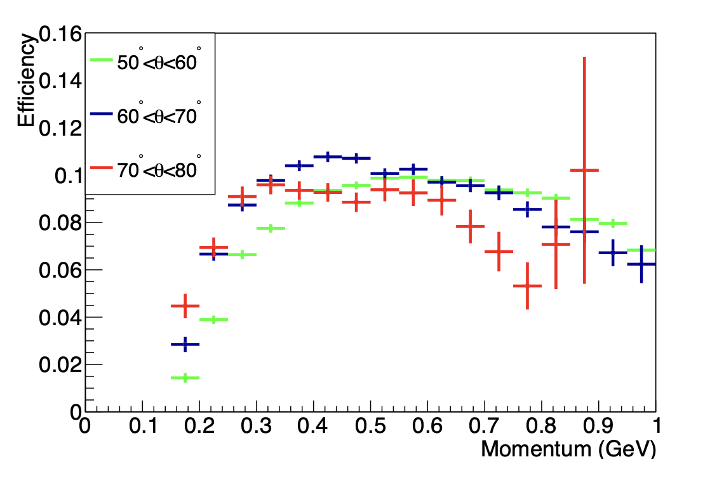
Neutron phasespace :
P. Chatagnon’s plot
Neutron detection efficiency in the FD
Neutron detection efficiency in the CND
Mathieu Ronayette
13/18
Mathieu Ronayette
rgB - meeting
13 Feb 2026

Slide 14
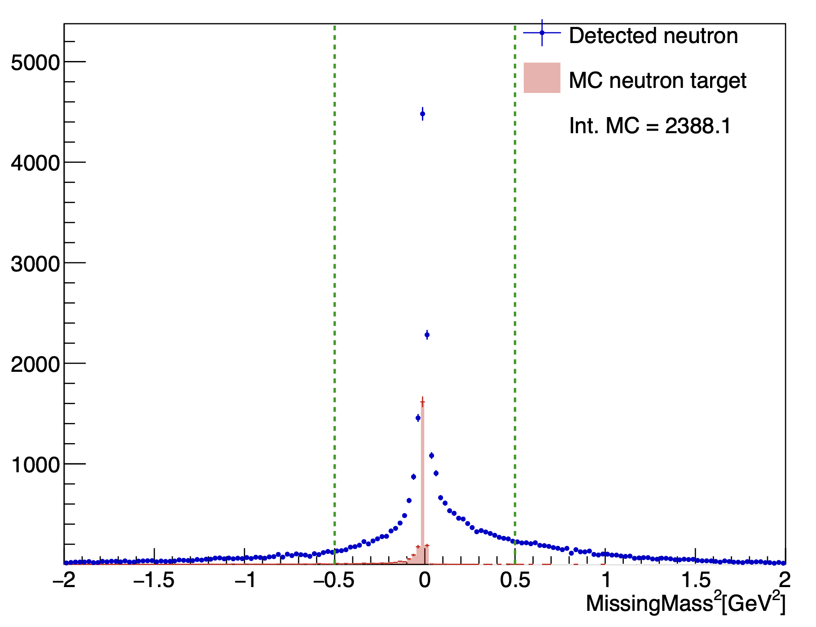
Details on cuts : Total missing mass
Total missing mass e n → e’ n’ K⁺ K⁻ X
(after all the previous cut)
–0.5 < MissingMass_{tot} ² < 0.5 GeV ²
Mathieu Ronayette
14/18
Mathieu Ronayette
rgB - meeting
13 Feb 2026

Slide 15
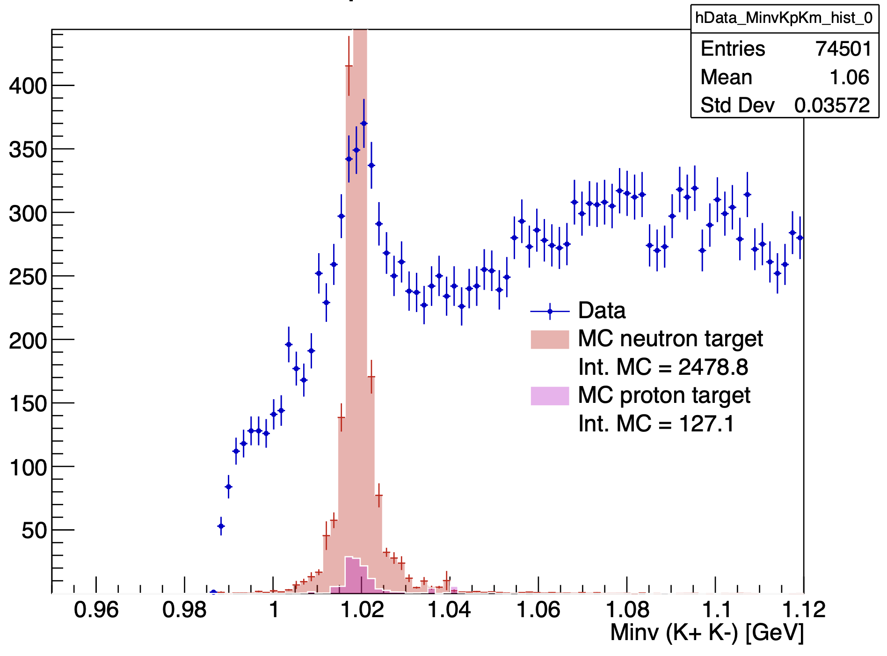
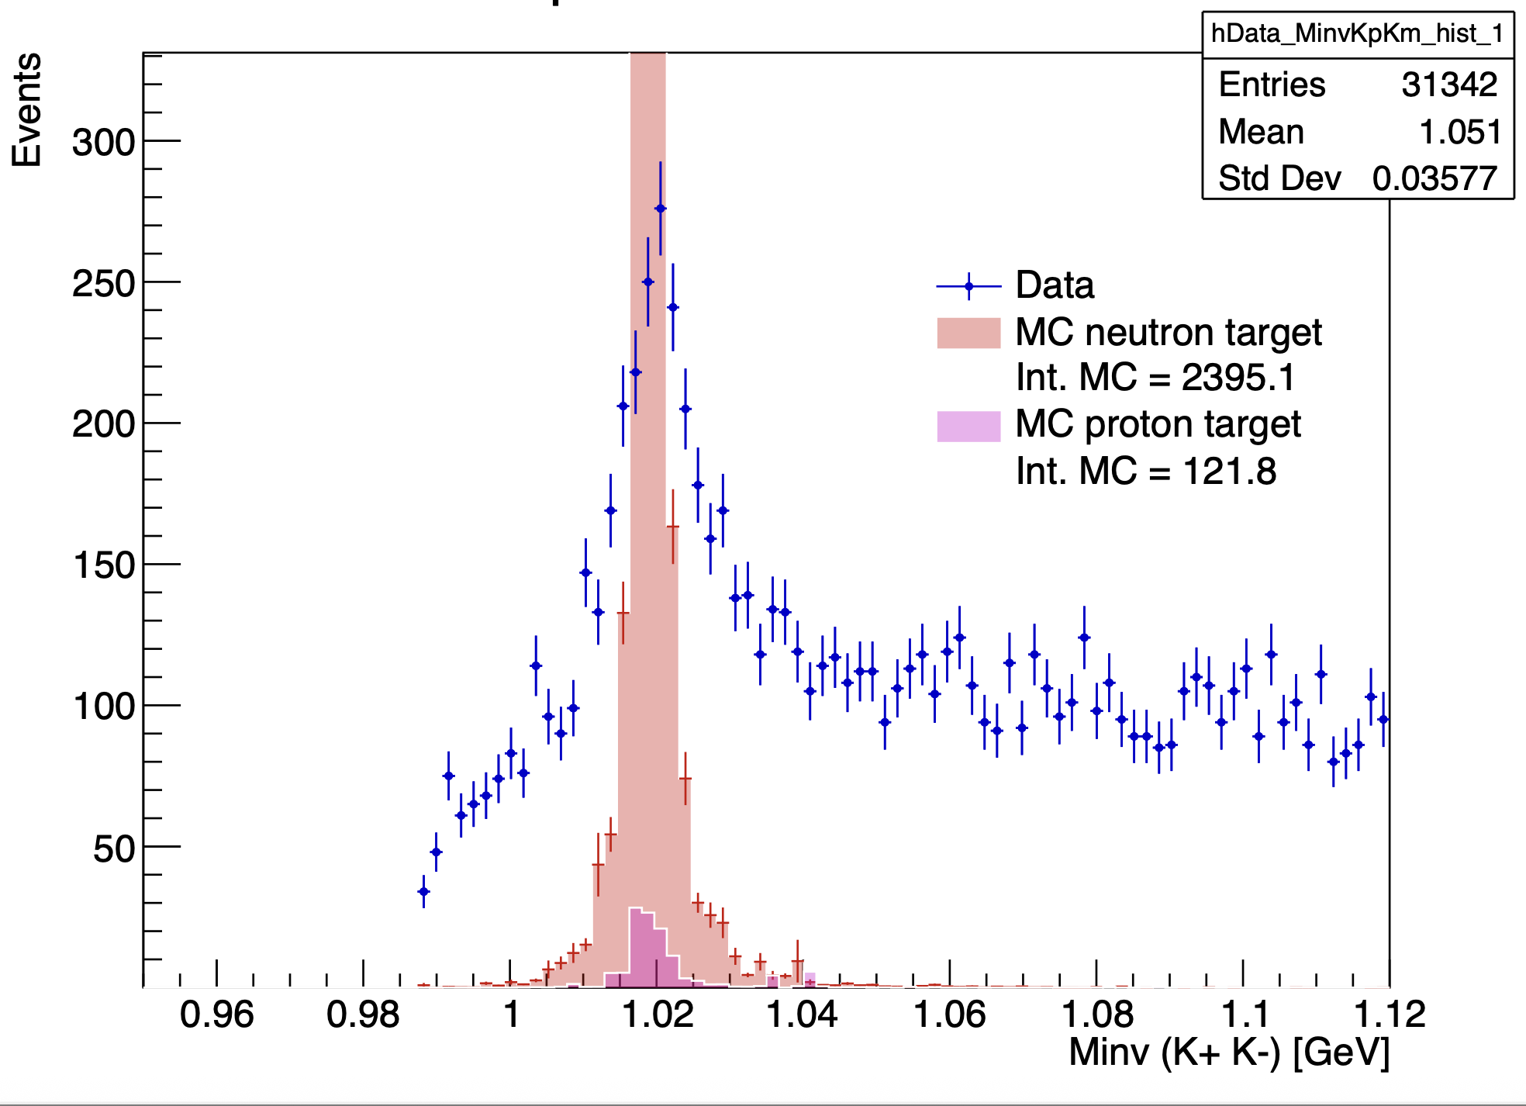
Invariant mass K⁺ K⁻ :
With angle cut
With angle cut and K+ K- in FD
Mathieu Ronayette
15/18
Mathieu Ronayette
rgB - meeting
13 Feb 2026

Slide 16
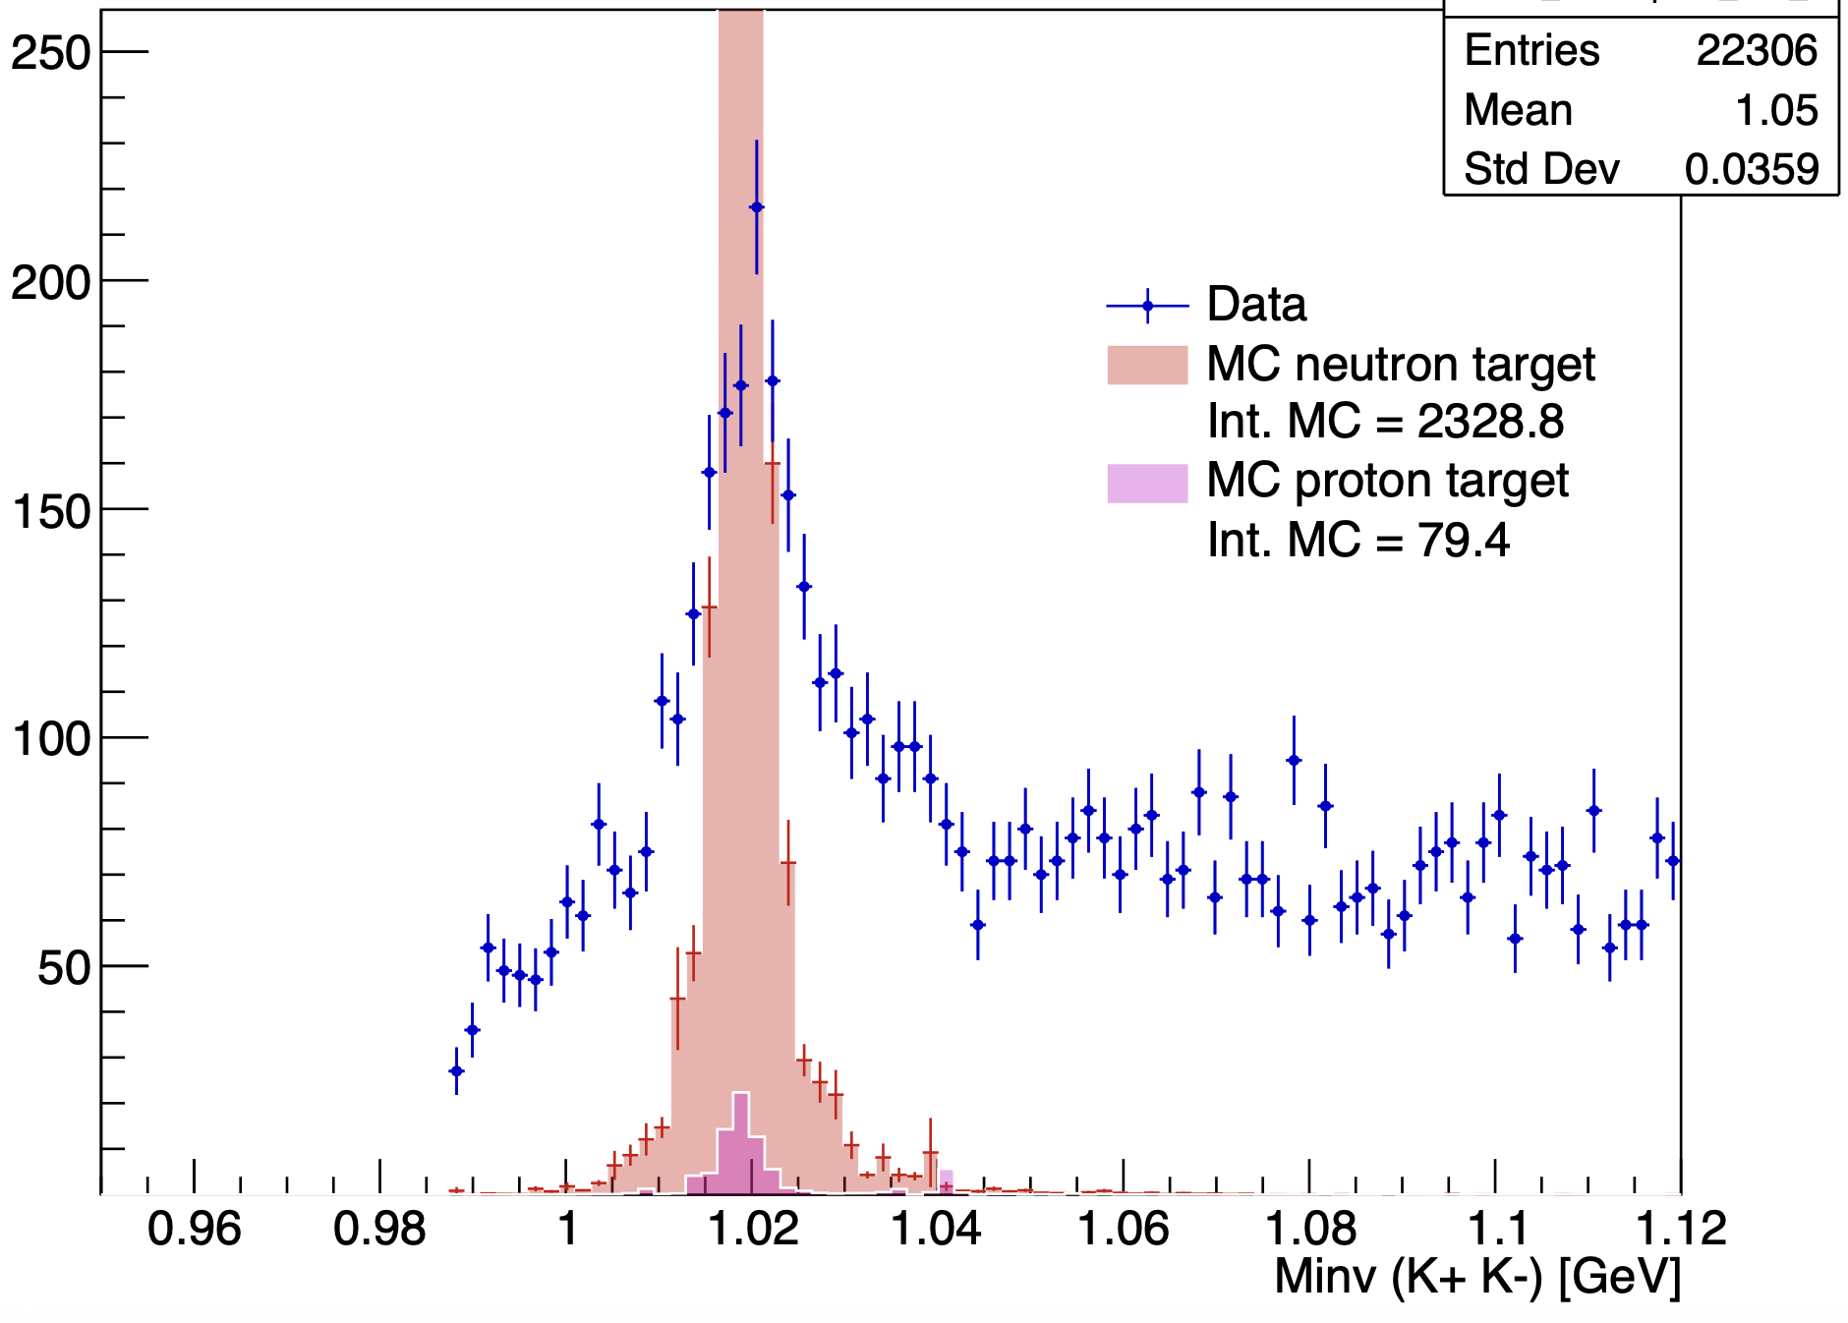
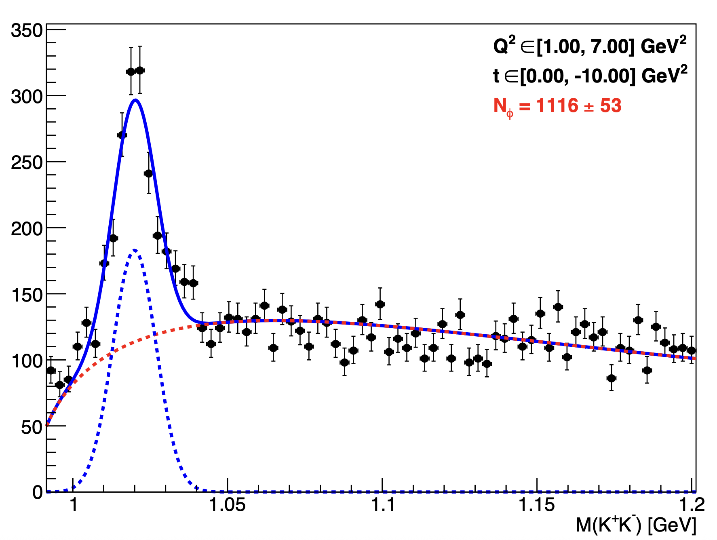
Invariant mass K⁺ K⁻ :
With angle cut, K+ K- in FD, and cut on MissingMass
Fit all fall2019 outbending data
Mathieu Ronayette
16/18
Mathieu Ronayette
rgB - meeting
13 Feb 2026

Slide 17
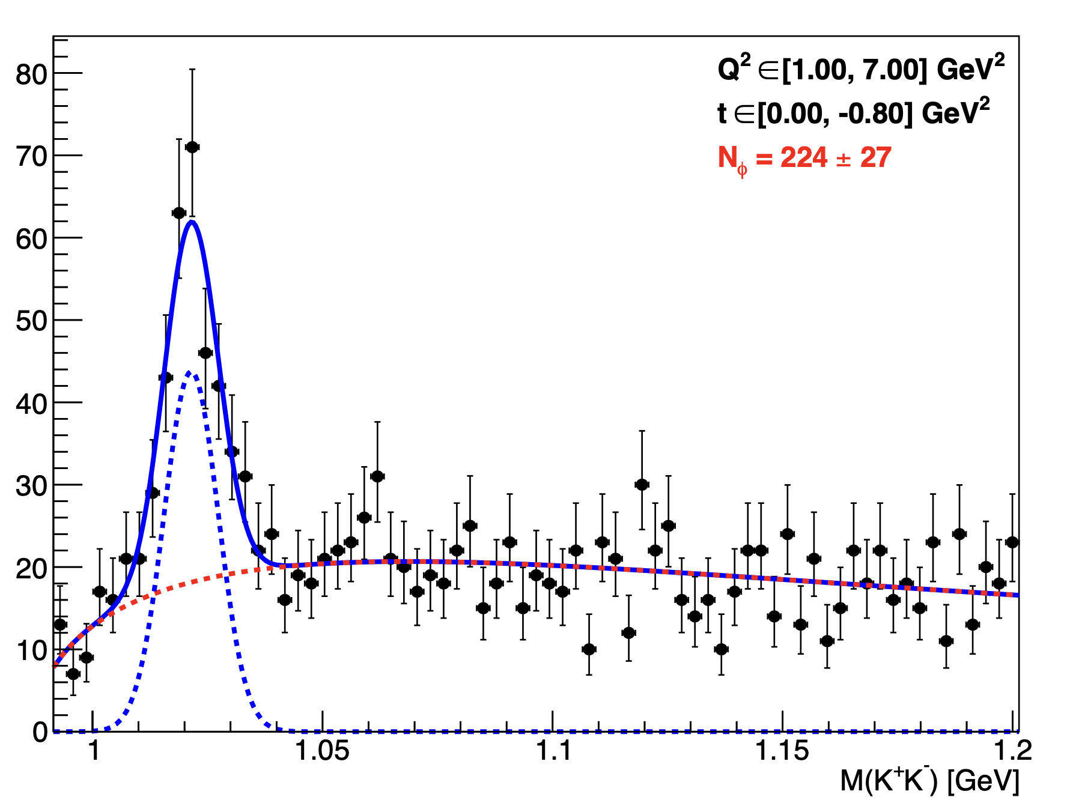
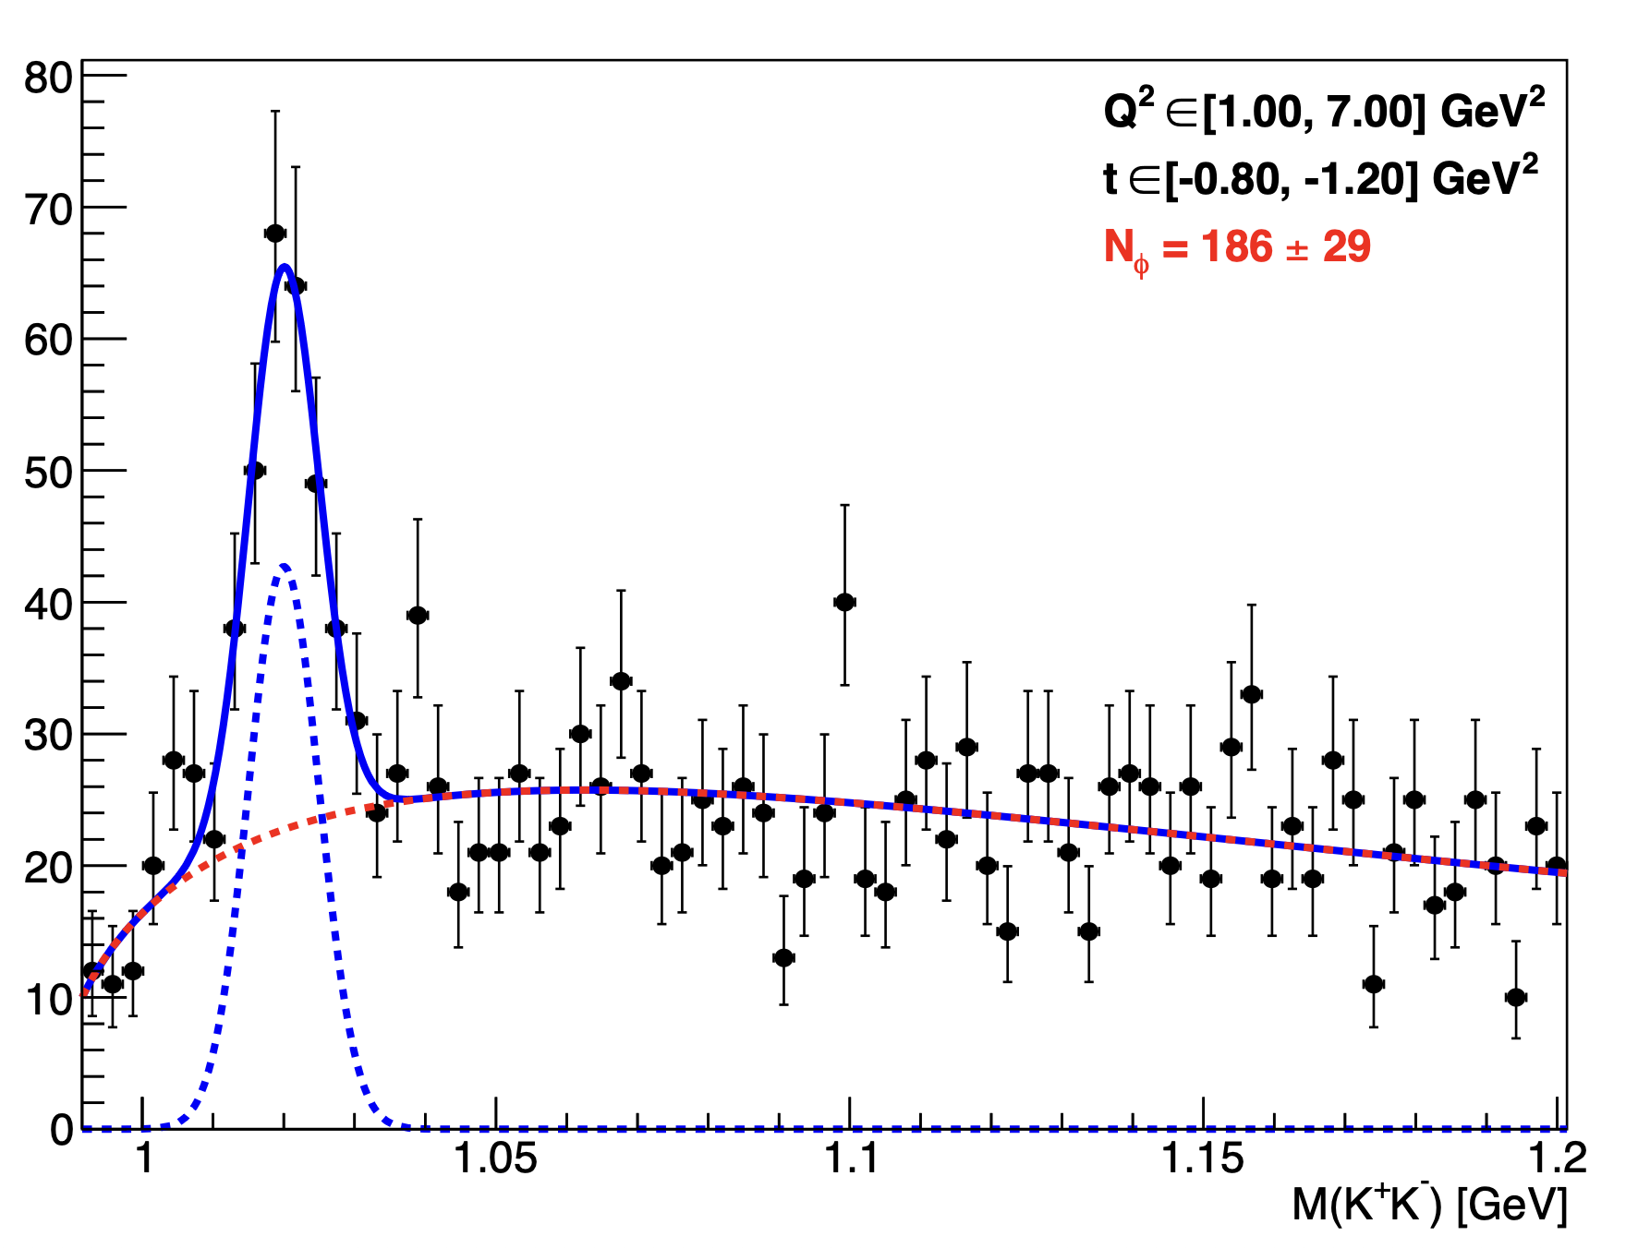
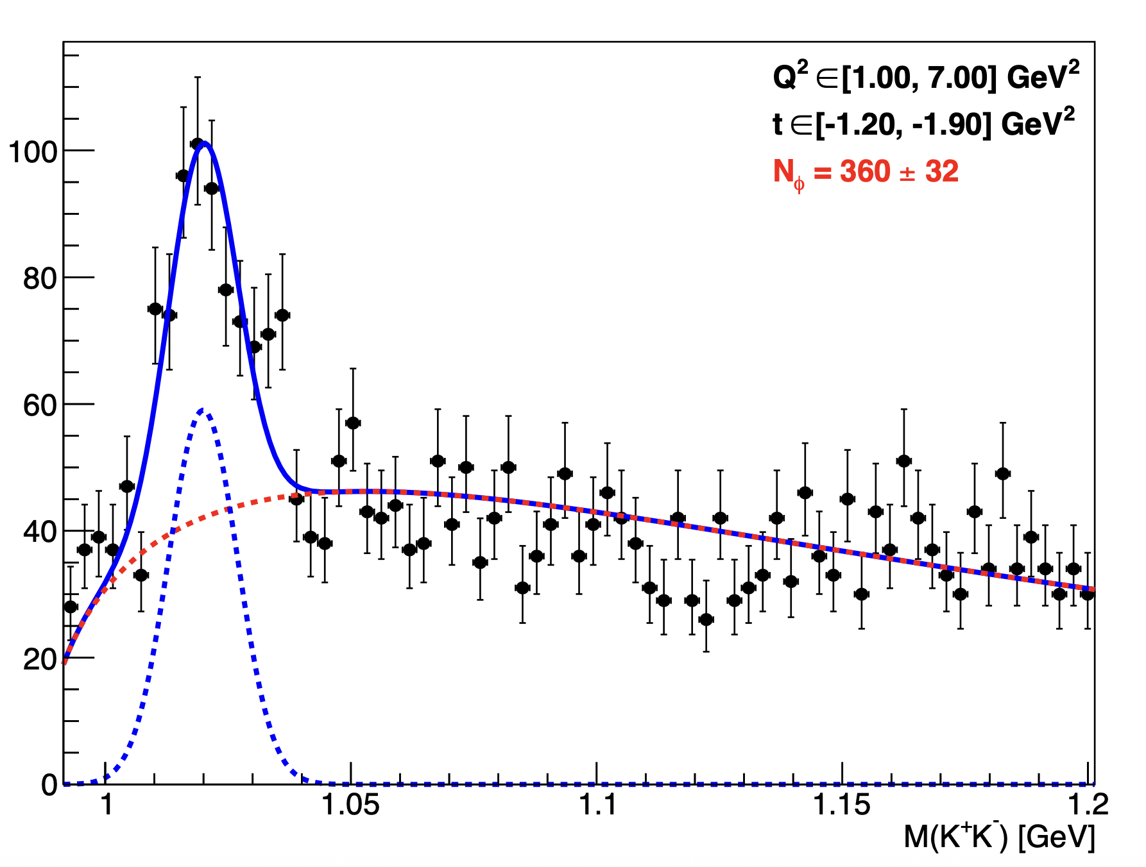
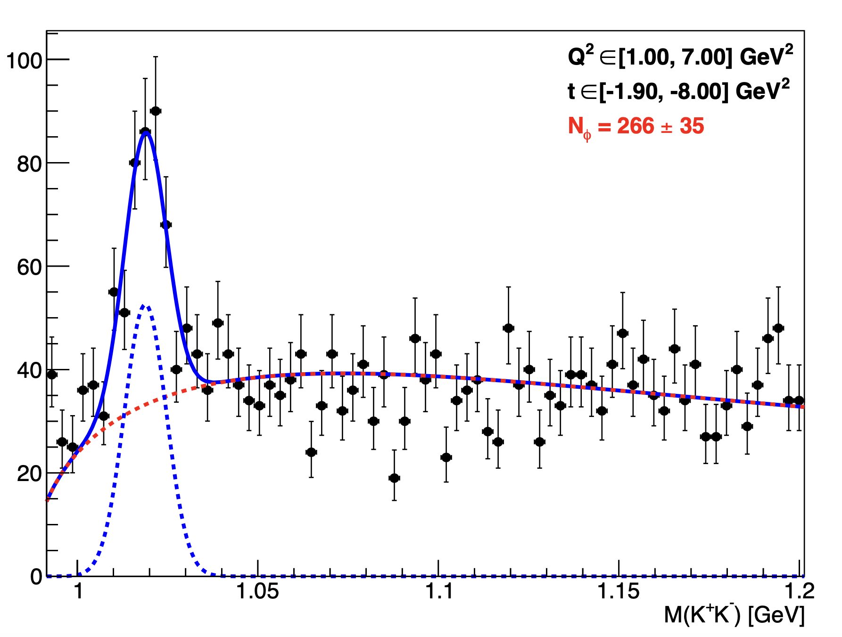
Invariant mass K⁺ K⁻ : Fit per bins
Mathieu Ronayette
17/18
Mathieu Ronayette
rgB - meeting
13 Feb 2026

Slide 18
Conclusion
Next steps :
- Improve fits for signal and background
- Evaluate the acceptance
- Run the code with the other data set
Thanks!
Mathieu Ronayette
18/18
Mathieu Ronayette
rgB - meeting
13 Feb 2026

Slide 19
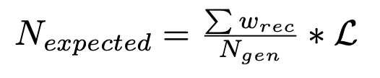
Update on ɸ generator
Simulation objectives :
- Estimate the expected number of ɸ with
- Find interresting cuts
π⁺
e
e’
Ks
π⁻
Previously with TGenPhasespace (root module) :
- Generate automatically quadri-impulsion in the phasespace
- But problems with the weight associated with the phasespace
q
ɸ
Kl
p
p’
→ In the next slides the generator that we implemented without TGenPhaseSpace
Mathieu Ronayette
1/18
Mathieu Ronayette
meeting
27 Nov 2025

Slide 20
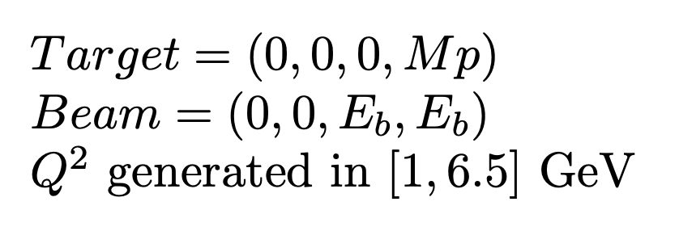
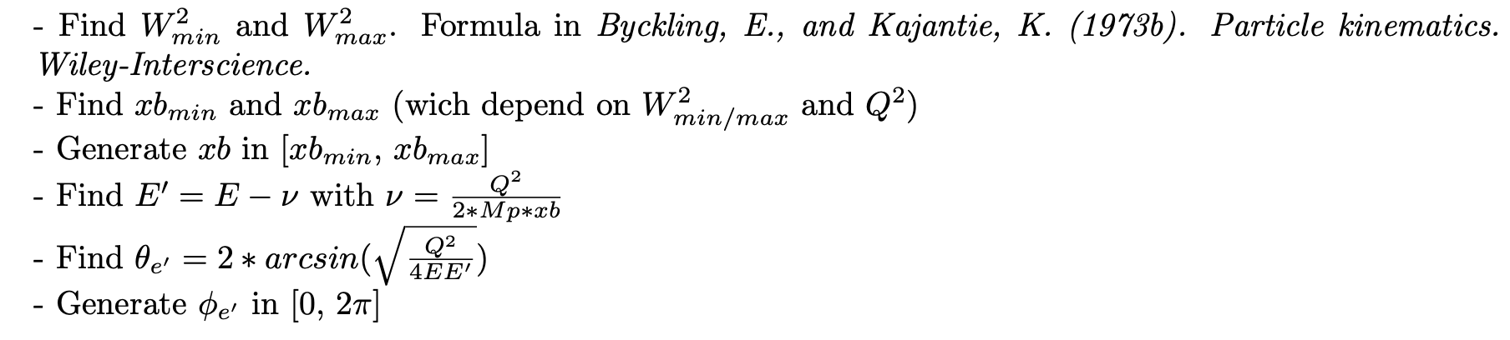
Update on ɸ generator
Initially :
e
e’
q
2. Scattering electron kinematics :
Mathieu Ronayette
2/18
Mathieu Ronayette
meeting
27 Nov 2025

Slide 21

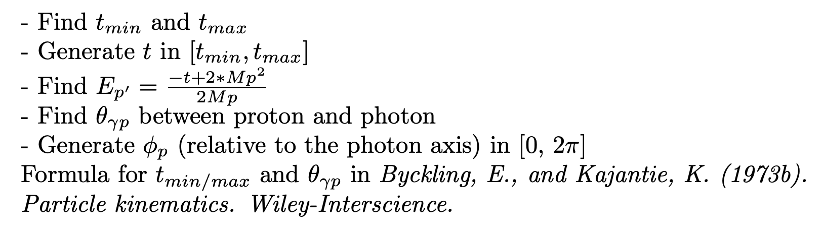

Update on ɸ generator
3. Virtual photon kinematics :
q
ɸ
4. Scattering proton kinematics :
p
p’
5. Meson ɸ kinematics :
Mathieu Ronayette
3/18
Mathieu Ronayette
meeting
27 Nov 2025

Slide 22
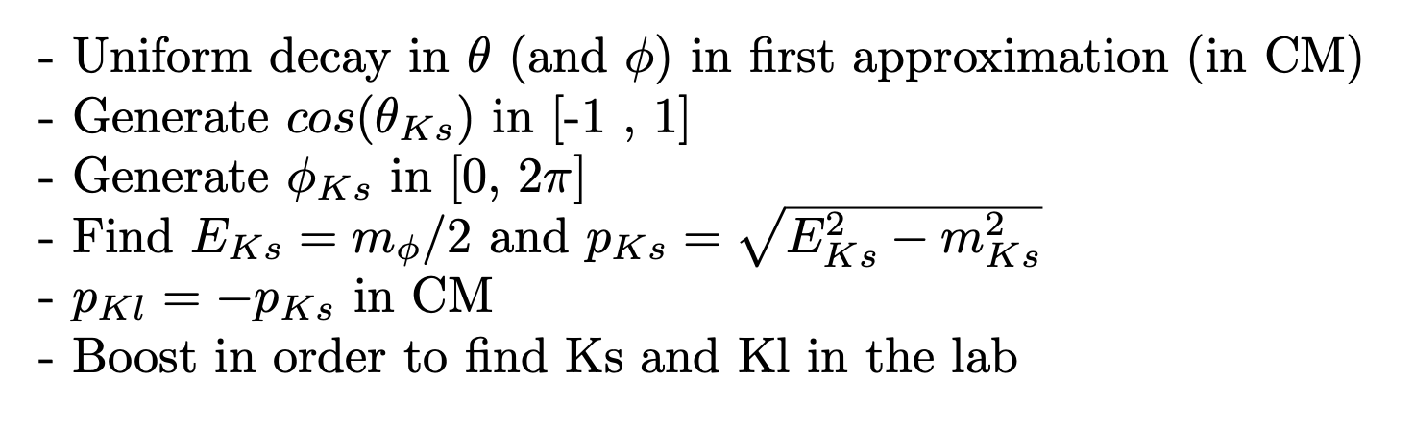
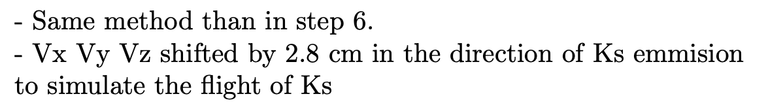
Update on ɸ generator
Ks
6. Kinematics of second decay ɸ → Ks Kl :
_{Ks}
ɸ
Kl
π⁺
7. Kinematics of thrid decay Ks → π⁺ π⁻ :
π⁺
Ks
π⁻
Mathieu Ronayette
4/18
Mathieu Ronayette
meeting
27 Nov 2025

Slide 23
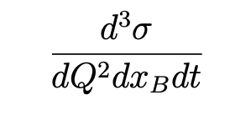

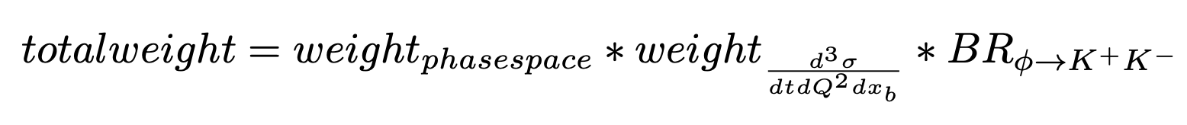
ɸ generator
From Proposal to Jeﬀerson Lab PAC39 Exclusive Phi Meson Electroproduction with CLAS12
Mathieu Ronayette
5/18
Mathieu Ronayette
rgB - meeting
13 Feb 2026

Slide 24
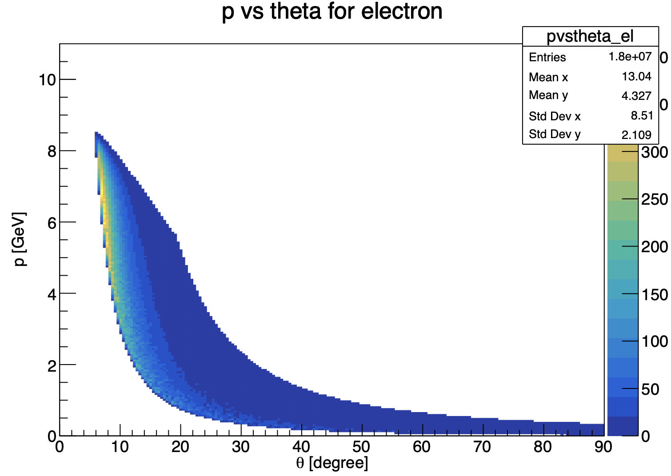
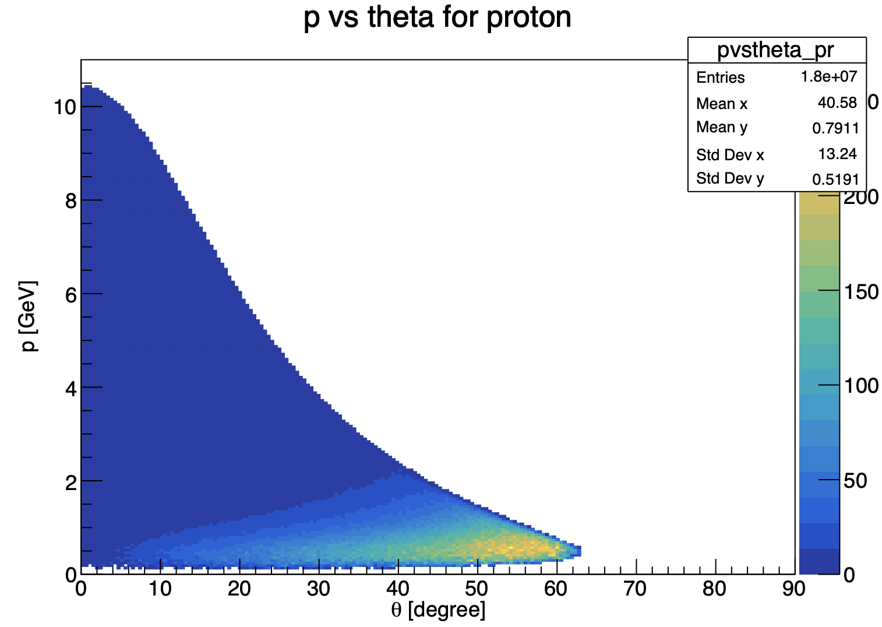
Update on ɸ generator
Mathieu Ronayette
6/18
Mathieu Ronayette
meeting
27 Nov 2025

Slide 25
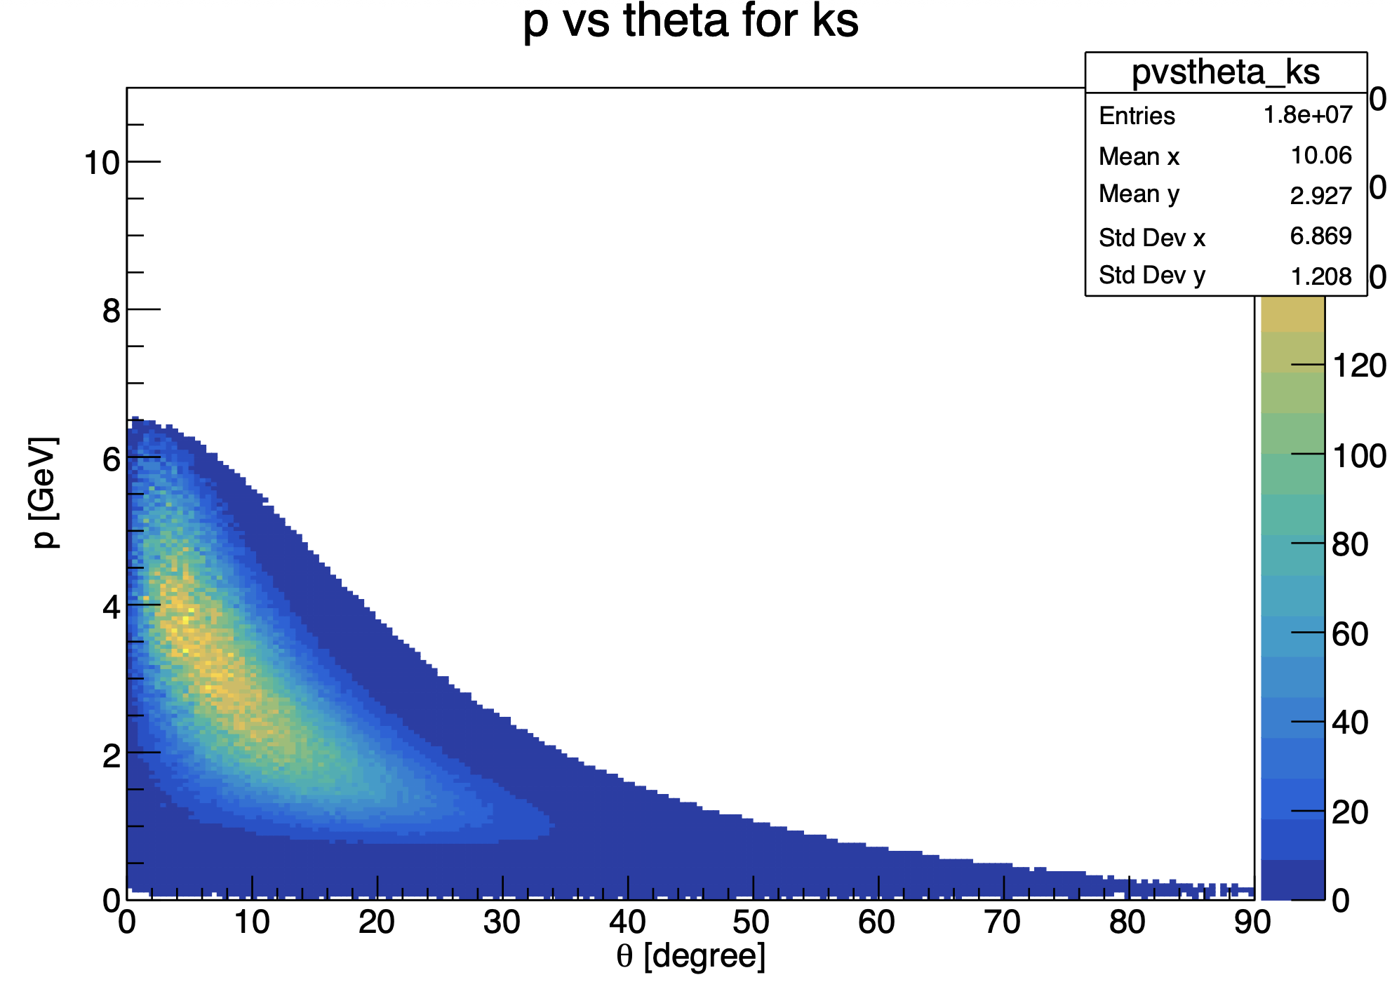
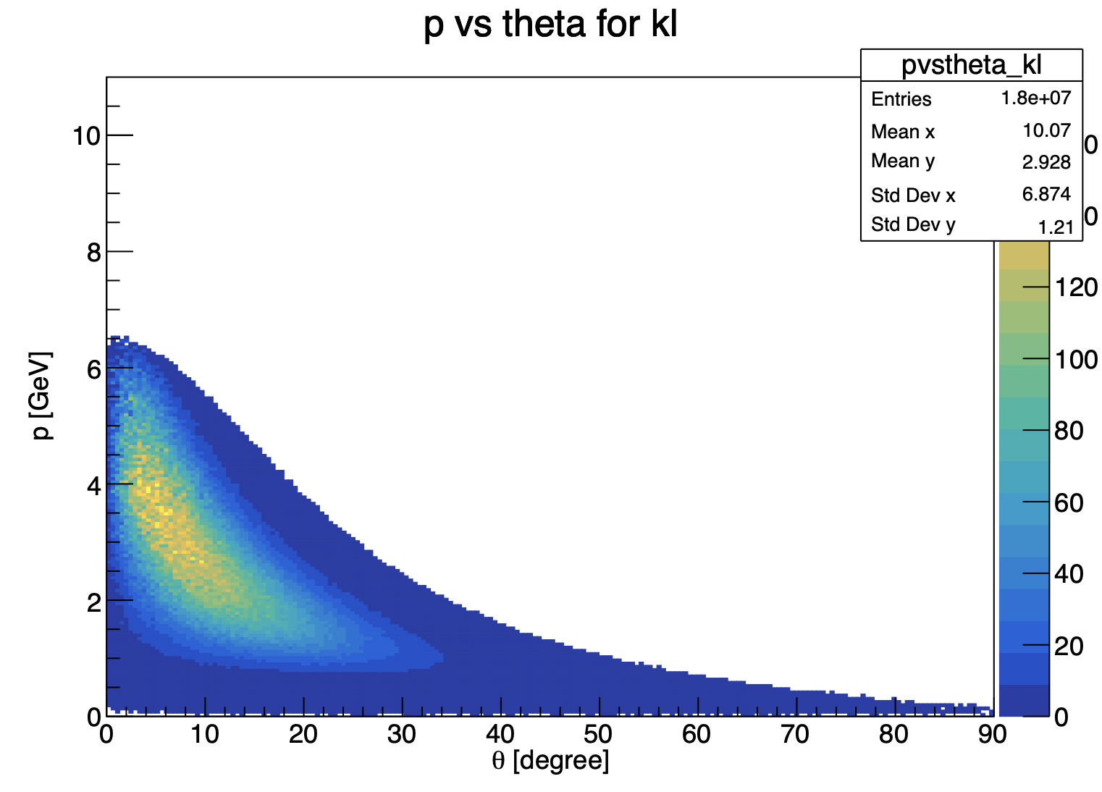
Update on ɸ generator
Mathieu Ronayette
7/18
Mathieu Ronayette
meeting
27 Nov 2025

Slide 26
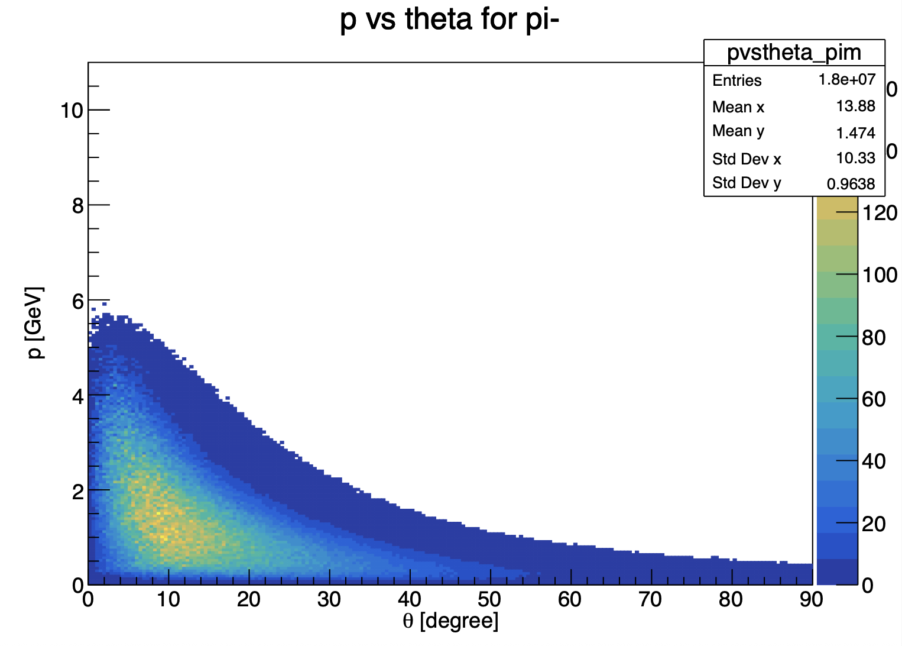

Update on ɸ generator
Mathieu Ronayette
8/18
Mathieu Ronayette
meeting
27 Nov 2025

Slide 27
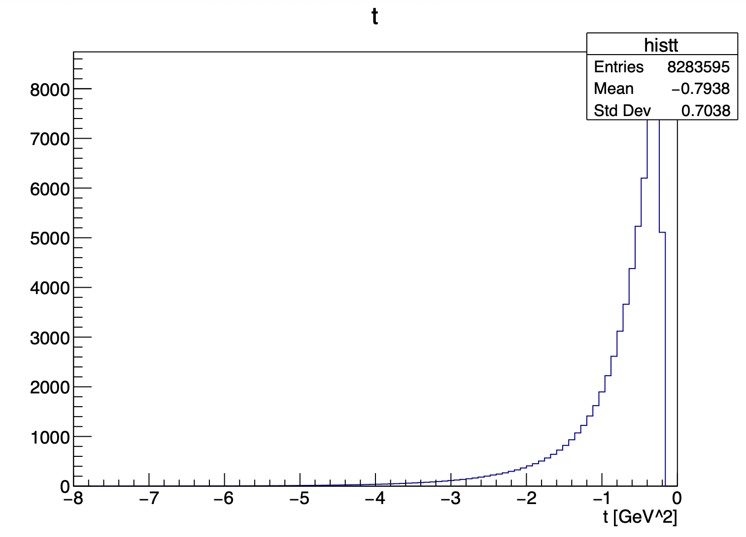
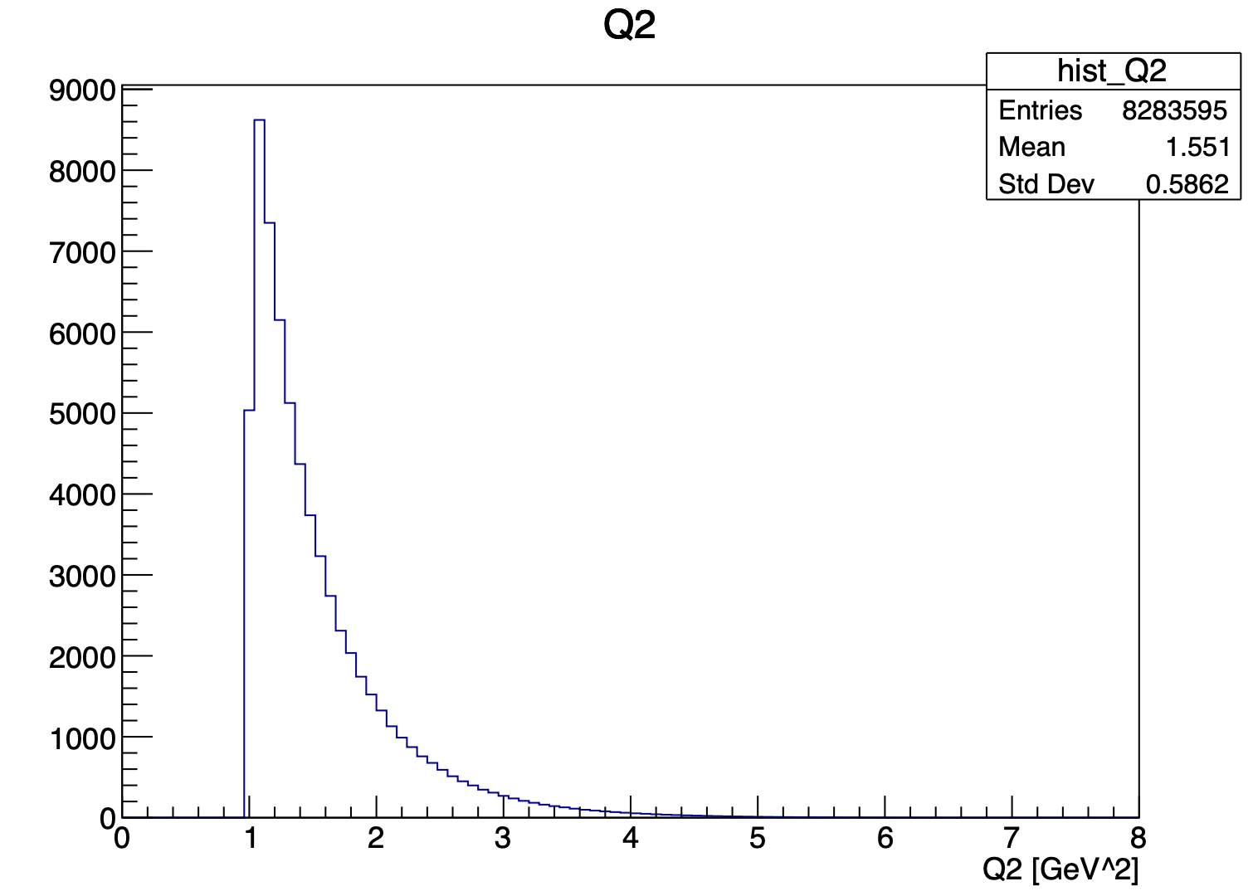
Update on ɸ generator
Mathieu Ronayette
9/18
Mathieu Ronayette
meeting
27 Nov 2025

Slide 28
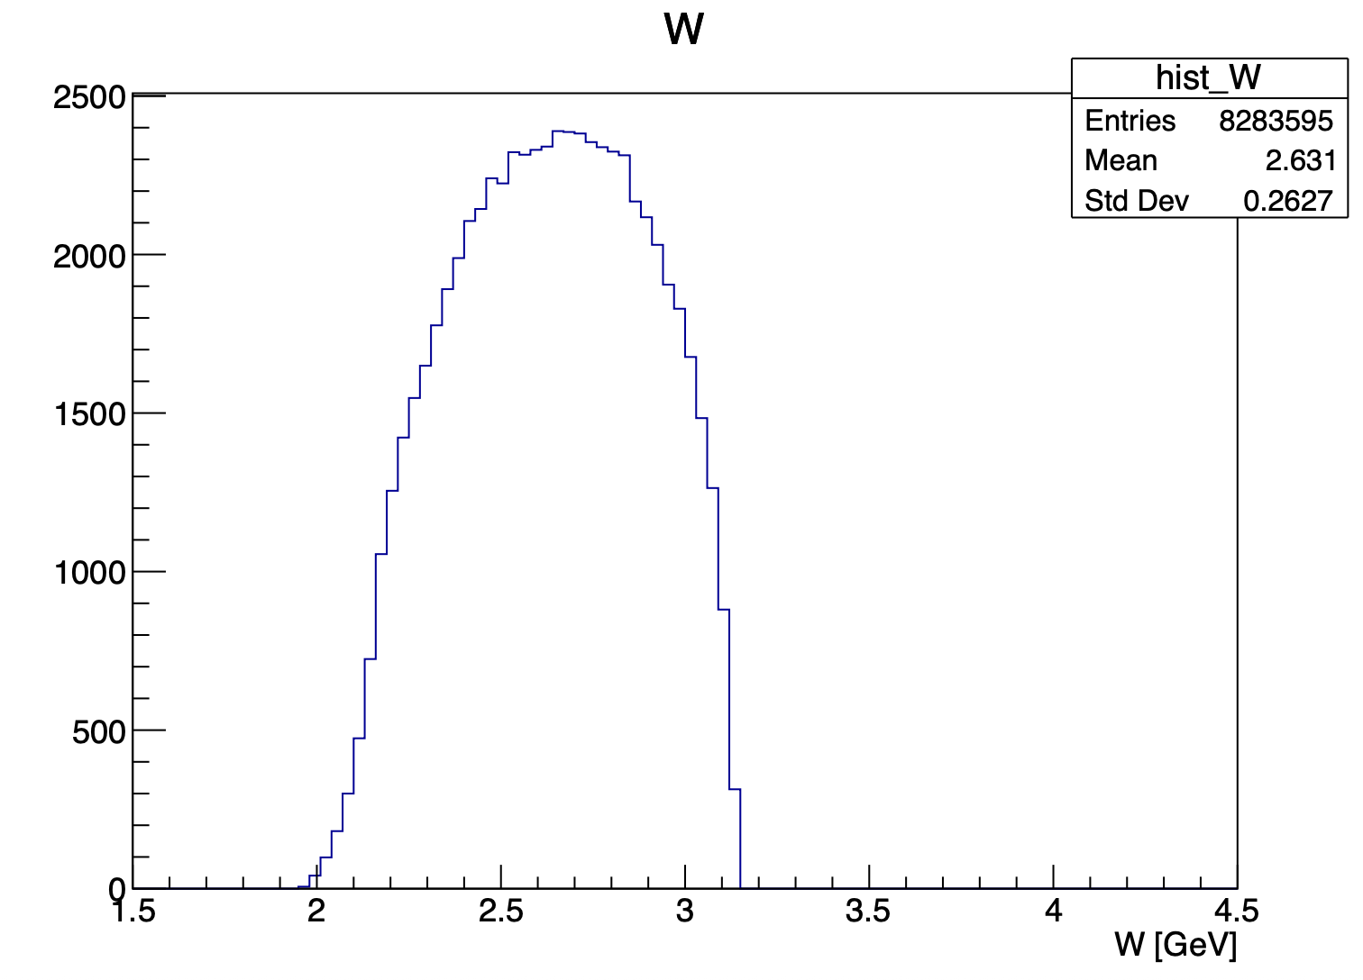
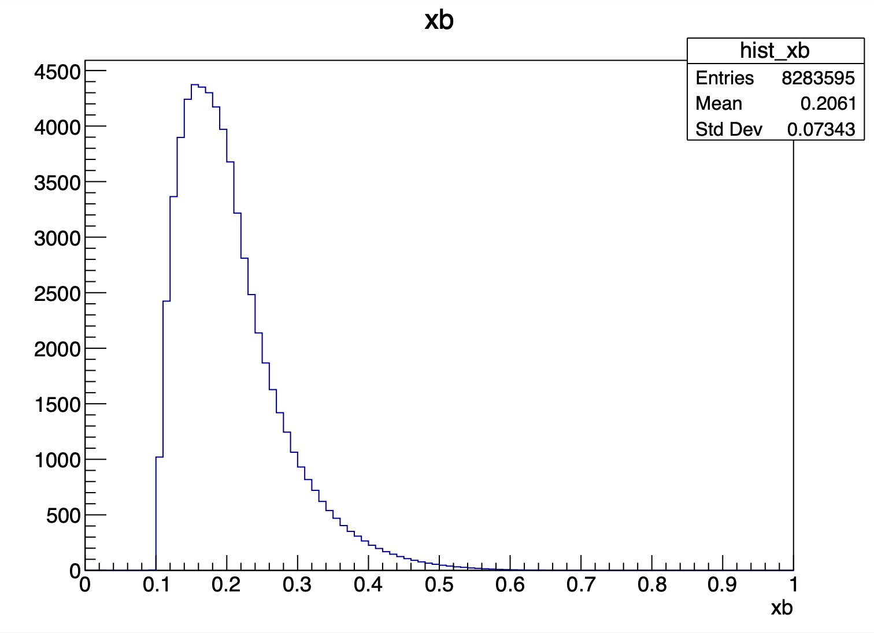
Update on ɸ generator
Mathieu Ronayette
10/18
Mathieu Ronayette
meeting
27 Nov 2025

Slide 29
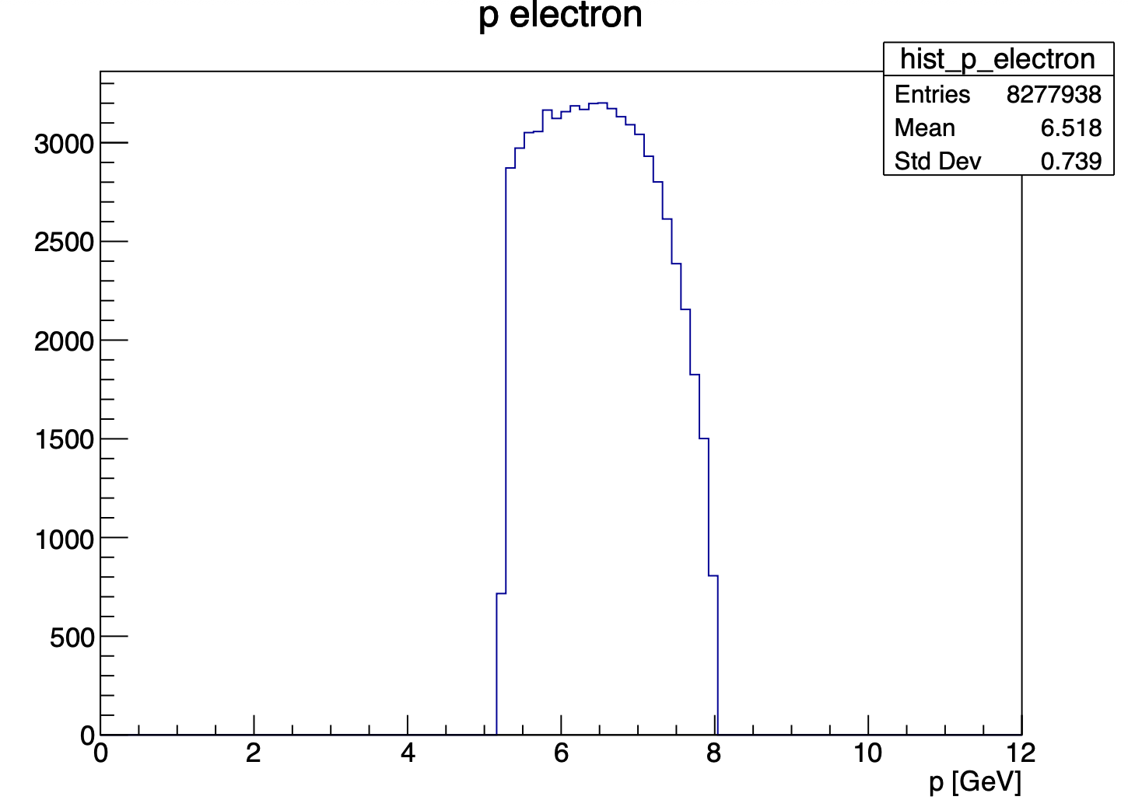
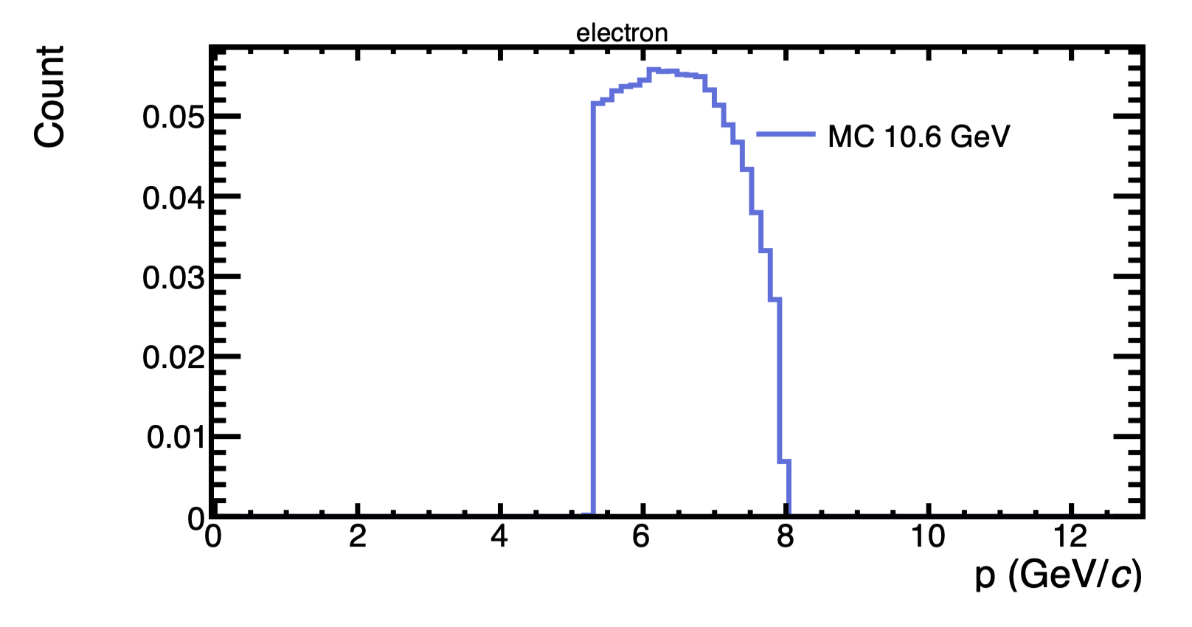
Update on ɸ generator
With this cuts : 5.25 < P_{electron} < 8 GeV and P_{proton} > 0.45 GeV
my generator
Bhawani plot
Mathieu Ronayette
11/18
Mathieu Ronayette
meeting
27 Nov 2025

Slide 30
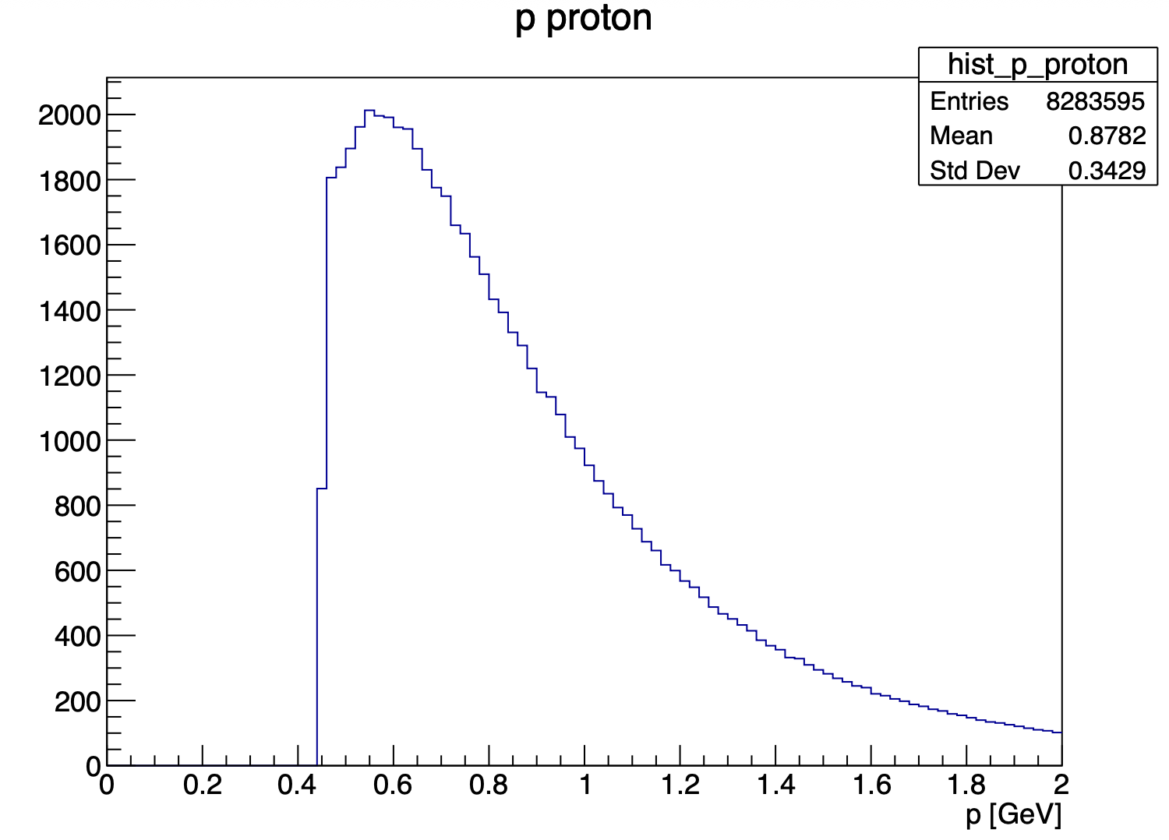
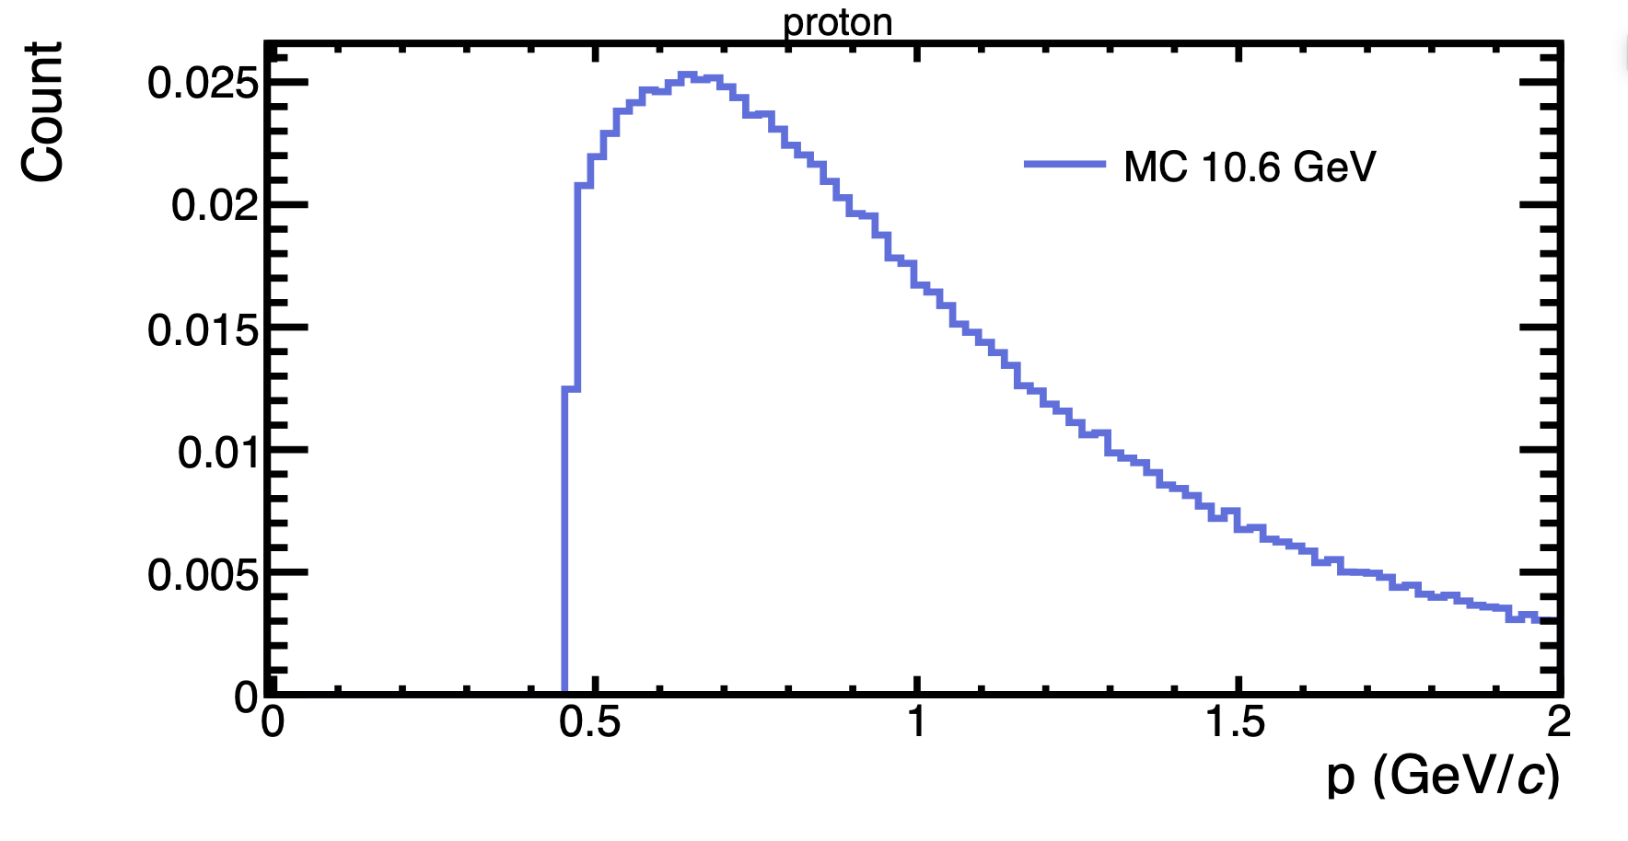
Update on ɸ generator
With this cuts : 5.25 < P_{electron} < 8 GeV and P_{proton} > 0.45 GeV
my generator
Bhawani plot
Mathieu Ronayette
12/18
Mathieu Ronayette
meeting
27 Nov 2025

Slide 31
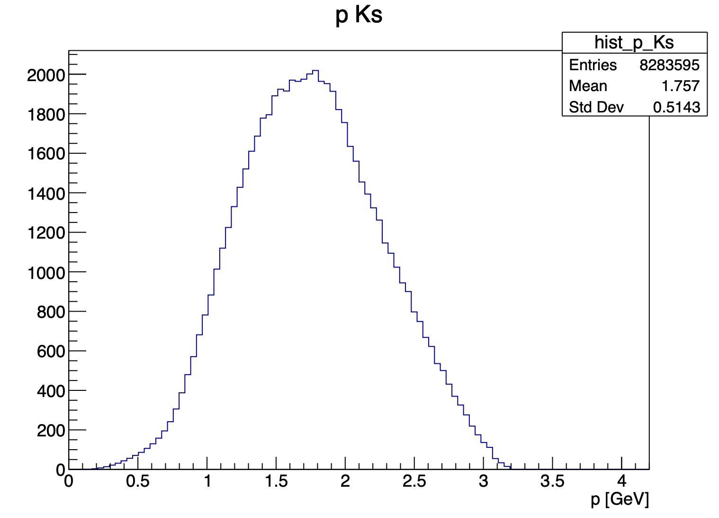
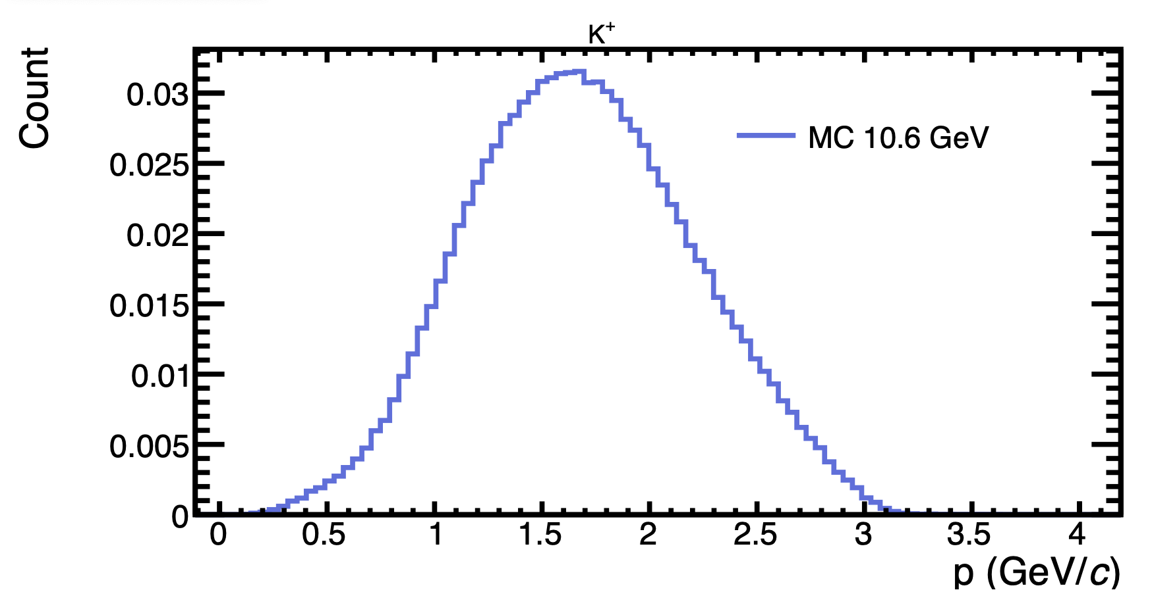
Update on ɸ generator
With this cuts : 5.25 < P_{electron} < 8 GeV and P_{proton} > 0.45 GeV
my generator
Bhawani plot
Mathieu Ronayette
13/18
Mathieu Ronayette
meeting
27 Nov 2025

Slide 32
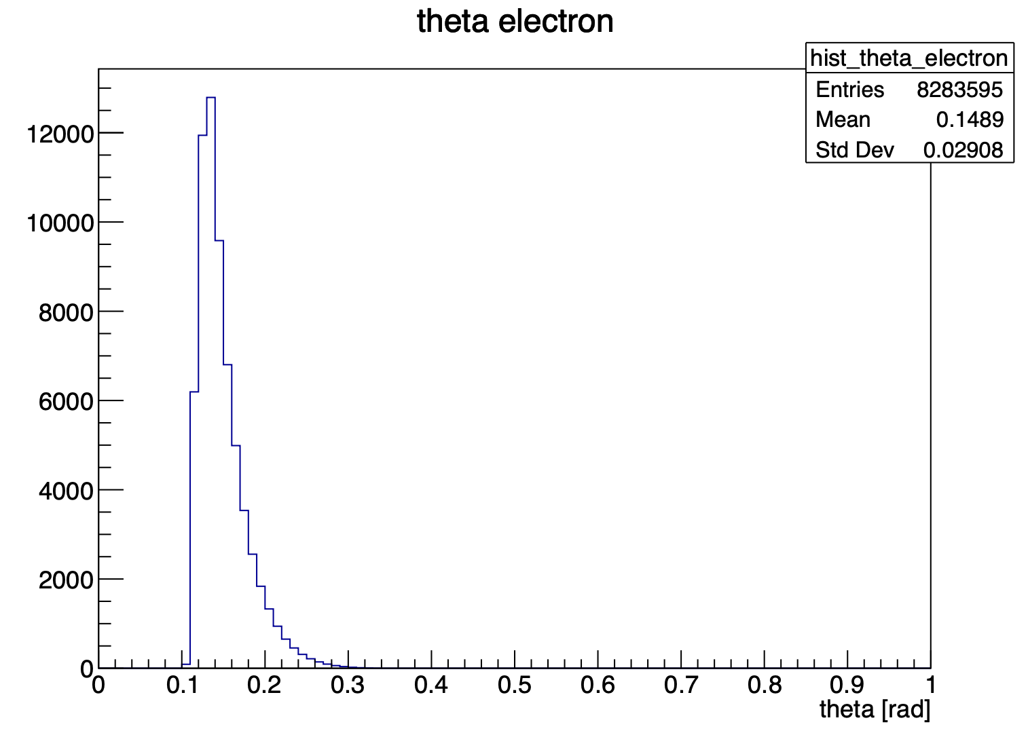
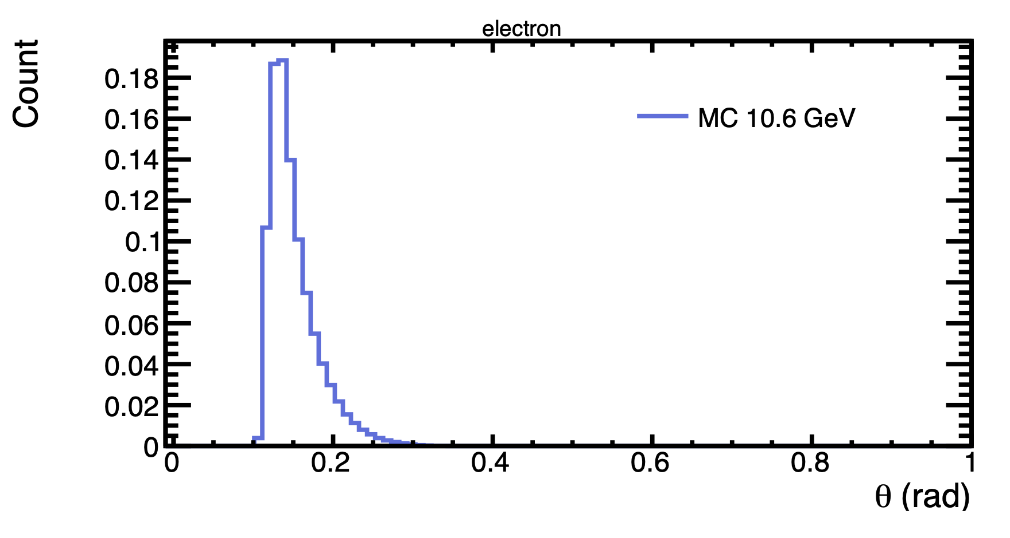
Update on ɸ generator
With this cuts : 5.25 < P_{electron} < 8 GeV and P_{proton} > 0.45 GeV
my generator
Bhawani plot
Mathieu Ronayette
14/18
Mathieu Ronayette
meeting
27 Nov 2025

Slide 33
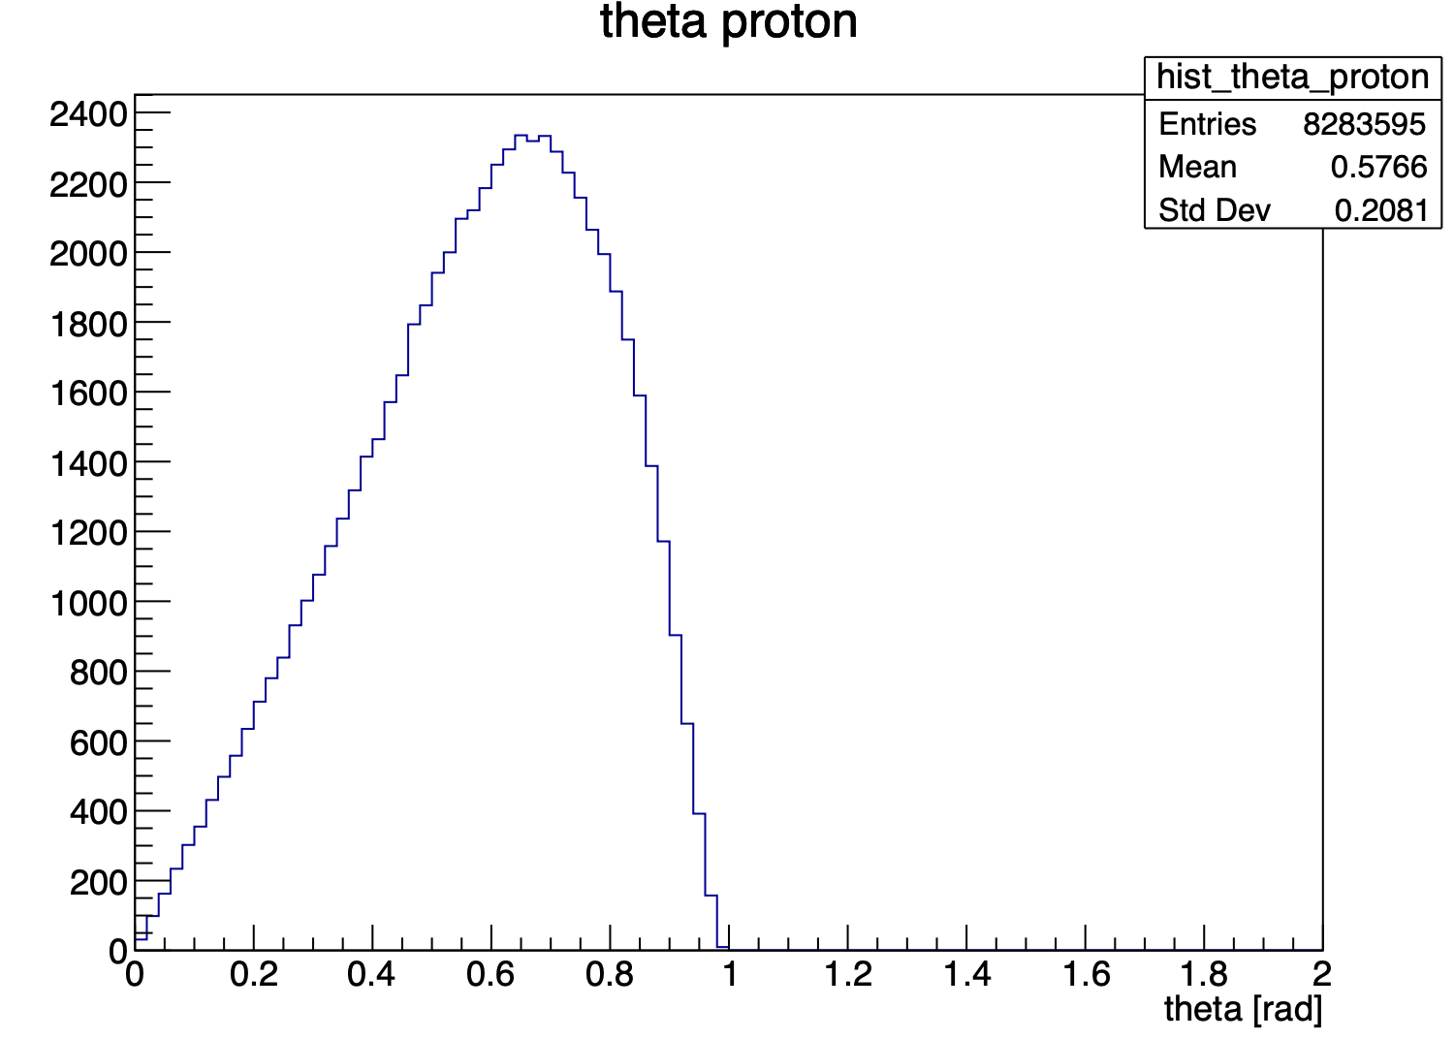
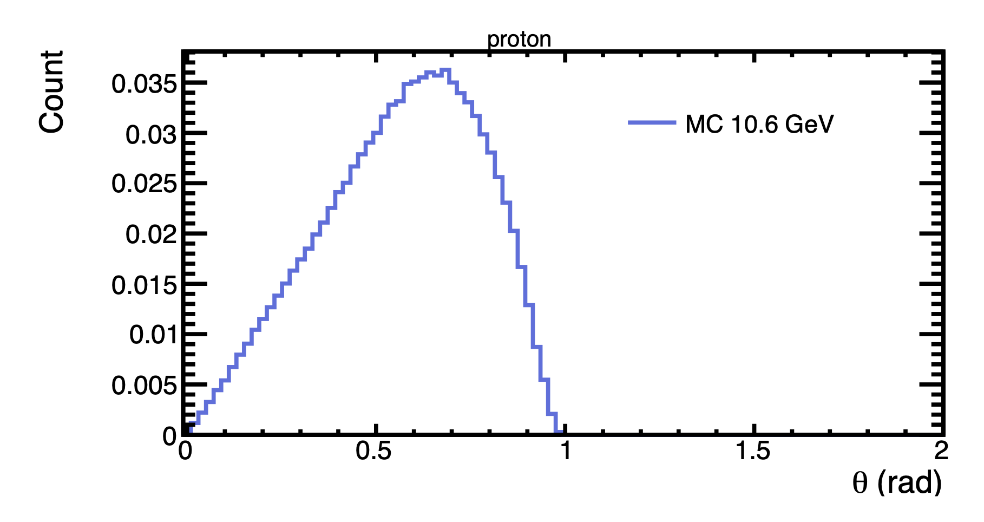
Update on ɸ generator
With this cuts : 5.25 < P_{electron} < 8 GeV and P_{proton} > 0.45 GeV
my generator
Bhawani plot
Mathieu Ronayette
15/18
Mathieu Ronayette
meeting
27 Nov 2025

Slide 34
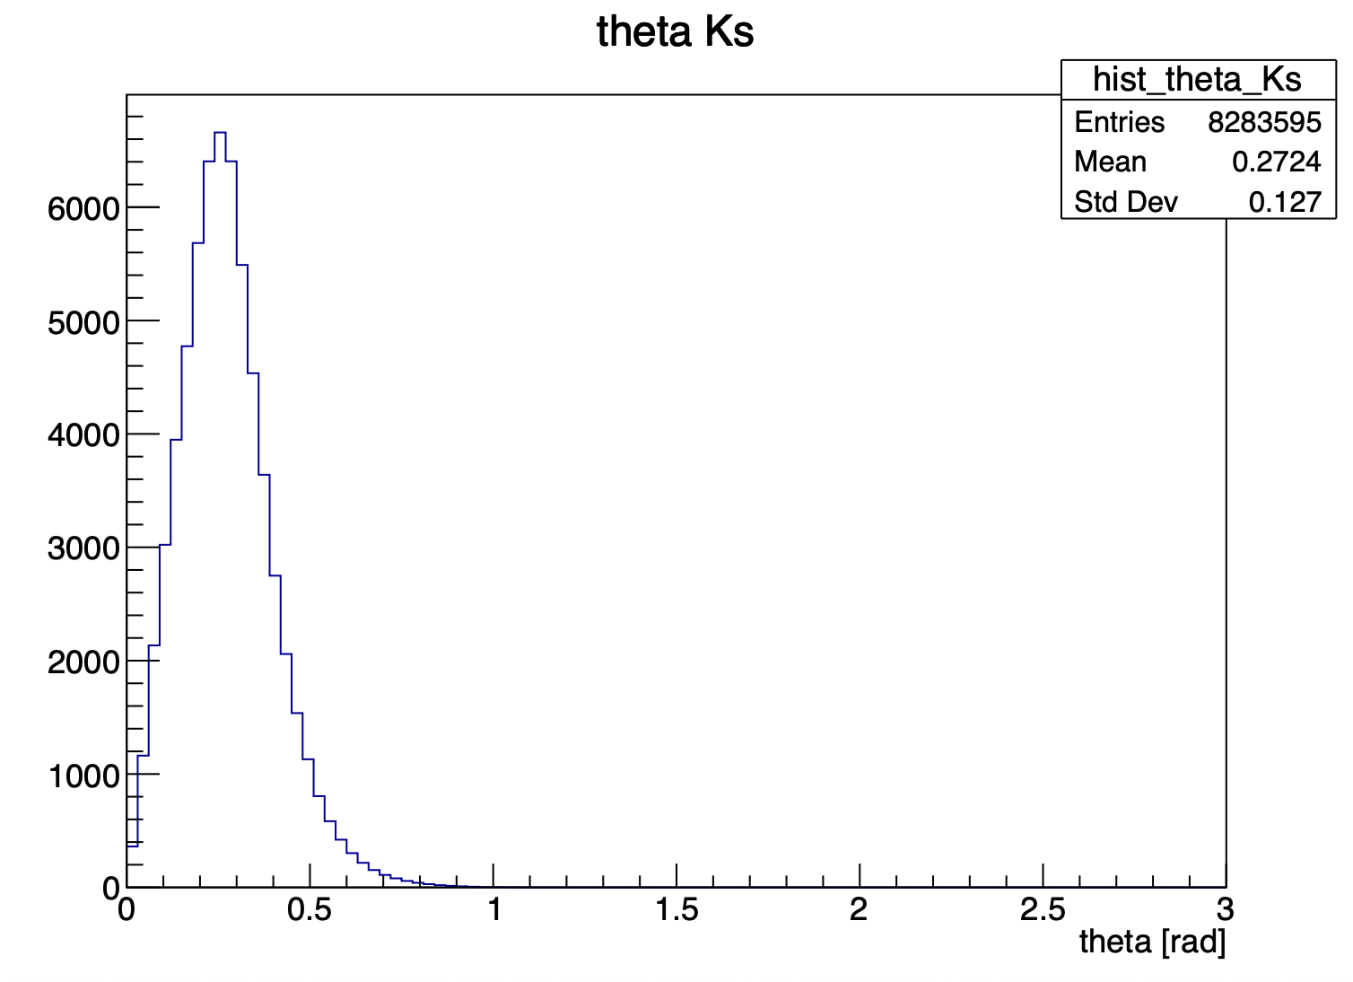

Update on ɸ generator
With this cuts : 5.25 < P_{electron} < 8 GeV and P_{proton} > 0.45 GeV
my generator
Bhawani plot
Mathieu Ronayette
16/18
Mathieu Ronayette
meeting
27 Nov 2025

Slide 35


Update on ɸ generator
With this cuts : 5.25 < P_{electron} < 8 GeV and P_{proton} > 0.45 GeV
my generator
Bhawani plot
Mathieu Ronayette
17/18
Mathieu Ronayette
meeting
27 Nov 2025

Slide 36
Update on ɸ generator
Backup cross section
Mathieu Ronayette
18/18
Mathieu Ronayette
meeting
27 Nov 2025

Slide 37





Update on ɸ generator
Details on cross section :
σ_{T} and σ_{L} (γ*p → ɸ p) :
t-dependence (dipole) :
Mathieu Ronayette
5/15
Mathieu Ronayette
meeting
7 Nov 2025

Slide 38


Update on ɸ generator
Cross section (ep → ɸ p) :
The virtual photon flux :
Mathieu Ronayette
6/15
Mathieu Ronayette
meeting
7 Nov 2025

Slide 39


Update on ɸ generator
Implemented in the generator
From Proposal to Jeﬀerson Lab PAC39
Mathieu Ronayette
7/15
Mathieu Ronayette
meeting
7 Nov 2025

Slide 40


Update on ɸ generator
Implemented in the generator
From Proposal to Jeﬀerson Lab PAC39
Mathieu Ronayette
8/15
Mathieu Ronayette
meeting
7 Nov 2025

Slide 41


Update on ɸ generator
Implemented in the generator
From Proposal to Jeﬀerson Lab PAC39
Mathieu Ronayette
9/15
Mathieu Ronayette
meeting
7 Nov 2025

Slide 42

Update on ɸ generator
Cross section (ep → ɸ p) (with the virtual photon flux) :
Implemented in the generator
Mathieu Ronayette
11/15
Mathieu Ronayette
meeting
7 Nov 2025

