Slide 1
rgB - meeting
ɸ electroproduction analysis : K⁺ K⁻ channel
13 Feb 2026
M. Ronayette, P. Chatagnon
Mathieu Ronayette
rgB - meeting
1/18
Mathieu Ronayette
13 Feb 2026

Slide 2
Introduction
Analysis objective :
- Measurement of the cross section and differential cross section of the electroproduction of ɸ in the K⁺ K⁻ channel with rgB data (deuterium target). 3 analysis are possible :
e’
e
K+
q
ɸ
K-
e n → e n’ K⁺ K⁻
→
Acces of gluons GPDs of the neutron
n
n’
e p → e p’ K⁺ K⁻
→
Acces of gluons GPDs of the proton and
compare with results on rgA
(e d → e d’ K⁺ K⁻)
→
Maybe possible : acces on gluons GPDs of the deuterium
Mathieu Ronayette
rgB - meeting
2/18
Mathieu Ronayette
13 Feb 2026

Slide 3
Introduction
Analysis :
Datas :
sidisdvcs RG-B outbending fall 2019
+ spring 2019 and spring 2020 inbending
e n → e n’ K⁺ K⁻
Cuts :
→ Selection of events with one e⁻ , K⁺ , K ⁻ , more than 1 neutron and 0 proton (select the best neutron wich minimize the angle between the missing nucleon and the neutron)
→ Q² > 1.0 GeV , P_{electron} > 2 GeV , θ_{neutron} > 4 ° and P_{neutron} > 0.25 GeV
→ Cut on the angle between the missing nucleon and the neutron
→ Cut on –0.5 < MissingMass_{tot} ² < 0.5 GeV ²
→ Cut on status of K⁺ and K⁻ (keep event with both kaons in FD)
Mathieu Ronayette
3/18
Mathieu Ronayette
rgB - meeting
13 Feb 2026

Slide 4
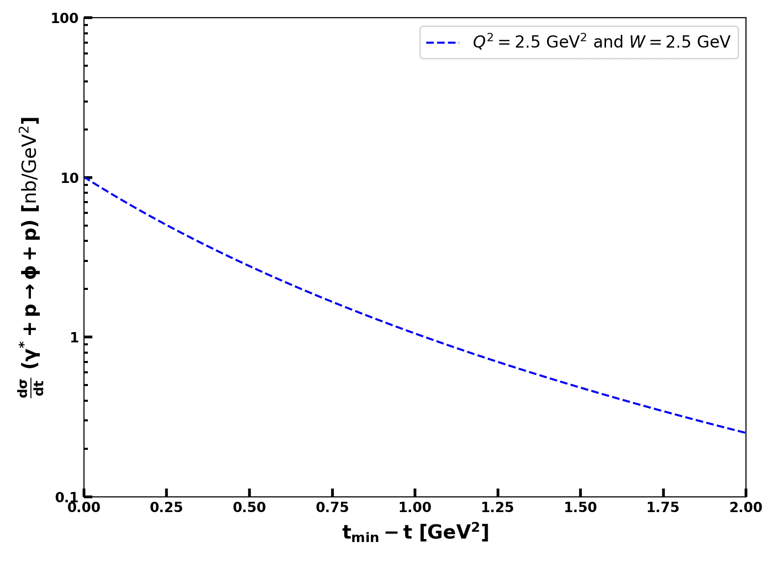

ɸ generator
Implemented in the generator
From Proposal to Jeﬀerson Lab PAC39
Mathieu Ronayette
4/18
Mathieu Ronayette
rgB - meeting
13 Feb 2026

Slide 5
Details on cuts : angle between miss nucleon and detected neutron
Missing_nucleon = beam + target - e’ - K⁺ - K⁻ (the missing particle of this reaction : e n → e’ K⁺ K⁻ X)
K⁺
K⁺
K⁻
K⁻
e⁻
e⁻
neutron
neutron
missing_nucleon
missing_nucleon
Not a good event
Good event
→ Cut on the angle between the missing nucleon and the neutron < 5 °
Mathieu Ronayette
5/18
Mathieu Ronayette
rgB - meeting
13 Feb 2026

Slide 6
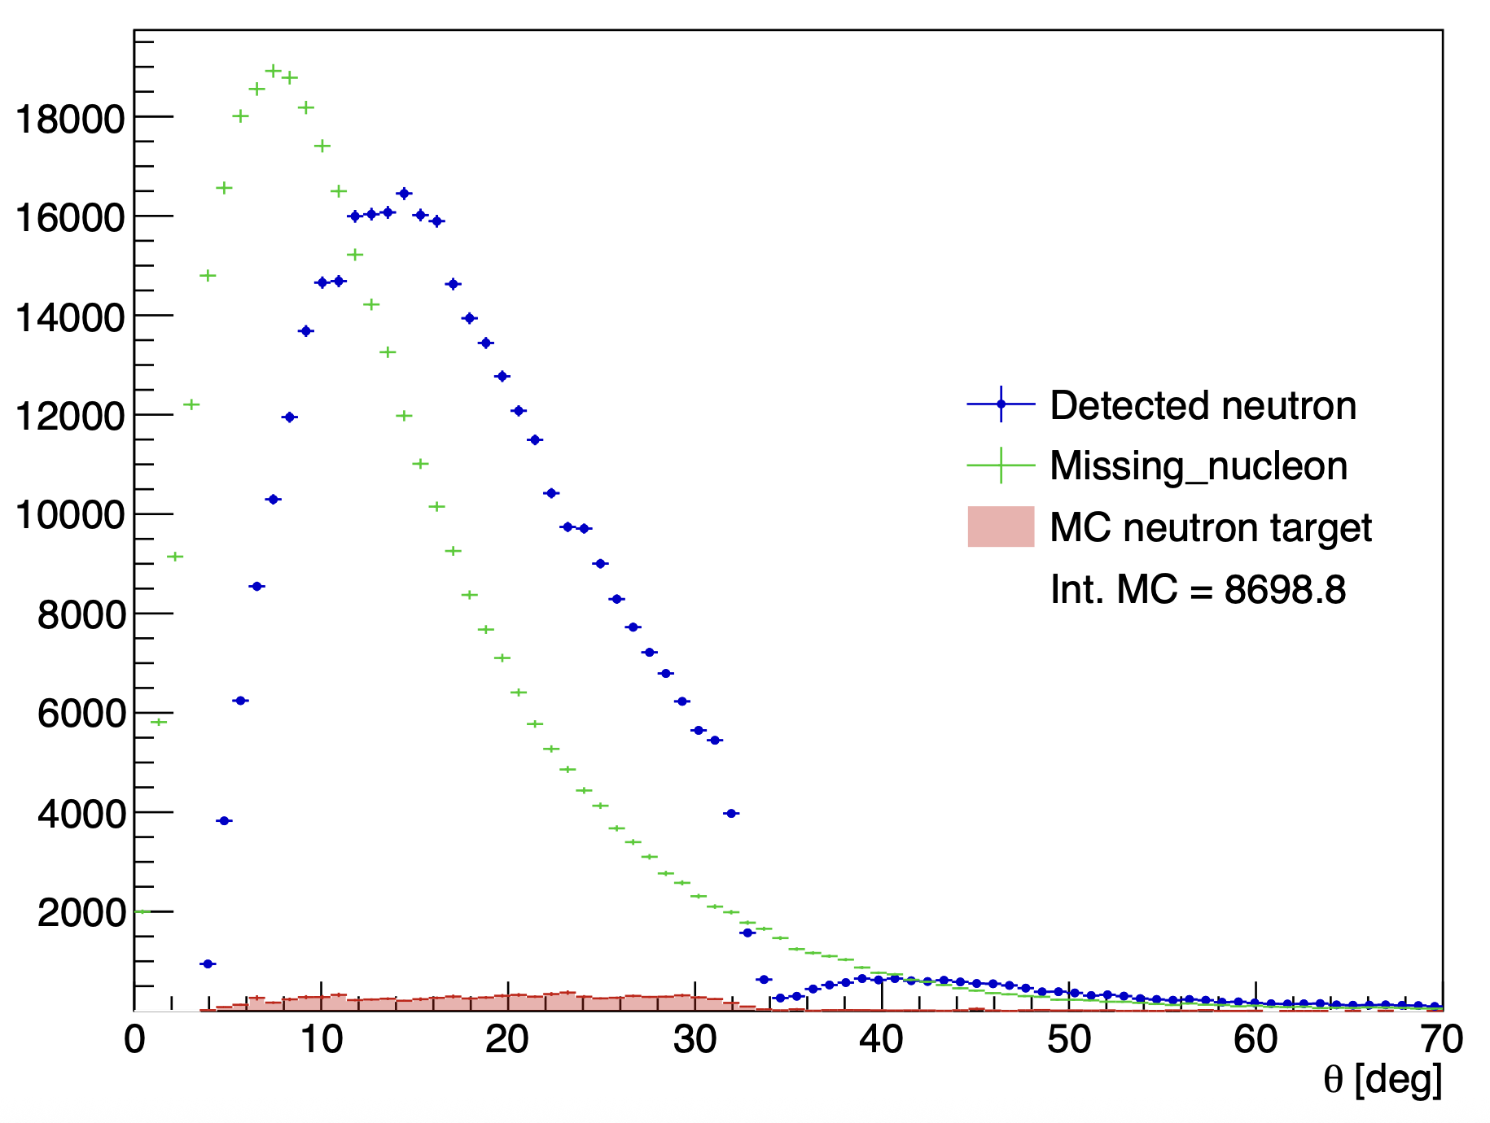
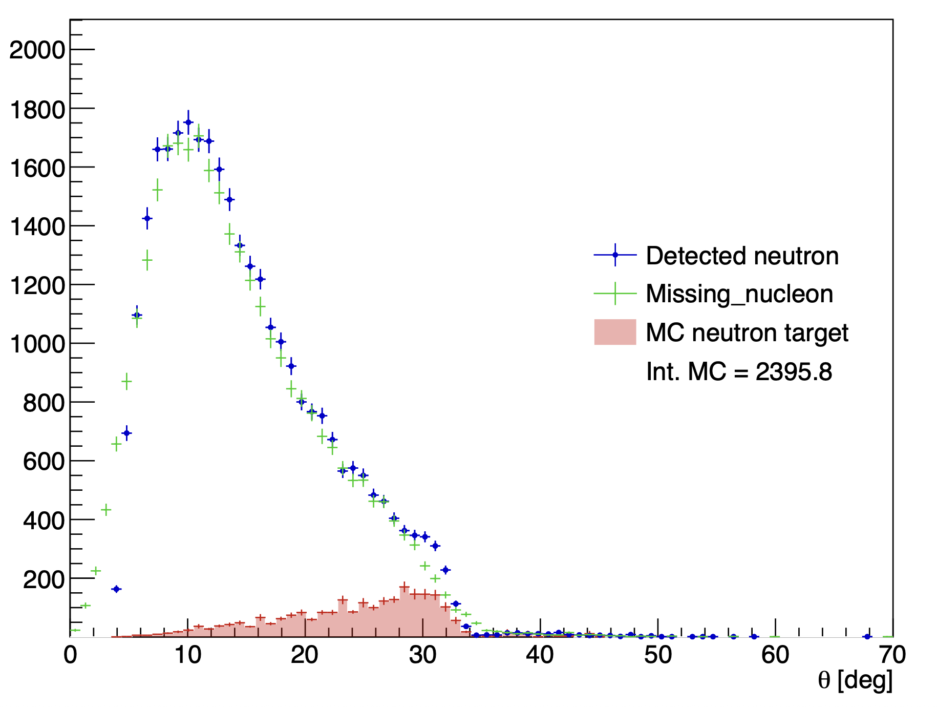
Details on cuts : angle between missing nucleon and detected neutron
Without the angle cut
With the angle cut
Mathieu Ronayette
6/18
Mathieu Ronayette
rgB - meeting
13 Feb 2026

Slide 7
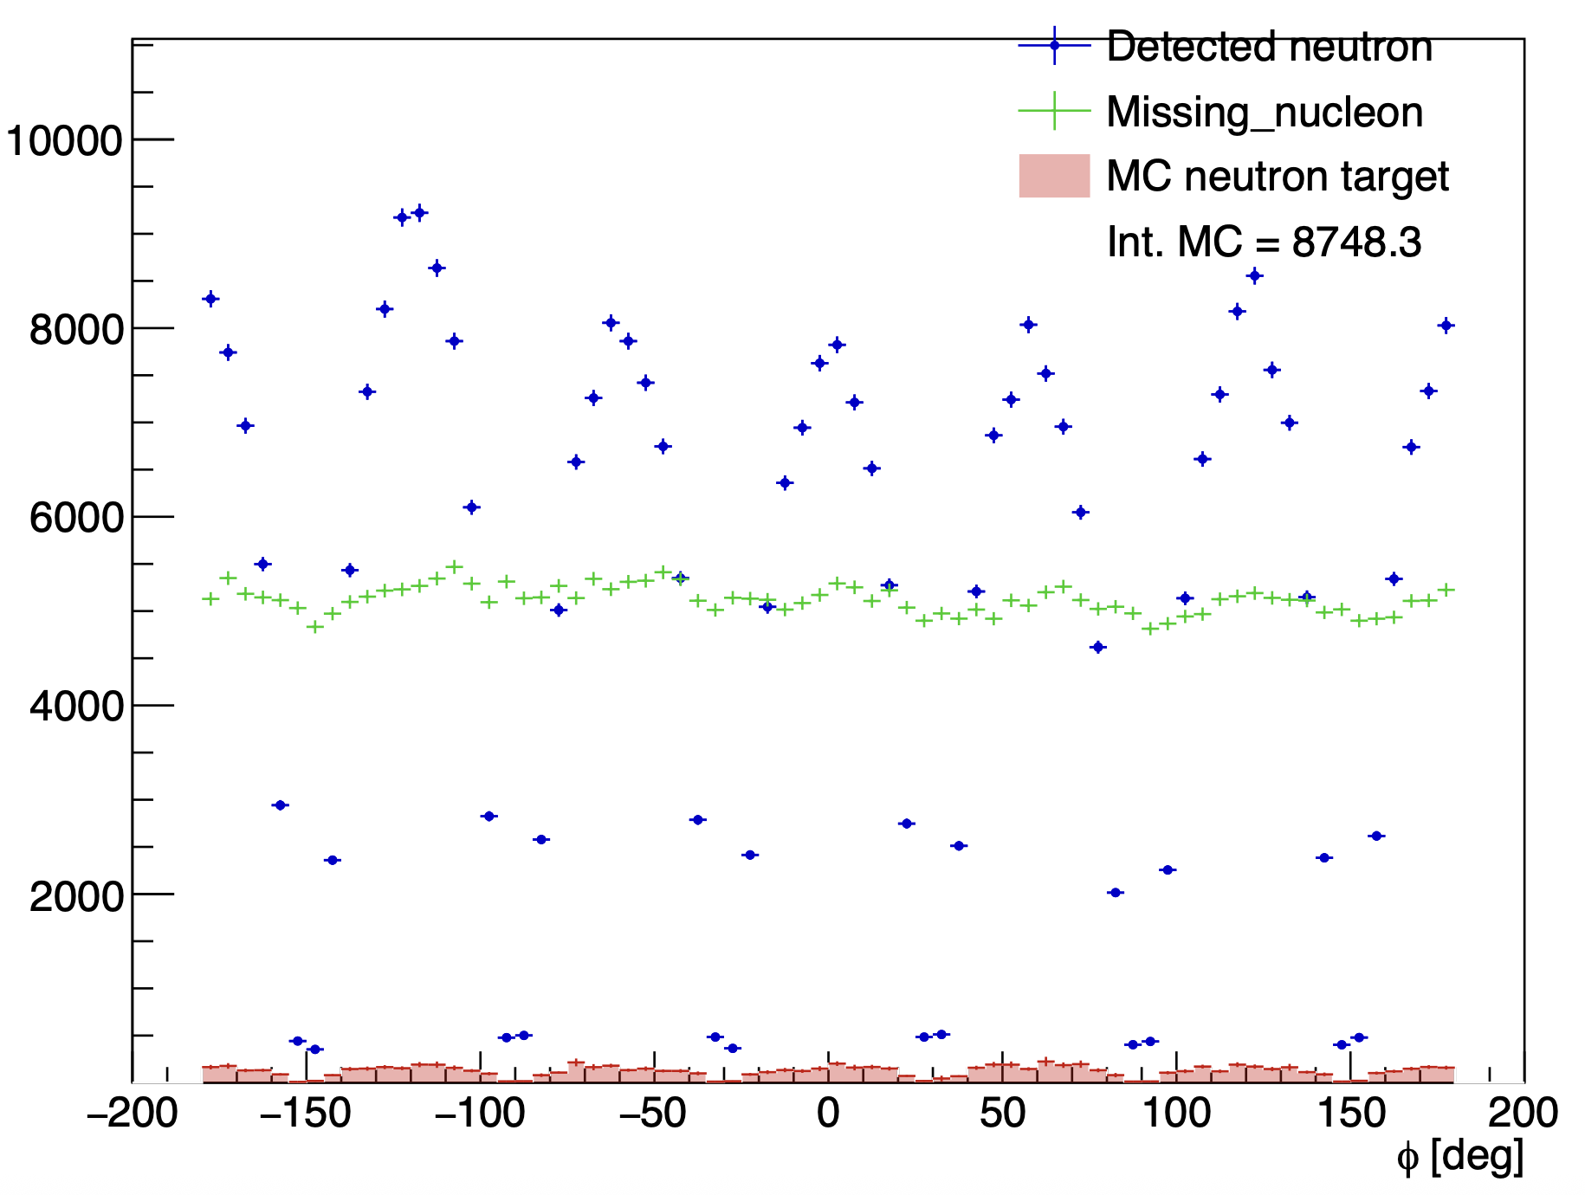
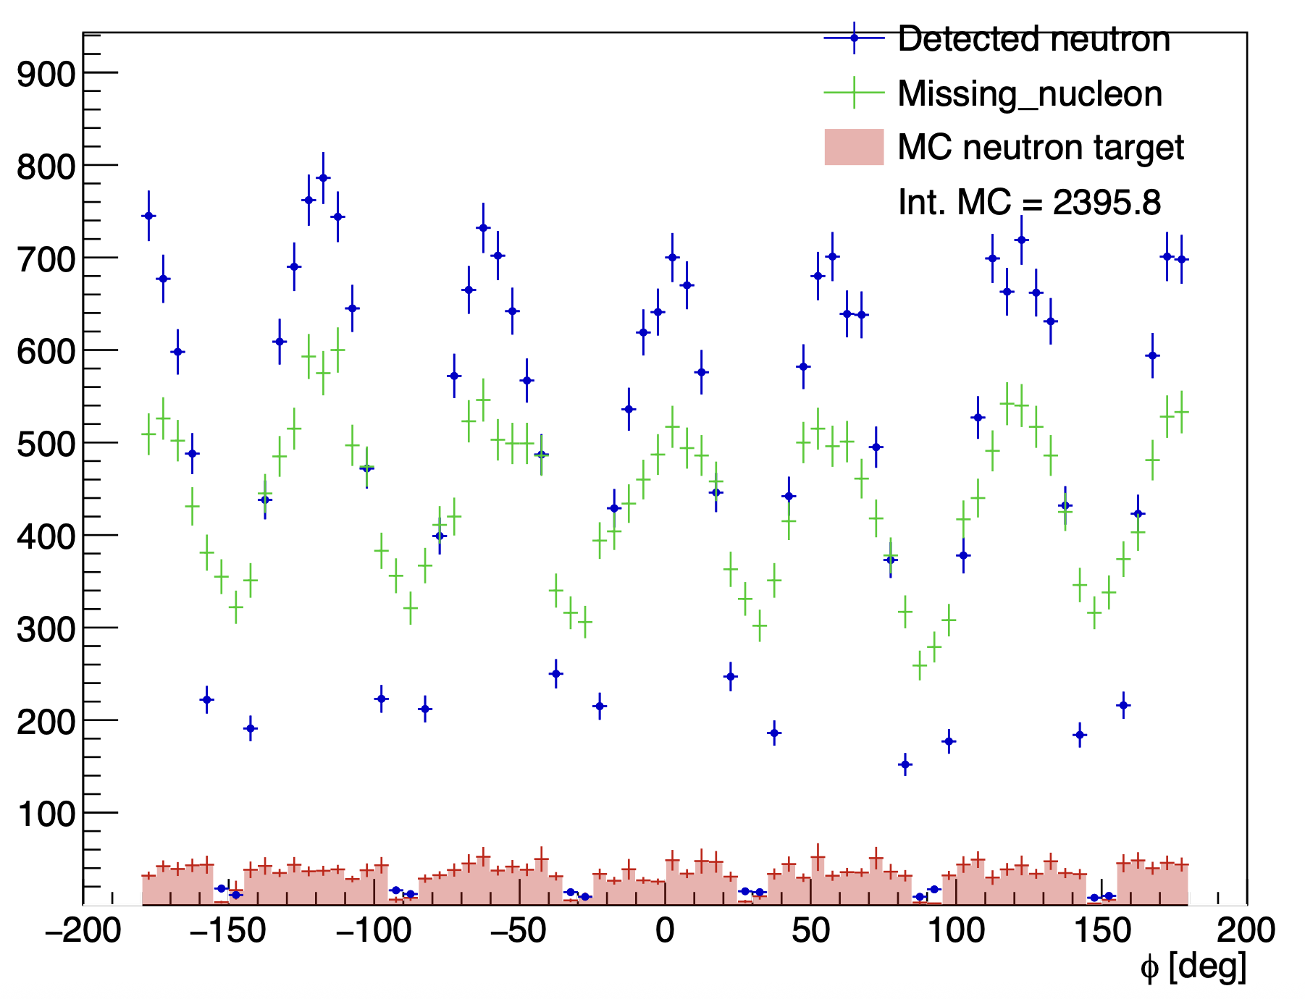
Details on cuts : angle between missing nucleon and detected neutron
Without the angle cut
With the angle cut
Mathieu Ronayette
7/18
Mathieu Ronayette
rgB - meeting
13 Feb 2026

Slide 8
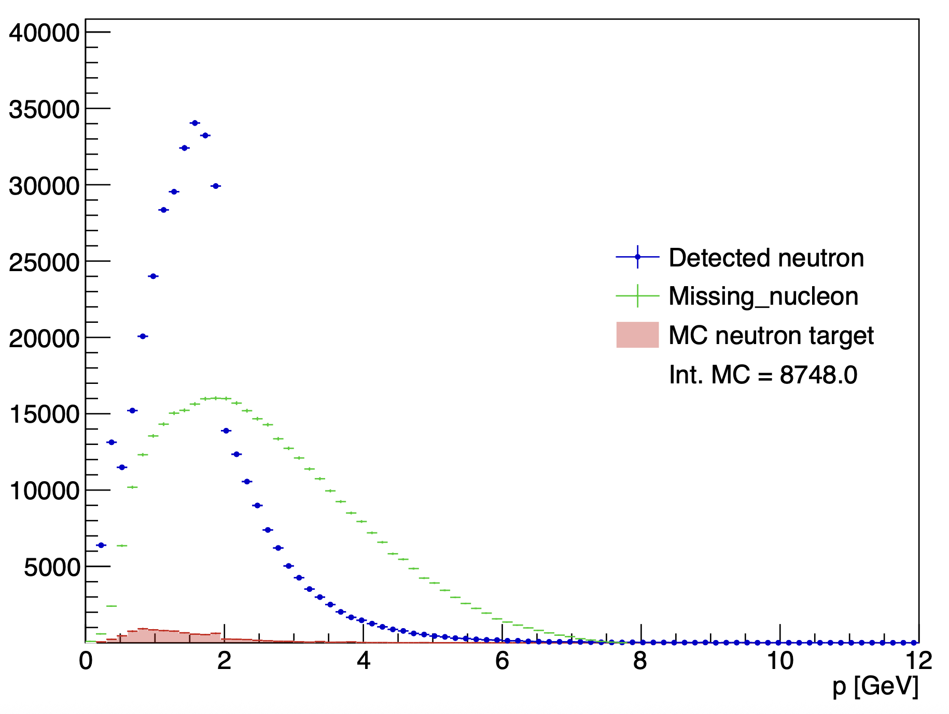
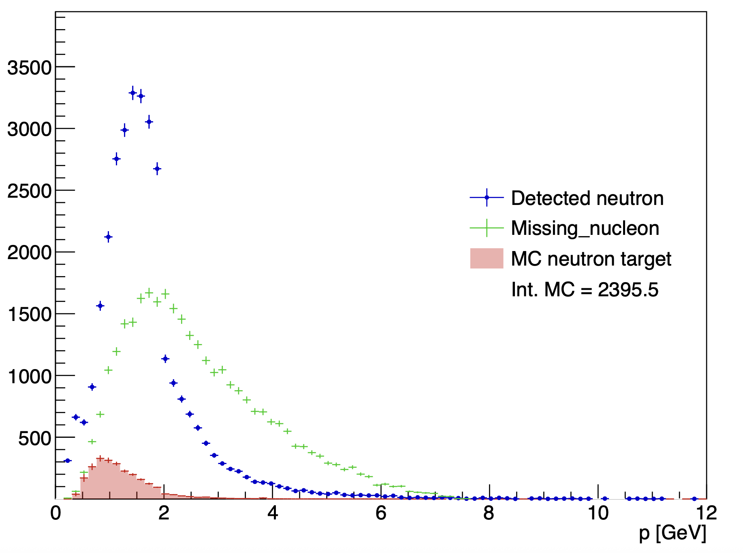
Details on cuts : angle between missing nucleon and detected neutron
Without the angle cut
With the angle cut
Mathieu Ronayette
8/18
Mathieu Ronayette
rgB - meeting
13 Feb 2026

Slide 9
Proton contamination
Missing_nucleon = beam + target - e’ - K⁺ - K⁻ (the missing particle of this reaction : e n → e’ K⁺ K⁻ X)
K⁺
K⁻
There is always a contamination when the missing_nucleon is a non detected proton and there is a fake signal neutron who pass the cut on the angle
e⁻
neutron
missing_nucleon
→ Evaluate the contamination with simulation on proton target and apply the cuts of neutron analysis and see how many
events pass the cuts
Keep event with the angle between the missing nucleon and the neutron < 5 °
Mathieu Ronayette
9/18
Mathieu Ronayette
rgB - meeting
13 Feb 2026

Slide 10
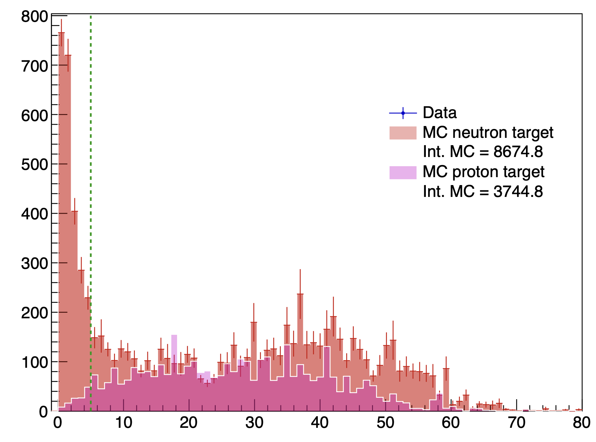
Proton contamination : prediction of MC
<-- Cut at 5 °
angle between the missing_nucleon and the neutron detected
Mathieu Ronayette
10/18
Mathieu Ronayette
rgB - meeting
13 Feb 2026

Slide 11
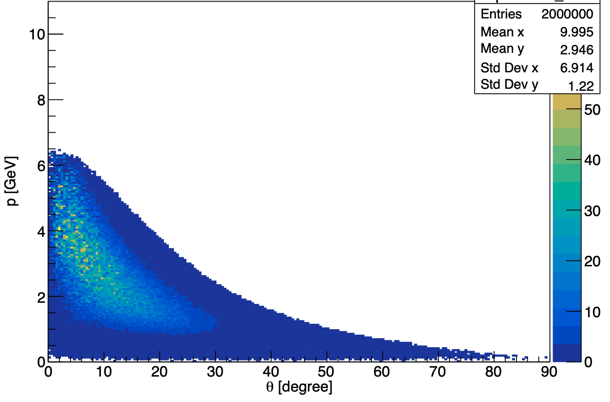
Details on cuts : keep K+ K- in FD
Generated event : p vs theta for K⁺⁻
Two argument to cut K+ K- in CD :
Reconstruction of kaons in the CD is less good than in the FD
The generator predict few events in the CD
Mathieu Ronayette
11/18
Mathieu Ronayette
rgB - meeting
13 Feb 2026

Slide 12
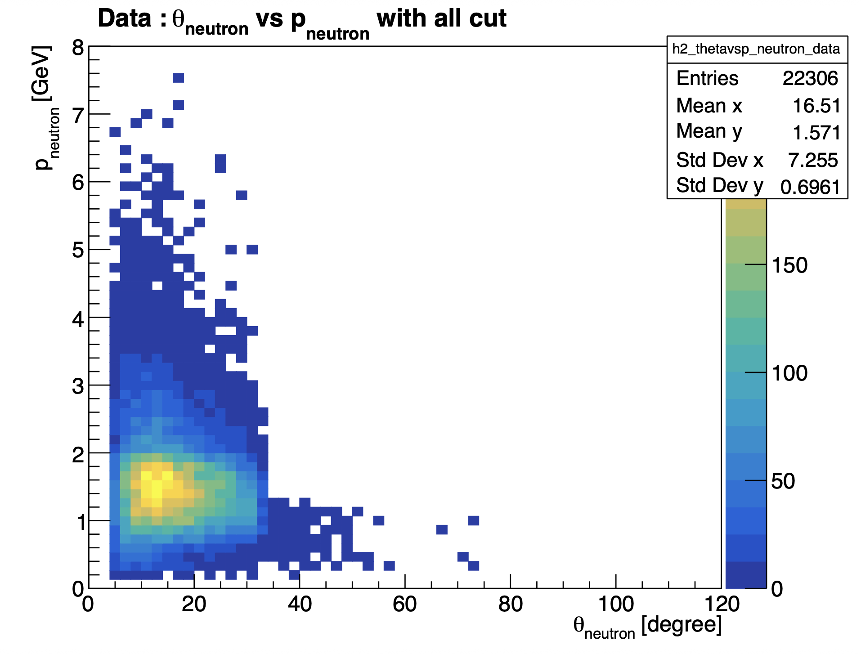
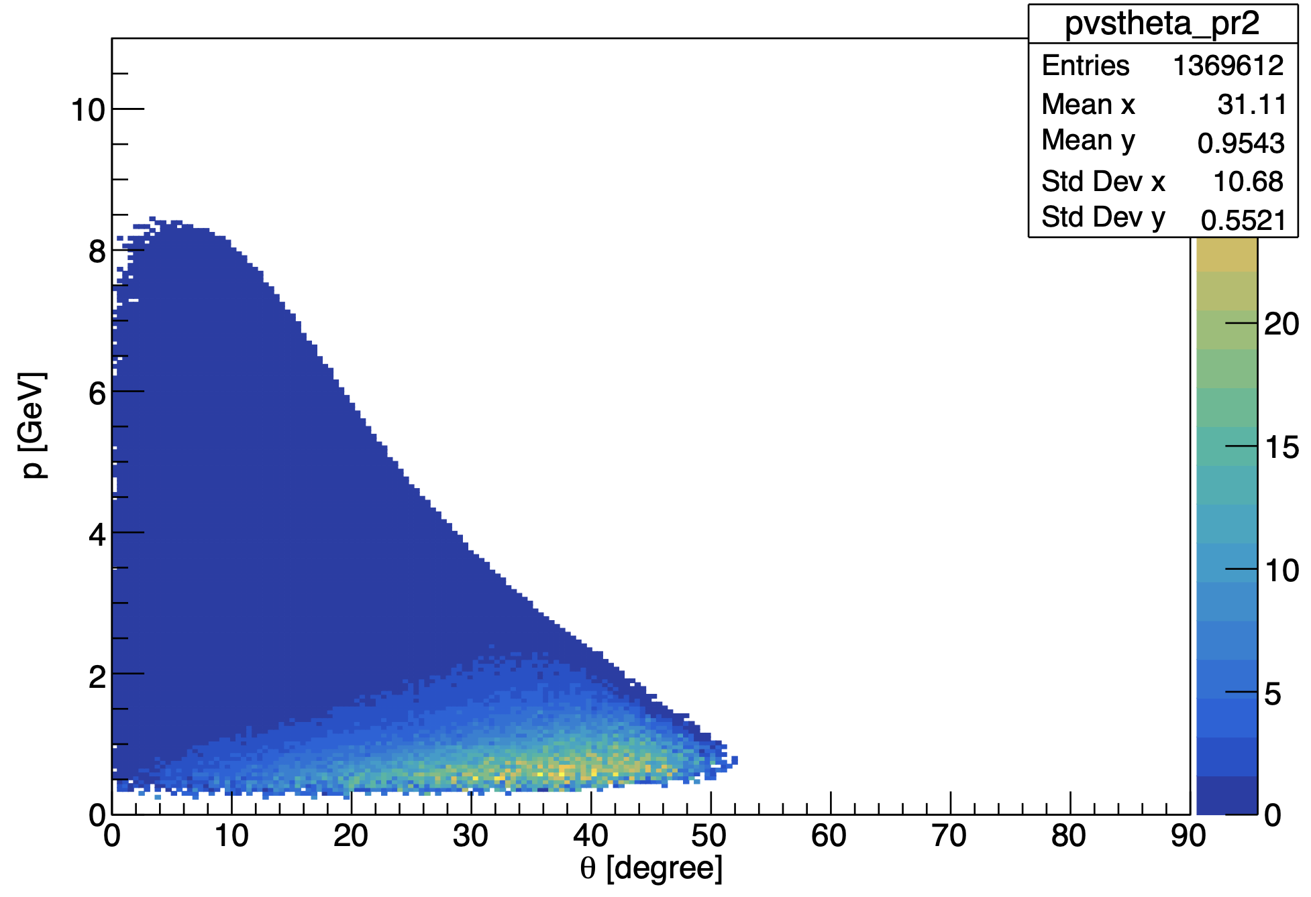
Neutron phasespace :
MC : θ_{neutron} vs P_{neutron} generated
(with acceptante cuts)
Mathieu Ronayette
12/18
Mathieu Ronayette
rgB - meeting
13 Feb 2026

Slide 13
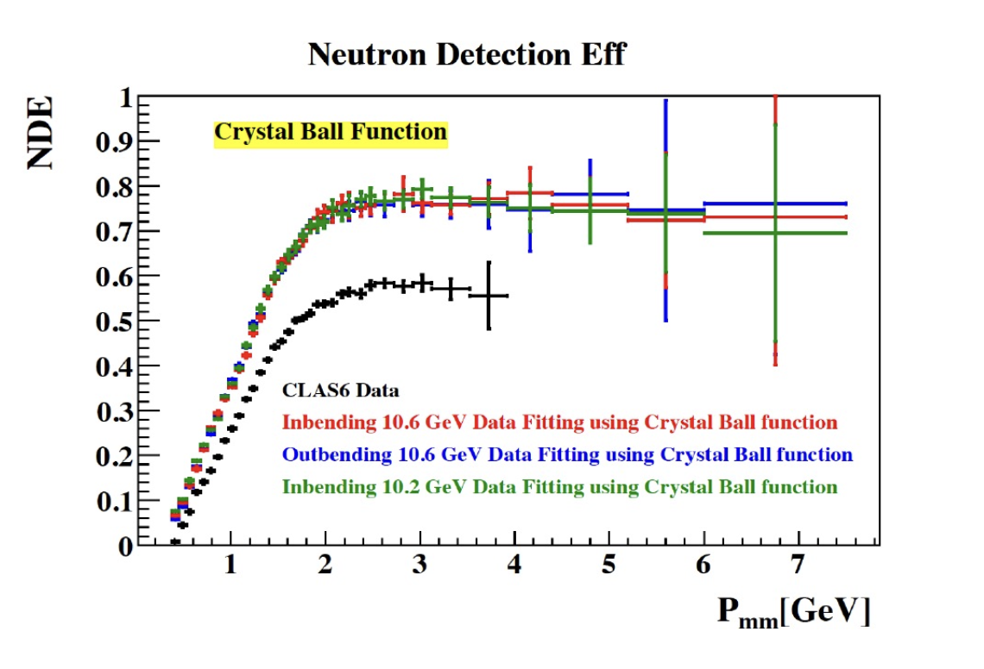
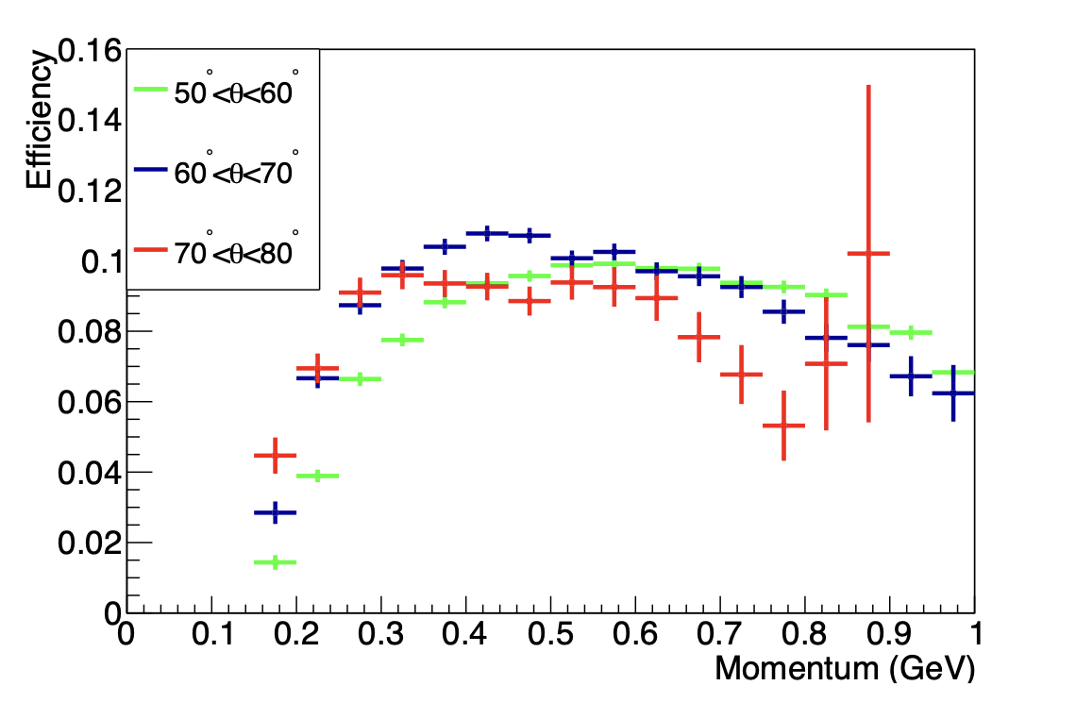
Neutron phasespace :
P. Chatagnon’s plot
Neutron detection efficiency in the FD
Neutron detection efficiency in the CND
Mathieu Ronayette
13/18
Mathieu Ronayette
rgB - meeting
13 Feb 2026

Slide 14
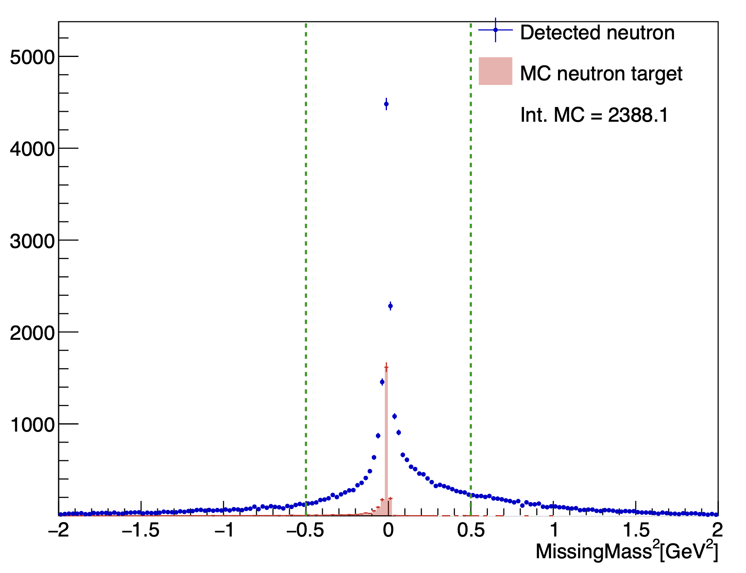
Details on cuts : Total missing mass
Total missing mass e n → e’ n’ K⁺ K⁻ X
(after all the previous cut)
–0.5 < MissingMass_{tot} ² < 0.5 GeV ²
Mathieu Ronayette
14/18
Mathieu Ronayette
rgB - meeting
13 Feb 2026

Slide 15
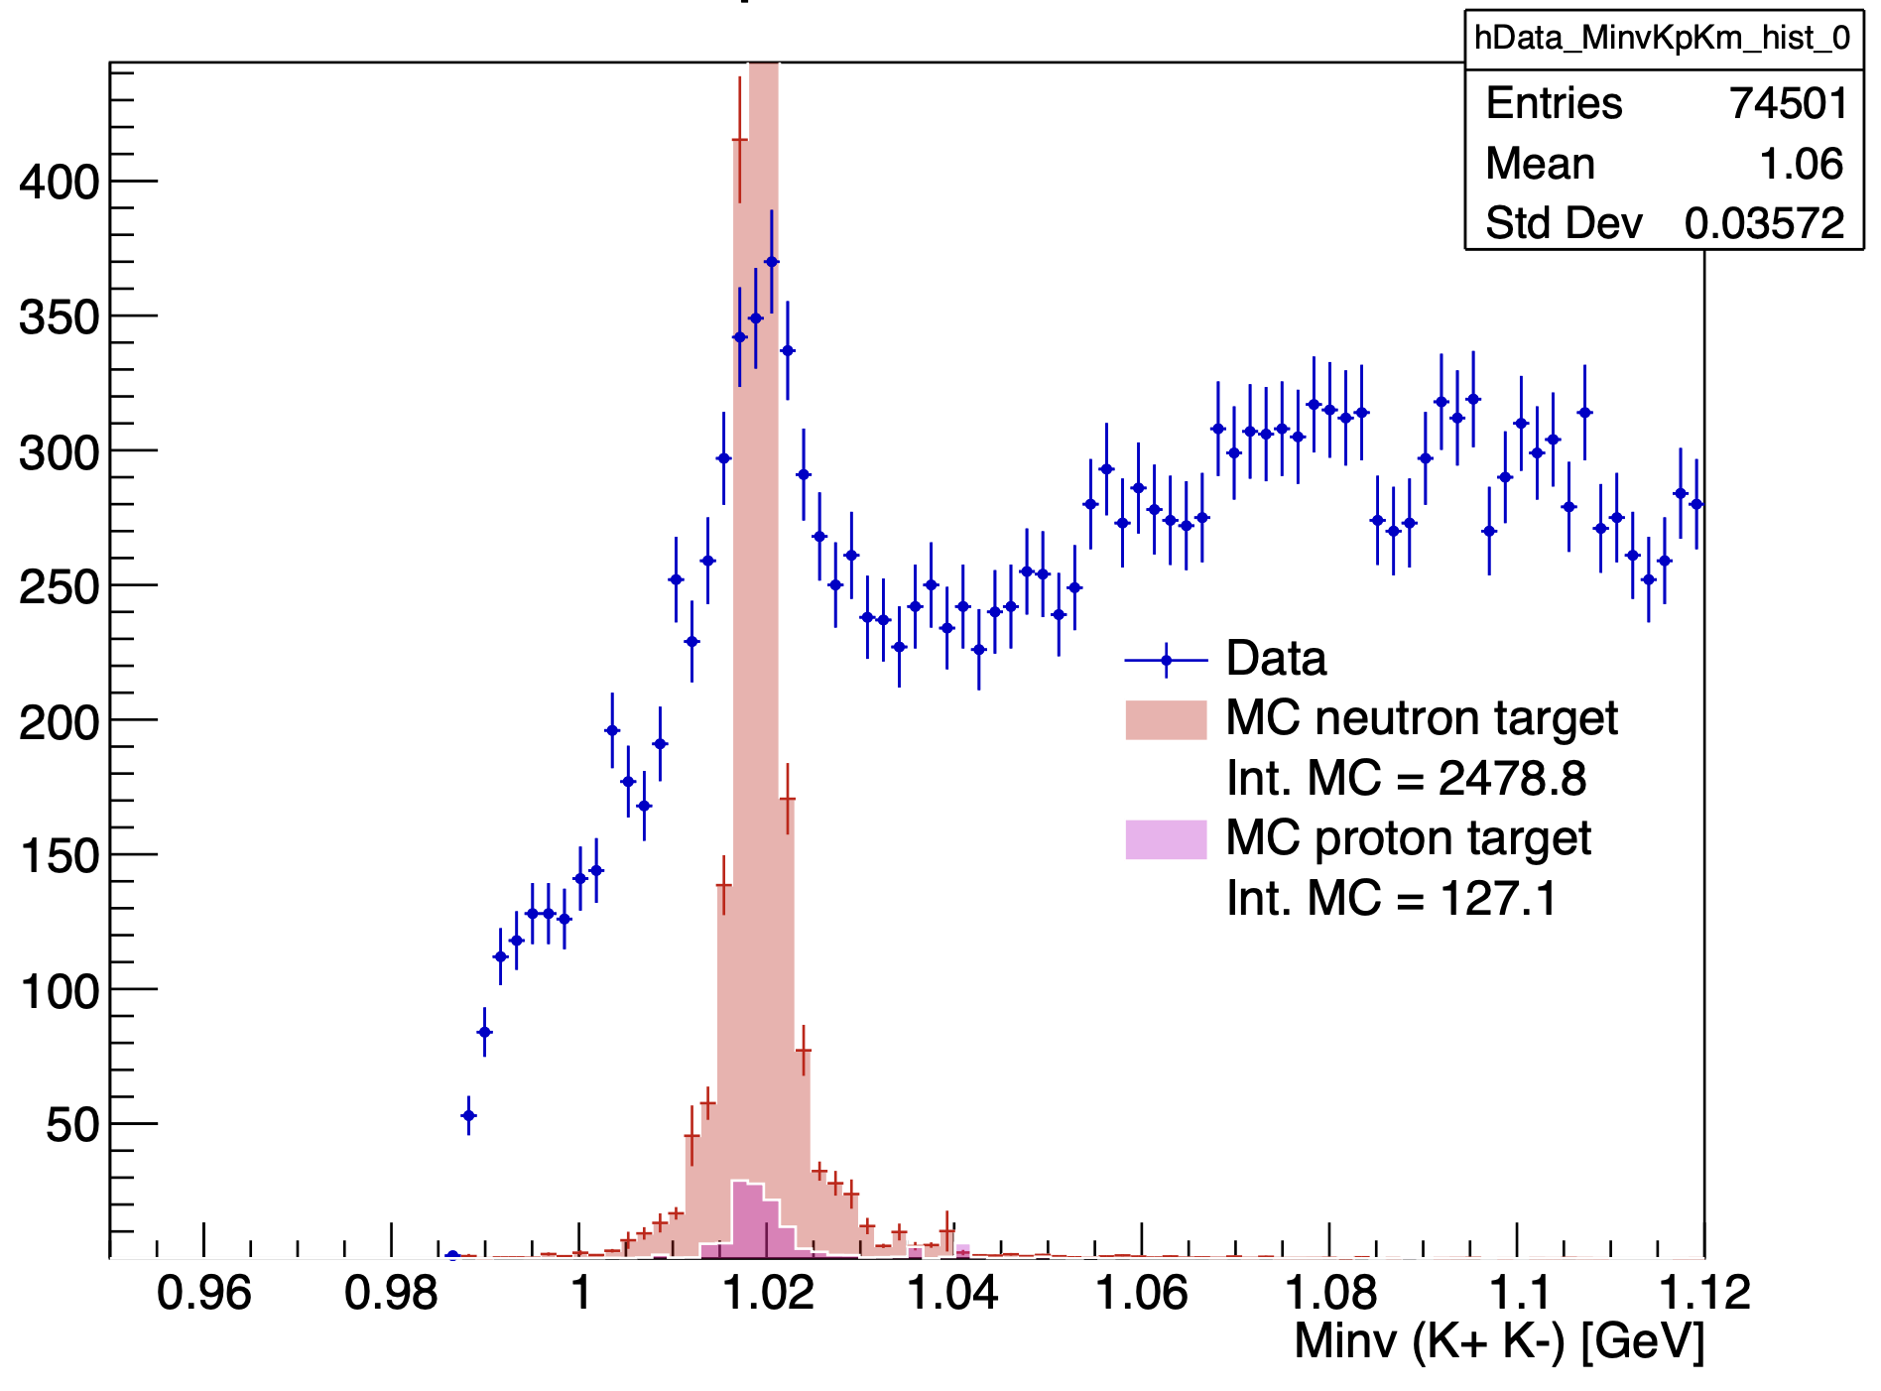
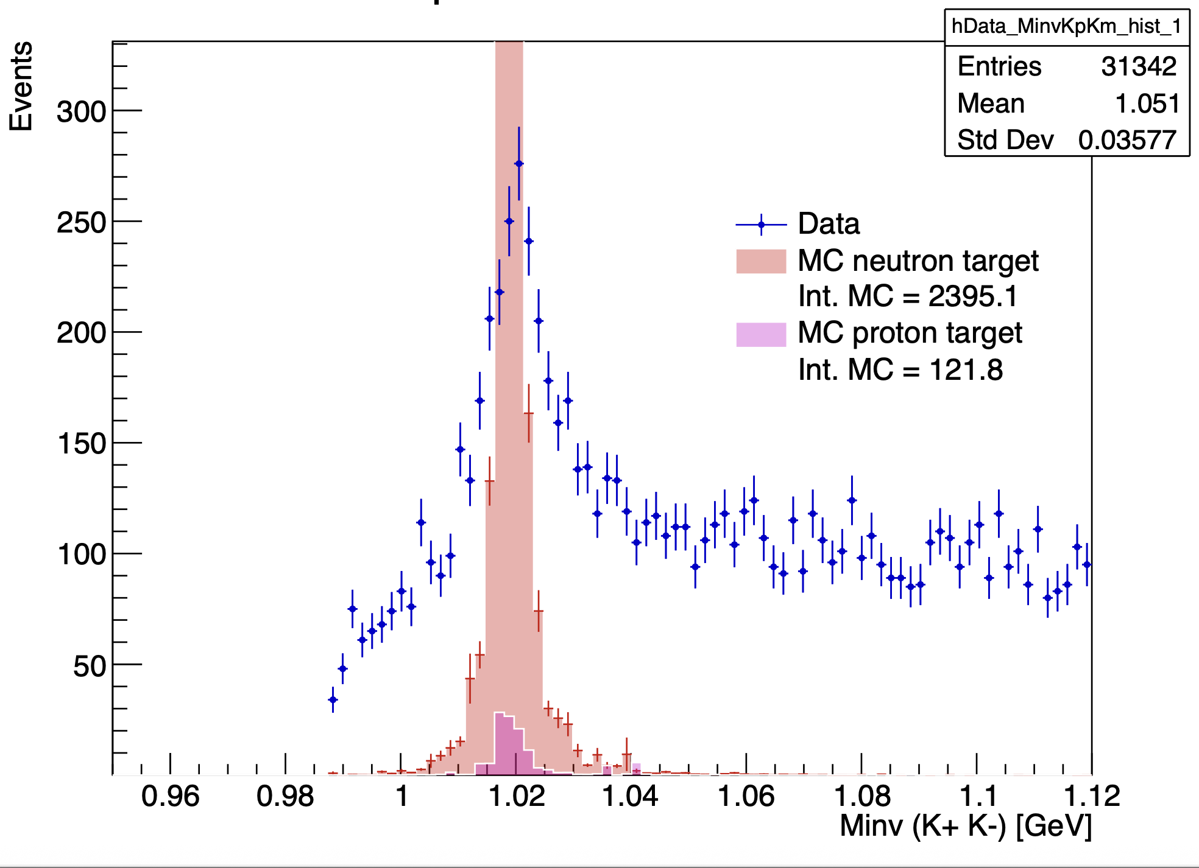
Invariant mass K⁺ K⁻ :
With angle cut
With angle cut and K+ K- in FD
Mathieu Ronayette
15/18
Mathieu Ronayette
rgB - meeting
13 Feb 2026

Slide 16
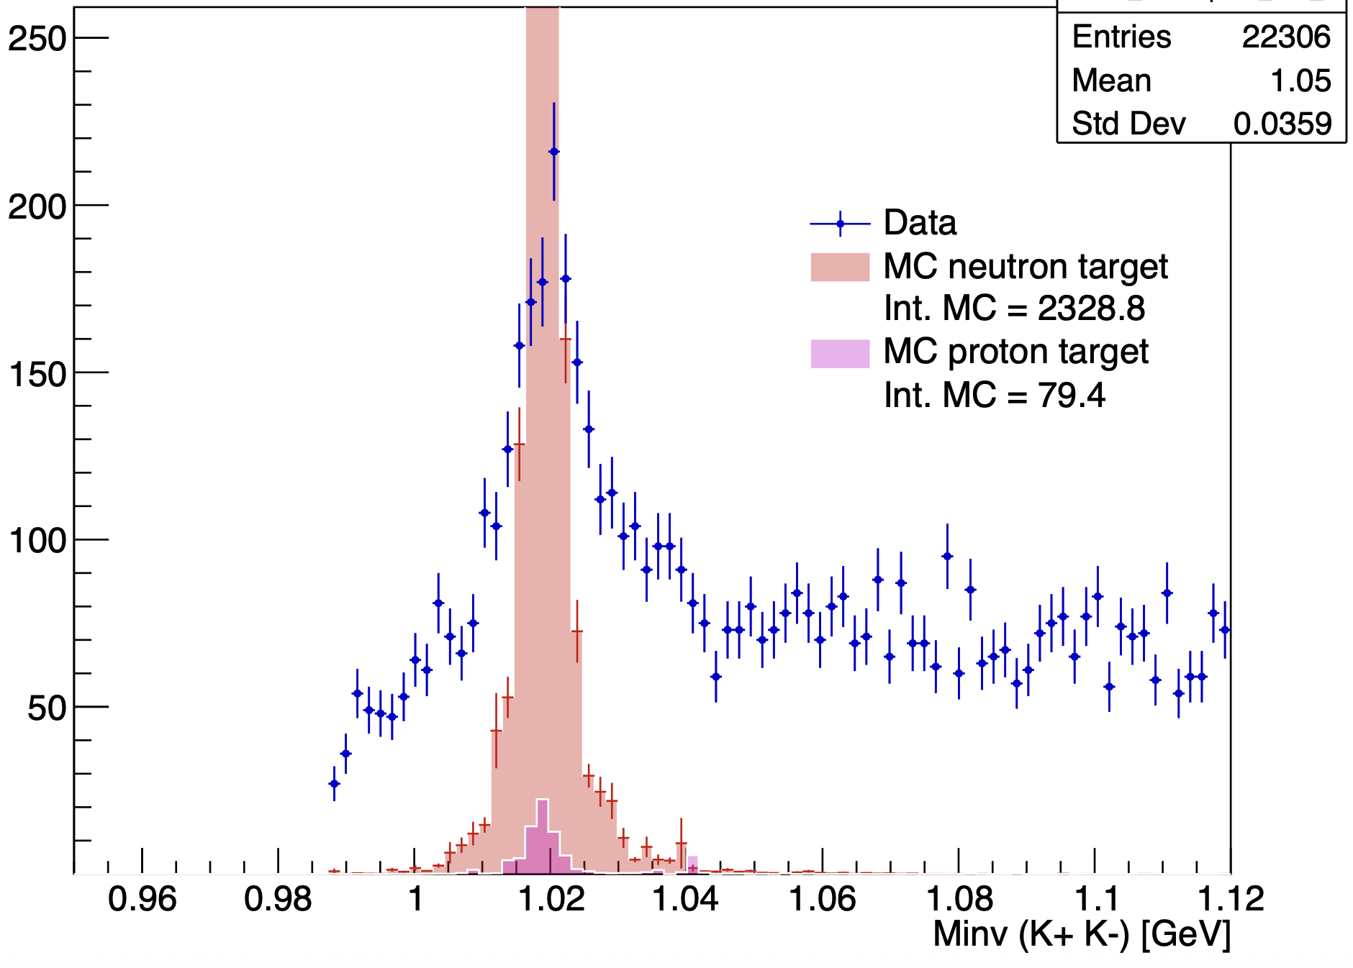
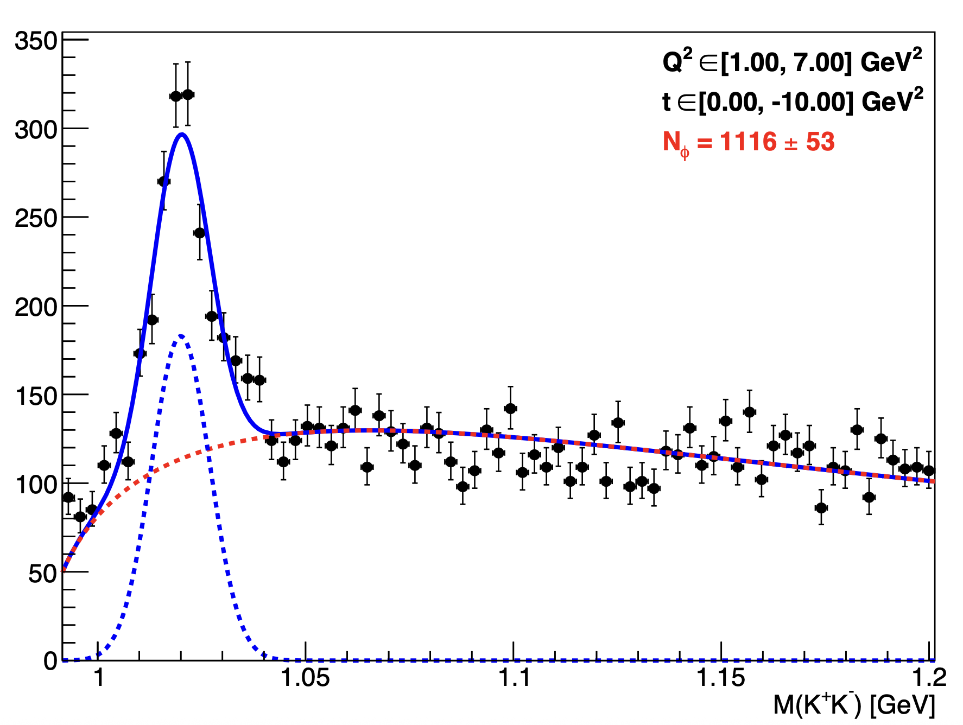
Invariant mass K⁺ K⁻ :
With angle cut, K+ K- in FD, and cut on MissingMass
Fit all fall2019 outbending data
Mathieu Ronayette
16/18
Mathieu Ronayette
rgB - meeting
13 Feb 2026

Slide 17
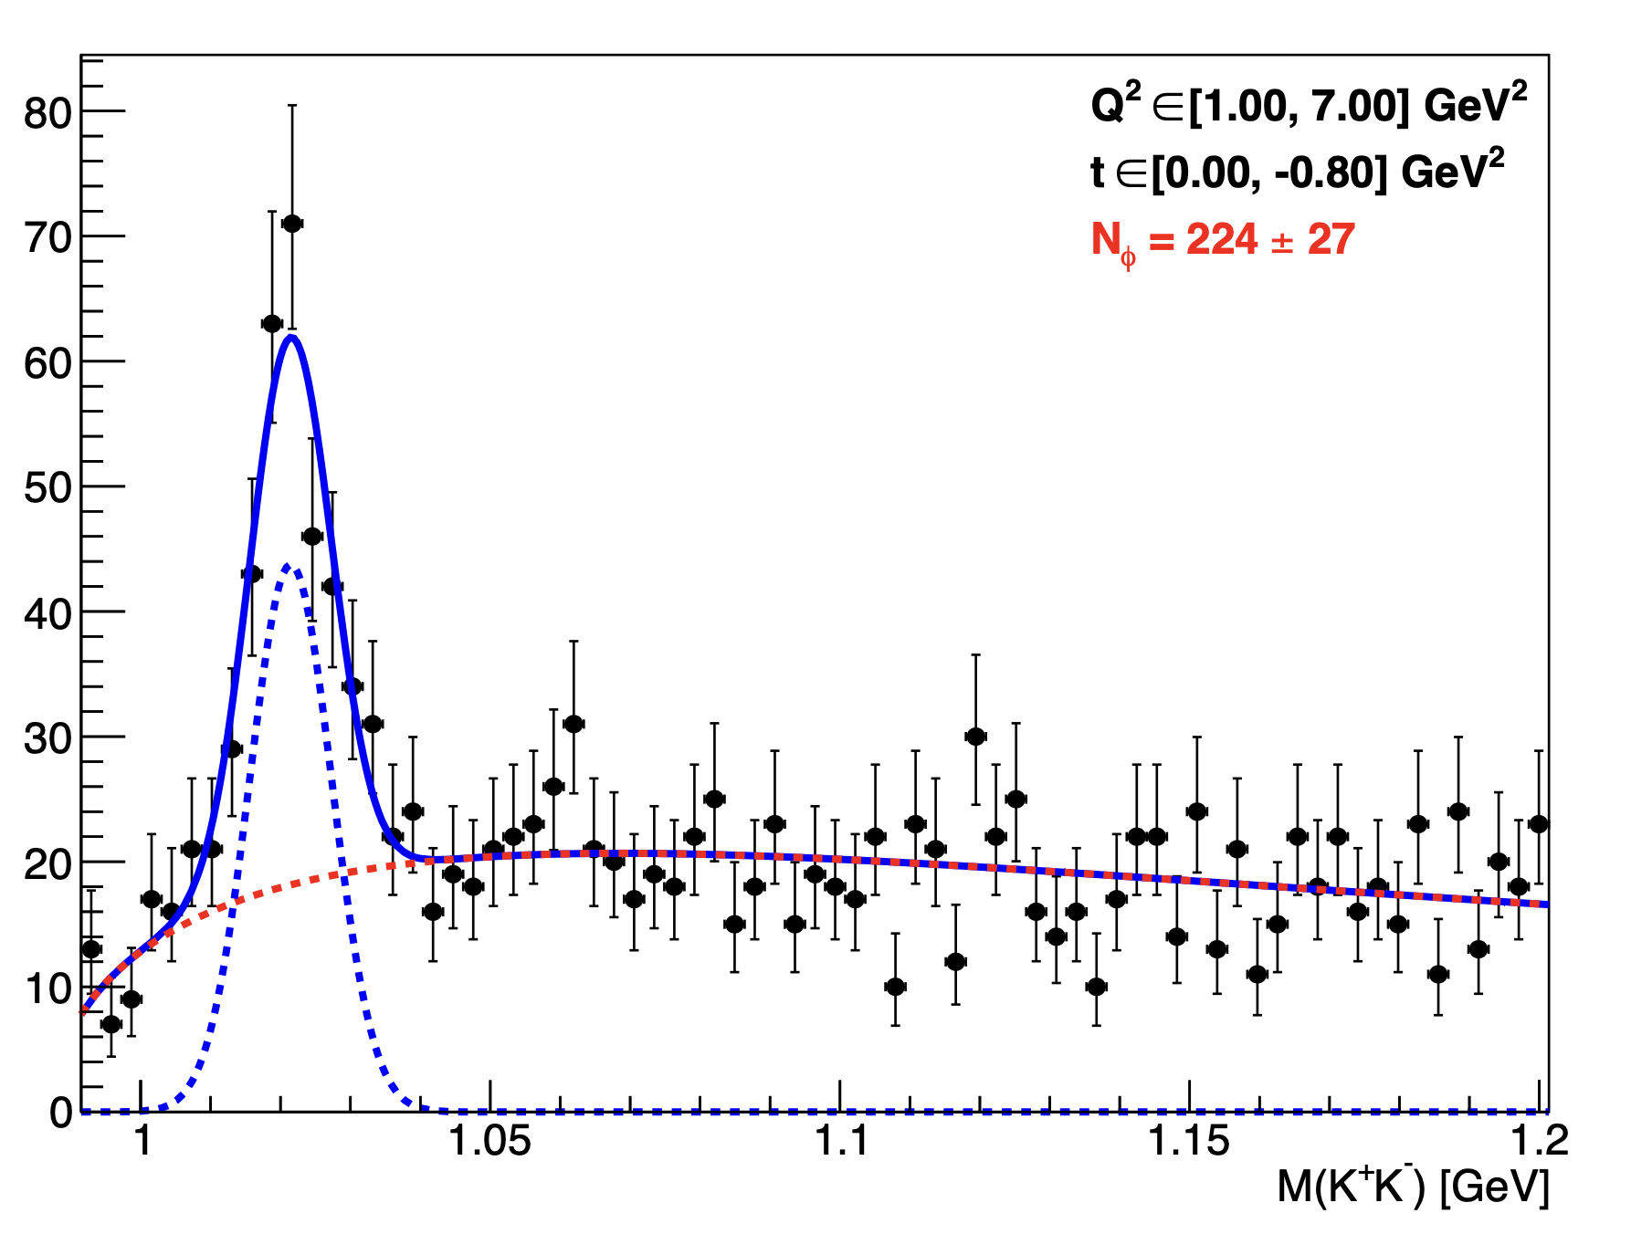
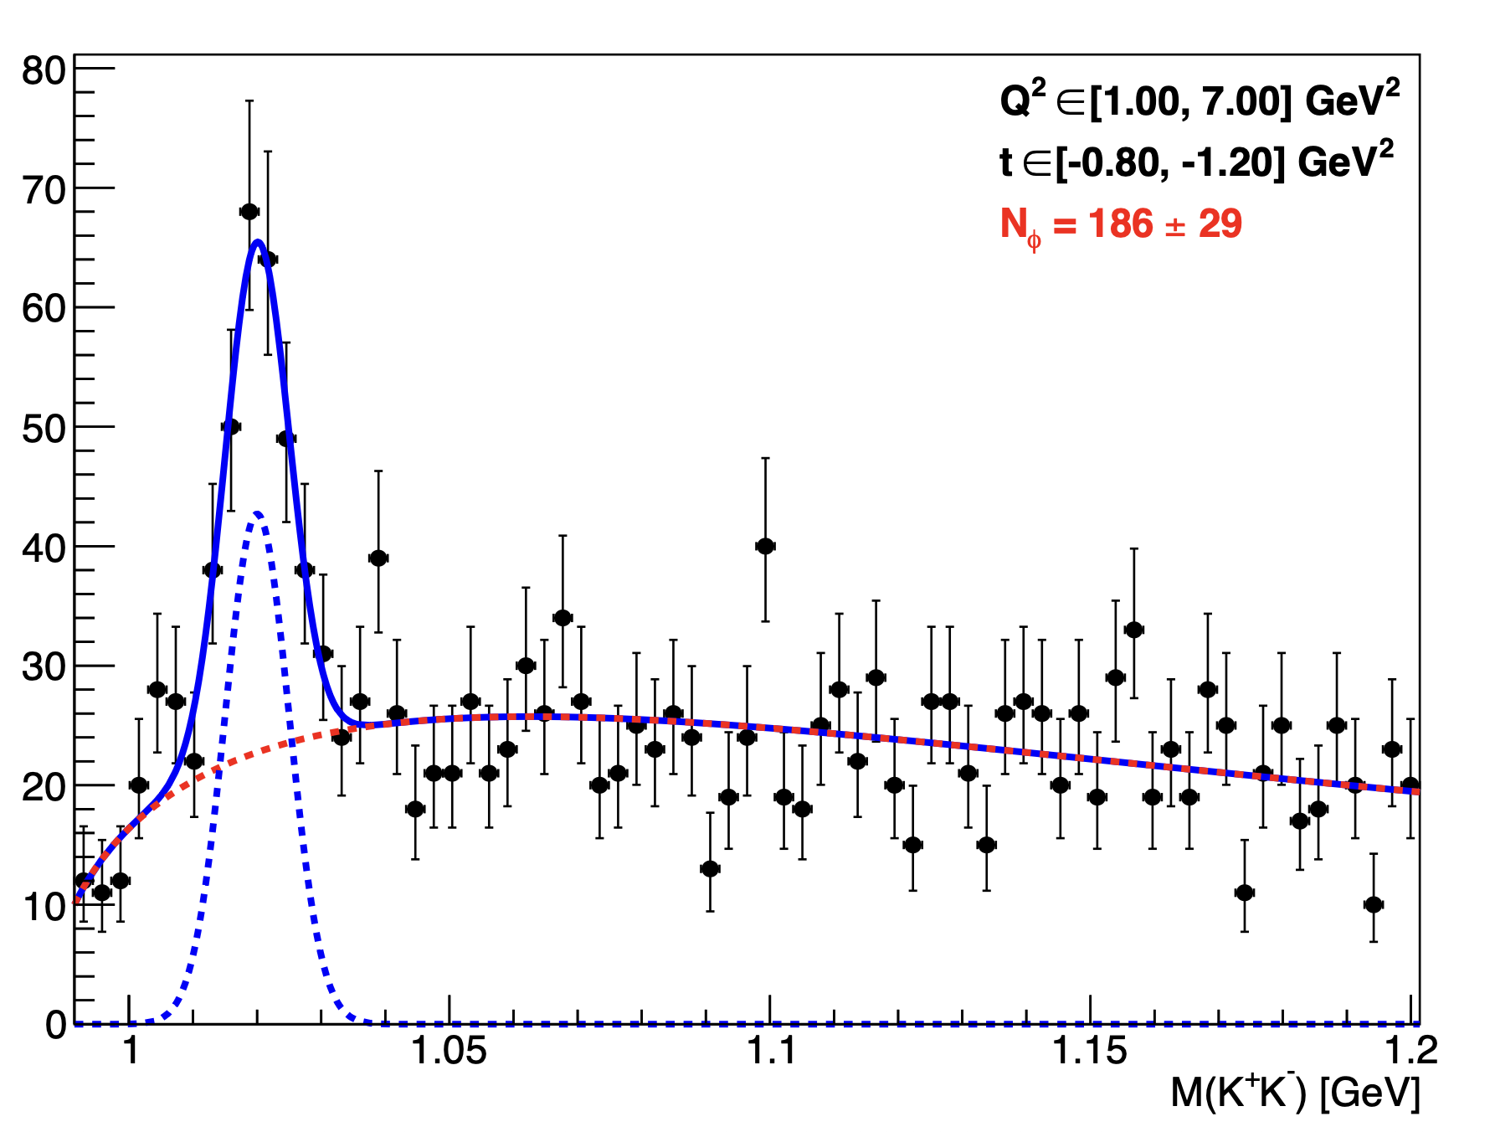
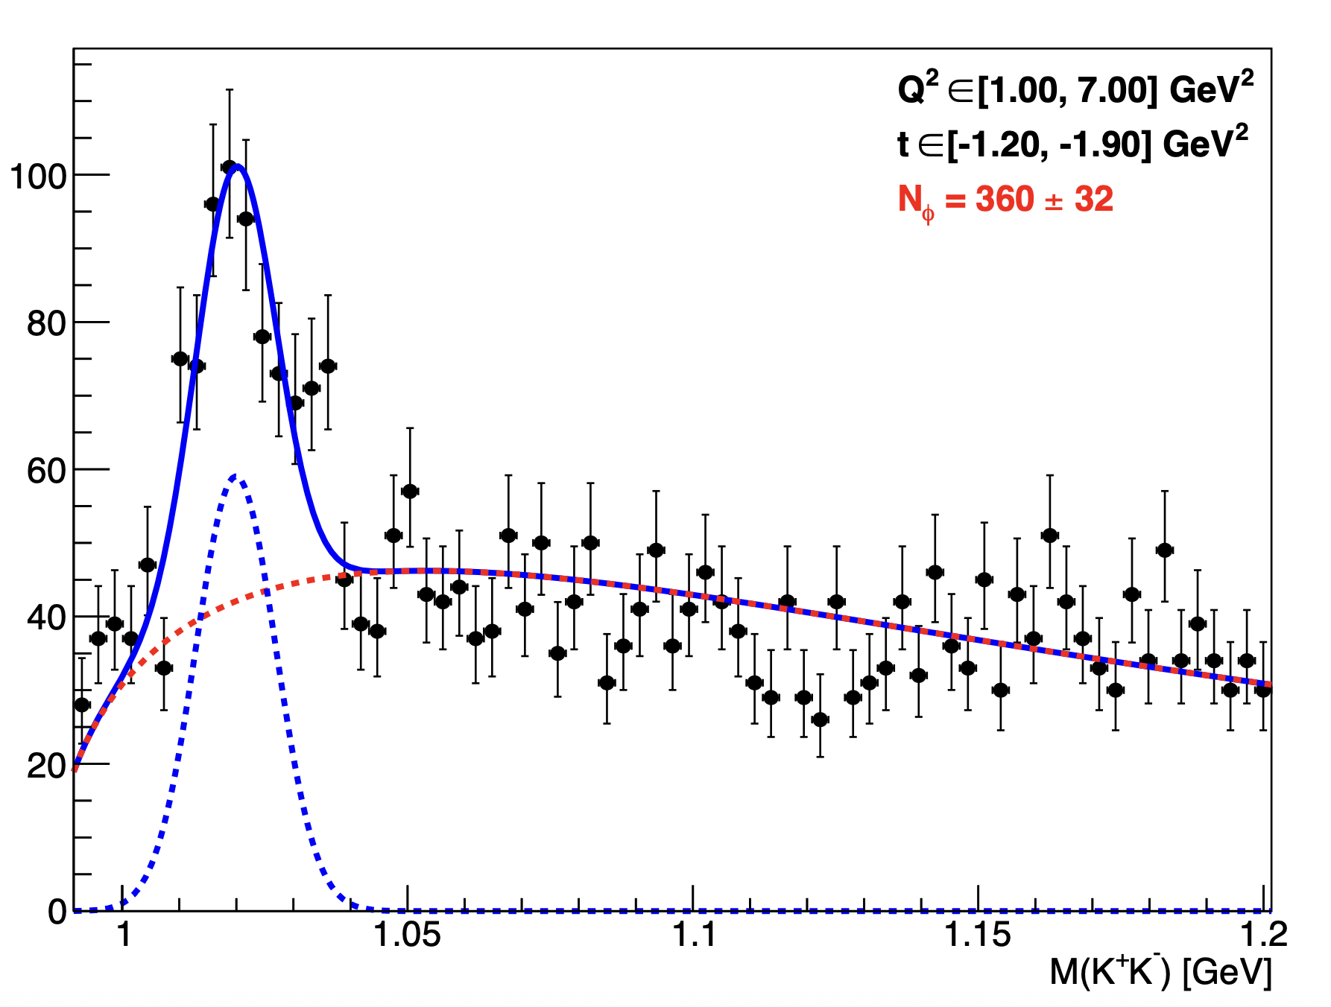
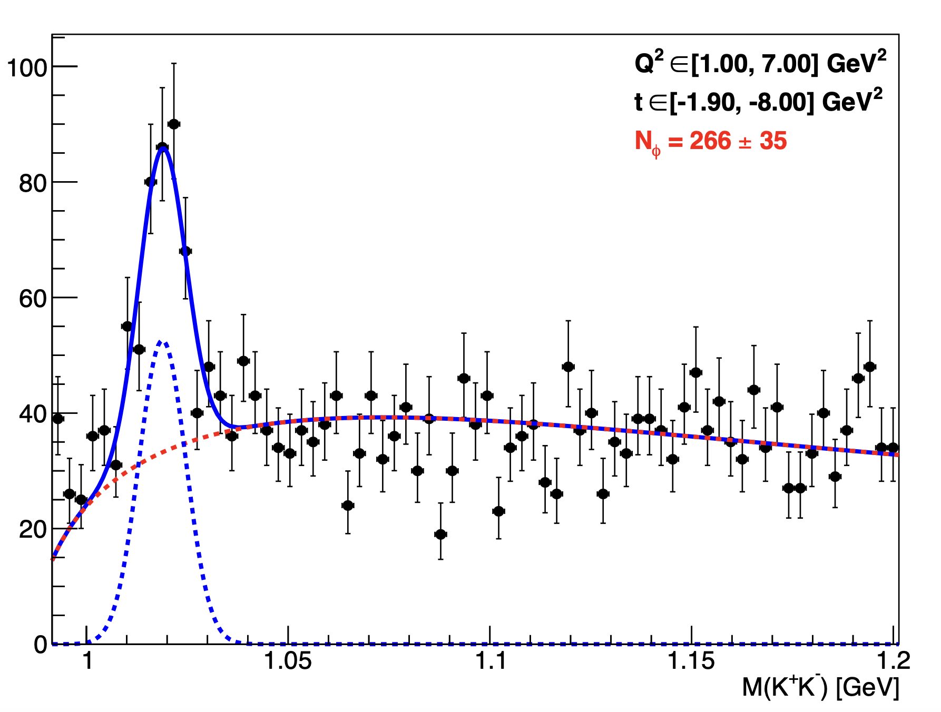
Invariant mass K⁺ K⁻ : Fit per bins
Mathieu Ronayette
17/18
Mathieu Ronayette
rgB - meeting
13 Feb 2026

Slide 18
Conclusion
Next steps :
- Improve fits for signal and background
- Evaluate the acceptance
- Run the code with the other data set
Thanks!
Mathieu Ronayette
18/18
Mathieu Ronayette
rgB - meeting
13 Feb 2026

