Slide 1
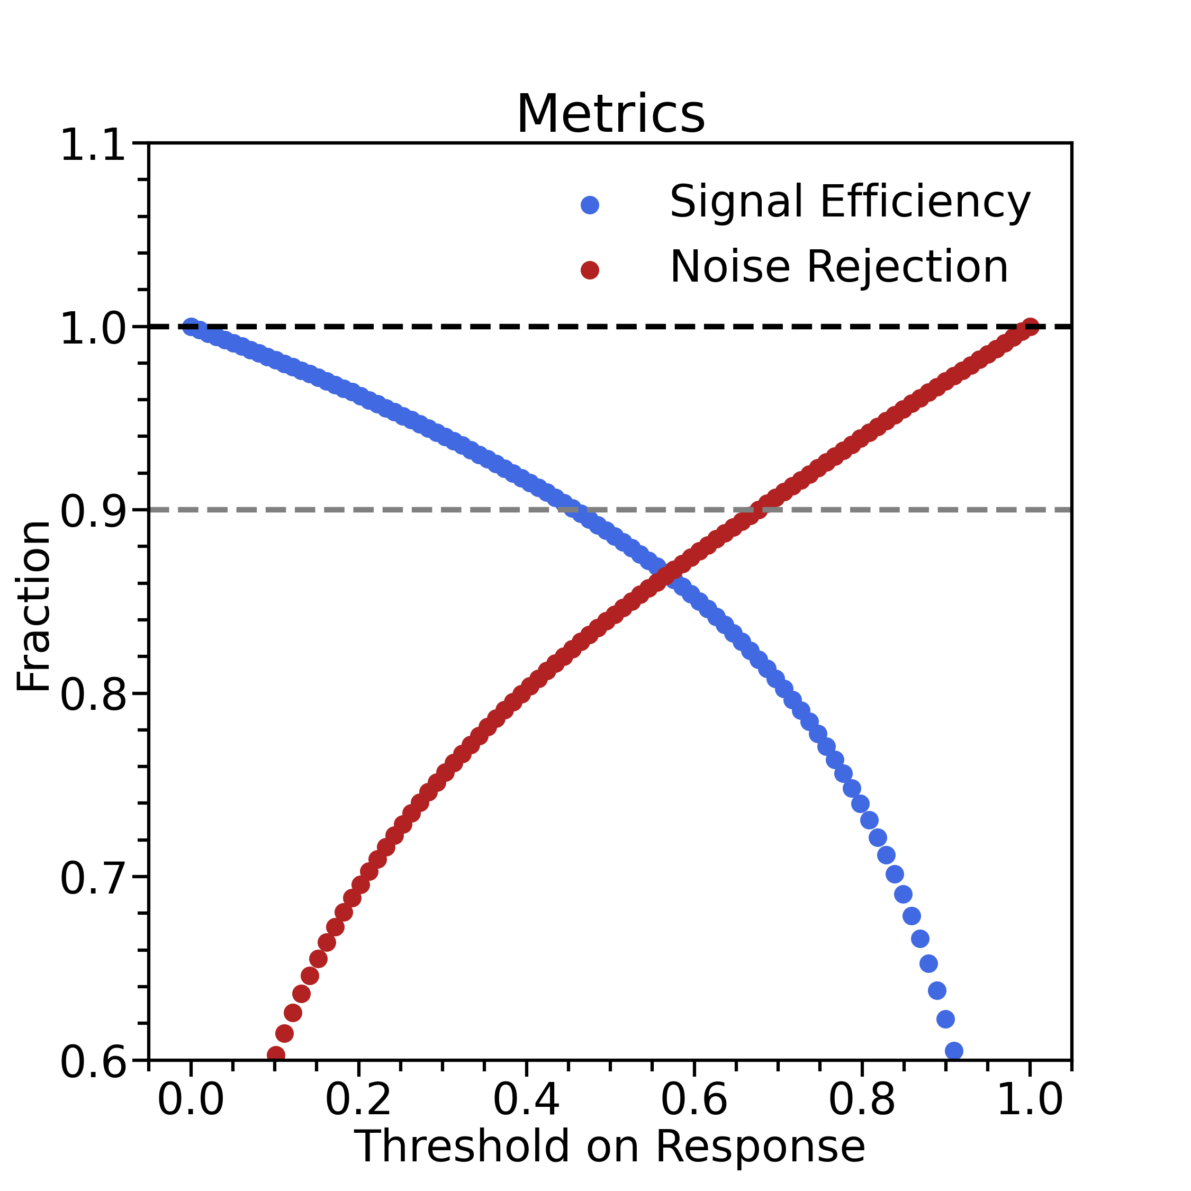
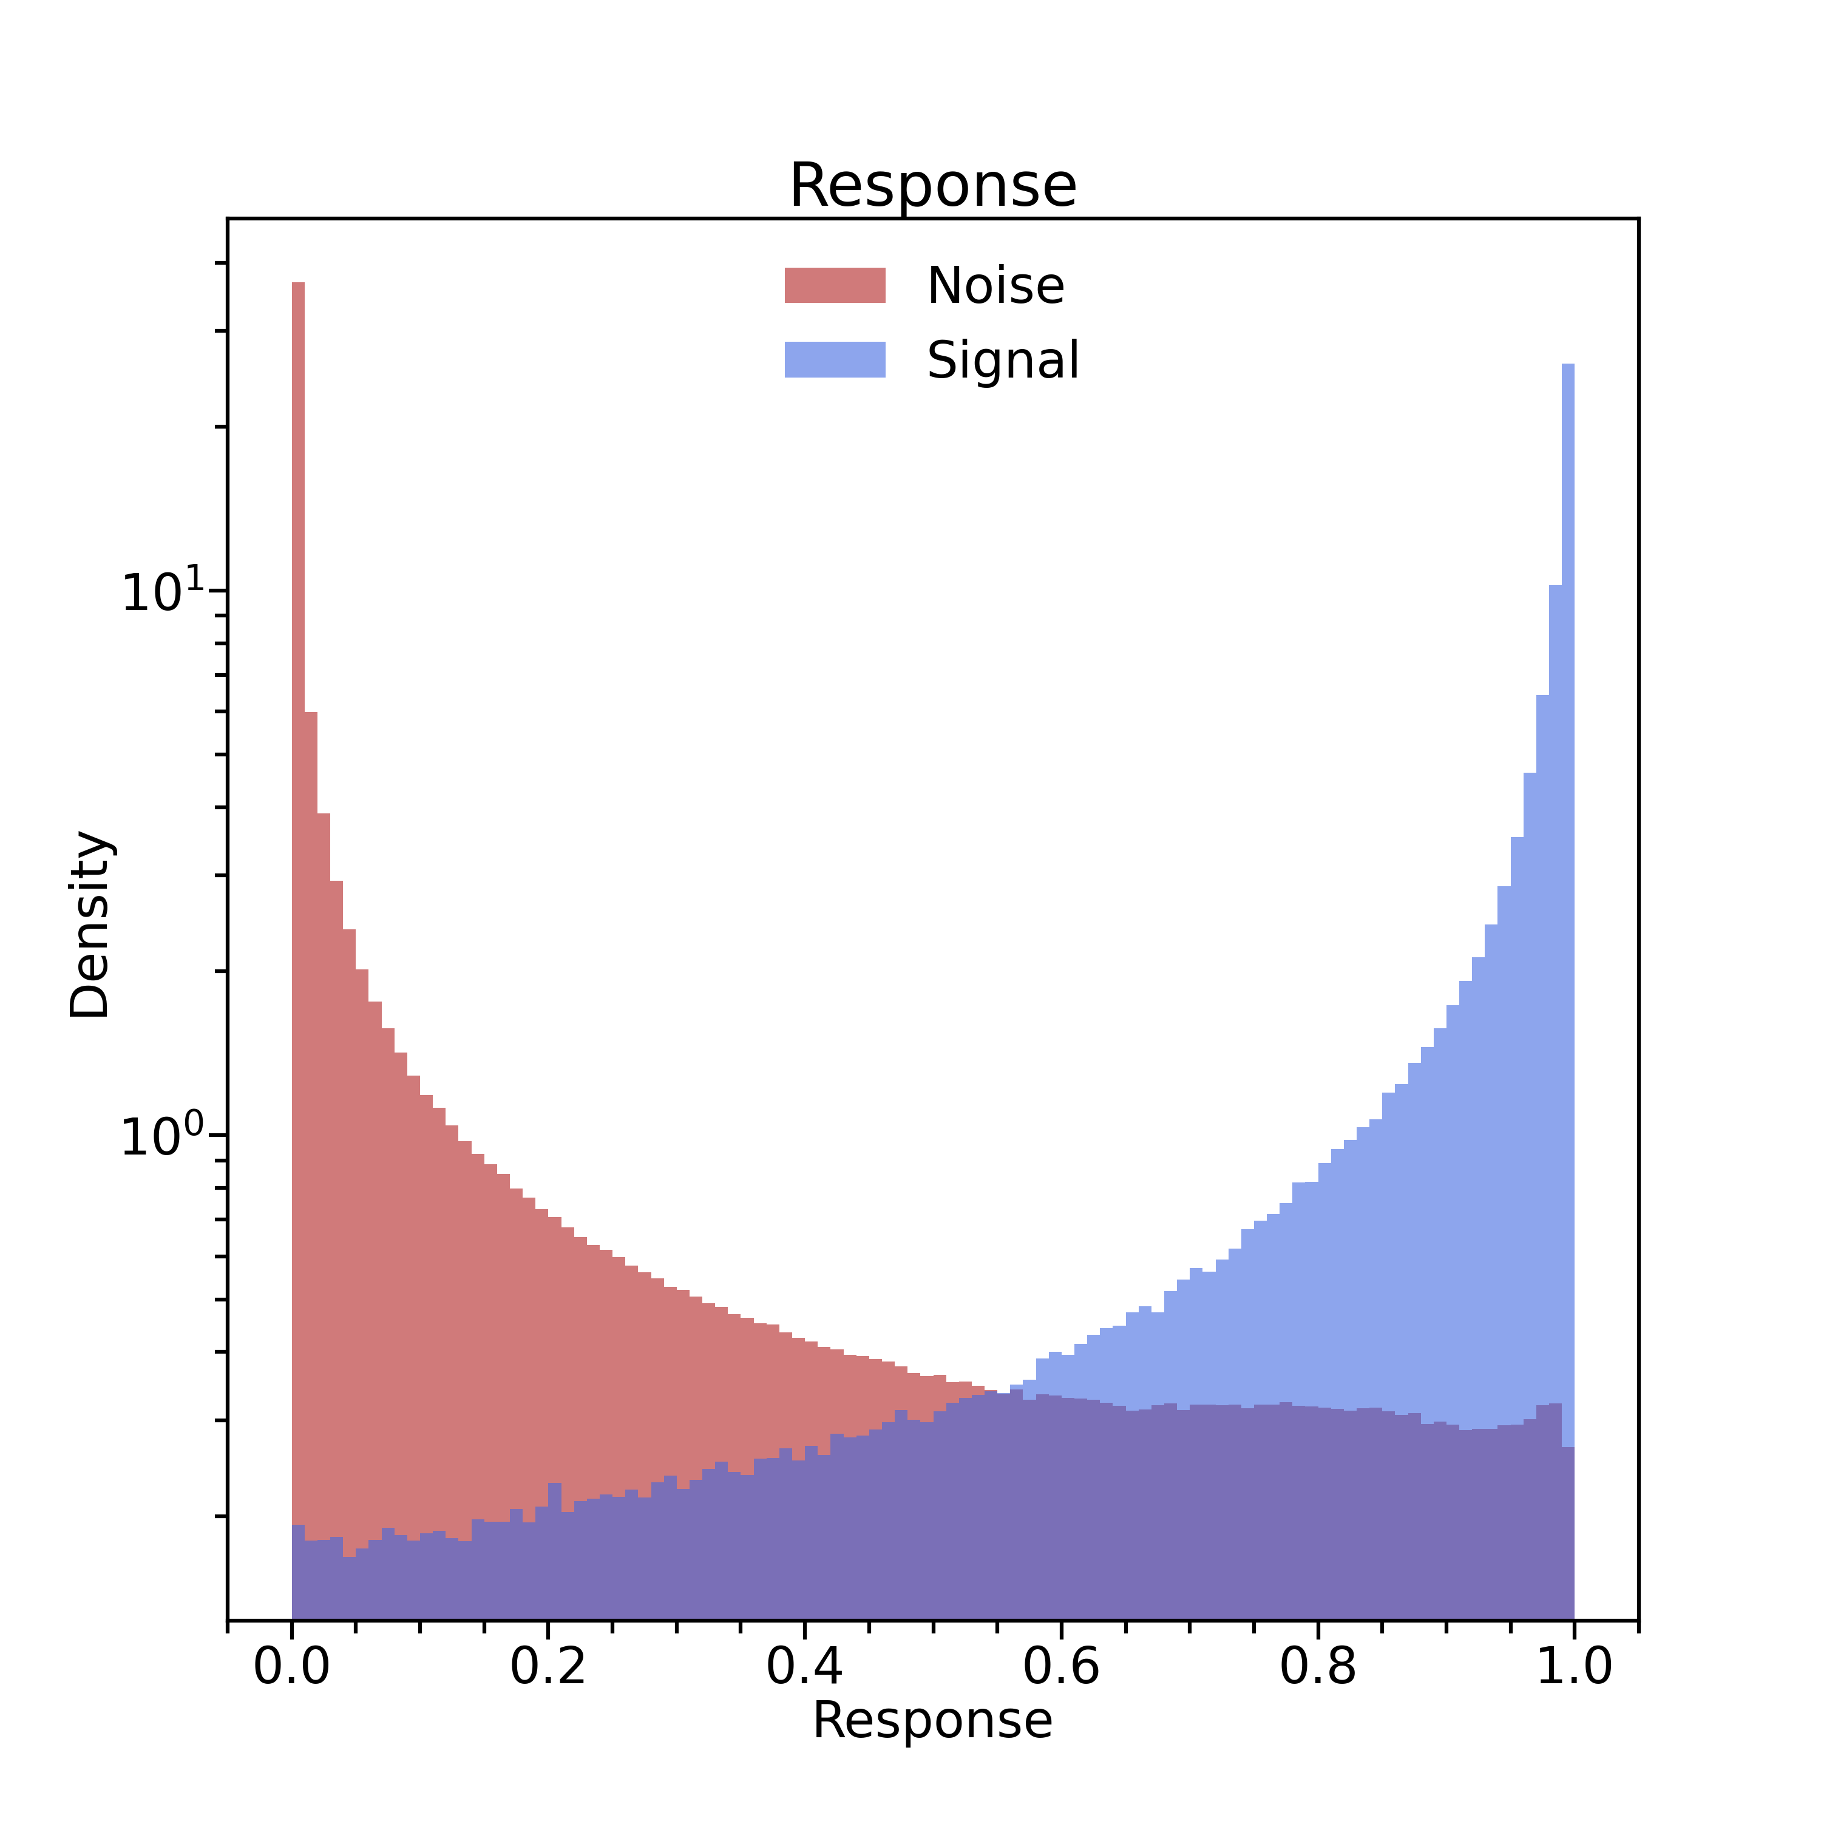
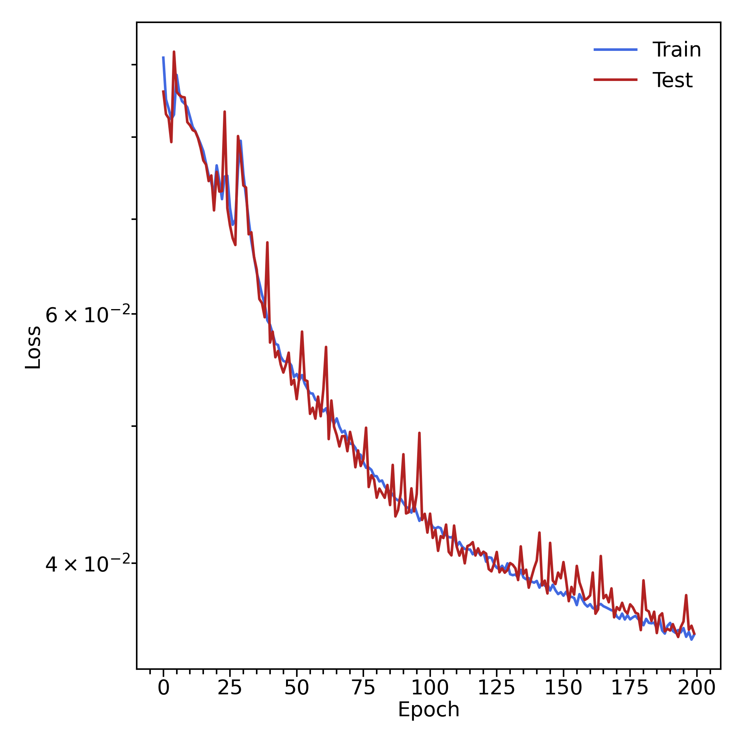
Variables : strip layer cweight sweight
Mathieu Ronayette
1/7
Mathieu Ronayette
ML tracking meeting
10 Feb 2026

Slide 2
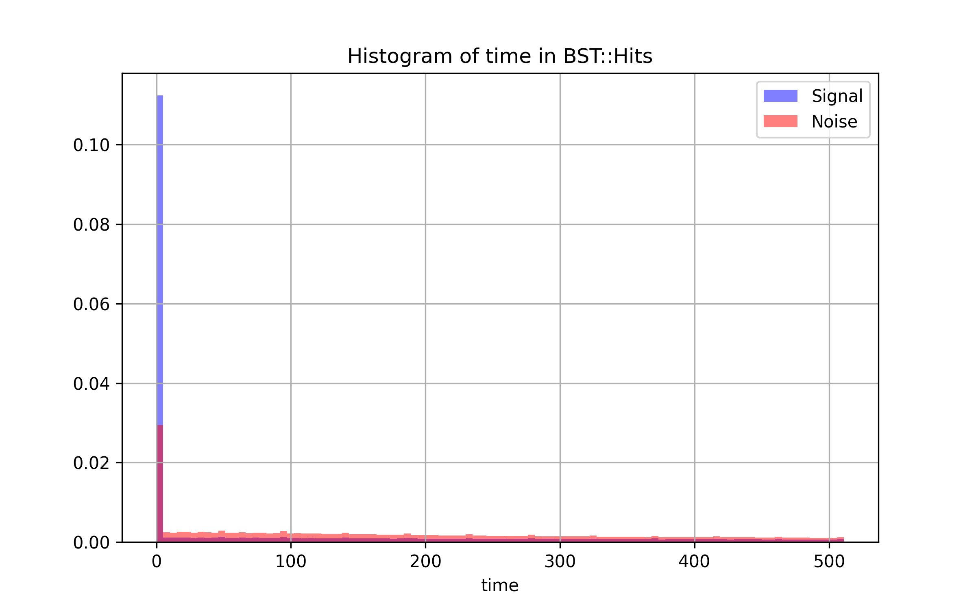
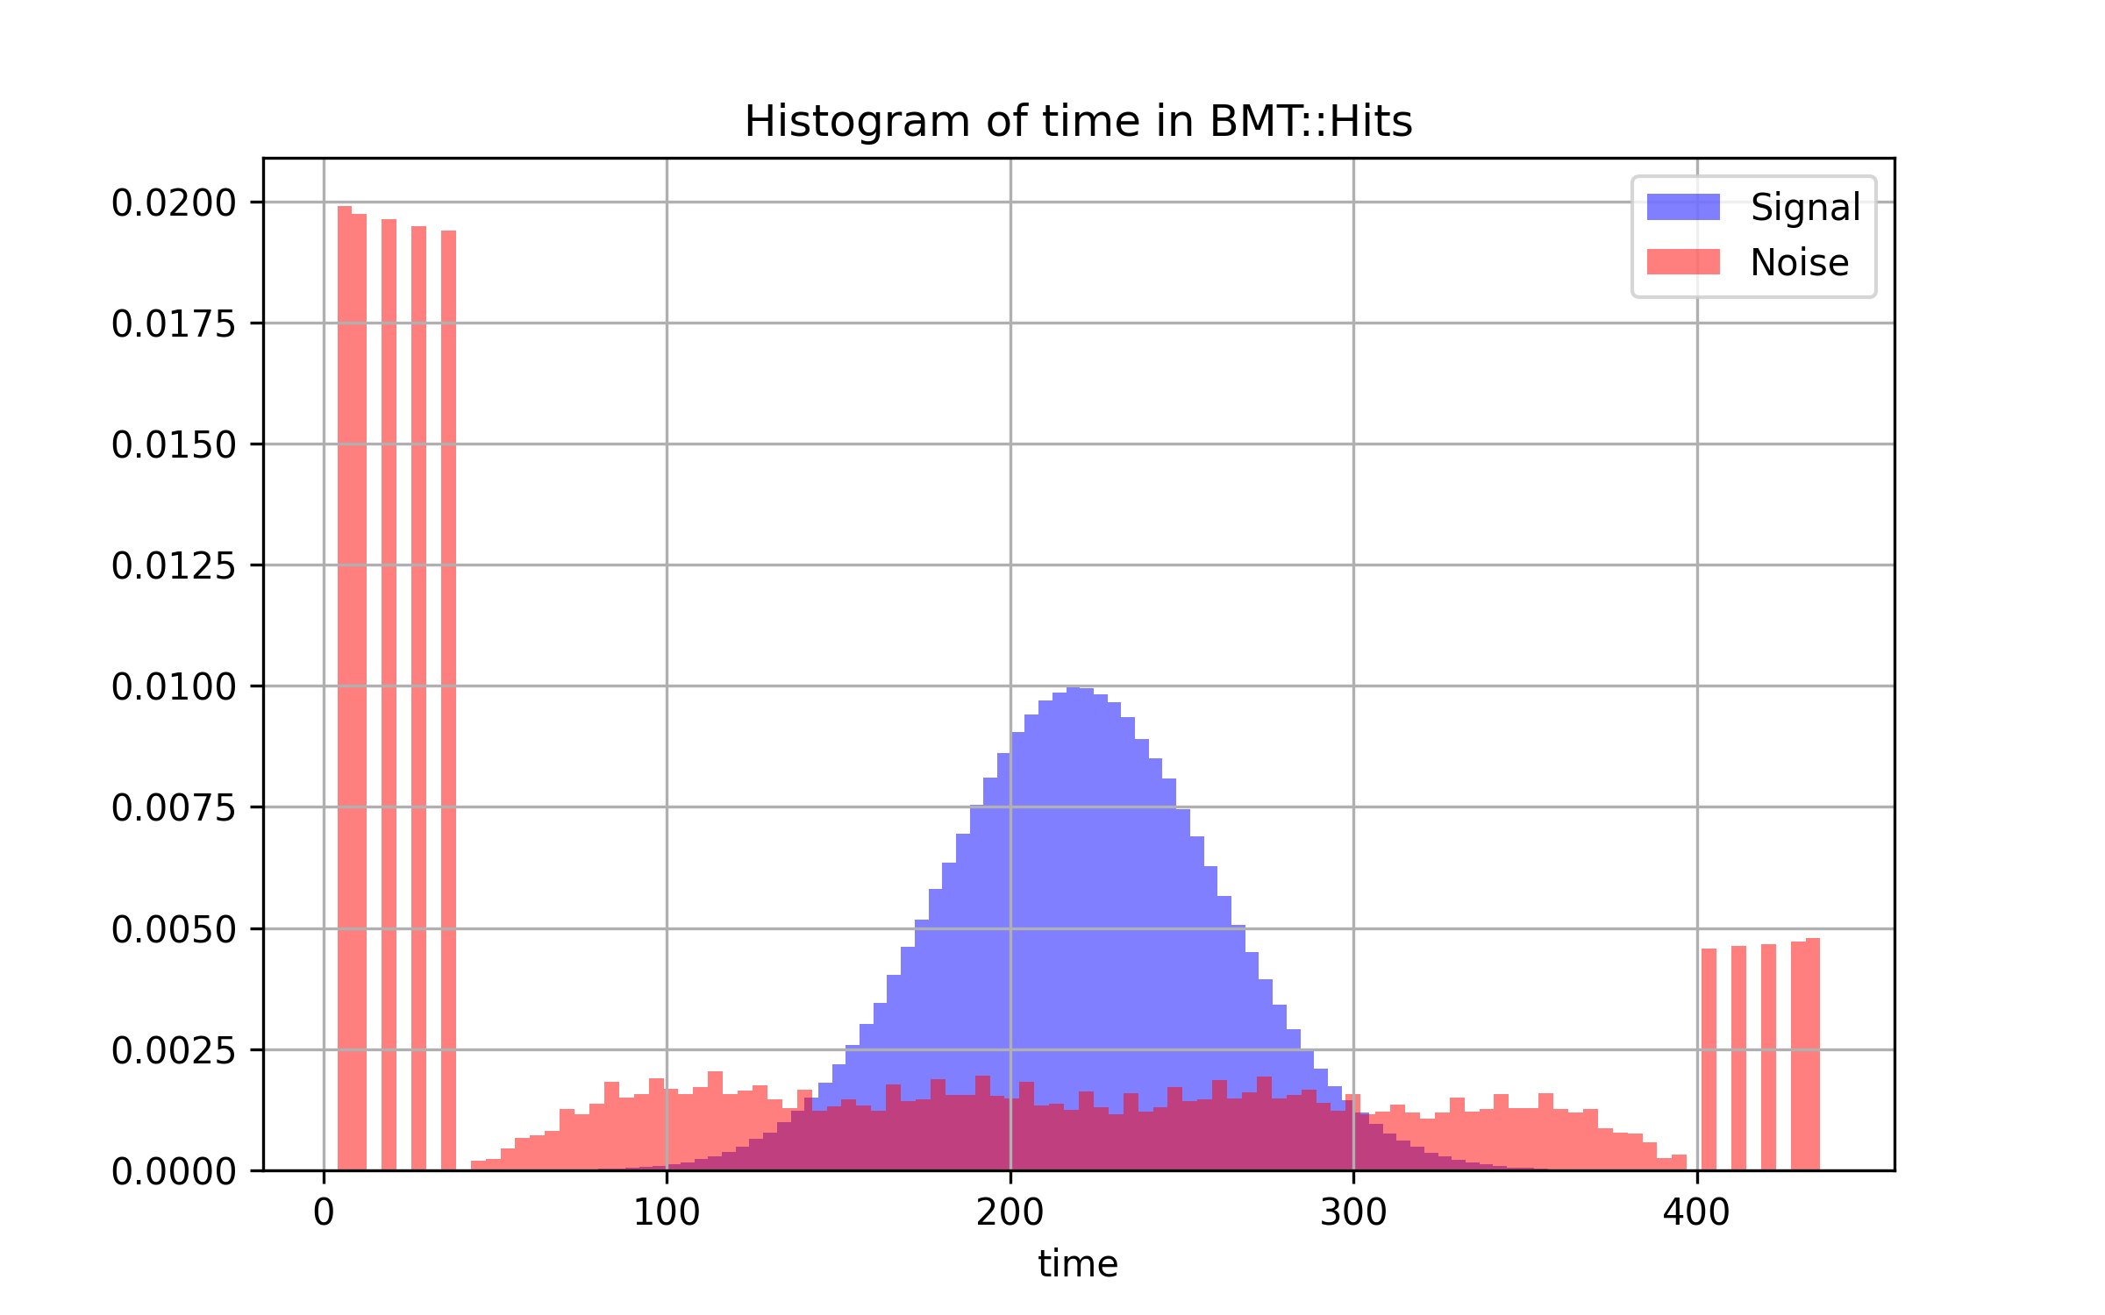
Histograms of time in BST and BMT
BST : seems unrealistic time for signal
BMT : The time for signal could be correctly simulated
Mathieu Ronayette
2/7
Mathieu Ronayette
ML tracking meeting
10 Feb 2026

Slide 3
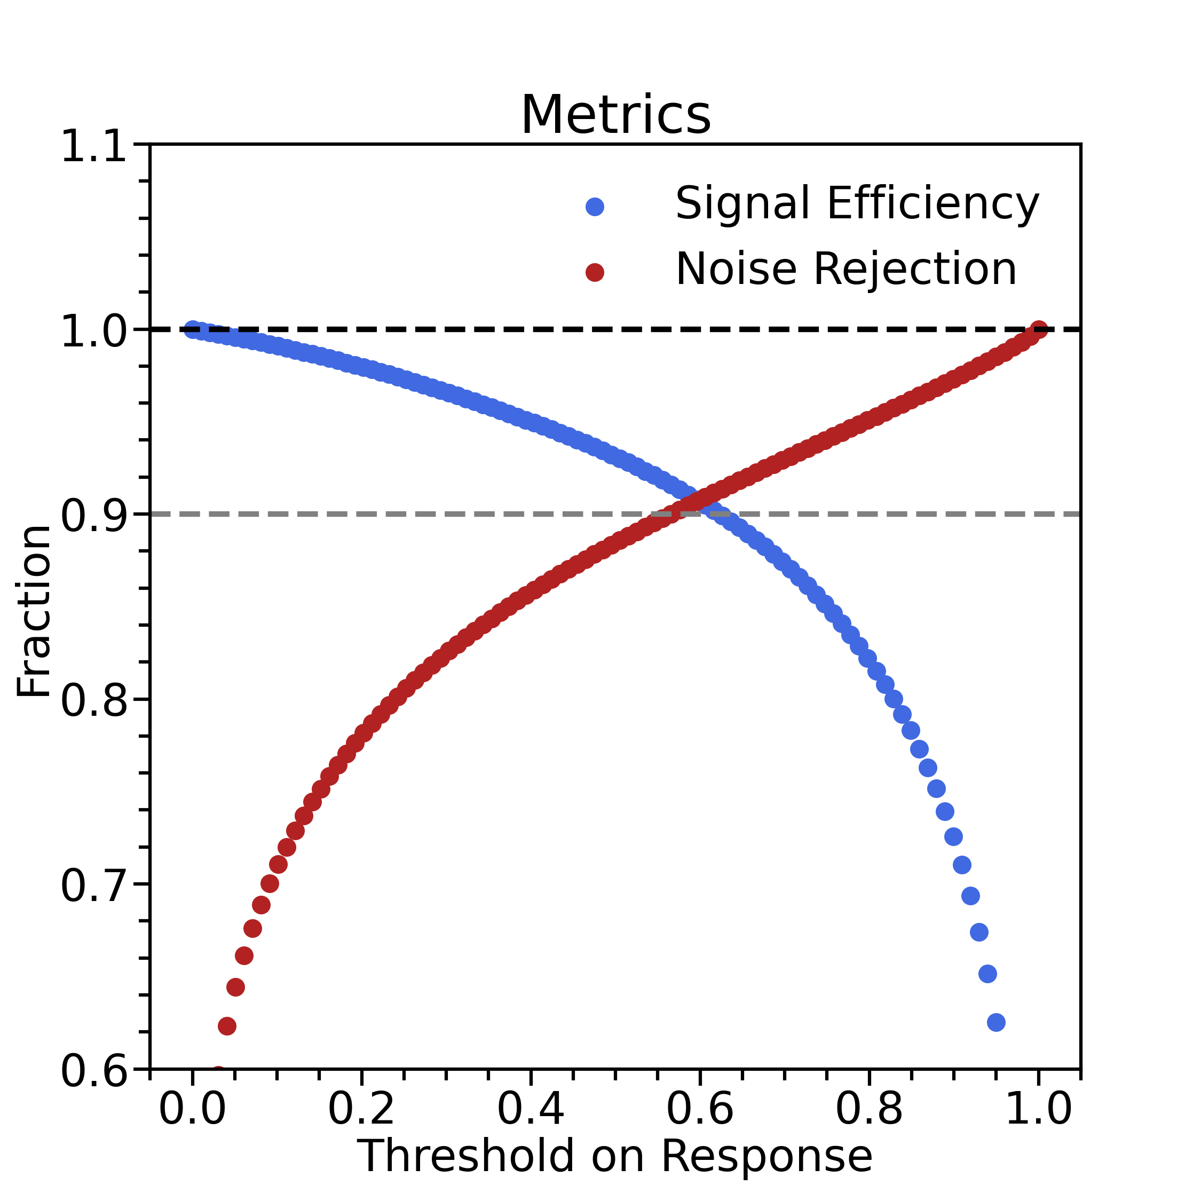
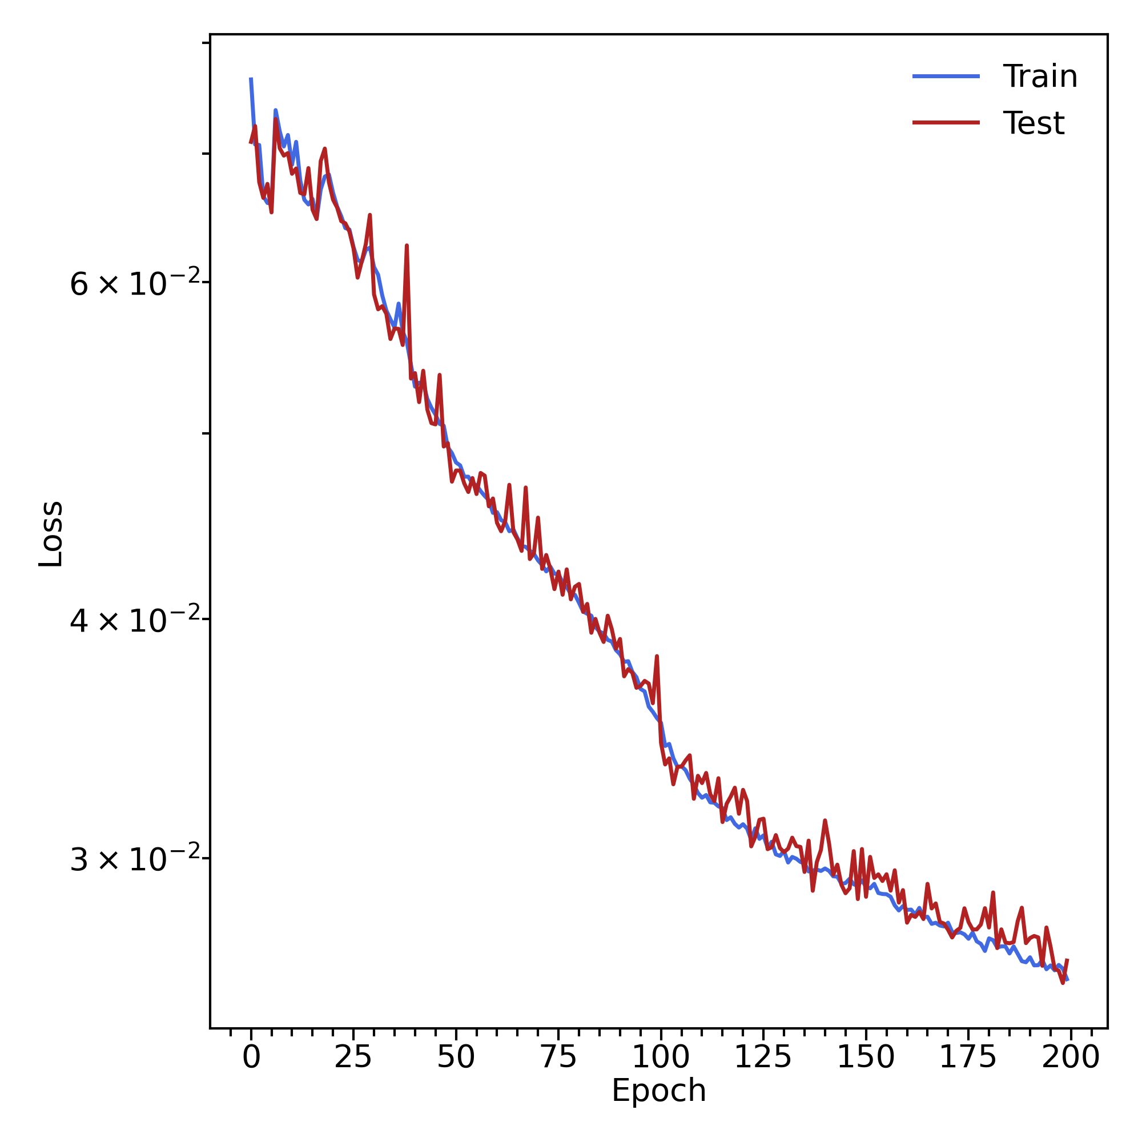
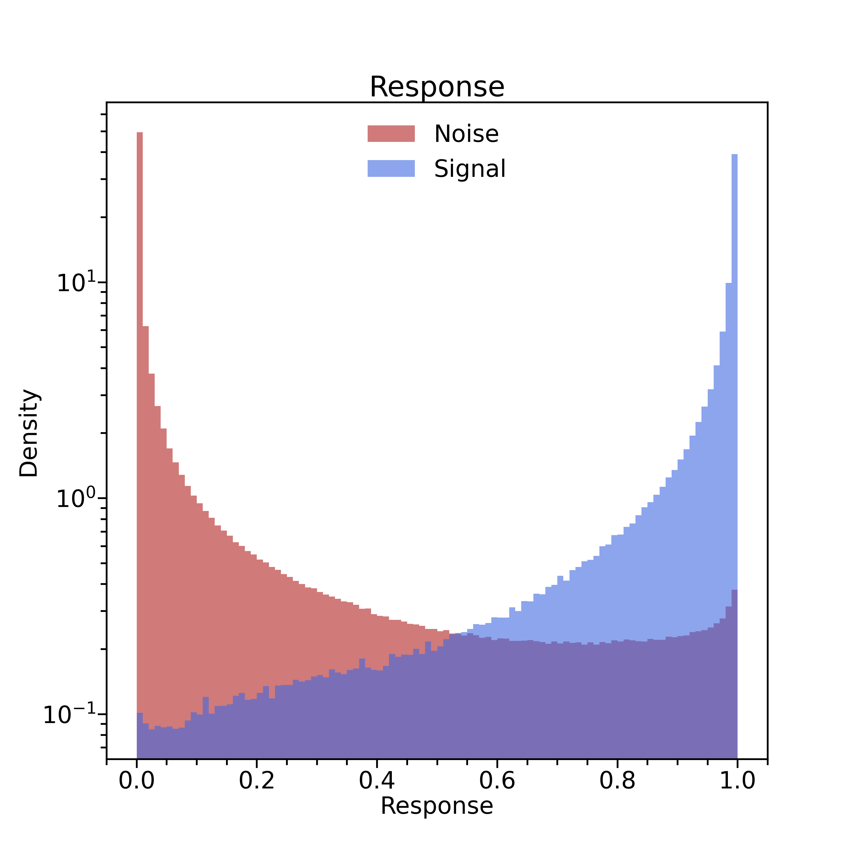
Variables : strip layer cweight sweight + BMT time
Mathieu Ronayette
3/7
Mathieu Ronayette
ML tracking meeting
10 Feb 2026

Slide 4
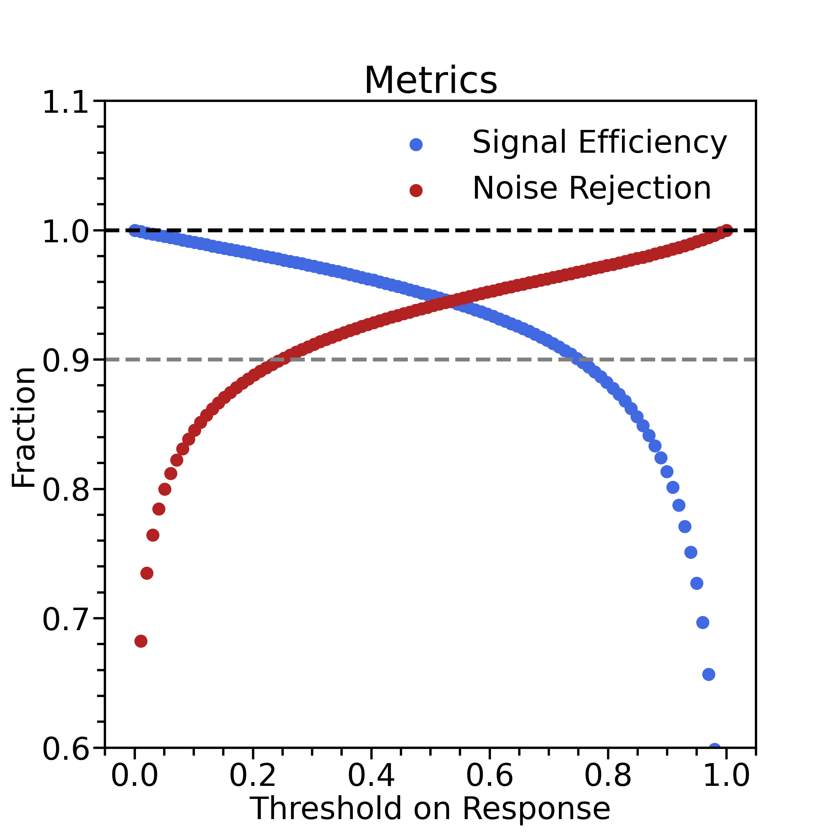
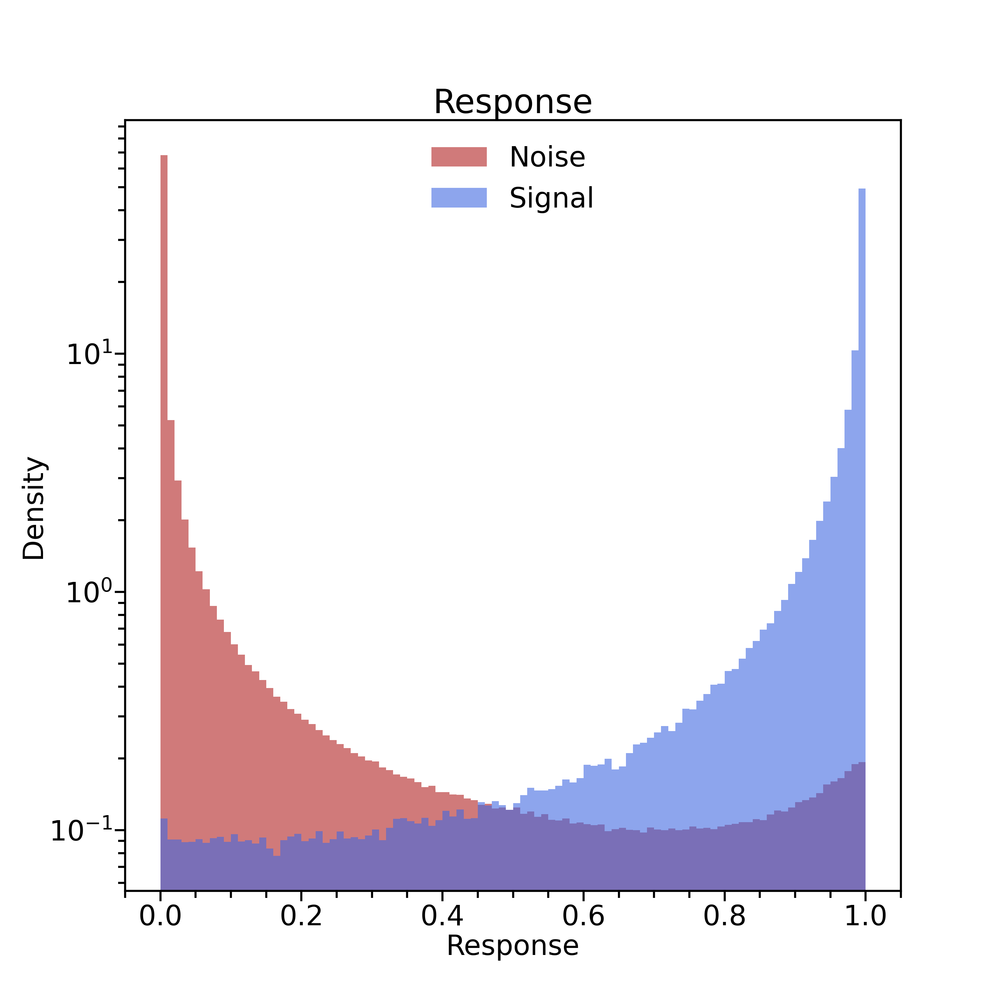
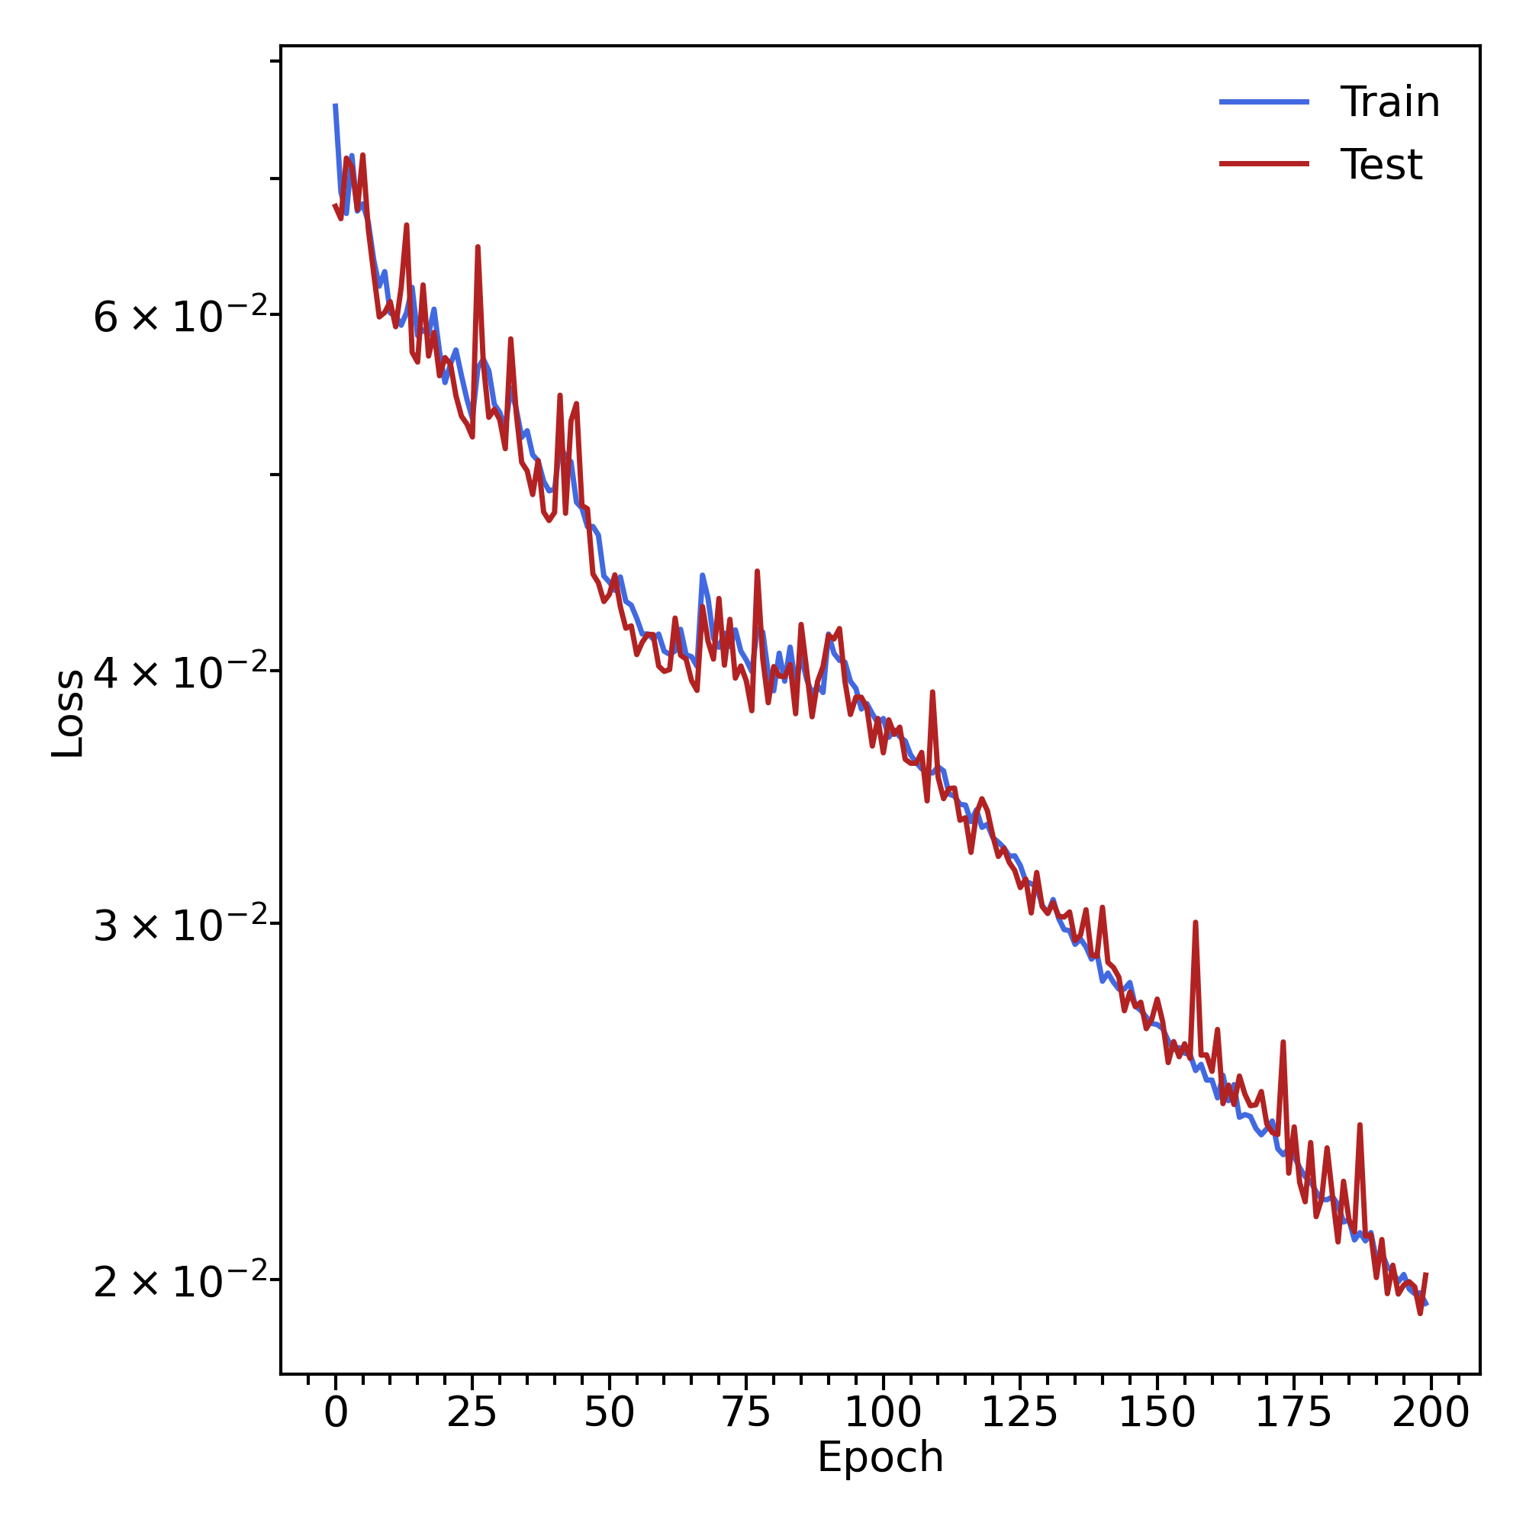
Variables : strip layer cweight sweight + BMT time + x/y/z
Mathieu Ronayette
4/7
Mathieu Ronayette
ML tracking meeting
10 Feb 2026

Slide 5
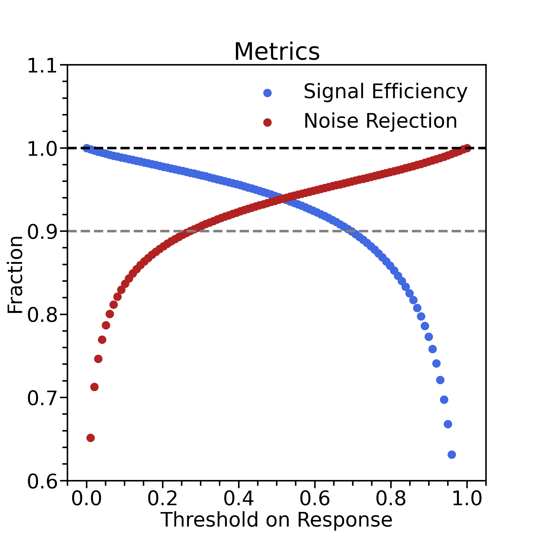
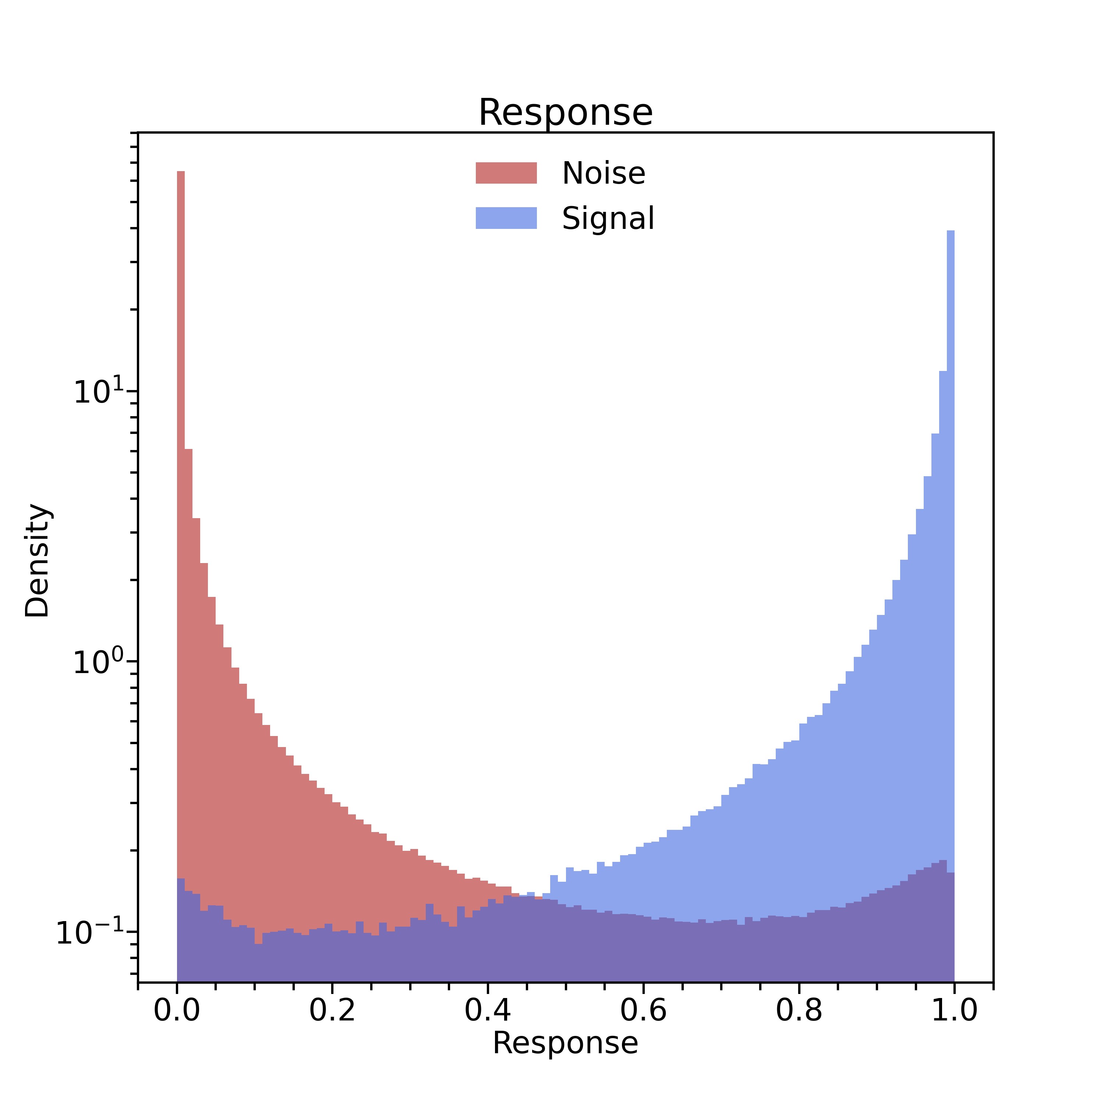
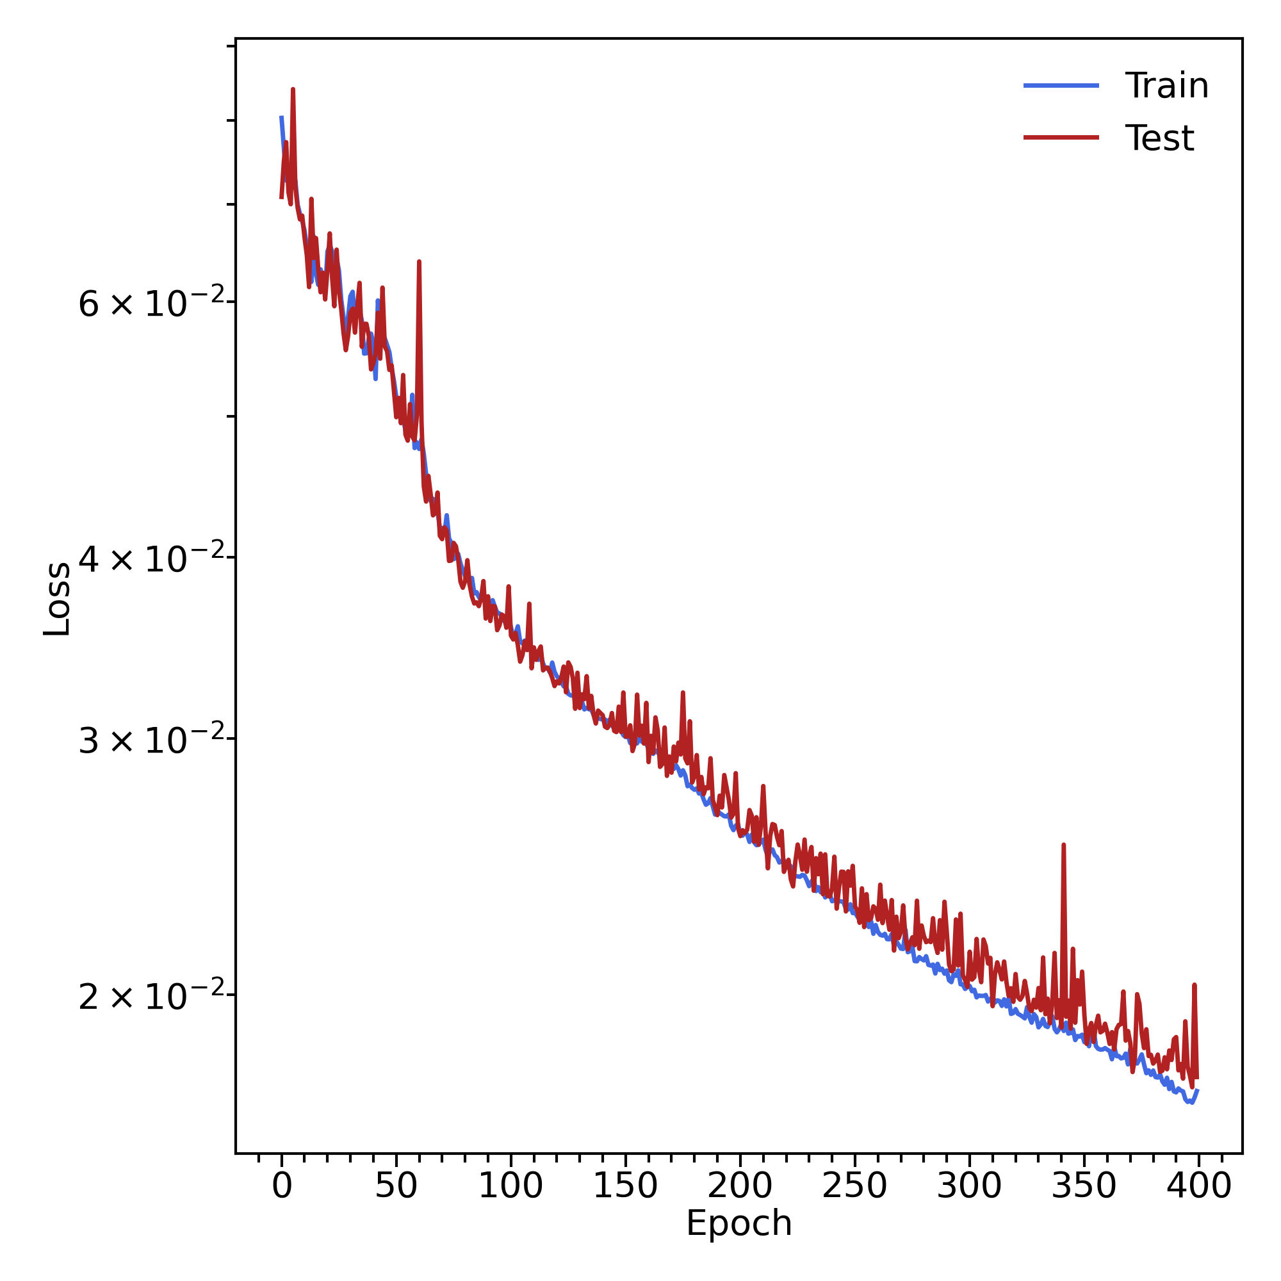
Variables : strip layer cweight sweight + BMT time + x/y/z + more training epochs
Mathieu Ronayette
5/7
Mathieu Ronayette
ML tracking meeting
10 Feb 2026

Slide 6
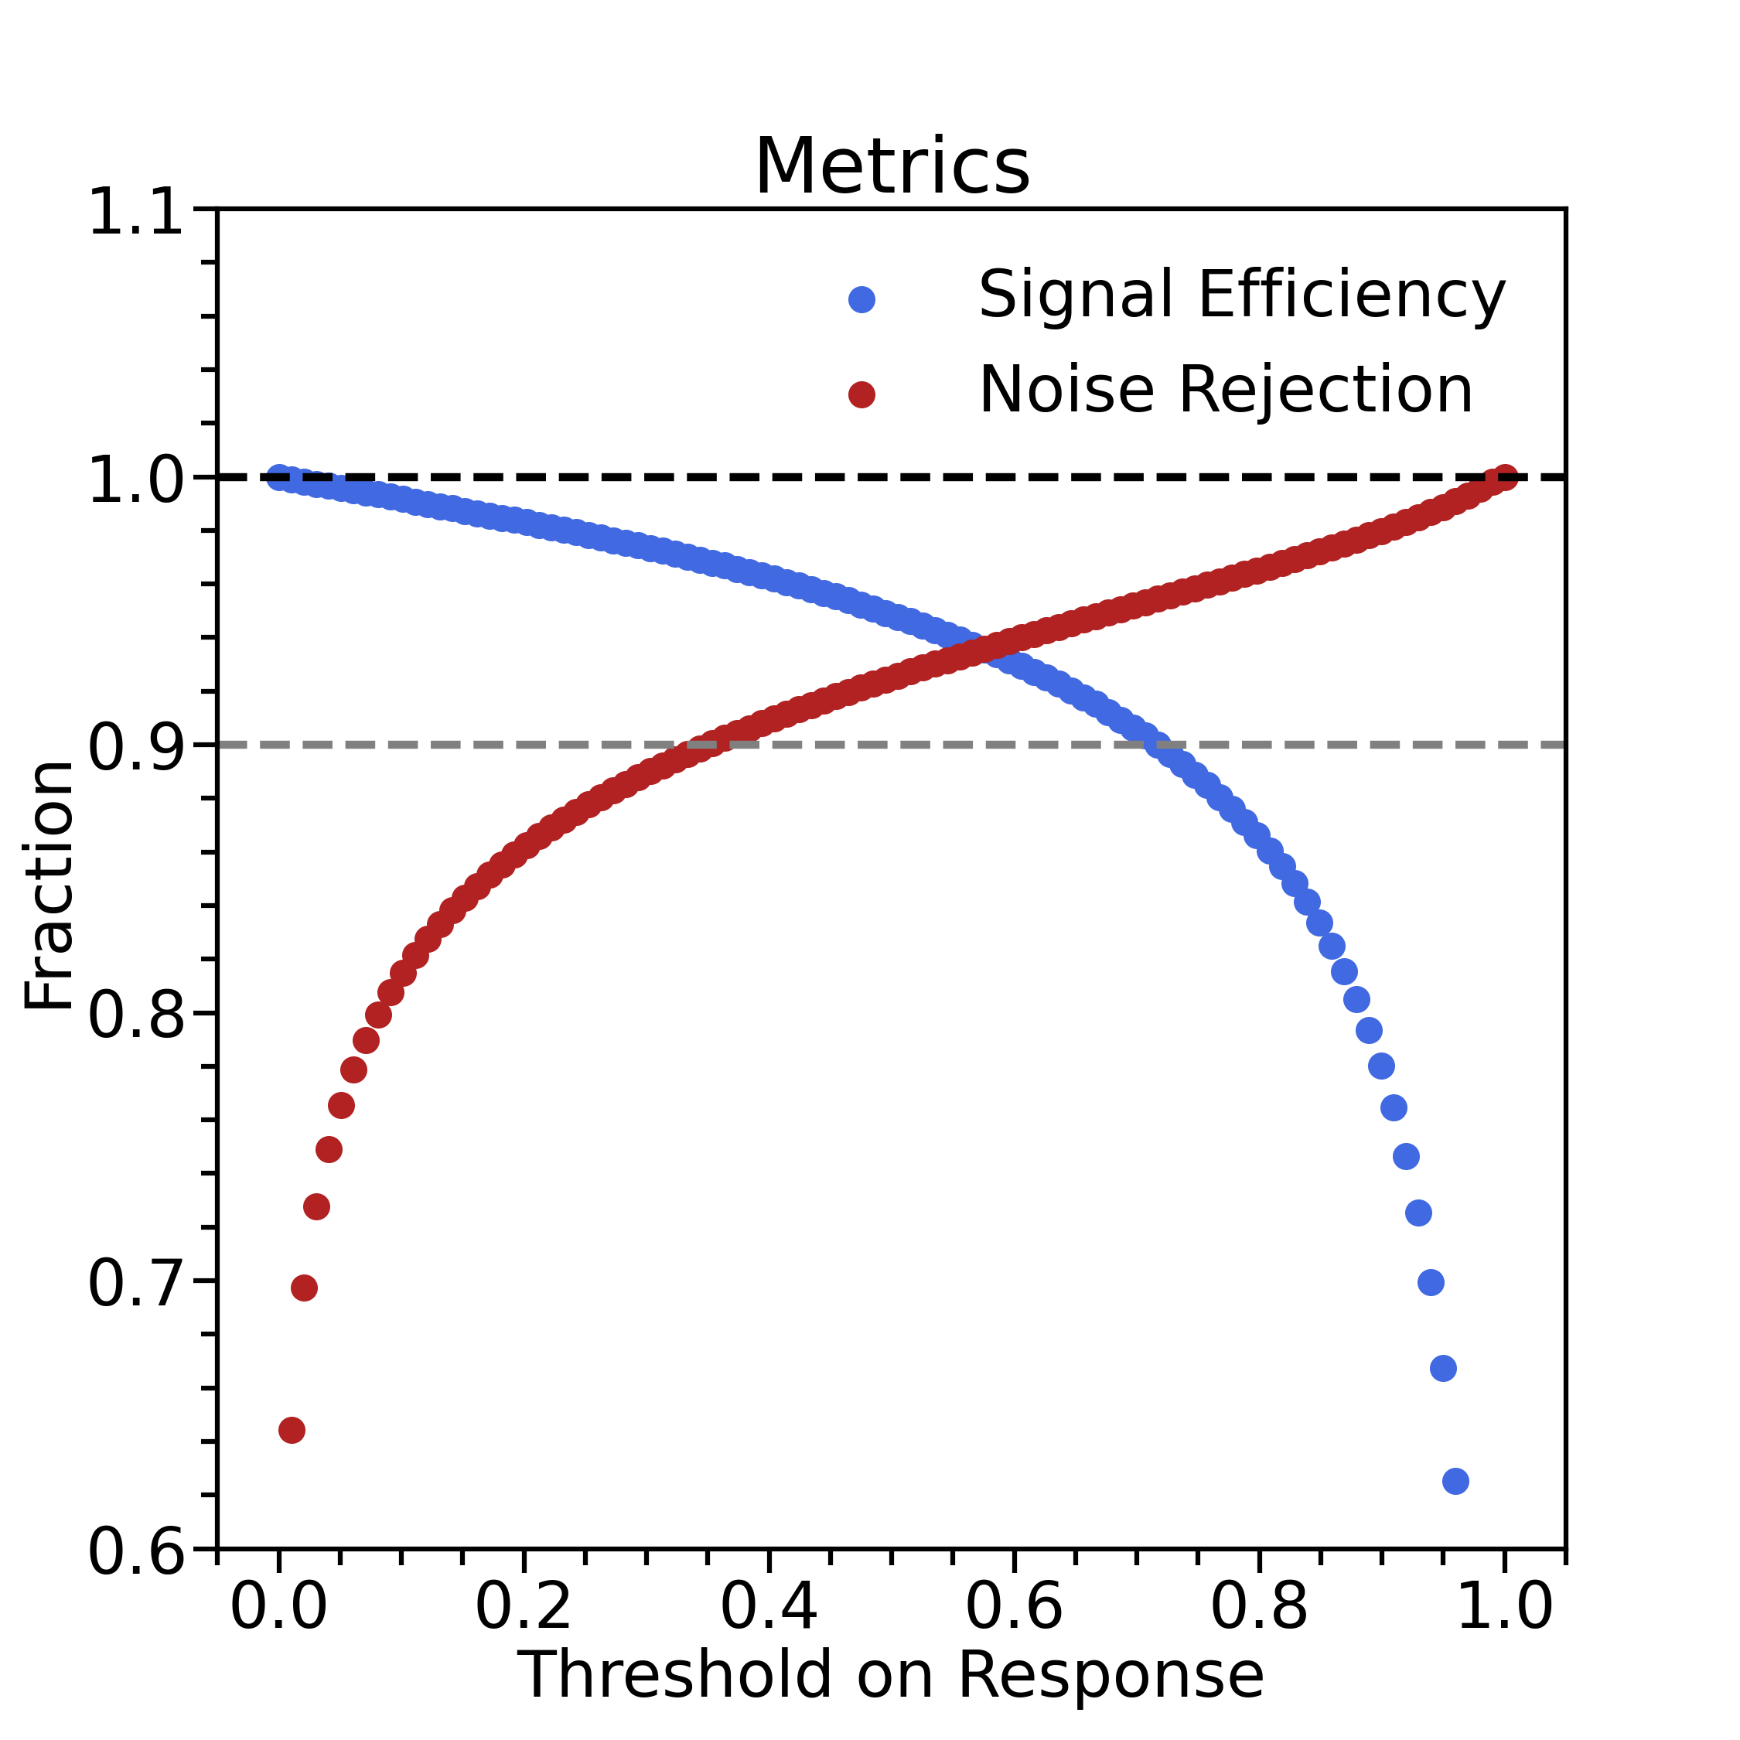
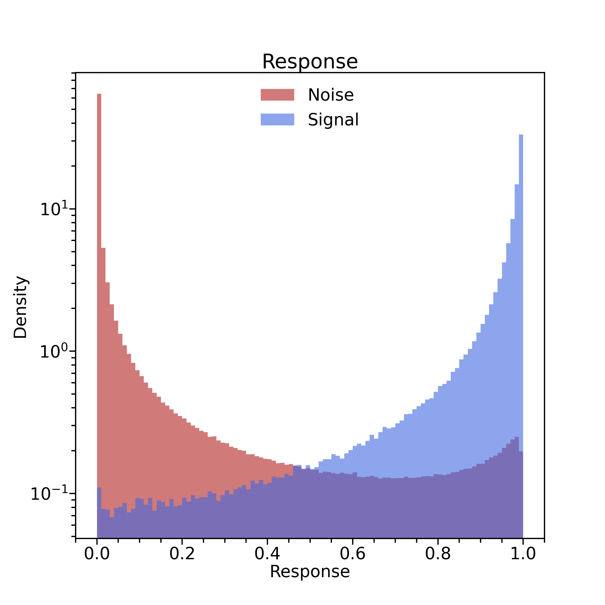
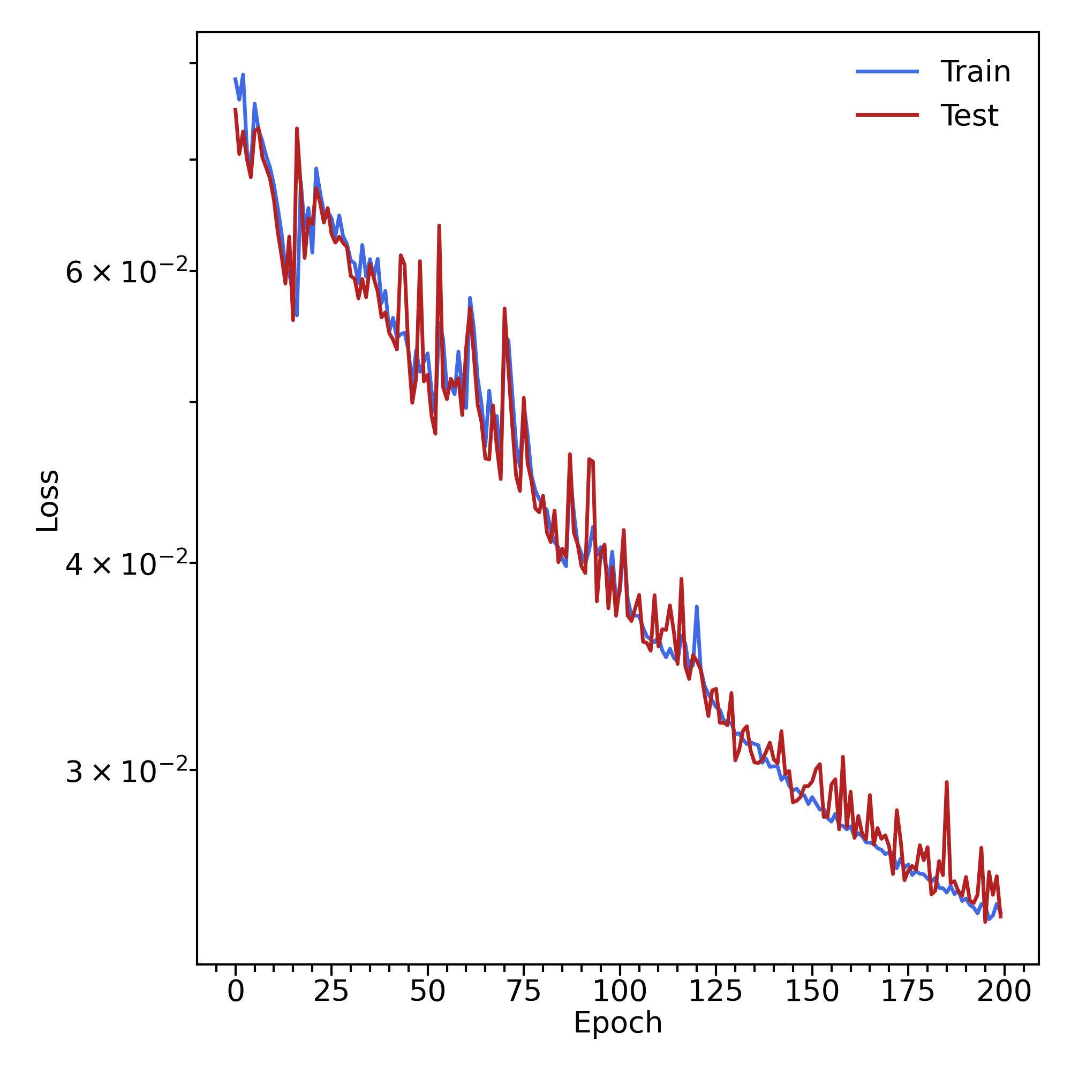
Variables : strip layer cweight sweight + BMT time + x/y/z
->Training and test without events with only background
Mathieu Ronayette
6/7
Mathieu Ronayette
ML tracking meeting
10 Feb 2026

Slide 7
Conclusion:
- BMT time and x/y/z improve the model performance
- More epochs do not change significantly the model performance.
Next steps :
- Test hyperparameters
Mathieu Ronayette
7/7
Mathieu Ronayette
ML tracking meeting
10 Feb 2026

