Slide 1
RGA meeting
ɸ electroproduction analysis : K_{s} K_{L} channel
20 Jan 2026
M. Ronayette, P. Chatagnon
Mathieu Ronayette
rgA - meeting
1/24
Mathieu Ronayette
21 Jan 2026

Slide 2
Analysis objective :
- Measurement of the cross section and differential cross section of the electroproduction of ɸ in the K_{s} K_{L} channel
π⁺
e
e’
Ks
π⁻
q
ɸ
Kl
- Datas : nSidis RG-A inbending and
outbending fall 2018 + spring 2019
p
p’
Mathieu Ronayette
rgA - meeting
2/24
Mathieu Ronayette
21 Jan 2026

Slide 3
General informations
Datas :
nSidis Rg-A datas : fall2018 inbending
Correction on π⁺ π⁻ vertex :
Vertex of π⁺ π⁻ are recalculated with the code
of Veronique Ziegler
Add some cut on :
→ Distance between vertex of π⁺ π⁻ < 3.5 cm
→ Distance between vertex Ks and e⁻ :
1.5 < Dist < 7.0 cm
because cτ_{Ks} = 2.68 cm
Cuts :
→ Selection of events with one
e⁻ , p , π ⁺ and π ⁻ in the final state. π ⁺ π ⁻ in FD.
→ Cut on invariant mass of π⁺ π⁻ with
0.4 < M_{inv}(π⁺ π⁻) < 0.6 GeV.
→ Cut on Missing Mass in the reaction
e p → e’ p’ K_{s} X with 0.4 < M_{issMass} < 0.6 GeV.
Mathieu Ronayette
3/24
Mathieu Ronayette
rgA - meeting
21 Jan 2026

Slide 4
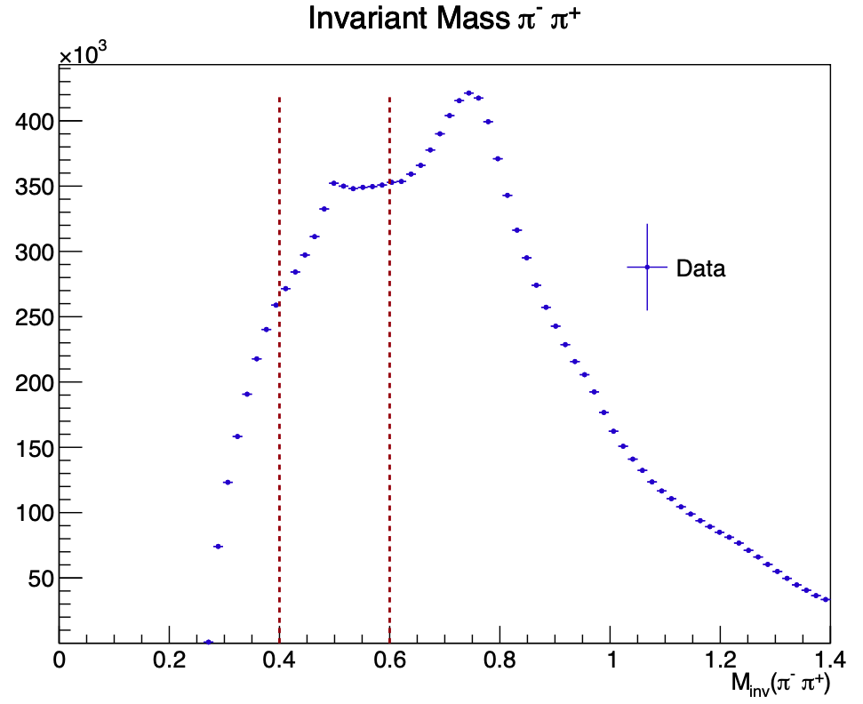
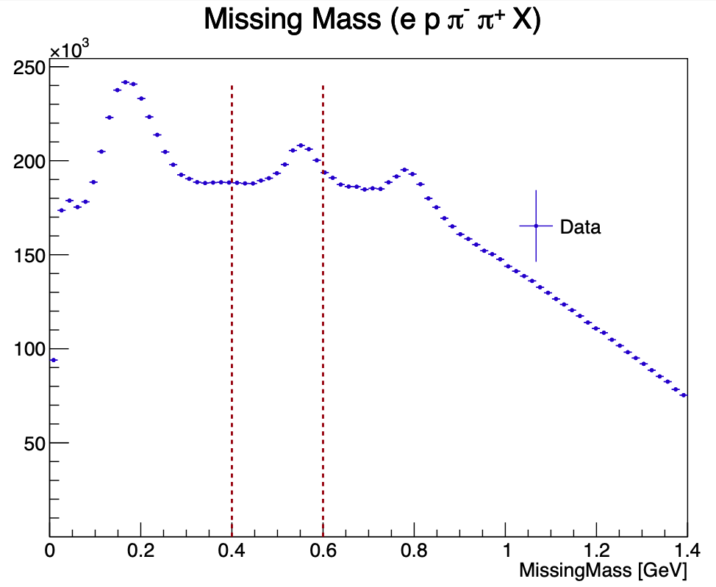
Details of cuts on data
ρ⁰
π ⁰
Ks
η⁰
ρ⁰
Mathieu Ronayette
4/24
Mathieu Ronayette
rgA - meeting
21 Jan 2026

Slide 5
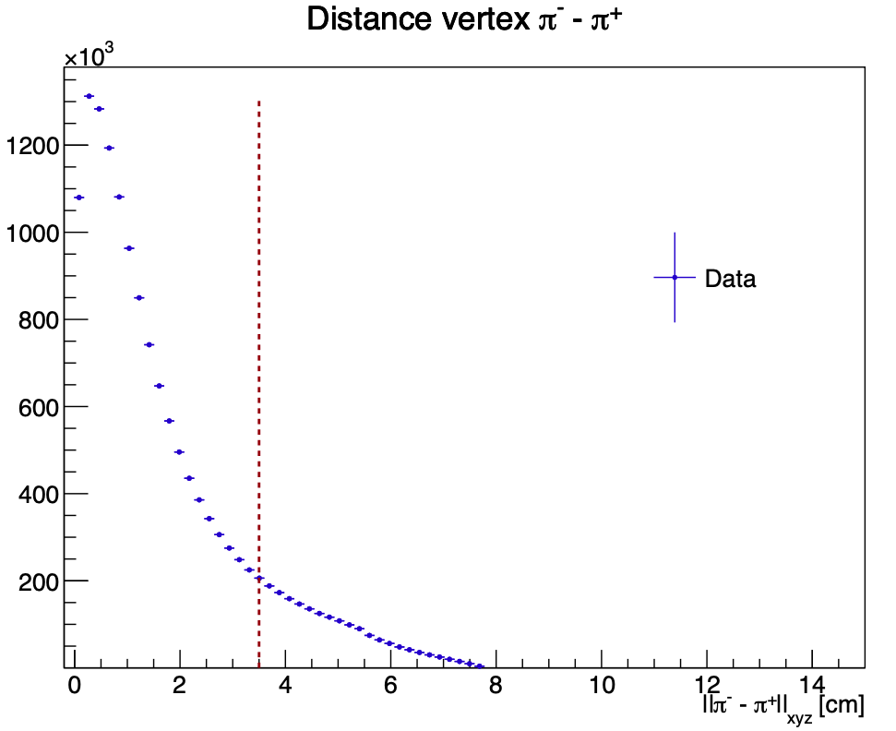
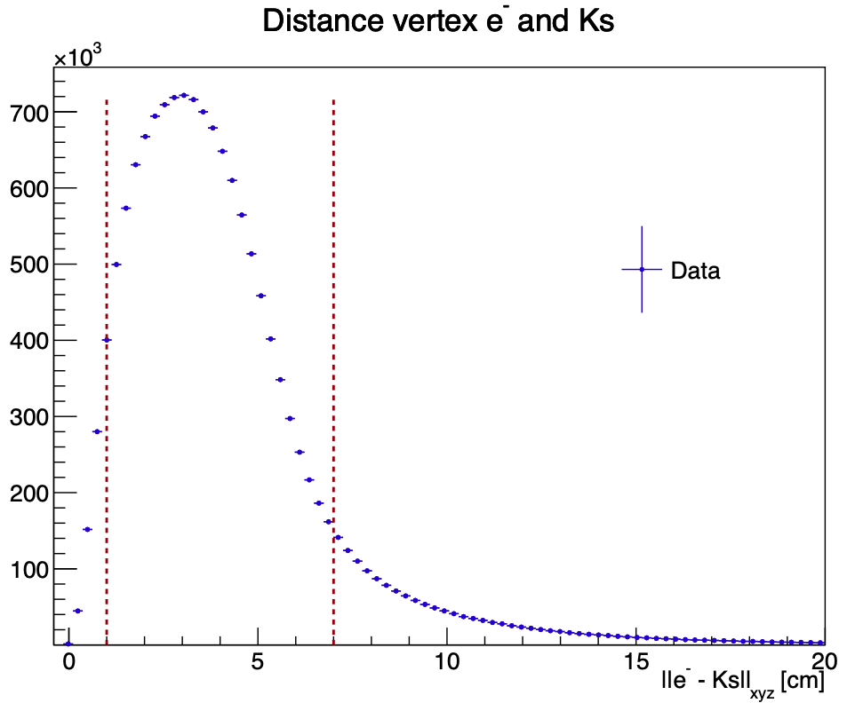
Details of cuts on data
Mathieu Ronayette
5/24
Mathieu Ronayette
rgA - meeting
21 Jan 2026

Slide 6
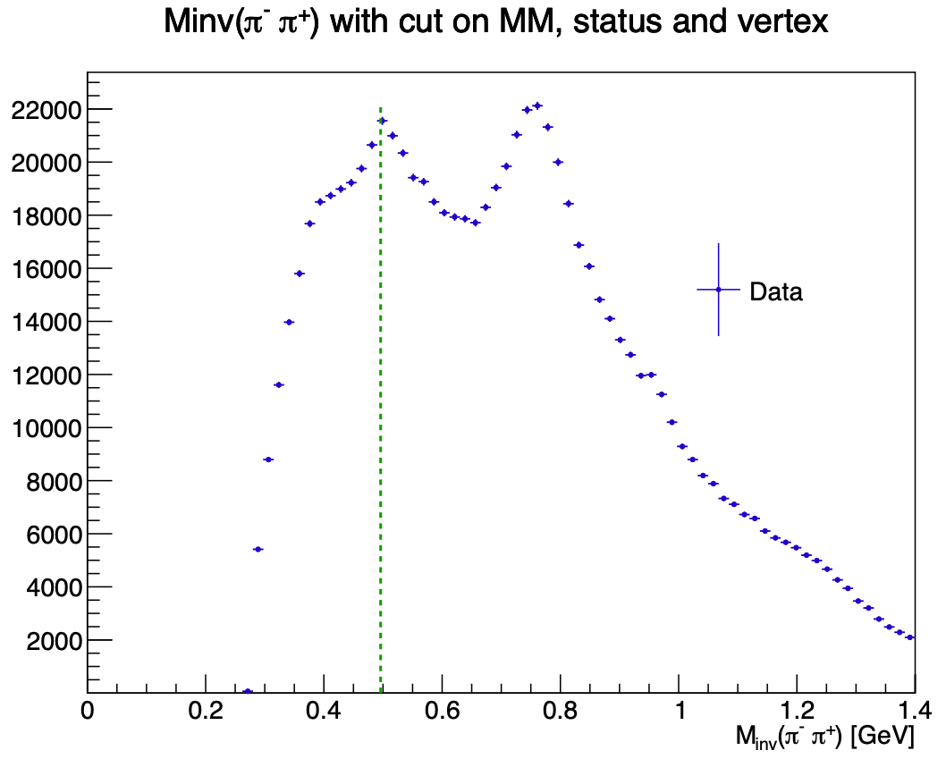
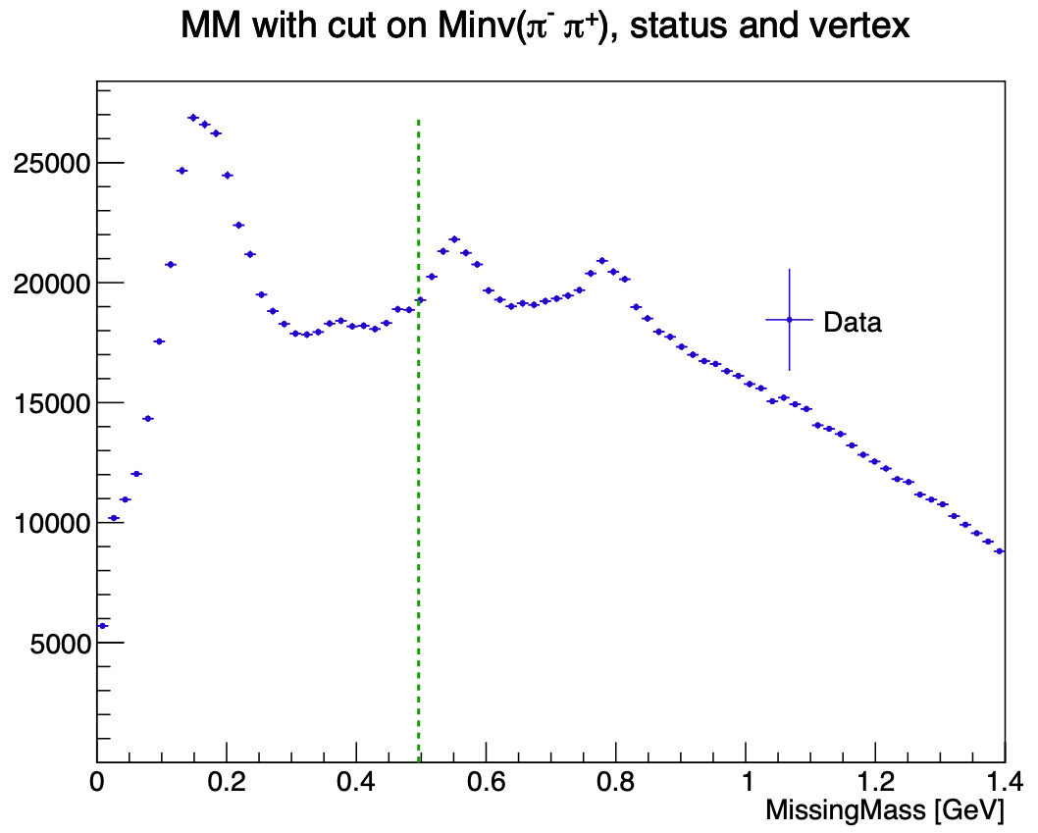
Influence of cuts on data
Ks
ρ⁰
π ⁰
η⁰
ρ⁰
Mathieu Ronayette
6/24
Mathieu Ronayette
rgA - meeting
21 Jan 2026

Slide 7
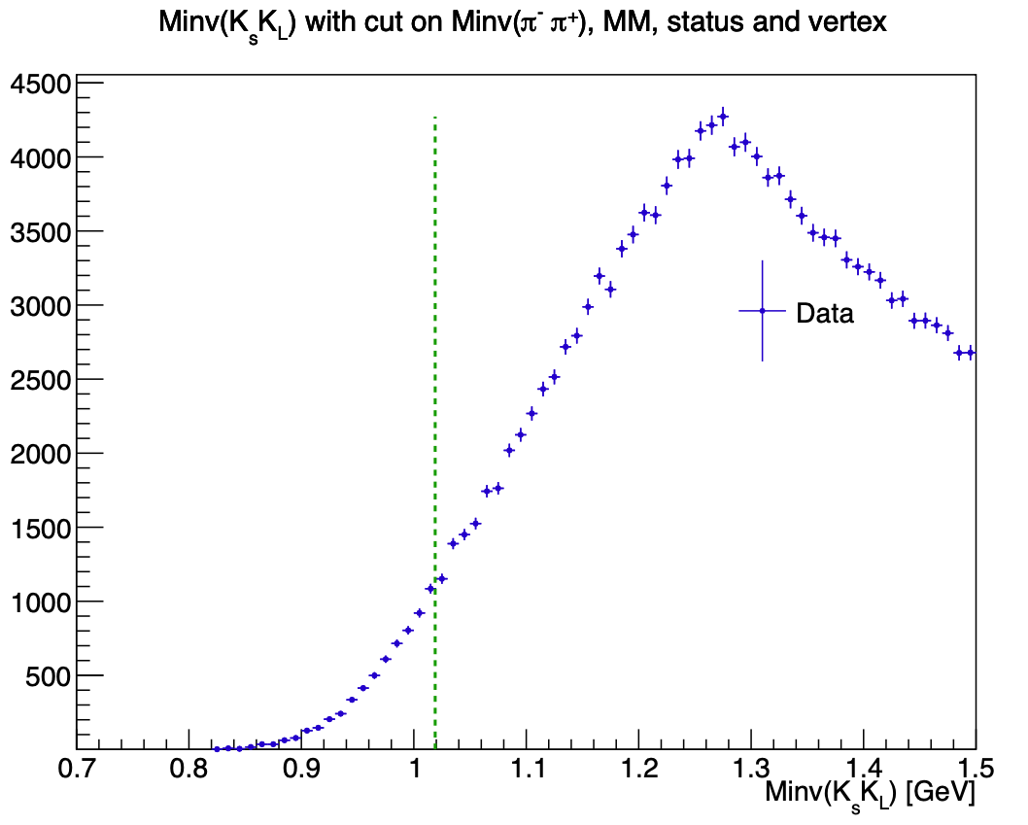
Influence of cuts on data
Mathieu Ronayette
7/24
Mathieu Ronayette
rgA - meeting
21 Jan 2026

Slide 8
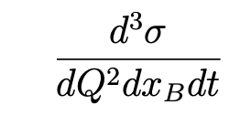
Monte Carlo Simulation : ɸ generator
From Proposal to Jeﬀerson Lab PAC39 Exclusive Phi Meson Electroproduction with CLAS12
Branching ratio ɸ → Ks Kl = 34%
Branching ratio Ks → π⁺ π⁻ = 69%
Mathieu Ronayette
8/24
Mathieu Ronayette
rgA - meeting
21 Jan 2026

Slide 9
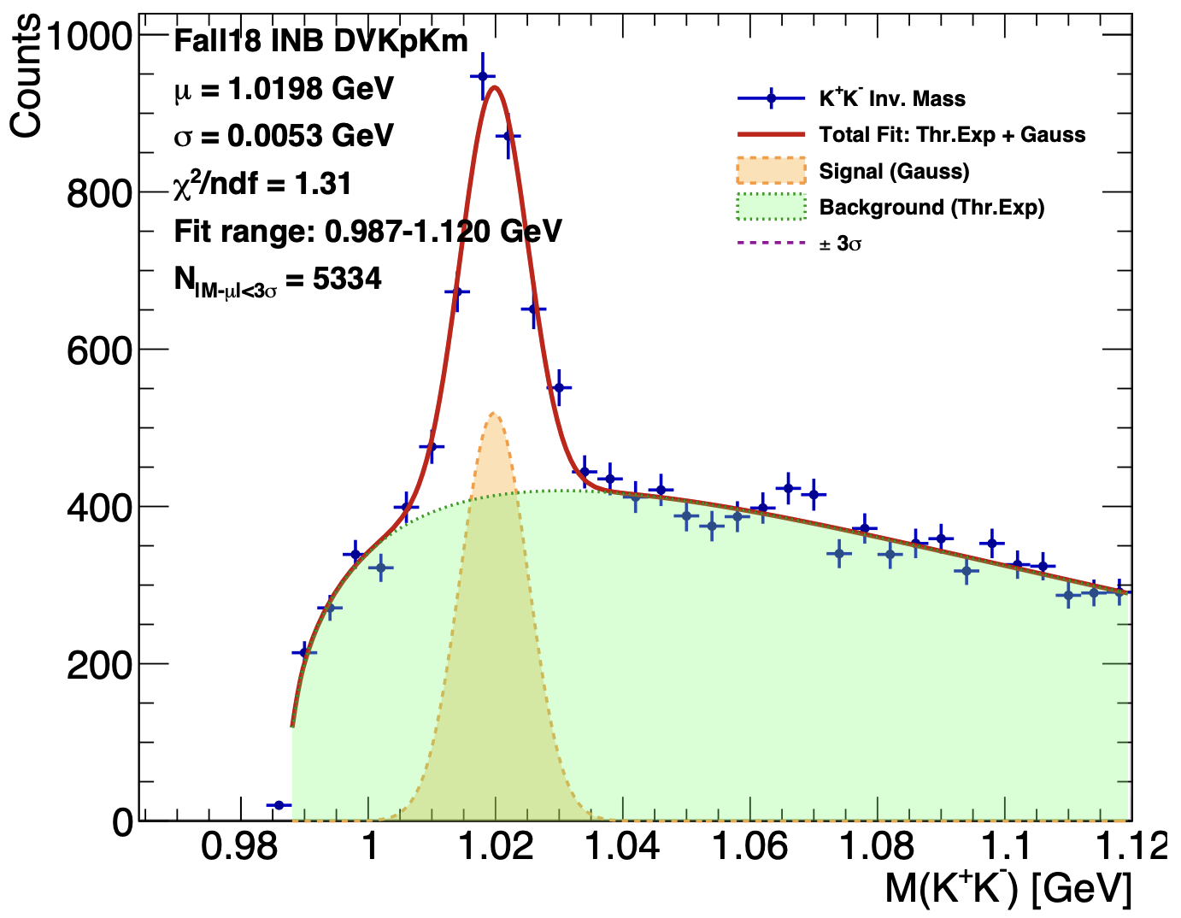
Monte Carlo Simulation : Validation with ɸ → K+ K-
→ Test my Monte Carlo with ɸ electroproduction channel ɸ → K+ K-
e
e’
K+
q
ɸ
K-
p
p’
Bhawani’s plot
Mathieu Ronayette
9/24
Mathieu Ronayette
rgA - meeting
21 Jan 2026

Slide 10
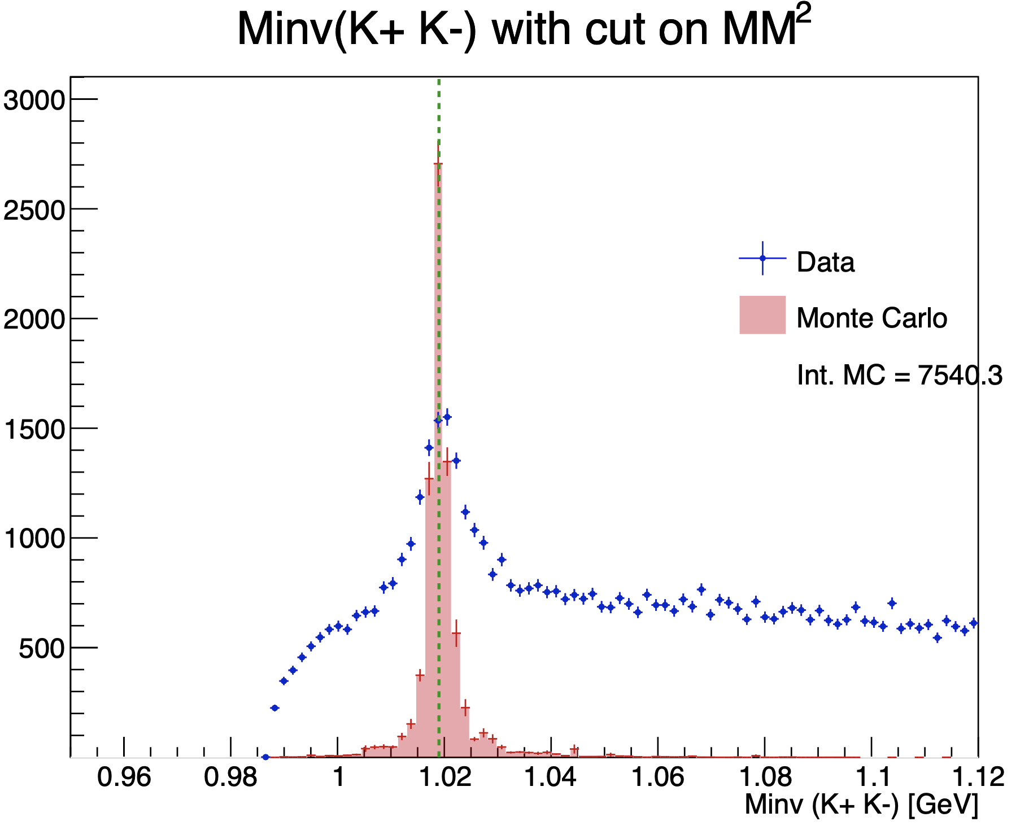
Monte Carlo Simulation : Validation with ɸ → K+ K-
Bhawani’s plot
Mathieu Ronayette
10/24
Mathieu Ronayette
rgA - meeting
21 Jan 2026

Slide 11
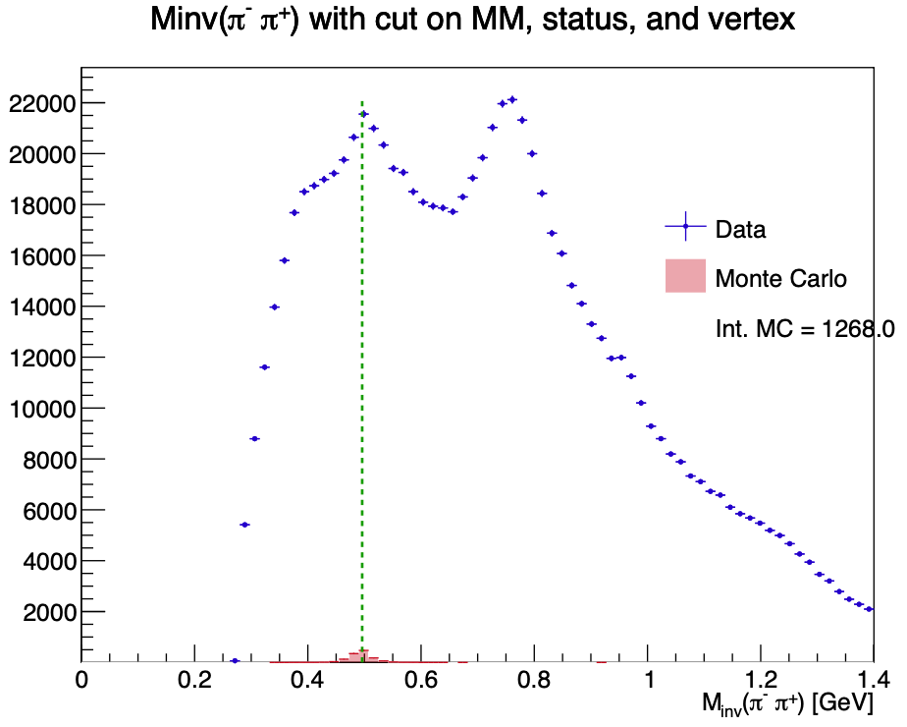
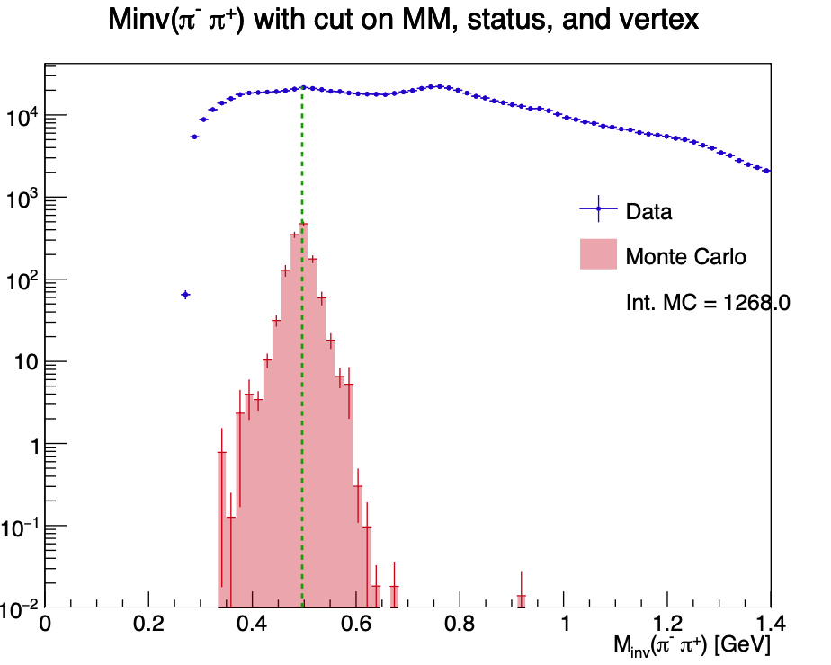
Monte Carlo Simulation : reconstructed events in ɸ → Ks Kl channel
Mathieu Ronayette
11/24
Mathieu Ronayette
rgA - meeting
21 Jan 2026

Slide 12
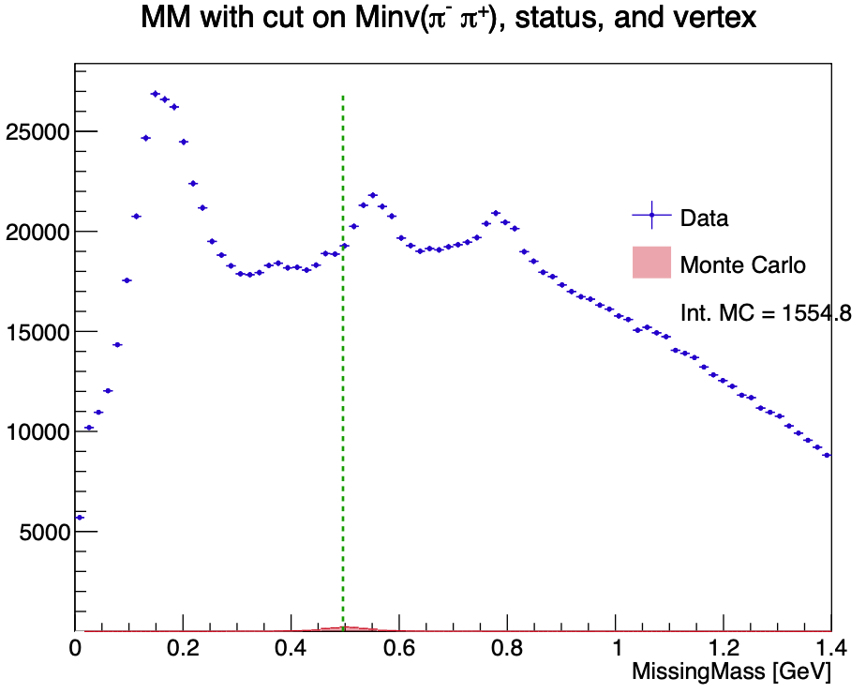
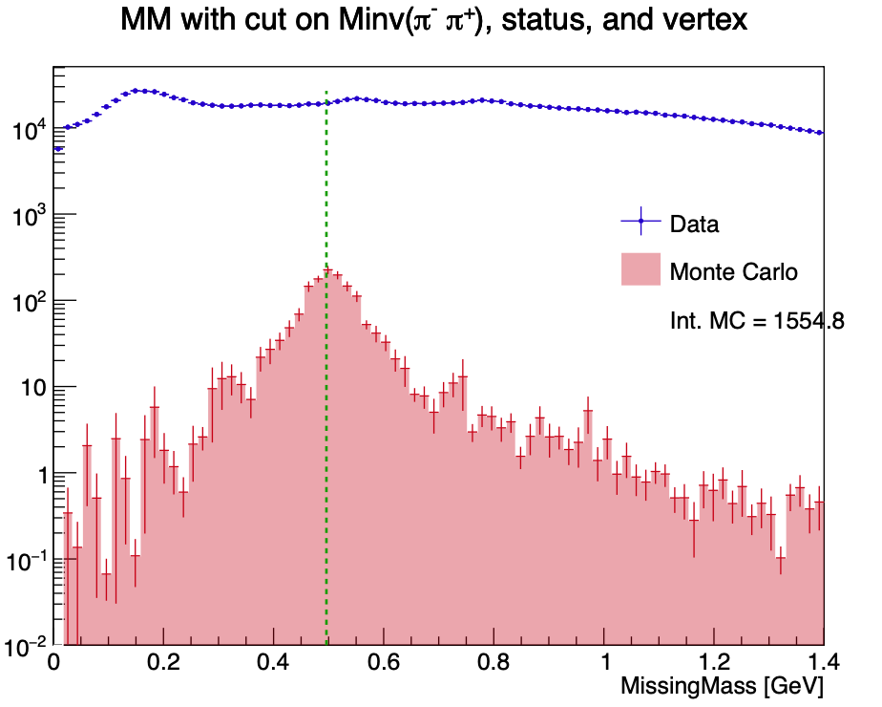
Monte Carlo Simulation : reconstructed events in ɸ → Ks Kl channel
Mathieu Ronayette
12/24
Mathieu Ronayette
rgA - meeting
21 Jan 2026

Slide 13
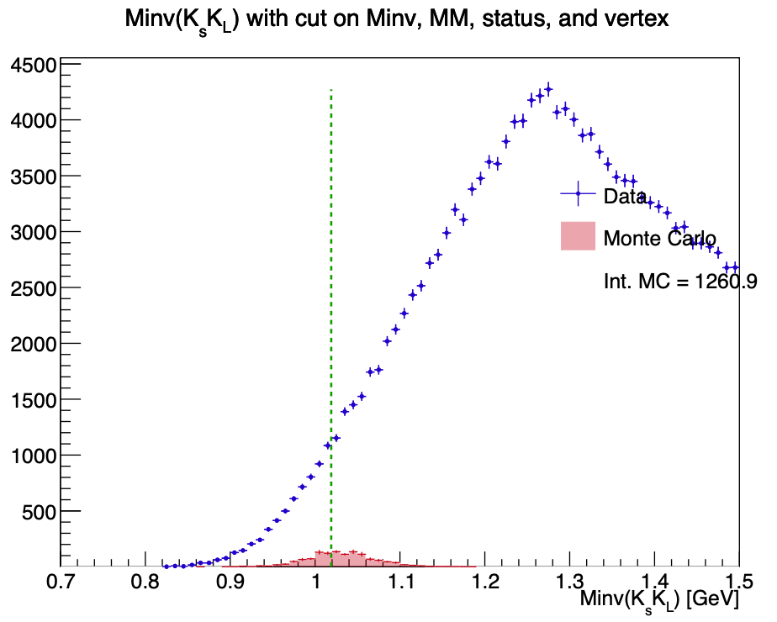
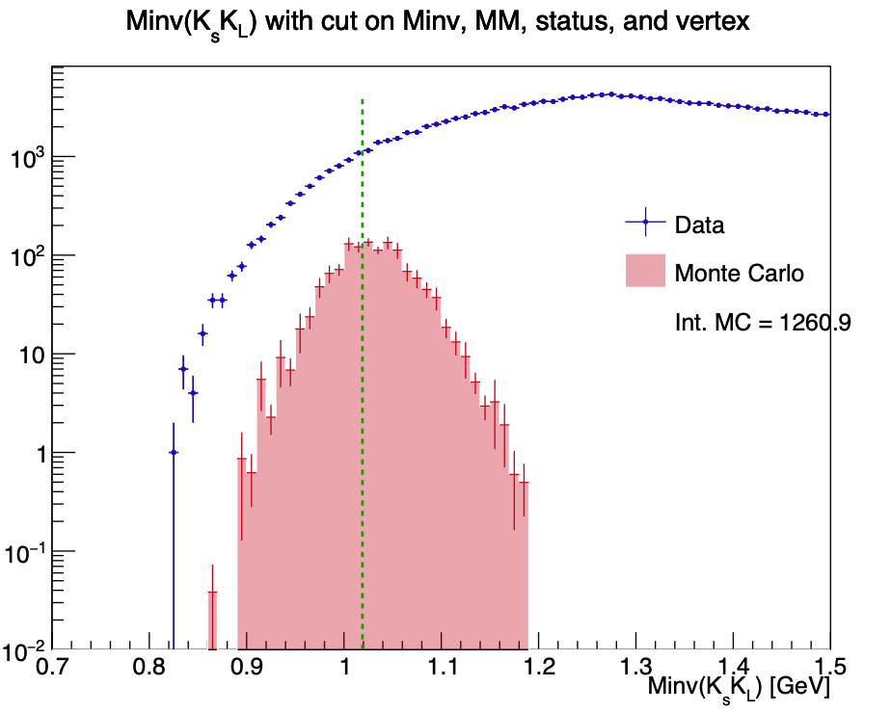
Monte Carlo Simulation : reconstructed events in ɸ → Ks Kl channel
Mathieu Ronayette
13/24
Mathieu Ronayette
rgA - meeting
21 Jan 2026

Slide 14
Monte Carlo Simulation : reconstructed events in ɸ → Ks Kl channel
→ MC predict less events and worse resolution in Ks Kl channel
Mathieu Ronayette
14/24
Mathieu Ronayette
rgA - meeting
21 Jan 2026

Slide 15
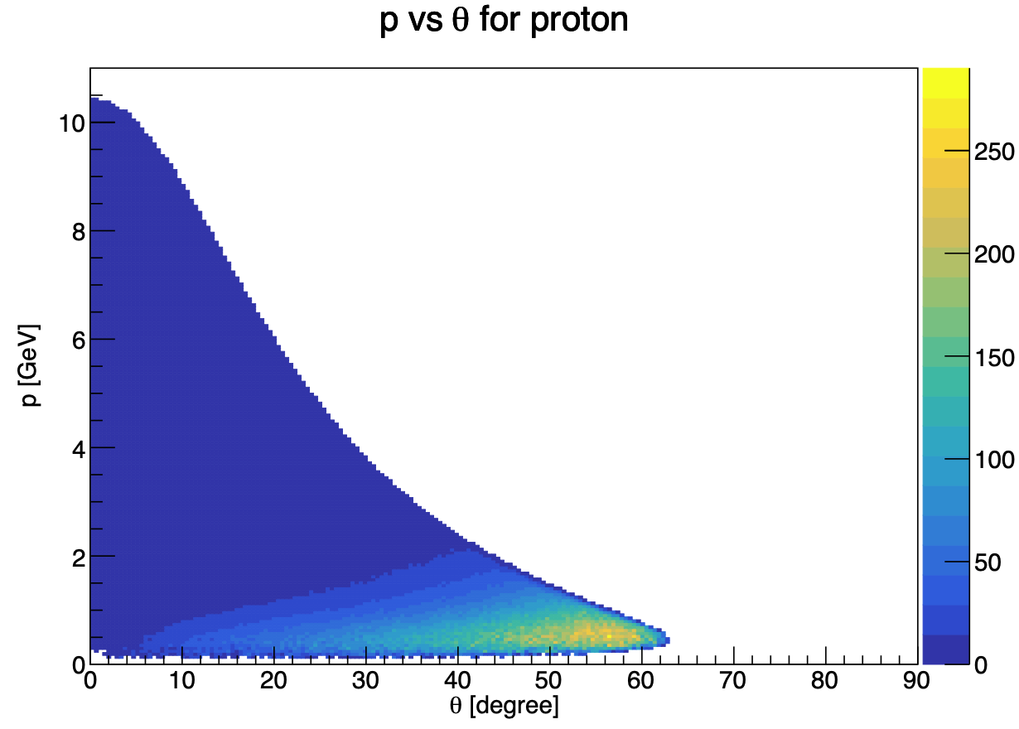
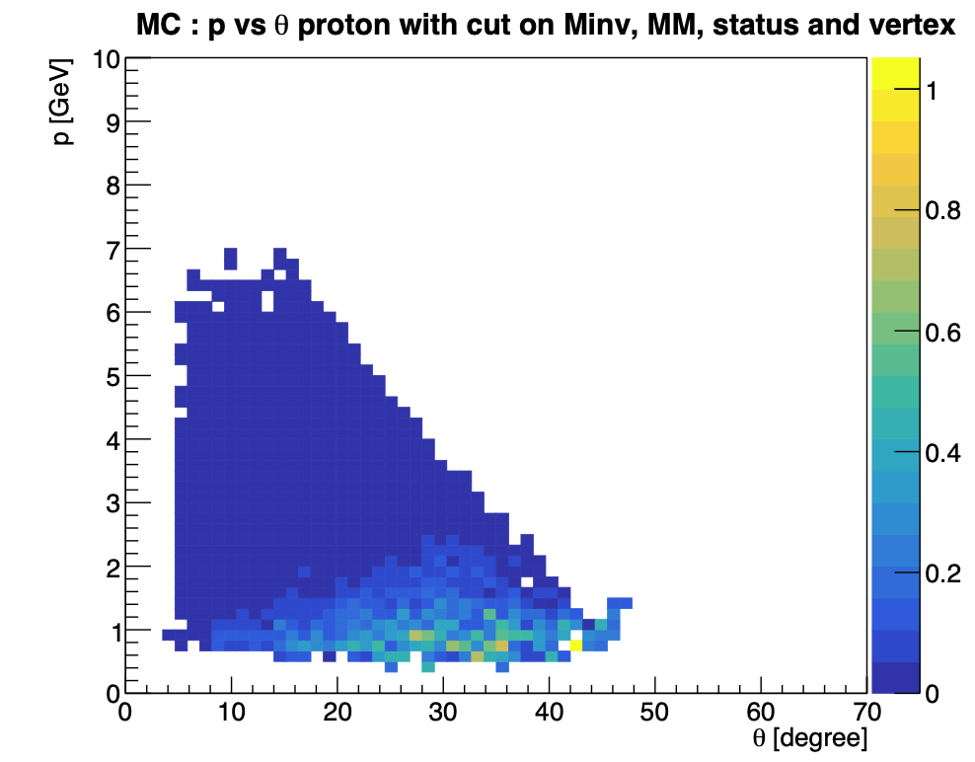
Monte Carlo simulation : comparison generated/reconstructed
Generated events
Reconstructed MC Events (after cuts)
Mathieu Ronayette
15/24
Mathieu Ronayette
rgA - meeting
21 Jan 2026

Slide 16
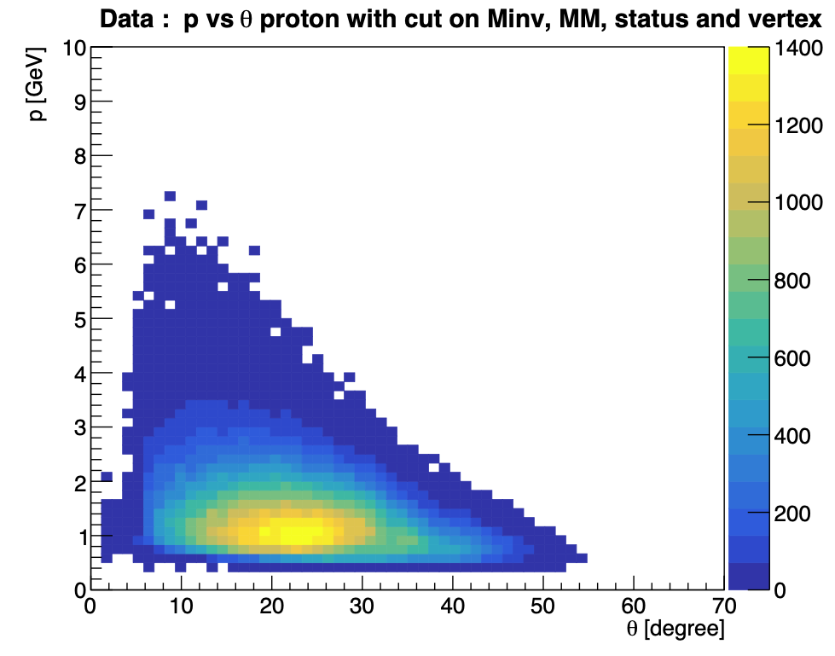
Monte Carlo simulation : comparison generated/reconstructed
Generated events
Events from data (after cuts)
Mathieu Ronayette
16/24
Mathieu Ronayette
rgA - meeting
21 Jan 2026

Slide 17
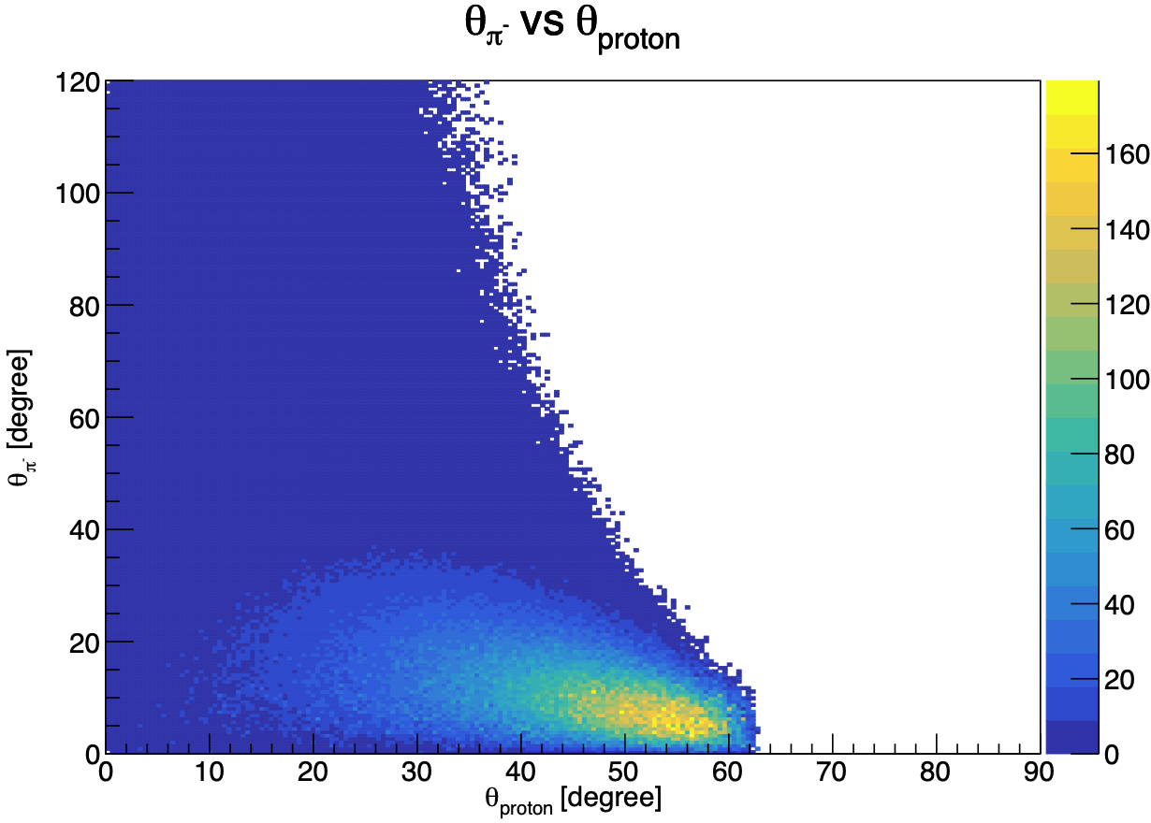
Monte Carlo simulation : comparison generated/reconstructed
Events generated
(same figure with π⁺)
Mathieu Ronayette
17/24
Mathieu Ronayette
rgA - meeting
21 Jan 2026

Slide 18
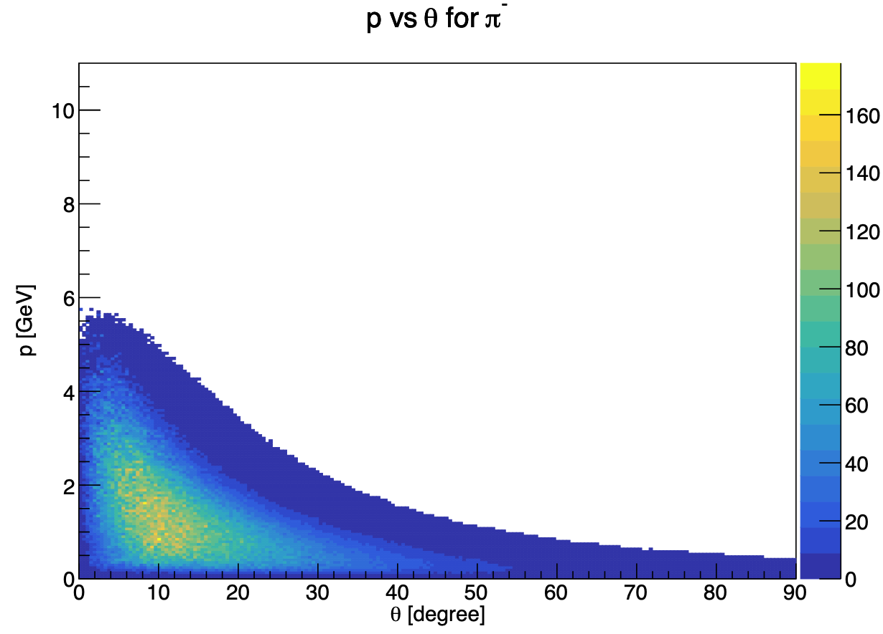
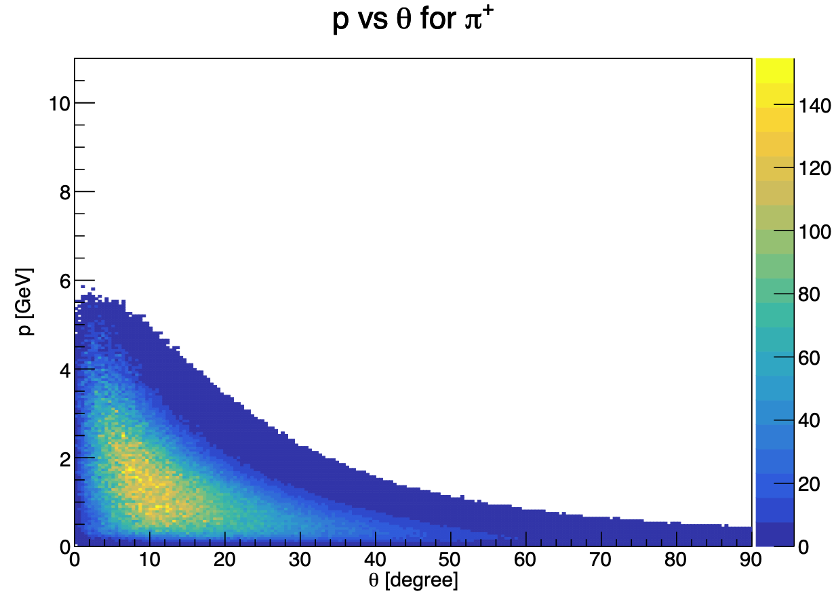
Monte Carlo simulation : comparison generated/reconstructed
Generated events
Mathieu Ronayette
18/24
Mathieu Ronayette
rgA - meeting
21 Jan 2026

Slide 19
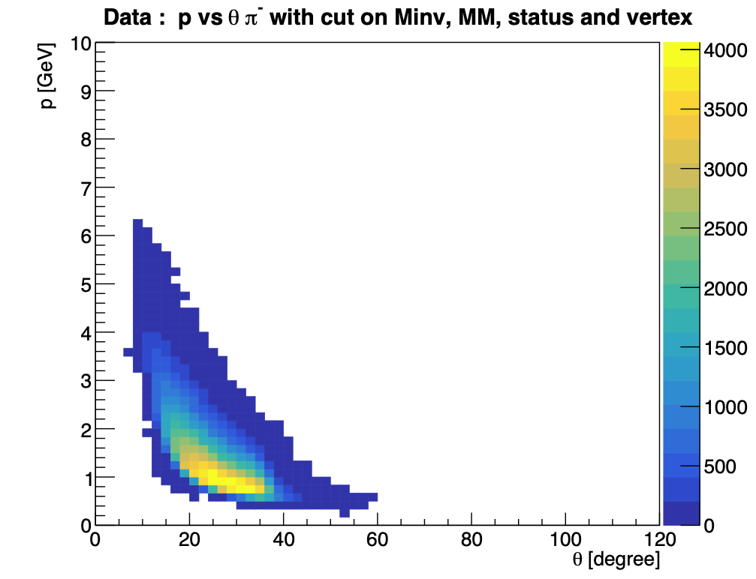
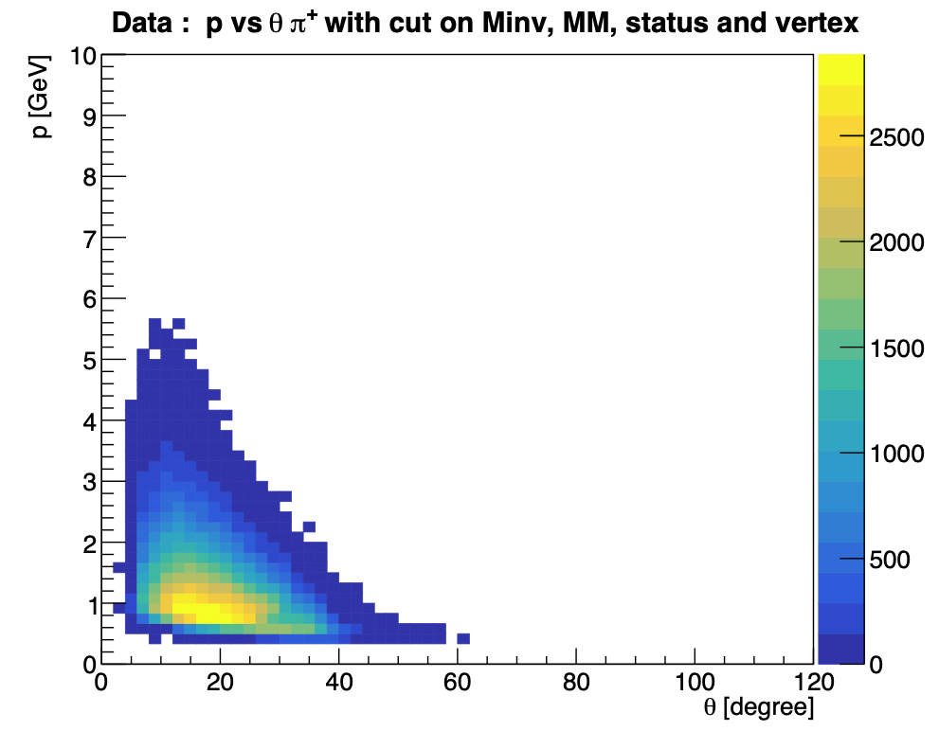
Monte Carlo simulation : comparison generated/reconstructed
DATA Inbending
Mathieu Ronayette
19/24
Mathieu Ronayette
rgA - meeting
21 Jan 2026

Slide 20
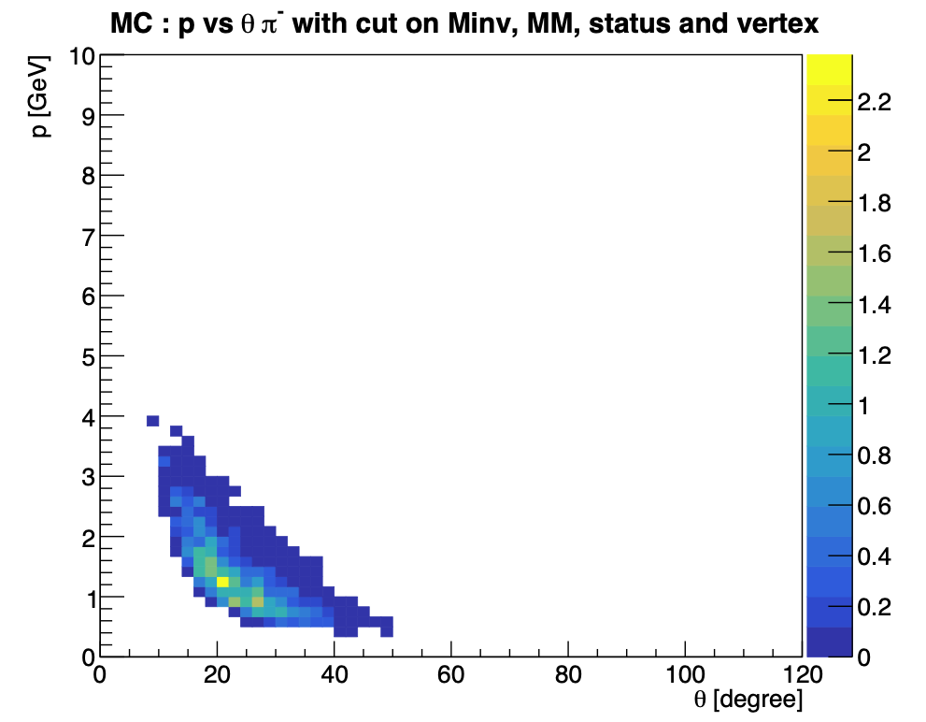
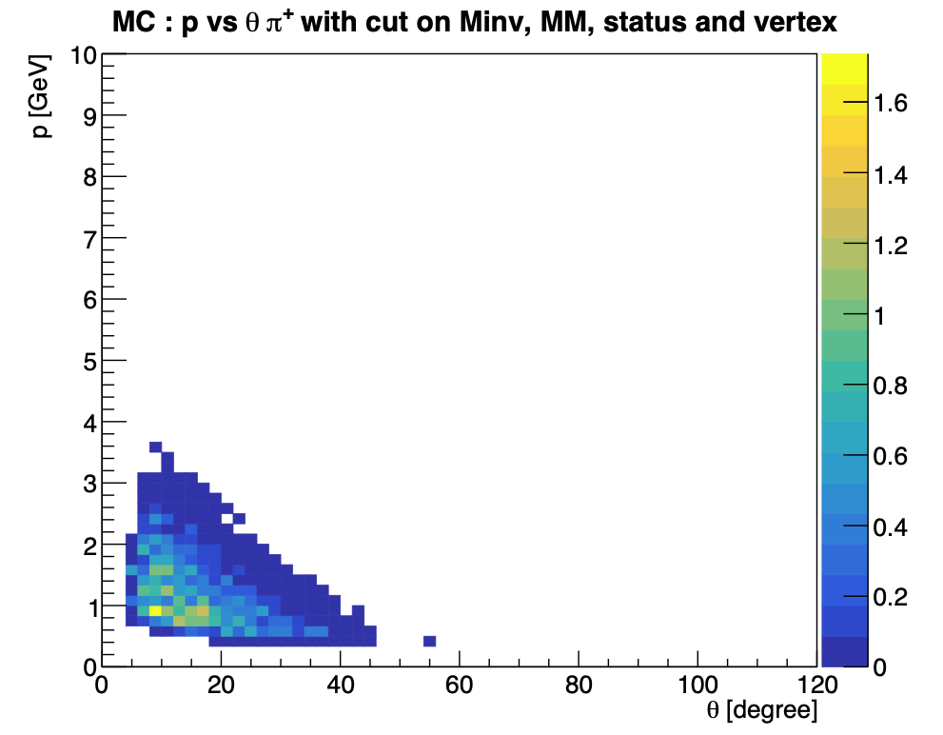
Monte Carlo Simulation : comparison generated/reconstructed
MC Inbending
Mathieu Ronayette
20/24
Mathieu Ronayette
rgA - meeting
22 Jan 2025

Slide 21
Pions in the FT ?
For inbending : events with 1 proton 1 π ⁺ and 2 e⁻
→ one e⁻ in the FD (real e⁻)
→ one e⁻ in the FT (π – identified like an e⁻)
For outbending : events with 1 proton 1 π ⁻ and 2 e⁻
→ one e⁻ in the FD (real e⁻)
→ one e⁻ in the FT (π ⁺ identified like an e⁻)
No correction with Veronique Ziegler code
→ no cuts on vertex
We do not expect a good reconstruction because theses cut have to be satisfied in the calorimeter of the FT :
- At least two crystal with energy > 30 MeV
- At least one crystal with energy > 50 MeV
- Total energy > 200 MeV
Mathieu Ronayette
21/24
Mathieu Ronayette
rgA - meeting
23 Jan 2026

Slide 22


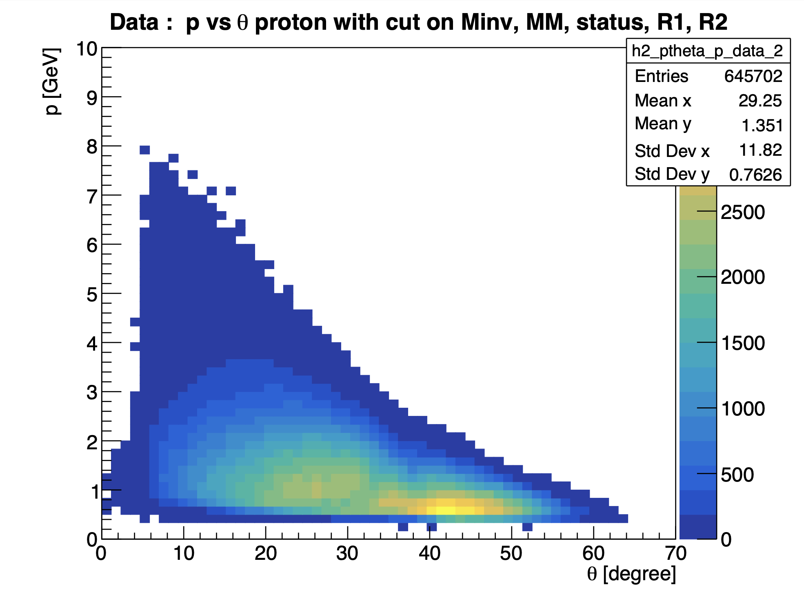
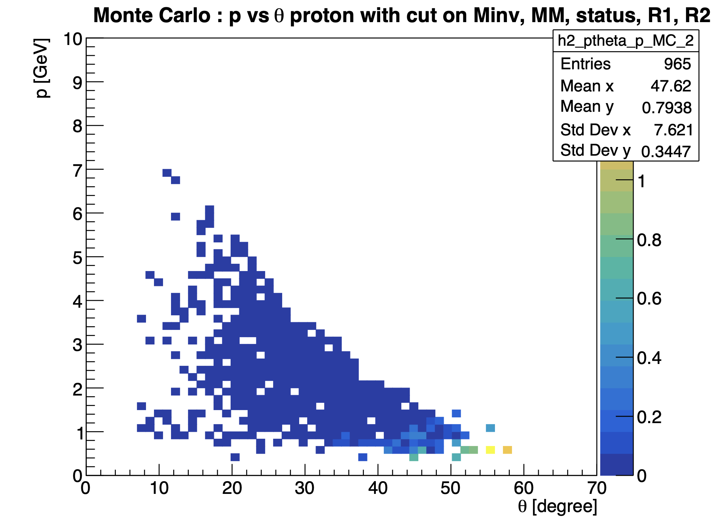
Pions in the FT ?
inbending
Mathieu Ronayette
22/24
Mathieu Ronayette
rgA - meeting
21 Jan 2026

Slide 23
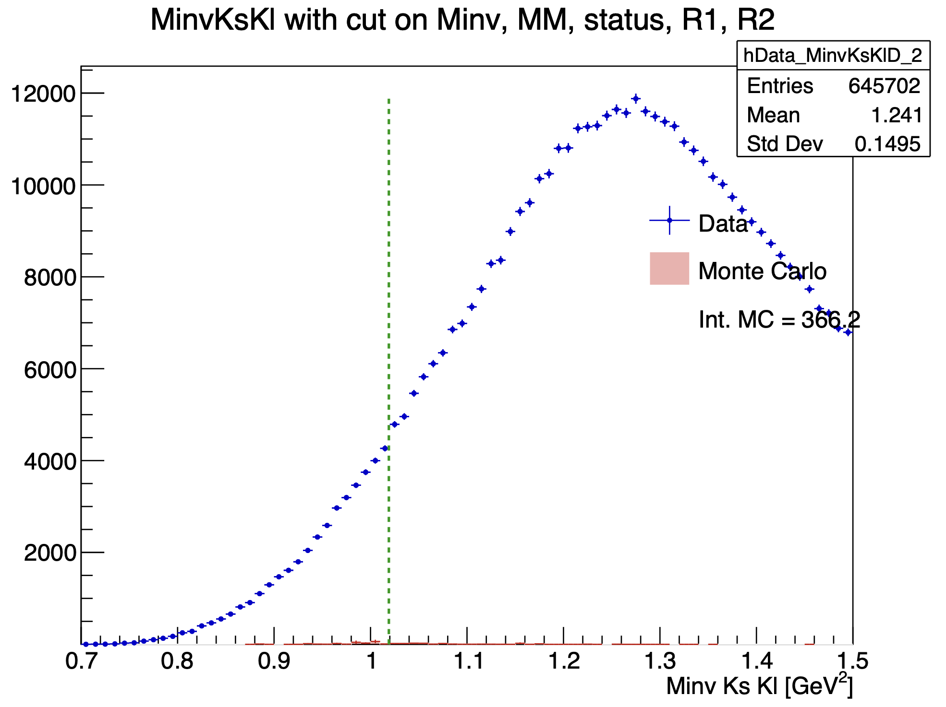
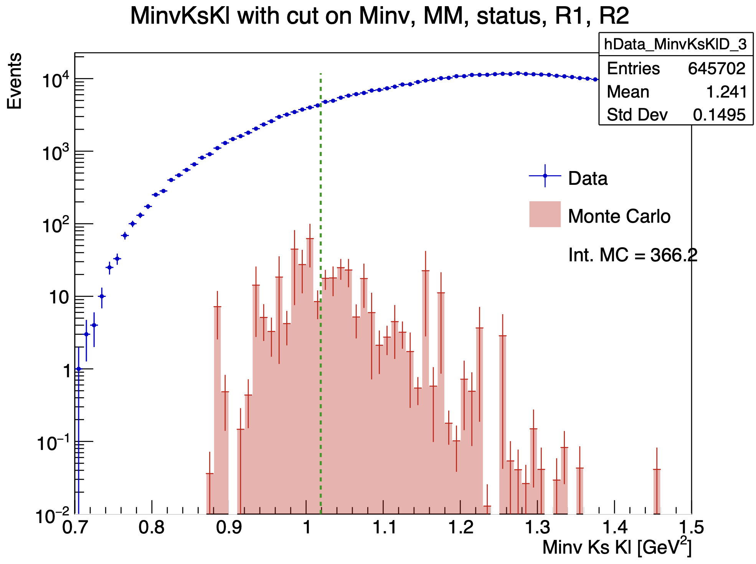
Pions in the FT ?
inbending
Mathieu Ronayette
23/24
Mathieu Ronayette
rgA - meeting
21 Jan 2026

Slide 24
Conclusion
Conclusion :
We do not see a signal in the Ks Kl channel because of pions acceptance and the peak resolution .
→ For the peak resolution : a kinematic fitter could be a solution
→ For the acceptance limitation : we could try to implement pions ID in the FT
Thanks!
Mathieu Ronayette
24/24
Mathieu Ronayette
rgA - meeting
21 Jan 2026

Slide 25
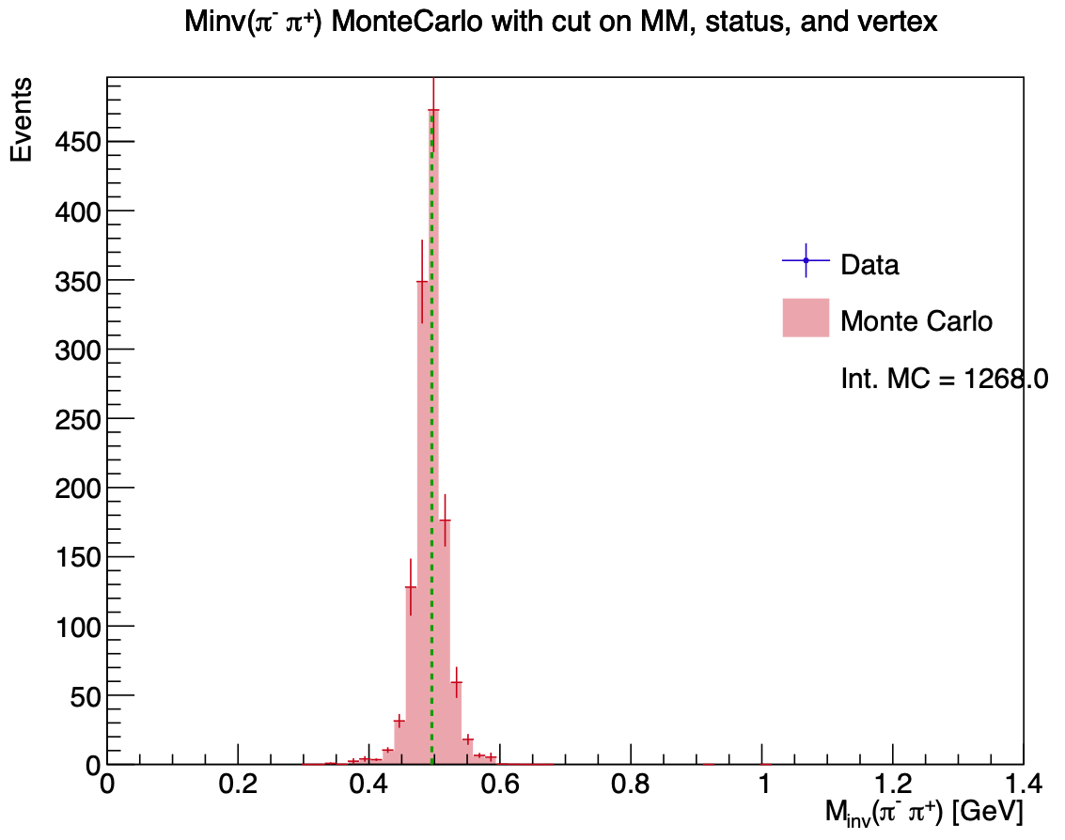
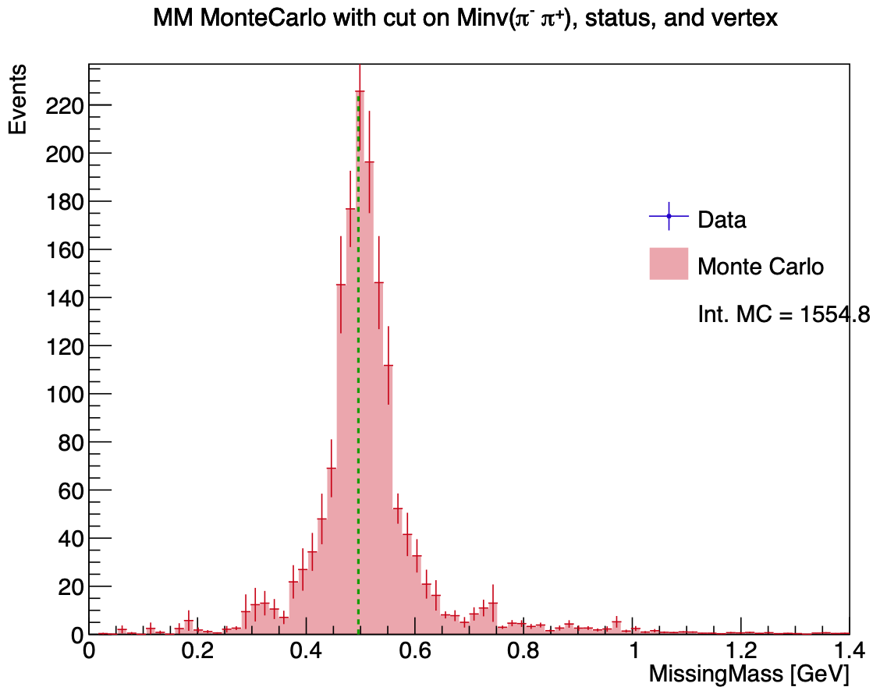
Monte Carlo Simulation : reconstructed events in ɸ → Ks Kl channel
Mathieu Ronayette
11/26
Mathieu Ronayette
rgA - meeting
21 Jan 2026

Slide 26
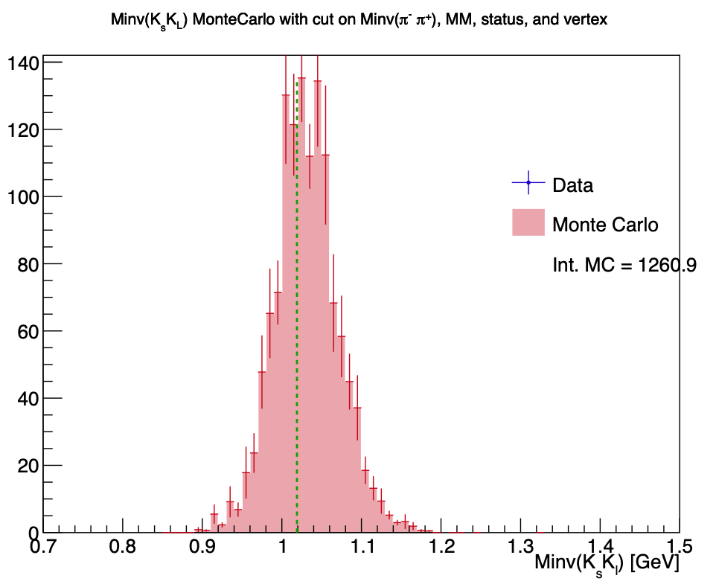
Monte Carlo Simulation : reconstructed events in ɸ → Ks Kl channel
Mathieu Ronayette
12/26
Mathieu Ronayette
rgA - meeting
21 Jan 2026

Slide 27
Update on ɸ generator
Backup ɸ generator
Mathieu Ronayette
18/18
Mathieu Ronayette
meeting
27 Nov 2025

Slide 28
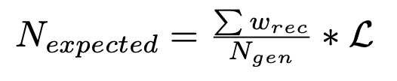
Update on ɸ generator
Simulation objectives :
- Estimate the expected number of ɸ with
- Find interresting cuts
π⁺
e
e’
Ks
π⁻
Previously with TGenPhasespace (root module) :
- Generate automatically quadri-impulsion in the phasespace
- But problems with the weight associated with the phasespace
q
ɸ
Kl
p
p’
→ In the next slides the generator that we implemented without TGenPhaseSpace
Mathieu Ronayette
1/18
Mathieu Ronayette
meeting
27 Nov 2025

Slide 29
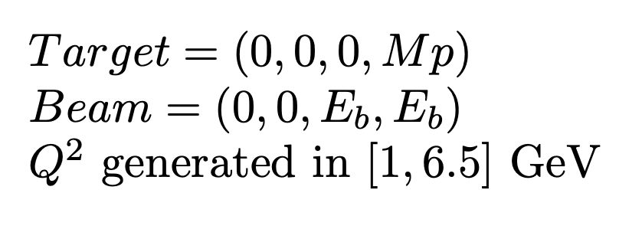
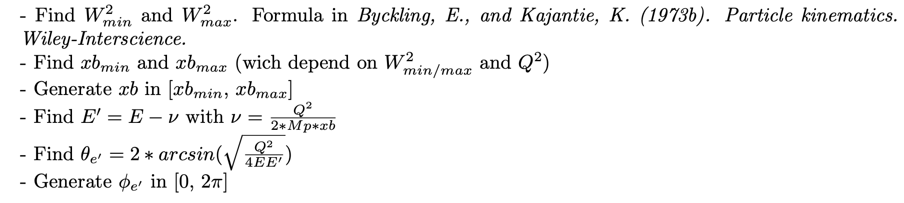
Update on ɸ generator
Initially :
e
e’
q
2. Scattering electron kinematics :
Mathieu Ronayette
2/18
Mathieu Ronayette
meeting
27 Nov 2025

Slide 30

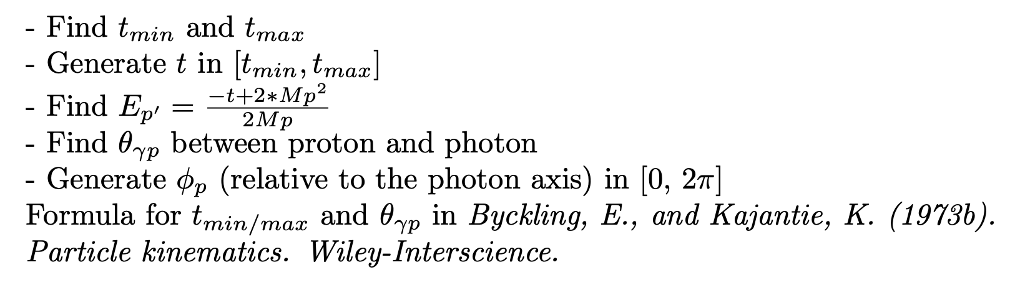

Update on ɸ generator
3. Virtual photon kinematics :
q
ɸ
4. Scattering proton kinematics :
p
p’
5. Meson ɸ kinematics :
Mathieu Ronayette
3/18
Mathieu Ronayette
meeting
27 Nov 2025

Slide 31
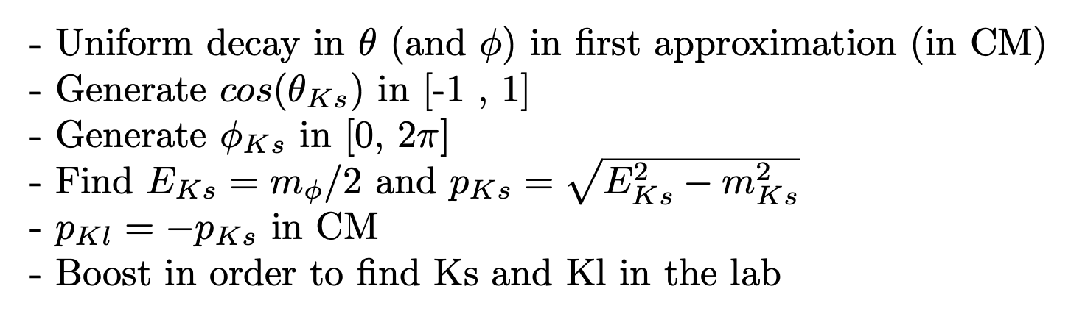
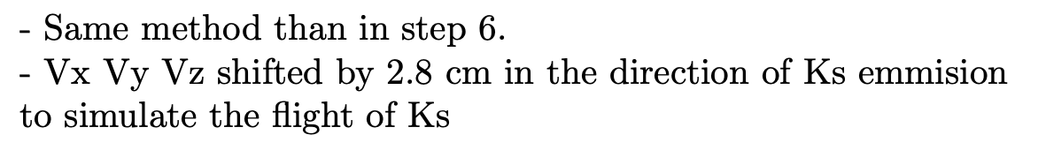
Update on ɸ generator
Ks
6. Kinematics of second decay ɸ → Ks Kl :
_{Ks}
ɸ
Kl
π⁺
7. Kinematics of thrid decay Ks → π⁺ π⁻ :
π⁺
Ks
π⁻
Mathieu Ronayette
4/18
Mathieu Ronayette
meeting
27 Nov 2025

Slide 32
Update on ɸ generator
From Proposal to Jeﬀerson Lab PAC39 Exclusive Phi Meson Electroproduction with CLAS12
Branching ratio Ks → π⁺ π⁻ = 69%
Branching ratio ɸ → Ks Kl = 34%
Mathieu Ronayette
5/18
Mathieu Ronayette
meeting
27 Nov 2025

Slide 33
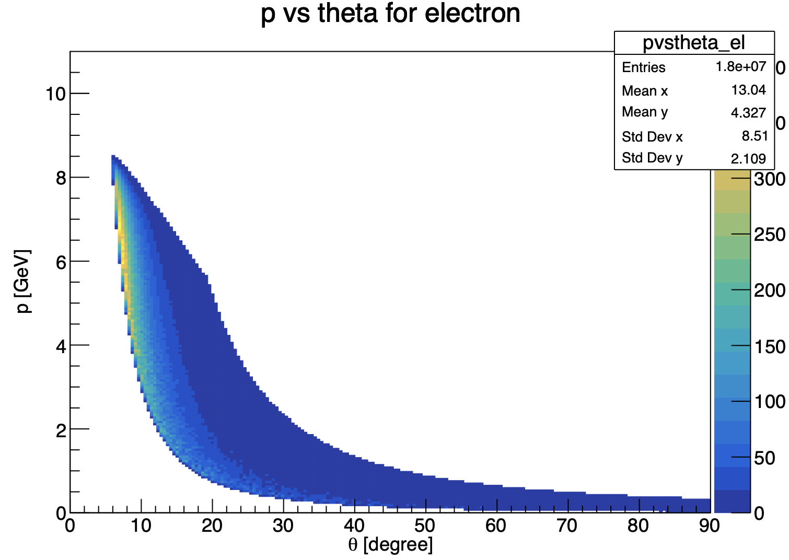
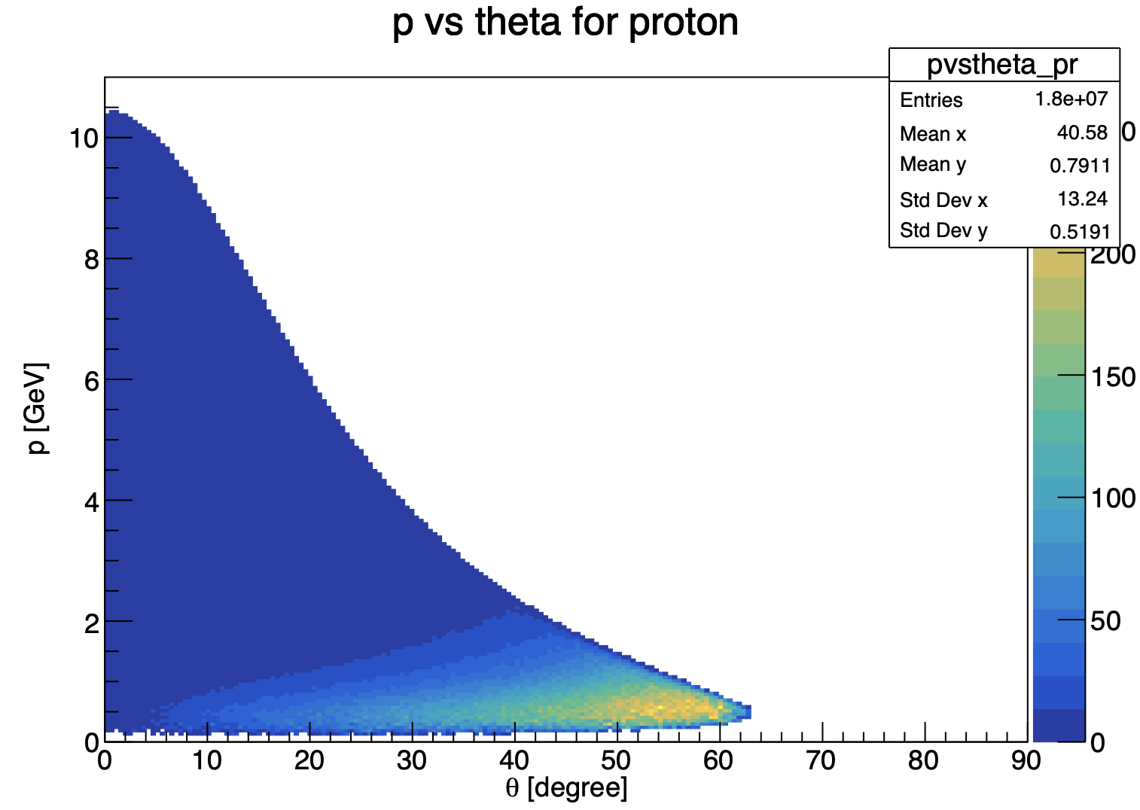
Update on ɸ generator
Mathieu Ronayette
6/18
Mathieu Ronayette
meeting
27 Nov 2025

Slide 34
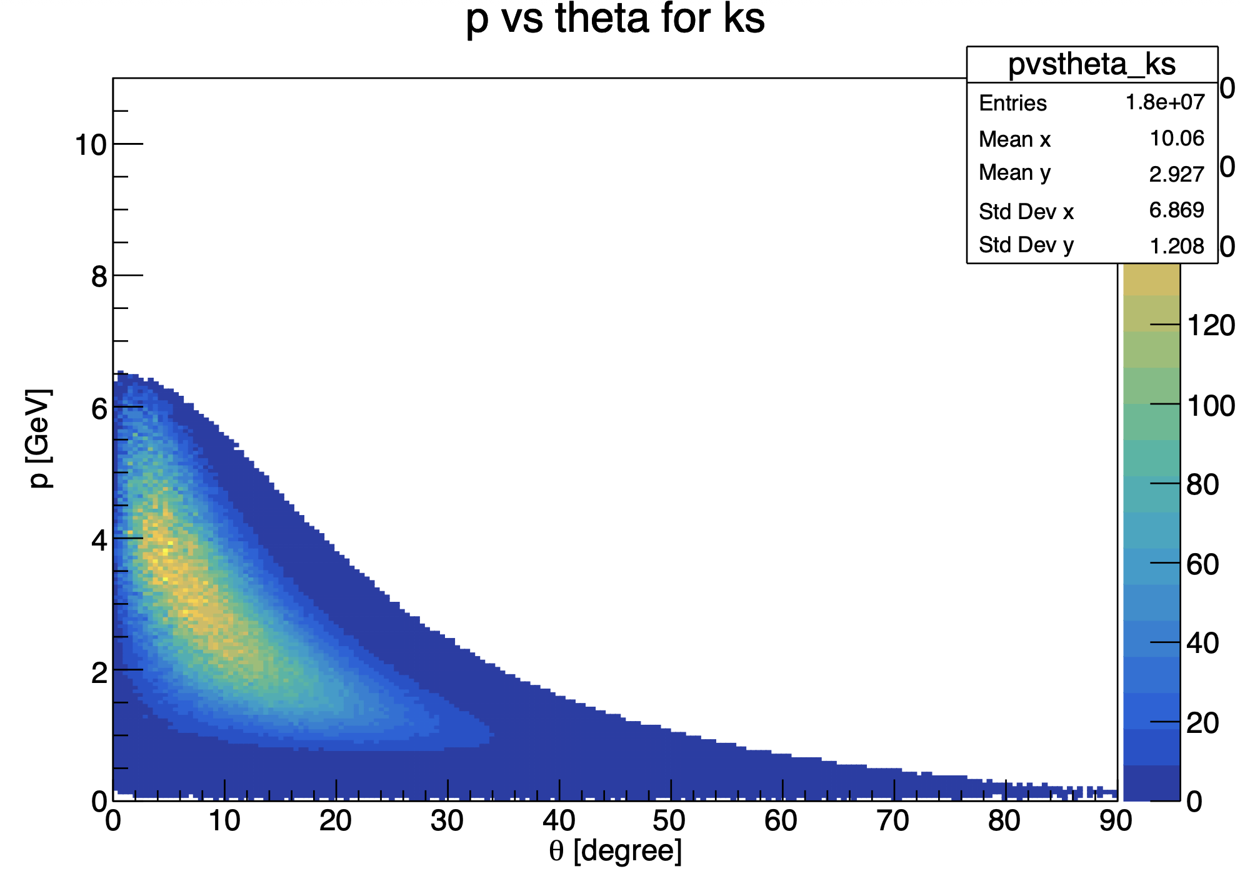
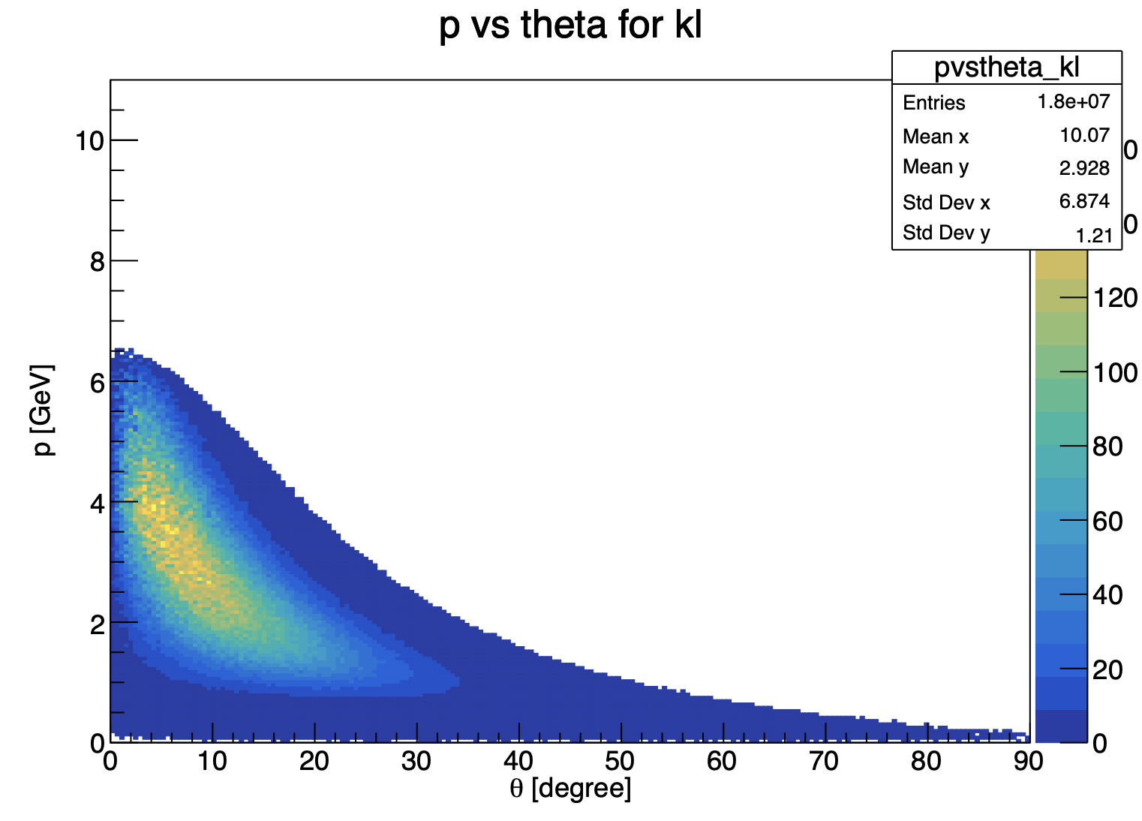
Update on ɸ generator
Mathieu Ronayette
7/18
Mathieu Ronayette
meeting
27 Nov 2025

Slide 35
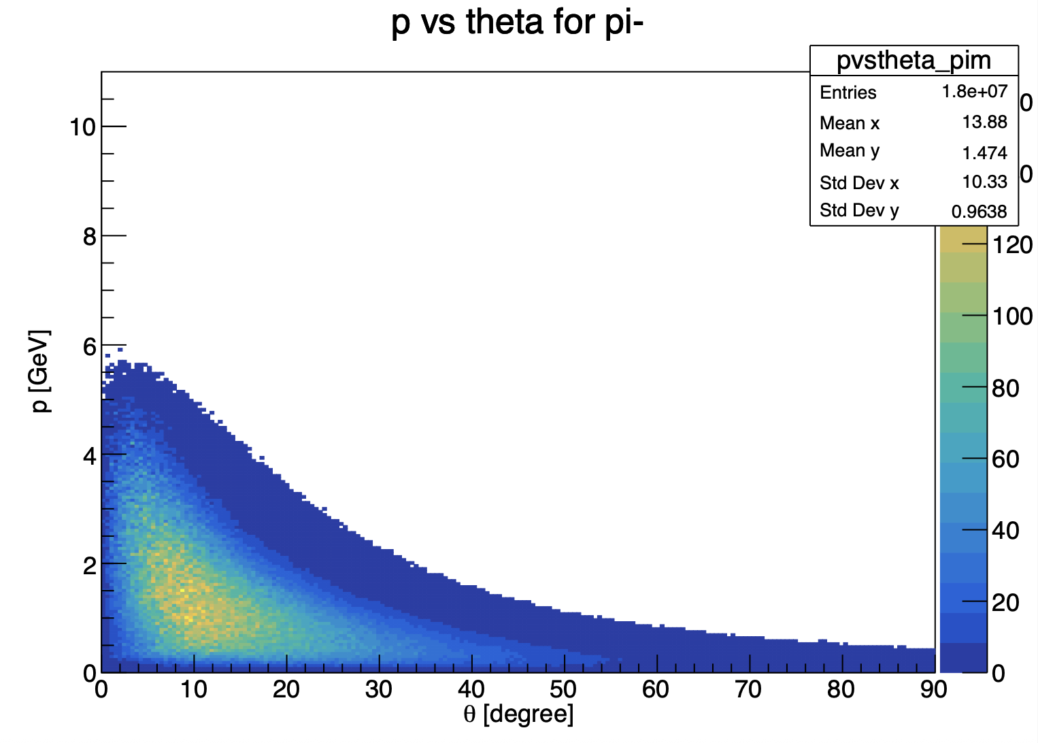

Update on ɸ generator
Mathieu Ronayette
8/18
Mathieu Ronayette
meeting
27 Nov 2025

Slide 36
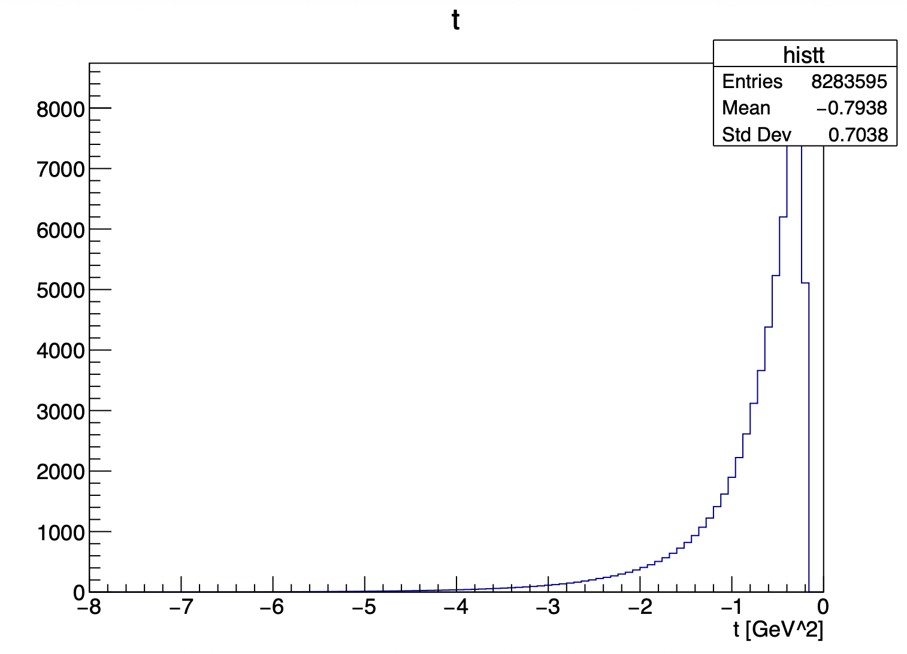
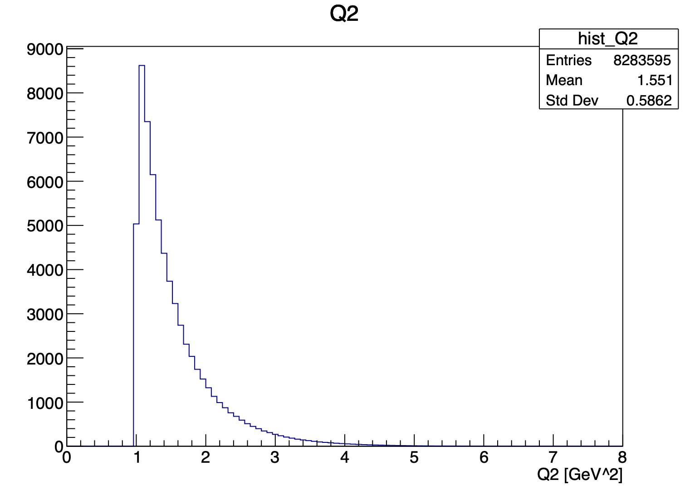
Update on ɸ generator
Mathieu Ronayette
9/18
Mathieu Ronayette
meeting
27 Nov 2025

Slide 37
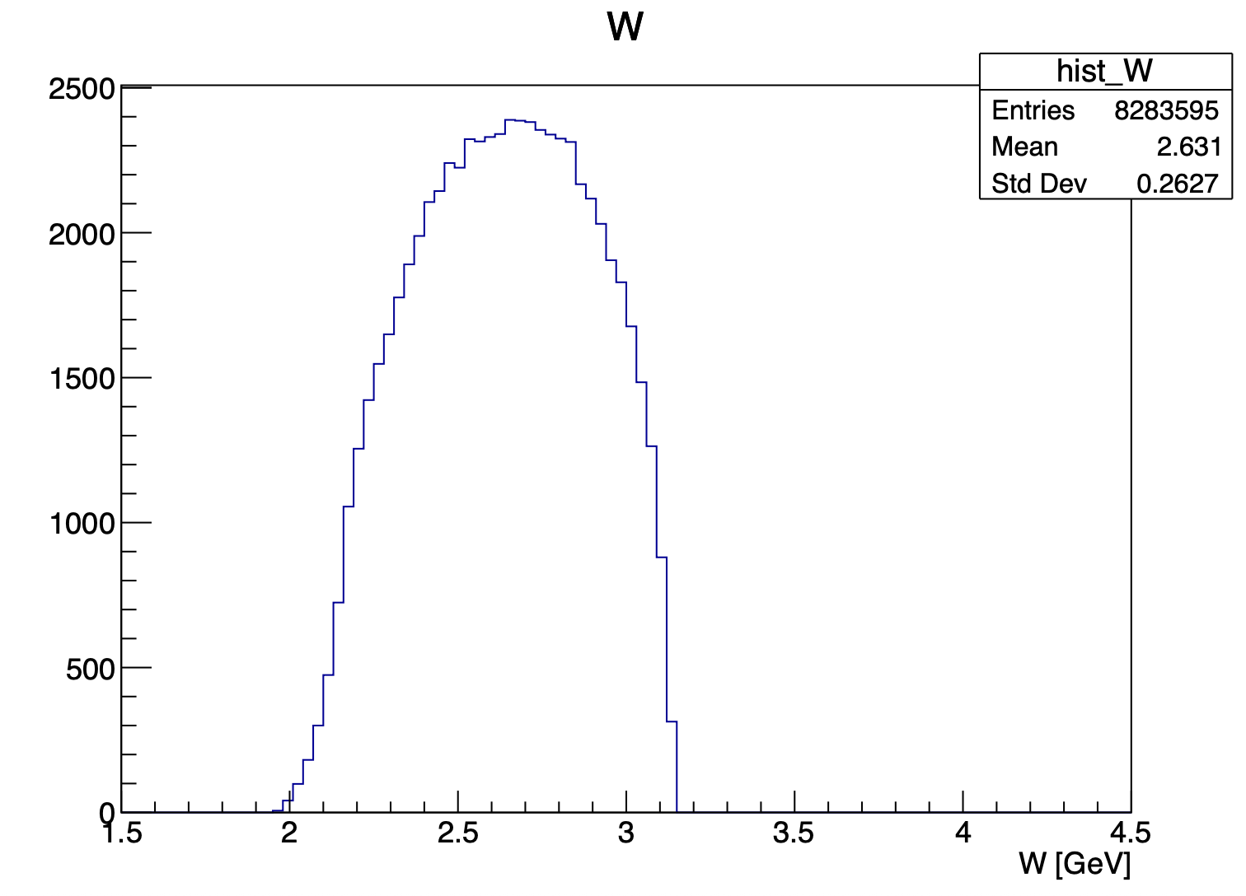
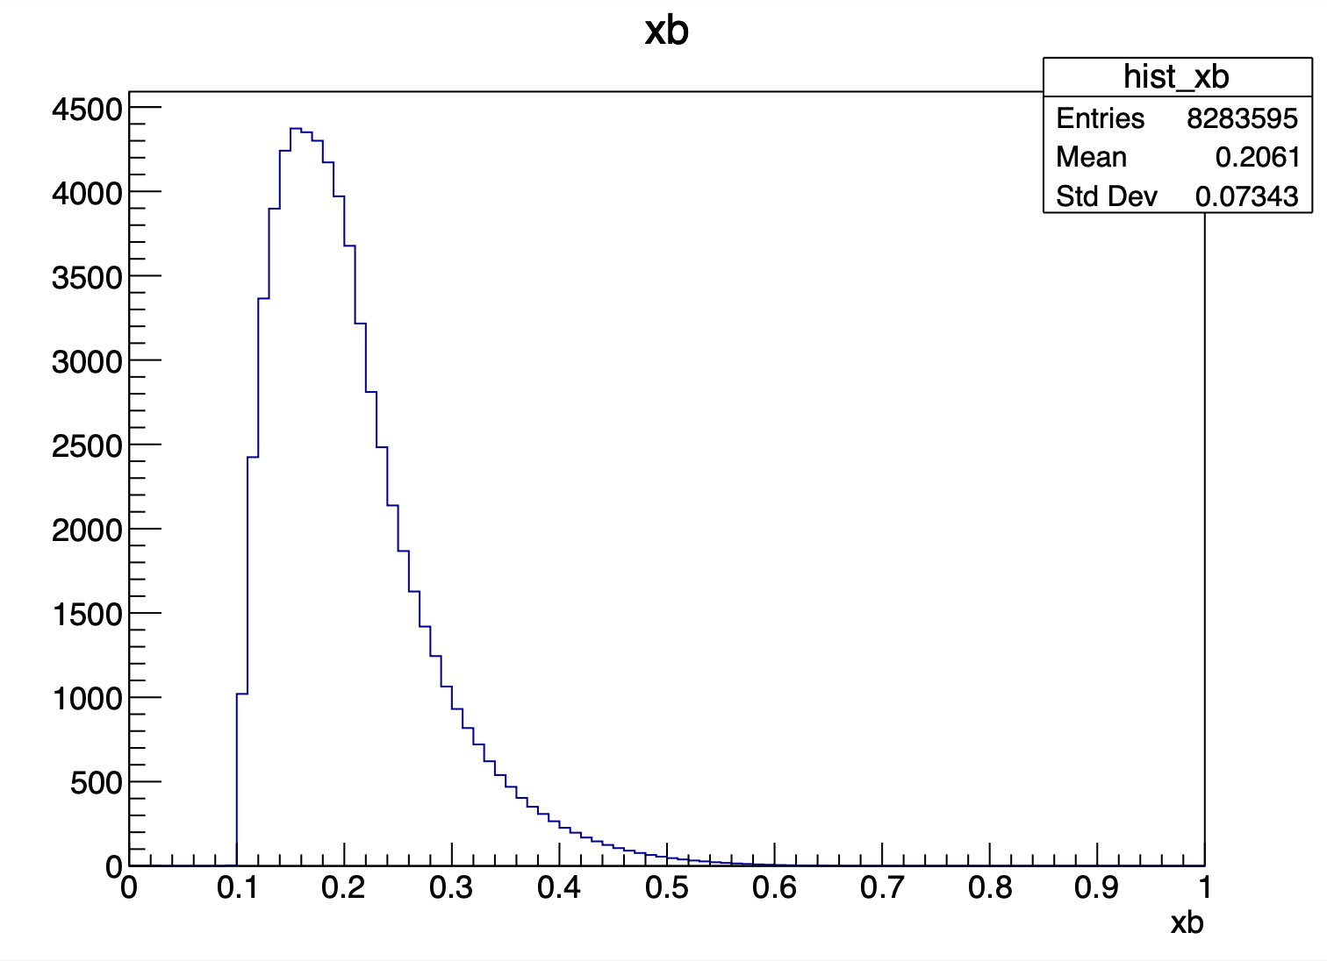
Update on ɸ generator
Mathieu Ronayette
10/18
Mathieu Ronayette
meeting
27 Nov 2025

Slide 38
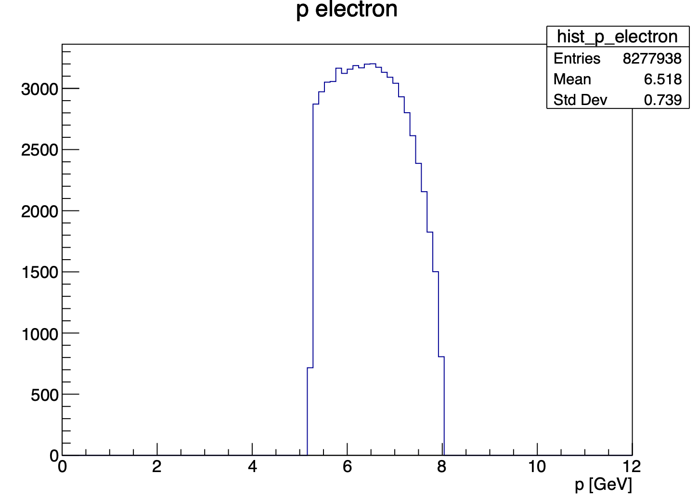
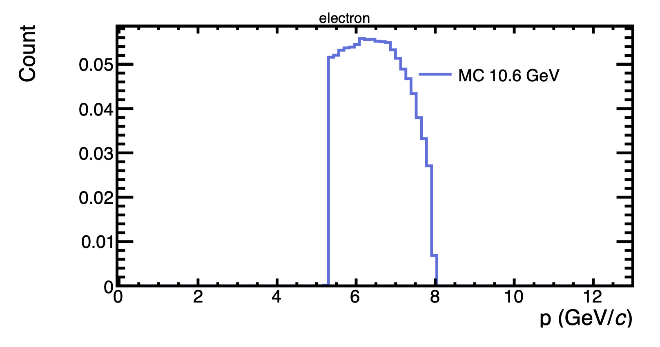
Update on ɸ generator
With this cuts : 5.25 < P_{electron} < 8 GeV and P_{proton} > 0.45 GeV
my generator
Bhawani plot
Mathieu Ronayette
11/18
Mathieu Ronayette
meeting
27 Nov 2025

Slide 39


Update on ɸ generator
With this cuts : 5.25 < P_{electron} < 8 GeV and P_{proton} > 0.45 GeV
my generator
Bhawani plot
Mathieu Ronayette
12/18
Mathieu Ronayette
meeting
27 Nov 2025

Slide 40


Update on ɸ generator
With this cuts : 5.25 < P_{electron} < 8 GeV and P_{proton} > 0.45 GeV
my generator
Bhawani plot
Mathieu Ronayette
13/18
Mathieu Ronayette
meeting
27 Nov 2025

Slide 41


Update on ɸ generator
With this cuts : 5.25 < P_{electron} < 8 GeV and P_{proton} > 0.45 GeV
my generator
Bhawani plot
Mathieu Ronayette
14/18
Mathieu Ronayette
meeting
27 Nov 2025

Slide 42


Update on ɸ generator
With this cuts : 5.25 < P_{electron} < 8 GeV and P_{proton} > 0.45 GeV
my generator
Bhawani plot
Mathieu Ronayette
15/18
Mathieu Ronayette
meeting
27 Nov 2025

Slide 43


Update on ɸ generator
With this cuts : 5.25 < P_{electron} < 8 GeV and P_{proton} > 0.45 GeV
my generator
Bhawani plot
Mathieu Ronayette
16/18
Mathieu Ronayette
meeting
27 Nov 2025

Slide 44


Update on ɸ generator
With this cuts : 5.25 < P_{electron} < 8 GeV and P_{proton} > 0.45 GeV
my generator
Bhawani plot
Mathieu Ronayette
17/18
Mathieu Ronayette
meeting
27 Nov 2025

Slide 45
Update on ɸ generator
Backup cross section
Mathieu Ronayette
18/18
Mathieu Ronayette
meeting
27 Nov 2025

Slide 46





Update on ɸ generator
Details on cross section :
σ_{T} and σ_{L} (γ*p → ɸ p) :
t-dependence (dipole) :
Mathieu Ronayette
5/15
Mathieu Ronayette
meeting
7 Nov 2025

Slide 47


Update on ɸ generator
Cross section (ep → ɸ p) :
The virtual photon flux :
Mathieu Ronayette
6/15
Mathieu Ronayette
meeting
7 Nov 2025

Slide 48


Update on ɸ generator
Implemented in the generator
From Proposal to Jeﬀerson Lab PAC39
Mathieu Ronayette
7/15
Mathieu Ronayette
meeting
7 Nov 2025

Slide 49


Update on ɸ generator
Implemented in the generator
From Proposal to Jeﬀerson Lab PAC39
Mathieu Ronayette
8/15
Mathieu Ronayette
meeting
7 Nov 2025

Slide 50


Update on ɸ generator
Implemented in the generator
From Proposal to Jeﬀerson Lab PAC39
Mathieu Ronayette
9/15
Mathieu Ronayette
meeting
7 Nov 2025

Slide 51


Update on ɸ generator
Implemented in the generator
From Proposal to Jeﬀerson Lab PAC39
Mathieu Ronayette
10/15
Mathieu Ronayette
meeting
7 Nov 2025

Slide 52

Update on ɸ generator
Cross section (ep → ɸ p) (with the virtual photon flux) :
Implemented in the generator
Mathieu Ronayette
11/15
Mathieu Ronayette
meeting
7 Nov 2025

Slide 53
Update on ɸ generator
Backup other plots
Mathieu Ronayette
18/18
Mathieu Ronayette
meeting
27 Nov 2025

Slide 54

Update on ɸ generator
Mathieu Ronayette
18/18
Mathieu Ronayette
meeting
27 Nov 2025

Slide 55

Update on ɸ generator
Test meson w
with cut on MM at the mass of pi0
Mathieu Ronayette
18/18
Mathieu Ronayette
meeting
27 Nov 2025

Slide 56

Update on ɸ generator
Mathieu Ronayette
18/18
Mathieu Ronayette
meeting
27 Nov 2025

