Slide 1
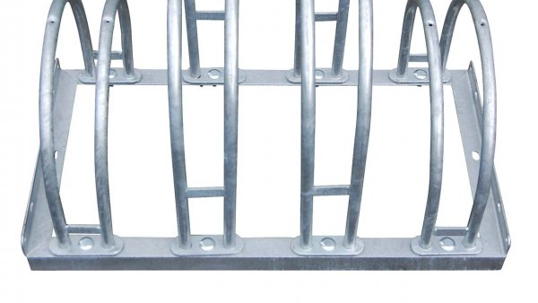
Smike
Smart bike

