Slide 1
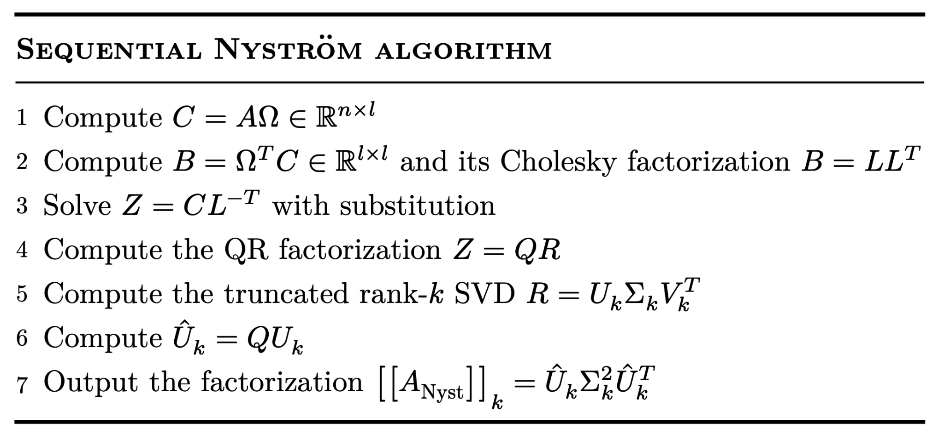
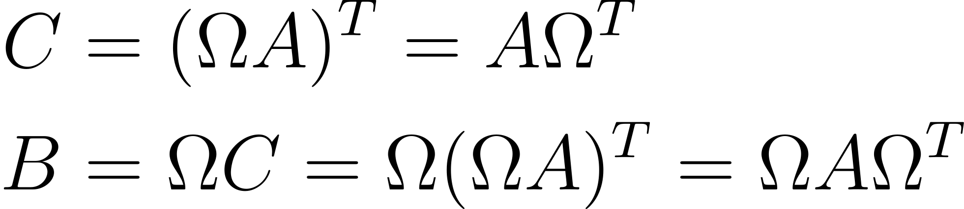
Randomized Nyström Algorithm for Rank-k Approximation
C : Locally on every P + sum_reduce on rows
B : Locally for P on the 1st row + sum_reduce on columns Cholesky: on root P + broadcast to 1st row
Z and TSQR : Locally for P on 1st row
SVD of R: On root P + broadcast to 1st row
Û: Locally for P on 1st row
Ω₁A₁₁ | Ω₁A₁₂ | Ω₁A₁₃
Ω₂A₂₁ | Ω₂A₂₂ | Ω₂A₂₃
Ω₃A₃₁ | Ω₃A₃₂ | Ω₃A₃₃
C₁^{T} | C₂^{T} | C₃^{T}
Ω₁C₁ | Ω₂C₂ | Ω₃C₃
B
L | L | L
L
Z₁ | Z₂ | Z₃
Q₁R | Q₂ | Q₃
U_{k}Σ_{k}
U_{k}Σ_{k} | U_{k} | U_{k}
Û_{k1}Σ_{k} | Û_{k2} | Û_{k3}
Choices for Ω:
Gaussian
SRHT
P₁ | P₂ | P₃
P₄ | P₅ | P₆
P₇ | P₈ | P₉
P₁ | P₂ | P₃
P₄ | P₅ | P₆
P₇ | P₈ | P₉
P₁ | P₂ | P₃
P₄ | P₅ | P₆
P₇ | P₈ | P₉
P₁ | P₂ | P₃
P₄ | P₅ | P₆
P₇ | P₈ | P₉
P₁ | P₂ | P₃
P₄ | P₅ | P₆
P₇ | P₈ | P₉
P₁ | P₂ | P₃
P₄ | P₅ | P₆
P₇ | P₈ | P₉
P₁ | P₂ | P₃
P₄ | P₅ | P₆
P₇ | P₈ | P₉

Slide 2
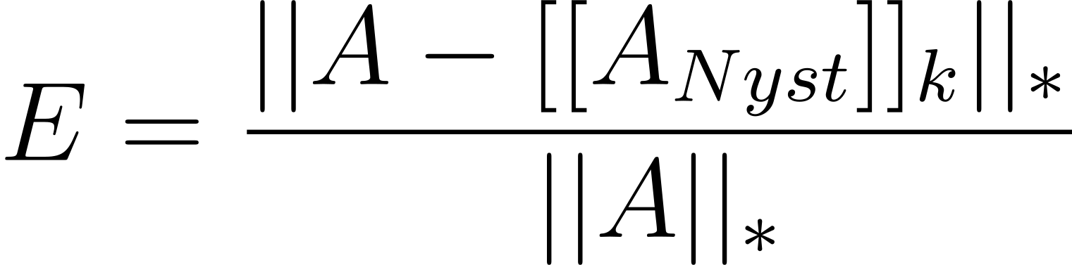
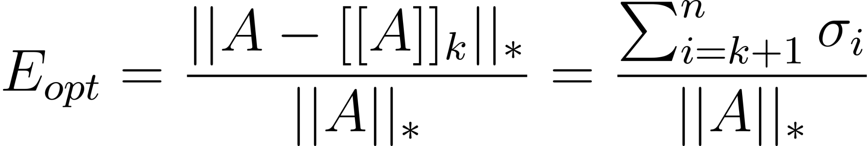
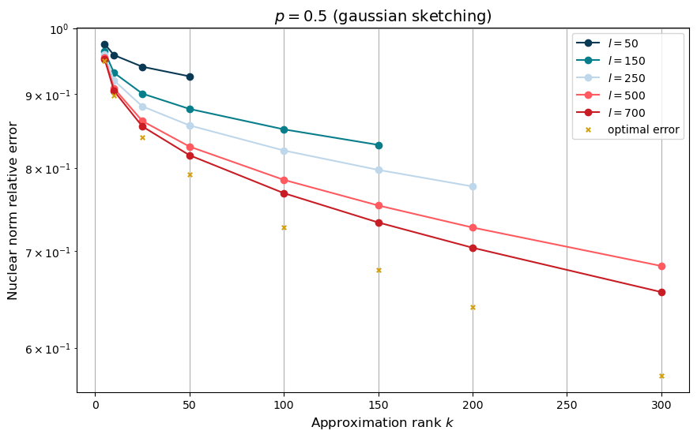
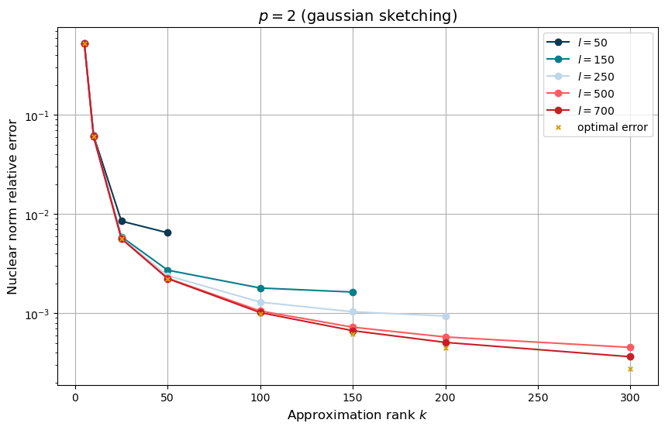
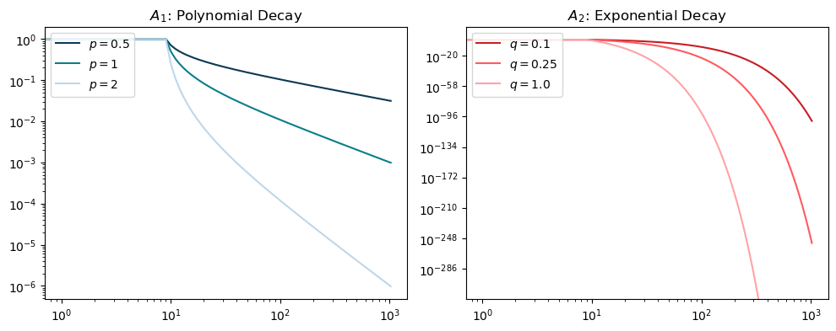
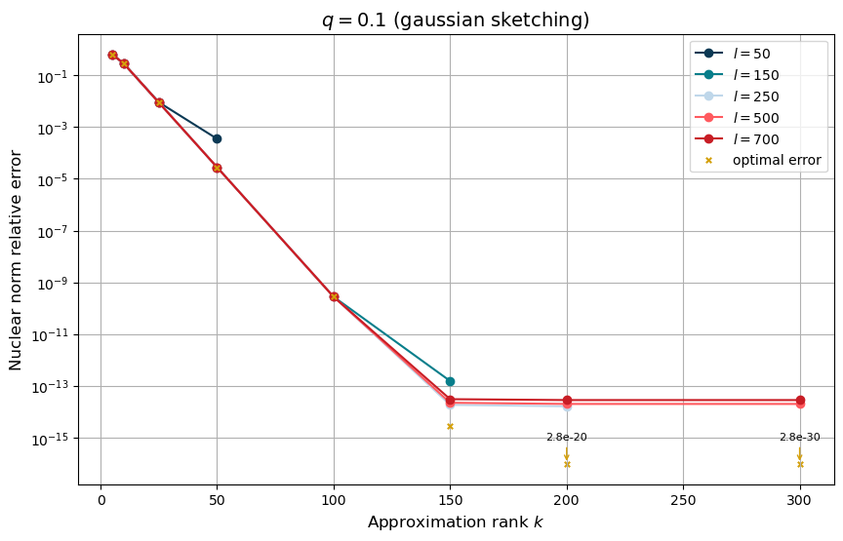
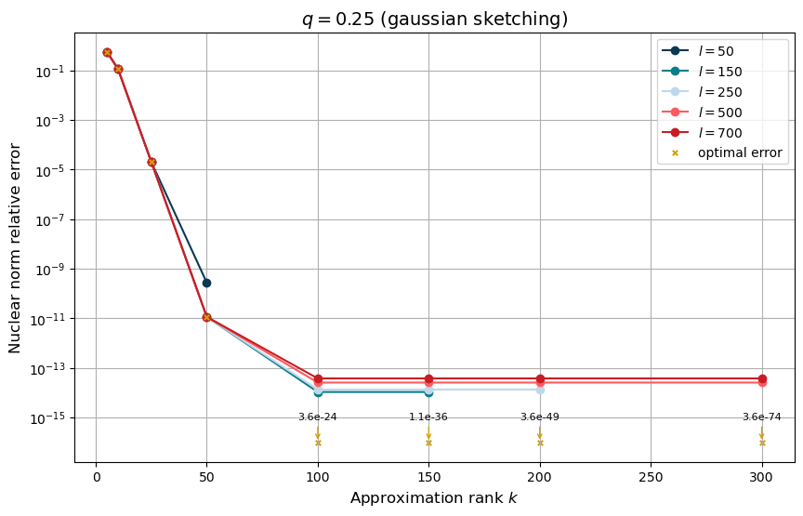
Stability Analysis

Slide 3
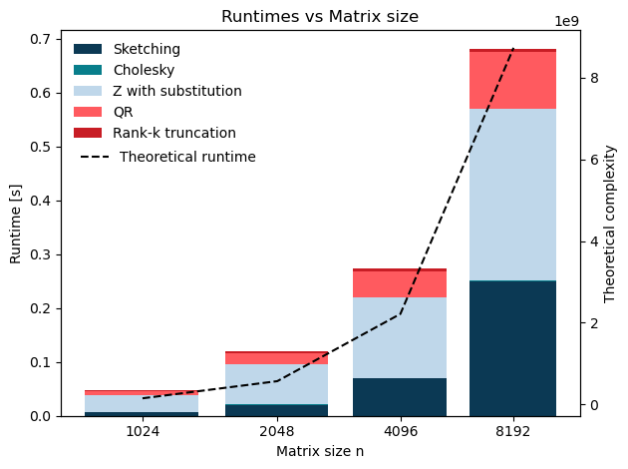
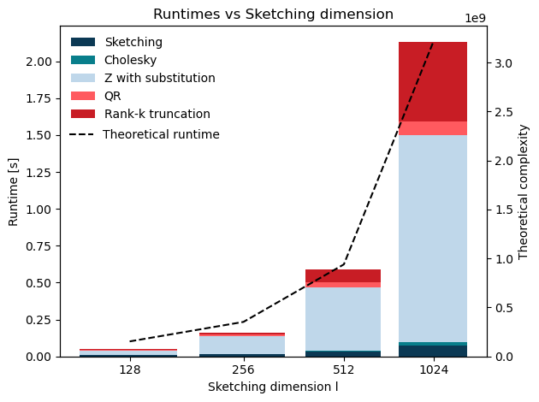
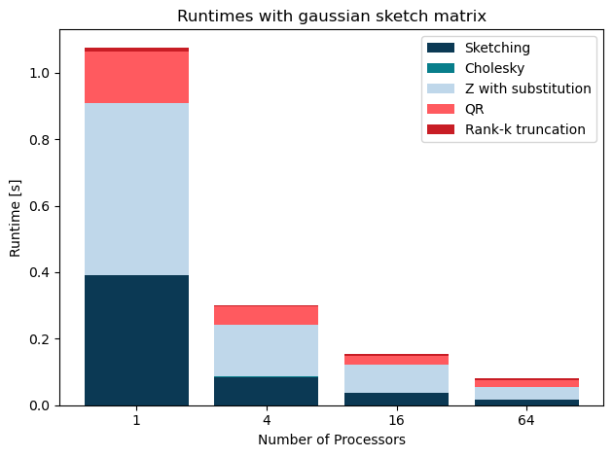
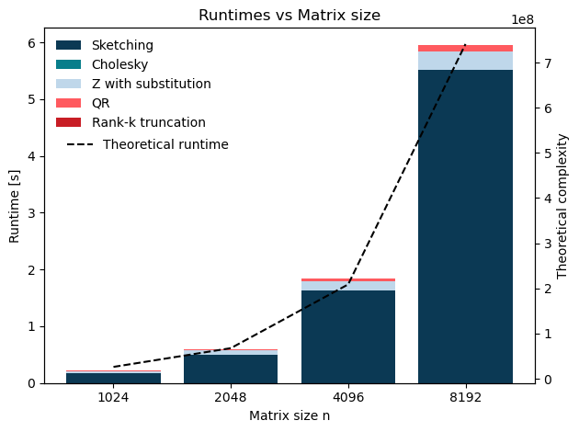
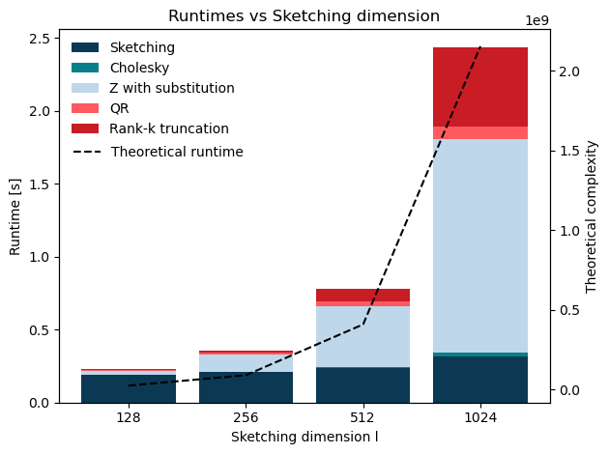
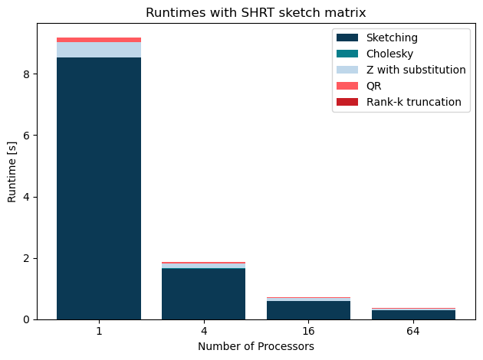
Sequential and Parallel Runtimes
 | Sequential Algo | Runtime VS n | Sequential Algo | Runtime VS l | Parallel Algo | Runtime VS P
Gaussian sketching
SRHT sketching

