Slide 1
A French-English translation machine

Slide 2
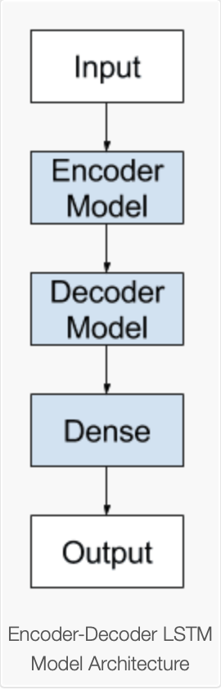
The project
Goal: translate sentences from French to English
Dataset: a text file of sentences in both languages
Algorithm:
Use of Keras Sequential() class to add multiple layers to the network
Sequence to sequence (seq2seq) model with encoder-decoder architecture
Encoder and decoder are a special kind of Recurrent Neural Network (RNN) : Long-Short Term Memory (LSTM) RNN

Slide 3
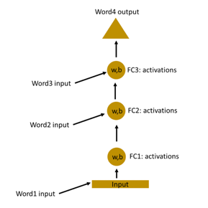
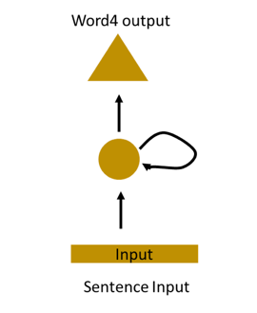
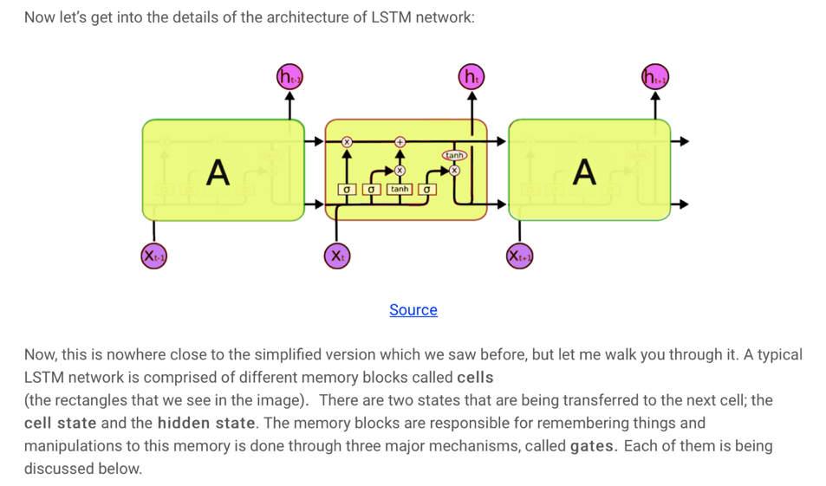
RNN and LSTM
RNN (Recurrent Neural Networks) LSTM (Long-Short Term Memory Networks)

Slide 4
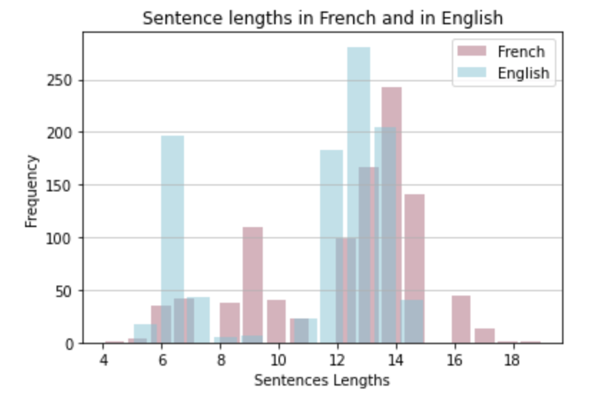


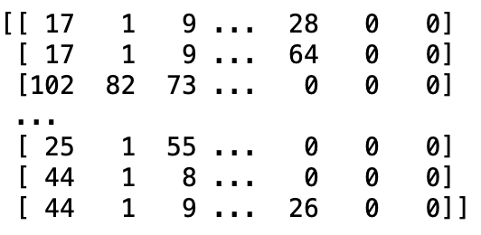
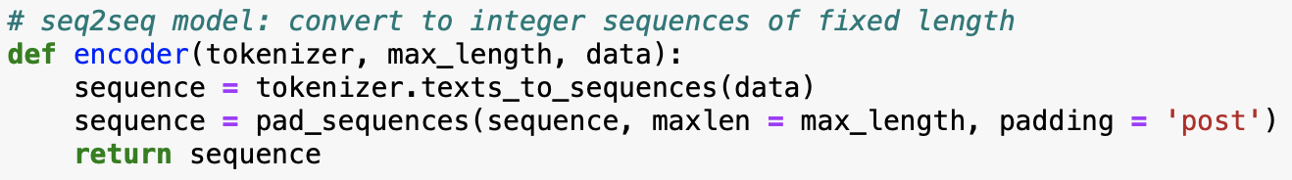
1) preprocessing
1) Read data and store it in an array
2) Remove punctuation & Convert the text to lowercase
3) Get the maximum sentence length in both languages
4) Vectorize the data with Keras Tokenizer Class
5) Encode the sentences

Slide 5
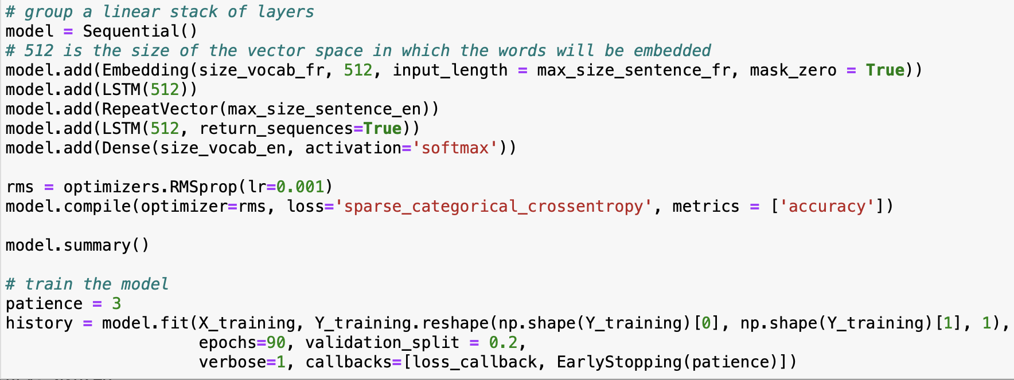
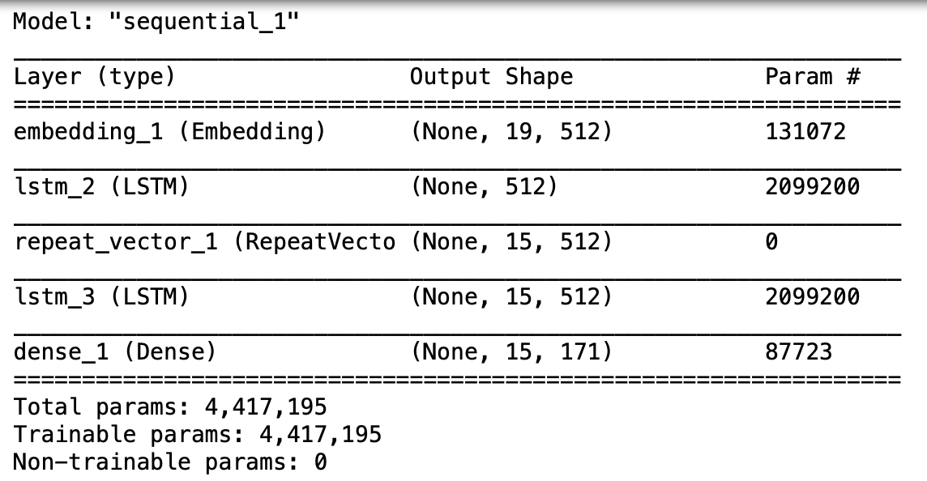
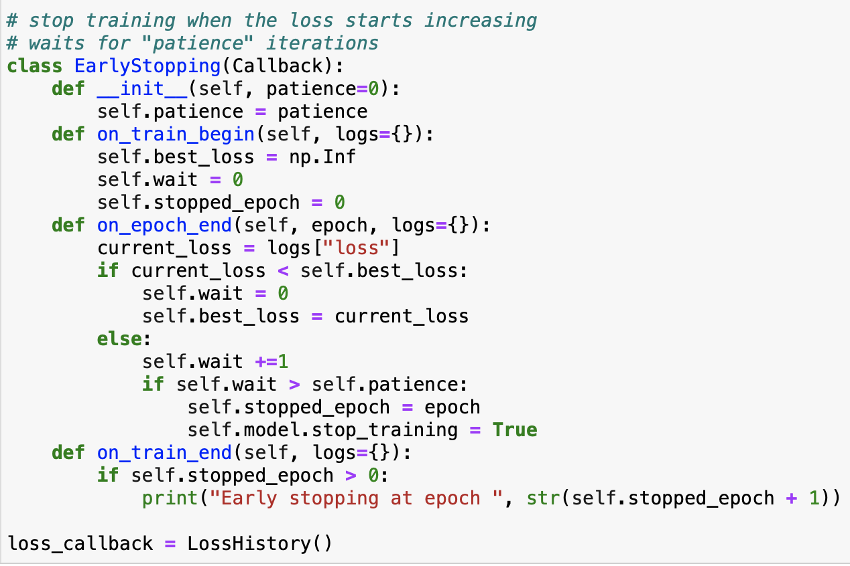
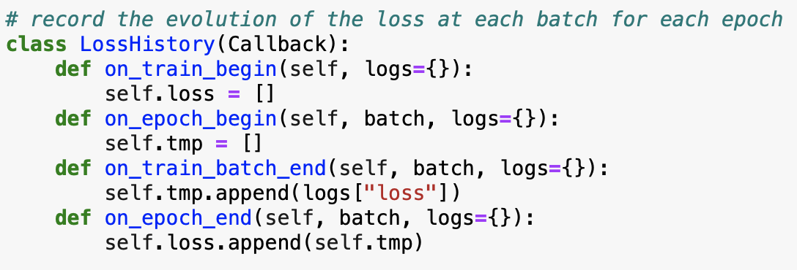

2) training
4 LAYERS
Embedding layer
LSTM layer
LSTM layer
Dense layer

Slide 6
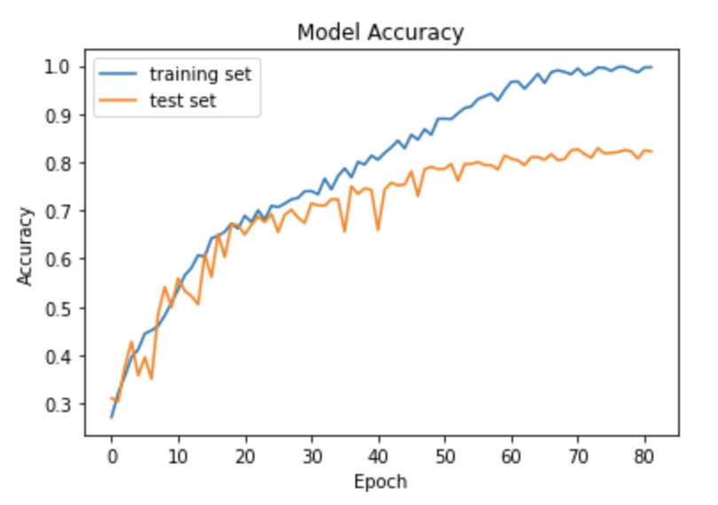
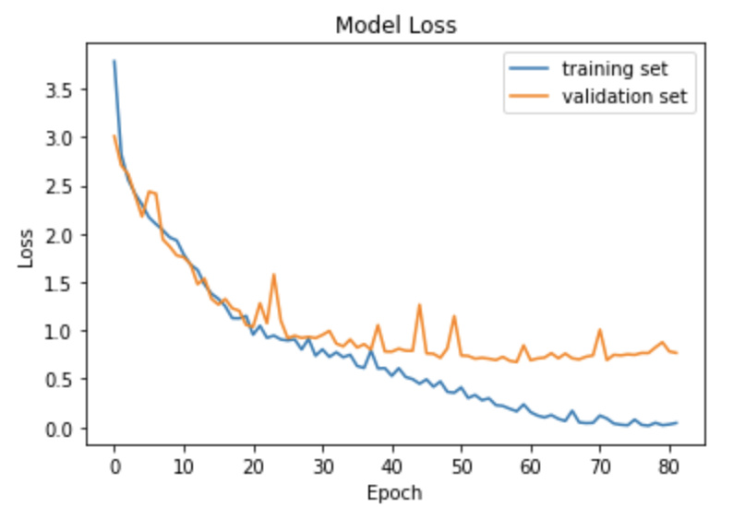
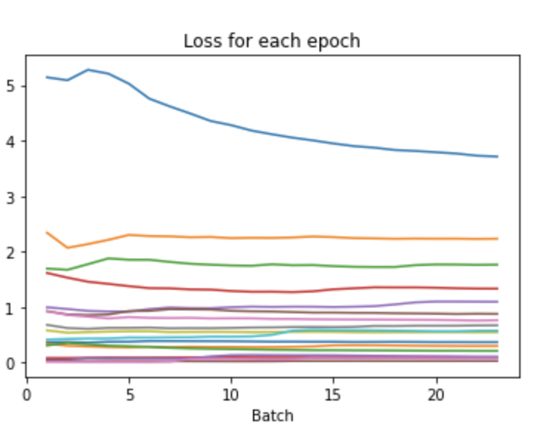
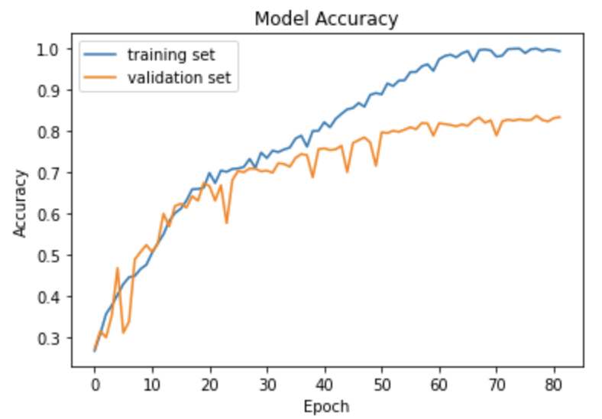
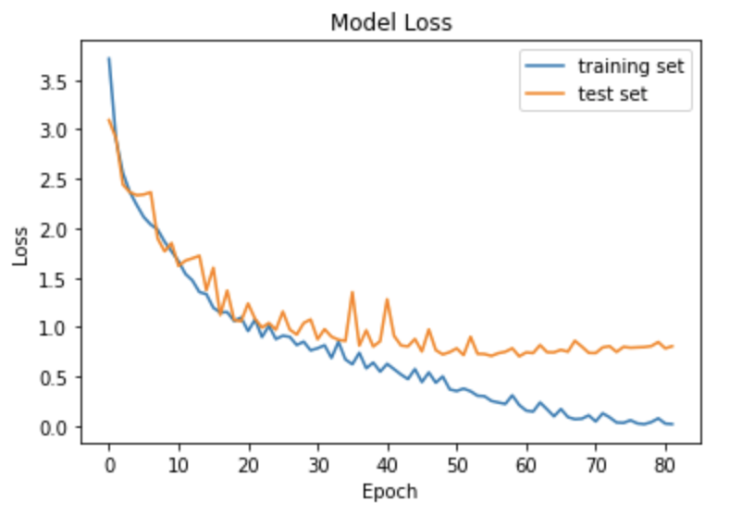
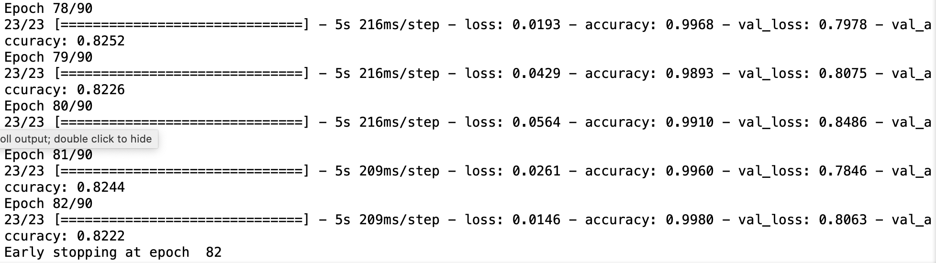
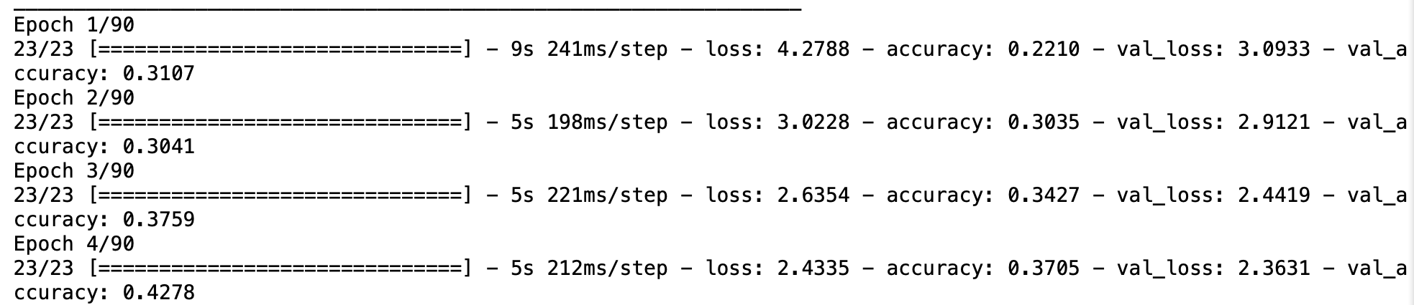

Slide 7
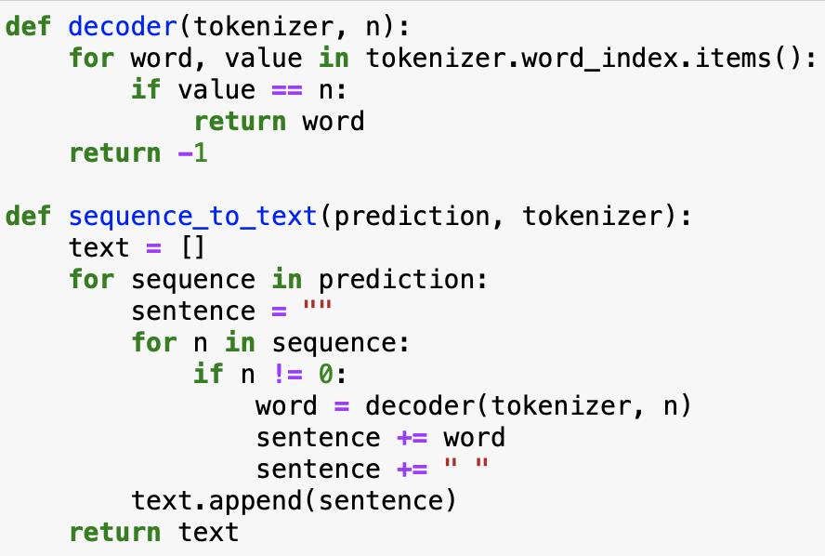
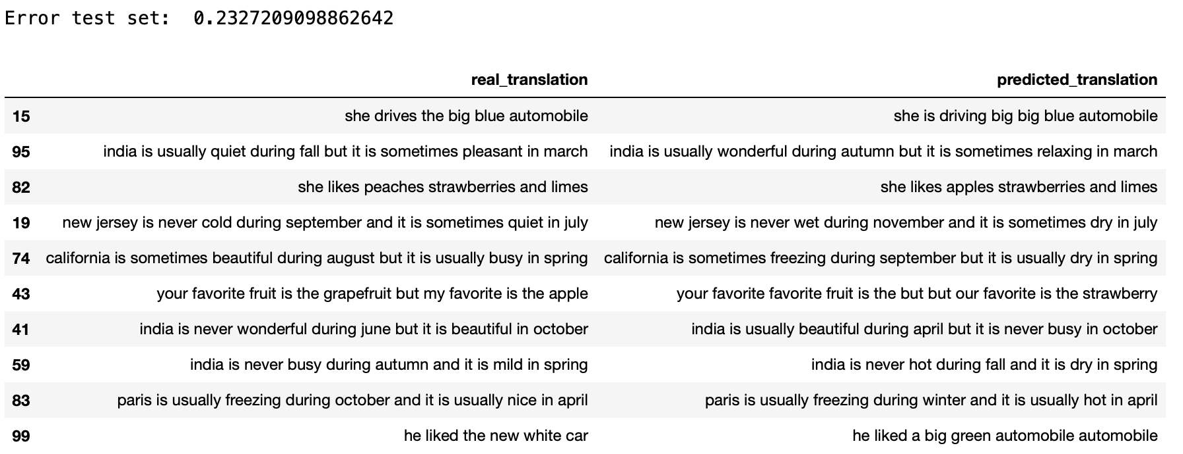
3) Testing & evaluating accuracy

Slide 8
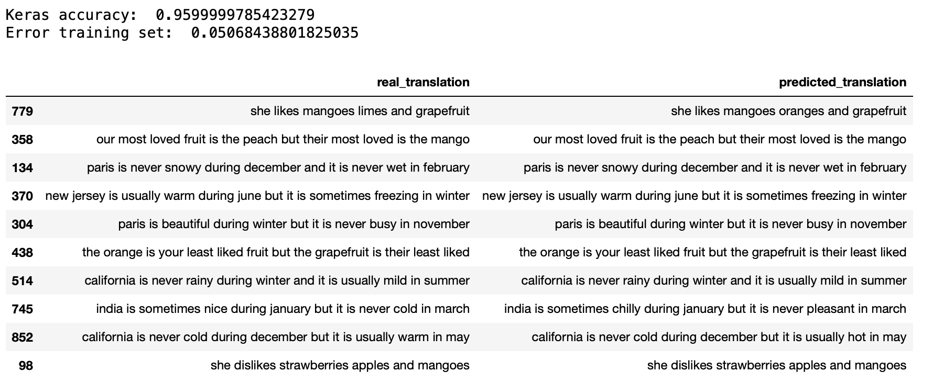
evaluating accuracy on the training set

Slide 9
Further improvement
Test the model with other datasets (shorter/longer sentences, more/less diverse)
Add different layers, change the order of layers (we have seen that the loss for the test set did not decrease after a specific number of epochs => a new approach is needed)
Reverse the order of words in the input sequences
Implement functions to add punctuation and Uppercase letters in the predicted sentences

Slide 10
Bibliograhpy
Neural Networks and Deep Learning (textbook), Charu C. Aggarwal, Springer (2018)
“A Must-Read NLP Tutorial on Neural Machine Translation – The Technique Powering Google Translate”, Prateek Joshi, Analytics Vidhya (2019) https://www.analyticsvidhya.com/blog/2019/01/neural-machine-translation-keras/
“How to Use Word Embedding Layers for Deep Learning with Keras”, Jason Brownlee, Machine Learning Mastery (2017) https://machinelearningmastery.com/use-word-embedding-layers-deep-learning-keras/
“Essentials of Deep Learning : Introduction to Long Short Term Memory”, Pranjal Srivastava, Analytics Vidhya (2017) https://www.analyticsvidhya.com/blog/2017/12/fundamentals-of-deep-learning-introduction-to-lstm/
“Encoder-Decoder Long Short-Term Memory Networks”, Jason Brownlee, Machine Learning Mastery (2017) https://machinelearningmastery.com/encoder-decoder-long-short-term-memory-networks/
“Understanding LSTM Networks”, Colah’s blog (2015) http://colah.github.io/posts/2015-08-Understanding-LSTMs/
“Natural Language Processing — Neural Machine Translator”, Sophie Zhao, Start It Up (2020) https://medium.com/swlh/nlp-11ff6aeb8259

Slide 11
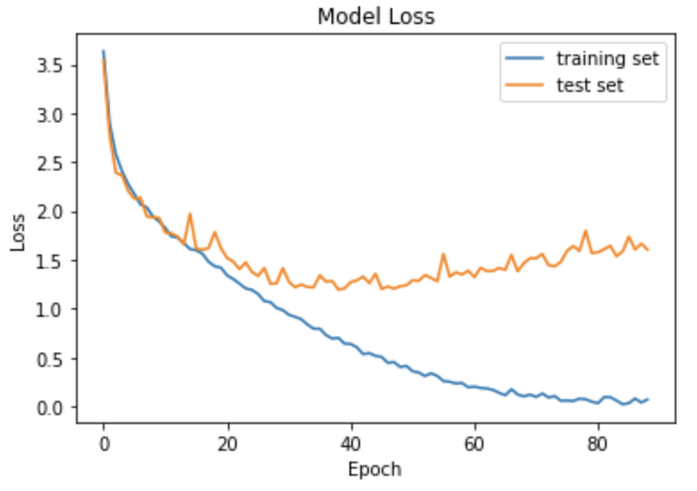
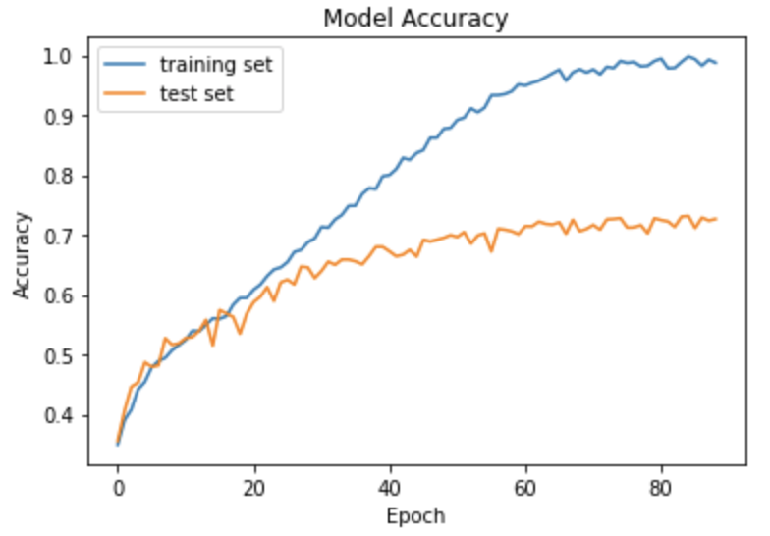
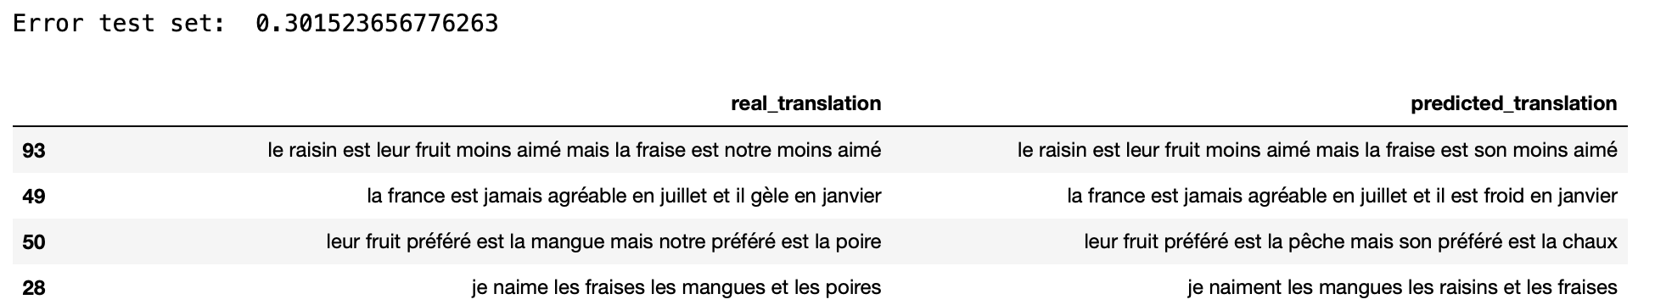
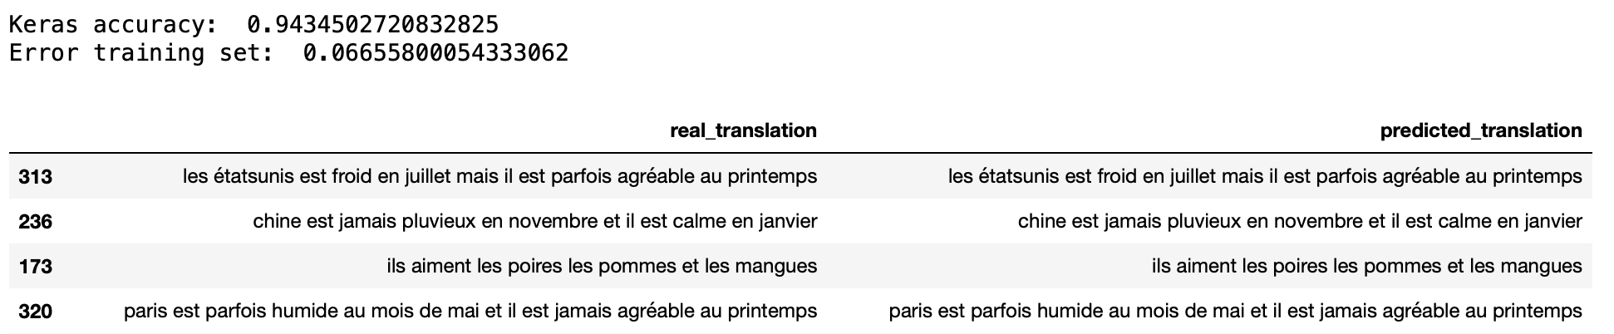
English to French

