Slide 1
Vehicular Network Services

Slide 2
Agenda
ITS Services
  Use cases
  Communication types
  Standardized messages

Slide 3
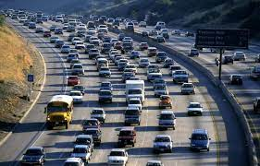
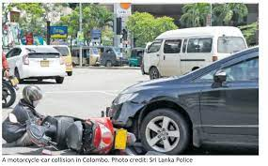
C-ITS Services
Improve safety
Reduce traffic congestion
Enhance user experience
➔ Cooperative Intelligent Transportation Systems (C-ITS)
Road Accident
Traffic Congestion
Point Of Interest

Slide 4
Cooperative-Intelligent Transport Systems
Applications :
  Road Safety, Traffic efficiency, infotainement
Communicating entities:
  Vehicles, pedestrians, cycles, road side units, etc
Access media:
  IEEE 802.11P, 3G/4G/5G and beyond, bluetooth/IR, etc

Slide 5
Communication Types
V2V
V2I
I2V
V2P
V2N
V2C
Source : A Survey of Security and Privacy Issues in V2X Communication Systems

Slide 6
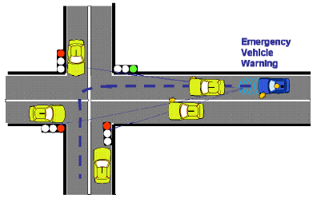
Broadcast Communications
The most used communication mode for safety application
A communicating entity sends messages to all other communicating entities in its communication range
Example : Emergency vehicle warning

Slide 7
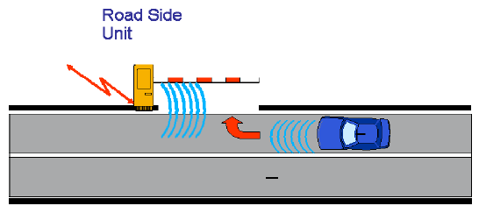
Unicast Communications
A communicating entity sends messages to a specific communication entity
Example : Automatic access control/parking access use case scenario

Slide 8
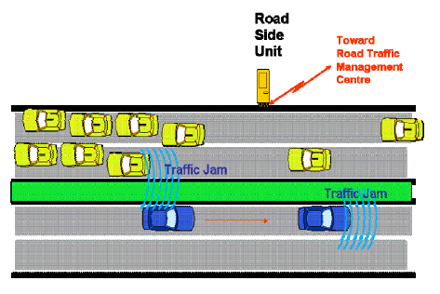
Geocast Communications
A communicating entity broadcasts messages in a specific geographic area
Example : Traffic condition warning
Geographic zone

Slide 9
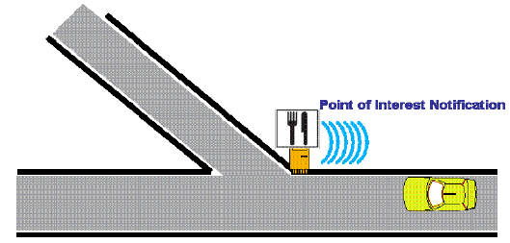
Multicast Communications
A communicating entity sends messages to a group of communicating entities
Example : Point Of Interest Notification

Slide 10
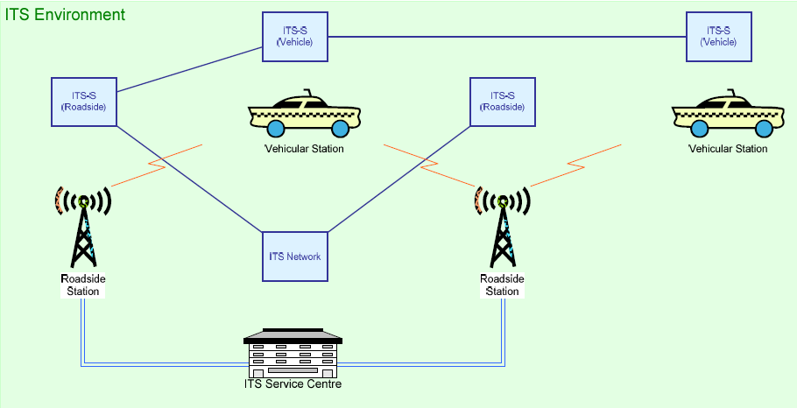
ITS Stations

Slide 11
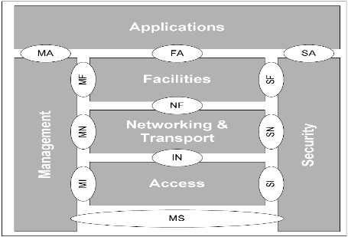
ITS Reference Architecture (ETSI)
Applications
  Road safety, traffic efficiency, and other types
Facilities
  Application support
  Information support
  Communication support
Networking & Transport
  Addressing and packet routing
Access
  Access technologies
Management
  Cross layer management
  Station management
Security
  Security and privacy protection

Slide 12
Examples
Autonomous mobility : Video EVA https://www.irt-systemx.fr/projets/eva/
Collective Perception : Video 5GMobiX https://www.youtube.com/watch?v=l1p2RrZhDoQ&ab_channel=InstitutVEDECOM

Slide 13

Facilities Layer : Support Messages
Examples
CAM Cooperative Awareness Messages
  ITS stations inform each other about their presence : one-hop broadcast
DENM Decentralized Environment Notification Message
  ITS stations send an alert to each other : multi-hop broadcast
CPM Collective Perception Message
  ITS station inform each other about their dynamic perceived objects : one hop broadcast
IVI Infrastructure to Vehicle Information
  Example : 1) Traffic Light Manoeuver to inform vehicle about the state of the traffic light state 2) Road and Lane Topology to inform vehicle avout the road topological map
MCM Manœuvre Coordination Message
  Exchange the manœuvre intention

Slide 14
Case Study : Intersection Movement Assist Service
Use case 1
Use case 2
Use Cases and application flows
Facilities service ?
Communication requirements?
  Network layer ?
  Access layer ?

Slide 15
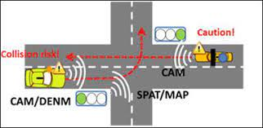
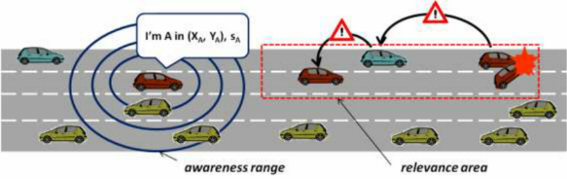
CAM/DENM scenario example
Turning collision risk warning
Source ETSI TS 101 539-2 V1.1.1

Slide 16
CAM Header
ETSI EN 302 637-2 V1.3.1 (2014-09)
stationType
referencePosition
…
Heading
Speed
DriveDirection
Vehiclelength
Vehiclewidth
LongitudinalAcceleration
Curvature
Yawrate
Acellerationcontrol
Lanepositon
Steeringwhellangle
lateralAcceleration
vehirticalAcceleration
performanceClass (max. data age w.r.t generationTime)
cenDsrcTollingZone

Slide 17
Practical case
Use Wireshark to visualize the traces
  etsi-its-cam-unsecured.pcapng
Notes:
C:\Users\ines.ben-jemaa\Documents\TAM\Livrables\L5.1\TracesRoulage25052023Corrigees_2023-06-14\Session du 2023-05-25 corrigée\2023-05-25-14_48_44_EF_bundle

Slide 18
DENM Header
ETSI EN 302 637-3 V1.2.1 (2014-09)
actionID
detectionTime (event detection time)
referenceTime (msg gen. time)
termination (indicates the termination of the event)
eventPosition
relevanceDistance
relevanceTrafficDirection
validityDuration
transmissionInterval
stationType
…
informationQuality
eventyType
linkedCause
eventHistory (the list of positions that the event has been detected prior to the current event position)
…

Slide 19
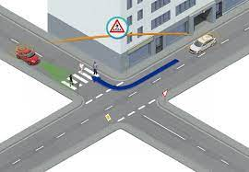
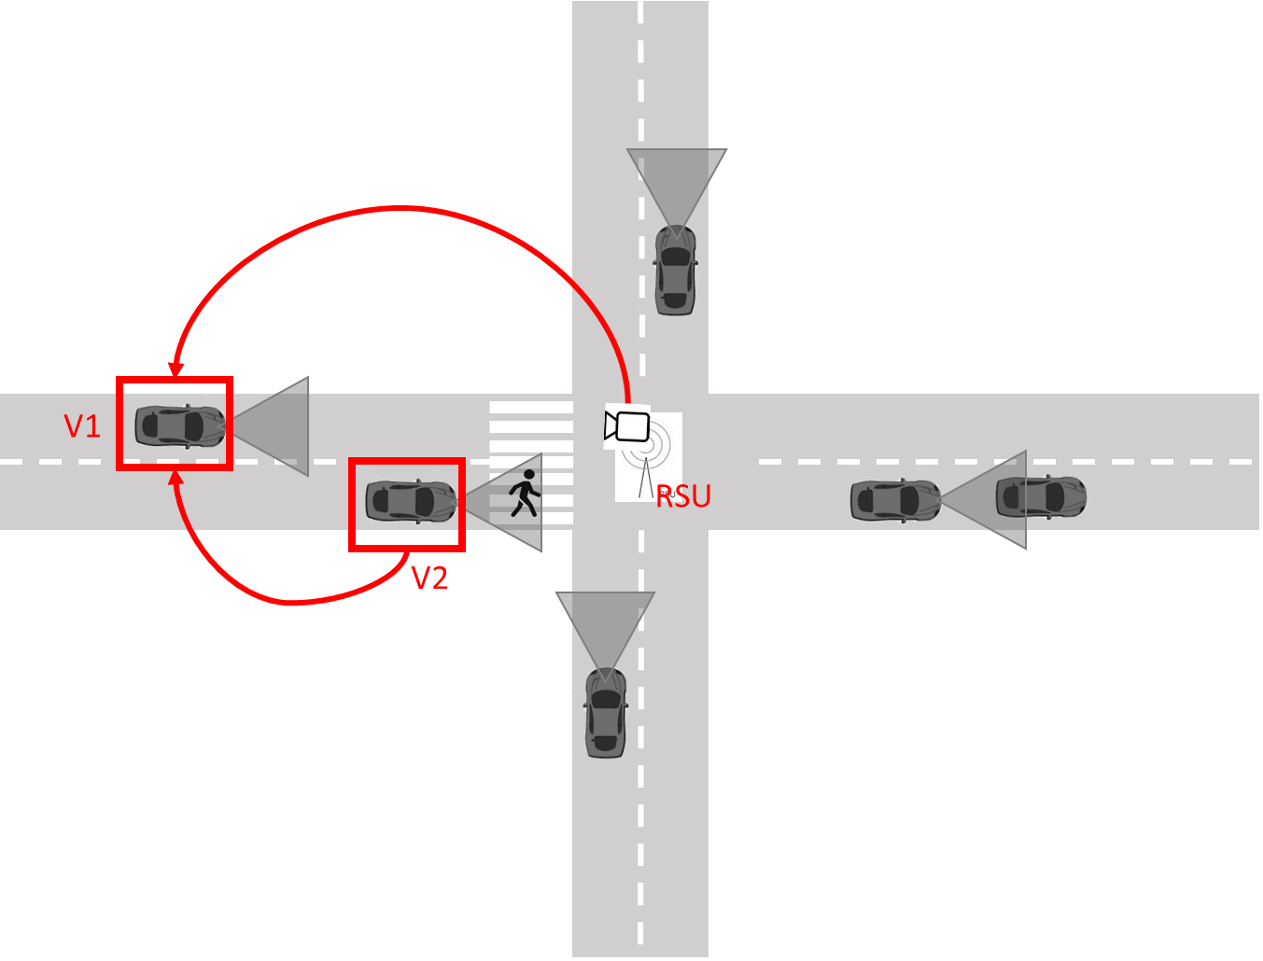
CPM scenario example
Inform vehicle drivers about Vulnerable road users (Pedestrians) in intersections with obstacles
Example https://www.youtube.com/watch?v=l1p2RrZhDoQ&ab_channel=InstitutVEDECOM

Slide 20
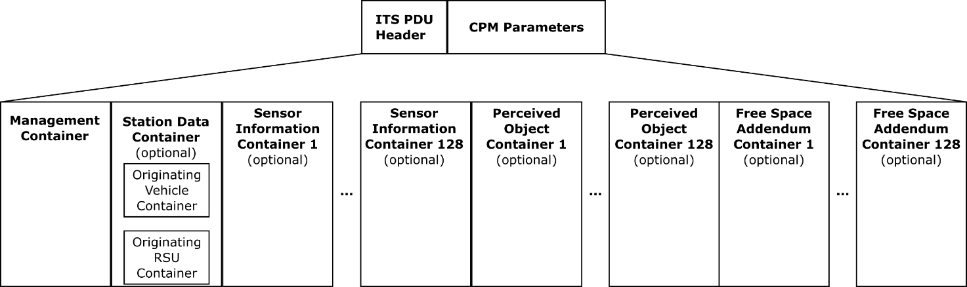
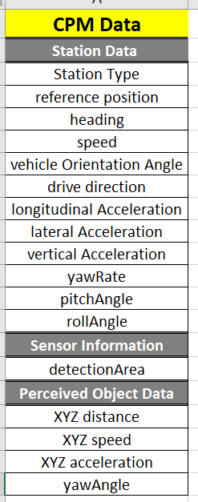
CPM Header
A simplified version
ETSI Standard ETSI TR 103 562 Analysis of the Collective Perception Service

Slide 21
ASN1 Format
See it directly in Vanetza implementation : Software implementation of the ETSI stack
  https://github.com/riebl/vanetza

Slide 22
Simulation of CAM/CPM
https://github.com/riebl/artery/tree/master/src/artery

Slide 23
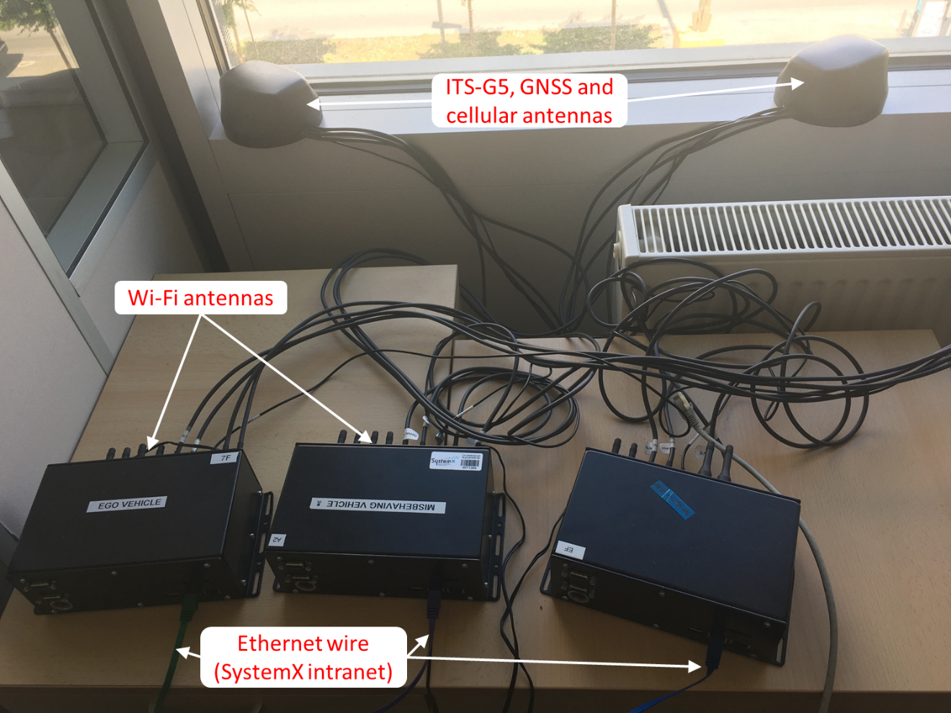
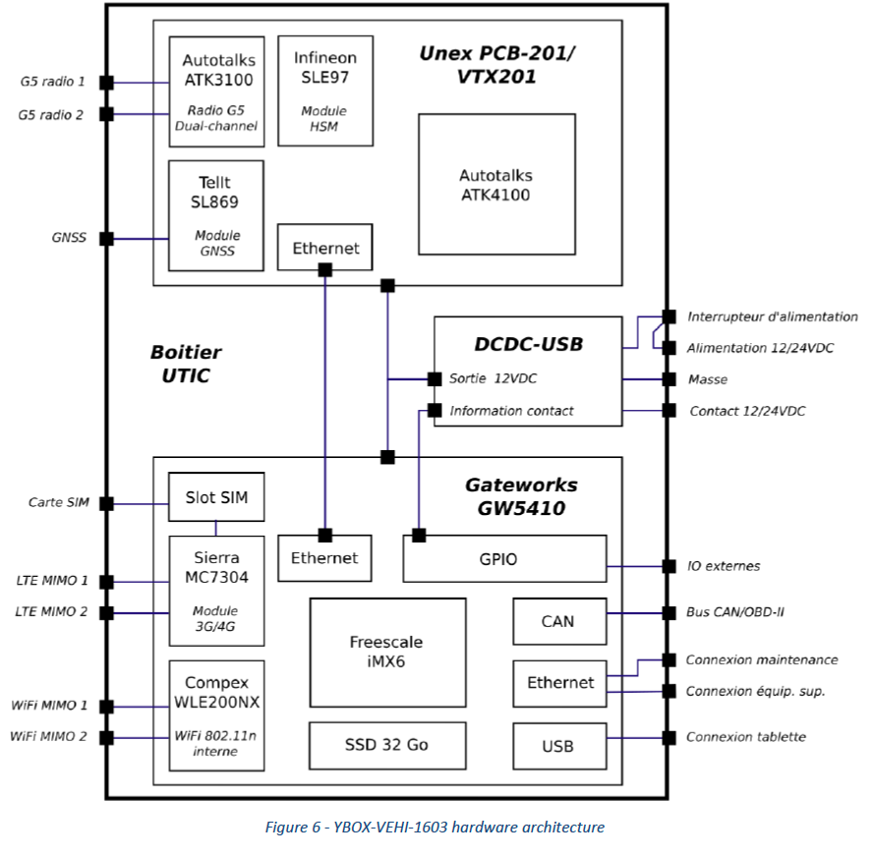
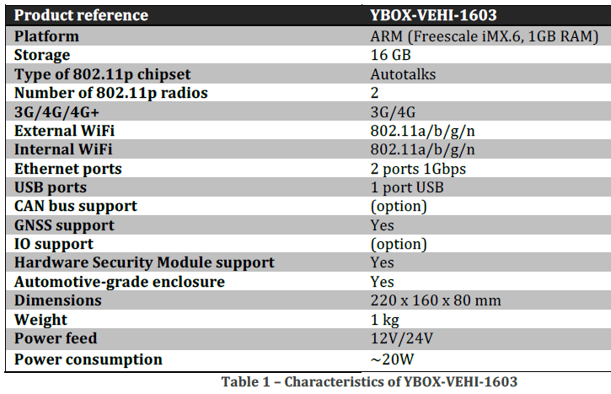

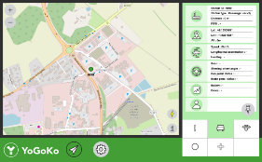
Experimental Platform Example: On Board Unit (OBU) and tablet app
YoGoKo OBU
  ITS G5 stack, GNSS antenna, V2X antennas, Eth, 4G…
  modulation / demodulation, construction of V2X messages, relay of messages, construction of log files
  security and plausibility checks of all in-coming messages (MBD)
  Sending of MR
23

Slide 24

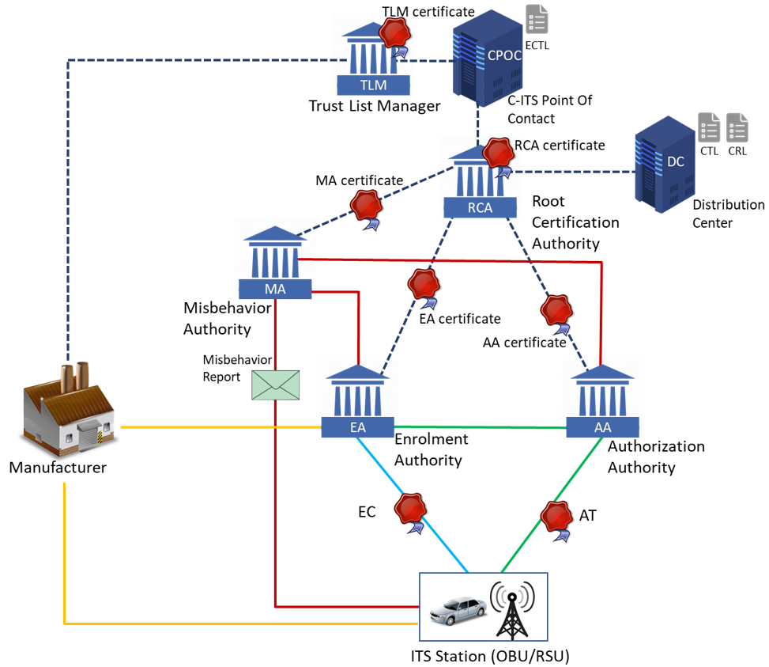


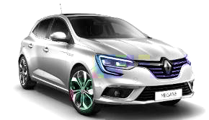


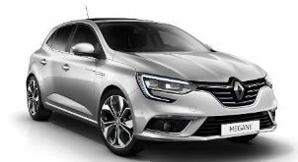
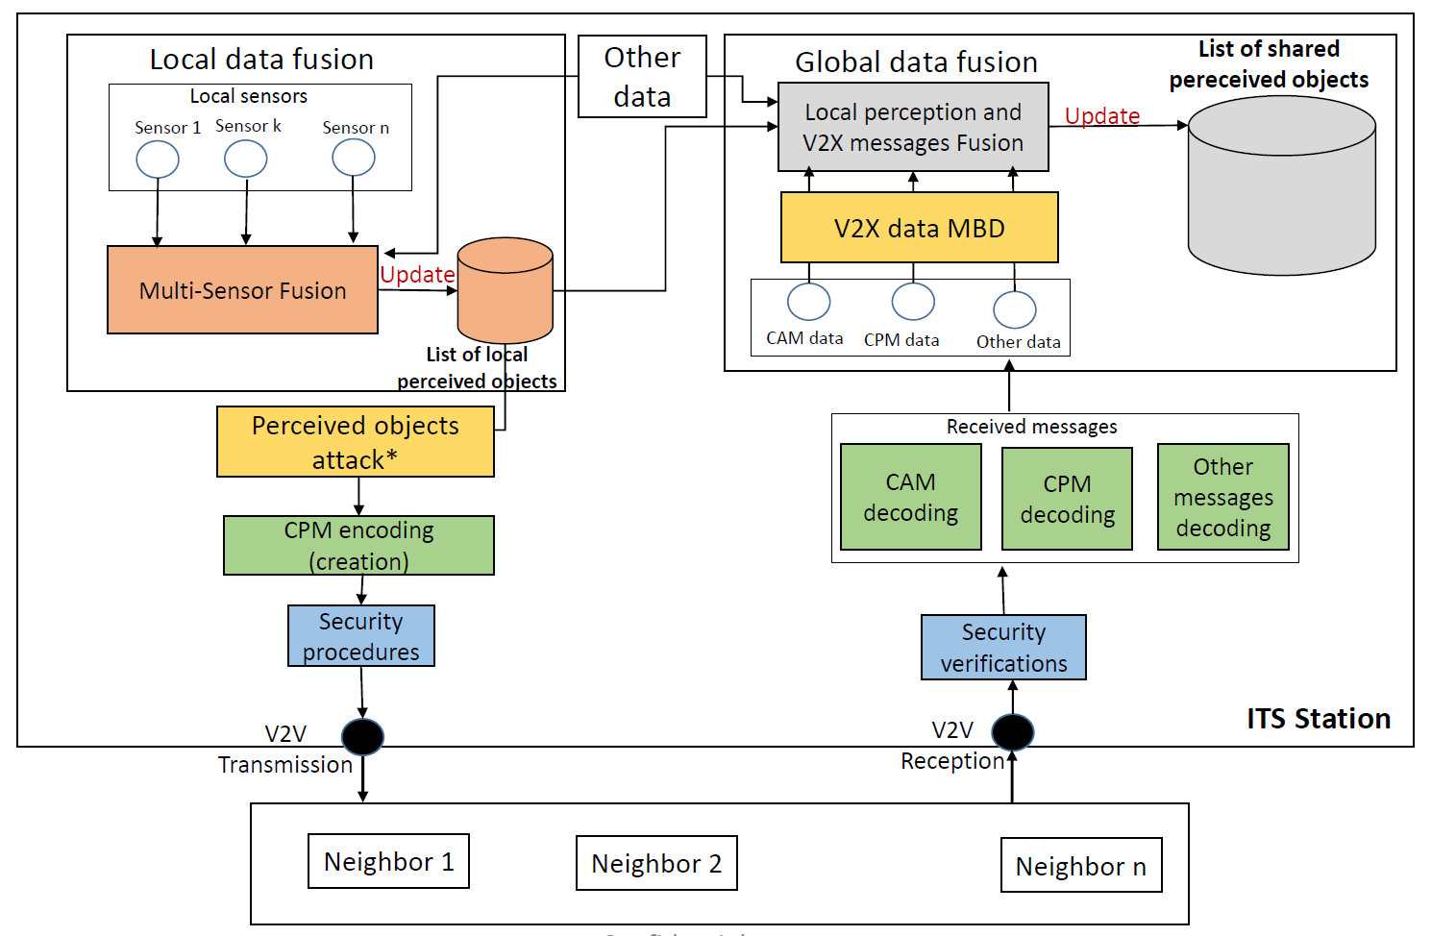


Test setup
Reporter
Attacker
  An attacker runs the attack routine
  A reporter runs the MBD framework
24

Slide 25
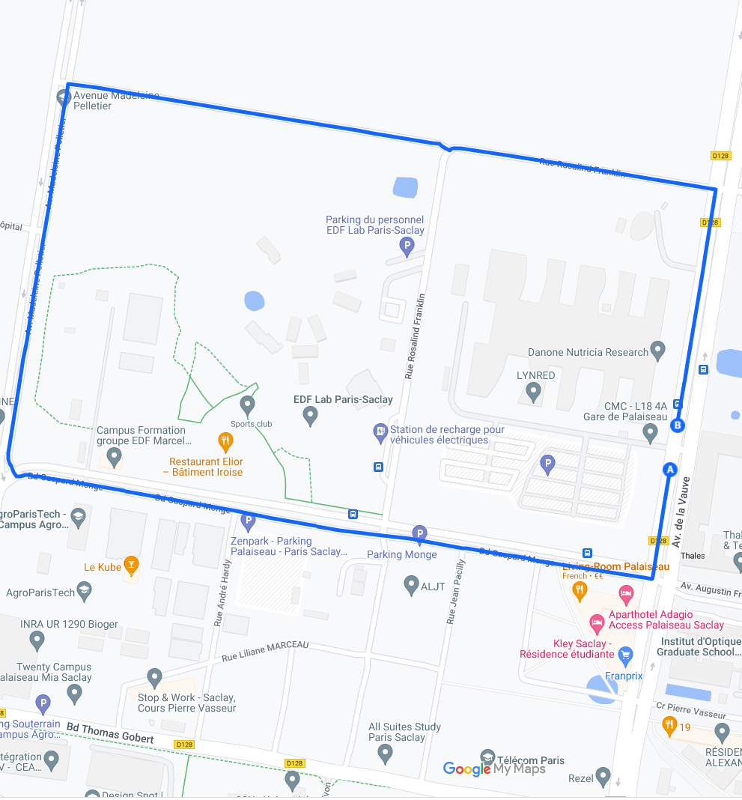
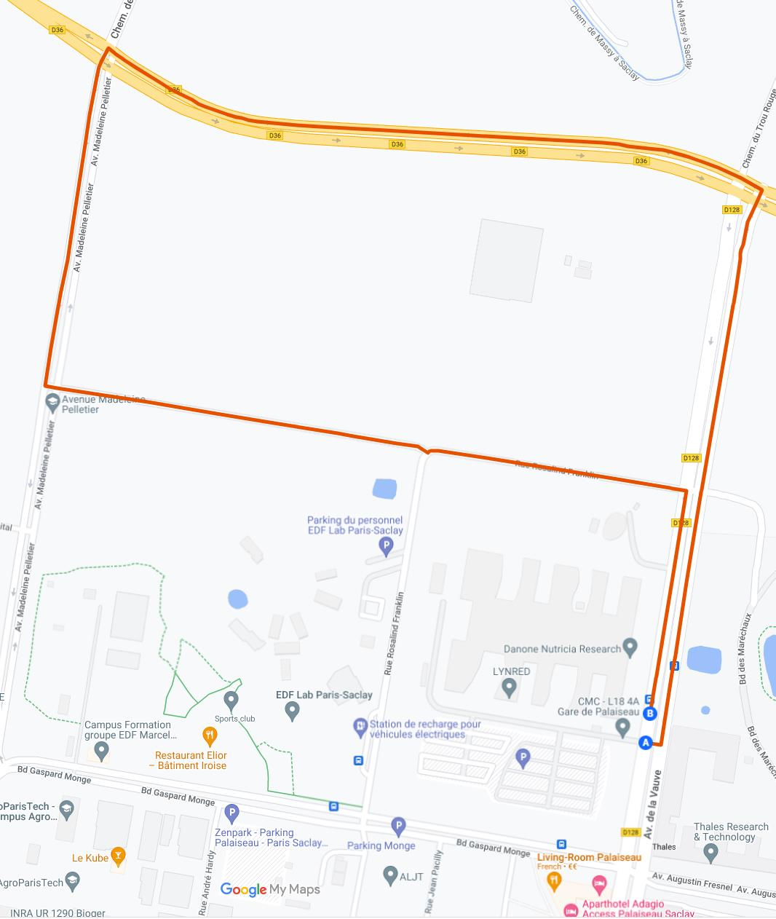
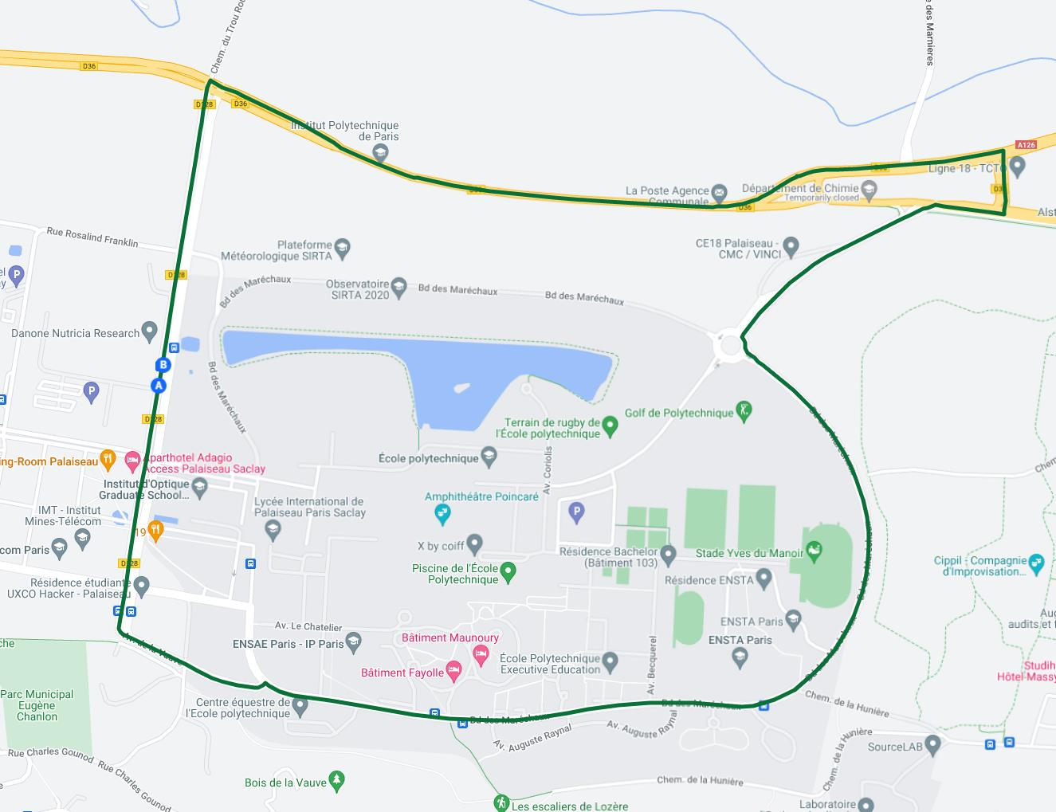
On-road test: test sites
Test drive 1 (small)
Test drive 2 (medium)
Test drive 3 (large)
Urban only - 2,2 km
Urban/road mix - 3,2 km
Urban/road mix - 5,8 km
25
Notes:
Les résultats de detecteurs legacycheck sont bien binaires.
Changer
25

