Slide 1
Wireless Networks
Ines Ben Jemaa
Research Engineer IRT-SystemX

Slide 2
Agenda
PART 1 : Wireless Networks
  Context
  Types
  Architectures
  The 802.11 standard
  The cellular networks
PART 2 : V2X Access Technologies
  Overview
  The 802.11P standard
  The Cellular V2X

Slide 3
Agenda
PART 3 : V2X services
  Context
  Types
  Examples
PART 4 : V2X Security
  PKI
  Misbehavior Detection
  Privacy
PART 5 : Practical examples
  Simulation Platform
  Examples

Slide 4
Part 1 : Wireless Networks: Architecture, Protocols, Examples
Ines Ben Jemaa
Research Engineer IRT-SystemX

Slide 5
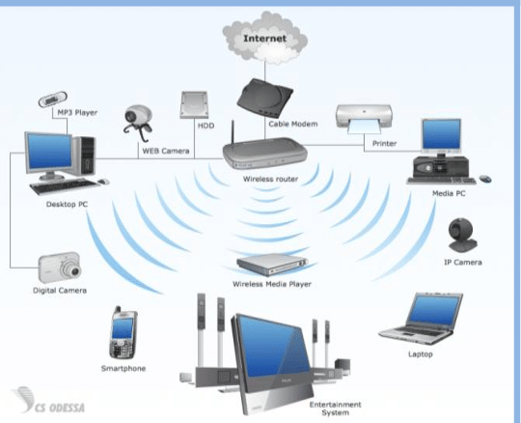
Introduction
Wireless networks are networks that use radio waves to connect devices, without the necessity of using cables of any kind
  Example : Portable computers, desktop computers, hand-held computers, personal digital assistants (PDAs), cellular phones

Slide 6
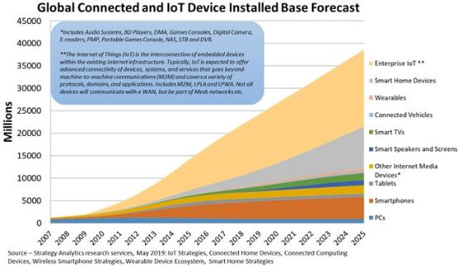
Context
Growth of wireless devices
New/smart services
Need for mobility
The « everywhere » network

Slide 7
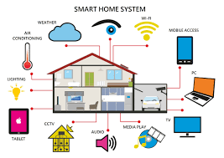
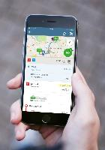

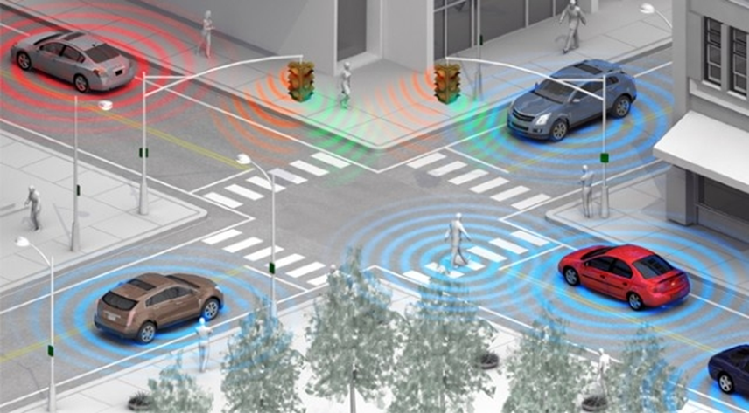
“Smart” Services Examples
Public transit mapping
ZebraNet: Tracking animals location and resources
Cooperative Intelligent Transport Systems

Slide 8
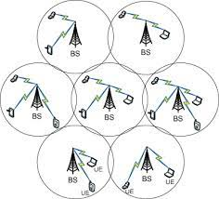

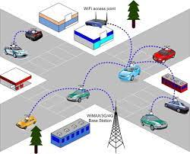
Several Wireless Networks
Internet or satellite
Sink
User
Sensors
Cellular Networks
Wireless Sensor Networks
Vehicular Networks

Slide 9
Benefits:
  Mobility and nomadism
  Easy installation
    No heavy infrastructure
    temporary installation
  Flexible topology
  Cost
  Interconnection of local networks
  Reliability
Limits:
  Bandwidth
  Interference
  Coverage
  Regulations to comply with power, frequency band…
  Battery
  Security vulnerabilities

Slide 10
Wireless Technologies
Radio range
Long-range network: WMAN, WWAN
  Large areas coverage : metropolitan areas, states, countries, etc
  Connectivity is typically provided by companies that sell the wireless connectivity as a service
Short-range network: LAN, PAN
  Limited areas coverage : school campus, homes, corporate buildings, etc
  Operate over unlicensed spectrum : the most common frequency bands are at 2.4 GHz and at 5 GHz

Slide 11
Wireless Technologies
Radio range and Data rate

Slide 12
Wireless Personal Area Networks WPAN
Based on the IEEE 802.15
Low power demands and low bit rate
Small, power-efficient, inexpensive solutions to be implemented for a wide range of devices
Technology | Bluetooth | Zigbee | Ultra Wide Band (UWB)
Standard | IEEE 802.15.1 | IEEE 802.15.4 | IEEE 802.15.3
Range | 100 meters, 10 meters and 1 meter | 10 meters | 1-50 meters
Frequency | 2.4 GHz | 2.4 GHz, 900 MHz and 868 MHz | America : 3.1 GHz to 10.6 GHz band Europe : 3.4 GHz to 4.8 GHz and 6 GHz to 8.5 GHz
Application/Use | cordless mouse, keyboard, and hands-free headset | reliable wirelessly networked monitoring and control networks | high-bandwidth multimedia links

Slide 13


WPAN Network examples
ZigBee network structure diagram
Bluetooth network structure

Slide 14

Wireless Local Area Networks WLAN
Based on IEEE 802.11 standards
Marketed under the Wi-Fi brand name
Typical range : around 100 to 300 meters
Standard | Year | Frequency | Rate | Range (outdoor)
802.11b | 1999 | 2.4 - 2.485 GHz | <=11 Mb/s | 140 m
802.11a | 1999 | 5.1 - 5.8 GHz | 54 Mb/s | 120 m
802.11g | 2003 | 2.4 - 2.485 GHz | 54 Mb/s | 140 m
802.11n | 2009 | 2.4 ou 5 GHz | 450 Mb/s | 250 m
802.11ac | 2014 | 5 GHz | 1300 Mb/s | 300 m
802.11ax | 2021 | 2,4 GHz / 5 GHz / 6 GHz | 10,53 Gbit/s | 300 m

Slide 15
Wireless Metropolitan Area Networks WMAN
Based on IEEE 802.16 standard
Often called WiMAX (Worldwide Interoperability for Microwave Access)
Supports point to multipoint architecture aimed at providing high-speed wireless data over metropolitan area networks
Operates on two frequency bands, a mixture of licensed and unlicensed band, from 2 GHz to 11 GHz and from 10 GHz to 66 GHz
Can transfer around 70 Mbps over a distance of 50 km to thousands of users from a single base station

Slide 16
WiMAX
WiMAX can work by line-of-sight and non-line-of-sight
  2GHz to 11GHz frequency range for non-line-of-sight, where a computer inside a building communicates with a tower/antenna outside the building.
  10 GHz to 66GHz Higher frequency range for line-of-sight. This enables to towers/antennas to communicate with each other over a greater distance.

Slide 17
Wireless Wide Area Networks WWAN
Use licensed frequencies
Can be maintained over large areas such as cities or countries
2 available technologies :
  Digital cellular technology
    The coverage area is divided into cells
    1G ➔ 5G generation networks
  Satellite technology
    Cover a wide area over the surface of the earth
    Usage : remote areas or islands where no submarine cables are in service
    Each satellite is equipped with various transponders consisting of a transceiver and an antenna. The incoming signal is amplified and then rebroadcast on a different frequency

Slide 18
WWAN
Satellite Communication

Slide 19
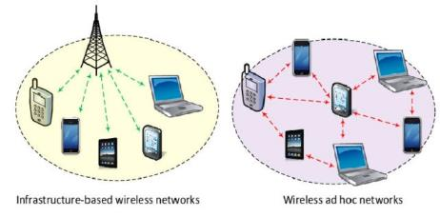
Communication Modes of Wireless Networks
Infrastructure vs Ad-hoc
Infrastructure Mode
  All the communication flows go through the infrastructure
  E.g. Bases Station or Access Point
Ad-hoc Mode
  No central station
  The communicating nodes may only communicate with other nodes in their radio range
  Self organization of the communicating nodes for packet routing

Slide 20
Service Set Identifier (SSID)
A service set identification (SSID) is a 32-character alphanumeric key identifying the name of the wireless local area network.
  The Basic Service Set Identification (BSSID) is used in ad hoc wireless network with no access points
  The Extended Service Set Identification (ESSID) is used in an infrastructure wireless network that includes an access point
To communicate with each other, devices must be configured with the same SSID

Slide 21
Wireless Networks Classification
One hop vs multi-hop
 | Infrastructure | No infrastructure
1 hop | 1,2,3G cellular networks | Bluetooth
Multi-hop | Mobile Adhoc Networks (MANET) Wireless Sensor Networks (WSN) Vehicular Adhoc Networks (VANET)

Slide 22
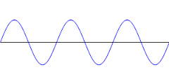
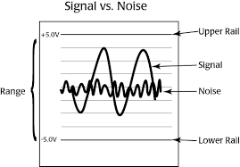

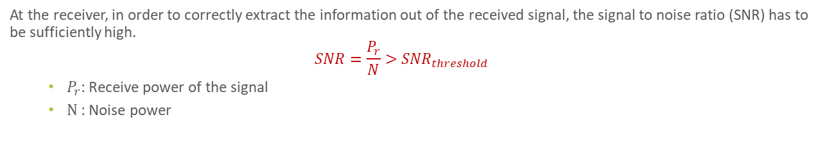
Wireless links : Signal propagation
During its travel through the environment, the radio signal gradually loses its energy (power).
The signal reaches at the receiver’s antenna together with the environmental and other noises.
Loses the strength
the environmental noise and interference
Receiver
Transmitter
At the receiver, in order to correctly extract the information out of the received signal, the signal to noise ratio (SNR) has to be sufficiently high.
  $$SNR=\frac{P_{r}}{N}>{SNR}_{threshold}$$
    $P_{r}$: Receive power of the signal
    $N$: Noise power

Slide 23
Wireless links : Interference and Path Loss
Interferences with other wireless sources
Path loss : decreased signal strength
  Signal reflection
  Signal diffraction
  Signal scattering

Slide 24
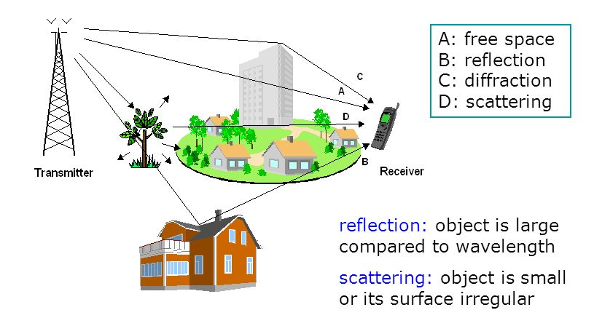
Wireless links : Interference and Path Loss

Slide 25
Wireless links: Some Properties
SNR = Signal to Noise Ratio in dB
BER = Bit Error Rate in %
For a given modulation technique, the BER is inversely proportional to the SNR ➔ a source can decrease the probability of receiving a frame with errors by increasing the signal power
For a given SNR, the BER is proportional to the data rate
Dynamic selection of the modulation technique for the 802.11 and cellular networks (from 3G) to adapt the transmission to the context (SNR)

Slide 26
Overview of the wireless technologies characteristics
Summary
Source: European Virtual Learning Platform for
Electrical and Information Engineering, Jordi Salazar, Wireless Networks

Slide 27
The 802.11 standard

Slide 28
The IEEE 802.11 Standard and the OSI Reference Model
Physical layer
  Encoding and transmission schemes for wireless communications
Data link layer
  MAC
    CSMA/CA : (Carrier Sense Multiple Access/Collision Avoidance)
  Logical Link Control LLC sub-layer
    Interface between the MAC and the network layer

Slide 29
The 802.11 Frame
Frame Control Main fields
Protocol Version provides the current version of the 802.11 protocol used
Type and Subtype determines the function of the frame. There are three different frame type fields: control, data, and management. There are multiple subtype fields for each frame type. Each subtype determines the specific function to perform for its associated frame type.
More Fragments indicates whether more fragments of the frame, either data or management type, are to follow.
Retry indicates whether or not the frame, for either data or management frame types, is being retransmitted.
Power Management indicates whether the sending STA is in active mode or power-save mode.
More Data indicates to a STA in power-save mode that the AP has more frames to send. It is also used for APs to indicate that additional broadcast/multicast frames are to follow.
WEP indicates whether or not encryption and authentication are used in the frame. It can be set for all data frames and management frames, which have the subtype set to authentication.

Slide 30
The 802.11 Frame
Duration : for RTS/CTS
Destination Address (DA) indicates the MAC address of the final destination to receive the frame.
Source Address (SA) indicates the MAC address of the original source that initially created and transmitted the frame.
Receiver Address (RA) indicates the MAC address of the next immediate node on the wireless medium to receive the frame.
Transmitter Address (TA) indicates the MAC address of the node that transmitted the frame onto the wireless medium.
Frame Check Sequence (FCS) is a generated value over all the fields of the MAC header and the frame body field by the transmitter using the cyclic redundancy check (CRC). The receiver uses the same CRC calculation to determine its own value of the FCS field to verify whether or not any errors occurred in the frame during the transmission.

Slide 31
Network Architecture
Basic Service Set (BSS) = Access Point + wireless stations
Service Set Identier (SSID) = Name of the Access Point (AP)
Beacon Frame : AP periodically sends beacons containing (SSID, MAC(AP))

Slide 32
Network association
Active or passive scan depending on the signal strength

Slide 33
802.11 Media Access
CSMA/CA
Random access to the media
CSMA/CA (Carrier Sense Multiple Access/Collision Avoidance)
Acknowledgements/retransmissions : high BER
No error detection
  Need to listen to the channel before transmitting but transmitted signal may be low at reception
  Can not detect all collisions (hidden terminals)

Slide 34
Acknowledgement
Acknowledgement (ACK) for every received data frame
  Transmitter :
    sends a frame and waits for ACK
  Receiver :
    if received frame and CRC OK, wait for SIFS (Short Inter-Frame Spacing) and send ACK
    If no ACK after α retransmissions, discard the frame

Slide 35
CSMA/CA
A) Carrier Sense
  A node first listens to the shared medium to determine whether another node is transmitting or not
B) Collision avoidance
  if another node was heard, we wait for a random backoff time for the node to stop transmitting before listening again for a free communication channel
  Else :
    Channel reservation (optional implementation): Send Request To Send (RTS) / Receive Clear to Send (CTS)
    If receive CTS (the channel is free) : transmission after a certain delay (DIFS, Distributed Inter-Frame Space)
    Else random timer (decreased each time the channel is free)
    When timer = 0, transmission and waiting for ACK
    If ACK is received then
      proceed to the transmission of next frame
      Else Step A)

Slide 36
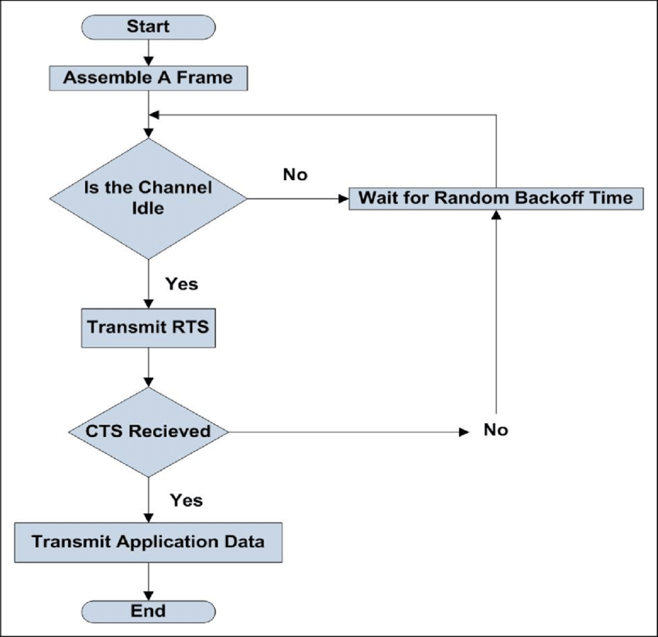
CSMA/CA diagram
Preamble time-division multiple access fixed slot assignment protocol for secure mobile ad hoc networks. Khalid Hussain Mohammadani et al. International Journal of Distributed Sensor Networks

Slide 37
Hidden Terminals Problem
Stations are not able to 'hear' another station's broadcast
  Causes : distance, receiver power, sensitivity
  ➔ Can not avoid collision in some cases

Slide 38
Security
Wireless communications is vulnerable to eavesdropping
Confidentiality and encryption
  WEP (Wired Equivalent Privacy)
  WPA (Wi-Fi Protected Access)
  WPA2 (Wi-Fi Protected Access, version 2)

Slide 39
Cellular Networks

Slide 40
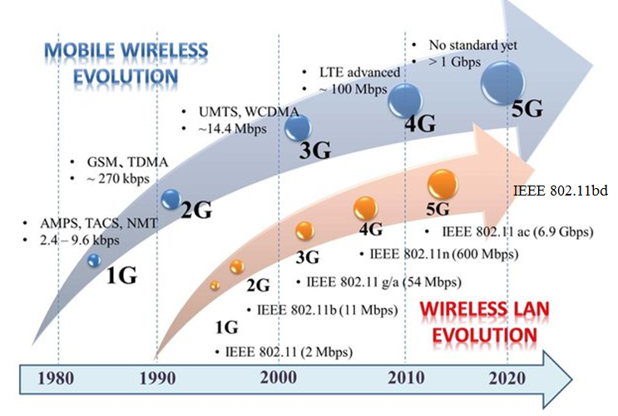
Cellular Networks vs 802.11 Networks

Slide 41
Cellular Network Evolution
1G : voice, analog
2G : voice, digital + data (2.5G) GSM, GPRS (FDMA/TDMA)
3G : voice and data, higher bandwidth, UMTS (CDMA)
4G : voice and data, higher bandwidth, LTE (OFDM + MIMO)
5G- beyond 5G: 2020 - present

Slide 42
GSM

Slide 43
Sources
M1 Informatique, Reseaux Cours 8 : Reseaux mobiles et sans fil, Olivier Togni Universite de Bourgogne, IEM/LE2I
Wireless networks, Jordi Salazar, Czech Technical University of Prague Faculty of electrical engineering, European Virtual Learning Platform for Electrical and Information Engineering

Slide 44
Part 2 : Vehicular Communications : Wireless Communication Technologies

Slide 45
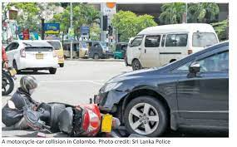
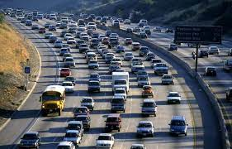
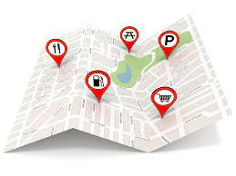
V2X (Vehicle-to-Everything): Background and services
Enhance road safety
  Collision awareness
  Hazard warning, etc
Reduce Road congestion
  Itinerary recommendation
  Congestion alert
Improve user comfort
  Point Of Interest
  Social Networking services

Slide 46
V2X (Vehicle-to-Everything) Communication Types
Image source : Ericsson

Slide 47
Performance Indicators of Communication Technologies
Metric | Description
Range/Coverage [meters] | The maximum distance for direct communication
Delay/Latency [seconds] | Time required for data delivery
Throughput [bits/seconds] | Communication speed
Reliability/Packet Delivery Ratio | The ratio of the number of received packets to the number of transmitted packets
Setup time | Connection time
Others | Cost, Security, Privacy etc.

Slide 48
Agenda
The 802.11P standard
  Characteristics
  The ITS-G5
  Decentralized Congestion Control
The Cellular V2X
  From LTE-V2X to NR-V2X

Slide 49
The 802.11P standard
IEEE 802.11P: IEEE 802.11 enhancements for vehicular communications operating at 5.9 GHZ frequency band (in Japan operating at 700 MHz)
Specification completed in 2010 (IEEE802.11p-2010)
  Later integrated in IEEE 802.11-2012
Key characteristics
  5.9 GHz frequency domain
  Based on IEEE 802.11a (OFDM PHY)
  BCC encoder
  10 MHz channel bandwidth
  Rates: 3, 4.5,6, 9, 12, 18, 24, 27 Mbps
  Operates without a BSS

Slide 50
IEEE 802.11P, DSRC and ITS-G5
IEEE 802.11P: IEEE 802.11 enhancements for vehicular communications operating at 5.9 GHZ frequency band (in Japan operating at 700 MHz)
DSRC: Dedicated Short Range Communication : 802.11P+MAC Sub-layer extensions in the USA
ITS-G5: 802.11P+ MAC extensions in Europe
Source: Standards for vehicular communication – from IEEE 802.11p to 5G, Andreas Festag (NEC Laboratories Europe, Germany, Elektrotechnik & Informationstechnik, Springer, 2015
Notes:
in Japan operatingat 700 MHz
These channels range from 5.825 GHz to 5.925 GHz (US)

Slide 51
Frequency Bands
Source: V2X Cellular sollutions, 5G America, October 2016

Slide 52
IEEE 802.11P/ITSG5
Physical layer characteristics
    Uses OFDM defined in IEEE 802.11-2012
    Having 10 MHz, the technology provides
    up to 27 Mbps data rate
MAC
  Stations communicate with each other in complete spontaneous manner without needing a creation/set-up of a network. For this reason the following functionalities of Wi-Fi are disactivated
      Association
      Energy saving
      Security
  Use of CSMA/CA for channel access
Modulation | Coding rate | Transfer rate (Mbps) | Minimum sensitivity (dBm) | SNR threshold (dB)
BPSK | ½ | 3 | -85 | 10
BPSK | ¾ | 4.5 | -84 | 11
QPSK | ½ | 6 | -82 | 13
QPSK | ¾ | 9 | -80 | 15
16QAM | ½ | 12 | -77 | 18
16QAM | ¾ | 18 | -73 | 22
64QAM | ½ | 24 | -69 | 26
64QAM | ¾ | 27 | -68 | 27

Slide 53
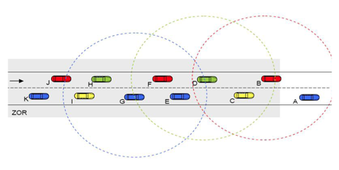
ITS-G5 : Congestion problems
The wireless vehicular channel has limited resources
  ITS-G5 suffers from congestion problems
  wireless network congestion can be defined as “the state in which the transmission channel is close to being completely utilized”

Slide 54
The Decentralized Congestion Control Mecanims (DCC)
DCC framework has been defined for ITS-S operating over ITS G5
DCC_ACC (ITS G5) continuously monitor channel occupancy
  Each layer control the communication parameters in order to avoid channel congestion
      Transmission power
      Data rate
      Geo-routing parameters
      CAM interval
      ETC.

Slide 55
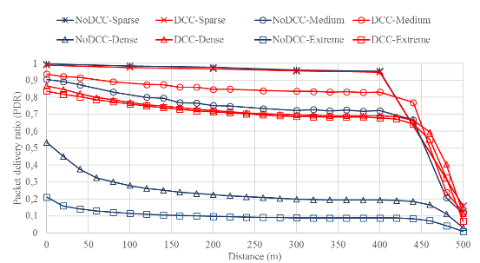
Congestion Problems in dense scenarios
Class | Inter-Vehicle distance | Mobility
Sparse | 100 m inter-distance (3 lanes/ 2 directions) | Static/Mobile
Medium | 45 m inter-distance (3 lanes / 2directions) | Static/Mobile
Dense | 20 m inter-distance (3 lanes / 2directions) | Static/Mobile
Extreme | 10 m inter-distance (3 lanes / 2directions) | Static

Slide 56
IEEE 802.11 Next Generation V2X
Mature Technology : More than 10 years of development
  Several experiments/prototypes
  Several enhancements: Example: DCC (Decentralized Congestion Control)
  Pre-deployments projects: Scoop (FR), C-Roads (EU), Corridor (EU), etc
However
  Some drawbacks: Ex. Robustness in high dense scenarios
IEEE 802.11 Next Generation V2X (NGV)
  IEEE Task Group BD
  High requirements for Next Generation V2X while maintain the backward compatible with 802.11P.
  IEEE 802.11bd : Physical layer enhancements
    20 MHz of channel band
    OFDM
    Resistant to Doppler effects

Slide 57
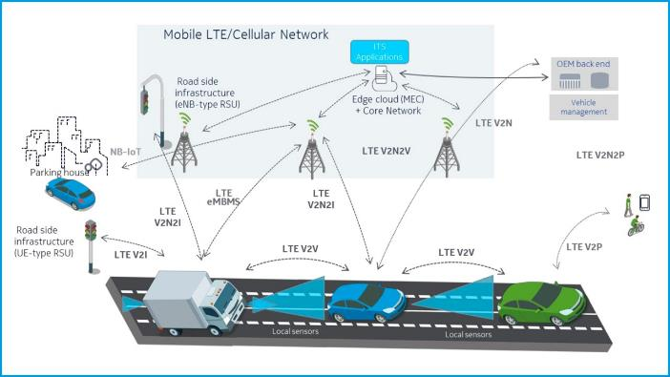
Cellular Technology for V2X Communications

Slide 58
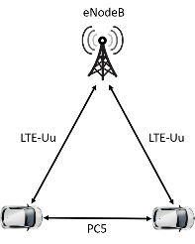
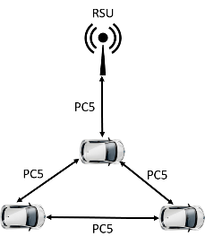
LTE-V2X Communication interfaces
LTE-Uu: Communication through the infrastructure
  « Traditional » LTE com. stack
  Same frequency band as LTE
LTE PC5: Direct Communication
  Similar application layer as ITS-G5
  Same frequency band as ITS-G5

Slide 59
LTEV2X communication modes
  Mode 3: the resource is allocated by the network
  Mode 4: Users (UEs) share the resource in a distributed manner (not needing a network controller)→ can use 5,9GHz band
Mode 4
Mode 3

Slide 60
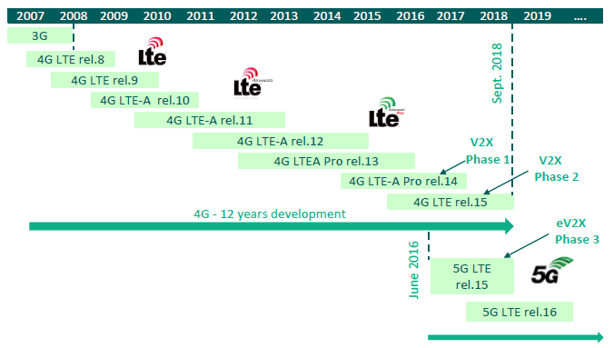
3GPP V2X Standardization Timeline

Slide 61
3GPP V2X Standardization Timeline
Source: Vehicular communications via cellular networks, Joachim Sachs, Ericsson Research

Slide 62
Technology characteristics | Frequency | Modulation technology | Access method | Bandwidth | Communication range | Synchronization
802.11P | 5.9 GHZ | OFDM | CSMA/CA | 10 MHZ | Several hundreds of meters | asynchronous
LTE LTE direct (PC5) | 450 MHZ to 3.8 GHZ | Base to terminal: OFDMA Terminal to base: SC-FDMA | Semi-persistent transmission with relative energy-based selection. | 3 to 20 MHZ | Several dozen of kilometers | Tight synchronization
 | 5.9 GHZ |  |  | 10 MHZ | Several hundreds of meters

Slide 63
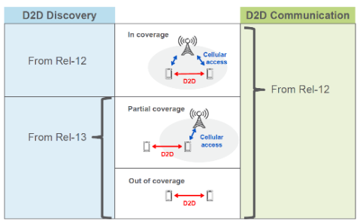
From LTE D2D to LTE V2V
What is the Device-to-Device communications?
LTE D2D communication, defined in Release 12, is the enabler of LTE-V2X.
Source: Vehicular communications via cellular networks, Joachim Sachs, Ericsson Research

Slide 64
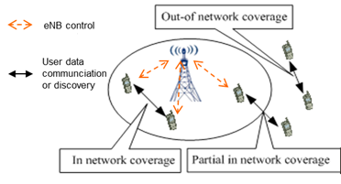
D2D scenarios in Rel12/Rel13
In-coverage
  The operator is in charge of user identity authentication, access control, connection establishment, resource allocation and security management in D2D communications
Relay
  The operator is in charge of connection establishment, resource allocation and security management for both UE-to-BS and D2D (UE-to-UE) connections
Out-of-Coverage
  Security spec was an ongoing work

Slide 65
From LTE D2D to LTE V2V
D2D: 2 communication modes
Resource allocation modes for D2D transmission
  Mode 1 (network scheduled)
    UE requests resources and eNB schedules
  Mode 2 (autonomous)
    eNB configures D2D resource pool
    UE selects autonomously D2D resources from the pool

Slide 66
From LTE D2D to LTE V2V
Interest of automotive industry in connected vehicle
Interest of operators in connected vehicles
First feasibility studies and spectrum considerations in China for LTE V2X

Slide 67
C-V2X Phase 2 (NR-V2X, Release 15)
The major contribution of Rel-15 for V2X communication
  Introduction of 5G new radio (5G NR): higher data rates and lower latencies for V2N communications
  Minor enhancement for PC5 communication: transmit diversity using MIMO and high-order modulation (64 QAM)
  Architecture enhancement
2 types of RSU implementation
  UE-type RSU, which combines a UE with the V2X application logic.
  eNB-type RSUs which comprises an eNB, a collocated GW, and a V2X Application Server.

Slide 68
C-V2X Phase 2 (NR-V2X, Release 16)
The major contribution of Rel-16 for V2X communications
  Enhancement to URLLC
      Physical/MAC layer design: low rate MCS, multi-antenna techniques, time synchronization
      5G-core network features such as network function virtualisation
      Positioning accuracy
      Network slicing
      Edge computing Introduction of 5G new radio: higher data rates and lower latencies for V2N communications
  Use of satellite access in 5G

Slide 69
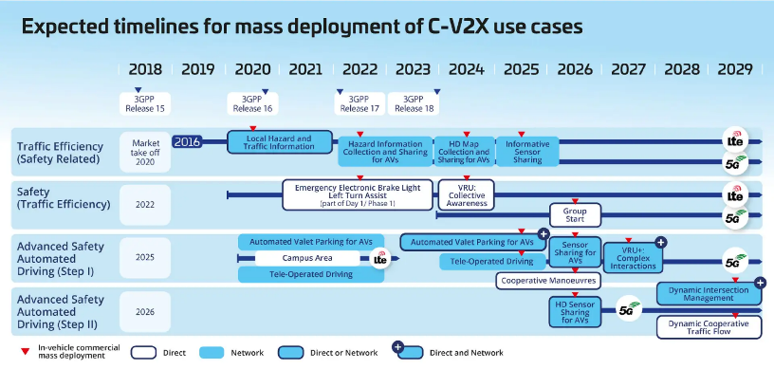

Slide 70
3GPP C-V2X Use Cases
Release 14
Release 15/16

Slide 71
LTE V2X Service Requirements
Source: Vehicular communications via cellular networks, Joachim Sachs, Ericsson Research

Slide 72
Comparison of Rel14/Rel15/Rel16
 | Rel-14 (LTE-V2X) | Rel-15 | Rel-16
Requirements for 5G architecture | LTE system architecture | 5G system phase 1: 5G NR + 5G core. Different deployment options: Non-Stand Alone, Stand Alone, Dual connectivity (4G / 5G) | 5G system phase 2 5G NR + 5G Core enhancements
V2X applications | Safety warnings (Collision Risk, Slow Vehicle and Stationary Vehicle) • Signal Phase and Timing • Vulnerable Road User Protection | Vehicle Platooning Advanced Driving Extended Sensors Remote Driving | Vehicle Platooning Advanced Driving Extended Sensors Remote Driving Vehicle QoS support
Architecture / service enhancements | MBMS over Uu speed up to 500 km/h | Network slicing MIMO over PC5 64-QAM modulation over PC5 | Advanced v2X support Enhanced URLLC Integration of Satellite Access in 5G
Safety level | Basic | Enhanced (range & reliability) | Advanced (throughput, reliability, latency, range, positioning)

Slide 73
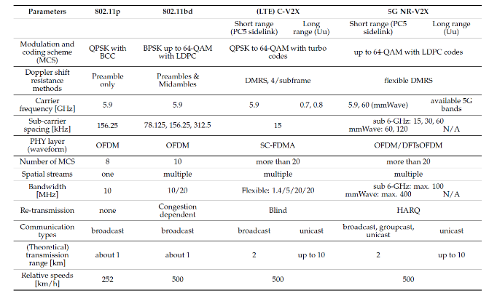
Comparison of V2X Access Technologies
Implementation of MEC-Assisted Collective Perception in an Integrated Artery/Simu5G Simulation Framework. Gergely Attila Kovács and László Bokor

Slide 74
Thank You
Ines Ben Jemaa
Research Engineer IRT-SystemX

