Slide 1
Comparing Ratings of Free Apps with Ads and Paid Apps Without Ads

Slide 2

Research Question:
Do free apps with ads enabled on average get lower ratings than paid apps without ads?

Slide 3
Business value of this research: Making Money!
$$$
$$$
Lower Ratings
Fewer Downloads
Less Profit

Slide 4
Making money from mobile apps
Sell the app
1
Publish the app for free with in-app advertising
2
Offer in-app purchases or subscriptions
3

Slide 5
Dataset
Google Play Store Apps
Gautham Prakash
Kaggle URL: https://www.kaggle.com/gauthamp10/google-playstore-apps
Over 2 million data points
24 variables

Slide 6
Variables
app name, app id, category
rating, rating count
installs, minimum installs, maximum installs
free, price, currency
size, minimum android
developer id, developer email, developer website
released, last updated
content rating, privacy policy
ad supported, in app purchases
editors choice
Scrap time

Slide 7
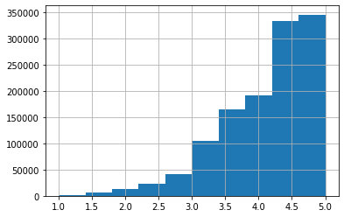
Rating
Average rating for the app
Values: 0.0 to 5.0
22,883 missing values
Transformation needed for statistical testing

Slide 8
Factors that Could Influence Rating
The number of downloads
The category of the app
The size and experience of the development team
The design of the user interface
How often updates are pushed
Apparent bugs

Slide 9
How Bias Was Handled
Filter for only apps with over 10k installs
Large random sample
A/A testing

Slide 10
Hypotheses
Null Hypothesis
Alternative hypothesis
There is no difference between average ratings of free apps with ads and paid apps without ads
Free apps with ads on average have lower ratings than paid apps without ads.

Slide 11

Getting data ready for the test
Filter for only apps which have a rating count greater than 0.
1
Split into two random groups – 2500 observations each
2
Subset 1 – free apps with ads enabled
Subset 2 – paid apps without ads enabled
Perform transformation on ratings to make it more normal
3

Slide 12
Results of Statistical Test: p value
P value – probability of seeing a difference this or more extreme
If p was measured in meters, it would be smaller than an atom
Extremely rare
Conclusion:
On Average, free apps with ads have lower average ratings than paid apps without ads

Slide 13
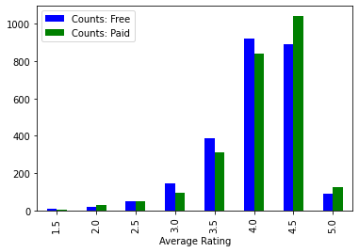
Rating Counts

Slide 14
Confidence Interval – How much lower?
Less than 0.1 Stars

Slide 15
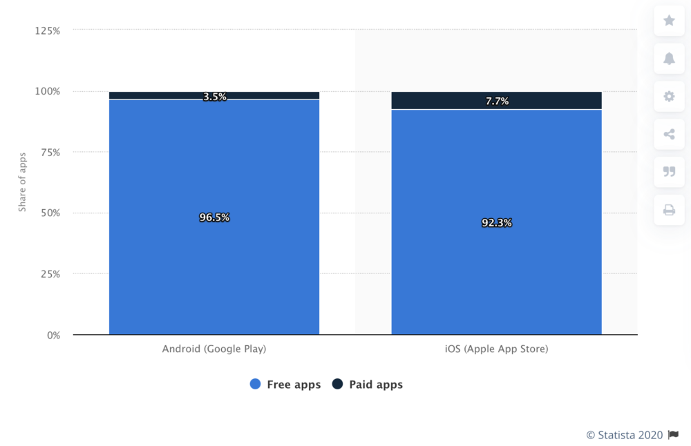
Decision – Make it free!
Free apps get more downloads!

Slide 16
Links
Jupyter notebook with research report: https://github.com/mathisme/ThinkfulDSCapstone1/blob/main/Results.ipynb
Buildfire -- Mobile App Download Usage Statistics: https://buildfire.com/app-statistics/
Kaggle Google Play Store Apps dataset: https://www.kaggle.com/gauthamp10/google-playstore-apps
LinkedIn Profile: https://www.linkedin.com/in/annelosch/

