Slide 1
Finding a model to predict total cholesterol level
Anne Losch

Slide 2
Background
Nearly 1 in 3 Americans have high cholesterol. ¹
According to the dataset used, over half of those with high cholesterol have never been told by a health professional they have high cholesterol.
High cholesterol is a major risk factor for heart disease, the leading cause of death of men and women in America. ^{2,3}
With fitness trackers that can track activity, pulse, blood pressure and health apps that can track nutrition, can models be created to predict cholesterol level so that those with predicted high total cholesterol can be advised to have their cholesterol checked?
As someone with high cholesterol this interests me.

Slide 3
Introduction
Introduce what it is that will be done here today and why

Slide 4
Table of Contents/Objectives
Executive Summary
Data Exploration
Methodology/Process
Results
Limitations
Conclusion
Recommendations
References
Appendix

Slide 5
Executive Summary
The problem to solve: Finding a model that predicts total cholesterol so that apps can warn people if they may have high cholesterol
The results: of different models tested, random forests were found to be the best for regression

Slide 6
Data Exploration
Data for modeling came form the 2013-2016 National Health and Nutrition Examination Survey, a yearly survey conducted by the National Center for Health Statistics (CDC)
Datasets cover:
Demographics data
Dietary data
Examination data
Laboratory data
Questionnaire Data
Over 100 files and over 1500 variables are included in a year of NHANES Data
Target – Laboratory data, Cholesterol – Total, LBXTC - Total Cholesterol (mg/dL)
64 variables were read in and used for modeling covering demographics, body measures, nutrition, physical activity, smoking and alcohol use and chronic conditions based on research on what effects total cholesterol

Slide 7
Methodology/Process
Cleaning Data
Filter data
Adjusting survey responses
Deal with missing data
Removing unnecessary redundancies
Feature Engineering
Average daily nutrition
Average daily alcohol intake
Average daily moderate and physical activity
Log of the y value, total cholesterol
Unsupervised Learning
Using DBSCAN to detect outliers
Dimensionality reduction with PCA
Supervised Learning
Ordinary Least Squares
K nearest neighbor regression
Support Vector Regression
Random Forest Regression
Nueral Networks

Slide 8
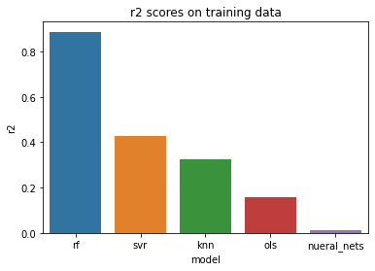
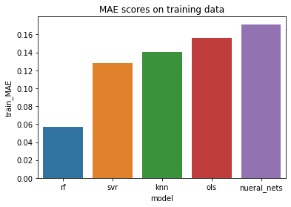
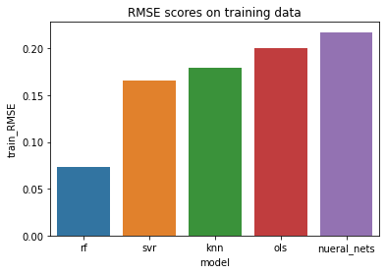
Results
Random forests performed best
R2 – 0.886
Testing mean absolute error -- 0.15
Testing root mean square error -- 0.19
Mean absolute error on non log-transformed data for random forests trained on full dataset – 22. Meaning: On average total cholesterol level may be off by 22 mg/dL

Slide 9
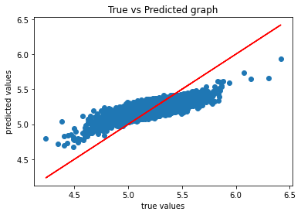
Limitations
16312
After filtering and cleaning data, only around 3500 observations were used for training out of around 16,000
Missing values needed to be imputed and so may not be accurate
As amount of physical activity was based on survey data, this may not be accurate
The final model struggles to predict extreme values.

Slide 10
Conclusion
Although Random Forests struggle with predicting extreme values, this model will be helpful

Slide 11
Recommendations
Any health app that uses this model will need to retrain and hence ask users if they have had their cholesterol checked, and if so, what their total cholesterol level was.
To improve performance, average daily activity data could come from fitness trackers.
Further exploration is needed to see if information regarding chronic conditions can be left out.

Slide 12
References
https://www.washingtonpost.com/health/cholesterol-level-young-adults/2020/09/04/6a1f1f4c-ed81-11ea-b4bc-3a2098fc73d4_story.html
https://www.webmd.com/heart-disease/default.htm
https://www.webmd.com/cholesterol-management/default.htm

Slide 13
Appendix

Slide 14
Variables needed for prediction
RIDAGEYR -- the age of the person (years), integer
Systolic -- systolic blood pressure reading (mm Hg), float
Diastolic -- diastolic blood pressure reading (mm Hg), float
BMXBMI --- the body mass index of the individual (kg/m**2), float
BPXPLS -- the pulse of the individual, int
avg_daily_vigorous_activity -- minutes of average daily vigorous activity. Remember to multiply by 8, float
avg_daily_moderate_activity -- minutes of average daily moderate activity. Remember to multiply by 4, float
DR1TKCAL_t -- average daily caloric intake (kcal), float
DR1TPROT_t -- average daily protein intake (gm), float
DR1TCARB_t -- average daily carbohydrate intake (gm), float
DR1TSUGR_t -- average daily total sugar (gm), float
DR1TFIBE_t -- average daily dietary fiber intake (gm), float
DR1TTFAT_t -- average daily total fat intake (gm), float
DR1TSFAT_t -- average daily saturated fat intake (gm), float
DR1TMFAT_t -- average daily monounsaturated fatty acids intake (gm), float
DR1TPFAT_t -- average daily polyunsaturated fatty acids (gm), float
DR1TCHOL_t -- average daily intake of Cholesterol (mg), float
DR1TSODI_t -- average daily intake of Sodium Sodium (mg), float
DR1TVD_t -- average daily intake of Vitamin D (D2 + D3) (mcg), float
DR1TCALC_t -- average daily intake of Calcium (mg), float
DR1TIRON_t -- average daily intake of Iron (mg), float
DR1TPOTA_t -- average daily intake of Potassium (mg), float
avgALC -- average number of alcoholic drinks per day, float
RIAGENDR -- the gender of the individual, 0 -- female, 1 -- male
RIDRETH3 -- race, 1 --Mexican American, 2 -- Other Hispanic, 3 -- Non-Hispanic White, 4 -- Non-Hispanic Black, 6 -- Non-Hispanic Asian, 7 -- other race including multi-racial
BPXPULS -- pulse type, 0 -- regular, 1 -- irregular
BPQ020 -- Ever told you had high blood pressure, 0 -- no, 1 -- yes
BPQ050A -- Now taking prescription medication for high blood pressure, 0 -- no, 1 -- yes
BPQ080 -- Ever told you have high cholesterol, 0 -- no, 1 -- yes
BPQ100D -- Now taking prescription medication for high cholesterol, 0 -- no, 1 -- yes
DIQ010 -- Doctor told you that you have diabetes, 0 -- no, 1 -- borderline, 2 -- yes
MCQ170M -- Do you still have thyroid problems, 0 -- no, 1 -- yes
SMQ681 -- smoked tobacco in the last 5 days, 0 -- no, 1 -- yes

Slide 15
Random Forest Pipeline
Scale with MinMaxScaler
Log transformed skewed numerical variables
Impute missing variables using:
KNN Imputer for numerical variables
SimpleImputer using most frequent for categorical variables
Use Random Forest Regressor
Hyperparameters

Slide 16
Features engineered

Slide 17
Data Cleaning Steps
Filtered for those who had total cholesterol level taken as well as those over age 20 and who fasted 9 hours or more
Adjusting responses on skipped survey questions
Replaced ‘do not know’ or ‘refused to answer’ survey responses with nans to be imputed later
Dropped observations or features with 1/3 or more of the data missing
Removing survey variables that were redundant

Slide 18

Why regression and not classification?
Better to know how high total cholesterol might be

Slide 19
Links
National Health and Nutrition Examination Survey: https://www.cdc.gov/nchs/nhanes/index.htm
Project on Github: https://github.com/mathisme/ThinkfulDSFinalCapstone
LinkedIn: https://www.linkedin.com/in/annelosch/

