Slide 1
Which machine learning model can be used to predict whether or not a client will fully pay back their loan?
Anne Losch

Slide 2
Main benefit of a predictive model
Help lending companies decide whether or not to accept the application of a potential client.
Possible drawbacks of using ml models
possible misclassifications

Slide 3
Type of misclassifications
False Positive
The ML model predicts the potential client will pay back their loan when in fact they will not
Effects: Loss of money to the lending company in the amount of the loan
False Negative
The ML model predicts the potential client will not pay back their loan when in fact they will
Effects: Loss of potential client, loss of money to the lending company in the amount of interest that would have been collected

Slide 4
Data
Lending Club loan data found on Kaggle
2007 - 2010
14 features: 13 numerical, 1 categorical
9,578 observations
0 missing values
Target feature: not fully paid

Slide 5
Dataset features
credit.policy - credit policy, whether or not the client meets the credit underwriting criteria for Lending Club. Boolean value, 1 for yes, 0 for no
purpose - the purpose of the loan
int.rate - the interest rate of the loan
installment - the monthly installments owed
log.annual.inc - the log of the borrowers annual income
dti - the debt to income ratio of the borrower
fico - the borrowers FICO score
days.with.cr.line - the number of days the borrower has had a credit line
revol.bal - revolving balance, the amount unpaid by the borrower at the end of their credit cycle
revol.util - revolving utilization rate, the amount of credit used relative to their credit limit
inq.last.6mths - the number of inquiries the borrower has had by creditors in the past six months
delinq.2yrs - the number of times the borrower has been thirty or more days past due in the last two years
pub.rec - the number of derogatory public records of the borrower
not.fully.paid - a boolean depicting if the loan is not fully paid, 1: the loan is not fully paid, 0: the loan is fully paid

Slide 6
Initial transformations of dataset
Created a fully paid column and removed not fully paid
Created possibly missing boolean features for those numerical features having values of 0.

Slide 7
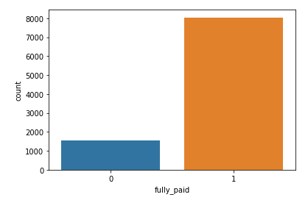
Main drawback of selected dataset:
Target class imbalance

Slide 8
Techniques utilized to handle imbalance
Adjusting the classification threshold
Random undersampling
Random oversampling
Use balanced class weights argument where possible

Slide 9
Machine Learning Algorithms Tested
K Nearest Neighbors
Random Forest
Logistic Regression

Slide 10
Metrics used to evaluate models
Precision – the proportion of positive classifications actually correct
Recall – the proportion of actually positive correctly identified
F1 score – a balance of precision and recall
F1 score will be used to help determine overfitting and underfitting and choose the final model

Slide 11
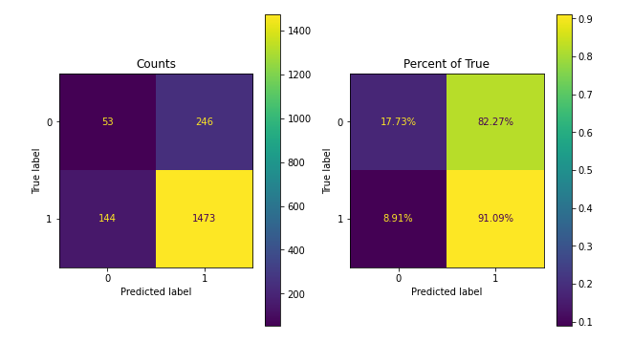
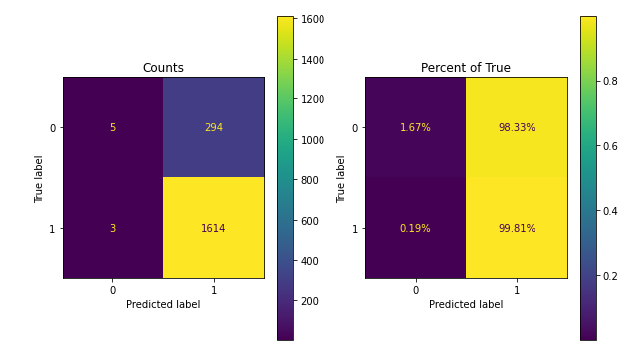
Moving the classification threshold
Better than base model
Still favors predicting as fully paid
Random forests base model
Random forests moving the threshold

Slide 12
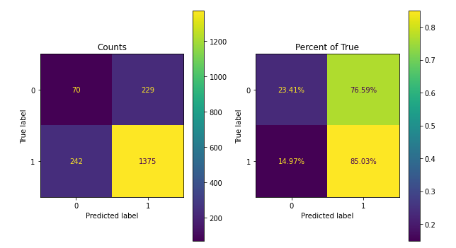
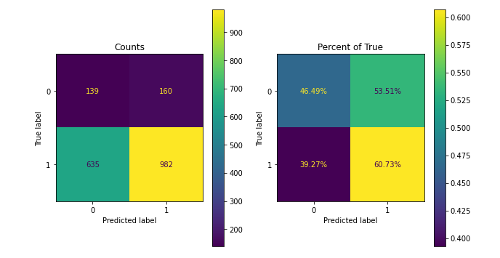
Random undersampling, oversampling, class weights: balanced
Did provide a better balance
Too many misclassifications
Knn moving threshold
Knn undersampling

Slide 13
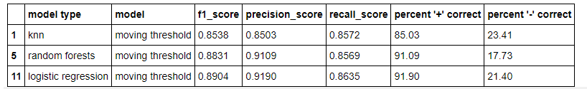
Comparison of models using moving the threshold

Slide 14
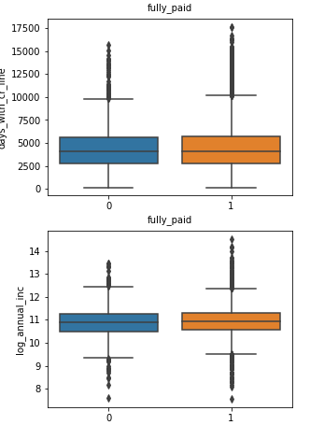
Other factors affecting choosing model
Random forests -- slow to train
Logistic regression -- more preprocessing; outliers need to be handled when training

Slide 15
Model of Choice
Logistic Regression with adjusted classification threshold

Slide 16
Model Details
Classification Threshold 0.7
All default arguments for Sci-Kit Learn’s LogisticRegression remain the same
Preprocessing steps:
Standardize the numerical features: int_rate, installment, log_annual_inc, dti, fico, days_with_cr_line, revol_bal, revol_util, inq_last_6mths, delinq_2yrs, pub_rec
One hot encode the categorial feature, purpose, dropping the first category
When retraining the model, outliers must first be dealt with. When predicting, the pipeline with the above preprocessing steps can be followed

Slide 17
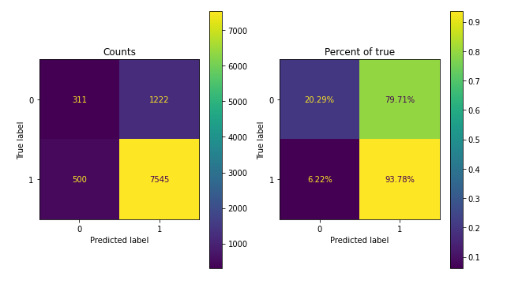

Model performance on dataset after retraining

Slide 18
Ways to improve the model
Gather more observations
Ask the lending company for more information on each applicant
Talk to someone in the financial industry about feature engineering

Slide 19
Links
Dataset on Kaggle -- https://www.kaggle.com/itssuru/loan-data
Github repository -- https://github.com/mathisme/ThinkfulSLCap
LinkedIn -- https://www.linkedin.com/in/annelosch/

