Slide 1

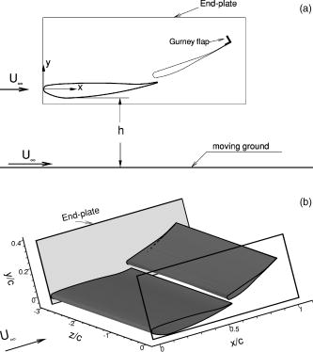
Date of download: 11/2/2020
Copyright © ASME. All rights reserved.
From: Ground Effect Aerodynamics of Race Cars
Appl. Mech. Rev. 2006;59(1):33-49. doi:10.1115/1.2110263
Figure Legend:
Schematic of a generic double-element wing in ground effect

