Slide 1
Computer Systems Organization
CHAPTER 2

Slide 2
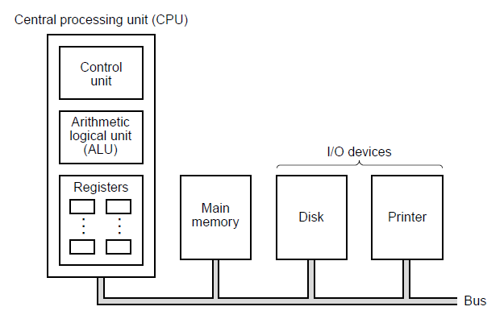
Processors

Slide 3
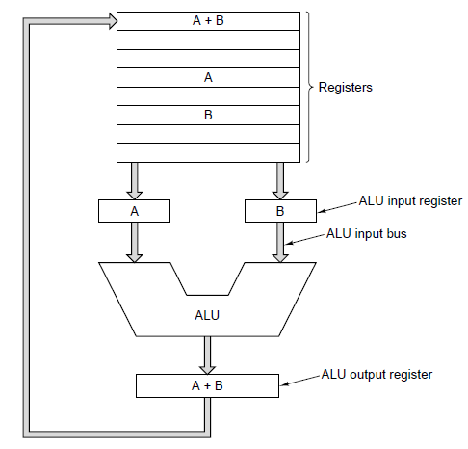
CPU Organization

Slide 4
Instruction Execution (1)
Fetch next instruction from memory
Change program counter to point to next instruction
Determine type of instruction just fetched
If instruction uses a word in memory, locate it
Fetch word, if needed, into a CPU register.
Execute instruction.
Go to step 1 to begin executing following instruction

Slide 5
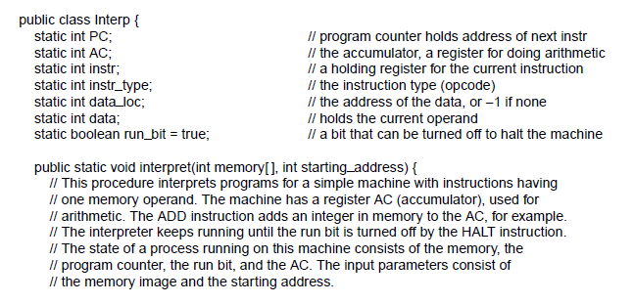
Instruction Execution (3)
Figure 2-3. An interpreter for a simple computer (written in Java).
. . .

Slide 6
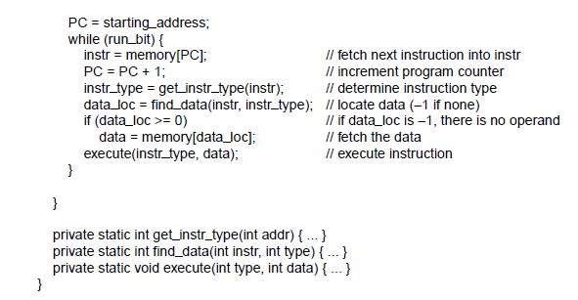
Instruction Execution (4)
. . .

Slide 7
Instruction Execution (5)
Benefits of machines with interpreted instructions
Ability to fix incorrectly implemented instructions in field,
even make up for design deficiencies in basic hardware
Opportunity to add new instructions at minimal cost,
even after delivery of machine
Structured design that permitted efficient development,
testing, documenting of complex instructions

Slide 8
Design Principles for Modern Computers
All instructions directly executed by hardware
Maximize rate at which instructions are issued
Instructions should be easy to decode
Only loads and stores should reference memory
Provide plenty of registers

Slide 9
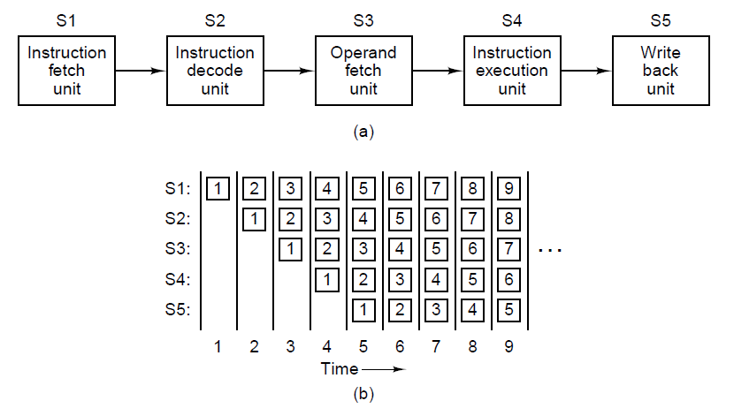
Pipelining
Figure 2-4. (a) A five-stage pipeline. (b) The state of each stage as a function of time. Nine clock cycles are illustrated

Slide 10
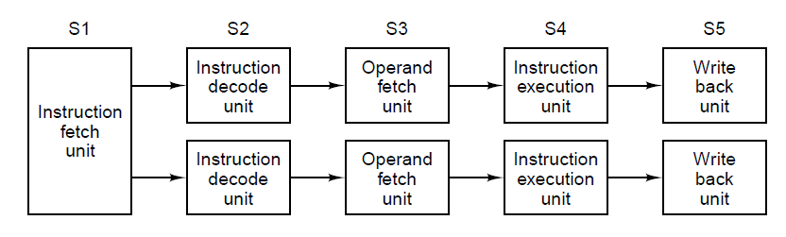
Superscalar Architectures (1)

Slide 11
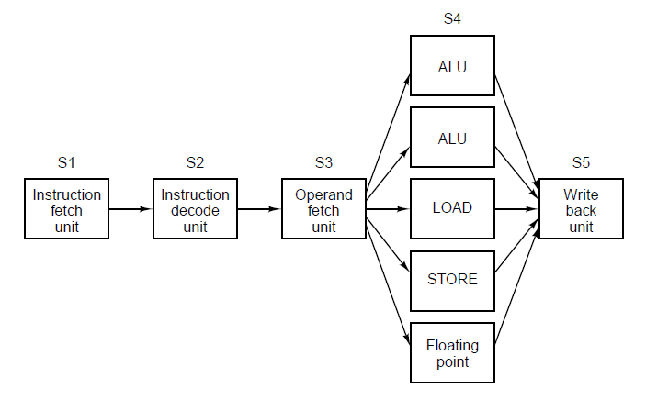
Superscalar Architectures (2)

Slide 12
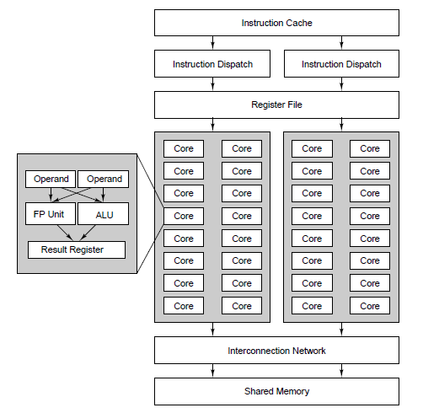
Data Parallel Computers

Slide 13
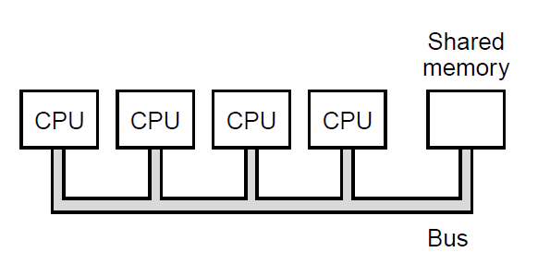
Multiprocessors (1)

Slide 14
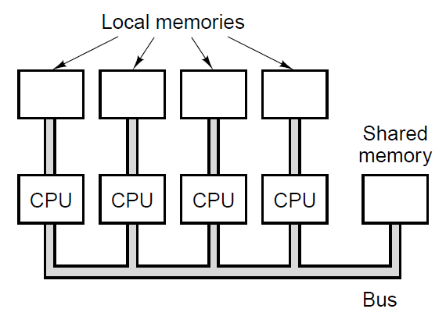
Multiprocessors (1)

Slide 15
Primary Memory (1)
The part of computer where programs and data are stored
Bit: binary digit
Memory address: location in memory of a cell containing data

Slide 16
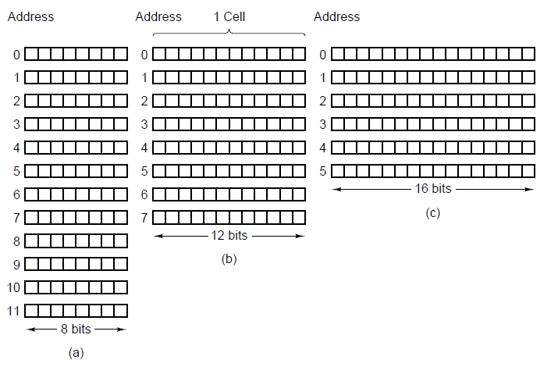
Primary Memory (2)

Slide 17
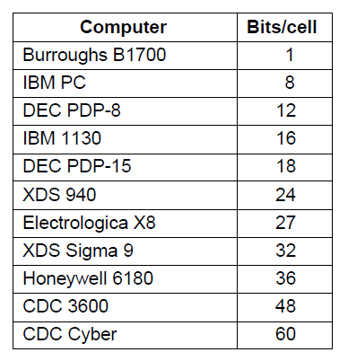
Primary Memory (3)

Slide 18
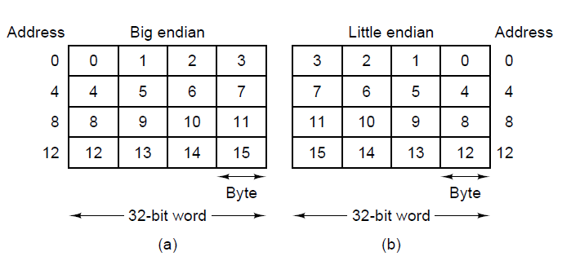
Byte Ordering (1)

Slide 19
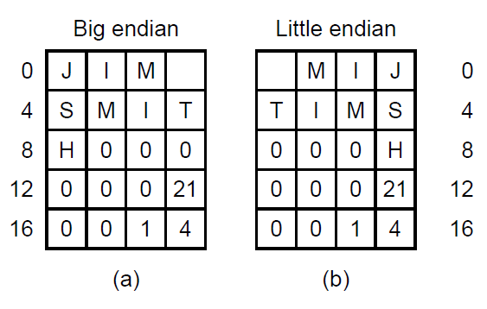
Byte Ordering (2)

Slide 20
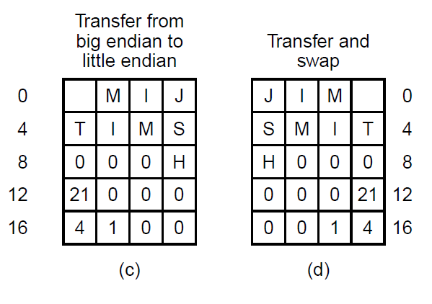
Byte Ordering (3)

Slide 21
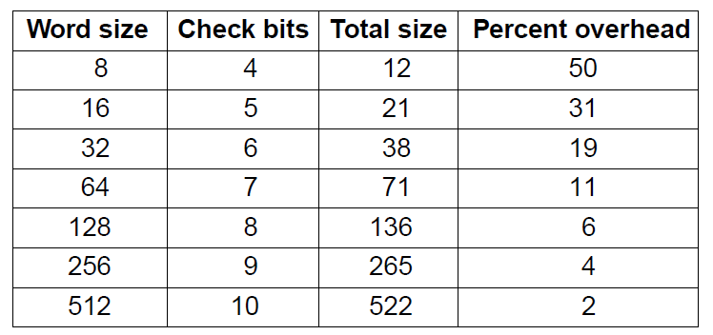
Error-Correcting Codes (1)

Slide 22
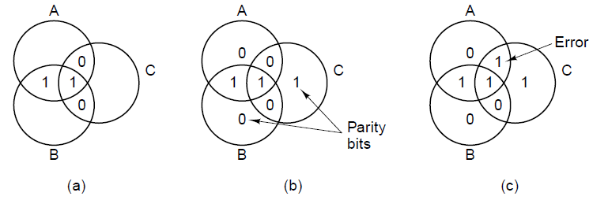
Error-Correcting Codes (2)

Slide 23
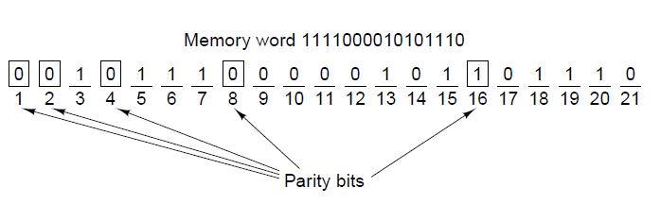
Error-Correcting Codes (3)

Slide 24
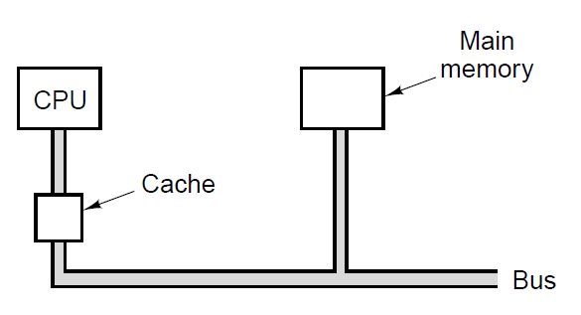
Cache Memory

Slide 25
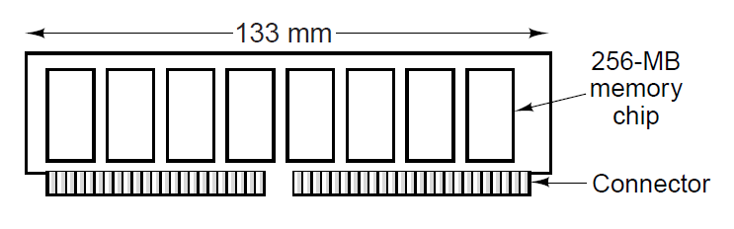
Memory Packaging and Types

Slide 26
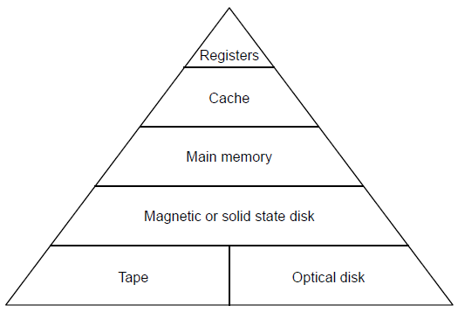
Secondary Memory
Memory Hierarchies

Slide 27
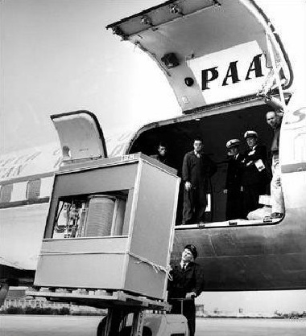
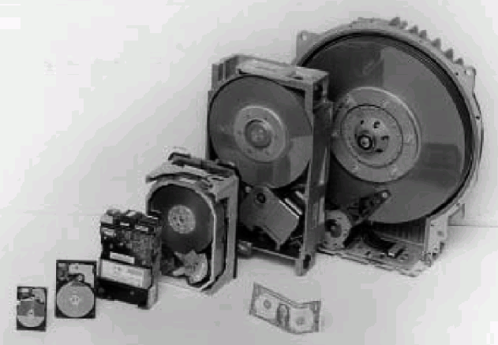
Magnetic Disks (1)
From 14 inch to 1.8 inch
5 MB in 1956

Slide 28
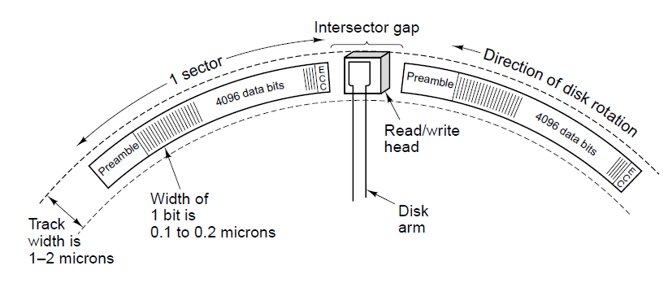
Magnetic Disks (2)
Figure 2-19. A portion of a disk track. Two sectors are illustrated.

Slide 29
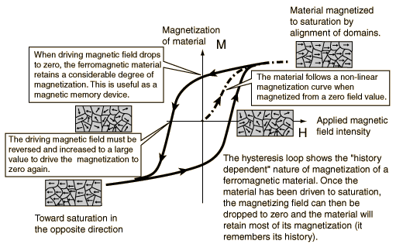
Magnetic Disks (3)

Slide 30
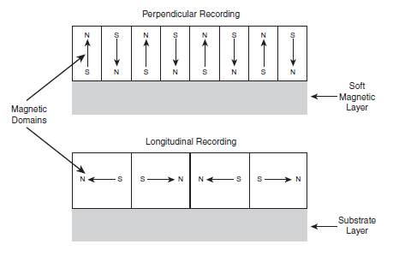
Magnetic Disks (4)

Slide 31
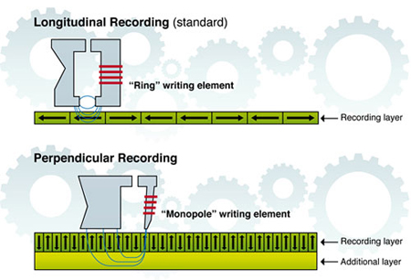
Magnetic Disks (5)

Slide 32
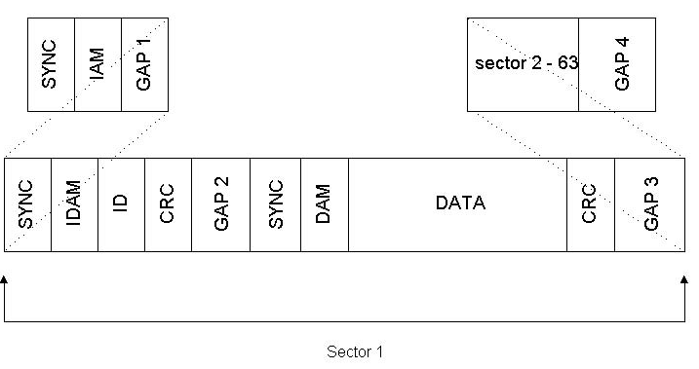
Magnetic Disks (6)

Slide 33
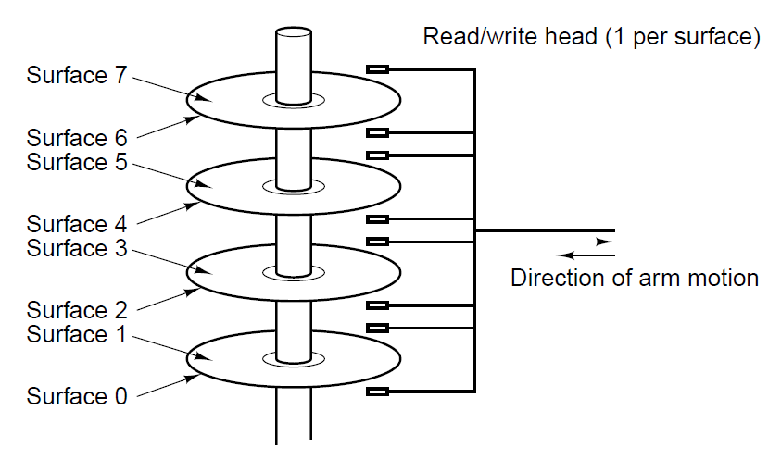
Magnetic Disks (7)

Slide 34
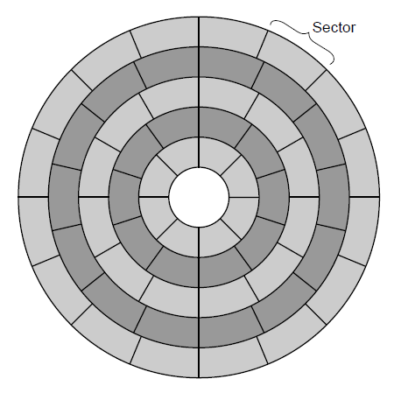
Magnetic Disks (8)

Slide 35
IDE disks
 | BIOS | ATA
Heads | 255 | 16 | 16
Cylinders | 1024 | 65536 | 1024
Sectors | 63 | 255 | 63
Max. Capacity | 7,8GB | 127,5GB | 504MB

Slide 36
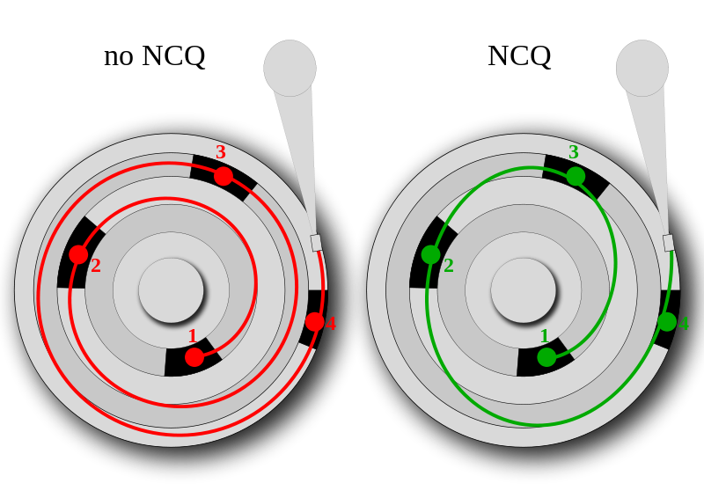
Serial ATA (Native Command queuing)

Slide 37
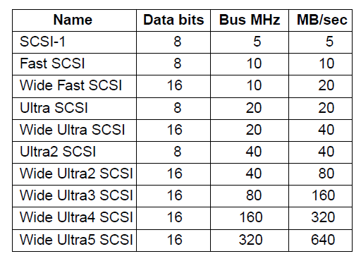
SCSI Disks

Slide 38
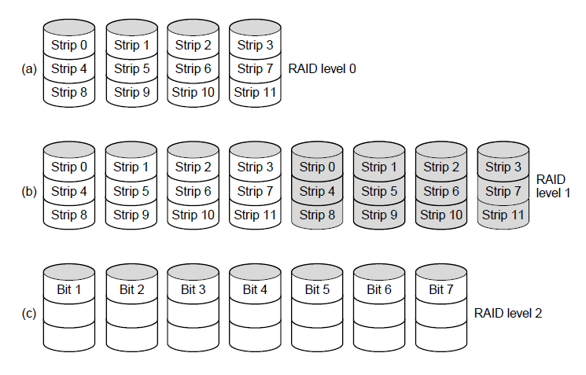
RAID (1)

Slide 39
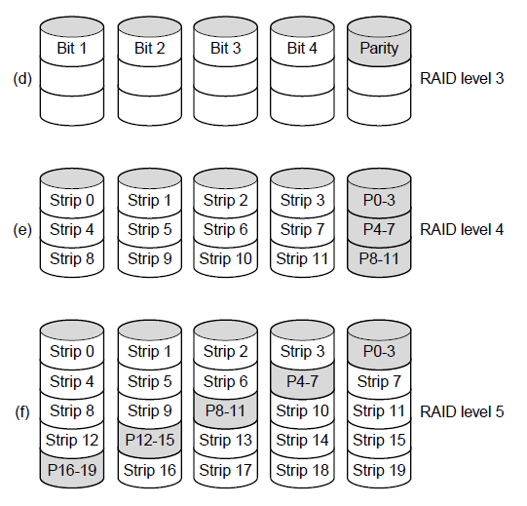
RAID (2)

Slide 40

RAID (3)

Slide 41
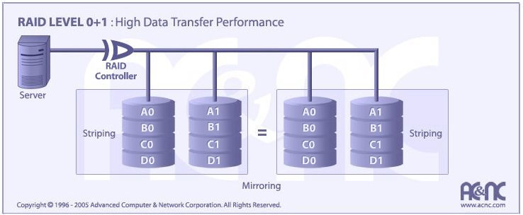
RAID (4)

Slide 42
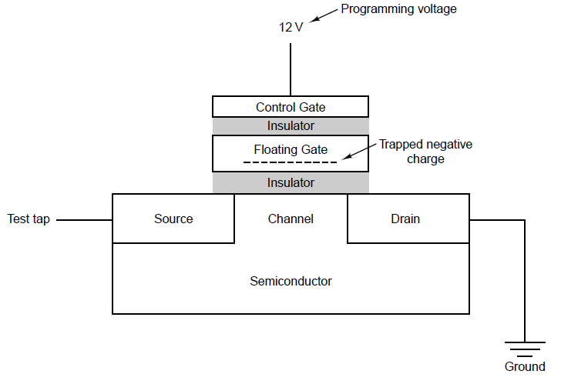
Solid-State Disks

Slide 43
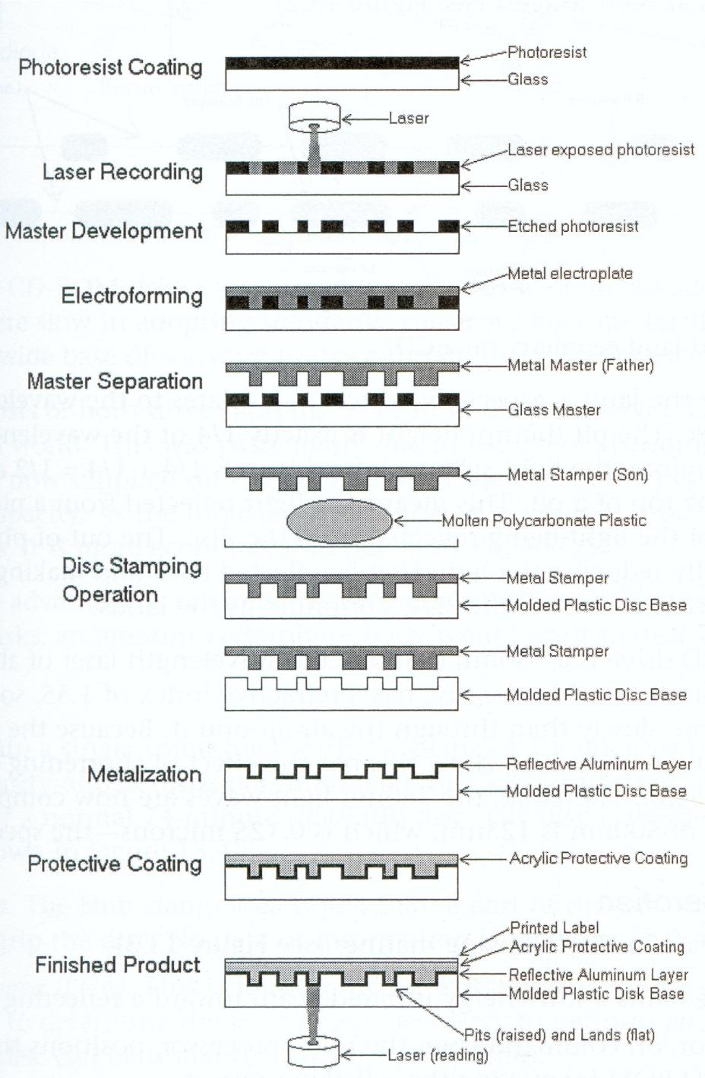

Slide 44
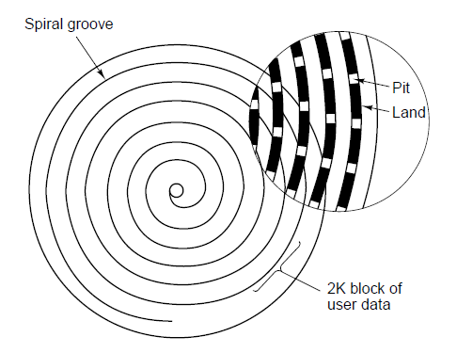
CD-ROMs (1)

Slide 45
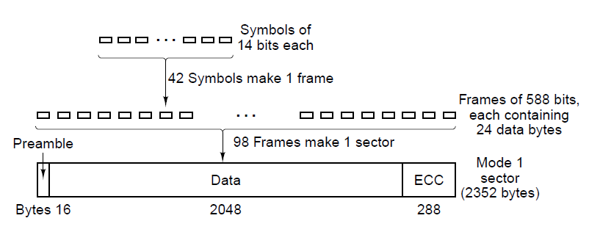
CD-ROMs (2)
Figure 2-26. Logical data layout on a CD-ROM.

Slide 46
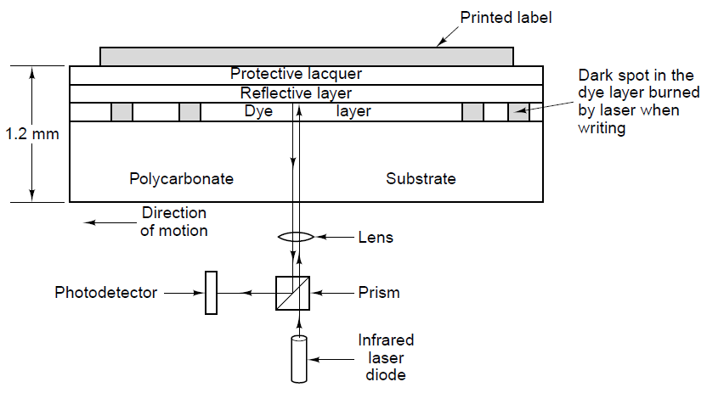
CD-Recordables

Slide 47
DVD (1)
Was Digital Video Disk
Now Digital Versatile Disk
New features
  Smaller pits
  A tighter spiral
  A red laser

Slide 48
DVD (2)
Formats:
Single-sided, single-layer (4.7 GB)
Single-sided, dual-layer (8.5 GB)
Double-sided, single-layer (9.4 GB)
Double-sided, dual-layer (17 GB)

Slide 49
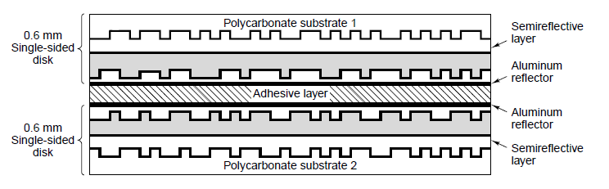
DVD (3)

Slide 50
DVD (4) Copy protection
RPC ( region playback control )
CSS ( content scramble system )
APC ( analog protection system )

Slide 51
DVD (5) RPC
Movies in the US are sooner available then in the rest of the world
Protect content by adding a region code which is embedded in the hardware of DVD players.

Slide 52
DVD (6) regiocodes
1 | USA and Canada
2 | Europe, middle East, Japan and South Africa
3 | South east Asia en east asia
4 | Australia, NZ, south America, Mexico and Central America
5 | Poland, Africa and North Korea
6 | China and Tibet

Slide 53
DVD (7) CSS
MPAA
Developed by Matsushita (Panasonic)
Digital scrambling of images and speech(encryption)
Descrambling requires three keys. The player key, disc key and title key

Slide 54
DVD (8) CSS (continued)
Keys are stored onto the medium during the the production process (glass master)
Every DVD player (computer, TV) contains 400 player keys (409?)
With the player key you can get the disc key
Every DVD has all disc keys encrypted with every possible player key. Also the disc key is encryped with itself and is also stored on the DVD medium
With the disc key you can retrieve the title key.

Slide 55

DVD (9) CSS (continued)
Safe until 1999 when the code was cracked by Jon Lech Johansen using reverse engineering

Slide 56
DVD (10) APS
Analog Protection System aka Copyguard
Developed by Macrovision (1985)
Prevent copying of DVD content onto VHS tape

Slide 57
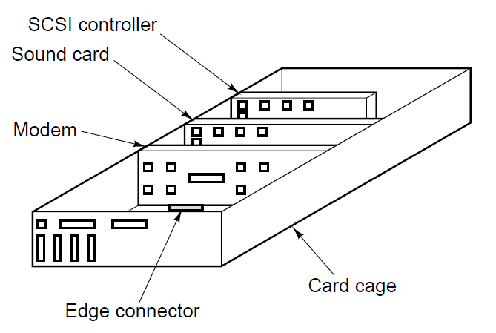
Input/Output Buses (1)

Slide 58
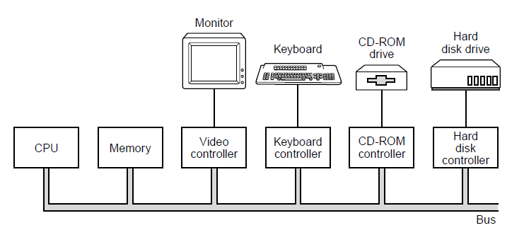
Buses (2)

Slide 59
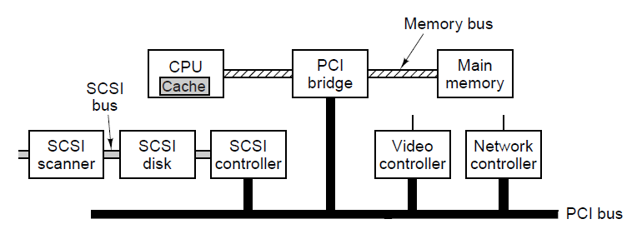
PCI and PCIe Buses (1)

Slide 60
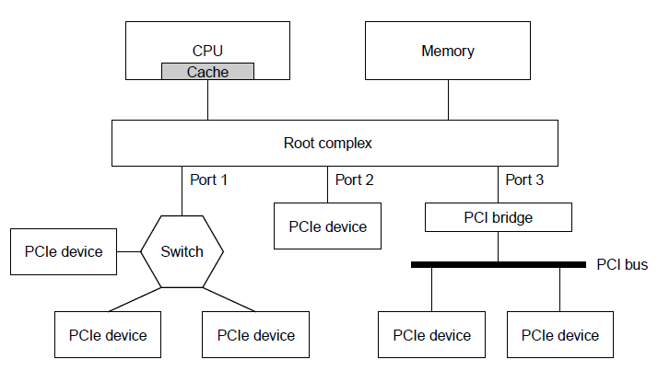
PCI and PCIe Buses (2)

Slide 61
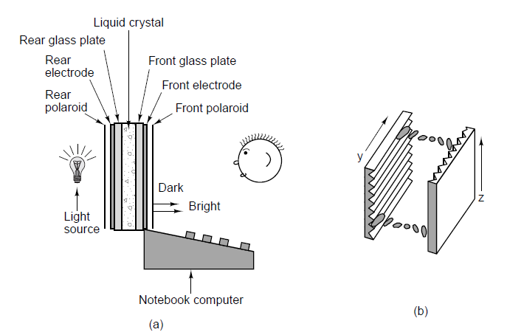
Terminals

Slide 62
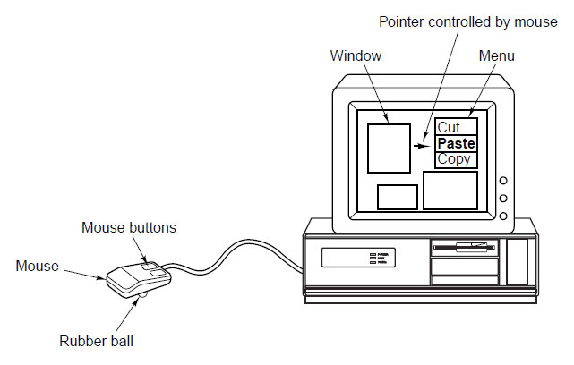
Mice

Slide 63
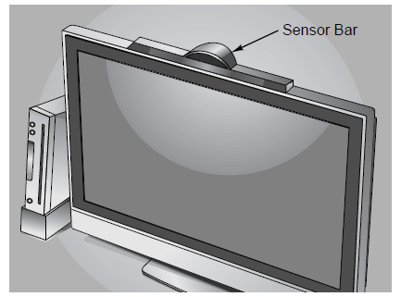
Game Controllers (1)

Slide 64
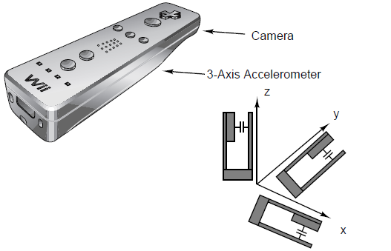
Game Controllers (2)

Slide 65
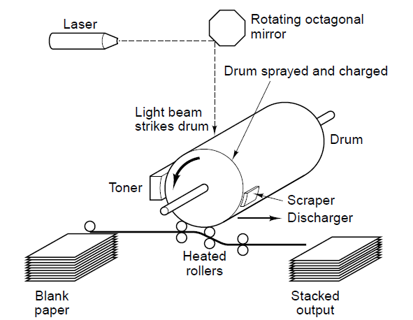
Laser Printers (1)

Slide 66

Laser Printers (2)

Slide 67
Color Printing
Color monitors use transmitted light;
  Color printers use reflected light.
Monitors have 256 intensities per color;
  Color printers must halftone.
Monitors have a dark background;
  Paper has a light background.
The RGB gamut of a monitor and the CMYK gamut of a printer are different.

Slide 68

Modems

Slide 69

Digital Subscriber Lines (1)

Slide 70

Digital Subscriber Lines (2)

Slide 71
Internet over Cable (1)
Problems to overcome:
How to add Internet access without interfering with TV programs.
How to have two-way traffic when amplifiers are inherently one way.

Slide 72

Internet over Cable (2)

Slide 73

Internet over Cable (3)

Slide 74

Digital Cameras

Slide 75

Character Codes (1)

Slide 76

Character Codes (2)

Slide 77

Character Codes (3)

Slide 78
End
CHAPTER 2

