Slide 1
Mutual Exclusion & Ricart-Agrawala Algorithm Implementation
Understanding Mutual Exclusion in Distributed Systems
Mathivaruni Rajakumar – M.E., software engineering

Slide 2
Introduction
- Mutual Exclusion ensures that multiple processes do not enter the critical section (CS) simultaneously.
- Essential for maintaining consistency in distributed systems.
- Used in OS, database systems, and multi-threading applications.

Slide 3
Types of Mutual Exclusion
1. Centralized Approach - A single coordinator grants access.
2. Distributed Approach - Processes coordinate without a central entity.
3. Token-Based Approach - A token circulates among processes to allow access.

Slide 4
Ricart-Agrawala Algorithm
- A distributed mutual exclusion algorithm.
- Uses timestamped requests and message passing.
- Ensures fairness by granting access in order of timestamps.

Slide 5
Working of Ricart-Agrawala Algorithm
1. A process sends a request message to all other processes.
2. Other processes reply immediately if they are not in CS; otherwise, they queue the request.
3. The process enters CS when all other processes have sent replies.
4. After execution, the process sends a release message to all waiting processes.

Slide 6
Code Implementation
- Implemented using Python’s threading and priority queues.
- Each process:
- Sends requests with timestamps.
- Receives requests and manages a queue.
- Waits for replies before entering CS.
- Releases CS after execution.

Slide 7
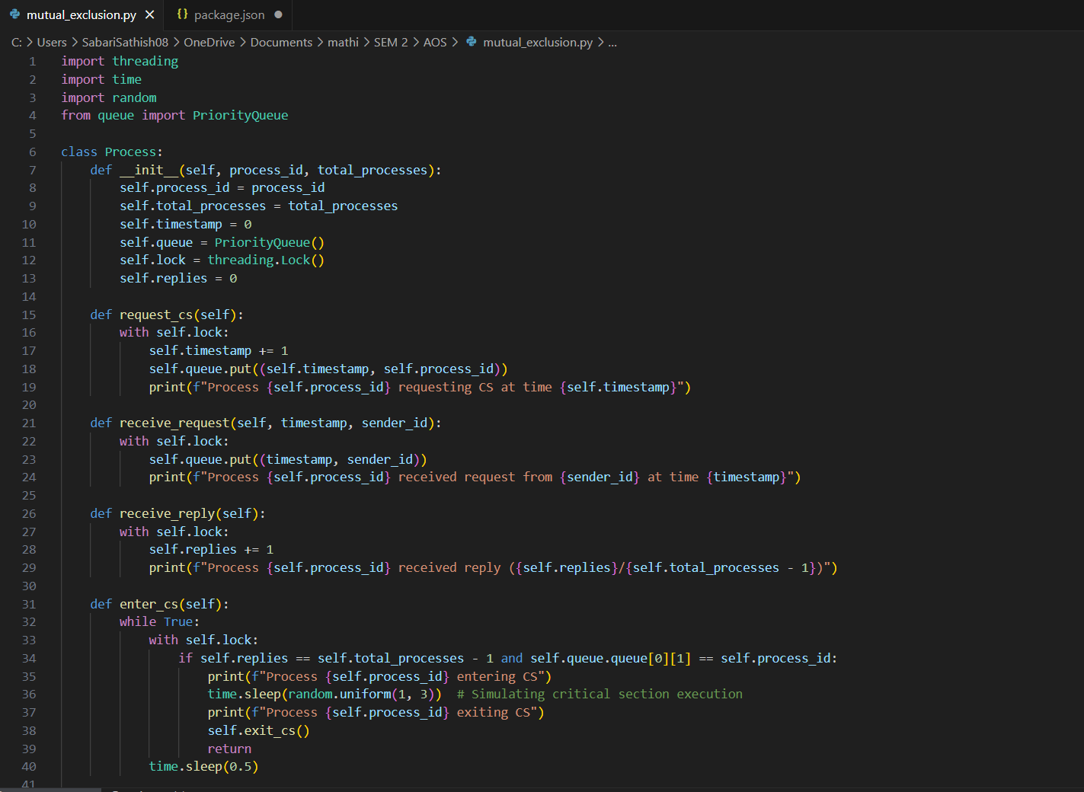
Python Code (Snippet)

Slide 8
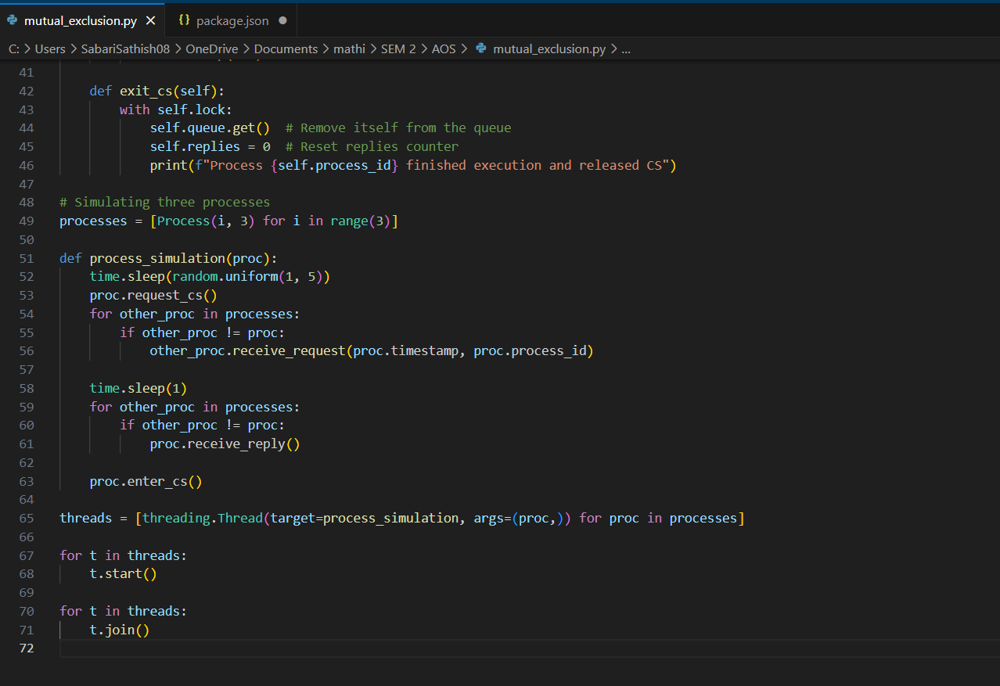

Slide 9
Execution Flow
- Processes randomly request the critical section.
- They wait for replies before proceeding.
- Ensures proper sequence of execution.
- Demonstrates fairness and deadlock prevention.

Slide 10
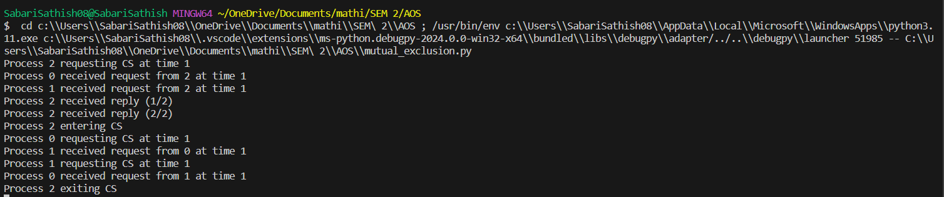
Output Example

Slide 11
Conclusion
- Ricart-Agrawala ensures efficient distributed mutual exclusion.
- Fair execution order using timestamps.
- Reduces message complexity compared to naive approaches.
- Widely used in distributed computing systems.

Slide 12
References
- 'Distributed Systems: Principles and Paradigms' by Andrew S. Tanenbaum.
Mukesh Singhal and Niranjan G. Shivaratri, “Advanced Concepts in Operating Systems –Distributed, Database and Multiprocessor Operating Systems”, Tata MC Graw-Hill, 2001.
- Python Threading Documentation.
- Online research papers on Distributed Mutual Exclusion.

