Slide 1
Digital Portfolio
STUDENT NAME: A.Mathiyoli
REGISTER NO AND NMID: 2428k0037 and
5DB0F05D69B04BF883B4B8B12EFAFC8A
DEPARTMENT: school of computer studies
COLLEG/UNIVERSITY:SHREE VENKATESHWARA ARTS and SCIENCE (CO-EDUCATION) COLLEGE

Slide 2
DIGITAL PORTFOLIO
using frontend developement using HTML , CSS and JAVASCRIPT

Slide 3
AGENDA
Problem Statement
Project Overview
End Users
Tools and Technologies
Portfolio design and Layout
Features and Functionality
Results and Screenshots
Conclusion
Github Link
3/21/2024 Annual Review

Slide 4
PROBLEM STATEMENT
In today’s competitive world, professionals and students require an organized way to showcase their skills, qualifications, and experiences. Traditional paper resumes are often static, lack interactivity, and fail to create a lasting impression. With increasing reliance on digital platforms, there is a need for a dynamic, user-friendly, and visually appealing digital portfolio that allows easy navigation and highlights an individual’s strengths effectively.
The challenge is to design and develop a responsive digital portfolio website that:
Presents personal details, educational background, skills, training, projects, and interests in a structured manner.
Ensures easy navigation with smooth scrolling and clear sectioning.
Uses simple yet professional design elements to maintain readability and attractiveness.
Can be accessed across devices (desktop, tablet, mobile) without losing functionality.
This project aims to provide an interactive alternative to resumes, enabling individuals to showcase their capabilities and achievements in a professional, accessible, and modern format.

Slide 5
PROJECT OVERVIEW
The Digital Portfolio Website is a web-based platform developed using HTML, CSS, and JavaScript to present personal, academic, and professional details in a structured and visually appealing format. It includes sections such as Objective, Education, Experience, Skills, Training, Workshops, Projects, and Interests, allowing users to explore the profile in an organized manner. The navigation menu with smooth scrolling enhances accessibility and ensures a user-friendly experience, while the clean design highlights professionalism and clarity.
This project demonstrates the practical application of front-end development skills by combining semantic HTML, modern CSS styling, and interactive JavaScript features. It serves as a dynamic alternative to traditional resumes, enabling individuals to showcase their achievements effectively across digital platforms. The portfolio not only reflects the individual’s qualifications but also their ability to design and develop a functional, responsive, and professional website.

Slide 6
THE END USERS
The end users of this digital portfolio are primarily recruiters, employers, and academic evaluators who wish to assess an individual’s skills, qualifications, and achievements in a clear and interactive format. Instead of going through a static resume, they can easily navigate through different sections such as Education, Experience, Skills, and Projects to gain a complete understanding of the candidate’s profile.
Additionally, the portfolio can also be used by teachers, peers, and professional networks who want to explore the individual’s background. It is designed to be responsive and user-friendly, ensuring that any user—whether on desktop, tablet, or mobile—can access the information conveniently.

Slide 7
TOOLS AND TECHNIQUES
The digital portfolio was developed using front-end web technologies that ensure both functionality and design quality. The primary tools and techniques used are:
HTML5 → For structuring the content and creating different sections of the portfolio such as Objective, Education, Experience, Skills, and Projects.
CSS3 → For styling the portfolio with layouts, colors, fonts, and responsiveness to make it visually appealing and professional.
JavaScript → For adding interactivity, including smooth scrolling for navigation links to improve user experience.
Code Editor (VS Code / Sublime Text / Notepad++) → For writing and managing the source code efficiently.
Web Browser (Google Chrome, Edge, Firefox) → For testing and previewing the portfolio during development.
These tools and techniques together helped in building a responsive, interactive, and professional portfolio website that can be accessed across multiple device

Slide 8
POTFOLIO DESIGN AND LAYOUT
The digital portfolio is designed with a clean, structured, and professional layout to ensure readability and ease of navigation. The design follows a section-based structure, where each category of information (Objective, Education, Experience, Skills, Training, Workshops, Projects, and Interests) is displayed in separate blocks for clarity. A header section at the top displays the name and contact details along with a navigation menu that allows users to move smoothly between sections.
The color scheme uses a dark header with white text for contrast, combined with a light background to maintain simplicity and professionalism. Each section is styled with subtle shadows, rounded corners, and padding to create a card-like layout that improves readability. The footer at the bottom provides closure with copyright information. The design is also responsive, ensuring that the portfolio adjusts automatically to different screen sizes such as desktop, tablet, and mobile, making it user-friendly and accessible across devices.
8

Slide 9
FEATURES AND FUNCTIONALITY
The digital portfolio website offers a range of features designed to present personal and professional details in an organized and interactive way. The main features include:
Header Section → Displays name, email, and mobile number, along with a navigation bar.
Navigation Menu with Smooth Scrolling → Allows users to jump between sections effortlessly with a JavaScript-based smooth scrolling effect.
Section-wise Information → Separate sections for Objective, Education, Experience, Skills, Training, Workshops, Projects, and Interests to maintain clarity.
Responsive Design → The layout automatically adapts to different devices such as desktops, tablets, and mobiles.
Clean and Professional Styling → CSS styling with card-like sections, soft shadows, and simple fonts for readability.
Footer → Provides a neat closing section with copyright information.
overall, the portfolio combines simplicity, accessibility, and professionalism with basic interactivity, making it an effective tool to showcase an individual’s achievements and skills.

Slide 10
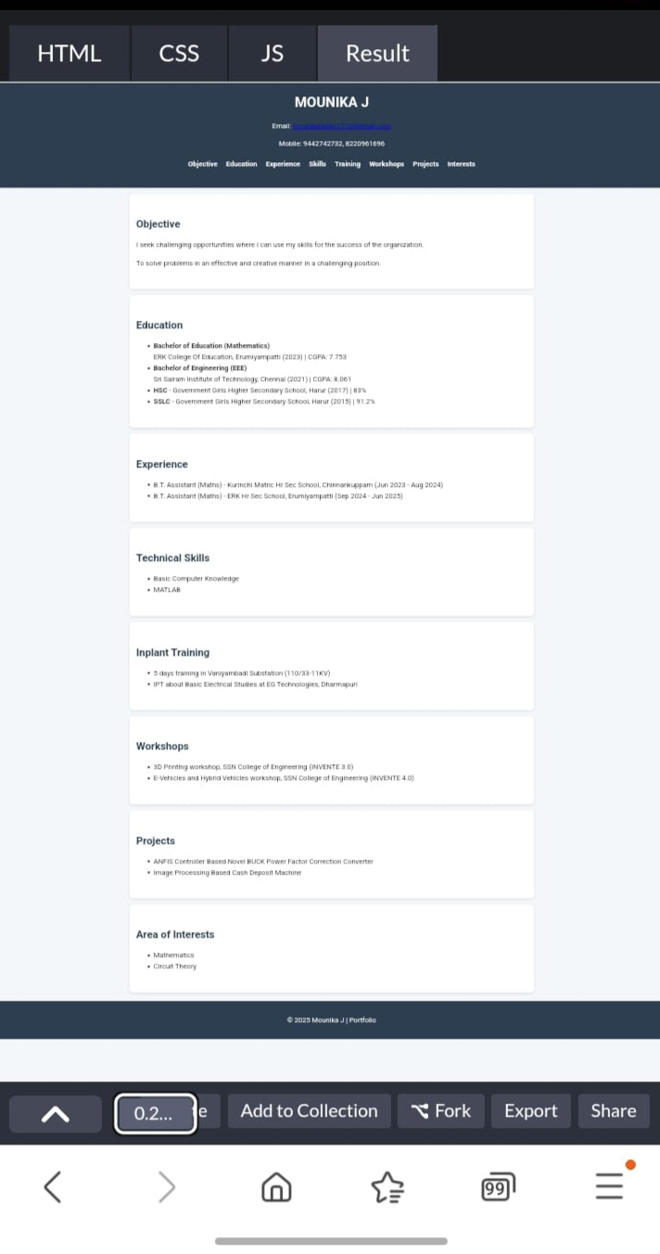
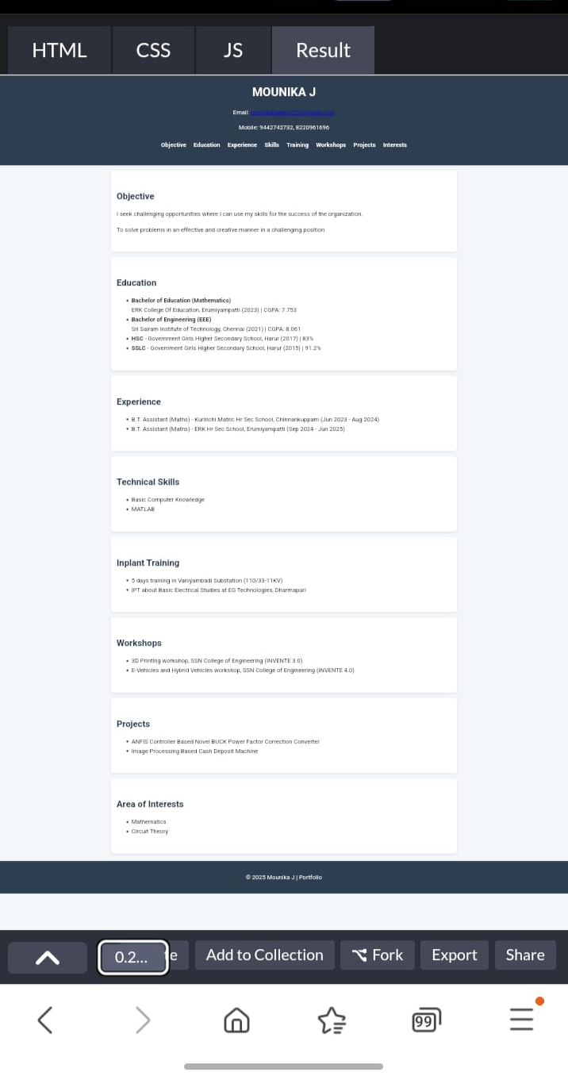
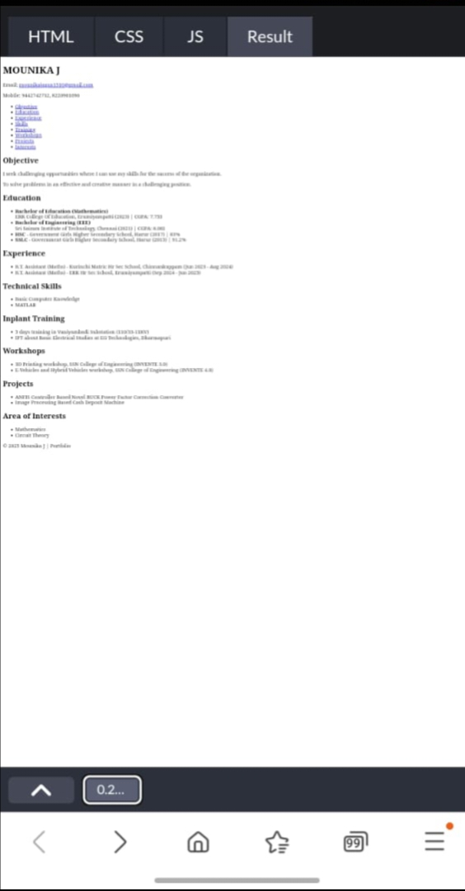
RESULTS AND SCREENSHOTS
3/21/2024 Annual Review
10

Slide 11
CONCLUSION
The Digital Portfolio project successfully demonstrates how web technologies like HTML, CSS, and JavaScript can be applied to create an interactive and professional platform for showcasing personal, academic, and professional achievements. By organizing details into clearly defined sections and enhancing navigation with smooth scrolling, the portfolio provides a user-friendly experience while maintaining a clean and responsive design.
This project highlights the importance of digital resumes in the modern world, where accessibility and presentation play a crucial role in career opportunities. The portfolio not only serves as a professional alternative to traditional resumes but also reflects the developer’s skills in web design and front-end development. Overall, it is a practical, efficient, and modern solution for presenting an individual’s profile in the digital era.
11

Slide 12
THANK YOU

