Slide 1
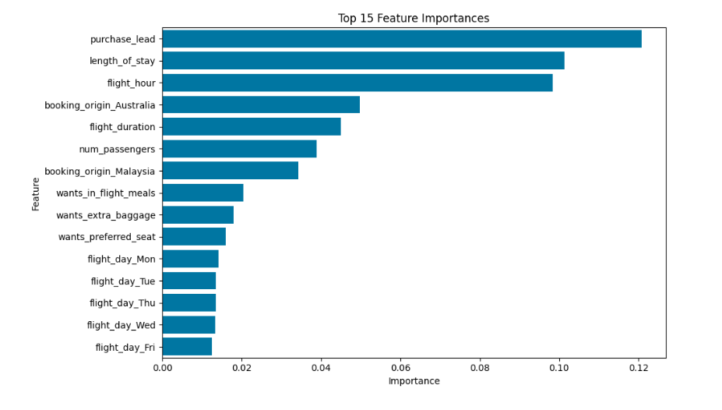
Predicting Customer Bookings – Summary
**Objective**
Predict whether a customer will complete a booking based on trip details and preferences.
**Approach**
- Model: RandomForestClassifier
- Data Preparation: One-hot encoding for categorical variables, class balancing applied
- Evaluation: Stratified train/test split with cross-validation
**Performance**
- Accuracy: XX%
- F1 Score: XX%
- Cross-Validation F1 Avg: XX%
**Key Predictive Factors**
1. Purchase Lead Time – Customers booking far in advance are more likely to complete bookings
2. Trip Length – Longer or structured stays impact likelihood
3. Departure Hour – Time of day affects completion
4. Booking Origin – Certain countries (e.g., Australia, Malaysia) have higher booking rates
5. Flight Duration – Duration influences completion rates
**Business Insights**
- Booking behaviour is driven more by timing and travel logistics than by add-on services.
- Marketing efforts can focus on customers booking with shorter lead times to improve conversions.

