Slide 1





Zero Day Future Contracts
Team 11
PS 2, Aptos Blockchain Challenge

Slide 2
Overview of Problem
We are Building a Zero Day Futures Trading App [PS-2]
Trading App Offers Trading Options for Various Assets(Ex.BTC,USDT etc)
Users can view buy and sell orders upon asset selection.
Supports Both Limit and Market Orders.

Slide 3
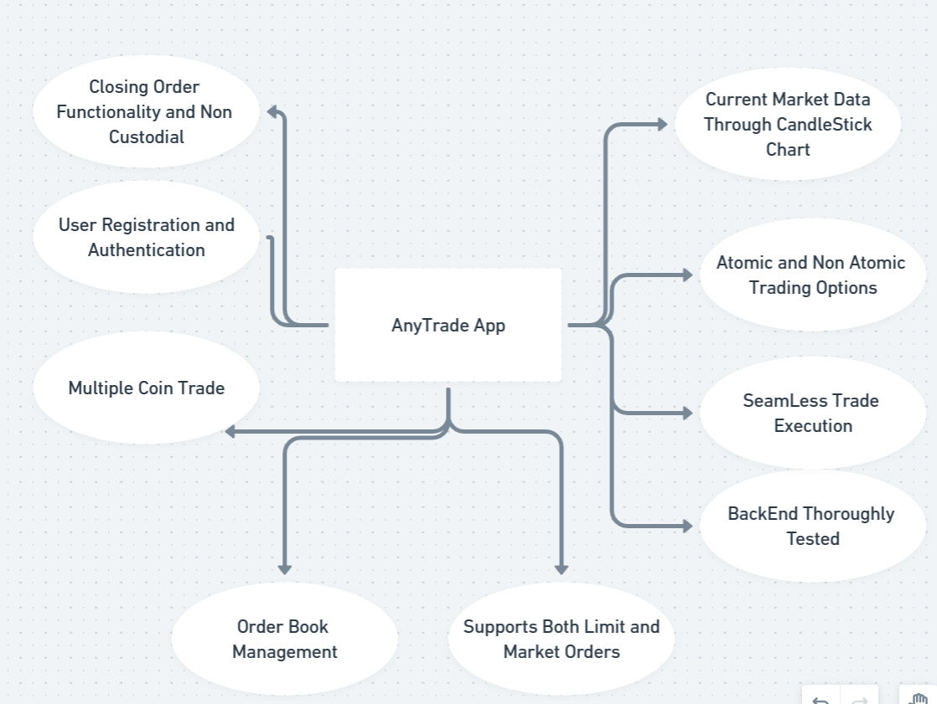
Features

Slide 4
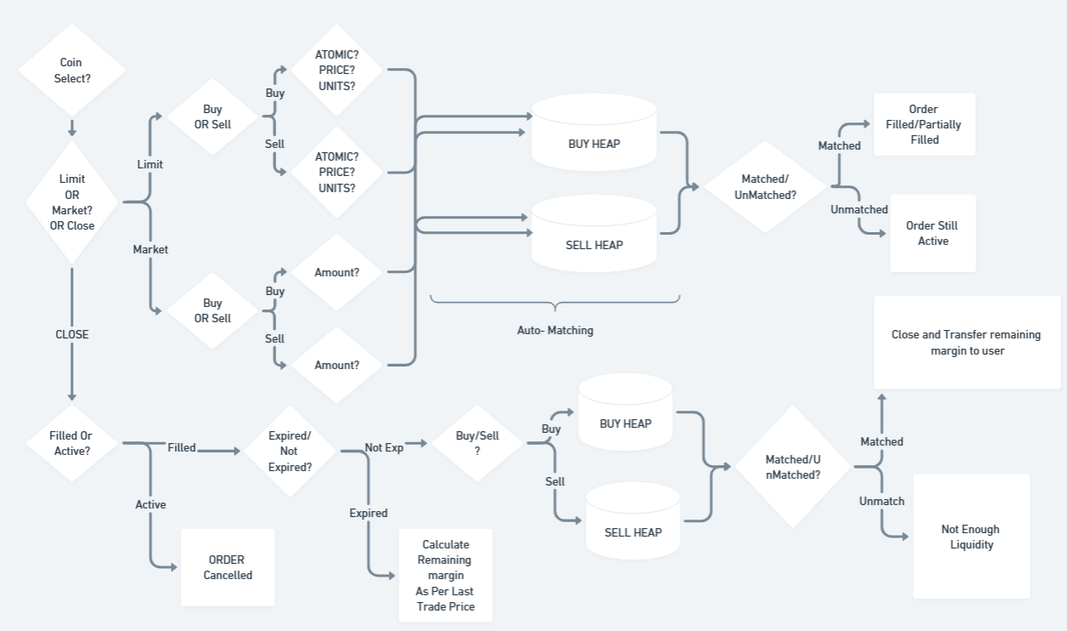
Workflow Diagram

Slide 5
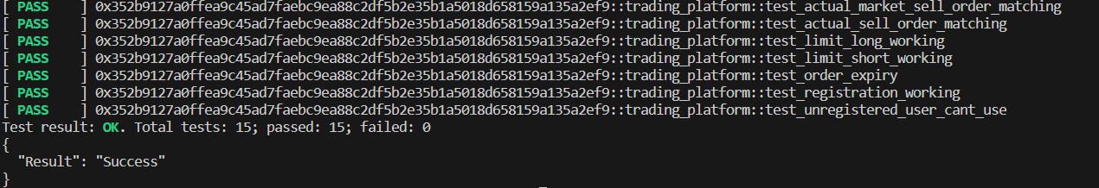
Technical Merit
1) Heavy Use of Data Structures -
2 Level of Heap Data Structures for Effective Matching
Price Level Heap and TimeStamp Heap
2) BackEnd Testing Using Move Test Functions -
15 TESTS Covering 90% BackEnd Code
3)Smart Contract Comprises 2000+ Lines of Code ( 4 Modules) and Extensive Use of Aptos Libraries and Documentation.
4)Use of Generics in Smart Contract To handle Multiple Coins Without Redundant Code. 5)

Slide 6
Utilization of Aptos BlockChain
1)Dedicated Resource Account For Storing Data
Mitigates the risk of unauthorized manipulation by administrators
Resource Account Acts as Secure Repository For Essential Data
2)Utilization of Fast Transaction Speed and High Throughput of Aptos BlockChain
The usage of heavy data structures in our smart contract, which might be impractical on platforms like Ethereum due to their slower processing speeds and higher gas costs, showcases one of the key advantages of the Aptos blockchain.
This technical merit highlights the superior infrastructure of Aptos for handling intricate and resource-intensive operations, making it a more suitable choice for our application's specific needs.

Slide 7


Utilization of Aptos BlockChain
3) Generic types: With a singular function entity to handle the future contracts, we used generic types available in Move to handle different type of tokens for the trade.
Using Generics Ensures Reducing Redundancy.
4) Safety: Aptos blockchain provides a much safer environment to develop applications compared to other blockchains. This becomes necessary when working with applications that are money sensitive.

Slide 8

Impact on the Aptos chain
APTOS Chain being a brand new blockchain, currently lack projects that help provide a user experience of major and old blockchains. The projects help create a sense of safe trading on-par with DEXs for future contracts. The project idea is not widely implemented even on older blockchains. A new decentralized platform, gives APTOS the much needed limelight that it deserves.

Slide 9
Our Roadmap
Initiative | Objective | 1 | 2 | 3 | 4 | 5 | 6 | 7 | 8 | 9 | 10 | 11 | 12
Understanding | Have a rough sketch about the features and ideas we would like to implement
Contracts | Creating a core application that facilitates creation of future contracts
Creating an MVP | Forming a frontend to help the end user interact with the contract
Research | Gathering the various possible feature addition over the basic product
Custom tokens | Include option for user to create contract with a custom token
Analyse feedback | Understand the opinion of the users who tried your product

Slide 10
DEMO

Slide 11

Market Strategy
Target Market Analysis
User-Friendly Interface
Identify and profile the target audience. Consider factors such as experience level, trading goals, and risk tolerance
A streamlined, intuitive design can make the trading process more accessible for both novice and experienced users.
Educational Resources
Risk Management Tools
A comprehensive educational program to empower users with the knowledge and skills needed for successful futures trading.
Features such as stop-loss orders, real-time margin calculations, and risk analytics can be provided in future updates.
Technology & Performance
Competitive Pricing
Low-latency execution, advanced charting tools, and real-time market data feeds are crucial in a futures trading application, which can be obtained on the Aptos ecosystem.
A competitive pricing model that aligns with the value offered by your platform, considering fee structures, account types, and any discounts or promotions for early adopters.

Slide 12
Future Potential
1. Integration of Liquidity Pools:
Current State: Our platform presently operates using an order book model for trading.
Future Potential: Embracing liquidity pools in our ecosystem.
Benefits:
Enhanced Market Liquidity: Liquidity pools contribute to a more liquid trading environment.
Automated Market Making: Implementation of automated algorithms for efficient trade execution.
User Participation: Encourages users to become liquidity providers and earn rewards.
2. Introduction of n-day Future Contracts:
Current Offering: Our current framework supports zero-day future contracts with a 24-hour expiration.
Future Enhancement: Expanding contract durations to n-days.
Advantages:
Diverse Trading Strategies: Allows users to engage in longer-term trading activities.
Strategic Planning: Facilitates the management of positions over extended time horizons.
Market Adaptability: Meeting the evolving needs of users and providing flexibility.

Slide 13




Thanks!

