Slide 1
eMaps
Fachpraktikum Algorithms on OpenStreetMap Data 19/20

Slide 2

Motivation
Electrically-powered vehicles important in fight against climate change
Unique characteristics:
Limited cruising range
Long recharge times
May run out of power
Adaption of route planners required!
Source

Slide 3
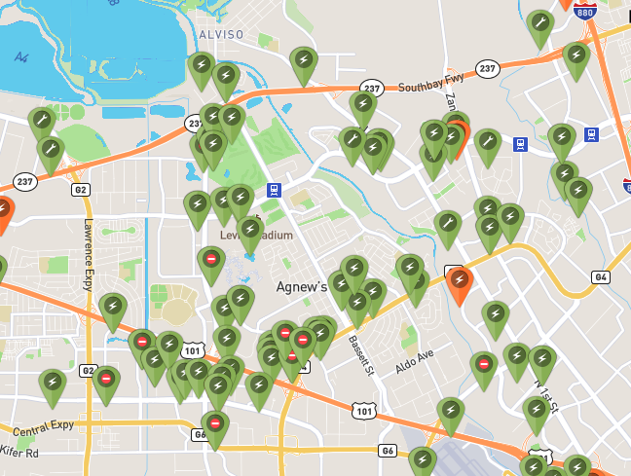
Idea
Route planner for e-Vehicles
Route planner should consider:
Current and maximum range of e-Vehicles
Availability of charging stations
Never running out of power
Source

Slide 4
Live Demo

Slide 5

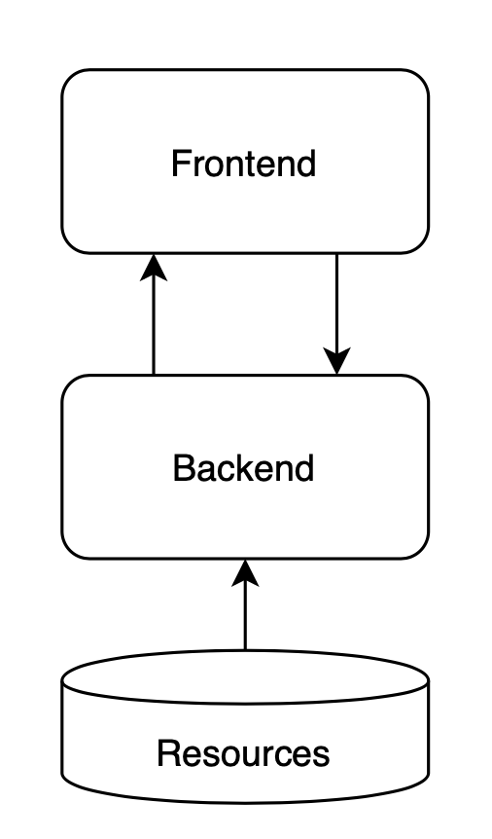



Architecture
Model-View-Controller
Resources: Raw OpenStreetMap data in PBF format
Backend: core functionality and API written in Rust
Frontend: display map and routes using React and Leaflet
Source
Source
Source
Source

Slide 6
Key Concepts
Parse amenities from OpenStreetMap data with {amenity: charging_station}
Parse vehicle supported by charging station, i.e. only Cars, only Bikes, or both
Extend graph with charging station nodes
Request for shortest path contains current and maximum range of e-Vehicle

Slide 7
Key Concepts
Start
Backend calculates distance of route
If distance within current range return route
Else: calculate route with charging station(s)
Calculate "optimal" charging station for current route
Start coordinates
Goal coordinates
Current range
Set current range to maximum range
45 km
60 km
100 km
45 km
70 km
Goal

Slide 8
Key Concepts
Calculate route with charging station
If distance from charging station to goal is within maximum range concatenate route + return
Else calculate route to next charging station until distance from charging station to goal is within maximum range

Slide 9
Other features
Search Cities, Places, POIs, … via Nominatim API
Show map of all charging stations

Slide 10
Limitations & Future Work
Determining charging station/route not optimal
Extend edges by a weight representing the energy consumption
Consider elevation profile to determine more energy efficient routes

Slide 11
Thank you!

