Slide 1

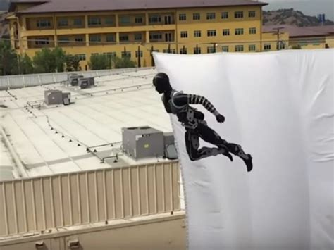
Senior Design Workshop: Mike Thorburn, Cal State LA

Slide 2
Contents
This is a framework to begin a model of the flight of an acrobot (robot-acrobat) called Stickman.
Modeled after the Disney Imagineering Stickman Project
https://la.disneyresearch.com/publication/stickman/
Set up for engineering design students to begin to build their own Simulink models as they develop their acrobot projects

