Slide 1

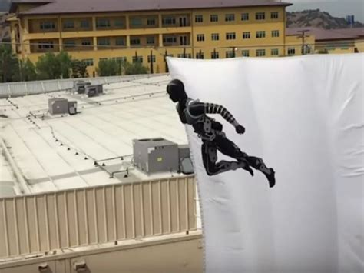
Senior Design Workshop: Mike Thorburn, Cal State LA

Slide 2
Contents
This is a framework to begin a model of the flight of an acrobot (robot-acrobat) called Stickman.
Modeled after the Disney Imagineering Stickman Project
https://la.disneyresearch.com/publication/stickman/
Set up for engineering design students to begin to build their own Simulink models as they develop their acrobot projects

Slide 3
Some Tasks You Can Do To Get Started
Update the mass and moments of inertia of your acrobot
Determine how the moments of inertia change and model the rate of change accordingly
Update the two models so that they can be one continuous model controlled by StateFlow
Add aerodynamic drag
Program your acrobot event control sequence (backflip? Something else?)
The controls are all open-loop (feed-forward). Add sensors and closed-loop controls.

