Slide 1


Introduction to R for Beginners
Lyda Hill department of Bioinformatics 2022 Nano-course Series
Date & Time: May 9-10: 9AM-5PM (NG3.202)
Course Instructors: Christopher Chaney, Amit Amritkar, & Micah Thornton

Slide 2
Overview & Schedule

Slide 3
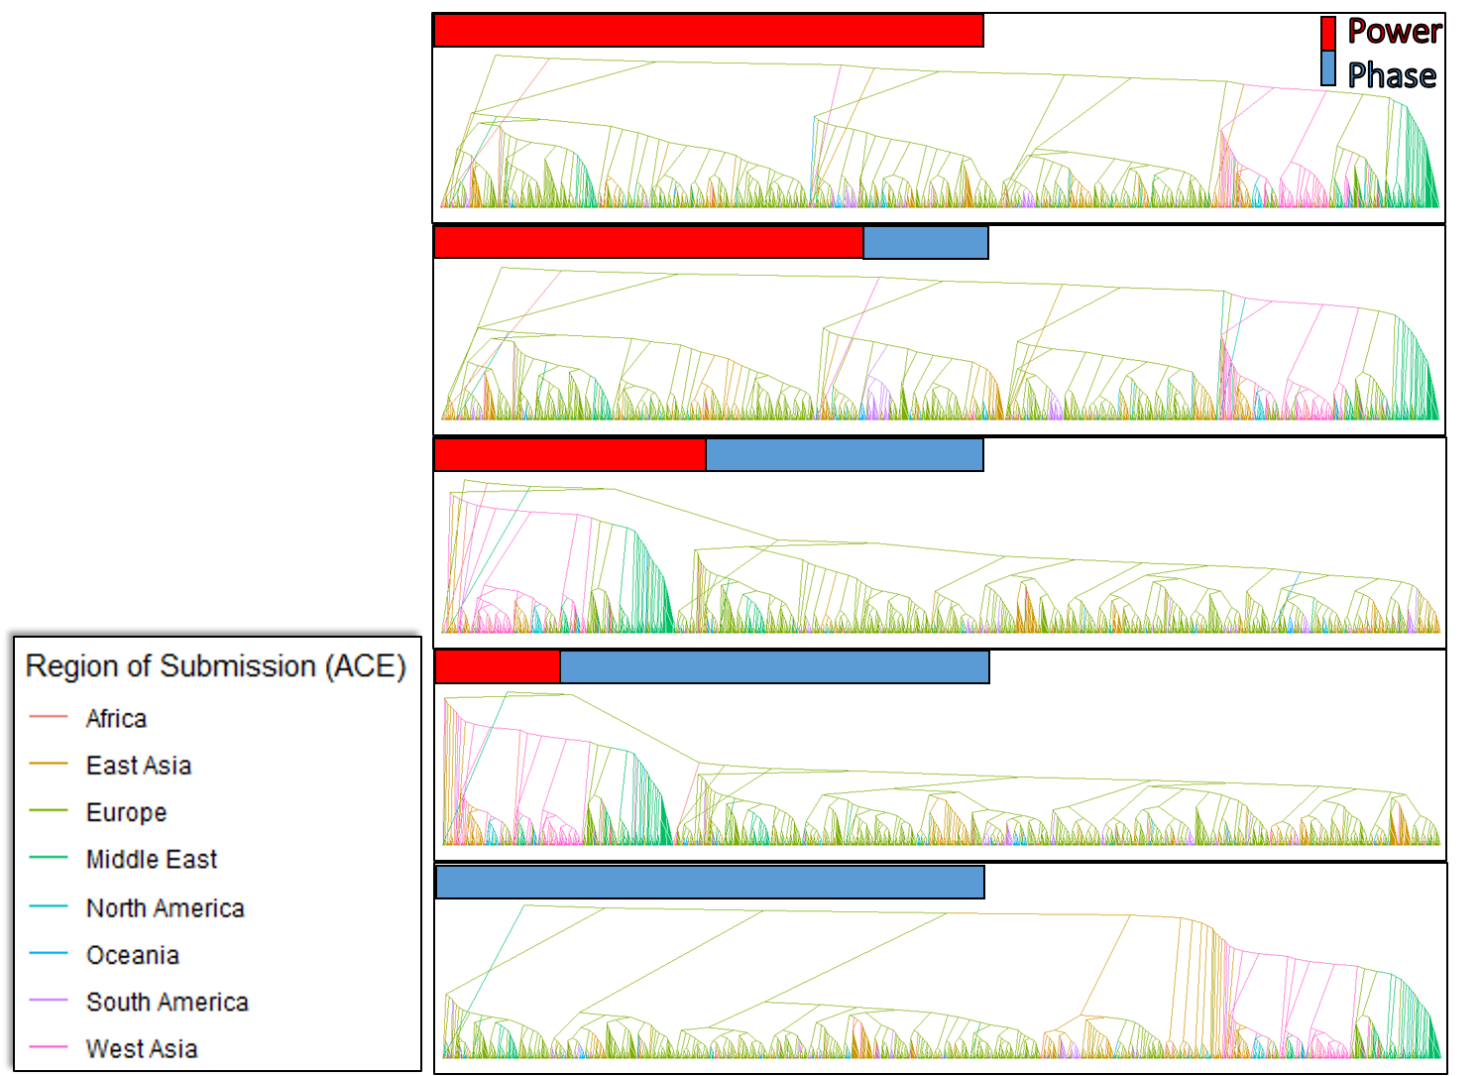
Motivation (Why Learn R? 1)
Create High-Quality graphics for your publications, utilizing state of the art statistical procedures such as Ancestral Character Estimation for Alignment Free Genetic Distance Comparisons for example (package afgencomp and ace)
Phylogenies for 1,397 SARS-CoV-2 genomes by Colored by Location, distances computed from sequences alone.
Taken from “Phase & Power in Genomic Harmonic Analysis”, ISMVL 2022
with author permission.

Slide 4
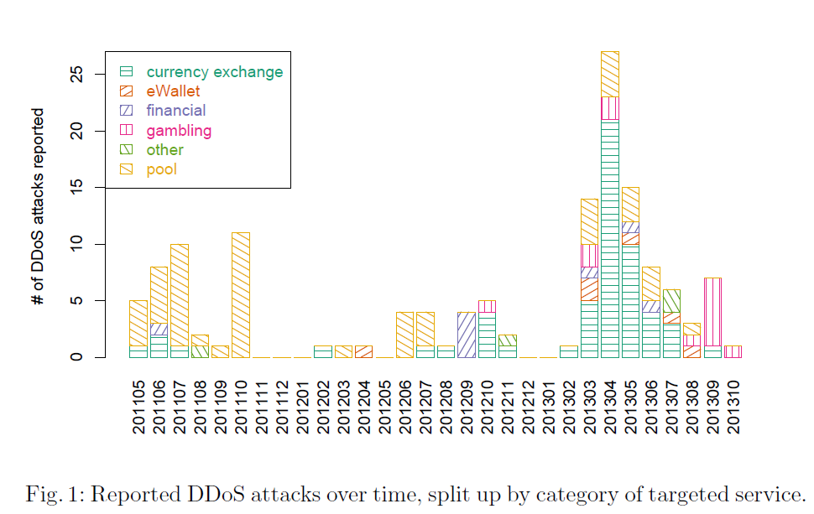
Motivation (Why Learn R? 2)
Take advantage of packages for publishing nice black and white displays of complex information.
Taken from “Empirical Analysis of Denial-of-Service Attacks in the Bitcoin Ecosystem”, Financial Cryptography 2014
with author permission.

Slide 5
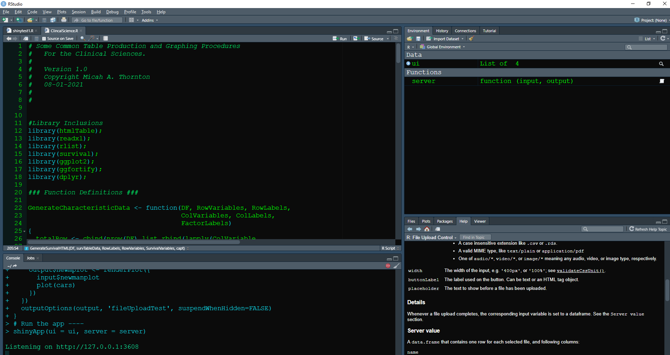
Motivation (Why Learn R? 3)
Powerful IDE (Integrated Development Environment) for creating many different kinds of R Codes.
We will be using R-Studio in this course.
Example R-Studio Environment displaying ClinicalSciences code.

Slide 6
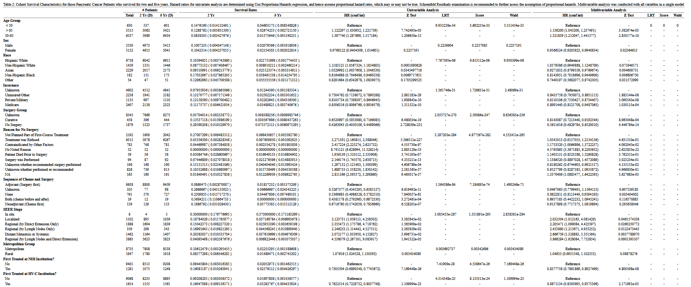
Motivation (Why Learn R? 4)
Use classical and modern modeling procedures (such as Cox Proportional Hazards models) and create custom tabulation and display procedures.
From “Early PDAC Survival Modeling” project, with permission from author.

Slide 7
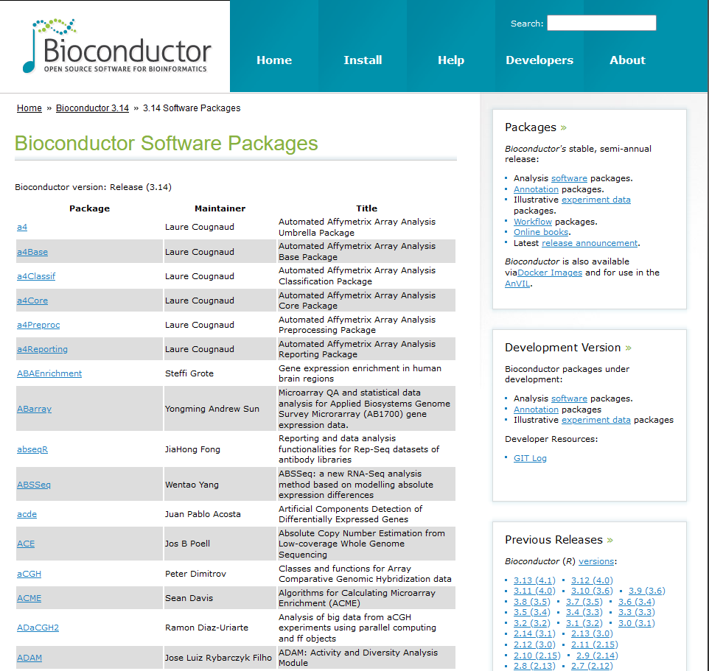
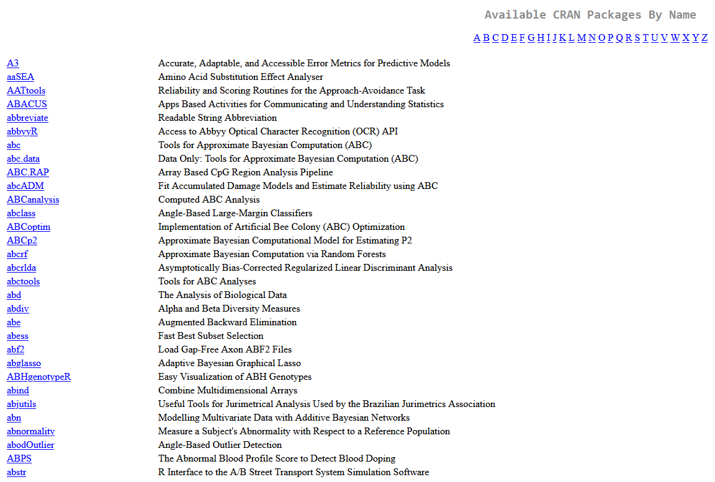
Motivation (Why Learn R? 5)
Thousands of R-Packages in different Repositories such as CRAN and Bioconductor for implementing hundreds of thousands of statistical procedures.
From https://cran.r-project.org/web/packages/available_packages_by_name.html and https://www.bioconductor.org/packages/release/bioc/

Slide 8
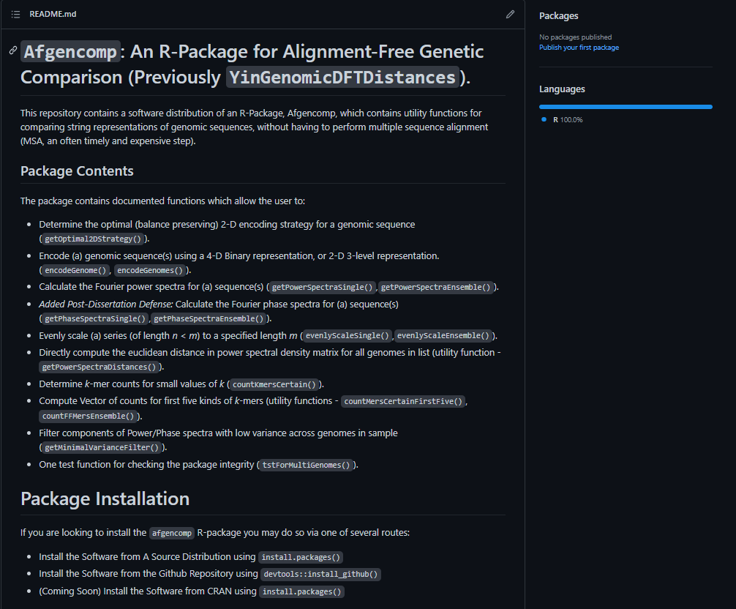
Motivation (Why Learn R? 6)
Create your own R-Packages for implementing routine procedures, and share easily with your colleagues.
From “Afgencomp: An R-Package for Alignment-Free Genetic Sequence Comparison” project, with permission from author.

Slide 9
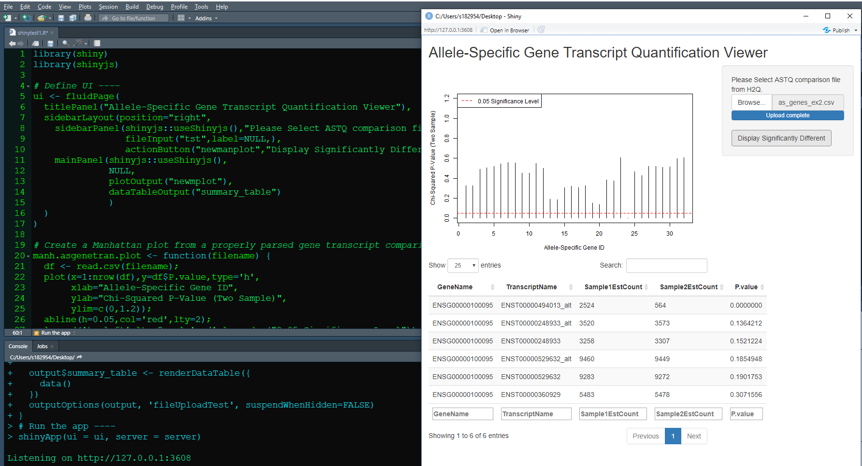
Motivation (Why Learn R? 7)
Use R-Shiny to produce Simple but powerful GUI for standardizing data analysis.
From “H2Q: Allele-Specific Gene Transcript Quantification” project, with permission from author.

Slide 10
Motivation (Why Learn R? 8)
Use R-Shiny to produce Simple but powerful GUI for standardizing data analysis.
From “H2Q: Allele-Specific Gene Transcript Quantification” project, with permission from author.

Slide 11
Why Learn R? (Summary)
Widely used for Statistical Analysis and Machine Learning approaches.
Vector-based language provides ability for quick implementation of parallel procedures.
Very large community allows:
frequent opportunities for courses and learning,
support of interested peers on R-development projects,
and a considerable number of packages implementing various statistical and machine learning models.
R-packages such as RCPP allow users to write subroutines requiring speed and finesse directly in C++, then embed these into their R-Programs.
Much, much more…

Slide 12



Meet the Team
Introduction to R for Beginners
Lyda Hill Department of Bioinformatics
2022 Nanocourse Instructors
Christopher Chaney, M.D. Assistant Professor
Internal Medicine
Amit Amritkar, Ph.D
Computer Scientist
Dept. of Bioinformatics
Micah Thornton, Ph.D. Post-Doctoral Researcher
Dept. of Bioinformatics

Slide 13
Tentative Schedule – Monday May 9th
Introduction to R for Beginners

Slide 14
Tentative Schedule – Tuesday May 10th
Introduction to R for Beginners

Slide 15
Resources for Learning R Used in This Course
The R Carpentry Tutorials (Amit Amritkar)
https://datacarpentry.org/R-ecology-lesson/01-intro-to-r.html
R Studio (Integrated Development Environment)
https://www.rstudio.com/
The R Language
https://www.r-project.org/
2022 Lyda Hill department of Bioinformatics Introduction to R for Beginners Nanocourse Github Repository
https://github.com/mathornton01/2022_UTSW_Lyda_Hill_Department_Beginning_R_Nanocourse

Slide 16
Additional Resources for Learning R

