Slide 1
Introduction to NGS Analysis (Day 2)
Lyda Hill department of Bioinformatics 2022 Nanocourse Series
Date & Time: May 19-20: 9AM-5PM (NG3.202)
Course Instructors: Bo Li, Daehwan Kim, Christopher Chaney, & Micah Thornton

Slide 2
Day 2: Section IV (Using IGV, and Genotype Information to Assess Phenotype in Human Genomic Data)

Slide 3
What you will learn in this Section (2 Parts)
What is the Integrative Genomics Viewer (IGV)?
History & Background Information.
How to Access the IGV:
Local installation of IGV.
Accessing IGV using the BioHPC and training accounts (associated with this nanocourse).
How to analyze human and other kinds of sequencing data to determine where variants are.
How to Analyze RNA Sequencing Data using the Hisat2 Alignment tool.

Slide 4
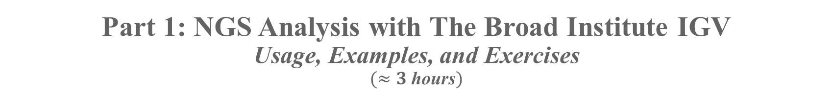
Part 1: NGS Analysis with The Broad Institute IGV
Usage, Examples, and Exercises
$(≈3$ hours$)$

Slide 5
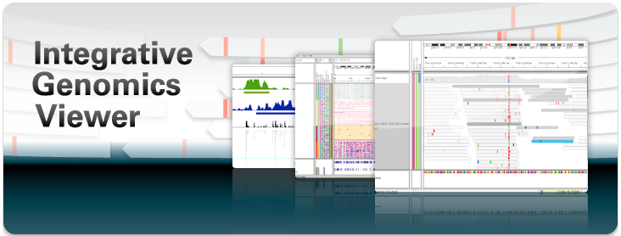
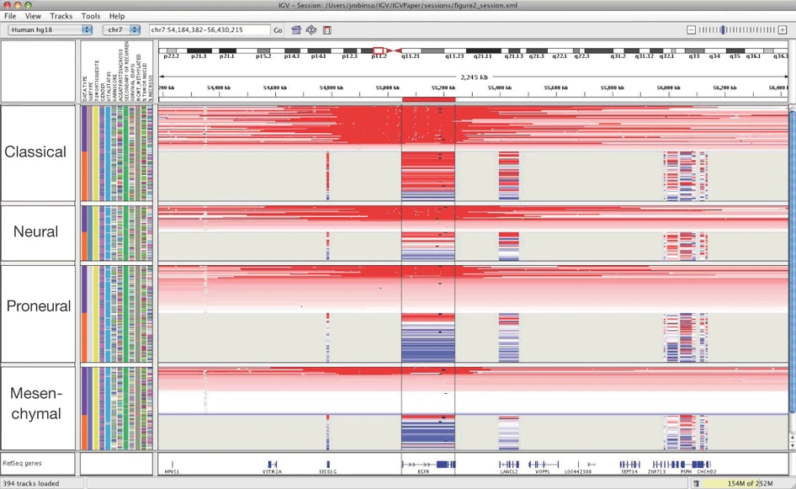

The Broad Institute Integrative Genomics Viewer
Developed and Maintained by the Broad Institute:
A Joint Institute of Harvard and MIT.
Founded in 2004 (from organizational remnants of the Human Genome Project) for the purposes of [from https://www.broadinstitute.org/about-us ]:
“Illuminating Human Disease”
“Reading and Editing Genomes”
“Sharing Data and Tools”
“Building Communities”
“Developing Diagnostics and Treatments”
“Collaborating, Innovating, and Empowering”
Integrative Genomics Viewer (IGV) is a software environment for analyzing NGS data
Provided and maintained by The Broad Institute, with IGV team based at UC San Diego, and MIT/Harvard Broad Institute.
Supported by funding from:
The National Cancer Institute (NCI)
The National Institutes of Health (NIH)
Informatics Technology for Cancer Research (ITCR)
Starr Cancer Consortium
From Robinson, J., Thorvaldsdóttir, H., Winckler, W. et al. Integrative genomics viewer. Nat Biotechnol 29, 24–26 (2011). https://doi.org/10.1038/nbt.1754

Slide 6
Locally Installing the IGV

Slide 7
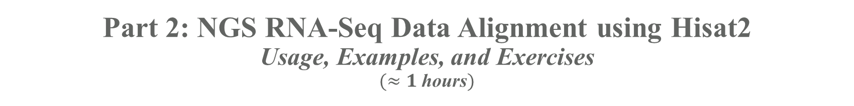
Part 2: NGS RNA-Seq Data Alignment using Hisat2
Usage, Examples, and Exercises
$(≈1$ hours$)$

Slide 8
References for Further Information and Practice

Slide 9
Thank you for your attention & Interest!
Please do not forget to complete the course survey! ☺.

