Slide 1
Introduction to NGS Analysis (Day 2) Session IV
Lyda Hill department of Bioinformatics 2022 Nanocourse Series
Date & Time: May 19-20: 9AM-5PM (NG3.202)
Course Instructors: Bo Li, Daehwan Kim, Christopher Chaney, & Micah Thornton

Slide 2
Day 2: Session IV (Using IGV, and Genotype Information to Assess Phenotype in Human Genomic Data)

Slide 3
What you will learn in this Session (2 Parts)
What is the Integrative Genomics Viewer (IGV)?
History & Background Information.
How to Access the IGV:
Local installation of IGV.
Accessing IGV using the BioHPC and training accounts (associated with this nanocourse).
How to analyze human and other kinds of DNA sequencing data to determine where variants are.
How to load the proper data, and find information in online databases.
How to determine whether SNPs are hetero or homozygous
Introduction to checking for errors such as strand bias.
How to analyze mouse and other kinds of RNA sequencing data to determine where variants are.

Slide 4

Part 1: NGS Analysis with The Broad Institute IGV
Usage, Examples, and Exercises
$(≈3−3.5$ hours$)$

Slide 5
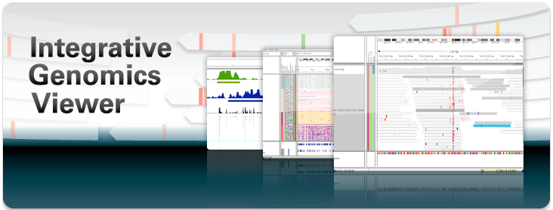

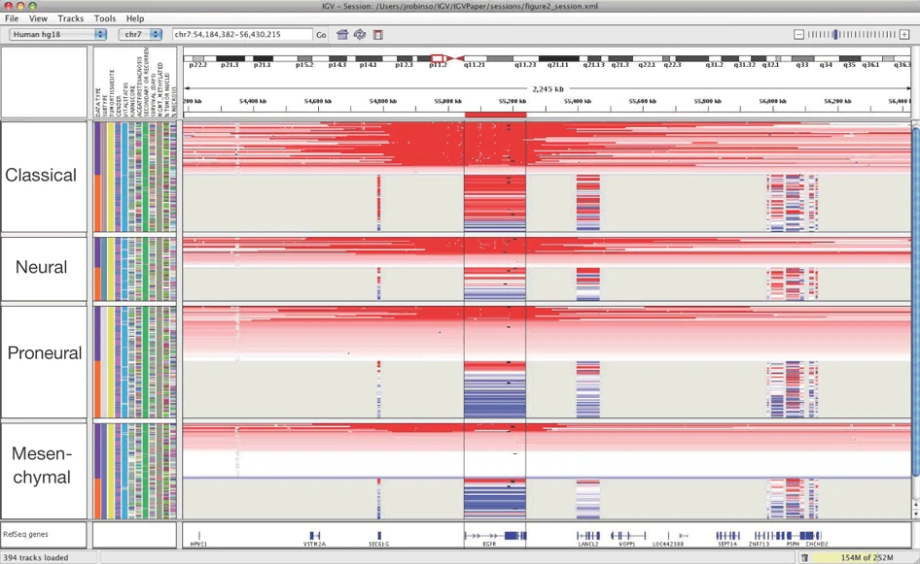
The Broad Institute Integrative Genomics Viewer
Developed and Maintained by the Broad Institute:
A Joint Institute of Harvard and MIT.
Founded in 2004 (from organizational remnants of the Human Genome Project) for the purposes of [from https://www.broadinstitute.org/about-us ]:
“Illuminating Human Disease”
“Reading and Editing Genomes”
“Sharing Data and Tools”
“Building Communities”
“Developing Diagnostics and Treatments”
“Collaborating, Innovating, and Empowering”
Integrative Genomics Viewer (IGV) is a software environment for analyzing NGS data
Provided and maintained by The Broad Institute, with IGV team based at UC San Diego, and MIT/Harvard Broad Institute.
Supported by funding from:
The National Cancer Institute (NCI)
The National Institutes of Health (NIH)
Informatics Technology for Cancer Research (ITCR)
Starr Cancer Consortium
Written in Java, hence allowing use of platform independent jvm.
From Robinson, J., Thorvaldsdóttir, H., Winckler, W. et al. Integrative genomics viewer. Nat Biotechnol 29, 24–26 (2011). https://doi.org/10.1038/nbt.1754
A
C
G
T

Slide 6
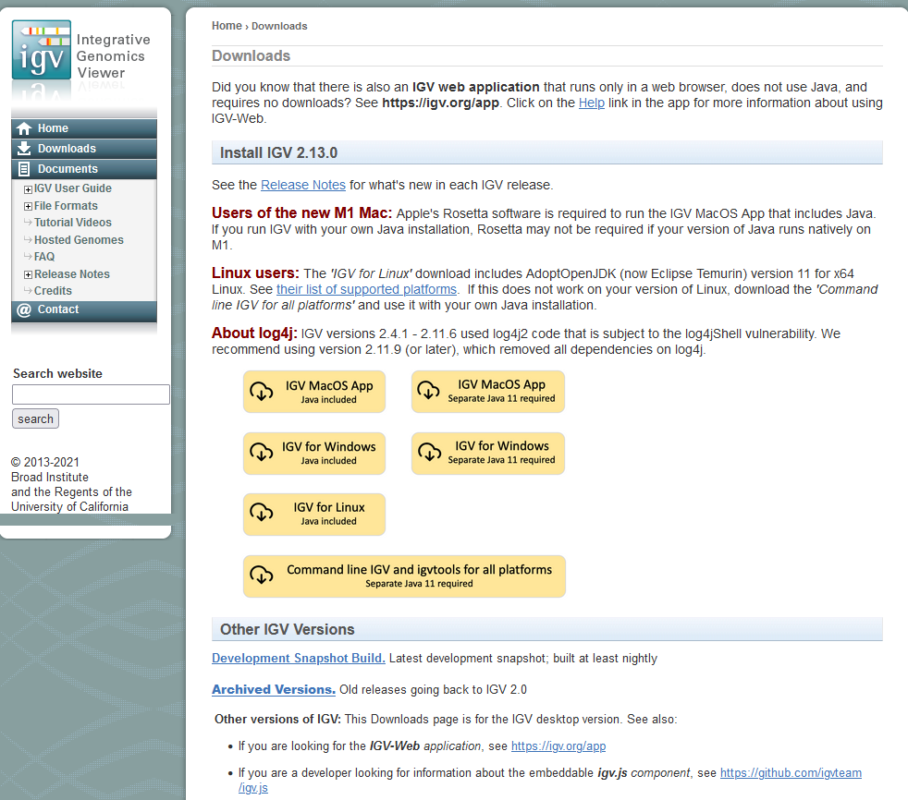
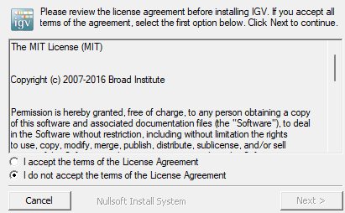
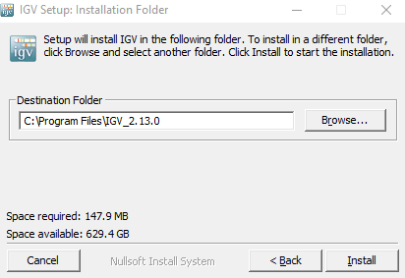
Locally Installing the IGV
IGV is freely available for download and use, and since it was written using java, versions exist for all major operating systems (on which the JVM can run):
Mac OS
Windows
Linux
Very non-restrictive license.
May do many things, as long as copy of original license included.
More info: https://choosealicense.com/licenses/mit/
Note: Must agree to The MIT License to install and use IGV.

Slide 7
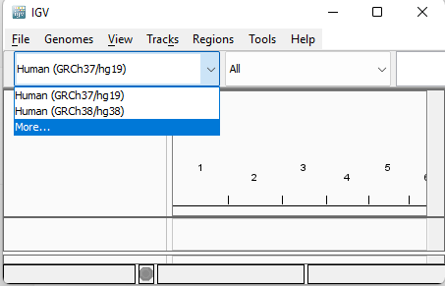
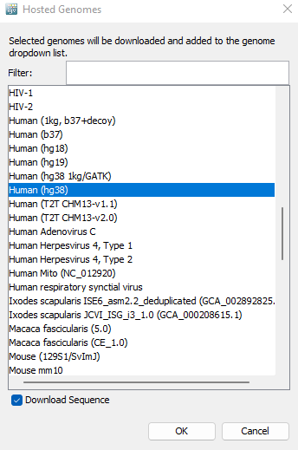
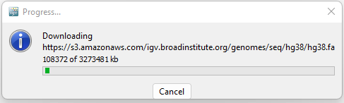
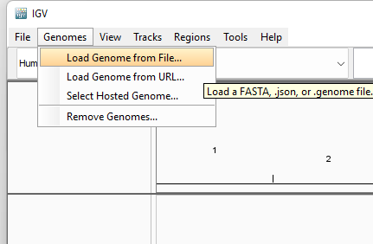
Installing new reference genomes in IGV
Recall that reference genomes are very large files which contain FASTA format versions of the consensus of many samples of the same organism.
The most commonly used version of the human reference genome is called GRCh38, which was the co-ordinated result (by the Genome Reference Consortium) of many different studies including
1000 Genomes Project
GRCh38 was released in December of 2013.
Most recent version February 2022
Gapless except chromosome Y.
Many different references available for download!
Can also install directly from downloaded or
Manually assembled FASTA reference file.

Slide 8
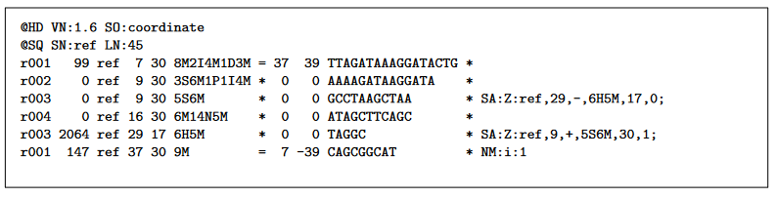
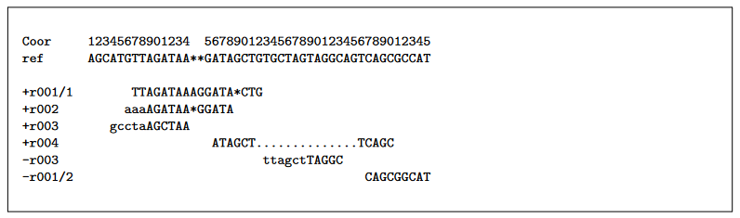
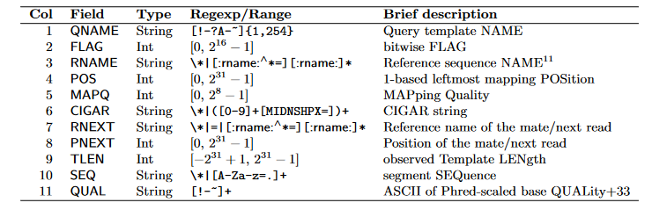
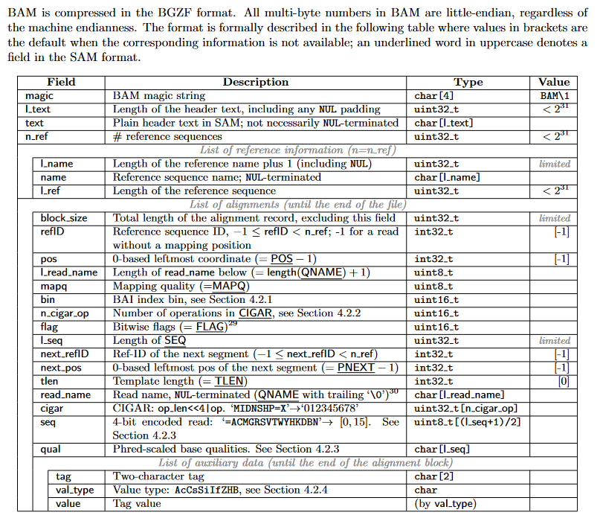
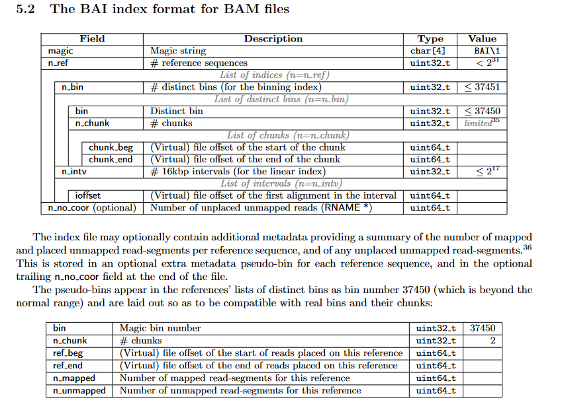
-bS
Loading a Sequence Alignment Map File (aligned sequencing reads file)
Two Result Files necessary for display:
Binary Alignment Map (.bam)
Binary Alignment Index (.bai)
Example SAM output (input to igv)
Alignment tool:
HISAT2
Bowtie
BWT
STAR
Example Queries and Reference (input reads to aligner)
samtools view -bS file.sam > file.bam
Fields of SAM
samtools sort file.bam –o file
samtools index file.bam
Format Specification Images all defined in SAM format document, images from document available below, with more detail:
https://samtools.github.io/hts-specs/SAMv1.pdf
(SAM Specification)
BAI – Binary Alignment Index
BAM – Binary Encoding of SAM

Slide 9
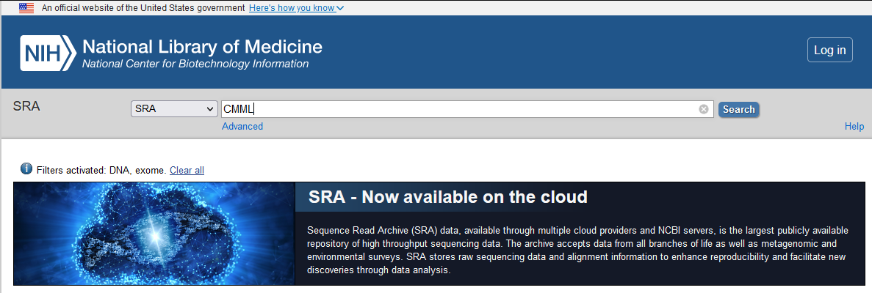
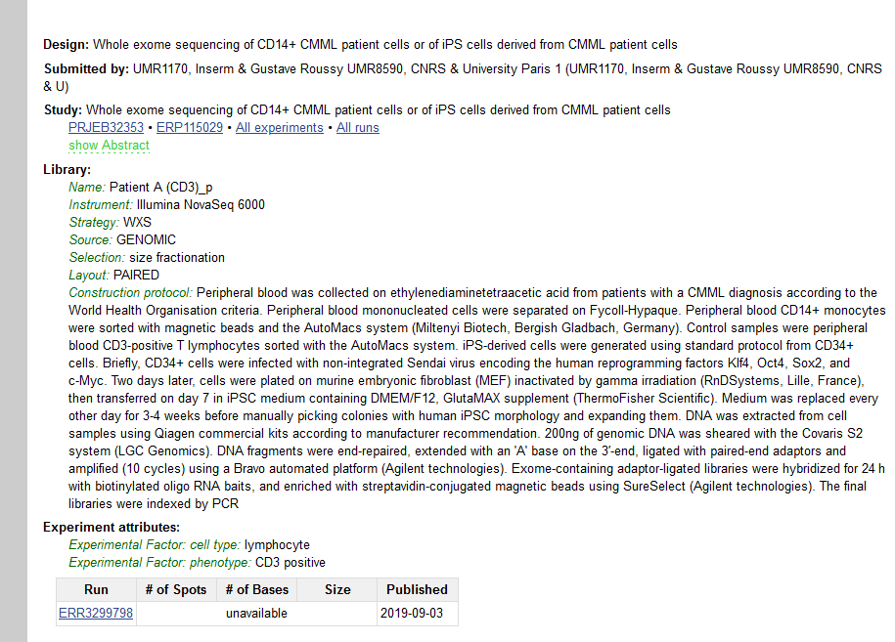
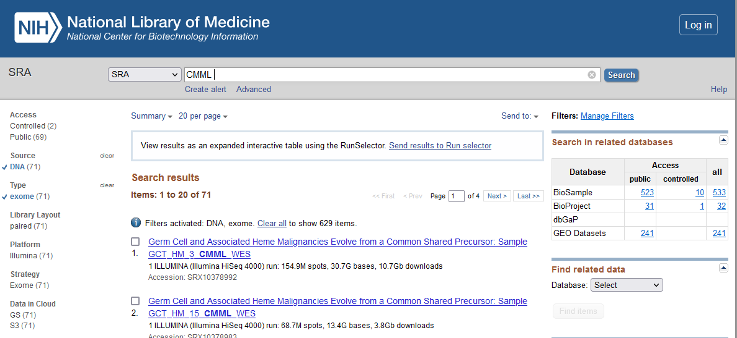
Finding and downloading Read Files for your analyses using SRA
Note: Add to .bashrc for persistent use
One way: Get sra-toolkit for linux! (or windows subsystem for linux)
Go to the sequencing reads archive (NCBI SRA)
https://www.ncbi.nlm.nih.gov/sra/
Create your search for the terms you are interested in investigating (Ie. “CMML”)
Select a result from those displayed (Bonus, use filters to subset the results displayed)
wget http://ftp-trace.ncbi.nlm.nih.gov/sra/sdk/2.4.1/sratoolkit.2.4.1-ubuntu64.tar.gz
tar xzvf sratoolkit.2.4.1-ubuntu64.tar.gz
export PATH=$PATH:/directory/sratoolkit.2.4.1-ubuntu64/bin
https://www.reneshbedre.com/blog/ncbi_sra_toolkit.html
(SRA Toolkit Download Full Tutorial)
Use ‘prefetch’ command to speed up fastq-dump
To download only a specific number of reads uses the –X flag with fastq-dump (note prefetch fetches the entire file by default, the –X flag for prefetch does something different.)
fastq-dump –X <# reads/pairs> ERR3299798
1
3
This will download a fastq file,
Caution, fastq files can be quite large!
2

Slide 10
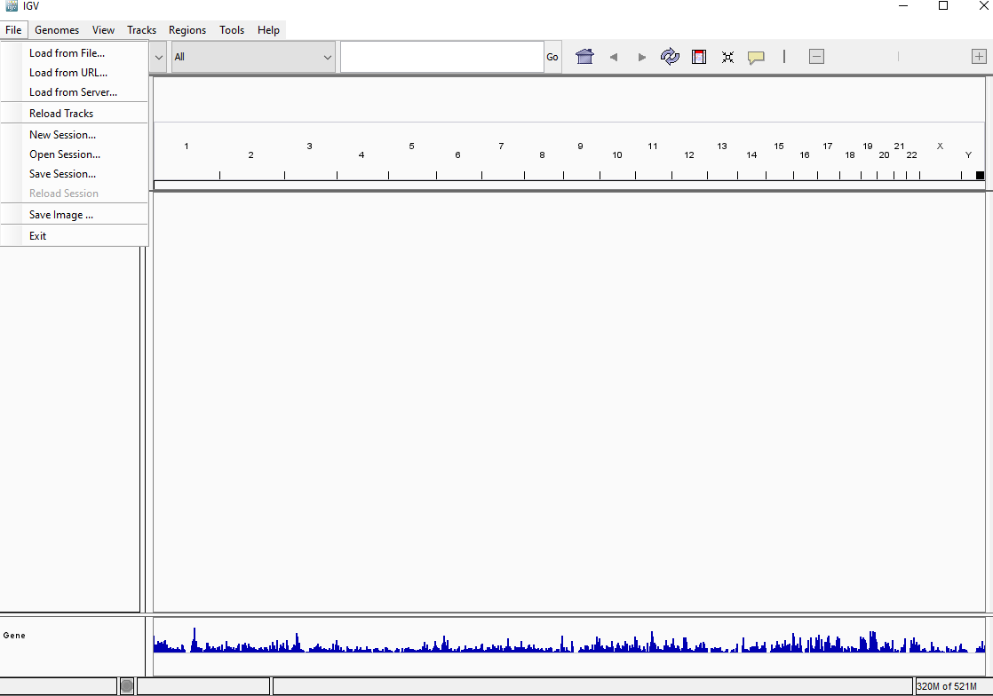
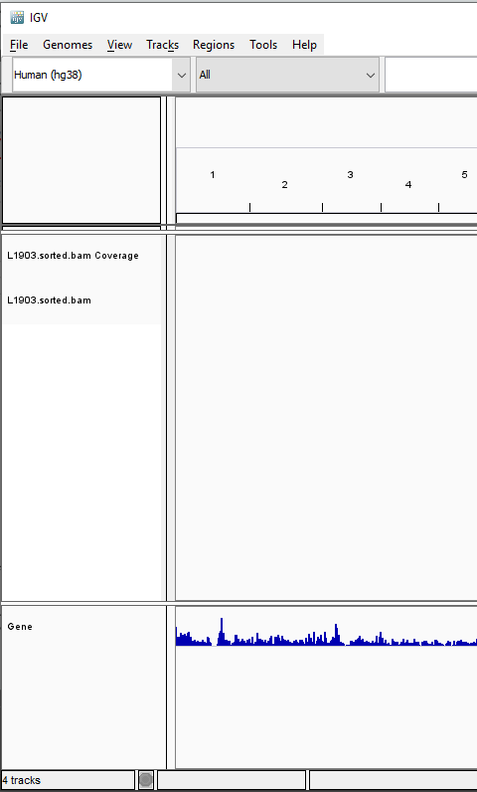
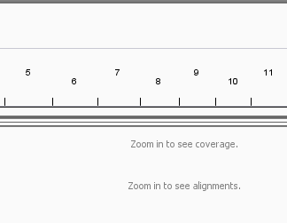
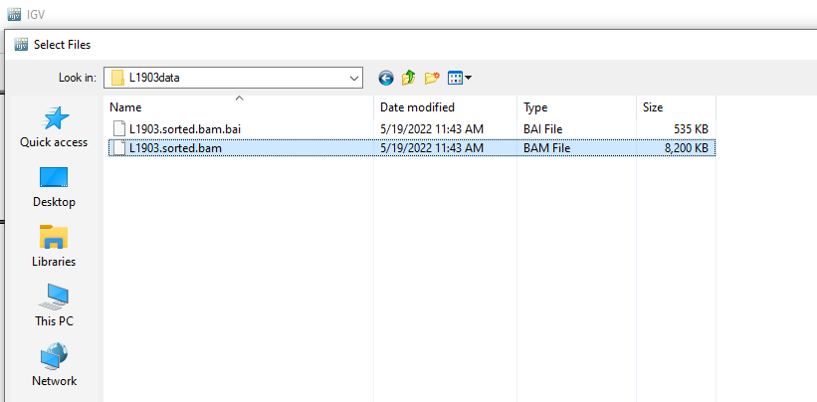
Loading a Sequence Alignment Map File (aligned sequencing reads file)
In this section we will look at some human sequencing reads that have been aligned to the human reference genome (GRCh38) using the HISAT2 software aligner.
The data has been converted into the binary format (BAM) using samtools, and an index has been properly created using the same (BAI).
Loaded files appear in the left-hand column (along with rows for coverage). These are called TRACKS.
1
3
To save memory,
At this full genome level resolution (all chromosomes shown) reads not shown, must zoom in first.
Load BAM and BAI files into IGV.
2
Locate and select the .bam file (.bai *must* be within the same directory).

Slide 11
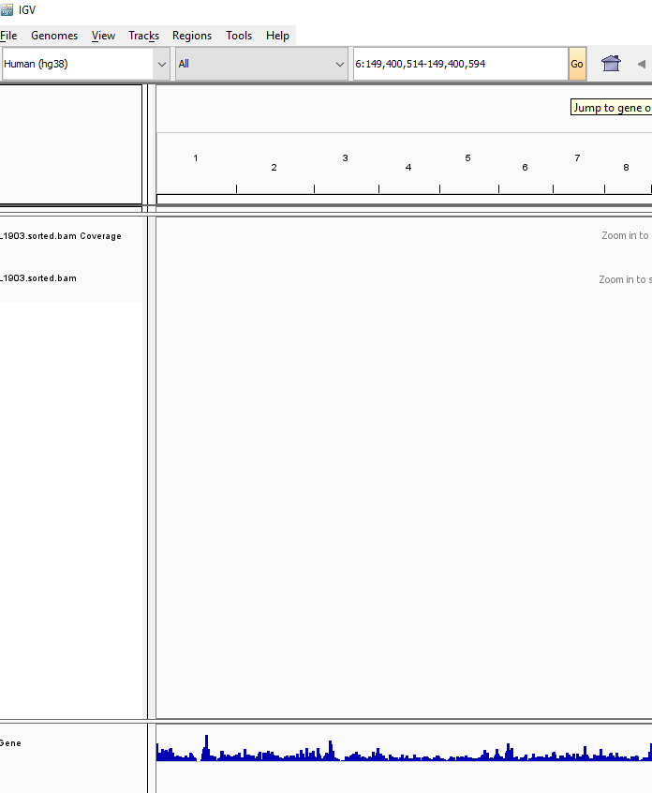
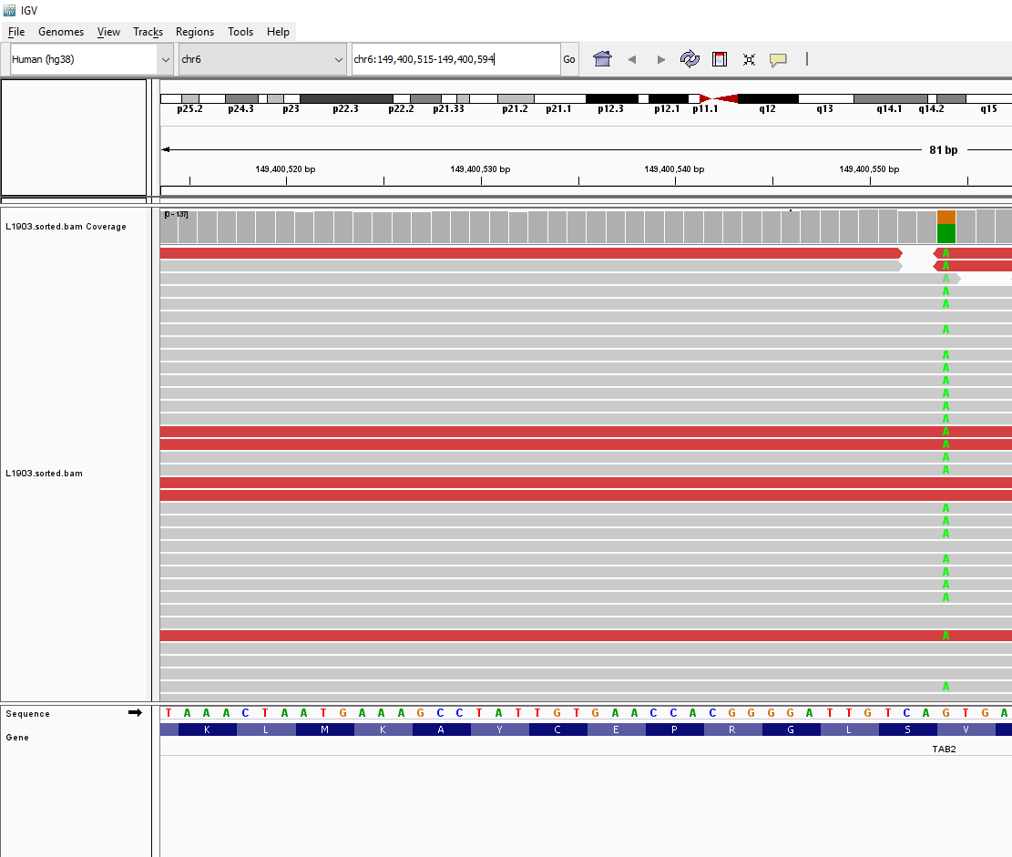
Selecting a new location in a reference genome with IGV
A
C
G
T
IGV Will not display reads at the full-reference level, (or in many cases even the chromosome level by default).
We will change this in view>preferences soon.
For now, we can change both the window zoom level (range) and location by specifying them in the “Enter a gene or locus” search box in the center of the top tool bar.
We would like to view between reference locus 149,400,514 and 149,400,594 (90 bases) on chromosome 6.
We can specify this as: “6: 149,400,514-149,400,594”
At this level of resolution (90 bp) we get coverage information from the bam/bai in the form of a histogram, read alignment information where reference matches are grey, and alternative bases are colored and labeled from the bam/bai, and reference sequence information from the reference selected.

Slide 12
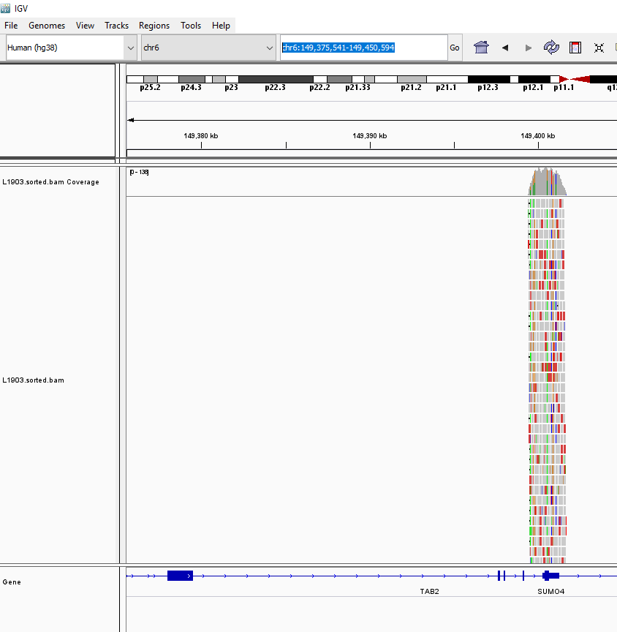
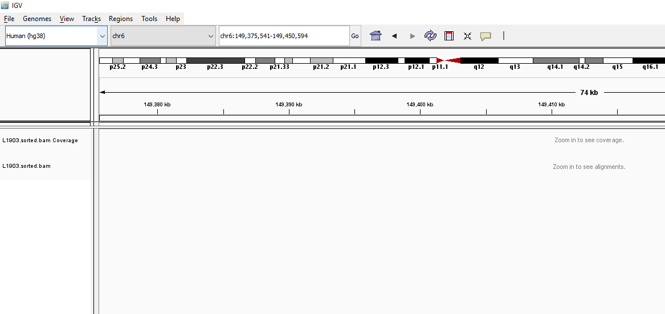
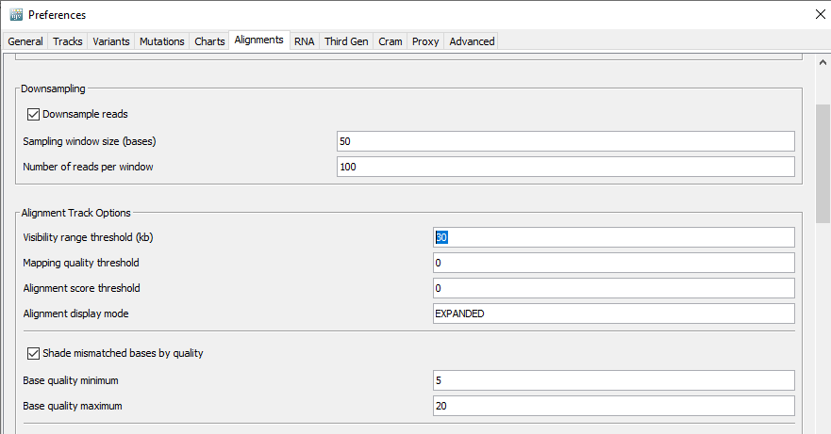
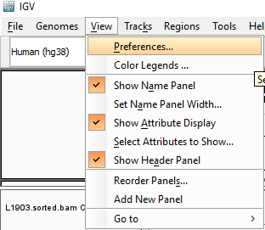
Selecting a new location in a reference genome with IGV (changing visibility range)
A
C
G
T
Now we can see reads at this level of resolution,
Note reference just displays gene at this level.
Change the zoom level for this region to examine the coverage in the file on a larger scale.
chr6:149,375,541-149,450,594
Note, zoom in to see coverage re-appears.
To change the default for displaying coverage to allow viewing at this level go to
view>preferences>Alignments
In the Alignment Track Options box, change the Visibility range threshold (kb) from 30 to 60 and press “save”.
Change visibility range threshold to 60 kb.

Slide 13
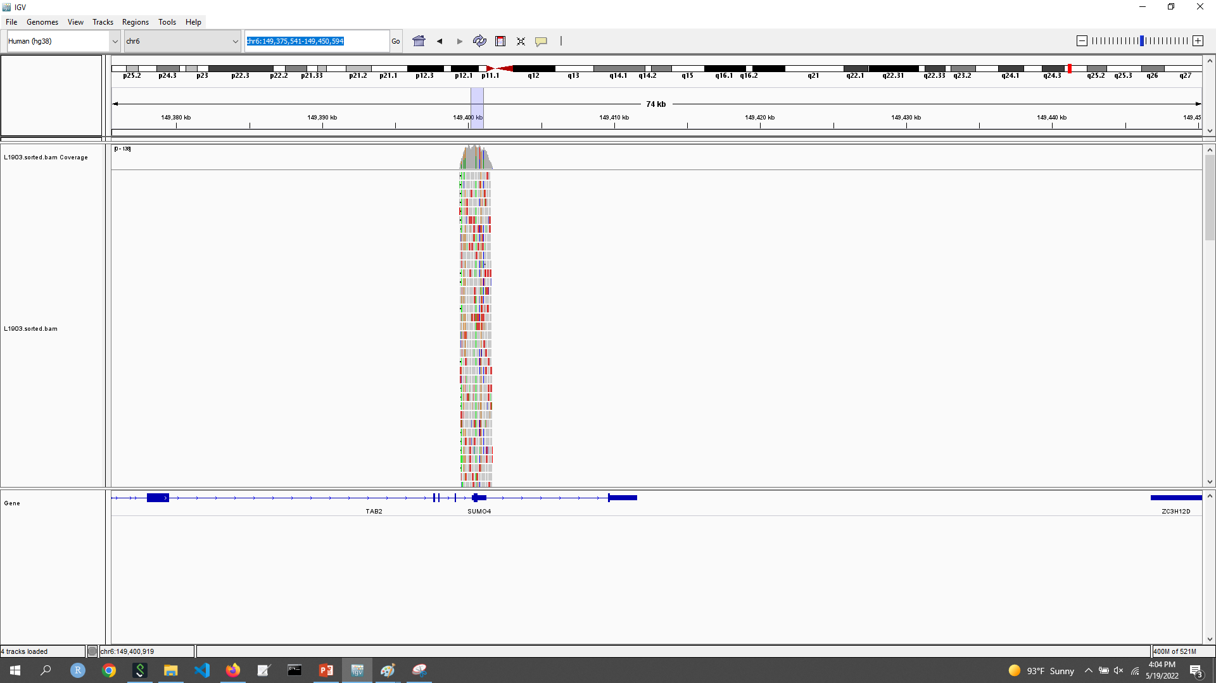
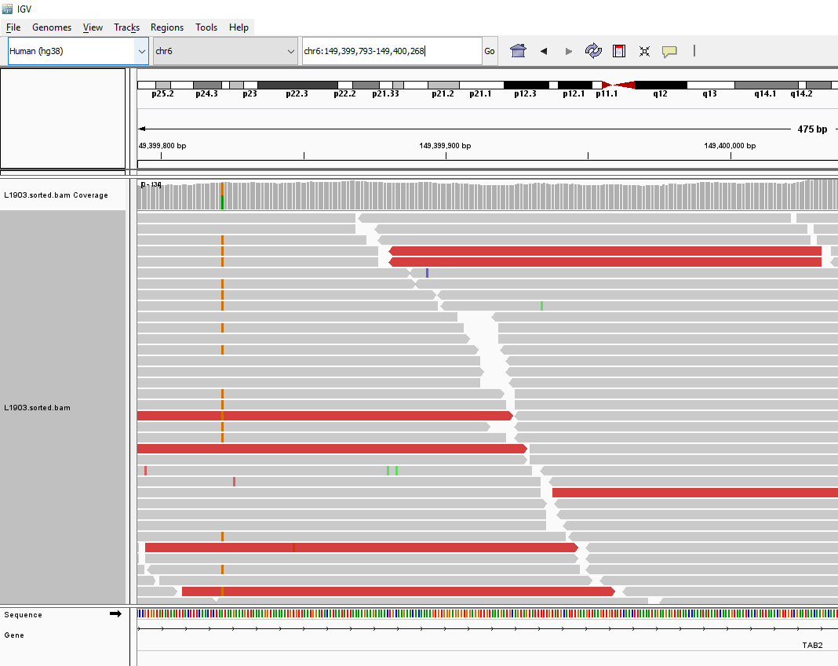
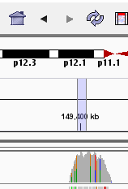
A
C
G
T
Navigating in the IGV Browser Window.
6:149,399,793-149,400,268
Click and drag in this area to select a region to investigate
At this level of resolution we can see bases are labeled by color in the reference
Those reads with base calls differing from the reference are marked by color, those which are the same are grey.
Click and drag in this region to pan manually in the sample.
Scroll in this region to view more reads and files.

Slide 14
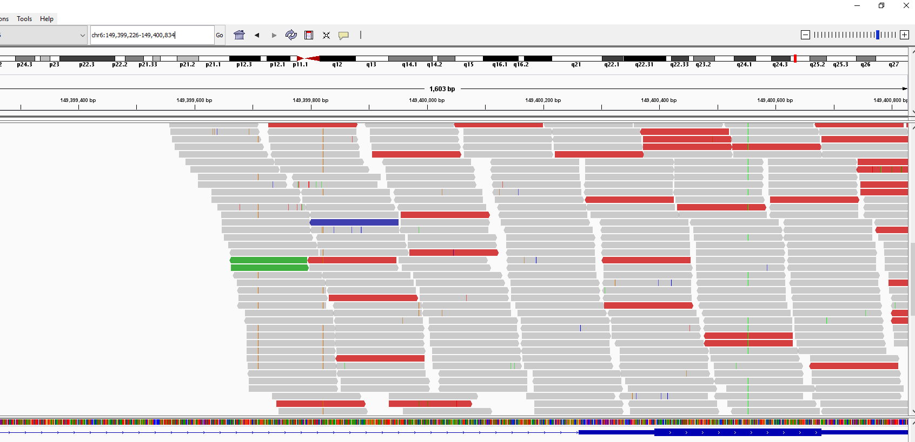
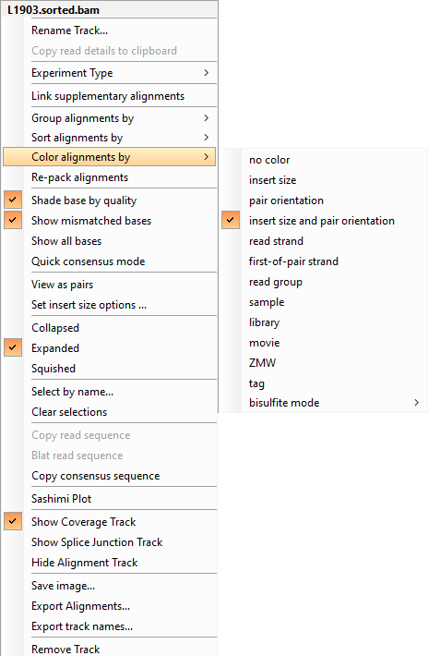
A
C
G
T
Navigating in the IGV Browser Window.
Zoom in and out manually with ‘+’ and ‘-’ buttons here.
6:149,399,226-149,400,834
Notice at this level of resolution that reads are sometimes displayed with different colors.
Red indicates there is possible evidence of deletion
Blue indicates that there is possible evidence of an insertion
Green indicates orientation of the read orientation RL
We can change what the colors refer to, by right clicking in the read display area (we can see it is insert size (red and blue) and pair orientation (shades of blue and green) by default). For more info about interpreting these see:
https://software.broadinstitute.org/software/igv/interpreting_pair_orientations

Slide 15
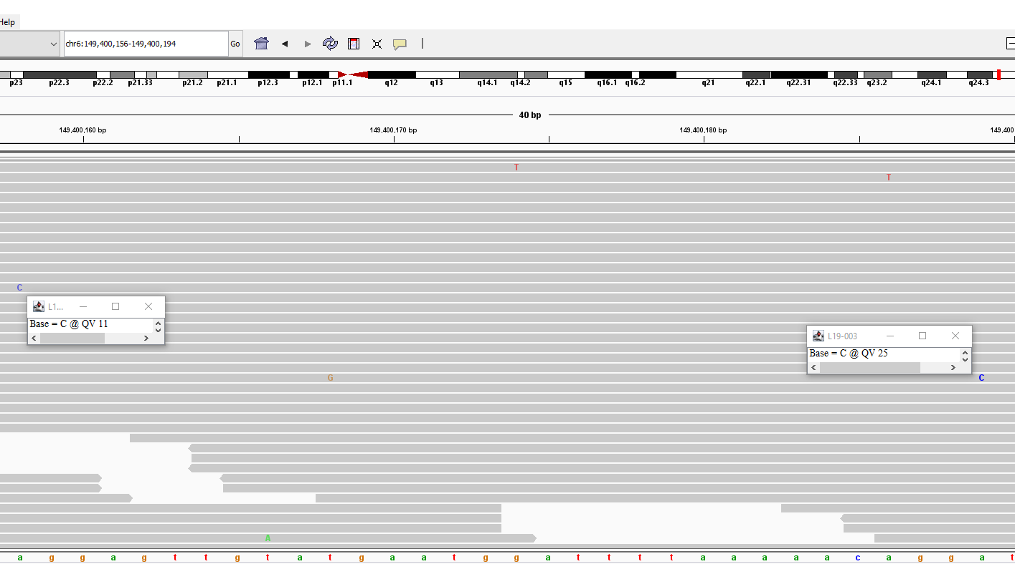
A
C
G
T
Navigating in the IGV Browser Window.
6:149,400,156-149,400,194
By Default, at this higher level of resolution the actual reference and base character is shown, we can see that they are also shaded lighter and darker by default depending on the quality value.

Slide 16

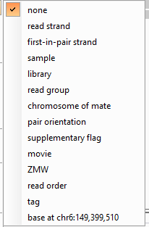
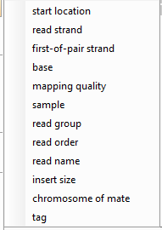
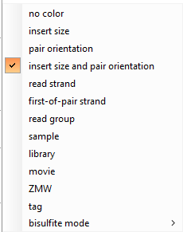
Changing IGV Window Options
In the right click menu, we can toggle the options in the display window, for instance, we can:
Change the name on the left, with rename track…
Change the Experiment type (other, RNA, 3rd gen)
Add additional alignments
Group alignments,
Sort alignments,
Color alignments,
Repack – redisplay
Toggle shading characters (darker for higher quality)
Toggle Whether the mismatched bases are highlighted.
Toggle Whether all of the bases are shown
Toggle quick consensus mode (only highlight alternative bases If consensus of base calls at loci [mode] is different.
Toggle display to show pairs (and identify inserts)
Change insert options.

Slide 17
Changing IGV Window Options (2)
In the right click menu, we can toggle the options in the display window, for instance, we can:
14. Change the vertical resolution (scrunch in the rows to show them all at once (squished), maximum detail (Expanded), and medium detail (Collapsed)).
15. Select a specific read by it’s name [if you happened to know it].
16. Clear your selection.
17. Copy the consensus (only for the selected region).
18. Display a sashimi plot [more useful for RNA sequences].
19. Show and hide default tracks (junctions off by default, really only useful for RNA-Seq).
20. Can save images of the current display
21. You can select specific alignments, and export them.
22. If you have a lot of tracks you can export track names to read them back in later.
23. Remove the track (you will have to add it back later to interpret it again).

Slide 18
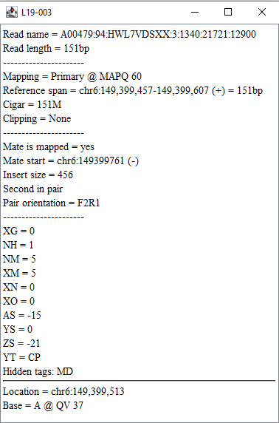
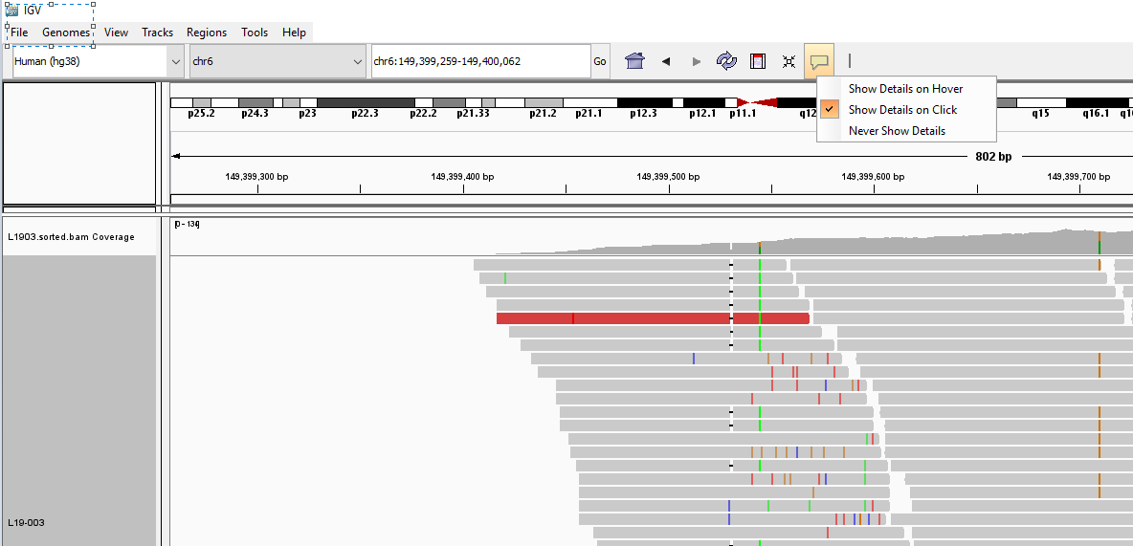
A
C
G
T
Displaying info about a specific base call
Information can be toggled to be displayed:
On mouse-button click.
On mouse-cursor hover.
Can be persisted to compare.
Not persistent!
Recall that IGV is primarily a tool for displaying the results of sequence alignment, therefore the information we find here is what we would see in the SAM file.

Slide 19

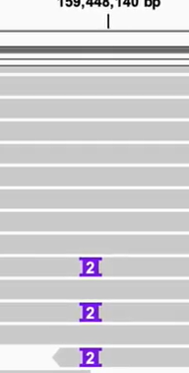
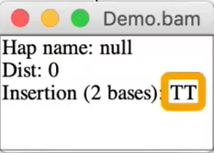
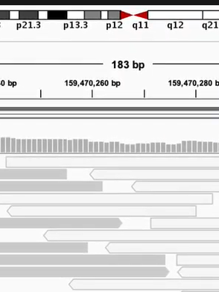
Insertions are shown by integers in these purple icons, when clicked the inserted bases will be displayed.
A few additional notes on basic analysis with IGV:
These symbols in the view window indicate gaps in the alignment, which is evidence of deletion.
*
Hollow reads represent low quality alignments
*
* From Official video tutorial: https://www.youtube.com/watch?v=E_G8z_2gTYM

Slide 20
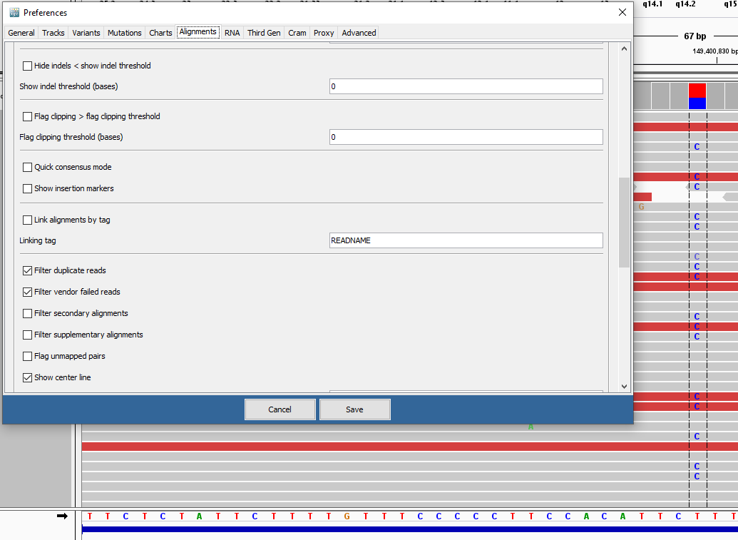
A
C
G
T
Display helpful centerline in view window
To access the settings for displaying the centerline on the plot (dotted vertical lines) go through:
view>preferences>alignments
Note there are many useful options to explore here, depending on your experiment you may want to spend some time customizing your view window to display information in the most meaningful way.
In the 3rd to last section of the Alignment Track Options tick the box next to show center line.

Slide 21
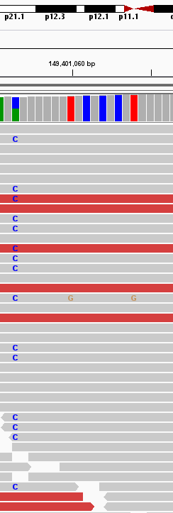
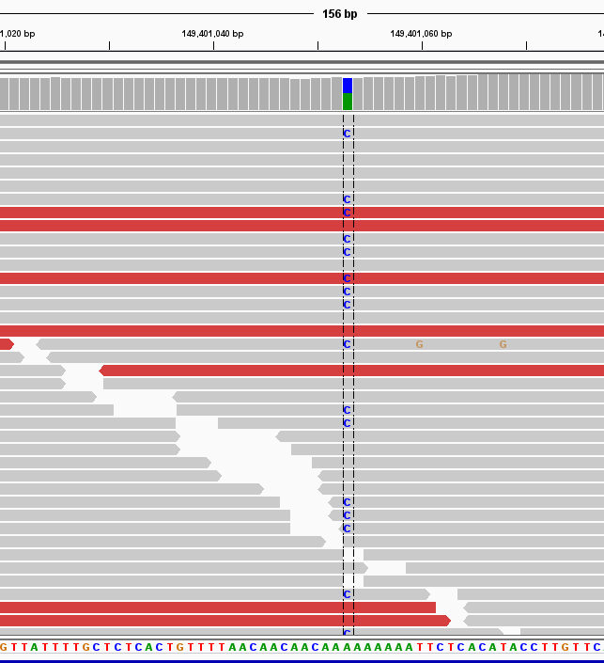
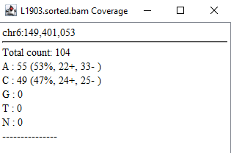
Note: Colored bars indicate imbalance in read base calls with frequency greater than a value defined by the user under
view>preferences>alignments
In the Coverage Track Options box, in the Coverage allele-fraction threshold change 0.2f (20 percent f-floating point) for example to 0.001f, ridiculous, but can now see even one mismatch.
Viewing SNV information.
Examine Histogram colors in the coverage TRACK for a quick peak at how the base call distribution is broken down for a specific position.
chr6:149,400,976-149,401,130
Click the bar in the coverage track for a more detailed breakdown of the distribution of base calls at a particular locus.
A
C
G
T

Slide 22
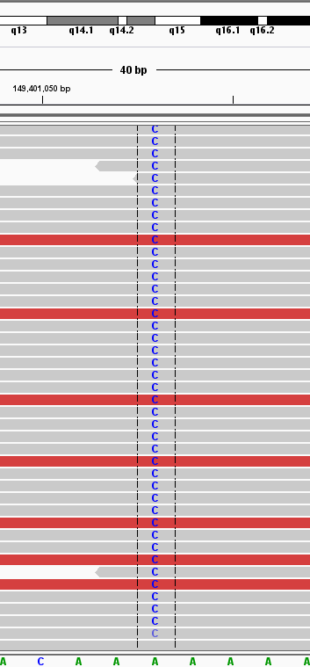
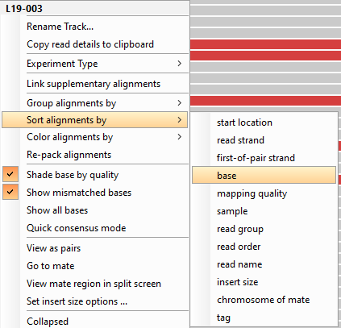
Viewing SNV information.
Sorting reads by base can allow easy identification of snps.
Note, these reads are also sorted in descending order of base call quality by default
Be Cautious of setting values too low,
This may make the visualization
Misleading.
Recall, decreasing quality is evidenced by fading of the intensity of the color displayed.

Slide 23
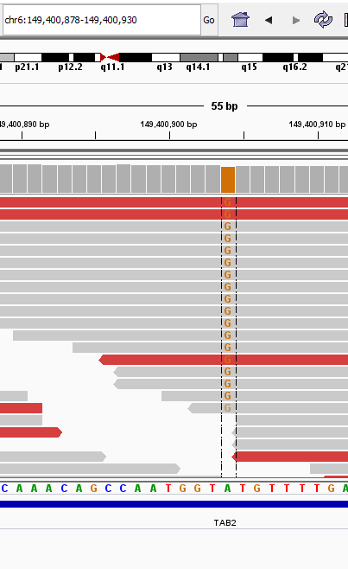
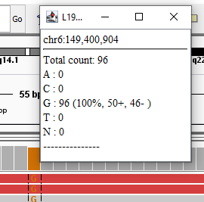
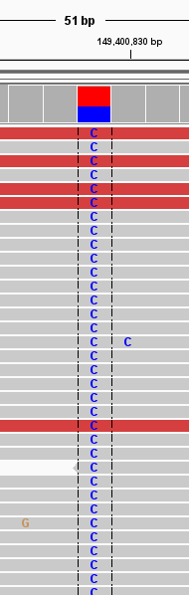


Viewing SNV information.
We can also use IGV to make determinations as to whether particular variants indicate homozygous or heterozygous.
Consider Chr6:149,400,904
All reads mapping to location differ from reference, and therefore
this variant (A->G) appears to be homozygous in the sample.
Can investigate strand bias (variant only appearing in near 50-50 ratio on strands of specific orientation) by coloring alignments by read strand.
Nearly split 50-50 indicates heterozygous for the variant.
Consider Chr6:149,400,829

Slide 24
Break
We will continue with an exercise after a short 5 minute break

Slide 25
Exercise 1 (1/2): Getting information about DNA variants from online databases
Look at the region: 6:149,400,514-149,400,594
a. Can you see an SNV?
b. At what position?
c. How many reads support the alt allele?
d. How many reads support the ref allele?
e. Which gene is this region a part of?
f. Use the following databases to find clinical information associated with this variant: MONDO (ID: 0010863), MedGen (ID: C1838260) and OMIM (ID: 600320)
If you have time, examine these other positions:
7:96,184,336-96,184,416 MONDO (ID: 0011601), MedGen (ID: C1853942), OMIM (ID: 605814), and Orphanet (ID: ORPHA247598))
10:52,771,435-52,771,515 MONDO (ID: 0013714), MedGen (ID: C3280586), and OMIM (ID: 614372)
16:23,619,946-23,620,026 MONDO (ID: 0016419), MedGen (ID: C0006142), OMIM (ID: 114480), Orphanet (ID: ORPHA227535), and SNOMED_CT (ID: 254843006)
(Exercises from workshop alignment by Dr. D. Kim)

Slide 26
Exercise 1 (2/2): Determining Likely Phenotypes from current literature.
Can you identify the most likely ethnicity?
Please refer to Figure 3 in the following paper: Tao Huang et al. 2015, Genetic differences among ethnic groups
When you search SNP location and allele frequency (e.g., rs6023406), use the dbSNP database available here
2. Can you identify the most likely eye color?
Please refer to Table 1 in the following paper: Branicki et al. 2011, Model-based prediction of human hair color using DNA variants
3. Can you identify the most likely hair color?
Please refer to Table 2 in the following paper: Spichenok et al. 2010, Prediction of eye and skin color in diverse populations using seven SNPs
(Exercises from workshop alignment by Dr. D. Kim)

Slide 27



Huang et al. Ethnicity SNP Exercise.
https://bmcgenomics.biomedcentral.com/articles/10.1186/s12864-015-2328-0
rs6023406
https://www.ncbi.nlm.nih.gov/snp
Search for SNP name, get info about location and variants! Including location. (chr20:54603422)
Huang, T., Shu, Y. & Cai, YD. Genetic differences among ethnic groups. BMC Genomics 16, 1093 (2015). https://doi.org/10.1186/s12864-015-2328-0

Slide 28

Branicki et al. Hair-Color SNP Exercise.
https://www.ncbi.nlm.nih.gov/pmc/articles/PMC3057002/
Probably a good idea to check those statistically significant variants first.
Branicki, Wojciech et al. “Model-based prediction of human hair color using DNA variants.” Human genetics vol. 129,4 (2011): 443-54. doi:10.1007/s00439-010-0939-8

Slide 29

Spichenok et al. Eye-Color SNP Exercise.
https://www.sciencedirect.com/science/article/pii/S1872497310001717?via%3Dihub
Spichenok O, Budimlija ZM, Mitchell AA, Jenny A, Kovacevic L, Marjanovic D, Caragine T, Prinz M, Wurmbach E. Prediction of eye and skin color in diverse populations using seven SNPs. Forensic Sci Int Genet. 2011 Nov;5(5):472-8. doi: 10.1016/j.fsigen.2010.10.005. Epub 2010 Nov 2. PMID: 21050833.

Slide 30
Resources on this section:
IGV video Tutorials.
https://www.youtube.com/watch?v=E_G8z_2gTYM
IGV Manual, and Installation Tutorial
https://software.broadinstitute.org/software/igv/UserGuide
Broad Institute Website
https://www.broadinstitute.org/
Papers for Exercises
Ethnicity -https://bmcgenomics.biomedcentral.com/articles/10.1186/s12864-015-2328-0
Hair-Color - https://www.ncbi.nlm.nih.gov/pmc/articles/PMC3057002/
Eye-Color - https://www.sciencedirect.com/science/article/pii/S1872497310001717?via%3Dihub
Databases
NCBI - https://www.ncbi.nlm.nih.gov/
SNP - https://www.ncbi.nlm.nih.gov/snp/
SRA - https://www.ncbi.nlm.nih.gov/sra/

Slide 31

Part 2: NGS RNA-Seq Example and Exercises with IGV
$(≈0.5−1$ hour$)$

Slide 32
We can also use HISAT2 to align RNASeq data and produce SAM/BAM with samtools
The file name and path to the real RNA single-end sequencing reads for this workshop is: session3/reads/RNA.heart.e11.rep1.fastq.gz To examine the file, you can optionally perform the following commands:
Extract a compressed read file and redirect to a text file gzip -cd session3/reads/RNA.heart.e11.rep1.fastq.gz > RNA.heart.e11.rep1.fastq
Display the text file; to stop the command, type ctrl+c cat RNA.heart.e11.rep1.fastq
Display the first 10 lines of the read file head RNA.heart.e11.rep1.fastq
Display the first page of the read file; type space to go to the next page, and type q to quit less RNA.heart.e11.rep1.fastq
Display the first page of the read file directly on the compressed file using pipe | gzip -cd session3/reads/RNA.heart.e11.rep1.fastq.gz | less
Count the number of lines in a read file wc -l RNA.heart.e11.rep1.fastq
Divide the number of lines we calculated above by 4 to get the number of reads expr 113425724 / 4
(Exercises from workshop alignment by Dr. D. Kim)
Linux commands from Dr. Kim For information on manipulating sequences with the commandline.

Slide 33
We can also use HISAT2 to align RNASeq data and produce SAM/BAM with samtools
(Exercises from workshop alignment by Dr. D. Kim)
Linux commands from Dr. Kim For information on manipulating sequences with the commandline.
We will use HISAT2 with a graph index to align reads as follows: session3/programs/hisat2 -p 8 -x session3/indexes/mouse/genome_snp_tran -U
session3/reads/RNA.heart.e11.rep1.fastq.gz > heart.e11.sam
Look at the SAM file (use space to go to the next page and q to quit) less heart.e11.sam
Convert the SAM file into a BAM file session3/programs/samtools view -@ 8
-bS heart.e11.sam > heart.e11.unsorted.bam
Create a sorted BAM file session3/programs/samtools sort -@ 8 heart.e11.unsorted.bam
-o heart.e11.sorted.bam
Make an index for the sorted BAM file session3/programs/samtools index heart.e11.sorted.bam
Look at the sorted alignments session3/programs/samtools view heart.e11.sorted.bam | less
Look at alignments between 61,989,341 and 61,990,361 on Chromosome 15 session3/programs/samtools view heart.e11.sorted.bam 15:61,989,341-61,990,361
Look at bases of reads located at a particular locus to identify variants session3/programs/samtools mpileup
-f session3/indexes/mouse/genome.fa
-r 15:61,989,341-61,990,361 heart.e11.sorted.bam
Align to reference (Mouse transcriptome)
Use Samtools to produce binary sequence alignment map and index for bam file.

Slide 34


Download the mouse Genome for displaying the RNA-Seq Alignment Results
Now we will look at the alignment using IGV (Integrative Genomics Viewer):
Run IGV module add IGV/2.3.90 igv.sh
Load the genome using: Genomes -> Load from Server -> Select Mouse mm10
Open the BAM file using File -> Load From File in IGV and choose heart.e11.sorted.bam
Look through genomic regions for genes such as Brca1, Myc, and Cav1

Slide 35
Lyda Hill Department of Bioinformatics 2022 Nanocourse Series
Introduction to NGS Analysis
Thank you for your attention & Interest!
Please do not forget to complete the course survey! ☺.

Slide 36

Bonus: VCF File Format
The Variant Call File File Format contains information about differences observed In a particular sample, these are often much smaller and contain much of the vital information to reconstruct an individual genome from a reference.
http://samtools.github.io/hts-specs/VCFv4.2.pdf

